Slide 1
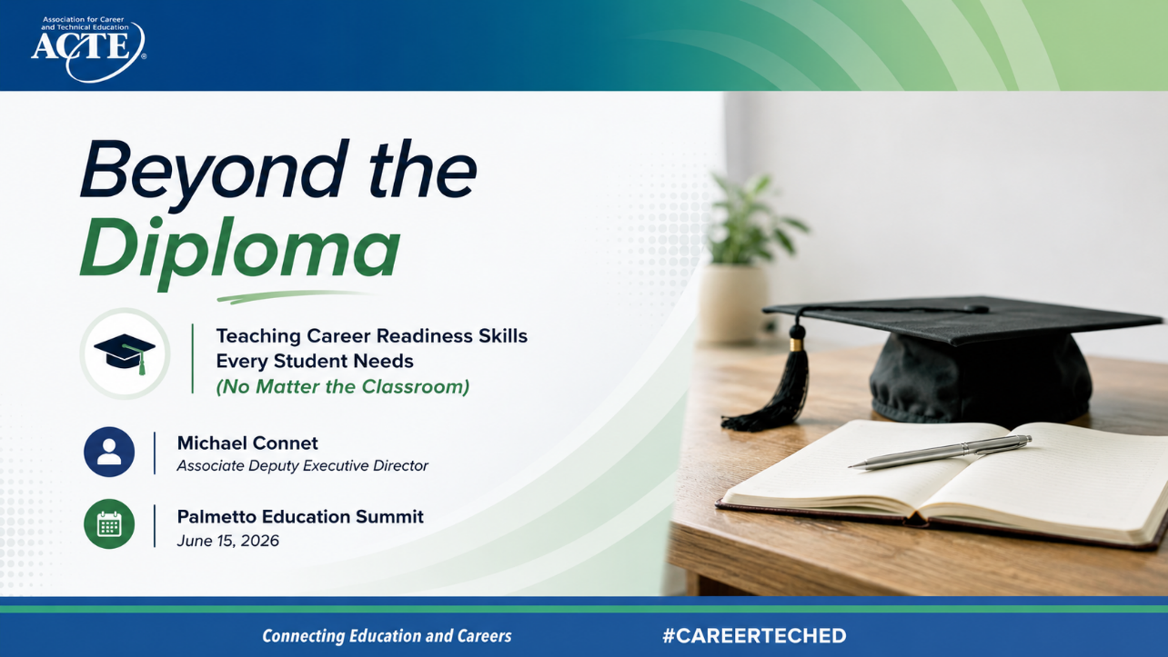
Notes:
Welcome everyone, and thank you for being here.
I’m really glad to see such a strong group of educators, leaders, and partners in the room—because this topic touches all of us.
Today we’re going to focus on a simple but powerful idea:
How do we prepare students not just to graduate—but to thrive after graduation?
This session is called “Beyond the Diploma,” because a diploma alone is no longer enough.
We’re going to explore how every classroom—not just CTE—can intentionally build the skills students need for success in work and life.

Slide 2
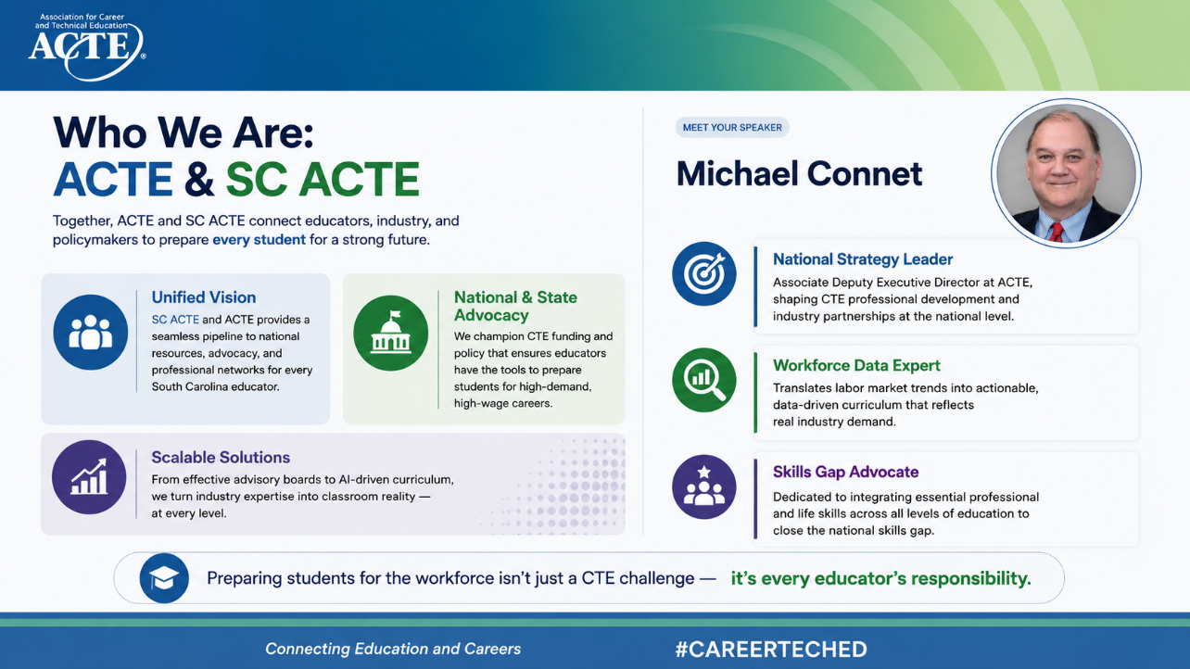
Notes:
Teachers in South Carolina have direct access to national-level advocacy, high-quality professional development, and a broader network of peers—all while staying grounded in the state’s priorities and context. And a big part of what we can do together is national and state advocacy. This partnership strengthens our collective voice.
At the national level, ACTE is working to advance policies and funding that support CTE programs across the country. At the state level, SC ACTE is bringing those priorities into focus based on what educators and employers need locally.
When those efforts are aligned, it ensures that:
Policy decisions reflect real classroom and workforce needs
Funding supports programs that lead to high-demand, high-wage careers
And educators have the tools they need to deliver meaningful outcomes for students
That coordination makes advocacy more effective—and more relevant.
As a national strategy leader, I’m focused on connecting these pieces—helping align professional development, partnerships, and strategy across states.
As a workforce data expert, a big part of the role is making sure decisions are driven by real labor market data—so programs reflect where opportunities actually exist.
And as a skills gap advocate, the focus is on ensuring students are not only technically prepared, but also equipped with the professional and life skills they need to succeed.
And that brings us to the key takeaway which is preparing students for the workforce isn’t just a CTE challenge—it’s a shared responsibility across the entire education system.
CTE plays a critical leadership role, but this work is most effective when it’s integrated across all classrooms, all subjects, and all levels.

Slide 3
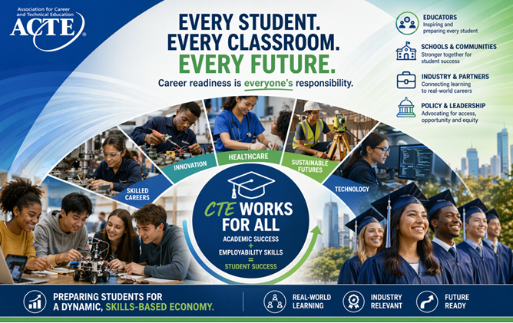
The Big Idea
Career readiness is everyone's responsibility
Every Classroom
Whole Student
Not just CTE — every classroom, every grade
Academic success + employability skills = student success
Future Economy
Preparing students for a dynamic, skills-based economy
Notes:
Let’s start with the core message.
Career readiness is no longer the responsibility of one program, one teacher, or one department.
It belongs to all of us.
Whether you teach math, English, science, or social studies—you are already shaping how students:
Think
Communicate
Problem-solve
The opportunity here is not to add more to your plate—but to make what you already do more intentional.
That’s really the theme of today.

Slide 4
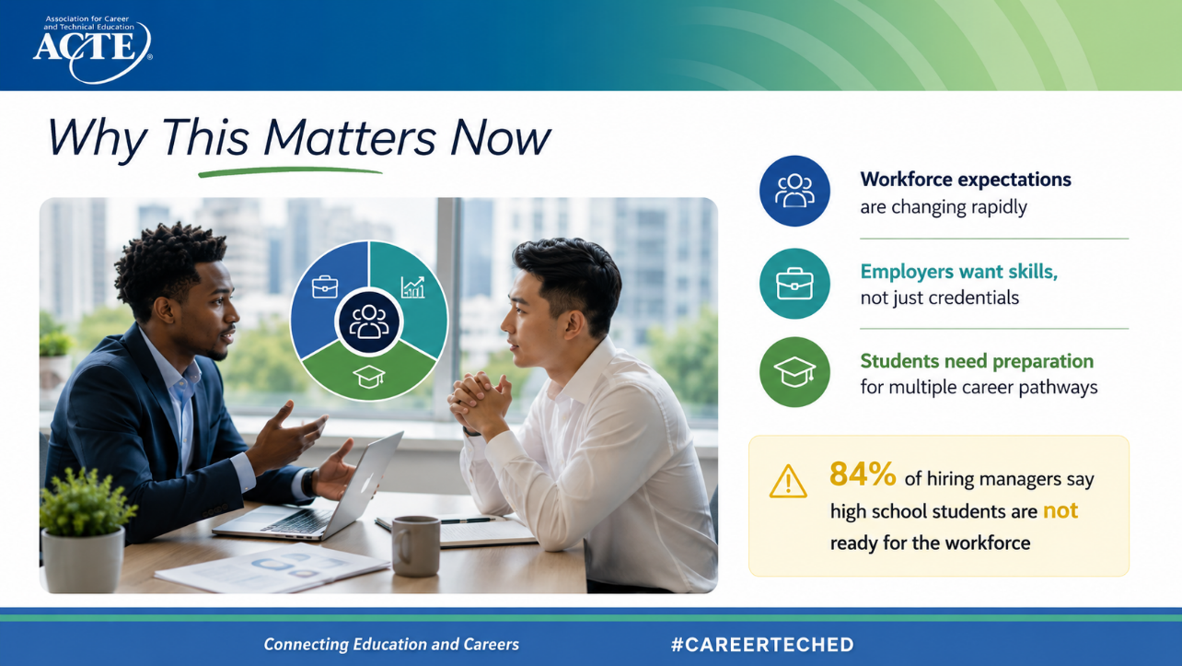
Notes:
The urgency here is real.
The workforce has changed—dramatically.
Technology is shifting jobs.
AI is reshaping industries.
And employers are looking for something very different than they were even 10 years ago.
The data tells us: 84% of hiring managers say high school students are not ready for the workforce.
Pause for a moment—that’s nearly all employers.
So the challenge isn’t whether we teach content well—it’s whether students can apply that learning in real-world contexts.

Slide 5
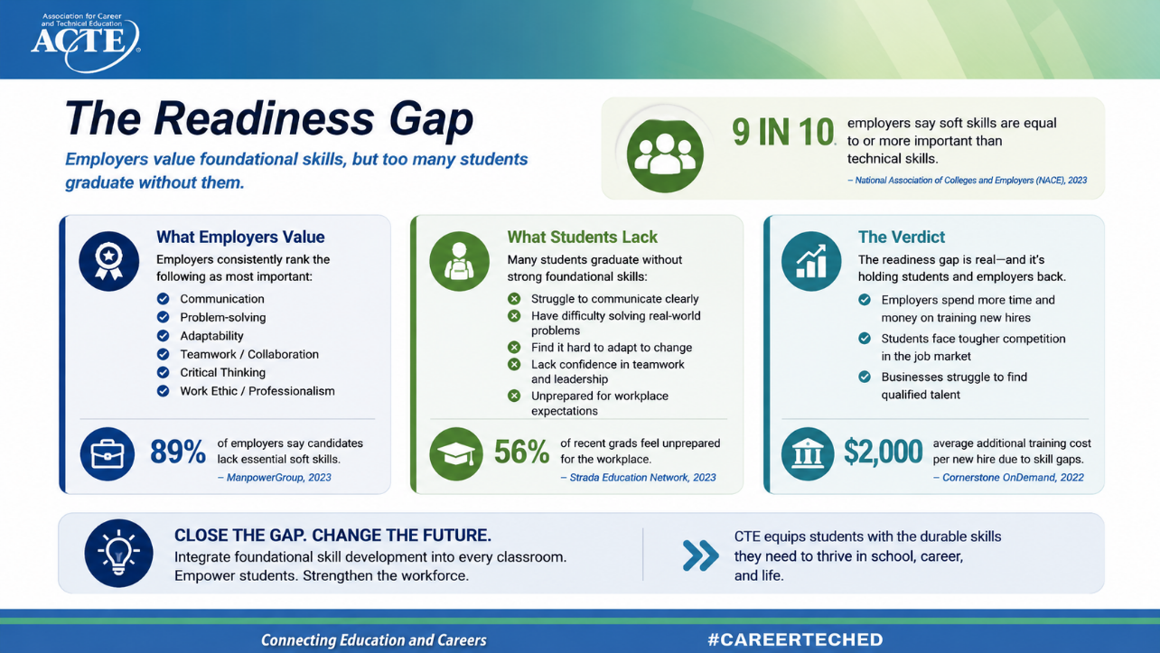
Notes:
Here’s what’s interesting.
When you ask employers what they want—it’s incredibly consistent:
They want people who can:
Communicate clearly
Think critically
Work with others
Adapt to change
These are not new skills—but they are more important than ever.
And yet, employers are telling us students aren’t consistently demonstrating them.
Employers spend additional time and money training new hires. Students face tougher competition in the job market. Businesses struggle to find qualified talent. Cornerstone OnDemand estimates that skill gaps cost employers an average of $2,000 in additional training costs per new hire.
Through authentic projects, teamwork, presentations, work-based learning experiences, CTSOs, industry engagement, and problem-solving tied to real-world contexts, students don't just learn about communication, adaptability, or professionalism—they actually use those skills.
They develop them through experience.
"So the question becomes: If we know these are the skills students need, what does it actually look like to teach them intentionally? Let's explore that next."?

Slide 6
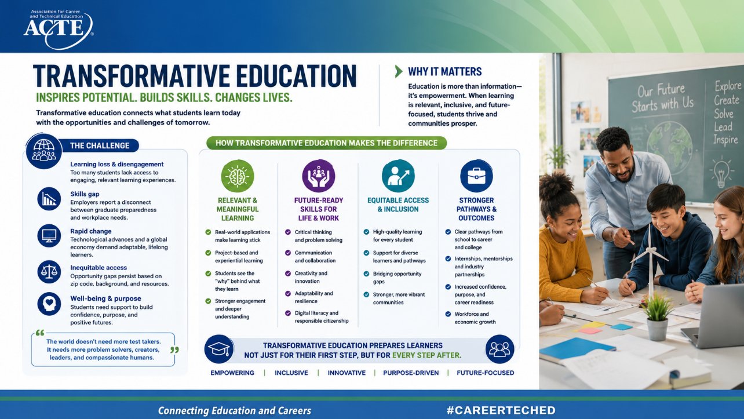
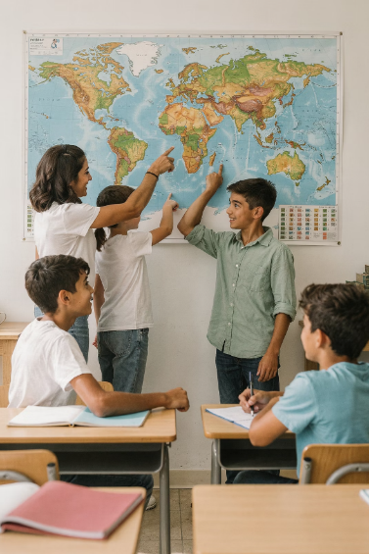
"Job expectations bear little relationship to actual labor market demand"
Notes:
This issue isn’t just happening in the U.S.—it’s global.
The OECD studied hundreds of thousands of students and found something concerning:
Students’ career expectations often don’t match real labor market demand.
In plain terms: Students are preparing for jobs that may not exist—or aren’t growing.
That tells us schools need to do more to connect learning to real careers.

Slide 7
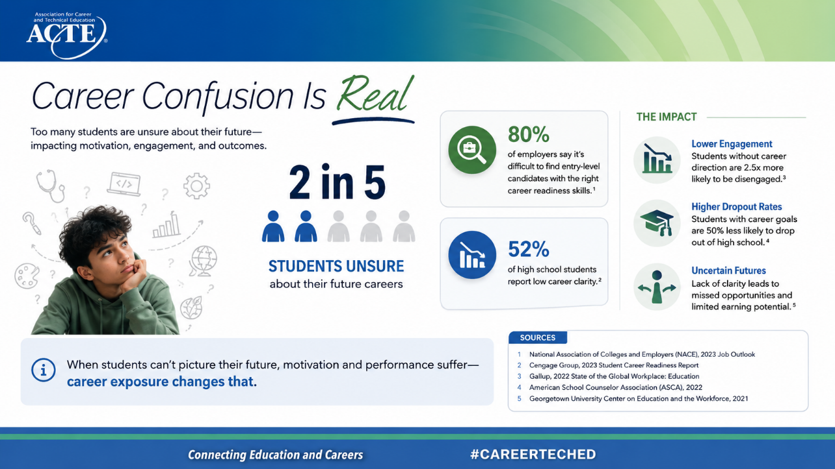
Career Confusion Is Real
2 in 5
Students Unsure
Nearly 2 in 5 students are unsure about their future careers
Many lack exposure to real-world work experiences
Career uncertainty affects engagement and outcomes
When students can't picture their future, motivation and performance suffer — career exposure changes that.
Notes:
And here’s another key insight:
Nearly 2 in 5 students aren’t sure what career they want.
That’s not just indecision—that’s a lack of exposure.
Most students haven’t:
Met professionals
Seen workplaces
Understood pathways
So they’re making decisions in the dark.
And when students don’t see a future—motivation suffers.

Slide 8
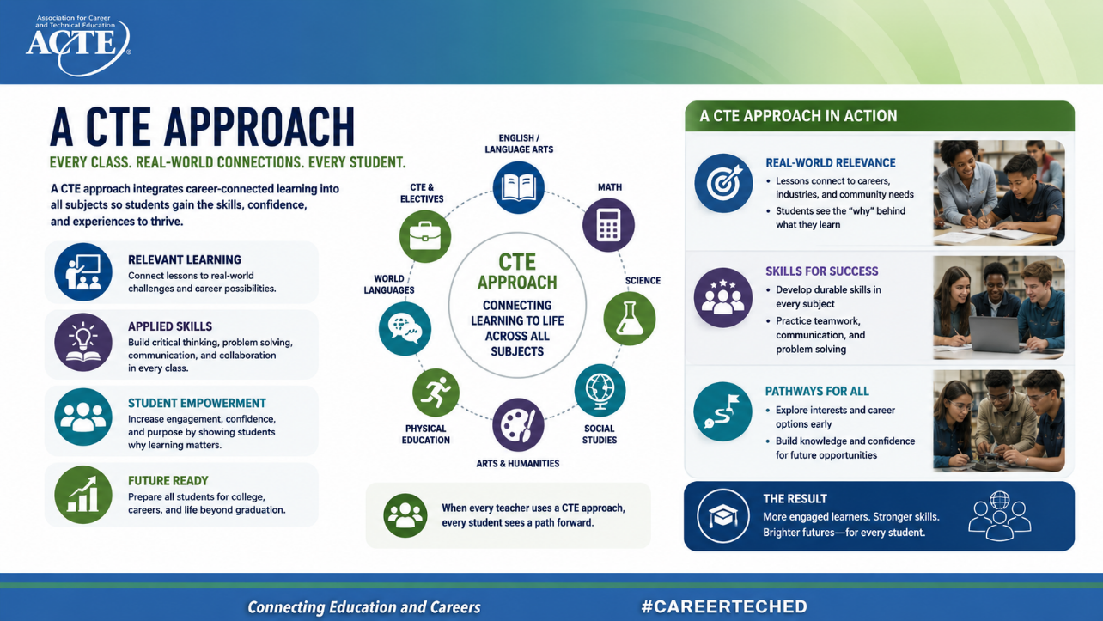
Notes:
We’re also seeing equity challenges emerge.
Students’ career plans are often shaped more by their background than their ability.
That means: Some students have access to networks, exposure, and opportunities—and others don’t.
So career readiness isn’t just about workforce preparation.
It’s about ensuring every student has access to opportunity.

Slide 9
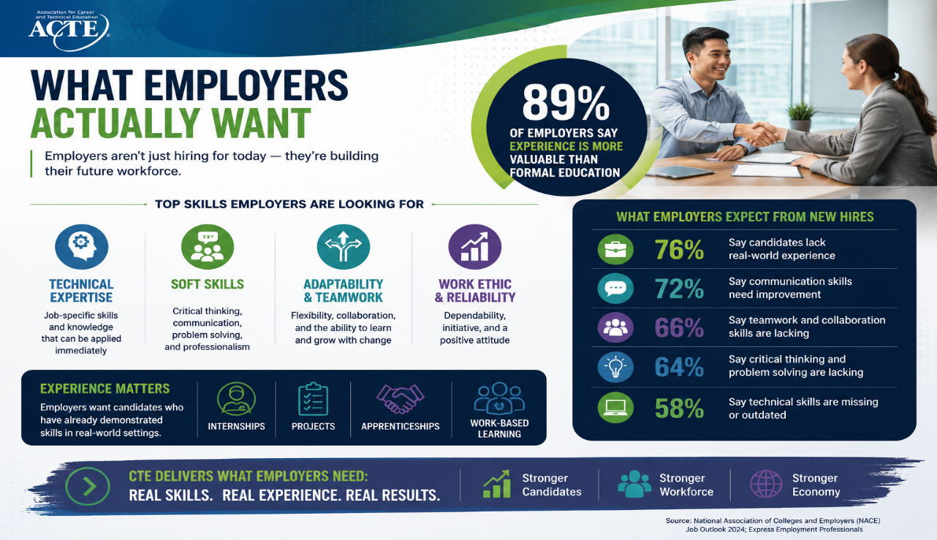
Notes:
Let’s ground this in employer expectations.
Employers don’t just want degrees or diplomas.
They want:
Experience
Skills
Evidence of readiness
Almost 90% say experience is more valuable than formal education.
That means: Students need opportunities to apply what they learn—not just memorize it.

Slide 10
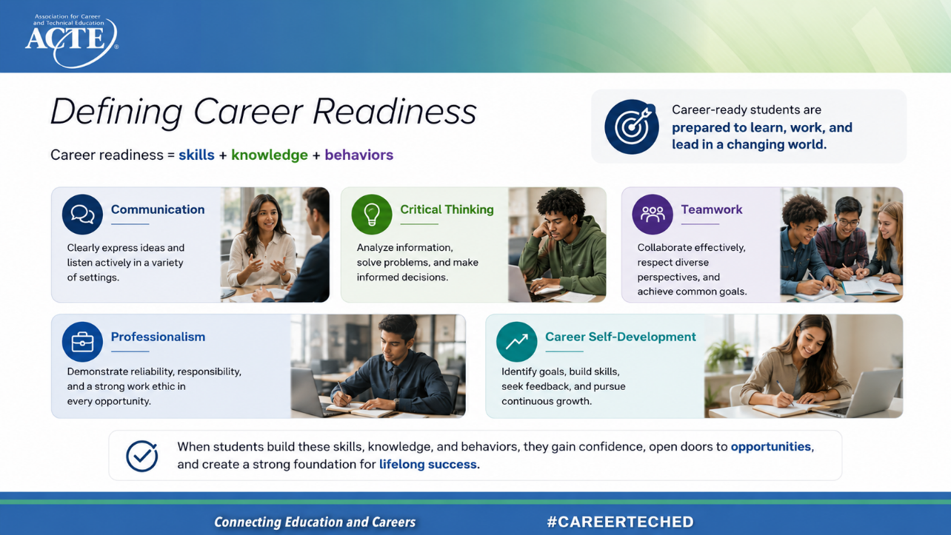
Notes:
So what exactly is career readiness?
At its core, it’s the ability to:
Apply knowledge
Navigate the workplace
Continue learning
Key competencies include:
Communication
Critical thinking
Teamwork
Professionalism
These are not “extra”—they are foundational.

Slide 11
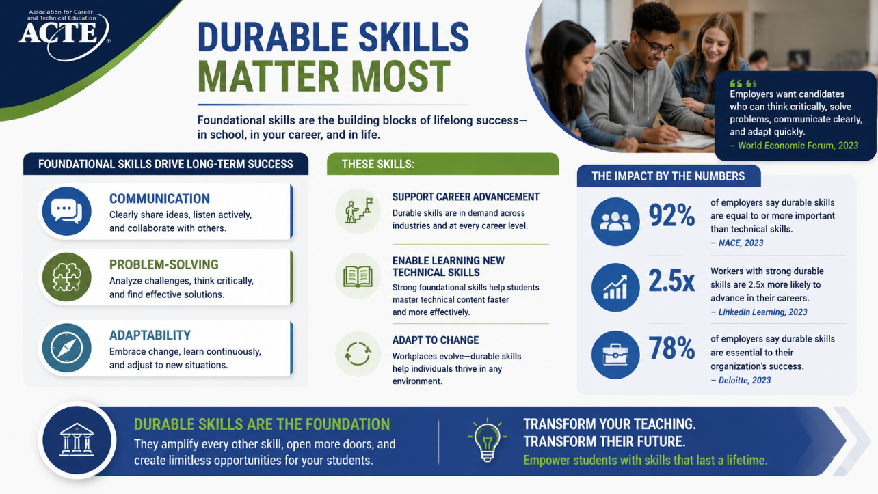
Notes:
Here’s a key takeaway from research:
Technical skills change.
Durable skills stay relevant.
Skills like communication and problem-solving:
Transfer across careers
Help individuals advance
Enable continuous learning
These are the skills that future-proof our students.

Slide 12
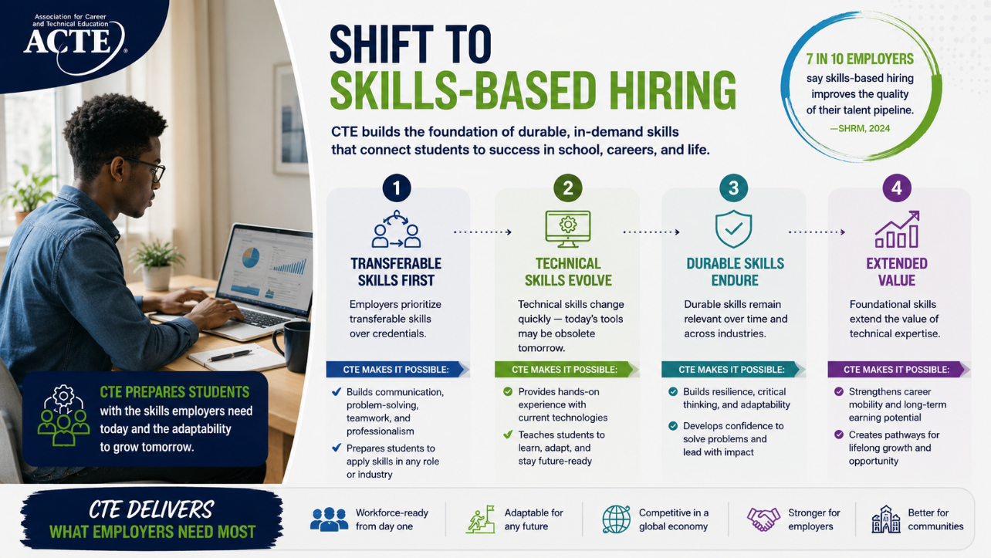
Notes:
We are in a clear shift toward skills-based hiring.
Employers are asking: Can you do the job?
Not: Where did you learn it?
This means students need to:
Demonstrate skills
Show evidence of learning
Apply knowledge in new situations
And that has big implications for instruction.

Slide 13
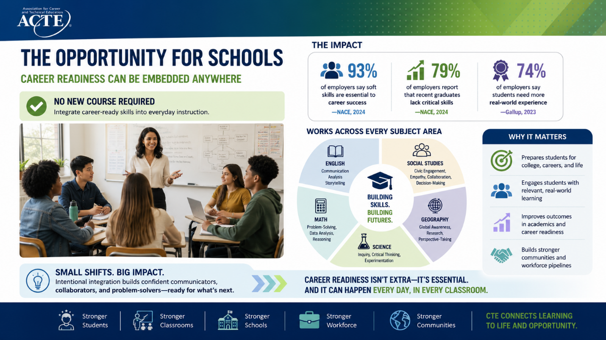
Notes:
Here's the encouraging news: we don't have to create an entirely new course to address it.
Career readiness can be embedded anywhere.
It doesn't require another graduation requirement, another initiative competing for time, or a complete redesign of the school day. Instead, it's about intentionally weaving these skills into the learning experiences that are already happening every day.
Think about what this looks like across different subject areas.
In English, students build communication skills through presentations, storytelling, analysis, and discussion.
In math, they strengthen problem-solving, reasoning, and data analysis.
Science classrooms naturally promote inquiry, experimentation, and critical thinking.
Social studies helps students develop empathy, collaboration, civic engagement, and decision-making.
The goal is to help students get more from what we're already doing—because career readiness can happen every day, in every classroom."
"So the next question becomes: If career readiness can be embedded anywhere, what are some practical strategies educators can use to make that happen intentionally?"

Slide 14
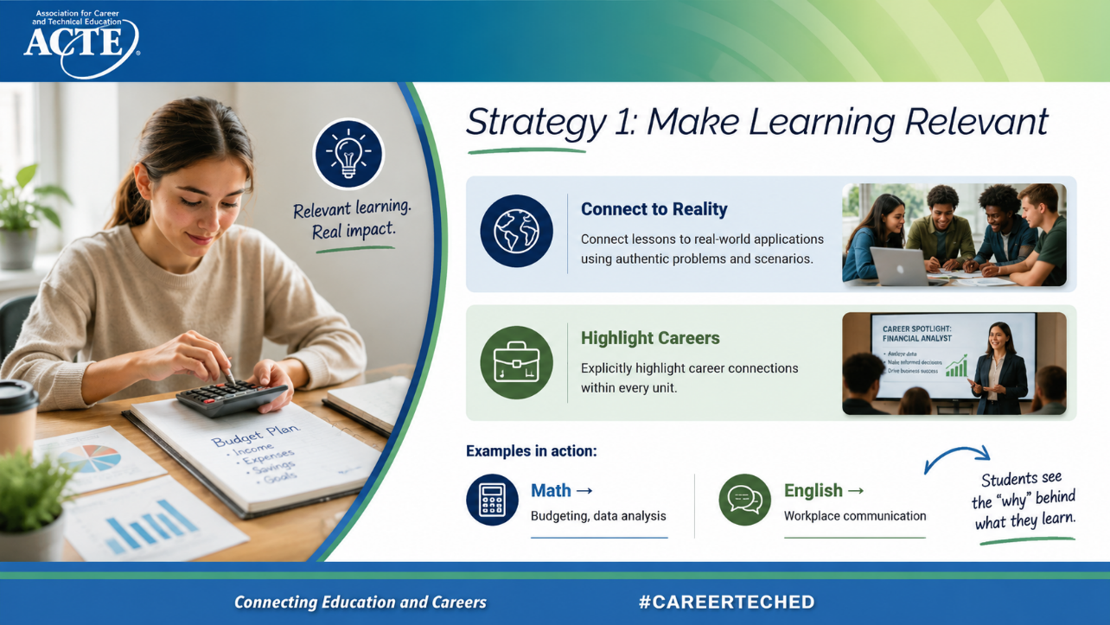
Notes:
The first strategy is relevance.
Students ask: “When will I ever use this?”
We need to answer that question—explicitly.
Examples:
Math → budgeting, data interpretation
Science → real-world problem-solving
English → professional communication
Optional audience prompt:
“Think about your next lesson—how could you connect it to a real-world application?”
Relevance drives engagement

Slide 15
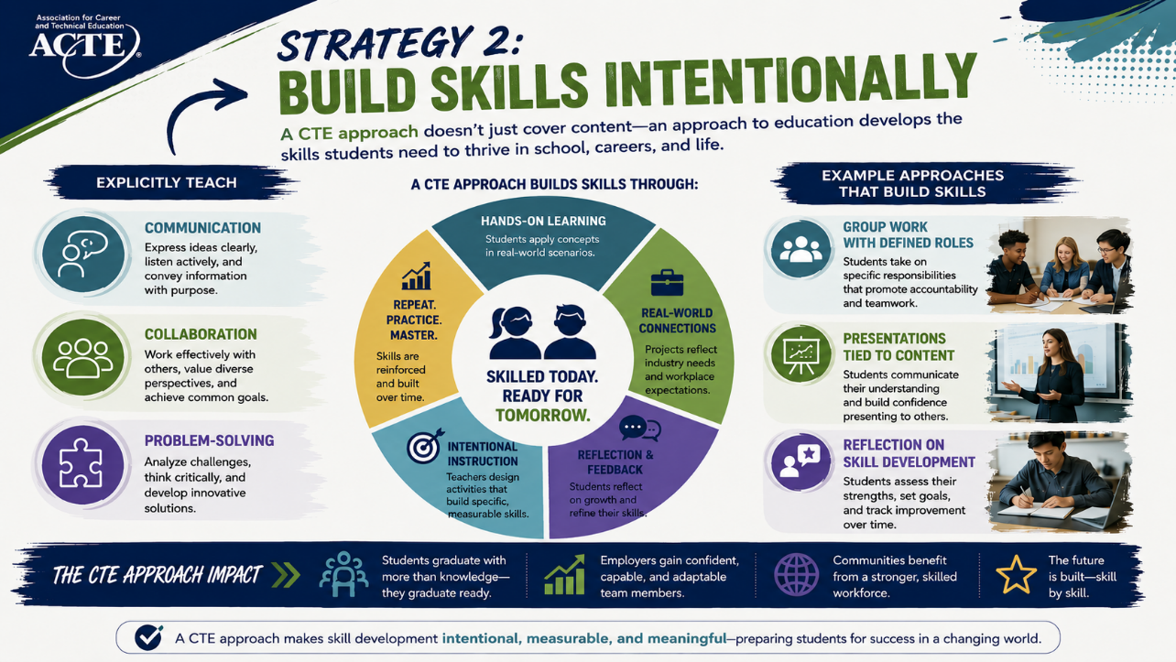
Notes:
The second strategy is intentionality.
You’re already teaching skills—but are you naming them?
When students understand: “I’m building communication skills right now”
They begin to:
Value it
Practice it intentionally
Transfer it beyond the classroom
Make skills visible.

Slide 16
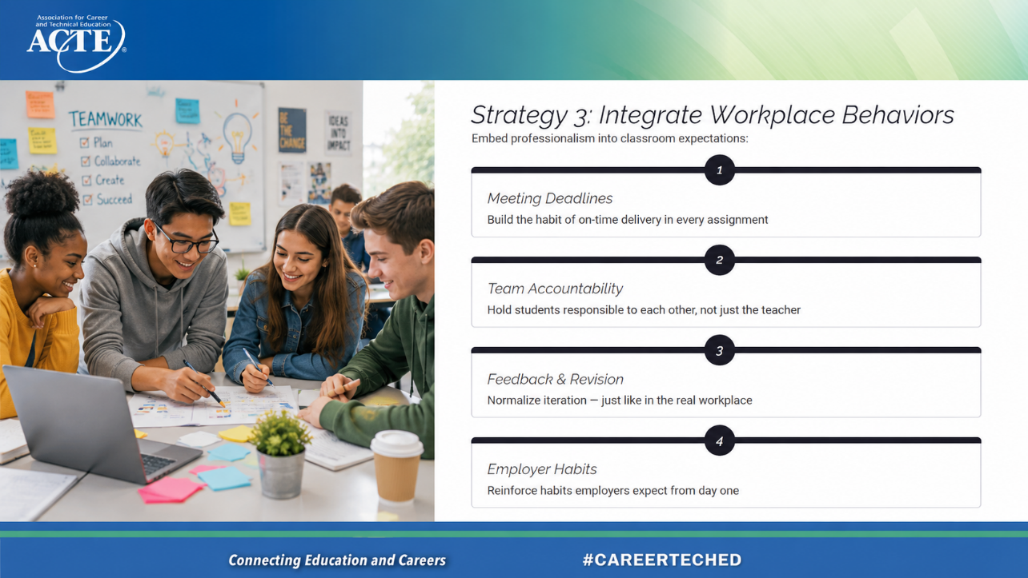

Strategy 3: Integrate Workplace Behaviors
Embed professionalism into classroom expectations:
1
Meeting Deadlines
Build the habit of on-time delivery in every assignment
2
Team Accountability
Hold students responsible to each other, not just the teacher
3
Feedback & Revision
Normalize iteration — just like in the real workplace
4
Employer Habits
Reinforce habits employers expect from day one
Notes:
The third strategy is embedding professional behaviors.
Things like:
Meeting deadlines
Participating in teams
Responding to feedback
These are classroom expectations—but also workplace expectations.
We can reinforce this by:
Naming it
Modeling it
Holding students accountable for it

Slide 17
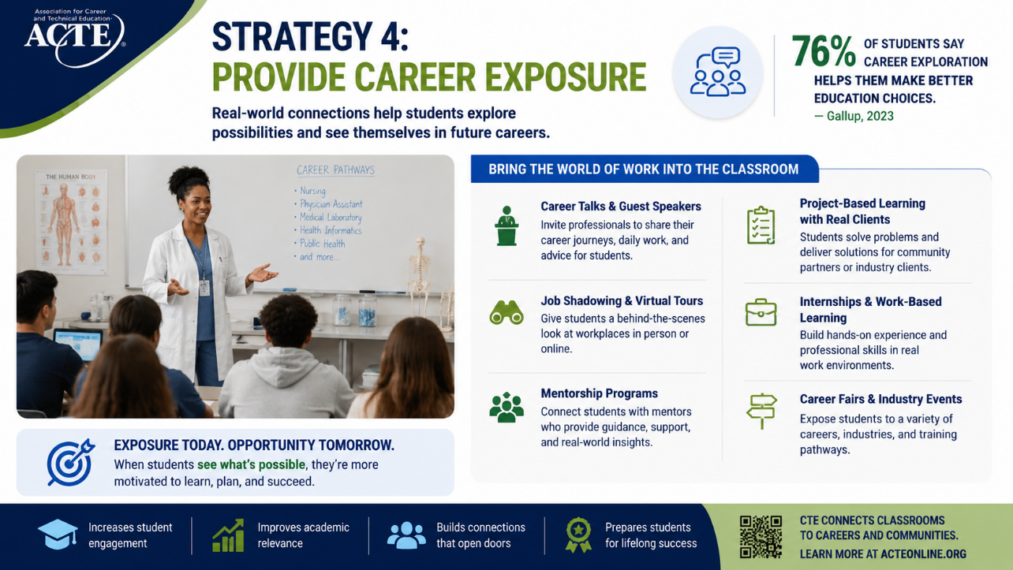
Notes:
Students need exposure.
Research shows many students lack basic access to career experiences.
This doesn’t have to be complicated:
Guest speakers
Virtual tours
Career exploration projects
Even small experiences can expand students’ understanding of what’s possible.

Slide 18
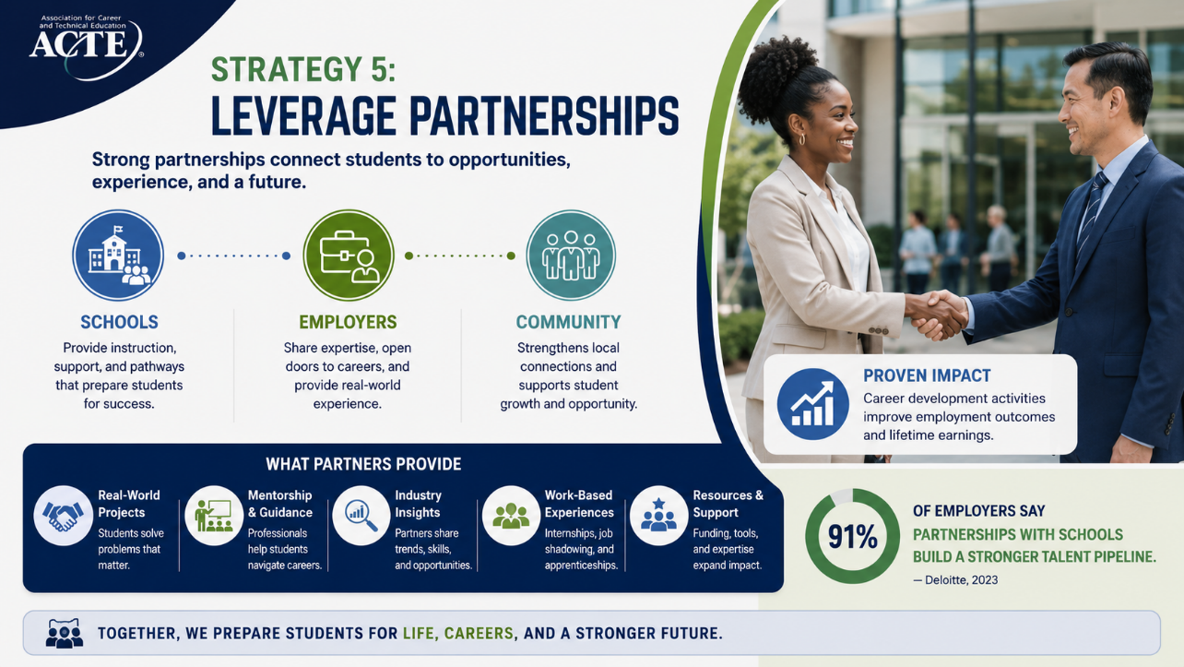
Notes:
We also need to tap into partners.
Education cannot do this alone.
Business and community partners can:
Provide real-world insight
Offer feedback on student work
Help design authentic experiences
Research shows students benefit from career-connected activities.

Slide 19
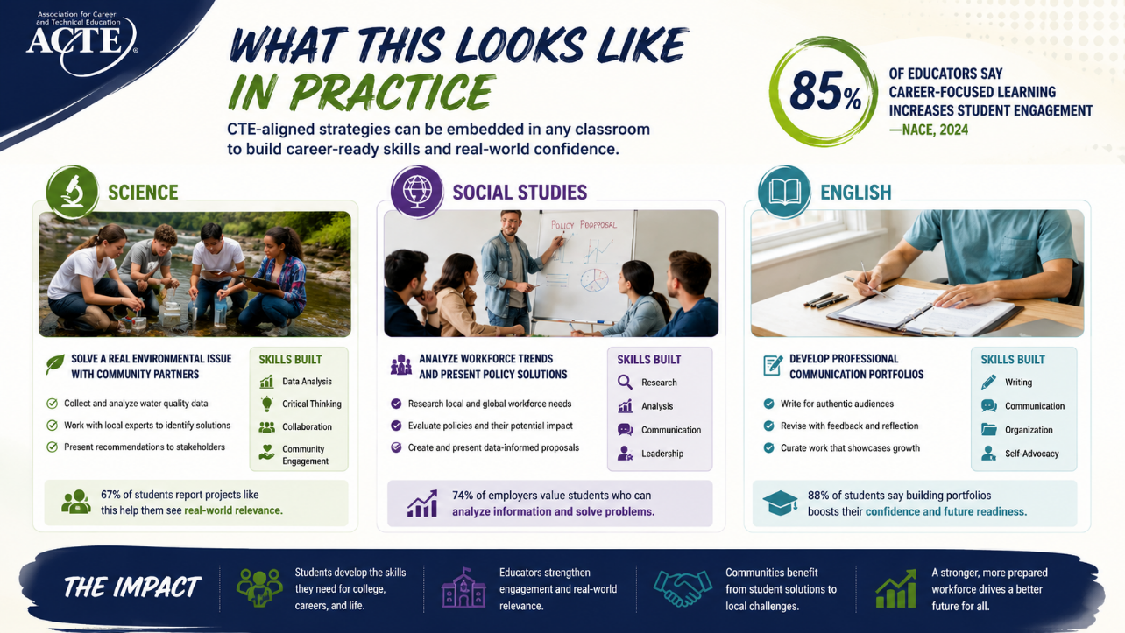
Notes:
Let’s bring this together with examples:
Science → solving community environmental challenges
English → writing professional emails or proposals
Social studies → analyzing workforce trends
The content stays the same—but the purpose becomes clearer.
That’s the shift.

Slide 20
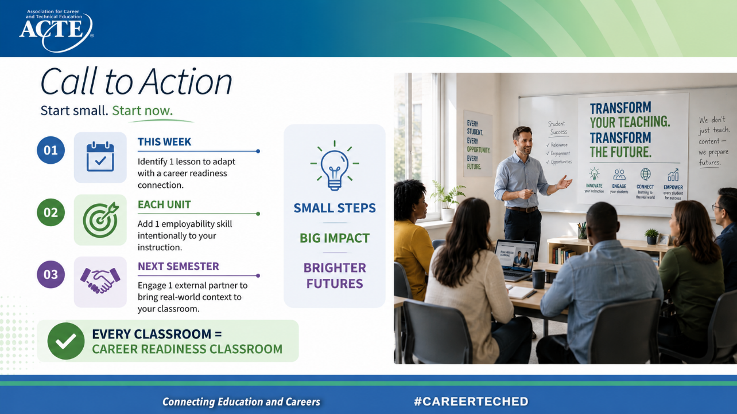
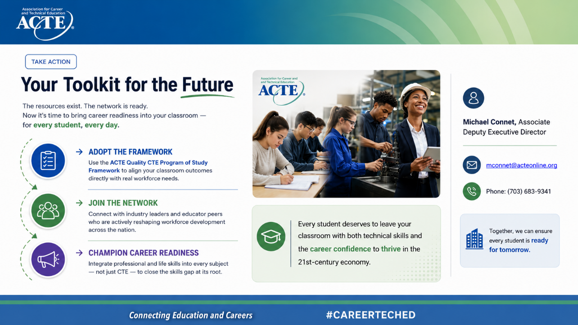
Notes:
I want to close with this:
You don’t need to do everything.
Just start somewhere.
Start with one lesson
Focus on one skill
Try one connection to the real world
Because when we do that consistently, we create something powerful:
A system where every classroom prepares students for what comes next.
And ultimately—that’s our goal.

