Slide 1

Hold’em or Fold’em: Big and Tall, Short & Small
Master Instructor
Cherry Herzog
Assisting MI’s Sammie Sappington Vered Abeles

Slide 2
Big & Tall Bodies
The Honest Limitations
Some Reformers are too small
Carriage feels too cramped
Springs max out too easily
Soulder pad and straps dig in
Weight Limits
The Truth
Big & Tall doesn’t limit Pilates, it makes it more effective
Longer Limbs = More Leverage
More body mass = More resistance
Stability work becomes more meaningful

Slide 3
Big & Tall Bodies
Props That Help
Equipment that helps
What to avoid early on or Modify
❌ Full teaser
Yoga mat (extra thick for comfort)
Flex Cushion or Half Barrel (for elevation)
Resistance band (adds challenge without joint stress)
Pilates ring (optional for inner thigh/core work)
❌ Straight-leg double leg lowers (too much strain initially)
❌ Anything that compresses your breathing

Slide 4
Short & Small Bodies
Adjust leverage, not effort
Shorter limbs mean different leverage. In moves like the Hundred or leg circles, you may feel less strain in some positions—so slow things down and focus on precision instead of range. Quality > length
Core engagement is your superpower
Smaller frames often benefit from naturally better balance and control. Lean into exercises like:
The Hundred
Roll-Up
Single leg stretches
These build strength without needing long limbs or heavy resistance.

Slide 5
Be mindful with equipment
On machines like the Reformer, foot bar and strap settings matter a lot. If things feel “too far away,” they probably are.
Watch neck and hip alignment
Because proportions differ, shorter people sometimes tuck too much or overcompensate. Keep your spine neutral and avoid pulling your head forward during ab work. :

Slide 6
Big & Tall Considerations
Short & Small Considerations
Range>Depth - Longer Limbs-Exercises take more control but also give more leverage-more core activation.
Larger midsection-Modifications for Spinal Flexion including Ab Series etc.
More body mass = More resistance on Joint Load-Wrists, Knees and Hips
Big Frame-Build mobility and control and serious strength over time.
Quality>Length – Shorter Limbs mean less leverage and different resistance curves.
Smaller midsection-Focus on length for Spinal Flexion-don’t let them pull upper body too high
Less body mass = Less resistance on Joint Load-Wrists, Knees and Hips
Small Frame-Build strong foundation with limitless potential

Slide 7
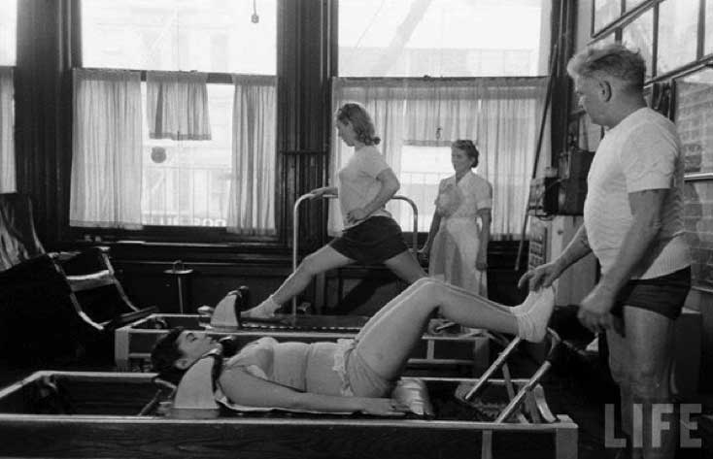
The Pilates Reformer

Slide 8
Explore Reformer
Footwork Series
Short Spine
Long Box Series- Tall
Short Box Series- Short/ Tall
Long Stretch Series- Tall
Knee Stretch Series

Slide 9
Reformer/Big & Tall
Setup tips that make a huge difference
Using more springs at first → gives support, not just resistance
Adjust foot bar height → higher = more accessible
Pad the headrest → comfort matters more than you think
Prioritize range of motion over textbook form
Avoid forcing “tight” positions
Allow wider stance or hand placement
Watch breathing-compression can limit it
Box placement adjustments
When using the box:
Place it closer to the shoulder blocks or Over for prone or seated work
Make sure your hips aren’t hanging off or too compressed

Slide 10
Reformer/Short & Small
. Foot bar position is everything
Work in lower gear
Set knees to bent at ~90
2. Sit /Stand closer than you think
Scoot closer to the shoulder blocks
Use this rule of thumb: if your shoulders or hips feel pulled forward, they are too far away.
4. Use lighter springs strategically
Because of shorter limb length:
They may have less leverage, so heavy springs can feel disproportionately hard
5. Box placement adjustments
When using the box:
Place it in front of shoulder blocks for prone or seated work

Slide 11
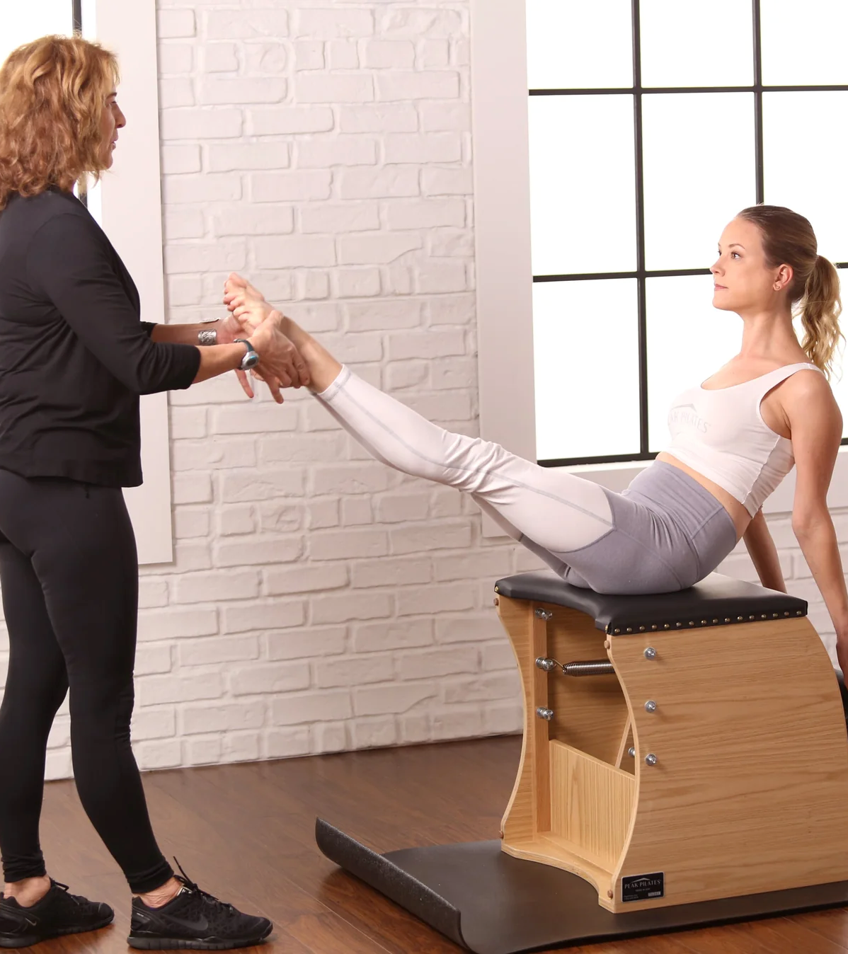
The Pilates Chairs

Slide 12
Explore
Chair
Footwork Series
Standing Press Down-Front
Standing Press Down-Side
Standing Press Down-Cross-over
Going Up-Front
Going Up-Side
Pull-up

Slide 13
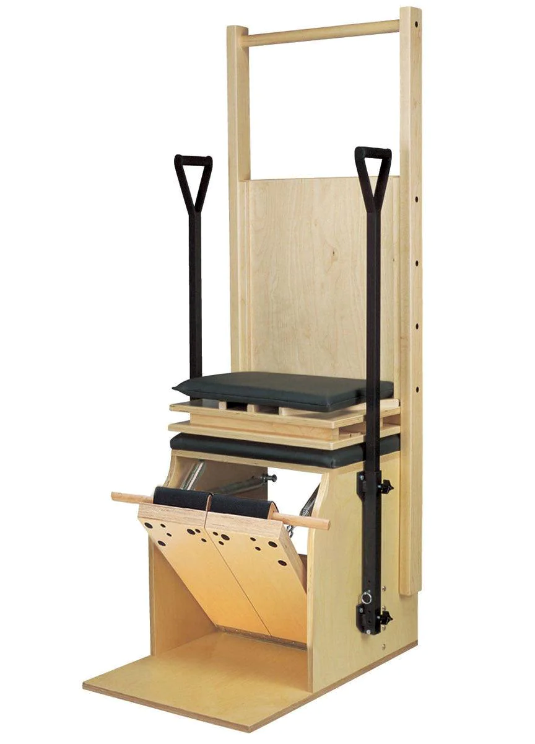
Big & Tall Considerations
Setup tweaks that make a huge difference
Use heavier springs initially → gives support, not just resistance
Wider stance → more stability
Keep range shorter > depth
Use handles when needed
Exercises to modify or avoid early
These are common but not big-body friendly at first:
Deep pikes (too much compression)
Full Teaser on the chair

Slide 14
Short & Small Considerations
Spring resistance: Smaller bodies generally need lighter spring tension to start — most quality chairs offer multiple resistance levels, so check that the low end is genuinely light.
Standing exercises: Some pedal-pressing moves require you to lean over the chair. If you're very short, the height of the chair top itself (typically 12–16 inches) can affect your leverage and alignment.
If your feet don't quite reach flat on the floor during highchair going up, a small foam block or mat under the pedal resolves this instantly.
Many chair exercises translate beautifully for petite frames because the movements are small, controlled, and precision-based — less about limb length, more about stability and core engagement.

Slide 15
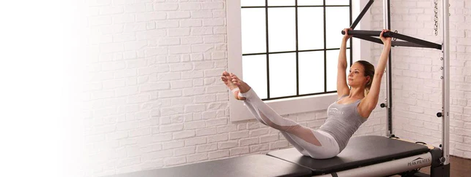
The Pilates Tower/Cadillac

Slide 16
Explore Tower
Roll-Back Bar
  Roll-Back
  Breathing
  Chest Expansion
  Long Back Stretch
  Thigh Stretch
Arm Springs
  Reach & Pull
  Circles
  Tri-cep Press
Leg Springs
  Frog/LC
  Circles
  Walking
  Beats
  Scissors
  Bicycle
Push-Through Bar
  Push-through long/short
  Saw
  Shoulder Bridge
  Swan

Slide 17
Big & Tall Considerations
Mat Position
For supine exercises, position shoulders a little farther from the tower than a smaller person would.
Roll-Down Bar Springs
Use a slightly heavier spring setting than average if you have a larger frame or longer limbs.
The longer lever created by long arms often makes the bar feel lighter.
Start with medium tension and adjust based on control, not strength.

Slide 18
Short & Small Considerations
Roll-Down Bar
Move the push-through/roll-down spring attachment 1–2 eyelets lower than you would for an average-height person.
When seated, you should be able to hold the bar with:
  Shoulders relaxed
  Elbows slightly bent
  Spine tall
Avoid having to shrug the shoulders to reach the bar.

Slide 19
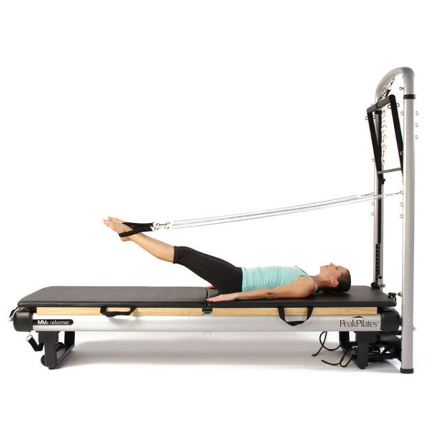
Leg Springs
Position yourself 4–8 inches closer to the Tower than an average-height user.
If available, use the short loops rather than long loops.
In supine exercises, your legs should reach full extension without the springs going completely slack
Arm Springs
Lower the spring attachment point by one setting if adjustable.
Sit or kneel slightly closer to the Tower.
At the starting position, there should already be light spring tension

Slide 20
.
Push-Through Bar
Use a lighter spring if your shorter lever lengths create excessive resistance.
During supine work, scoot slightly toward the Tower so:
  Knees can bend comfortably.
  Arms can reach the bar without rib flare.
Safety Chain
Shorter users often need the safety strap shortened.
The bar should stop before reaching the face or chest if the springs disengage

Slide 21
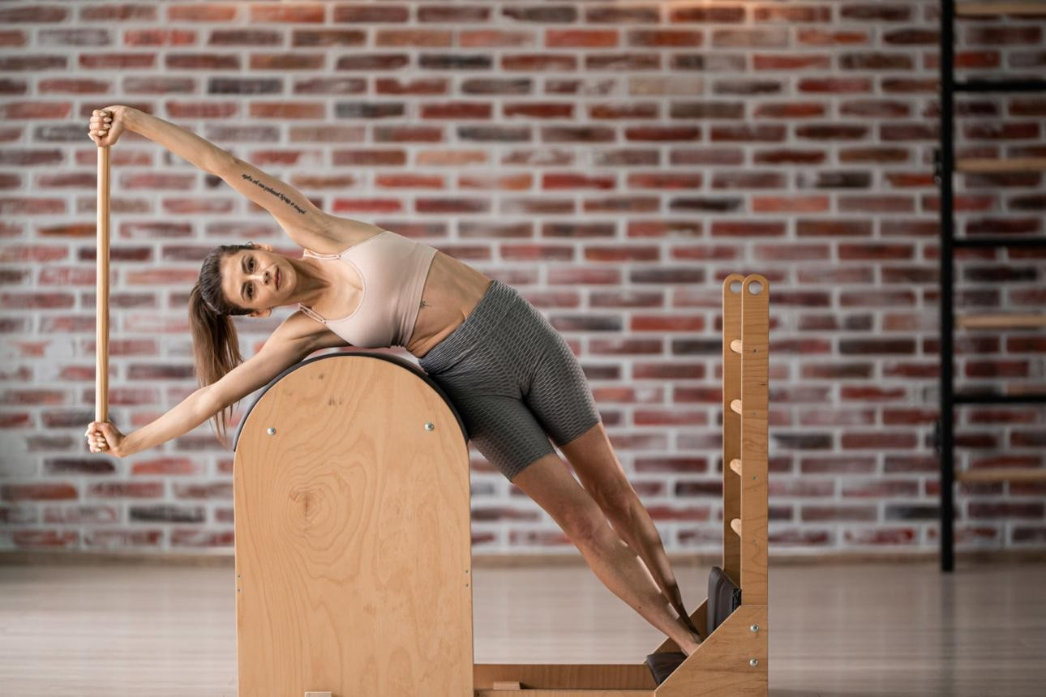
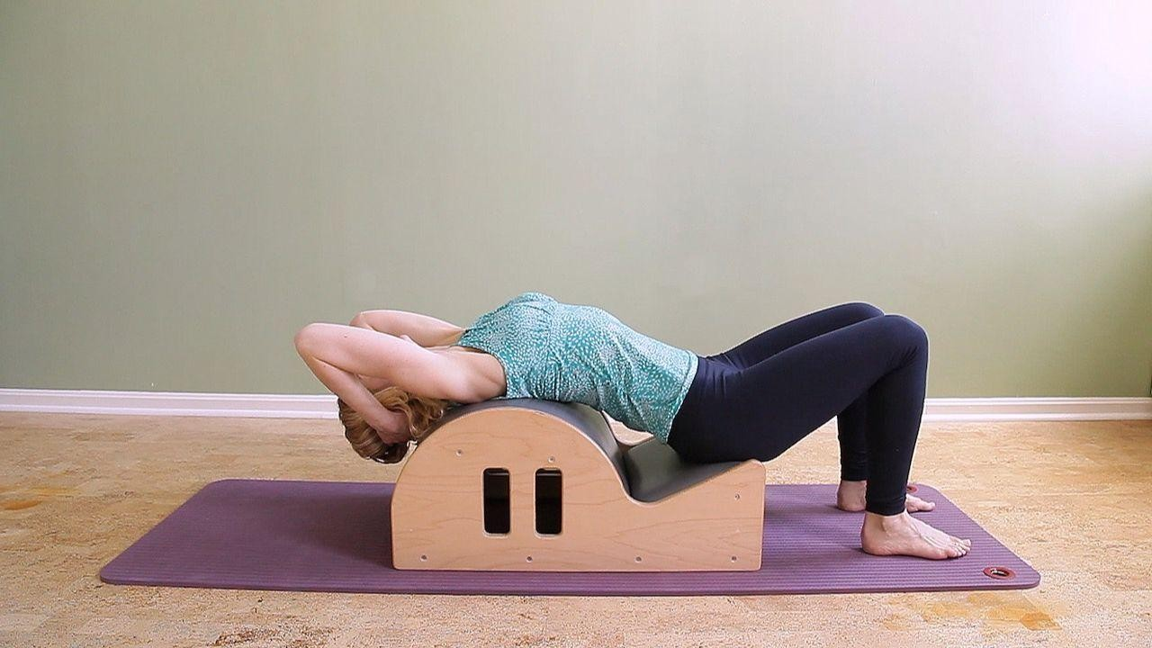
The Pilates Barrels

Slide 22
Explore Barrels
Spine Corrector vs Small Barrel
Arm Series
Leg Series
Ladder Barrel
Ballet Stretches
Short Box Series
Side Sit-ups
Basic Tree

Slide 23
Big & Tall Considerations
. Setup Tips for Ladder Barrel
Move the ladder farther from the barrel or the furthest setting to create more space for longer legs and a longer torso.
If your barrel is adjustable, start with the widest comfortable setting.
Focus on maintaining length through the spine rather than trying to achieve the same shape or depth as a smaller person.
Use the ladder rungs strategically for support and leverage.
Avoid compressing the low back by limiting extreme extension until you find the right barrel position.
Place your hips slightly behind the apex of the barrel during extension exercises if you feel compressed.
Emphasize thoracic mobility; many tall people compensate with excessive lumbar movement.
Move more slowly through transitions, as longer limbs create greater leverage and challenge balance.

Slide 24
Big & Tall Considerations
Focus on maintaining length through the spine instead of trying to fit your entire back perfectly onto the curve.
If your legs are very long, bend the knees slightly during some exercises to reduce tension in the hip flexors.
.Reduce ROM until core control is maintained
. Setup Tips for Spine Corrector
Position yourself slightly farther away from the barrel than shorter practitioners.
Allow the head to extend beyond the edge when appropriate rather than forcing the entire spine onto the arc and use pillows or hands for support.
Widen your stance in seated and standing exercises for better leverage.

Slide 25
Short & Small Considerations
Setup Tips for Ladder Barrel
Barrel Distance
Move the ladder closer to the barrel than a taller person would.
When standing on the rung used for support, your hips should align comfortably over the apex of the barrel without having to stretch excessively. Use a box for height as needed
If you feel pulled through your shoulders or lower back before starting the exercise, bring the ladder closer.
Foot Placement
Use a higher rung when appropriate.
Shorter legs often require a higher rung to maintain neutral pelvic alignment.
Avoid locking your knees to compensate for distance.
Range of Motion
Smaller bodies often benefit from a slightly reduced range that preserves abdominal support and not overarching the low back.
Shoulders hiking ,bring hands to a lower, closer rung

Slide 26
Short & Small Considerations
Setup Tips for Spine Corrector
Sit slightly closer to the barrel's apex (highest point) than a taller person might.
If your feet don't comfortably reach the floor during seated exercises, place yoga blocks or a stable platform under them.
Focus on maintaining length through the spine rather than trying to create a larger range of motion.
During backbends, stop when you feel support from the barrel; don't chase depth.
For side-bending exercises, position your waist directly over the apex of the barrel for better leverage.

