Slide 1
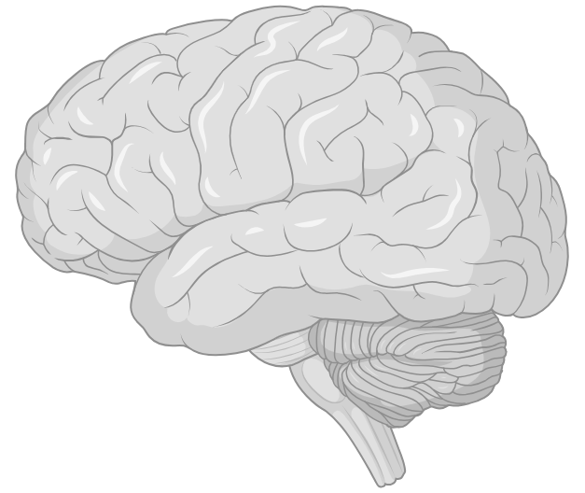
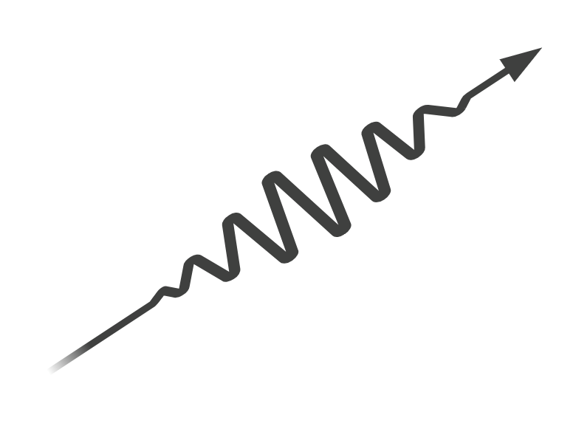
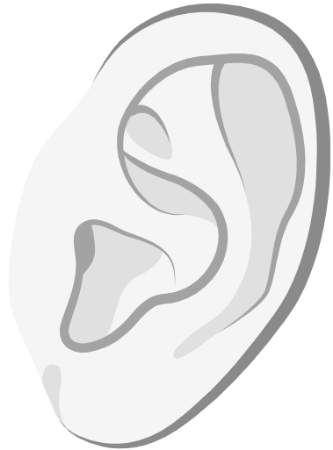
Hearing and Listening After Epilepsy Surgery
Emily Harford, MA; UPMC Children’s Hospital of Pittsburgh
PESA Conference & Family Reunion, 2026

Slide 2

Today's Session
  Hearing vs Listening
  Effects of Surgery
  What We Know
  What We Don't Know
  What We Can Do

Slide 3
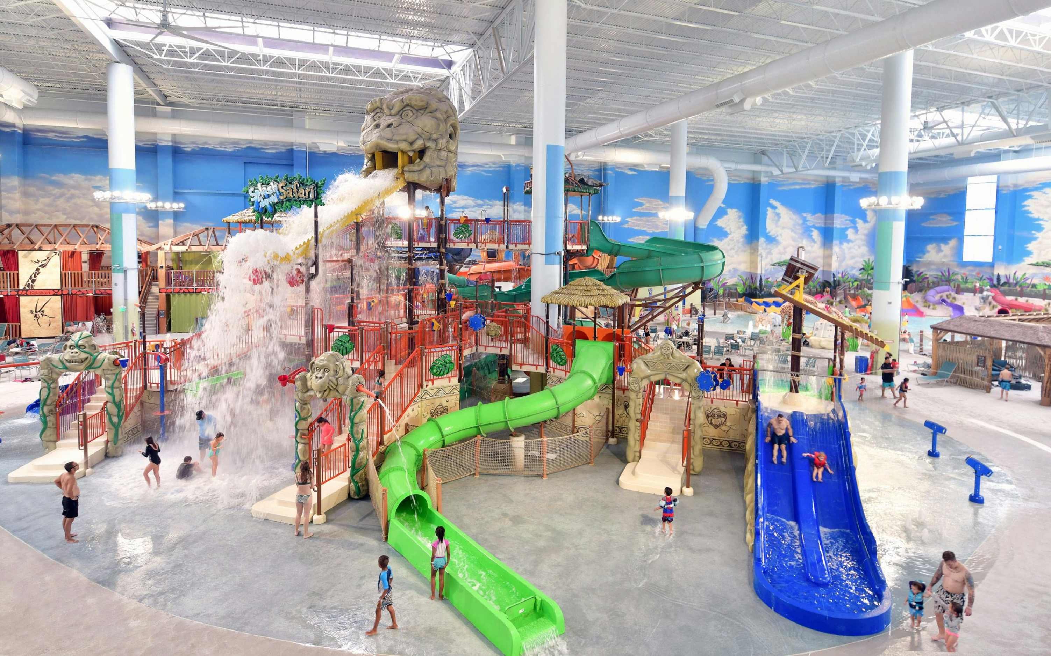
Sound is Everywhere!

Slide 4
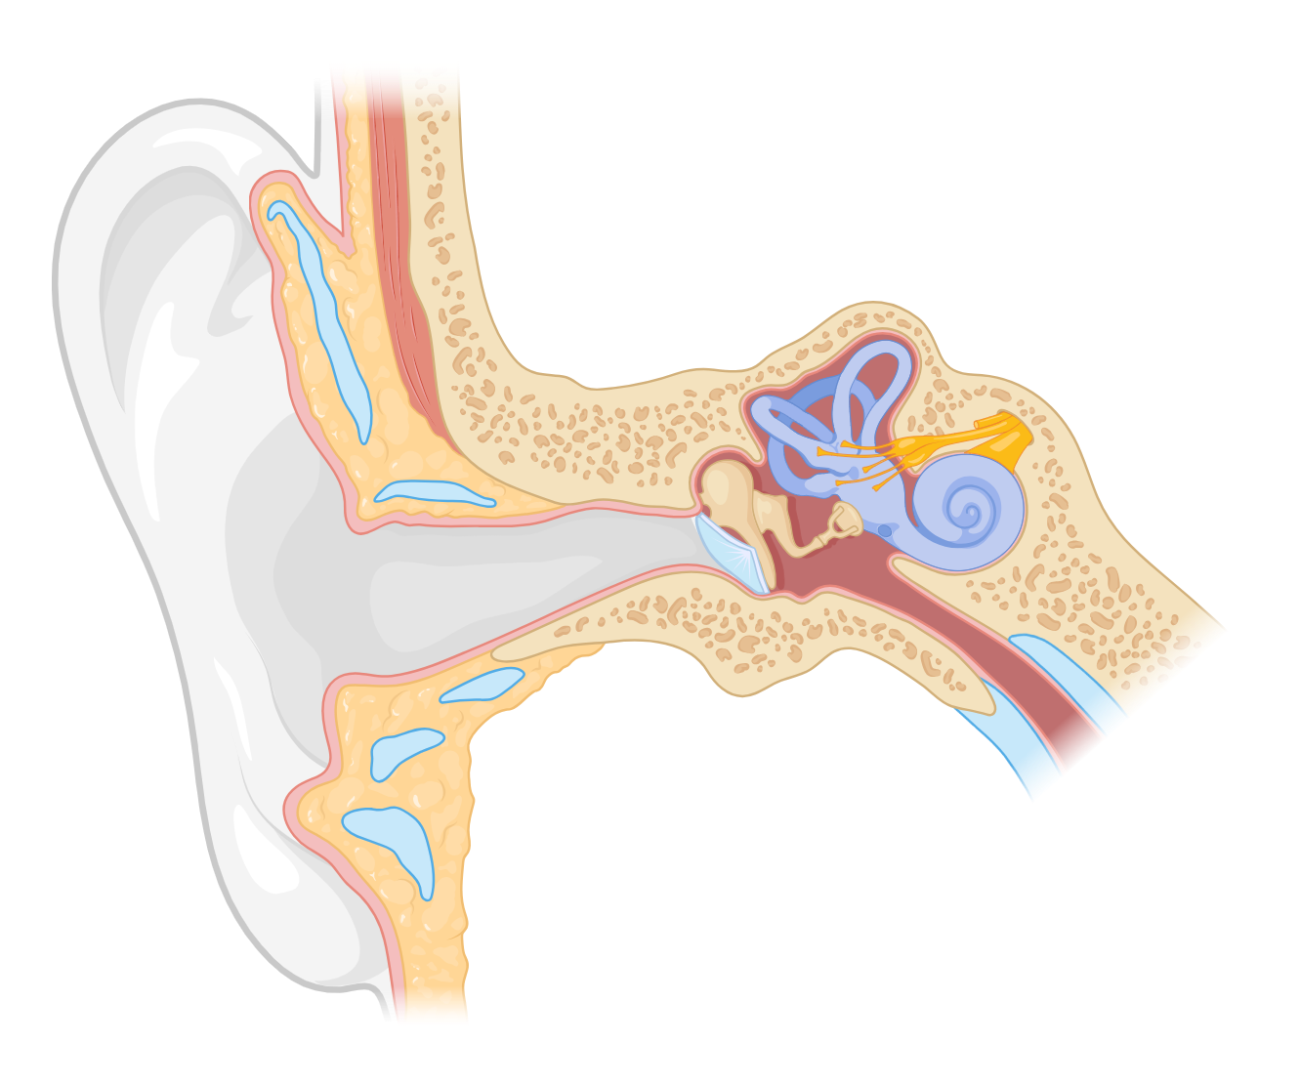
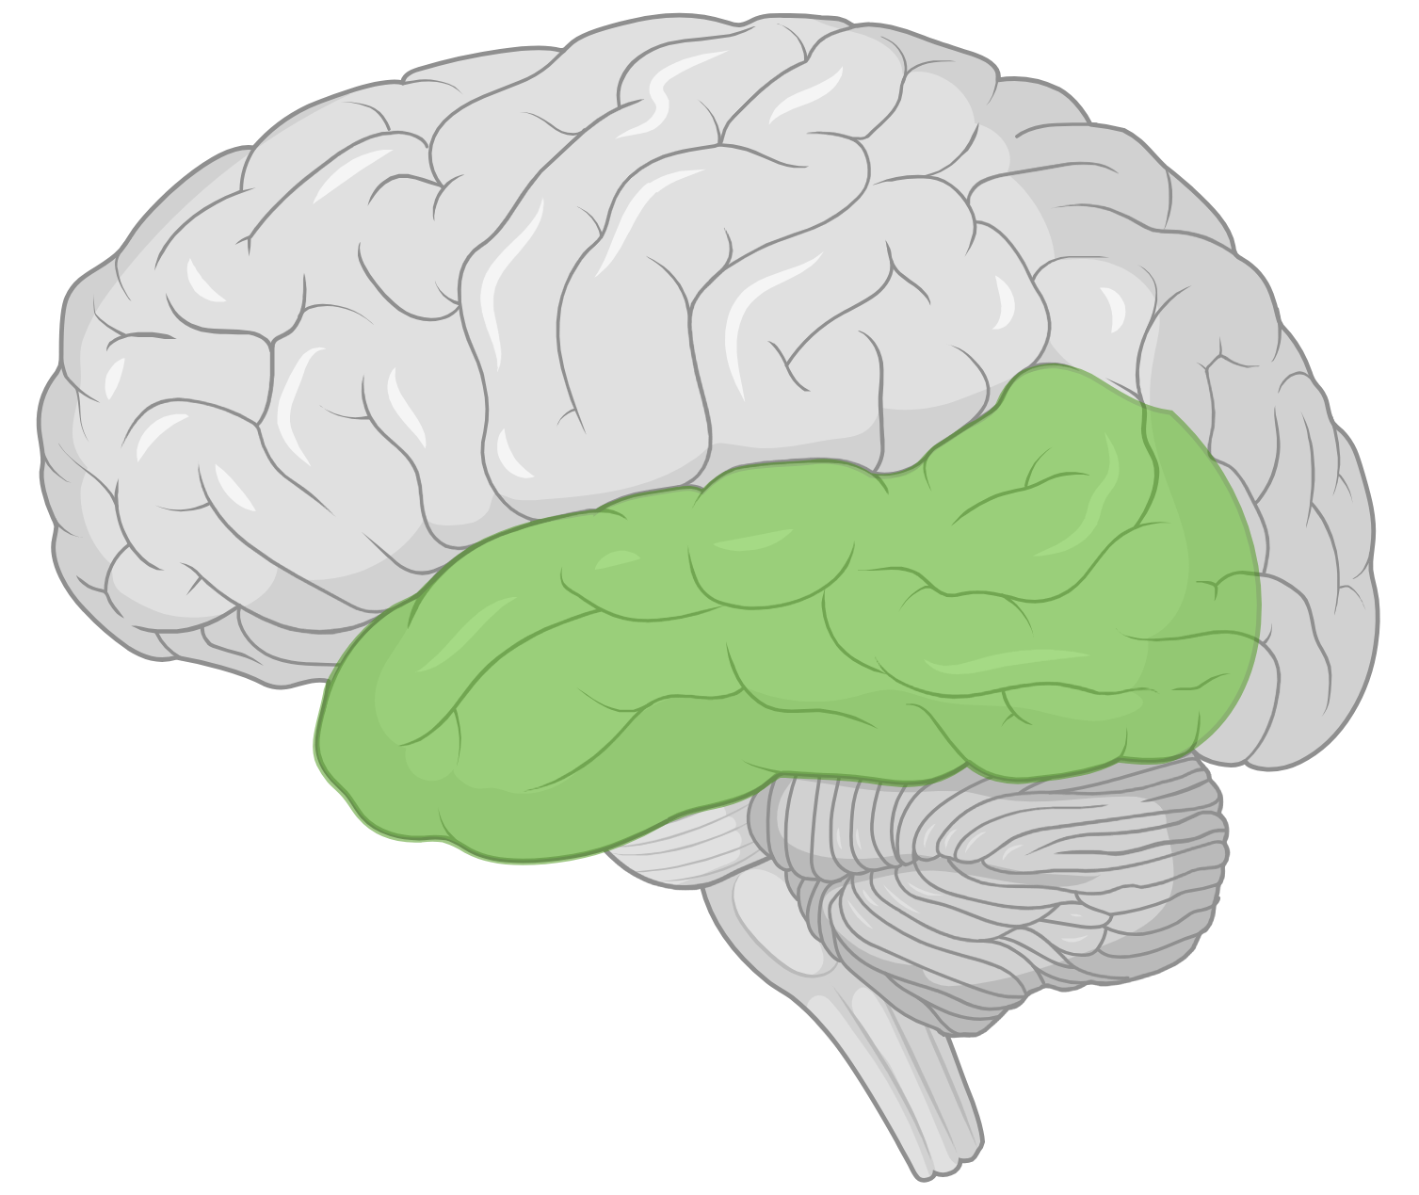

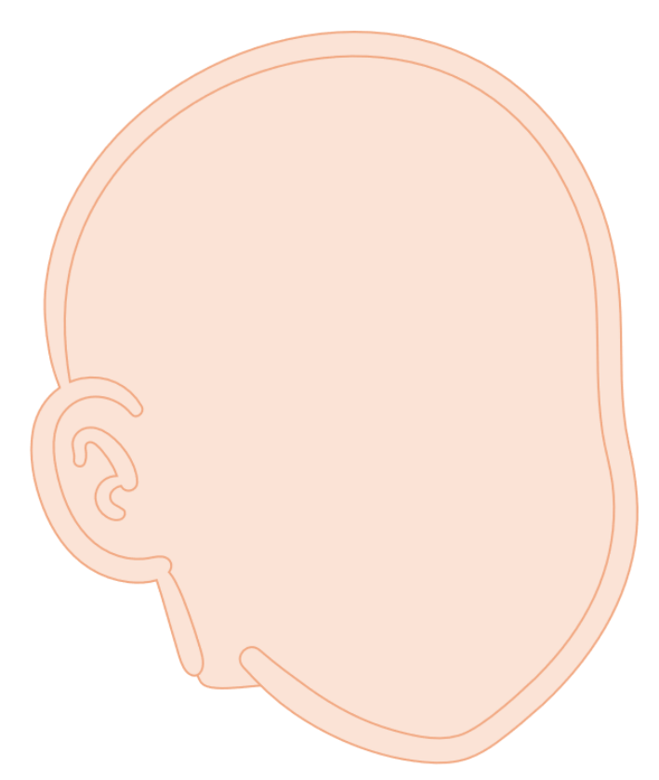


Hearing
Listening
vs
Is there sound?
Loudness
Pitch
What is that sound?
Separating sounds
Speech

Slide 5
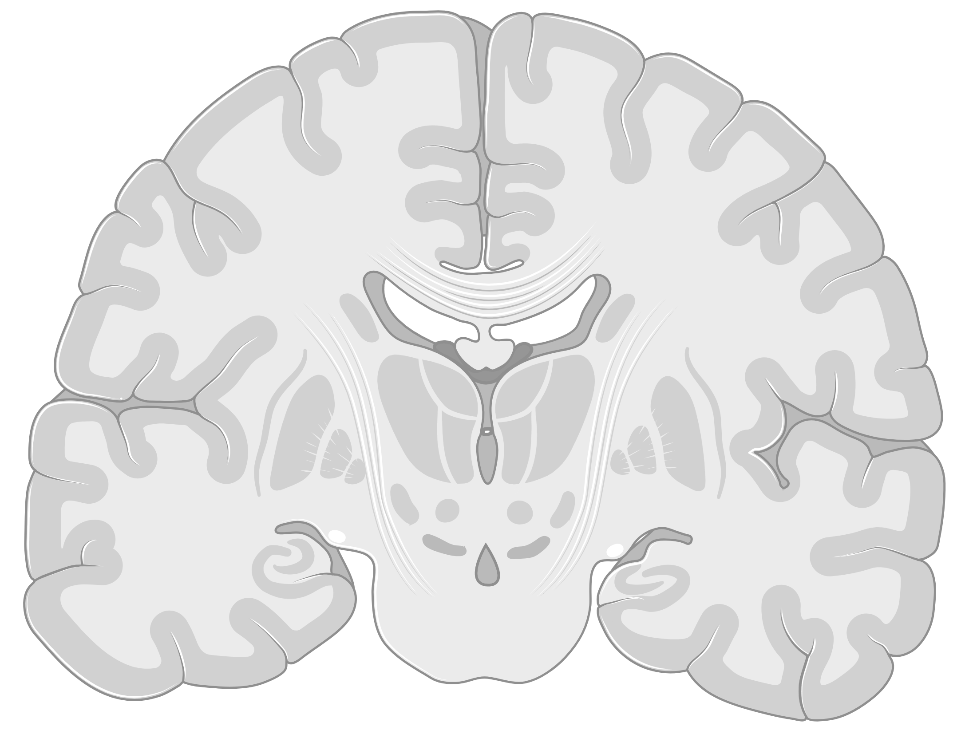
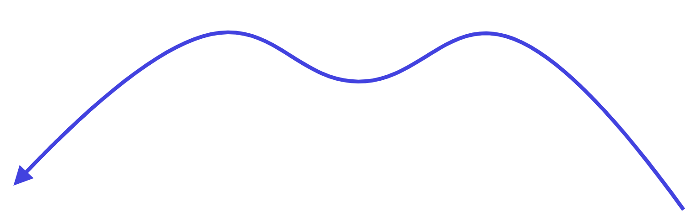



Effects of Epilepsy Surgery
Some connections remain
Interrupts or removes connections
Listening > hearing
Depends on type of surgery

Slide 6

What We Know
Deficits
Tracking moving sounds
Understanding speech in noise
Picking out one sound from many
Sensitivity to noise
Worse in ear opposite surgery
Hearing is not affected

Slide 7

What We Don’t Know
A lot!
Lack of pre- and post-op testing
How deficits change
Formal testing difficulties
Auditory processing is complex
Notes:
Deficits could be stable, worse, or improve over time
Compensatory strategies may develop
Formal testing barriers = age, cognition, access to professionals
Auditory processing wrapped up in language, cognition, attention, etc.
Deficits likely vary person to person

Slide 8





What Can We Do?
Know what auditory processing deficits look like!
Understanding speech (filling in the gaps) in noisy environments
Focusing in noisy environments
Following verbal directions
Understanding or finding sounds coming from one side
Tolerating noisy environments

Slide 9
What Can We Do?
Testing
If possible
Therapy/Rehab
Programs not tested in epilepsy surgery
Accommodations
Minimize noise
Strategic seating & positioning
Written instructions, pre-teaching, “chunking”
Amplification systems?
Strategies
Active listening
Strengths compensate for weaknesses
Self-advocacy

Slide 10
Thank you!
Any questions?

