Slide 1
Developmental and Epileptic Encephalopathy (DEE) -
What is it and Why is it so Hard to Treat?
Sonal Bhatia MBBS, MD, FACNS, FAES
Associate Professor, Pediatrics
UTSW & Children’s Medical Center, Dallas

Slide 2


Slide 3
Learning Objectives
What is a DEE?
Why do DEEs happen?
Why are seizures so hard to control?
Why is treating seizures simply not enough?
What is in store for a hopeful future?

Slide 4
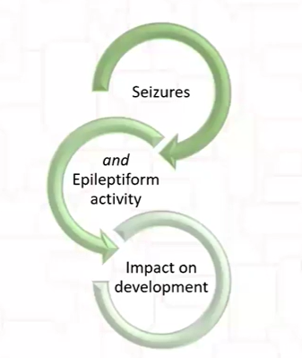
Defining the Concepts
Epileptic Encephalopathy
Normal brain development before epilepsy
Epilepsy slows brain development
Early seizure treatment salvages development
Berg A et al, 2010; Scheffer IE et al, 2020

Slide 5
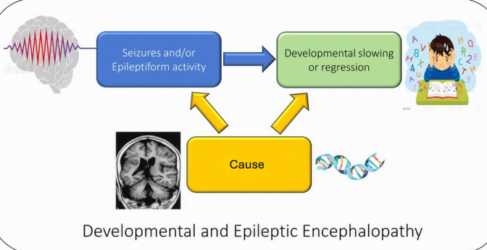
What is a DEE?
Frequent seizures and/or abnormal EEG activity (“spikes” or “sharps”)
Slowed development or loss skills
The underlying cause also contributes to developmental challenges
Scheffer IE et al, 2017

Slide 6
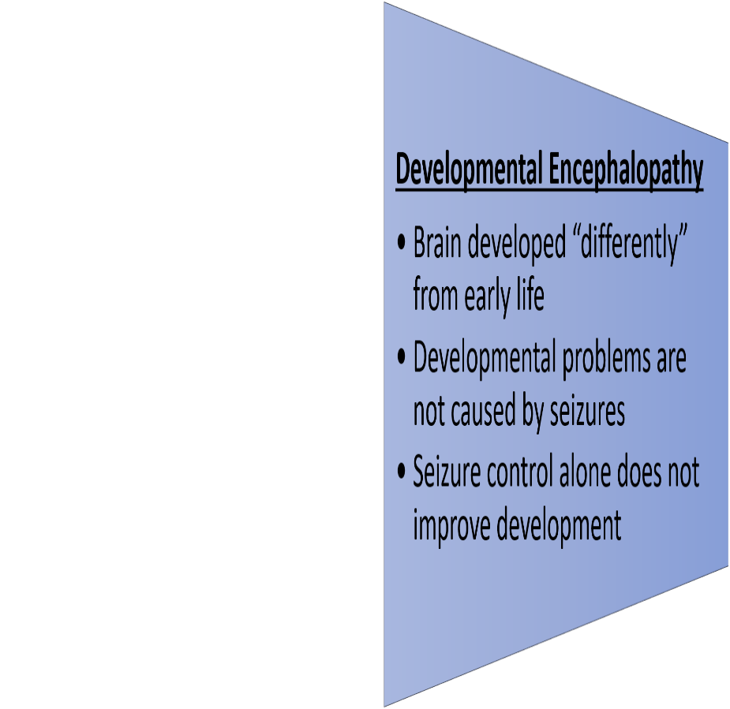
Defining the Concepts
Intellectual Disability
Epilepsy
Developmental Encephalopathy

Slide 7

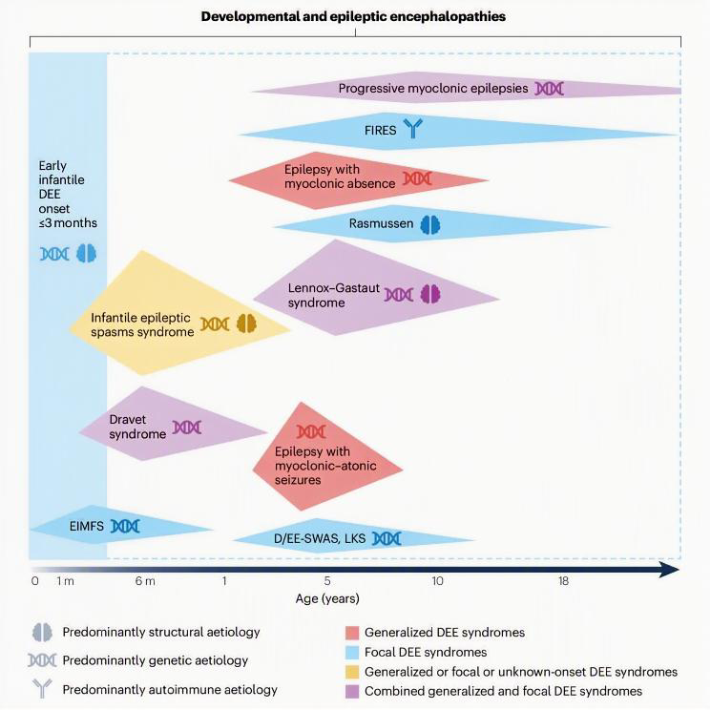


DEEs result from
Genetic changes
> 900 genes and counting!
Structural brain differences/malformations
Metabolic disorders
Unknown cause
Scheffer IE et al, 2024
Notes:
Mention genetics carefully.
Today we know hundreds of genes that can cause DEEs.
These discoveries have transformed how we diagnose children.
Importantly, most of these genetic changes happen by chance—they are not something parents caused or could have prevented.

Slide 8

Why are seizures so hard to control in DEEs?
The underlying problem remains!
Most ASMs:
Do not correct the underlying cause
Simply reduce seizures
ASM = Antiseizure medications
Notes:
One of the hardest questions parents ask is:
"Why isn't there one medicine that just fixes this?"

Slide 9
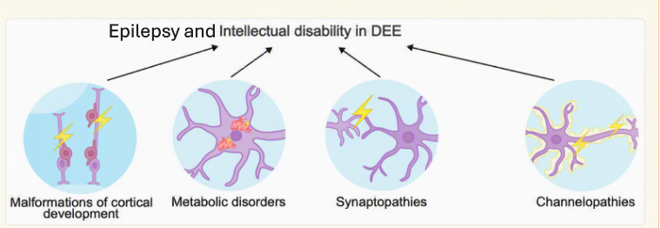
Why are seizures so hard to control in DEEs?
Many different biological mechanisms
Brain development pathways
Sodium or Potassium channels
Synapses
Neurotransmitters
Medyanik A et al, 2025

Slide 10
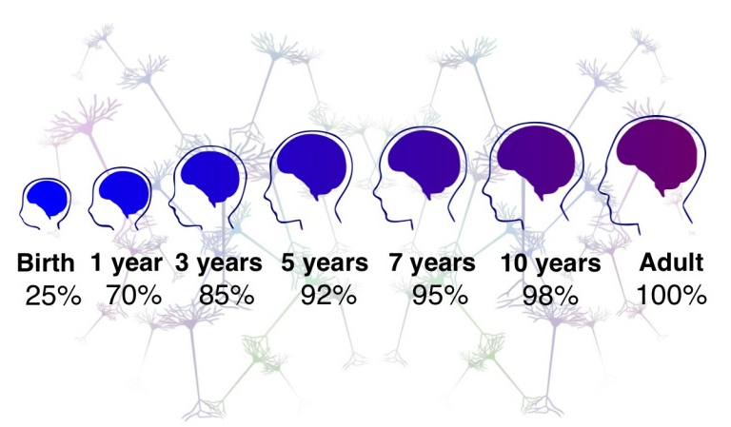
Why are seizures so hard to control in DEEs?
Children’s brains are constantly growing!
Seizure types change
Medication responses change

Slide 11
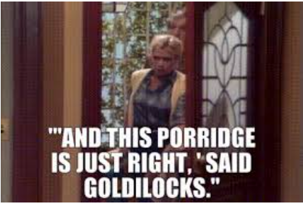
The Road to Seizure Control in DEEs
The Power of the Right Diagnosis
One at a Time: Less Chaos, More Clarity
Start Low, Go Slow
Less Is More
Finding the Sweet Spot (Does not happen Overnight!)
No Permanent Enemies
Notes:
The Power of the Right Diagnosis
“Before we even talk about medications, we need the right diagnosis.
Epilepsy isn’t one single condition — it’s hundreds of different types.
If we mislabel the seizure type, we may end up treating the wrong thing.
The right diagnosis is like having the correct map — it guides everything that comes next.”
One at a Time: Less Chaos, More Clarity
“When we start medication, we almost always try one medication at a time.
Why? Because if you start two at once and something goes wrong — a side effect, behavior change, sleep issues — you can’t tell which one is the culprit.
One at a time keeps the picture clean, clear, and calm.”
Start Low, Go Slow
“We don’t blast in with a big dose on day one.
We start low and go slow — it gives the brain time to adjust and helps avoid side effects.
Most seizure meds work best when the body eases into them, not when we sprint.”
Less Is More
“In epilepsy, more medication is not always better.
Sometimes the safest, most effective plan is the simplest one.
One well-chosen medication beats a handful of half-effective ones any day.”
Finding the Sweet Spot (Does Not Happen Overnight!)
“Finding the right dose is like tuning a radio — twist too far one way or the other and the signal gets fuzzy.
It takes time to find that middle ground where seizures stop and side effects stay low.
It’s a journey… not a switch we can flip.”
A Two-Year Contract (Conditions Apply!)
“When a medication works and seizures stop, we usually stay on it for about two years before thinking about tapering.
Think of it like a two-year contract with the brain — stability first, then renegotiation.
And of course… conditions apply! The seizure type, EEG findings, and history all matter.”

Slide 12
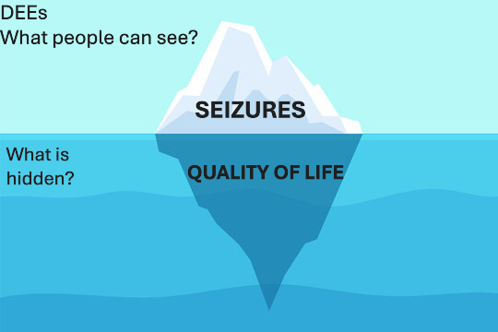
Why is treating seizures simply not enough?
COMORBIDITIES
Development
Behavior
Gait
Gut
Sleep
Abnormal movements

Slide 13
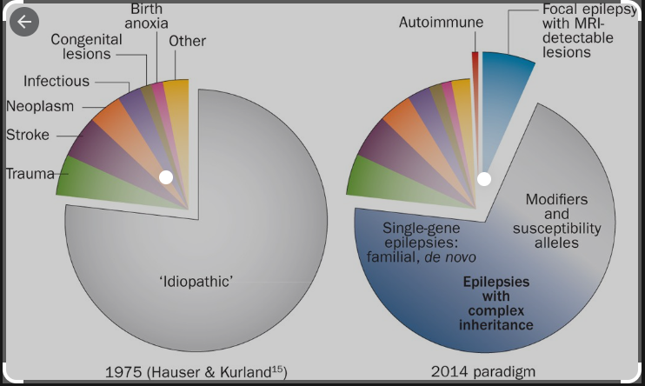
What Gives Me Hope?
From Band-Aids to Breakthroughs
Targeted drugs:
Fenfluramine, Ganoxolone, Everolimus
Gene therapies & Antisense oligonucleotides:
Dravet syndrome
Thomas RH & Berkovic SF, 2014
Notes:
Twenty years ago many children never received a precise diagnosis.
Today many families receive an answer through genetic testing.
And increasingly, that diagnosis may guide treatment.

Slide 14

Together, We Create Hope
Hope is NOT for every seizure to disappear BUT
Hope is:
Finding the right diagnosis
Finding newer therapies
Celebrating every gain, big or small
Seeing a child more alert, comfortable & engaged
And So Is Their DEE
Notes:
Hope is finding newer therapies that weren’t available just a few years ago
Every child with a DEE has a unique story.
Our job as clinicians is not only to reduce seizures, but to help each child reach their fullest potential and to support the entire family along the journey.

