Slide 1

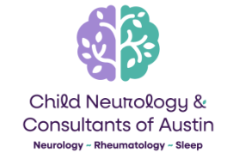
Social Success & the regulated brain:
The impacts of epilepsy and epilepsy surgery
Karen Keough, MD Child Neurologist & Epileptologist

Slide 2
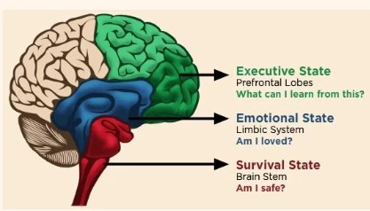
Neural Networks involved in regulation
Widespread and interconnected
Impacted by underlying brain conditions, & seizure activity & medication effects

Slide 3
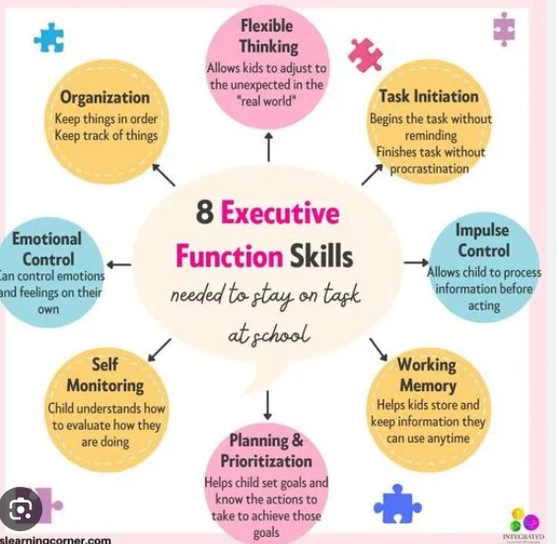
Epilepsy is strongly a/w Executive function deficits
Impacts:
Focus/attention
Memory/learning
Planning/organization
Control of Impulses & emotion
Social relationships

Slide 4
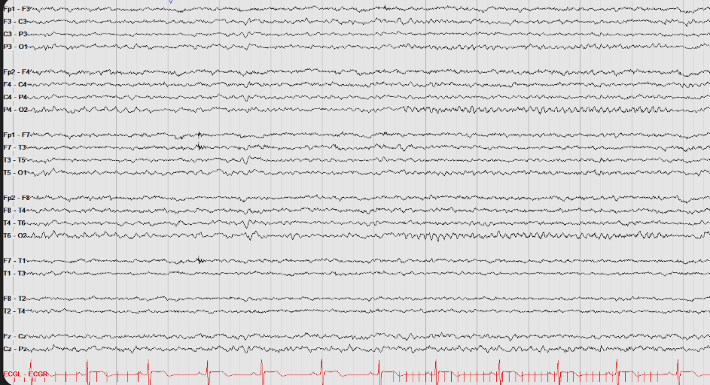
Normal awake EEG background
Well organized
Consistent rhythms
Reactive to eye opening/closing and stimulation

Slide 5
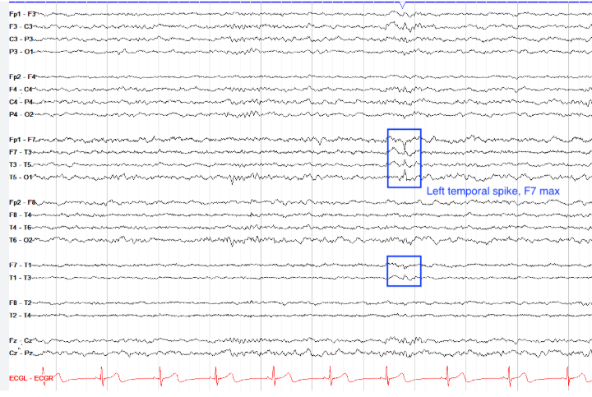
Simple epilepsy:
EEG with Epileptiform activity
Discharges indicate a place where seizures can start
Most of the background remains normal

Slide 6
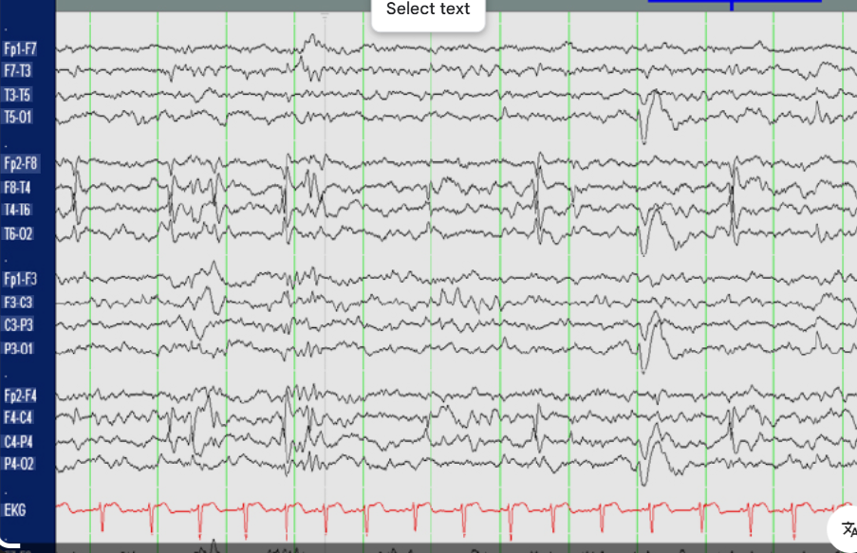
EEG discharges only partially predict cognitive & behavioral Impacts
More active discharges/ multiple locations
Predicts more frequent seizure & more associated symptoms…
Except when it doesn’t…

Slide 7
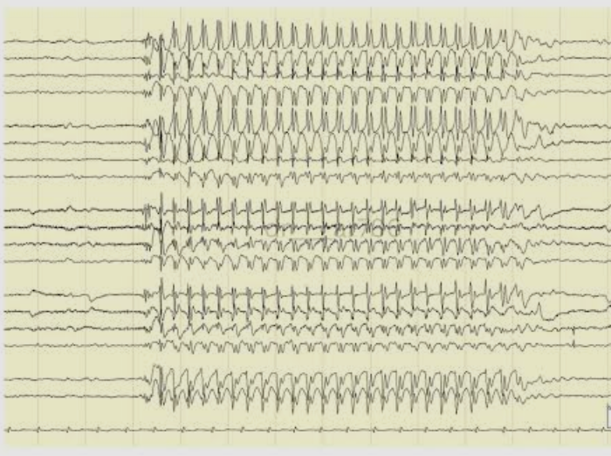
Some seizures are worse than others
Absence seizures
Usually well-controlled w medication
Strongly associated with learning disability & attention deficits

Slide 8
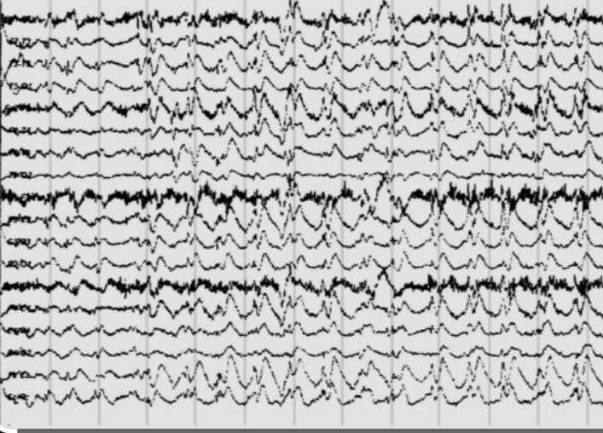
Atypical Absence seizures
--Harder to control with medication
--Associated w other seizure types & more serious underlying diagnoses
--More serious learning/developmental issues

Slide 9
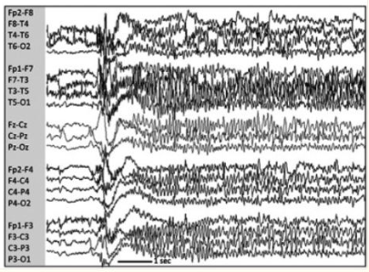
Tonic Seizures
Often occur in epileptic encephalopathies
Usually involve multiple different seizures
Moderate to severe social & cognitive impairment expected

Slide 10
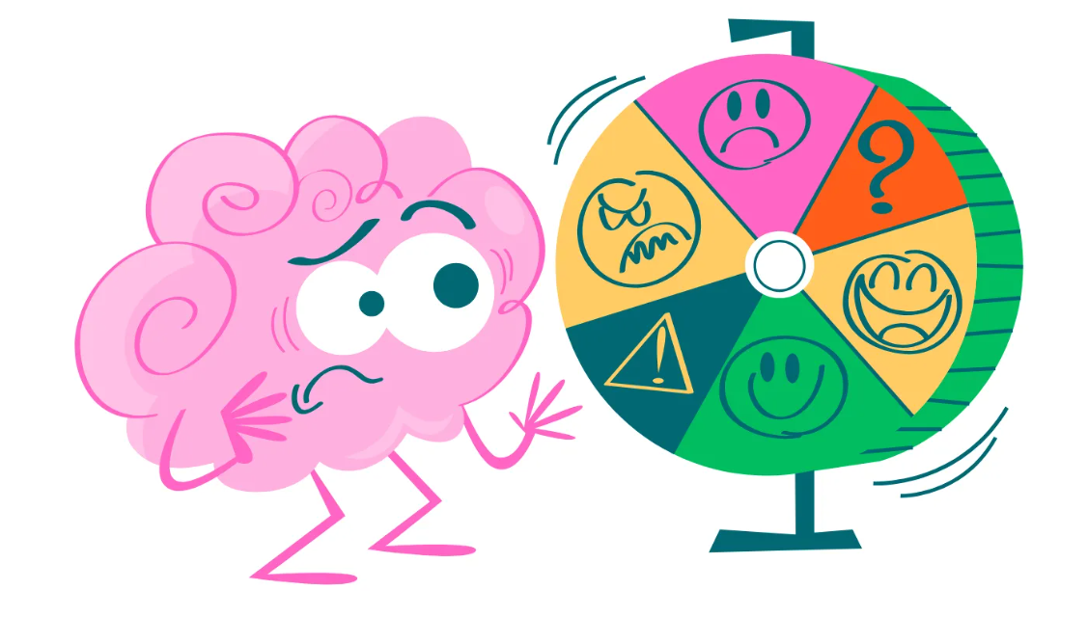
How Does Epilepsy affect self-regulation

Slide 11
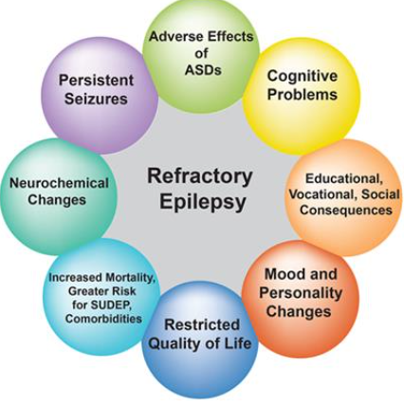
Studies suggest that psychological Factors have stronger influence than seizures

Slide 12
Neuropsychological Testing and epilepsy surgery
Identify strengths and weaknesses
Formulate predicted impact of proposed procedures
Set realistic expectations for non-seizure related outcome
Recommend therapies/educational accommodations
Track improvements/changes post-surgery
Restrategize interventions based on post-operative function

Slide 13
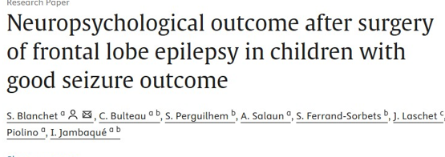
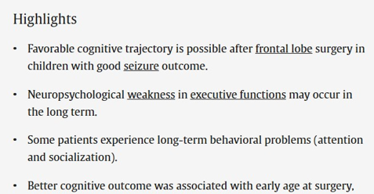
How does epilepsy surgery impact social functioning?

Slide 14
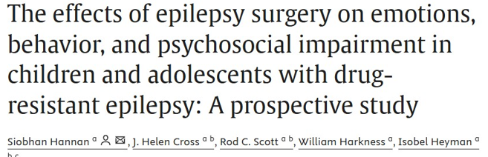
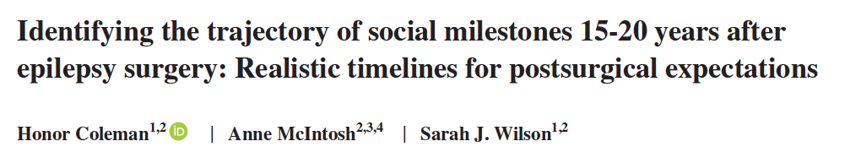
Limited data from small study samples
*13 children followed for 8.5 years
*39 adults with temporal lobe resections

Slide 15

Pooled data from literature review of 24 studies evaluating children after epilepsy surgery

Slide 16
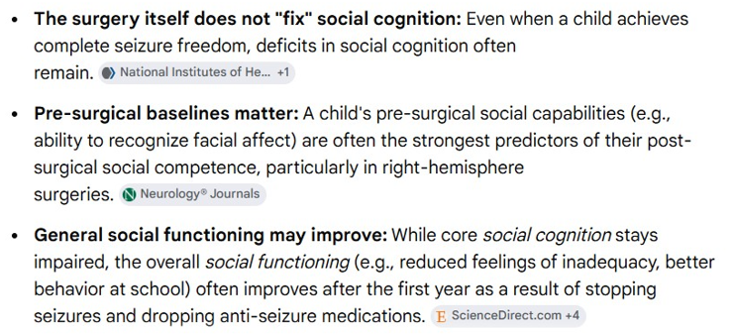
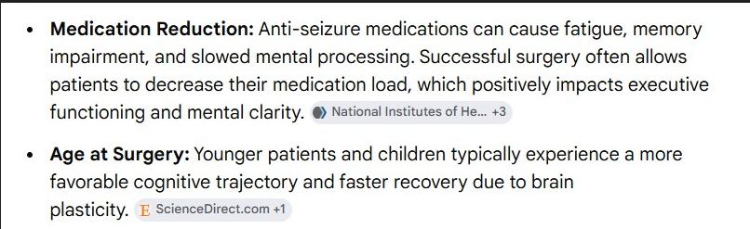
Take home messages

Slide 17
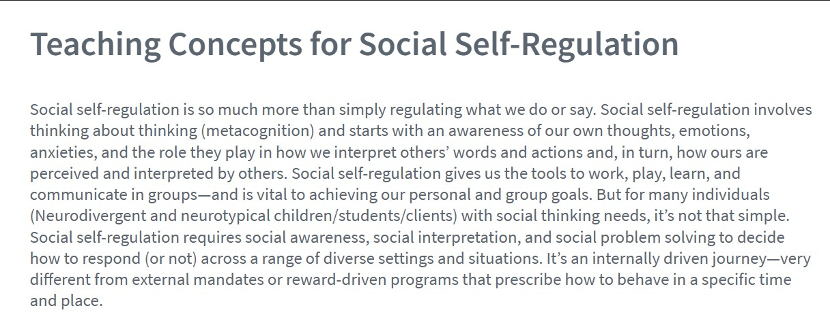

Slide 18
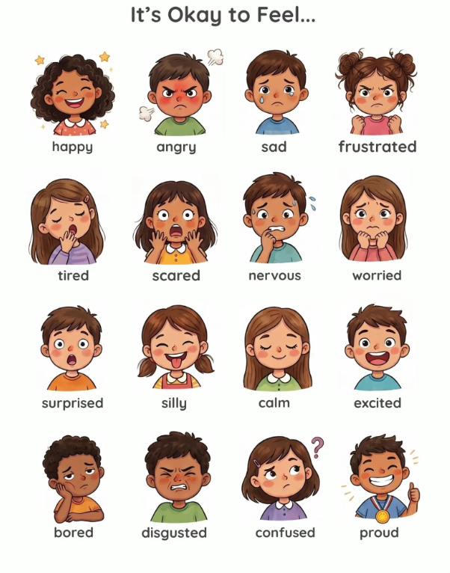
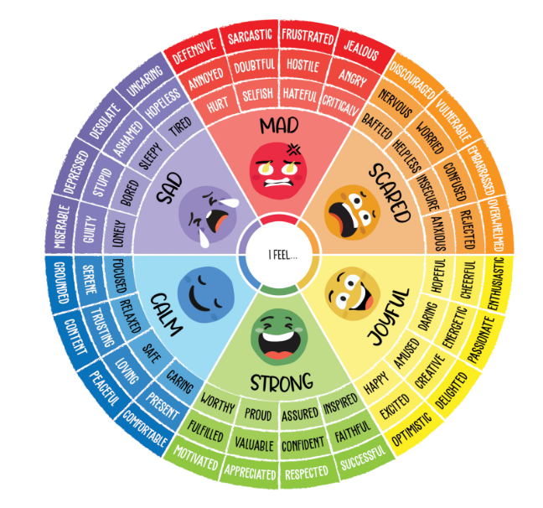
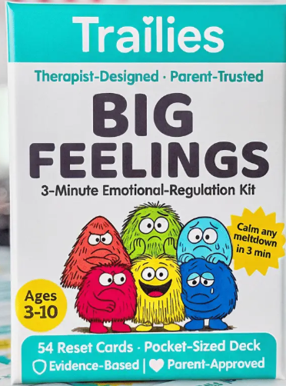
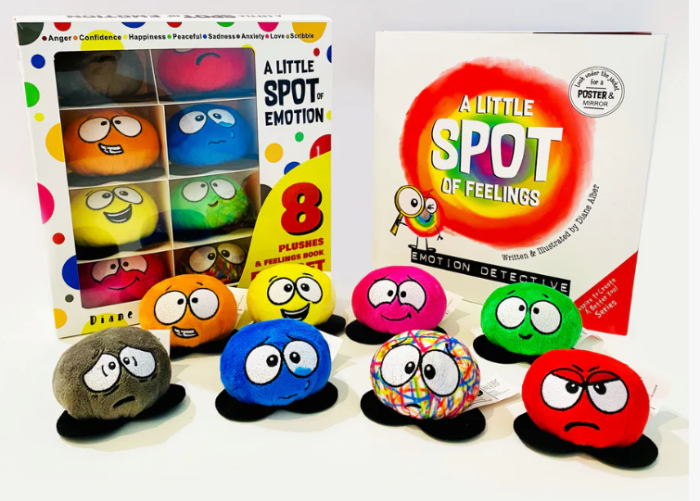
Tools to teach emotional recognition at home & at school

Slide 19
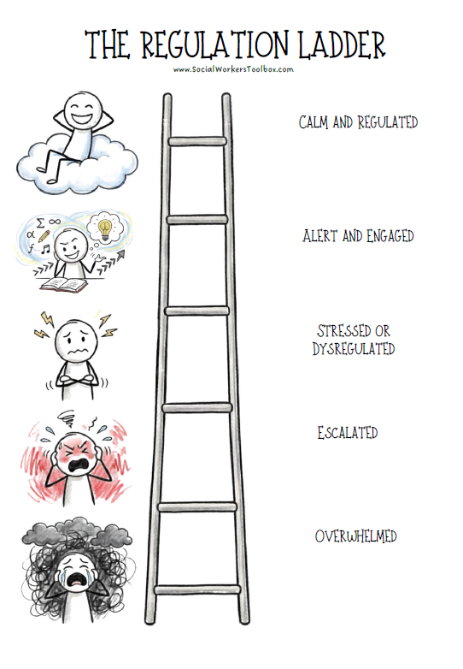
Strategies for de-escalation

Slide 20
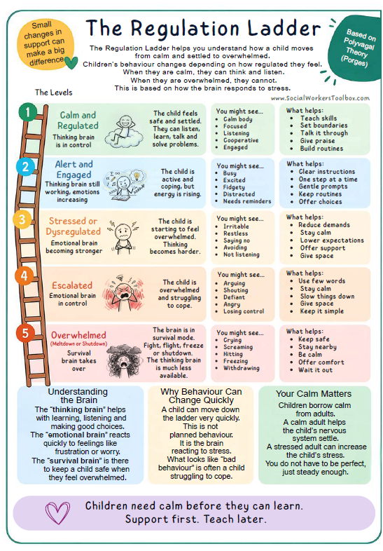
De-escalation in action

Slide 21
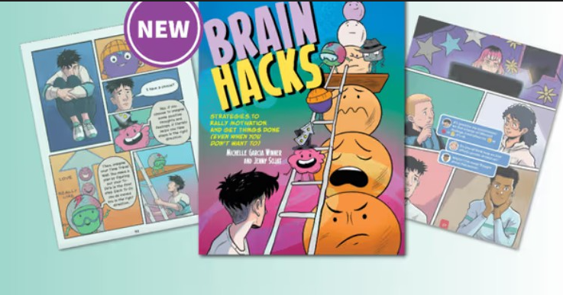
Age-appropriate interventions

Slide 22
Formal therapies
Occupational Therapy (OT)
Applied Behavioral Analysis (ABA)
Play therapy
Hippotherapy
Music/Art Therapy
Social Skills Training
Behavioral therapy
Cognitive Behavioral Therapy (CBT)
Counseling (individual/family)

Slide 23
Considering medications?
It’s about balancing neurochemistry
Enhance focus:
--stimulants & non-stimulants
Improve impulse control:
--guanfacine/clonidine
--amantadine
--atypical antipsychotics
Reduce anxiety: SSRIs & SNRIs
Improve sleep:
--melatonin
--guanfacine/clonidine
--trazodone
--Lunesta
Reduce self-injurious behavior:
--N-acetyl cysteine (NAC)
--naltrexone
Cannabinoids: limited data but anecdotal benefits

Slide 24


