Slide 1
BPA’s Grid Expansion
PNW OSSIA/WASEIA
April 29th, 2026

Slide 2
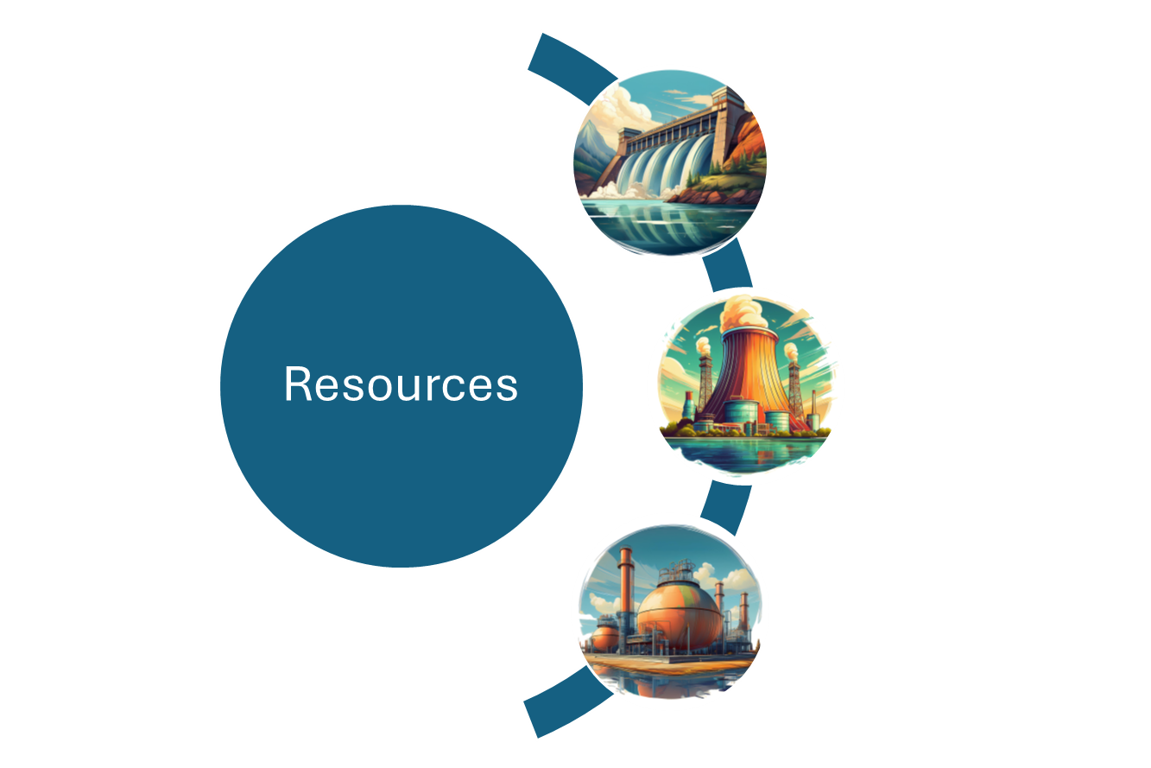

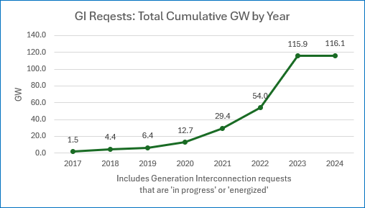
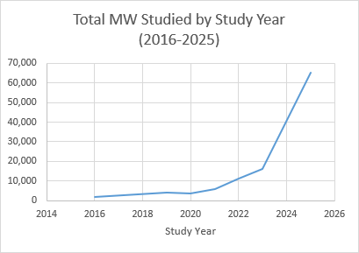
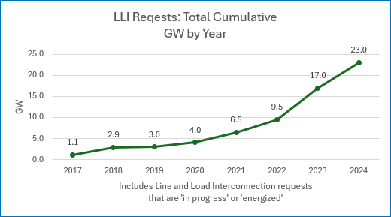
Transmission Requests
BPA identifies transmission upgrades in response to customer needs in three general areas: 1) Generator Interconnection; 2) New Transmission Service; and 3) Line/Load Interconnection
Point of Receipt
Point of Delivery
1. Generator Interconnection
2. Transmission Service
3. Line/Load Interconnection
Pre-decisional

Slide 3
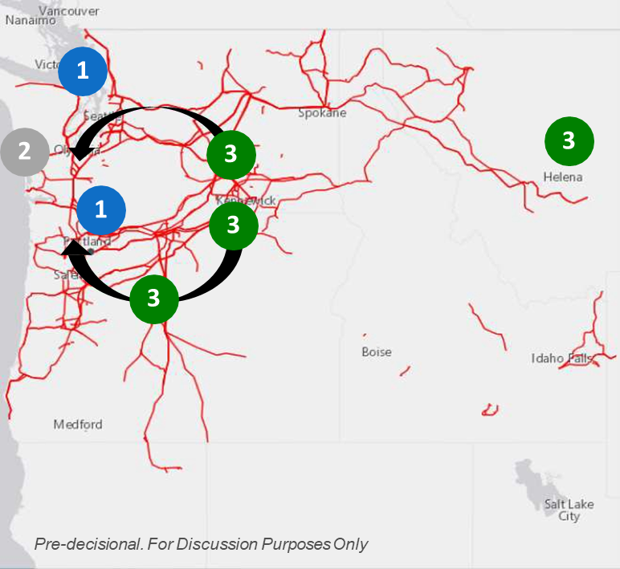
What Drove Transmission Builds
The following factors heavily impact electrical flows across the Federal Columbia River Transmission System (FCRTS):
Load growth in Portland and Seattle – driven by high tech industry, transportation and building electrification
Reduced Operation of 4.5 GW of carbon emitting generators on the west side along the I-5 corridor
Replacement wind and solar resources are located east of the Cascades
Will increase flows on cross-Cascades transmission paths and throughout the load centers
Pre-decisional

Slide 4
Grid Expansion and Reinforcement Portfolio
In 2023 and 2024 BPA announced over 20 new transmission line and substation projects, totaling over $6 billion in estimated costs, which will help improve transmission capacity and reliability throughout the Northwest.
These expansion projects, previously referred to as Evolving Grid projects, have been rebranded to the Grid Expansion and Reinforcement Portfolio (GERP) to reflect the expanded scope and purpose of the work.
Web site: Grid Expansion and Reinforcement Portfolio (GERP) - Bonneville Power Administration
Pre-decisional

Slide 5
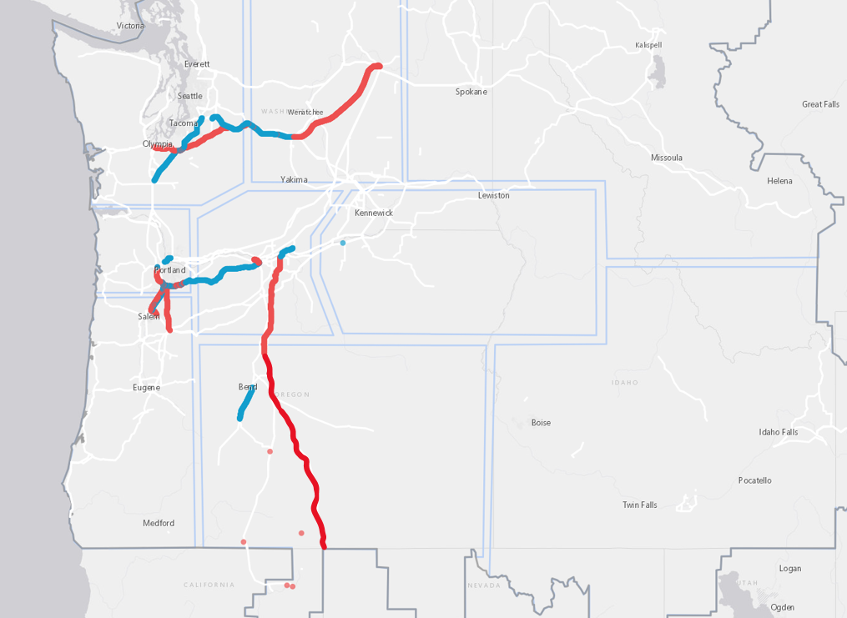
GERP 1.0 & 2.0 Map
GERP 1.0
1 | Cross Cascades North Upgrades Schultz-Raver 500 kV Line Upgrade Paul 500 kV Substation Upgrade Olympia 230 kV Substation Upgrade
2 | Big Eddy-Chemawa 230/500 kV Line Upgrade
3 | Portland Area Upgrades Pearl-Sherwood McLoughlin 230 kV Line Upgrade Keeler-Horizon 230 kV Line Keeler 230/500 kV Transformer Addition
4 | Chehalis-Covington 230 kV Line Upgrade
5 | Ross-Rivergate 230 kV Line Upgrade
6 | Rock Creek-John Day 500 kV Line Upgrade
7 | Six Mile Canyon 230/500 kV Substation (New Construction)
8 | Bonanza 230/500 kV Substation (New Construction)
9 | La Pine-Bonanza 230 kV Line (New Construction)
10 | Buckley 500 kV Substation Rebuild
GERP 2.0
1 | Grand Coulee-Columbia-Schultz 500 kV Line Upgrade
2 | Schultz-Olympia 500 kV Line Upgrade
3 | North of Pearl Upgrades
4 | Central Oregon 500 kV Dynamic Reactive Upgrades
5 | RATS: Reno-Alturas Reactive Addition
6 | Salem Area Upgrades #1 (North of Marion)
7 | Salem Area Upgrades #2 (North of Marion)
8 | NOB Substation (New Construction)
9 | Lower Columbia-Bonanza 500 kV Line (New Construction)
10 | Bonanza to NOB 500 kV Line (New Construction)
11 | Ostrander-Pearl 500 kV Line Upgrade
12 | Big Eddy-Quenett Creek Upgrade
13 | Big Eddy-The Dalles Line Rebuild
1
4
1
2
3
5
12
2
13
7
3
6
7
11
6
9
8
9
10
4
10
GERP 1.0
GERP 2.0
5
8
5

