Slide 1
Notes:
The 2026 Chevrolet Corvette Stingray features a mid-mounted 6.2L LT2 V8 engine producing 490 horsepower (495 hp with the Z51 performance exhaust) and 465 lb-ft of torque.
When you put pressure to the gas peddle this thing moves! It is amazing
What is wrong with it? You are out of gas!
I’m not sure if I am the best or the worst person to speak on this subject
Worst – I think that we have huge issues with laziness
I think that there are a lot of preachers who use burnout and family priorities as excuses for laziness
They need to get busy for the cause of Christ
I don’t want to hear you wine about how hard your job is
Best – I think I have experienced burnout more often than I would like to admit and may actually be flirting with it in my life as a minister today.
Elijah’s encounter with the prophets of Baal left him burned out and fearful. He speaks as one who has lost perspective
I come from a long line of working people

Slide 2
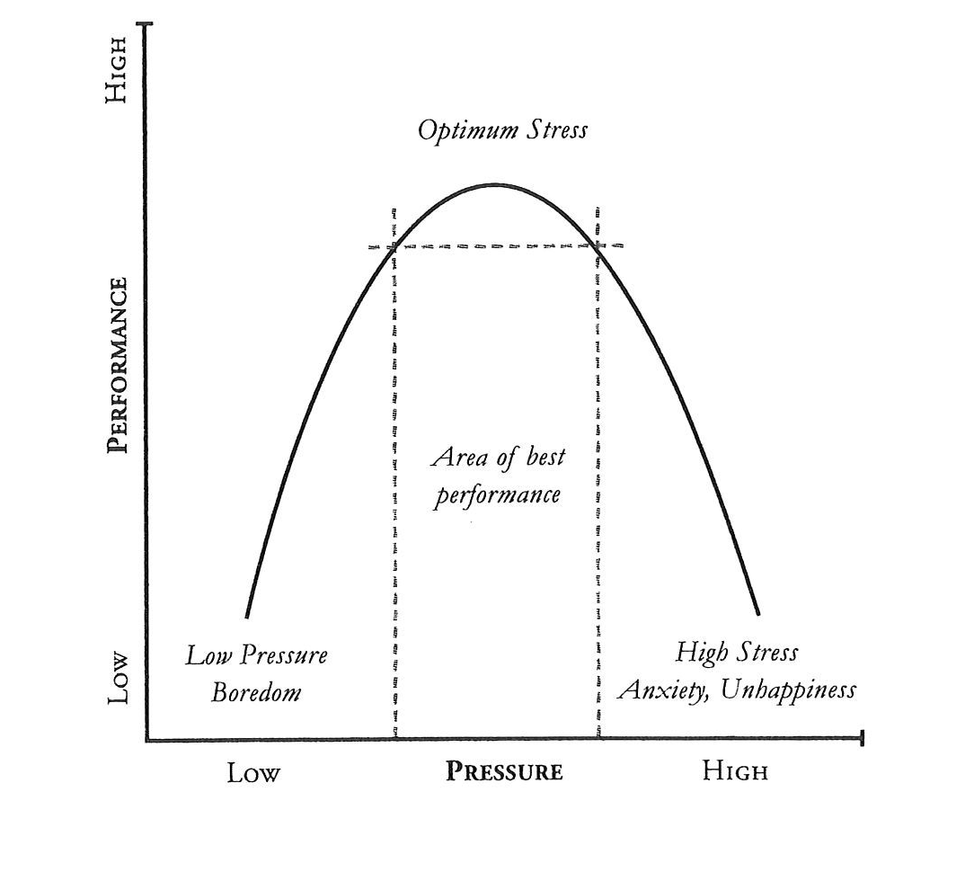
Notes:
One of the hardest things to do in preparation for this lesson is the define Burnout
The definition tends to be nebulous and the term is used to describe a lot of different things
It is not depression or anxiety although those things can contribute and/or be the end result of burn out.
Everyone of us has a certain amount of pressure on us.
Probably the more capable you are the more pressure you have
Pressure to preach a home run. Pressure to be there for people when they are in need. Pressure to help people in incredibly difficult situation. Pressure to know the scriptures.
Strife at Church, Strife in the Church (FB!)
Pressure causes us to perform. On some level the fact that people have an expectation from you is a good things.
Butterflies in your stomach. Use it! Make them take flight!
Michael Jordan thrived when the pressure was on. Clutch James Harden is a great basketball player, but he chokes when the pressure is on
Press that pedal – you go faster and faster. It is exhilarating.
You are draining your fuel
Every person has a different capacity for handling pressure, but none of us are without limits (I hate that!)
If you constantly deal with high pressure at some point you will begin to slow down or maybe even crash. Big Ole paper weight on the side of the road! The problem is not that this isn’t a powerful machine. The problem is that all the fuel has been burned out.
Whether you are a Ferrari or a Volvo you still need maintenance and fuel

Slide 3
Then He said to them all, “If anyone desires to come after Me, let him deny himself, and take up his cross daily, and follow Me. For whoever desires to save his life will lose it, but whoever loses his life for My sake will save it.
Luke 9:23-24
Sacrifice is not the same as Burnout
Notes:
Not just preaching, but especially preaching is a life of sacrifice.
Work hard. Preach the best sermons, lead that campaign. Write that material. Set up one more Bible study. Visit that hospital. Challenge yourself spiritually
You will never get it all done but you will die trying.
If it does not cost you something it is probably not worth much
“I would rather wear out than rust out” George Whitfield
There is a difference in Godly Sacrifice and needless burnout
Robert Murray McCheye, an early 19th Century Scottish preacher who died at age 30 said on his deathbed
“The Lord gave me a message to deliver and a horse to deliver it with, but, alas, I have killed the horse and can no longer deliver the message.”

Slide 4
We are Creatures of dust
You return man to dust
and say, “Return, O children of man!
Psalm 90:3
For he knows our frame; he remembers that we are dust.
Psalm 103:14
Notes:
God is God and we are Dust
Genesis 2:7 then the Lord God formed the man of dust from the ground and breathed into his nostrils the breath of life, and the man became a living creature.
You have limitations
God gave us sleep to remind us that we are not Him
We need sleep; but God does not
We need rest; but God does not
We need food; but God does not
We need friends; but God does not
God created us with limitations
Revived in strength as the woman was when she touched the hem of Jesus’ garment.

Slide 5
Signs of Burnout
Sermon Prep becomes laborious, mechanical and lacks joy
Cynicism and Detachment
Overwhelming Exhaustion
Personal Spiritual Life Suffers
Sense of ineffectiveness.
Notes:
We don’t like to acknowledge that we are burned out because our ministry role is so much more than just a job, it’s part of our identity.
Low Fuel Light – it better get your attention!
Prep becomes Laborious "I just have so much trouble getting stuff done!” My work has slowed to a snail’s pace I find my self staring at my computer or Bible. ENGAGE!
Jeremiah 20:9 If I say, “I will not mention him, or speak any more in his name,” there is in my heart as it were a burning fire shut up in my bones, and I am weary with holding it in, and I cannot.
I have to share this!
Cynicism and Detachment – I do not think highly of the people I preach or minister to. Always have something bad to say about my brethren I remove myself from interactions
Avoid Certain people, withdraw from collegues
2 Cor.
Overwhelming Exhaustion – There is something wrong with my body
Personal Spirtual Life Suffers – Am I praying, Do I read my Bible?
Sense of Ineffectiveness

Slide 6
Avoiding and Recovering
We Need Rest
We need Relationship
We Need Inward Renewal
Exercise
Rely on the Lord.
Beware Celebrity
Learn to Delegate
Proper Perspective
Notes:
We Need Rest. I come from a long line of working people. My default to almost every problem is, “Work Harder.” Go to bed at night. If you are not getting regular sleep it is going to impact your life and ability to cope. I have learned to embrace naps without shame
Do you take a day off during the week? Do you take some of your personal time for vacation (stay-cation if necessary)
There will be things that are left undone. That’s okay. There will be things undone if you work 8 days a week.
We Need Relationships
1 Samuel 23:16 And Jonathan, Saul's son, rose and went to David at Horesh, and strengthened his hand in God.
Elders – Shepherd your preacher don’t just work him (Barry Robinson)
Wives – Respect (Eph 5) He needs to know that you believe in him. Sex – 1 Cor 7 Don’t neglect it even though burnout may encourage that
Brothers – We are in this together. (Not alone) Increase ability to handle pressure. Preachers Meetings., Sit down with a counselor
Eccl 4:9-10 Two are better than one, because they have a good reward for their toil. ¹⁰ For if they fall, one will lift up his fellow. But woe to him who is alone when he falls and has not another to lift him up
We Need Inward Renewal - PTP (Renew, Refresh, Recharge)
Exercise – it makes a difference. Take time to go to the gym, go for a walk. Some of what you are feeling is the result of your body being severely unhealthy
Rely on the Lord – 1 Cor 3:6 I planted, Apollos watered, but God gave the increase. Lets take the pressure off that you have to save the world. Save your congregation. Save this person
I did what I could do, and now this is in God’s hands. I am good with that.
Beware Celebrity – John 5:41 I do not receive honor from men.
Learn to Delegate – Purposeful Work (Acts 6) The Apostles had to say no to feeding widow. There are some things much less than that you probably need to say no to. Exodus 18:17 So Moses’ father-in-law said to him, “The thing that you do is not good.
Proper Perspective
“If I never preach another sermon, never lead another church meeting, never give another talk, never have another one-to-one spiritual conversation with anyone, never use my gifts ever again in ministry, my name is still written in heaven. And in that I will rejoice.”

Slide 7


