Slide 2
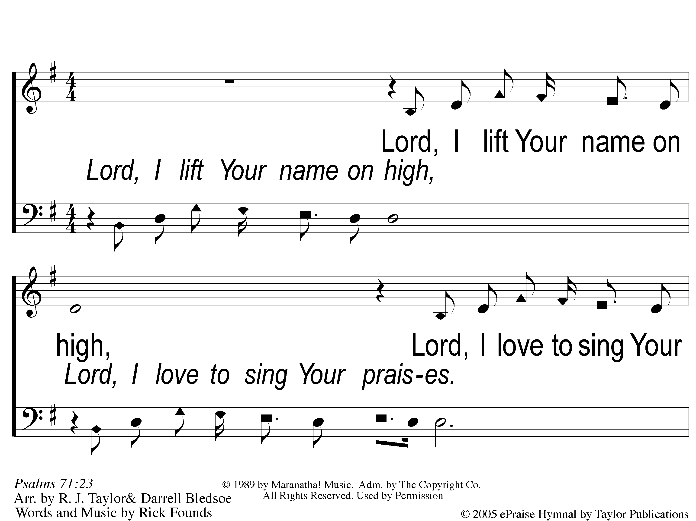
1 Lord I Lift Your Name On High
Lord, I Lift Your Name On High

Slide 3
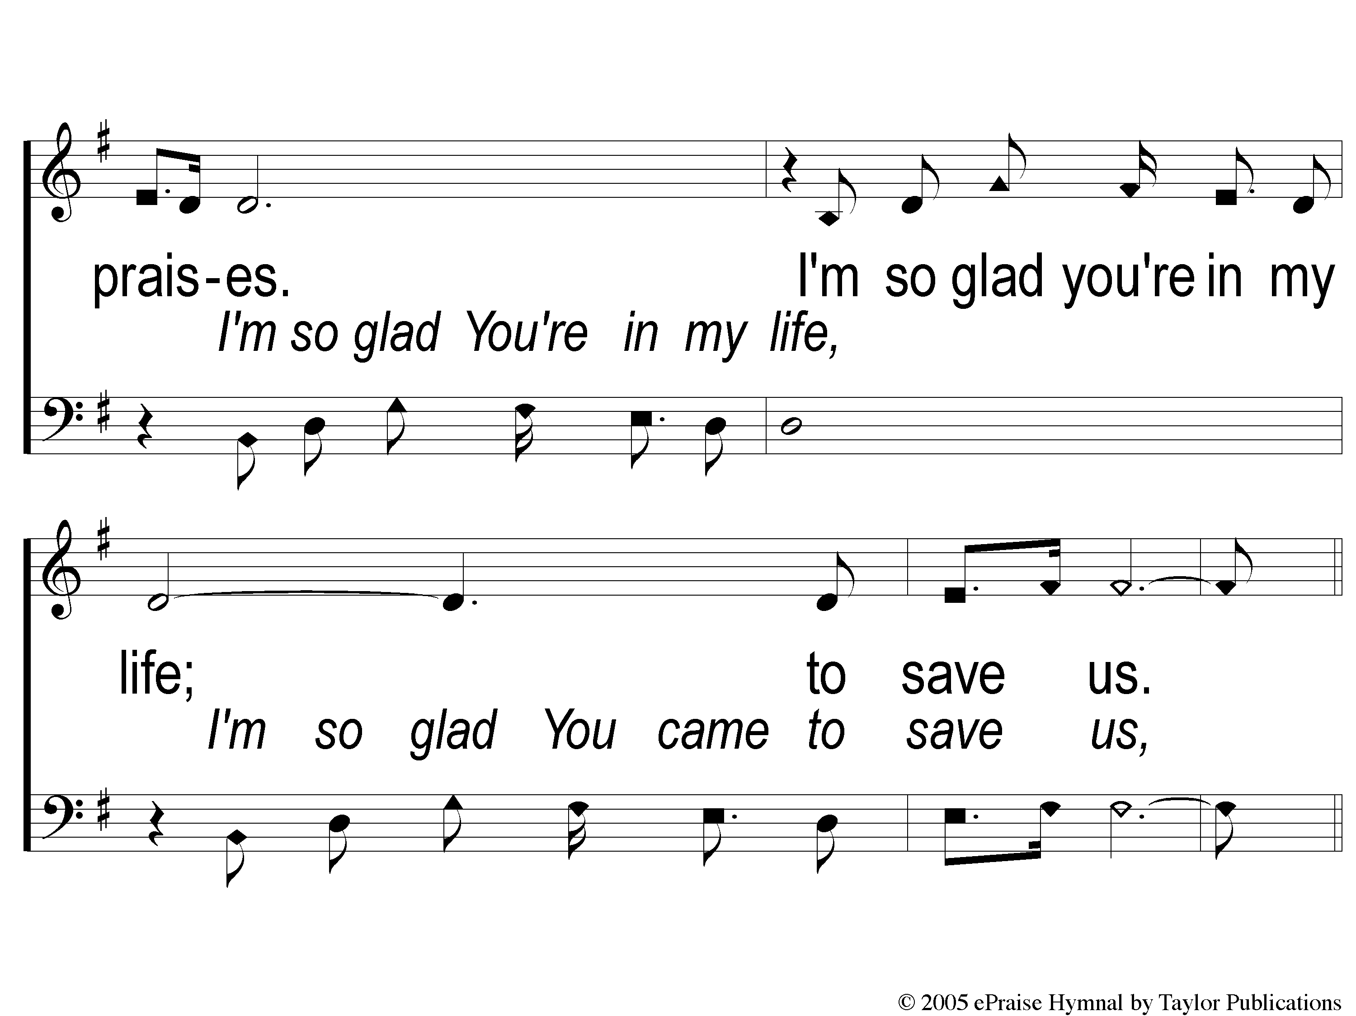
2 Lord I Lift Your Name On High
Lord, I Lift Your Name On High

Slide 4
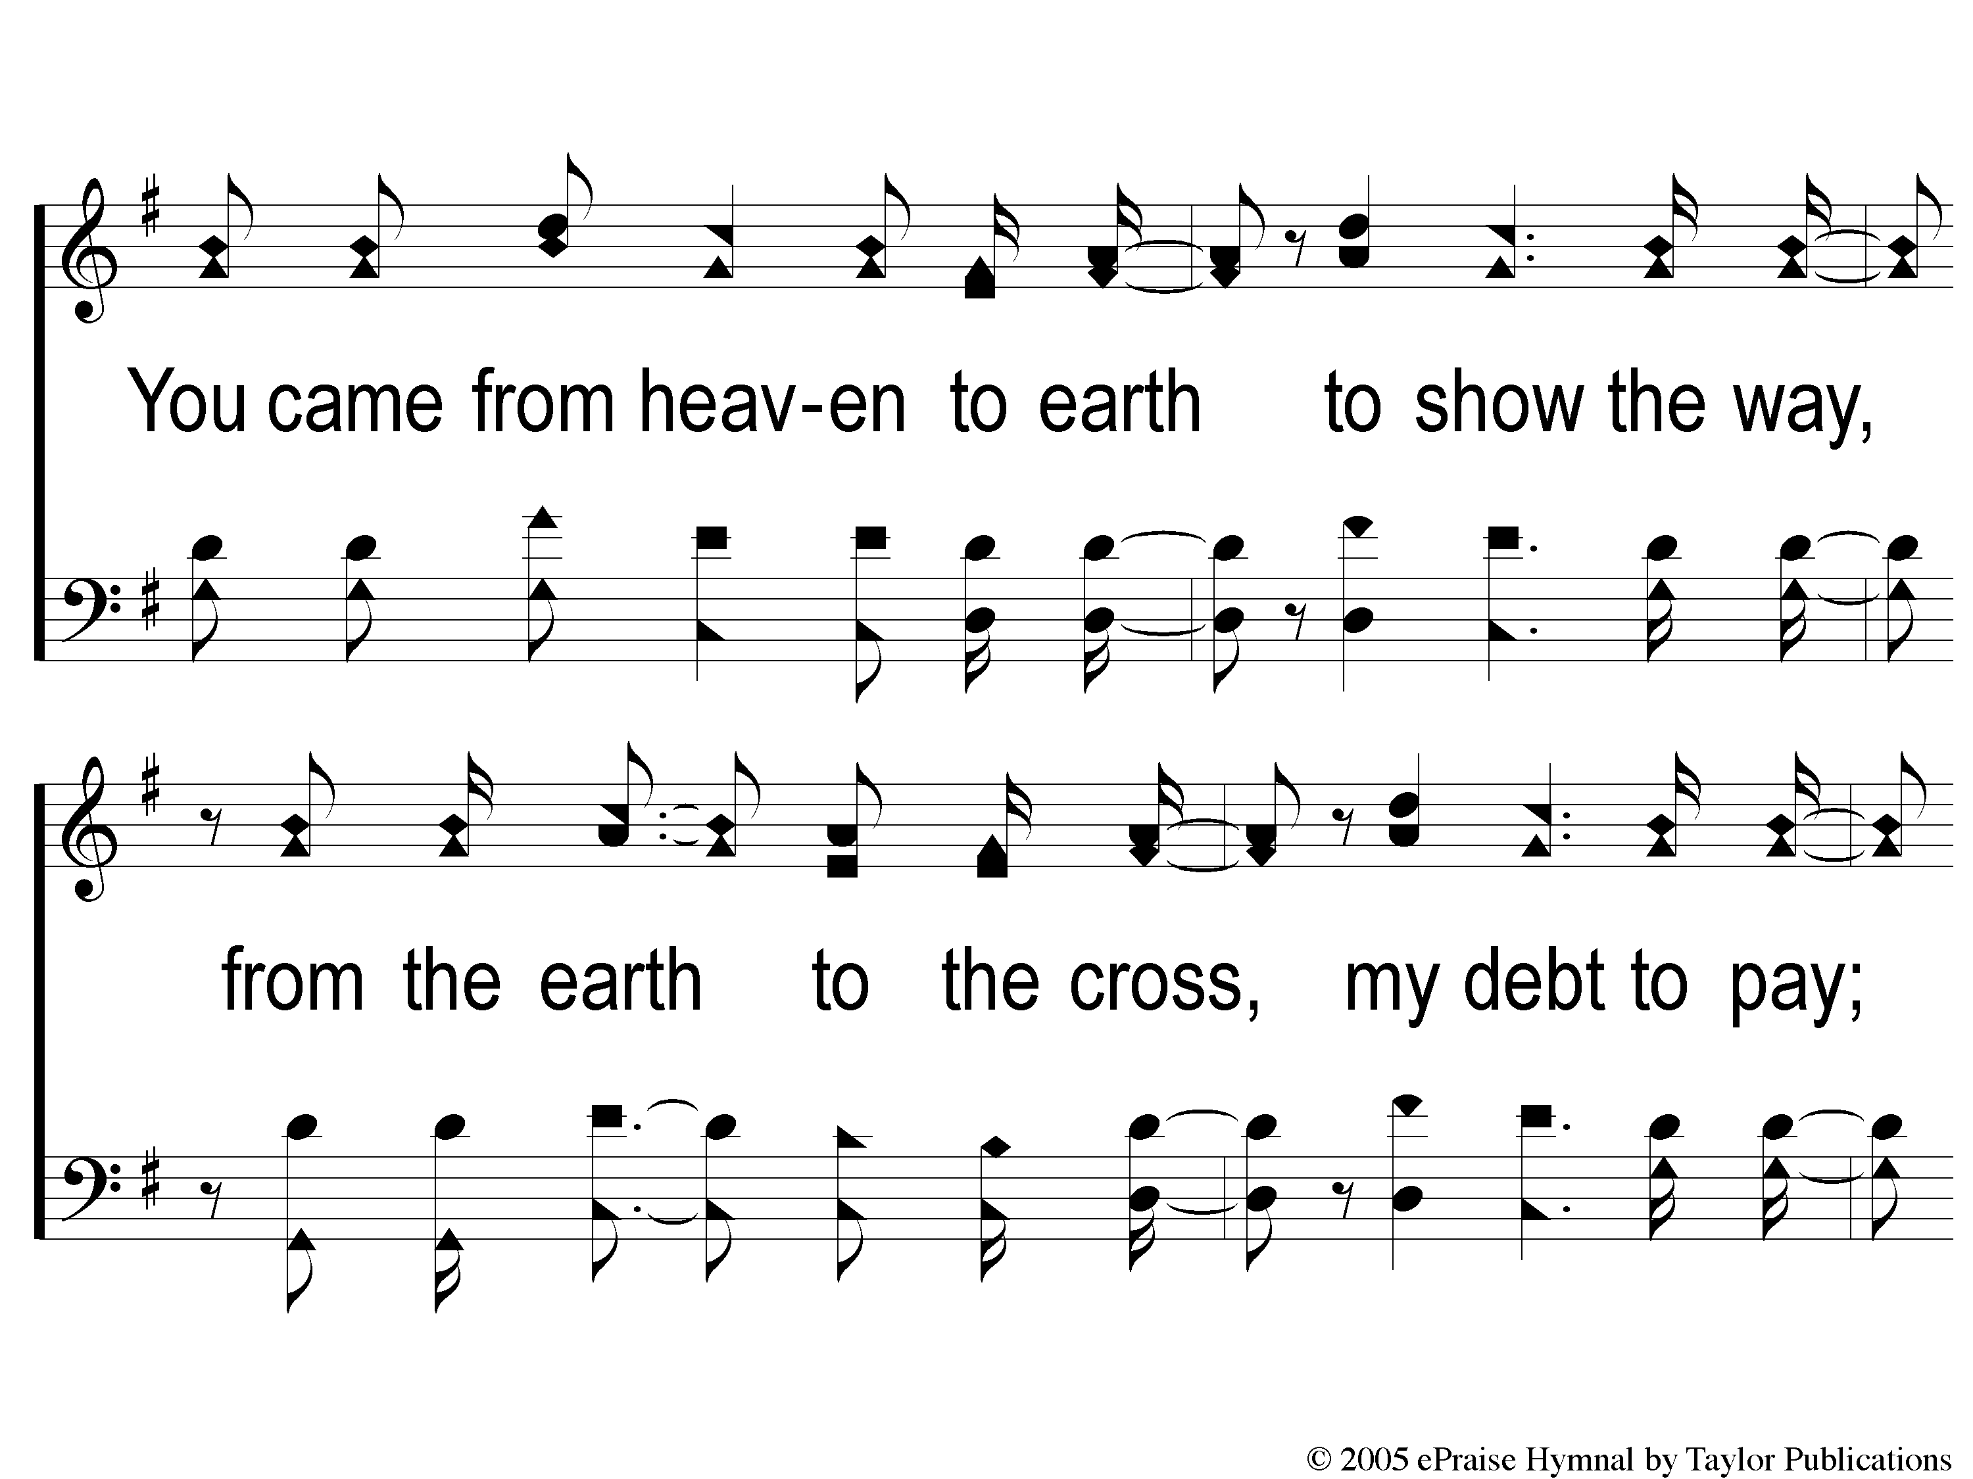
C-1 Lord I Lift Your Name On High
Lord, I Lift Your Name On High

Slide 5
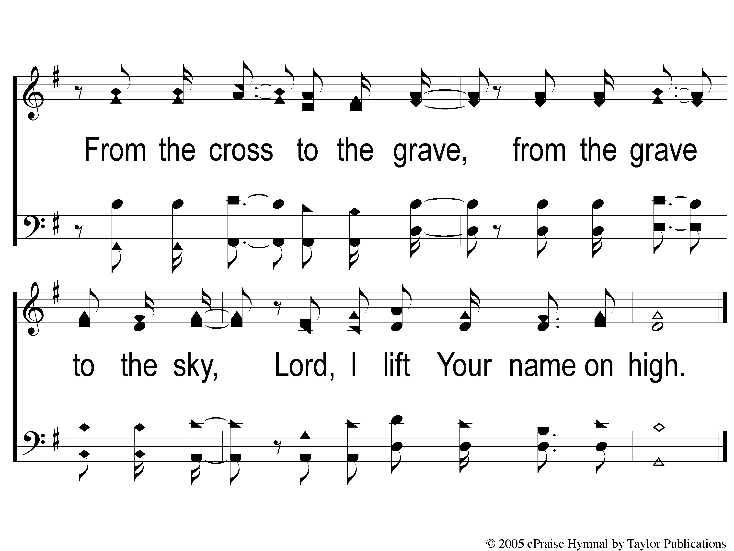
C-2 Lord I Lift Your Name On High
Lord, I Lift Your Name On High

Slide 6
1 Lord I Lift Your Name On High
Lord, I Lift Your Name On High

Slide 7
2 Lord I Lift Your Name On High
Lord, I Lift Your Name On High

Slide 8
C-1 Lord I Lift Your Name On High
Lord, I Lift Your Name On High

Slide 9
C-2 Lord I Lift Your Name On High
Lord, I Lift Your Name On High

Slide 11
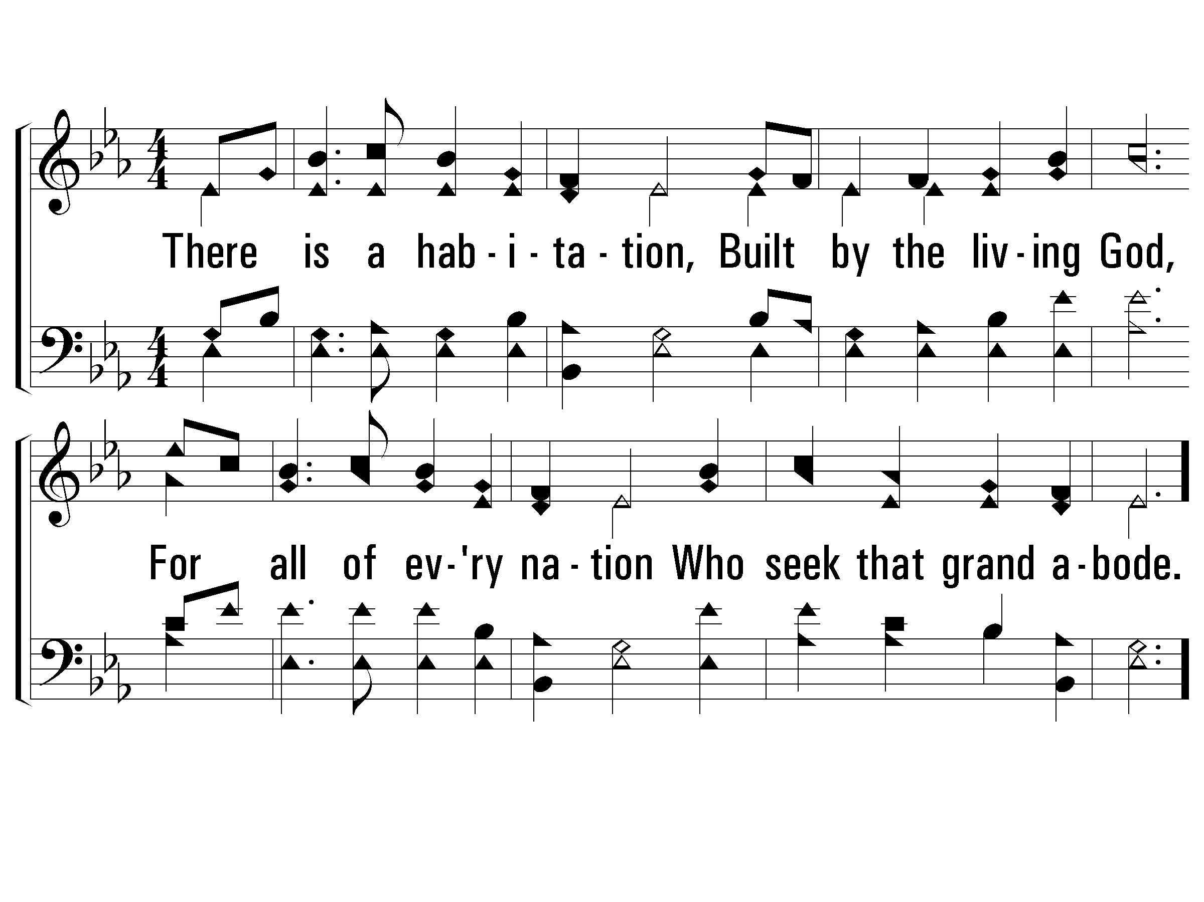
1 - There Is a Habitation (TOGETHER)
1.
There is a habitation,
Built by the living God,
For all of every nation
Who seek that grand abode.
Words by: L. H. Jameson
Music by: J. H. Rosecrans
© 2001 The Paperless Hymnal™

Slide 12
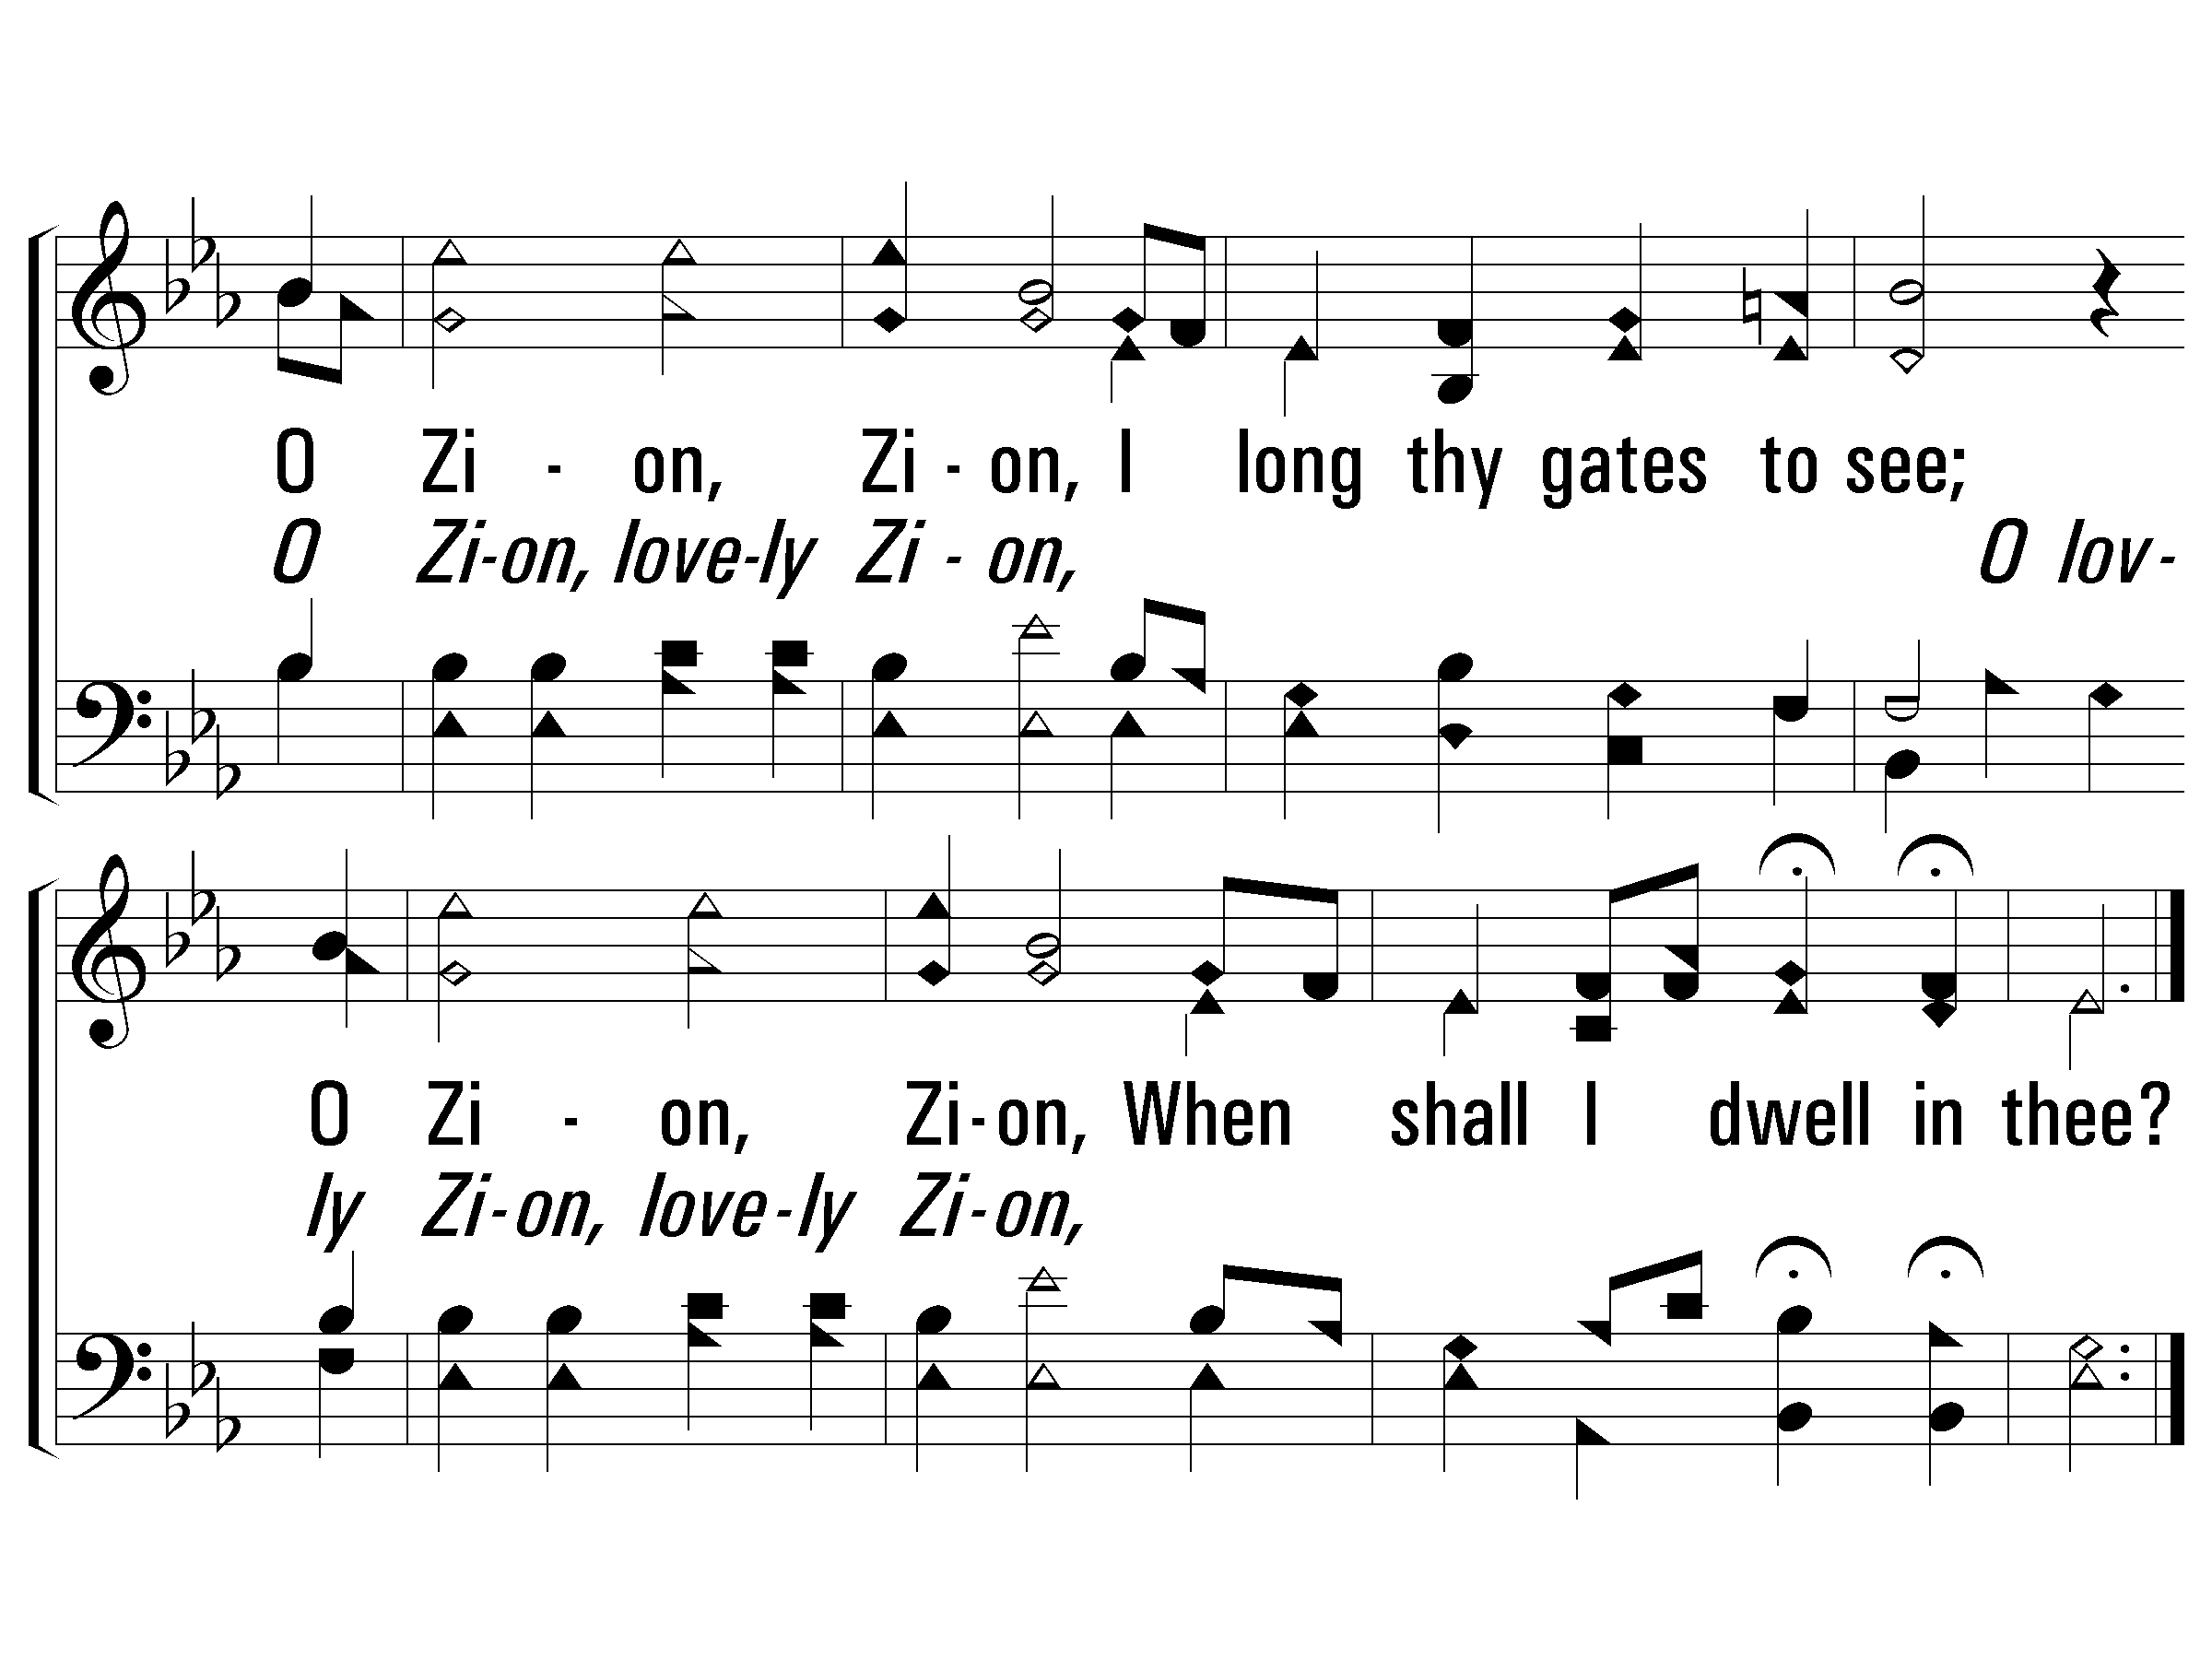
c - There Is a Habitation
O Zion, Zion,
I long thy gates to see;
O Zion, Zion,
When shall I dwell in thee?
© 2001 The Paperless Hymnal™

Slide 13
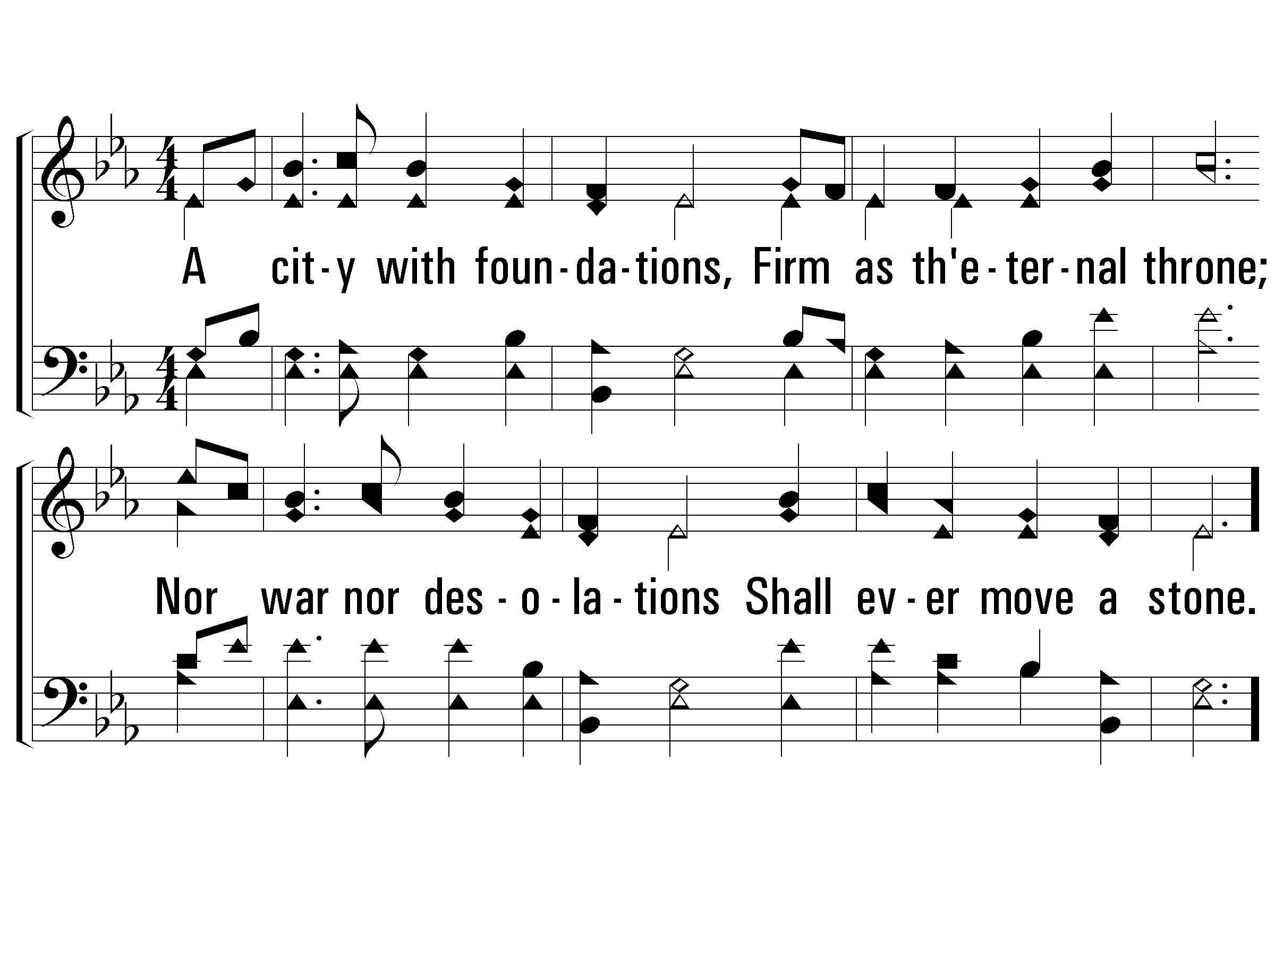
2 - There Is a Habitation (MEN ONLY)
2.
A city with foundations,
Firm as the eternal throne;
Nor war nor desolations
Shall ever move a stone.
Words by: L. H. Jameson
Music by: J. H. Rosecrans
© 2001 The Paperless Hymnal™

Slide 14
c - There Is a Habitation
O Zion, Zion,
I long thy gates to see;
O Zion, Zion,
When shall I dwell in thee?
© 2001 The Paperless Hymnal™

Slide 15
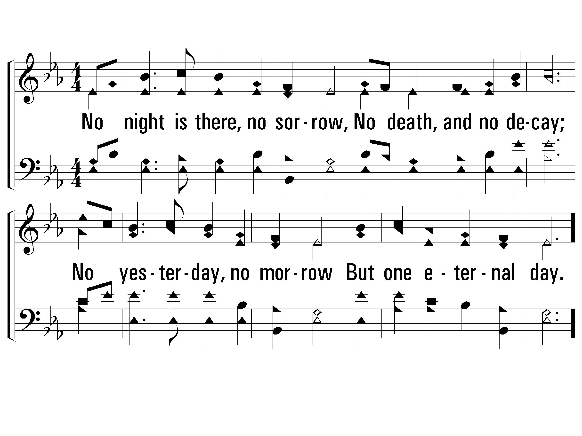
3 - There Is a Habitation (LADIES ONLY)
3.
No night is there, no sorrow,
No death, and no decay;
No yesterday, no morrow
But one eternal day.
Words by: L. H. Jameson
Music by: J. H. Rosecrans
© 2001 The Paperless Hymnal™

Slide 16
c - There Is a Habitation
O Zion, Zion,
I long thy gates to see;
O Zion, Zion,
When shall I dwell in thee?
© 2001 The Paperless Hymnal™

Slide 17
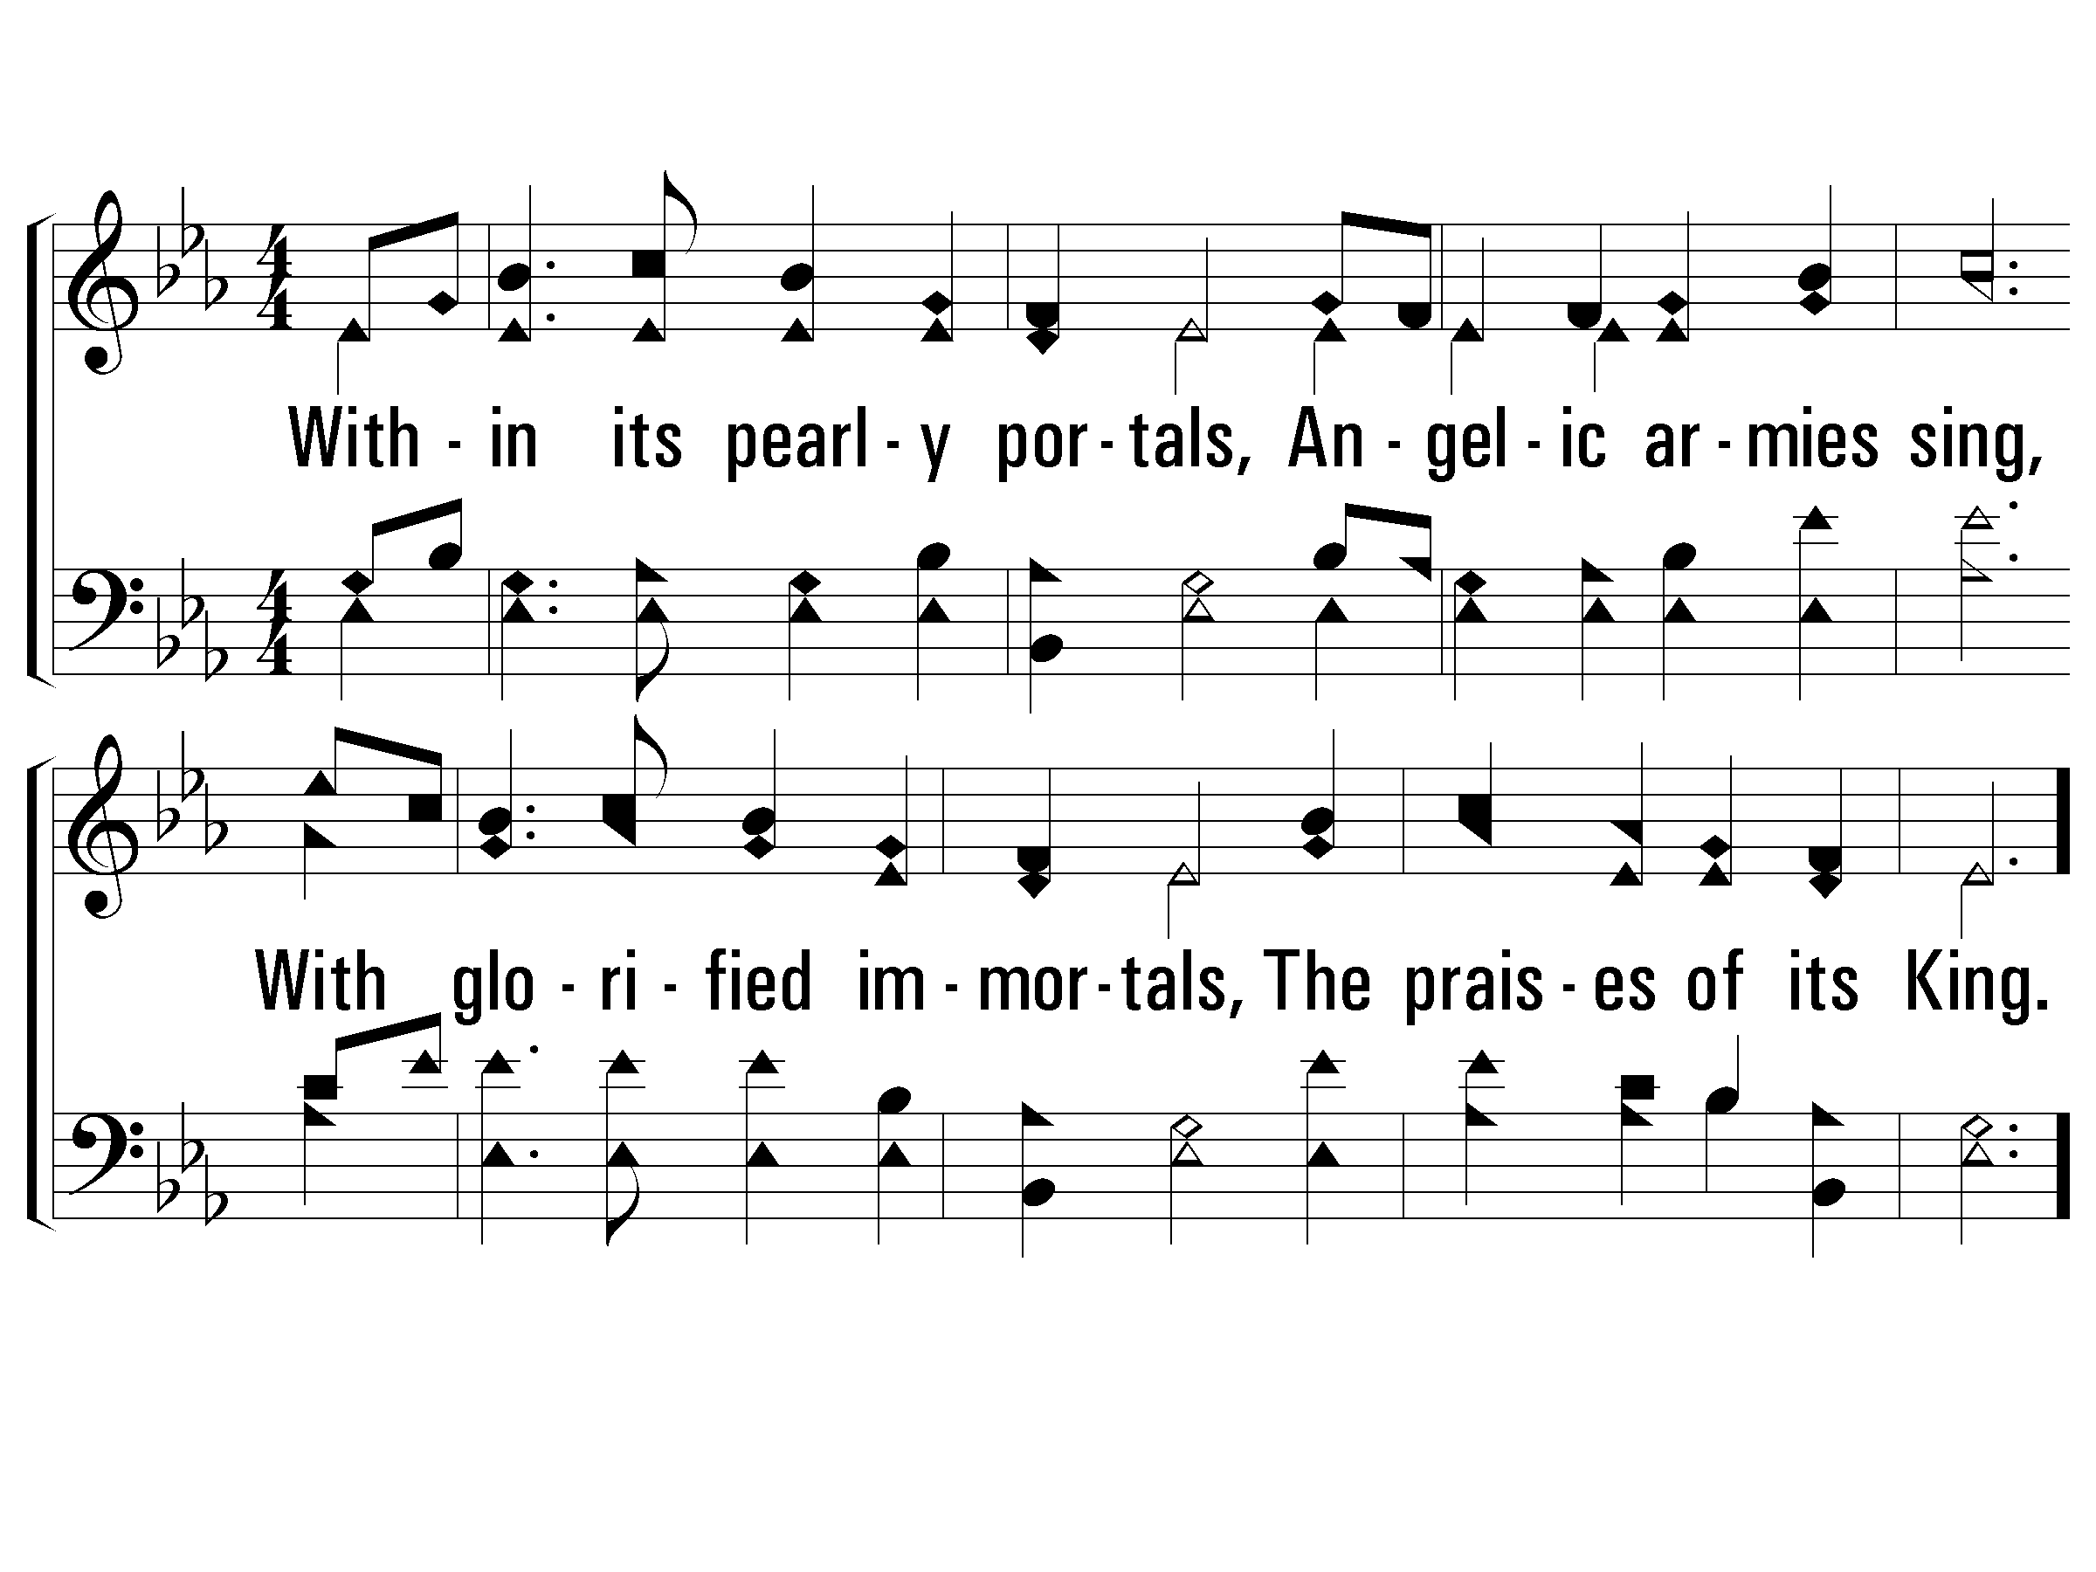
4 - There Is a Habitation (TOGETHER)
4.
Within its pearly portals,
Angelic armies sing,
With glorified immortals,
The praises of its King.
Words by: L. H. Jameson
Music by: J. H. Rosecrans
© 2001 The Paperless Hymnal™

Slide 18
c - There Is a Habitation
O Zion, Zion,
I long thy gates to see;
O Zion, Zion,
When shall I dwell in thee?
© 2001 The Paperless Hymnal™

Slide 20

V1a – All to Us
Arr: Mike Rogers
Words and Music by: Chris Tomlin, Jesse Reeves, Matt Maher, Matt Redman
© 2015 The Acappella Company

Slide 21
V1b – All to Us
© 2015 The Acappella Company

Slide 22
V2a – All to Us
© 2015 The Acappella Company

Slide 23
V2b – All to Us
© 2015 The Acappella Company

Slide 24
C1a – All to Us
© 2015 The Acappella Company

Slide 25
C1b – All to Us
© 2015 The Acappella Company

Slide 26
C1c – All to Us
© 2015 The Acappella Company

Slide 27
C1d – All to Us
© 2015 The Acappella Company

Slide 28
V3a – All to Us
© 2015 The Acappella Company

Slide 29
V3b – All to Us
© 2015 The Acappella Company

Slide 30
C2a – All to Us
© 2015 The Acappella Company

Slide 31
C2b – All to Us
© 2015 The Acappella Company

Slide 32
C2c – All to Us
© 2015 The Acappella Company

Slide 33
C2d – All to Us
© 2015 The Acappella Company

Slide 34
C3a – All to Us
© 2015 The Acappella Company

Slide 35
C3b – All to Us
© 2015 The Acappella Company

Slide 36
C3c – All to Us
© 2015 The Acappella Company

Slide 37
CODA – All to Us
© 2015 The Acappella Company

Slide 39
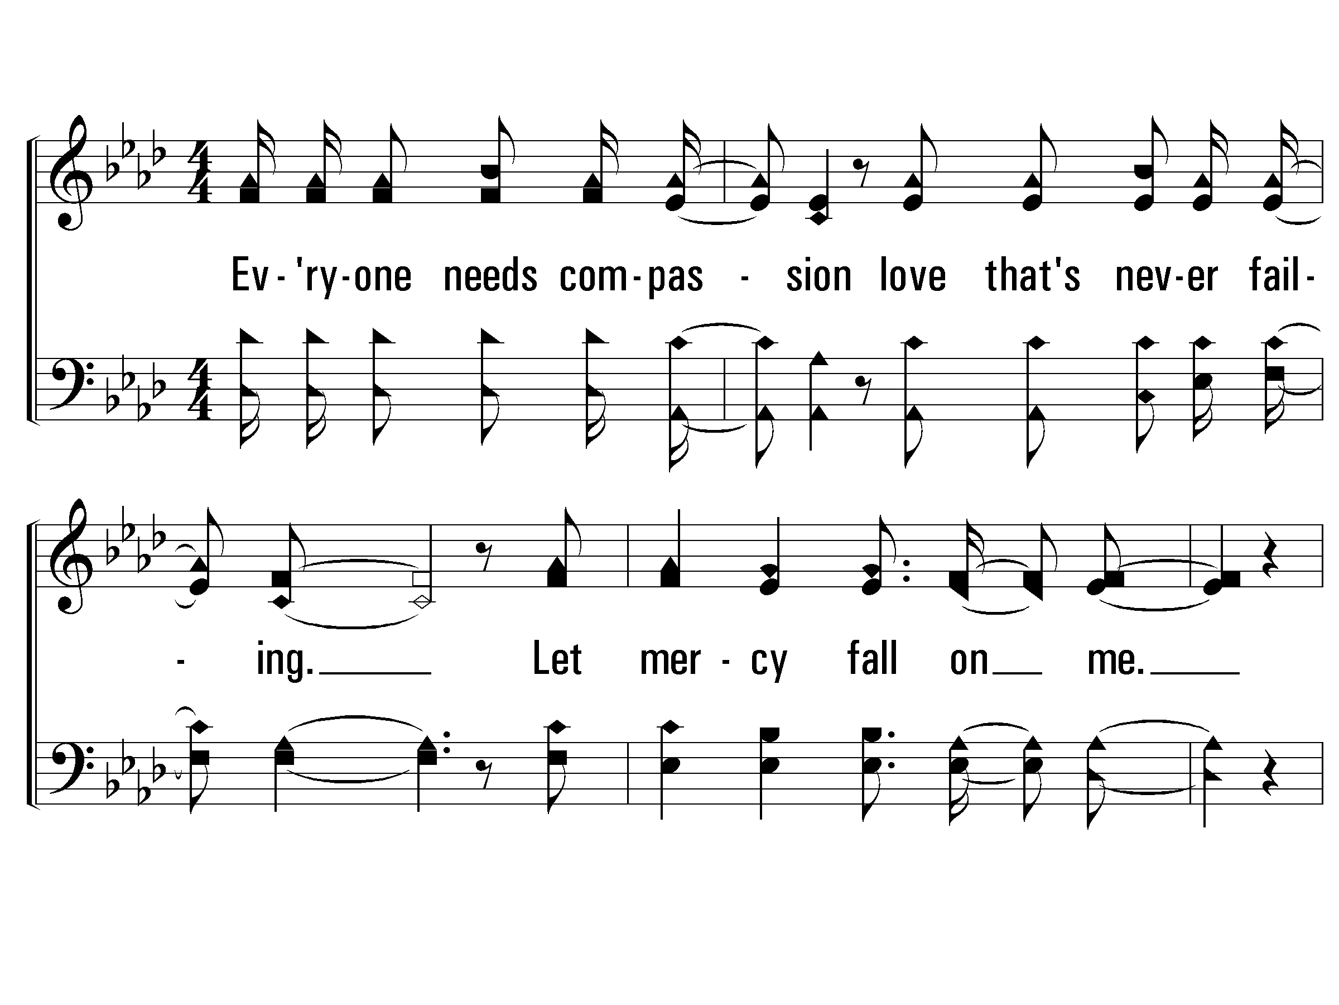
Verse 1 of 2 – Mighty To Save
Words & Music by:
Reuben Morgan & Ben Fielding
Copyright © 2006 Hillsong Publishing (Admin. In U.S. & Canada by Integrity’s Hosanna! Music

Slide 40
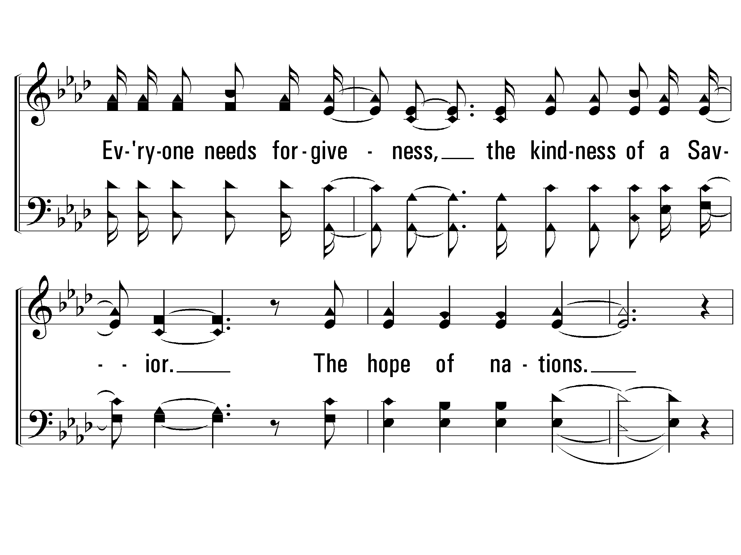
Verse 1 of 2 – Mighty To Save

Slide 41
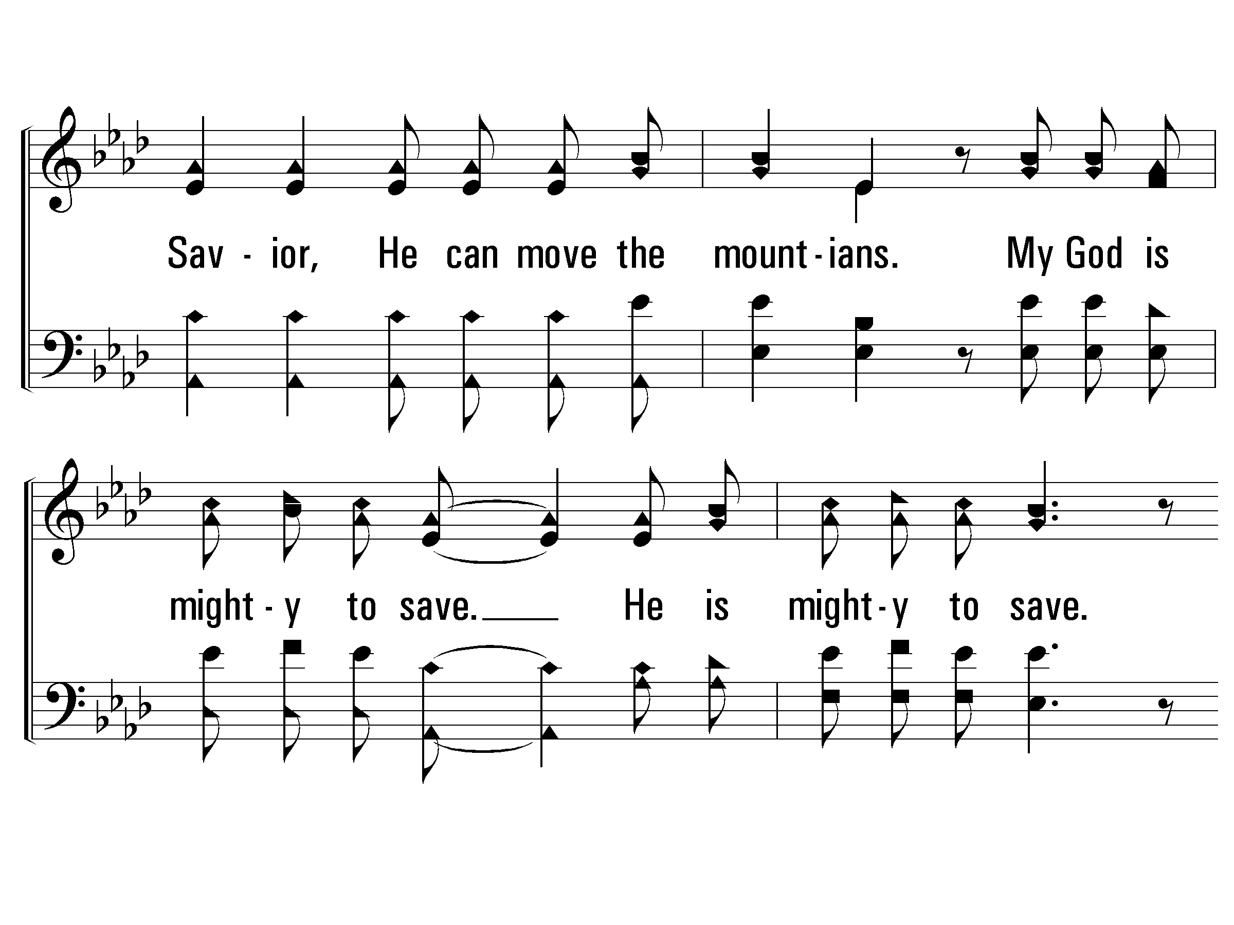

Chorus – Mighty To Save

Slide 42
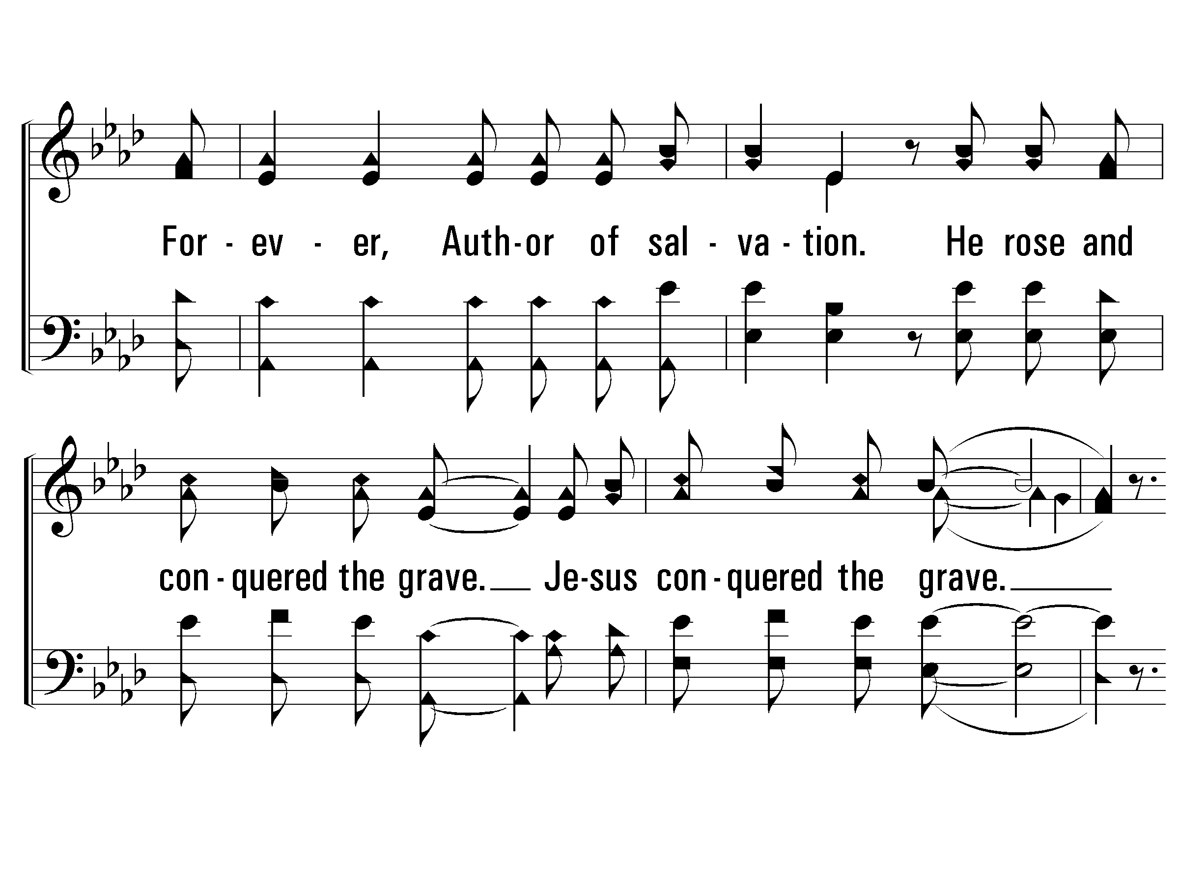
Chorus – Mighty To Save

Slide 43
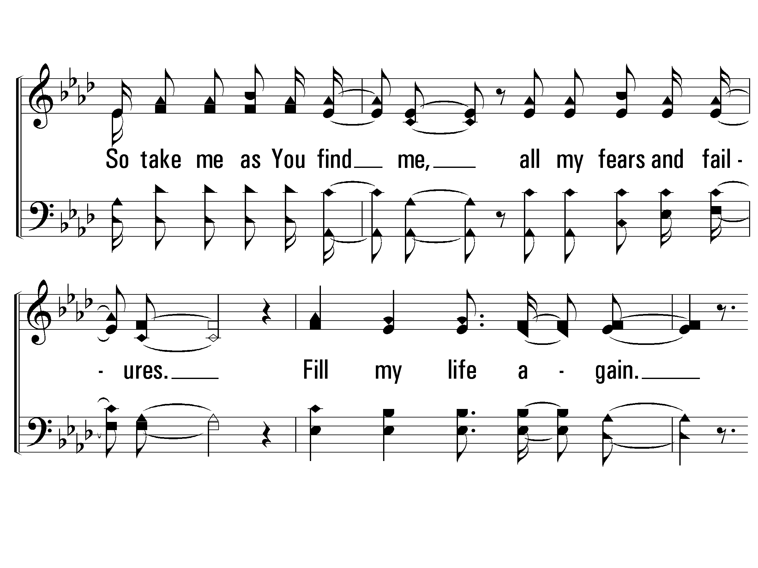
Verse 2 of 2 – Mighty To Save

Slide 44
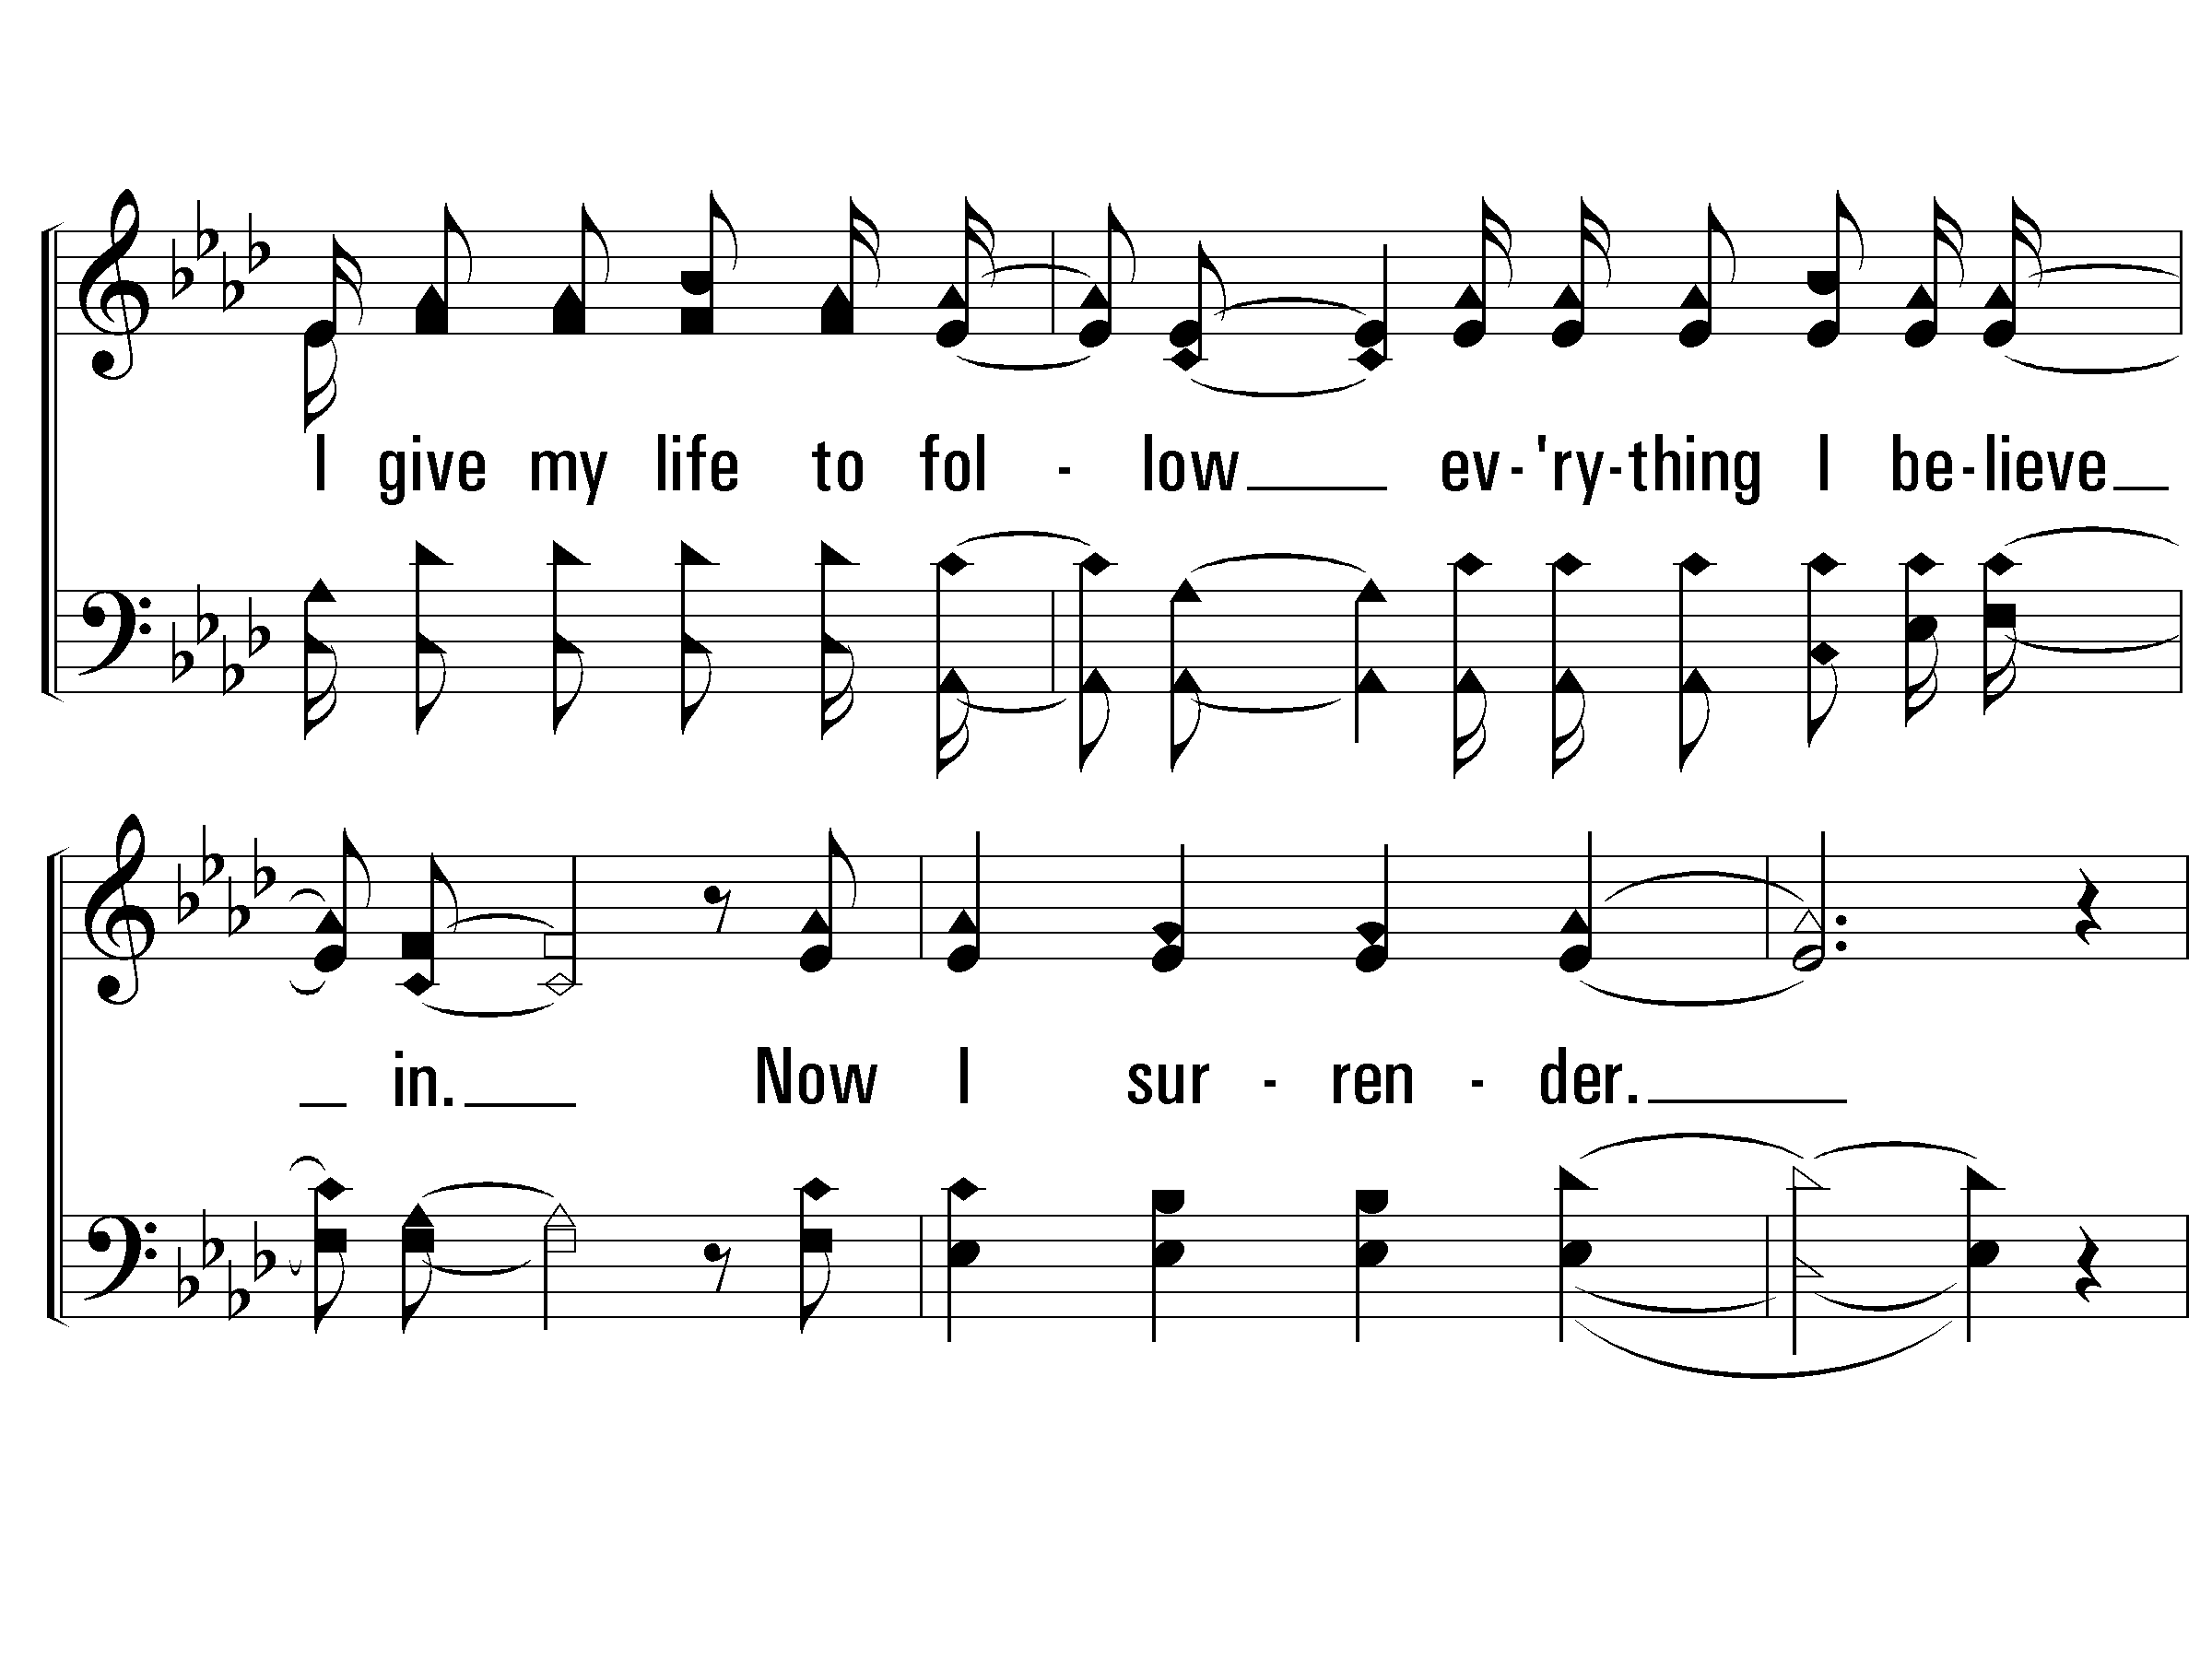
Verse 2 of 2 – Mighty To Save

Slide 45
Chorus – Mighty To Save

Slide 46
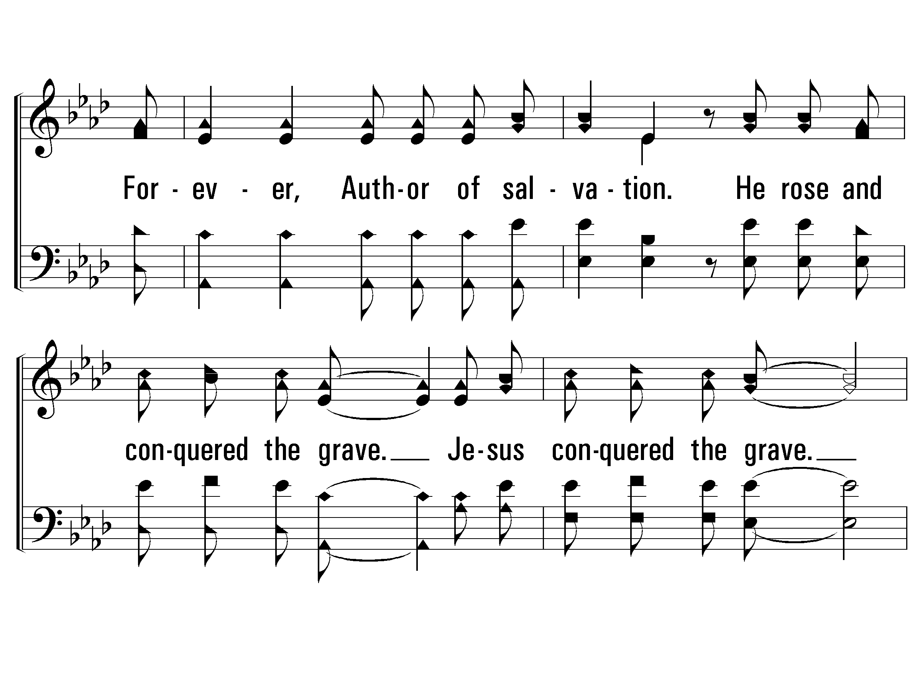
Chorus – Mighty To Save

Slide 47
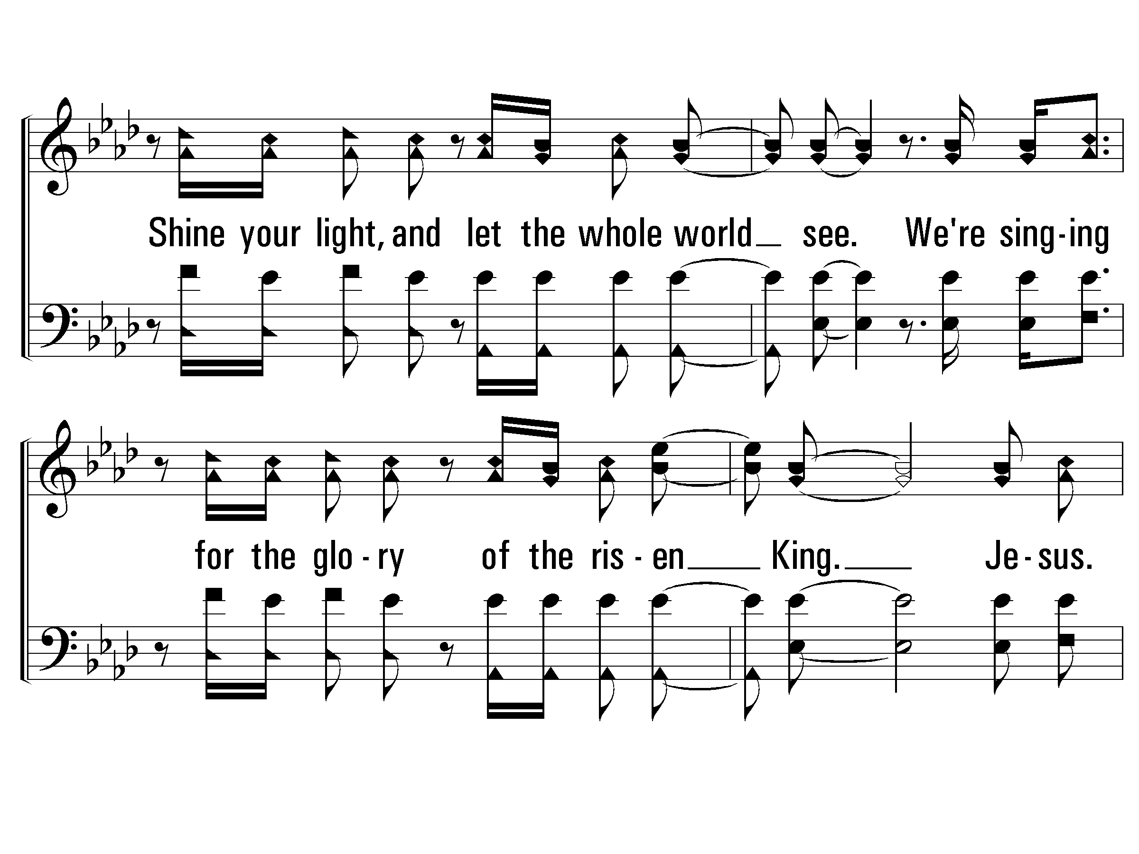
Bridge – Mighty To Save

Slide 48
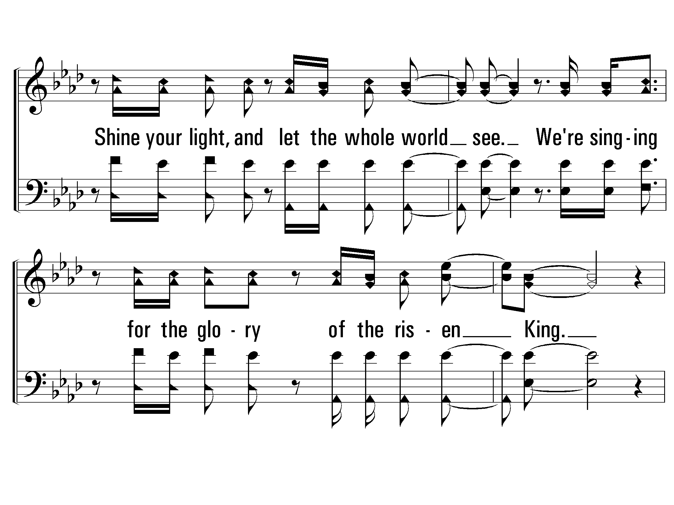
Bridge – Mighty To Save

Slide 49
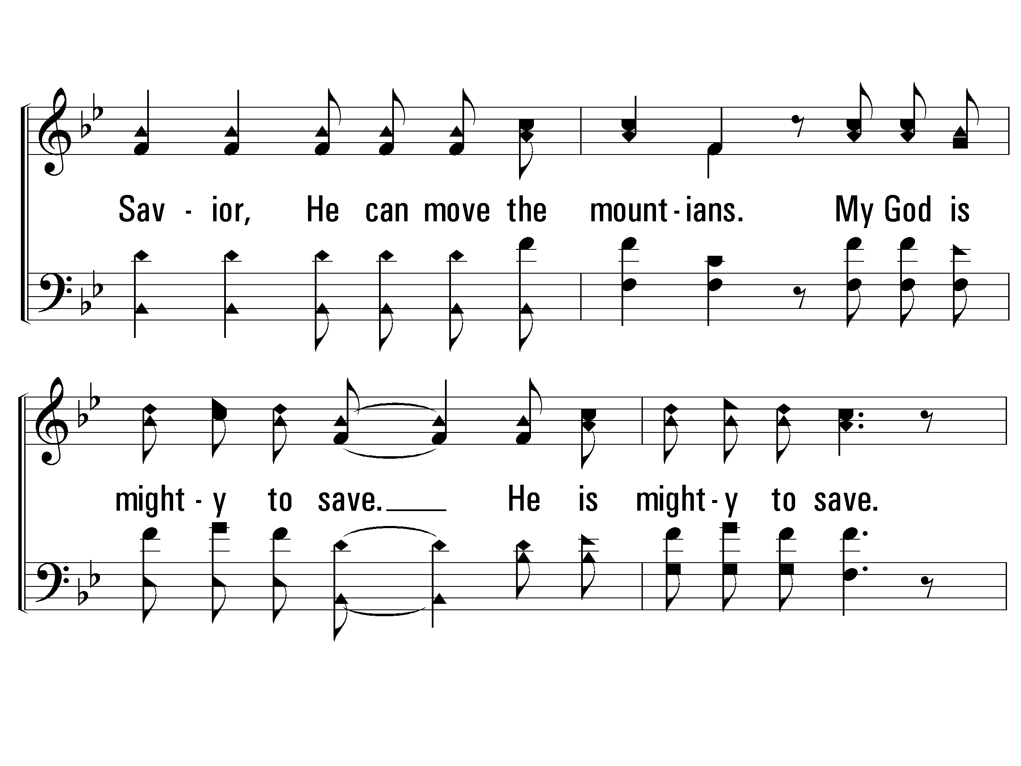
Chorus – Mighty To Save

Slide 50
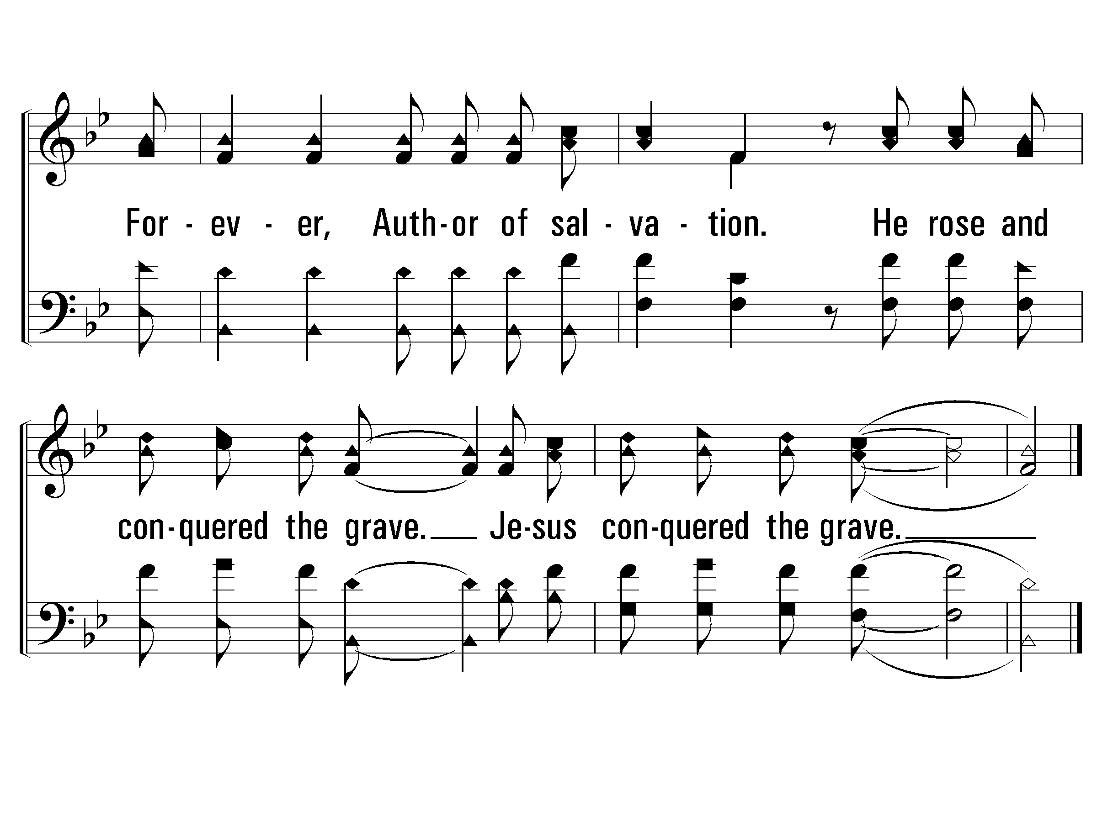
Chorus – Mighty To Save
END

Slide 52
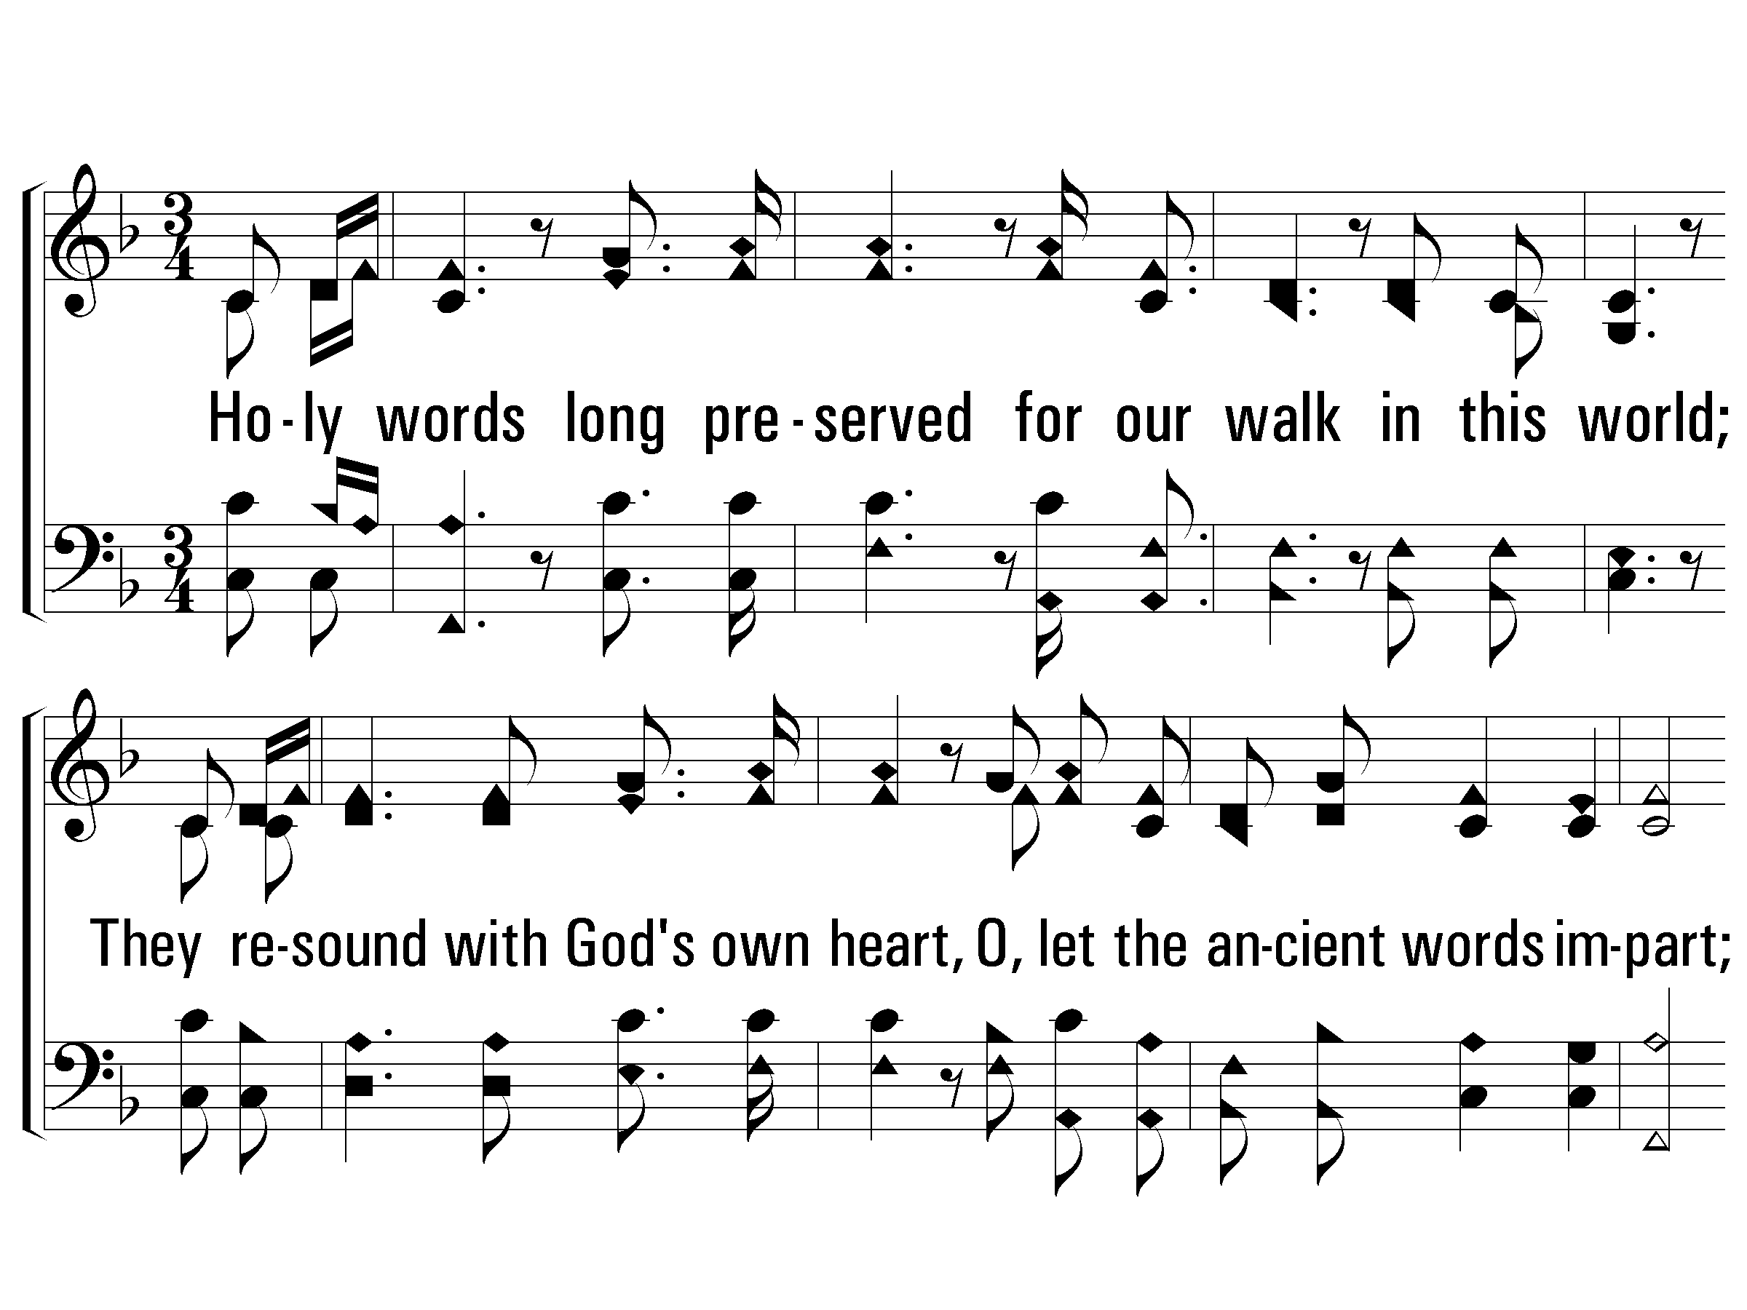
1 - Ancient Words
1.
Holy words long preserved for our walk in this world;
They resound with God's own heart,
O, let the ancient words impart;
Words of life, words of hope, give us strength, help us cope;
In this world wherever we roam, ancient words will guide us home.
Words & Music: Lynn Deshazo / Arr.: Zoe Group
Copyright © 2001 Integrity’s Hosanna! Music/ASCAP
C/o Integrity Media, Inc., 1000 Cody Road, Mobile, AL 36695 All rights reserved. Used by permission.
© 2005 The Paperless Hymnal™

Slide 53
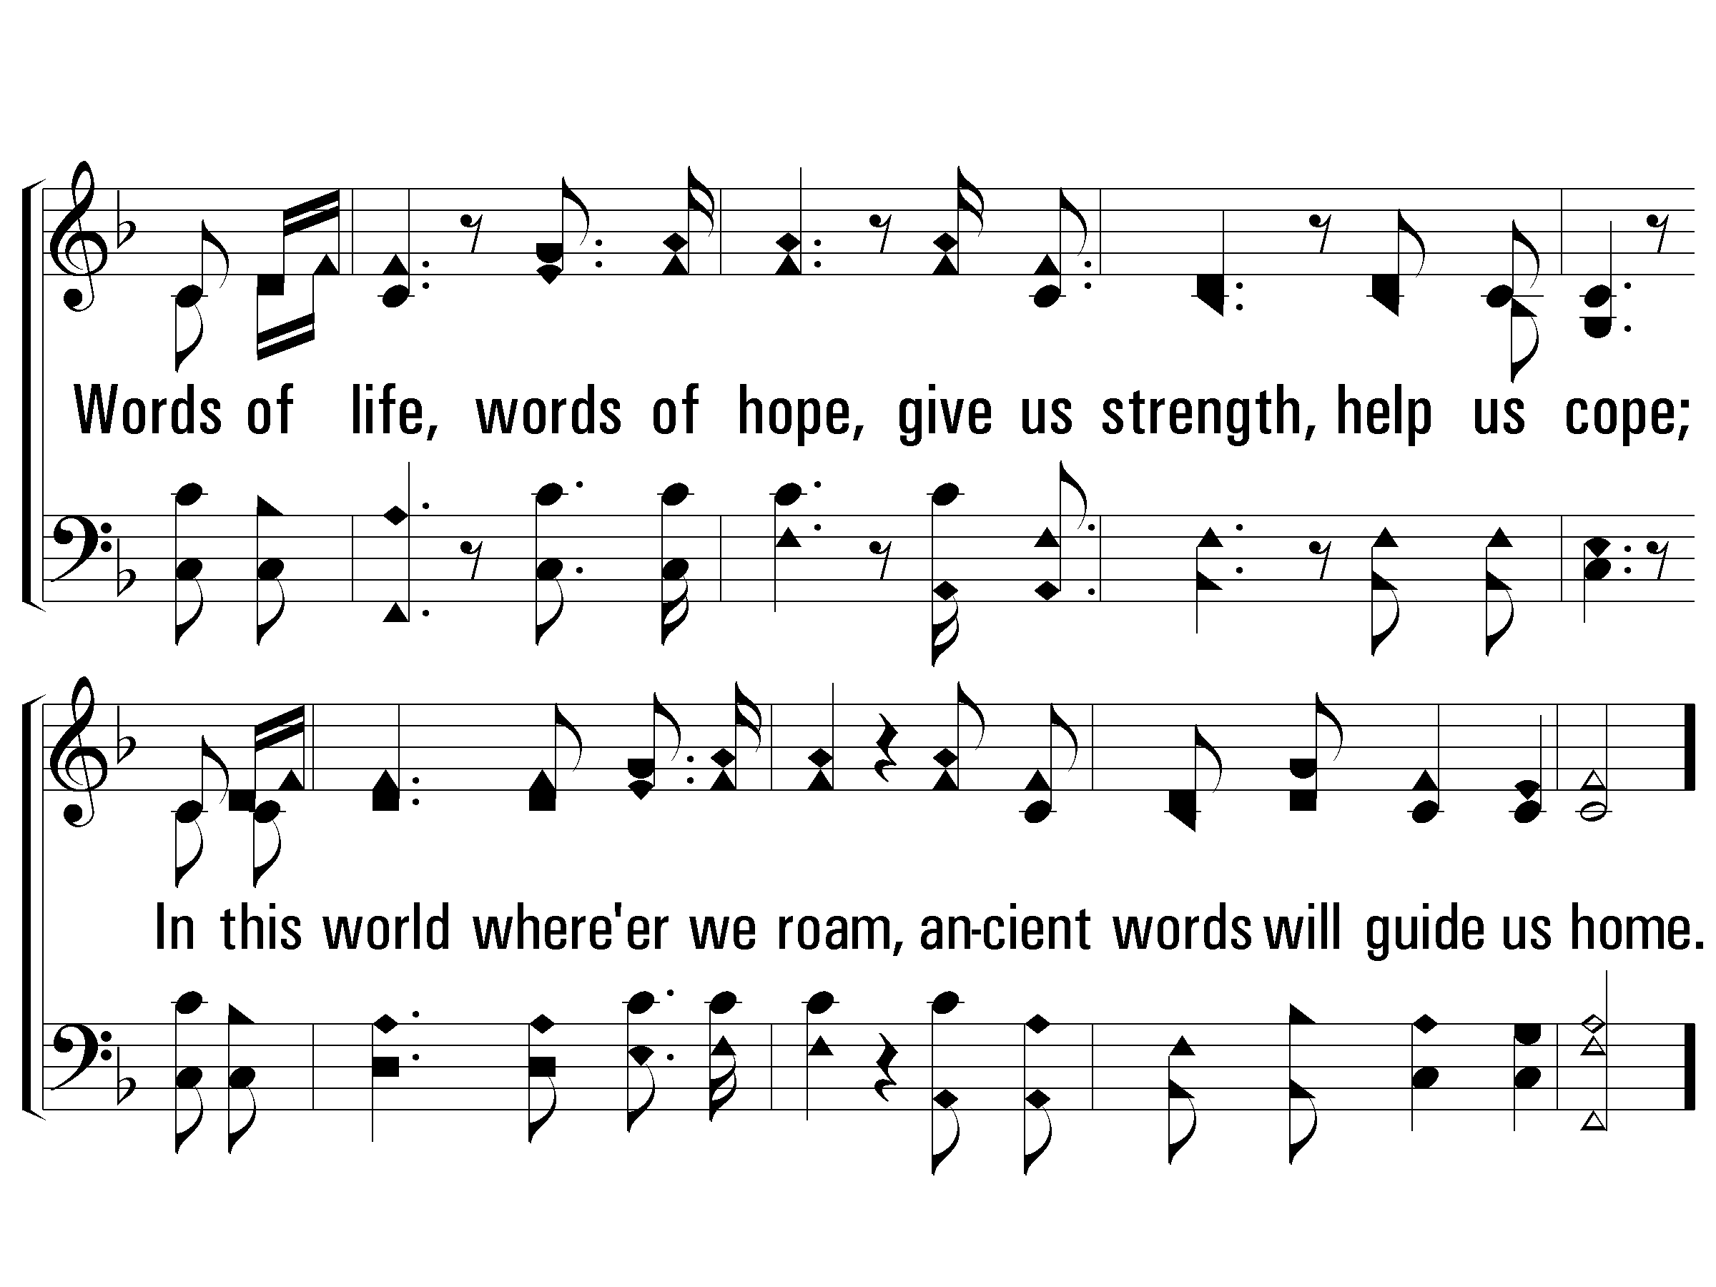
1 - Ancient Words
© 2005 The Paperless Hymnal™

Slide 54
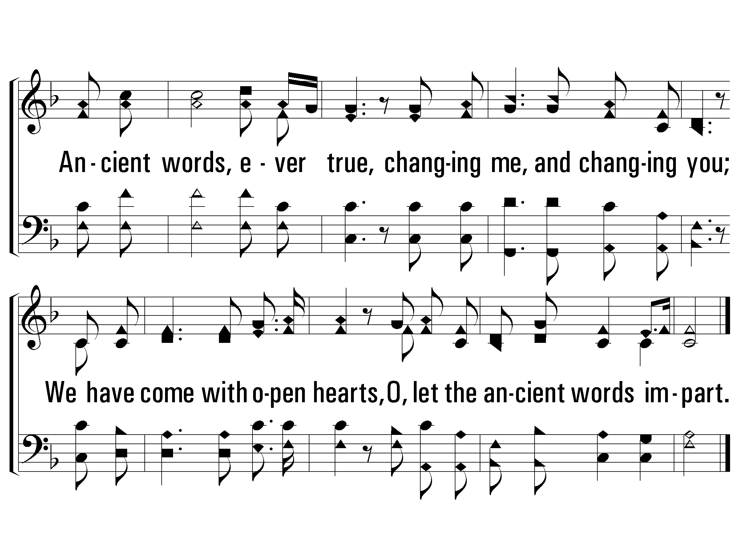
c - Ancient Words
Ancient words, ever true, changing me, and changing you;
We have come with open hearts, O, let the ancient words impart.
© 2005 The Paperless Hymnal™

Slide 55
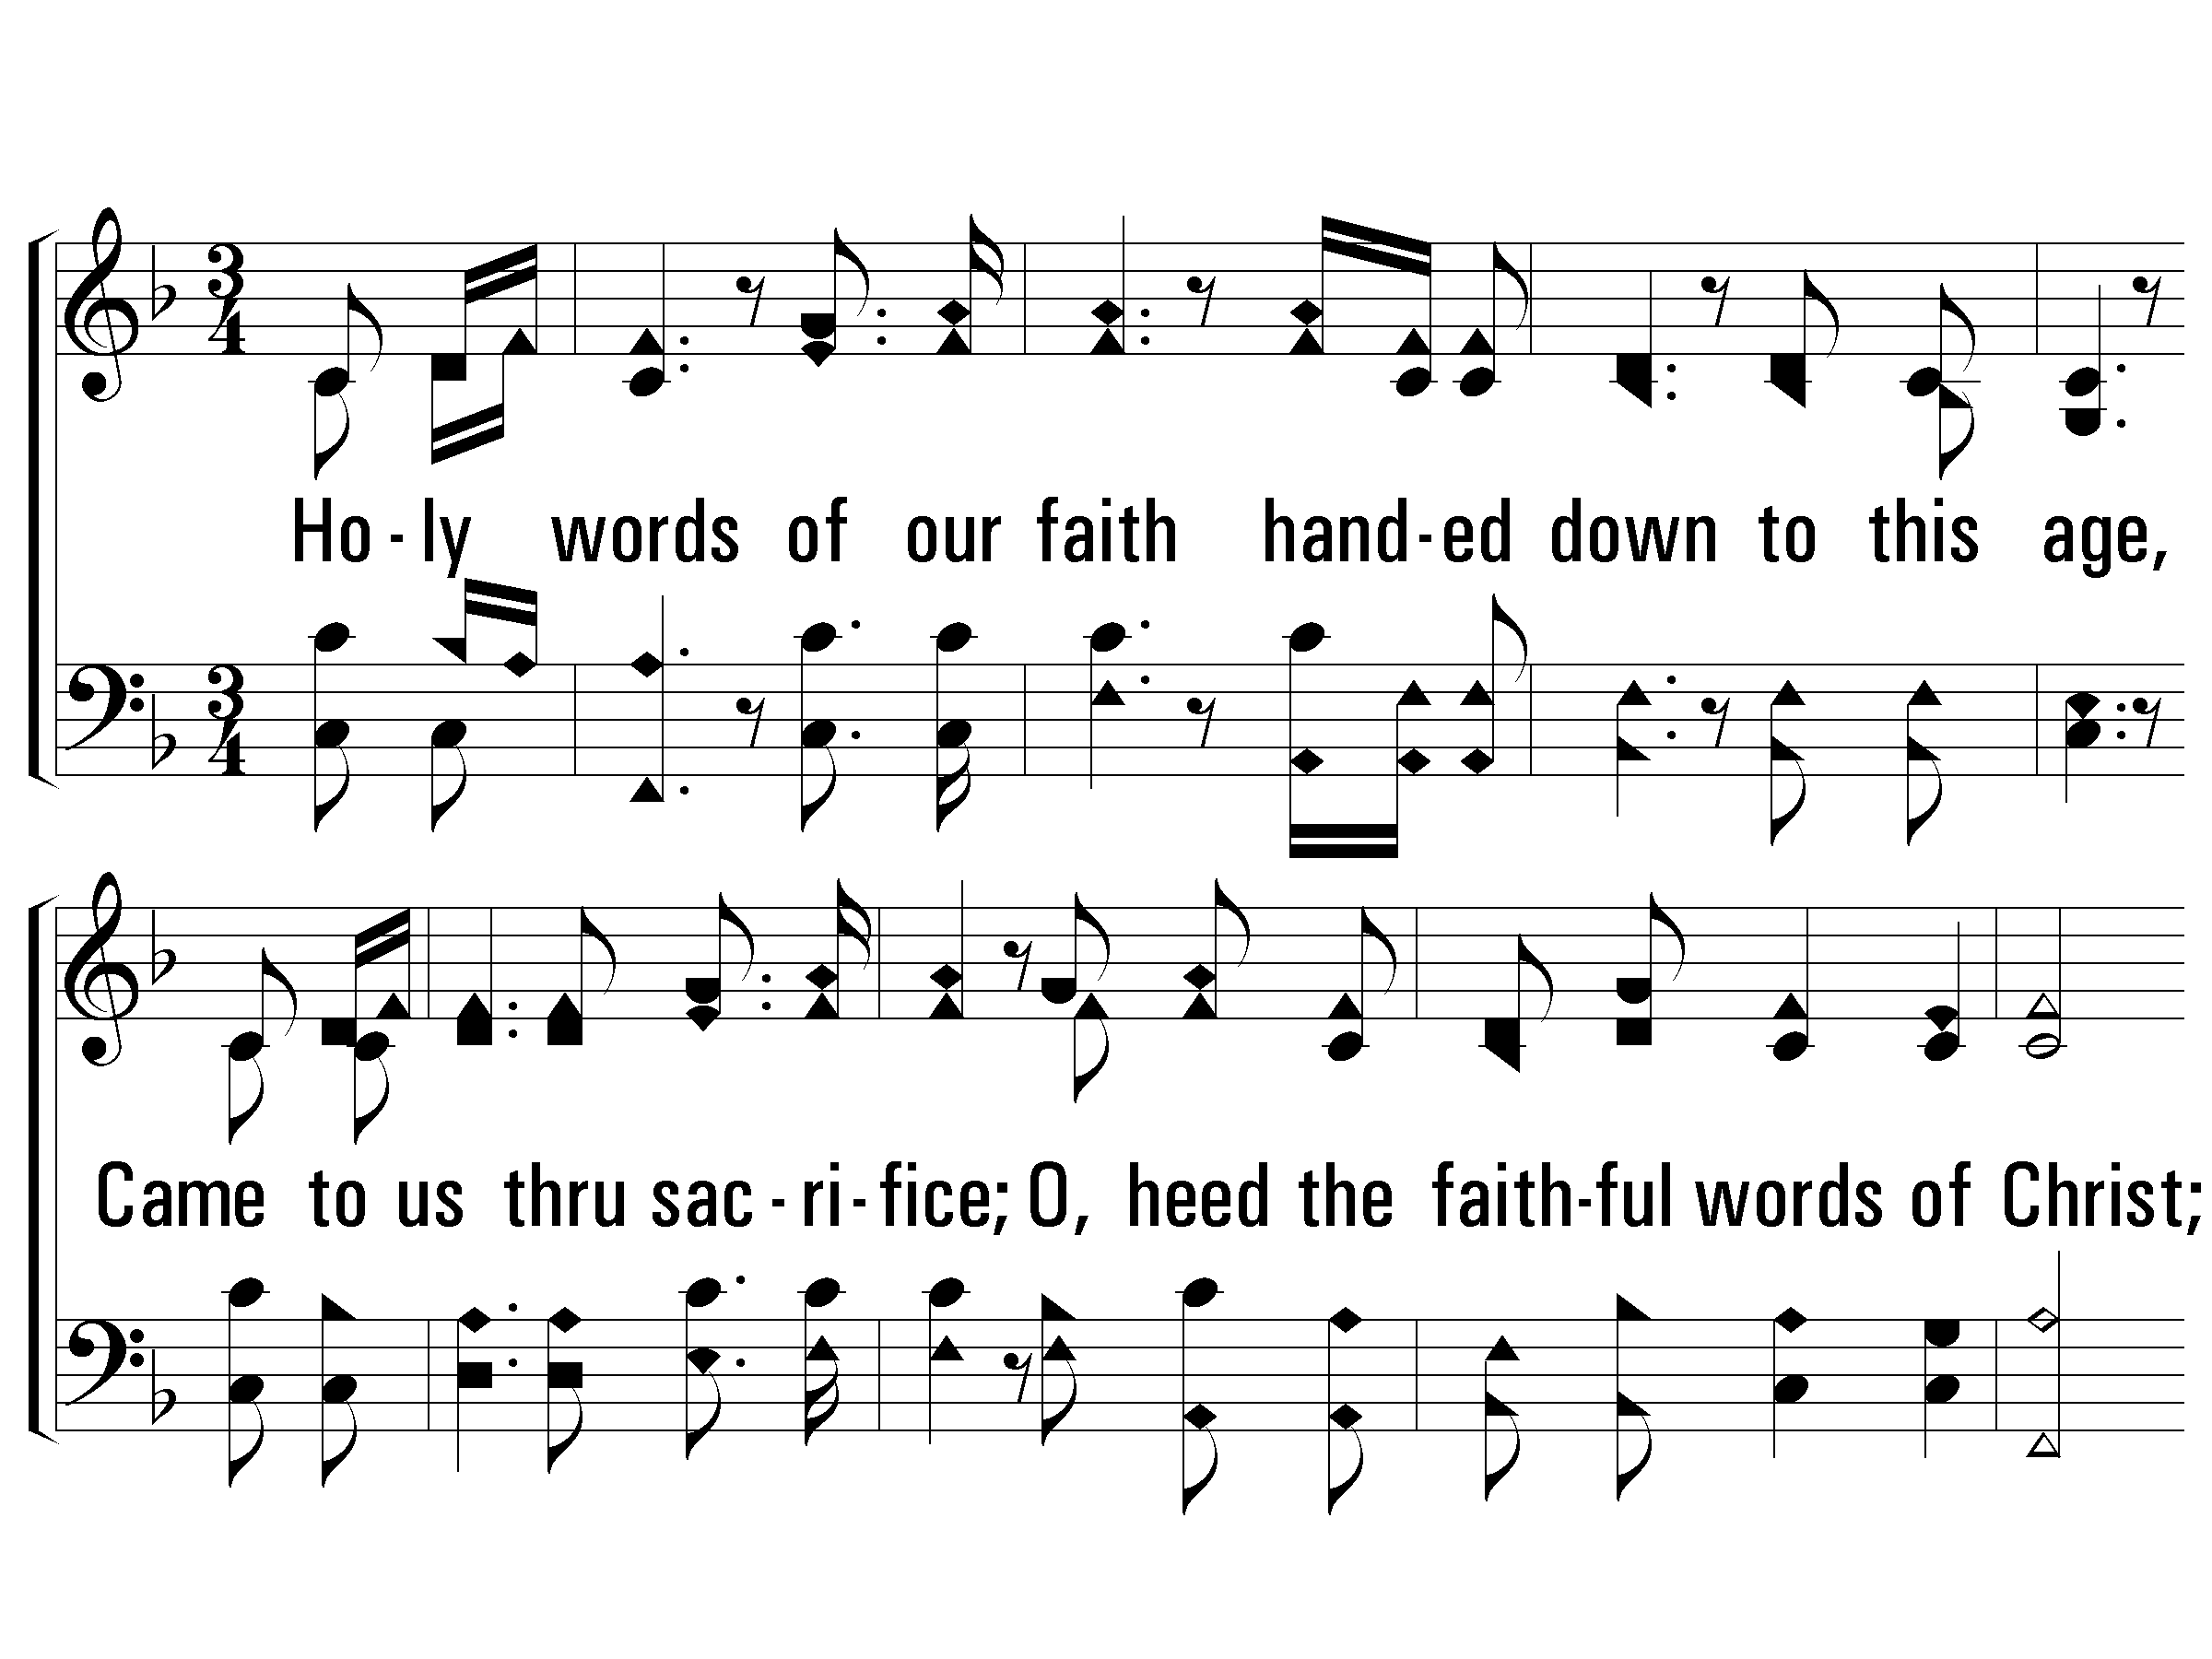
2 - Ancient Words
2.
Holy words of our faith handed down to this age,
Came to us thru sacrifice;
O, heed the faithful words of Christ;
Holy words long preserved for our walk in this world;
They resound with God's own heart;
O, let the ancient words impart.
Words & Music: Lynn Deshazo / Arr.: Zoe Group
Copyright © 2001 Integrity’s Hosanna! Music/ASCAP
C/o Integrity Media, Inc., 1000 Cody Road, Mobile, AL 36695 All rights reserved. Used by permission.
© 2005 The Paperless Hymnal™

Slide 56
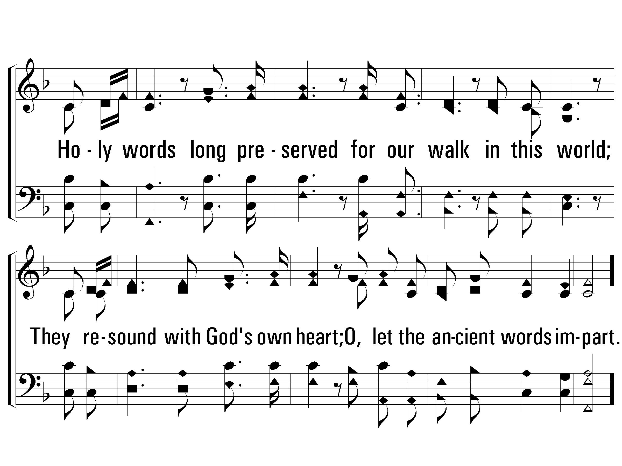
2 - Ancient Words
© 2005 The Paperless Hymnal™

Slide 57
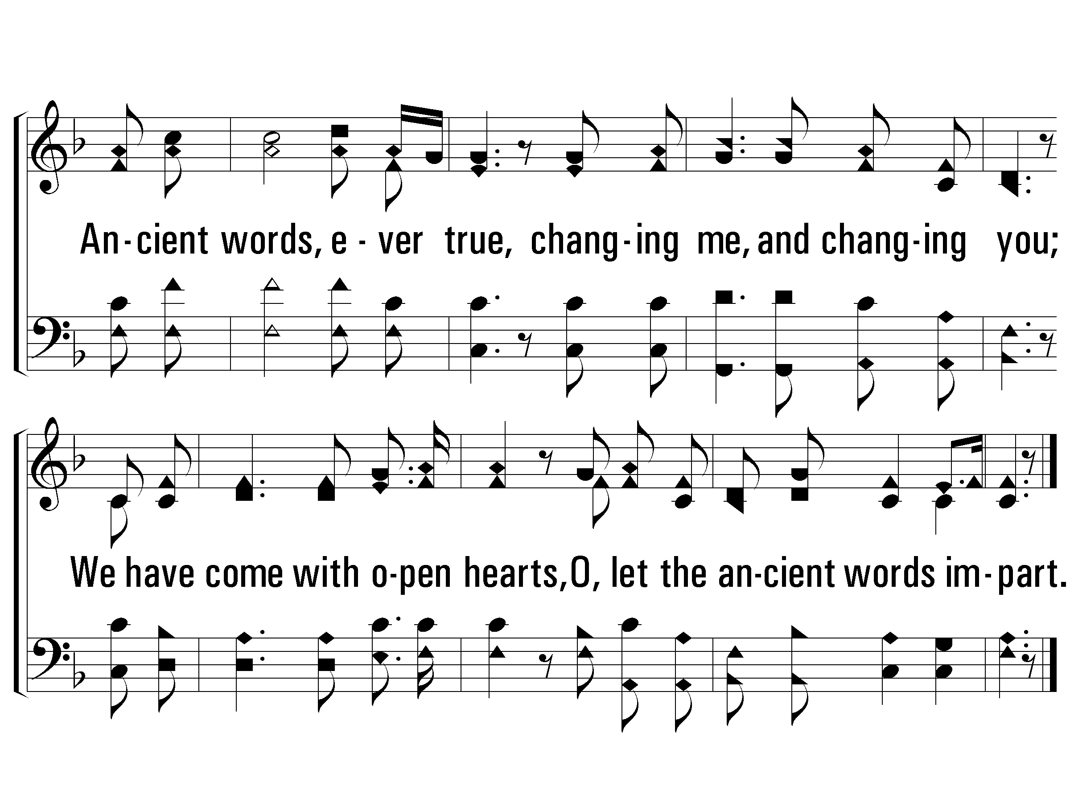
c - Ancient Words
© 2005 The Paperless Hymnal™

Slide 58
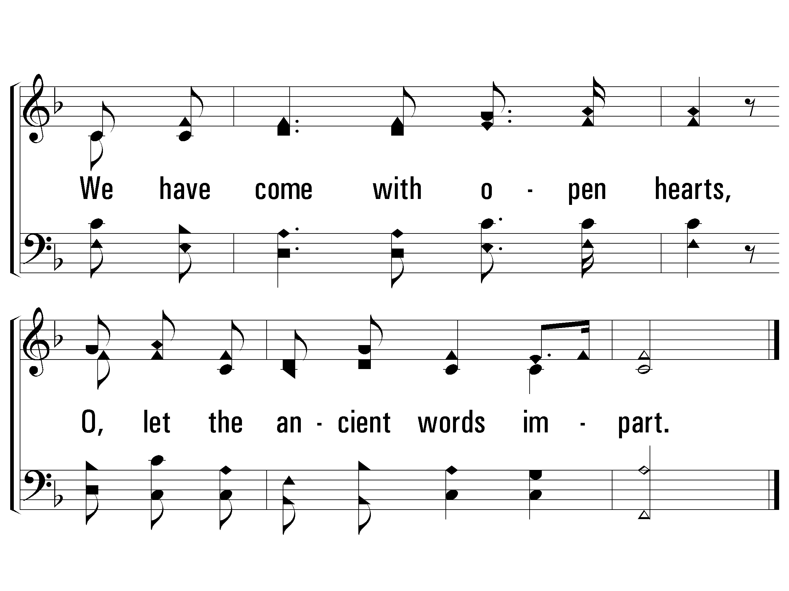
C - Ancient Words
© 2005 The Paperless Hymnal™

Slide 60
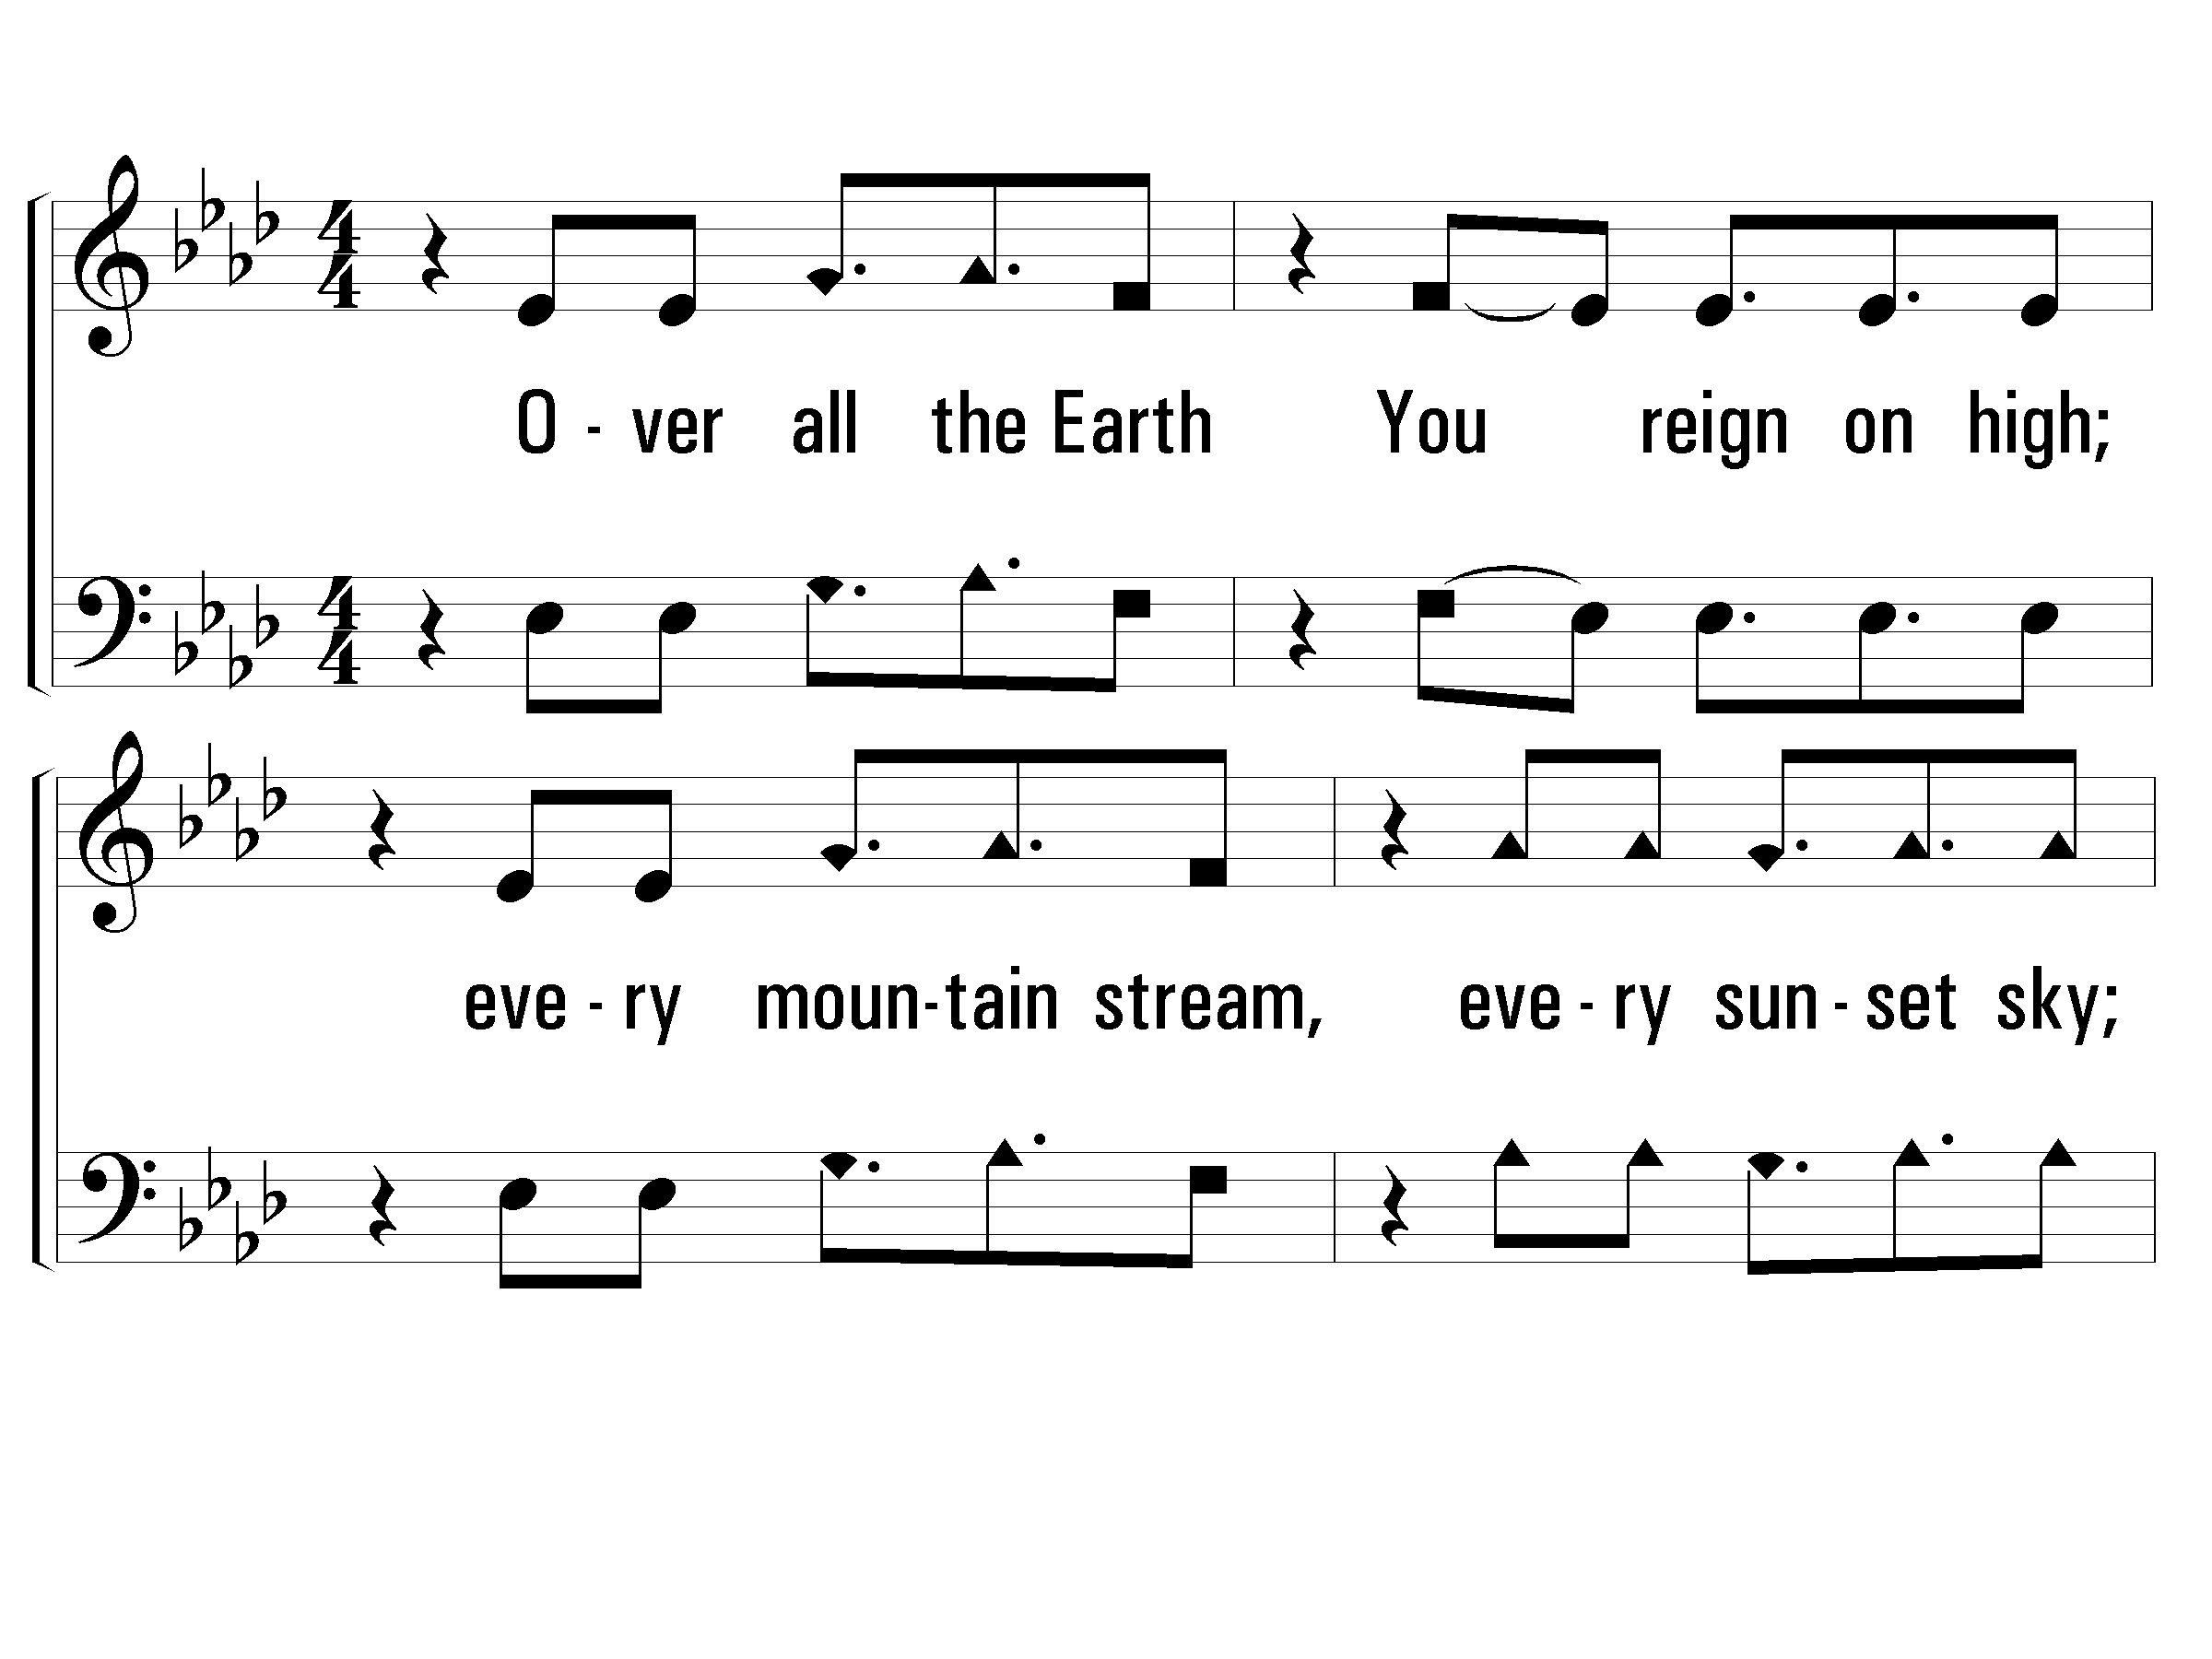
Verse 1 of 2 Lord, Reign In Me
Words & Music: Brenton Brown / Arr.: Free Indeed
Copyright © 1998 Vineyard Songs (UK/EIRE)
Admin. in North America by Music Services o/b/o Vineyard Music Global, Inc. (PRS)

Slide 61
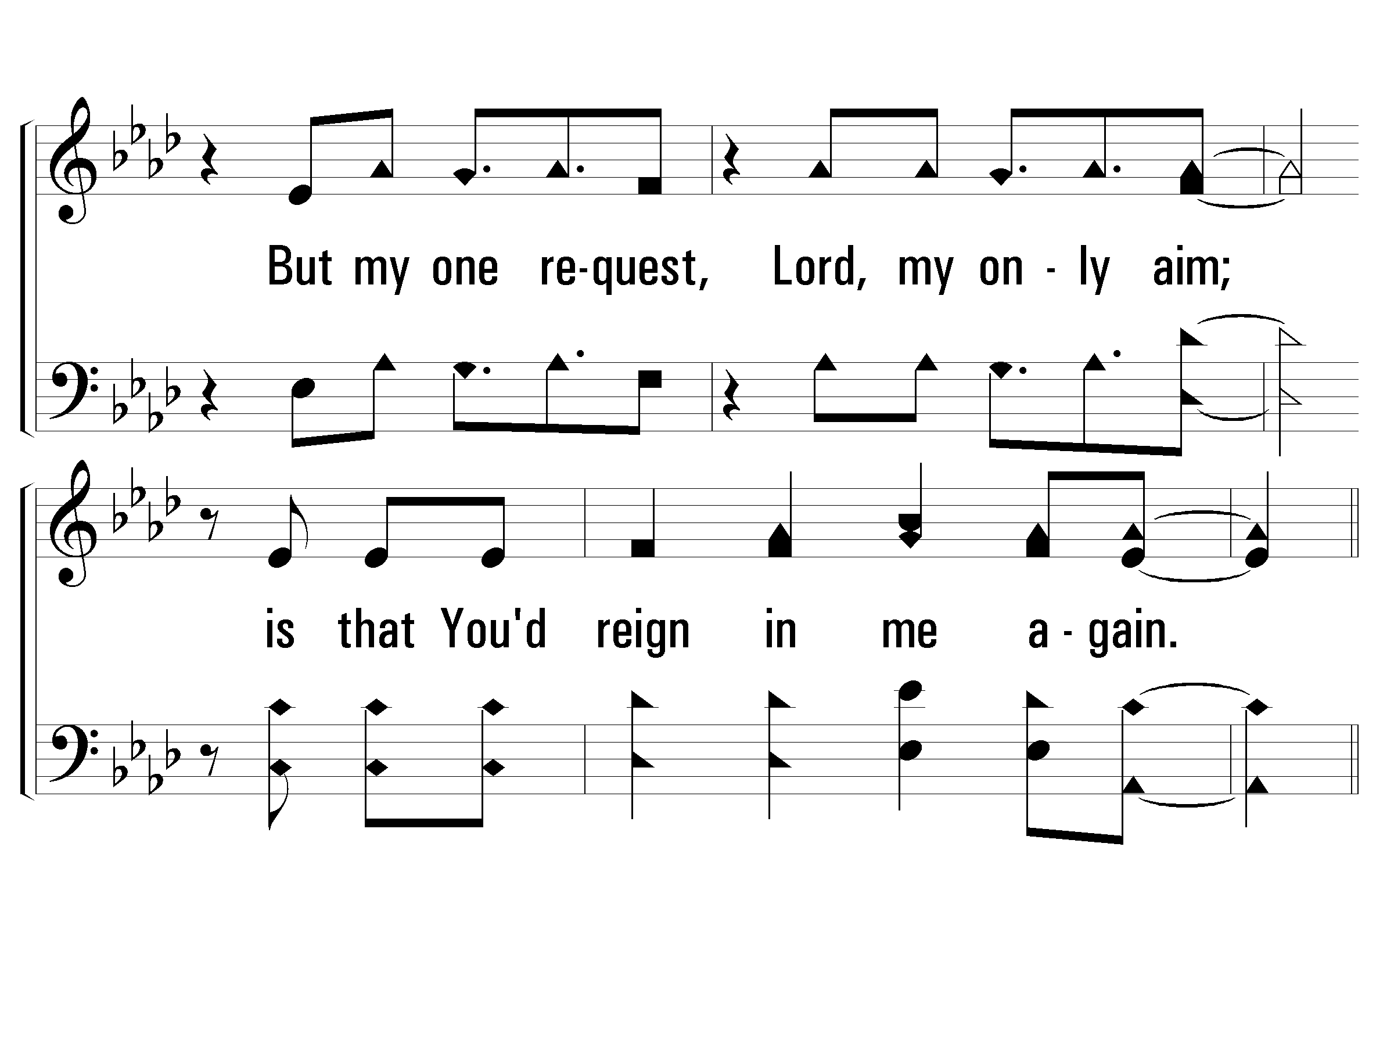
Verse 1 of 2 Lord, Reign In Me

Slide 62
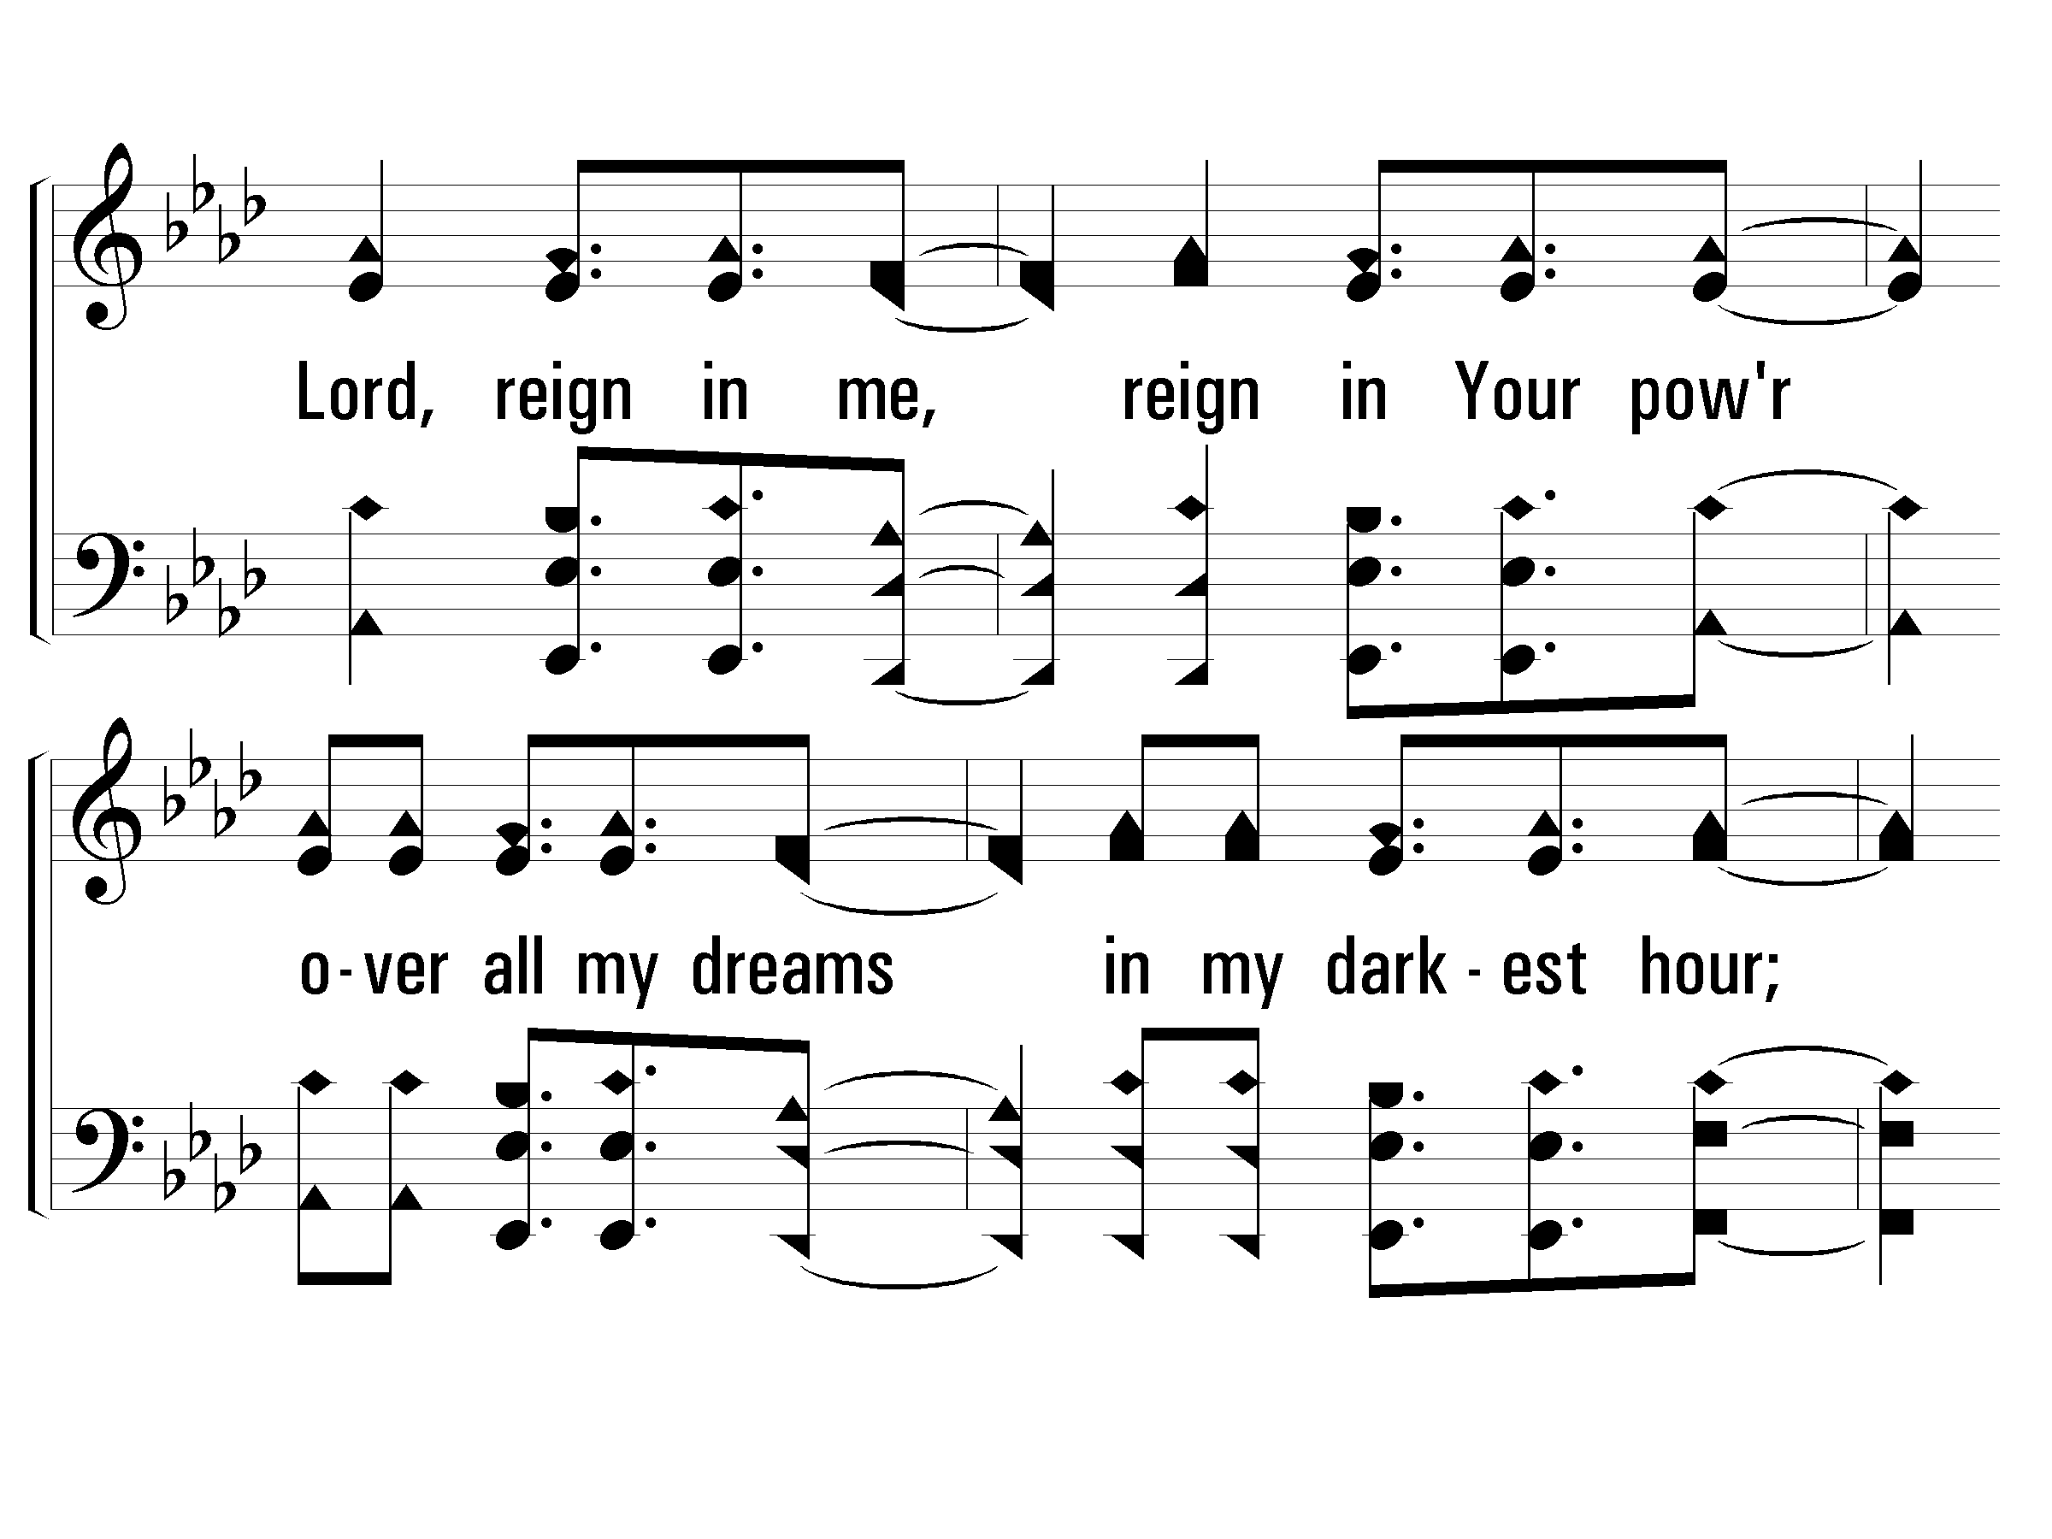
c - Lord, Reign In Me

Slide 63
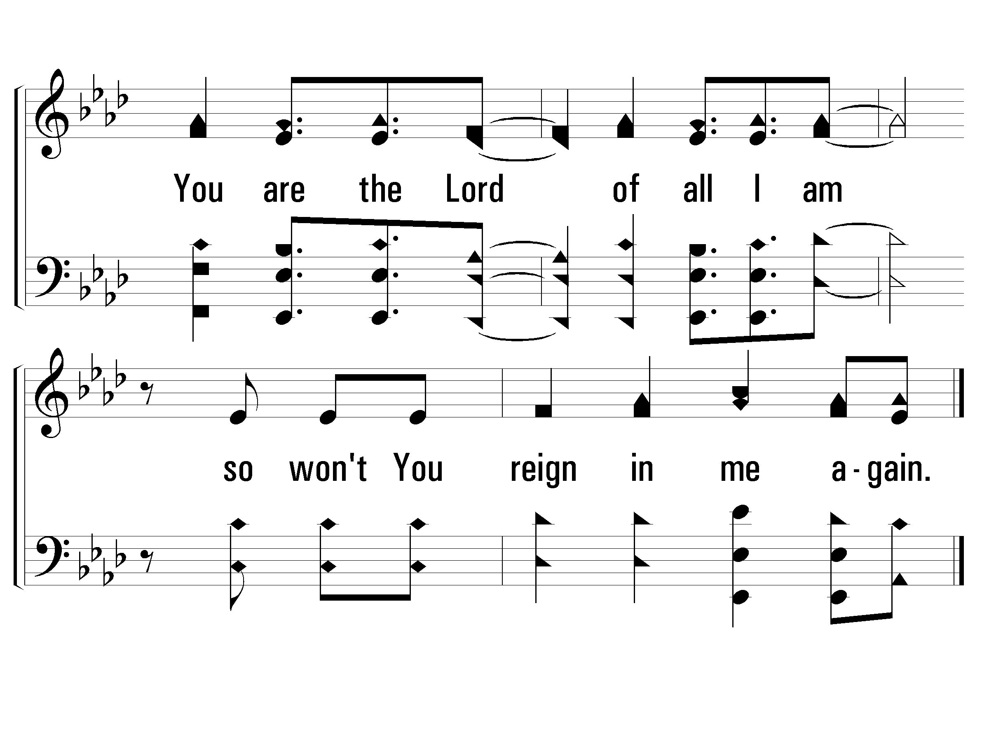
c - Lord, Reign In Me

Slide 64
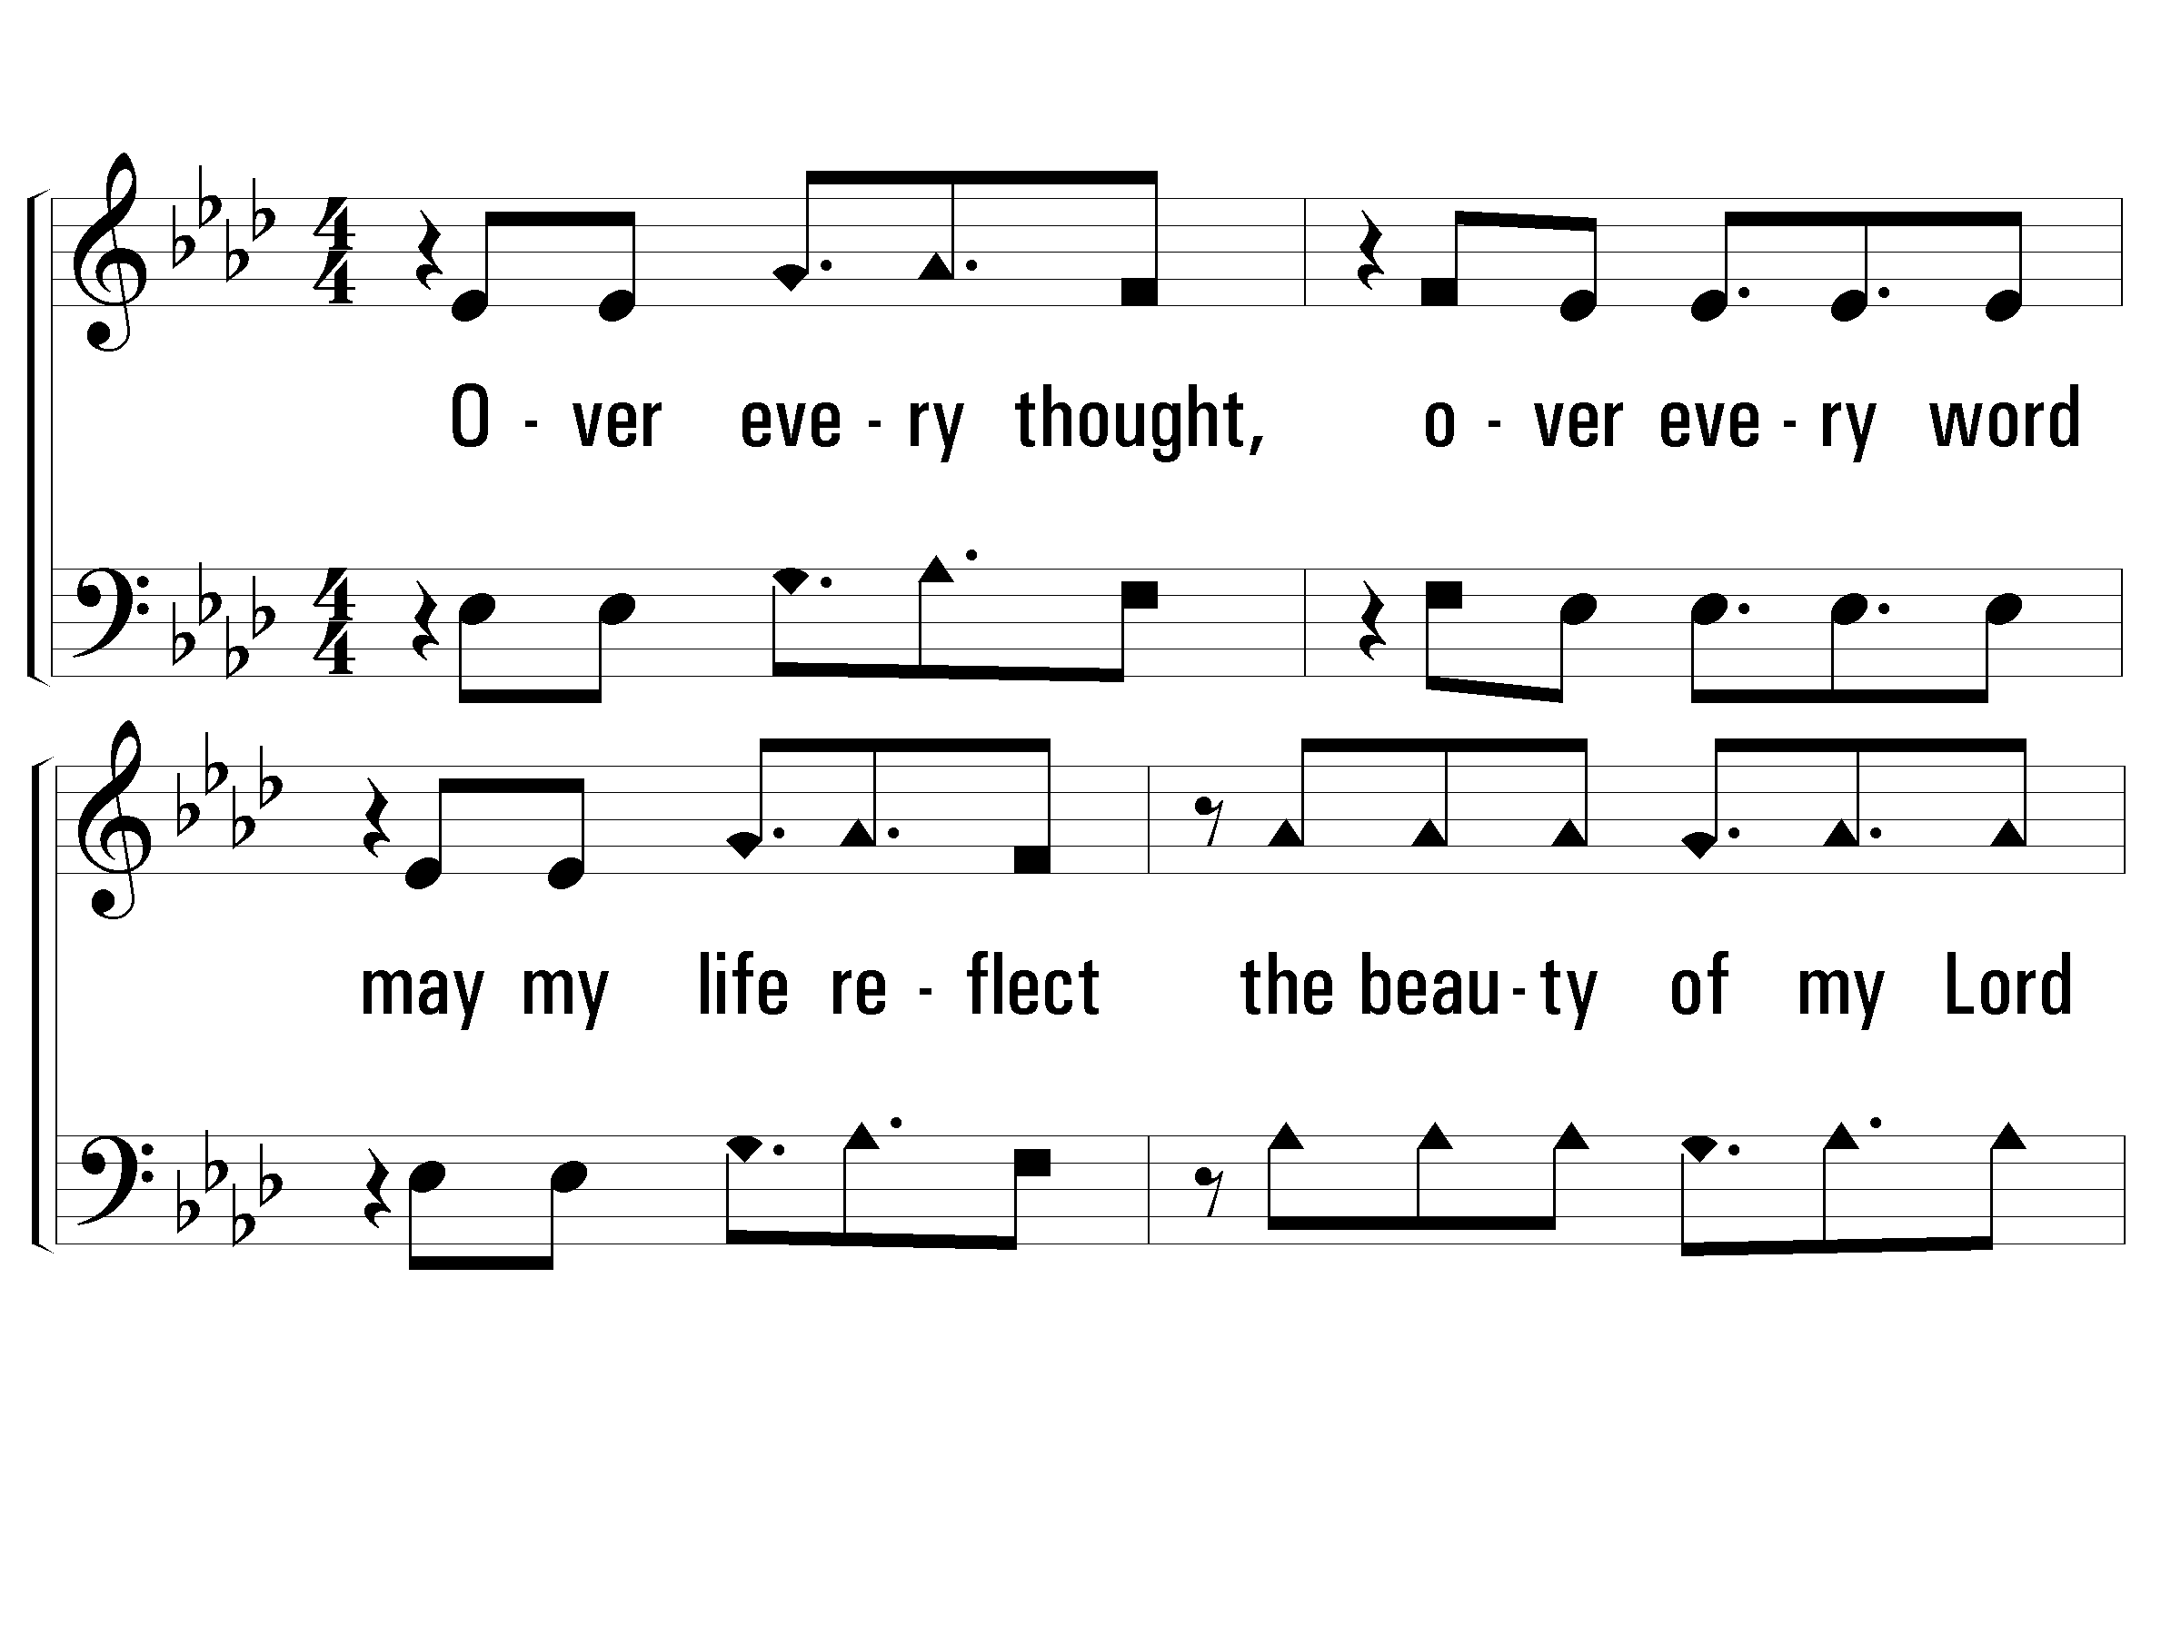
Verse 2 of 2 Lord, Reign In Me

Slide 65
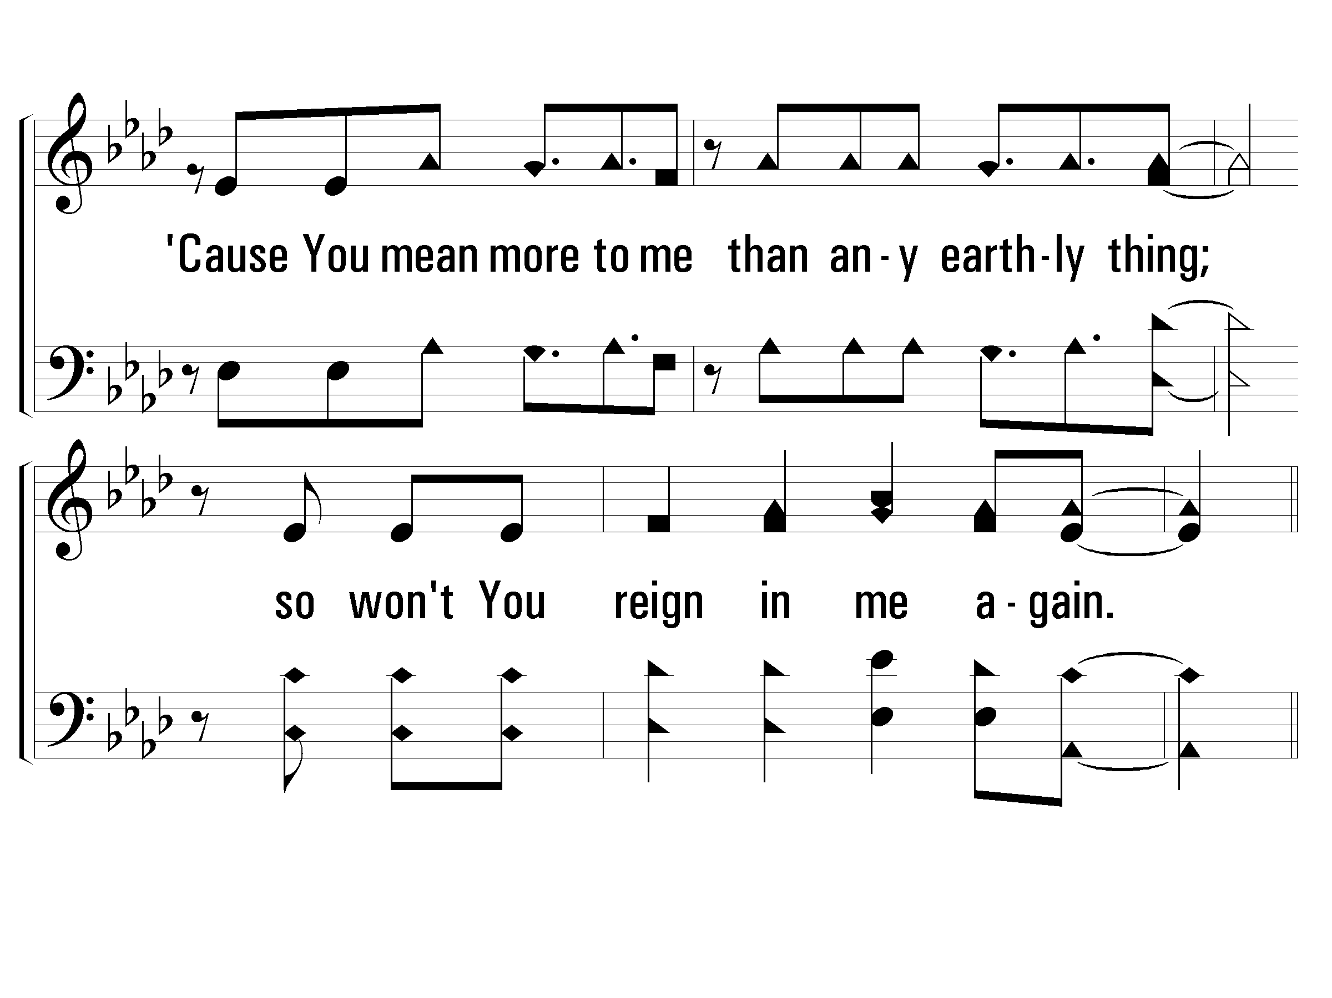
Verse 2 of 2 Lord, Reign In Me

Slide 66
c - Lord, Reign In Me

Slide 67
c - Lord, Reign In Me

