Slide 1


Slide 2

“If you have integrity, nothing else matters.
If you don’t have integrity, nothing else matters”
(Alan K. Simpson)

Slide 3
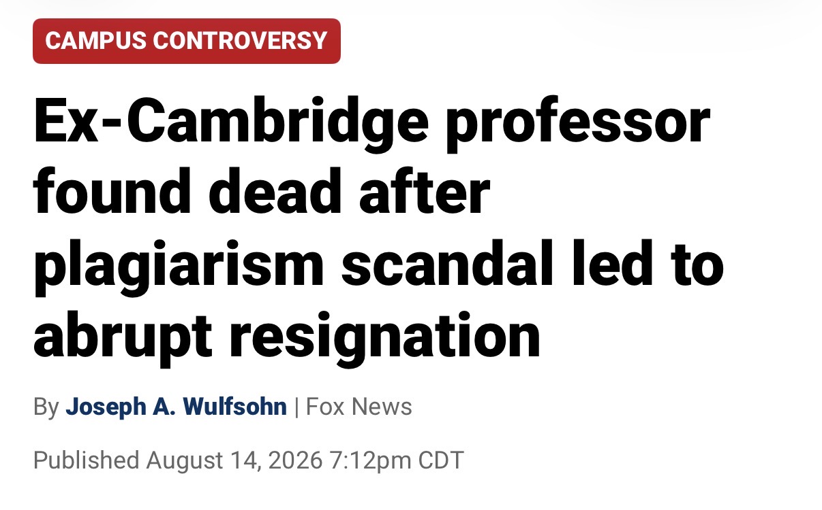
Notes:
This story is a reminder that position, power, & prestige can vanish in an instant if we are not people of character and integrity.

Slide 4
“If you have integrity, nothing else matters.
If you don’t have integrity, nothing else matters”
(Alan K. Simpson)

Slide 5
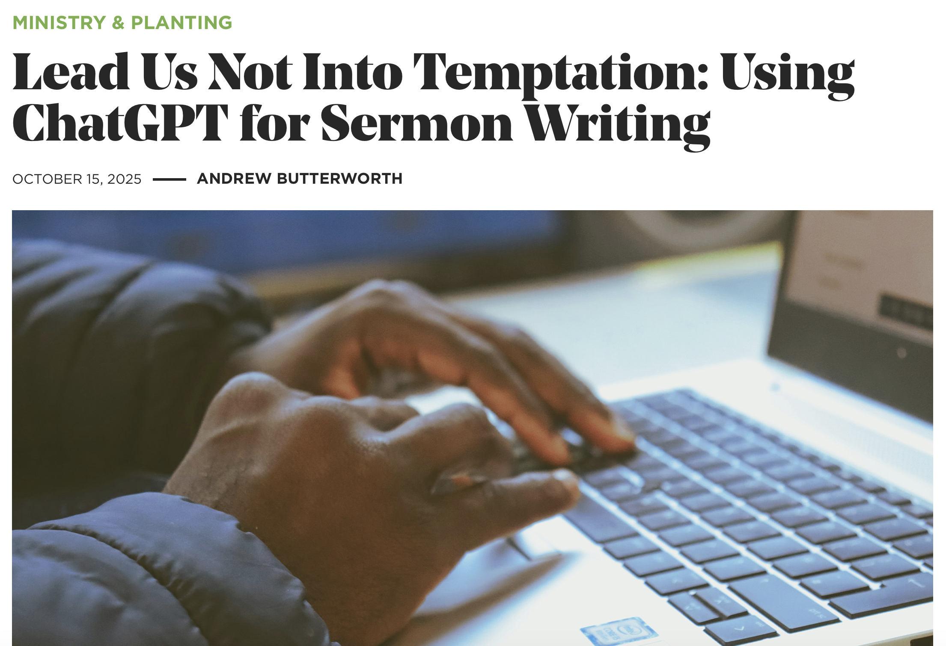
Notes:
“It’s already controversial on university campuses. Professors are using it to set assignments, while students are using it to wholly complete assignments. Is ChatGPT, therefore, answering its own questions? Use of ChatGPT spikes in May as the Northern Hemisphere academic year comes to a close. Does this controversy have parallels in Christianity?
Users already generate a massive 2.5 billion queries per day, and 45% of these come from people under 25. If you haven’t tried it yet, ChatGPT (and other similar generative AIs such as Gemini, Grok and DeepSeek) can produce poems. It can write essays and crunch complex number problems in seconds. And it often gives better outputs than humans. The challenge for the church is that ChatGPT can also generate sermons.
But before you dismiss it too quickly. Here’s the response I got when I asked a generative AI to define the gospel: “the gospel, meaning ‘good news,’ is the core message of Christianity, proclaiming that God loves humanity and offers salvation through Jesus Christ. It teaches that all people have sinned, separating them from God, but Jesus, through his sinless life, sacrificial death on the cross, and resurrection, provides forgiveness and reconciliation with God for those who believe in him. This gift of eternal life is received by faith, not works, and calls believers to repent, follow Jesus’ teachings, and share this message of hope with others.”
Not bad. And it’s getting better and better at producing theologically tight and well-illustrated expositions on a passage. But here’s the temptation. If it can generate something in seconds that takes 20 hours to produce by yourself, might you be tempted to take a bite of this forbidden fruit?
The Danger ChatGPT Brings to Sermon Prep
Using AI to generate a sermon is the technological equivalent of preaching somebody else’s sermon as your own. Except that this isn’t a sermon by a person, but a robot. Well, at the very least, a robot gleaning snippets of other people’s sermons across the web and stitching them together. Preachers have rightly been fired for regularly passing off someone else’s sermon as their own. Will we witness the first firing of a pastor for passing off a ChatGPT sermon as his own?
Let’s be clear: using ChatGPT or other generative AIs to produce an entire sermon isn’t right. One of my elders stated that he would not be able to sit through a sermon if he knew it was generated by AI. Without any wrestling with the text, without any interaction with the Holy Spirit through prayer, he felt it would be disingenuous to stand up there and claim to speak to the congregation authoritatively. In addition, he said, “A machine cannot fully describe the depth of feeling and experience, in the way that a human can.”
Only I don’t think we should be too quick to dismiss the value of ChatGPT preparing sermons. Because there is a whole range of ways that AI can be used to assist, which are helpful and not harmful.
The Benefits of AI for Sermon Prep
You have probably been using AI already without realising.
For instance, I use Google’s Grammarly to check grammar and spelling on everything that goes to print. Even this article you are reading now has been polished for grammar and spelling using the AI in Grammarly. It’s a great help and saves me from asking somebody else to proofread my documents. I have been using it for almost a decade.
Through doing this, I have become more knowledgeable in some of the nuances of grammar. I don’t accept every grammatical change it suggests, but it is helpful. I used it when I worked as a copywriter, and it was encouraged by my company to do so. We also used an app called Hemingway that highlights bad writing habits, such as too much use of the passive voice, using too many adverbs, and too many clauses stuffed into one sentence. It really helped improve my writing.
This was all before generative AI. But even generative AI can be a servant to you in your study. You can use ChatGPT to assist in research. For example, if you ask it to list all the verses that cover a certain topic, it will generate a list in seconds. And if you are looking at a specific text, you can ask it to provide a literary breakdown of the text, according to structure, context and so on. While it can be helpful to see if you missed something, I still think that you shouldn’t short-circuit your own exegetical work. This is part of the wrestle and allowing God to convict you as you prepare. But checking afterwards, I was surprised by how good it is in this area, generally.
It’s also helpful for assessing a sermon draft for readability and conciseness. Once you have a sermon draft, you can feed it into ChatGPT. It will tell you if you are meandering or taking too long to make a point. Obviously, this is ultimately a judgment call. But I have found it helpful to have this sort of critical feedback that is often franker than a fellow preacher reading my draft.
Using AI Properly
If you do want to use ChatGPT to enhance your sermon prep, my advice would be to use the same way you would treat a commentary or a famous preacher’s sermon on a topic. Do the work first. Exegete. Reflect theologically. Ponder how the meaning of your passage relates to what your people are going through today. Then, and only then, look at commentaries and other sermons and feed the draft into ChatGPT to see if there was a perspective you were missing.”

Slide 6
“If you have integrity, nothing else matters.
If you don’t have integrity, nothing else matters”
(Alan K. Simpson)

Slide 7

Character is the Loudest Form of Leadership

Slide 8

Character:
“moral excellence and firmness” (Webster’s Dictionary
Notes:
Definition determines doing - Webster’s Dictionary has 8 definitions of “character.”

Slide 9
Integrity:
“Firm adherence to a code of especially moral or artistic values; incorruptibility” (Webster’s Dictionary
Notes:
Definition determines doing - Webster’s Dictionary has 3 definitions for “integrity”

Slide 10

“But integrity is more than honesty. It means doing the right thing regardless of circumstances or inconvenience to the leader or the organization”
(Former Secretary of Defense, William Cohen, Heroic Leadership)

Slide 11
The most important personal quality people look for and admire in a leader is personal credibility. Credibility is the foundation of leadership. If people don’t believe in the messenger, they won’t believe the message. This finding has been so consistent for over twenty years that we’ve come to call it The First Law of Leadership (2004, 120).

Slide 12

Deut. 17:18 "Also it shall be, when he sits on the throne of his kingdom, that he shall write for himself a copy of this law in a book, from the one before the priests, the Levites. 19 And it shall be with him, and he shall read it all the days of his life, that he may learn to fear the Lord his God and be careful to observe all the words of this law and these statutes,
Notes:
18 "Also it shall be, when he sits on the throne of his kingdom, that he shall write for himself a copy of this law in a book, from the one before the priests, the Levites. 19 And it shall be with him, and he shall read it all the days of his life, that he may learn to fear the Lord his God and be careful to observe all the words of this law and these statutes, 20 that his heart may not be lifted above his brethren, that he may not turn aside from the commandment to the right hand or to the left, and that he may prolong his days in his kingdom, he and his children in the midst of Israel. Deut 17:18-20

Slide 13
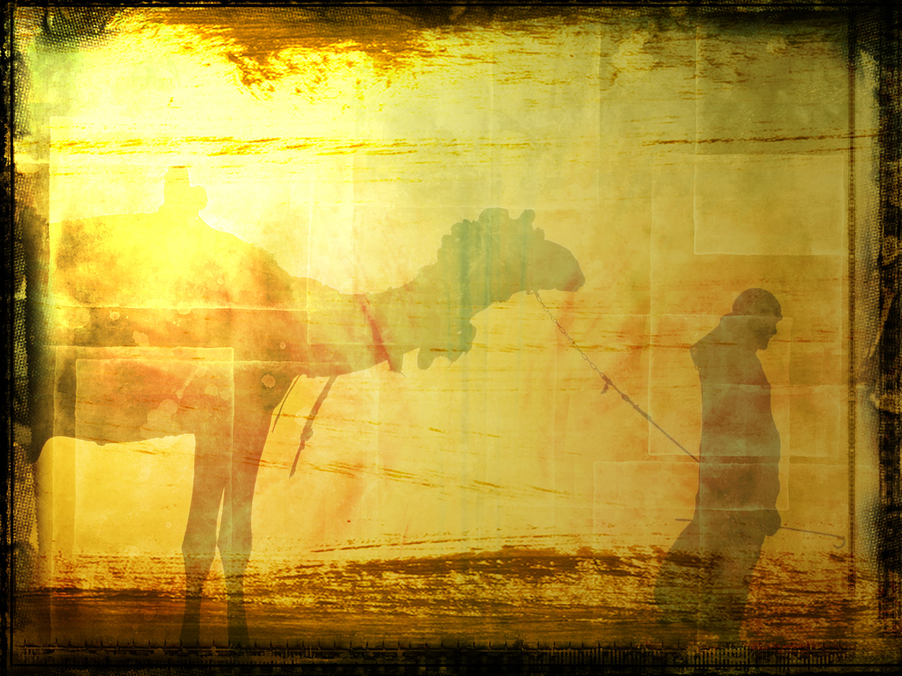
Joshua 1:7 "Only be strong and very courageous; be careful to do according to all the law which Moses My servant commanded you; do not turn from it to the right or to the left, so that you may have success wherever you go. 8 “This book of the law shall not depart from your mouth, but you shall meditate on it day and night, so that you may be careful to do according to all that is written in it; for then you will make your way prosperous, and then you will have success. NAS

Slide 14

Prov. 28:6 Better is the poor who walks in his integrity Than he who is crooked though he be rich.
Prov. 10:9 He who walks in integrity walks securely, But he who perverts his ways will be found out.
Prov. 11:3 The integrity of the upright will guide them, But the crookedness of the treacherous will destroy them.
Notes:
The Extraordinary Leader, Zenger & Folkman, 53 - The Leadership Tent - They highlight 5 characteristics of good leaders. Character is the center pole because without it, the whole tent falls. Let us walk through Scripture and look at some biblical examples of this.

Slide 15

⛺️
King Saul
Rehoboam
Ahab & Jezebel
The Sons of Eli
Caiaphas
Pilate

Slide 16


Slide 17

Job 2:3 The LORD said to Satan, “Have you considered My servant Job? For there is no one like him on the earth, a blameless and upright man fearing God and turning away from evil. And he still holds fast his integrity, although you incited Me against him to ruin him without cause.”

Slide 18
Job 2:9 Then his wife said to him, “Do you still hold fast your integrity? Curse God and die!”
Job 27:5 Far be it from me that I should declare you right; Till I die I will not put away my integrity from me.

Slide 19
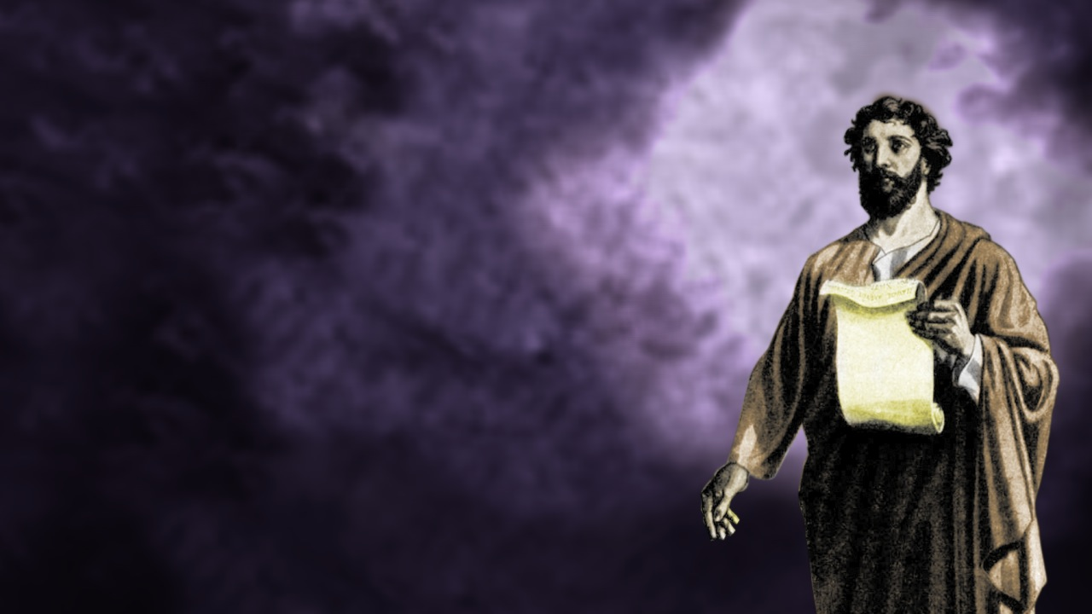
Acts 23:1 Paul, looking intently at the Council, said, “Brethren, I have lived my life with a perfectly good conscience before God up to this day.”
Acts 24:16 In view of this, I also do my best to maintain always a blameless conscience both before God and before men.

Slide 20

2 Thess 3:7 For you yourselves know how you ought to follow our example, because we did not act in an undisciplined manner among you,
2 Thess 3:9 not because we do not have the right to this, but in order to offer ourselves as a model for you, so that you would follow our example.
1 Cor. 11:1 Be imitators of me, just as I also am of Christ.

Slide 21
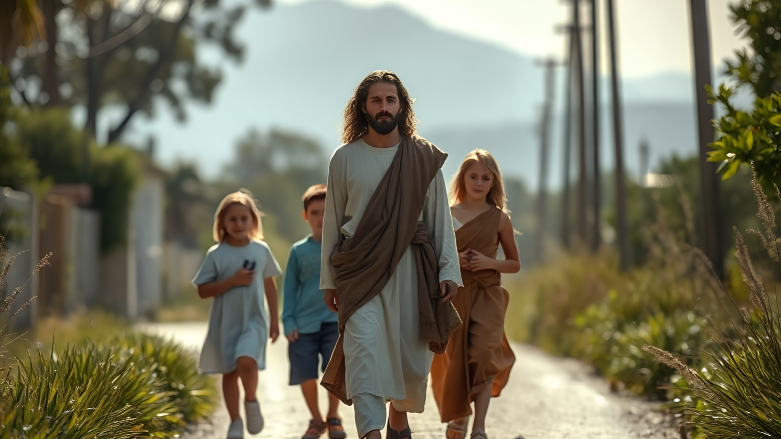

Slide 22
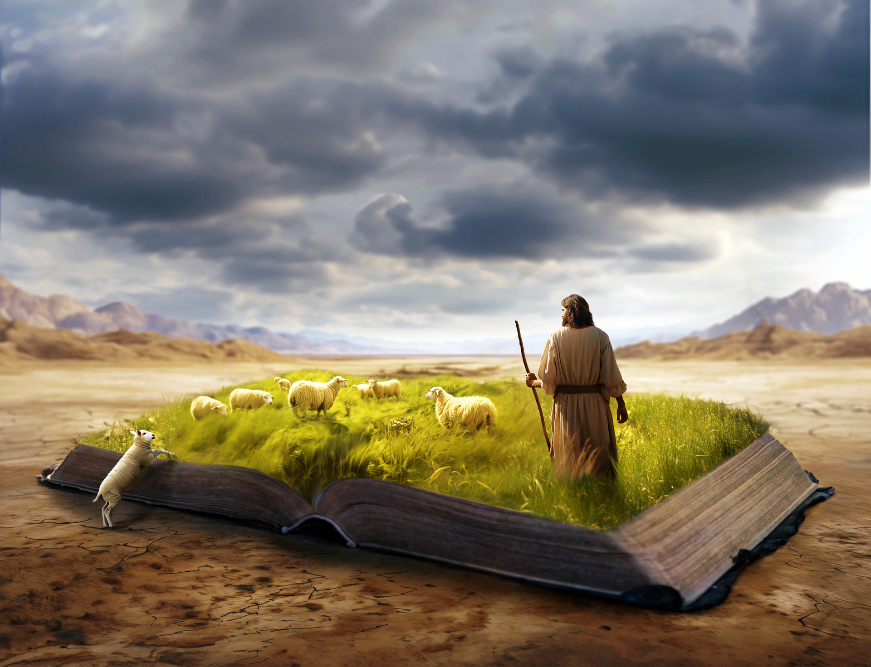
John 13:15
For I gave you an example that you also should do as I did to you.

Slide 23
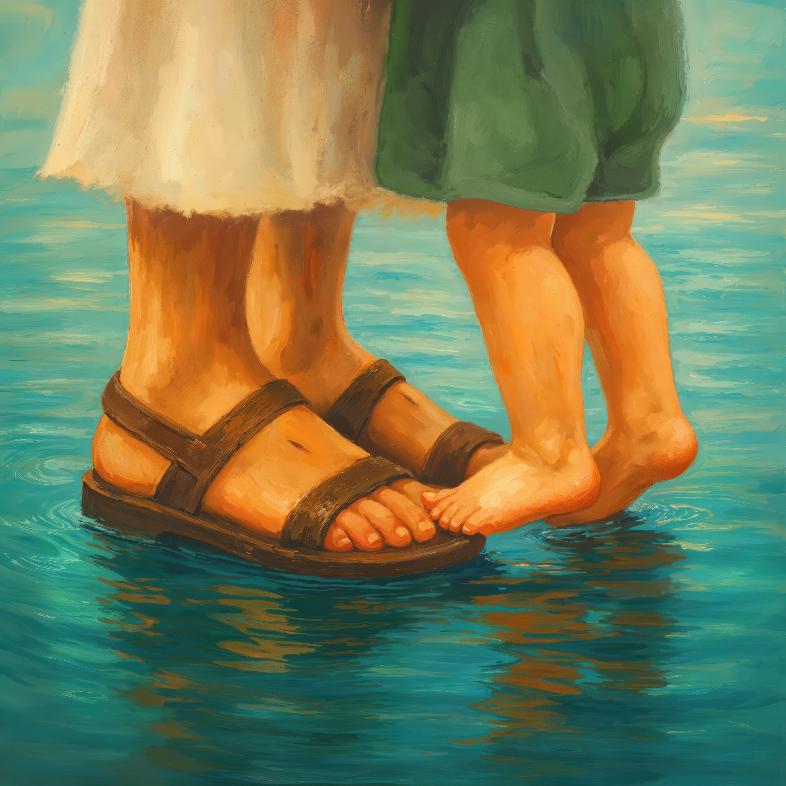
1 Pet. 2:21 For you have been called for this purpose, since Christ also suffered for you, leaving you an example for you to follow in His steps

Slide 24

“For we do not have a high priest who cannot sympathize with our weaknesses, but One who has been tempted in all things as we are, yet without sin” (Heb 4:15-16).

Slide 25

Notes:
If Jesus had not had character, integrity, He could not have saved us.

Slide 26
“If you have integrity, nothing else matters.
If you don’t have integrity, nothing else matters”
(Alan K. Simpson)

Slide 27
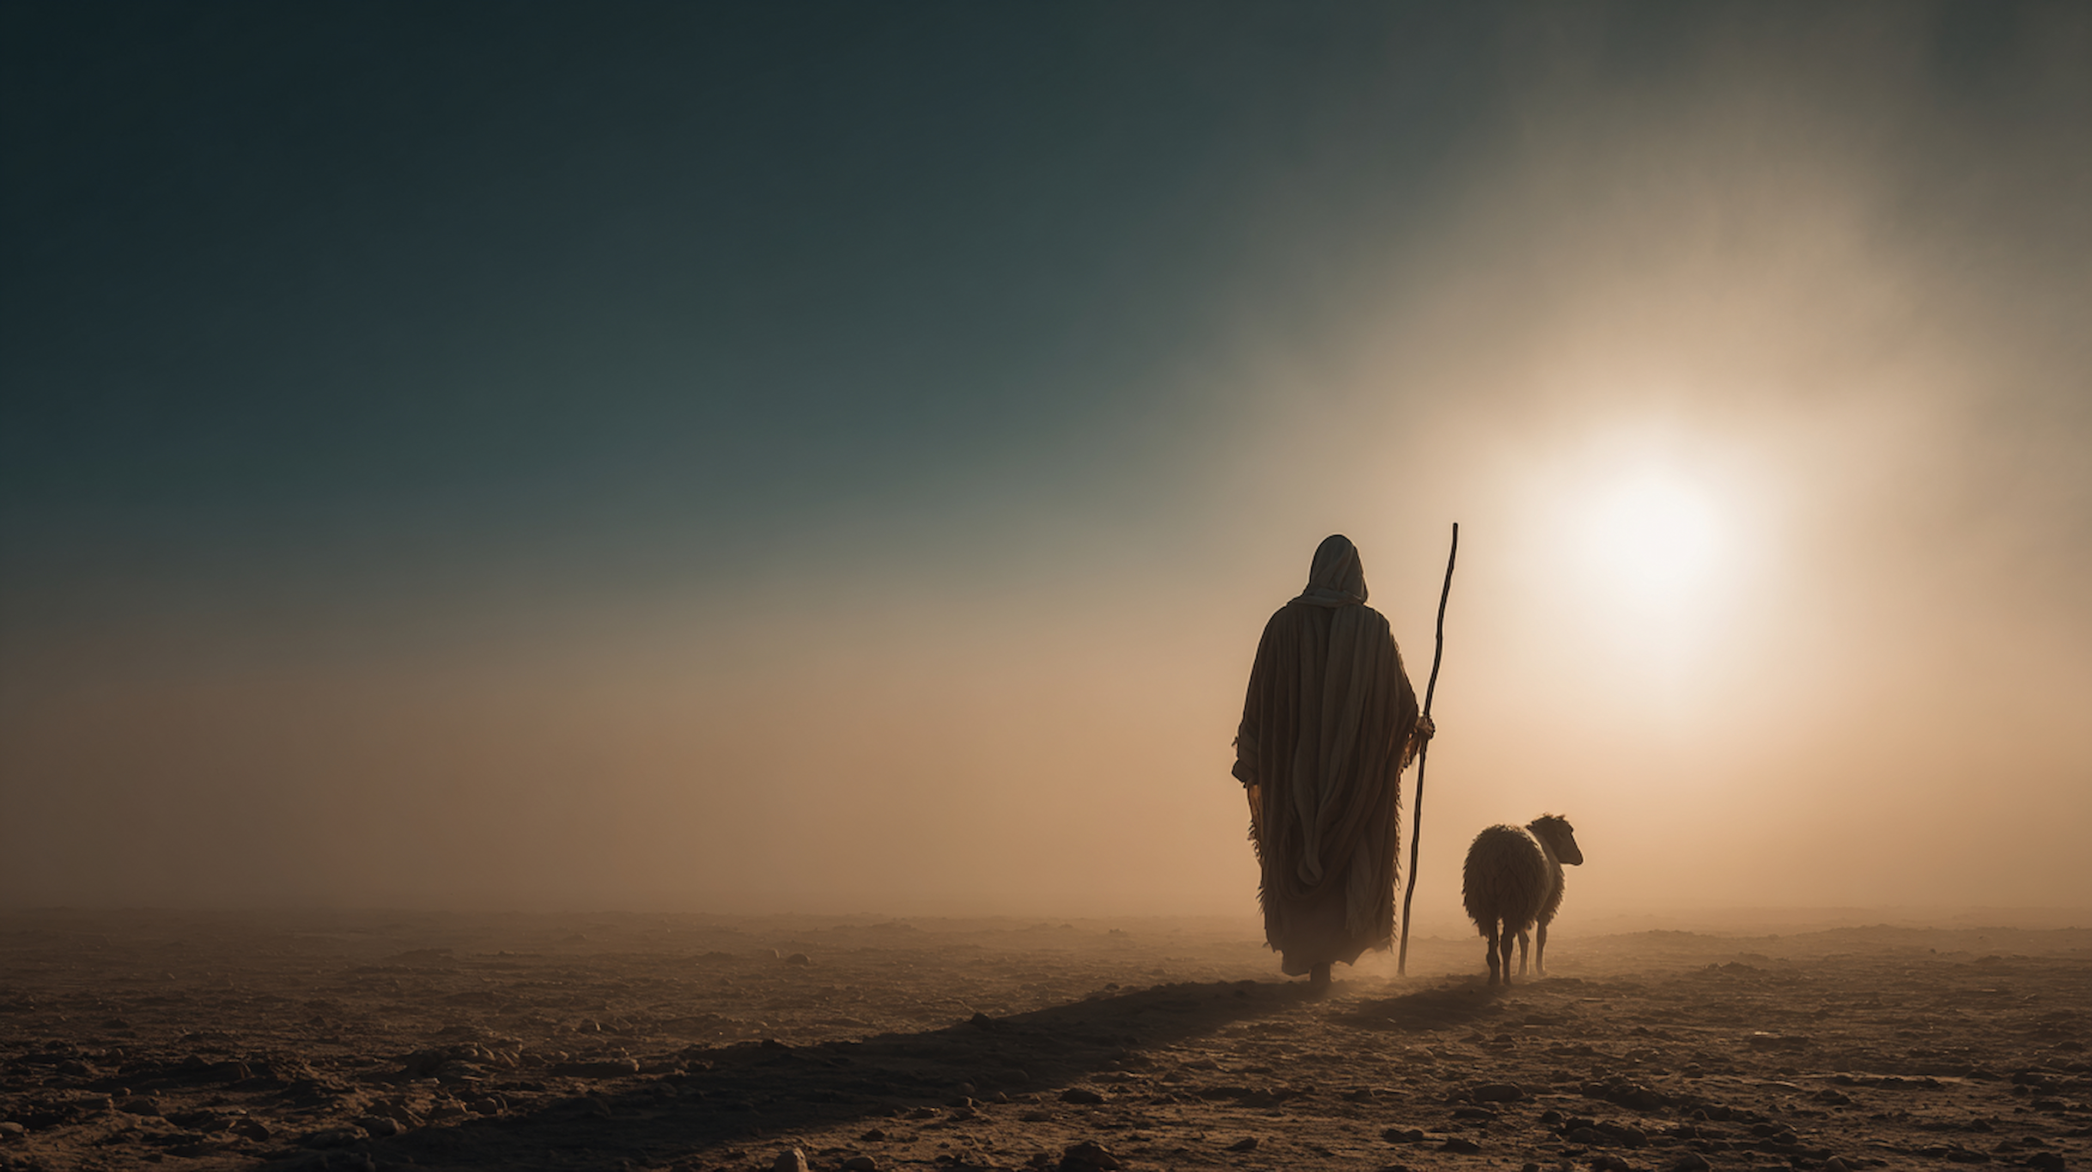

Slide 28
Character is the Loudest Form of Leadership

Slide 29
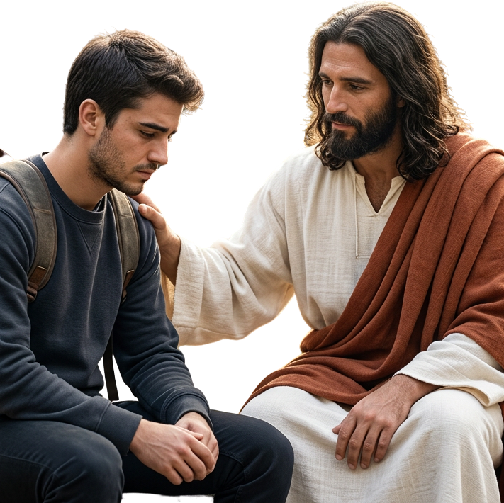
Can they hear us?

