Slide 1
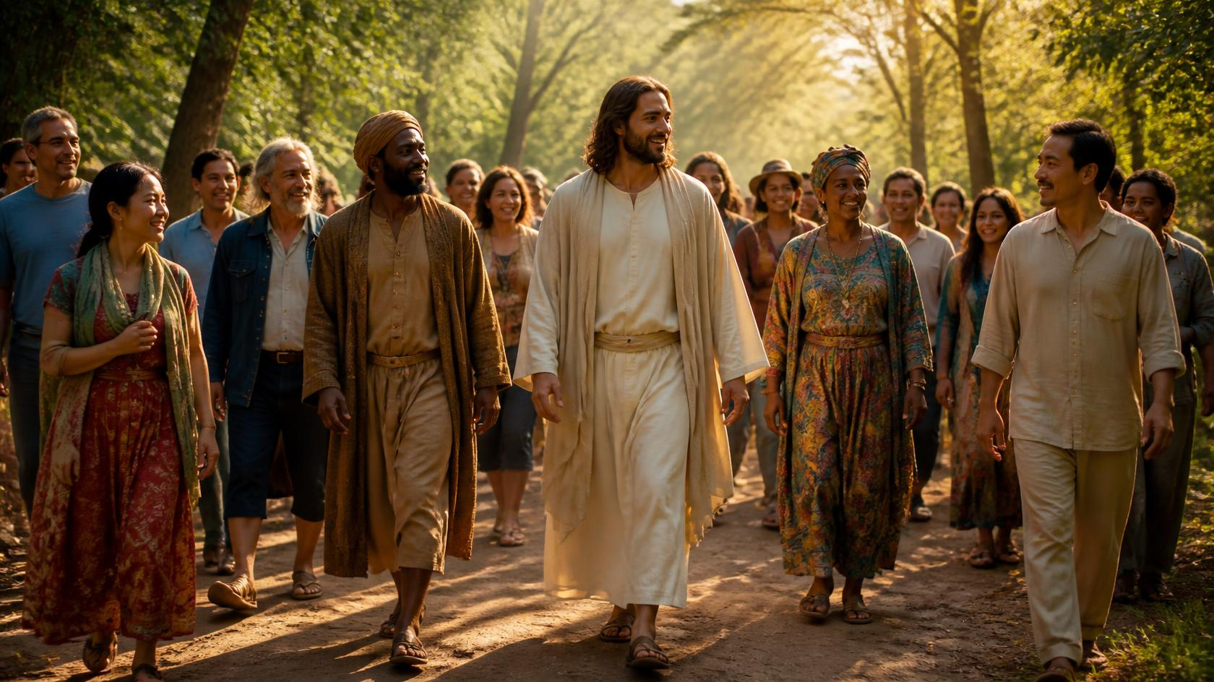
Notes:
Developmental theories - Erickson’s theory of personality development - search of identity

Slide 2
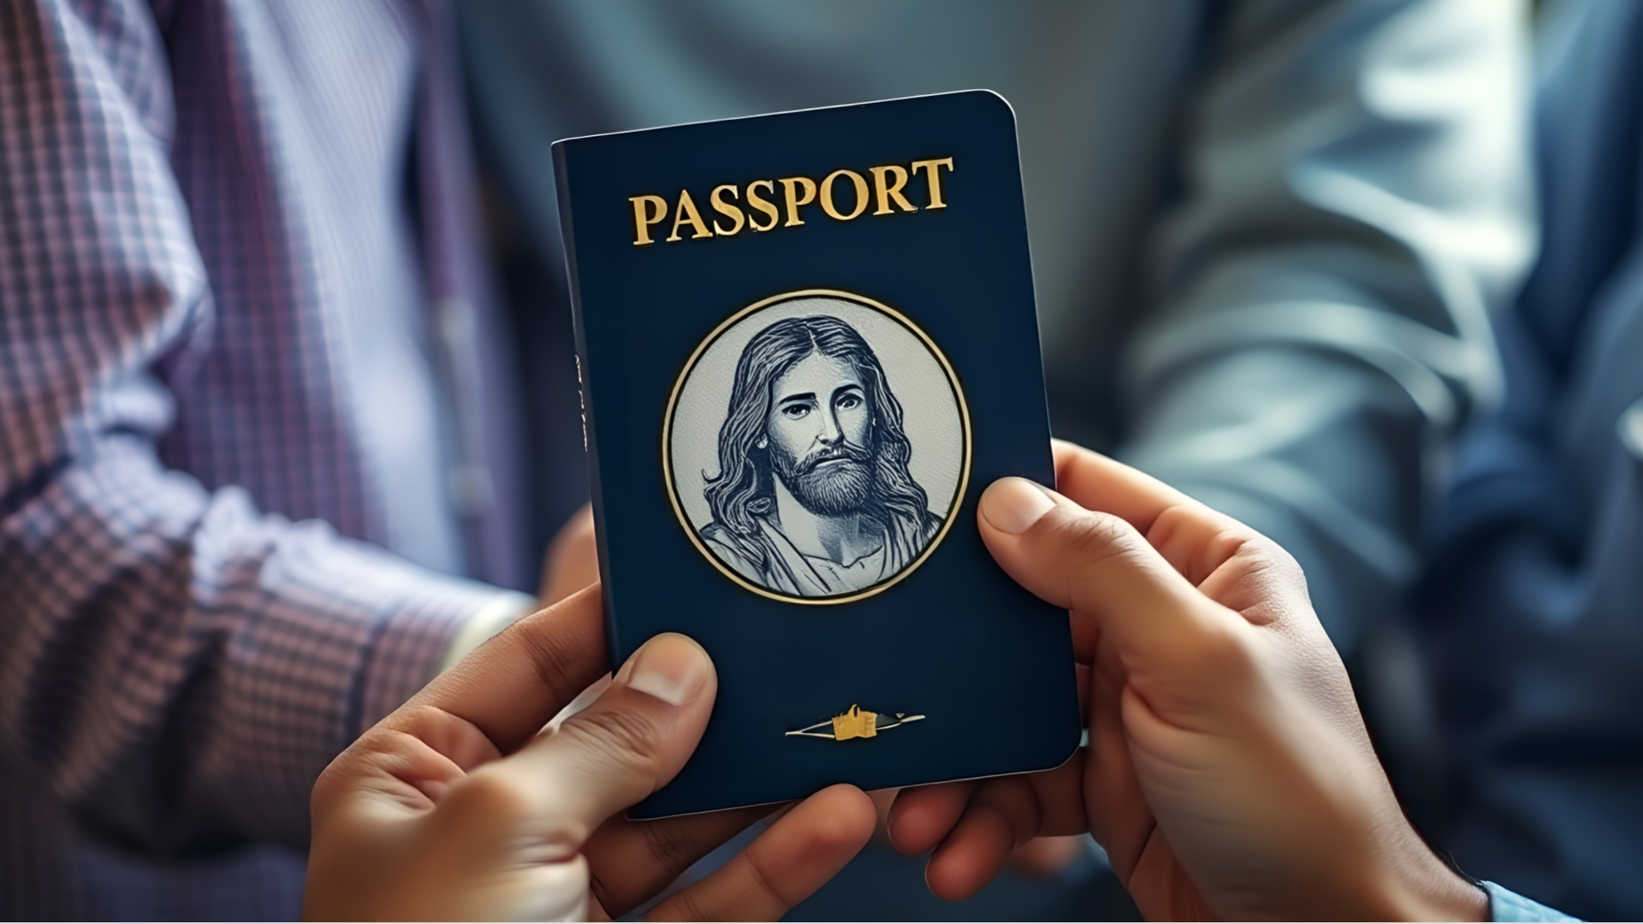
Recovering the Weight of Being Called…
People of God

Slide 3
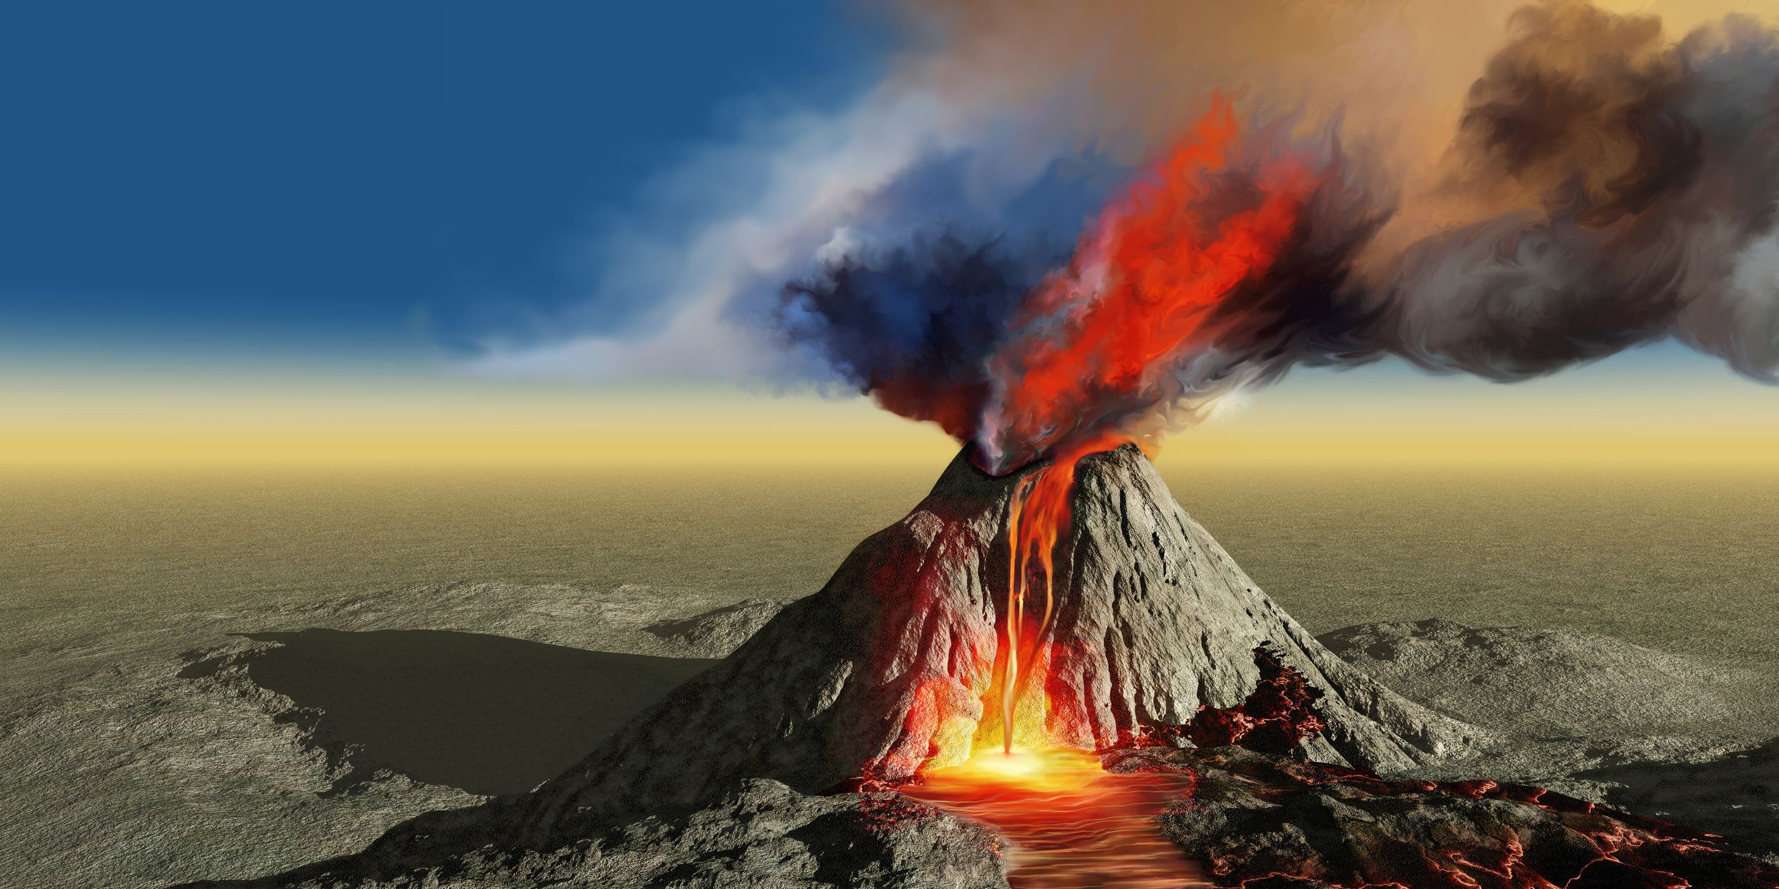
The Marriage on
the Mountain

Slide 4
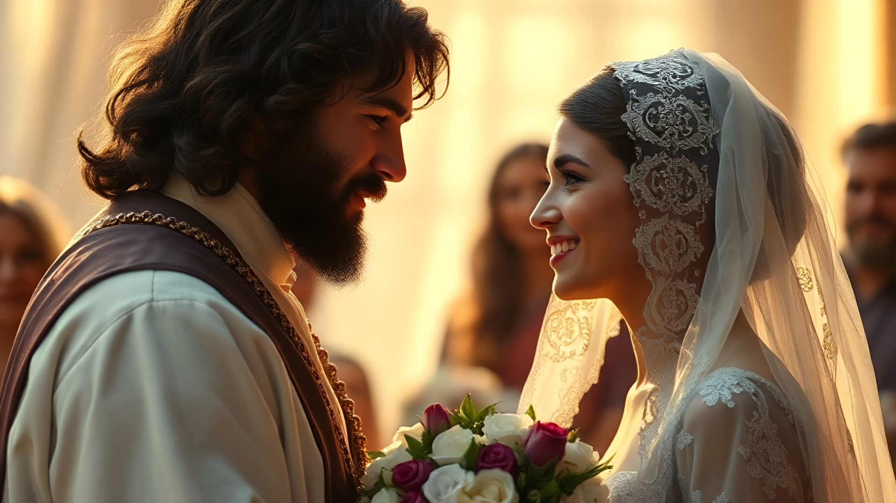
Notes:
It is hard for most men to understand the change in identity that women go through when they get married. Thus, many men may miss what is happening in Exodus 19-20

Slide 5
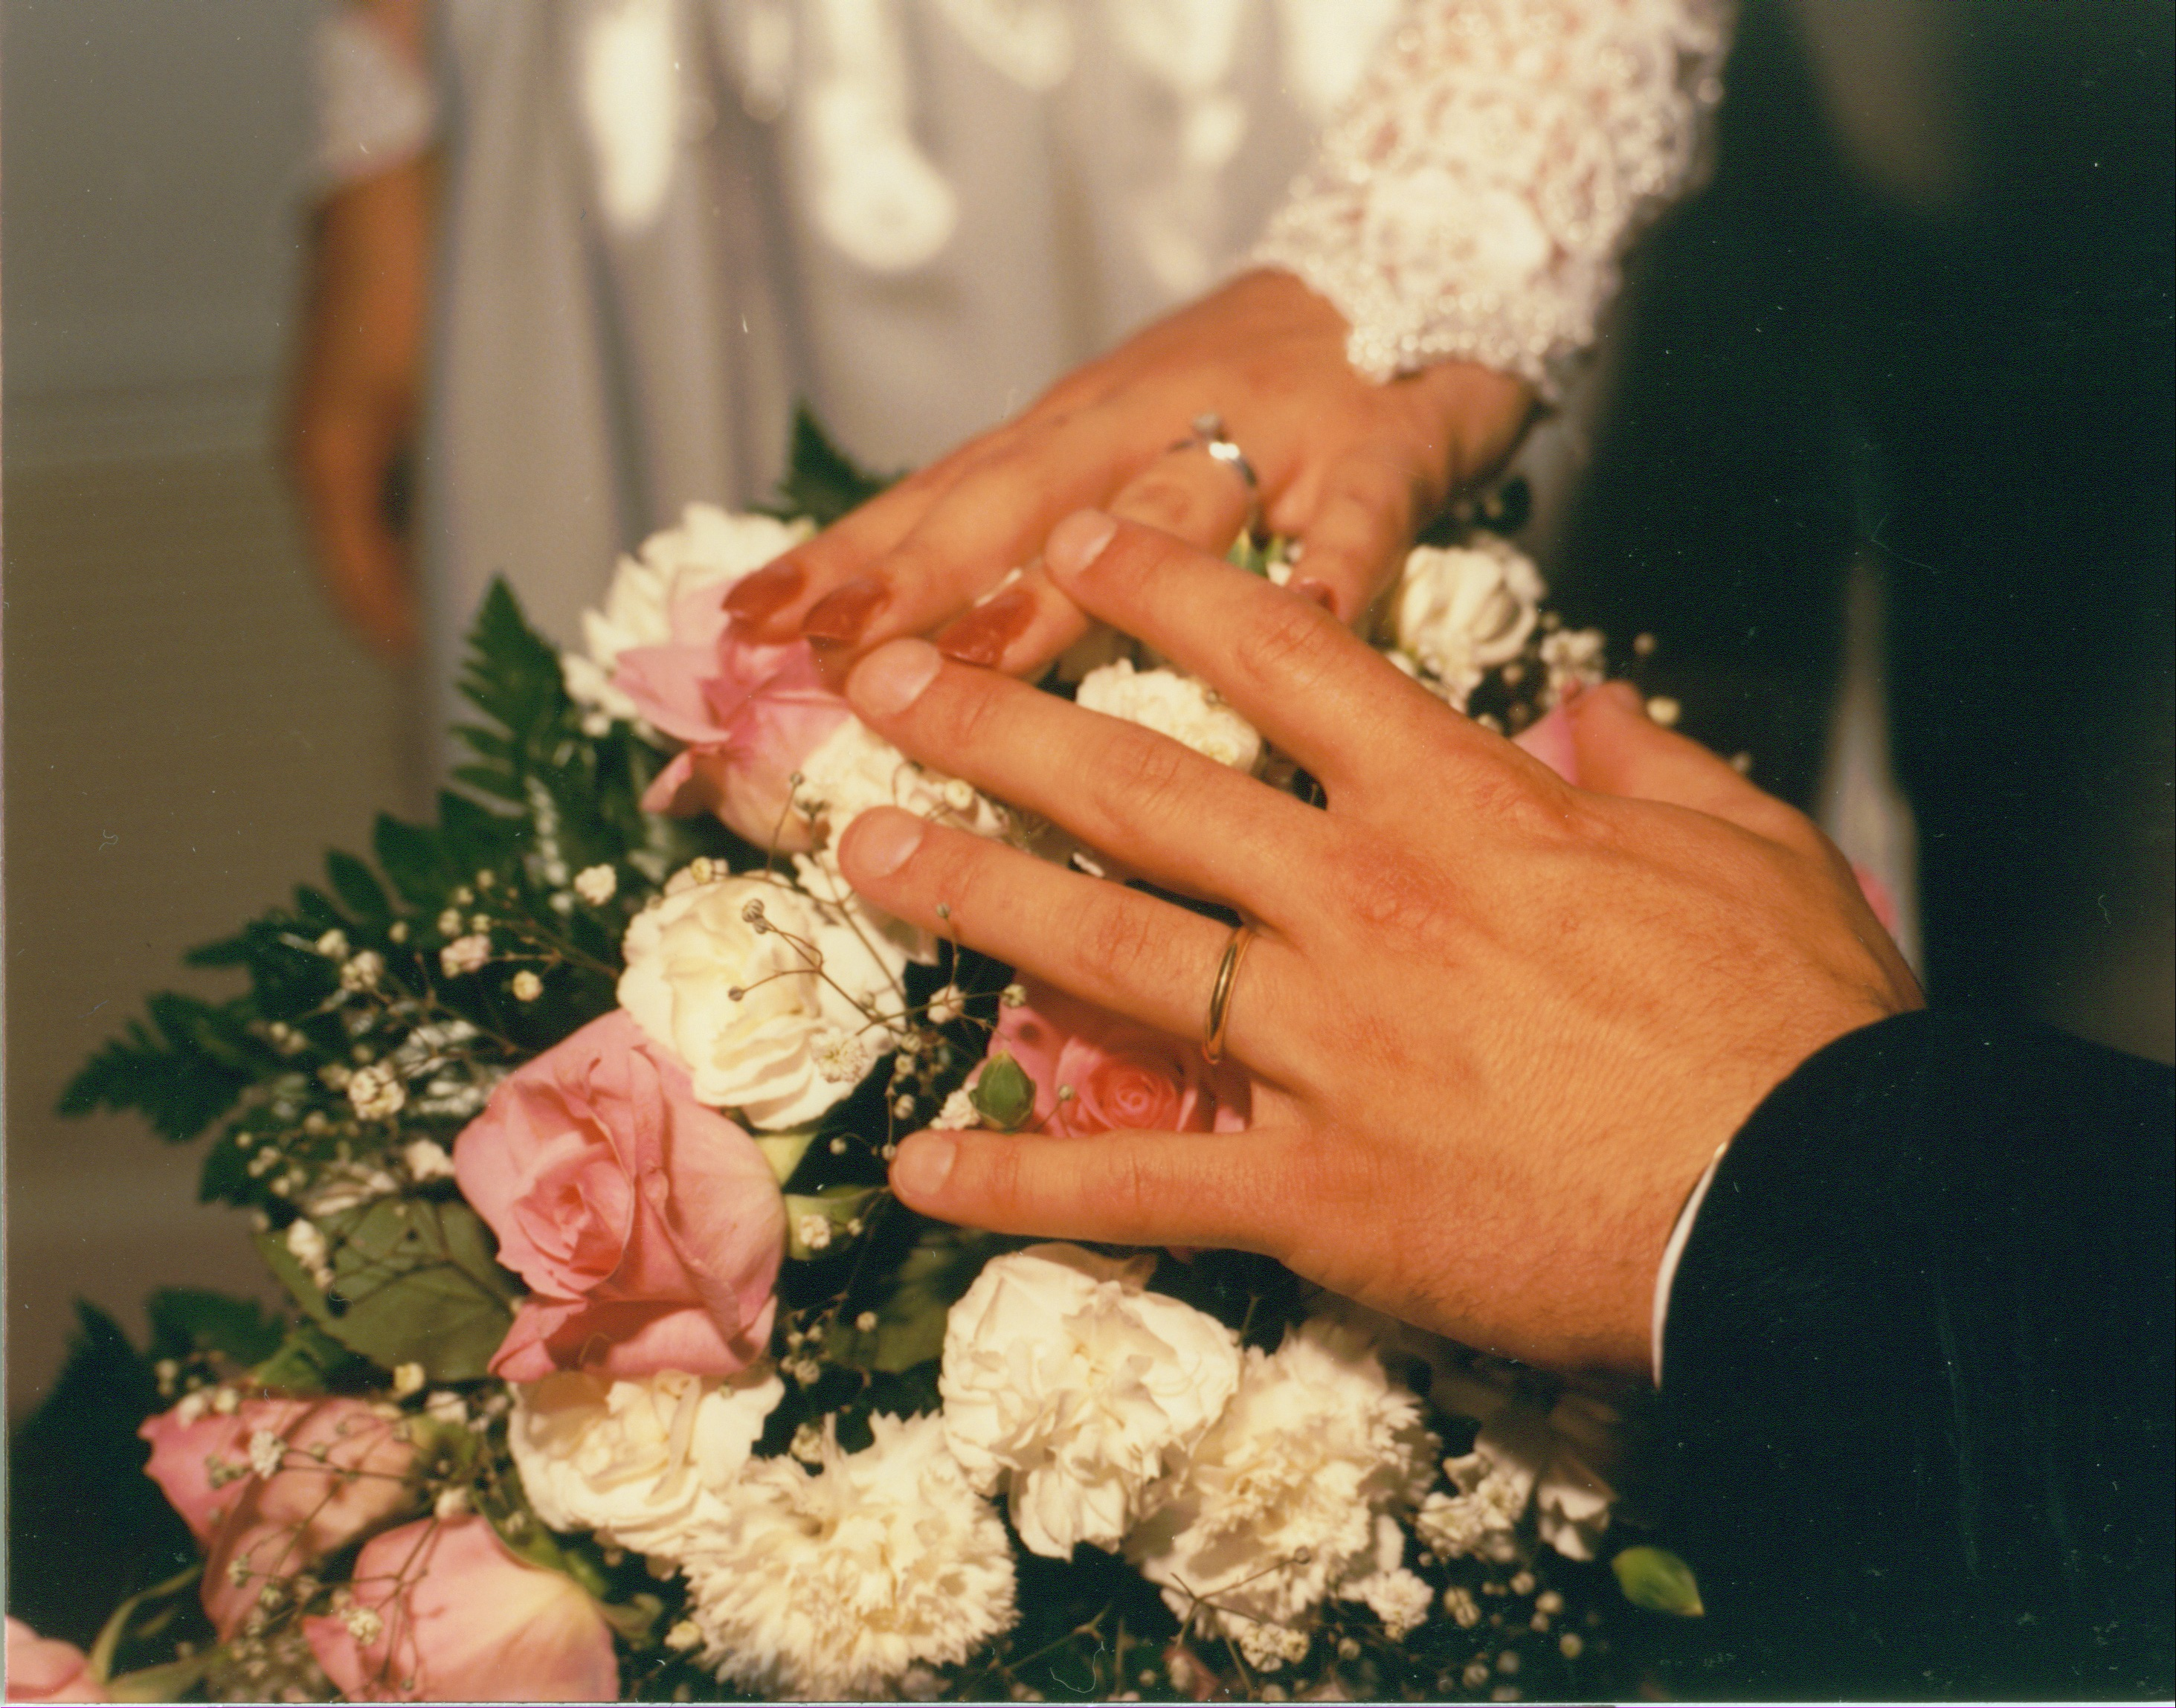
December 26, 1987
Notes:
We begin with the proposal. I asked Cindy to marry me on December 26, 1987. Exodus 19 records God asking Israel to marry Him.

Slide 6

Ex 19:4 'You yourselves have seen what I did to the Egyptians, and how I bore you on eagles' wings, and brought you to Myself. 5 'Now then, if you will indeed obey My voice and keep My covenant, then you shall be My own possession among all the peoples, for all the earth is Mine;
Notes:
God begins by reminding them of how much he loves them. He loved them enough to deliver them from the hands of the Egyptians. He wants them to be his own people. He is offering a covenant relationship to them. This passage once bothered me because it looked like God was picking favorites. He picked the Jews to be saved and everyone else was just out of luck. Yet, that is not what is happening here.

Slide 7
Proposal with a Purpose
Ex 19:4 'You yourselves have seen what I did to the Egyptians, and how I bore you on eagles' wings, and brought you to Myself. 5 'Now then, if you will indeed obey My voice and keep My covenant, then you shall be My own possession among all the peoples, for all the earth is Mine; 6 and you shall be to Me a kingdom of priests and a holy nation.' These are the words that you shall speak to the sons of Israel."
Notes:
He also tells them that this is a proposal with a purpose. They are to be a “kingdom of priests” (19:6). Priests function as mediators or go-betweens between God and human beings. Many falsely assume that the Father chose Israel because he did not care about the rest of humanity. He actually chose them as a kingdom of priests who were to help the rest of the world to know about him. Israel, by and large, forgot this purpose.

Slide 8
Exodus 19:8 All the people answered together and said, "All that the Lord has spoken we will do!" And Moses brought back the words of the people to the Lord.
9 The Lord said to Moses, "Behold, I will come to you in a thick cloud, so that the people may hear when I speak with you and may also believe in you forever."
Notes:
They said. “Yes.”

Slide 9
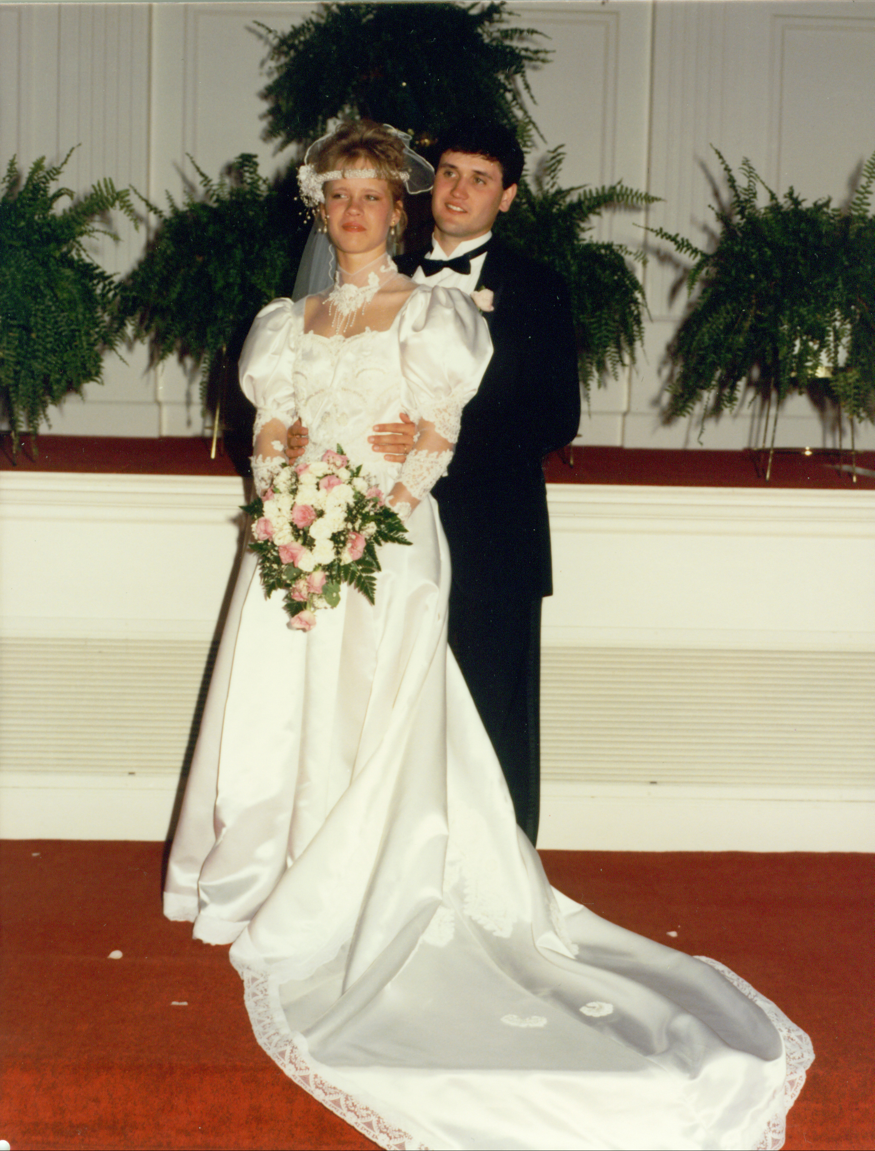
May 7, 1988
Notes:
Now we turn our attention to the Ceremony

Slide 10
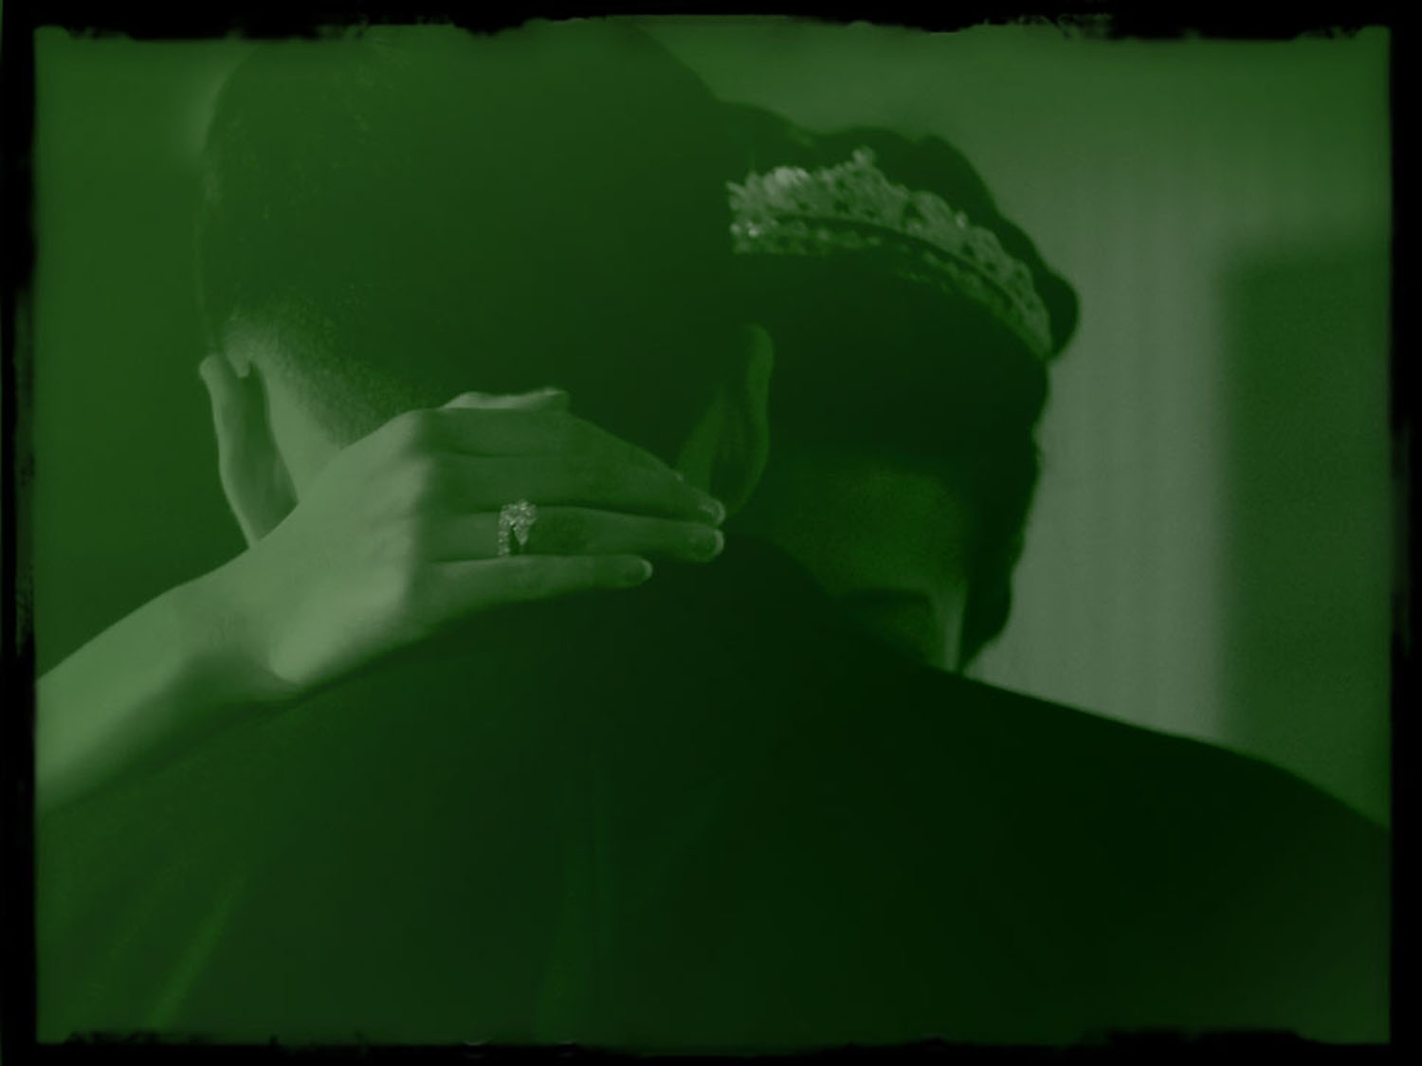
The Ceremony
  Exodus 20:1 Then God spoke all these words, saying,
  2 "I am the Lord your God, who brought you out of the land of Egypt, out of the house of slavery (cf. 1 Jh 4:19)
Notes:
He begins the ceremony by reminding them that He loves them. “He first loved us…”
Wedding ceremonies typically feature the exchanging of vows. The vows describe the level of commitment the two are making to each other. Their love will continue in sickness and health and in prosperity and adversity.

Slide 11

“The Ten Commandments” – Exo. 34:28
“The words of the covenant” - Deut. 34:28
“The tables of the covenant” - Deut. 9:9
“The covenant” – Deut. 4:13
“The two tables” – Deut. 9:10-17
“The testimony” – Exo. 16:34; 25:16
“The tablets of the testimony” – Exo. 31:18
“The commandments” – Matt. 19:17
Notes:
The commands in Exodus 20 (literally, “The Ten Words” or “The Ten Sayings”) are referred to in various ways in Scripture:

Slide 12

The Ten Wedding Vows
Notes:
Every wedding I have done, had the exchanging of vows.

Slide 13
Wedding Vows
Do you, ________, take this _______ to be Your wedded ________, to live together after God's ordinances in the holy state of matrimony? To love, comfort, cherish, honor and keep in sickness and in health, in prosperity and adversity; and, forsaking all others, keep yourself only for ______, as long as you both shall live? [I do.]

Slide 14

Matt. 22:37 And He said to him, “‘YOU SHALL LOVE THE LORD YOUR GOD WITH ALL YOUR HEART, AND WITH ALL YOUR SOUL, AND WITH ALL YOUR MIND.’ ³⁸ “This is the great and foremost commandment. ³⁹ “The second is like it, ‘YOU SHALL LOVE YOUR NEIGHBOR AS YOURSELF.’
⁴⁰ “On these two commandments depend the whole Law and the Prophets.”

Slide 15
God’s Wedding Vows
THE VOWS: Love God (Matt. 22:37-40)
Notes:
Couples in a marriage relationship should also be committed and faithful to each other. That is what commandments/vows 1-4 are about. They are nothing more than the reasonable expectations of someone making a lifetime commitment to the one they love.

Slide 16
“You shall have no other gods before Me” (20:3)
Notes:
God just wants to know that They are totally committed to him, and him only. God says, “You shall have no other gods before Me.” (Exo. 20:3). This is no different from a husband expecting his spouse to “keep yourself only for him, as long as you both shall live.” God has been and will be faithful to Israel. He wants them to be faithful to him. Idolatry was a way of life in the ancient world. God consistently referred to worship of false gods as adultery in Scripture.

Slide 17
God’s Wedding Vows
THE VOWS: Love God (Matt. 22:37-40)
  No other Gods – Don’t sleep with another
  No Images – No other pictures in wallet
  Name in Vain – Don’t dishonor my name
  Sabbath – Make time for me
Notes:
A tremendous example of this is found in the book of Hosea. Hosea was to marry a prostitute because this prostitute became a living illustration of Judah’s unfaithfulness to God (Hos. 1:2). They were told to name their second child, “Lo-ammi, for you are not My people and I am not your God.” (1:8). Lo-ammi means “not my people.” Contrast this with God’s statement in Exodus 19:5, “Now then, if you will indeed obey My voice and keep My covenant, then you shall be My own possession among all the peoples, for all the earth is Mine” (emphasis mine). They had failed to keep their wedding vows. God goes on to declare, “Contend with your mother, contend, For she is not my wife, and I am not her husband; And let her put away her harlotry from her face And her adultery from between her breasts” (Hosea 2:2). God does not take unfaithfulness to Him lightly.
When one reads through the books of 1 and 2 Kings, one finds that the kings were not evaluated so much on their military or economic prowess as their faithfulness to God. An example of this can be found in 1 Kings 11:1-8. Solomon took many wives and concubines “who turned his heart aside after other gods; and his heart was not wholly devoted to the Lord, as the heart of his father David had been” (19:4). King David had his issues, but one thing you could say about him is that he was a one-God man. He never worshiped any idols. That can be said of a very few of the kings of Israel and Judah. Most of these kings forgot the commitment to have no other gods that their nation made in the original wedding ceremony with God. God is regularly described as a jealous God (Exodus 20:5, 34:14; Deut. 4:24, 5:9, etc.). He wants Israel all to himself. That is what any bride or groom would want from his or her spouse.

Slide 18
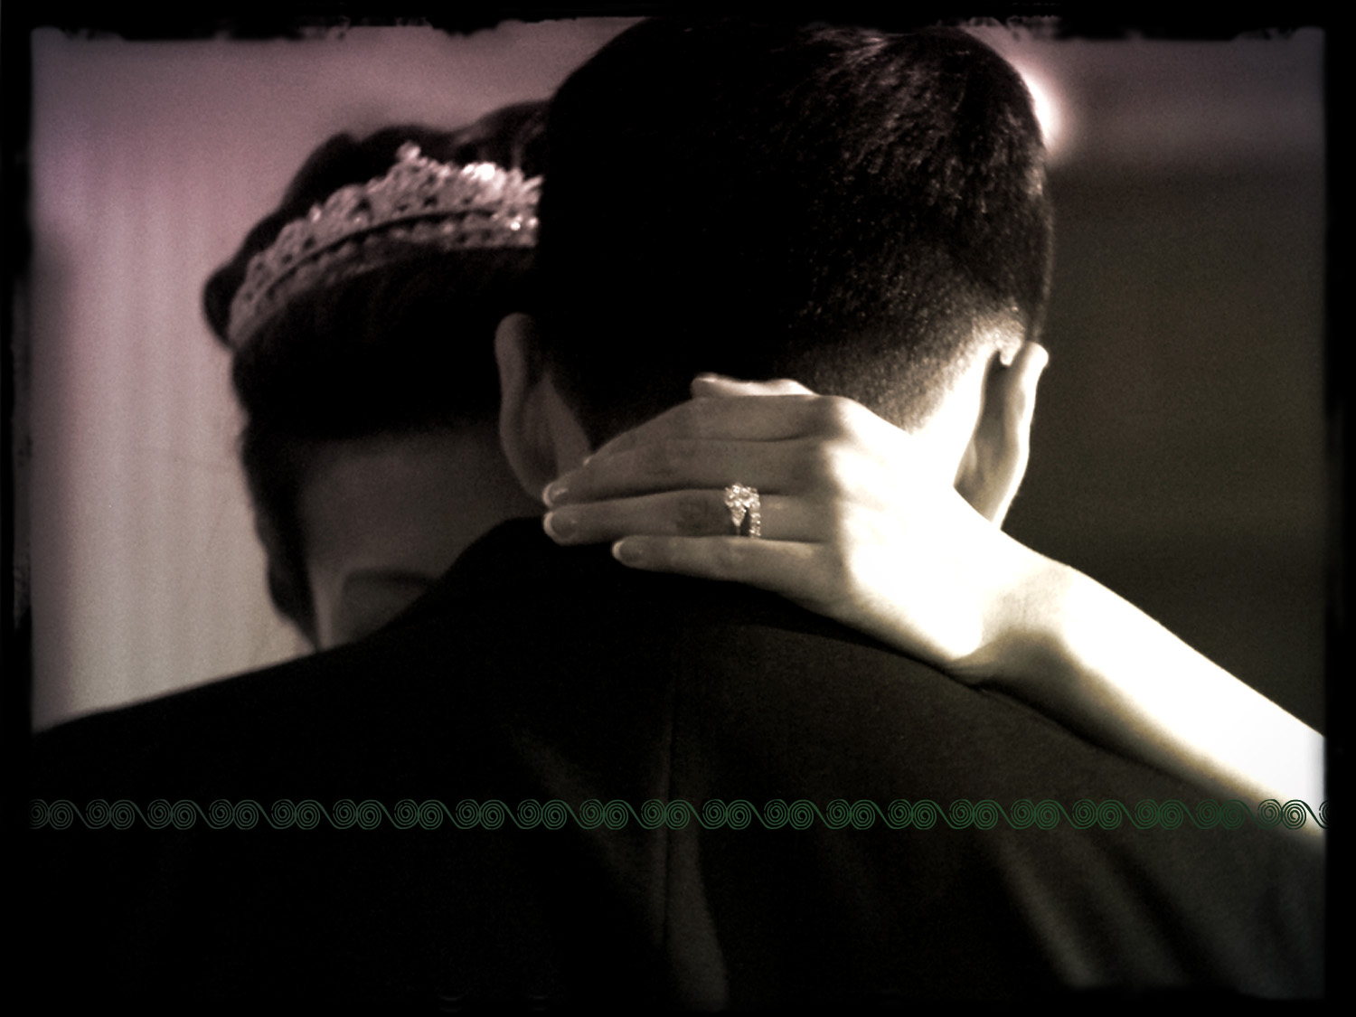
God’s Wedding Vows
THE VOWS: Love Neighbor (Mt 22:37ff)

Slide 19

God’s Wedding Vows
THE VOWS: Love Neighbor (Mt 22:37ff)
  Honor Parents – God respects others
  Honor Spouse – God keeps His word
  No murder – God made life
  No Stealing – God is giving
  No Lying – God cannot lie
  No Coveting – God meets our needs
Notes:
Why did Israel need to be committed to God and share His values!

Slide 20
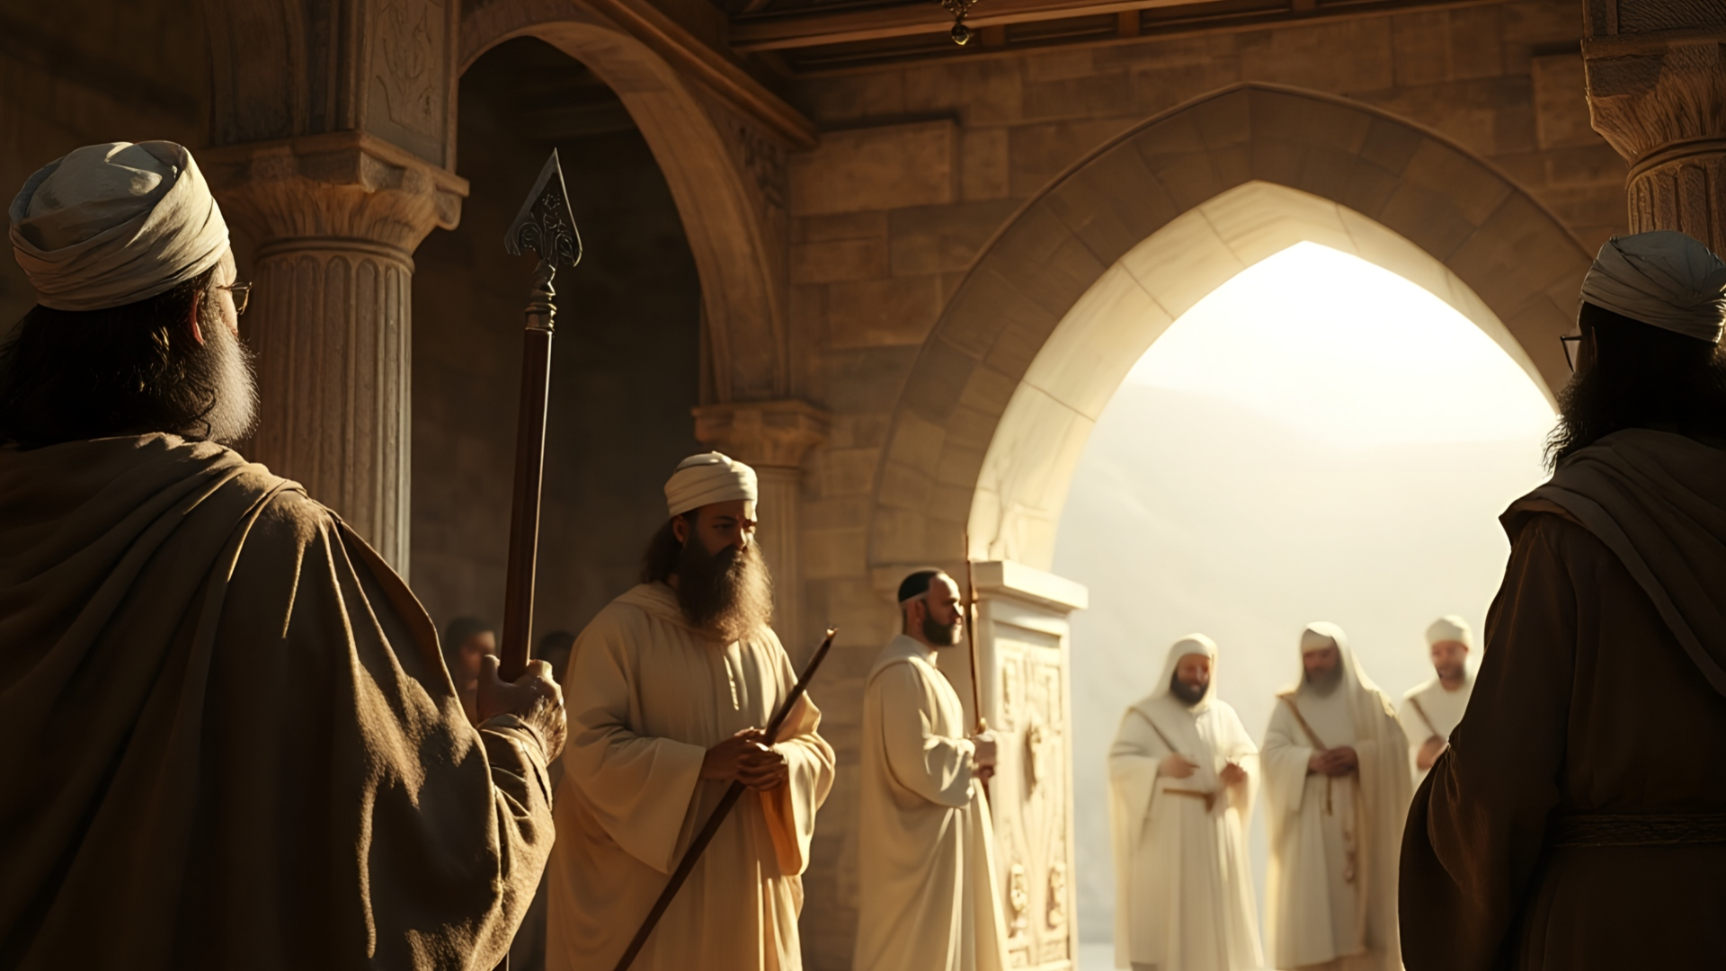
and you shall be to Me a kingdom of priests and a holy nation.' These are the words that you shall speak to the sons of Israel." (Exo 19:6)

Slide 21
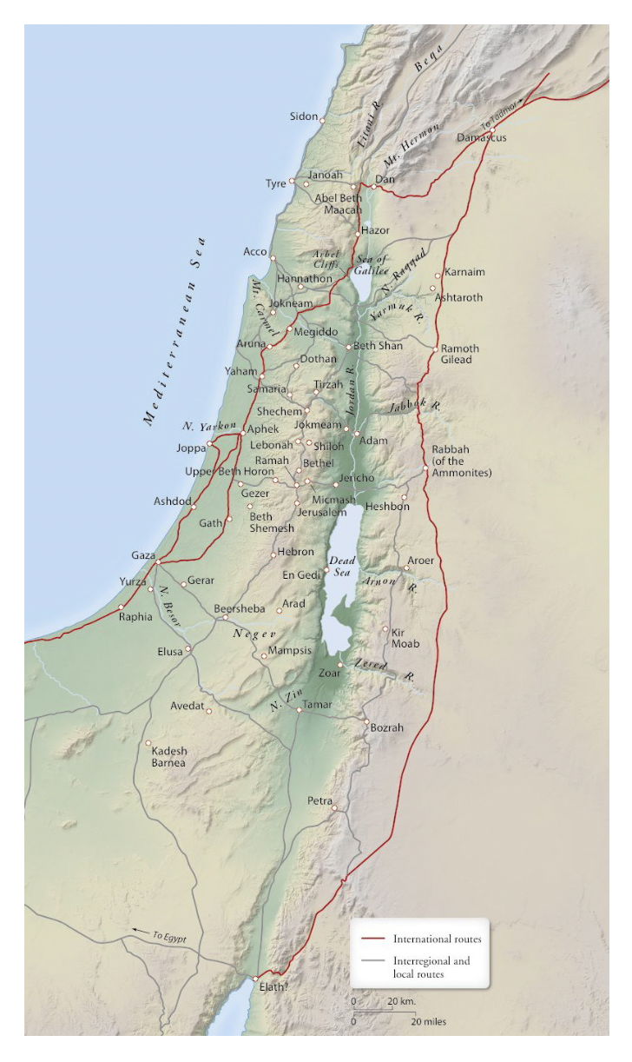
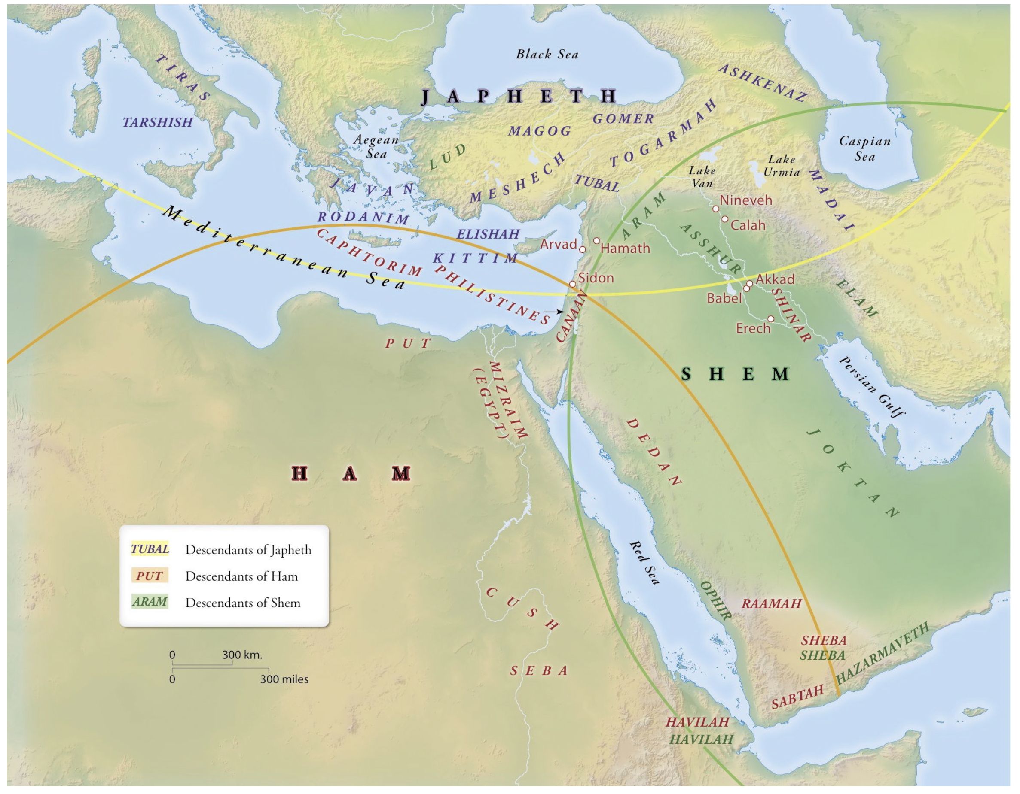

Zondervan Atlas of the Bible

Slide 22
➜
➜
➜
Zondervan Atlas of the Bible

Slide 23
➜
➜
➜
Zondervan Atlas of the Bible

Slide 24
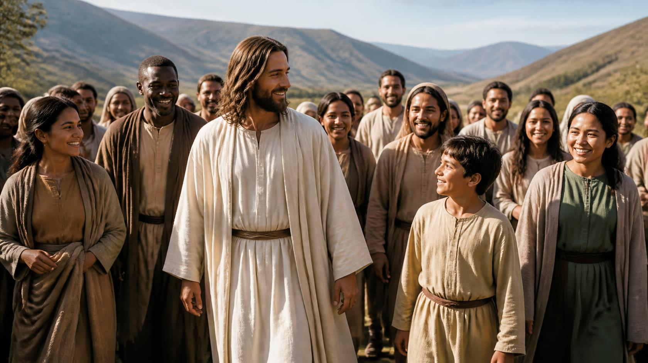
Notes:
Now let us turn our attention to Jesus and walk with Him for a while. We begin our journey at the Ceasarea Philippi at the foot of Hermon mountain range. Jesus asks a question to prompt discussion and to see where the apostles are in their development. It was also a teaching moment. Having asked what the people in general are saying about Him, he next asks what they think about Him. Peter responds, “You are the Christ, the Son of the living God.”

Slide 25
Matt. 16:18 And I tell you, you are Peter, and on this rock I will build my church, and the gates of hell shall not prevail against it (cf. Acts 2:47)
Notes:
Jesus is going to use this statement and a play on the meaning of Peter’s nickname (”stone,” Simon was his birth name) to highlight His purpose in coming to earth. ”I will build my church.” Sometimes the words used in our English Bibles are unfortunate (baptism, gospel, church) because they do not adequately represent the words originally used by the inspired writers of the New Testament. “Church” comes from a word that means “assembly, gathering, congregation, or community” (depending on the context). Jesus came to build a community, a community of the saved (cf. Acts 2:47).
Matt. 16:15 He said to them, “But who do you say that I am?” ¹⁶ Simon Peter replied, “You are the Christ, the Son of the living God.” ¹⁷ And Jesus answered him, “Blessed are you, Simon Bar-Jonah! For flesh and blood has not revealed this to you, but my Father who is in heaven. ¹⁸ And I tell you, you are Peter, and on this rock I will build my church, and the gates of hell shall not prevail against it. ¹⁹ I will give you the keys of the kingdom of heaven, and whatever you bind on earth shall be bound in heaven, and whatever you loose on earth shall be loosed in heaven.”

Slide 26

SALVATION - John 3:16 – “For God so loved the world, that He gave His only begotten Son, that whoever believes in Him shall not perish, but have eternal life.”
SANCTIFICATION - Romans 8:29 – “For those whom He foreknew, He also predestined to become conformed to the image of His Son, so that He would be the firstborn among many brethren.”
Notes:
This is consistent with what John 3:16 tells us about God’s purpose in sending Jesus. Yet, God does not seek to merely save us, he wants us to be sanctified. He wants us to become like Jesus.

Slide 27
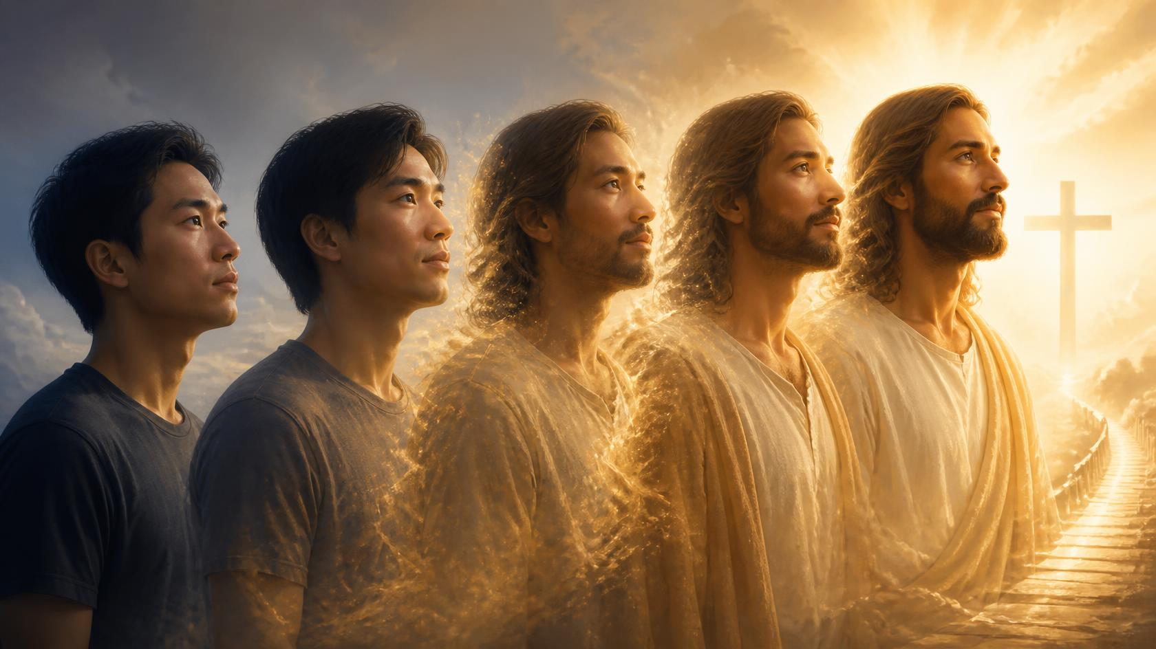
2 Cor. 3:18 But we all, with unveiled face, beholding as in a mirror the glory of the Lord, are being transformed into the same image from glory to glory, just as from the Lord, the Spirit.
Ephesians 4:15 But speaking the truth in love, we are to grow up in all aspects into Him who is the head, even Christ,
Notes:
The Community of Christ, the People of God are to be shaped into the image of Christ.

Slide 28
Notes:
We are to think like him, talk like him, act like him. His mission should be our mission. Why is it so important that we be so committed to God and become like Jesus?

Slide 29

Notes:
PURPOSE: To warn Christians about false teachers and to exhort them to grow in their faith in and knowledge of Christ
ORIGINAL AUDIENCE: The church at large
DATE WRITTEN: Approximately A.D. 67, three years after 1 Peter was written, possibly from Rome
SETTING: Peter knew that his time on earth was limited (1:13, 14), so he wrote about what was on his heart, warning believers of what would happen when he was gone—especially about the presence of false teachers. He reminded his readers of the unchanging truth of the gospel.
KEY VERSE: “By his divine power, God has given us everything we need for living a godly life. We have received all of this by coming to know him, the one who called us to himself by means of his marvelous glory and excellence” (1:3). [Life Application Study Bible, Introduction to 2 Peter]

Slide 30
1 Peter 2:9 But you are A CHOSEN RACE, A royal PRIESTHOOD, A HOLY NATION, A PEOPLE FOR God’s OWN POSSESSION, so that you may proclaim the excellencies of Him who has called you out of darkness into His marvelous light;

Slide 31
1 Peter 2:9 But you are A CHOSEN RACE, A royal PRIESTHOOD, A HOLY NATION, A PEOPLE FOR God’s OWN POSSESSION, so that you may proclaim the excellencies of Him who has called you out of darkness into His marvelous light;

Slide 32

The Great Commission
And Jesus came up and spoke to them, saying, “All authority has been given to Me in heaven and on earth. Go therefore and make disciples of all the nations, baptizing them in the name of the Father and the Son and the Holy Spirit, teaching them to observe all that I commanded you; and lo, I am with you always, even to the end of the age” (Matthew 28:18-20).
Notes:
μαθητεύω (s. μαθητής) (4x in NT) 1 aor. ἐμαθήτευσα, pass. ἐμαθητεύθην.
1. to be a pupil, with implication of being an adherent of the teacher
2. to cause one to be a pupil, teach, Mt 28:19. ἱκανούς make a number of disciples Ac 14:21. Abs. ἃ μαθητεύον
μαθητής; mathētēs, mathētou, ho (manthanō) (261x in NT)
1. one who engages in learning through instruction from another, pupil, apprentice (in contrast to the teacher 2. one who is rather constantly associated with someone who has a pedagogical reputation or a particular set of views, disciple, adherent (BDAG).
Found only in Matthew through Acts.

Slide 33
The Means of the Mission
And Jesus came up and spoke to them, saying, “All authority has been given to Me in heaven and on earth. Go[ing] therefore and make disciples of all the nations, baptizing them in the name of the Father and the Son and the Holy Spirit, teaching them to observe all that I commanded you; and lo, I am with you always, even to the end of the age” (Matt 28:18-20).

Slide 34

“It is not so much the case that God has a mission for his church in the world, as that God has a church for his mission in the world. Mission was not made for the church; the church was made for mission – God’s mission.”
Christopher J.H. Wright, The Mission of God's People: A Biblical Theology of the Church’s Mission
Notes:
God wants a community of the saved and the sanctified who can add people too His people, His community.

Slide 35
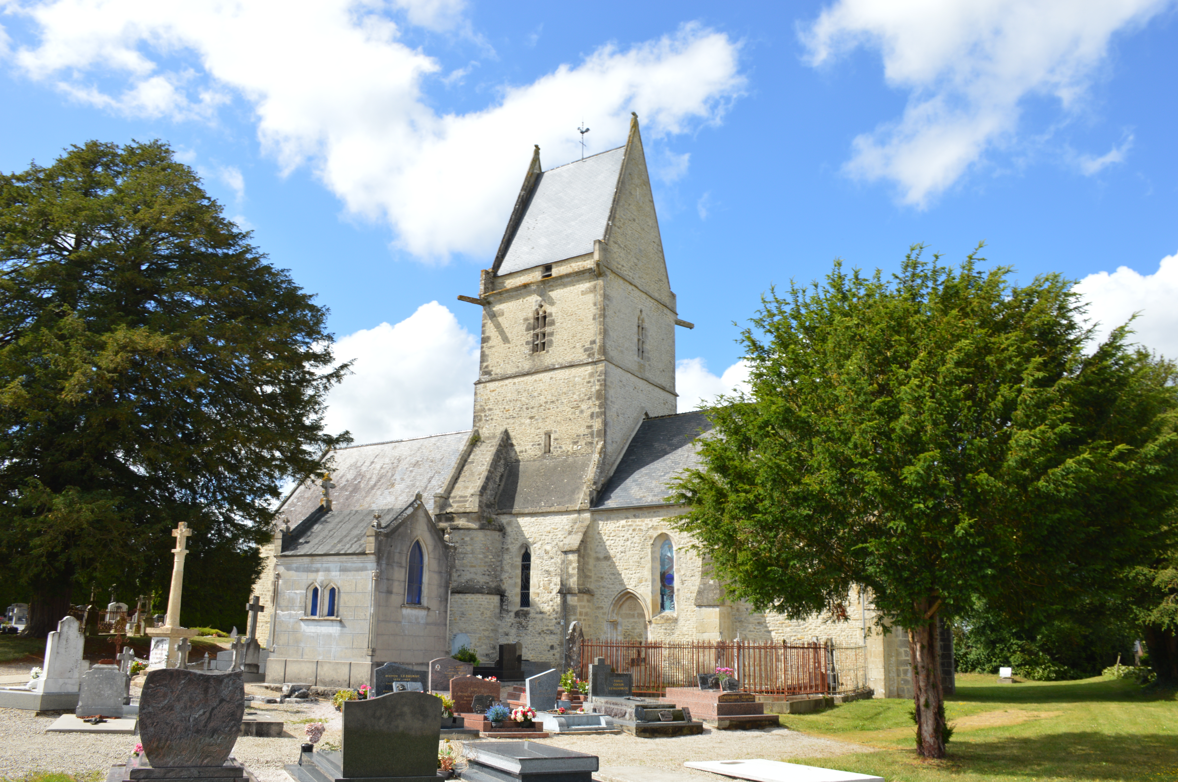
Notes:
Church in France where two medics from the 101st airborne set up a hospital.

Slide 36
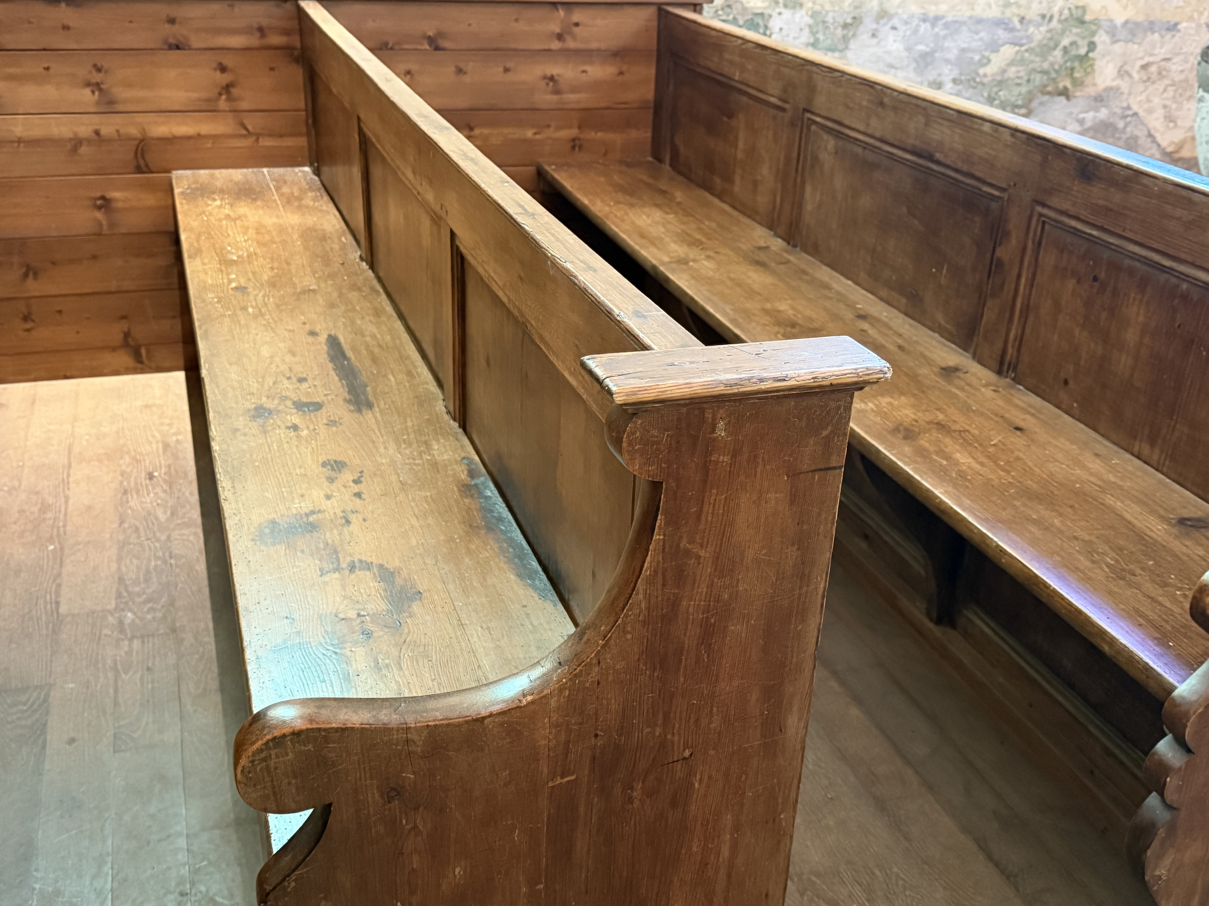
Notes:
Those are blood stains.

Slide 37
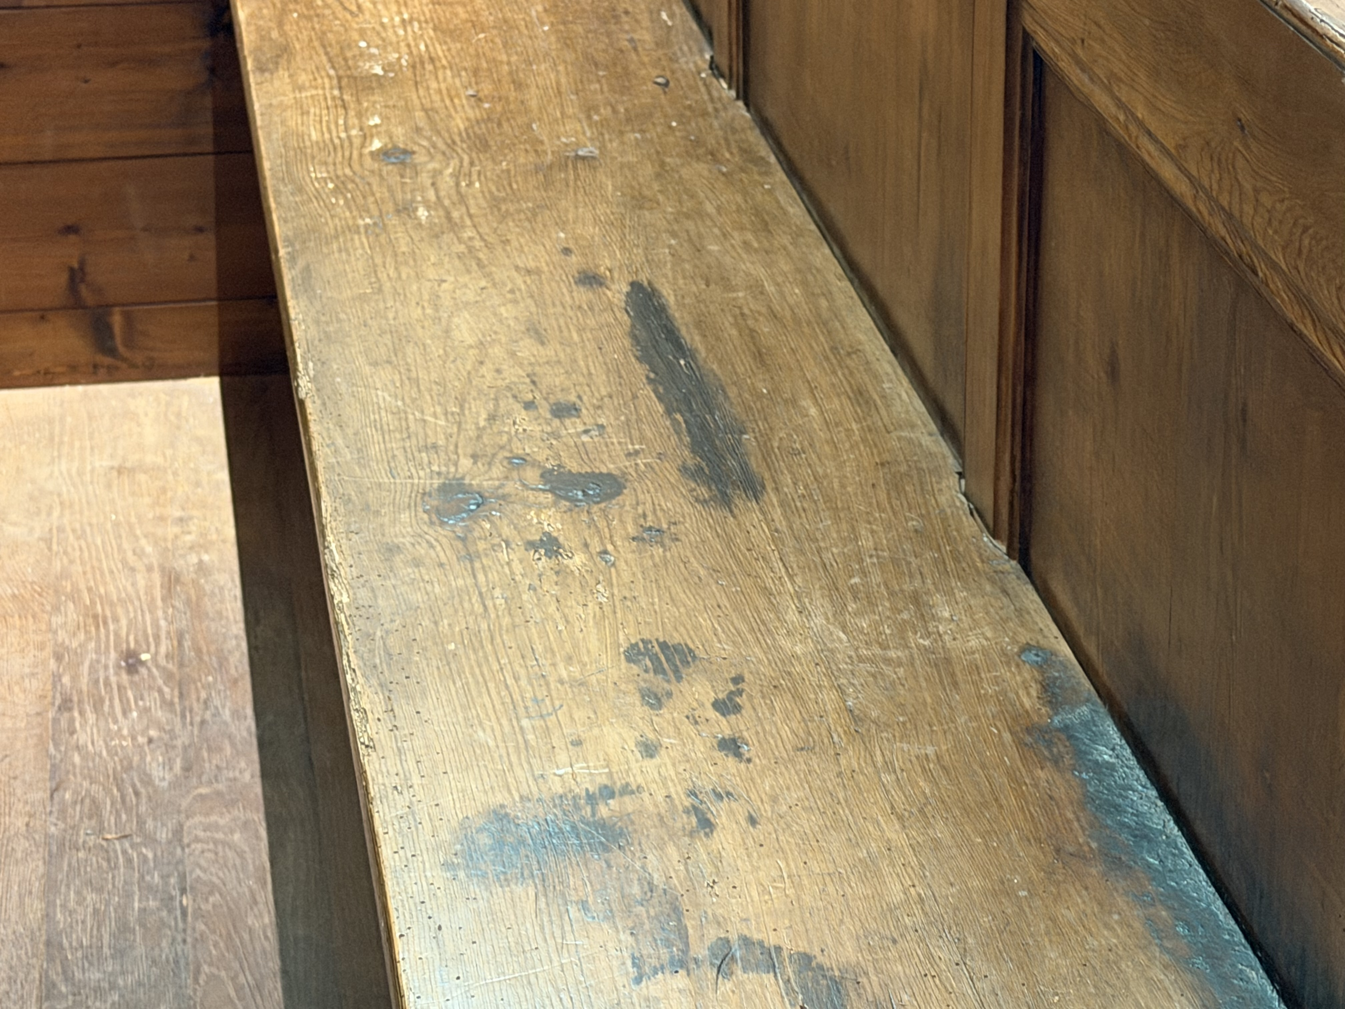
Notes:
Have we forgotten that we are in a spiritual war? We did not join a country club. We joined and army. My dad used to say, “Son, it’s a war out there and the devil never takes a day off.” (cf. Eph 6:10-13).

Slide 38
Notes:
Our job is to bring people to Jesus. Have we forgotten our purpose?

Slide 39

Notes:
Are we hiding our identity?

Slide 40
Recovering the Weight of Being Called…
People of God

Slide 41
It is time to embrace our true identity!
People of God

