Slide 1



Slide 2


Slide 3
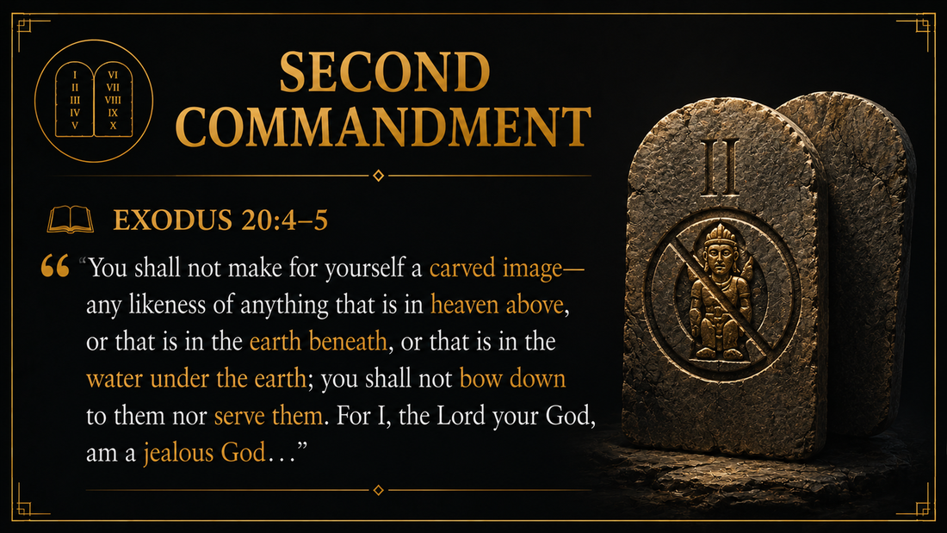

Slide 4


Slide 5


Slide 6
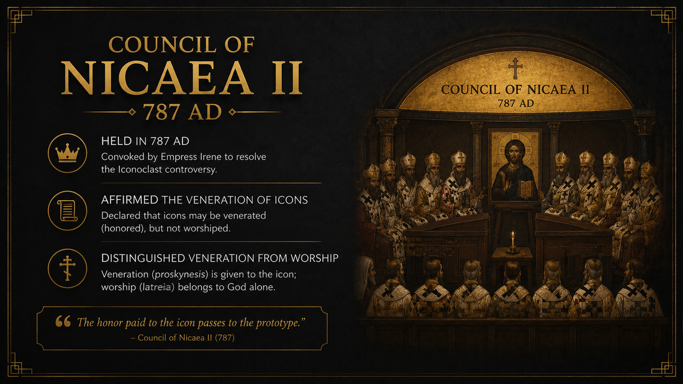

Slide 7
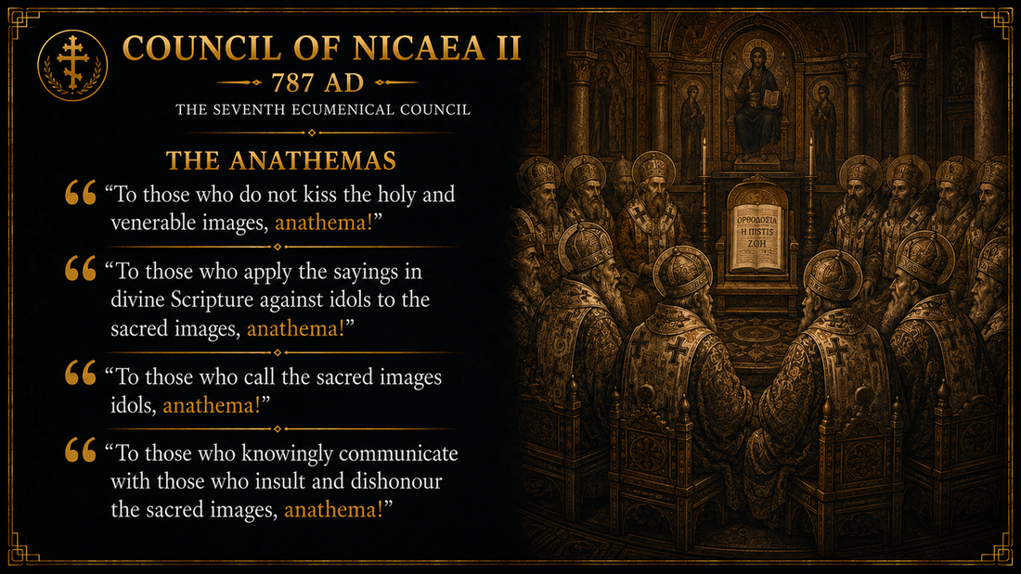

Slide 8
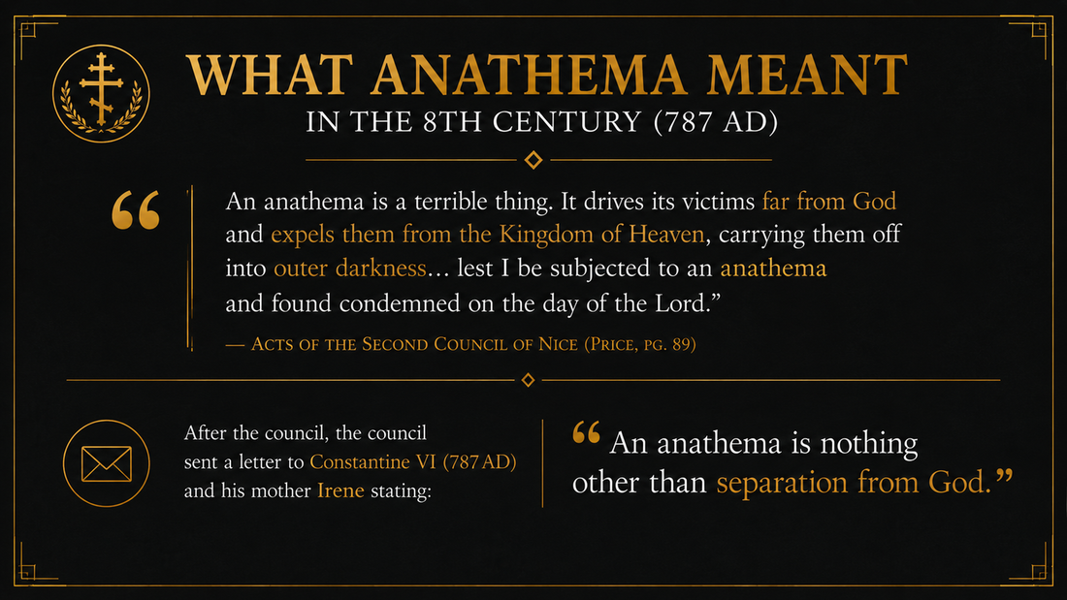

Slide 9


Slide 10
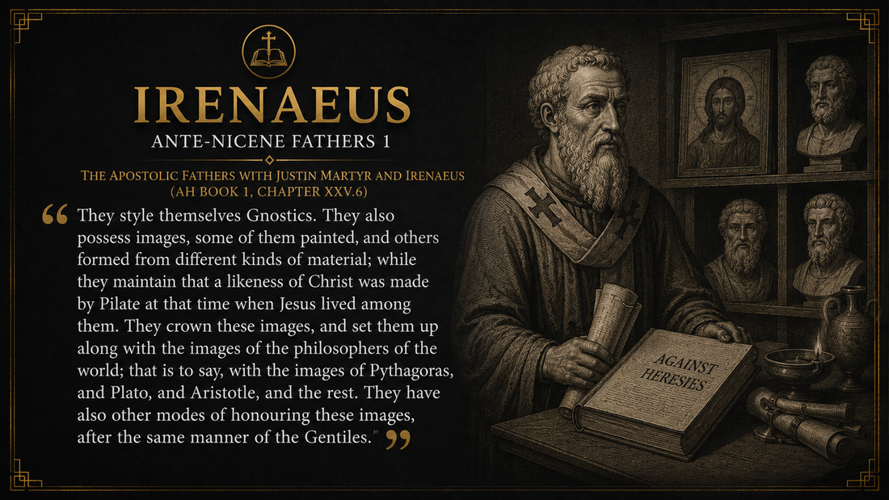

Slide 11
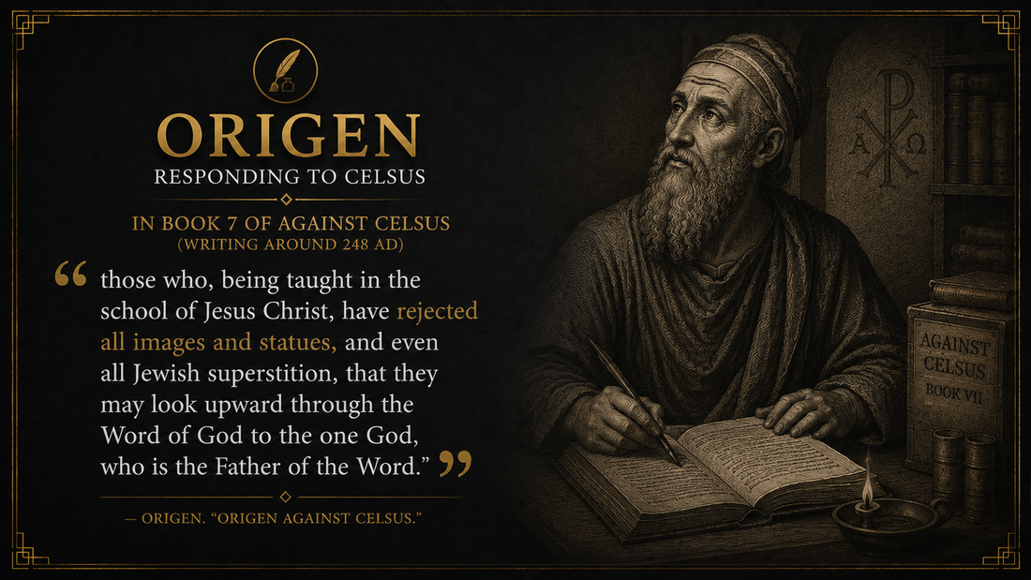

Slide 12
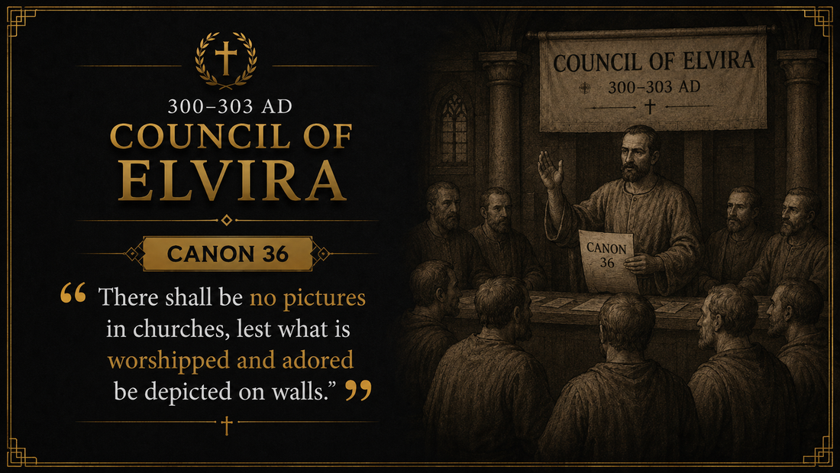

Slide 13


Slide 14
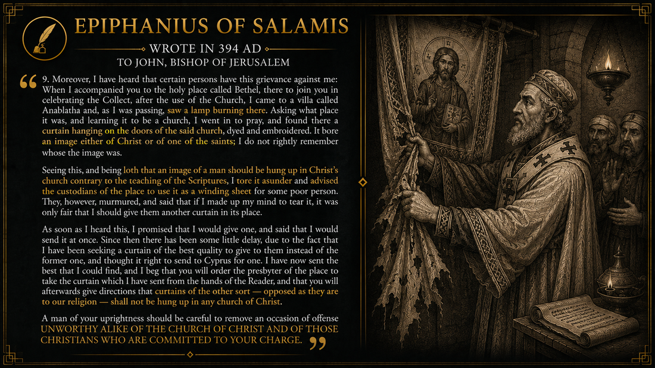

Slide 15
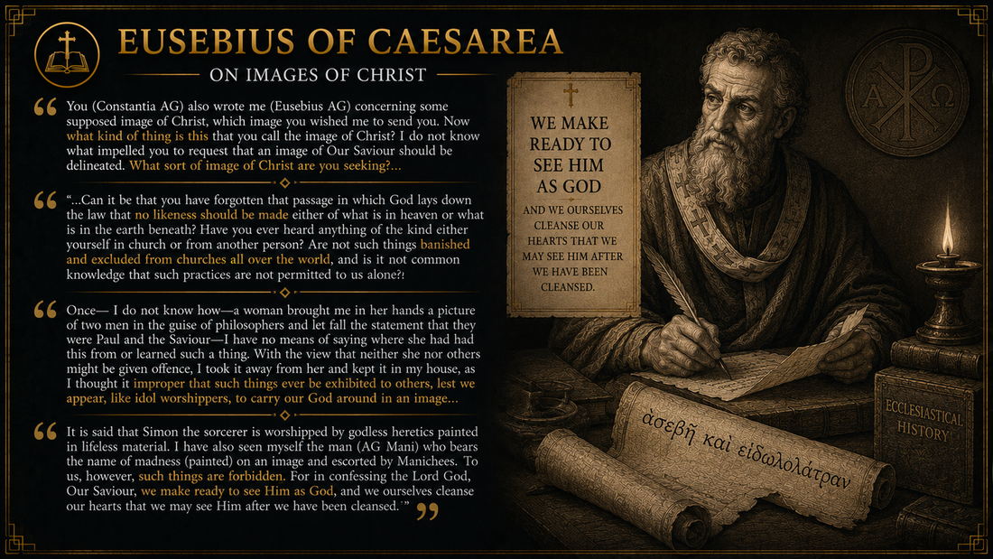

Slide 16


Slide 17


Slide 18


Slide 19


Slide 20


Slide 21


Slide 22
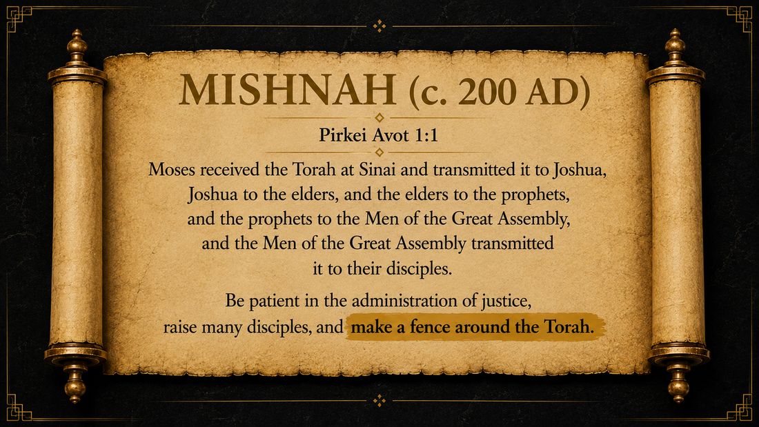

Slide 23


Slide 24
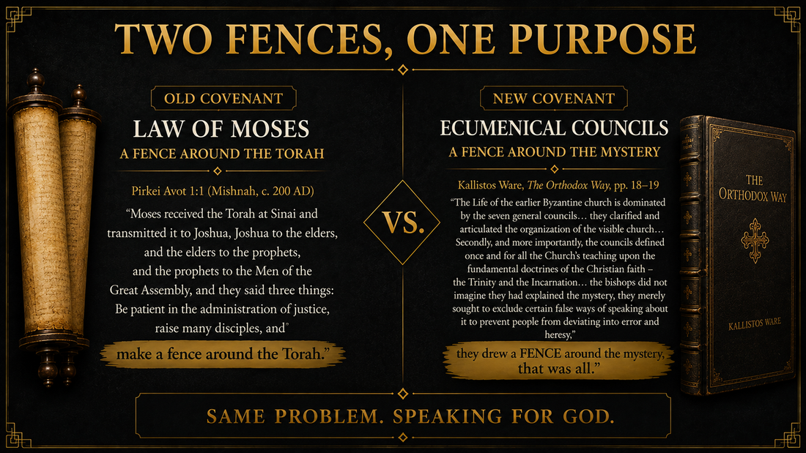

Slide 25


Slide 26
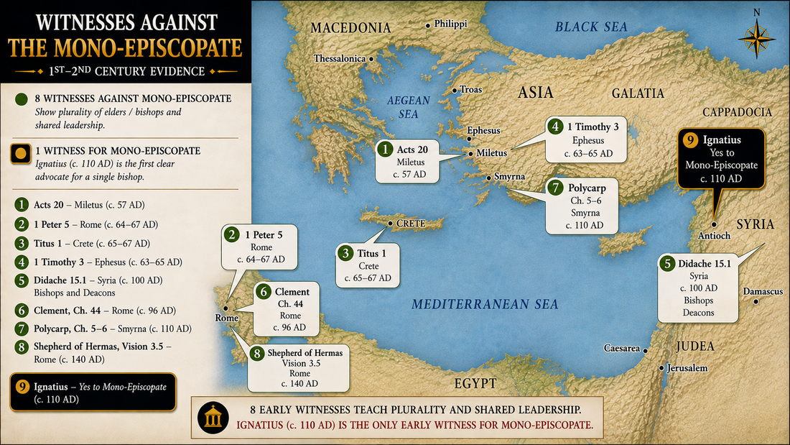

Slide 27


Slide 28


Slide 29


Slide 30
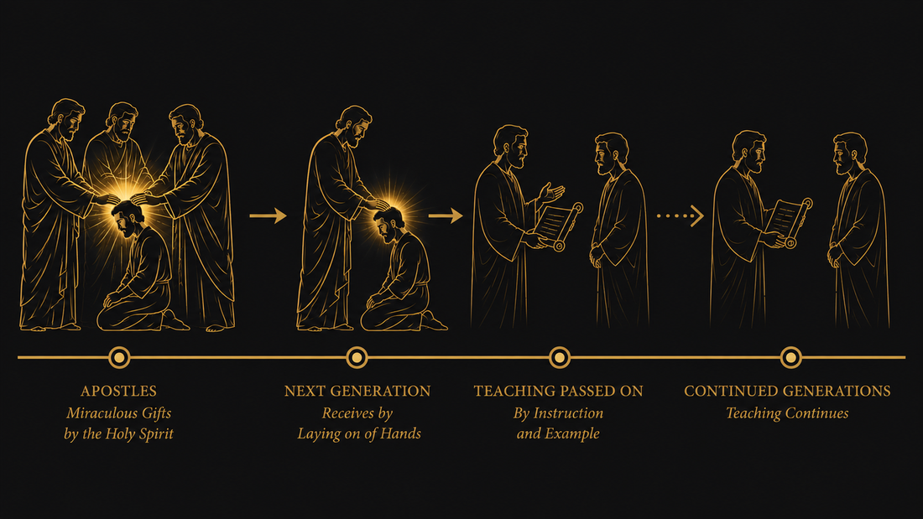

Slide 31
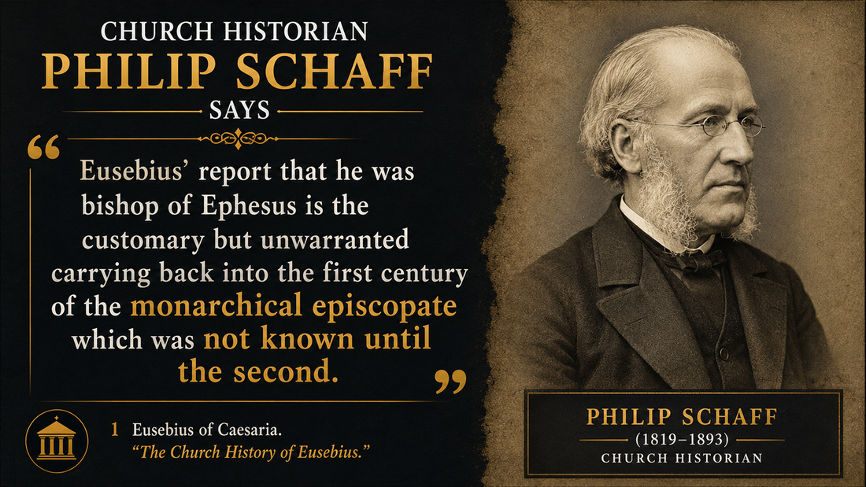

Slide 32


Slide 33
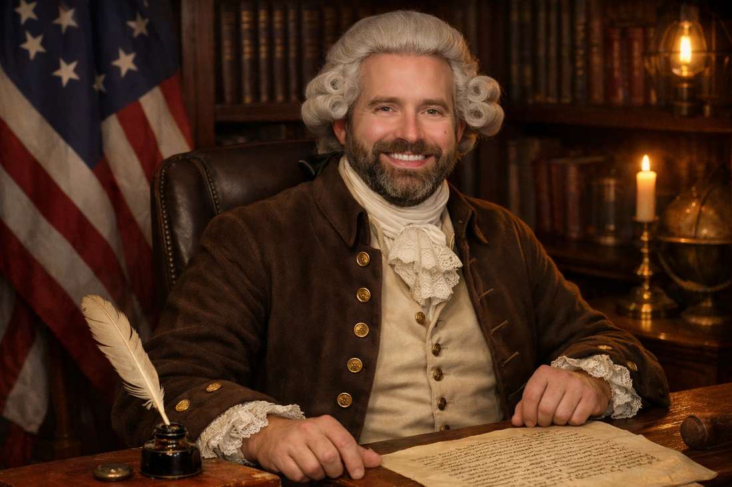

New Testament
1776
Eusebius
2025
Historical Timeline
250 Years
250 Years
Notes:
Help put this in perspective
Did you know the time between 1 Timothy and Eusebius is approximately 250 years (1775).
That is the same time between today and the Declaration of Independence.
How much has changed between Declaration of Independence and today?
Alex is an attorney, I bet he has strong opinions about how the different supreme court justices interpret Constitution and the Bill of Rights written in the 1780’s.
1 Timothy to Eusebius is the same timeframe as the Founding fathers to us today

Slide 34
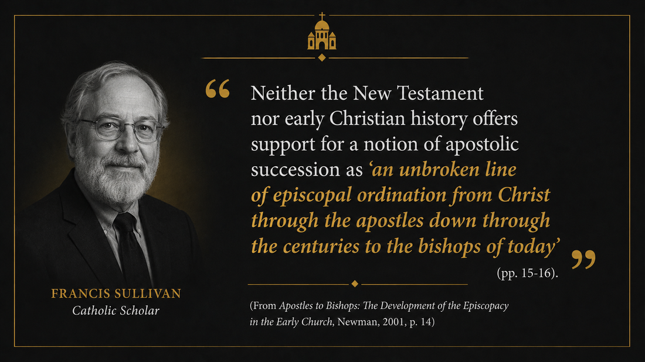

Slide 35
