Slide 2

Are Christianity & Islam Compatible?
Dave Miller

Slide 3
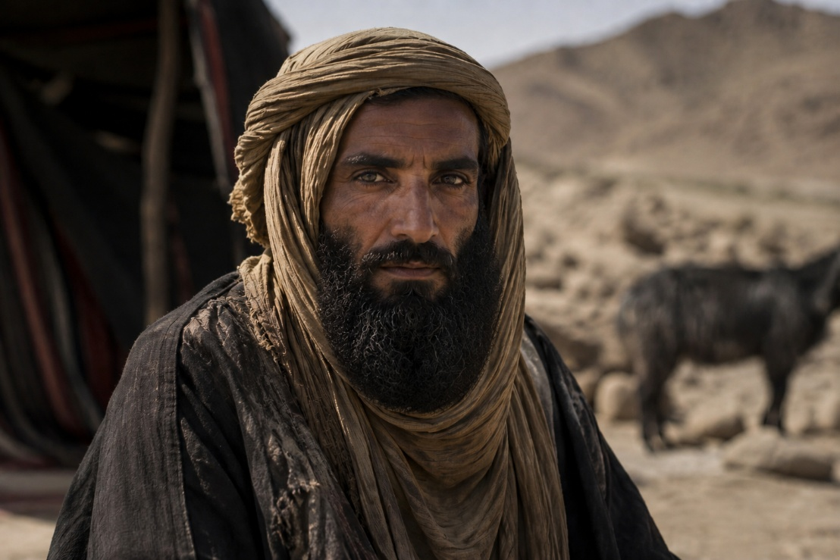
Layout of Our Study...

Life of Muhammad
& Basic Tenets
of Islam

Is the Quran Inspired?

Are Christianity
& Islam Compatible?
Typical 7th Century Bedouin

Slide 4
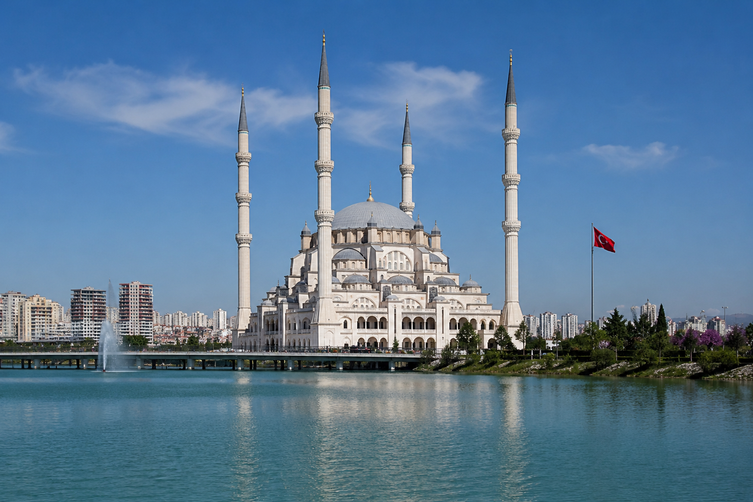
May Christians
& Muslims
Agree?

Slide 5
#1 Conflict
The
DEITY & Person
of
Christ

Slide 6
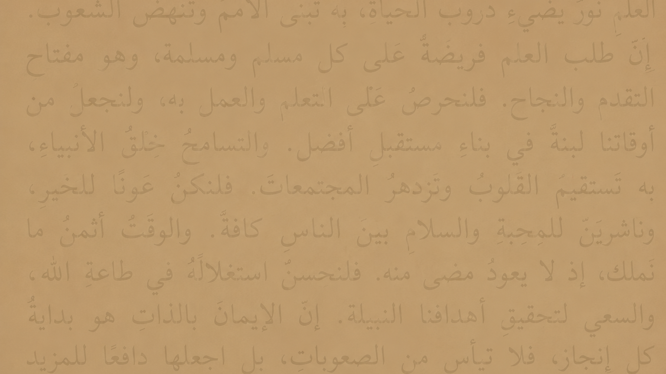
The Quran teaches…
☑
Jesus is not the Son of God!

Slide 7
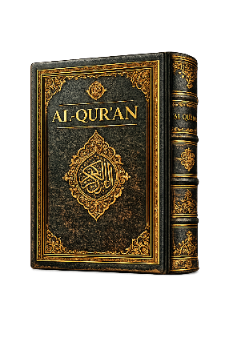
Jews and/or Christians
“Say: O People of the Scripture!
Come to an agreement between us and you: that we shall worship none but Allah, and that we shall ascribe no partner unto Him, and that none of us shall take others for lords beside Allah.”
Surah 3:64

Slide 8
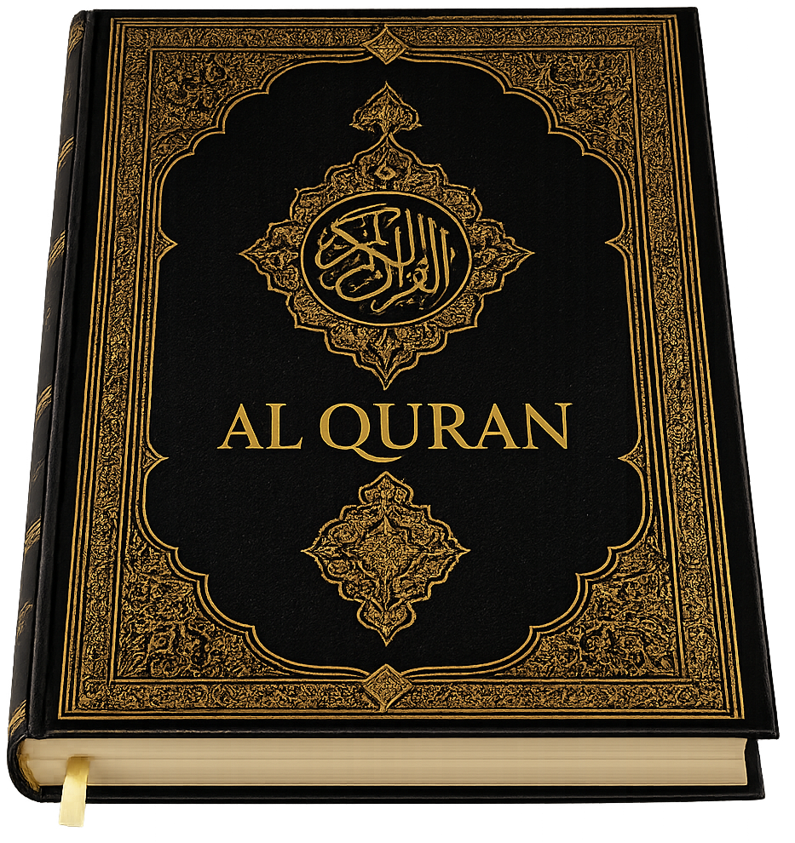
Surah 18:1-5
“Praise be to Allah, Who hath sent to His Servant the Book…that he may warn (the godless) of a terrible punishment from Him…that He may warn those (also) who say, ‘Allah hath begotten a son’: No knowledge have they of such a thing, nor had their fathers. It is a grievous thing that issues from their mouths as a saying. What they say is nothing but falsehood.”

Slide 9
“Christ, the son of Mary, was no more than a Messenger; many were the Messengers that passed away before him. His mother was a mother of truth.” Surah 5:75
“She never claimed that she was a mother of God, or that her son was God. She was a pious and virtuous woman.”
Abdullah Yusuf Ali

Slide 10
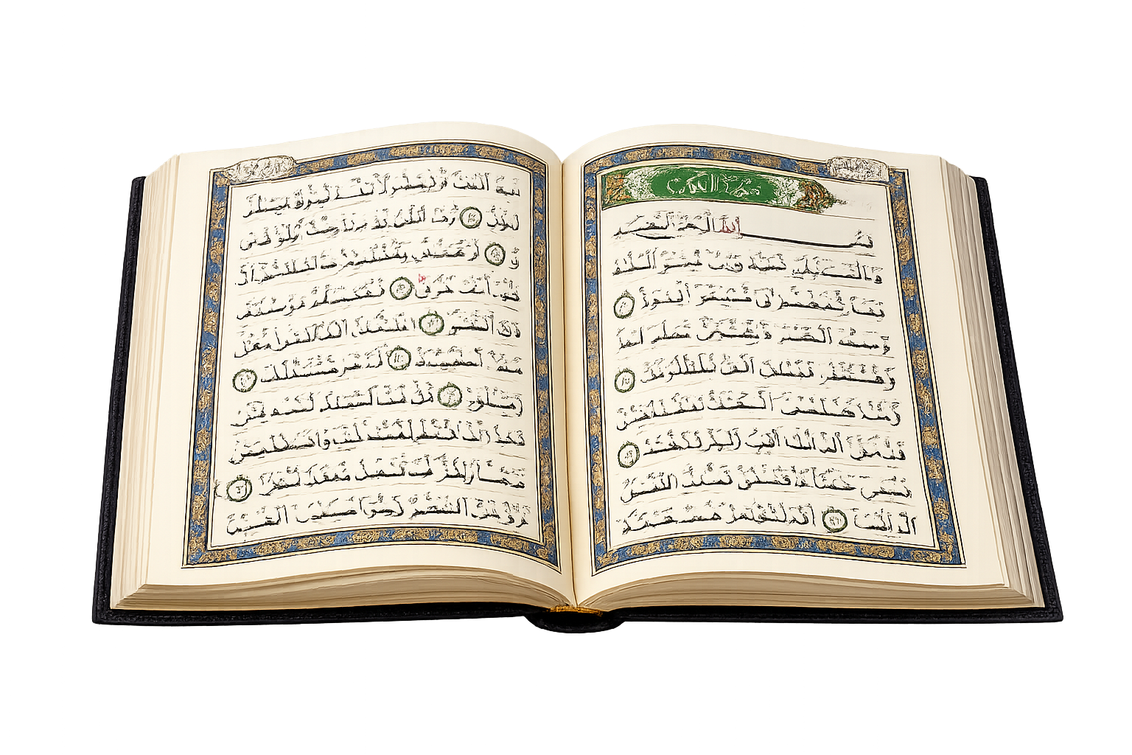
“And they say: The Beneficent hath taken unto Himself a son. Assuredly ye utter a disastrous thing, whereby almost the heavens are torn, and the earth is split asunder and the mountains fall in ruins, that ye ascribe unto the Beneficent a son, when it is not meet for (the Majesty of) the Beneficent that He should choose a son. There is none in the heavens and the earth but cometh unto the Beneficient as a slave.” Surah 19:88-93

Slide 11
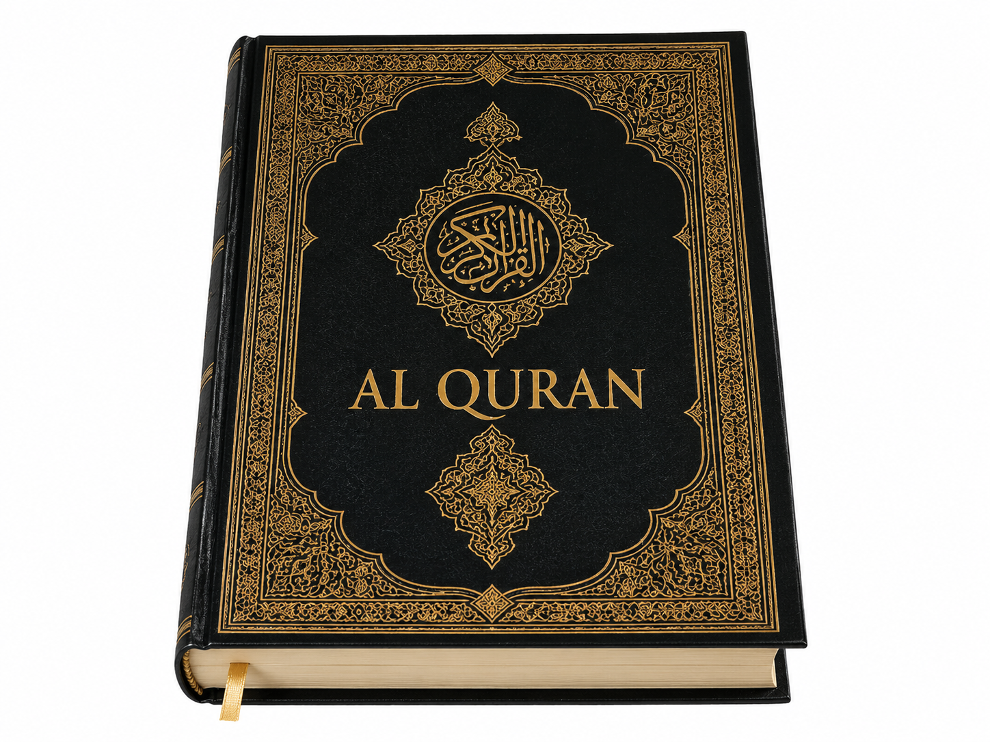
“And the Jews say: Ezra is the son of Allah, and the Christians say: The Messiah is the son of Allah. That is their saying with their mouths. They imitate the saying of those who disbelieved of old. Allah (Himself) fighteth against them. How perverse are they! They have taken as lords beside Allah their rabbis and their monks and the Messiah son of Mary, when they were bidden to worship only One God. There is no God save Him.”
Surah 9:30-31

Slide 12
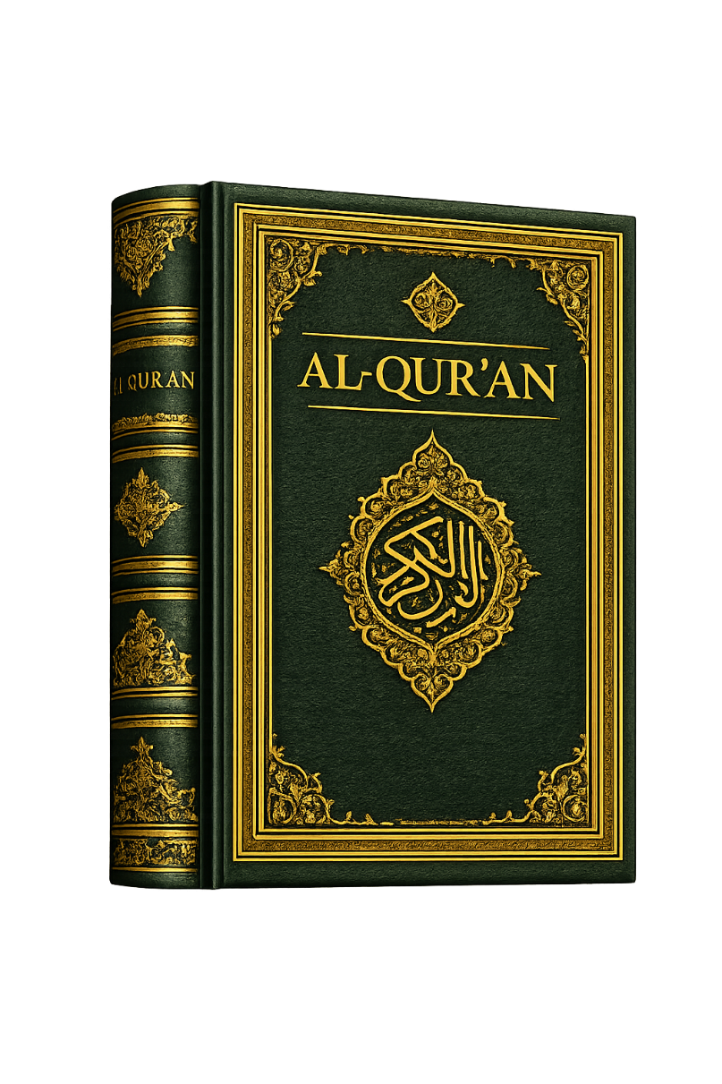
Surah 25:2
“He unto Whom belongeth the sovereignty of the heavens and the earth, He hath chosen no
son nor hath He any partner in the sovereignty. He hath created everything and hath meted out for it a measure.”

Slide 13
Surah 6:102-103
“The Originator of the heavens and the earth! How can He have a child, when there is for Him no
consort, when He created all things and is aware of all things? Such is Allah, your Lord. There is no God save Him, the Creator of all things, so worship Him.”

Slide 14
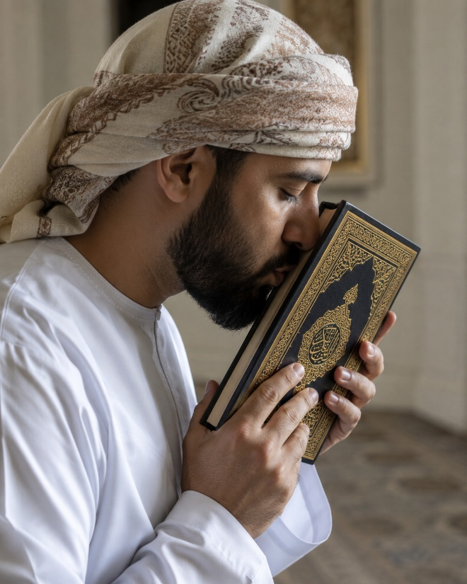
[Pickthall’s Translation]
Surah 5:72
“They surely disbelieve who say: Lo! Allah is the Messiah, son of Mary. The Messiah (himself) said: O Children of Israel, worship Allah,
my Lord and your Lord. Lo! whoso ascribeth partners unto Allah, for him Allah hath forbid-den Paradise. His abode is the Fire. For evil‑
doers there will be no helpers.”

Slide 15
[Ali’s Translation]
Surah 5:72
“They do blaspheme who say: ‘(Allah) is Christ the son of Mary.’ But said Christ: ‘O Children of Israel! worship Allah, my Lord and your Lord.’
Whoever joins other gods with Allah, Allah will forbid him the Garden, and the Fire will be his abode. There will for the wrong-doers be no one to help.”

Slide 16
[Muhammad Sarwar’s Translation]
Surah 5:72
“Those who say that Jesus, the son of Mary, is Allah, have, in fact, turned to disbelief. Jesus said to the Israelites, ‘Worship Allah, my Lord
and yours. Allah will deprive of paradise anyone who considers anything equal to Allah,
and his dwelling will be fire. The unjust people have no helpers.”

Slide 17
In stark contrast, the Bible
affirms concerning Christ....
Colossians 1:15-17; 2:9
He is “the image of the invisible God.”
“By Him all things were created.”
“All things were created through Him and for Him.”
“He is before all things.”
“In Him all things consist.”
“In Him dwells all the fullness
          of the Godhead bodily.”

Slide 18
In stark contrast, the Bible
affirms concerning Christ....
He is “the image of God.”
2 Corinthians 4:4
He is “the brightness of His (God’s) glory and the express image of His person.”
                Hebrews 1:3
He “upholds all things by the word of His power.” Hebrews 1:3

Slide 19
In stark contrast, the Bible
affirms concerning Christ....
“[Jesus] said to them, ‘But who do you say that I am?’ Simon Peter answered and said, ‘You are the Christ, the Son of the living God.’ Jesus answered and said to him, ‘Blessed are you, Simon Bar-Jonah, for flesh and blood has not revealed this to you, but My Father who is in heaven.’”
Matthew 16:15-17
.”

Slide 20
In stark contrast, the Bible
affirms concerning Christ....
“Therefore let all the house of Israel know assuredly that God has made this Jesus, whom you crucified, both Lord and Christ.”
Acts 2:36
.”

Slide 21

In stark contrast, the Bible
affirms concerning Christ....
“who, being in the form of God, did not consider it robbery to be equal with God…. Therefore God also has highly exalted Him and given Him the name which is above every name, that at the name of Jesus every knee should bow…and that every tongue should confess that Jesus Christ is Lord, to the glory of God the Father.”
Philippians 2:6-11

Slide 22
In stark contrast, the Bible
affirms concerning Christ....
“The Jews answered Him, saying, ‘For a good work we do not stone You, but for blasphemy, and because You, being a Man, make Yourself God.’”
John 10:33

Slide 23
In stark contrast, the Bible
affirms concerning Christ....
“And now, O Father, glorify Me together with Yourself, with the glory which I had with You before the world was.
John 17:5

Slide 24
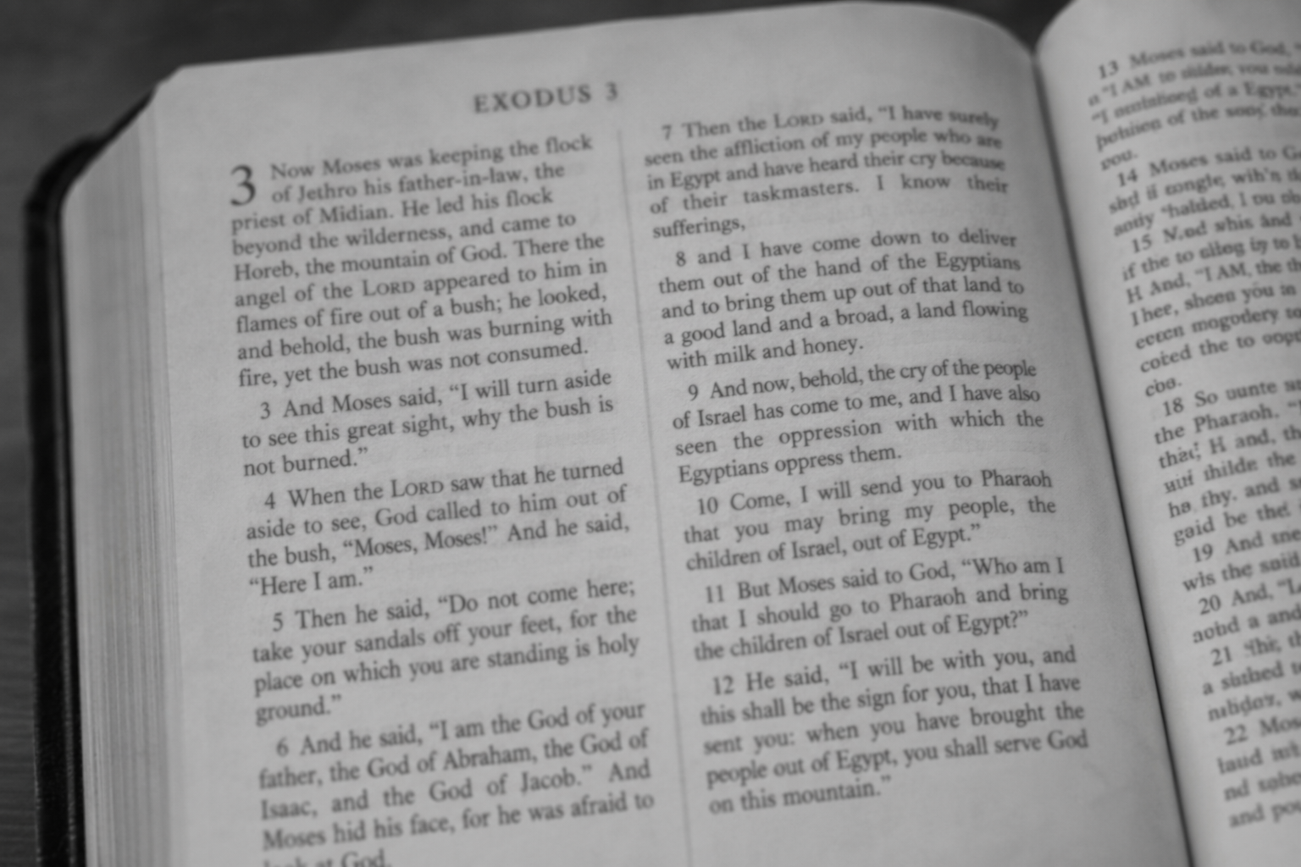
“I AM”
Exodus 3:1-14
(cf. Revelation 1:8; 4:8; Hebrews 13:8)

Slide 25
'Egwv eijmi
7 “I AMs” of John
“I who speak to you am” (4:26)
“I am do not be afraid” (6:20)
“you do not believe that I am” (8:24)
“you will know that I am” (8:28)
“Before Abraham was, I am” (8:58)
“You may believe that I am” (13:19)
“when He said to them, ‘I am,’ they drew
back and fell to the ground” (18:5-6,8)

Slide 26
“Whoever transgresses and does not abide in the doctrine of Christ does not have God. He who abides in the doctrine of Christ has both the Father and the Son.” 2 John 9
“He who believes in the Son has everlasting life; and he who does not believe the Son shall not see life, but the wrath of God abides on him.”
  John 3:36
“But when the fullness of the time had come, God sent forth His Son….”
Galatians 4:4

Slide 27
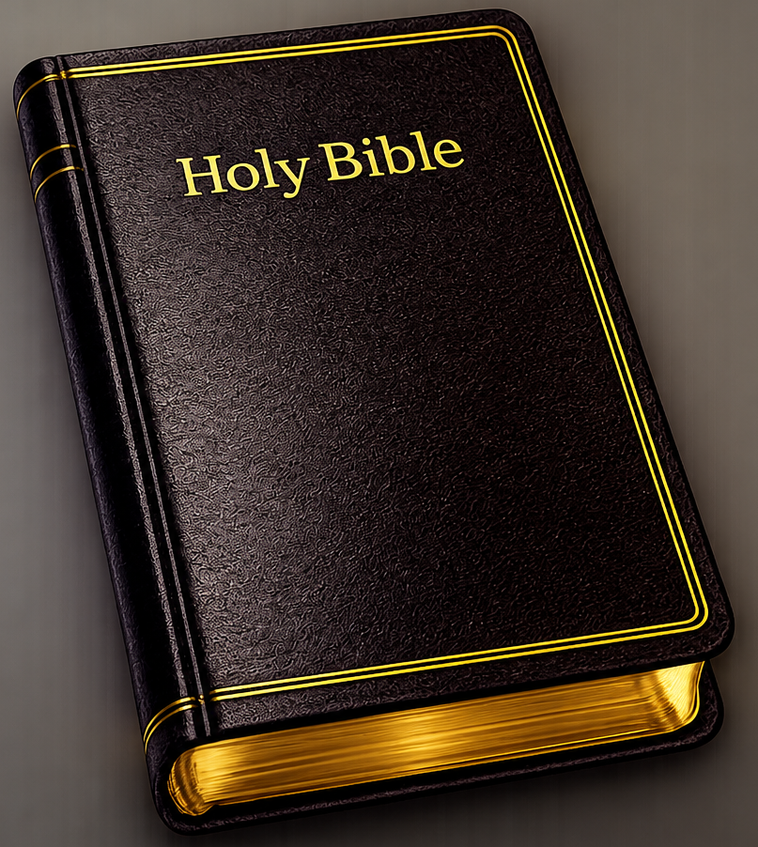
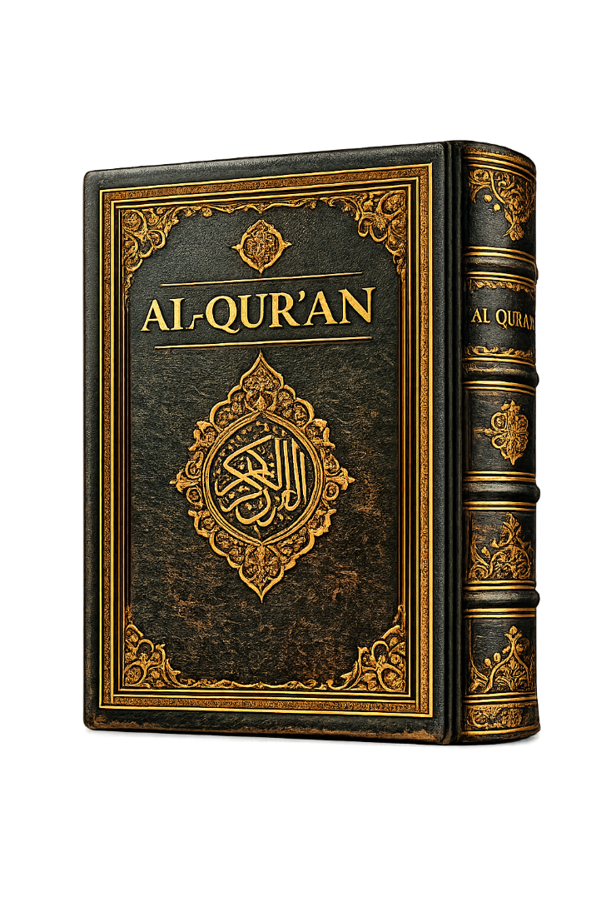


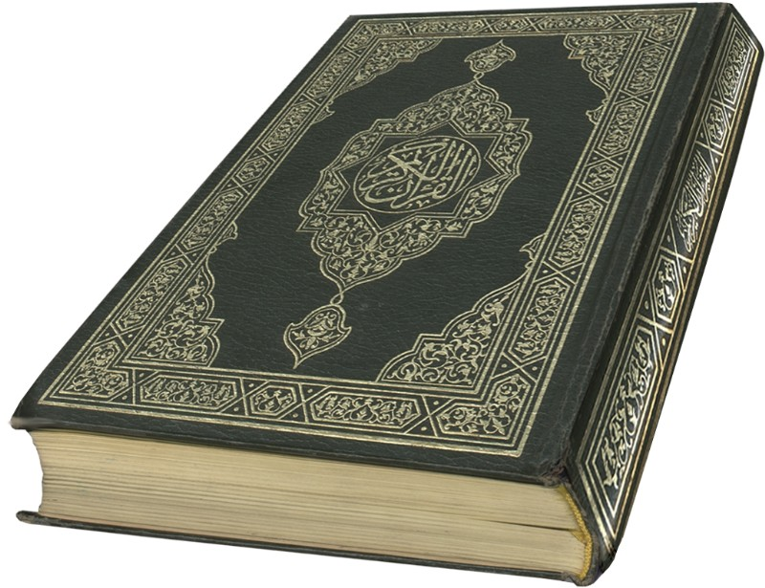
UNRESOLVABLE
CONFLICT

Slide 28
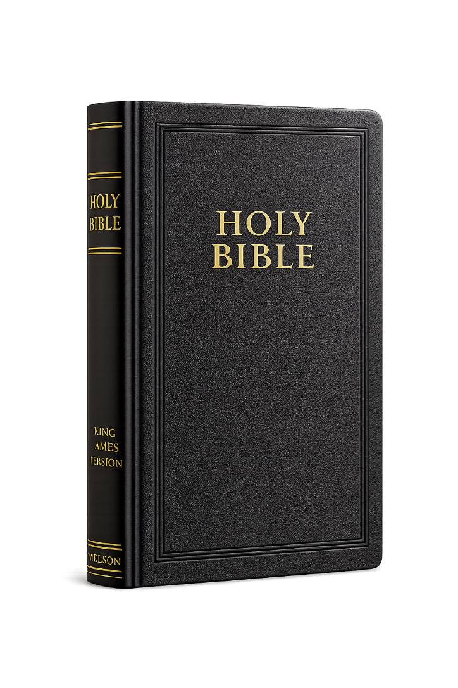
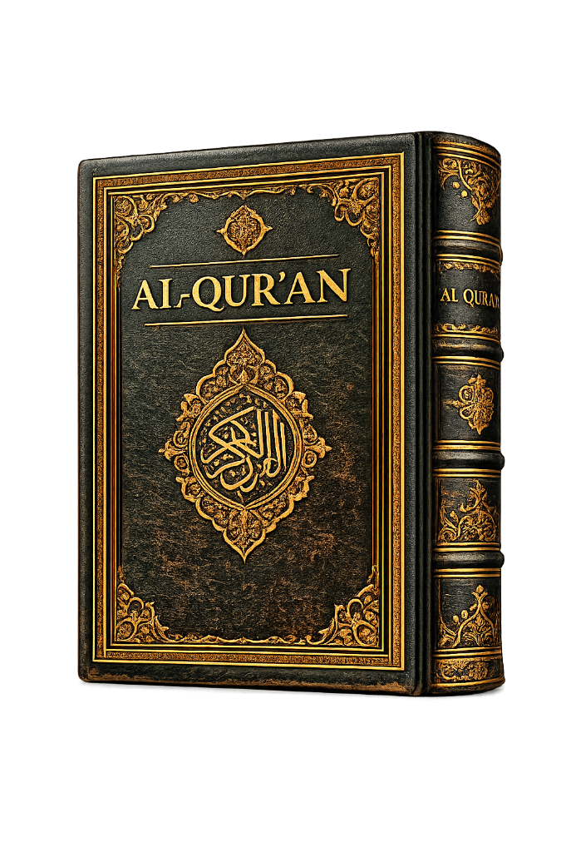
“Who is a liar but he who denies that Jesus is the Christ? ...Whoever denies the Son does not have the Father either.” 1 John 2:22-23
“This is My beloved Son, in whom I am well pleased. Hear Him!”
Matthew 17:5
If you do NOT believe that Jesus is the Son of God, you will be lost eternally in hell.
Jesus said:
“Unless you believe
that I AM, you will
die in your sins.”
John 8:24
“Those who say: Allah hath chosen a son speak nothing but a lie.”
Surah 18:4-5
“Allah hath not chosen any son, nor is there any God along with Him.”
Surah 23:91
If you believe that Jesus is the Son of God, you will be lost eternally in hell!

Slide 29
The Quran teaches…
☑
Jesus is not the Son of God!
☑
Jesus was not crucified!

Slide 30
“And because of their saying: We slew the Messiah Jesus son of Mary, Allah’s messenger—They slew him not nor crucified, but it appeared so unto them; and lo! those who disagree concerning it are in doubt thereof; they have no knowledge thereof save pursuit of a conjecture; they slew him not for certain, but Allah took him up unto Himself. Allah was ever Mighty, Wise.”
Surah 4:157-158

Slide 31
The Quran teaches…
☑
Jesus is not the Son of God!
☑
Jesus was not crucified!
☑
No need for blood atonement!

Slide 32
“And lo! unto each thy Lord will verily repay his works in full. Lo! He is informed of what they do. So tread thou the straight path as thou art commanded, and those who turn (unto Allah) with thee, and transgress not. Lo! He is Seer of what ye do…. Establish worship at the two ends of the day and in some watches of the night. Lo! good deeds annul ill deeds. This is a reminder for the mindful. And have patience, (O Muhammad), for lo! Allah loseth not the wages of the good.” Surah 11:111-112,114-115

Slide 33
“Those are they from whom We accept the best of what they do, and overlook their evil deeds. (They are) among the owners of the Garden. This is the true promise which they were promised (in the world).” Surah 46:16
This is why terrorists believe they earn a ticket straight to Paradise when they die fighting for Allah—even though they have deliberately engaged in immorality.

Slide 34
Many N.T. passages state the necessity of blood atonement to forgive sin:
Hebrews 9:12-14,22
“without shedding of blood there is no remission.”
1 Peter 1:19
Redeemed “with the precious blood of Christ, as of a lamb without blemish and without spot.”
Without blood—
no forgiveness!

Slide 35
The Quran teaches…
☑
Jesus is not the Son of God!
☑
Jesus was not crucified!
☑
No need for blood atonement!
☑
No Trinity!

Slide 36
“O People of the Scripture! Do not exaggerate in your religion nor utter aught concerning Allah save the truth. The Messiah, Jesus son of Mary, was only a messenger of Allah, and His word which He conveyed unto Mary, and a spirit from Him. So believe in Allah and His messengers, and say not ‘Three’—Cease! (it is) better for you!—Allah is only One God. Far is it removed from His transcendant majesty that he should have a son. His is all that is in the heavens and all that is in the earth. And Allah is sufficient as Defender. The Messiah will never scorn to be a slave unto Allah, nor will the favoured angels.” Surah 4:171-172

Slide 37
“Lo! whoso ascribeth partners unto Allah, for him Allah hath forbidden Paradise. His abode is the Fire. For evil doers there will be no helpers. They surely disbelieve who say: Lo! Allah is the third of three; when there is no God save the One God. If they desist not from so saying a painful doom will fall on those of them who disbelieve. Will they not rather turn unto Allah and seek forgiveness of Him? For Allah is Forgiving, Merciful.”
Surah 5:72-74

Slide 38
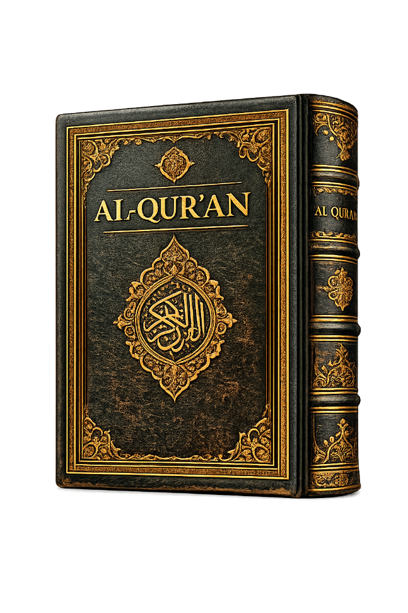
“Say: He is Allah, the One and Only; Allah, the Eternal, Absolute; He begetteth not, nor is He begotten.”
Surah 112:1-3

Slide 39
The Quran teaches…
☑
Jesus is not the Son of God!
☑
Jesus was not crucified!
☑
No need for blood atonement!
☑
No Trinity!

Slide 40
Explicit declarations regarding Christians:
“O ye who believe! take not the Jews and the Christians for your friends and protectors: They are but friends and protectors to each other. And he amongst you that turns to them (for friendship) is of them. Verily Allah guideth not a people unjust.” Surah 5:51, Ali

Slide 41
Explicit declarations regarding Christians:
“Those who reject (Truth), among the People of the Book and among the Polytheists, will be in Hell-Fire, to dwell therein (for aye). They are the worst of creatures.”
Surah 98:6, Ali

Slide 42
Islam & Christianity are in irreparable conflict.
The Quran & the Bible contradict each other.
The Quran teaches...
☹
No Son of God
☹
No Crucifixion
☹
No Trinity
☹
No Blood Atonement

Slide 43
The Suicide of the West
Due to the widespread expulsion of God, the Bible, and Christianity from national life, fomented by the liberal forces of “political correctness, WOKE, and ‘tolerance’,” anti-Christian ideologies (like Islam, Marxism, & Socialism) are encroaching and will hasten the demise of the Republic.

Slide 44
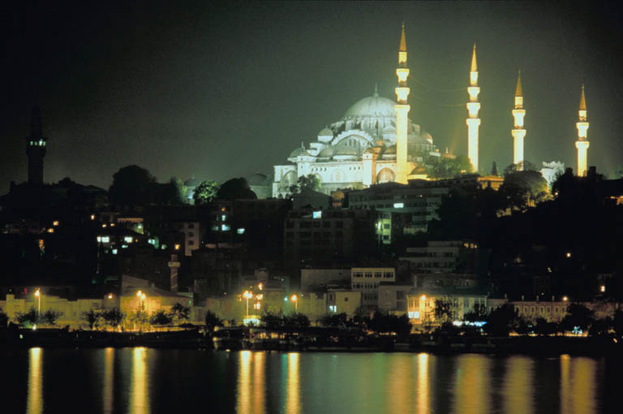
What are we to do?
PRAY AND
EVANGELIZE!

Slide 45
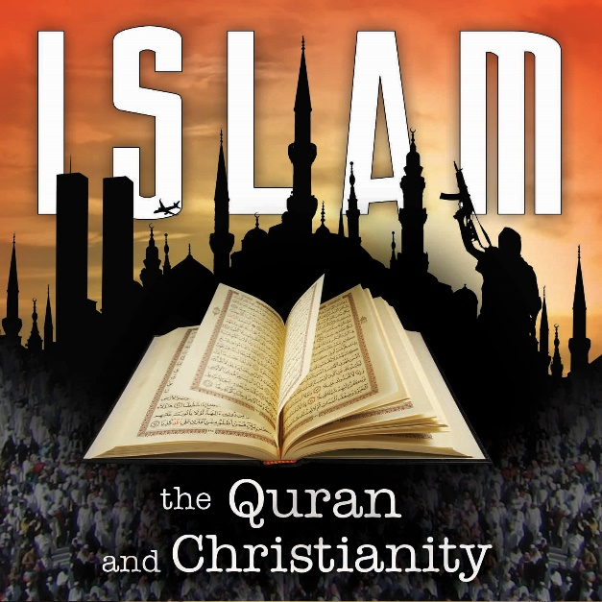
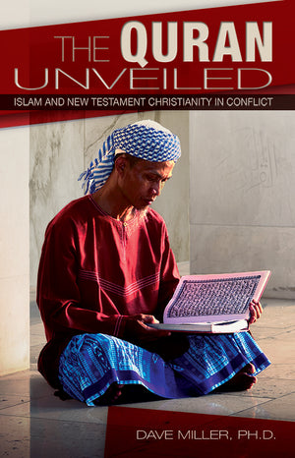
The Entire Islam Seminar
may be viewed for free on the
    AP website
    WVBS website
    GBN website
Free Download
ApologeticsPress.org

