Slide 1

The Ethics of Obedience
When is Submission Righteous and When is it a Sin?
Jon Burnett

Slide 2
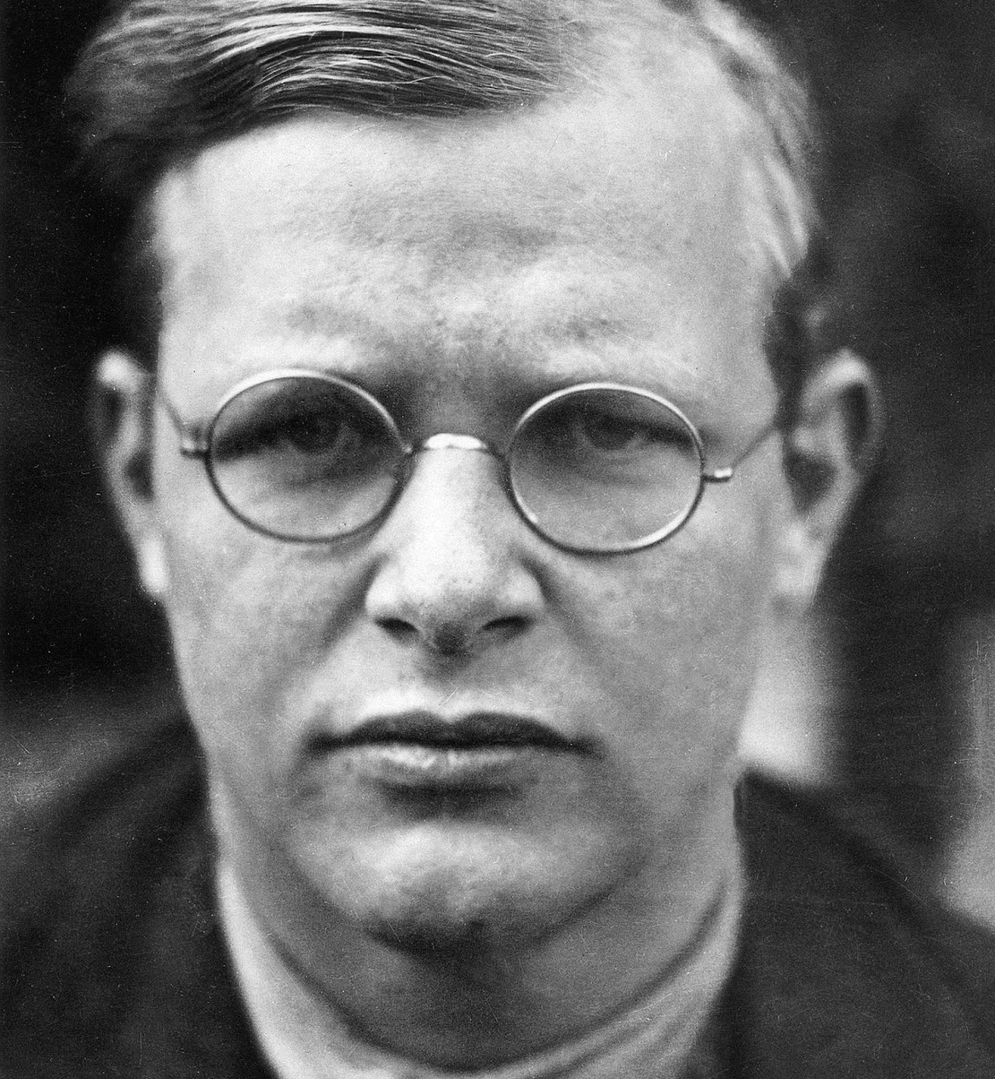
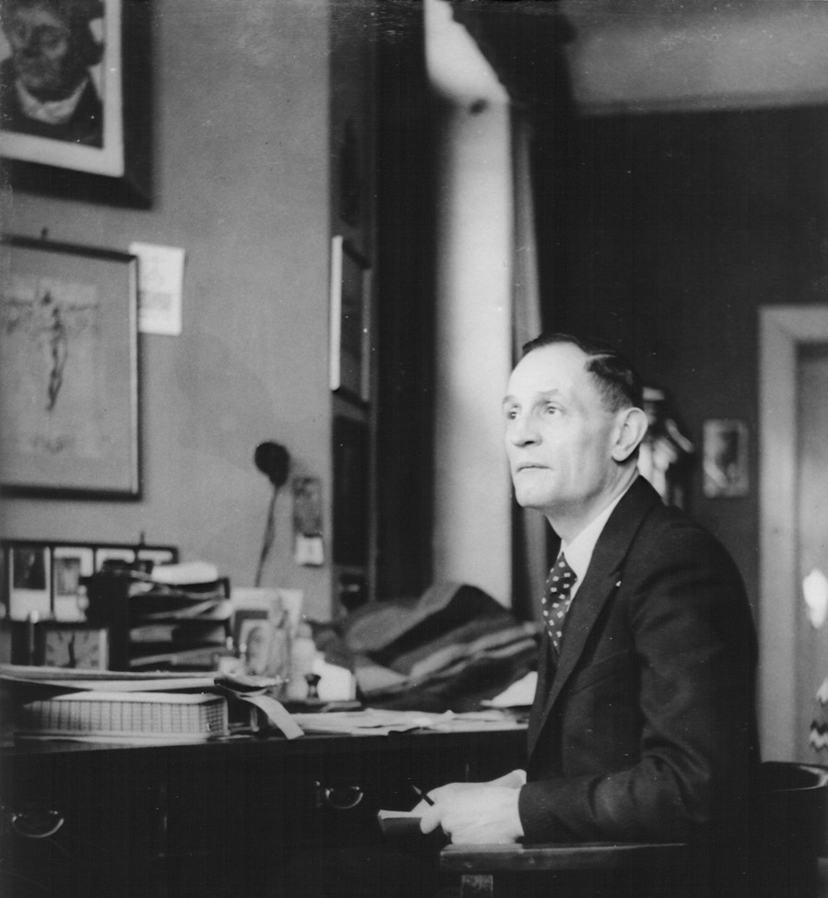
Notes:
First, they came for the socialists, and I did not speak out—because I was not a socialist.
Then they came for the trade unionists, and I did not speak out—because I was not a trade unionist.
Then they came for the Jews, and I did not speak out—because I was not a Jew.
Then they came for me—and there was no one left to speak for me.
—Martin Niemöller

Slide 3

Biblical Ethics in a Nutshell
Love the LORD your God
Deut 6:4–6 // Mark 12:29–30
Love your neighbor
Lev 19:18, 34 // Mark 12:31
Be holy
Lev 19:2 // 1 Pet 1:16
Do not covet
Exod 20:17 // Rom 7:7; see Mark 10:17–22
I desire mercy
Hos 6:6 // Matt 9:13; 12:7

Slide 4
King of Kings, Prince of Peace
Of the increase of his government and of peace there will be no end, on the throne of David and over his kingdom, to establish it and to uphold it with justice and with righteousness from this time forth and forevermore. The zeal of the LORD of hosts will do this. (Isa 9:7 ESV)

Slide 5
Justice & Peace
Unjust Peace | Just Peace
Unjust War | Just War
Greater Peace →
Greater Justice →

Slide 6
Justice & Peace
Unjust Peace | Just Peace
Unjust War | Just War
Greater Peace →
Greater Justice →

Slide 7
Justice & Peace (Ps 146; cf. 9, 82)
Unjust Peace | Just Peace
Unjust War | Just War
Keeps faith forever
Executes justice for the oppressed
Gives food to the hungry
Sets the prisoners free
Opens the eyes of the blind
Lifts those who are bowed down
Loves the righteous
Watches over the sojourners
Upholds the widow and orphan
Brings to ruin the way of the wicked
Greater Peace →
Greater Justice →

Slide 8
Know Justice, Know Peace
Faithful Leaders…
Serve God
  Rom 13:1–2, 4
Seek the good
  Rom 13:3–4
Avenge injustice
  Rom 13:2–4; 12:17–19
For Good Conscience
  Rom 13:5–7

Slide 9
Know Justice, Know Peace
Faithful Leaders…
Faithful Followers…
Serve God
  Rom 13:1–2, 4
Seek the good
  Rom 13:3–4
Avenge injustice
  Rom 13:2–4; 12:17–19
For Good Conscience
  Rom 13:5–7
Pray often
  1 Tim 2:1–2
Live well
  1 Tim 2:2
To Know Christ Jesus
  1 Tim 2:3–6
Speak truth
  1 Tim 2:7; Eph 3:10, 21

Slide 10

No Justice, No Peace (see Rom 2:14–15)
“Those who frame injustice by statute”
(Ps 94:20)
“Woe to those who decree iniquitous decrees, and the writers who write oppression” (Isa 10:1–2)
“The law is paralyzed, and justice never goes forth” (Hab 1:4)
“Woe to him who builds a town with blood and founds a city on iniquity” (Hab 2:12)
“Shall I not punish them for these things … and shall I not avenge myself” (Jer 5:29)?
“Woe to you … for you … have neglected the weightier matters of the law: justice and mercy and faithfulness”
(Matt 23:23)

Slide 11
Unjust Peace → Just Peace
Insiders
Joseph + Pharaoh’s daughter + Young Moses + Old David + Daniel & the Three + Zerubbabel + Ezra + Vashti + Esther + Mordecai + Nehemiah + Nicodemus + Cornelius +
Joseph of Arimathea
Outsiders
Abraham + Shiphrah & Puah + Old Moses + Rahab + the Judges + Young David + the Prophets
+ John the Baptist +
Simon the Zealot + Peter +

Slide 12
Unjust Peace → Just Peace
Outsiders
Abraham + Shiphrah & Puah + Old Moses + Rahab + the Judges + Young David + the Prophets
+ John the Baptist +
Simon the Zealot + Peter +
John (Acts & Rev)
Insiders
Joseph + Pharaoh’s daughter + Young Moses + Old David + Daniel & the Three + Zerubbabel + Ezra + Vashti + Esther + Mordecai + Nehemiah + Nicodemus + Cornelius +
Joseph of Arimathea

Slide 13
Unjust Peace → Just Peace
“So, whatever you wish that others would do to you, do also to them,
for this is the Law and the Prophets” (Matt 7:12; see Mic 6:8).
Outsiders
Abraham + Shiphrah & Puah + Old Moses + Rahab + the Judges + Young David + the Prophets
+ John the Baptist +
Simon the Zealot + Peter +
John (Acts & Rev)
Insiders
Joseph + Pharaoh’s daughter + Young Moses + Old David + Daniel & the Three + Zerubbabel + Ezra + Vashti + Esther + Mordecai + Nehemiah + Nicodemus + Cornelius +
Joseph of Arimathea

Slide 14
The Return of the King
The kingdom of the world has become the kingdom of our Lord and of his Christ, and he shall reign forever and ever. … Just and true are your ways, O King of the nations! … All nations will come and worship you, for your righteous acts have been revealed.
(Rev 11:15; 15:3–4)

Slide 15

Bring Me the Books
Goldingay, John. OT Ethics. IVP, 2019.
Grudem, Wayne. Christian Ethics. Crossway, 2018.
Hays, Richard. The Moral Vision of the NT. HarperCollins, 1996.
Miller, Paul. Ethics of War. B&H, 2025.
Nye, Joseph. Do Morals Matter? Oxford, 2020.
Wright, N. T. & Michael Bird. Jesus & the Powers. Zondervan, 2024.

