Slide 2
Layout
of
Our
Study
Who Was Muhammad
& What is Islam?
Is the Quran the
Word of God?
Are Christianity &
Islam Compatible?

Slide 3
The authenticity of every religion can be established only on the basis of its source of
authority.
Book of
Mormon
Mormonism
Christianity
Bible
Islam
Quran

Slide 4
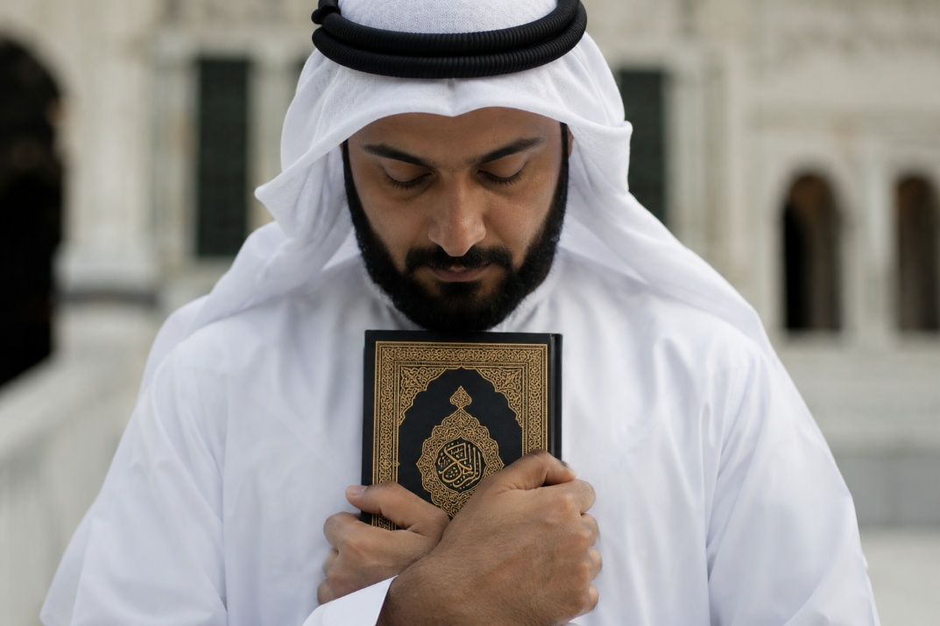
Is the
Quran
the
Word of God?

Slide 5
6th/7th Century Arabia...
An oral society
Trade caravans
Largely illiterate
Polytheistic
Jewish Tribes
Wealthy, successful merchants
Strongly monotheistic
Fond of oral traditions
(i.e., Talmud/Midrash folklore)

Slide 6
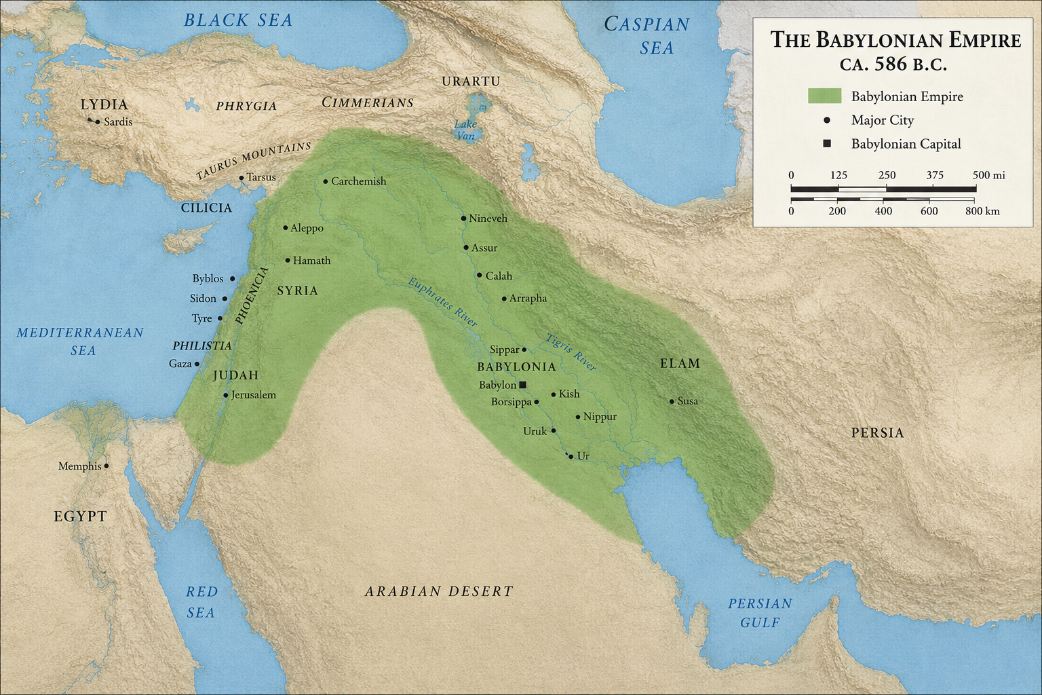
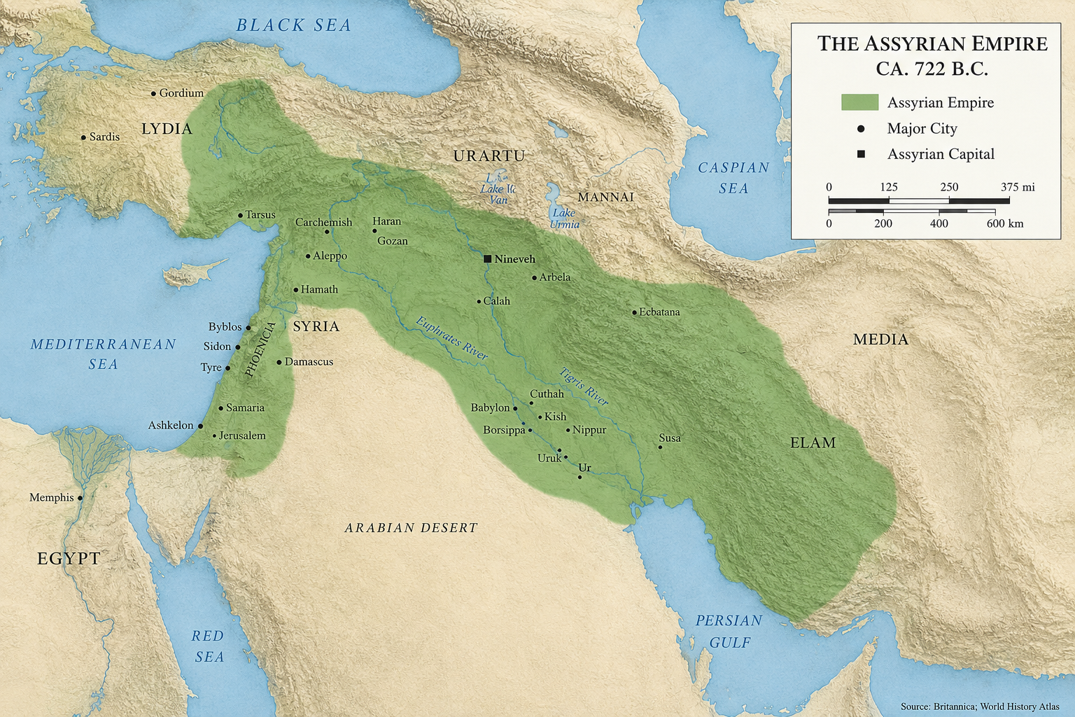
Jews in Arabia?

Slide 7
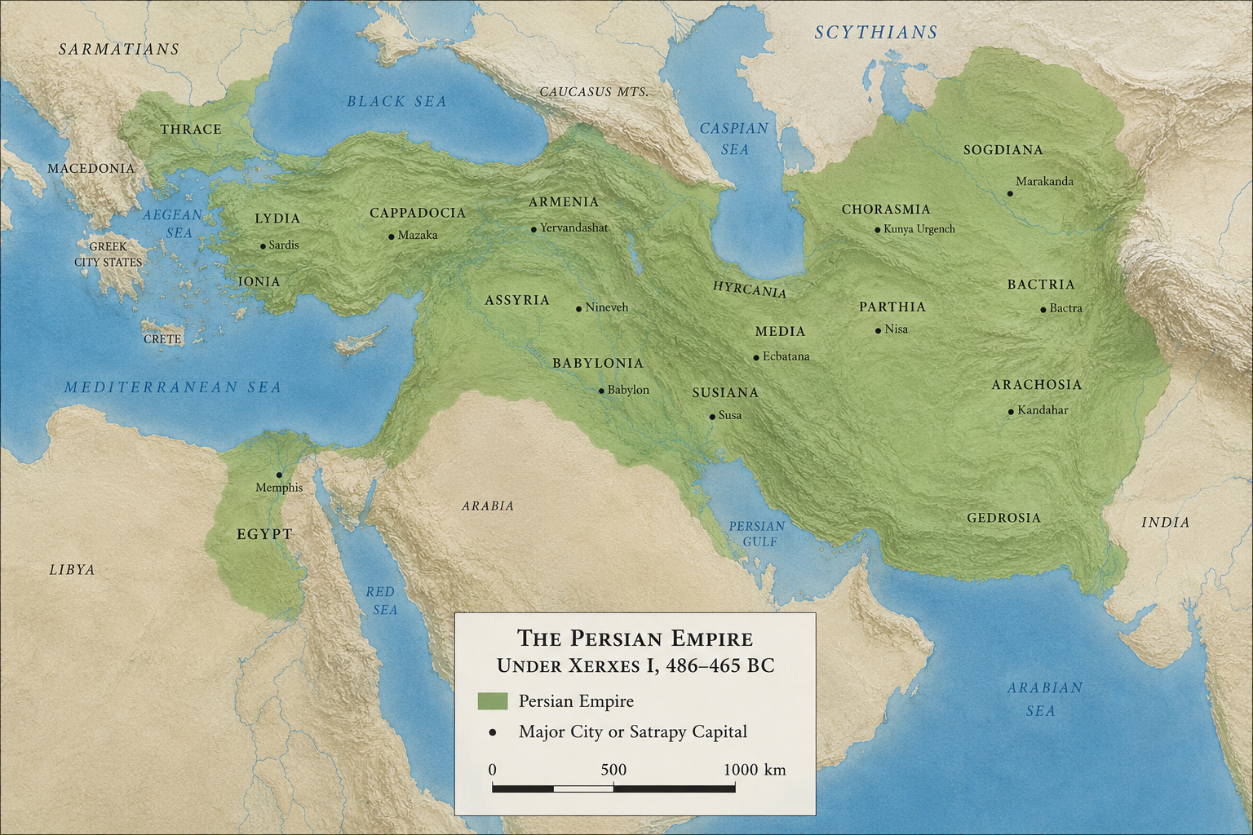
Jews in Arabia?
Acts 2:5,9-11—
“And there were dwelling in Jerusalem Jews, devout men, from every nation under heaven…. Parthians and Medes and Elamites, those dwelling in Mesopotamia, Judea and Cappadocia, Pontus and Asia, Phrygia and Pamphylia, Egypt and the parts of Libya adjoining Cyrene, visitors from Rome, both Jews and proselytes, Cretans and Arabs.”
Esther 3:8—
Haman told the king that Jews were “scattered and dispersed among the people in all the provinces of your kingdom” = 127 provinces = from north Africa to India.

Slide 8
6th/7th Century Arabia...
An oral society
Trade caravans
Largely illiterate
Polytheistic
The Quran reflects an implicit respect for Jews and Christians (at least initially).
Jewish Tribes
Wealthy, successful merchants
Strongly monotheistic
Fond of oral traditions (Talmud/folklore)
Corrupt Christian Sources

Slide 9
If the author of the Quran was not inspired, where would one expect him to acquire his information?
From oral stories he heard.
From those whom he respected as spiritually legitimate, i.e., Jews & Christians.
From his own imagination.

Slide 10
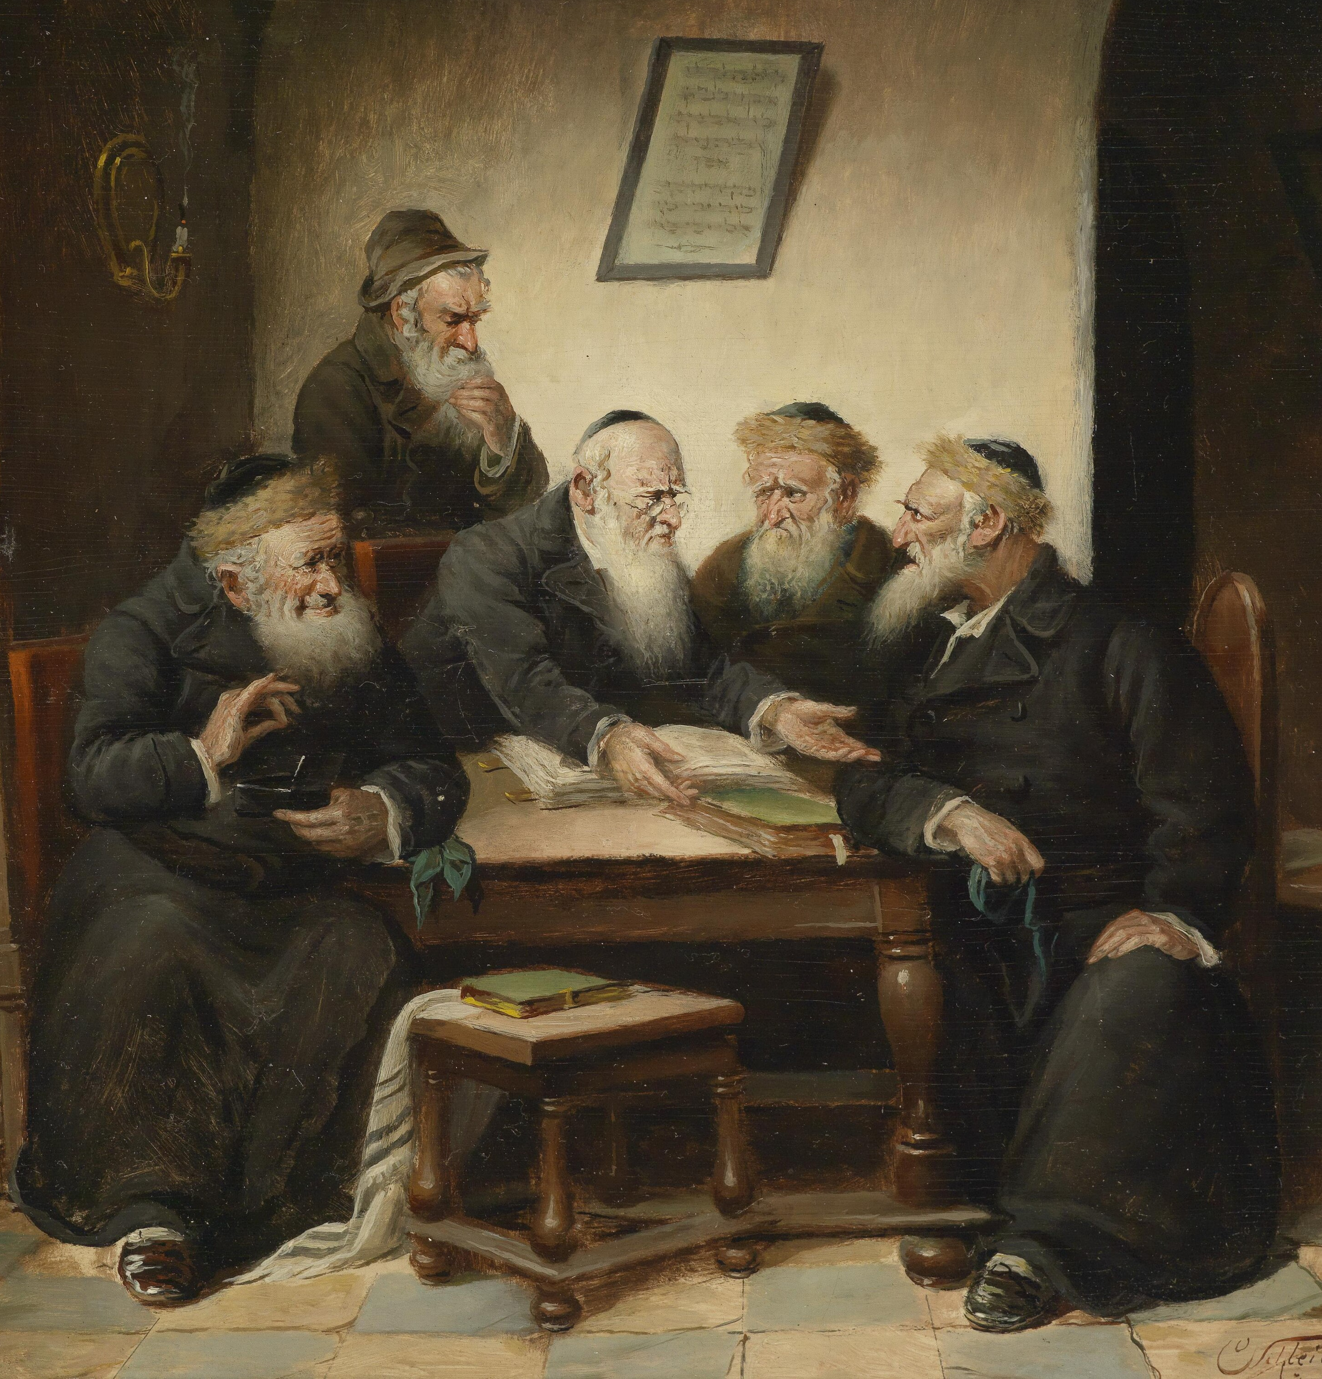
dwmlth
Talmud
An authoritative record of rabbinic discussions on the Old Testament, including ethics, laws, customs,
legends, case histories, and moral exhortations.

Slide 11
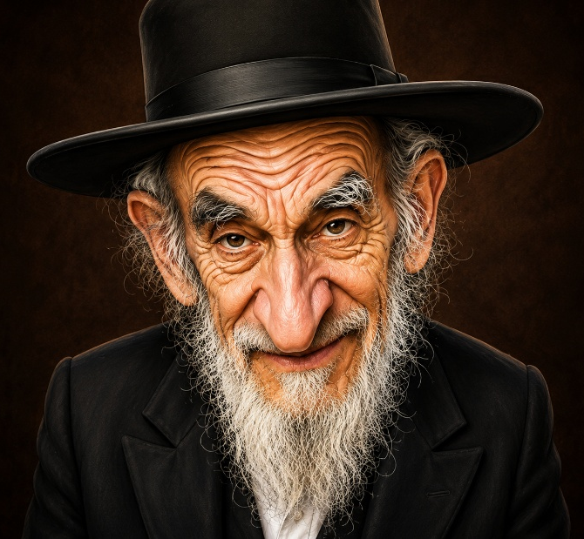
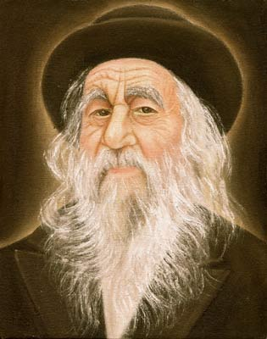
dwmlth
Merriam-Webster: “Chimera” =
“an illusion or fabrication of the mind”
Talmud
“Abounding, moreover, in fantastic
trifles and Rabbinical reveries, it must
appear almost incredible that any sane man could exhibit such acumen and such ardor in the invention of those unintelligible comments, in those nice scrupulosities, and those ludicrous chimeras which the rabbins have solemnly published to the world.” McClintock & Strong, 1970, 10:168
Heinrich Graetz (1939), History of the Jews (Philadelphia: The Jewish Publications Society of America), 2:631-632.
F.F. Bruce (1963), The Books & the Parchments (Westwood, NJ: Fleming H. Revell, 3rd revised edition), p. 37

Slide 12
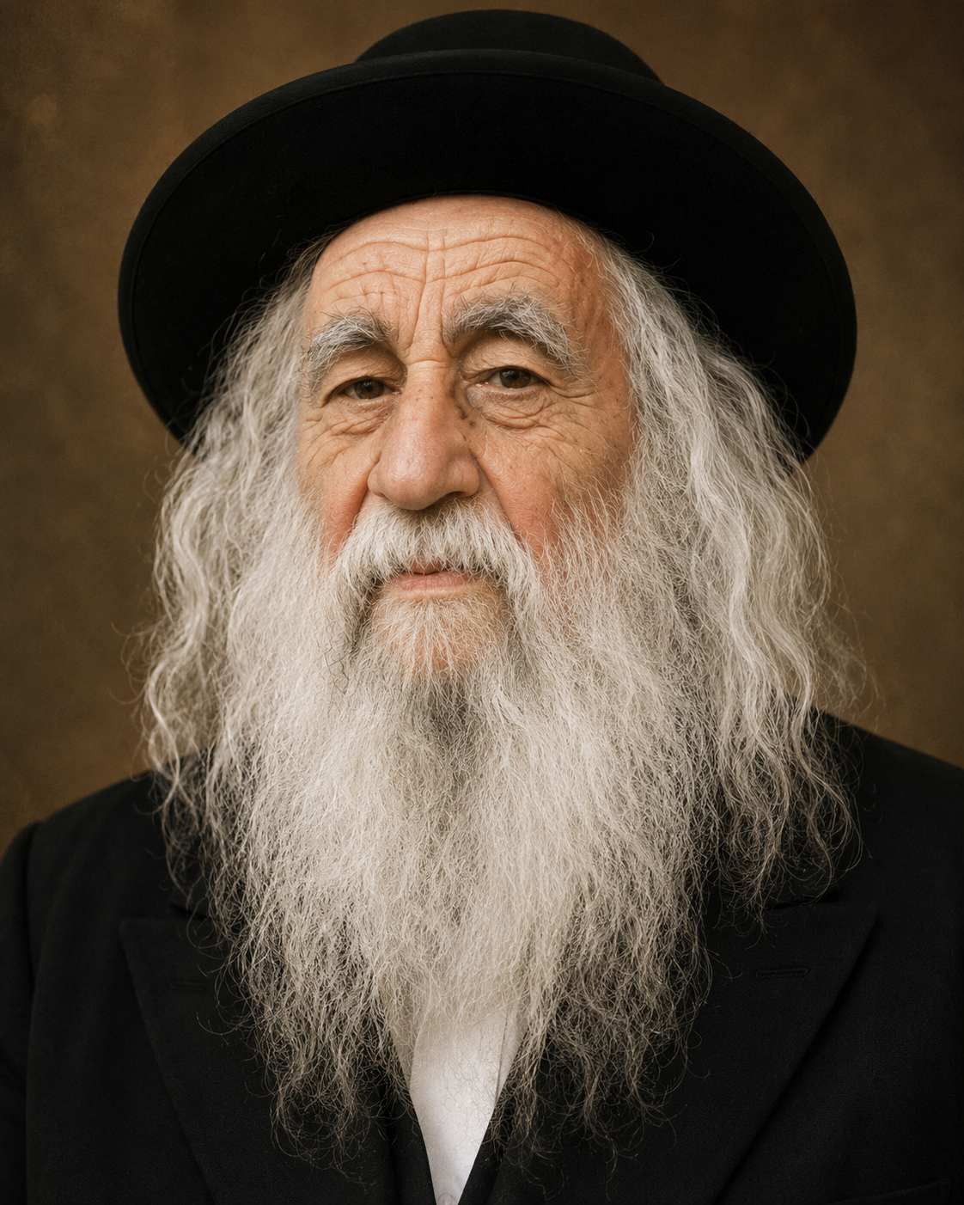
dwmlth
Talmud
“If we imagine something combining law reports…, and notes of a theological debating club—all thoroughly Oriental,
full of digressions, anecdotes, quaint sayings, fancies, legends, and too often of what, from its profanity, superstition, and even obscenity, could scarcely be quoted, we may form some general idea of what the Talmud is.”
Alfred Edersheim (1972), Life & Times of the Messiah, p. 103.

Slide 13
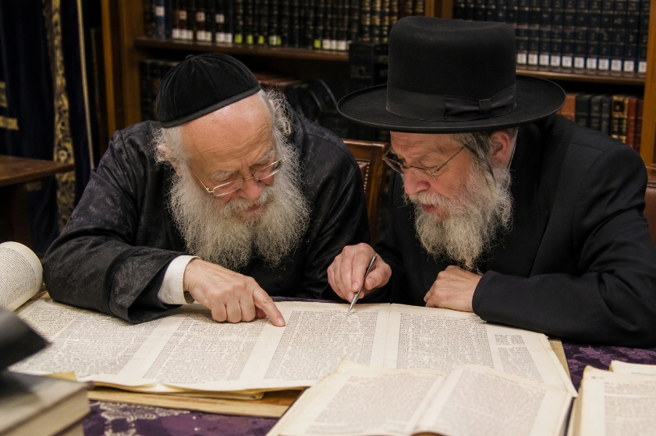
dwmlth
Talmud
“The summary of oral law that
evolved after centuries of scholarly effort by sages who lived in Palestine and Babylonia…. It is a conglomerate of law, legend, and philosophy, a blend of unique logic and shrewd pragmatism, of history and science, anecdotes and humor.” Adin Steinsaltz (2006), The Essential Talmud

Slide 14
dwmlth
Talmud
Final
Redaction
Jerusalem
Talmud
A.D. 350
Predate
Muhammad
Babylonian
Talmud
A.D. 500

Slide 15
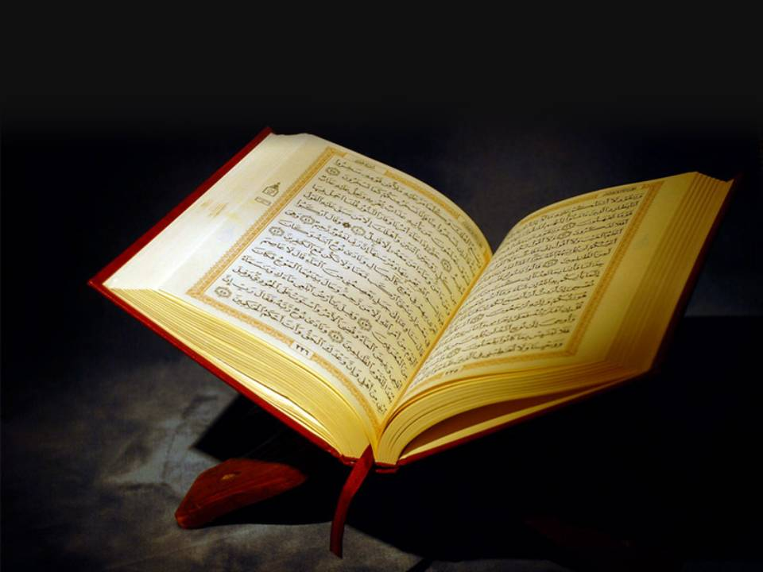
Bible Characters Mentioned By Name in the Quran
Aaron
Abraham
Adam
David
Elias
Elisha
Enoch
Ezekiel
Gabriel
Gog/Magog
Goliath
Heber
Isaac
Ishmael
Jacob
Jesus
Jethro
Job
John
Jonah
Joseph
Lot
Mary
Methusaleh
Michael
Moses
Nimrod
Noah
Pharaoh
Satan
Solomon
Zachariah

Slide 16
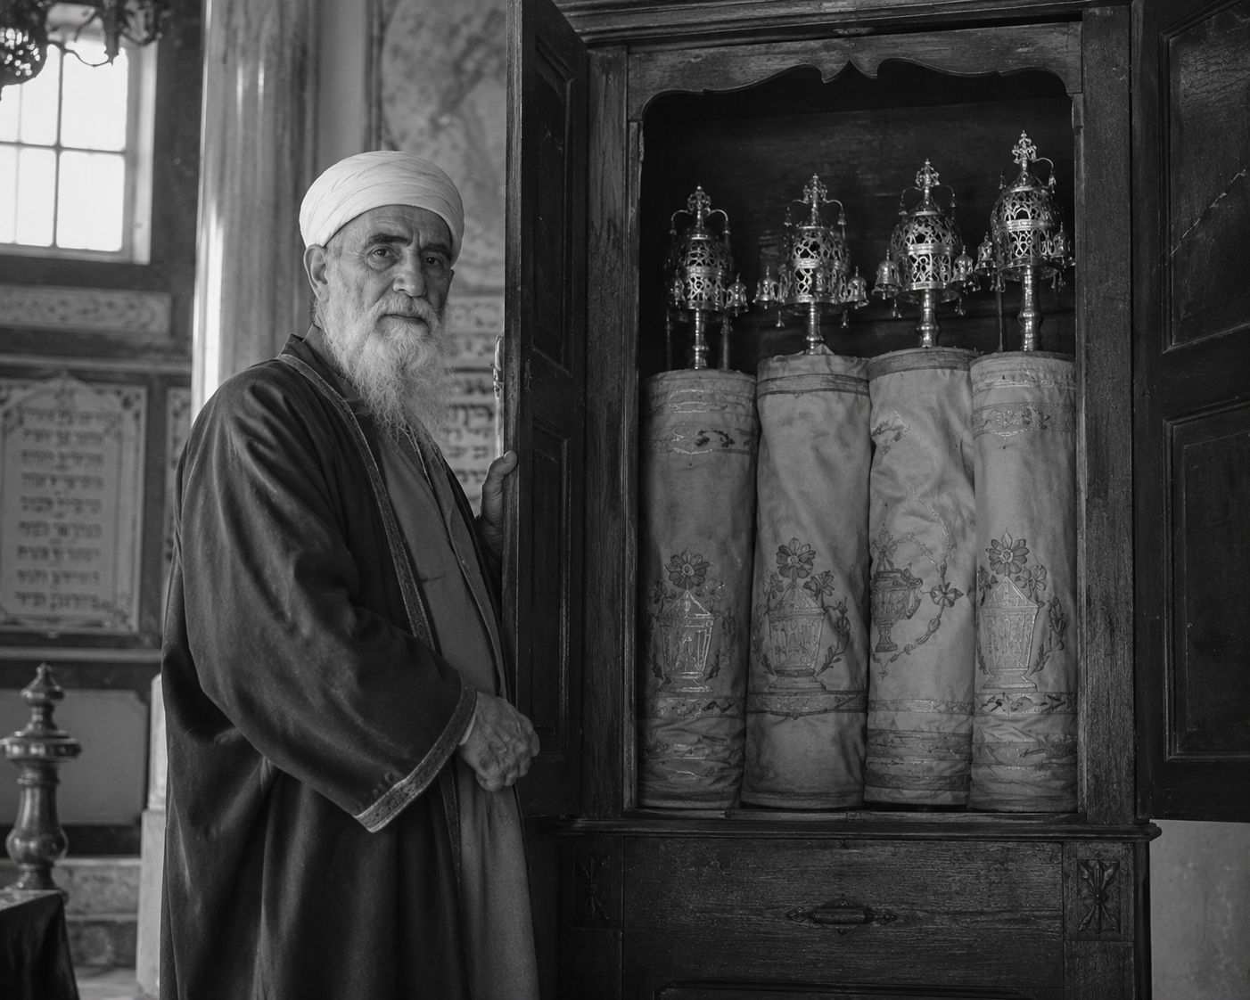
The Quran shows itself to have been strongly influenced by Jewish folklore.
The Burial of Abel
Noah and the Flood
Korah’s keys
Joseph

Slide 17
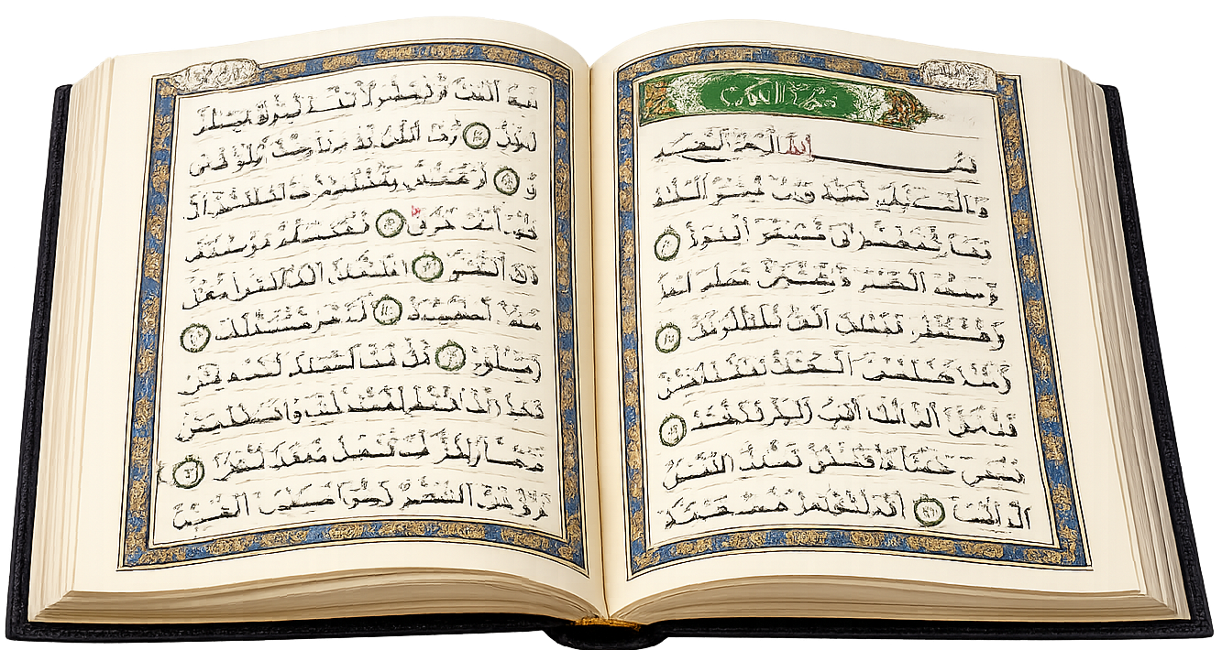
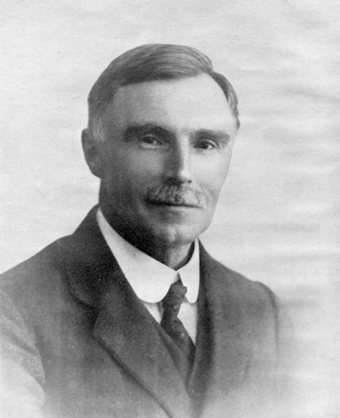
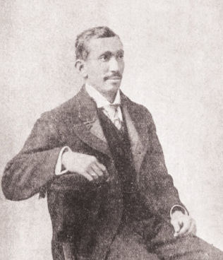
1. Allah is speaking to Muhammad
2. “Say/Recite” = Allah telling Muhammad what
to declare to his contemporaries
3. Passages from the Quran are taken from two reputable, popular Muslim translations:
The Meaning of the Glorious Koran (1930)
by British Islamic scholar Muhammad Pickthall
Authorized by Al-Azhar University in Cairo, Egypt.
The Holy Qur’an (1934)
by Indian Islamic scholar Abdullah Yusuf Ali
Extremely popular in the Islamic & Western world
Points to keep in mind when reading the Quran

Slide 18
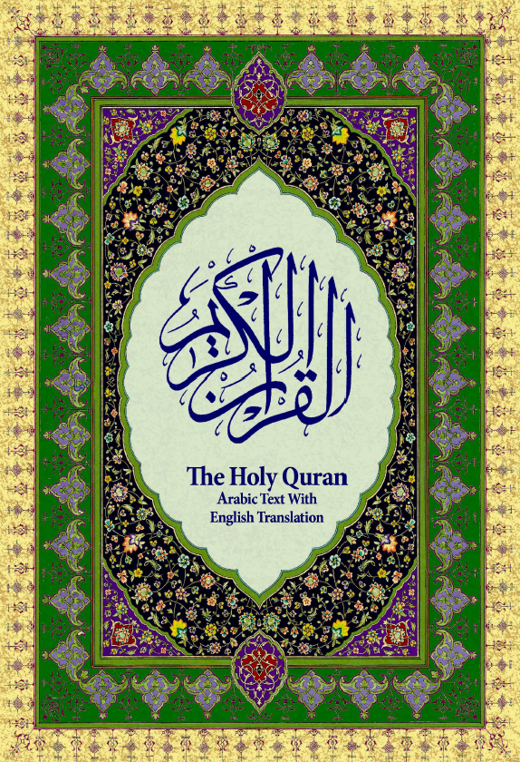
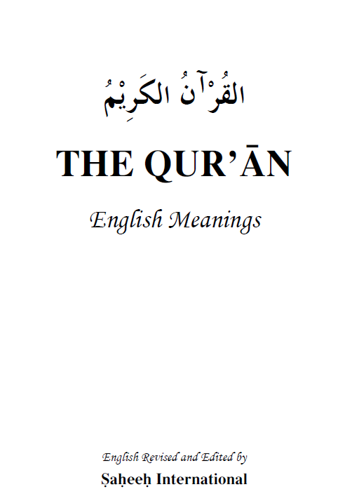
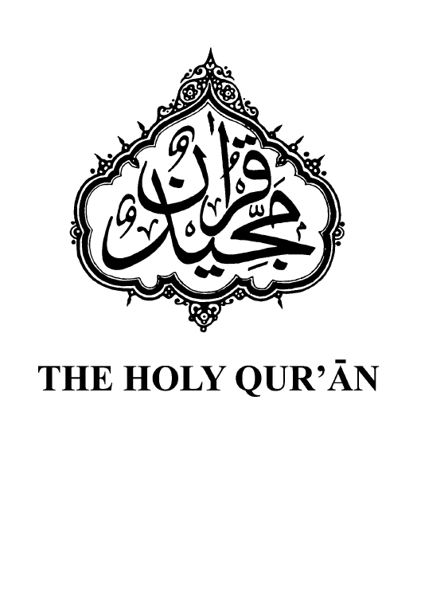
Additional Muslim Translations Compared
Muhammad Sarwar
Ali Quri Qara’i
Saheeh International
Maulawi
Sher ‘Ali
Holy
Quran

Slide 19
The Burial
of Abel

Slide 20
The Burial of Abel
Surah 5:27-32
“But recite unto them with truth the tale of the two sons of Adam, how they offered each a sacrifice, and it was accepted from the one of them and it was not accepted from the other. (The one) said: I will surely kill thee. (The other) answered: Allah accepteth only from those who ward off (evil). Even if thou stretch out thy hand against me to kill me, I shall not stretch out my hand against thee to kill thee, lo! I fear Allah, the Lord of the Worlds.

Slide 21
The Burial of Abel
Surah 5:27-32
“Lo! I would rather thou shouldst bear the punishment of the sin against me and thine own sin and become one of the owners of the Fire. That is the reward of evil‑doers. But (the other’s) mind imposed on him the killing of his brother, so he slew him and became one of the losers. Then Allah sent a raven scratching up the ground, to show him how to hide his brother’s naked corpse. He said: Woe unto me! Am I not able to be as this raven and so hide my brother’s naked corpse? And he became repentant.”

Slide 22
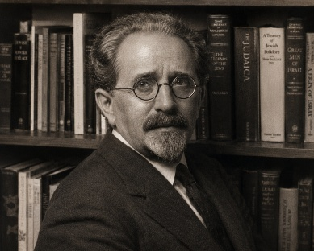
The Burial of Abel
Tanchuma Bereshit (10)
Pirke Rabbi Eliezer (21)
Midrash Breishit Rabbah (22:8)
Louis Ginzberg (1909), The Legends of the Jews, Vol. 1, p. 77.
“Nature was modified also by the burial of the corpse of Abel. For a long time it lay there exposed, above ground, because Adam and Eve knew not what to do with it. They sat beside it and wept, while the faithful dog of Abel kept guard that birds and beasts did it no harm. On a sudden, the mourning parents observed how a raven scratched the earth away in one spot, and then hid a dead bird of his own kind in the ground. Adam, following the example of the raven, buried the body of Abel, and the raven was rewarded by God.
His young are born with white feathers, wherefore the old birds desert them, not recognizing them as their offspring. They take them for serpents. God feeds them until their plumage turns black, and the parent birds return to them. As an additional reward, God grants their petition when the ravens pray for rain.”

Slide 23
The Burial of Abel
QURAN
TALMUD
Raven
Raven
Scratching up the ground
Scratched the
earth away
To hide his
brother’s
naked corpse
Buried
the body
of Abel

Slide 24
Noah
and the
Flood

Slide 25

Noah & the Flood
Surah
11:36-38
Midrash Tanchuma 5
Rosh Hashanah 12a
Sanhedrin 108b; Zebahim 113b; et al.
“And it was inspired in Noah, (saying): No one of thy folk will believe save him who hath believed already. Be not distressed because of what they do. Build the ship under Our Eyes and by Our inspiration, and speak not unto Me on behalf of those who do wrong. Lo! they will be drowned. And he was building the ship, and every time that chieftains of his people passed him, they made mock of him. He said: Though ye make mock of us, yet we mock at you even as ye mock.”
“Even after God had resolved upon the destruction of the sinners, He still permitted His mercy to prevail, in that He sent Noah unto them, who exhorted them for 120 years to amend their ways, always holding the flood over them as a threat. As for them, they but derided him. When they saw him occupying himself with the building of the ark, they asked, ‘Wherefore this ark?’”

Slide 26
Noah & the Flood
Surah
11:39-40
“And ye shall know to whom a punishment that will confound him cometh, and upon whom a lasting doom will fall. (Thus it was) till, when Our commandment came to pass and the oven gushed forth water.”

Slide 27
?
Noah & the Flood
Surah 23:27
“Then We inspired in him, saying: Make the ship under Our eyes and Our inspiration. Then, when Our command cometh and the oven gusheth water, introduce therein of every (kind) two spouses, and thy household save him thereof against whom the Word hath already gone forth. And plead not with Me on behalf of those who have done wrong. Lo! they will be drowned.”

Slide 28

Noah & the Flood
Midrash Tanchuma 5
Rosh Hashanah 12a
Sanhedrin 108b; Zebahim 113b; et al.
“The crowd of sinners tried to take the entrance to the ark by storm, but the wild beasts keeping watch around the ark set upon them, and many were slain, while the rest escaped, only to meet death in the waters of the flood. The water alone could not have made an end of them, for they were giants in stature and strength. When Noah threatened them with the scourge of God, they would make reply:

Slide 29
Noah & the Flood
Midrash Tanchuma 5
Rosh Hashanah 12a
Sanhedrin 108b; Zebahim 113b; et al.
“‘If the waters of the flood come from above, they will never reach up to our necks; and if they come from below, the soles of our feet are large enough to dam up the springs.’ But God bade each drop pass through Gehenna before it fell to earth, and the hot rain scalded the skin of the sinners. The punishment that overtook them was befitting their crime. As their sensual desires had made them hot, and inflamed them to immoral excesses, so they were chastised by means of heated water.”

Slide 30
The
Keys of
Korah

Slide 31
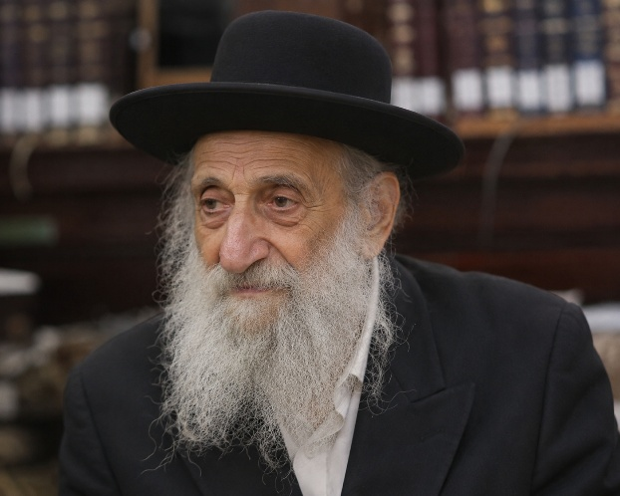
Korah’s Keys
Surah 28:76
“...such were the treasures We had bestowed on him, that their very keys would have been a burden to a body of strong men.”
“Rabbi Levi said: The keys of Korah’s treasure house were a load for three hundred white mules, though all the keys and locks were of leather.”
Sanhedrin (110a)
Pesachim (119a)

Slide 32
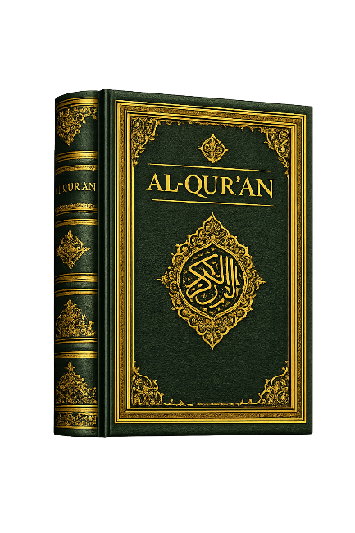
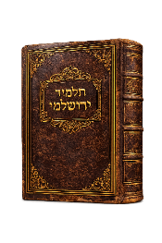
ADDITIONAL PARALLELS
Surah 28:12-13 | Allah forbade Moses being nursed by any but his mother. | Sotah 12b Shemot Rabbah 1:25
Surah 20:80-97 | The gold calf made a lowing sound. | Pirke Rabbi Eliezer 45
Surah 2:54-56 Surah 4:153 | Lightening struck several Israelites dead, but God revived them. | Sanhedrin 5
Surah 2:63,93 Surah 7:171 | Allah lifted Mt. Sinai into the air and held it over the Israelites. | Midrash Shir 44a Tehillim 75,337 Tanchuma Noah 3
Surah 7:113-126 Surah 20:61-73 Surah 26:39-51 | Pharaoh’s magicians were converted. | Shemot Rabbah 42:6 Mid. Tanchuma Zohar

Slide 33
Joseph

Slide 34
JOSEPH | BIBLE | QURAN | TALMUD
Purpose of Search for Brothers | Genesis 37:14 Safety | Surah 12:11-12 Recreation | Rabbah 84:8-10 Recreation
Identity of Alleged Predator | Genesis 37:20,33 Wild Beast | Surah 12:11-12 Wolf | Yashar W. 85 Wolf
Who Retrieved Him from the Pit | Genesis 37:28 Brothers | Surah 12:11-12 Caravan | Yashar W. 81-82 Caravan
Amount Joseph Sold For | Genesis 37:28 20 Shekels | Surah 12:20 Low Price | Tanchuma W. 2 Low Price
Why Joseph did not Succumb | Genesis 39:9 To Not Sin | Surah 12:24 Argument of Lord | Sotah 36b; et al. Vision of Parents
Whether Tempted | Genesis 39:12 No Hint of | Surah 12:33 Tempted | Tanchuma W. 9 Tempted
What Done to His Garment | Genesis 39:12 Left Behind Intact | Surah 12:25 Torn from Behind | Mid. Hagadol 589 Torn in Front/ Moved to Back

Slide 35
JOSEPH | BIBLE | QURAN | TALMUD
Potiphar’s Attitude | Genesis 39:19 Angry | Surah 12:25 Believes Innocent | Mid. Yalkut 145-6 Believes Innocent
Whether Someone Defended Him | Genesis 39:20 No One | Surah 12:26 In-House Witness | Yashar W. 88a-89a In-House Child
Why Joseph Left in Prison Longer | Genesis 40:23 Forgot | Surah 12:42 Satan Caused | Tehillim 105,451 God Caused
How Brothers to Enter City Gate | Genesis 43:11ff. Not Said | Surah 12:67 Not by One Gate | Mid. Mikkez 99b Not by One Gate
Whether Jacob Knew Joseph Alive | Genesis 42:38 Thought Dead | Surah 12:85-86,96 Knew Alive | Soferim 21; et al. Knew Alive
Whether Joseph told Benjamin | Genesis 45:12 With Brothers | Surah 12:69 Private to Benj. | Yash. Mikkez 105a Private to Benj.
What Said When Cup Found | Genesis 44:15ff. Guilty will Pay | Surah 12:77 Kin to Thief | Mid. B. Rab. 102:9 Kin to Thief

Slide 36
?
Joseph
Surah
12:31-32
“And women in the city said: The ruler’s wife is asking of her slave-boy an ill deed. Indeed he has smitten her to the heart with love. We behold her in plain aberration. And when she heard of their sly talk, she sent to them and prepared for them a cushioned couch (to lie on at the feast) and gave to every one of them a knife and said (to Joseph): Come out unto them! And when they saw him they exalted him and cut their hands, exclaiming: Allah Blameless! This is not a human being. This is no other than some gracious angel. She said: This is he on whose account ye blamed me. I asked of him an evil act, but he proved continent.”

Slide 37
Surah
12:31-32
?
Question
Why did Potiphar’s wife give the women knives,
and why did they cut their hands?
It’s as if the author is speaking to an audience that he knows is familiar with the unexplained details.
It’s as if the author failed to anticipate a future audience who would be unable to make
sense of the background details.

Slide 38
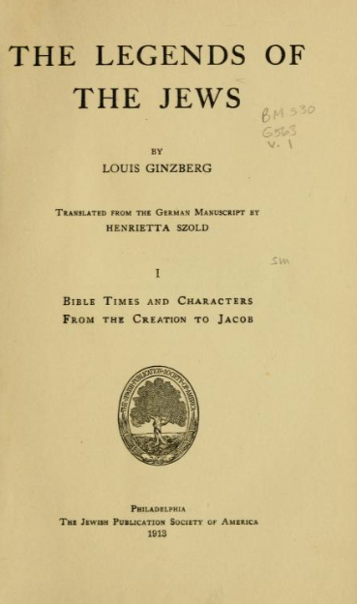

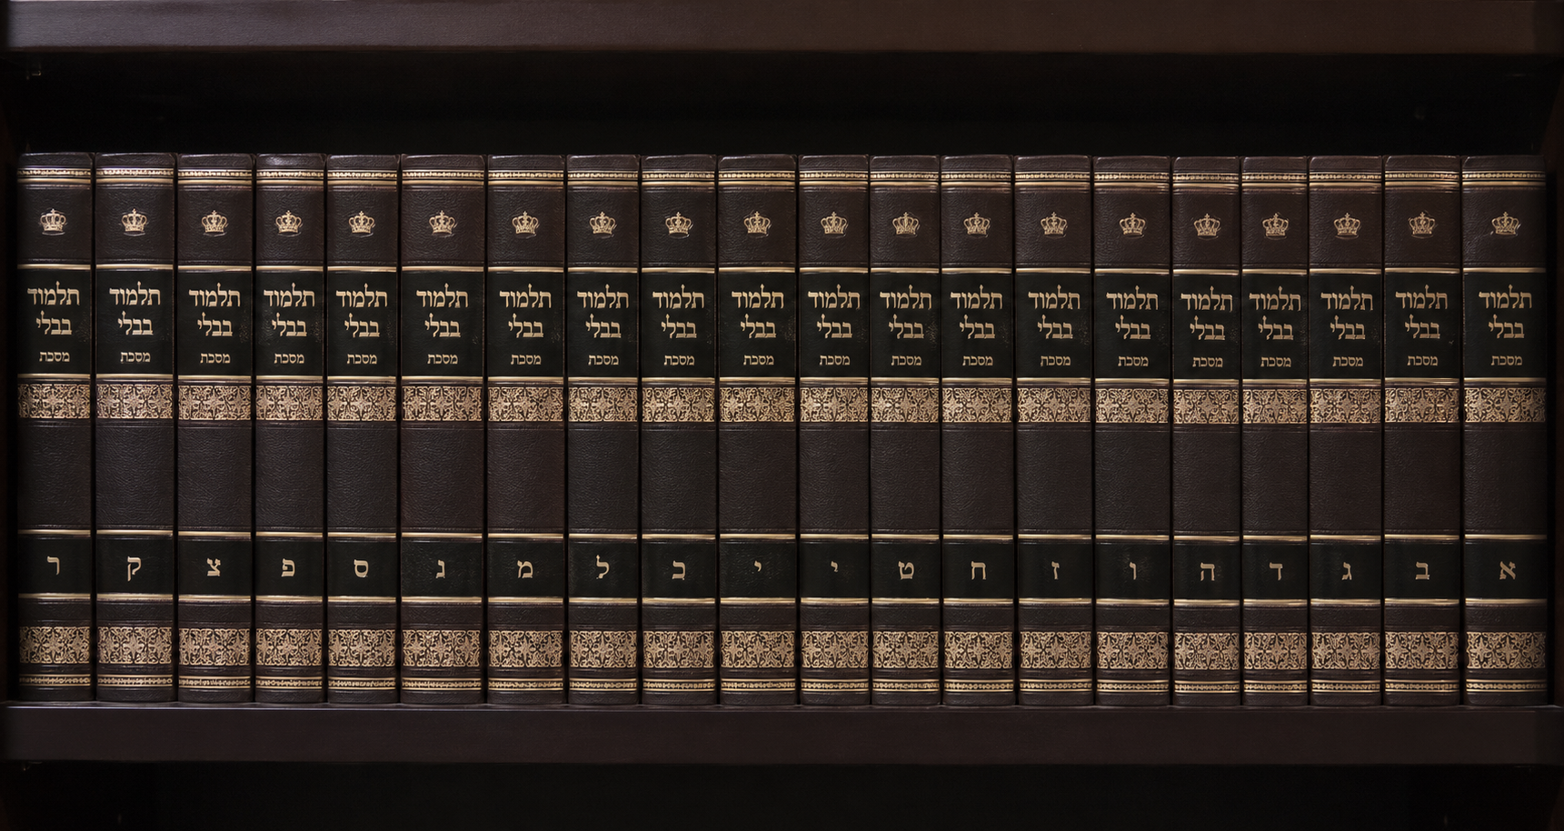
book cover =
public
domain
Consider the following
Talmudic/Midrashic sources:
Louis Ginzberg
Sepher Hayashar, 87a-87b
Tanchuma Wayesheb 5
Abkir in Midrash Yalkut 146
Midrash Hagadol 590

Slide 39
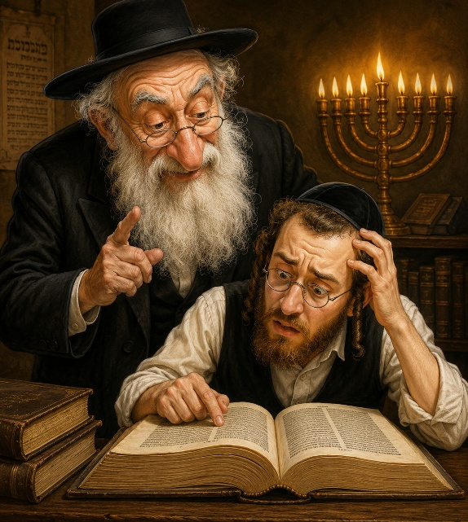
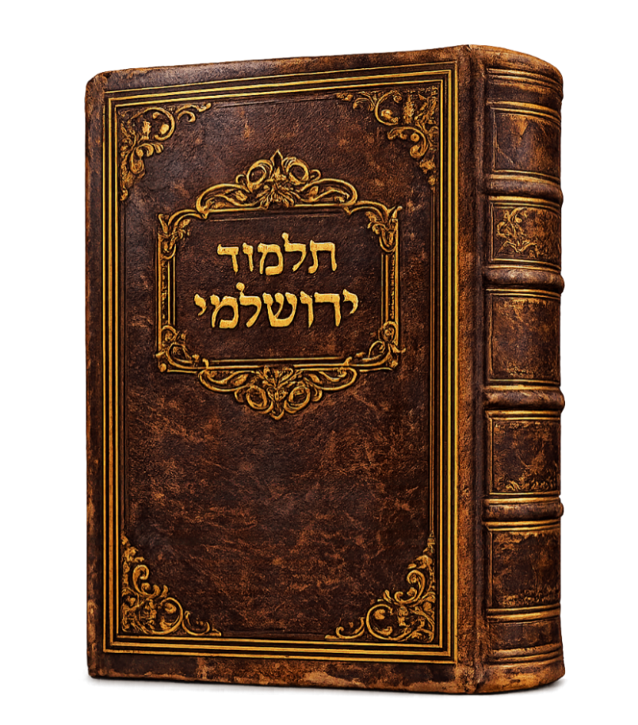
“When Zuleika could not prevail upon him, to persuade him, her desire threw her into a grievous sickness, and all the women of Egypt came to visit her, and they said unto her, ‘Why art thou so languid and wasted,
thou that lackest nothing? Is not thy husband a prince great and esteemed in the sight of the king? Is it possible that thou canst want aught of what thy heart desireth?’ Zuleika answered them, saying, ‘This day shall it be made known unto you whence cometh the state wherein you see me.’

Slide 40
“She commanded her maid-servants to prepare food for all the women, and she spread a banquet before them in her house. She placed knives upon the table to peel the oranges, and then ordered Joseph to appear, arrayed in costly
garments, and wait upon her guests. When Joseph came in, the women could not take their eyes off him, and they all cut their hands with the knives, and the oranges in their hands were covered with blood, but they, not knowing what they were doing, continued to look upon the beauty of Joseph without turning their eyes away from him.”

Slide 41
“Then Zuleika said unto them: ‘What have ye done? Behold, I set oranges before you to eat, and you have cut your hands.’ All the women looked at their hands, and, lo, they were full of blood, and it flowed down and stained their garments. They said to Zuleika, ‘This slave in thy
house did enchant us, and we could not turn our eyes away from him on account of his beauty.’ She then said: ‘This happened to you that looked upon him but a moment, and you could not refrain yourselves! How, then, can I control myself in whose house he abideth continually, who see him go in and out day after day?’”

Slide 42
“How, then, should I not waste away, or keep from languishing on account of him!’ And the women spake, saying: ‘It is true, who can look upon this beauty in the house, and refrain her feelings? But he is thy slave! Why dost thou not disclose to
him that which is in thy heart, rather than suffer thy life to perish through this thing?’ Zuleika answered them: ‘Daily do I endeavor to persuade him, but he will not consent to my wishes. I promised him everything that is fair, yet have I met with no return from him, and therefore I am sick, as you may see.’”

Slide 43
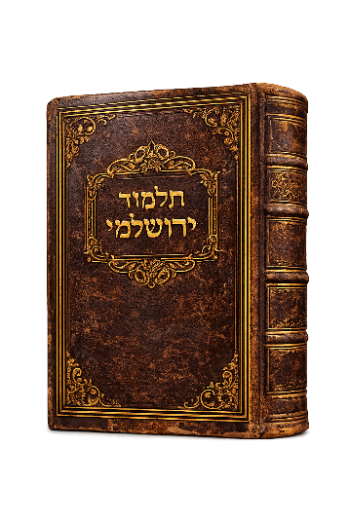
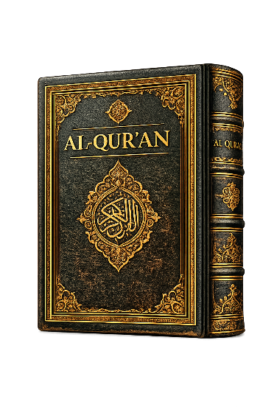
Parallels Between the Quran and Jewish Folklore
1. Potiphar’s wife tries to justify her
lovesick condition to the women.
2. She does so by inviting them to a banquet.
3. Each woman is given a knife as part of the table place setting.
4. She orders Joseph to
make an appearance.
5. On seeing Joseph’s handsome appearance, the women cut their hands with the knives.

Slide 44
Parallels Between the Quran and Jewish Folklore
6. The women verbally extol Joseph’s looks.
7. Potiphar’s wife verbalizes
her sense of exoneration.
8. She verbally reaffirms to them that she attempted to seduce him.
9. She reiterates his refusal to consent to her overtures.

Slide 45
Parallels Between the Quran and Jewish Folklore
1. Potiphar’s wife tries to justify her lovesick condition to the women.
2. She does so by inviting them to a banquet.
3. Each woman is given a knife as part of the table place setting.
JUST COINCIDENCE?
4. She orders Joseph to make an appearance.
5. On seeing Joseph’s handsome appearance, the women cut their hands with the knives.
6. The women verbally extol Joseph’s looks.
7. Potiphar’s wife verbalizes her sense of exoneration.
8. She verbally reaffirms to them that she attempted to seduce him.
9. She reiterates his refusal to consent to her overtures.

Slide 46
Conclusions
1. It is self-evident and unmistakable that the Quran contains a considerable amount of borrowed material from uninspired Talmudic sources, rabbinical oral traditions, and Jewish legends—stories that abound in puerile, apocryphal, absurd, outlandish pablum.

Slide 47
Conclusions
2. An occasional link between two sources might be explainable on legitimate grounds that would refute the charge of collusion.
However, the Quran’s reliance on uninspired Jewish sources is extensive and specific.

Slide 48
Conclusions
3. The author of the Quran demonstrated considerable ignorance of the Bible, but a striking acquaintance with Jewish legends.
4. Muhammad likely had very little, if any, contact with the actual Bible. His contact with the Bible was dependent on the represent-ations presented to him by the Jews.

Slide 49
Conclusions
5. The Jews, in turn, seemed to be more enamored with rabbinic folklore and legend rather than in actually expounding the biblical text.
6. Consequently, in detail after detail where the Quran differs with the biblical record, it coincides with the Jewish legends that were current in Muhammad’s day.

Slide 50
Conclusions
7. The parallels between the Quran and Jewish legends are of such a nature that it is apparent to the unbiased observer that the Jewish legends provide the context to items that the Quran otherwise leaves undecipherable.

Slide 51
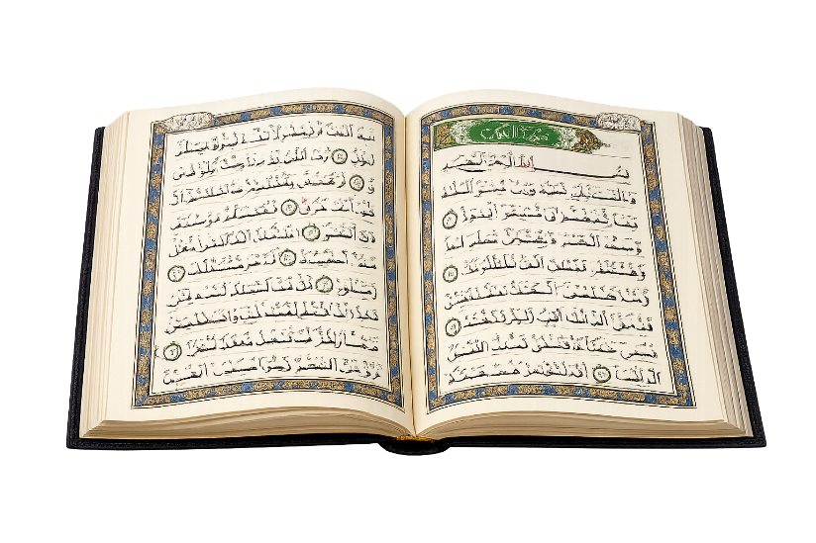
Conclusions
The Quran does not possess the attributes of divine inspiration.
The Quran possesses characteristics that verify its human origin.

