Slide 1
Notes:
In Genesis 19 we read one of the most disturbing passages in the Bible
Angels of the Lord have come to the city of Sodom to
Genesis 19:2-3 And he said, “Here now, my lords, please turn in to your servant’s house and spend the night, and wash your feet; then you may rise early and go on your way.”
And they said, “No, but we will spend the night in the open square.”
³ But he insisted strongly; so they turned in to him and entered his house. Then he made them a feast, and baked unleavened bread, and they ate.
The men of Sodom came and surrounded the house, demanding that the men be brought out so that they might have sexual relations with them (vs. 5)
Lot goes out and pleads with them
Vs. 6-8 “Please, my brethren, do not do so wickedly! ⁸ See now, I have two daughters who have not known a man; please, let me bring them out to you, and you may do to them as you wish; only do nothing to these men, since this is the reason they have come under the shadow of my roof.”
I can not explain everything about the offer of his daughters, what I am impressed with was how seriously Righteous Lot took the subject of hospitalit
In particular in contrast to the people of Sodom.
They obviously struggled with homosexuality, but that was a part of their sinfulness
In Contrast to Sodom
Ezekiel 16:49 Look, this was the iniquity of your sister Sodom: She and her daughter had pride, fullness of food, and abundance of idleness; neither did she strengthen the hand of the poor and needy.
The people of Sodom only cared about themselves and used people.
Christians are called to actually think more of others than ourselves (Phil 2)
We are called to be Hospitable

Slide 2
Be hospitable to one another without grumbling.
1 Peter 4:9
Notes:
Literally it means to “Love Strangers”
Greek work is “philoxenia” Love (philo) strangers (xenia)
This is not something that we should do kicking and screaming but something that we should find joy in practicing
Not “I guess I will do this”
Rather “I am so glad that I have the opportunity to show you Jesus!”
We may be tempted to say, “that is not how the world works anymore” That’s true. The world is more closed off than ever.
I can remember sitting out in our front yard as a kid and all the neighbors came over.
Our swing set was in the front yard, not the back yard!
Now I would do good to tell you my neighbor's name.
If you talk to much to a stranger or even the person checking you out at the store, people say that is awkward.
I want to get my gas, order my food, pay by bill, get my groceries without ever talking to another human being.
People are lonelier than ever!
It is this reality that gives hospitality more power than ever before. Light shines brightest in the darkest room

Slide 3
not lagging in diligence, fervent in spirit, serving the Lord; rejoicing in hope, patient in tribulation, continuing steadfastly in prayer; distributing to the needs of the saints, given to hospitality.
Romans 12:11-13
Notes:
I use this verse sometimes to describe someone who is on fire for the Lord!
Remember – Love of Strangers
What are we doing for people who can do nothing for us?
Meeting basic needs
The Biblical picture of hospitality does seem to center around providing a roof over someone’s head
Food for their belly
What are you doing with your home for the sake of the Kingdom. It is probably your largest asset. It is probably your most valuable thing God has given you. What are you doing with it beyond yourself?
Don’t undersell the value of your home?
For Evangelism….The Gospel comes with a door key!
For Fellowship…..Paul was always staying with someone. Simon the Tanner, Aquilla and Priscilla, Philip the Evangelist
For Safety…..this is a safe place. From persecution From intimidation
There is something special about sharing a meal together!
Breaking Bread
You want to change your relationship with others, have them into your home for a meal. Sit at Bojangles and eat some chicken together!
More than that
How can I meet the needs of others.
I’m think about people who have looked up from their table and said, “Sit with me”
People who brought meals when I had surgery and could not move
When the Hurricane Hit and Cary said, “you are welcome at my house”
People who cared for our children while we packed, unpacked, and started over
People rolling up their sleaves to help with hard projects. Not just looking for someone to move
Maybe those who just sent a text, “I appreciate you, I’m praying for you” in those moments of need
The friends who will drives hours and hours just to sit around and laugh together. I needed that
“given” Not a grand gesture, but a steady, quiet way of life

Slide 4
A bishop then must be blameless, the husband of one wife, temperate, sober-minded, of good behavior, hospitable, able to teach;
^{1 Timothy 3:2}
Notes:
This is a qualification for an Elder
We might expect to see qualifications in regard to being blameless, serious minded, able to teach
Right their in the middle, HOSPITABLE
If you are going to impact souls you are going to have to care for them
Not just care about souls. Literally care for souls!
Do you get the picture that hospitality is not just a lesson for ladies!

Slide 5
Let a widow be enrolled if she is not less than sixty years of age, having been the wife of one husband, and having a reputation for good works: if she has brought up children, has shown hospitality, has washed the feet of the saints, has cared for the afflicted, and has devoted herself to every good work.
^{1 Timothy 5:9-10}
Notes:
Not just for the wealthy with fine homes
This is a part of being recognized as a widow in deed.
A Widow in deed is not just about being a certain age with a passed on husband.
This is about being qualified to be put on a benevolence list!
Hospitality is not about having or spending a bunch of money
It is not entertaining!
This is not about Pinterest Boards and having the finest feast
It can be that. Jesus Himself talks about a great feast where the unwanted are invited.

Slide 6
Let brotherly love continue. Do not neglect to show hospitality to strangers, for thereby some have entertained angels unawares.
^{Hebrews 13:1-2}
Notes:
Lets talk about the gift!
Genesis 18:2-8 He lifted up his eyes and looked, and behold, three men were standing in front of him. When he saw them, he ran from the tent door to meet them and bowed himself to the earth ³ and said, “O Lord,^{[b]} if I have found favor in your sight, do not pass by your servant. ⁴ Let a little water be brought, and wash your feet, and rest yourselves under the tree, ⁵ while I bring a morsel of bread, that you may refresh yourselves, and after that you may pass on—since you have come to your servant.” So they said, “Do as you have said.” ⁶ And Abraham went quickly into the tent to Sarah and said, “Quick! Three seahs^{[c]} of fine flour! Knead it, and make cakes.” ⁷ And Abraham ran to the herd and took a calf, tender and good, and gave it to a young man, who prepared it quickly. ⁸ Then he took curds and milk and the calf that he had prepared, and set it before them. And he stood by them under the tree while they ate.
He ran from his tent
He begged for the privilege
Quick!

Slide 7
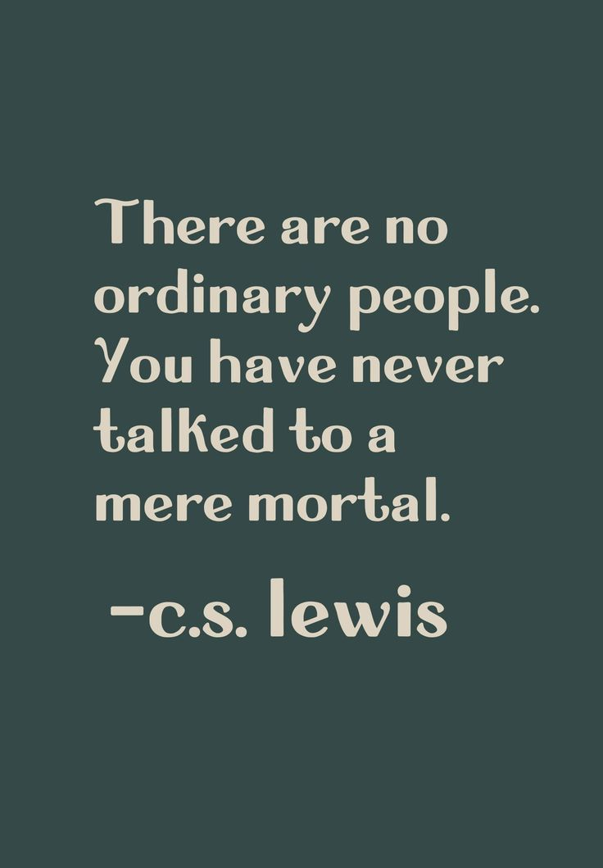
Impact Another Soul
Given What Was Given
Live out the Gospel
Notes:
Impact Another Soul
Angels!
Angels will be here tonight and we need someone to take care of them. The line would be out the door
You might say, “These are not angels, that’s just John.”
C.S. Lewis. There are no ordinary people. You have never met a mere mortal. Nations, cultures, arts, civilizations – these are mortal, and their life is to ours as the life of a gnat. But it is immortals whom we joke with, work with, marry, snub, and exploit – immortal horrors and everlasting splendors.
Give What We Have Been Given
Think about all the people who have helped you up
Think about all the times that the Lord has provided for you
Here is your opportunity to do the same for others.
Live Out the Gospel
Can I show you what Jesus is Like? Can I show you the Gospel?
Why are you caring for me?
Jesus came and died for those who could not help themselves.
Christians are people who care about more than themselves.
They care about the souls of
This is why Jesus washed feet
I’m glad that we did that!

Slide 8
Notes:
Matthew 25:34-40 Then the King will say to those on His right hand, ‘Come, you blessed of My Father, inherit the kingdom prepared for you from the foundation of the world: ³⁵ for I was hungry and you gave Me food; I was thirsty and you gave Me drink; I was a stranger and you took Me in; ³⁶ I was naked and you clothed Me; I was sick and you visited Me; I was in prison and you came to Me.’
³⁷ “Then the righteous will answer Him, saying, ‘Lord, when did we see You hungry and feed You, or thirsty and give You drink? ³⁸ When did we see You a stranger and take You in, or naked and clothe You? ³⁹ Or when did we see You sick, or in prison, and come to You?’ ⁴⁰ And the King will answer and say to them, ‘Assuredly, I say to you, inasmuch as you did it to one of the least of these My brethren, you did it to Me.’

