Slide 2
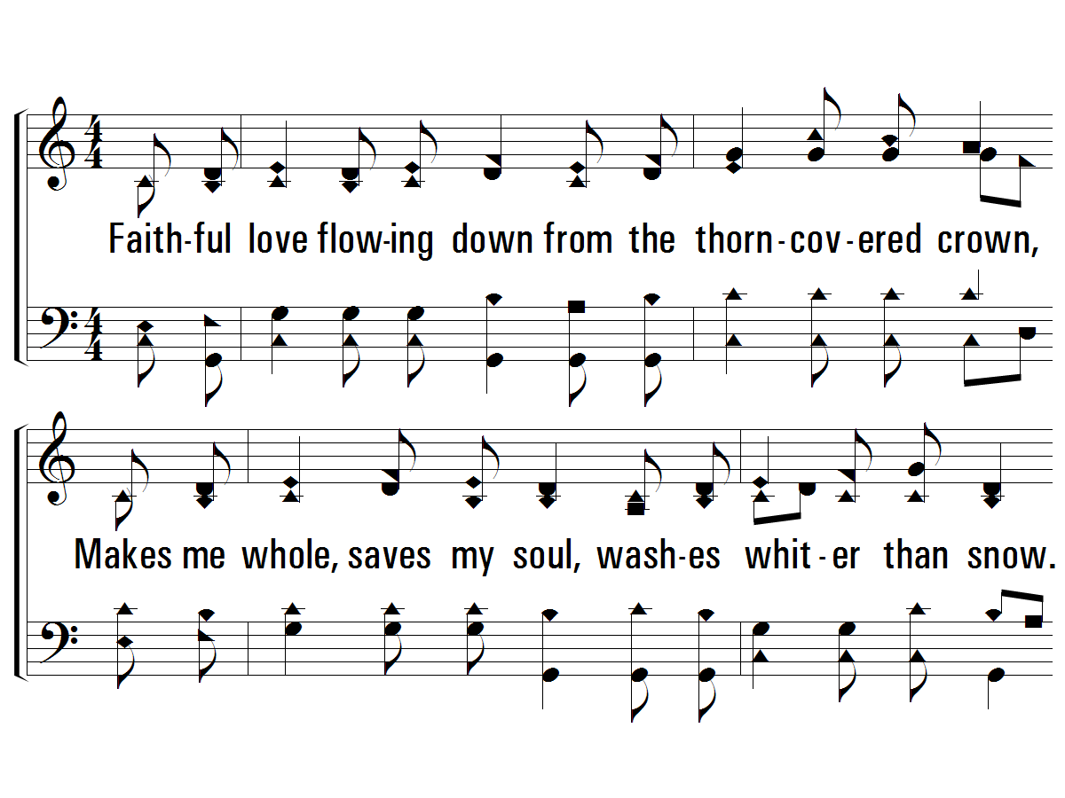
1 – Faithful Love
1.
Faithful love flowing down from the thorn-covered crown,
Makes me whole, saves my soul, washes whiter than snow.
Faithful love calms each fear, reaches down, dries each tear;
Holds my hand when I can't stand on my own.
Words & Music: Ken Young
Copyright © 1993 by Hallal Music
PaperlessHymnal.com

Slide 3
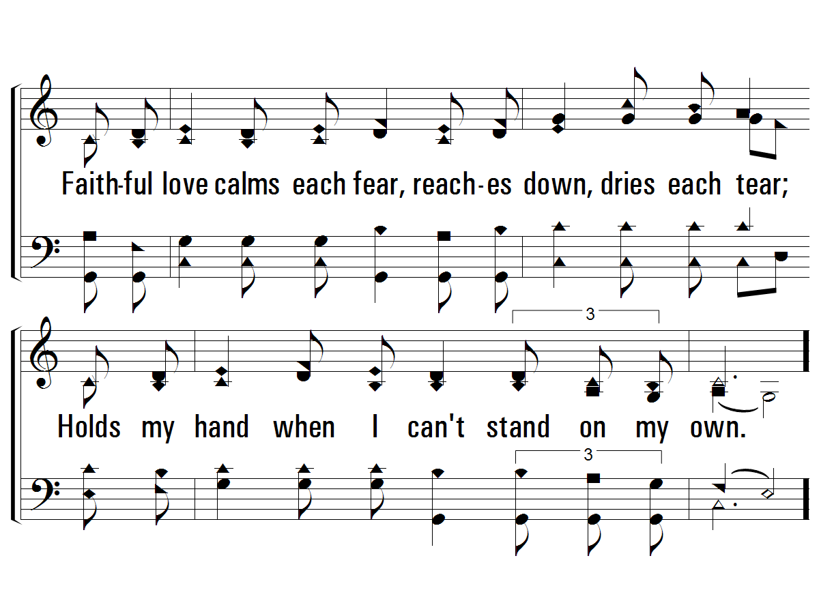
1 – Faithful Love
PaperlessHymnal.com

Slide 4
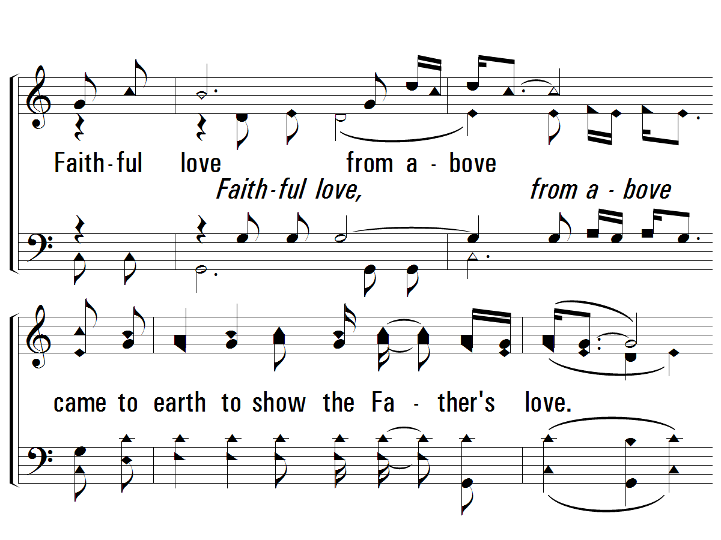
c – Faithful Love
Faithful love from above
came to earth to show the Father's love.
And I'll never be the same,
for I've seen faithful love face to face,
and Jesus is His name.
PaperlessHymnal.com

Slide 5
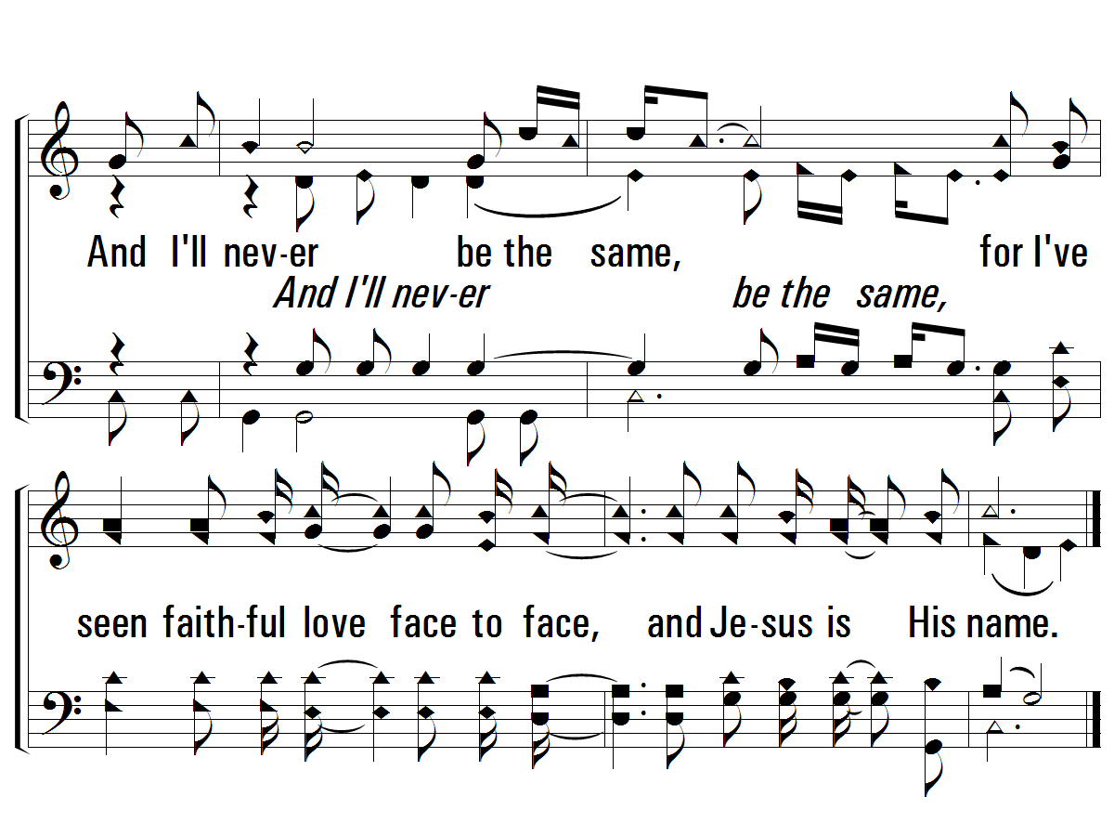
c – Faithful Love
PaperlessHymnal.com

Slide 6
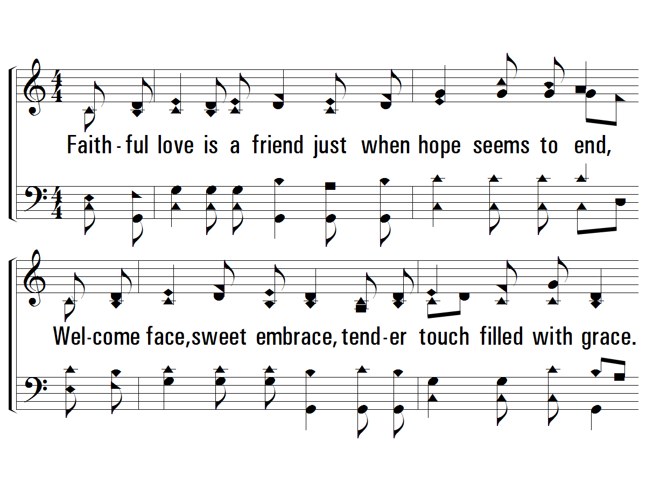
2 – Faithful Love
2.
Faithful love is a friend just when hope seems to end,
Welcome face, sweet embrace, tender touch filled with grace.
Faithful love, endless power, living flame, Spirit's fire;
Burning bright in the night, guiding my way.
Words & Music: Ken Young
Copyright © 1993 by Hallal Music
PaperlessHymnal.com

Slide 7
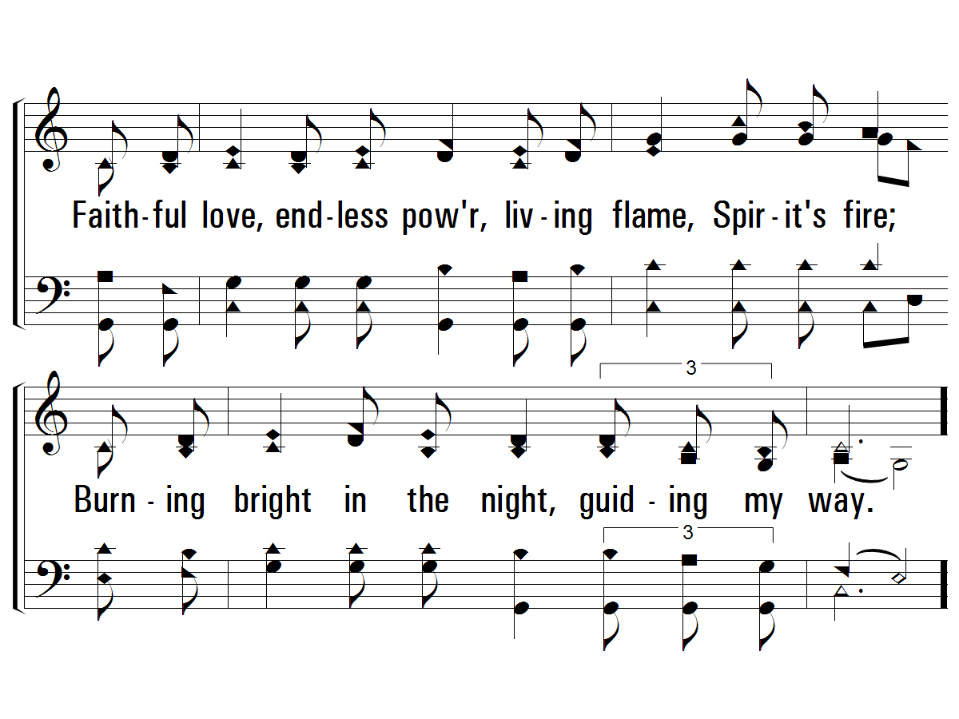
2 – Faithful Love
PaperlessHymnal.com

Slide 8
c – Faithful Love
Faithful love from above
came to earth to show the Father's love.
And I'll never be the same,
for I've seen faithful love face to face,
and Jesus is His name.
PaperlessHymnal.com

Slide 9
c – Faithful Love
PaperlessHymnal.com

Slide 12
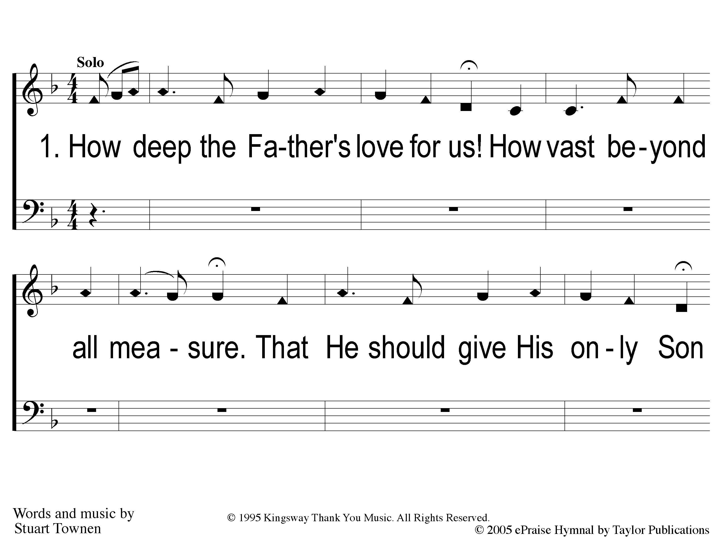
1-1 How Deep the Father’s Love
How Deep The Father’s Love

Slide 13
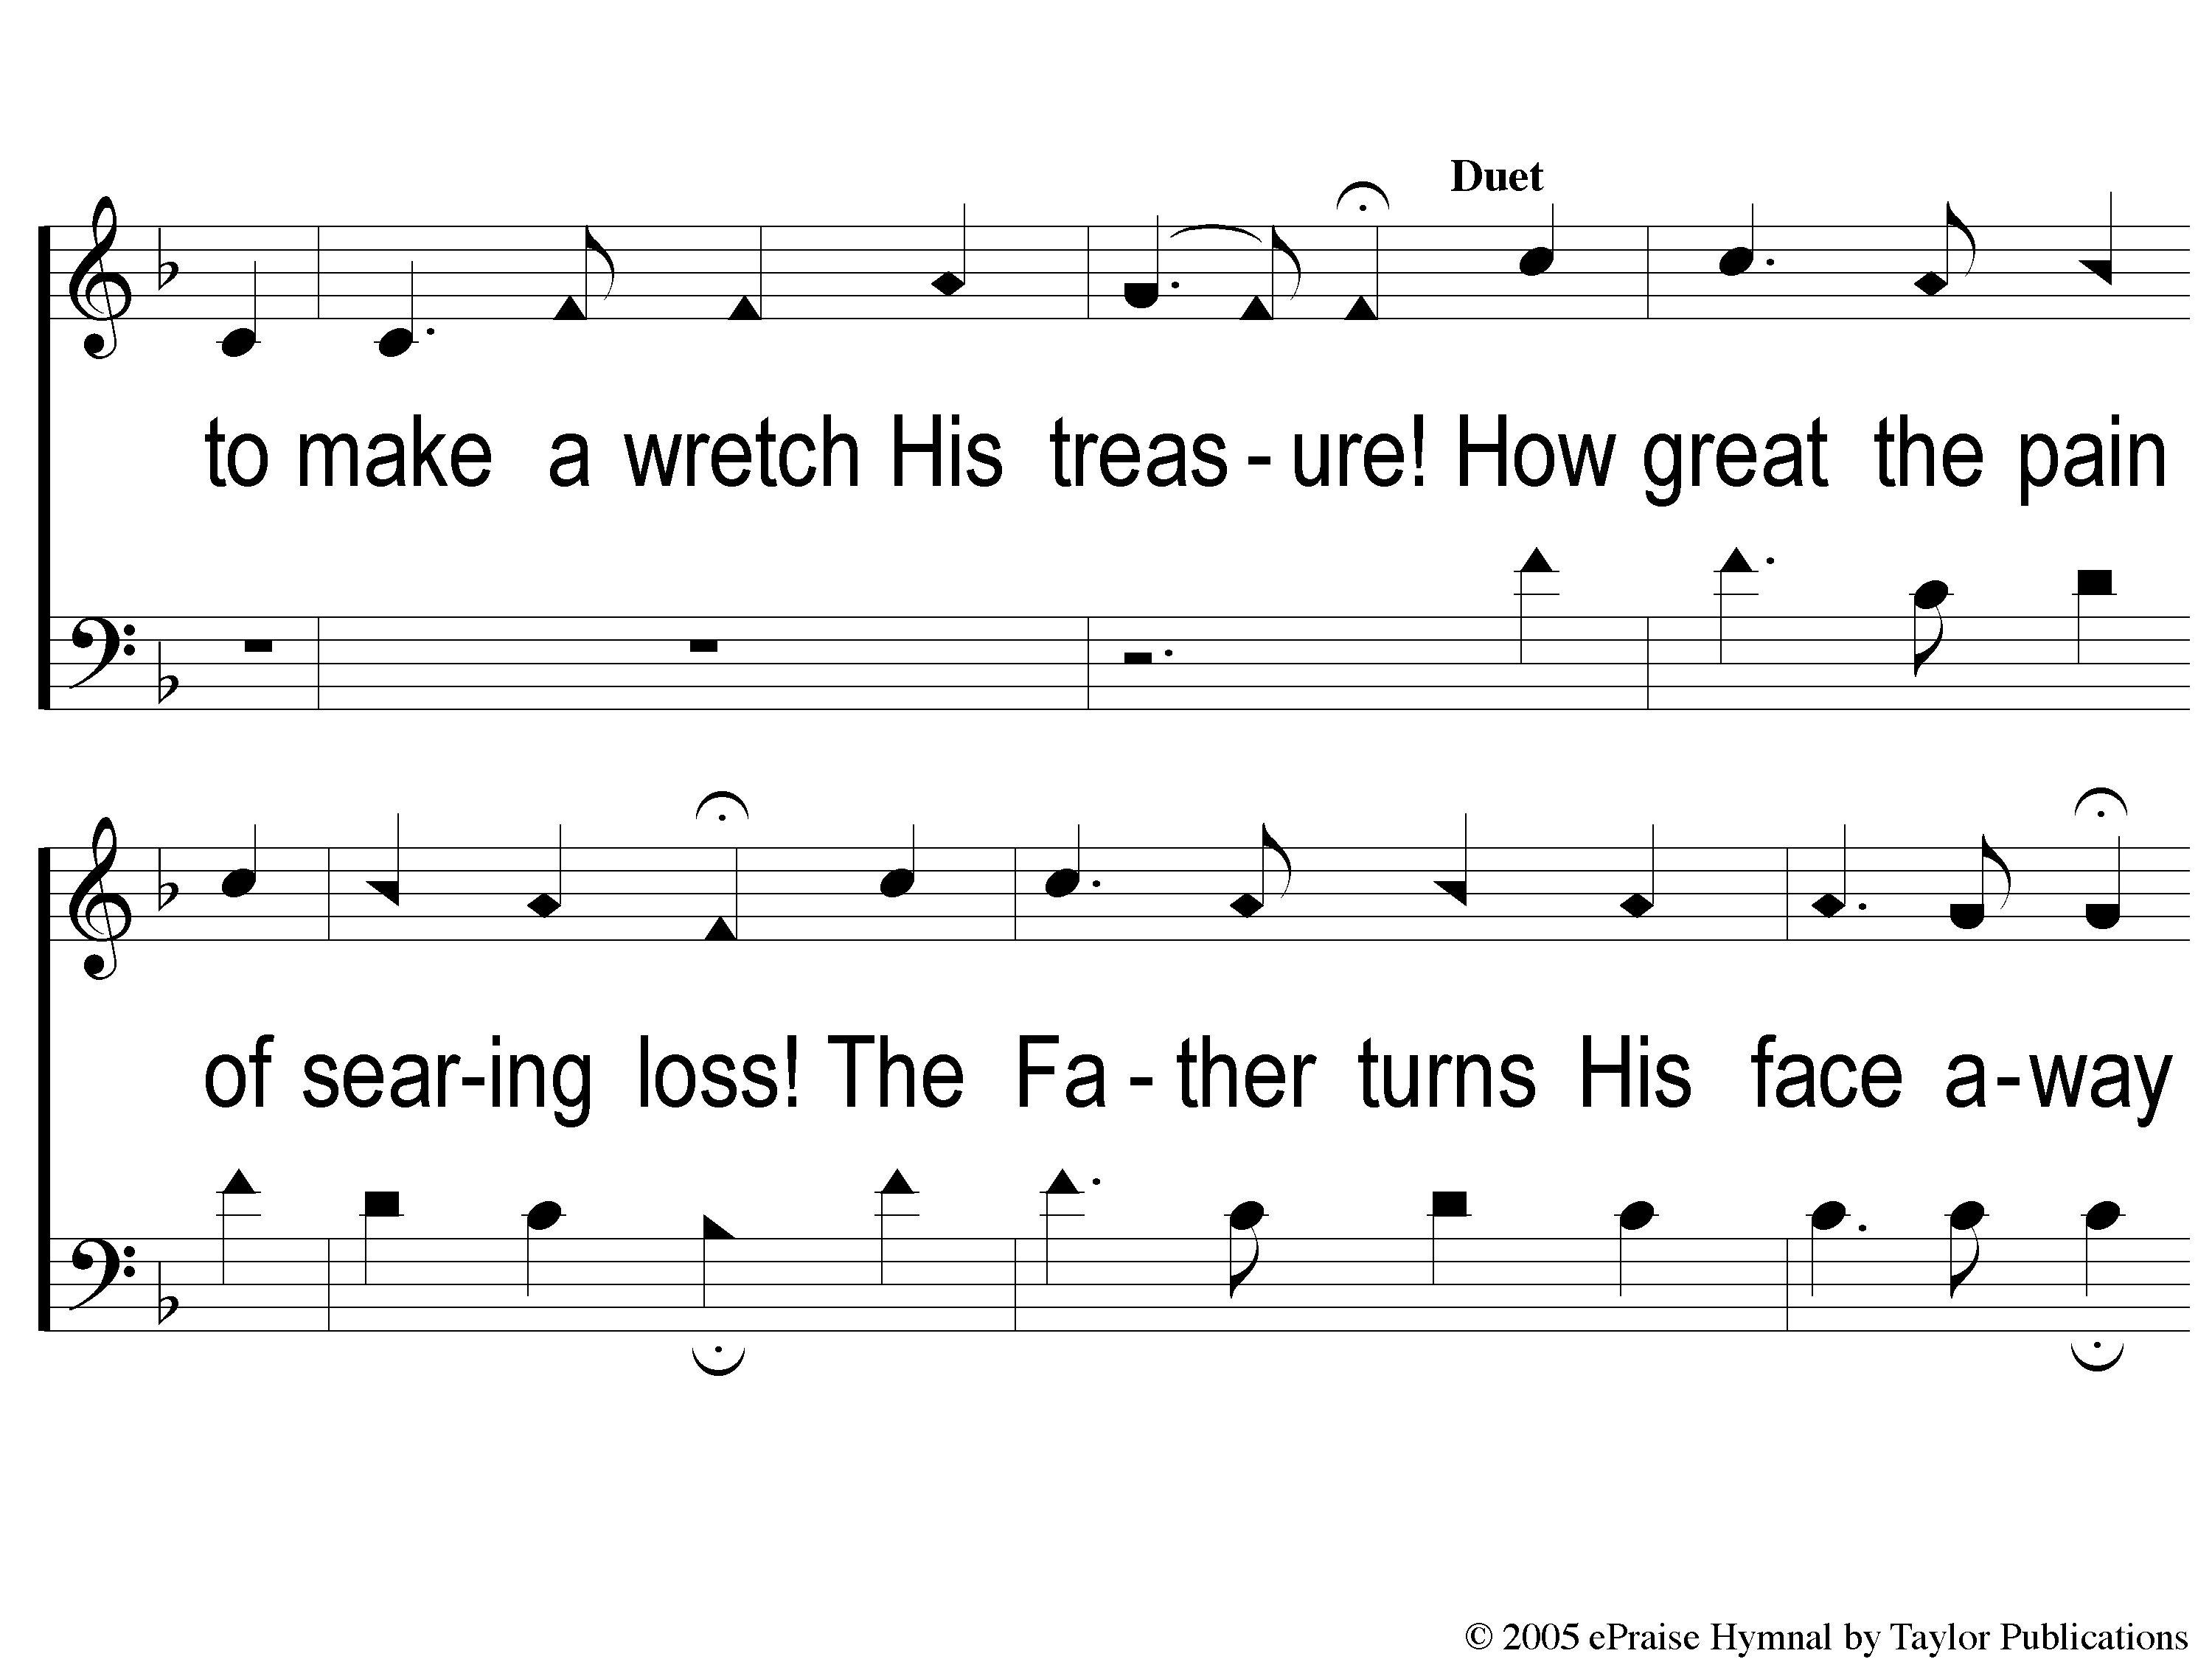
1-2 How Deep the Father’s Love
How Deep The Father’s Love

Slide 14
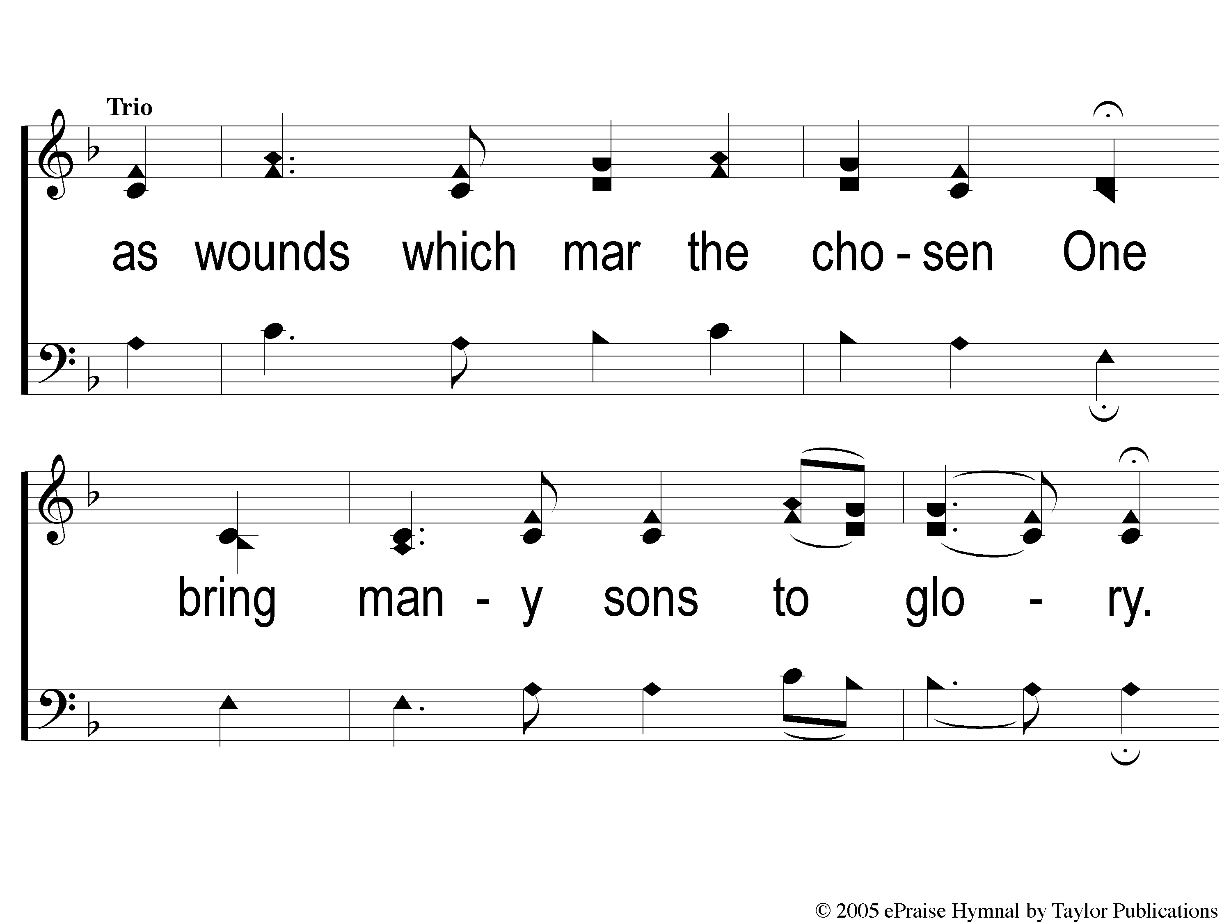
1-3 How Deep the Father’s Love
How Deep The Father’s Love

Slide 15
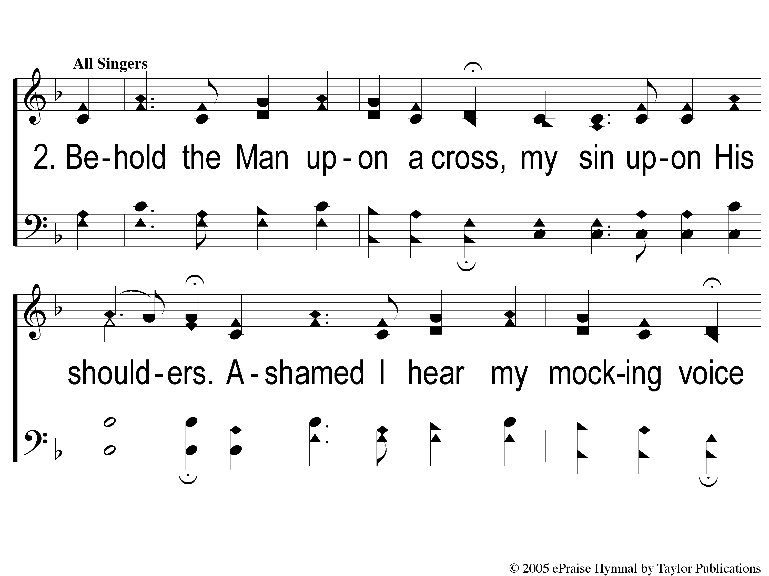
2-1 How Deep the Father’s Love
How Deep The Father’s Love

Slide 16
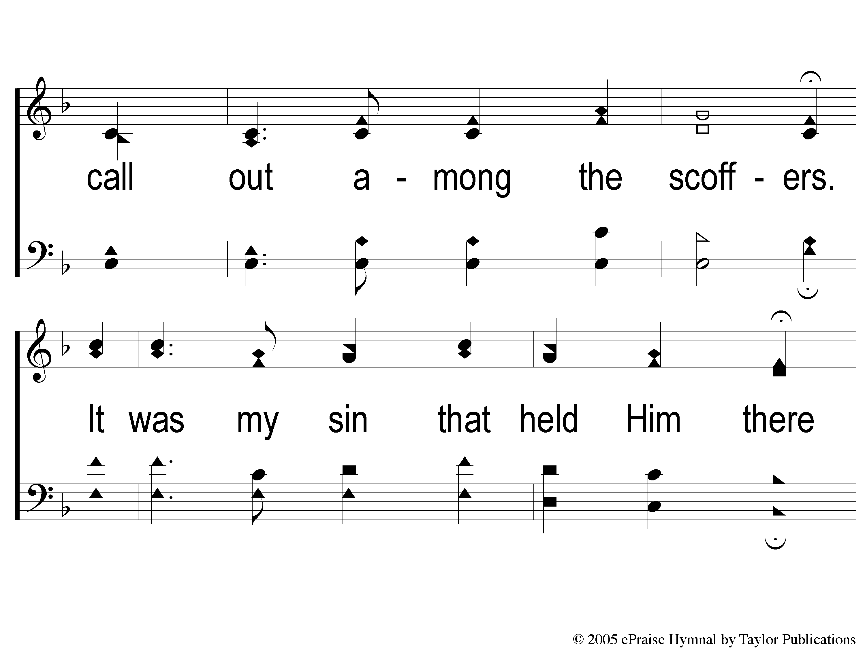
2-2 How Deep the Father’s Love
How Deep The Father’s Love

Slide 17
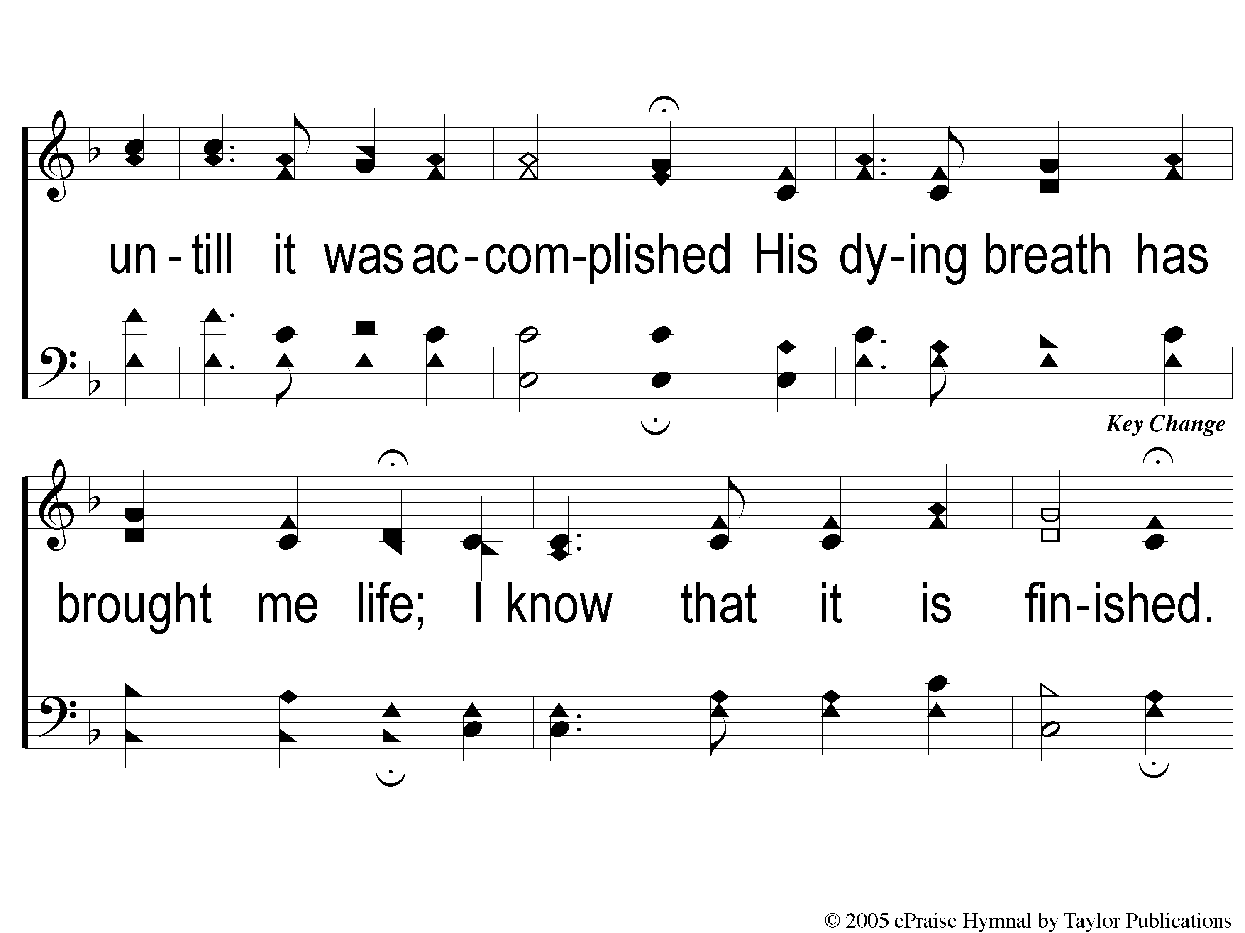
2-3 How Deep the Father’s Love
How Deep The Father’s Love

Slide 18
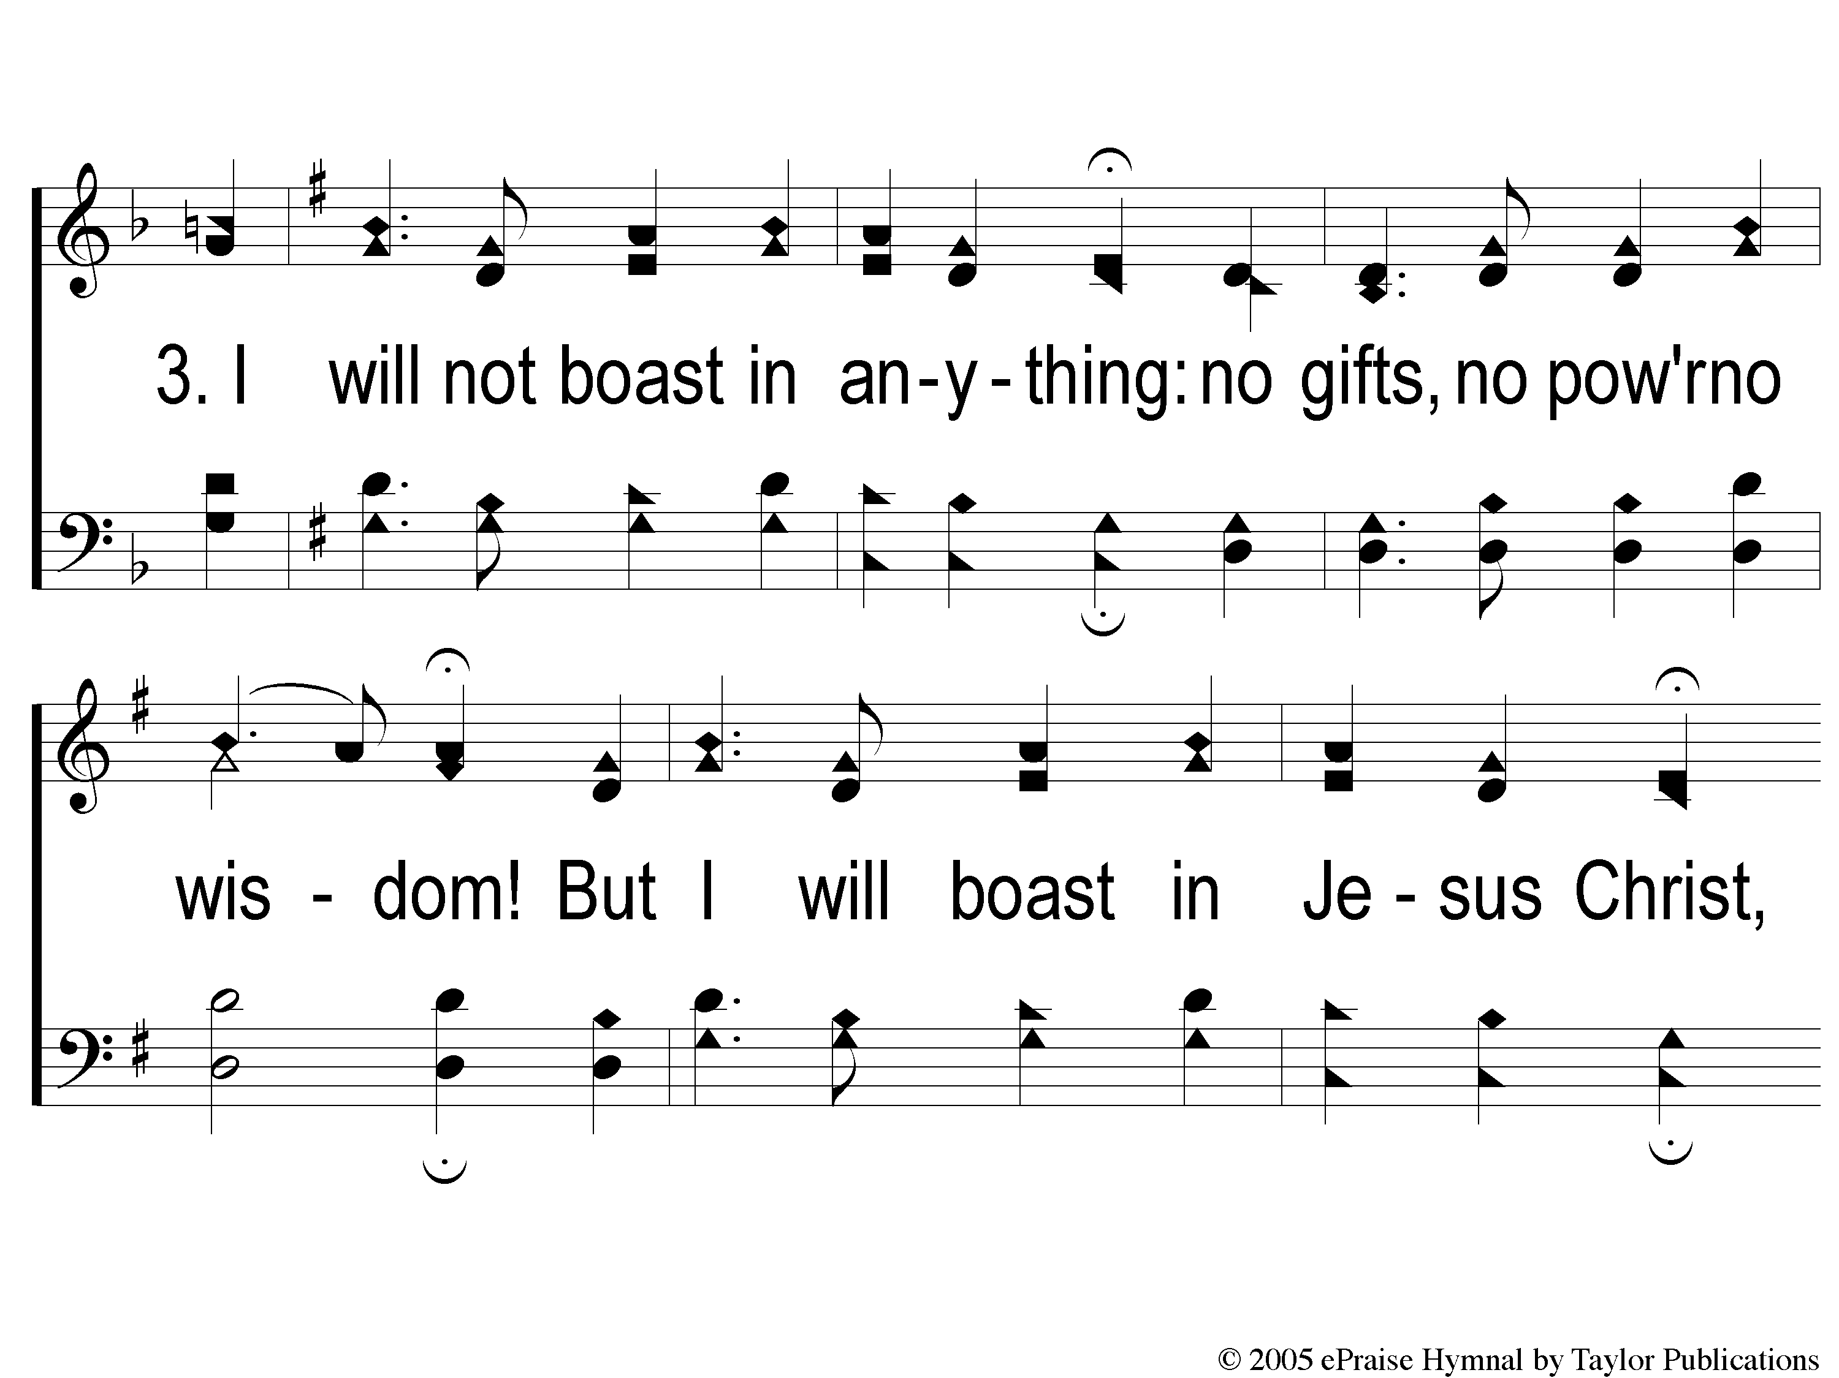
3-1 How Deep the Father’s Love
How Deep The Father’s Love

Slide 19
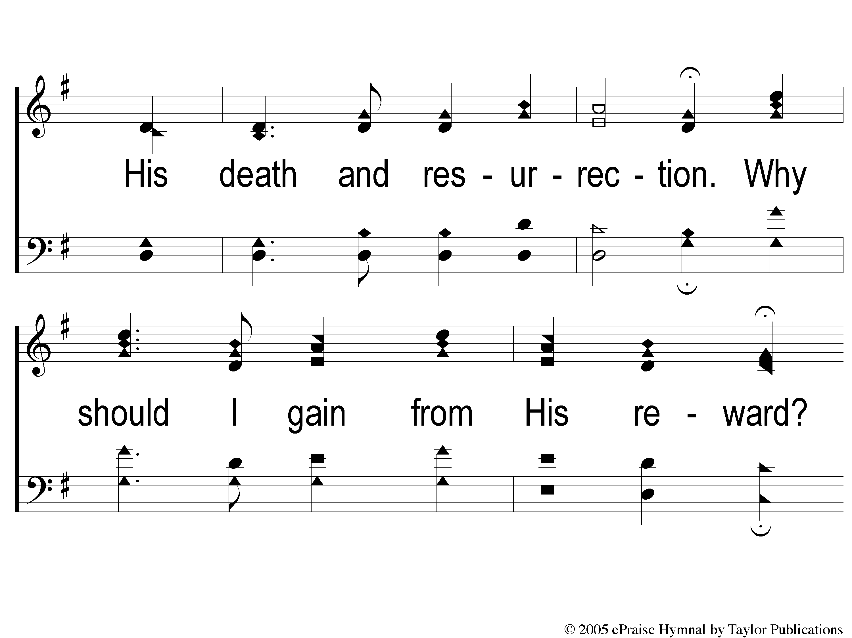
3-2 How Deep the Father’s Love
How Deep The Father’s Love

Slide 20
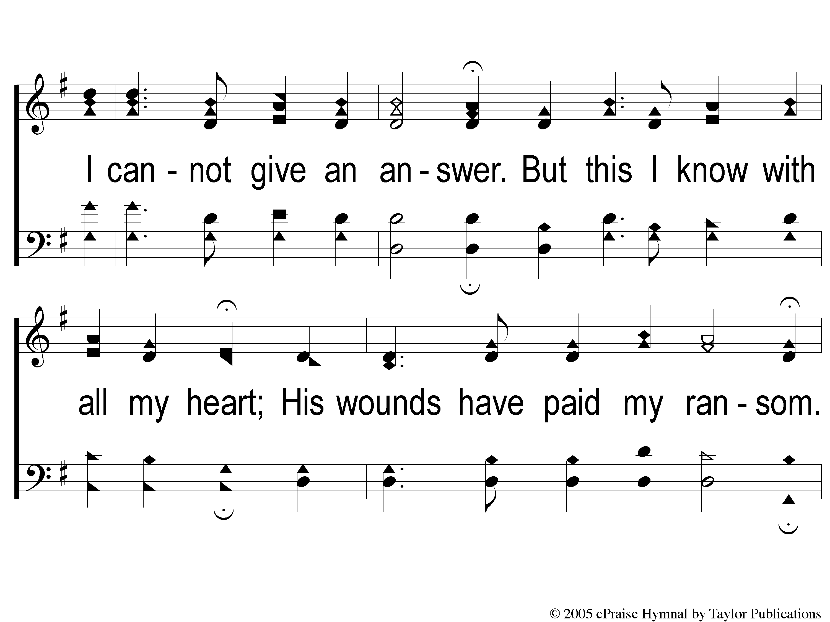
3-3 How Deep the Father’s Love
How Deep The Father’s Love

Slide 21
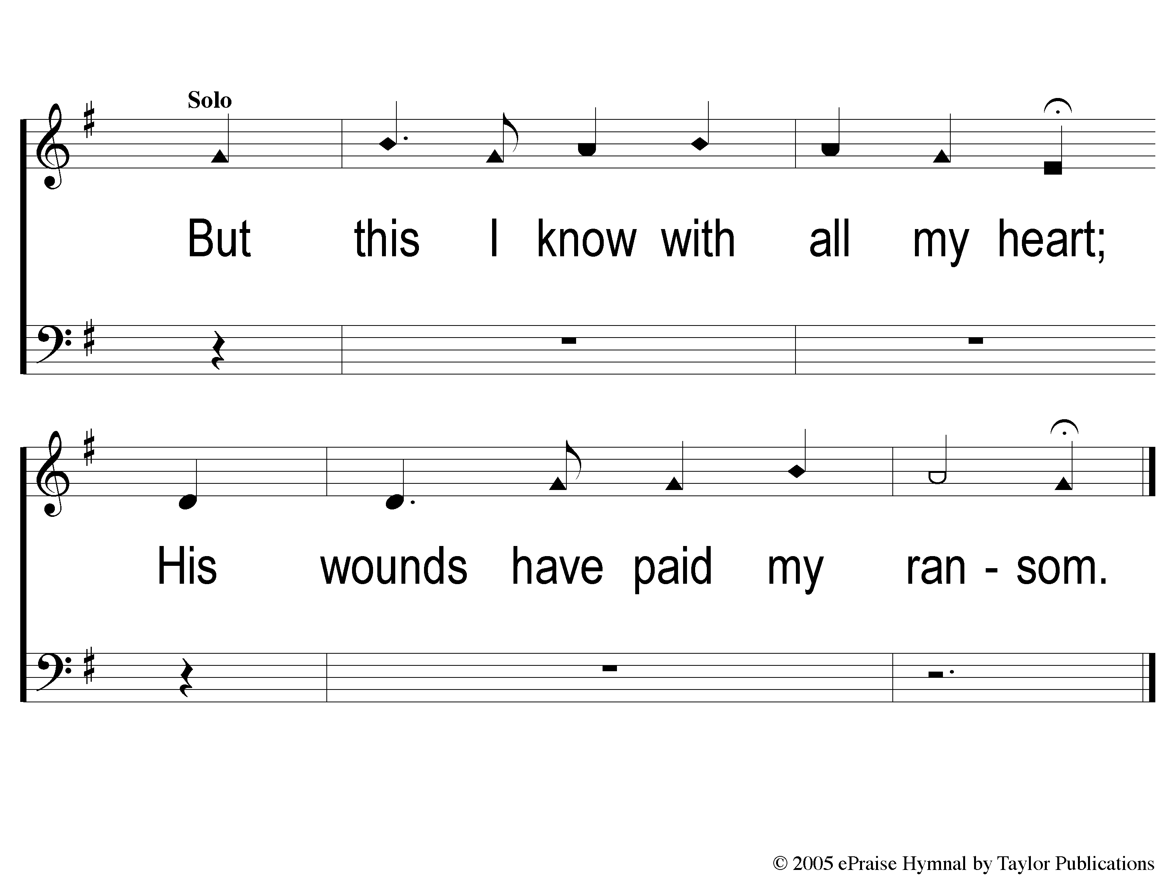
tag How Deep the Father’s Love
How Deep The Father’s Love

Slide 23
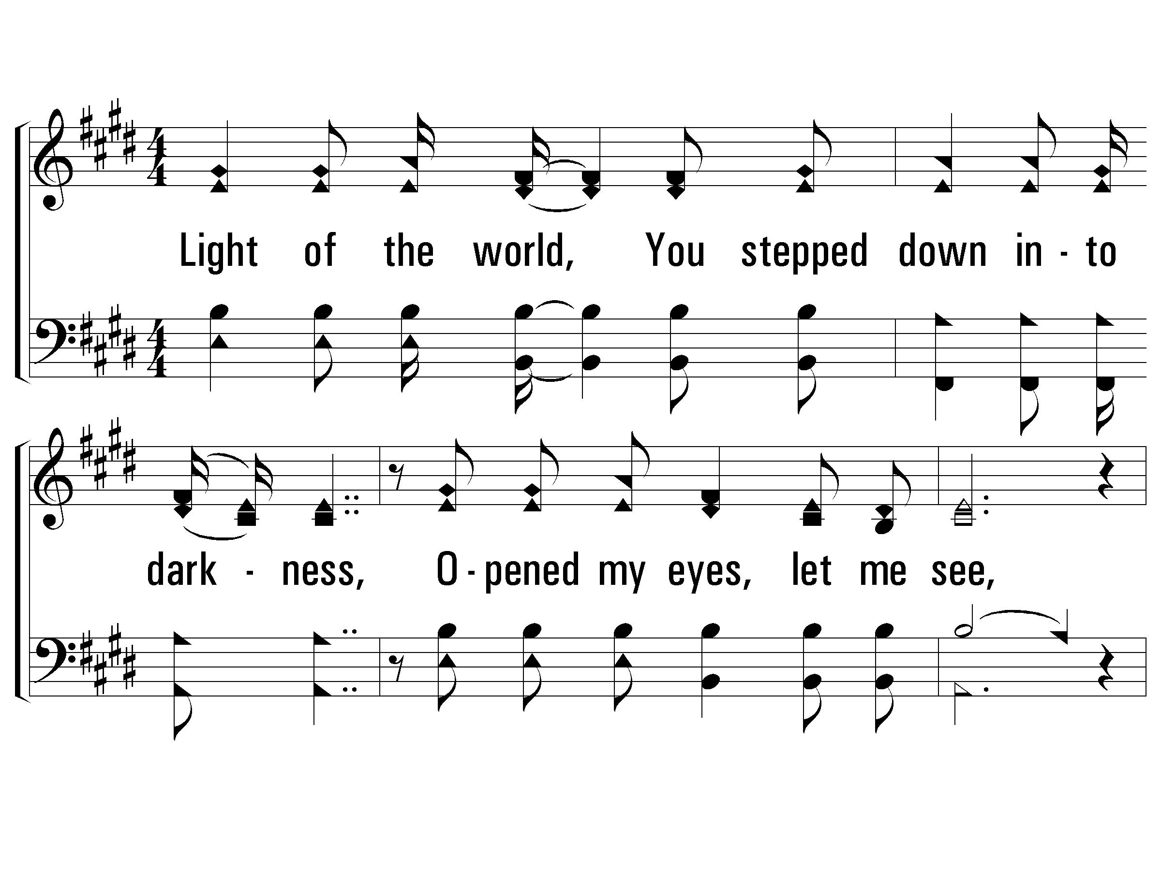
1 – Here I Am To Worship
Light of the world, You stepped down into darkness,
Opened my eyes, let me see,
Beauty that made this heart adore You,
Hope of a life spent with You.
Here I am to worship. Here I am to bow down.
Here I am to say that You're my God.
You're altogether lovely, altogether worthy,
altogether wonderful to me.
King of all days, all so highly exalted,
Glorious in heaven above,
Humbly You came to the earth You created,
All for our sake be-came poor.
Beauty that made this heart adore You,
Hope of a life spent with You.
Word and Music: Tim Hughes / Arr: Zoe Group
Copyright © 2000 Thankyou Music (Admin. EMI Christian Music Publishing)
International Copyright Secured. All Rights Reserved. Used By Permission.
© 2006 The Paperless Hymnal®

Slide 24
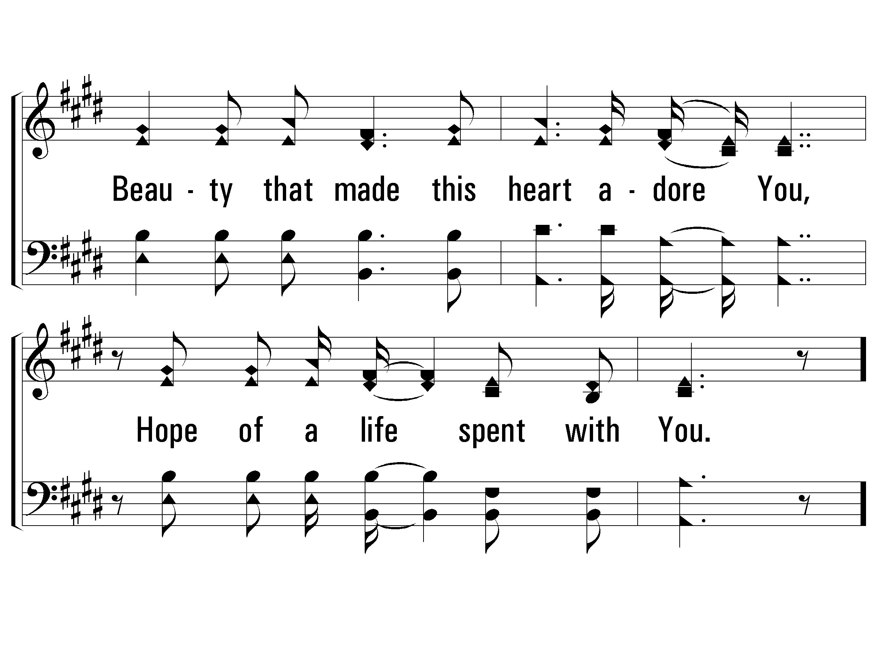
1 – Here I Am To Worship
© 2006 The Paperless Hymnal®

Slide 25
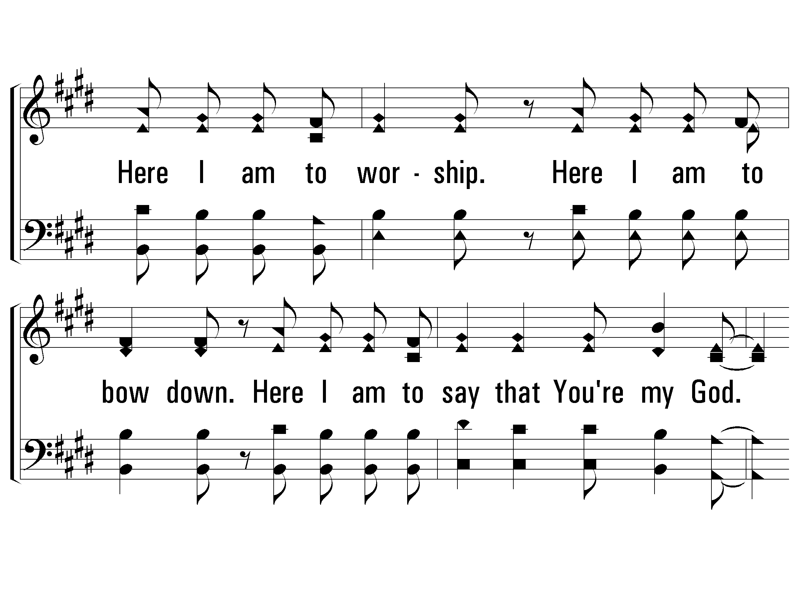
1 – Here I Am To Worship
© 2006 The Paperless Hymnal®

Slide 26
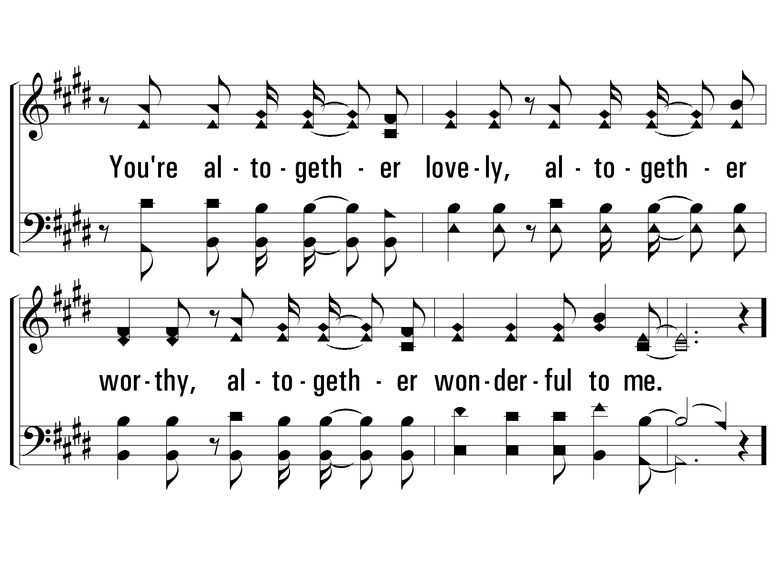
1 – Here I Am To Worship
© 2006 The Paperless Hymnal®

Slide 27
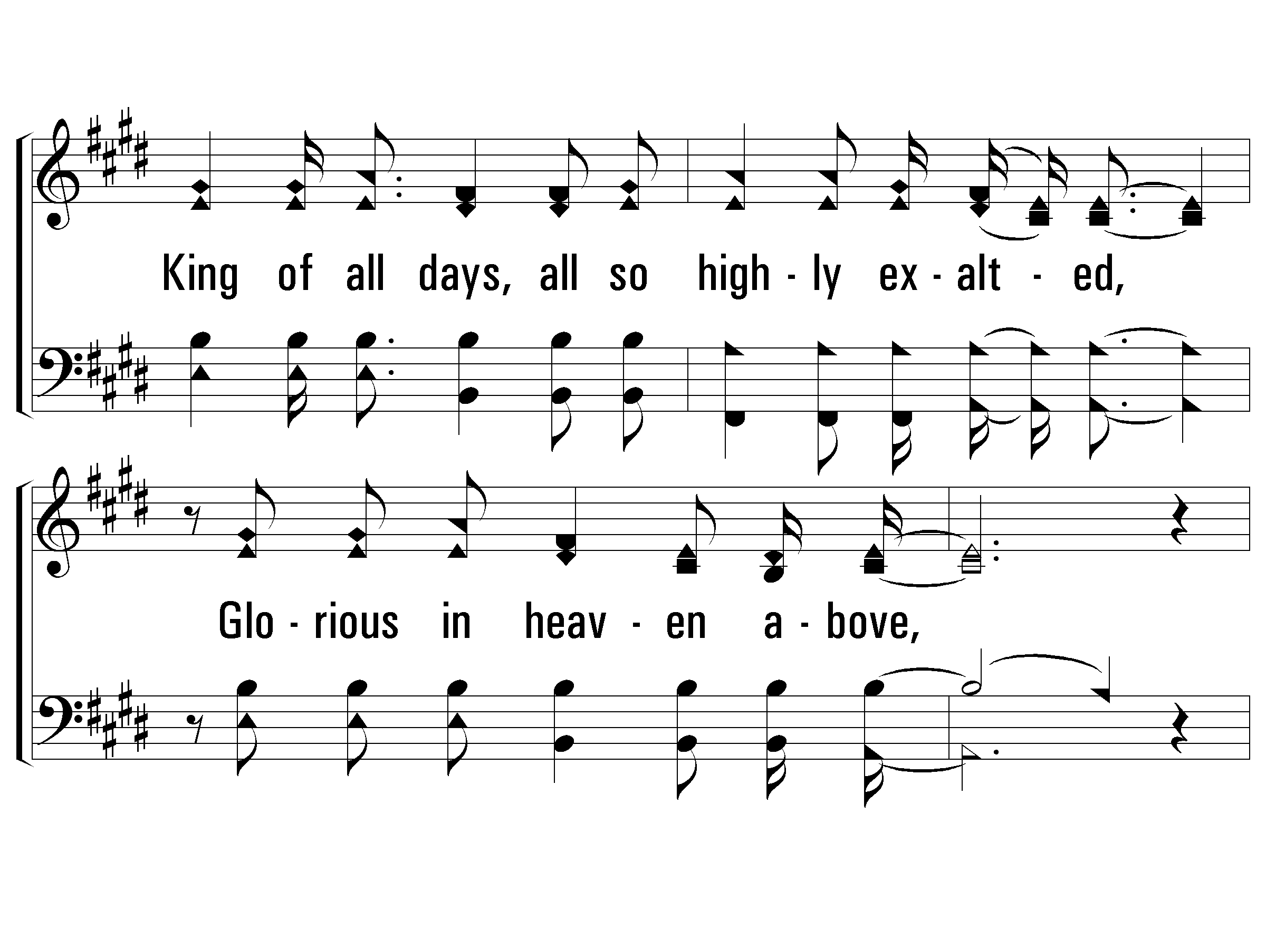
B – Here I Am To Worship
© 2006 The Paperless Hymnal®

Slide 28
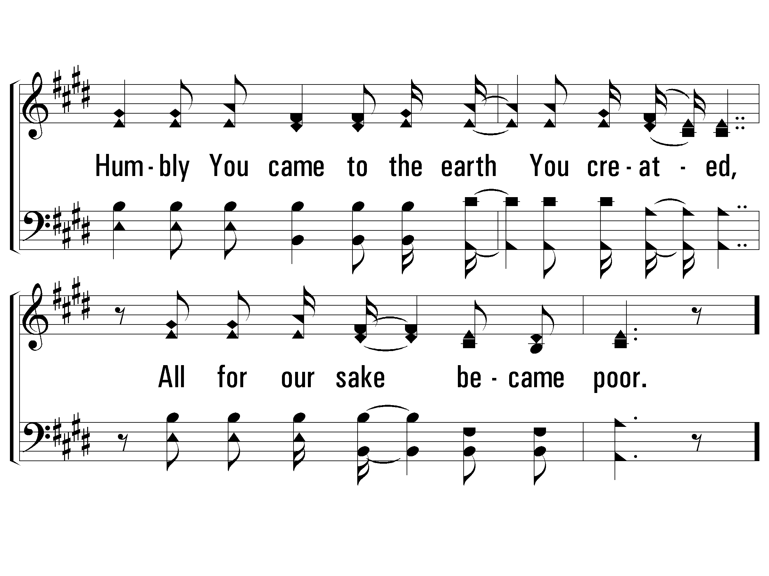
B – Here I Am To Worship
© 2006 The Paperless Hymnal®

Slide 29
2 – Here I Am To Worship
Word and Music: Tim Hughes / Arr: Zoe Group
Copyright © 2000 Thankyou Music (Admin. EMI Christian Music Publishing)
International Copyright Secured. All Rights Reserved. Used By Permission.
© 2006 The Paperless Hymnal®

Slide 30
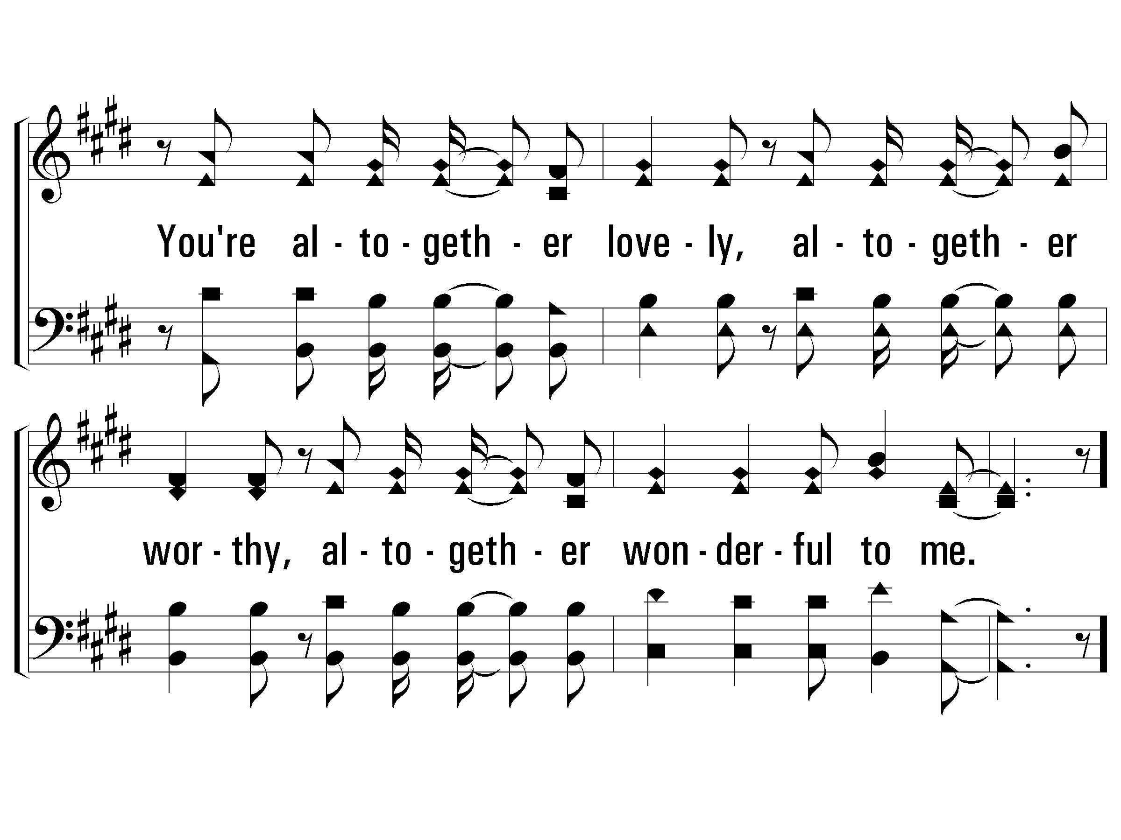
2 – Here I Am To Worship
© 2006 The Paperless Hymnal®

Slide 31
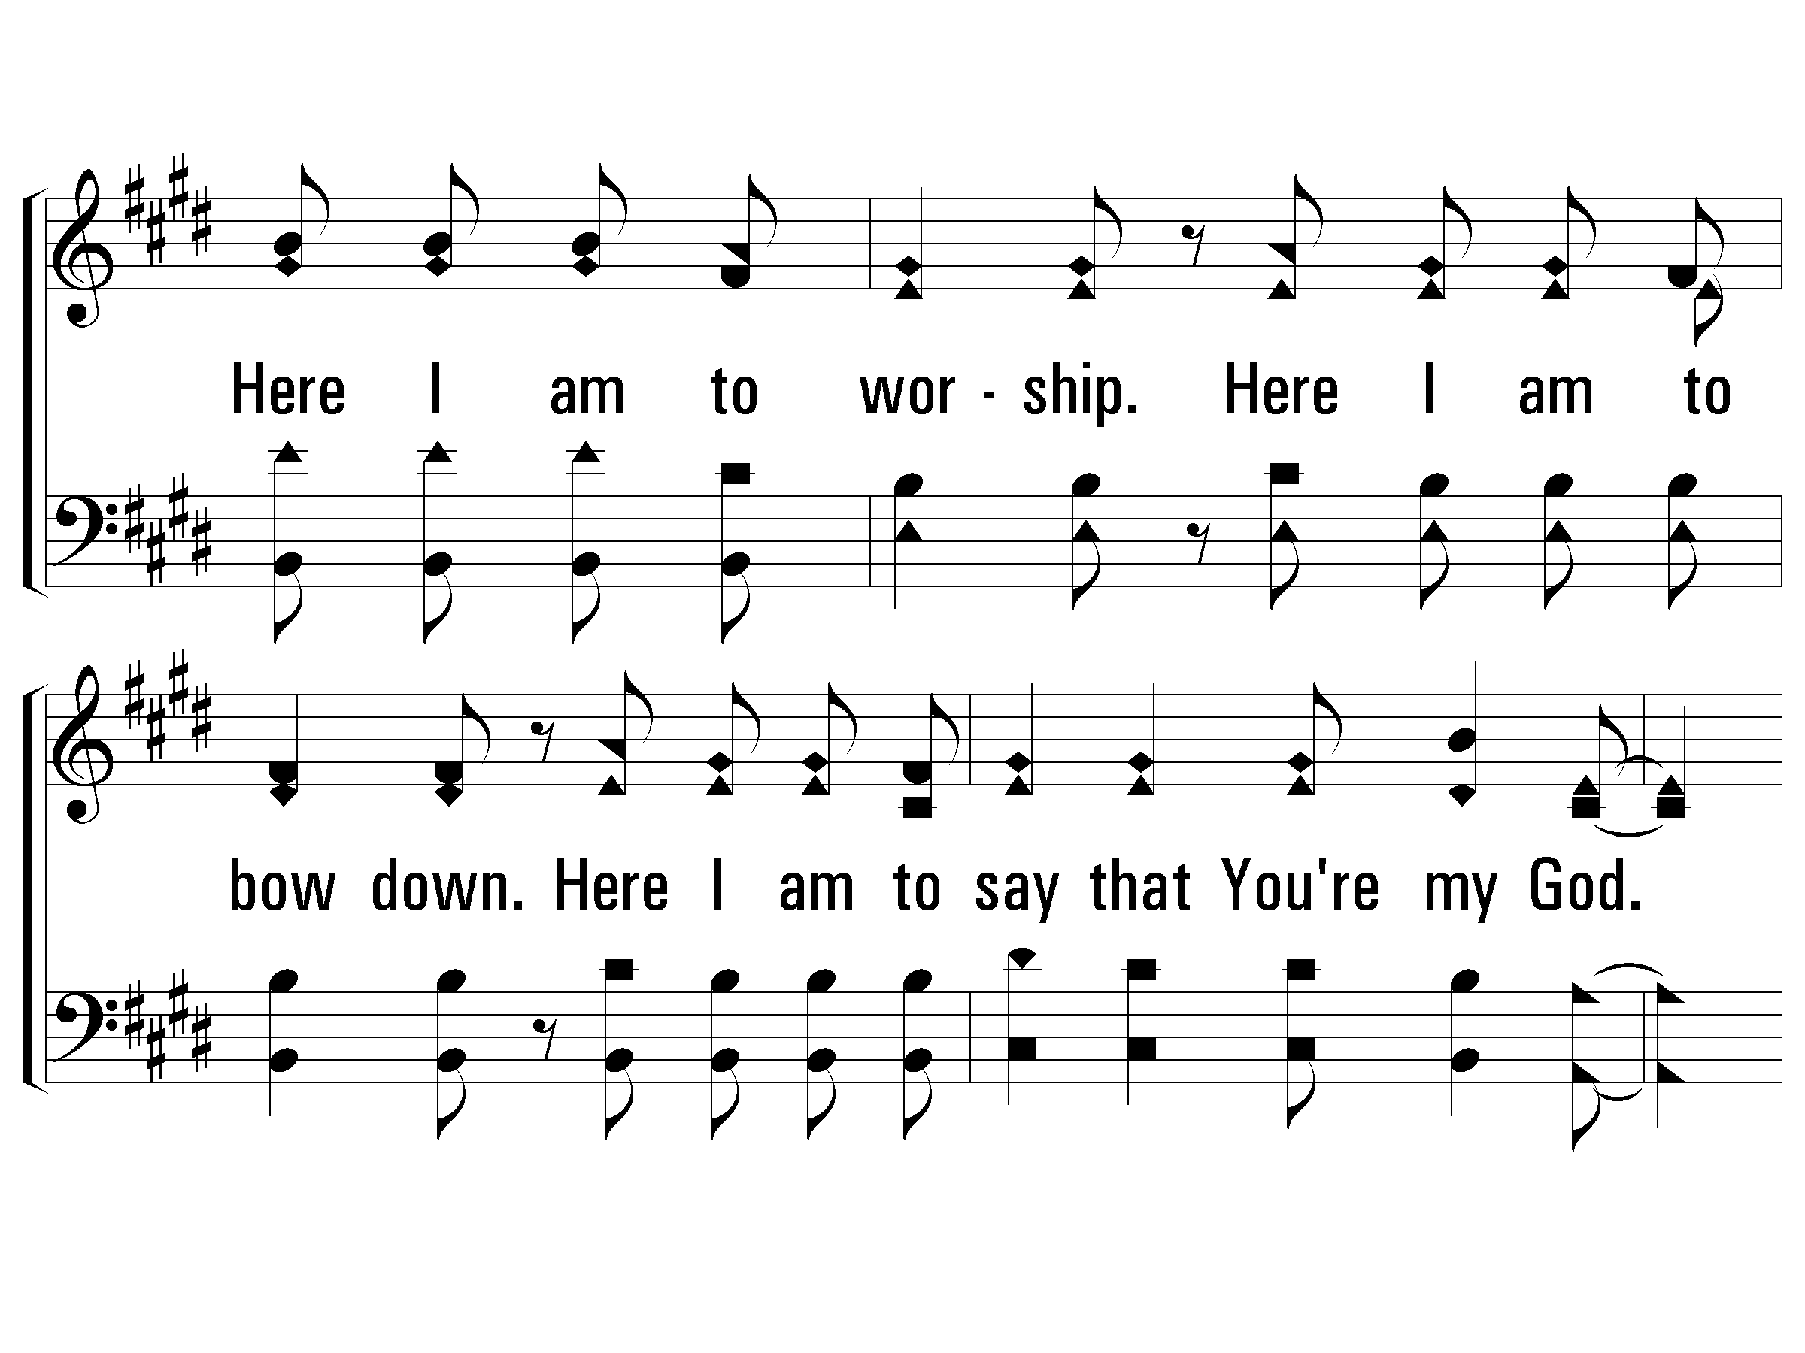
3 – Here I Am To Worship
© 2006 The Paperless Hymnal®

Slide 32
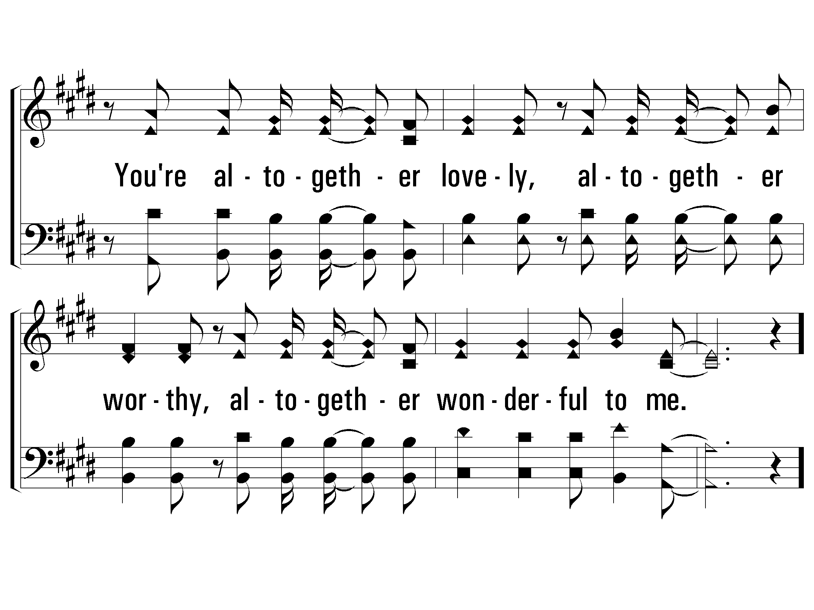
3 – Here I Am To Worship
© 2006 The Paperless Hymnal®

Slide 33
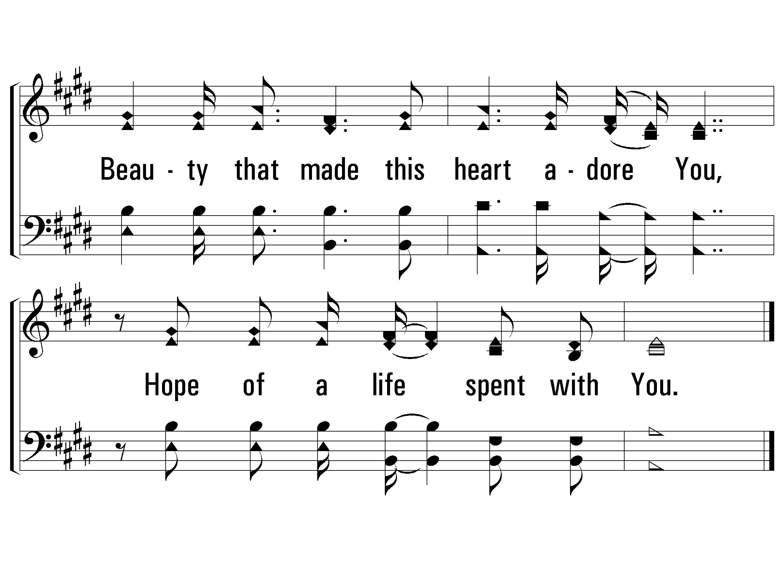
c – Here I Am To Worship
© 2006 The Paperless Hymnal®

Slide 35
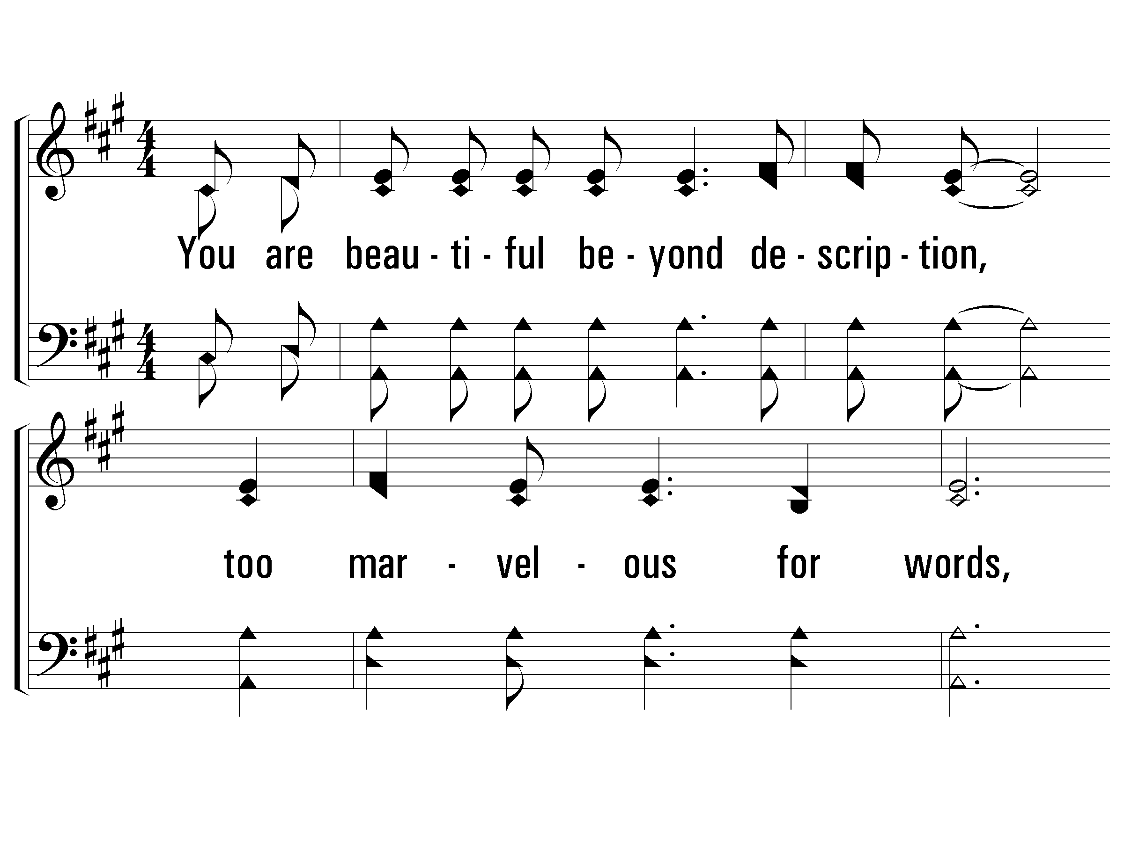
1 - I Stand In Awe
You are beautiful be-yond description,
too marvelous for words,
Too wonderful for comprehension,
like nothing ever seen or heard.
Who can grasp Your infinite wisdom,
who can fathom the depth of Your love?
You are beautiful beyond description,
majesty enthroned above.
And I stand, I stand in awe of You,
I stand, I stand in awe of You;
Holy God, to whom all praise is due,
I stand in awe of You.
Words and Music by: Mark Altrogge / Arr: Reid Lancaster / Copyright © 1988 by People of Destiny International
(Administrated by CopyCare USA c/o The Copyright Company, Nashville, TN)
All Rights Reserved. International Copyright Secured. Used By Permission
© 2001 The Paperless Hymnal™

Slide 36
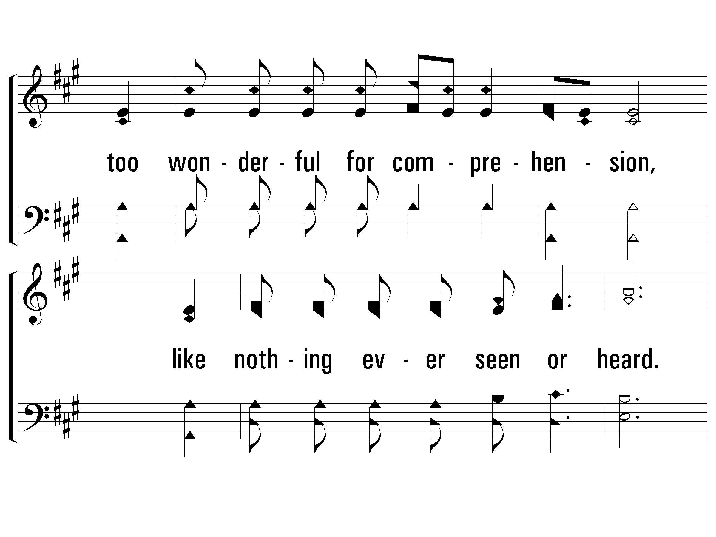
1 - I Stand In Awe
© 2001 The Paperless Hymnal™

Slide 37
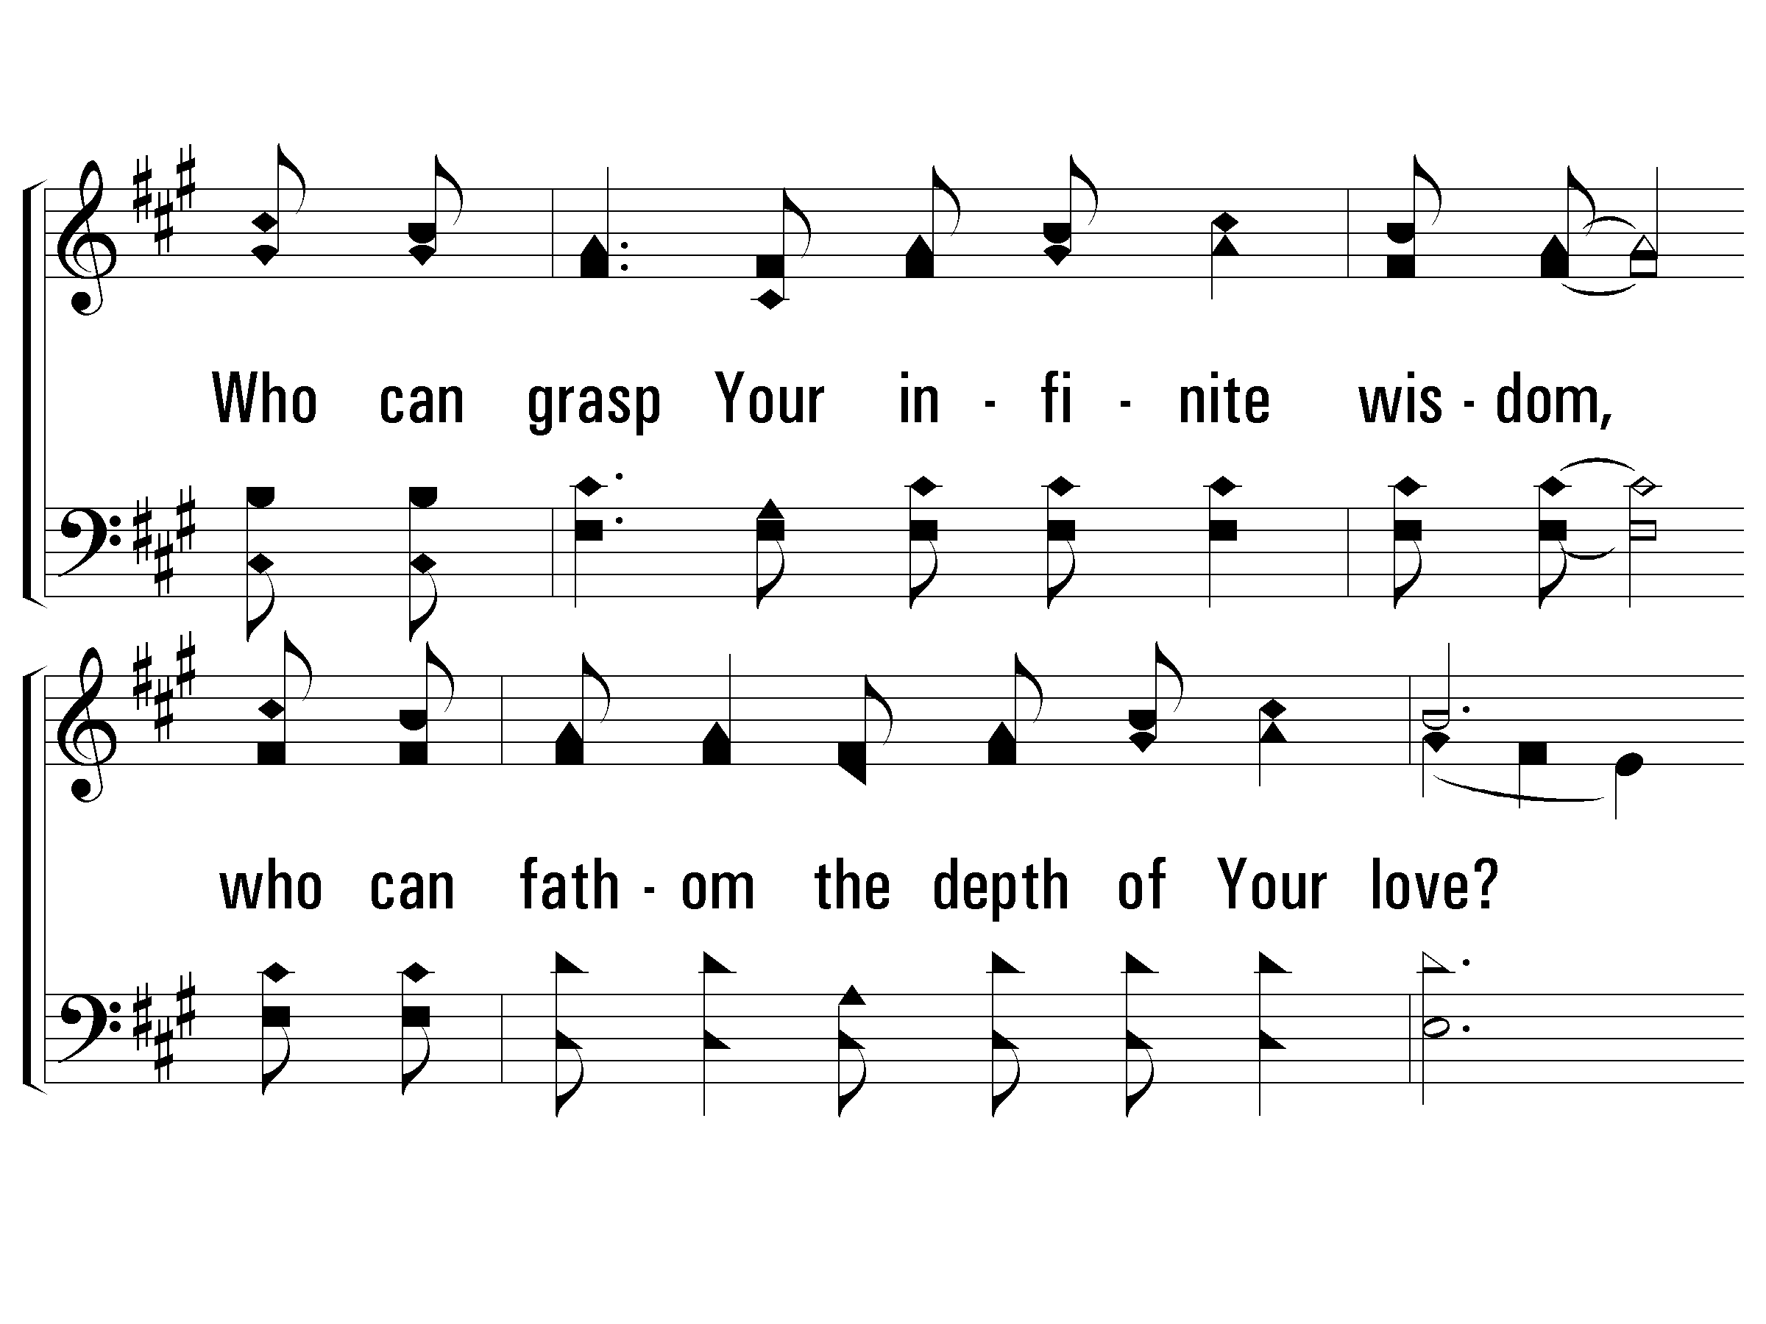
1 - I Stand In Awe
© 2001 The Paperless Hymnal™

Slide 38
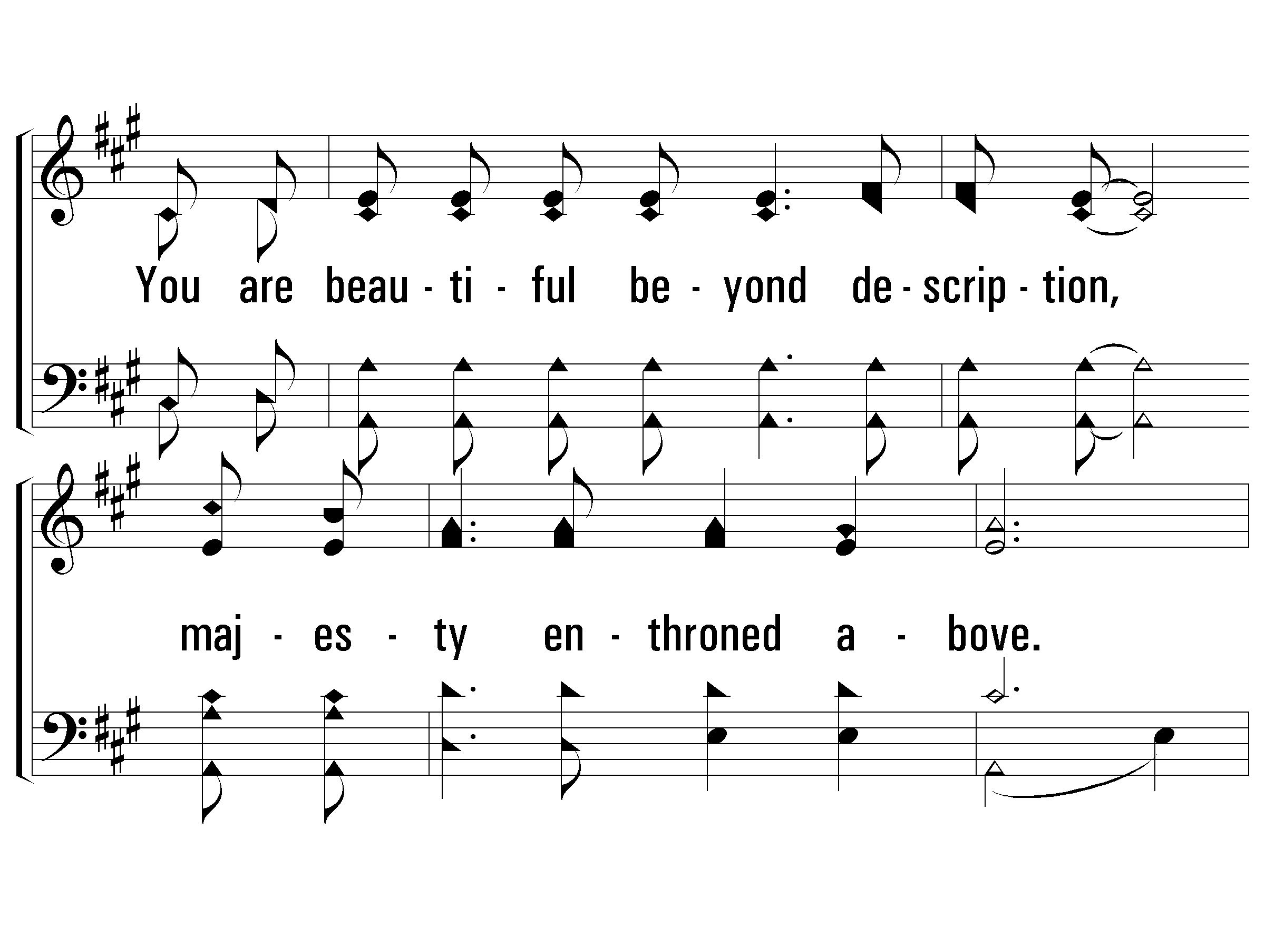
1 - I Stand In Awe
© 2001 The Paperless Hymnal™

Slide 39
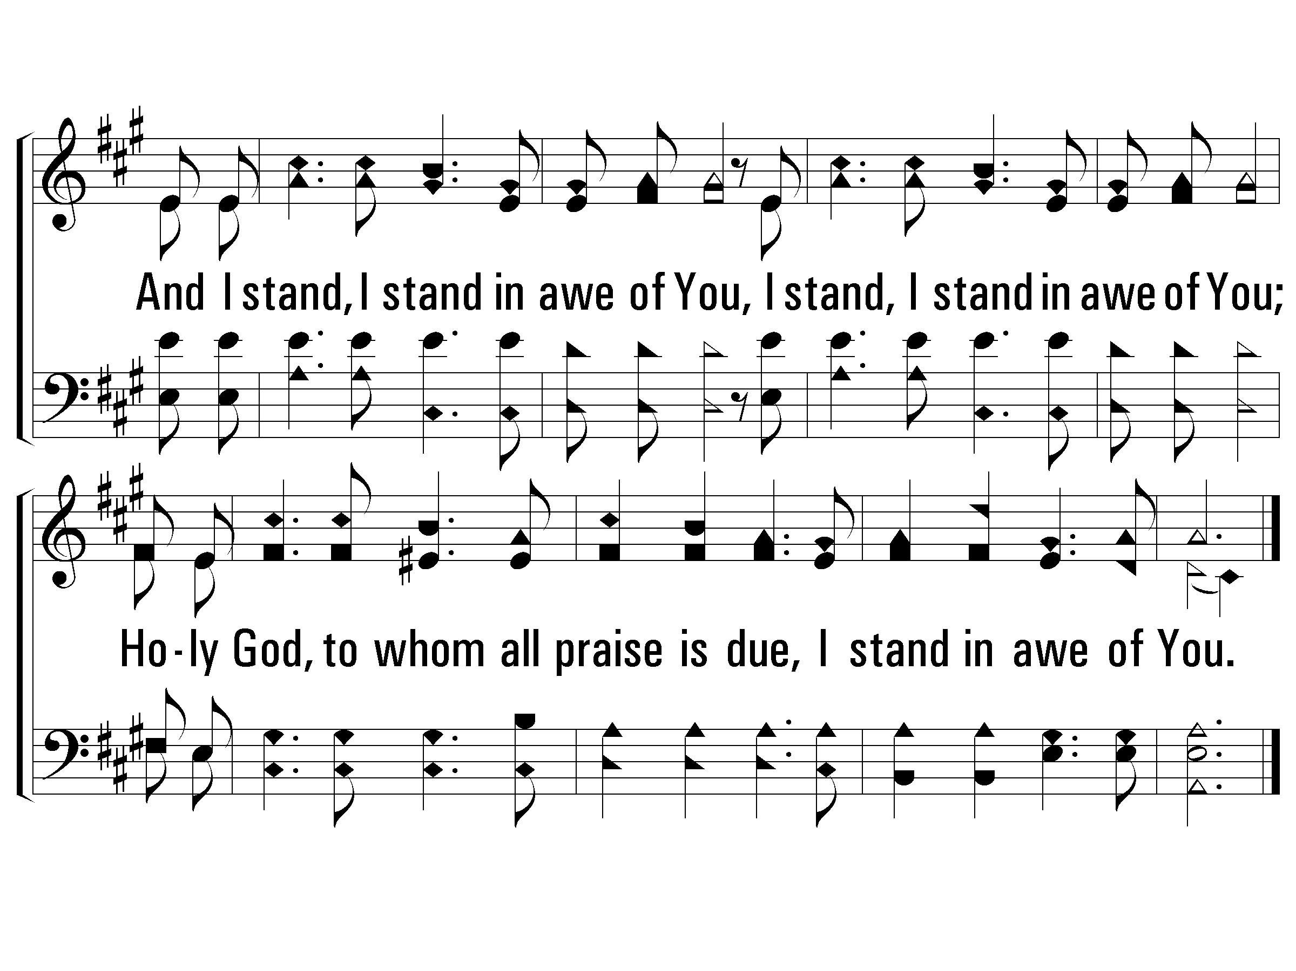
1 - I Stand In Awe
© 2001 The Paperless Hymnal™

Slide 40
1 - I Stand In Awe
© 2001 The Paperless Hymnal™

Slide 42
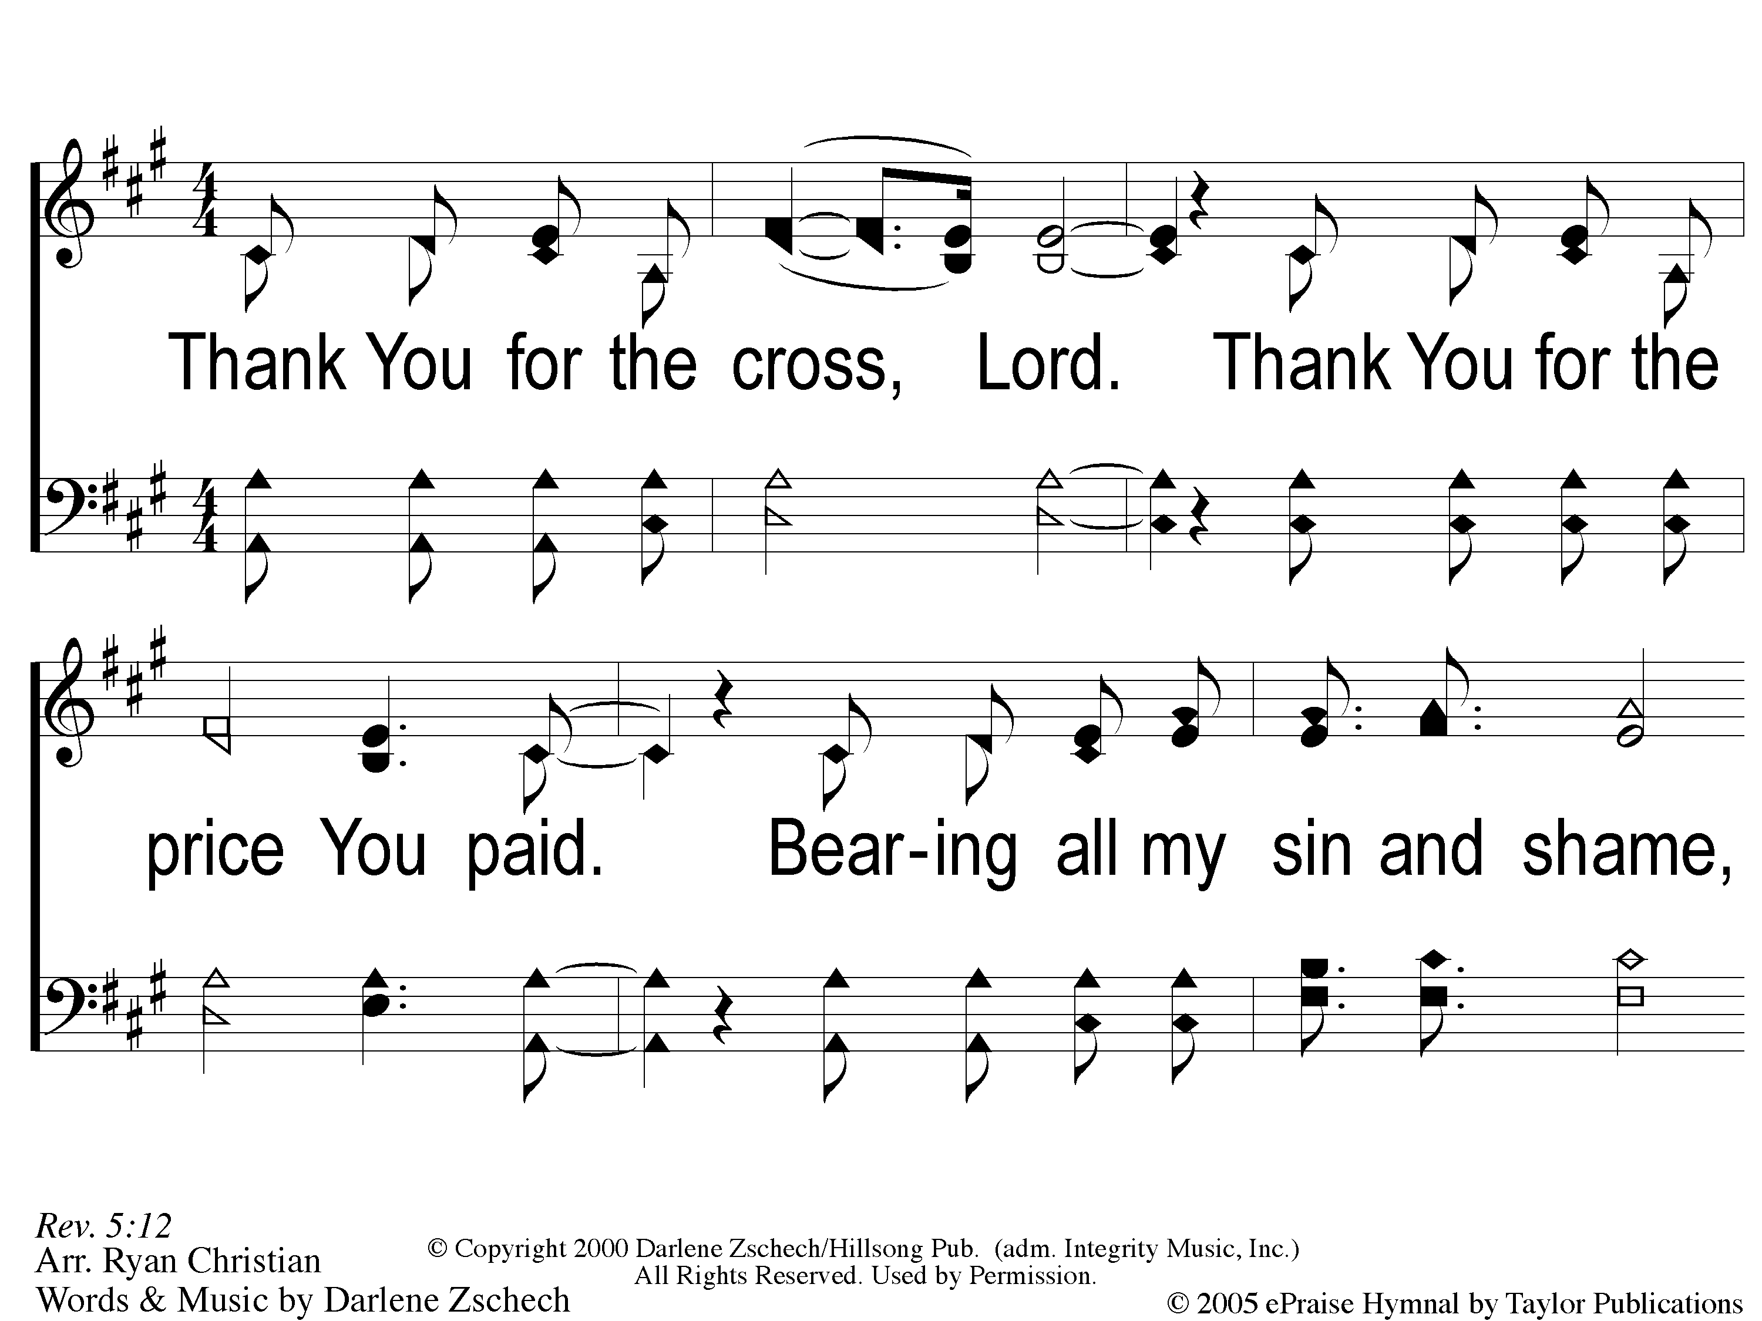
1 Worthy is the Lamb
Worthy Is The Lamb

Slide 43
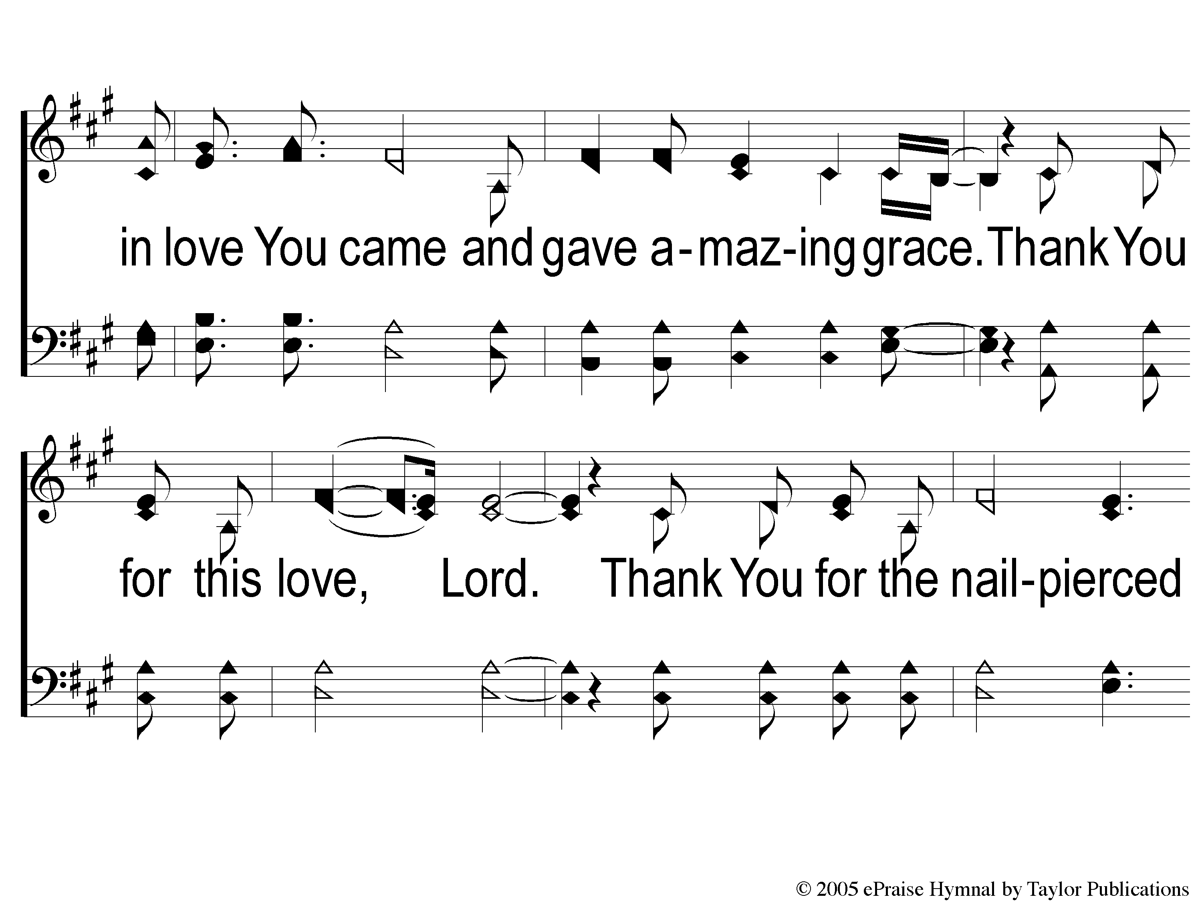
2 Worthy is the Lamb
Worthy Is The Lamb

Slide 44
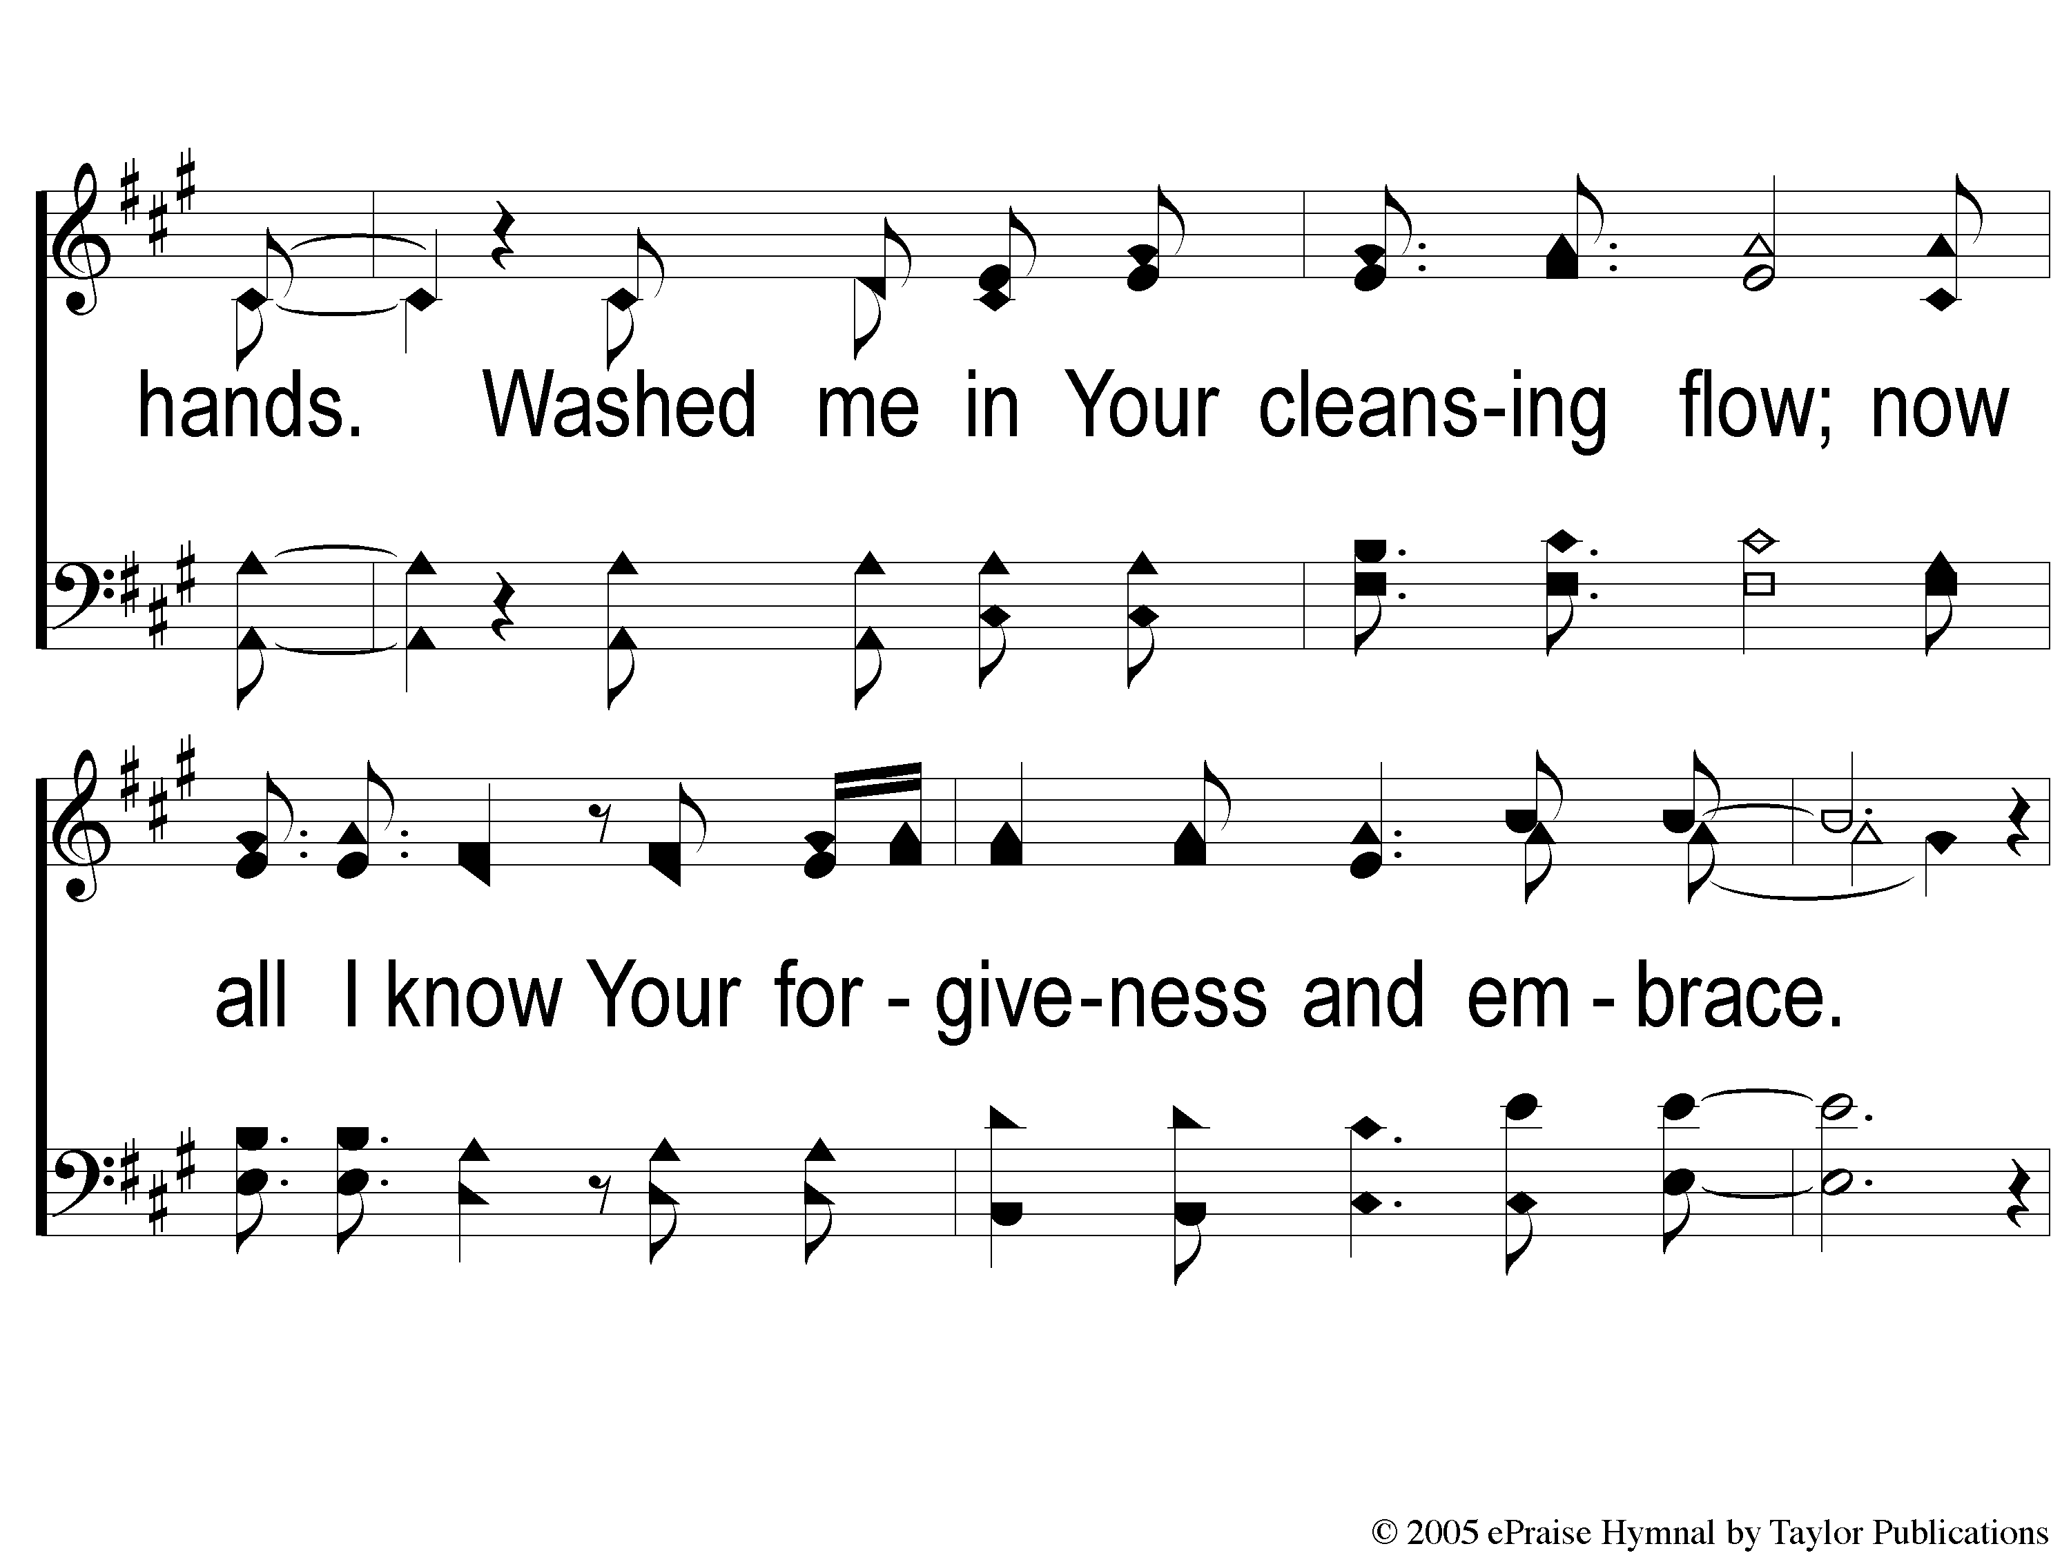
3 Worthy is the Lamb
Worthy Is The Lamb

Slide 45
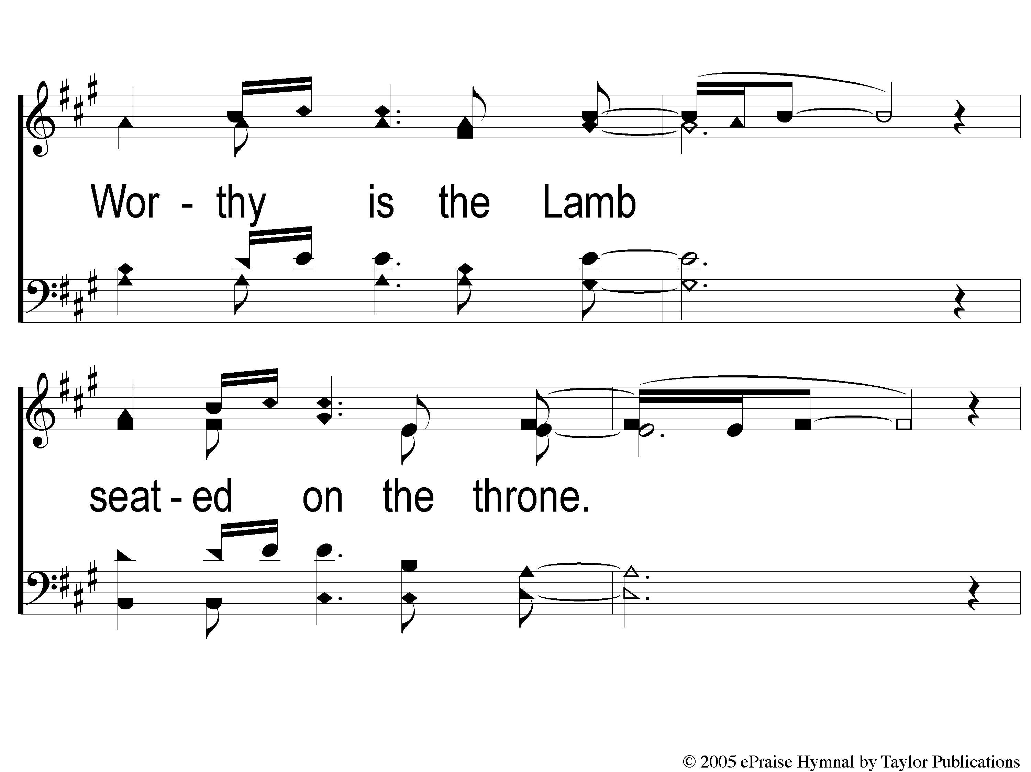
4 Worthy is the Lamb
Worthy Is The Lamb

Slide 46
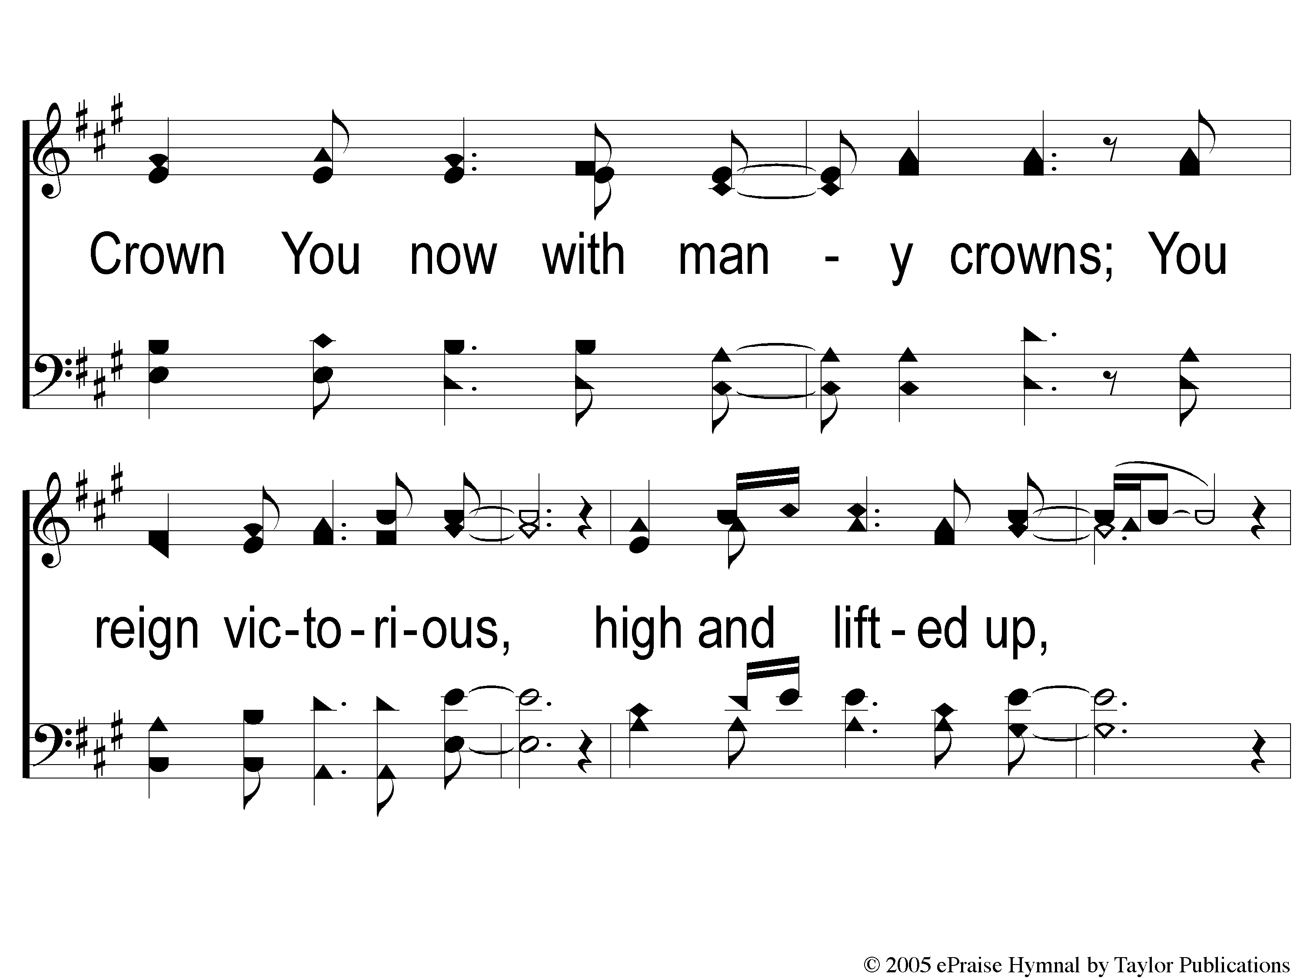
5 Worthy is the Lamb
Worthy Is The Lamb

Slide 47
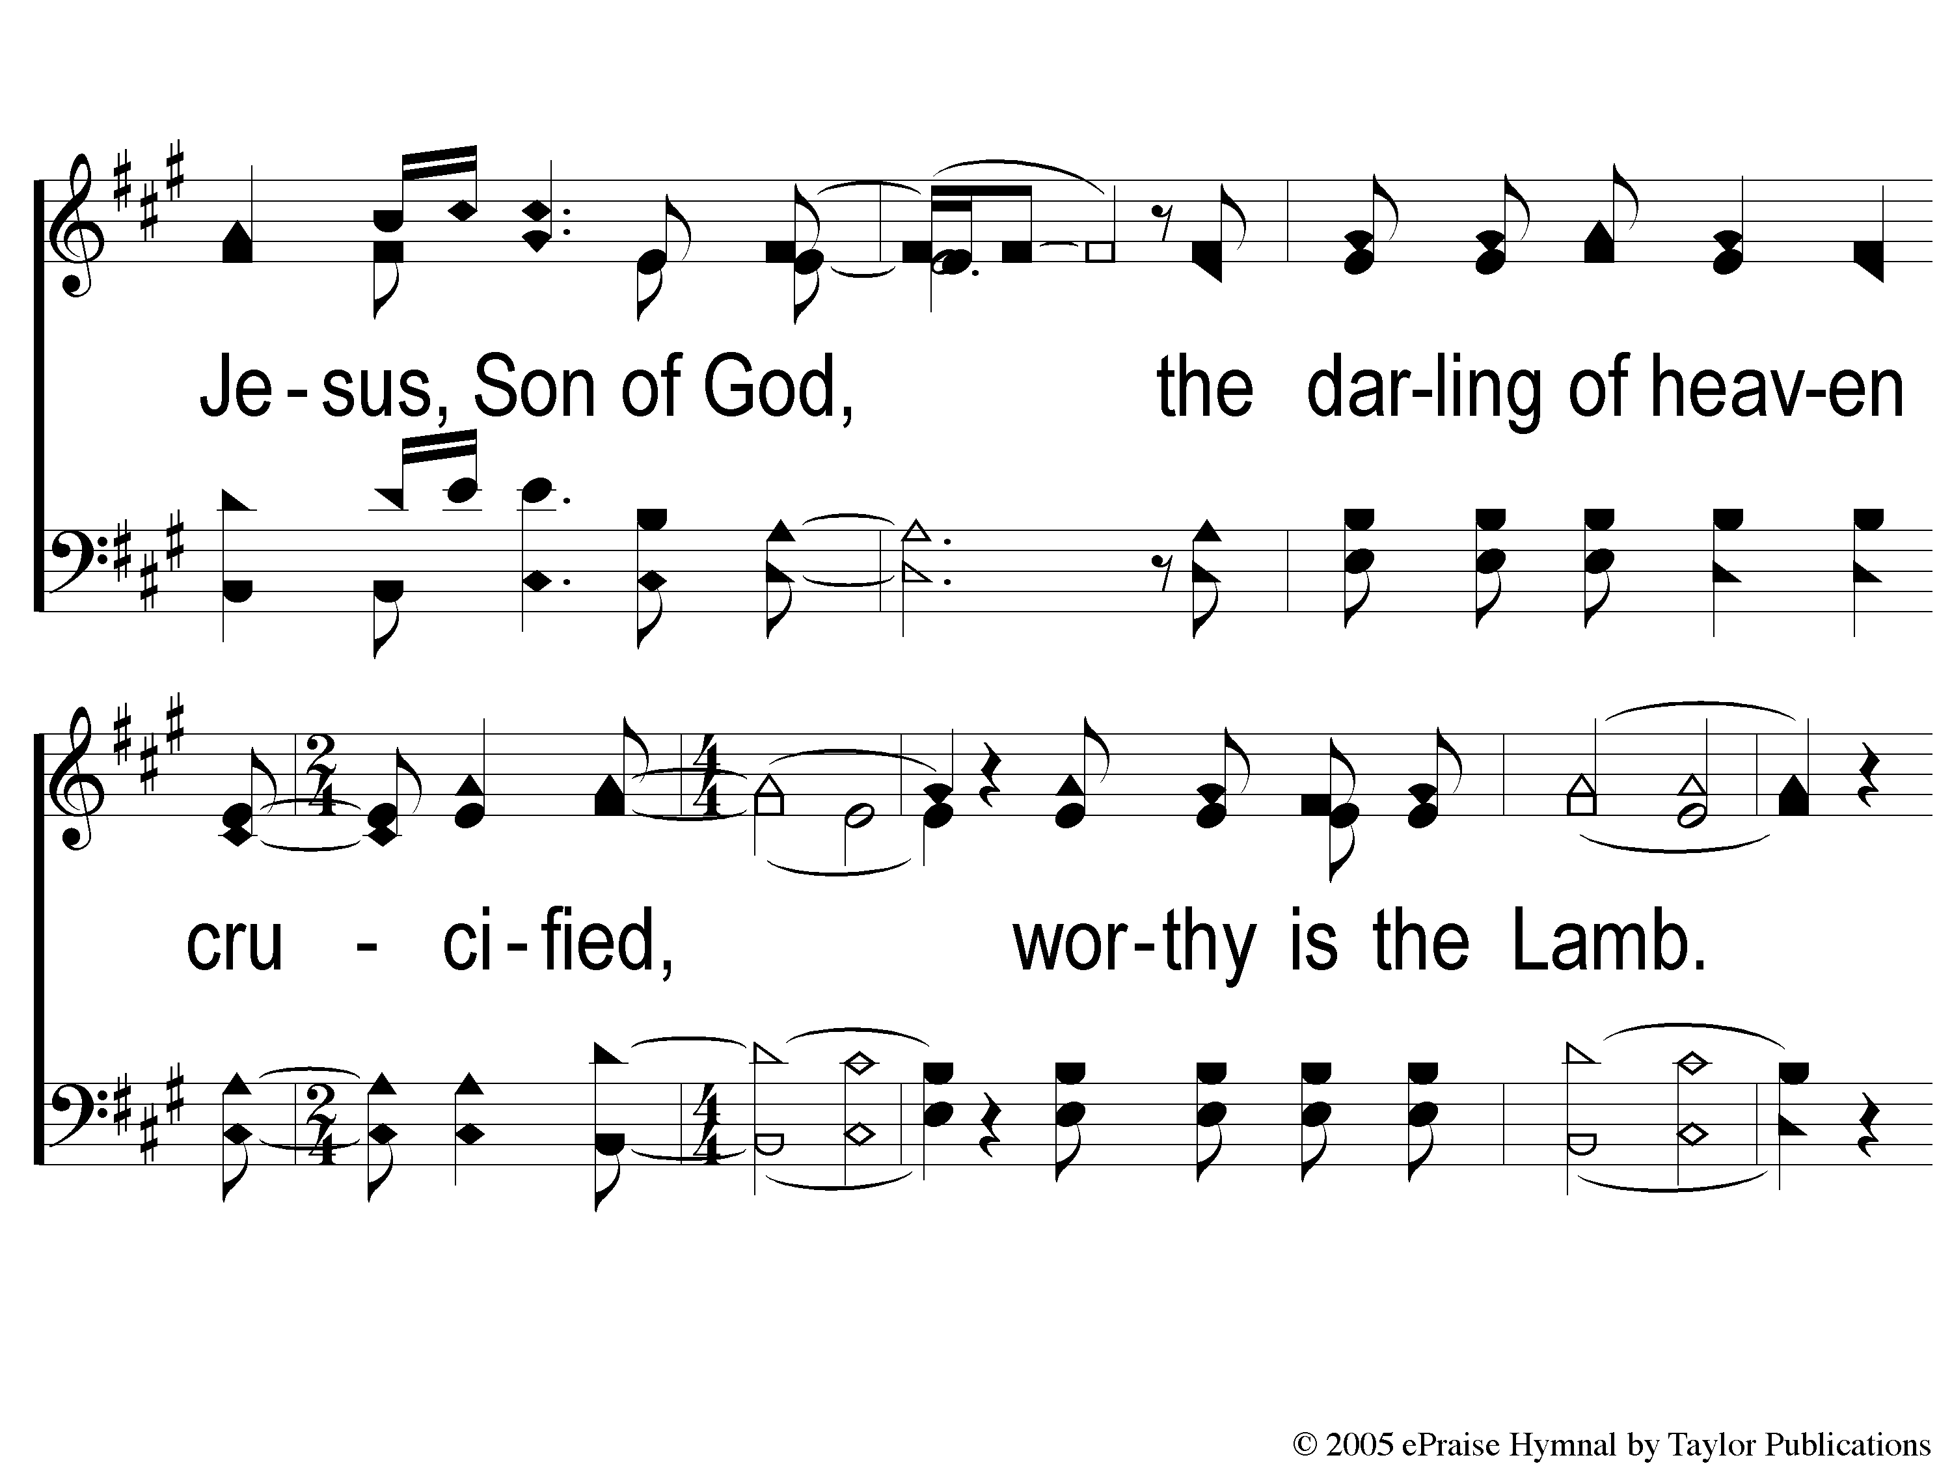
6 Worthy is the Lamb
Worthy Is The Lamb

Slide 48
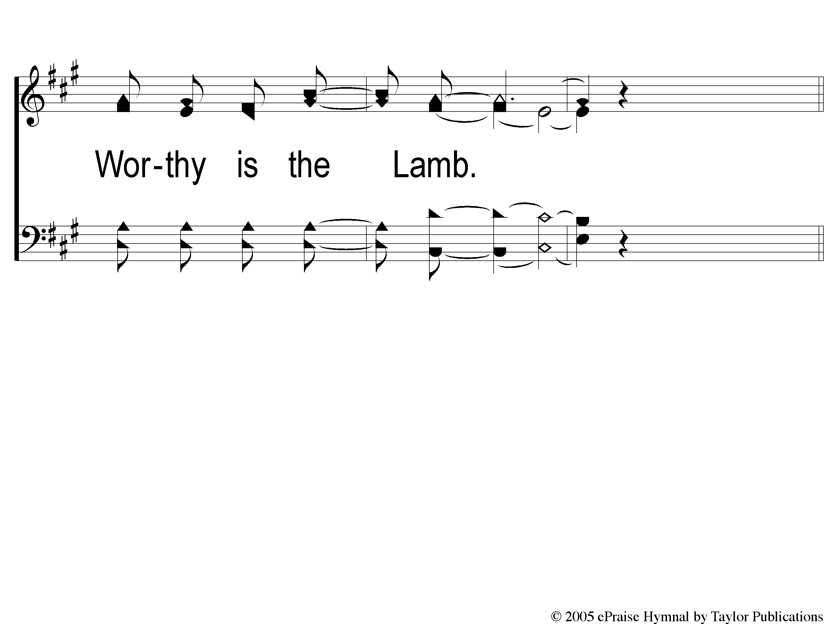
7 Worthy is the Lamb
Worthy Is The Lamb

Slide 49
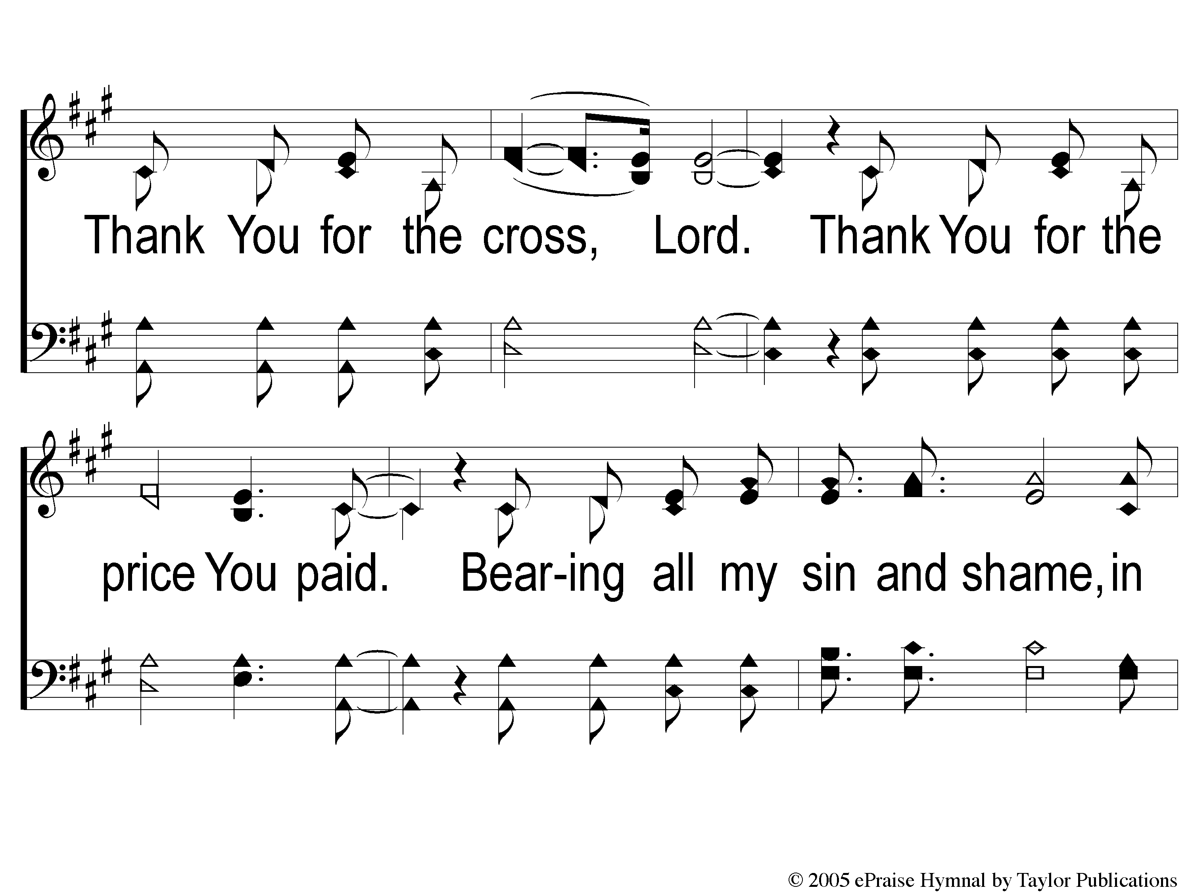
dC-1 Worthy is the Lamb
Worthy Is The Lamb

Slide 50
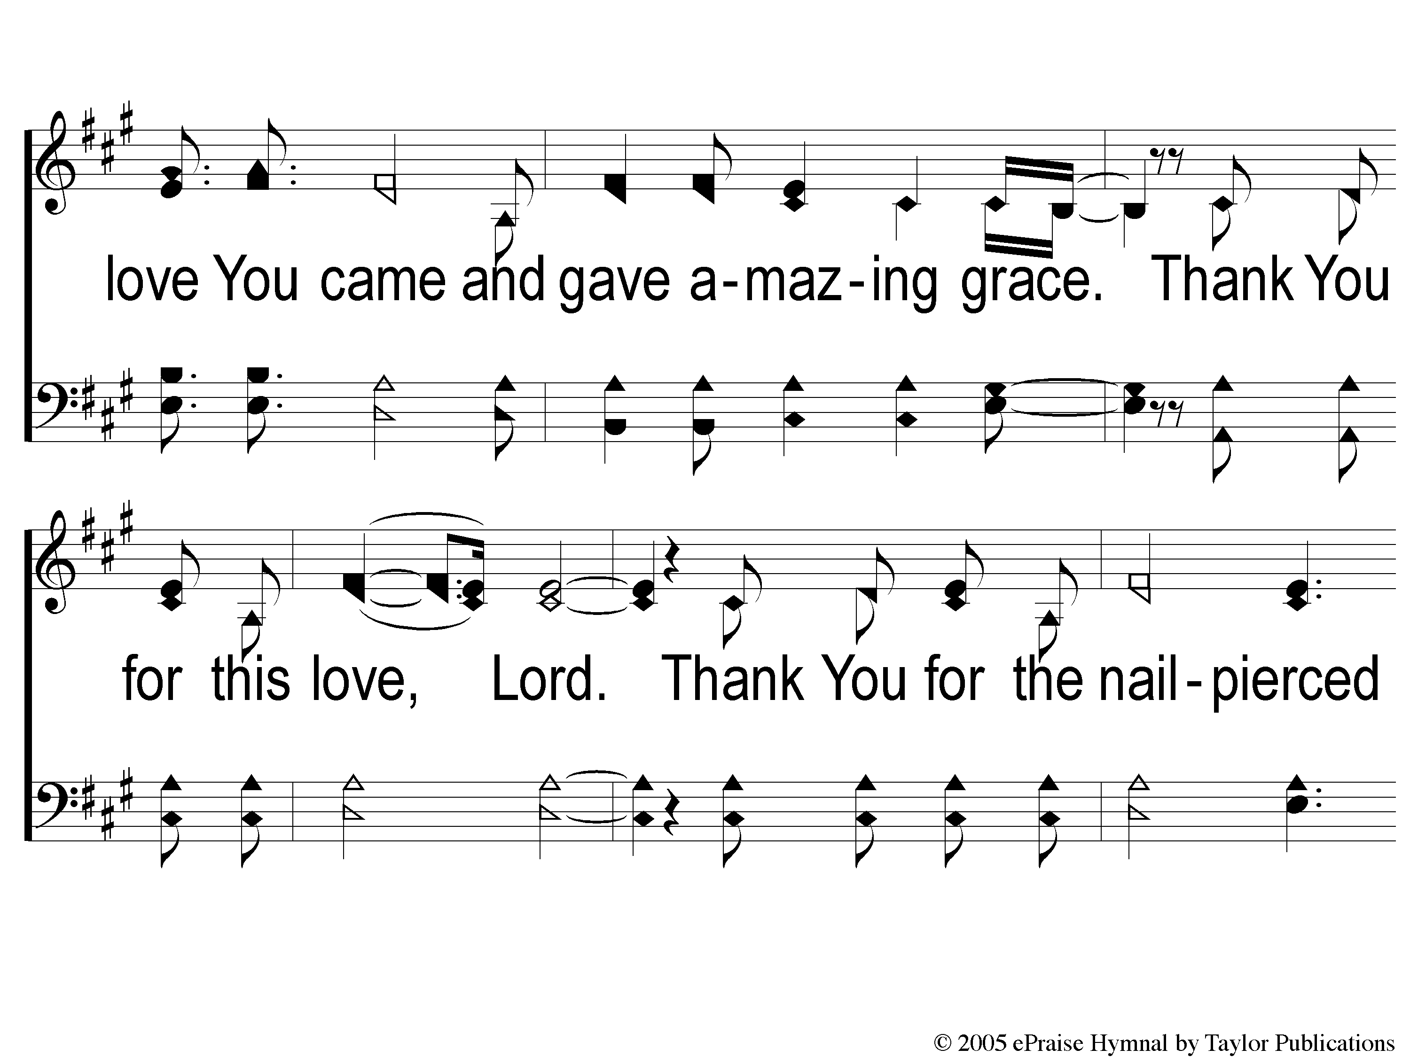
dC-2 Worthy is the Lamb
Worthy Is The Lamb

Slide 51

dC-3 Worthy is the Lamb
Worthy Is The Lamb

Slide 52

dC-4 Worthy is the Lamb
Worthy Is The Lamb

Slide 53
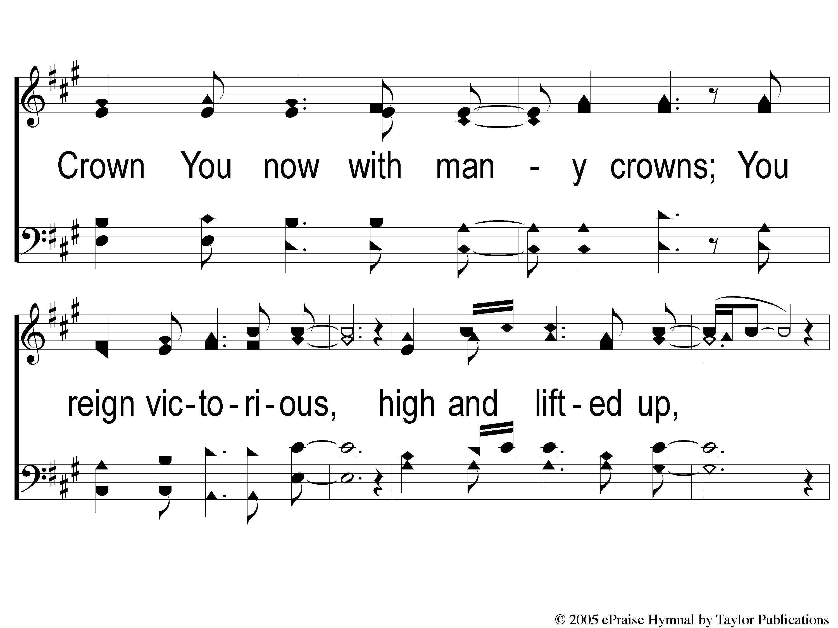
dC-5 Worthy is the Lamb
Worthy Is The Lamb

Slide 54
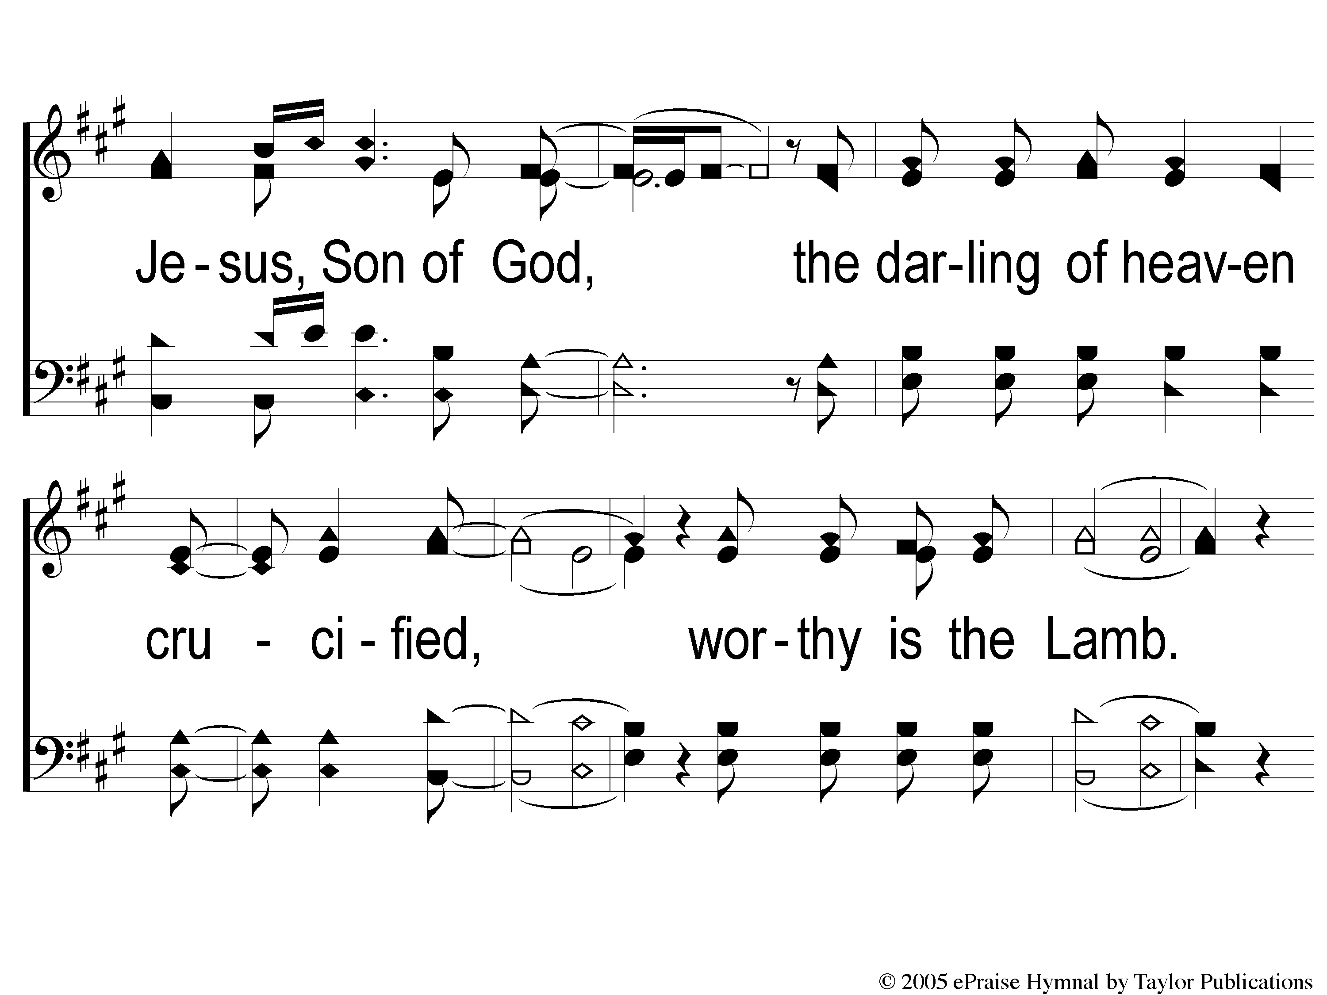
dC-6 Worthy is the Lamb
Worthy Is The Lamb

Slide 55
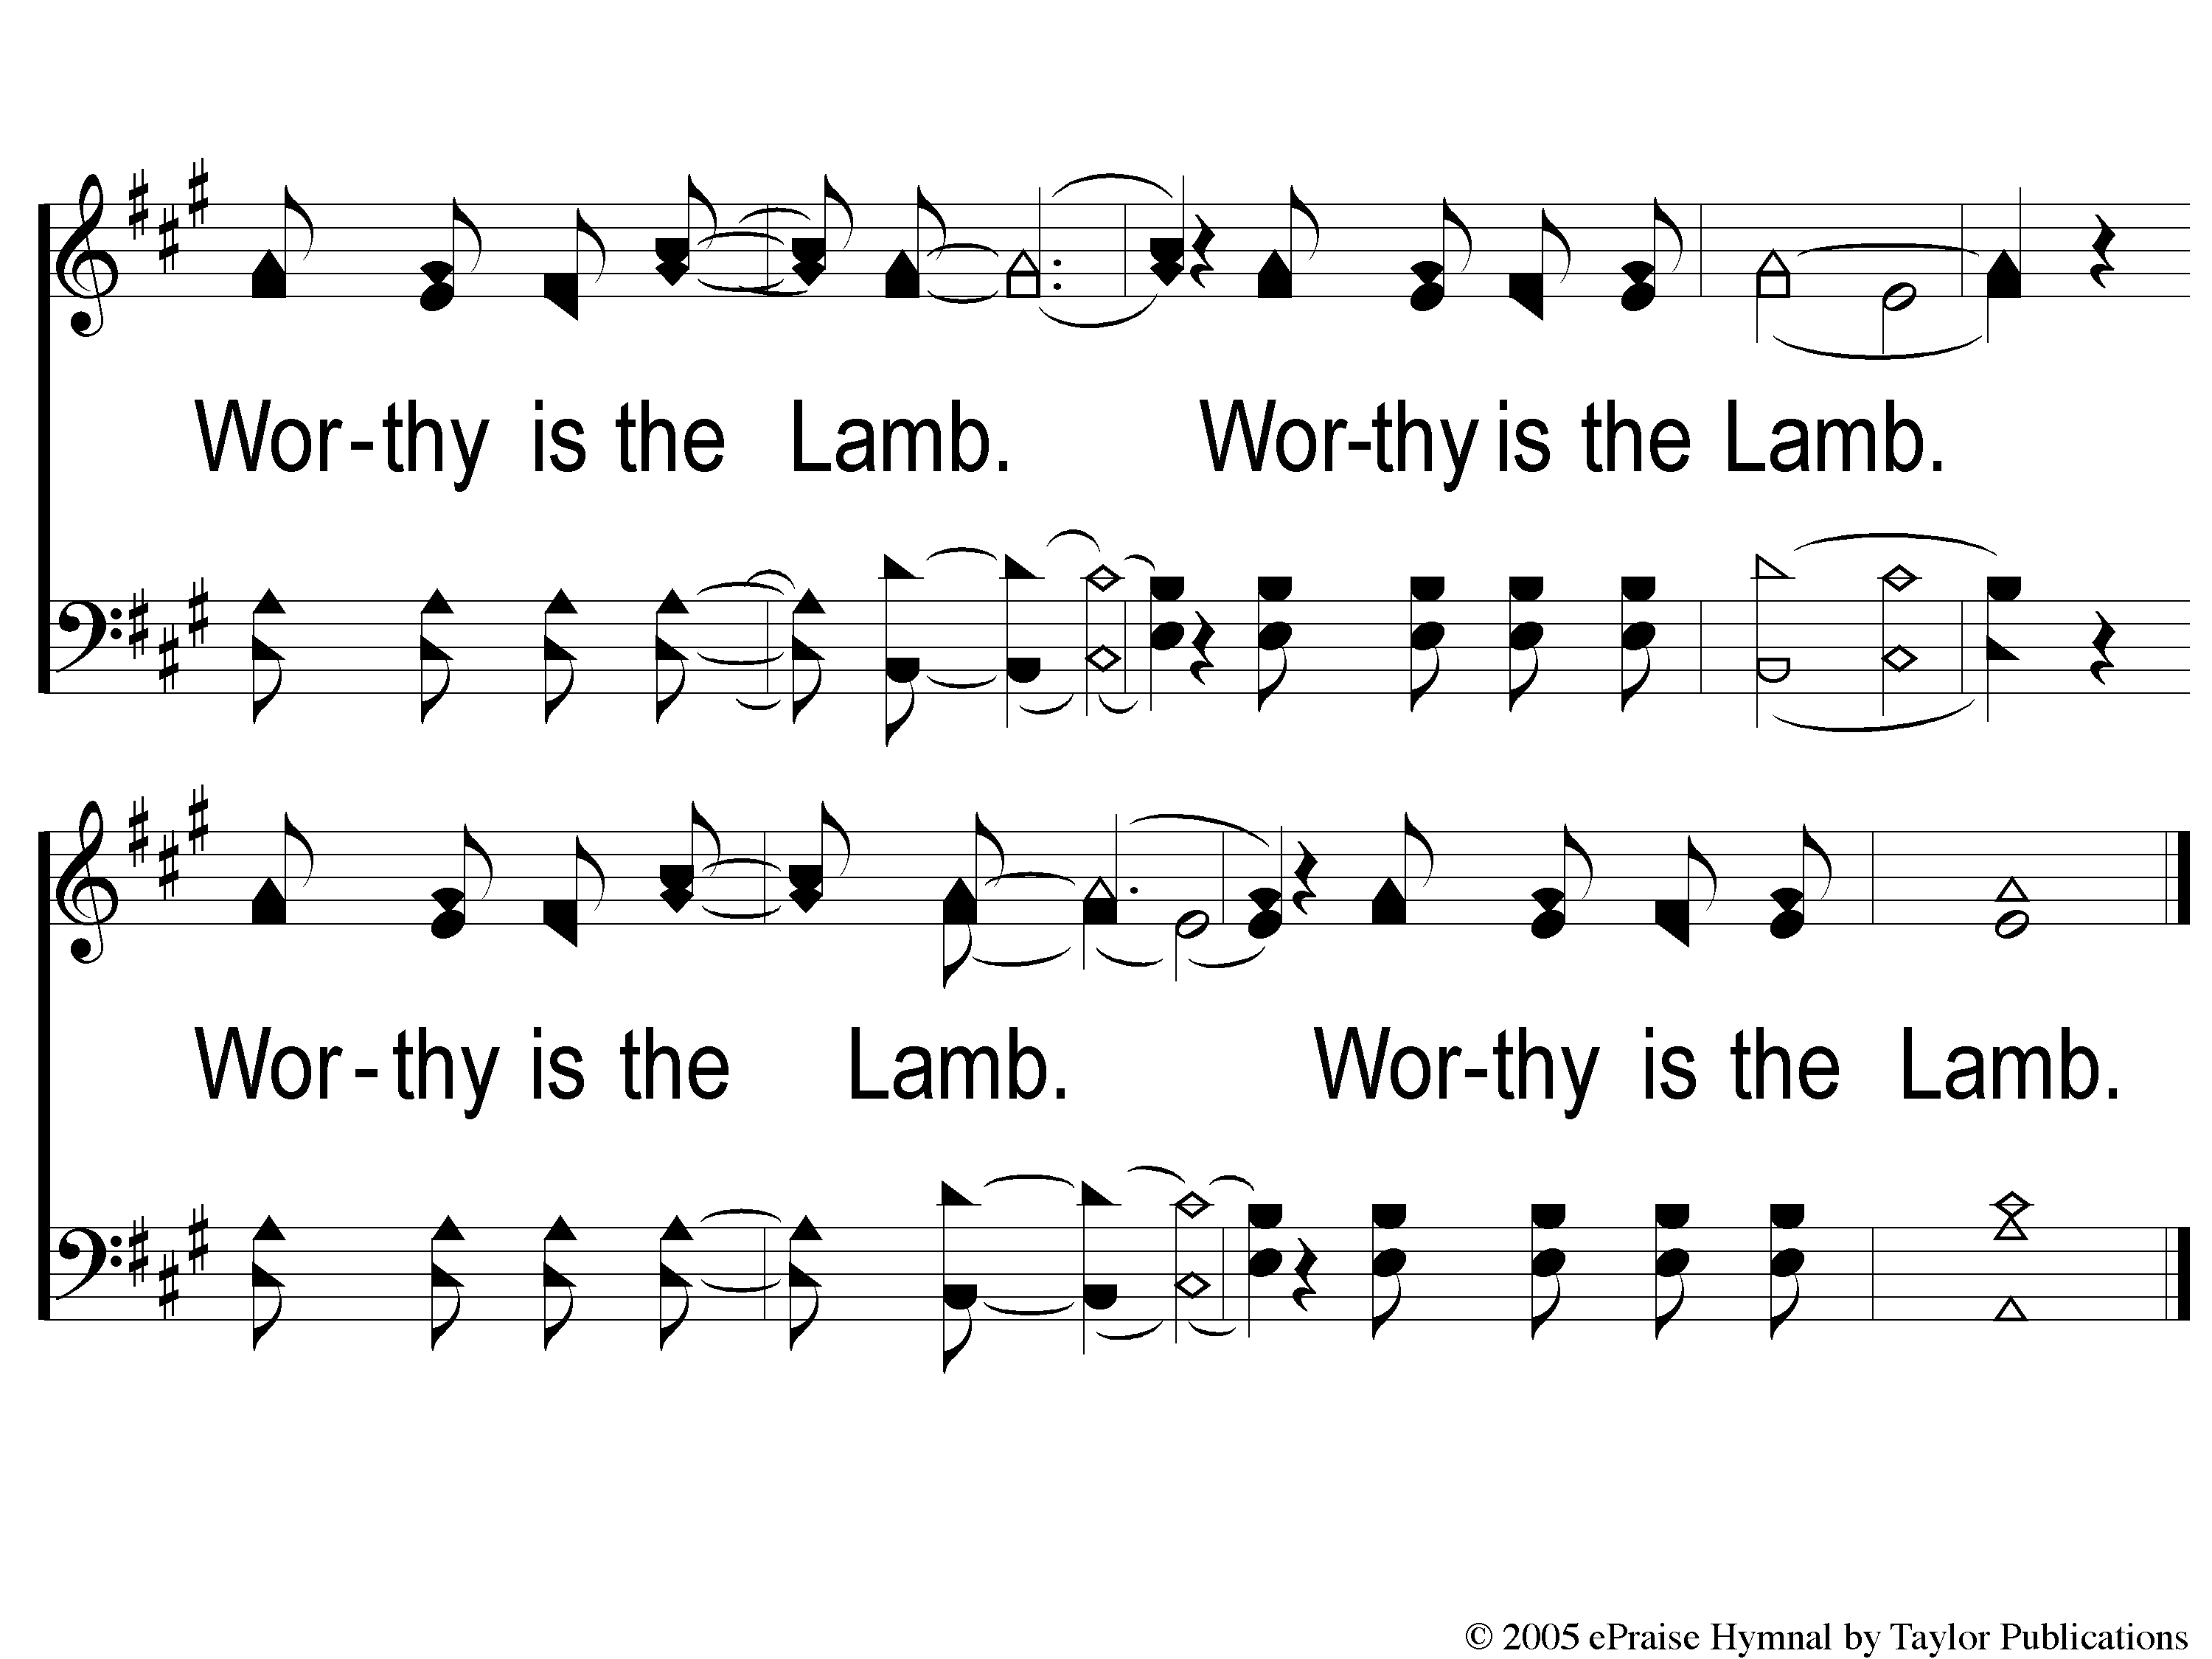
dC-7 Worthy is the Lamb
Worthy Is The Lamb

Slide 57
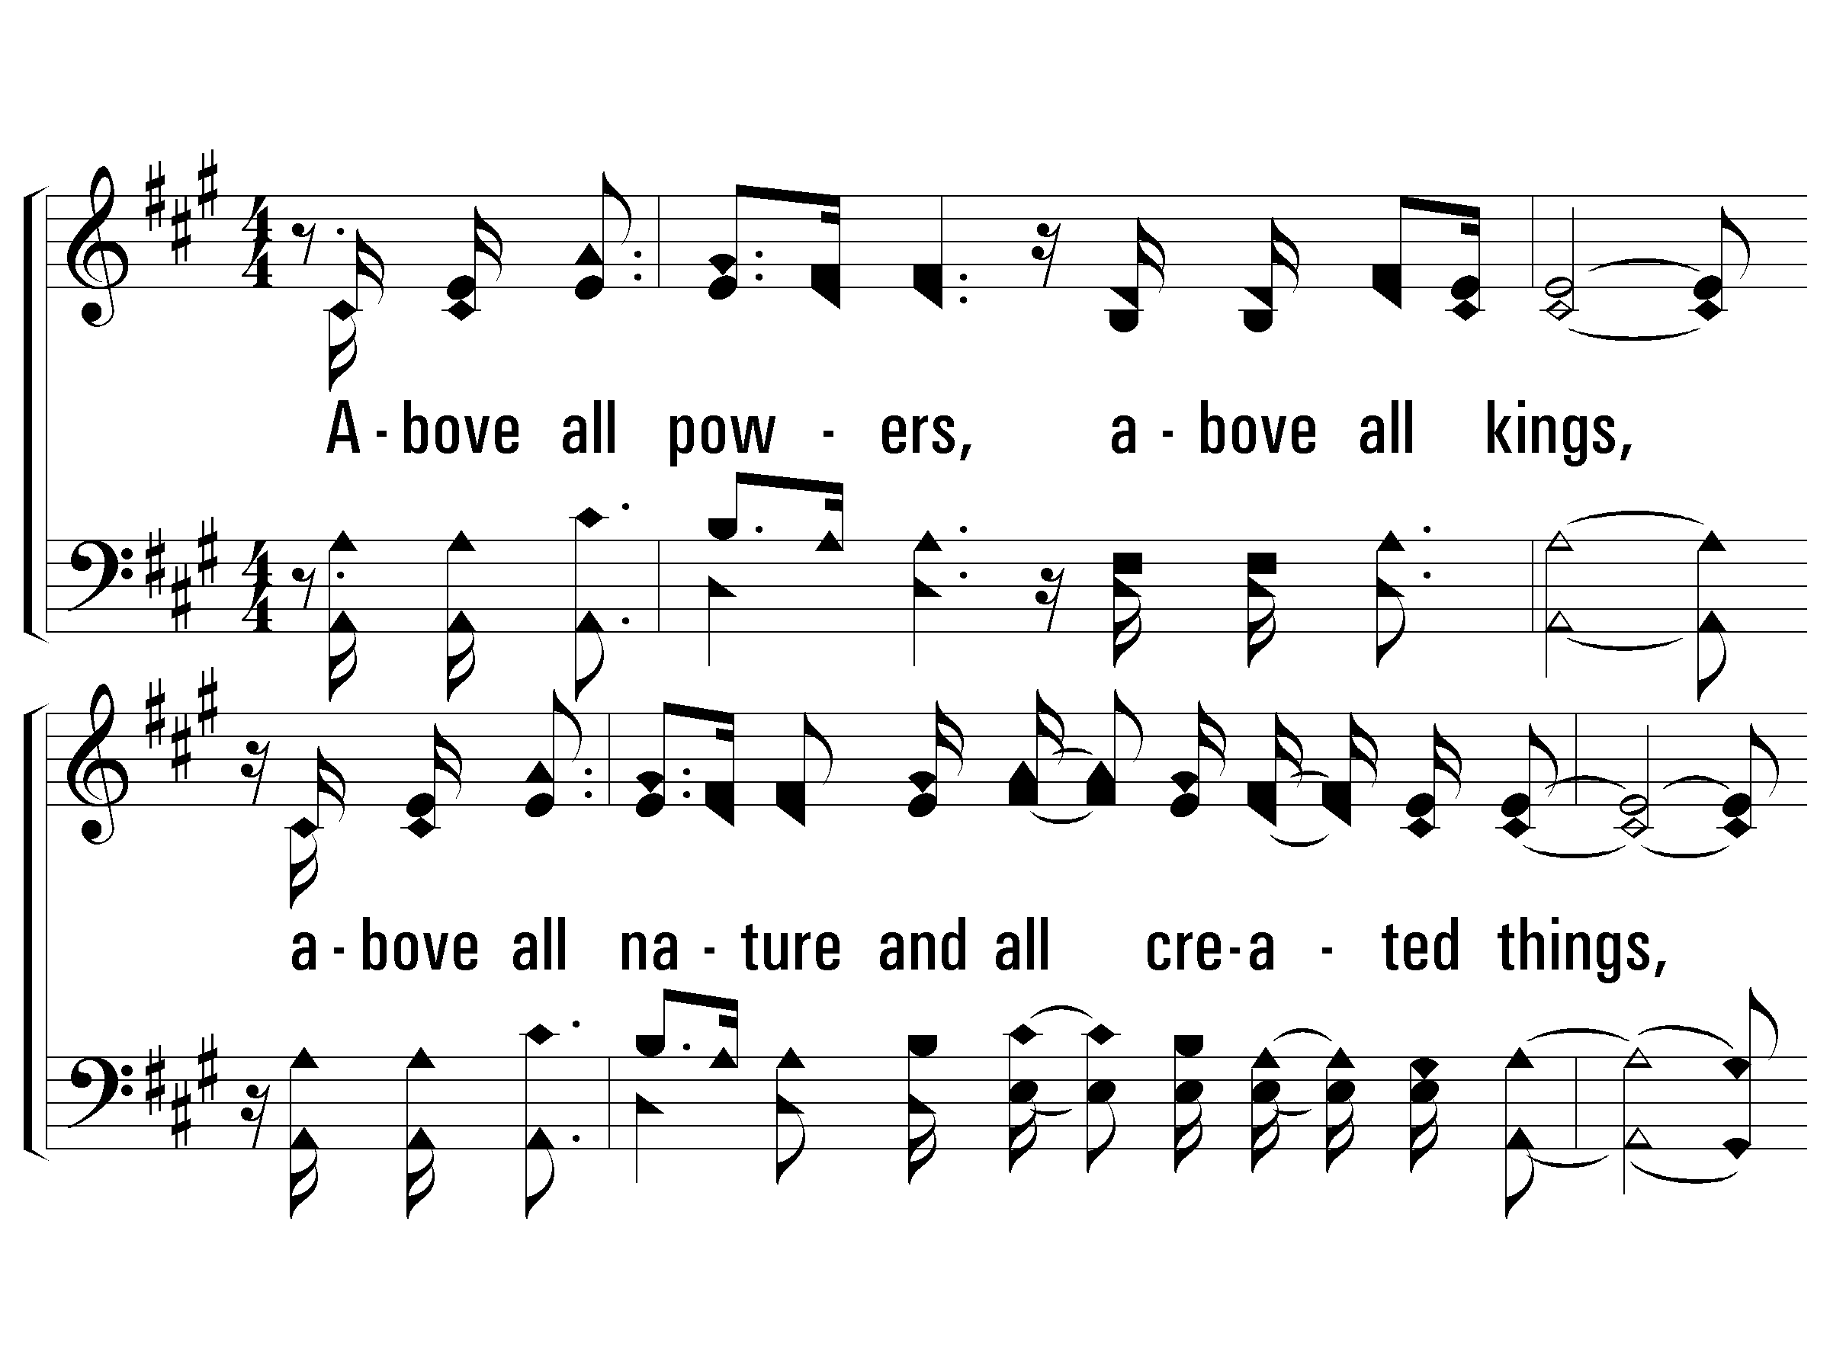
1 – Above All
Above all powers, above all kings,
above all nature and all created things,
above all wisdom and all the ways of man,
You were here before the world began.
Above all kingdoms, above all thrones,
above all wonders the world has ever know,
above all wealth and treasures of the earth,
there's no way to measure what You're worth.
Crucified, laid behind the stone,
You lived to die, rejected and alone.
Like a rose trampled on the ground,
You took the fall and thought of me above all.
Words & Music: Lenny LeBlanc & Paul Baloche / Arr. Zoe Singers & Robin Smith
Copyright © 1999 by Integrity’s Hosanna! Music / LenSongs Publishing
© 2003 The Paperless Hymnal™

Slide 58
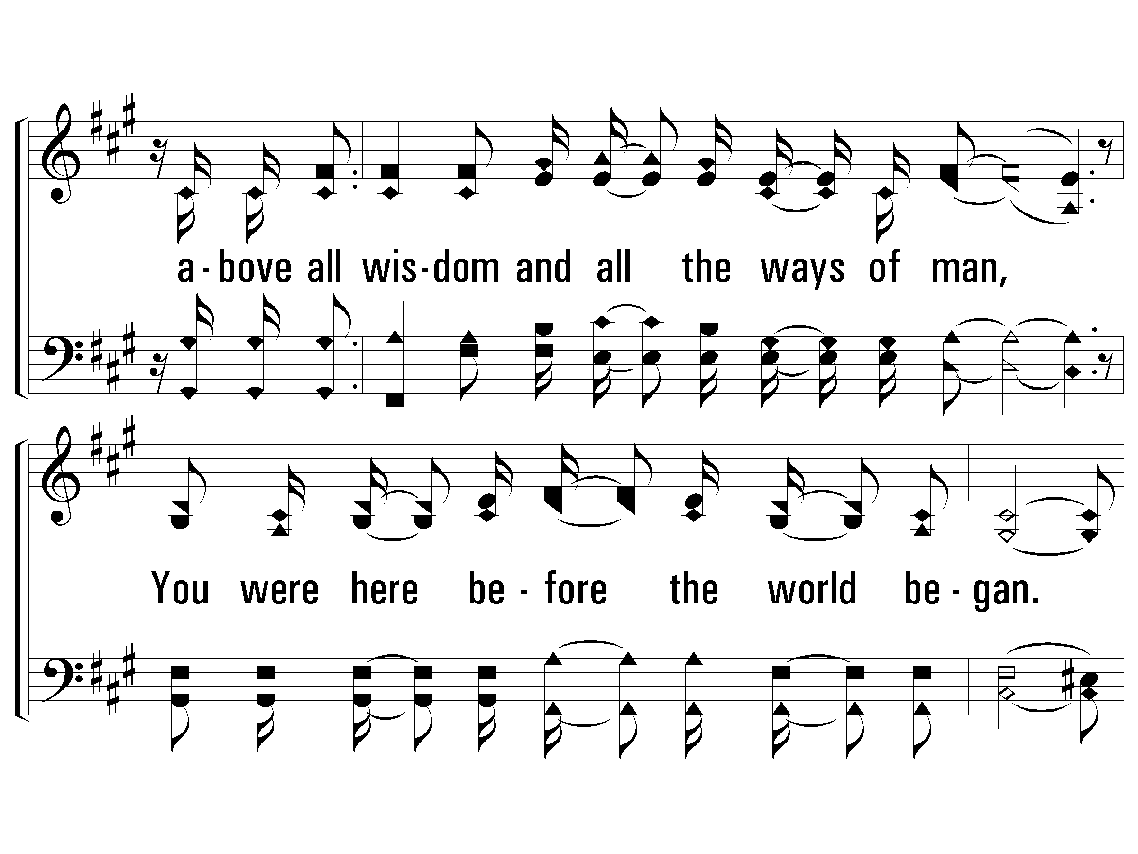
1 – Above All
© 2003 The Paperless Hymnal™

Slide 59
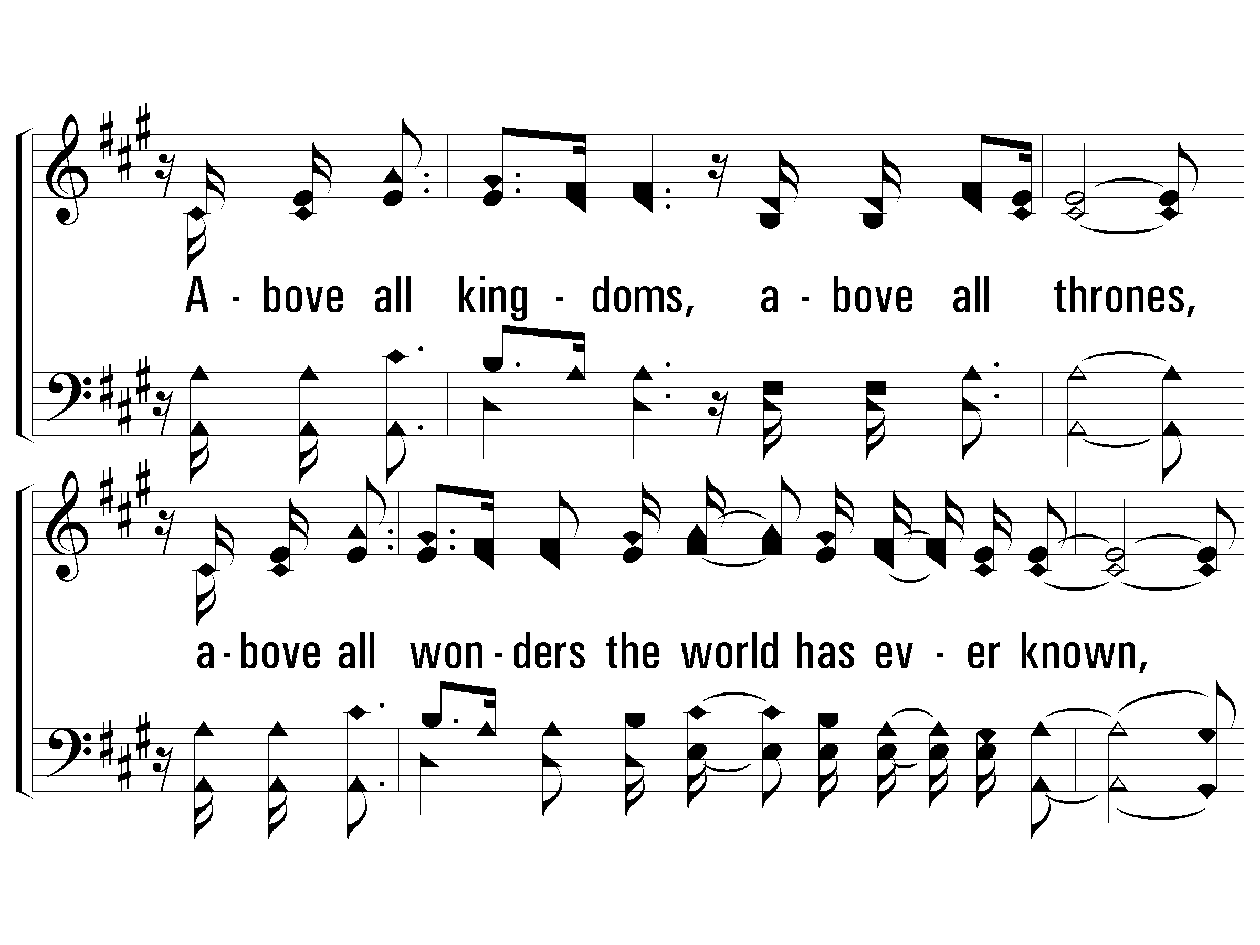
1 – Above All
© 2003 The Paperless Hymnal™

Slide 60
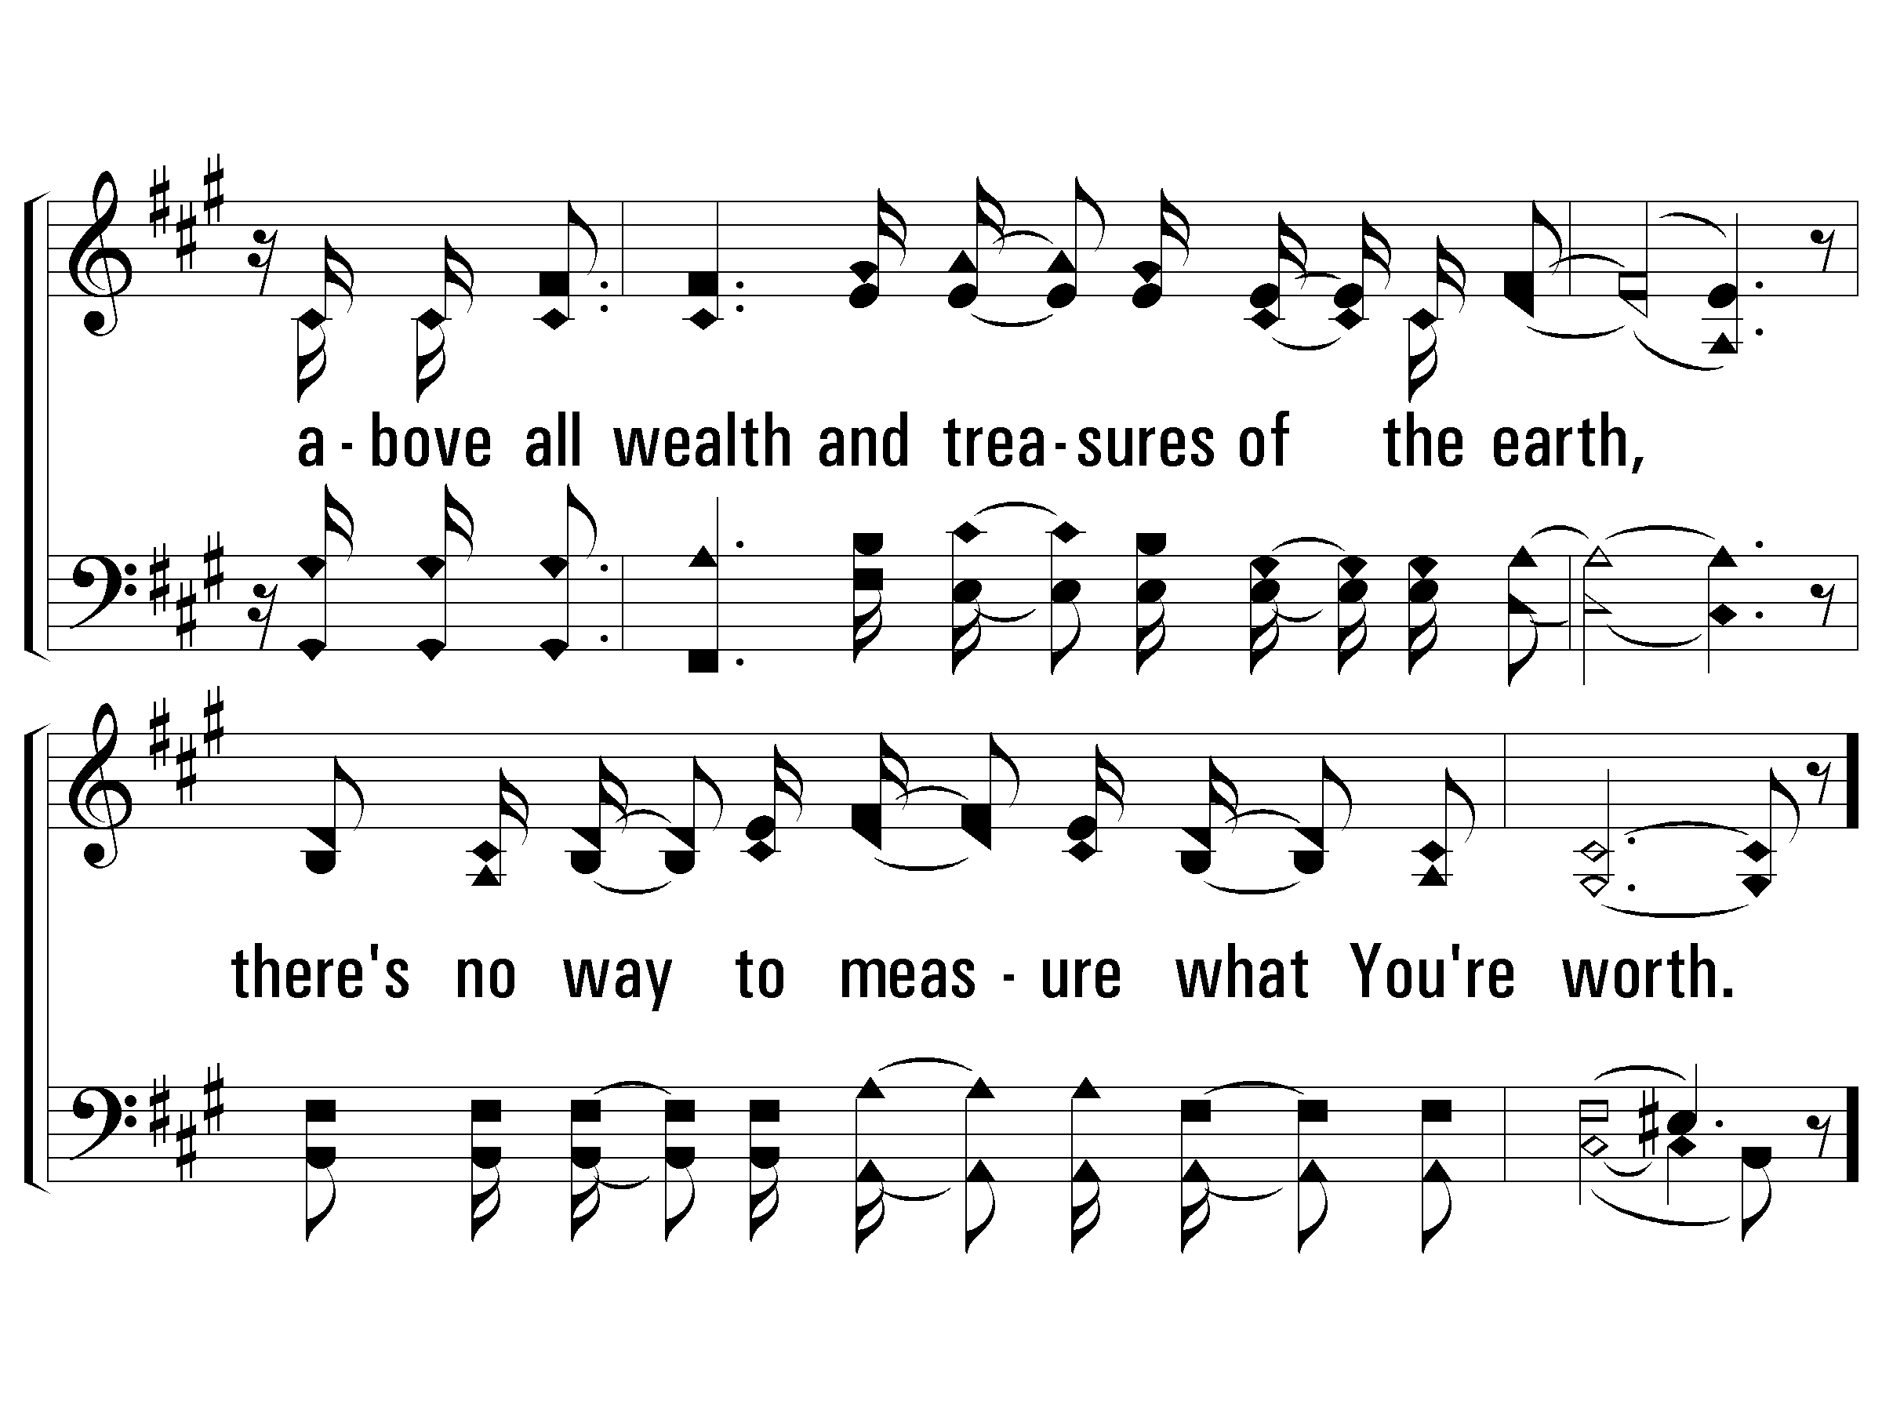
1 – Above All
© 2003 The Paperless Hymnal™

Slide 61
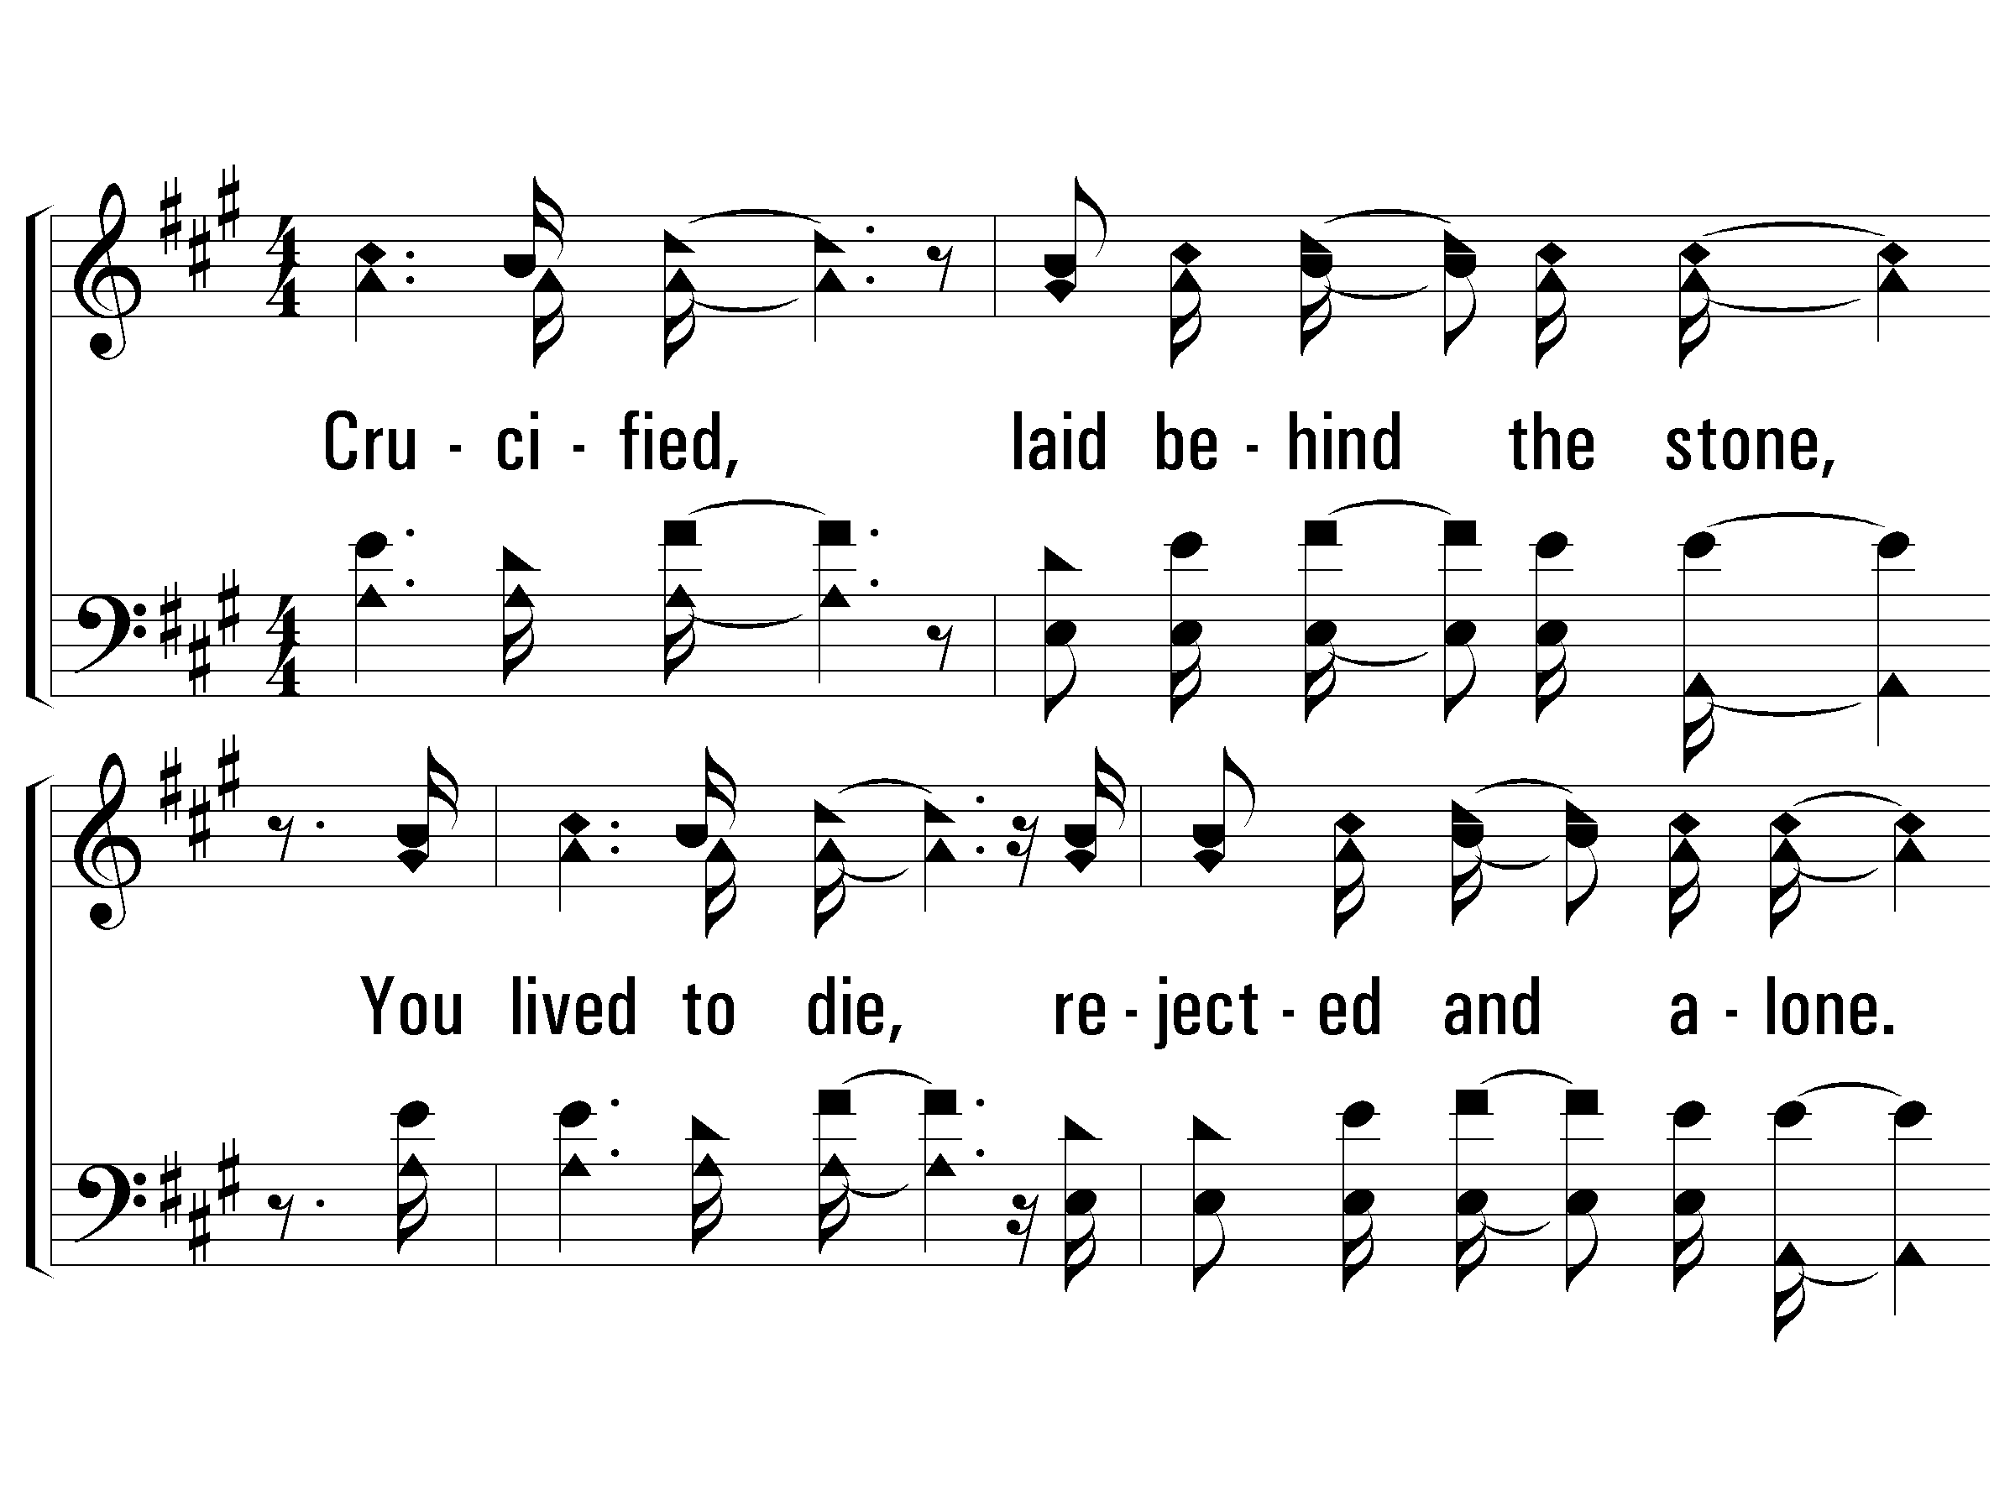
c – Above All
© 2003 The Paperless Hymnal™

Slide 62
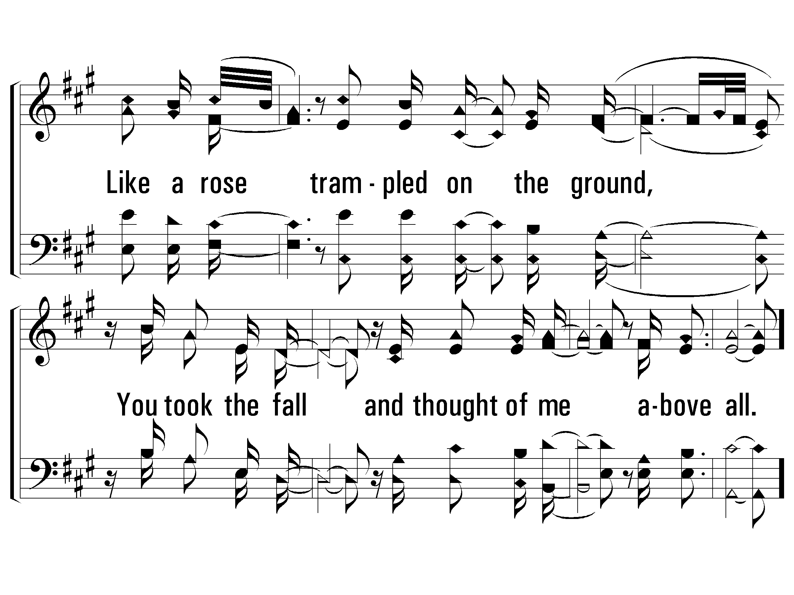
c – Above All
© 2003 The Paperless Hymnal™

Slide 63
2 – Above All
Above all powers, above all kings,
above all nature and all created things,
above all wisdom and all the ways of man,
You were here before the world began.
Above all kingdoms, above all thrones,
above all wonders the world has ever know,
above all wealth and treasures of the earth,
there's no way to measure what You're worth.
Crucified, laid behind the stone,
You lived to die, rejected and alone.
Like a rose trampled on the ground,
You took the fall and thought of me above all.
Words & Music: Lenny LeBlanc & Paul Baloche / Arr. Zoe Singers & Robin Smith
Copyright © 1999 by Integrity’s Hosanna! Music / LenSongs Publishing
© 2003 The Paperless Hymnal™

Slide 64
2 – Above All
© 2003 The Paperless Hymnal™

Slide 65
2 – Above All
© 2003 The Paperless Hymnal™

Slide 66
2 – Above All
© 2003 The Paperless Hymnal™

Slide 67
c – Above All
© 2003 The Paperless Hymnal™

Slide 68
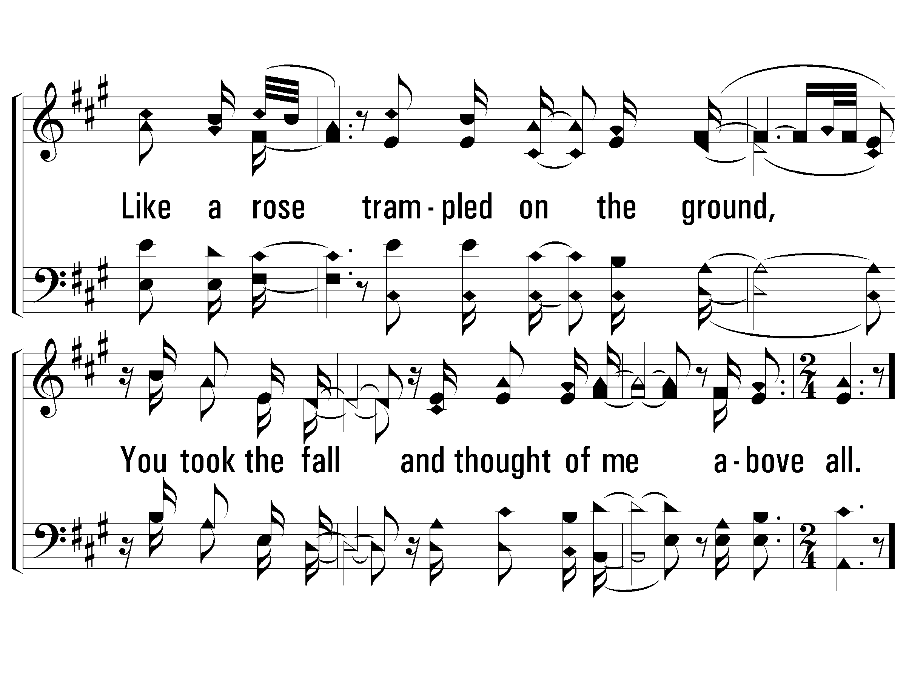
c – Above All
© 2003 The Paperless Hymnal™

Slide 69
C – Above All
© 2003 The Paperless Hymnal™

Slide 70

C – Above All
© 2003 The Paperless Hymnal™

Slide 71

C – Above All
© 2003 The Paperless Hymnal™

Slide 73

V1a – All to Us
Arr: Mike Rogers
Words and Music by: Chris Tomlin, Jesse Reeves, Matt Maher, Matt Redman
© 2015 The Acappella Company

Slide 74
V1b – All to Us
© 2015 The Acappella Company

Slide 75
V2a – All to Us
© 2015 The Acappella Company

Slide 76
V2b – All to Us
© 2015 The Acappella Company

Slide 77
C1a – All to Us
© 2015 The Acappella Company

Slide 78
C1b – All to Us
© 2015 The Acappella Company

Slide 79
C1c – All to Us
© 2015 The Acappella Company

Slide 80
C1d – All to Us
© 2015 The Acappella Company

Slide 81
V3a – All to Us
© 2015 The Acappella Company

Slide 82
V3b – All to Us
© 2015 The Acappella Company

Slide 83
C2a – All to Us
© 2015 The Acappella Company

Slide 84
C2b – All to Us
© 2015 The Acappella Company

Slide 85
C2c – All to Us
© 2015 The Acappella Company

Slide 86
C2d – All to Us
© 2015 The Acappella Company

Slide 87
B1a – All to Us
© 2015 The Acappella Company

Slide 88
B1b – All to Us
© 2015 The Acappella Company

Slide 89
C3a – All to Us
© 2015 The Acappella Company

Slide 90
C3b – All to Us
© 2015 The Acappella Company

Slide 91
C3c – All to Us
© 2015 The Acappella Company

Slide 92
CODA – All to Us
© 2015 The Acappella Company

Slide 94


V1a – Goodness of God
Words and Music by: Jenn Johnson, Ed Cash, Jason Ingram, Ben Fielding & Brian Johnson
Arr: Mark Simmons & Shane Coffman
© 2019 Fellowship Music, Shout! Music Publishing, So Essential Tunes, Bethel Music Publishing, Capitol CMG Paragon
© 2023 The Acappella Company

Slide 95


V1b – Goodness of God
© 2023 The Acappella Company

Slide 96


C1a – Goodness of God
© 2023 The Acappella Company
Notes:
Not sure where to put the copyright but at the bottom won’t work

Slide 97


C1b – Goodness of God
© 2023 The Acappella Company

Slide 98


V2a – Goodness of God
© 2023 The Acappella Company

Slide 99


V2b – Goodness of God
© 2023 The Acappella Company

Slide 100
C2a – Goodness of God
© 2023 The Acappella Company

Slide 101

C2b – Goodness of God
© 2023 The Acappella Company

Slide 102


B1a – Goodness of God
© 2023 The Acappella Company

Slide 103


B1b – Goodness of God
© 2023 The Acappella Company

Slide 104


B1c – Goodness of God
© 2023 The Acappella Company

Slide 105
C3a – Goodness of God
© 2023 The Acappella Company

Slide 106

C3b – Goodness of God
© 2023 The Acappella Company

Slide 107

C3c – Goodness of God
© 2023 The Acappella Company

Slide 109
1 – Hymn of Heaven
Words and Music: Phil Wickham, Chris Davenport, Brian Johnson & Bill Johnson, Arrangement: Jake Keefer & Luke Coles
© 2020 SHOUT MP Brio, Phil Wickham Music, Simply Global Songs, Bethel Music Publishing

Slide 110
1 – Hymn of Heaven

Slide 111
c – Hymn of Heaven

Slide 112
c – Hymn of Heaven

Slide 113
2 – Hymn of Heaven

Slide 114
2 – Hymn of Heaven

Slide 115
c – Hymn of Heaven

Slide 116
c – Hymn of Heaven

Slide 117
3 – Hymn of Heaven

Slide 118
3 – Hymn of Heaven

Slide 119
c – Hymn of Heaven

Slide 120
c – Hymn of Heaven

Slide 121
c – Hymn of Heaven

Slide 122
c – Hymn of Heaven

Slide 123
c – Hymn of Heaven

