Slide 2
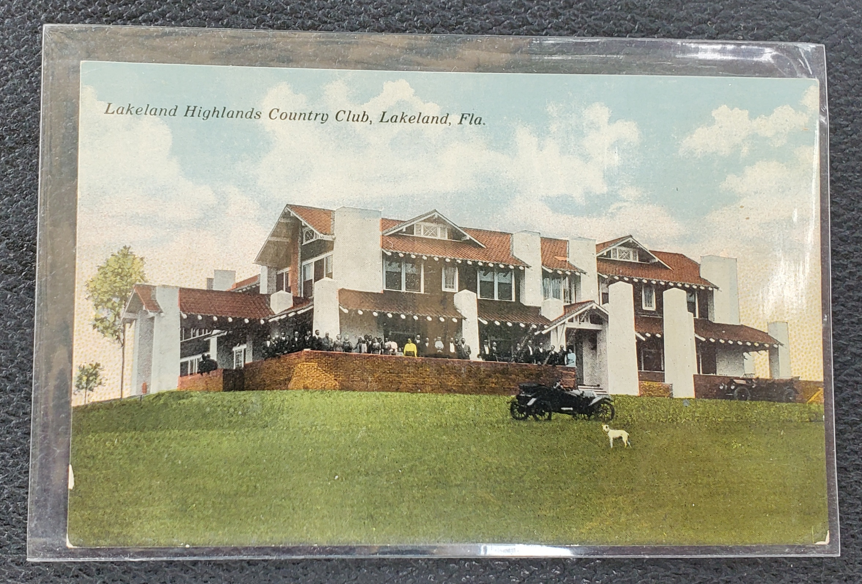

Slide 3
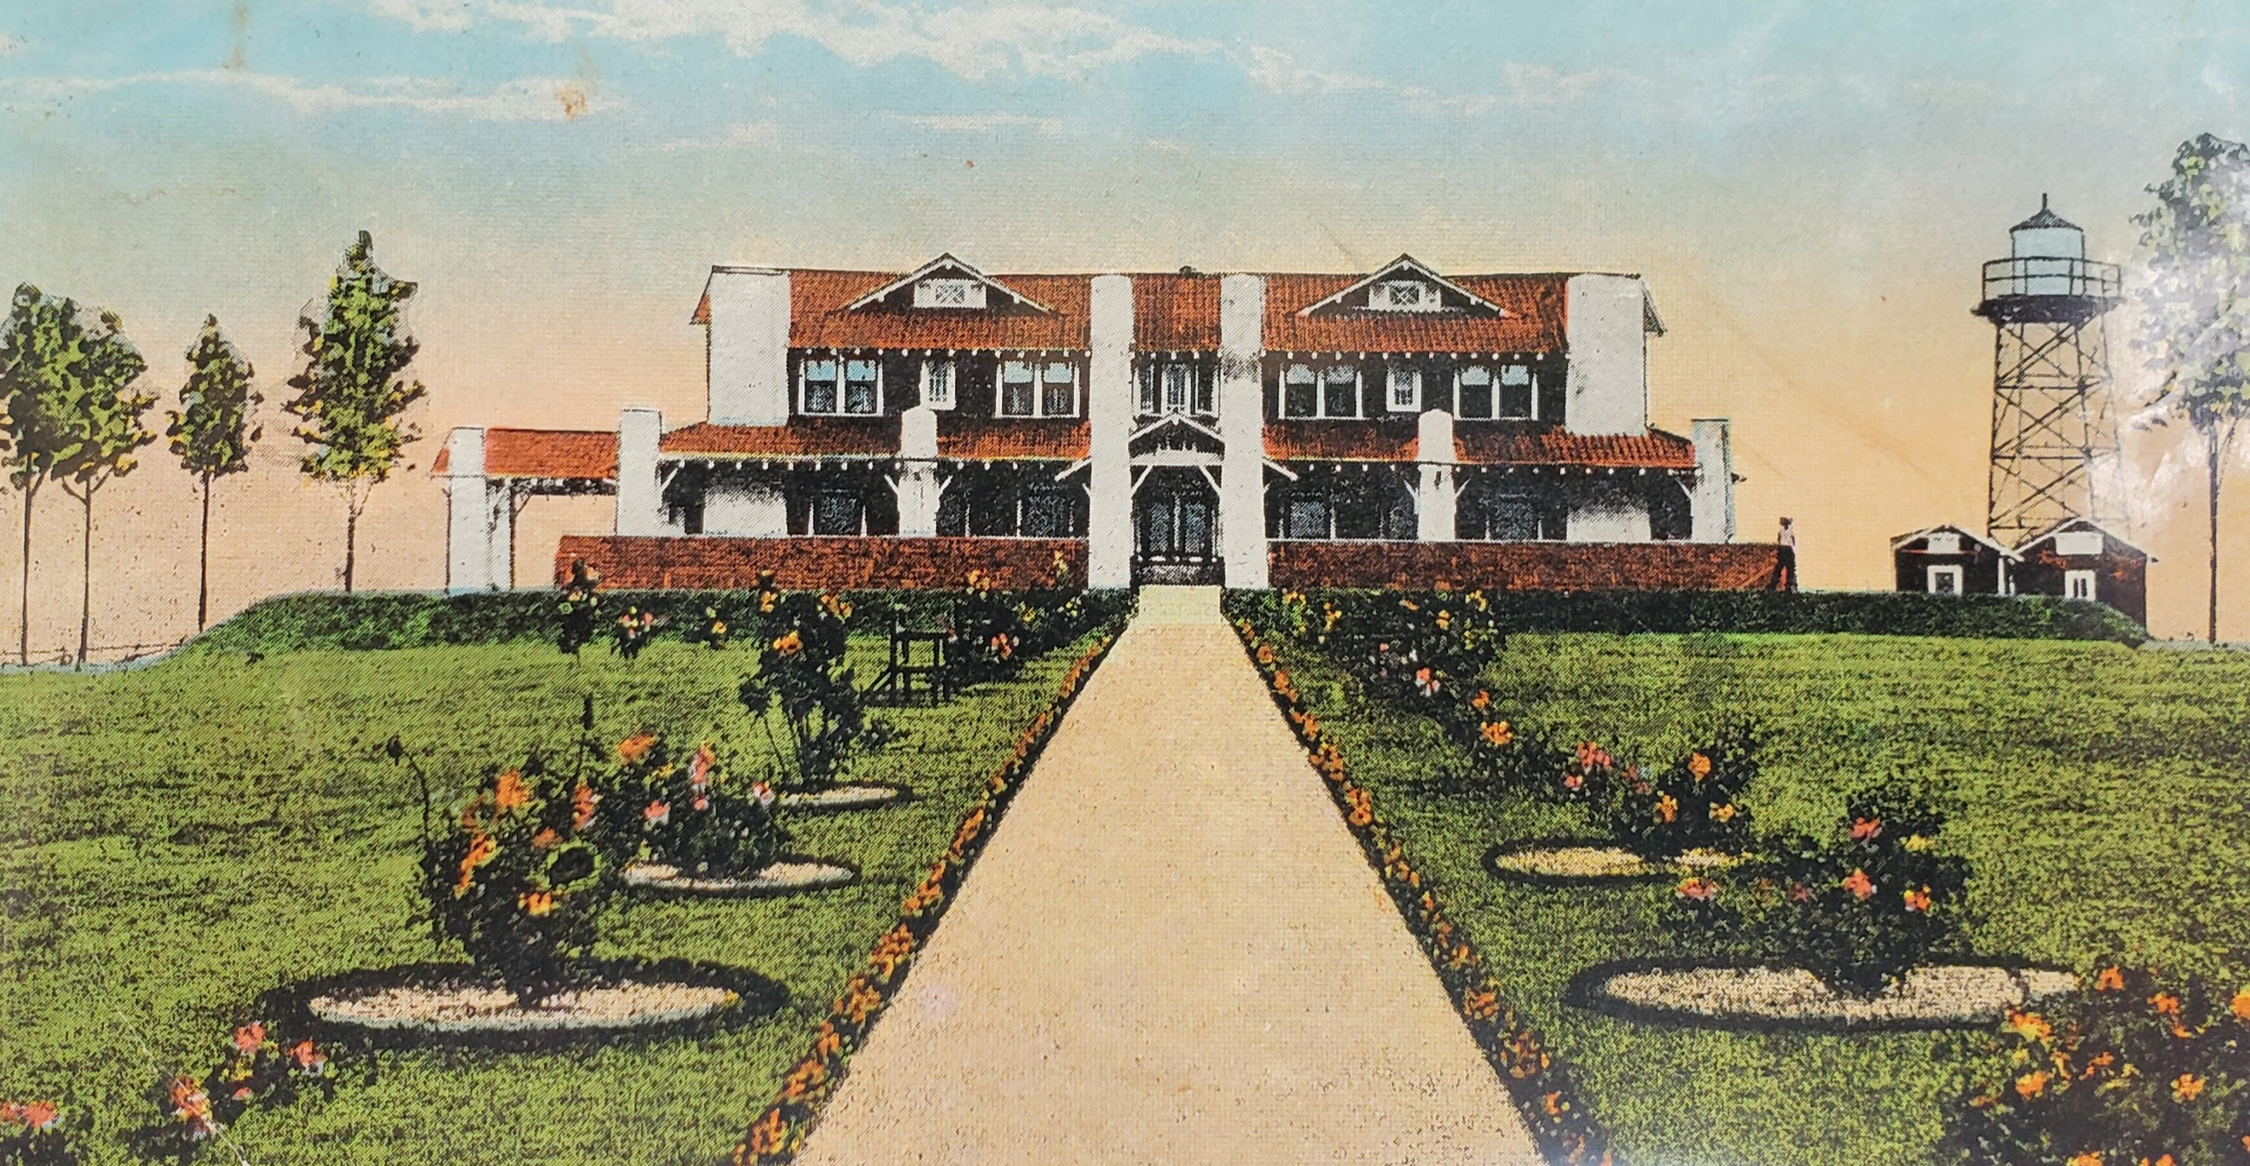

Slide 4
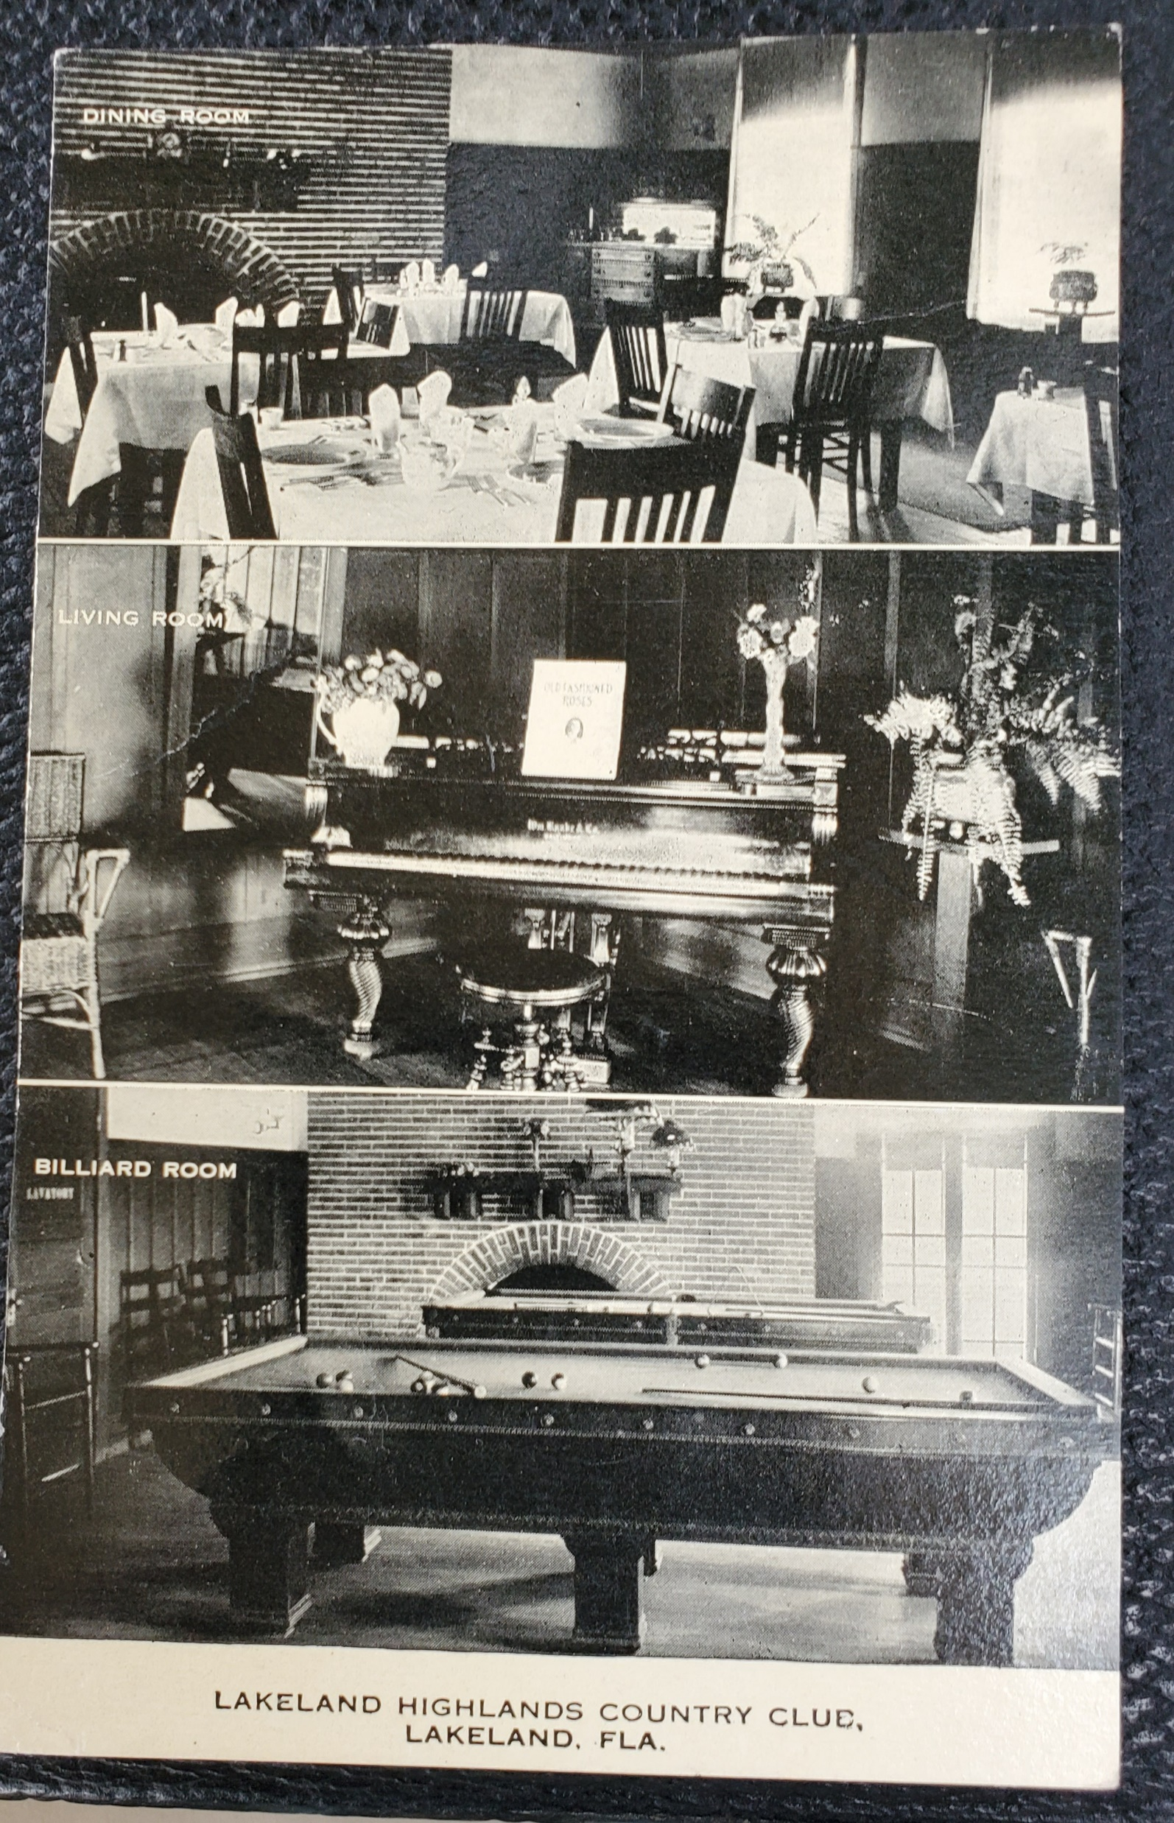
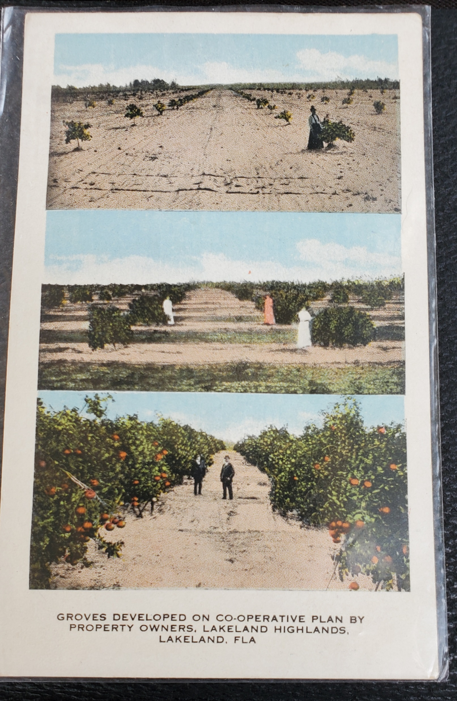

Slide 5
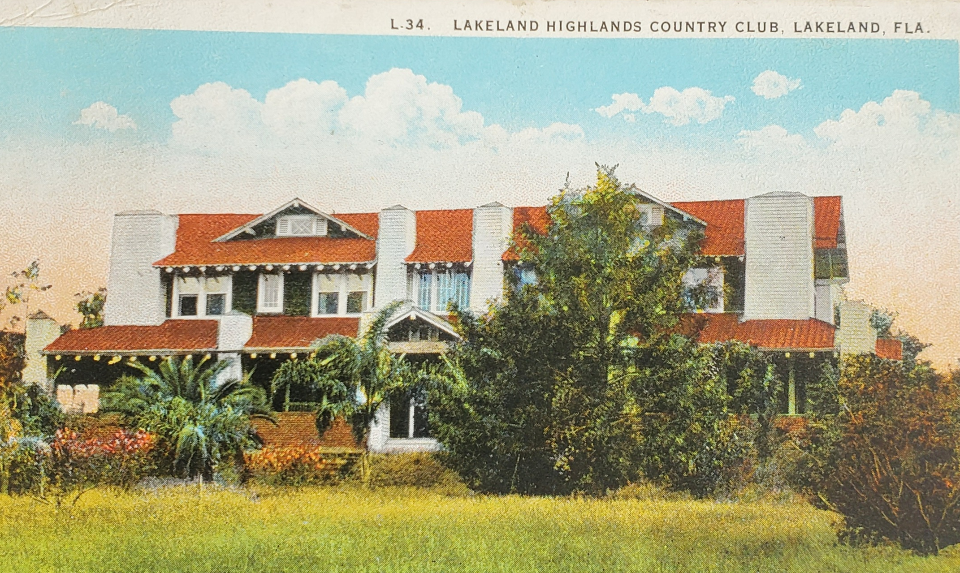

Slide 6
Unrealized
Serenity 1 Pet 1:3-5
“The state of being calm, peaceful, and untroubled”

Slide 7
Blessed be the God and Father of our Lord Jesus Christ, who according to His abundant mercy has begotten us again to a living hope through the resurrection of Jesus Christ from the dead, 4 to an inheritance incorruptible and undefiled and that does not fade away, reserved in heaven for you, 5 who are kept by the power of God through faith for salvation ready to be revealed in the last time. 1 Pet 1:3-5

Slide 8
Blessed be the God and Father of our Lord Jesus Christ, who according to His abundant mercy has begotten us again to a living hope through the resurrection of Jesus Christ from the dead, 4 to an inheritance incorruptible and undefiled and that does not fade away, reserved in heaven for you, 5 who are kept by the power of God through faith for salvation ready to be revealed in the last time. 1 Pet 1:3-5

Slide 9
Blessed be the God and Father of our Lord Jesus Christ, who according to His abundant mercy has begotten us again to a living hope through the resurrection of Jesus Christ from the dead, 4 to an inheritance incorruptible and undefiled and that does not fade away, reserved in heaven for you, 5 who are kept by the power of God through faith for salvation ready to be revealed in the last time. 1 Pet 1:3-5

Slide 10
Blessed be the God and Father of our Lord Jesus Christ, who according to His abundant mercy has begotten us again to a living hope through the resurrection of Jesus Christ from the dead, 4 to an inheritance incorruptible and undefiled and that does not fade away, reserved in heaven for you, 5 who are kept by the power of God through faith for salvation ready to be revealed in the last time. 1 Pet 1:3-5

Slide 11
Blessed be the God and Father of our Lord Jesus Christ, who according to His abundant mercy has begotten us again to a living hope through the resurrection of Jesus Christ from the dead, 4 to an inheritance incorruptible and undefiled and that does not fade away, reserved in heaven for you, 5 who are kept by the power of God through faith for salvation ready to be revealed in the last time. 1 Pet 1:3-5

Slide 12
Unrealized
Serenity 1 Pet 1:3-5
“The state of being calm, peaceful, and untroubled”

Slide 13
Serenity Now →“Living Hope”
1 Pet 1:3
▪ Hope = certain expectation Rom 8:24-25
▪ Grounded upon God’s promise Heb 6:18-19
▪ Object is Eternal Life Titus 1:2
▪ Guaranteed by the Living Christ
1 Cor 15:12-19

Slide 14
Serenity Forever →“Inheritance”
1 Pet 1:4
▪ Old Testament = Canaan
Ps 105:11; Josh 11:23 cf. Heb 11:8
▪ New Testament = Kingdom Blessings
Eph 1:14, 18; Col 3:24; Heb 9:15
▪ “Born again” NOT to receive earthly Canaan
but eternity with God! cf. Rev 21-22

Slide 15
Serenity Forever →“Inheritance”
1 Pet 1:4
▪ Not physical cf. Matt 5:5 [Psalm 37]
▪ Incorruptible (imperishable, ESV) 1:23; 3:4
Rom 1:23; 1 Cor 9:25; 15:52; 1 Tim 1:17
▪ Undefiled = unstained; pure
Heb 7:26; 13:4; Jas 1:27
▪ Does not fade away = permanent!

Slide 16
Serenity Forever →“Inheritance”
1 Pet 1:3
▪ Not physical
▪ Incorruptible (imperishable, ESV)
▪ Undefiled
▪ Does not fade away
▪ Reserved (kept, ESV) 2 Pet 2:4, 9, 17; 3:7;
John 17:15; 1 Thess 5:23

Slide 17
Serenity Guaranteed!
1 Pet 1:5
▪ “Kept [protected, NAS; guarded, ESV]”
(phroureo, φρουρέω) = keep watch over;
guard Gal 3:23; Phil 4:7
▪ “By … God through faith”
Eph 2:8-9; 2 Tim 3:15

Slide 18
Do You Have the Serenity
God Offers?

Slide 20
Blessed be the God and Father of our Lord Jesus Christ, who according to His abundant mercy has begotten us again to a living hope through the resurrection of Jesus Christ from the dead, 4 to an inheritance incorruptible and undefiled and that does not fade away, reserved in heaven for you, 5 who are kept by the power of God through faith for salvation ready to be revealed in the last time. 1 Pet 1:3-5

