Slide 1

NO TURNING BACK -- THE
FIERCE RESOLVE OF JESUS
TO DO THE FATHER’S WILL!
Notes:
What a GREAT Study!
The Fierce Resolve Of Jesus -- The Defining Characteristic Of His Earthly Ministry!
No Turning Back -- The Fierce Resolve Of Jesus To Do The Father’s Will!
Tenacity
Determination

Slide 2
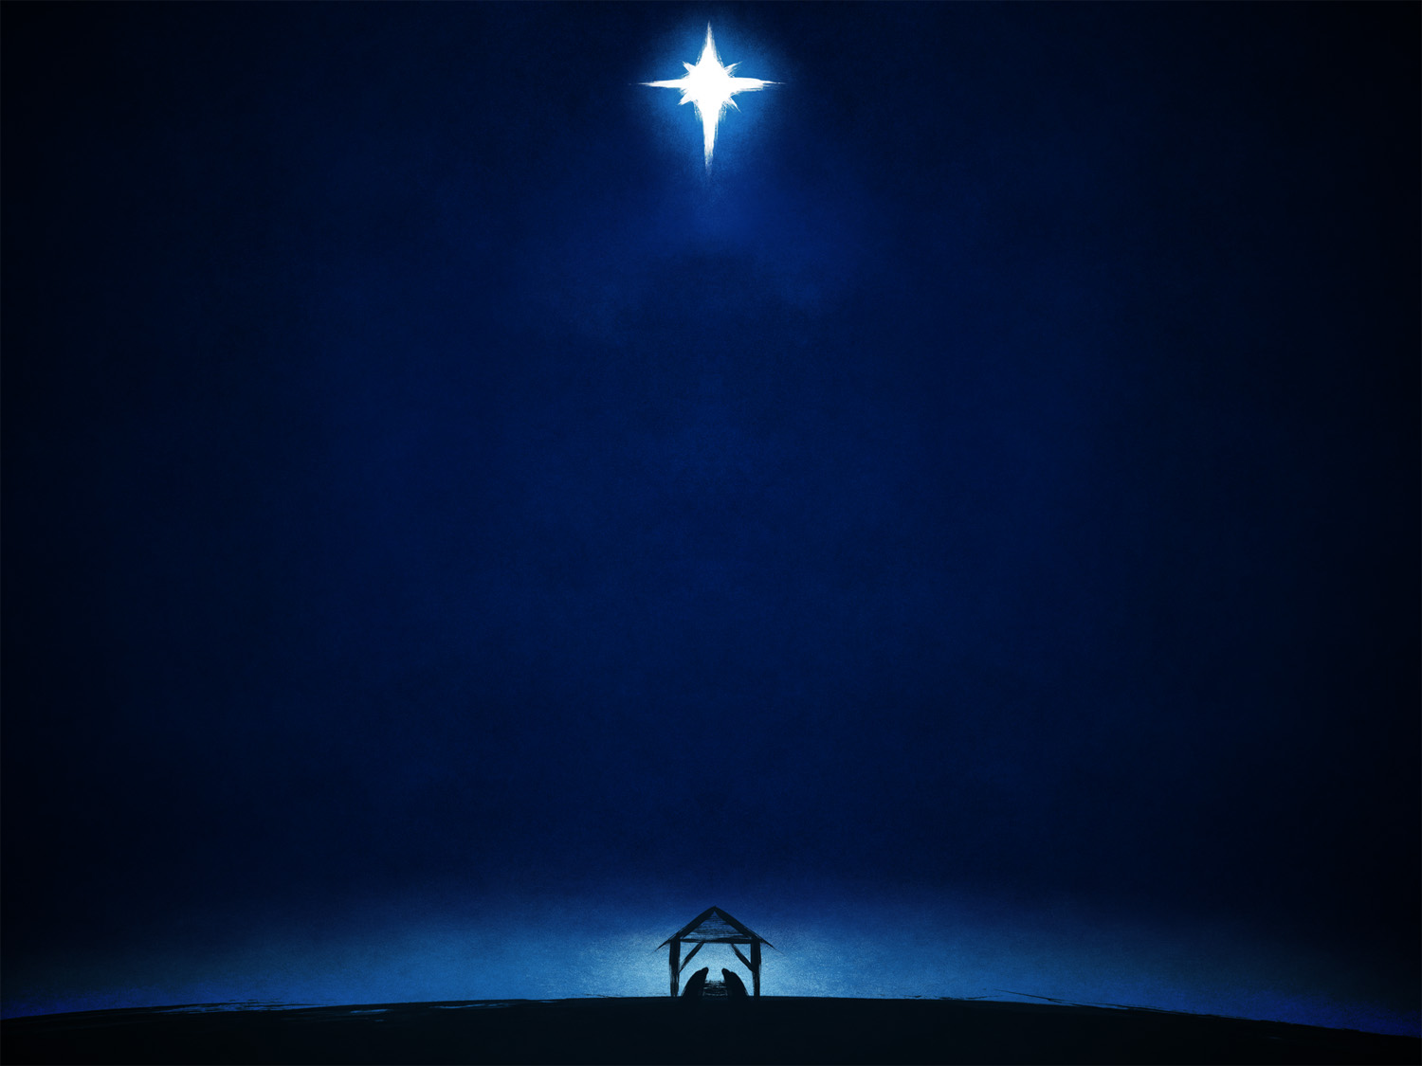
“Who Is Jesus Christ?”
Notes:
100% of people answer “Son of God!”
My brethren are ready to talk about baptism!
“Question?” When did Jesus come into existence? 75% of my students say “At His conception” or “At His Birth!” They DO NOT KNOW the real Jesus!
Side point: He was NEVER called the Son of God until the H.S. miraculously caused Mary’s pregnancy! Mt. 1:23 “‘Behold, the virgin shall be with child, and bear a Son, and they shall call His name Immanuel,’ which is translated, ‘God with us.’”

Slide 3
JESUS --
A DIVINE Being!

Slide 4

Notes:
Is. 7:14; Mt. 1:
Fullness Of The Godhead Bodily! Col. 2:9
He did not divest himself of His Deity when He came to earth; He Was/Is/And Always Will Be “God!” He was “God WITH us!” on Earth!
He forgave Sins!
He accepted worship!

Slide 5
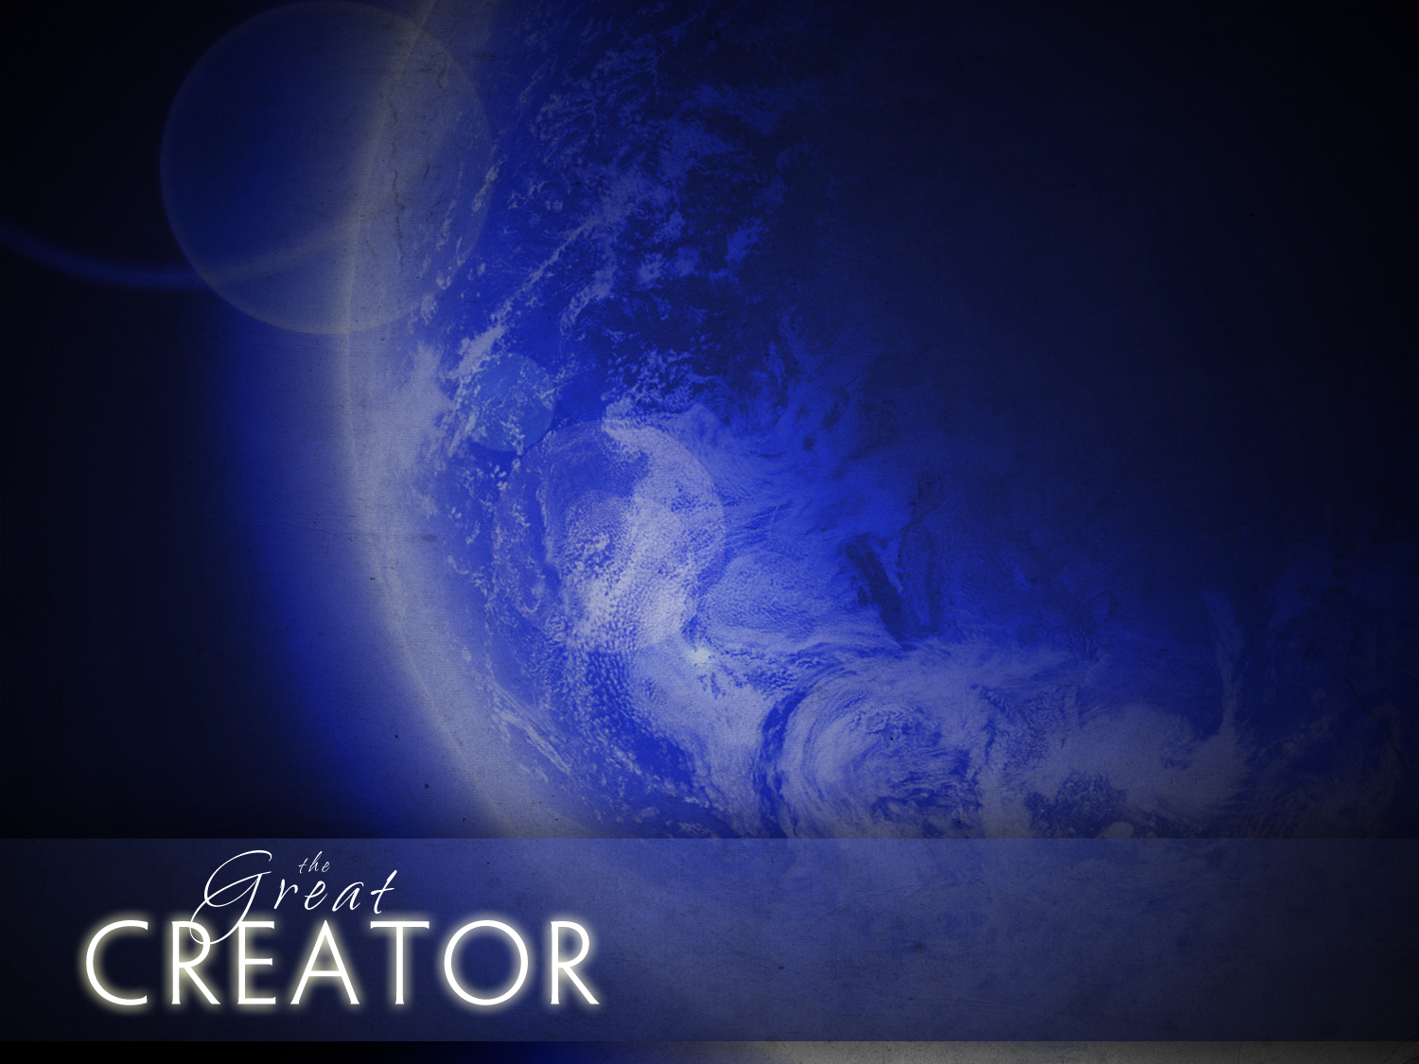
John 1:3, 10-11
Hebrews 1:1-3
Colossians 1:12-20
Notes:
B. (Slide #5) CREATOR!
1. Jn. 1:3 “All things were made through Him, and without Him nothing was made that was made.”
2. Heb. 1:1,2 “God, who at various times and in various ways spoke in time past to the fathers by the prophets, ²has in these last days spoken to us by His Son, whom He has appointed heir of all things, through whom also He made the worlds;”
3. Col. 1:12-19 READ
a. Verses 12, 13 -- The Father
b. Verses 13b - 19 -- Jesus
1. Because of His Blood, we have redemption. 14
2. He has the identical image of the Father! He has every trait of Deity!
3. He is greater than all of the Creation. Why? Because He created it all!
He existed before the Creation; His Divine Word also holds it all together!
B. These 2 Traits Are CRITICAL For Us To Keep In Mind Before We Talk About His Fierce Resolve!

Slide 6
SAGACIOUS -- He KNEW The Predestined Plan!
Notes:
He was “In the know” as to what was going to happen!
Sagacious [“In The Know!” -- He KNEW The Predestined Plan!
He knew the plan the Godhead predetermined [predestined; established] in eternity!
Eph. 3:10,11 “to the intent that now the manifold wisdom of God might be made known by the church to the principalities and powers in the heavenly places, ¹¹according to the eternal purpose which He accomplished in Christ Jesus our Lord,”
He was involved in Its planning; He was involved in carrying it out!
Prophesied:
Gen. 3:15
Gen. 12:1-3
Gen. 22:18 “In your seed all the nations of the earth shall be blessed, because you have obeyed My voice.”
Ps. 22
Is. 7:14
Is. 53
He knew what the plan was when He came here!
It HAS TO BE DONE!
Thus, He Left Heaven To Come To This Ignorant, Sin-Sick, Rebellious, Unappreciative World To Enact The Plan!

Slide 7
STRATEGIC -- He Had Complete Understanding
Of And By-in Of His Mission!
Notes:
Strategic -- He KNEW His Mission:
Greek word “dei`” [pronounced “die” -- from “devw”. Meaning: “ought”, “must”, “needed to”; “obliged to”, “had to” or “It is necessary.”
Lk. 2:48.49 “So when they saw Him, they were amazed; and His mother said to Him, ‘Son, why have You done this to us? Look, Your father and I have sought You anxiously.’ ⁴⁹And He said to them, ‘Why did you seek Me? Did you not know that I must be about My Father's business?’”
Jn. 3:14,15 “And as Moses lifted up the serpent in the wilderness, even so must the Son of Man be lifted up, ¹⁵that whoever believes in Him should not perish but have eternal life.” Nicodemus
Mt. 16:21 “From that time Jesus began to show to His disciples that He must go to Jerusalem, and suffer many things from the elders and chief priests and scribes, and be killed, and be raised the third day.”
Jn. 4:4 “But He needed to go through Samaria.” [“had to” -- NIV, ESV] Woman of Samaria
Lk. 19:5 “And when Jesus came to the place, He looked up and saw him, and said to him, ‘Zacchaeus, make haste and come down, for today I must stay at your house.’”
Heb. 2:9 “But we see Jesus, who was made a little lower than the angels, for the suffering of death crowned with glory and honor, that He, by the grace of God, might taste death for everyone.” [NOT the elect ones of Calvinism -- He died so that ANY who come to Him can be saved!]
Heb. 2:17,18 “Therefore, in all things He had to be made like His brethren, that He might be a merciful and faithful High Priest in things pertaining to God, to make propitiation for the sins of the people. ¹⁸For in that He Himself has suffered, being tempted, He is able to aid those who are tempted.”
Lk. 19:10 “for the Son of Man has come to seek and to save that which was lost.”
HE HAD TO FULFILL IT! Jn. 17:4 “I have glorified You on the earth. I have finished the work which You have given Me to do.”
IT IS FINISHED! Jn. 19:30 “So when Jesus had received the sour wine, He said, ‘It is finished!’ And bowing His head, He gave up His spirit.”

Slide 8
SELFLESS -- He Did Not Demand That He
Retain His Rightful Place!
Notes:
Selfless -- He Did Not Demand That He Retain His Rightful Place!
Phil. 2:6-8 “who, being in the form of God, did not consider it robbery to be equal with God, ⁷but made Himself of no reputation, taking the form of a bondservant, and coming in the likeness of men. ⁸And being found in appearance as a man, He humbled Himself and became obedient to the point of death, even the death of the cross.”
He was, is, and always be God!
“being”
“form” -- every intrinsic trait of a Divine Being!
He did not, He could not divest Himself of His Deity -- He was, is, and always will be Divine!
He could no more divest himself of His Deity than you could divest yourself of your humanity -- a spirit made in the image of God residing in an earthly body.
He was a Divine Spirit residing in an earthly body!
He did not demand that He had every right to remain in the perfection of Heaven; He did not feel that He was deprive of His rights!
He did not resent the Father and the Spirit who would remain in Heaven and would not be subjected to any of the restrictions, humiliations, or mistreatments that He faced!
He made Himself of NO reputation.
He was viewed as a mere man.
He had no comeliness -- Is. 53
He became a slave.
He appeared to men a mere mortal man
In His Body, he became obedient to Death on the Cross.

Slide 9
SUBMISSIVE --He Learned The Demands
Of Obedience!
Notes:
Submissive -- He Learned The Demands Of Obedience!
Obedience is not always easy!
Often it can be extremely demanding!
Heb. 5:8 [7-9 “who, in the days of His flesh, when He had offered up prayers and supplications, with vehement cries and tears to Him who was able to save Him from death, and was heard because of His godly fear, ⁸though He was a Son, yet He learned obedience by the things which He suffered. ⁹And having been perfected, He became the author of eternal salvation to all who obey Him,”]
Here is Heaven’s plan -- it has to be carried out; it demands submission!
The Gospel of John highlight’s His submission to the Father’s Will:
Jn. 4:34 “Jesus said to them, "My food is to do the will of Him who sent Me, and to finish His work.”
Jn. 5:19-30
5:19 “Then Jesus answered and said to them, ‘Most assuredly, I say to you, the Son can do nothing of Himself, but what He sees the Father do; for whatever He does, the Son also does in like manner.’”
5:30 “I can of Myself do nothing. As I hear, I judge; and My judgment is righteous, because I do not seek My own will but the will of the Father who sent Me.”
Jn. 6:38 “For I have come down from heaven, not to do My own will, but the will of Him who sent Me.”
Jn. 8:28,29 “Then Jesus said to them, ‘When you lift up the Son of Man, then you will know that I am He, and that I do nothing of Myself; but as My Father taught Me, I speak these things. ²⁹And He who sent Me is with Me. The Father has not left Me alone, for I always do those things that please Him.’”
Jn. 14:31 “But that the world may know that I love the Father, and as the Father gave Me commandment, so I do. Arise, let us go from here.”
ESV “but I do as the Father has commanded me, so that the world may know that I love the Father. Rise, let us go from here.”
Obedience is not always easy; it can be super-demanding!
His cries, “Father, if it’s possible……”
Mt. 26:39 “He went a little farther and fell on His face, and prayed, saying, ‘O My Father, if it is possible, let this cup pass from Me; nevertheless, not as I will, but as You will.’”
Mt. 26:42 “Again, a second time, He went away and prayed, saying, ‘O My Father, if this cup cannot pass away from Me unless I drink it, Your will be done.’”
The intensity -- LK. 22:44 “And being in agony, He prayed more earnestly. Then His sweat became like great drops of blood falling down to the ground.”
Lk 22:42 “saying, ‘Father, if it is Your will, take this cup away from Me; nevertheless not My will, but Yours, be done.’”

Slide 10
SYMPATHETIC -- He HAD To Understand
The Struggles That Men Faced!
Notes:
Sympathetic -- He HAD To Understand The Struggles That Men Faced!
Heb. 4:15 “For we do not have a High Priest who cannot sympathize with our weaknesses, but was in all points tempted as we are, yet without sin. ¹⁶Let us therefore come boldly to the throne of grace, that we may obtain mercy and find grace to help in time of need.”
He understands the struggles we face -- temptation, weakness,
He HAD TO DO THIS in order to be our perfect High Priest!
He KNEW the facts about what He face “Greed word ginosko”: however he had to experience or to have understanding [to see] “Oida” in Greek!

Slide 11
SHARP-SIGHTED -- He Knew The End Result.
Notes:
He Knew The End Result.
He would provide remission of sin for sinners who came to faith in Him!
He would be restored back to His Heavenly home and rightful place!

Slide 12
His Fierce Resolve -- He Would Endure:
Fleshly Restrictions.
Misunderstanding.
Resentment And Hate.
Betrayal By An Apostle And Supposed Friend!
Denial By His Beloved Peter!

Slide 13
Being Forsaken By All Of His Apostles!
Rejection By His Own People!
Arrested Like A Seditious Criminal!
Illegal Farces Of Trials.
Horrendous Death By Crucifixion!
Being Forsaken By The Father!
Notes:
Rejection By His Own People!
Jn. 1:10,11 “He was in the world, and the world was made through Him, and the world did not know Him. ¹¹He came to His own [Neuter plural -- “His Own Things”], and His own [Masculine plural -- “His own people”] did not receive Him.”
His own people -- The Descendants of Abraham -- people who for 2,000 years had been told that through their nation the Messiah would come!

Slide 14
Traits This Refusal To Turn Back Demanded:
Fierce Resolve!
Meekness!
Love!
Notes:
Fierce Resolve! [Absolute Determination!]
Meekness: (Strength Under Control!)
“He Could Have Called 10,000 Angels…..”
Love!
Hymn: “I Gave My Life For Thee!”
Verse 1:
I gave My life for thee,
My precious blood I shed,
That thou might’st ransomed be,
And quickened from the dead;
Verse 2:
My Father’s house of light,
My glory-circled throne
I left for earthly night,
For wanderings sad and lone;
Verse 3:
I suffered much for thee,
More than thy tongue can tell,
Of bitterest agony,
To rescue thee from hell;
Verse 4:
And I have brought to thee,
Down from My home above,
Salvation full and free,
My pardon and My love;

Slide 15

The Christian’s Determination --
NO TURNING BACK --
The FIERCE RESOLVE To Do
Our Father’s Will!
Notes:
When I understand that it was the Divine Creator who experienced all this horror and that He did it for ME, it DRIVES ME To live for Him!

Slide 16

Will You Have FIERCE RESOLVE
To Imitate Jesus?
Phil. 2:5 “Let this mind be in you which was also in Christ Jesus,”
Jn. 13:15 “For I have given you an example, that you should do as I have done to you.”
I Pet. 2:21 “For to this you were called, because Christ also suffered for us, leaving us an example, that you should follow His steps:”
I Jn. 2:6 “He who says he abides in Him ought himself also to walk just as He walked.”
Notes:
Hear Scripture ‘s Call:
Phil. 2:5 “Let this mind be in you which was also in Christ Jesus,”
Jn. 13:35 Be a humble servant NEVER exalting yourself or demanding to be served!
I Pet. 2:21 “For to this you were called, because Christ also suffered for us, leaving us an example, that you should follow His steps: ²²Who committed no sin, Nor was deceit found in His mouth’;
²³who, when He was reviled, did not revile in return; when He suffered, He did not threaten, but committed Himself to Him who judges righteously;
He is the perfect example of living this principle: Rom. 12:19 “Beloved, do not avenge yourselves, but rather give place to wrath; for it is written, ‘Vengeance is Mine, I will repay,’ says the Lord.”
When you suffer, do not retaliate, commit your in justice to Jesus; let Him repay -- You may be TOO harsh; He knows the whole story; He will repay.

Slide 17

What Am I Going To Give Back To Him?
I gave, I gave My life for thee,
What hast thou done for Me?
I gave, I gave My life for thee,
What hast thou done for Me?
I left, I left it all for thee,
Hast thou left aught for Me?
I left, I left it all for thee,
Hast thou left aught for Me?

Slide 18
What Am I Going To Give
Back To Him?
I've borne, I've borne it all for thee,
What hast thou borne for Me?
I've borne, I've borne it all for thee,
What hast thou borne for Me?
I bring, I bring rich gifts to thee,
What hast thou brought to Me?
I bring, I bring rich gifts to thee,
What hast thou brought to Me?

Slide 19
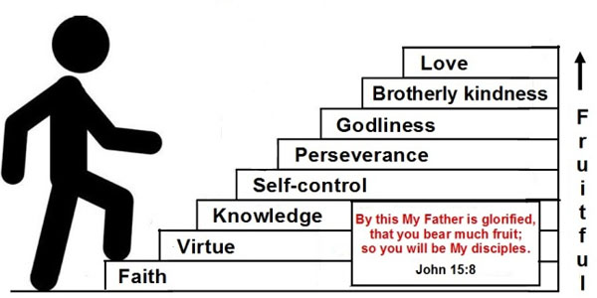

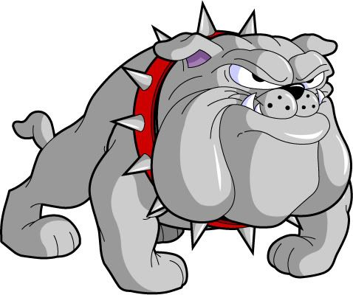
The Christian’s FIERCE RESOLVE -- I WILL BE
A PARTAKER OF THE DIVINE NATURE!
THE MISSING
Christian Grace!

Slide 20
The Christian Fierce Resolve -- I WILL NOT Turn Back To Sin!
Rom. 12:21 “Do not be overcome by evil, but overcome evil with good.”
II Pet. 2:20-22 “For if, after they have escaped the pollutions of the world through the knowledge of the Lord and Savior Jesus Christ, they are again entangled in them and overcome, the latter end is worse for them than the beginning. ²¹For it would have been better for them not to have known the way of righteousness, than having known it, to turn from the holy commandment delivered to them.”
Notes:
“I WILL NOT SELL MY SOUL TO SIN AND THE DEVIL!”
“I Am Resolved!”

Slide 21
“I Have Decided To Follow Jesus!”
Verse 1:
“I have decided to follow Jesus;
I have decided to follow Jesus;
I have decided to follow Jesus;
No turning back; no turning back.

Slide 22
Verse 2:
Tho’ one go with me, still I will follow;
Tho’ none go with me, still I will follow;
Tho’ none go with me, still I will follow;
No turning back; no turning back.

Slide 23
Verse 3:
The world behind me, the cross before me;
The world behind me, the cross before me;
The world behind me, the cross before me;
No turning back; no turning back.

Slide 24
Verse 4:
My cross I’ll carry, till I see Jesus;
My cross I’ll carry, till I see Jesus;
My cross I’ll carry, till I see Jesus;
No turning back; no turning back.

Slide 25
Verse 5:
Will you decide now to follow Jesus?
Will you decide now to follow Jesus?
Will you decide now to follow Jesus?
No turning back; no turning back.”

