Slide 2
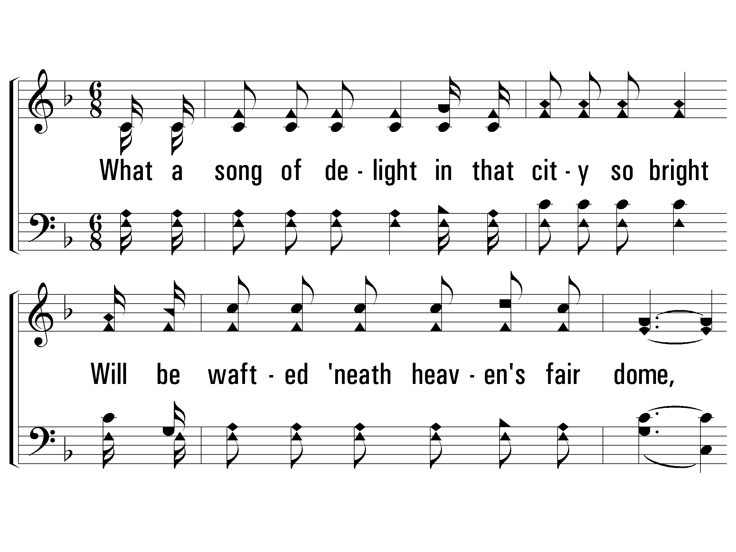
1 - When All of God’s Singers Get Home
1.
What a song of delight
in that city so bright
Will be wafted beneath heaven's fair dome,
How the ransomed will raise
happy songs in His praise,
When all of God's singers get home.
Words: Luther G. Presley / Cho.: Virgil O. Stamps / Music: Virgil O. Stamps
Copyright © 1937 by Stamps-Baxter Music (BMI) (adm. by Brentwood-Benson Music Publishing, Inc.)
All rights reserved. Used by permission.
PaperlessHymnal.com

Slide 3
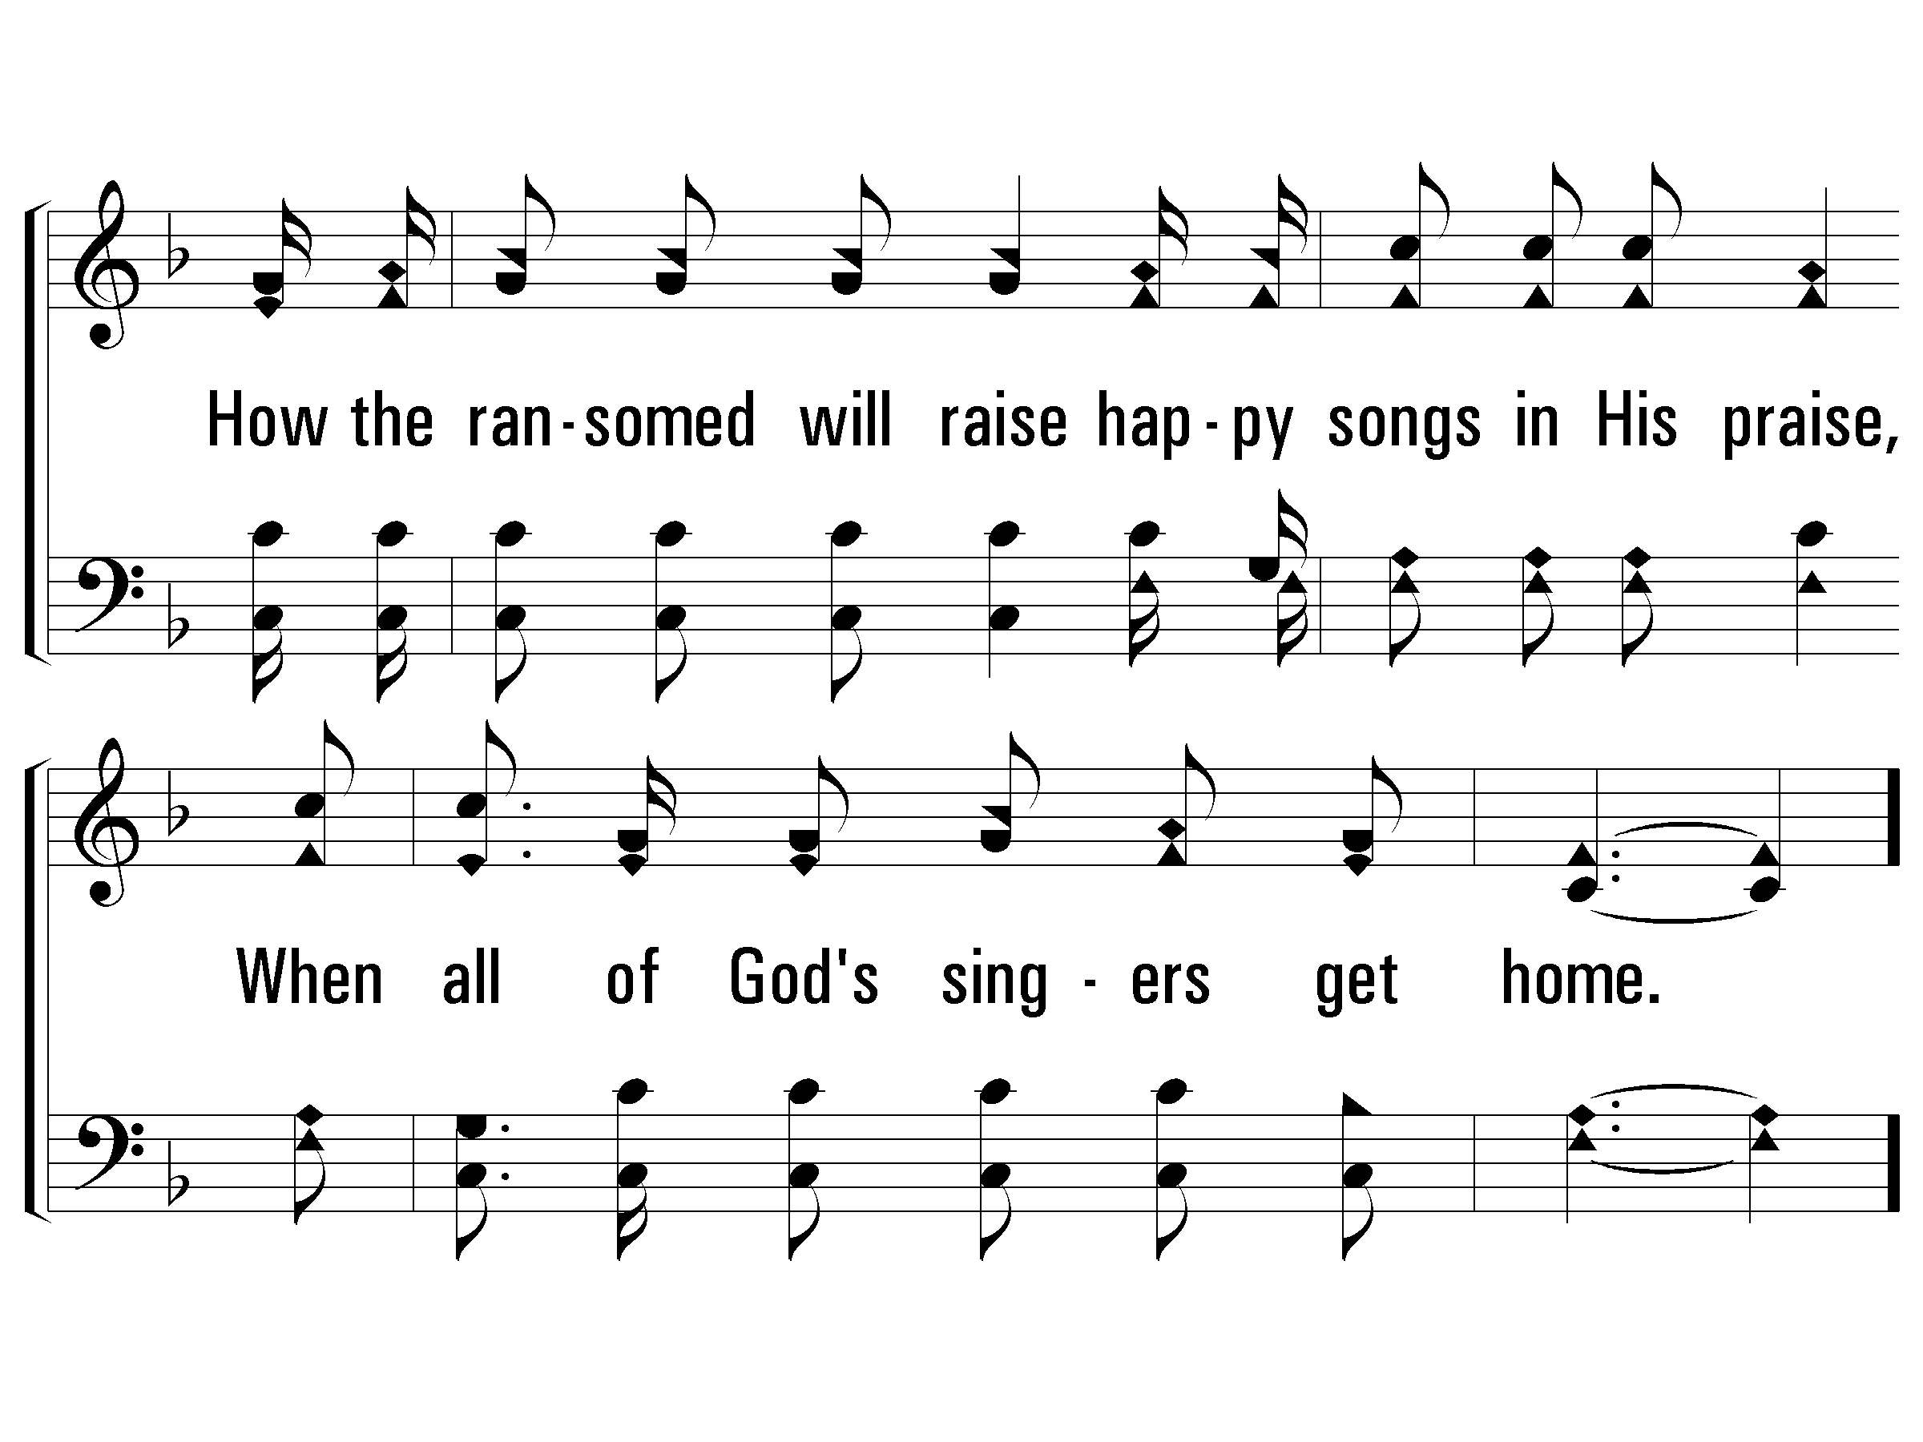
1 - When All of God’s Singers Get Home
PaperlessHymnal.com

Slide 4
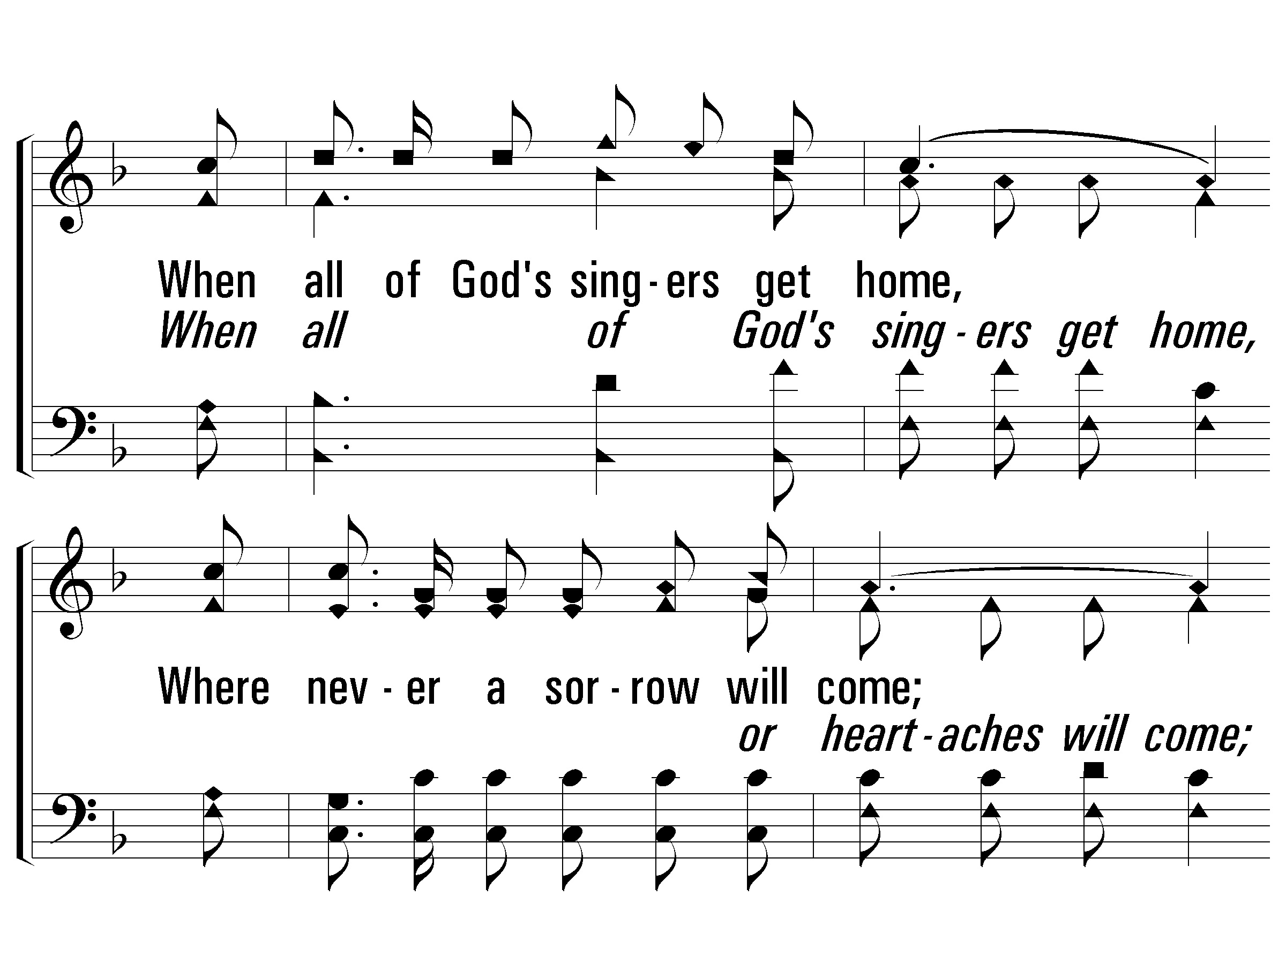
c - When All of God’s Singers Get Home
When all of God's singers get home,
Where never a sorrow will come;
There'll be "no place like home,"
When all of God's singers get home.
PaperlessHymnal.com

Slide 5
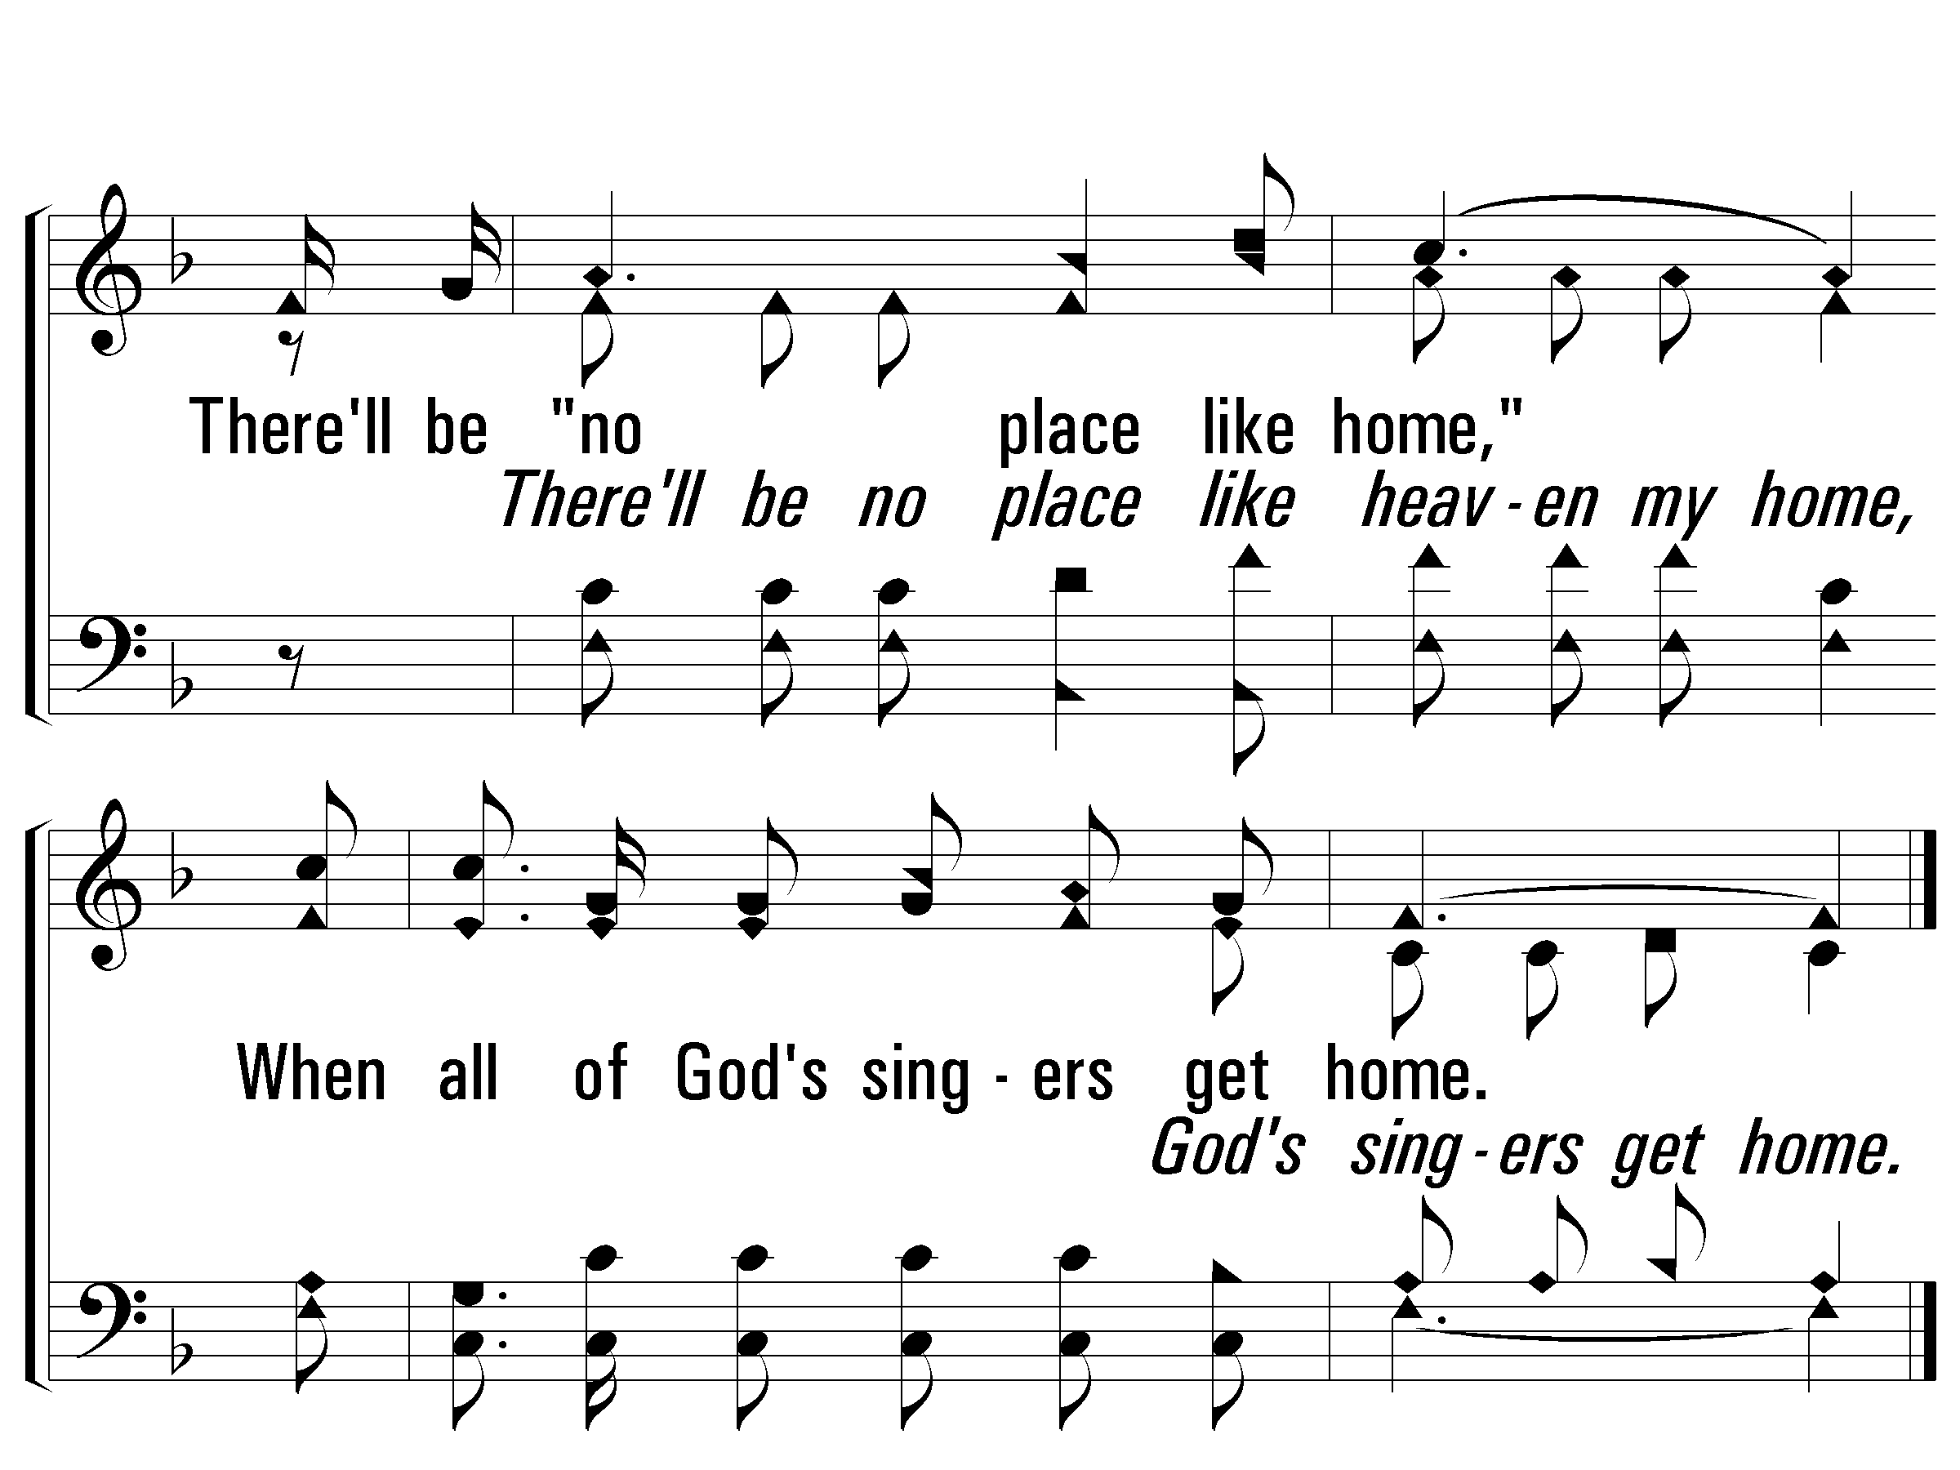
c - When All of God’s Singers Get Home
PaperlessHymnal.com

Slide 6
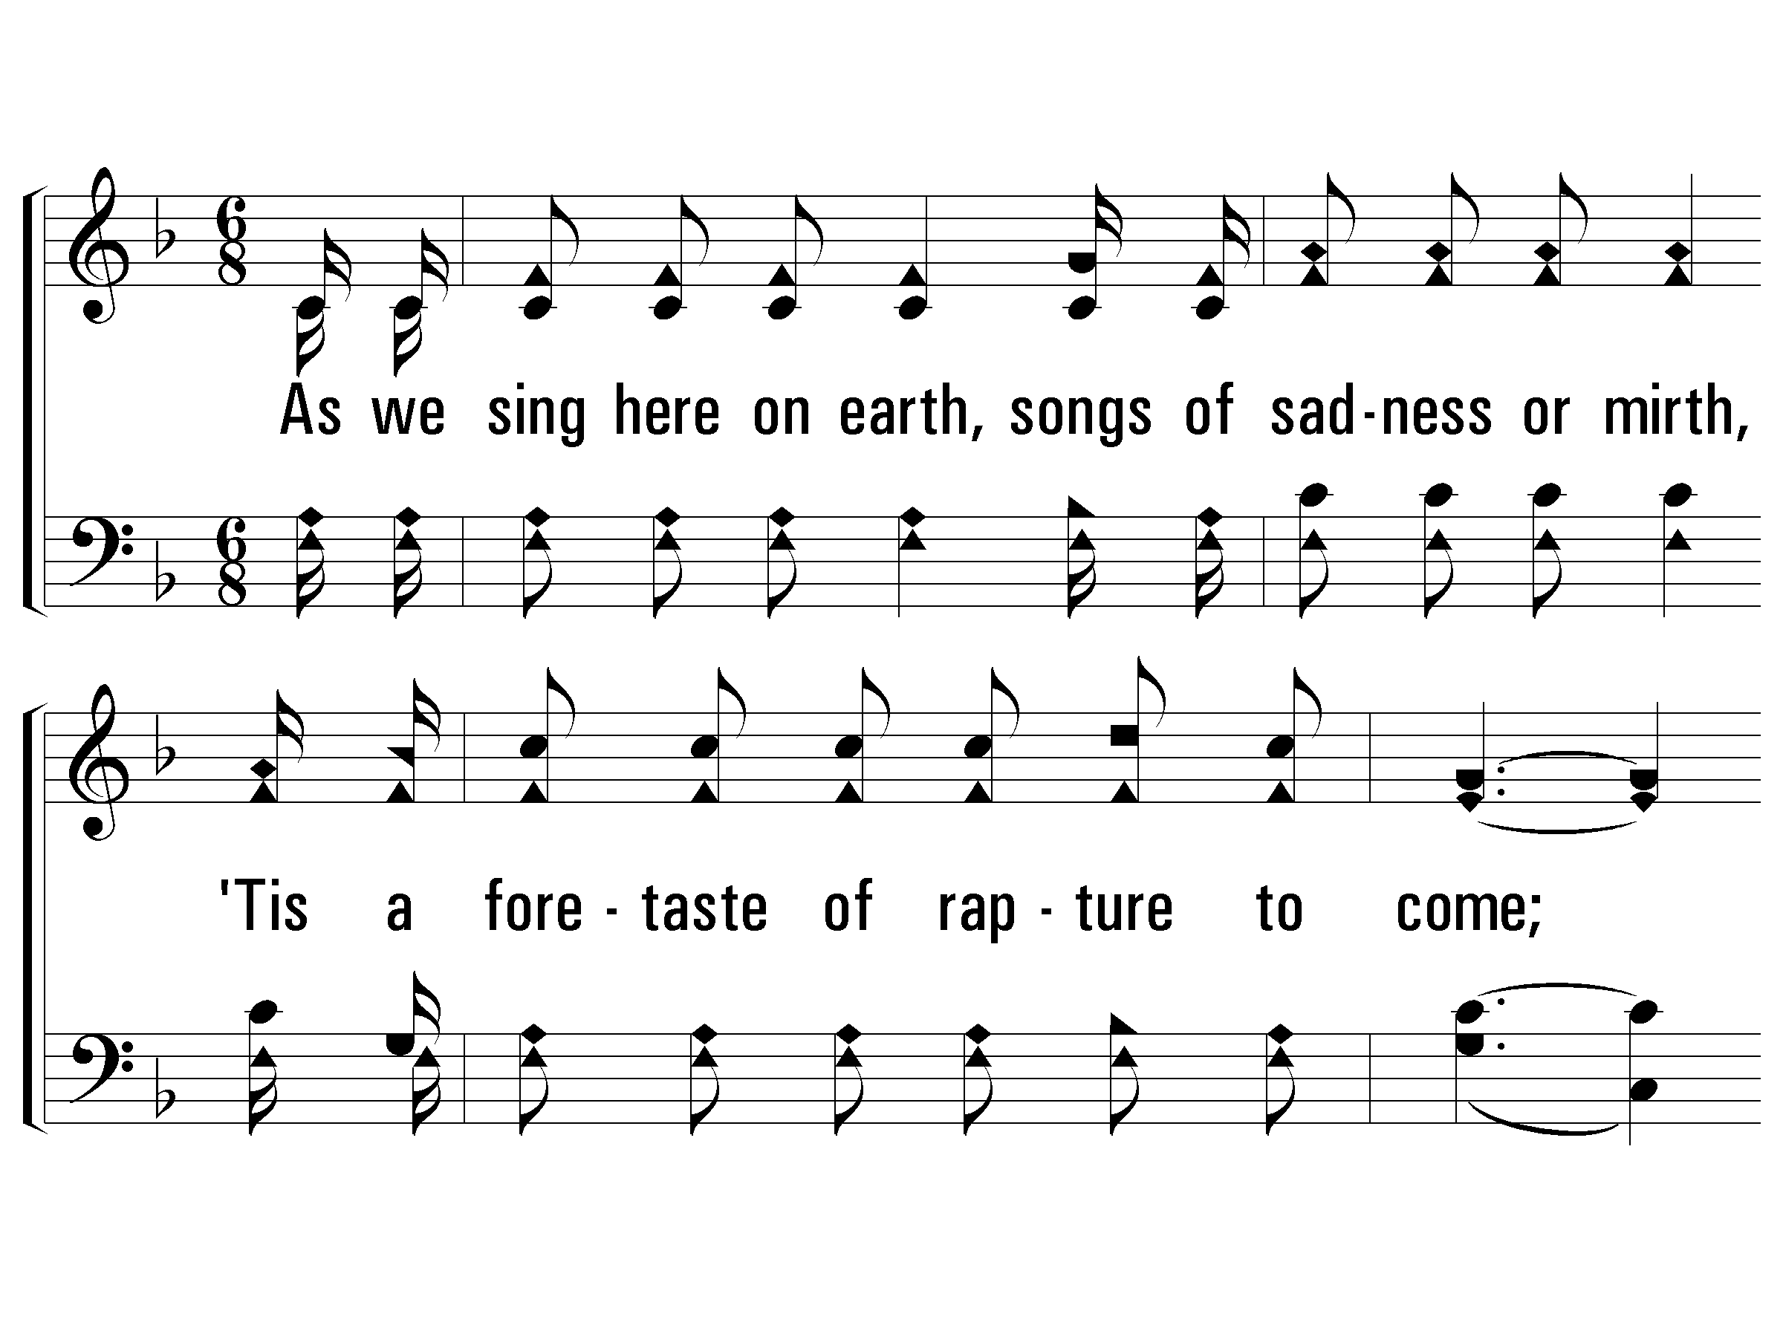
2 - When All of God’s Singers Get Home
2.
As we sing here on earth,
songs of sadness or mirth,
'Tis a foretaste of rapture to come;
But our joy can't compare
with the glory up there,
When all of God's singers get home.
Words: Luther G. Presley / Cho.: Virgil O. Stamps / Music: Virgil O. Stamps
Copyright © 1937 by Stamps-Baxter Music (BMI) (adm. by Brentwood-Benson Music Publishing, Inc.)
All rights reserved. Used by permission.
PaperlessHymnal.com

Slide 7
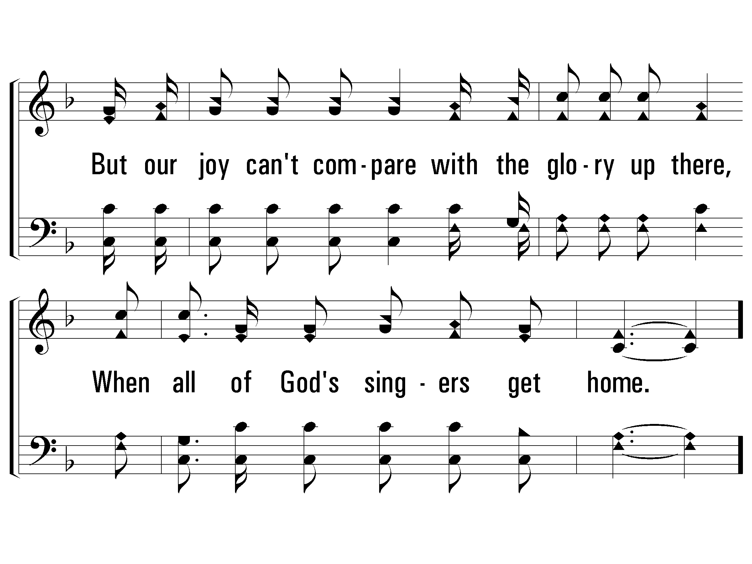
2 - When All of God’s Singers Get Home
PaperlessHymnal.com

Slide 8
c - When All of God’s Singers Get Home
When all of God's singers get home,
Where never a sorrow will come;
There'll be "no place like home,"
When all of God's singers get home.
PaperlessHymnal.com

Slide 9
c - When All of God’s Singers Get Home
PaperlessHymnal.com

Slide 10
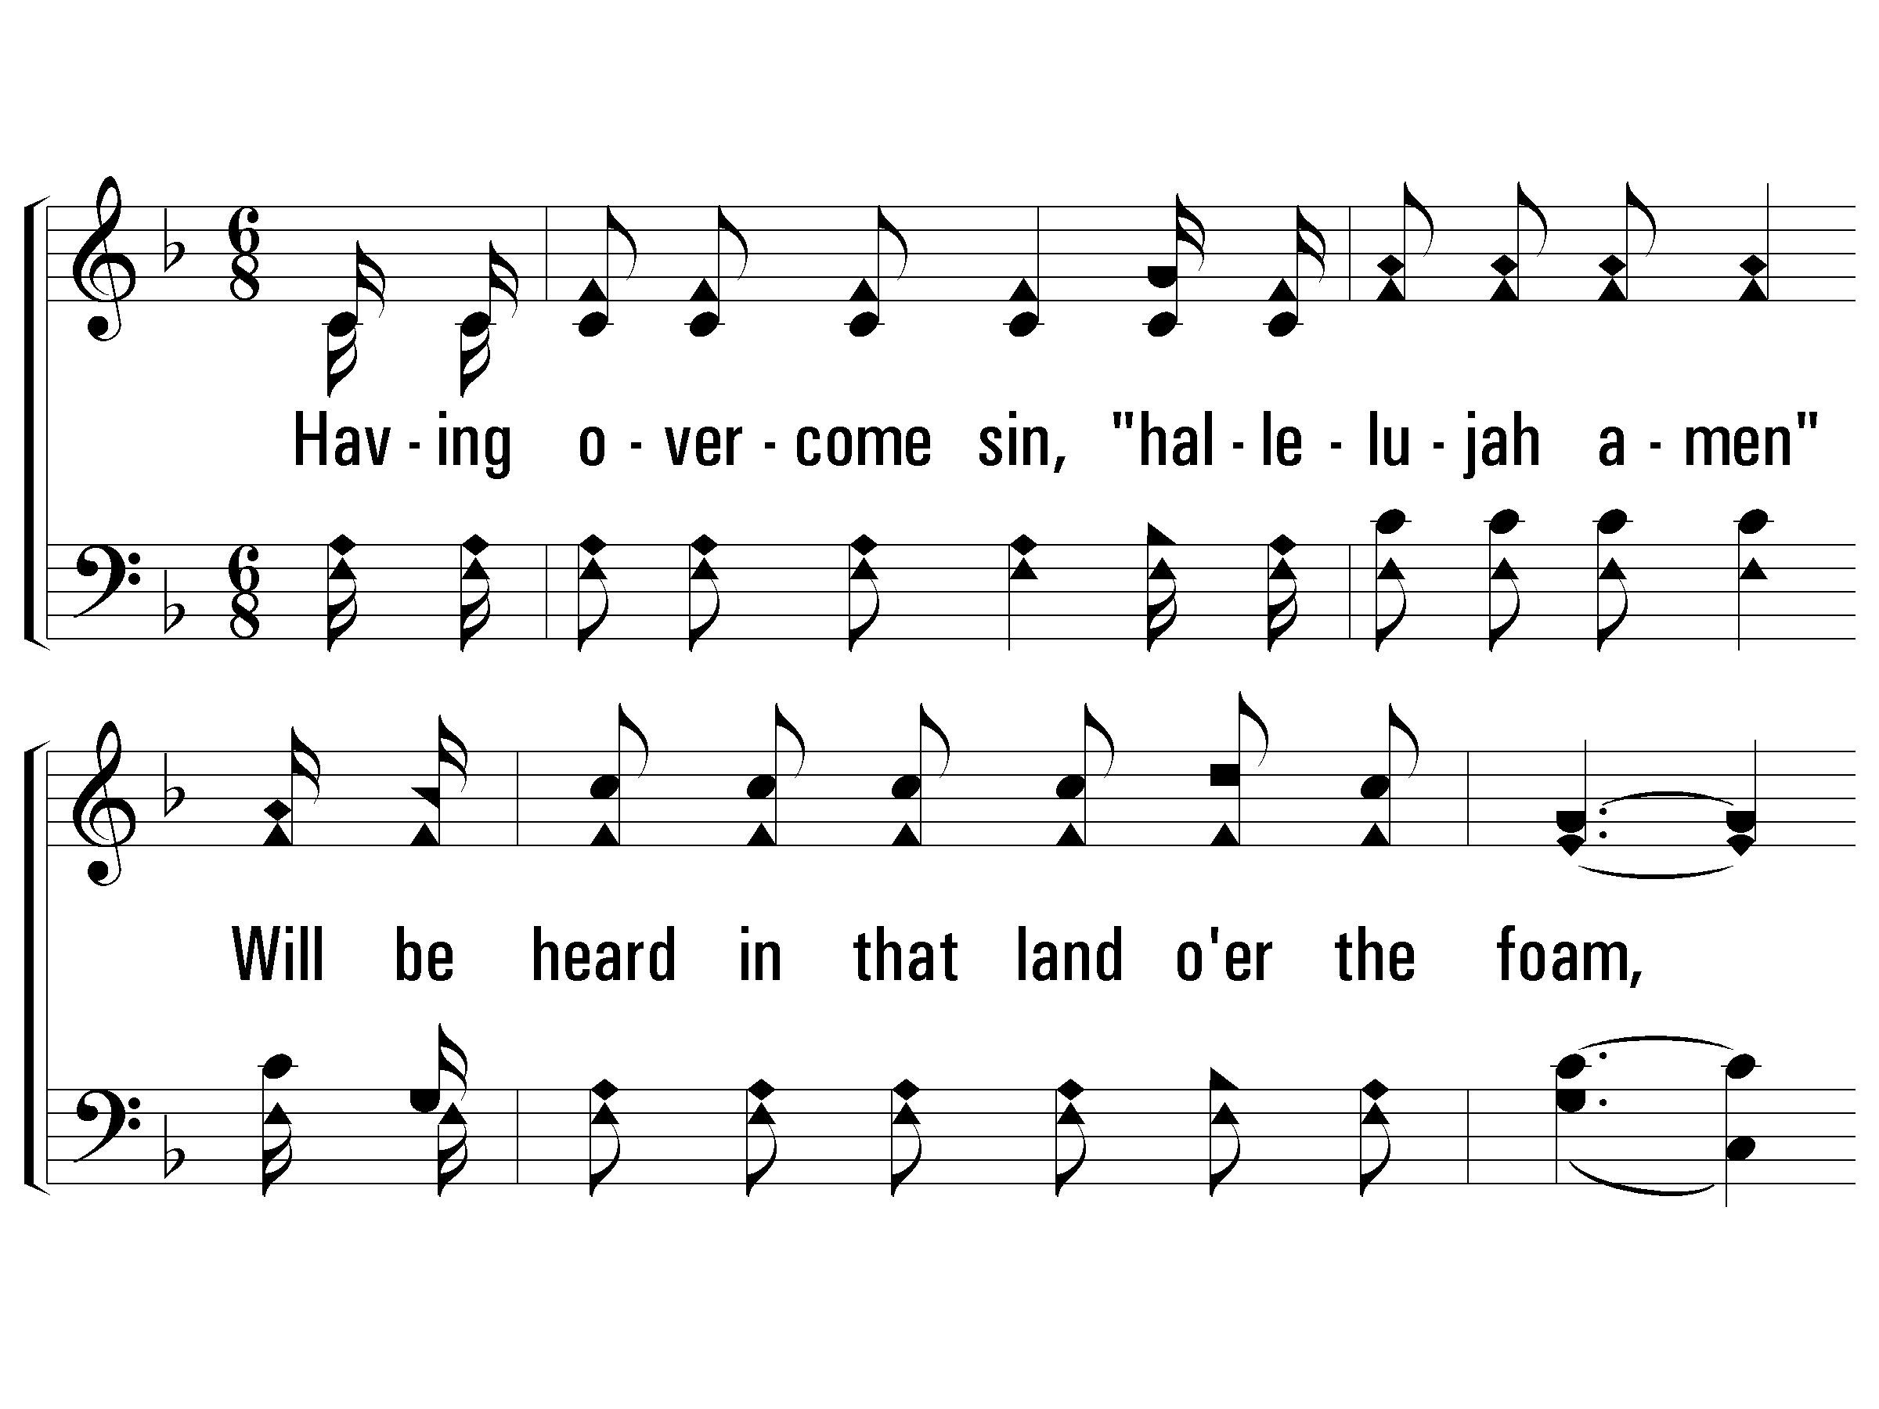
3 - When All of God’s Singers Get Home
3.
Having overcome sin,
"hallelujah amen"
Will be heard in that land over the foam,
Every heart will be light
and each face will be bright,
When all of God's singers get home.
Words: Luther G. Presley / Cho.: Virgil O. Stamps / Music: Virgil O. Stamps
Copyright © 1937 by Stamps-Baxter Music (BMI) (adm. by Brentwood-Benson Music Publishing, Inc.)
All rights reserved. Used by permission.
PaperlessHymnal.com

Slide 11
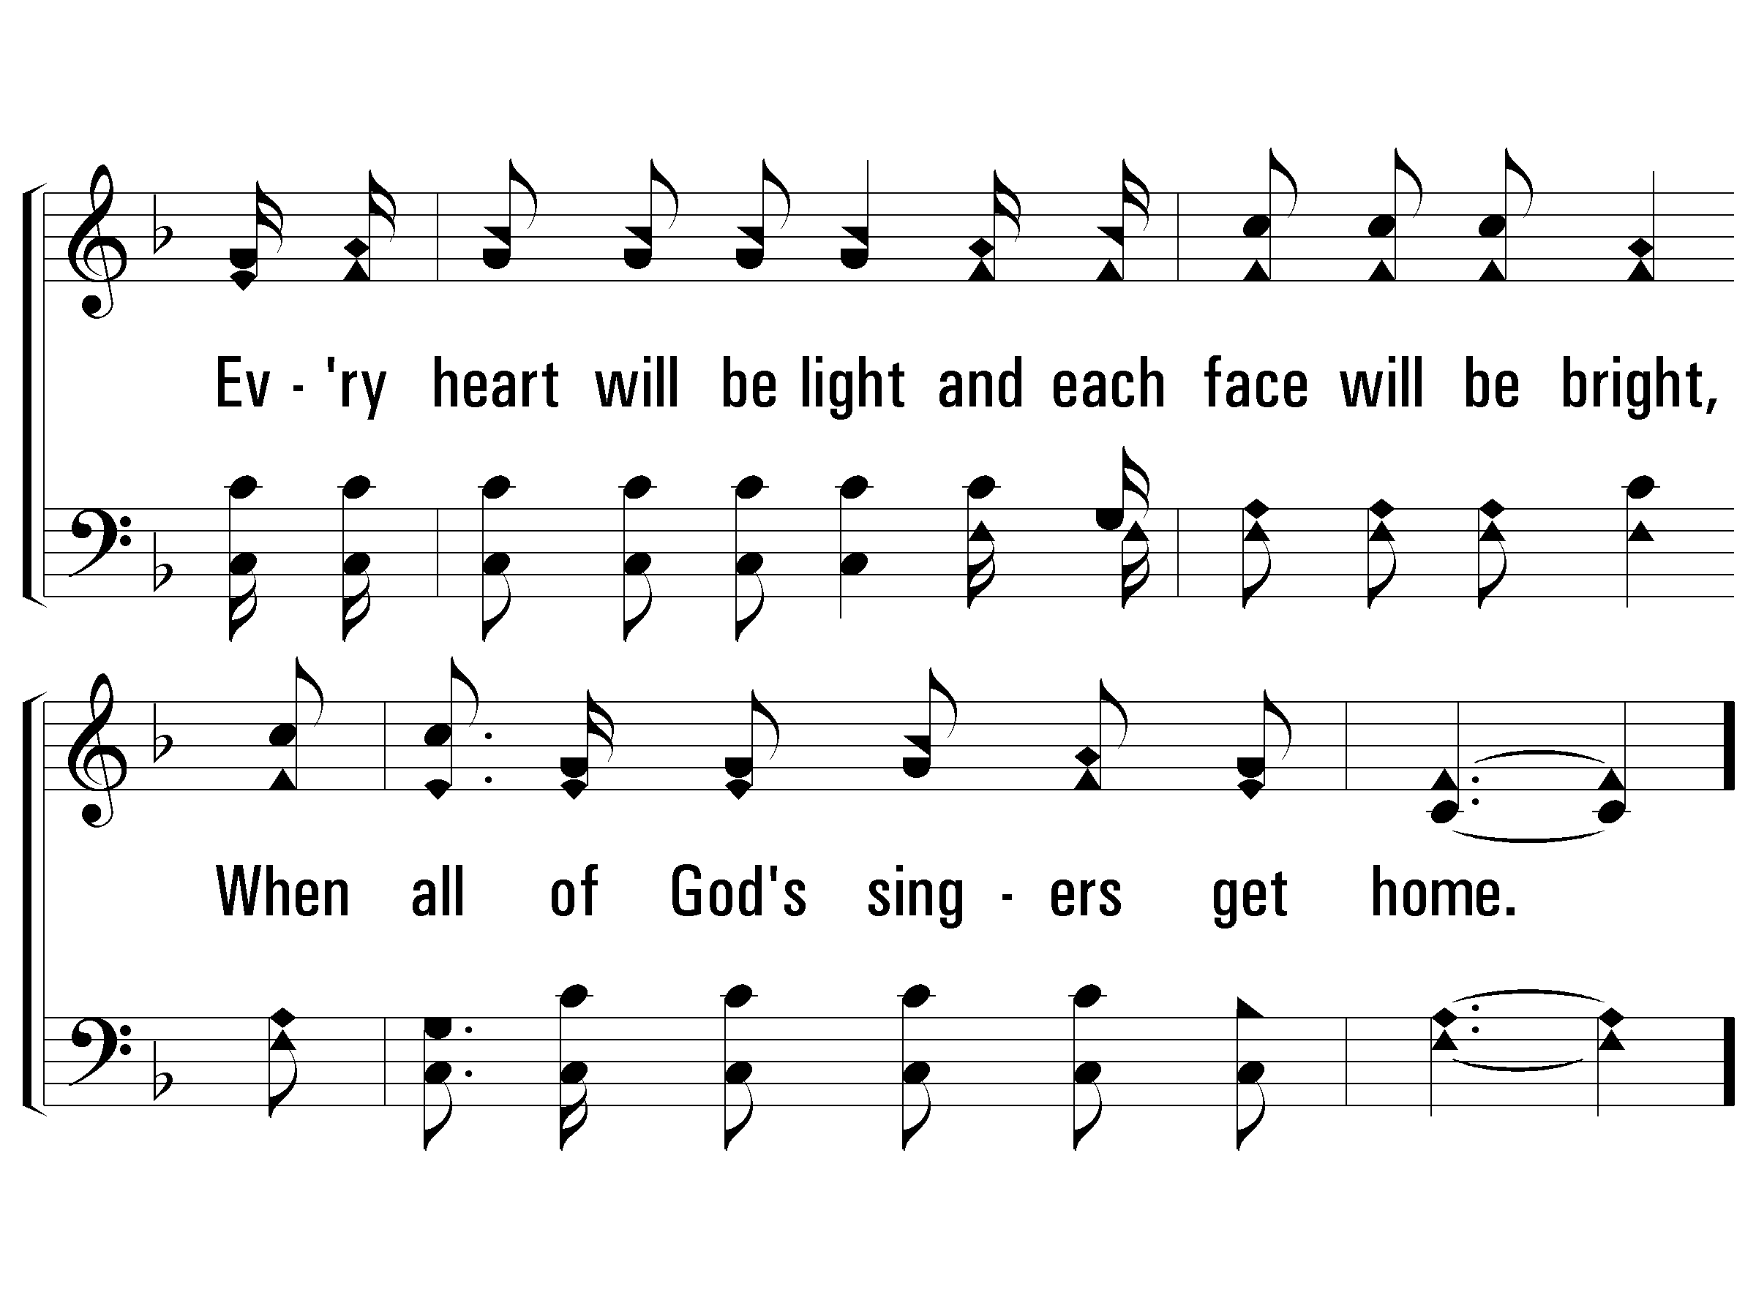
3 - When All of God’s Singers Get Home
PaperlessHymnal.com

Slide 12
c - When All of God’s Singers Get Home
When all of God's singers get home,
Where never a sorrow will come;
There'll be "no place like home,"
When all of God's singers get home.
PaperlessHymnal.com

Slide 13
c - When All of God’s Singers Get Home
PaperlessHymnal.com

Slide 15
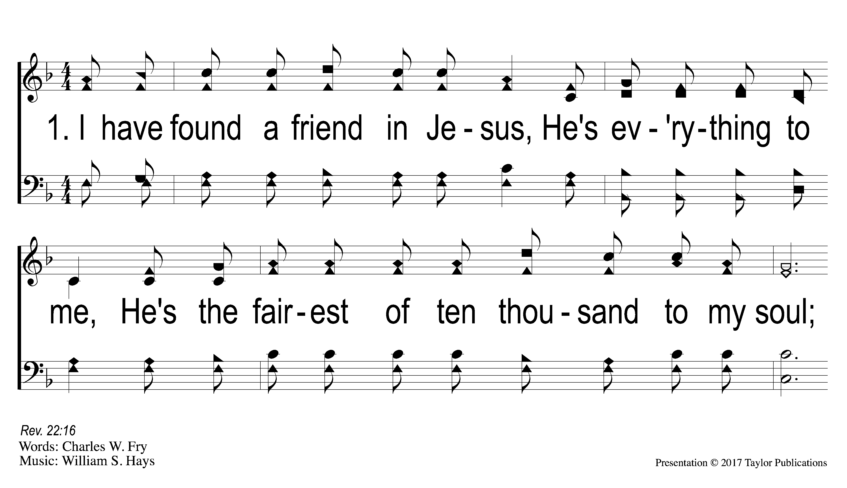
1-1 The Lily of the Valley
The Lily of the Valley
384

Slide 16
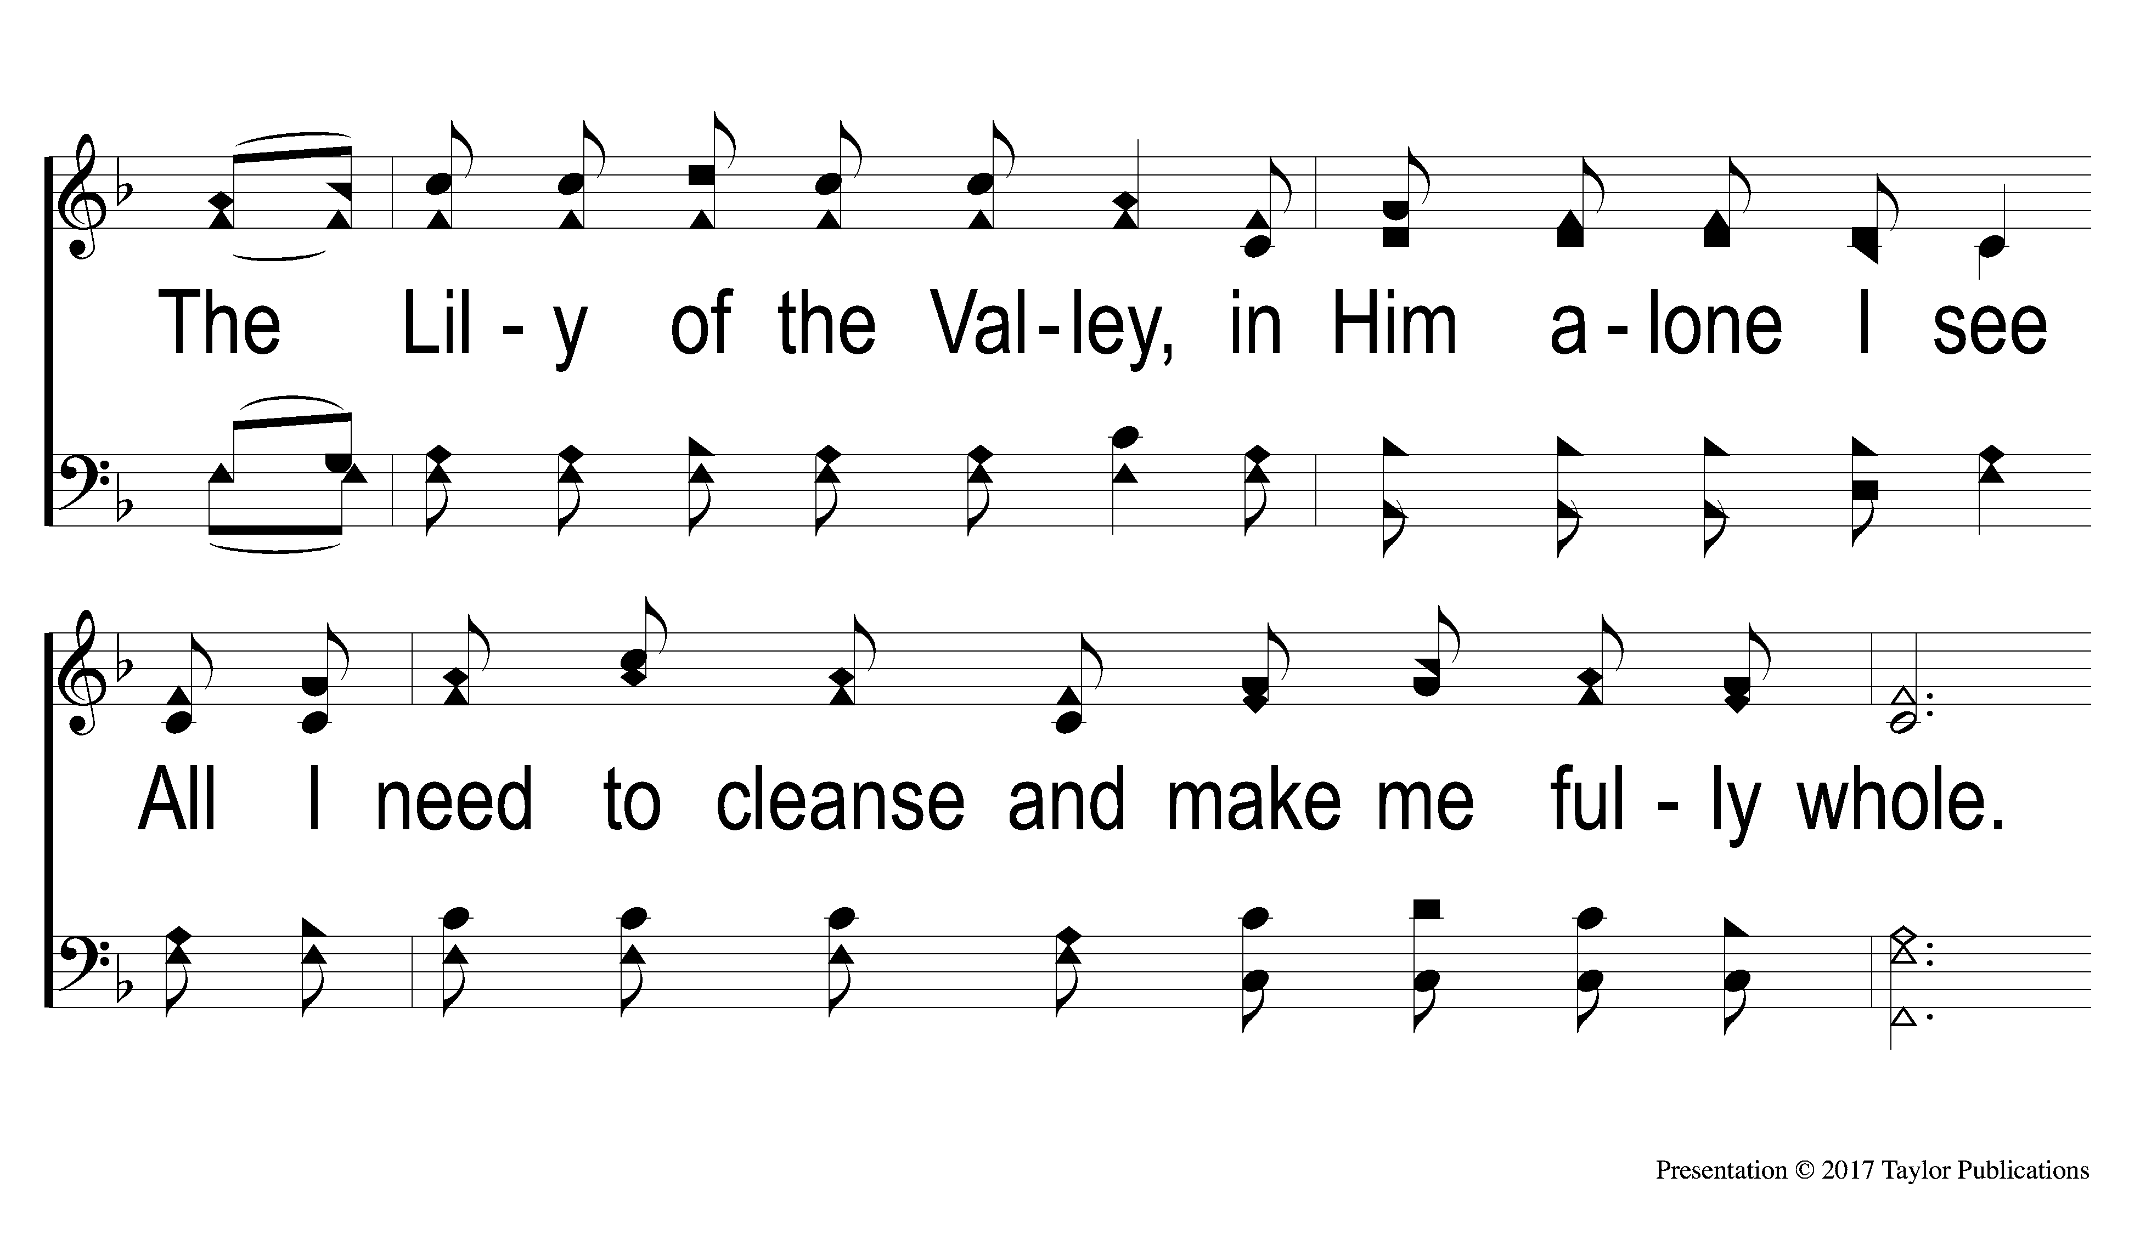
1-2 The Lily of the Valley
The Lily of the Valley
384

Slide 17
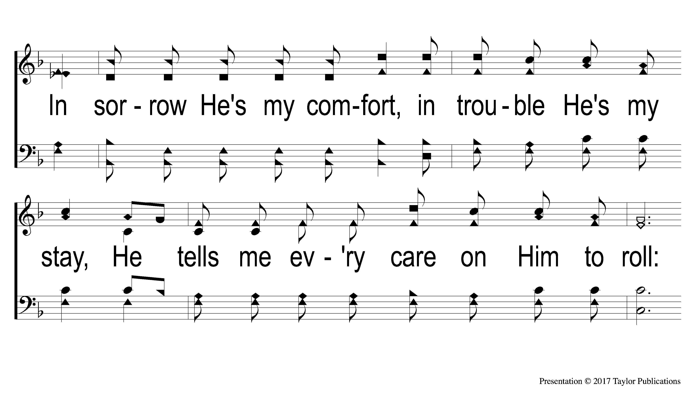
1-3 The Lily of the Valley
The Lily of the Valley
384

Slide 18
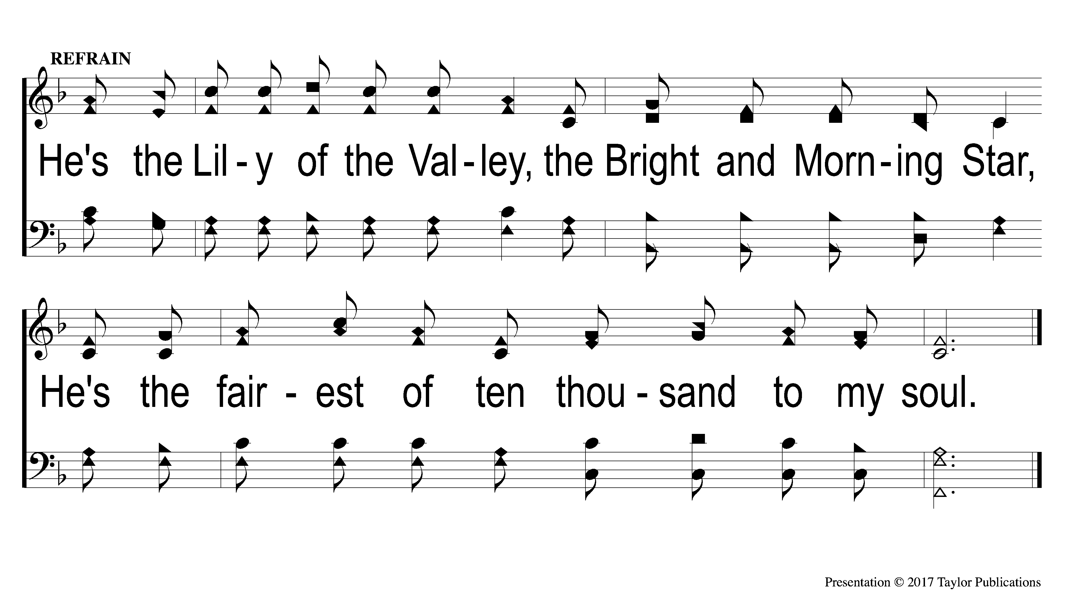
C The Lily of the Valley
The Lily of the Valley
384

Slide 19

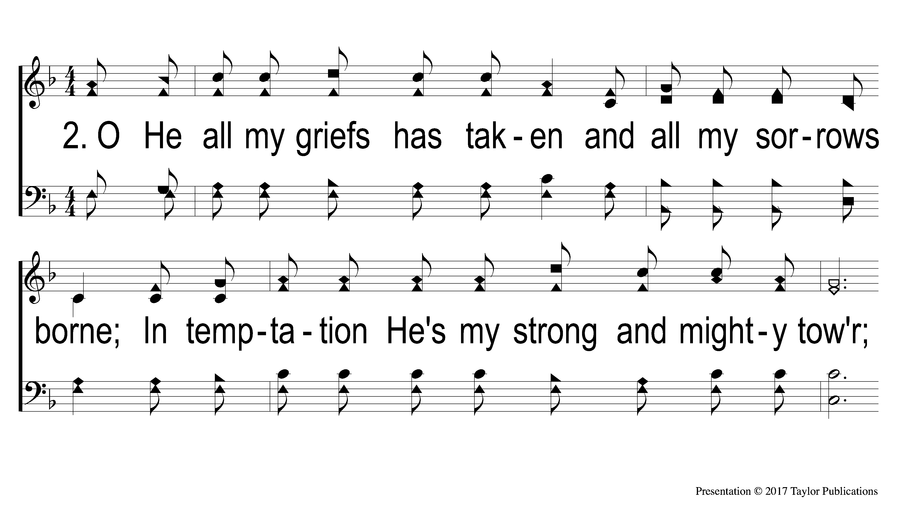
2-1 The Lily of the Valley
The Lily of the Valley
384

Slide 20
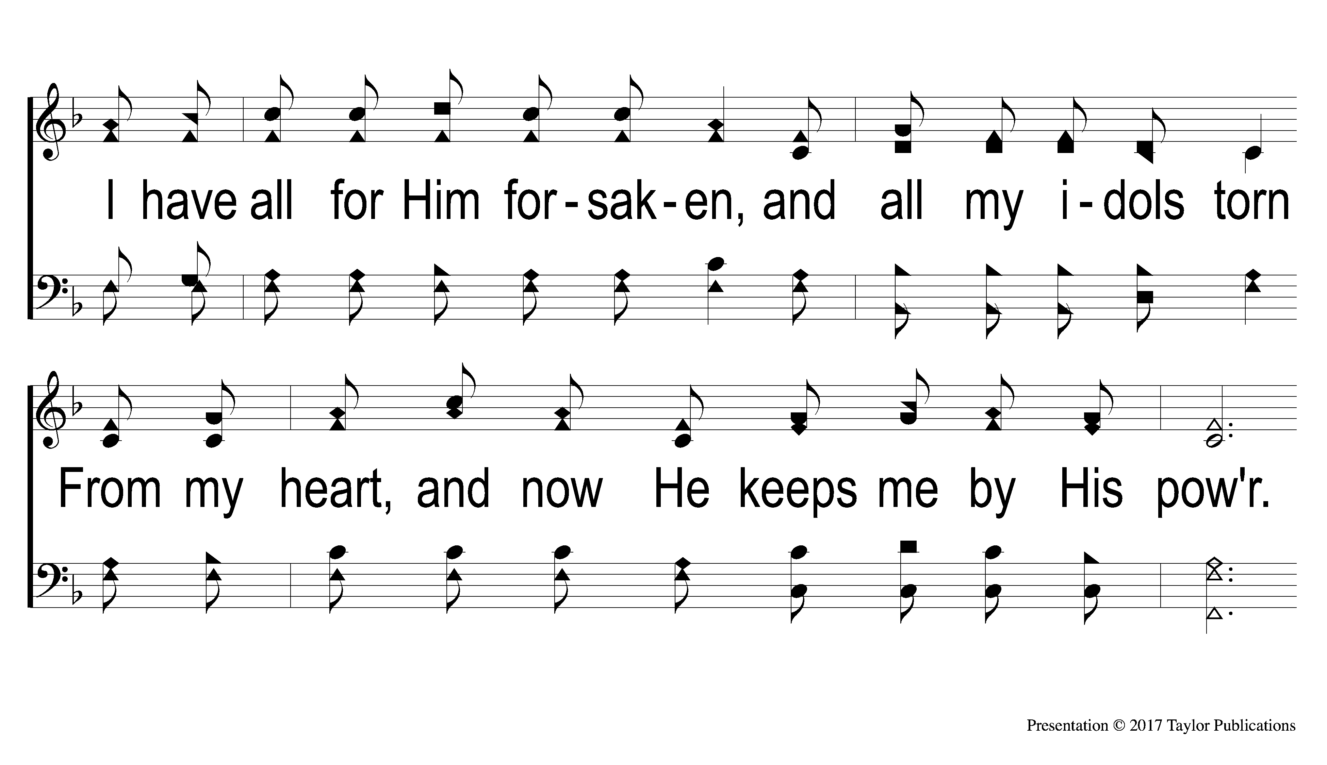
2-2 The Lily of the Valley
The Lily of the Valley
384

Slide 21
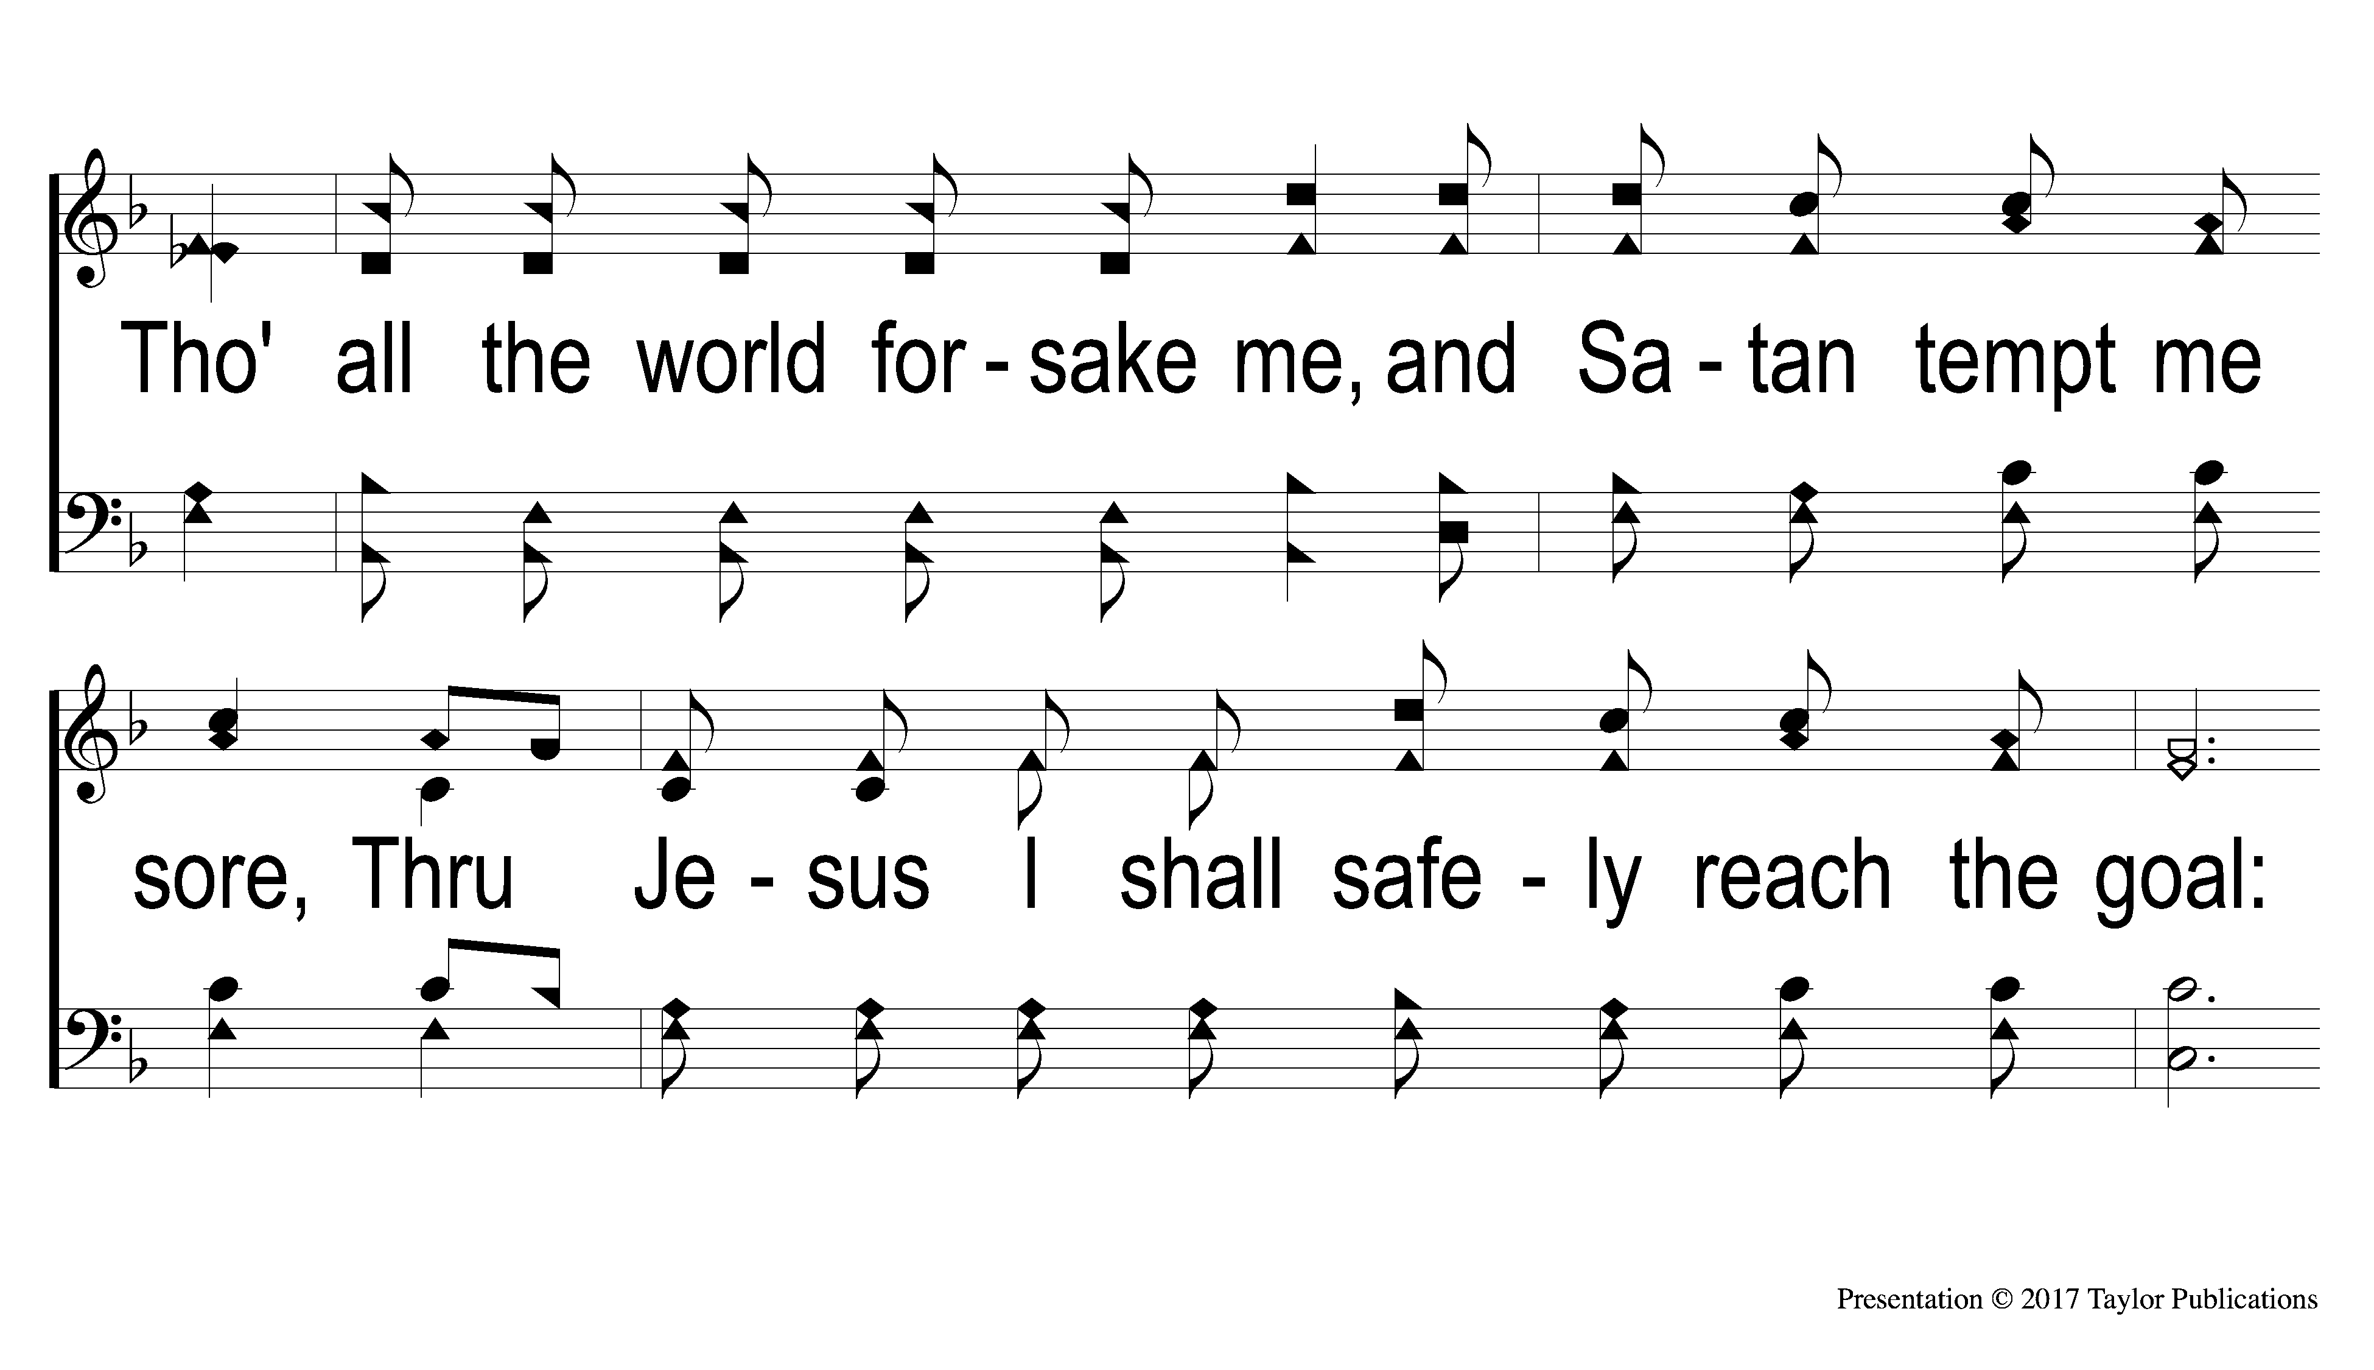
2-3 The Lily of the Valley
The Lily of the Valley
384

Slide 22
C The Lily of the Valley
The Lily of the Valley
384

Slide 23

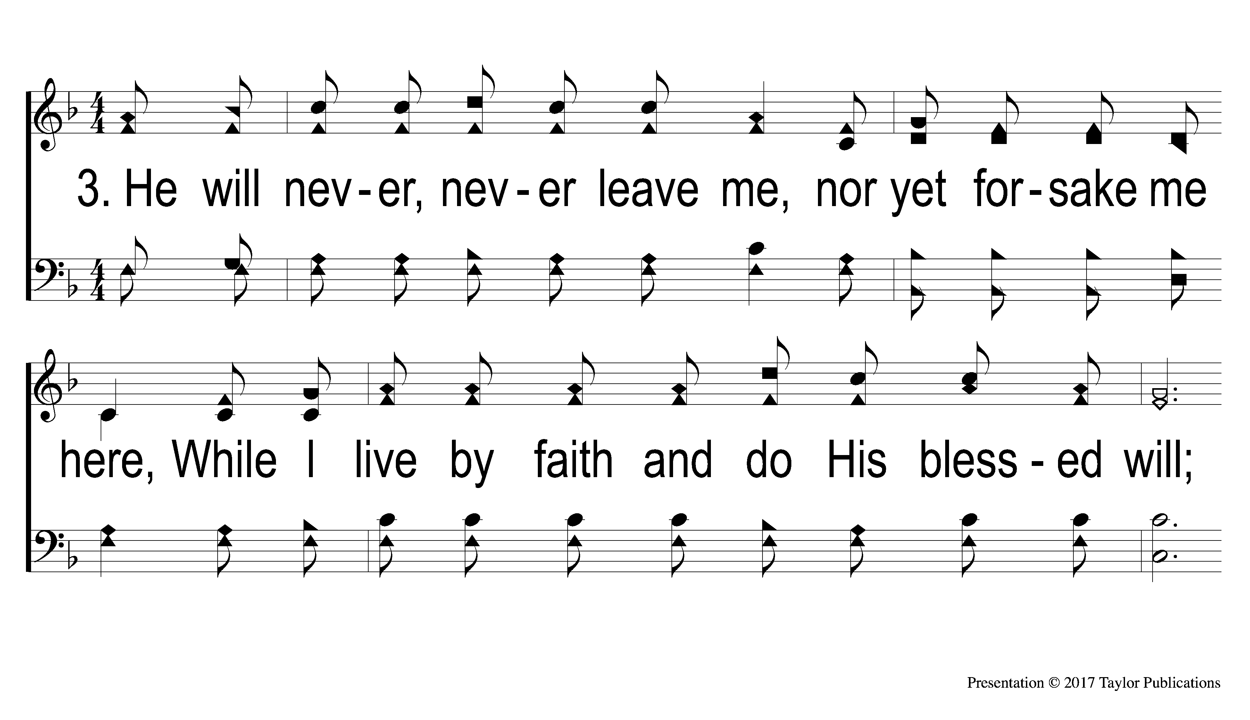
3-1 The Lily of the Valley
The Lily of the Valley
384

Slide 24
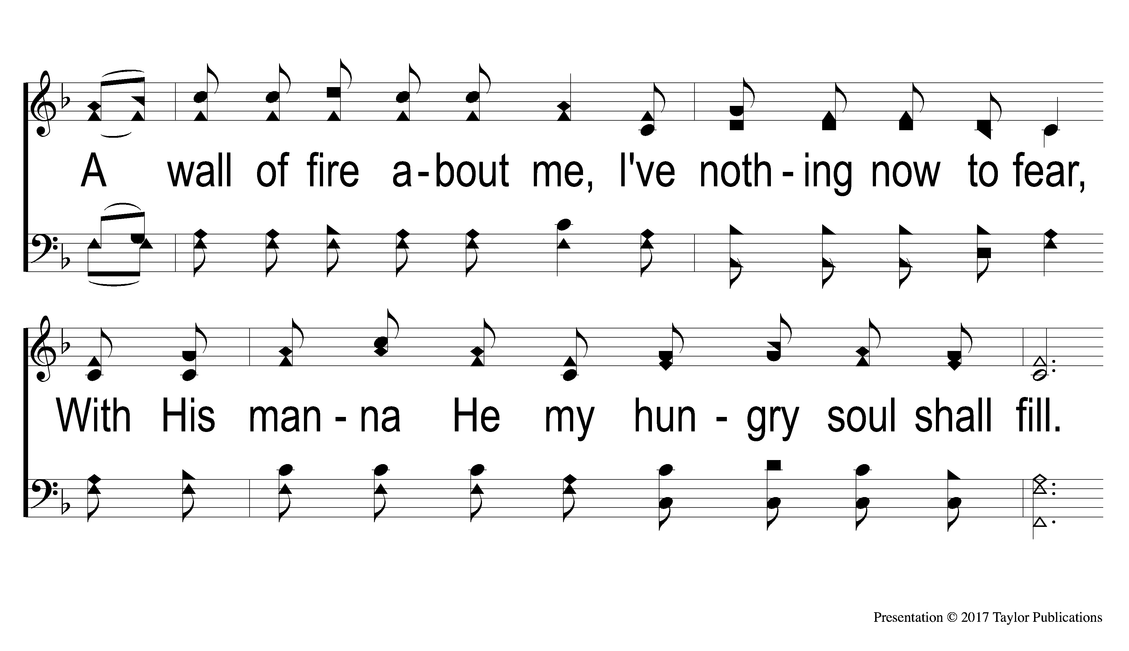
3-2 The Lily of the Valley
The Lily of the Valley
384

Slide 25
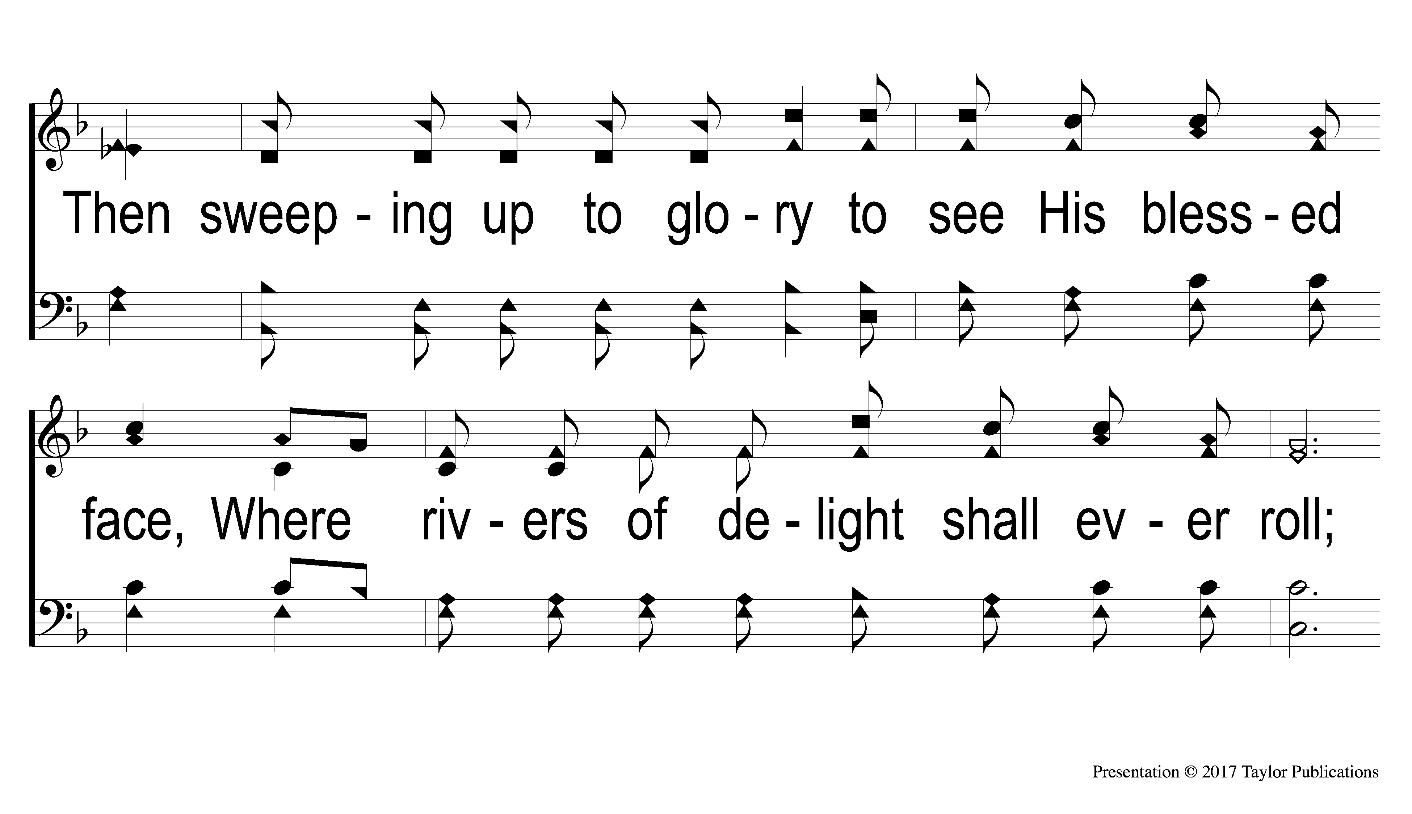
3-3 The Lily of the Valley
The Lily of the Valley
384

Slide 26
C The Lily of the Valley
The Lily of the Valley
384

Slide 28
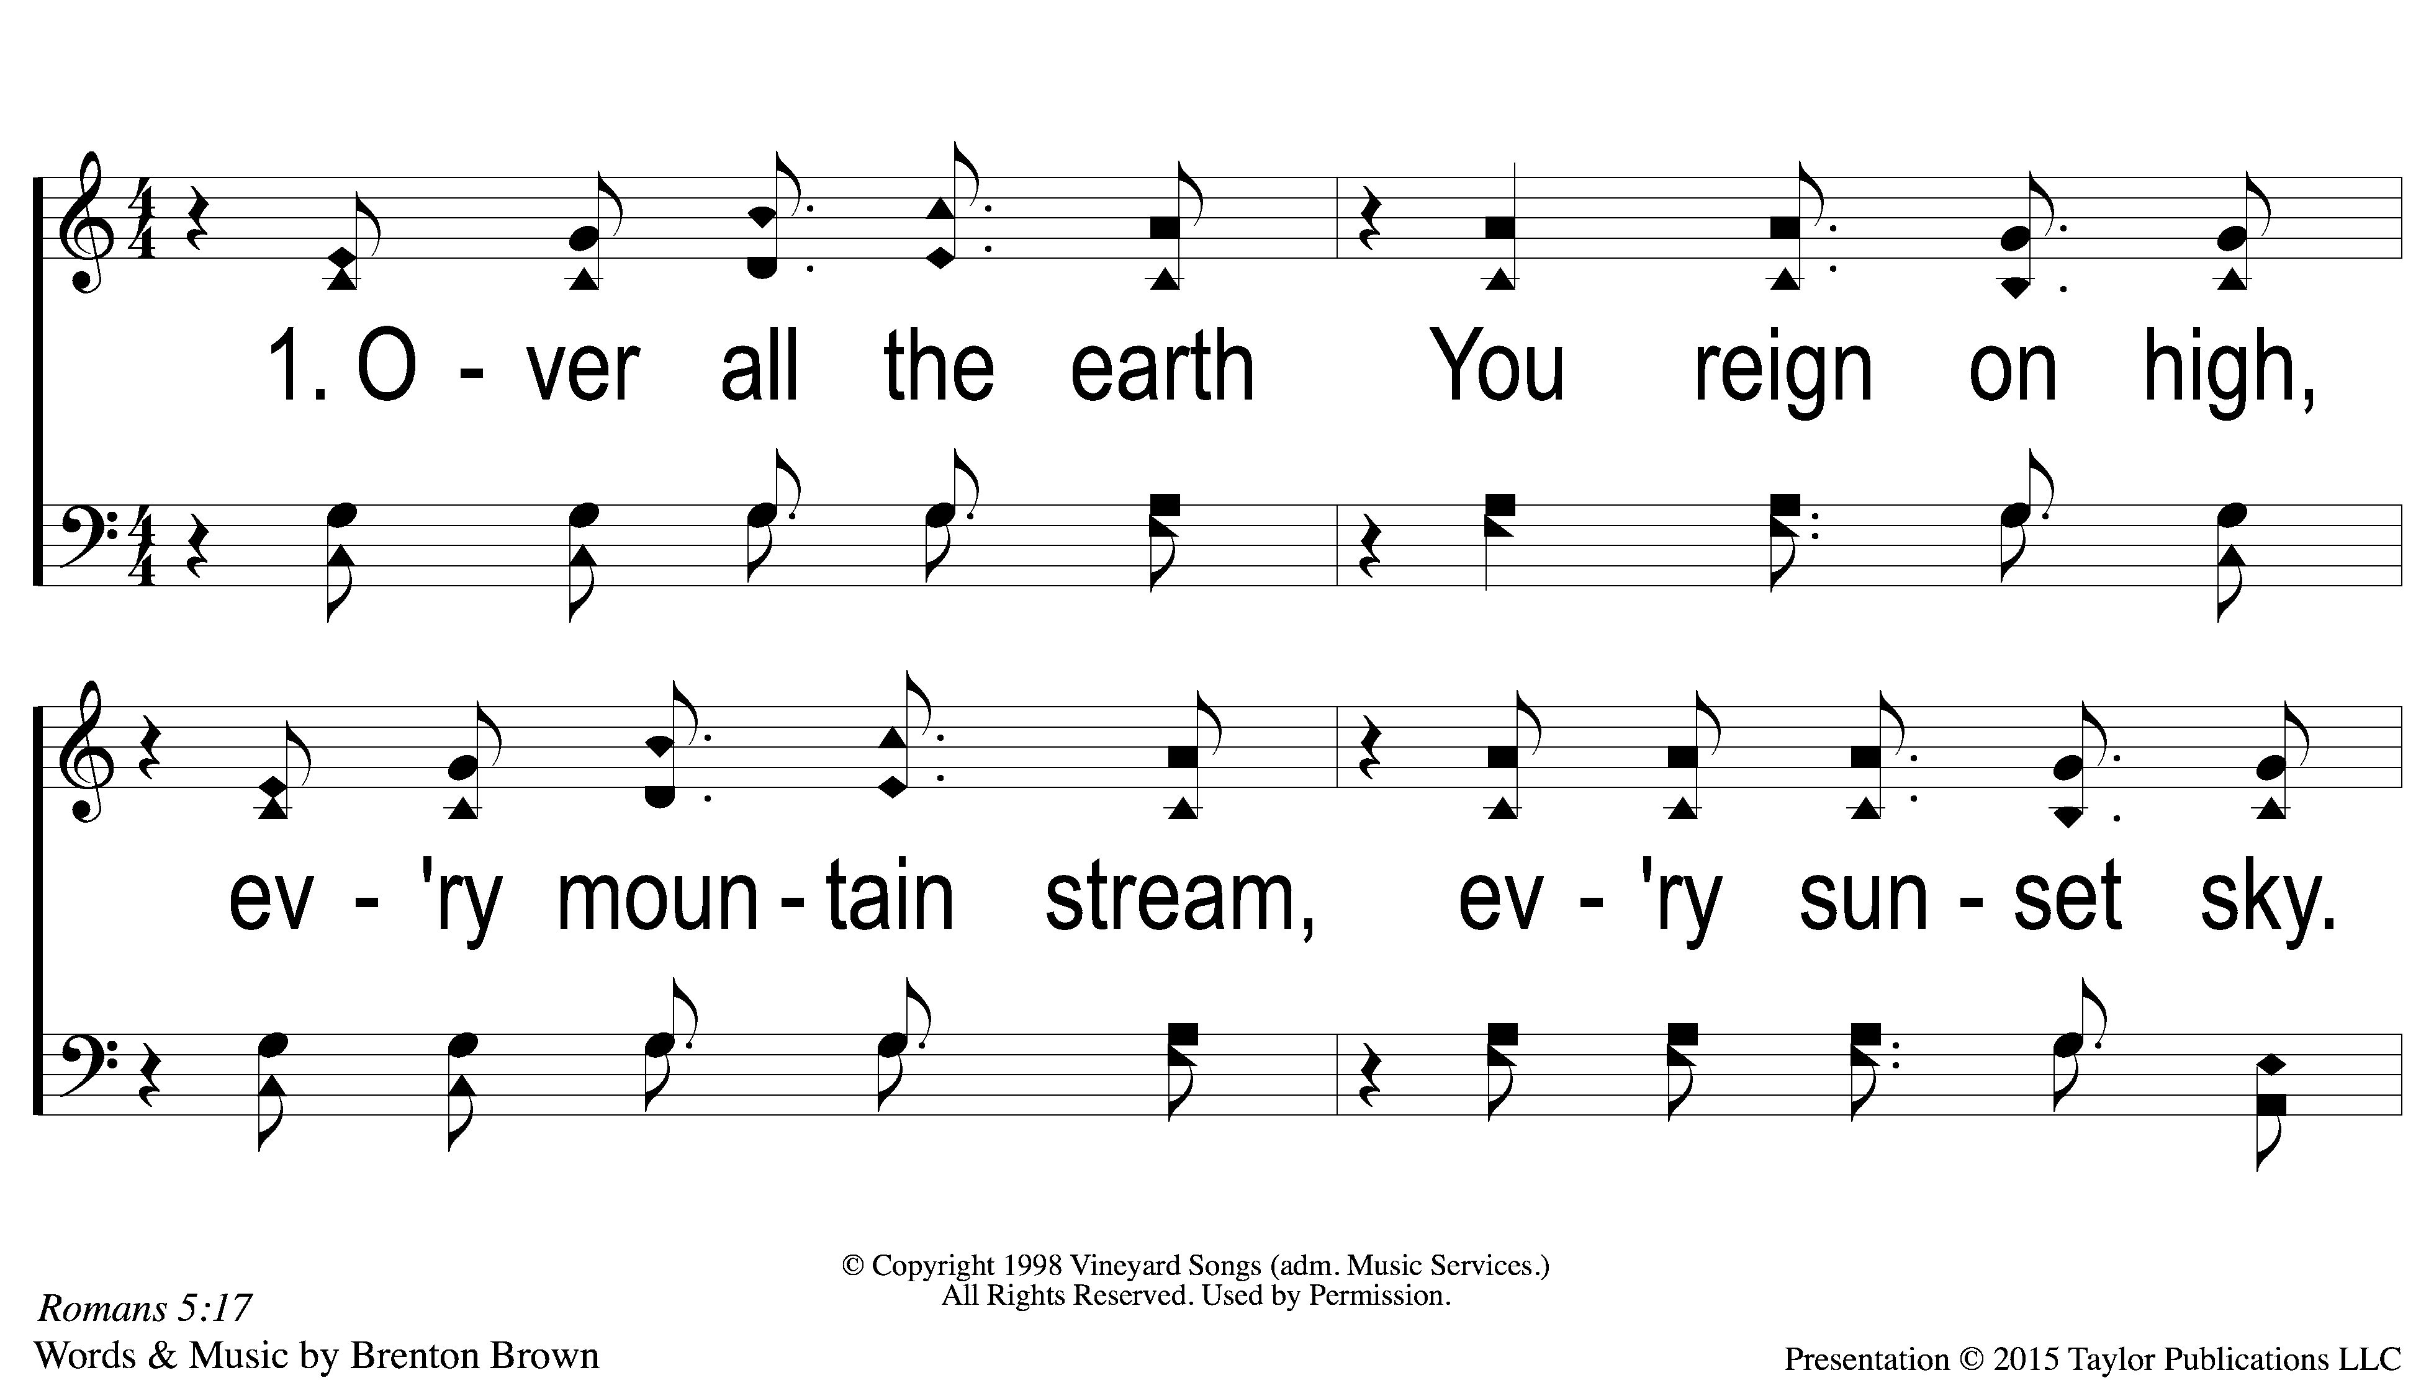
1-1 Lord Reign in Me
Lord Reign in Me
424

Slide 29
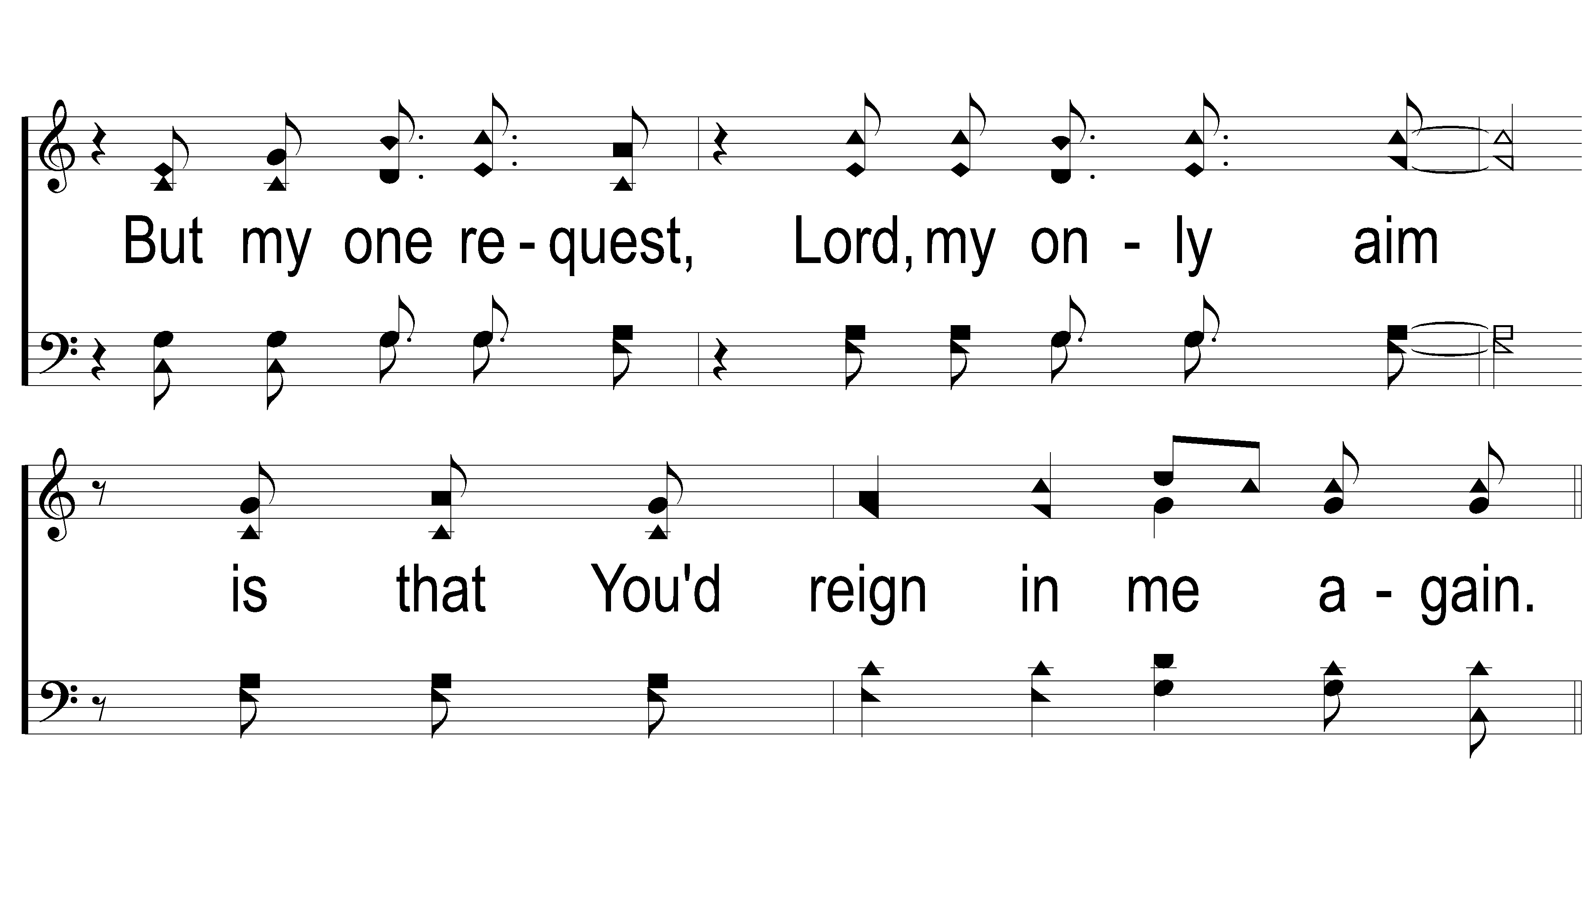
1-2 Lord Reign in Me
Lord Reign in Me
424

Slide 30
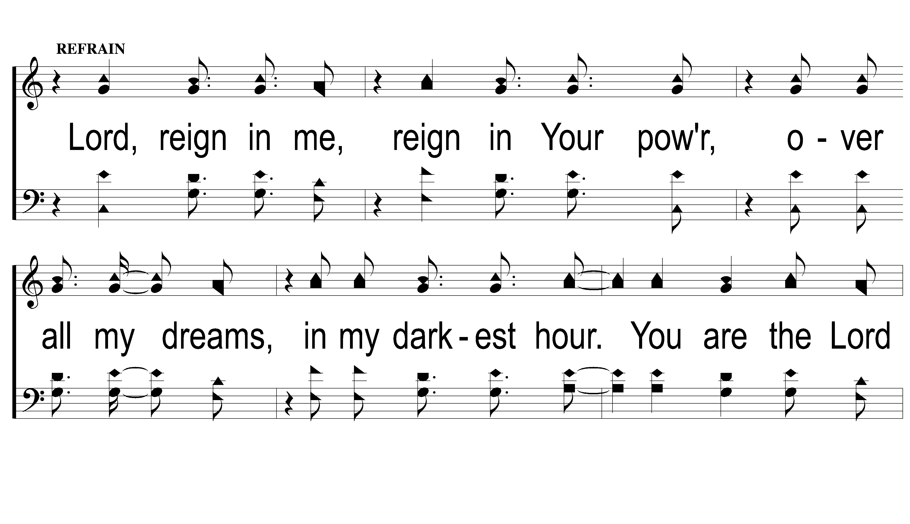
C-1 Lord Reign in Me
Lord Reign in Me
424

Slide 31
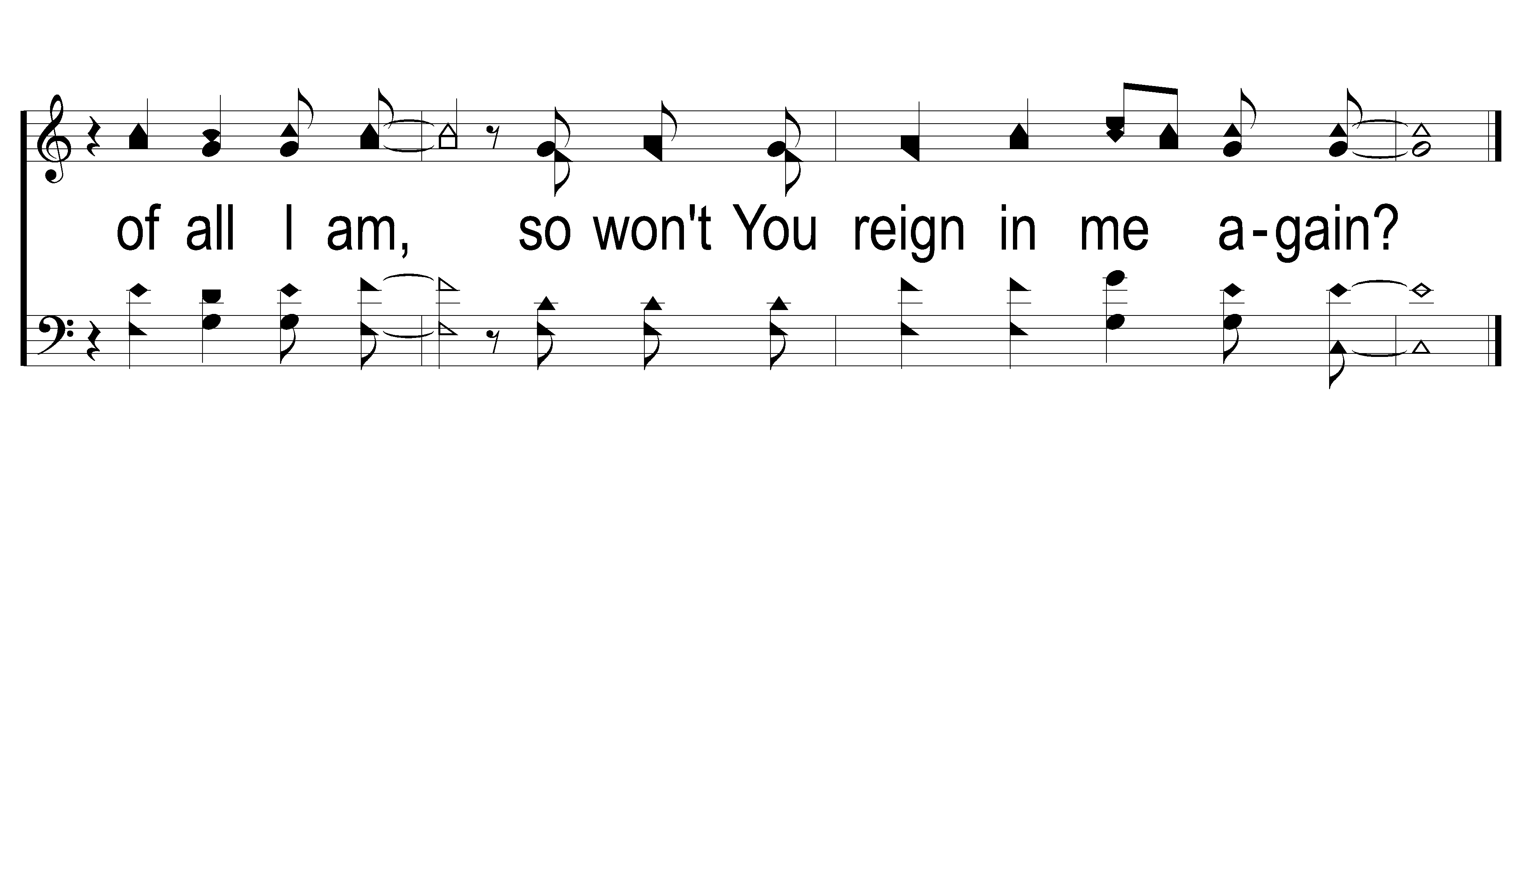
C-2 Lord Reign in Me
Lord Reign in Me
424

Slide 32
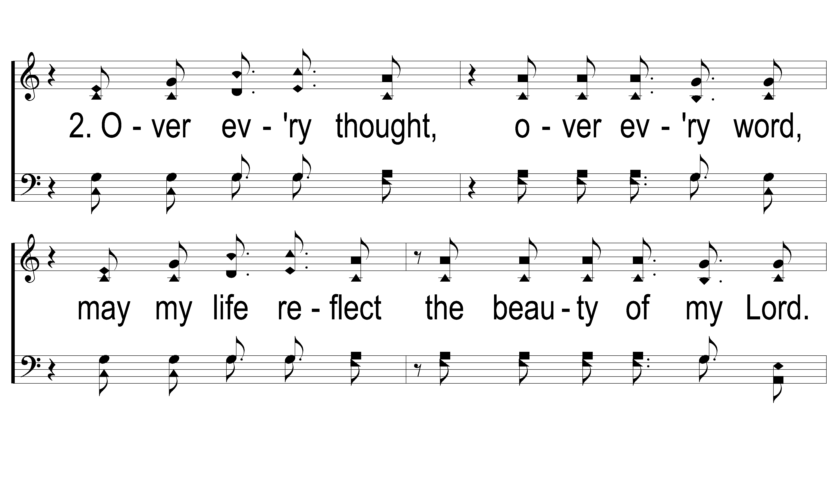
2-1 Lord Reign in Me
Lord Reign in Me
424

Slide 33
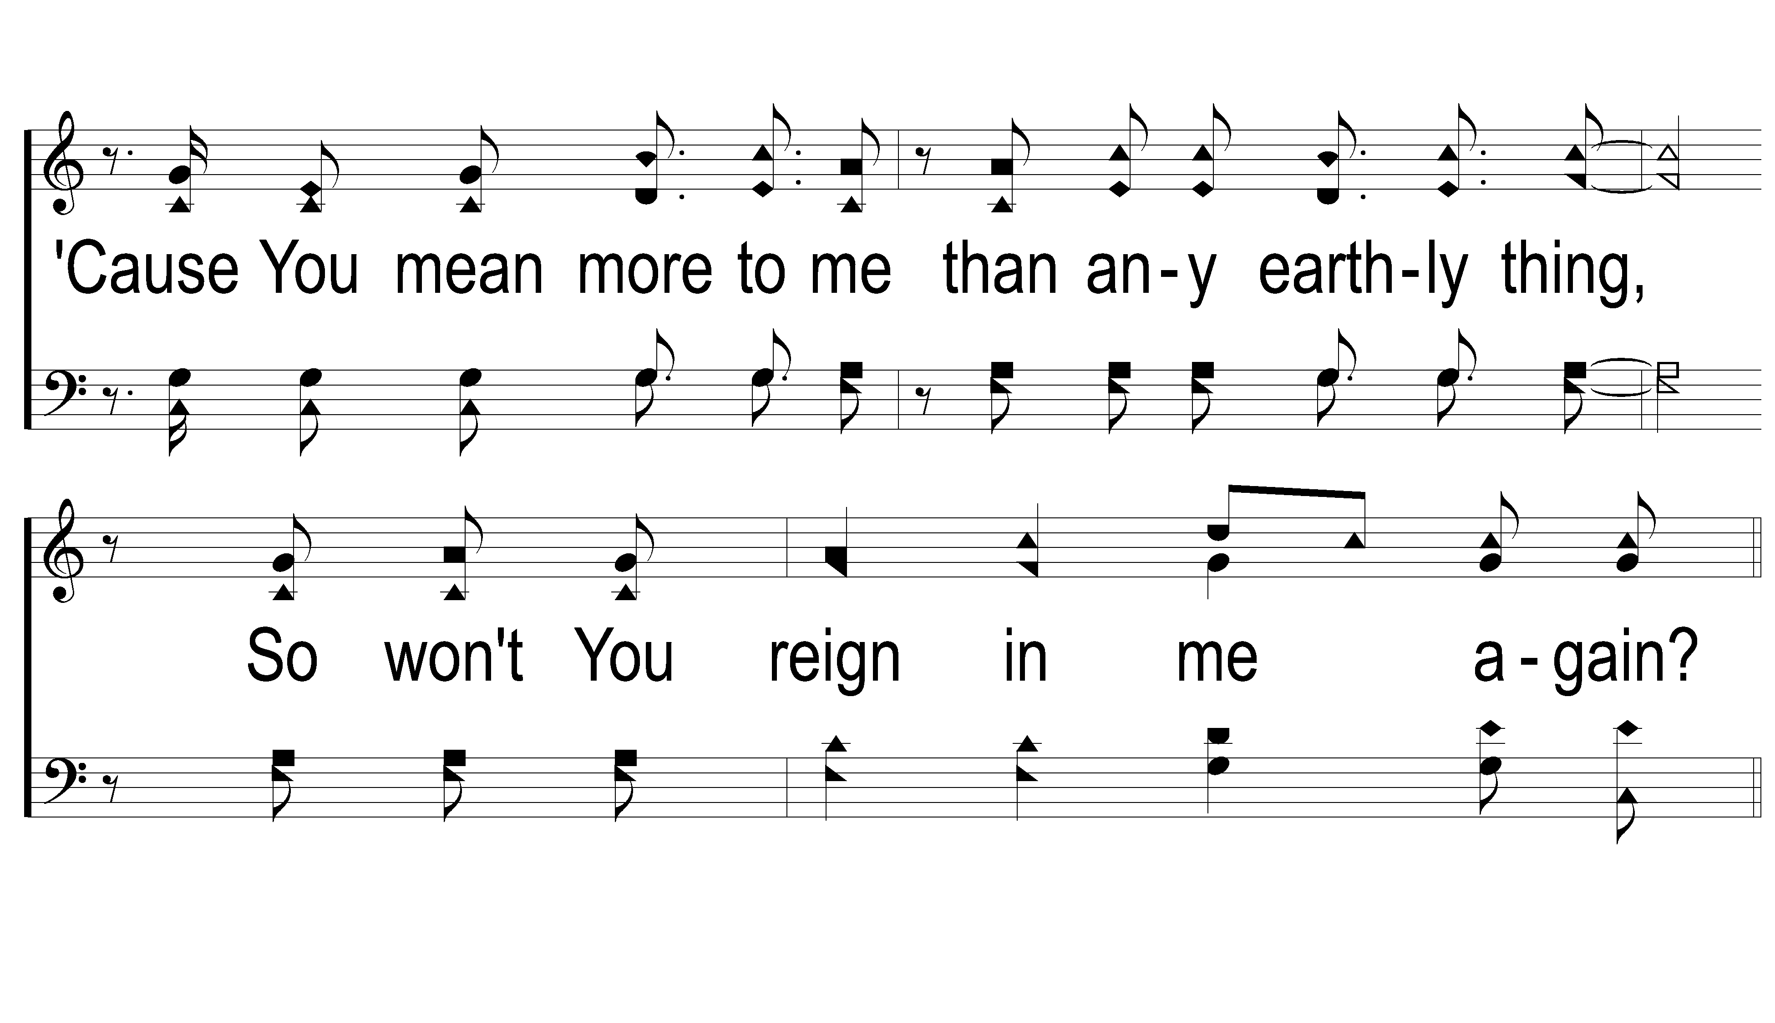
2-2 Lord Reign in Me
Lord Reign in Me
424

Slide 34
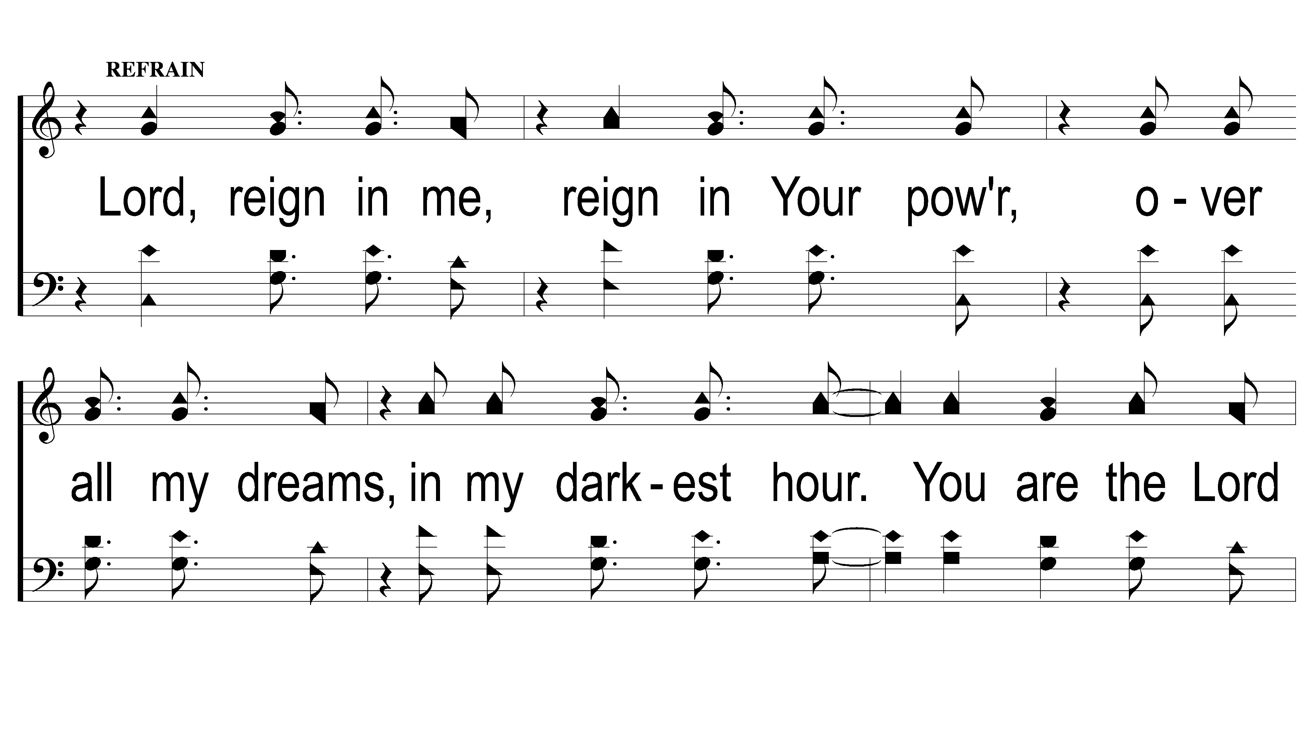
2C-1 Lord Reign in Me
Lord Reign in Me
424

Slide 35
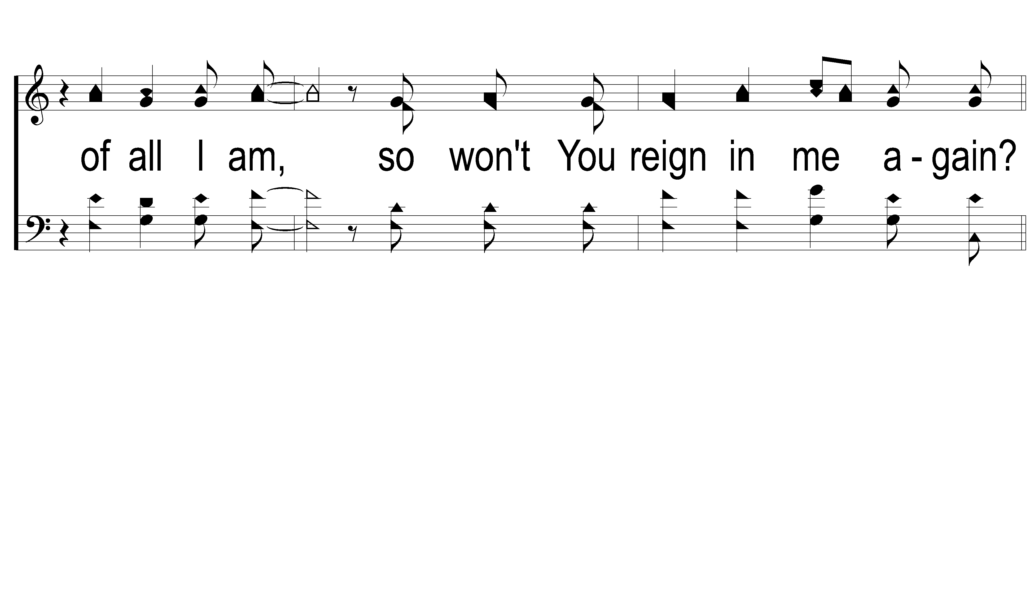
2C-2 Lord Reign in Me
Lord Reign in Me
424

Slide 36
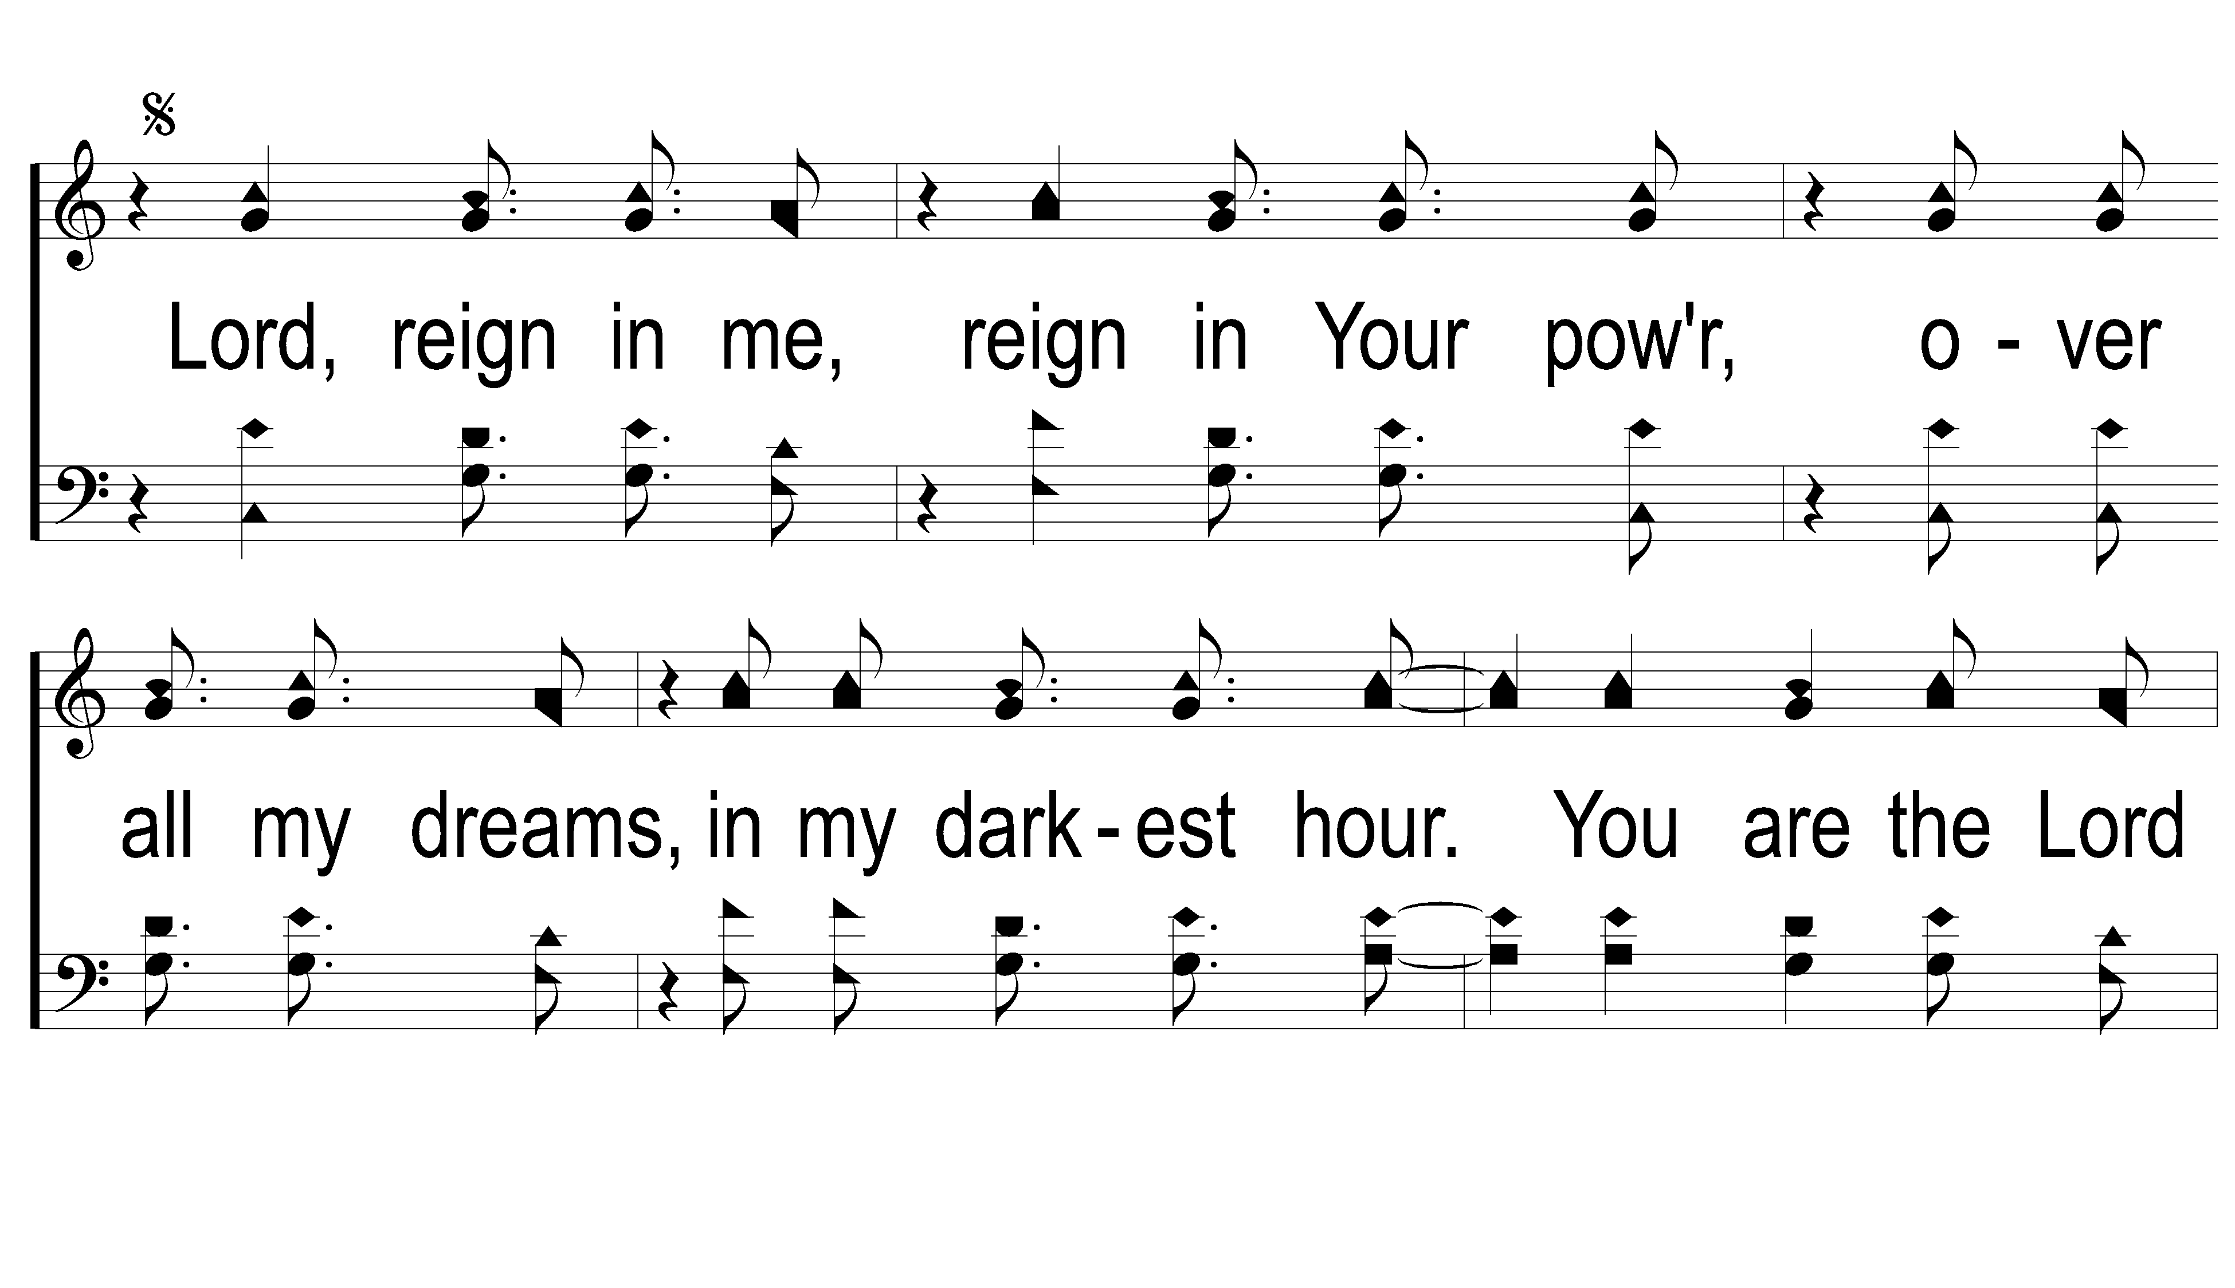
DS-1 Lord Reign in Me
Lord Reign in Me
424

Slide 37
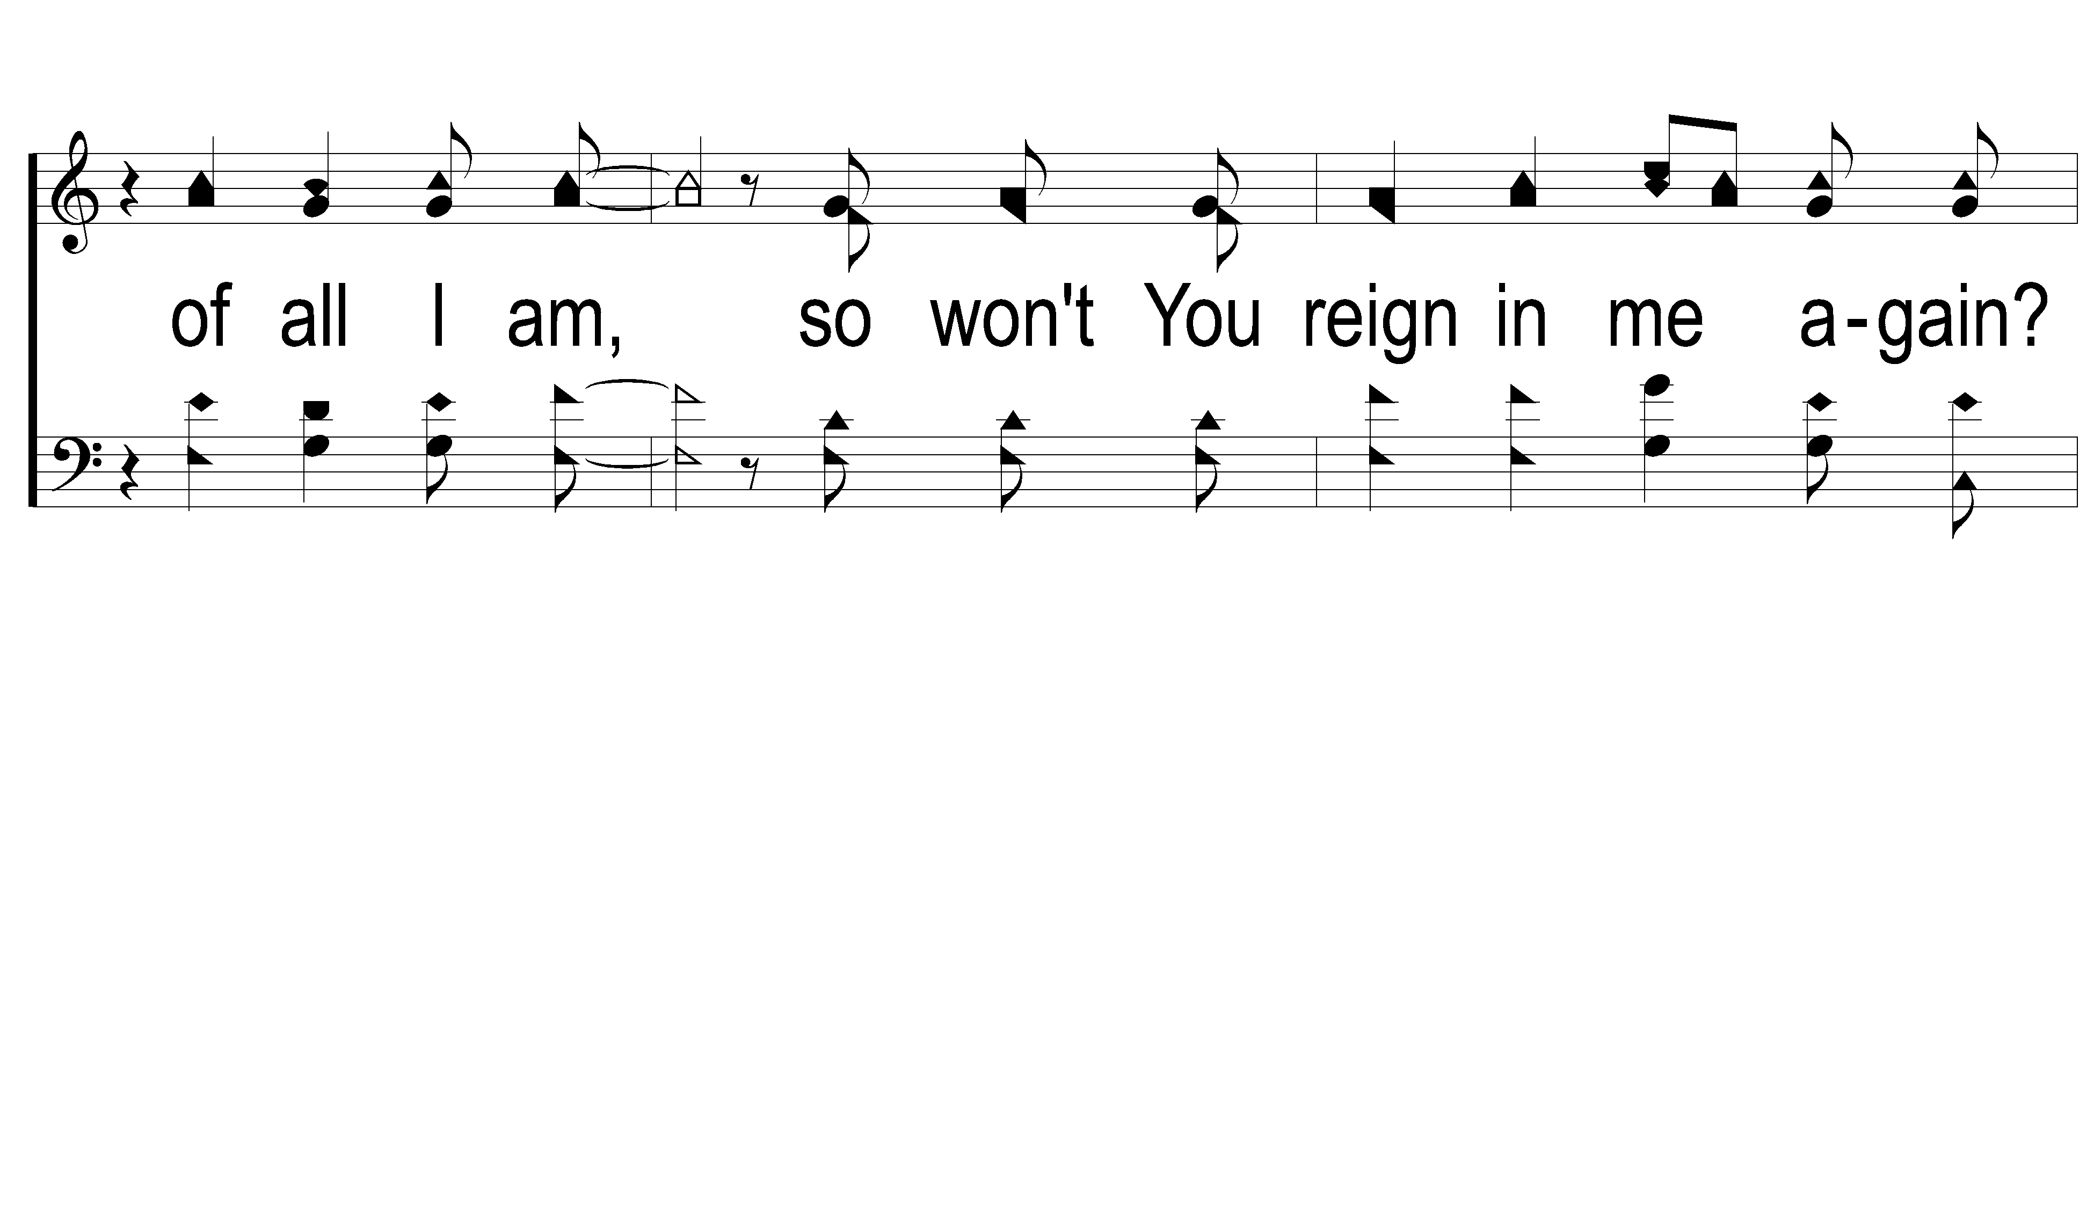
DS-2 Lord Reign in Me
Lord Reign in Me
424

Slide 38
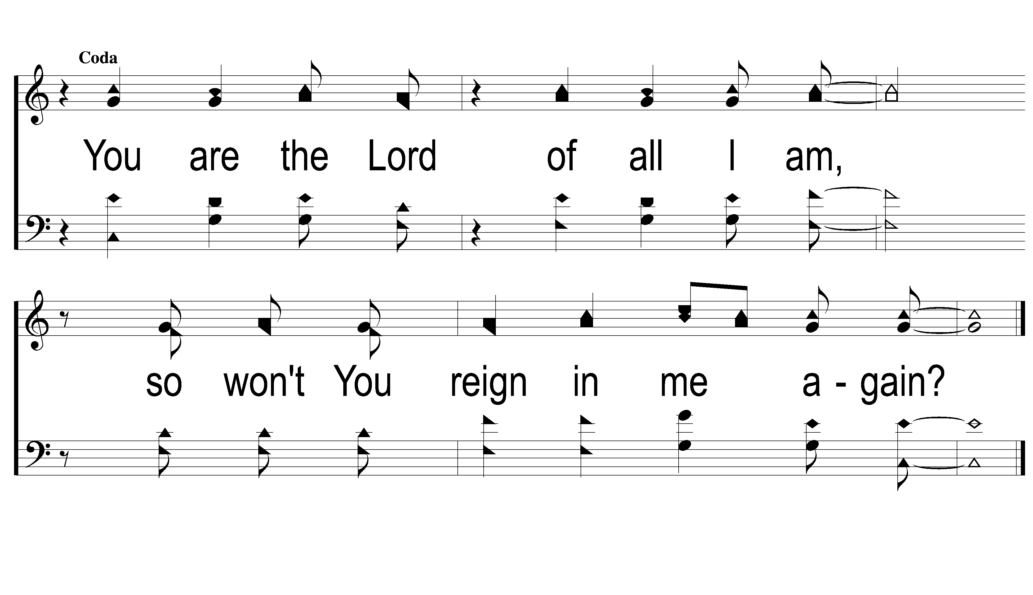
Coda Lord Reign in Me
Lord Reign in Me
424

Slide 40
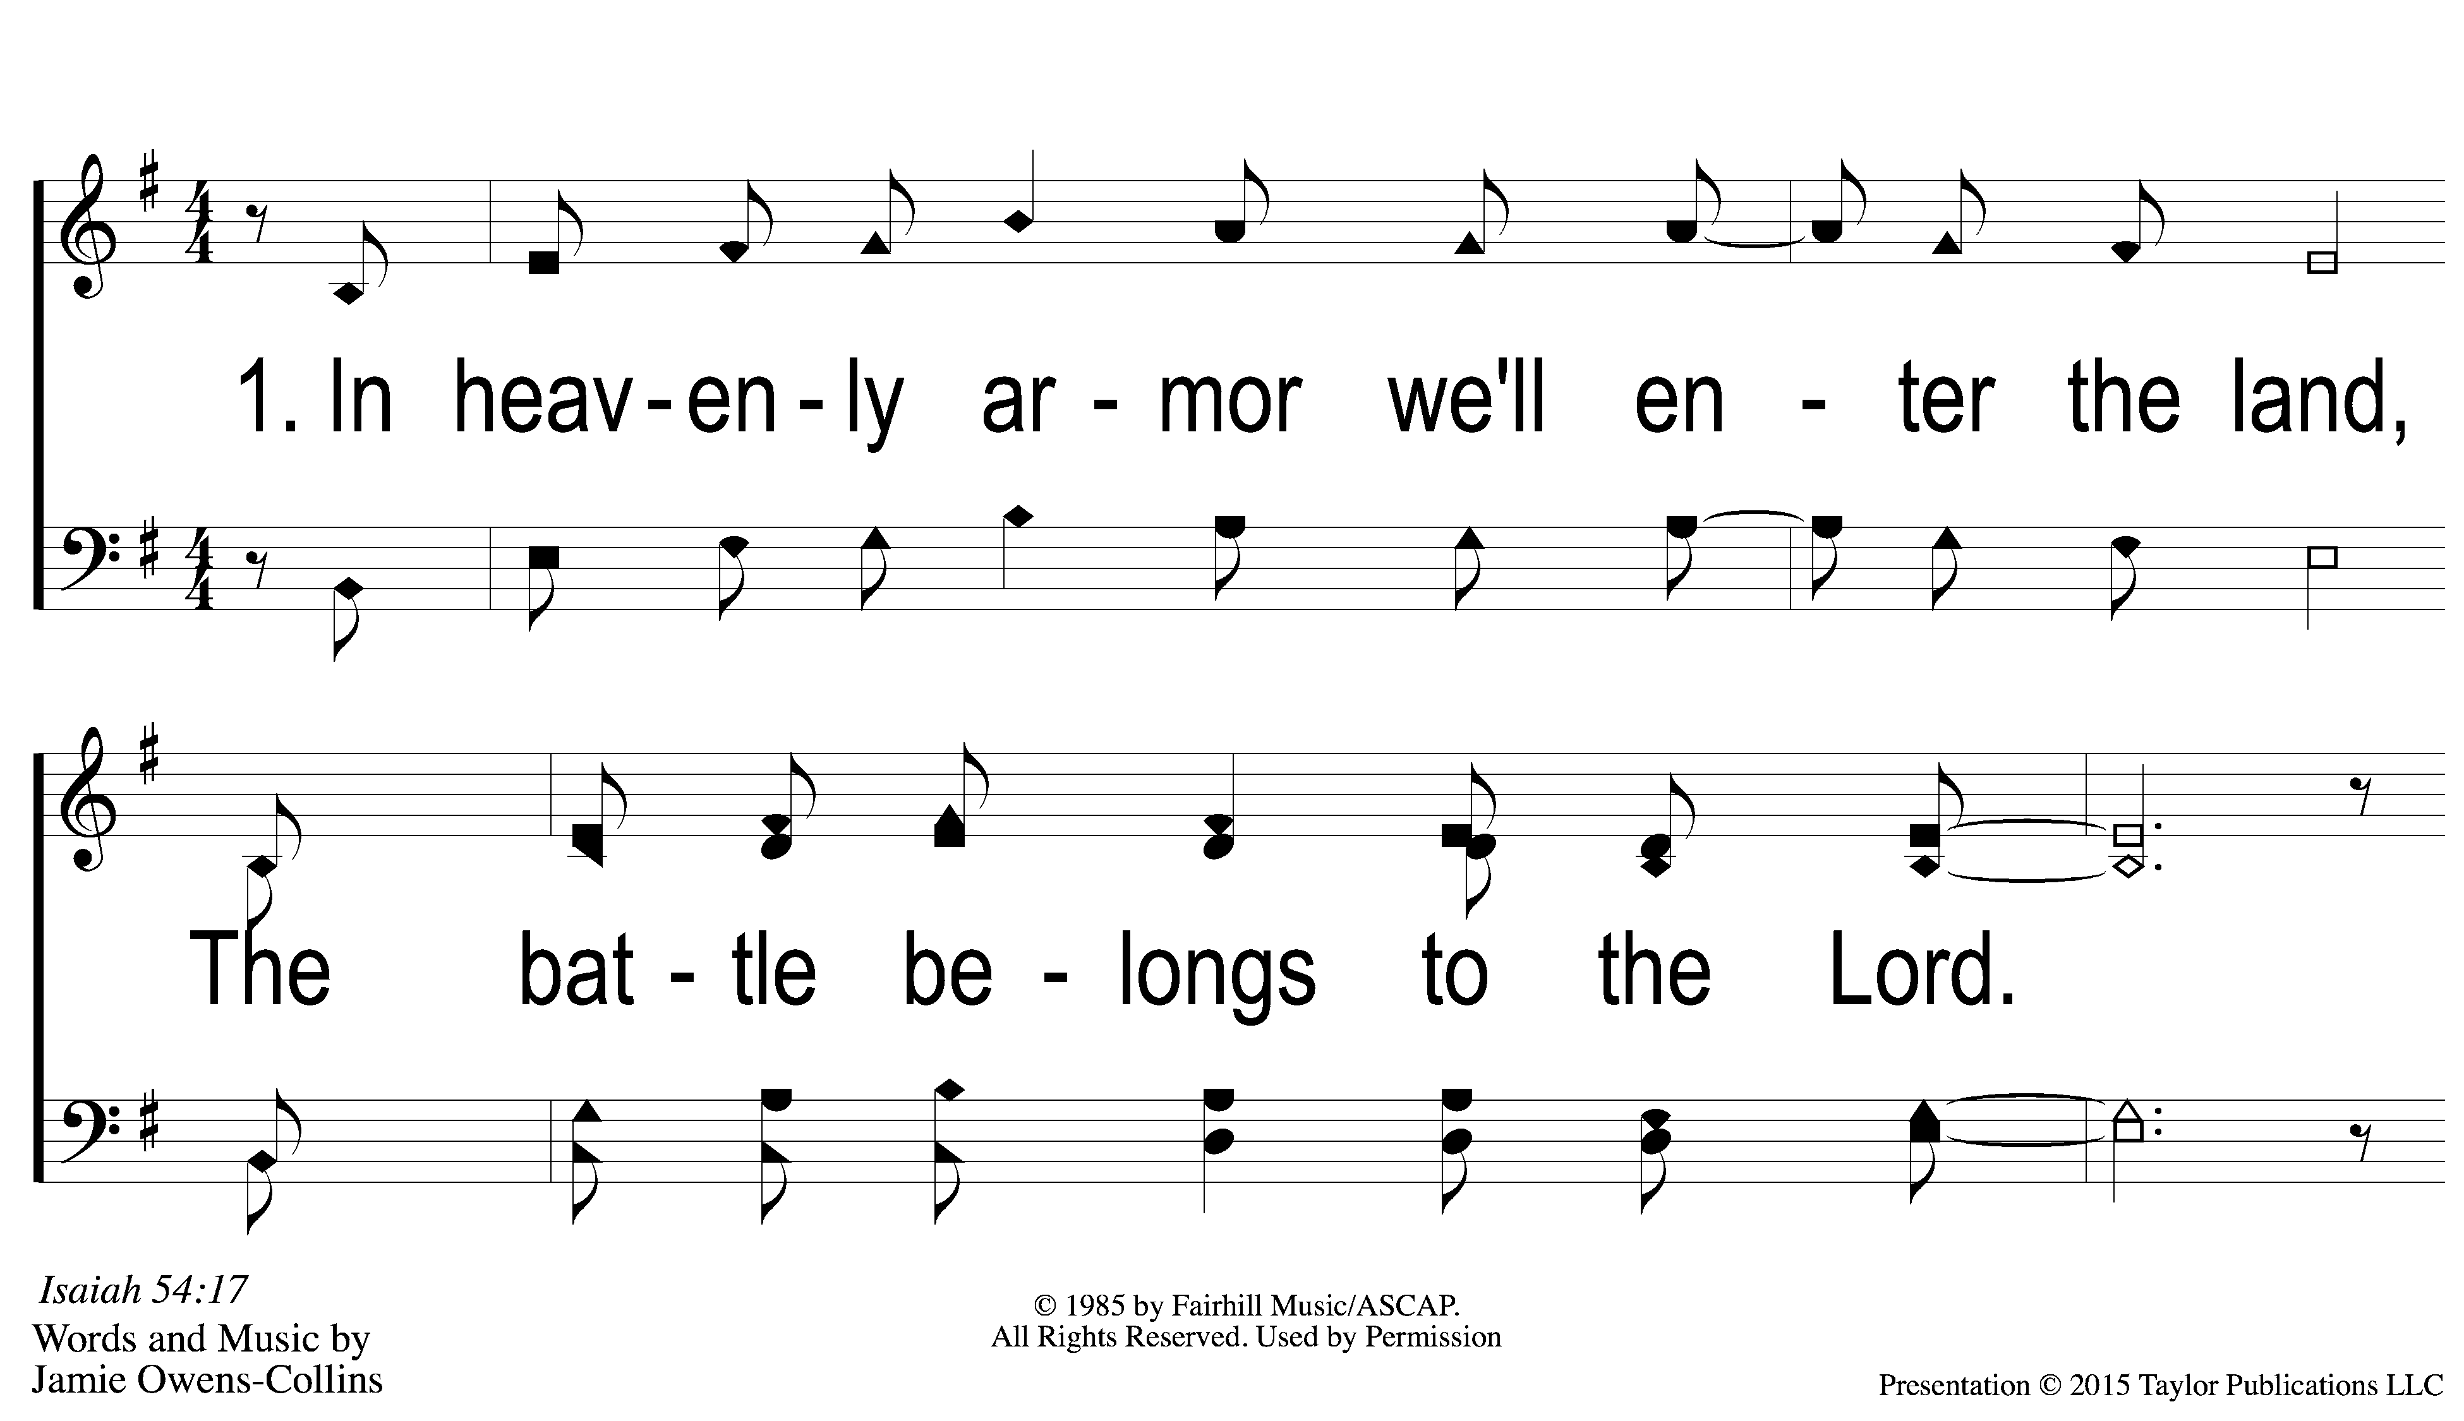
1-1 The Battle Belongs to the Lord
The Battle Belongs to the Lord
589

Slide 41
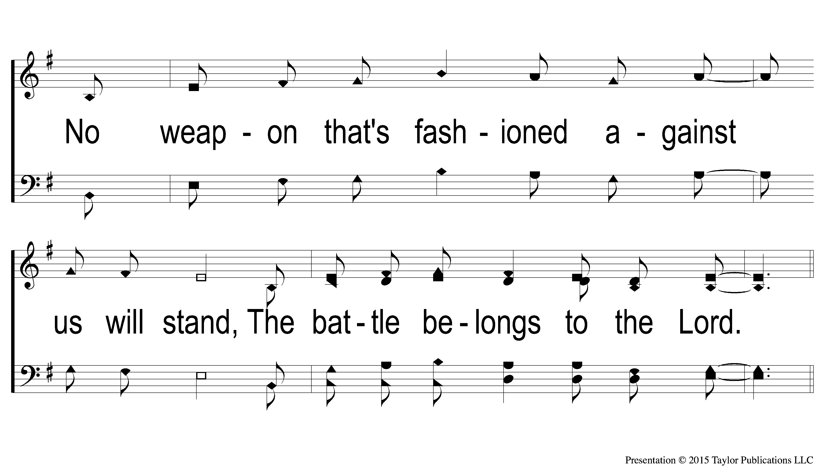
1-2 The Battle Belongs to the Lord
The Battle Belongs to the Lord
589

Slide 42
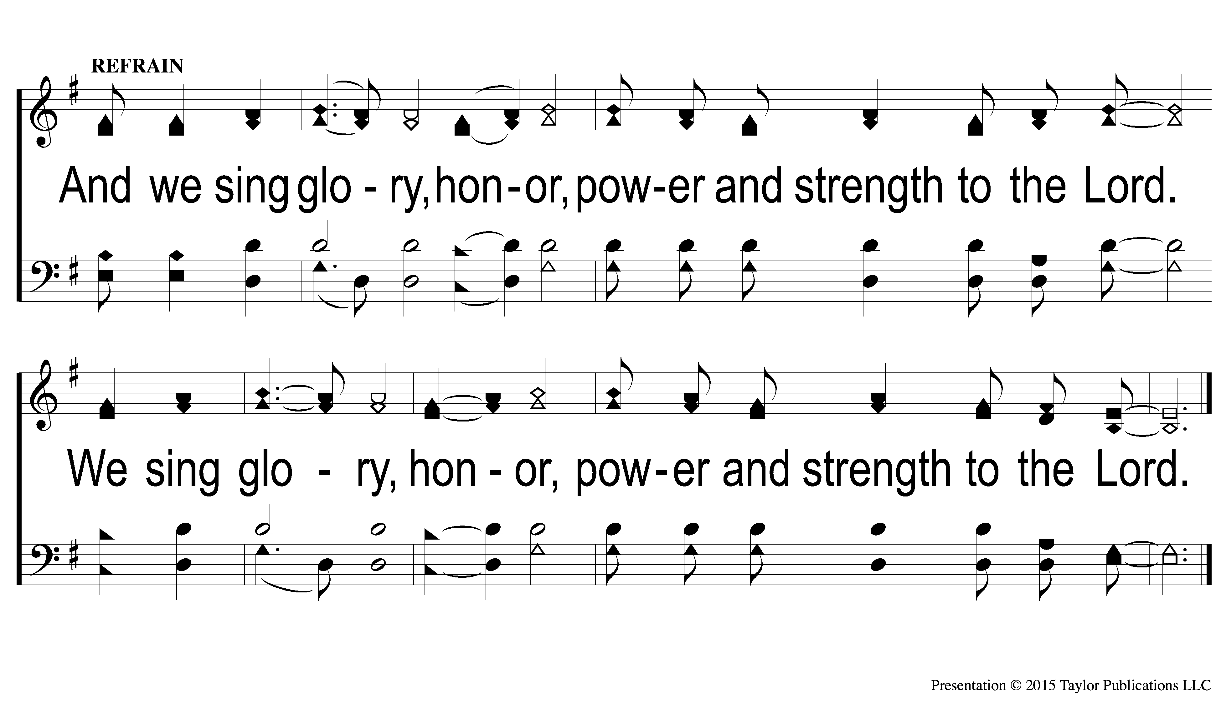
C-1 The Battle Belongs to the Lord
The Battle Belongs to the Lord
589

Slide 43
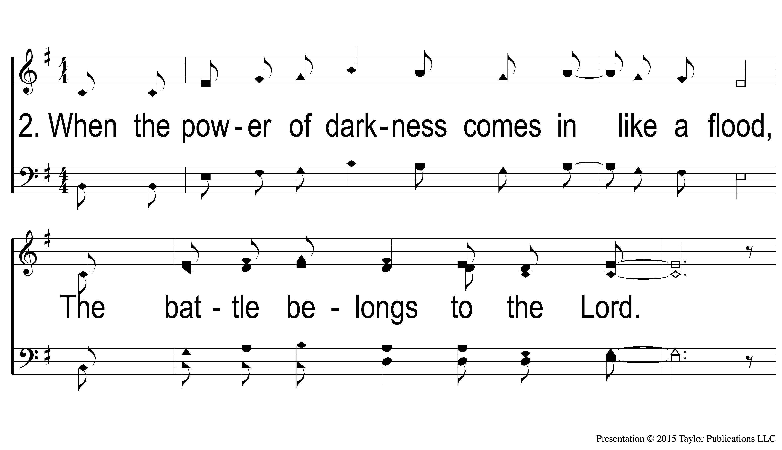
2-1 The Battle Belongs to the Lord
The Battle Belongs to the Lord
589

Slide 44
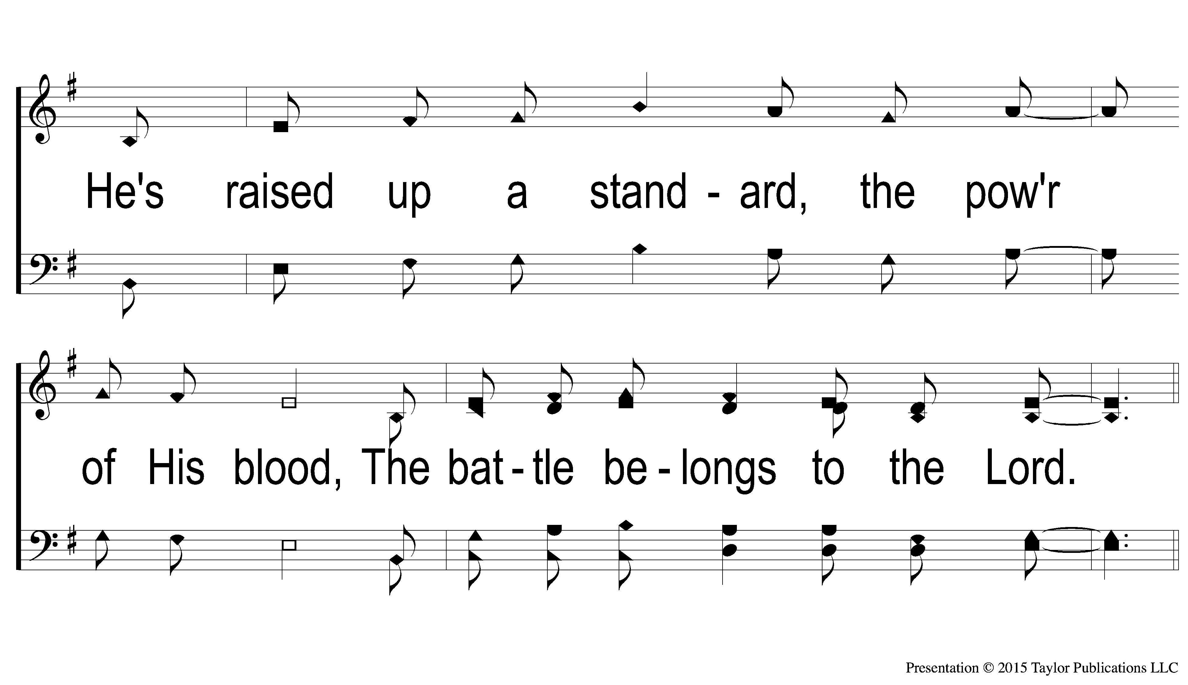
2-2 The Battle Belongs to the Lord
The Battle Belongs to the Lord
589

Slide 45
C-1 The Battle Belongs to the Lord
The Battle Belongs to the Lord
589

Slide 46
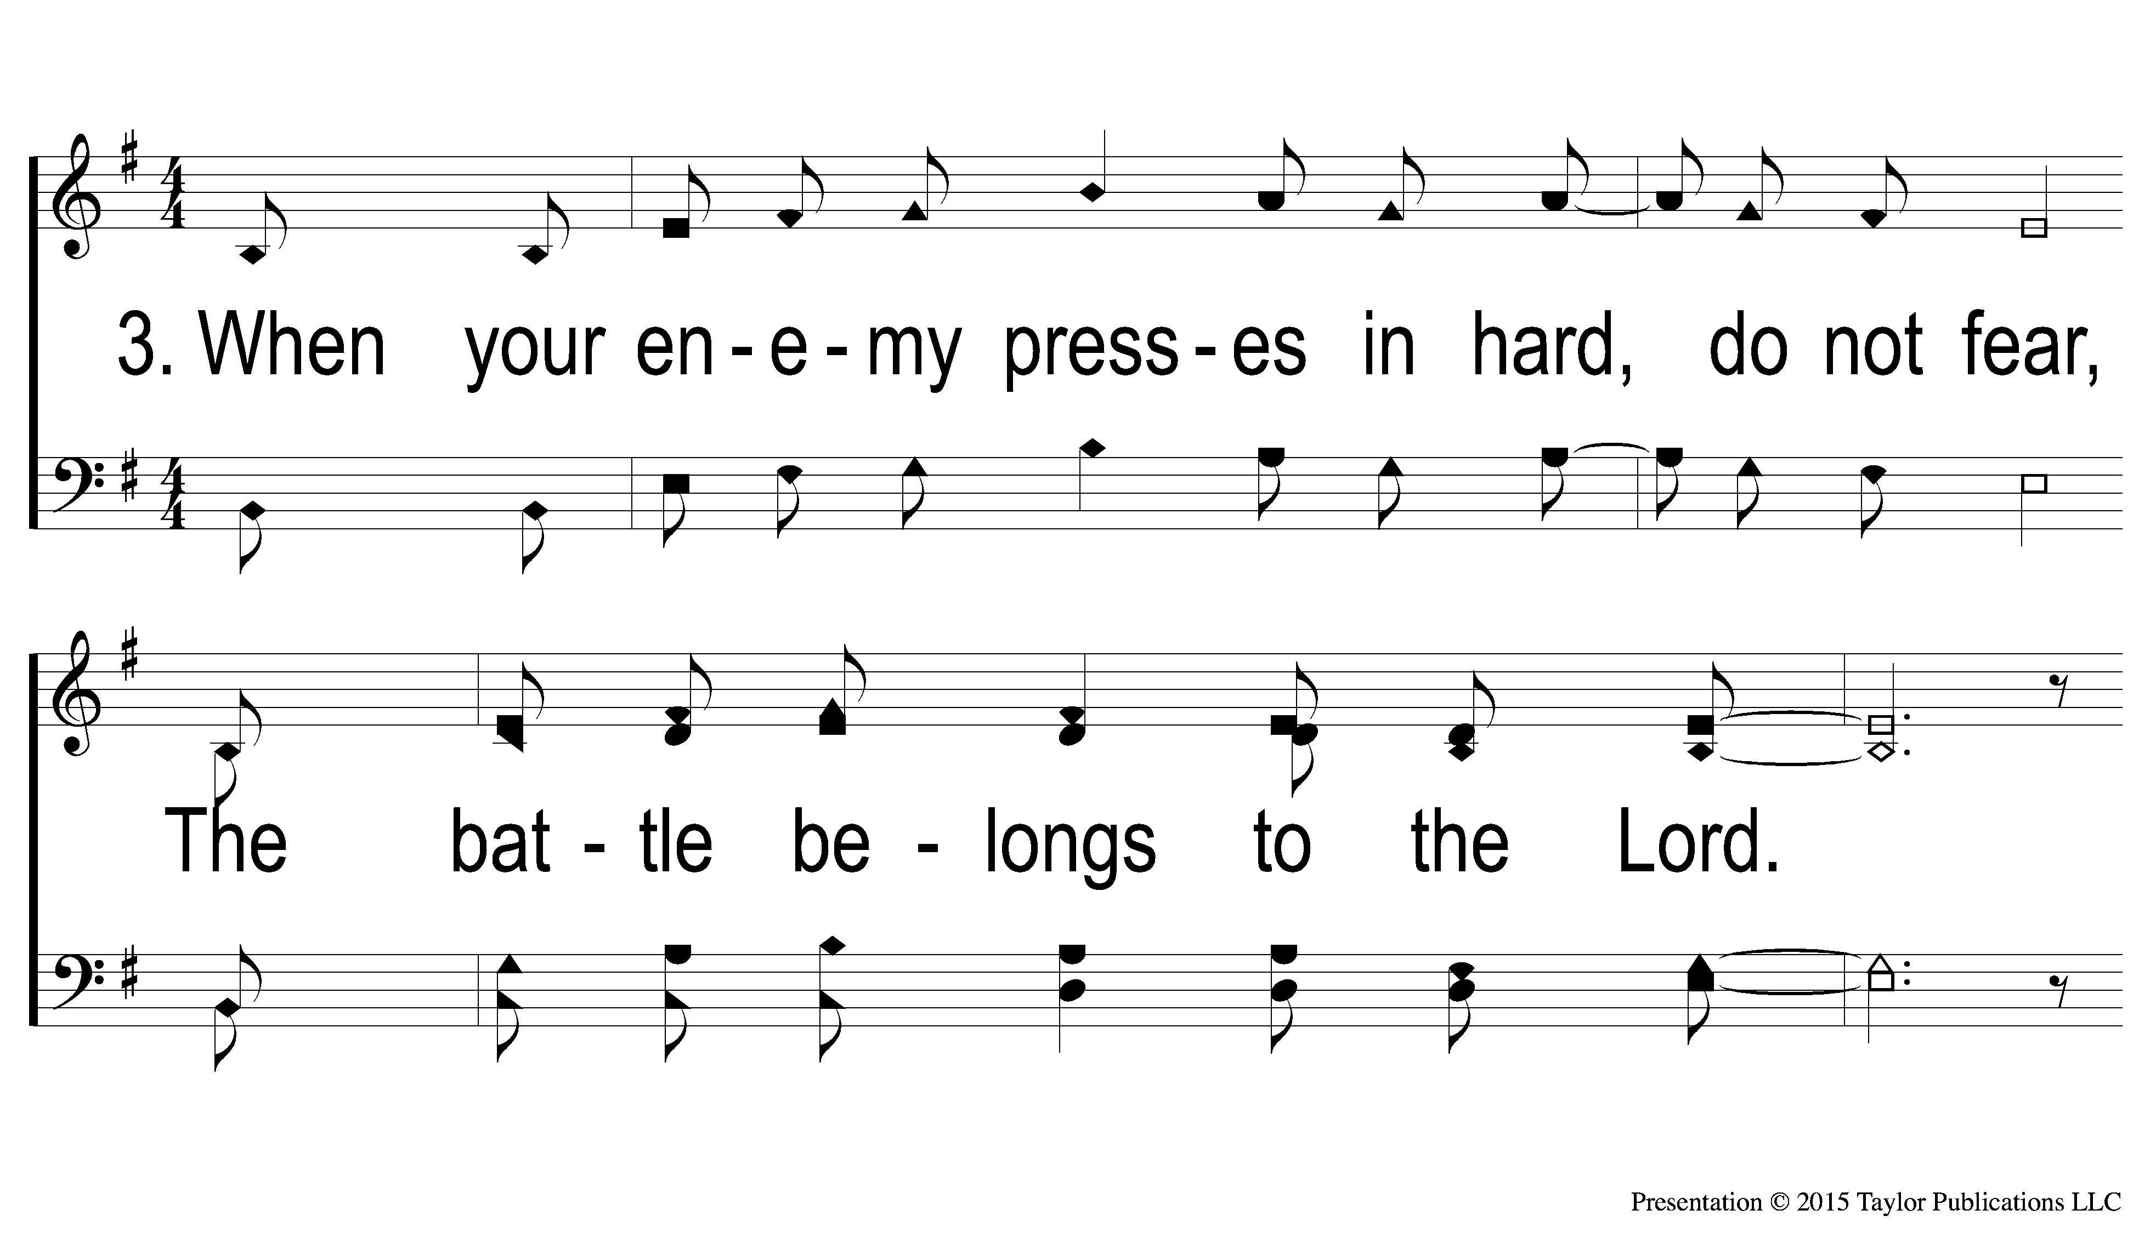
3-1 The Battle Belongs to the Lord
The Battle Belongs to the Lord
589

Slide 47
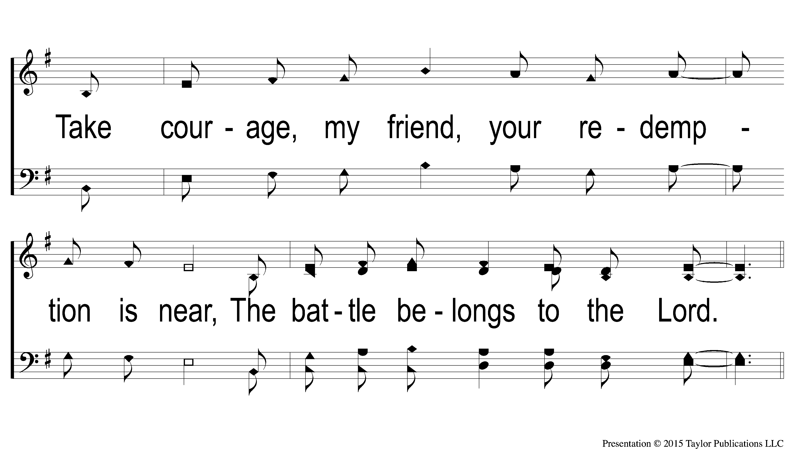
3-2 The Battle Belongs to the Lord
The Battle Belongs to the Lord
589

Slide 48
C-1 The Battle Belongs to the Lord
The Battle Belongs to the Lord
589

Slide 49
C-1 The Battle Belongs to the Lord
The Battle Belongs to the Lord
589

Slide 51
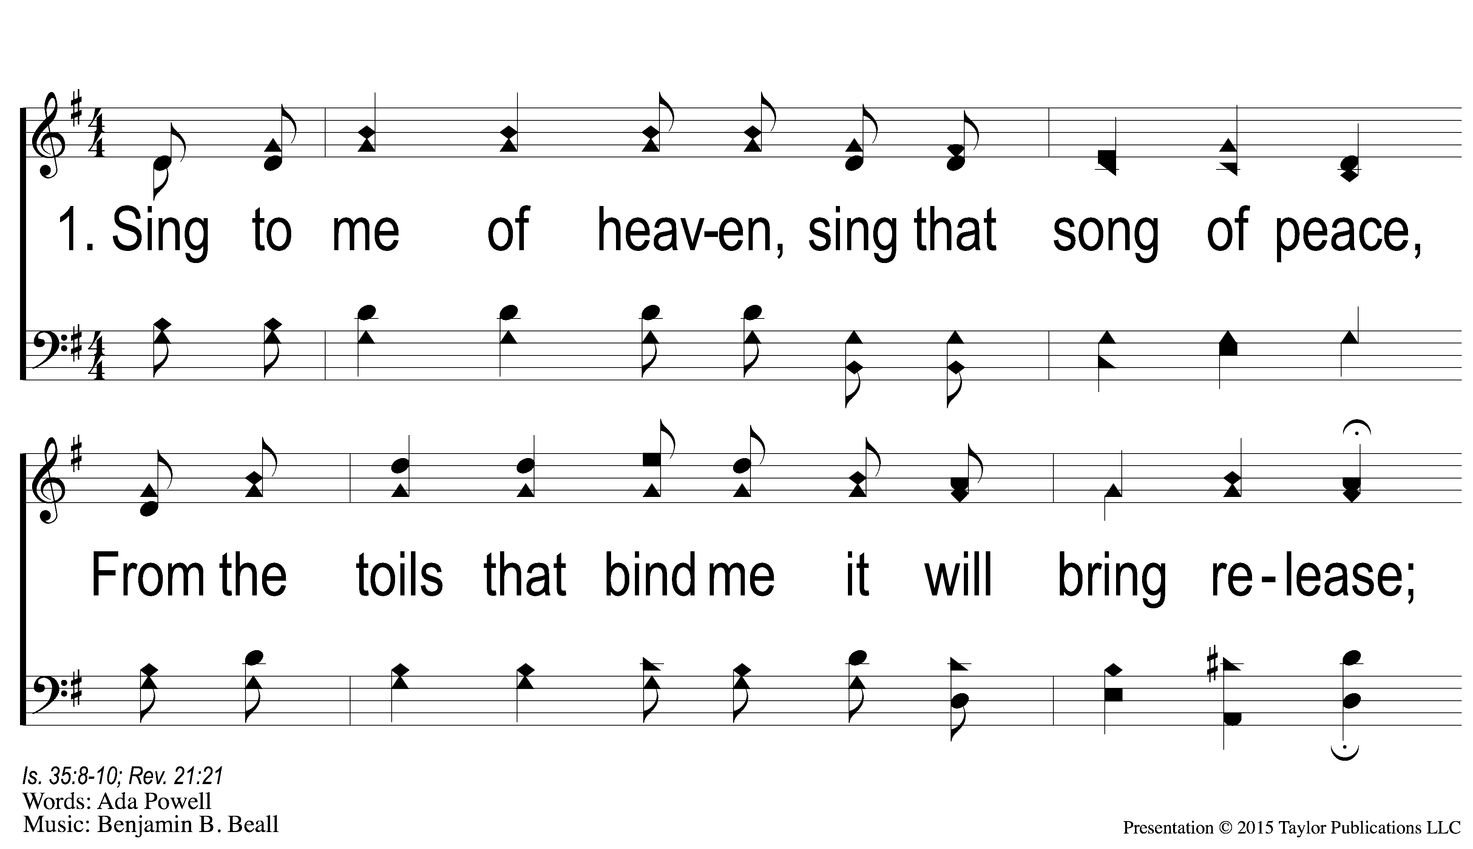
1-1 Sing to me of Heaven
Sing to Me of Heaven
595

Slide 52
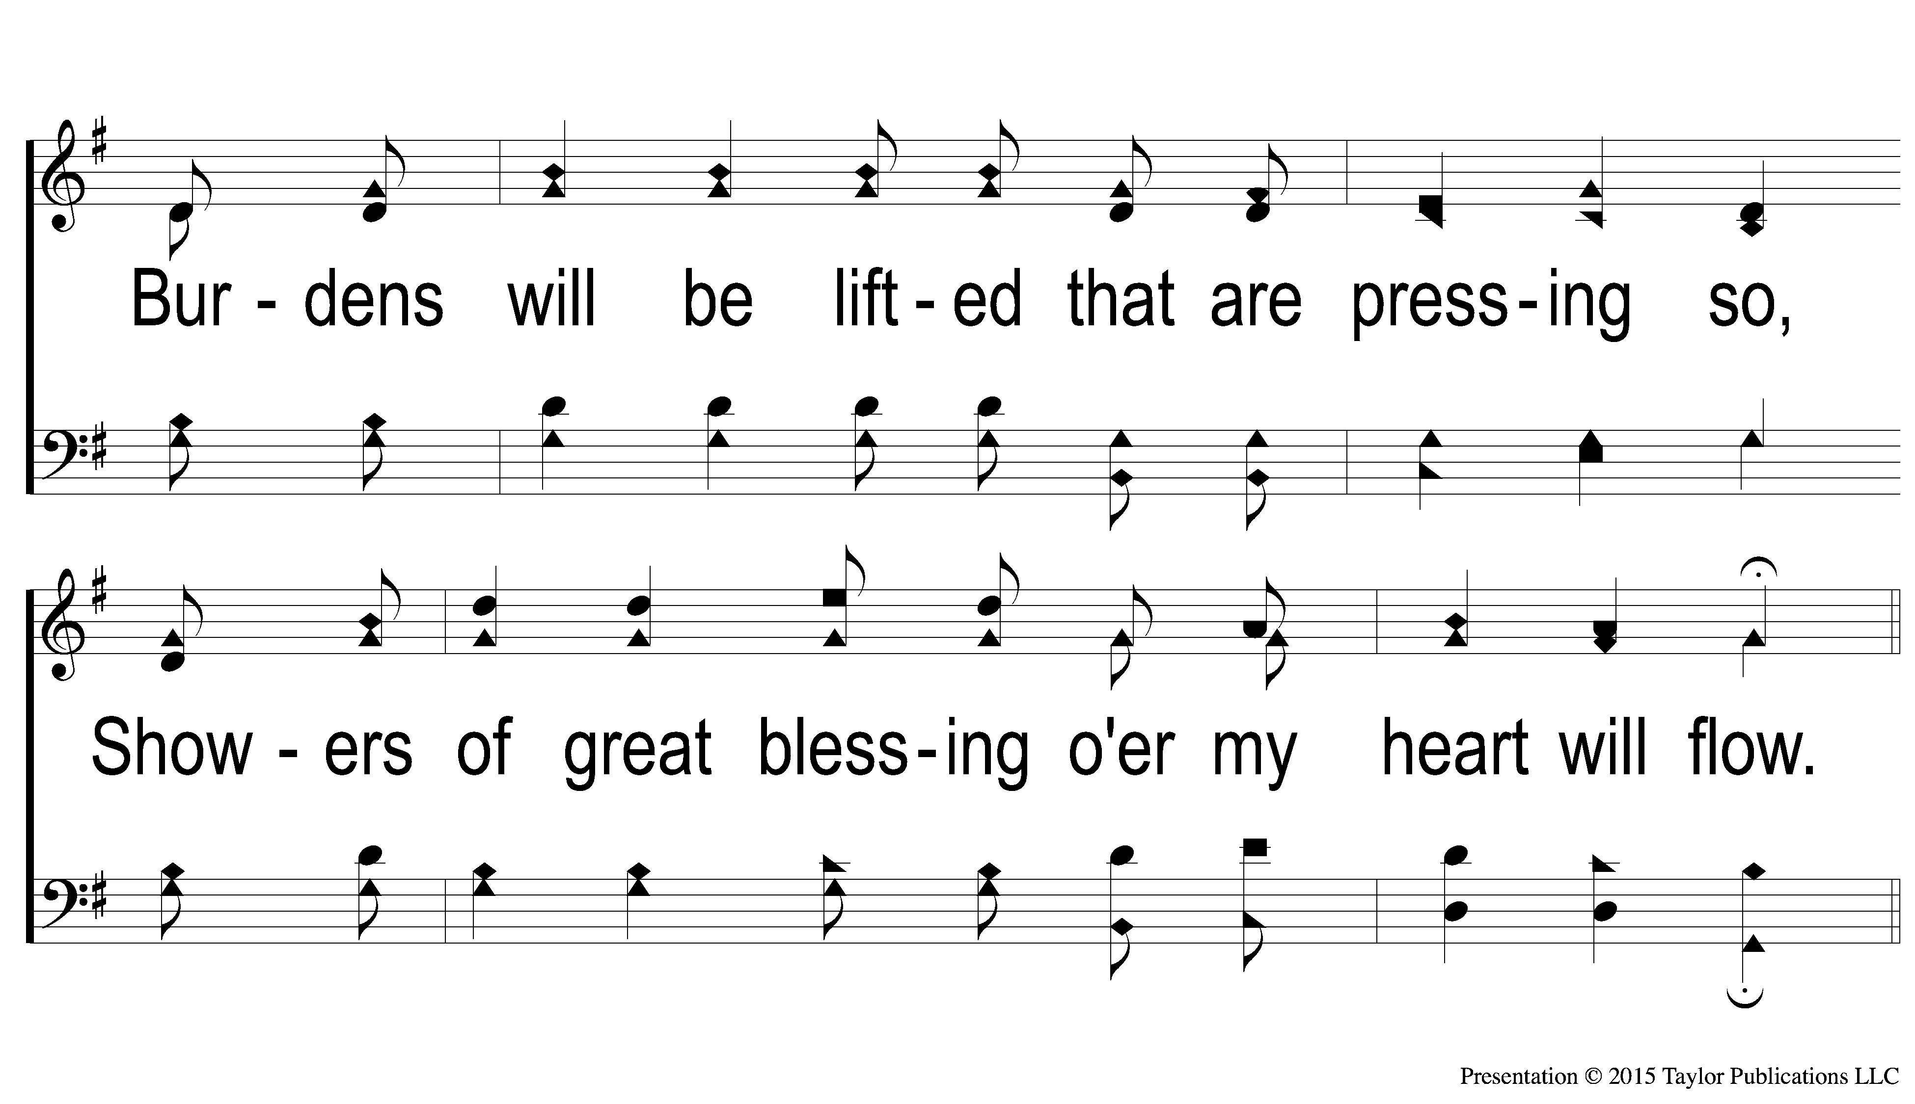
1-2 Sing to me of Heaven
Sing to Me of Heaven
595

Slide 53
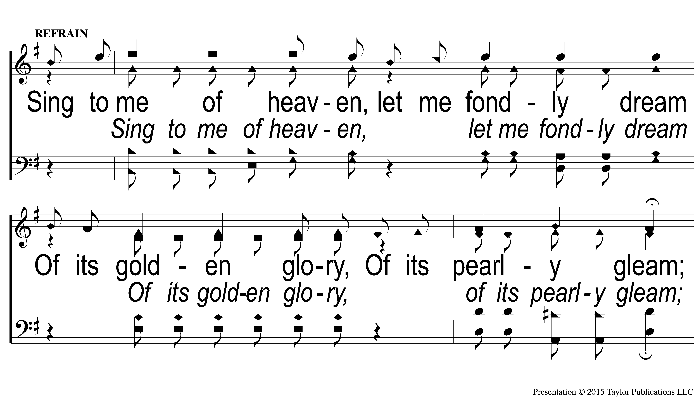
C-1 Sing to me of Heaven
Sing to Me of Heaven
595

Slide 54
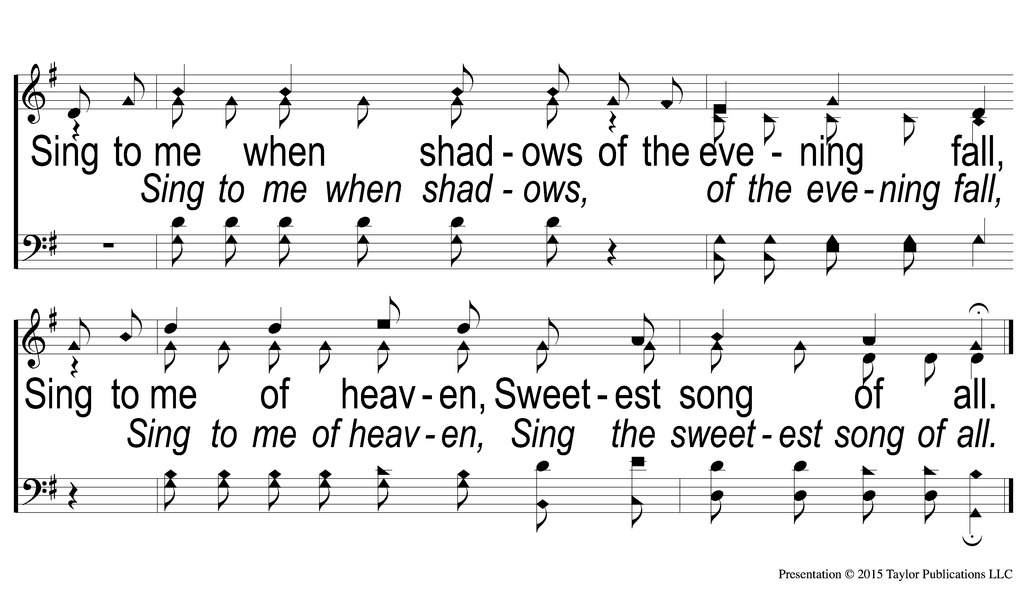
C-2 Sing to me of Heaven
Sing to Me of Heaven
595

Slide 55
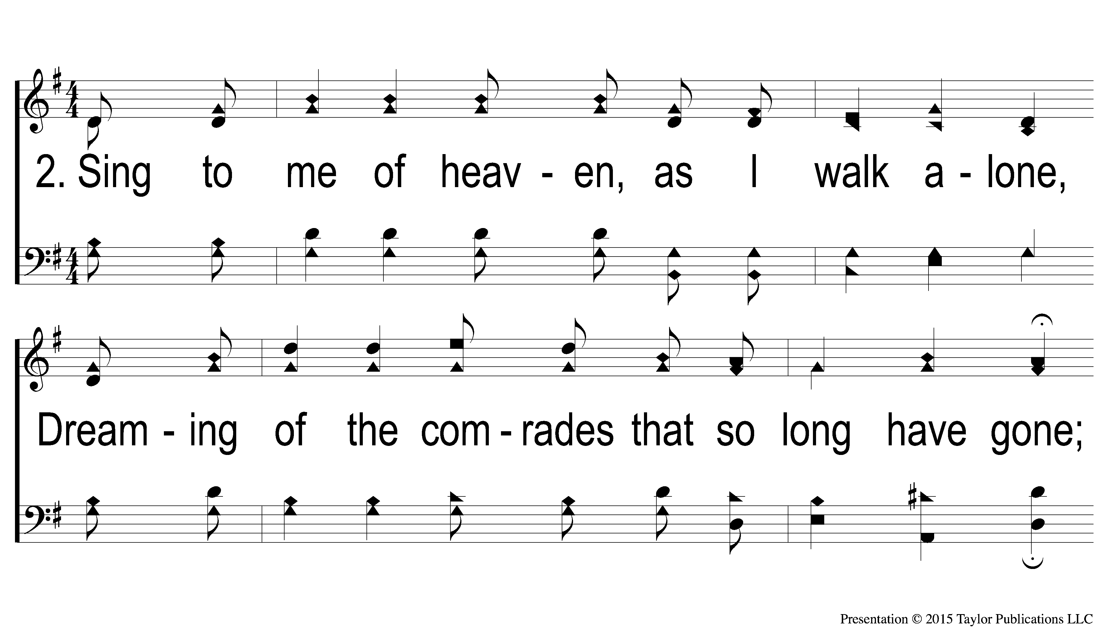
2-1 Sing to me of Heaven
Sing to Me of Heaven
595

Slide 56
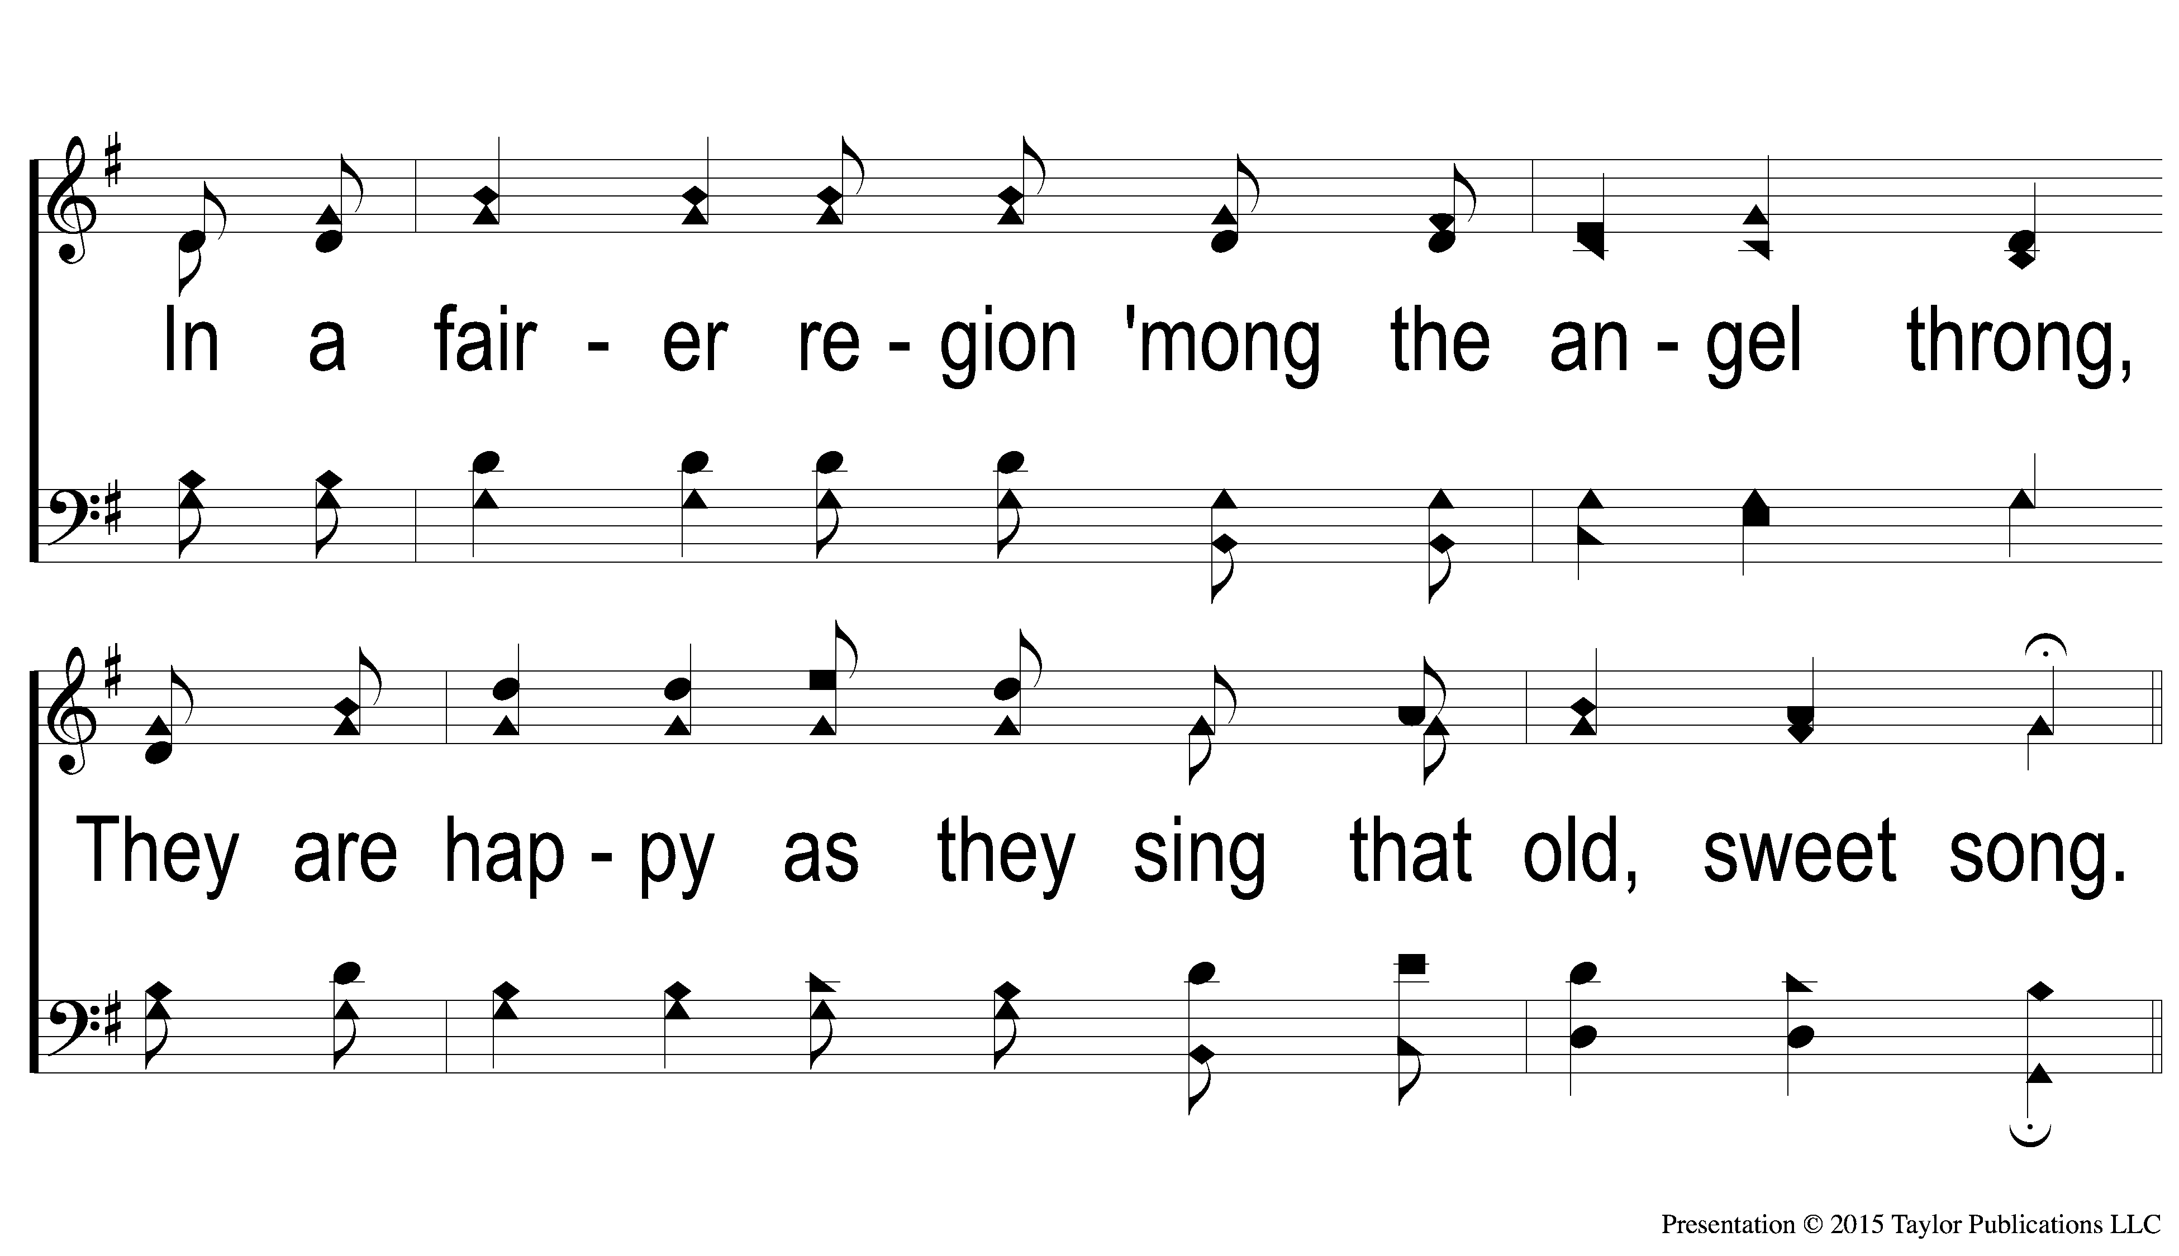
2-2 Sing to me of Heaven
Sing to Me of Heaven
595

Slide 57
C-1 Sing to me of Heaven
Sing to Me of Heaven
595

Slide 58
C-2 Sing to me of Heaven
Sing to Me of Heaven
595

Slide 59
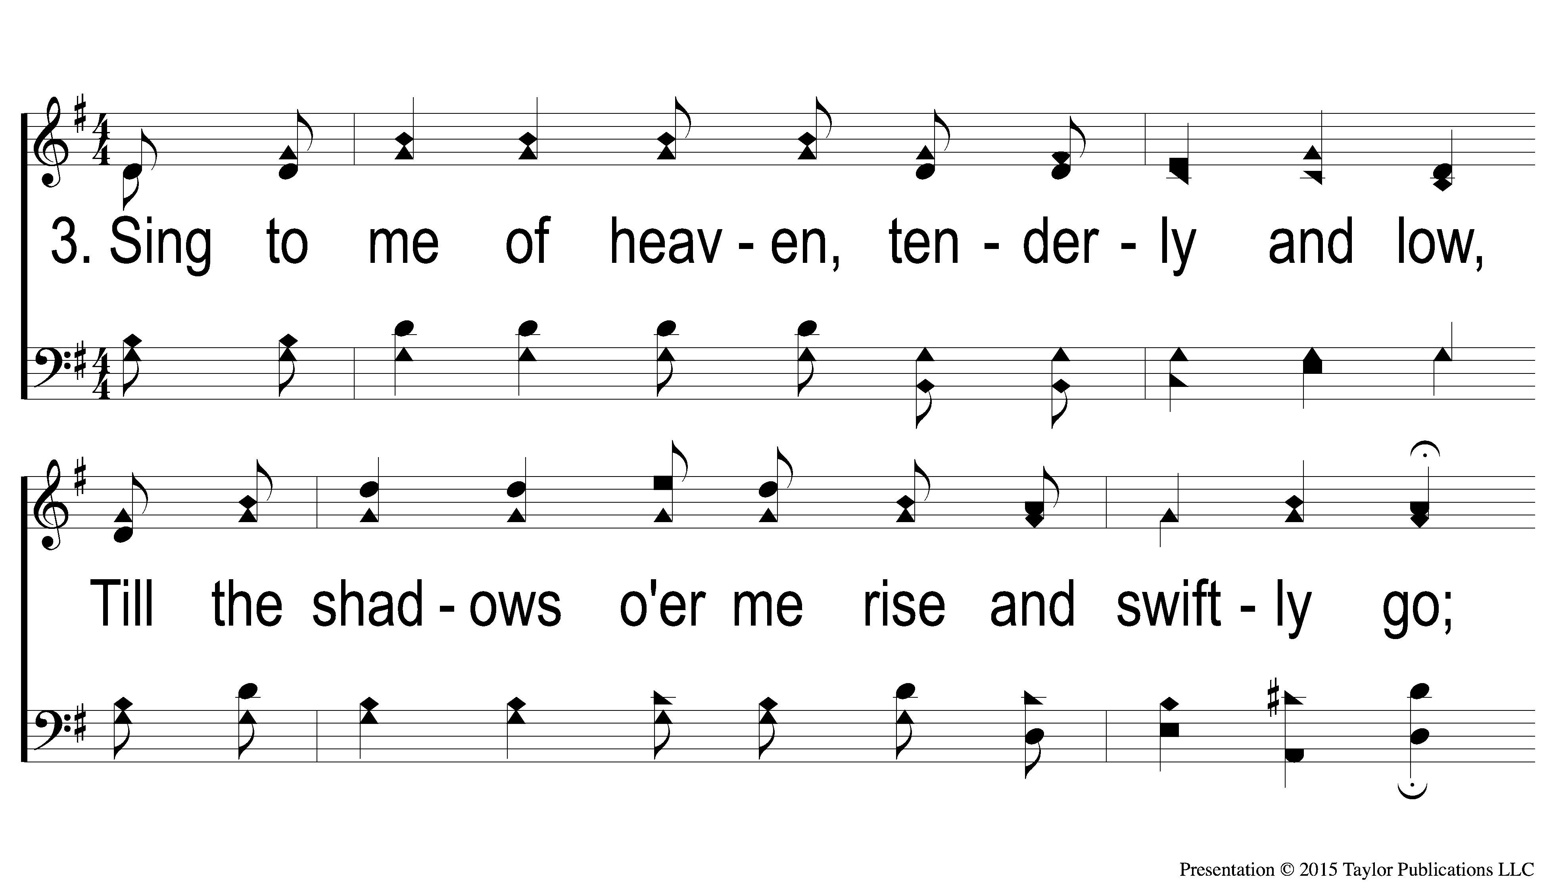
3-1 Sing to me of Heaven
Sing to Me of Heaven
595

Slide 60
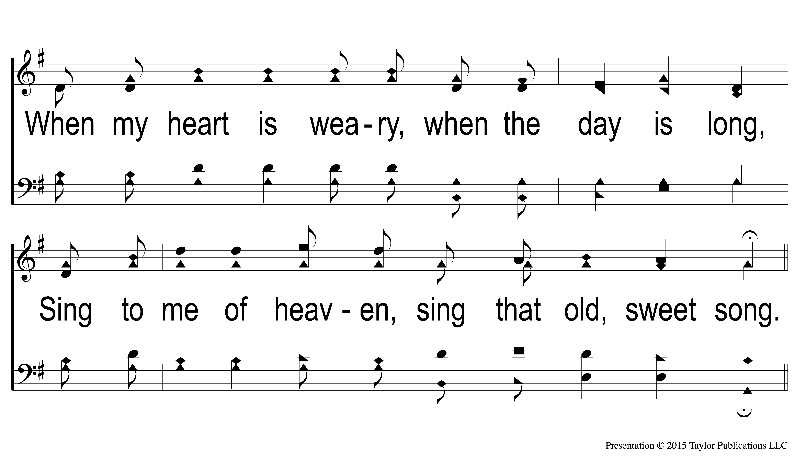
3-2 Sing to me of Heaven
Sing to Me of Heaven
595

Slide 61
C-1 Sing to me of Heaven
Sing to Me of Heaven
595

Slide 62
C-2 Sing to me of Heaven
Sing to Me of Heaven
595

