Slide 1


Navigating Times of Transition in Leadership
2 Kings 2

Slide 2


Existing Leaders Must Prepare for Transition

Slide 3
Anoint before you appoint
Do not surprise leaders with leadership (1 Kings 19:16)
Allow them to assist
Apprenticeships have a purpose (Acts 16:3; 1 Kings 19:19–21)

Slide 4

Allows Relationships to Blossom
The R.O.I. of Apprenticeship
Promotes Observation of Current Leadership
Encourages Intentionality in Mentoring

Slide 5
Acknowledge their Apprenticeship
Elisha was associated with Elijah for a while (2 Kings 2:3, 5, 7)
People need to know their leaders (Paul mentions 37 coworkers by name)

Slide 6
Emerging Leaders Must Prepare for Transition

Slide 7
Appreciate the past
Respect former leaders (2 Kings 2:9)
Recognize what made them successful (2 Kings 2:9)
Retain symbols of former success (2 Kings 2:13–14)

Slide 8
Anticipate the future
Move on (2 Kings 2:16–18; Josh 1:1–2)
“The most pervasive and common thread of our autopsies was that the deceased churches lived for a long time with the past as the hero” –Thom Rainer
Make your own way (Elisha did more than Elijah!)

Slide 9
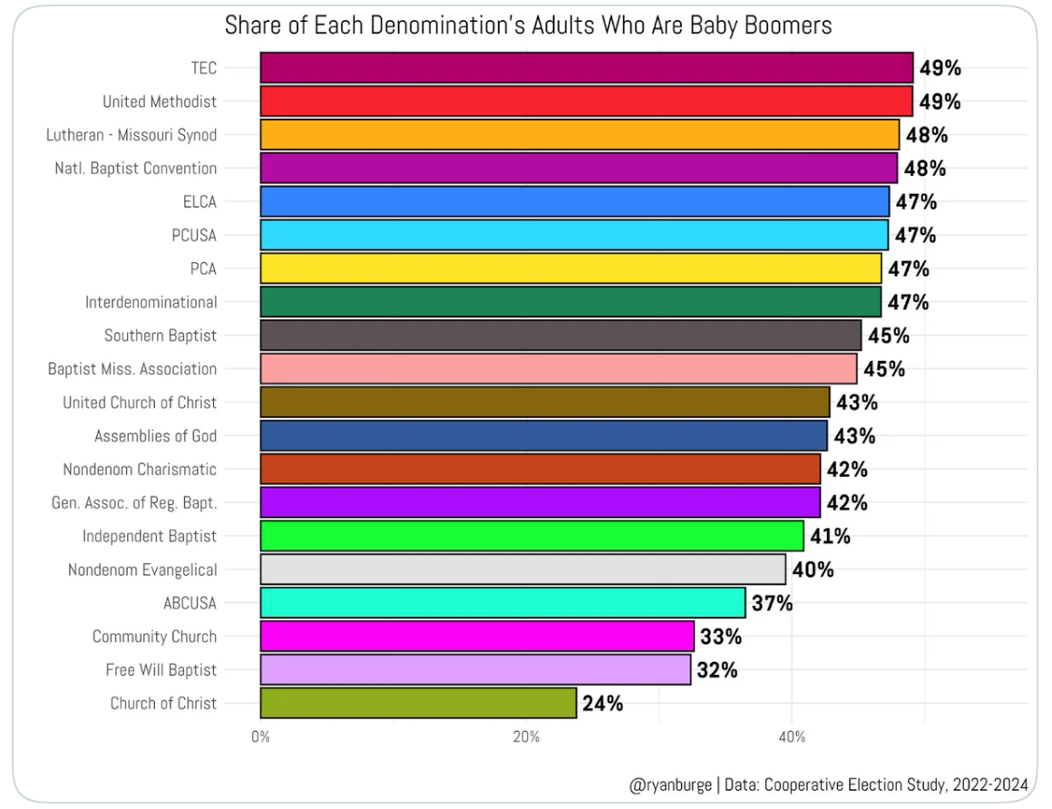
The Opportunity!

Slide 10

“In leadership, success is succession. If someone coming along behind me is not able to take what I have offered and build on it, then I have failed in my responsibility to the next generation” —Andy Stanley

