Slide 1
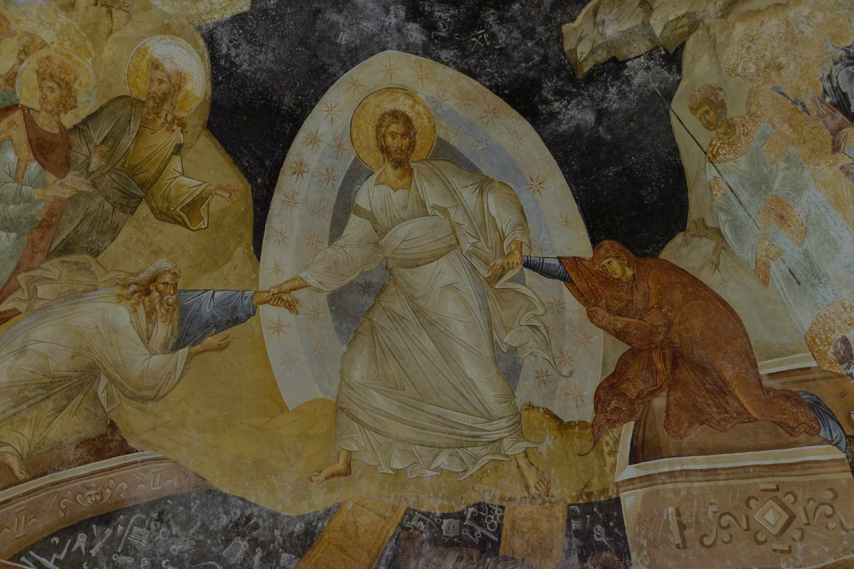

What the Early Church Knew About Heresy
(that we have forgotten)

Slide 2
Marcionism
Basic teachings
Two gods, one of the OT and one of the NT
Rejected the entire OT + Gospels (except an edited Luke)
Accepted Paul, minus Hebrews, Timothy, and Titus
“Micro-Marcionism” is present today
Rejection of the Old Testament
Critics who accuse OT God of being a moral monster

Slide 3
Montanism
Basic teachings
The Spirit is enabling additional revelation
Miracles continue, especially tongue-speaking
“Micro-Montanism” is present today
Holiness movement
Those who claim miracles have yet to cease (1 Cor 13:8–10)

Slide 4
Modalism
Basic teachings
AKA Sabellianism or Monarchianism
One God who appears in three modes
Modalism is present today
“The same man is a father, a son, and a husband”
“Oneness” Pentecostals (against Heb 1:8; Acts 5:3–4)

Slide 5
Novatianism
Basic teachings
What to do with “the lapsed?”
Heb 6:4–6 was key in denying repentance
Novatianism is present today
Some deny restoration to sinners (against Gal 6:1)

Slide 6
Arianism
Basic teachings
Jesus is the greatest of created beings
Prov 8:22 (LXX) was key in Arius’ theology
Arianism is present today
Jehovah’s Witnesses teach that Jesus was “a god“
See the New World Translation of John 1:1–2

Slide 7
Apollinarianism
Basic teachings
Jesus had a human body and soul, but a divine mind (in the form of the eternal Logos)
Apollinarianism is present today
Those who struggle to understand the 100% divinity and 100% humanity of Jesus (Luke 2:52)

Slide 8
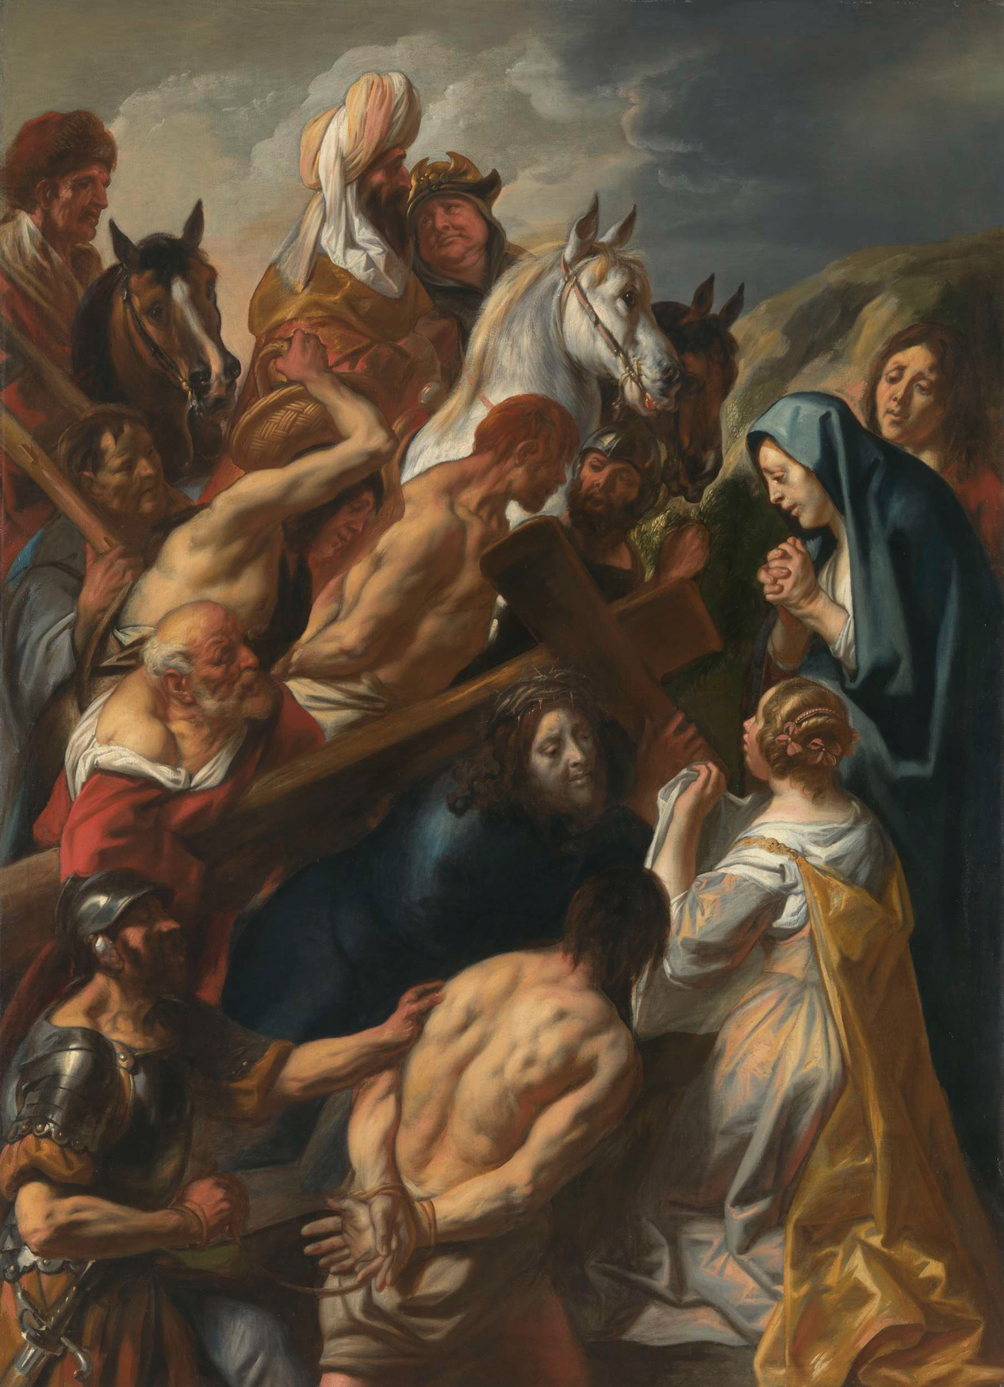

Truth is singular; error is multiple
Scripture alone makes Christians alone

