Slide 1

LIVING A LIFE OF PURPOSE:
FINDING MEANING AND DIRECTION IN GOD'S PLAN
1 PETER 2:9-12

Slide 2

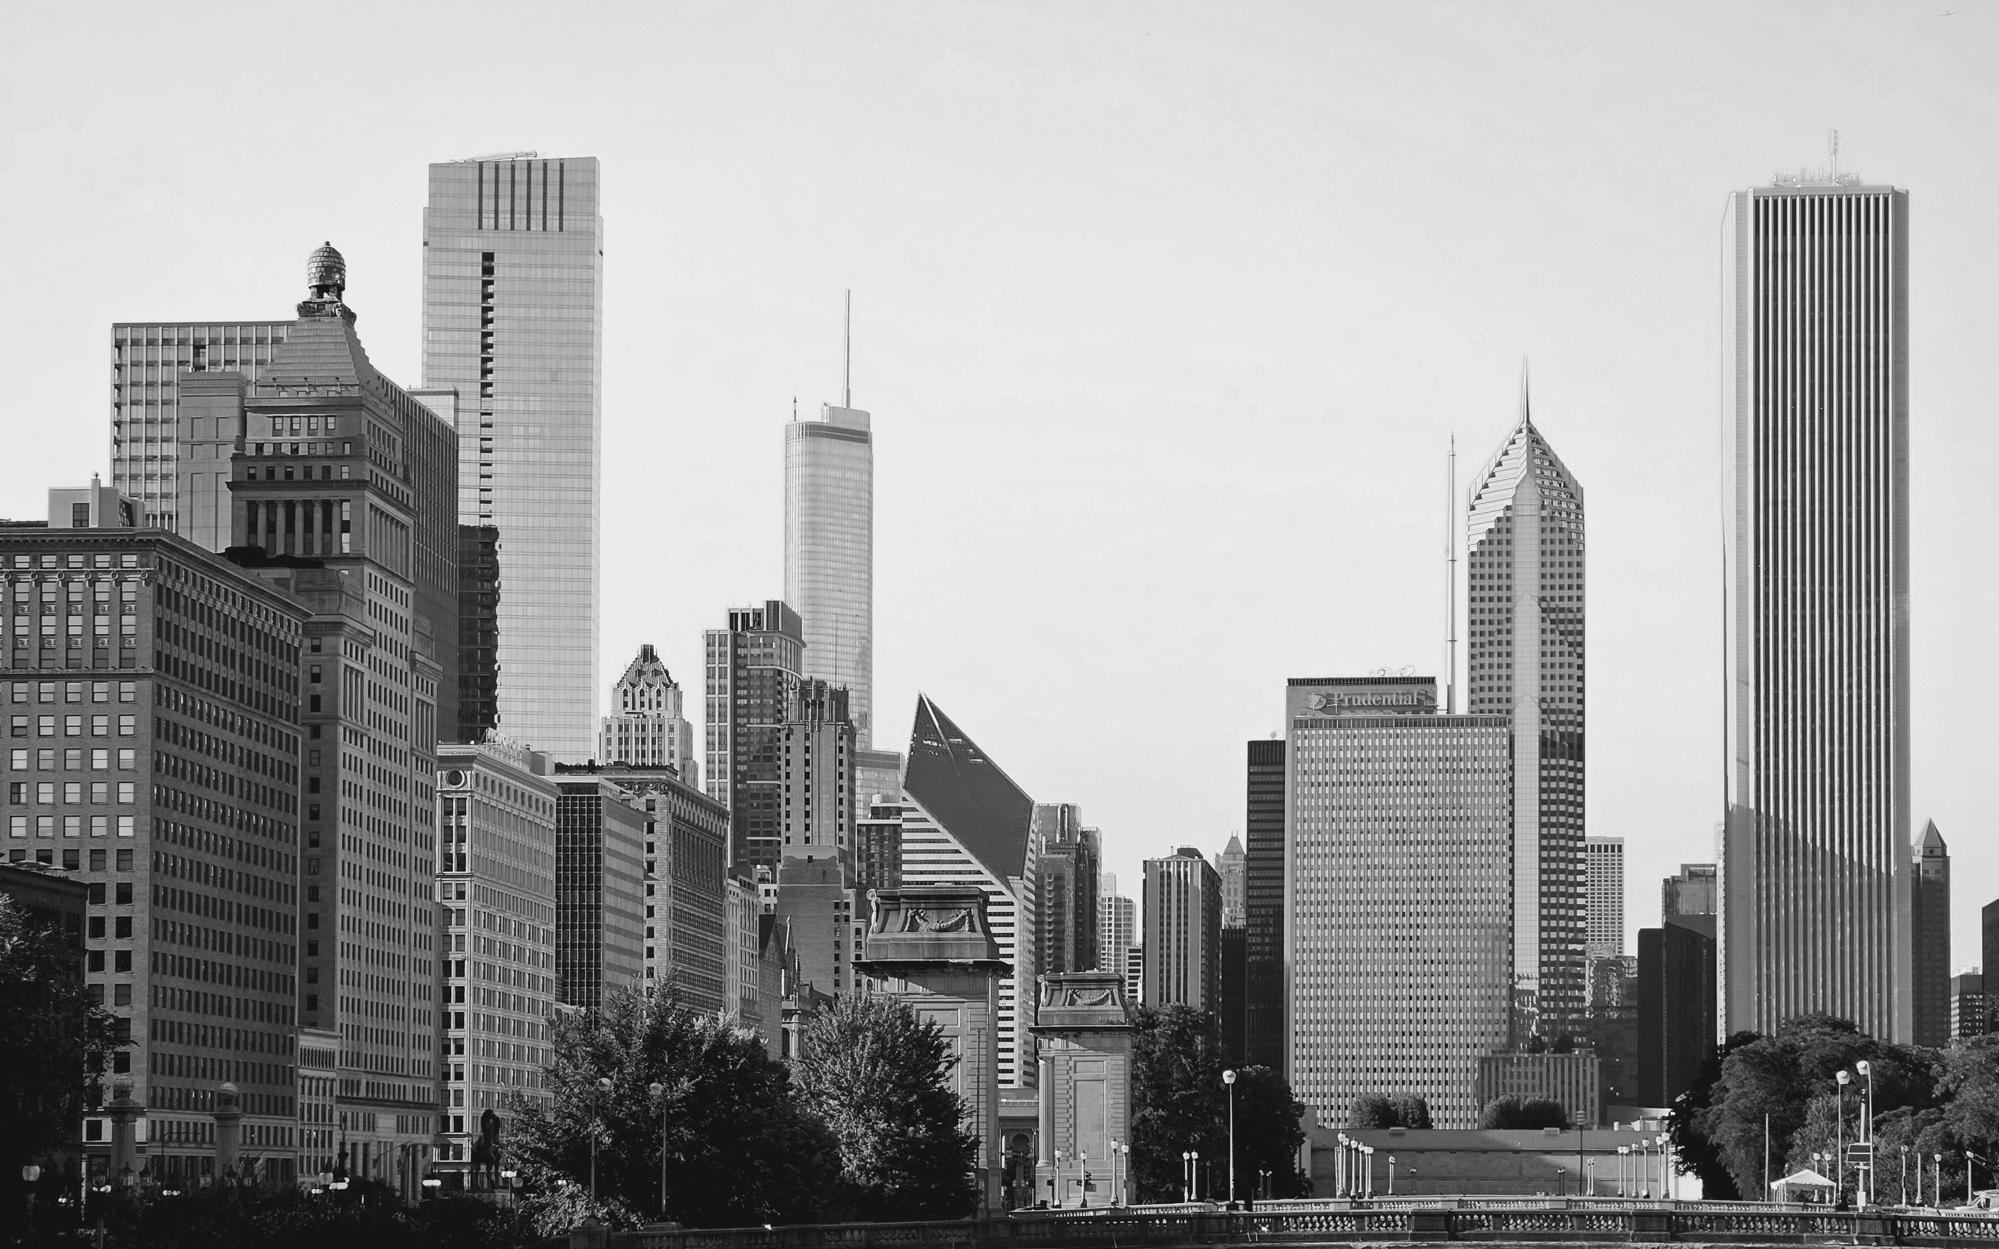

WHO AM I?
I am created in God’s image
Gen 1:27
I am recreated in Christ’s image
Eph 2:10

Slide 3

WHY AM I HERE?
I am here to obey God
Ecc 12:13–14
I am here to glorify God
1 Cor 10:31
I am here to save others
Luke 19:10; 1 Cor 9:22

Slide 4

HOW SHOULD I LIVE?
I live sacrificially
Gal 5:13
I live evangelistically
Matt 5:16
I live eternally
2 Cor 5:10

Slide 5

WE MOVE FROM SELFISHNESS TO SACRIFICE TO SERVICE
“QUOD VULT DEUS”

