Slide 2
Herodias: Dancing and Decapitating
Matthew 14:1-12; Mark 6:14-29
Kevin W. Rhodes
PTP Branson 2026
Notes:
Most people have a very distinct idea in their mind when you mention the word “villain.”
We tend to see villains as evil incarnate, because that is how they are often portrayed.

Slide 3
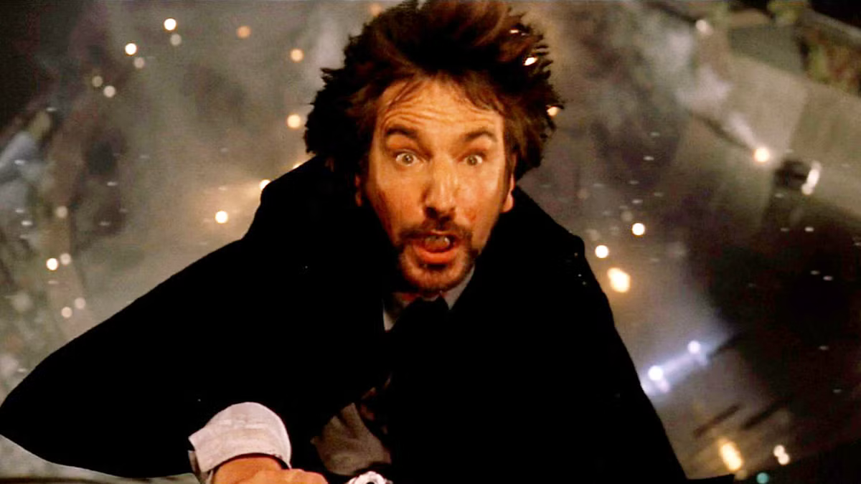
Notes:
Hans Gruber
Professor Moriarty
Sauron
Emperor Palpatine
Voldemort, and
Thanos
are recognizable villains because they combine complete evil with total ambition.
You will also notice that most villains are men, but more villainous women have been portrayed than you think.

Slide 4
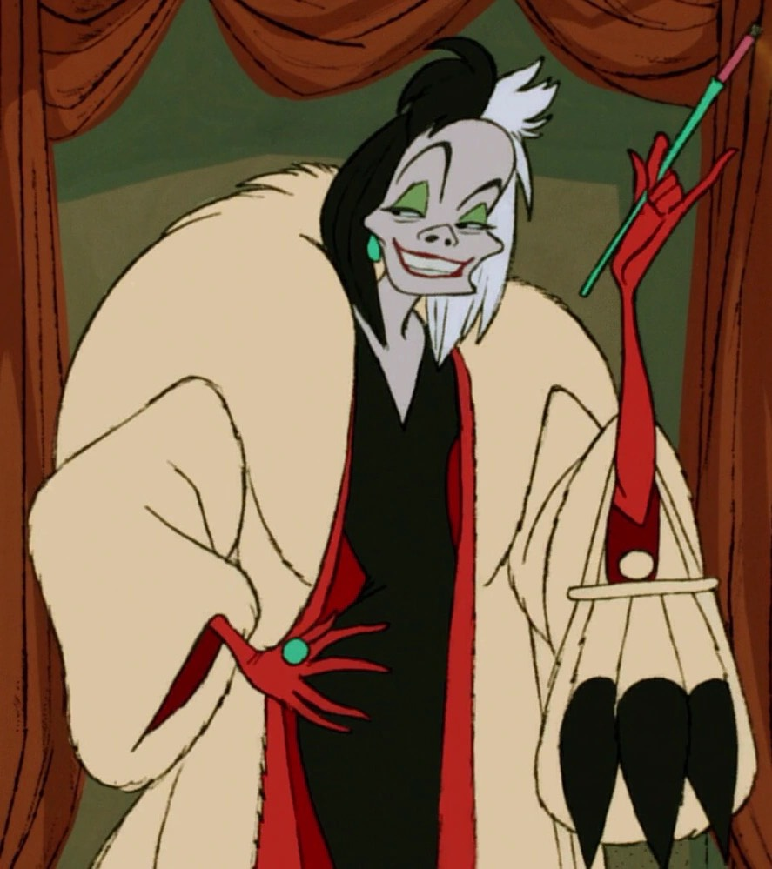
Notes:
Cruella Deville
Marvel - Hela, Thor’s sister
Professor Umbridge
The problem is that we have grown accustomed to seeing villains as over the top caricatures rather than people making choices completely based on self-interest because of their lack of character.
And that is important to understand if we are to appreciate true villainy throughout scripture—save for Satan himself.

Slide 5

Background
Notes:
The story of Herodias is not the development of a master villain; it is a soap opera. And that makes her behavior even more relevant to us.

Slide 6
Background
Born into royalty
Married to half-uncle, Herod Philip
Herod Antipas married to the daughter of King Aretas IV
Herod Antipas became tetrarch
Met in Rome where they agreed to marry
Married in 27 A.D.
Notes:
Herodias was born into luxury and royalty.
She was the granddaughter of Herod the Great, born to Aristobulus and Bernice (Family Tree for reference).
While there is some question as to the year of her birth, at a very young age she was engaged to marry her half-uncle, Herod Philip, who had been in line to take the throne.
Subsequent political intrigue caused Herod the Great to drop him from the line of succession shortly before Herod’s death.
The couple had a daughter, named Salome, in 14 A.D.
In the meantime, Herod Antipas, Herod Philip’s half-brother, married Phasa’el, the daughter of King Aretas IV, the king of Nabataea, and ultimately became tetrarch of Galilee and Perea, ruling as a client king under Roman rule.
However, during a visit to Rome, Antipas and Herodias, mutually decided to leave their spouses and marry, which they did around 27 A.D.
Therefore, if Herod the Great began remodeling the temple around 19 B.C. and it was in its 46th year of construction when Jesus began His ministry (John 2:20), then the date of their marriage coincided with John’s death, which means he essentially voiced his opposition from the time they returned from their honeymoon.
(Sources: Josephus, ISBE Revised, Wikipedia)

Slide 7
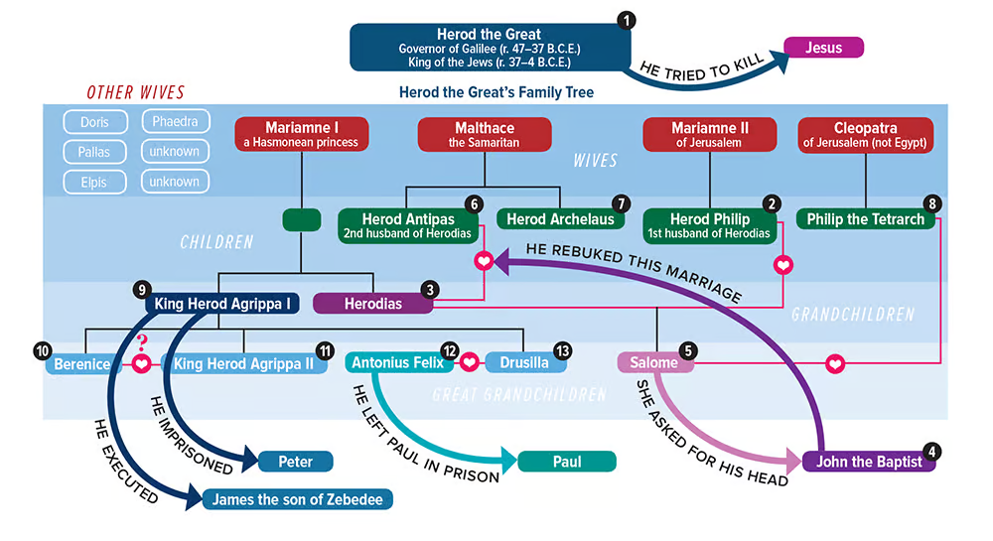
Notes:
This chart from Biblical archaeology.org may not help alleviate all your confusion, but it might help at least illustrate it!
All of this background is extremely important when we consider the texts of Matthew 14:1-12 and Mark 6:14-29.
Matthew and Mark do not include this account in chronological order or even arranged topically with the life of John the Baptist as Luke does (Luke 3:18-20).
Instead, because the gospel centers on Jesus, they place it where it has most relevance to Him.
All of these are subtle choices, and that is very appropriate considering our topic.
Because what made Herodias such a dangerous figure was not some bold and daring plan but the subtlety of her evil.

Slide 8

Narrative
Notes:
This is an amazing story.
And today we are going to consider this text by looking at as literature.
Because its characters are vivid an its plot is diabolical.
And I believe that combination brings out its point better than a simple reading of the text.

Slide 9
Foreword
Notes:
This account appears later in the text of Matthew and Mark.
Therefore, it functions as a sort of flashback in the text.
Matthew and Mark each begin with a brief foreword that focuses on Herod’s reaction to Jesus explained, in part, by the story that follows.
This explains the relevance of the account.

Slide 10
Foreword
“Now King Herod heard of Him, for His name had become well known. And he said, ‘John the Baptist is risen from the dead, and therefore these powers are at work in him.’ Others said, 'It is Elijah.’ And others said, 'It is the Prophet, or like one of the prophets.’ But when Herod heard, he said, ‘This is John, whom I beheaded; he has been raised from the dead!’”
Mark 6:14-16
Notes:
Within the context of Matthew and Mark, this account not only provides closure to the story of John the Baptist but also heightens the tension of Jesus’ own situation.
Herod’s guilt showed through in his fear that John had been resurrected, perhaps even afraid of what would happen to him now.
But contextually this also foreshadows the conflict that Jesus would later have with the political and spiritual leadership in Israel.
This story highlights what is at stake for Jesus.

Slide 11
Foreword
“At that time Herod the tetrarch heard the report about Jesus and said to his servants, ‘This is John the Baptist; he is risen from the dead, and therefore these powers are at work in him.’”
Matthew 14:1-2

Slide 12
Exposition
Notes:
This explains the situation that led to the conflict.

Slide 13
Exposition
“For Herod himself had sent and laid hold of John, and bound him in prison for the sake of Herodias, his brother Philip’s wife; for he had married her. Because John had said to Herod, ‘It is not lawful for you to have your brother’s wife.’ Therefore Herodias held it against him and wanted to kill him, but she could not; for Herod feared John, knowing that he was a just and holy man, and he protected him. And when he heard him, he did many things, and heard him gladly.”
Mark 6:17-20
Notes:
While Herod feared John, his relationship with Herodias mattered more.
And Herodias’ anger and malice created escalating tension that began with John’s imprisonment for nothing more than offending her.

Slide 14
Exposition
“For Herod had laid hold of John and bound him, and put him in prison for the sake of Herodias, his brother Philip’s wife. Because John had said to him, ‘It is not lawful for you to have her.’ And although he wanted to put him to death, he feared the multitude, because they counted him as a prophet.”
Matthew 14:3-5
Notes:
In the end, the only thing keeping John alive was Herod’s fear of the multitudes.

Slide 15
Rising Action
Notes:
This explains how the situation and tension escalated further, and this went far beyond normal behavior.

Slide 16
Rising Action
“Then an opportune day came when Herod on his birthday gave a feast for his nobles, the high officers, and the chief men of Galilee. And when Herodias’ daughter herself came in and danced, and pleased Herod and those who sat with him, the king said to the girl, ‘Ask me whatever you want, and I will give it to you.’ He also swore to her, ‘Whatever you ask me, I will give you, up to half my kingdom.’ So she went out and said to her mother, 'What shall I ask?’ And she said, “The head of John the Baptist!” Immediately she came in with haste to the king and asked, saying, ‘I want you to give me at once the head of John the Baptist on a platter.’”
Mark 6:21-25
Notes:
Almost everything that happened in this section violated Judaea’s cultural norms.
A birthday party like this was considered Roman and pagan.
Free flowing alcohol was usually typical in such royal gatherings.
Someone of royal descent dancing in a gathering of men would have been considered indecent on its face (bringing to mind the Persian queen Vashti’s refusal in Esther 1).
All these factors decreased Herod’s inhibitions and increased the role of lust and rashness, so that Herod behaved like a pagan king drunk on his own power.
Even the phrase, “Up to half my kingdom” is reminiscent of Xerxes in Esther 5.
But notice the phrasing that opened this section: “Then an opportune day came."
This situation was no accident.
It was carefully orchestrated.
Herodias bided her time to manipulate events to get what she wanted.

Slide 17
Rising Action
“But when Herod’s birthday was celebrated, the daughter of Herodias danced before them and pleased Herod. Therefore he promised with an oath to give her whatever she might ask. So she, having been prompted by her mother, said, ‘Give me John the Baptist’s head here on a platter.’”
Matthew 14:6-8
Notes:
Herodias prompted Salome to ask for John’s execution.
But since Herodias would not have been present in the chamber, she had to have not only told her daughter to check with her but likely been the one who suggested that Salome dance for the assembly in the first place.

Slide 18
Climax
Notes:
This explains how the conflict was resolved—whether for good or for bad.

Slide 19
Climax
“And the king was exceedingly sorry; yet, because of the oaths and because of those who sat with him, he did not want to refuse her. Immediately the king sent an executioner and commanded his head to be brought.”
Mark 6:26-27a
Notes:
Part of what made this situation “an opportune time” was because it was a public gathering where social pressure would have made backing out of a promise practically impossible.

Slide 20
Climax
“And the king was sorry; nevertheless, because of the oaths and because of those who sat with him, he commanded it to be given to her. So he sent and had John beheaded in prison.”
Matthew 14:9-10
Notes:
Therefore, while the king himself regretted the outcome, Herodias had worked the situation to make it impossible for him not to carry out his promise, which is what Herodias had wanted all along.

Slide 21
Falling Action
Notes:
This explains the fallout—what naturally happened as a result of the climax.

Slide 22
Falling Action
“And he went and beheaded him in prison, brought his head on a platter, and gave it to the girl; and the girl gave it to her mother.”
Mark 6:27b-28
Notes:
The gruesomeness of not only the execution but also of the presentation made publicly is difficult enough to ponder.

Slide 23
Falling Action
“And his head was brought on a platter and given to the girl, and she brought it to her mother.”
Matthew 14:11
Notes:
That is was presented to a teenage girl and then to her mother who received it with glee provides another tragic layer to this story.
Herodias got exactly what she wanted, making this a personal triumph for her but a tragedy for everyone else.

Slide 24
Resolution
Notes:
Also known as the denouement, this presents the close of the story and includes how the author wants you to feel about it.

Slide 25
Resolution
“When his disciples heard of it, they came and took away his corpse and laid it in a tomb.”
Mark 6:29
Notes:
While Herodias treated John with contempt and malice, his disciples treated him with great respect.
And that is what Matthew and Mark expected from their readers.

Slide 26
Resolution
“Then his disciples came and took away the body and buried it, and went and told Jesus.”
Matthew 14:12
Notes:
On top of this, his disciples knew that John’s death would would mean something to Jesus.

Slide 27

Characters
Notes:
Within this narrative both Matthew and Mark presented five very different kind of characters common in literature.

Slide 28
John the Baptist = The Innocent

Slide 29
Characters
Just
Holy
Prophet
Respected
John the Baptist: THE INNOCENT
Notes:
Note the respect for John the Baptist described throughout the text.
He had sufficient character to be compared to Jesus
He showed boldness in preaching the truth without partiality
He was recognized by people as a prophet.
He was loved enough for his disciples to risk their own reputations to honor him.
He mattered to Jesus and people knew it.

Slide 30
John’s Disciples = The Everyman

Slide 31
Characters
Normal
Respectful
Dignified
Spiritual
John’s Disciples

Slide 32
Herod Antipas = The Ruler

Slide 33
Characters
Aloof
Clueless
Conflicted
Impulsive
Not as personally powerful as his role would indicate
Herod Antipas: THE RULER

Slide 34
Herodias’ Daughter = The Seductress

Slide 35
Characters
Dancing
13 years old (just reached marriageable age)
Audience entirely of older men
Positioned here deliberately by her mother
Salome:
THE SEDUCTRESS

Slide 36
Herodias = The Trickster

Slide 37
Characters
Malicious
Opportunistic
Manipulative
Deceptive
Herodias:
THE TRICKSTER
Notes:
Herodias herself actually appears very little in the story.
And yet she is at the center of it: “Therefore Herodias held it against him and wanted to kill him, but she could not.”
Working as a shadowy figure, this ungodly woman worked through her daughter, through her husband, and even through the noblemen to bring about the murder of John the Baptist.

Slide 38

Application

Slide 39
Application
The more personal the sin, the more personal the resentment. V. 18
Playing the victim (instead of repenting) breeds malice. V. 19
Malice distorts reality and impedes proper judgment. V. 20
A evil heart corrupts others without remorse. V. 22-23
Wickedness takes advantage of everyone in pursuit of more wickedness. V. 24-25
Sin compounds exponentially. Vs. 26-27
Villainous behavior has many victims. V. 28-29
Herodias:
Dancing and Decapitating

Slide 40

Conclusion
Notes:
But there is just a little more to the story.
When Herod divorced his first wife, the daughter of the Nabatean king, Aretas, in order to marry Heroidias, this personal affront rekindled animosity over an earlier border dispute.
This, in turn, led to a war that proved to be disastrous.
While Rome had defended their client king, their counter-attack was called off after the death of Tiberius in 37 A.D.
Two years later, accused of conspiring against the new emperor, Caligula, he and Heroidas were sent into exile and apparently died there.
Regarding this, Josephus wrote,…

Slide 41
Josephus, Antiquities 18:5.2
“Now, some of the Jews thought that the destruction of Herod’s army came from God, and that very justly, as a punishment of what he did against John, that was called the Baptist; for Herod slew him, who was a good man, and commanded the Jews to exercise virtue, both as to righteousness towards one another, and piety towards God, and so to come to baptism…”
Notes:
The most important lesson from Herodias’s infamous role in the death of John the Baptist is not the typical warning against power and prestige.
Instead, we find here a subtle warning that lust, pride, malice, and manipulation can be deadly—even if you are just a wife and mother.
The broader picture, of course, is still focused on Jesus.
Because He would pose an even greater threat to the entire leadership establishment in Judaea.

Slide 42
Herodias: Dancing and Decapitating
Matthew 14:1-12; Mark 6:14-29
Kevin W. Rhodes
PTP Branson 2026
Notes:
The saddest part of this story is not even in the loss of John the Baptist.
It is in easily Christians will excuse the sins that led to his death.

Slide 43
Conclusion
Never allow anyone to become the reason you do the wrong thing. V. 3
Sin committed for someone you love is still sin and still inexcusable. V. 3, 8
Silencing God’s messenger does not change the truth of God’s message. V. 4
Gaging spiritual decisions by others’ influence shows a complete lack of integrity. V. 5
If you place yourself in the wrong environment, you will often fall prey to that environment. V. 6
Giving in to temptation breaks down our moral defenses in far broader ways that we originally consider. V. 7
Pride and peer pressure routinely prevent proper behavior. V. 9
Evil influence in private can be just as destructive as anything done in public. Vs. 10-11
Social mores rarely reflect spiritual realities. V. 12
The people we claim to love are often the first victims of our lack of character.
Herodias:
Dancing and Decapitating

Slide 44
Herodias: Dancing and Decapitating
Matthew 14:1-12; Mark 6:14-29
Kevin W. Rhodes
PTP Branson 2026

