Slide 1
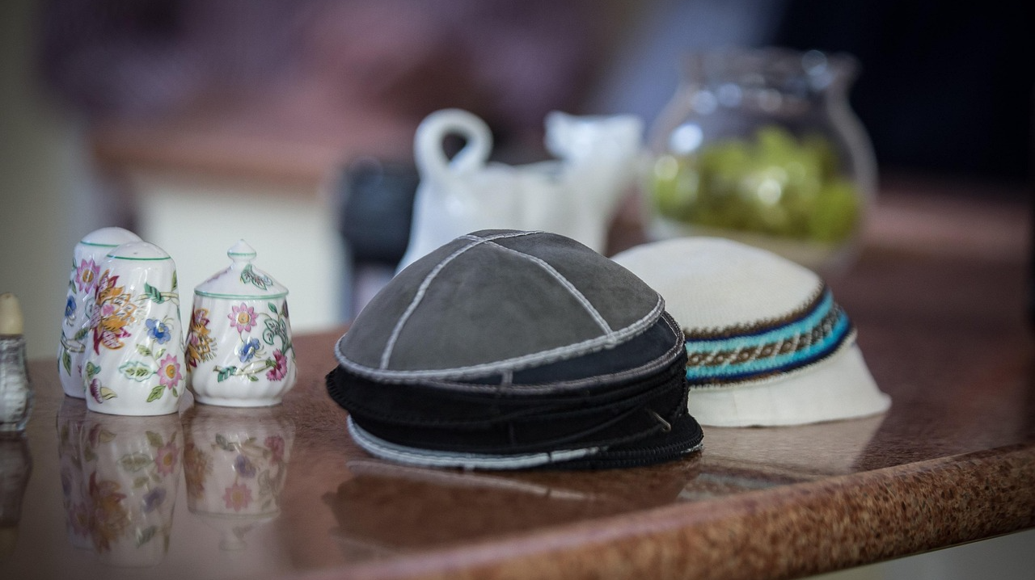
How Would You Do in a Jewish Synagogue?
Dale Hoggatt, Carthage, Missouri

Slide 2
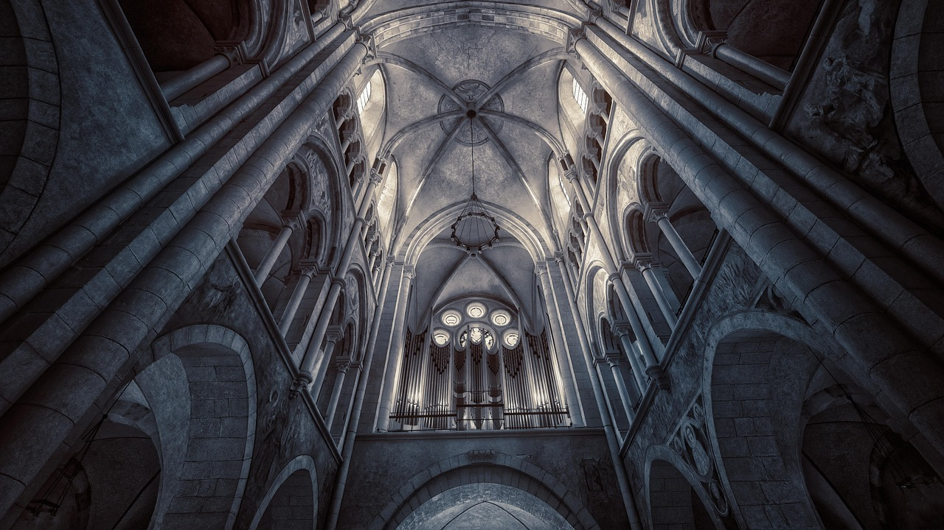

Slide 3
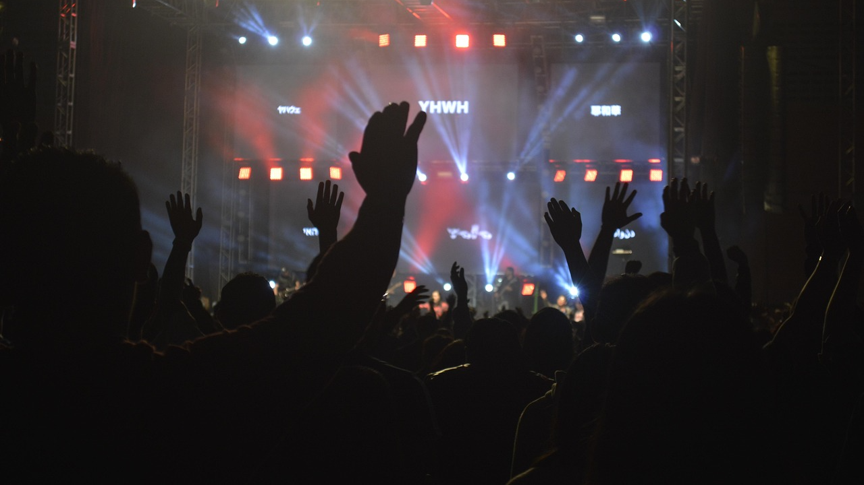

Slide 4
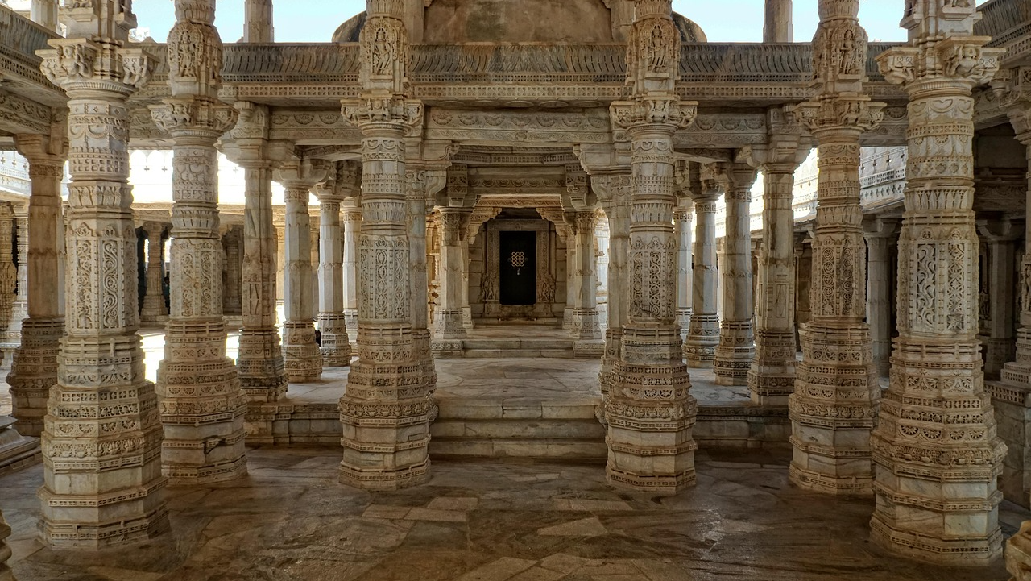

Slide 5


Slide 6
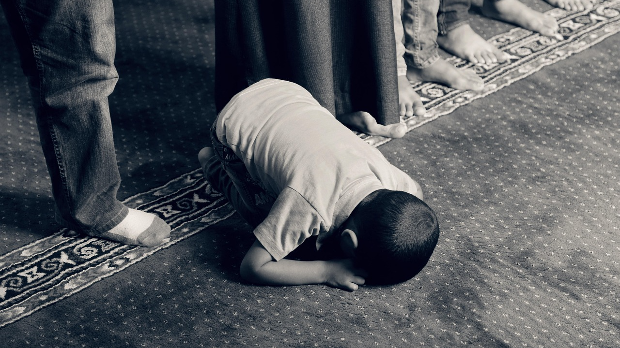

Slide 7
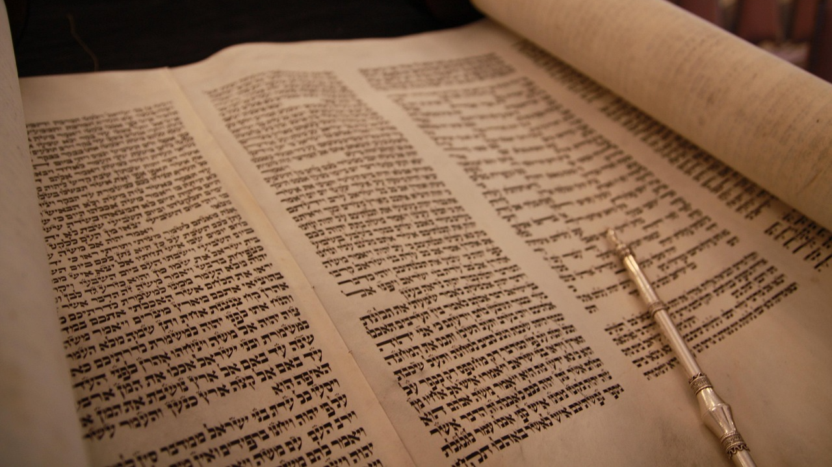
How Would You Do in a Jewish Synagogue?
Romans 1:16

Slide 8
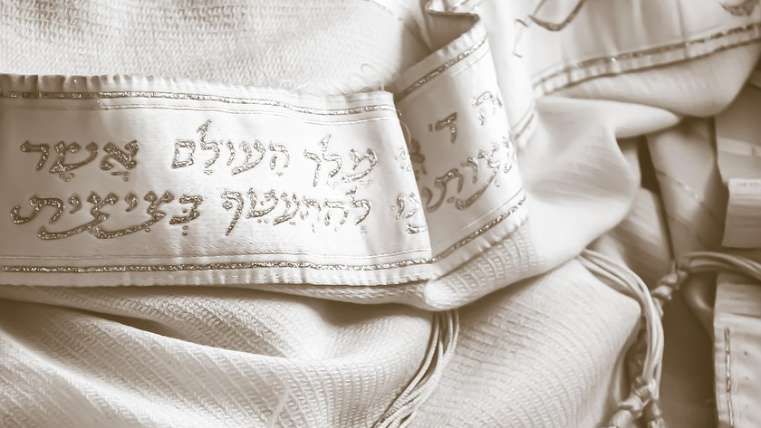
How Would You Do in a Jewish Synagogue?
Shared History
Shared Heritage
Shared Library
Messianic Expectation
Abrahamic Covenant
Temple vs. Synagogue
Seat of Moses
Pivot Point

Slide 9
How Would You Do in a Jewish Synagogue?
Shared History
400 Years

Slide 10
How Would You Do in a Jewish Synagogue?
2. Shared Heritage
Luke 4:16; Acts 17:1

Slide 11
How Would You Do in a Jewish Synagogue?
2. Shared Heritage
Luke 4:16; Acts 17:1
Scripture Reading – Acts 13:15; 1 Timothy 4:13

Slide 12
How Would You Do in a Jewish Synagogue?
2. Shared Heritage
Luke 4:16; Acts 17:1
Scripture Reading – Acts 13:15; 1 Timothy 4:13
Interactive Teaching – Acts 13:15; 18:4

Slide 13
How Would You Do in a Jewish Synagogue?
2. Shared Heritage
Luke 4:16; Acts 17:1
Scripture Reading – Acts 13:15; 1 Timothy 4:13
Interactive Teaching – Acts 13:15; 18:4
Acapella Singing – Ephesians 5:19;
Colossians 3:16

Slide 14
How Would You Do in a Jewish Synagogue?
2. Shared Heritage
Luke 4:16; Acts 17:1
Scripture Reading – Acts 13:15; 1 Timothy 4:13
Interactive Teaching – Acts 13:15; 18:4
Acapella Singing – Ephesians 5:19;
Colossians 3:16
Leadership Structure – Mark 5:22; Acts 14:23; Titus 1:5

Slide 15
How Would You Do in a Jewish Synagogue?
2. Shared Heritage
Luke 4:16; Acts 17:1
Scripture Reading – Acts 13:15; 1 Timothy 4:13
Interactive Teaching – Acts 13:15; 18:4
Acapella Singing – Ephesians 5:19;
Colossians 3:16
Leadership Structure – Mark 5:22; Acts 14:23; Titus 1:5
Immersion – Acts 2:38; Romans 6:4

Slide 16
How Would You Do in a Jewish Synagogue?
2. Shared Heritage
Where You Would Struggle

Slide 17
How Would You Do in a Jewish Synagogue?
2. Shared Heritage
Where You Would Struggle
The Sacrifice – Hebrews 10:12

Slide 18
How Would You Do in a Jewish Synagogue?
2. Shared Heritage
Where You Would Struggle
The Sacrifice – Hebrews 10:12
The Day – Acts 20:7; 1 Corinthians 16:2;
1 Corinthians 11:23-26

Slide 19
How Would You Do in a Jewish Synagogue?
3. Shared Library
Acts 13:15; 2 Timothy 3:15; Acts 17:2f

Slide 20
How Would You Do in a Jewish Synagogue?
4. Messianic Expectation
Luke 24:21; Isaiah 53; Psalm 22; Acts 17:3

Slide 21
How Would You Do in a Jewish Synagogue?
5. Abrahamic Covenant
Genesis 12:1-3; Galatians 3:27-29

Slide 22
How Would You Do in a Jewish Synagogue?
6. The Temple vs. The Synagogue
Hebrews 9:11f

Slide 23
How Would You Do in a Jewish Synagogue?
7. Authority (How Authority Was Handled)
Matthew 23:2; 1 Peter 4:11

Slide 24
How Would You Do in a Jewish Synagogue?
8. Pivot Point
Galatians 3:24f; Hebrews 10:9f; Galatians 5:4

Slide 25
How Would You Do in a Jewish Synagogue?
Shared History
Shared Heritage
Shared Library
Messianic Expectation
Abrahamic Covenant
Temple vs. Synagogue
Seat of Moses
Pivot Point

