Slide 1
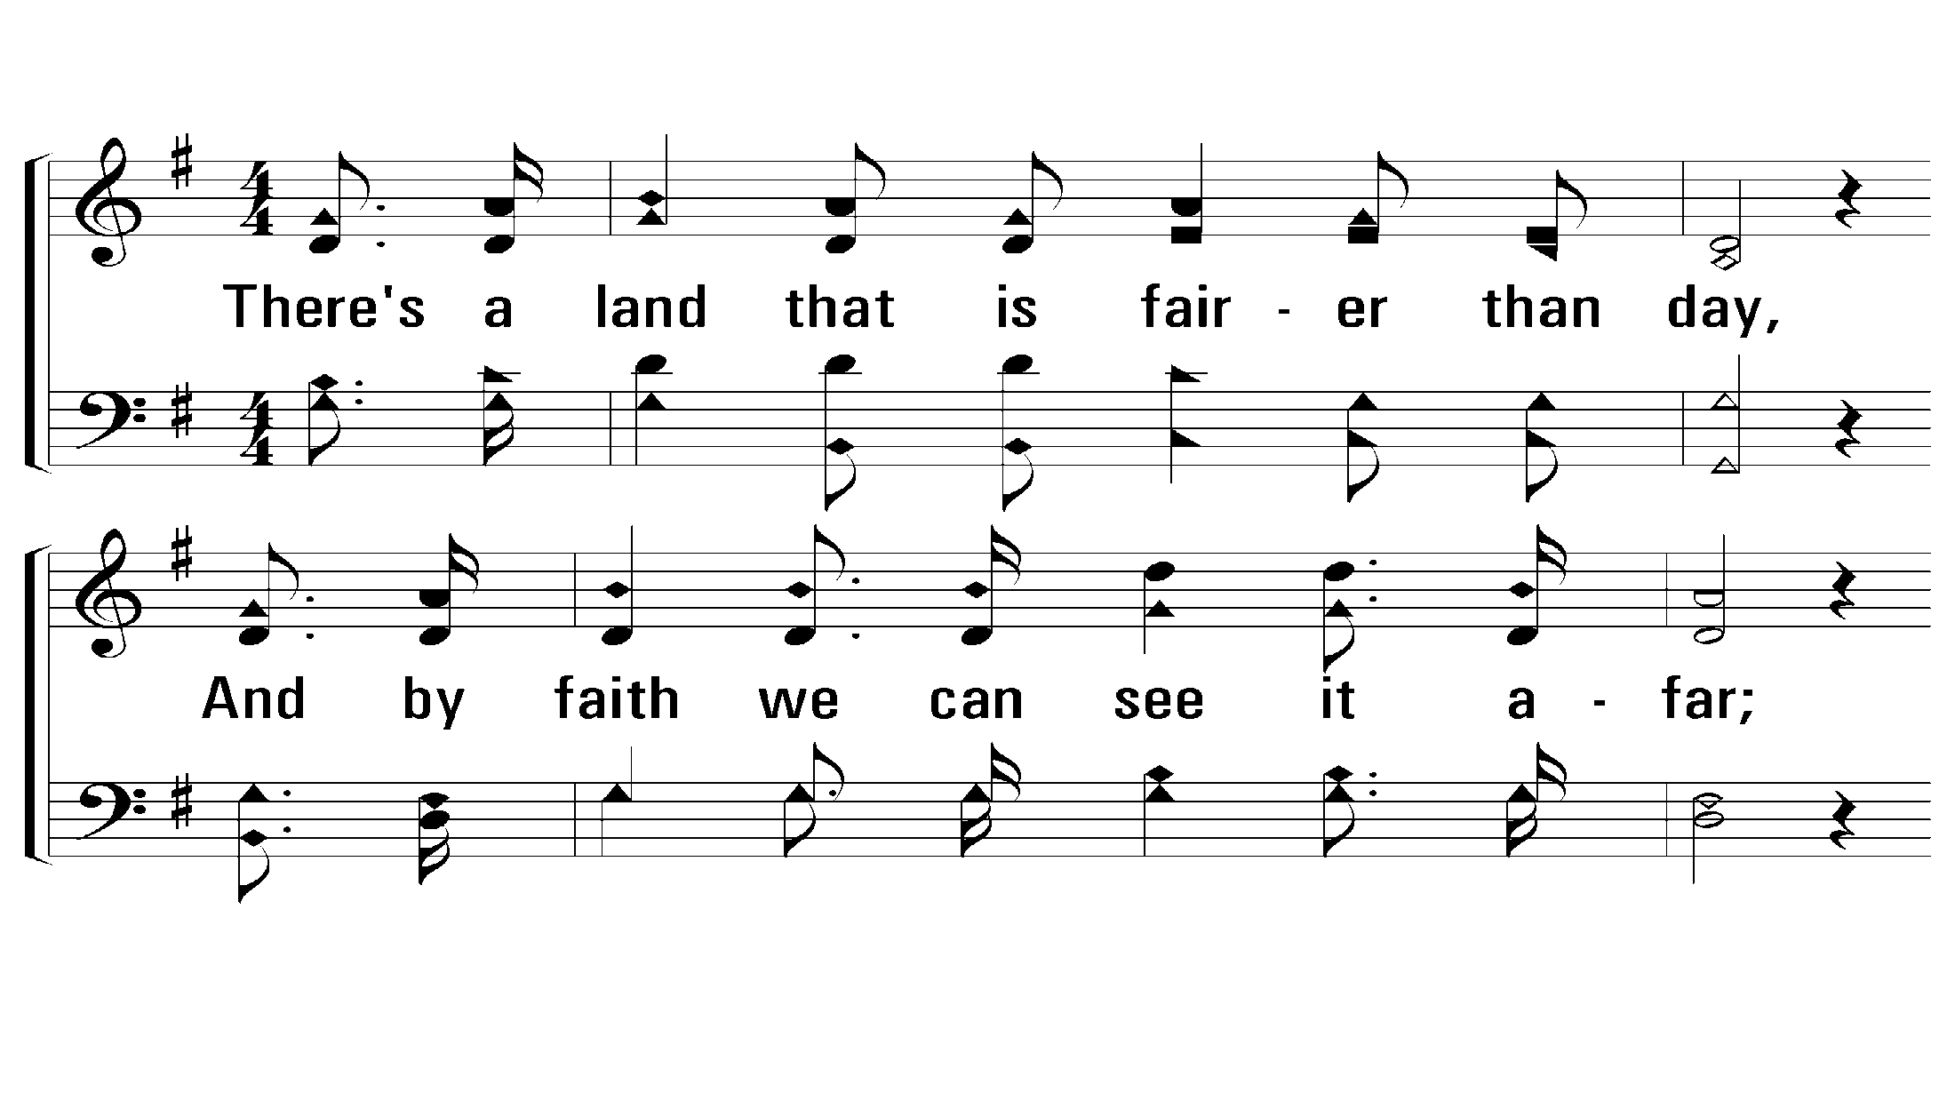
1 - Sweet By and By
1.
There's a land that is fairer than day,
And by faith we can see it afar;
For the Father waits over the way,
To prepare us a dwelling place there.
Words: Sanford F. Bennett
Music: Joseph P. Webster
© 2009 The Paperless Hymnal®
Notes:
5 Enter - Verse 2
9 Enter - Verse 3

Slide 2
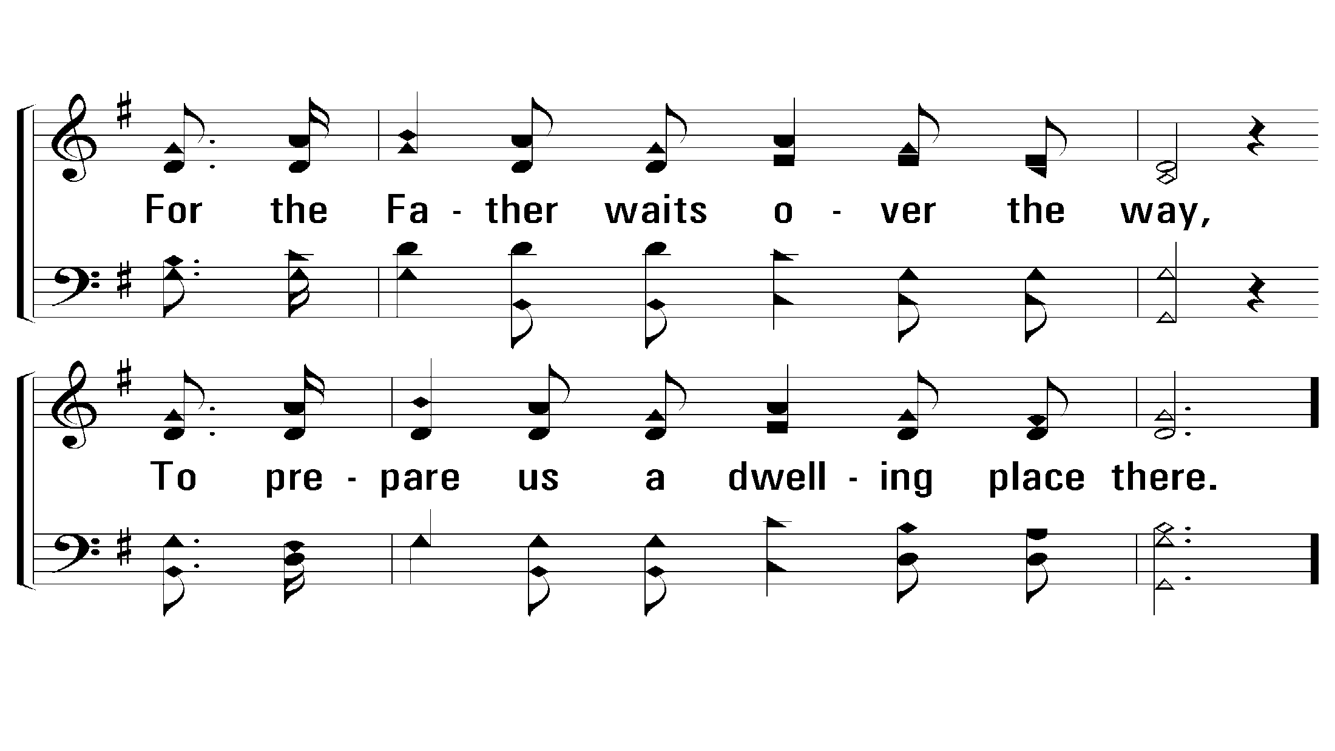
1 - Sweet By and By
© 2009 The Paperless Hymnal®
Notes:
5 Enter - Verse 2
9 Enter - Verse 3

Slide 3
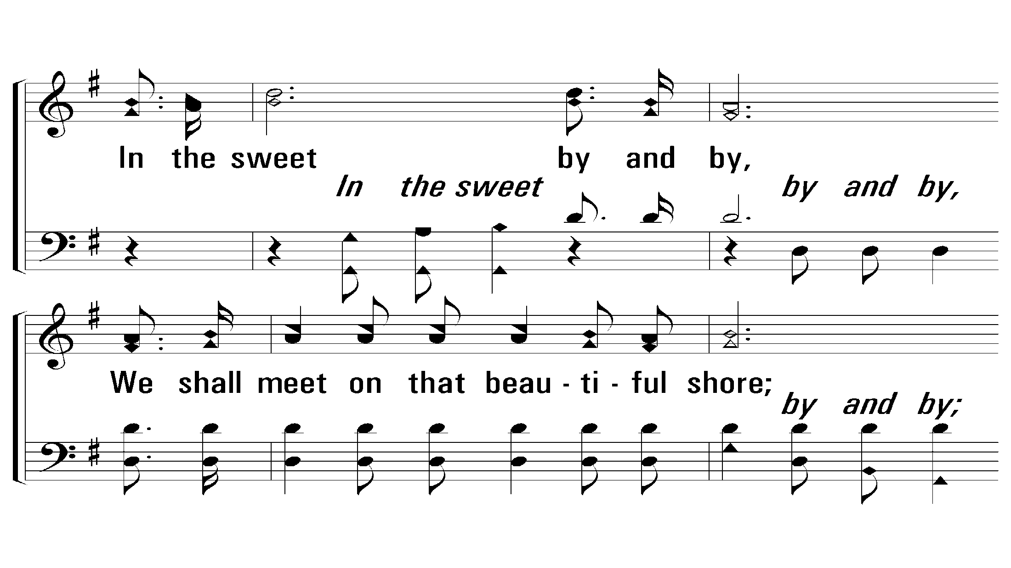
c - Sweet By and By
In the sweet by and by,
We shall meet on that beautiful shore;
In the sweet by and by,
We shall meet on that beautiful shore.
© 2009 The Paperless Hymnal®
Notes:
5 Enter - Verse 2
9 Enter - Verse 3

Slide 4
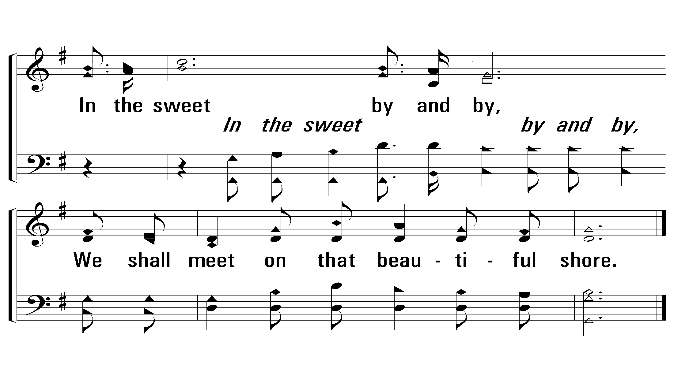
c - Sweet By and By
© 2009 The Paperless Hymnal®
Notes:
5 Enter - Verse 2
9 Enter - Verse 3

Slide 5
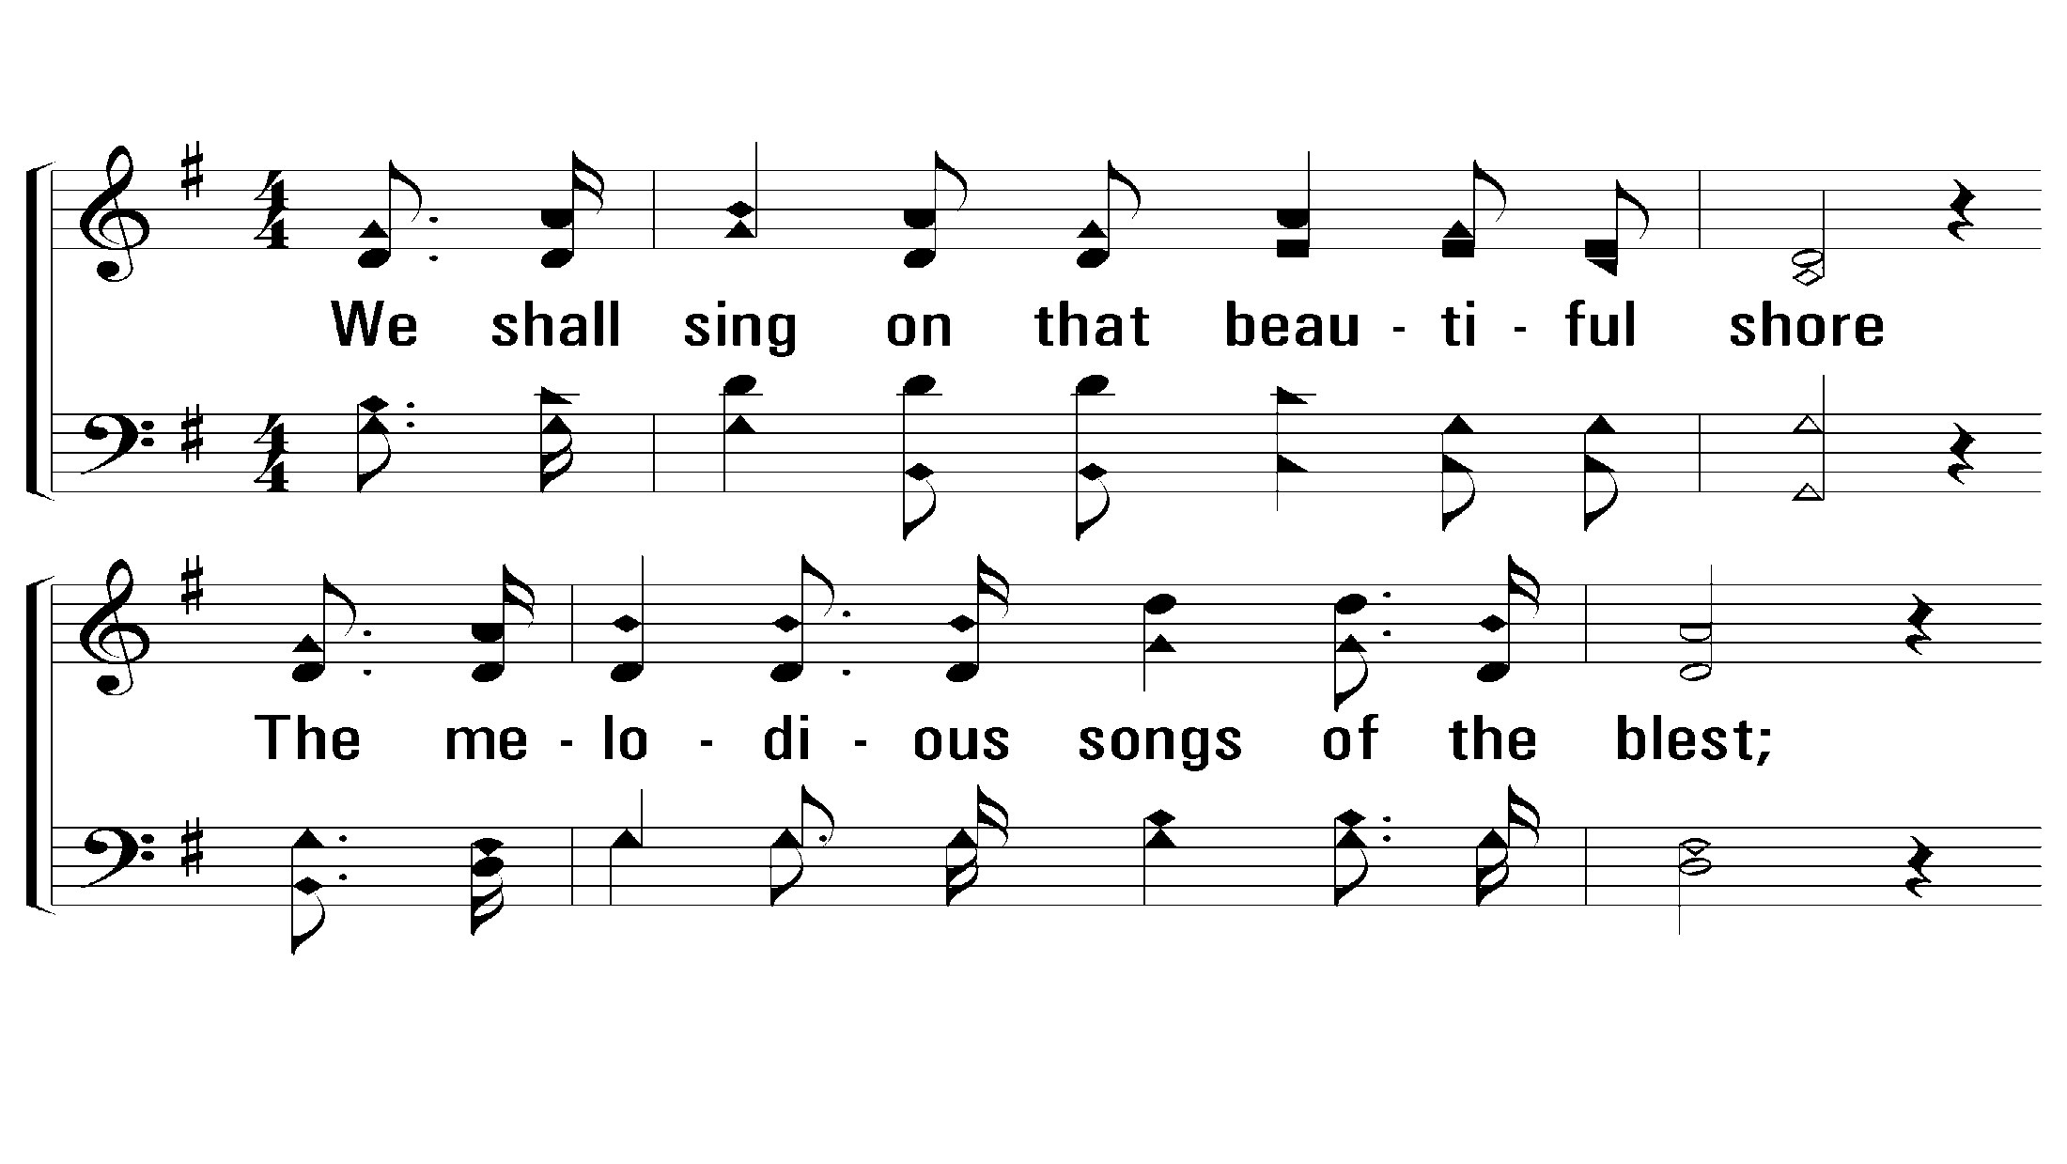
2 - Sweet By and By
2.
We shall sing on that beautiful shore
The melodious songs of the blest;
And our spirits shall sorrow no more–
Not a sigh for the blessing of rest.
Words: Sanford F. Bennett
Music: Joseph P. Webster
© 2009 The Paperless Hymnal®
Notes:
5 Enter - Verse 2
9 Enter - Verse 3

Slide 6
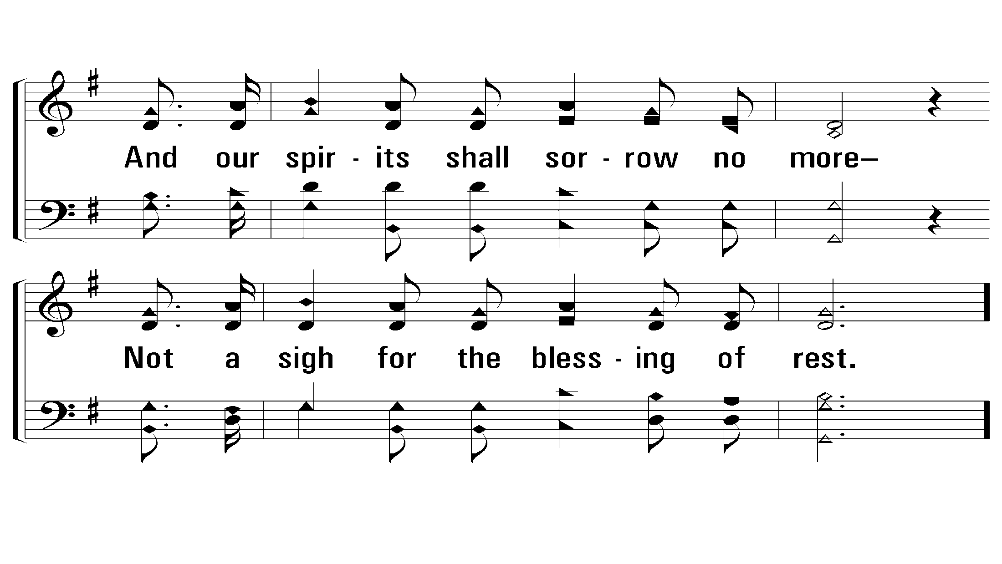
2 - Sweet By and By
© 2009 The Paperless Hymnal®
Notes:
5 Enter - Verse 2
9 Enter - Verse 3

Slide 7
c - Sweet By and By
In the sweet by and by,
We shall meet on that beautiful shore;
In the sweet by and by,
We shall meet on that beautiful shore.
© 2009 The Paperless Hymnal®
Notes:
5 Enter - Verse 2
9 Enter - Verse 3

Slide 8
c - Sweet By and By
© 2009 The Paperless Hymnal®
Notes:
5 Enter - Verse 2
9 Enter - Verse 3

Slide 9
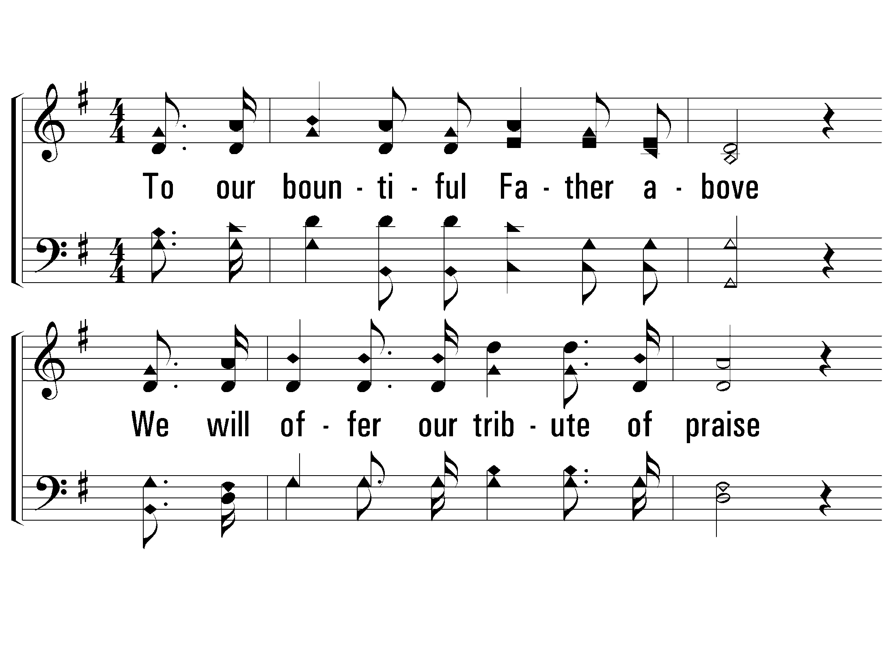
3 - Sweet By and By
3. To our bountiful Father above
We will offer our tribute of praise
For the glorious gift of His love,
And the blessings that hallow our days.
Words: Sanford F. Bennett
Music: Joseph P. Webster
© 2009 The Paperless Hymnal®
Notes:
5 Enter - Verse 2
9 Enter - Verse 3

Slide 10
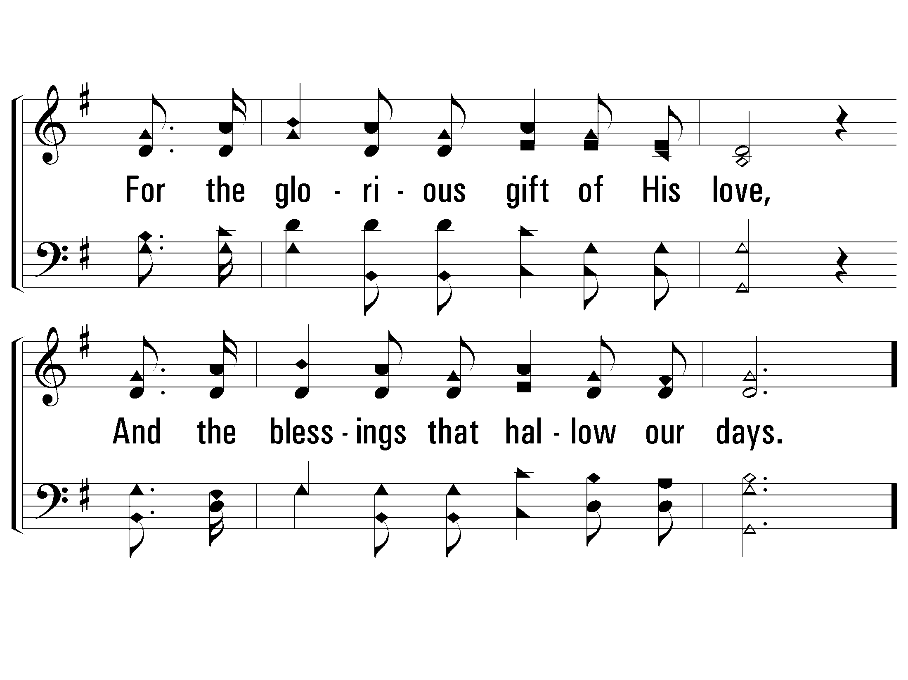
3 - Sweet By and By
© 2009 The Paperless Hymnal®
Notes:
5 Enter - Verse 2
9 Enter - Verse 3

Slide 11
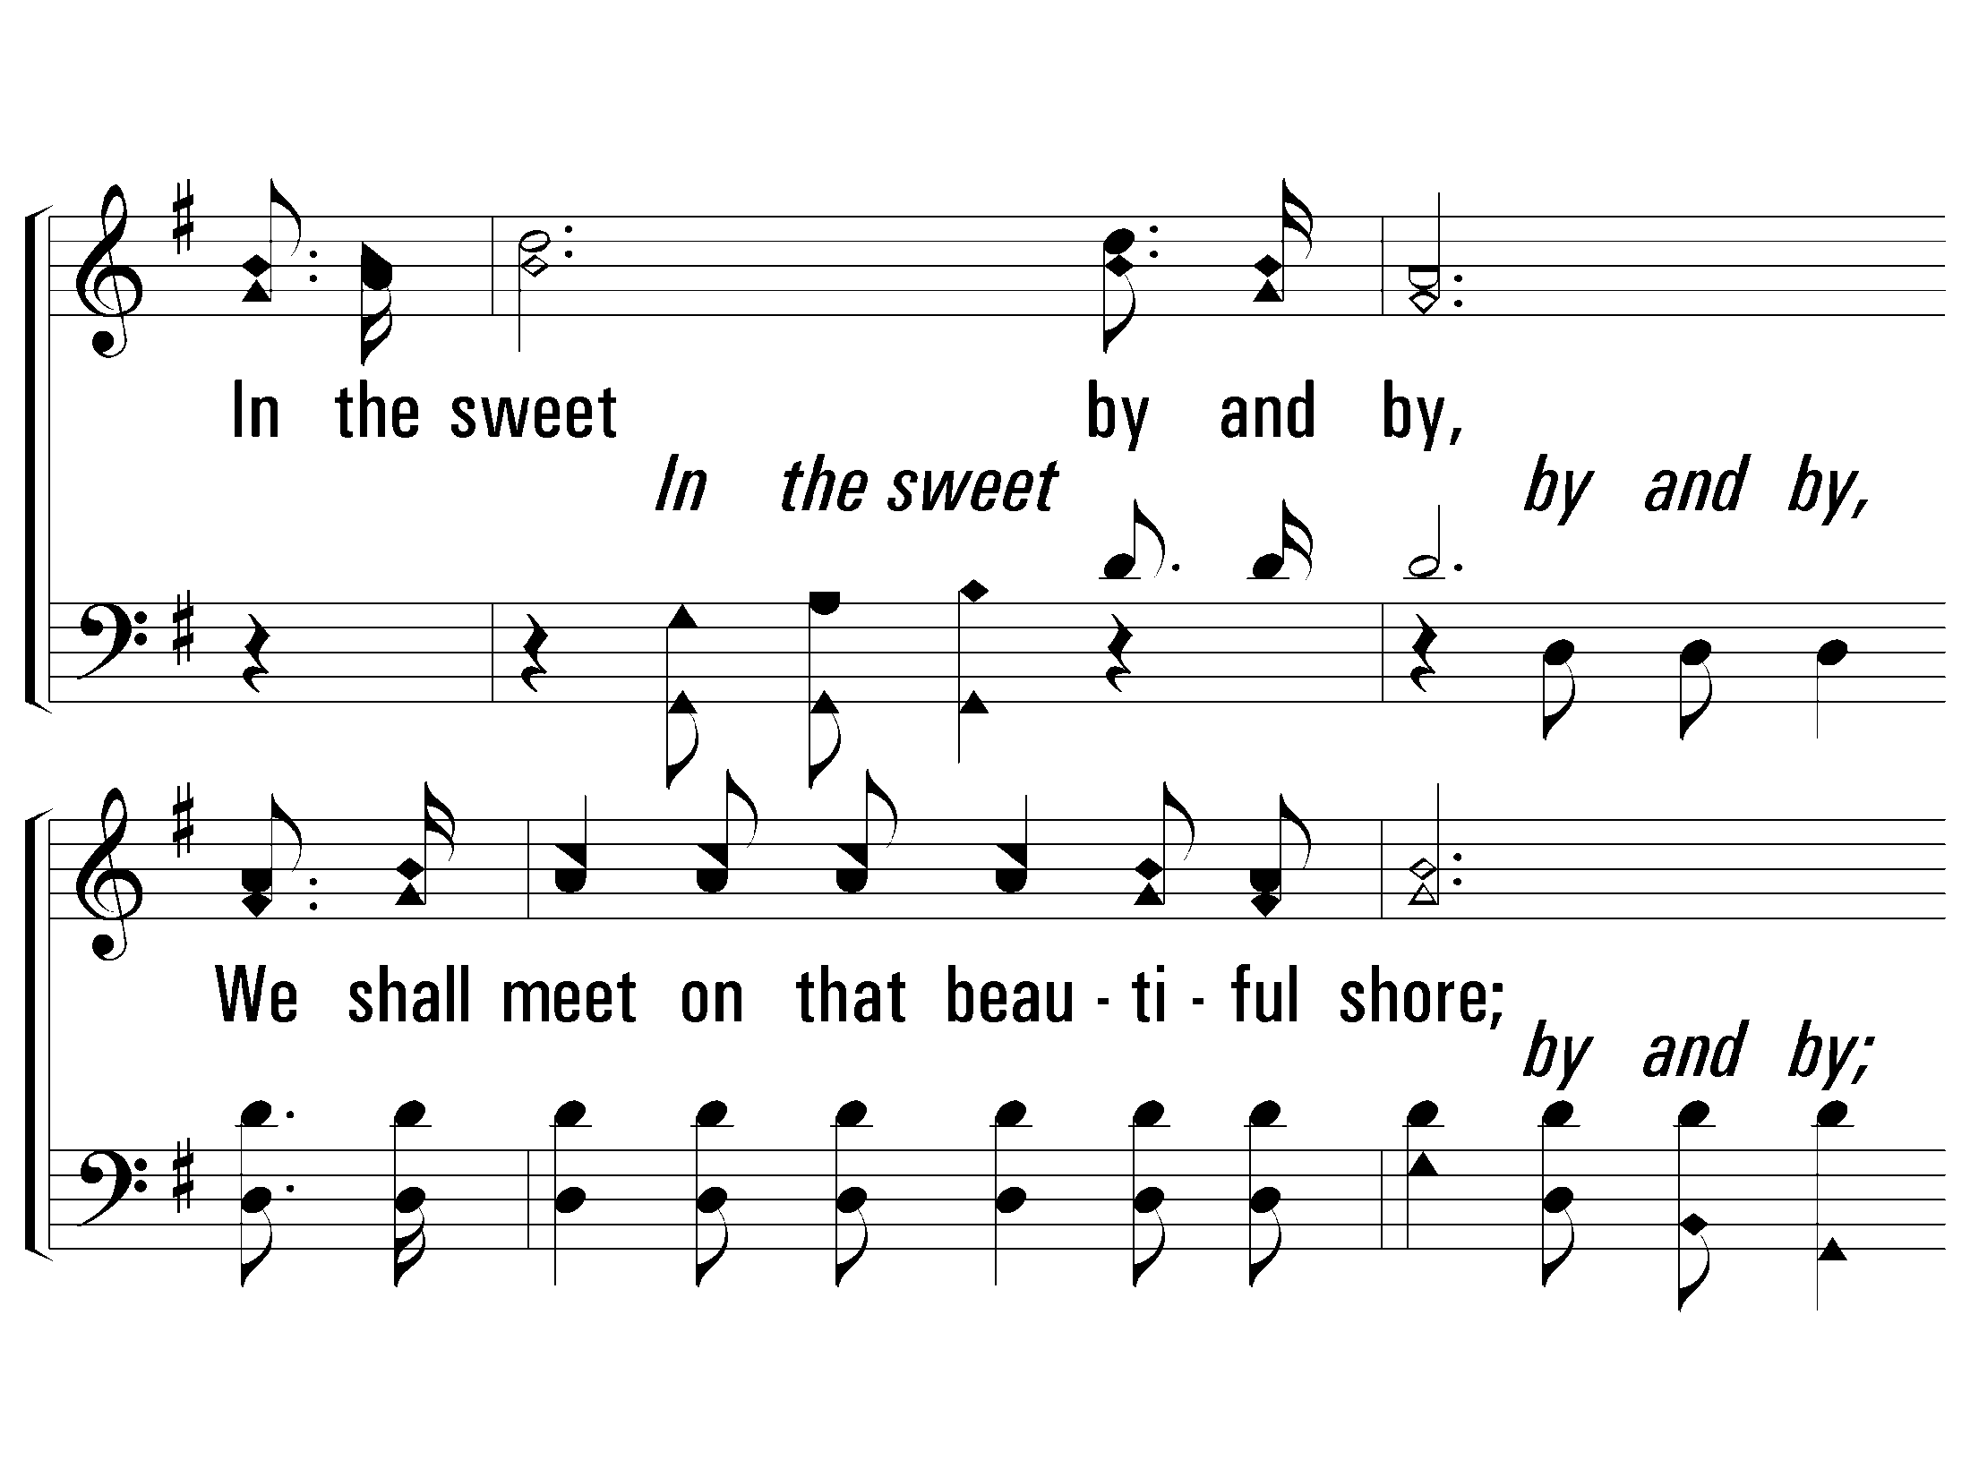
c - Sweet By and By
In the sweet by and by,
We shall meet on that beautiful shore;
In the sweet by and by,
We shall meet on that beautiful shore.
© 2009 The Paperless Hymnal®
Notes:
5 Enter - Verse 2
9 Enter - Verse 3

Slide 12

c - Sweet By and By
© 2009 The Paperless Hymnal®
Notes:
5 Enter - Verse 2
9 Enter - Verse 3

Slide 13
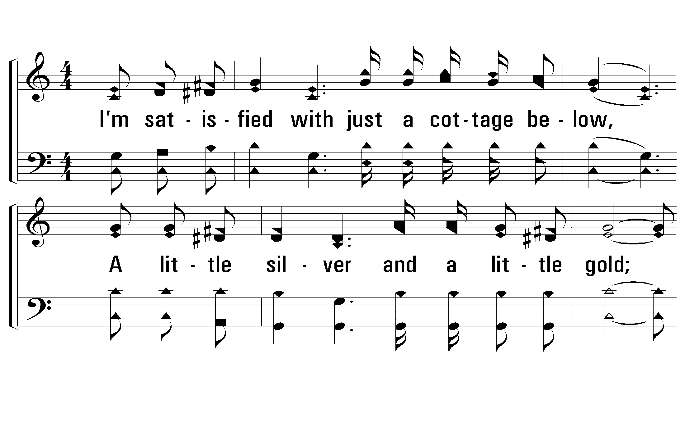
1 – Mansion Over the Hilltop
1.
I'm satisfied with just a cottage below,
A little silver and a little gold;
But in that city where the ransomed will shine,
I want a gold one that's silver lined.
Words and Music by: Ira Stanphill
Copyright © 1949 by Singspiration Music(ASCAP)(admin. By Brentwood-Benson Music Publishing, Inc.)
All Rights reserved. Used by permission.
© 2001 The Paperless Hymnal™
Notes:
5 Enter - Verse 2
9 Enter - Verse 3

Slide 14
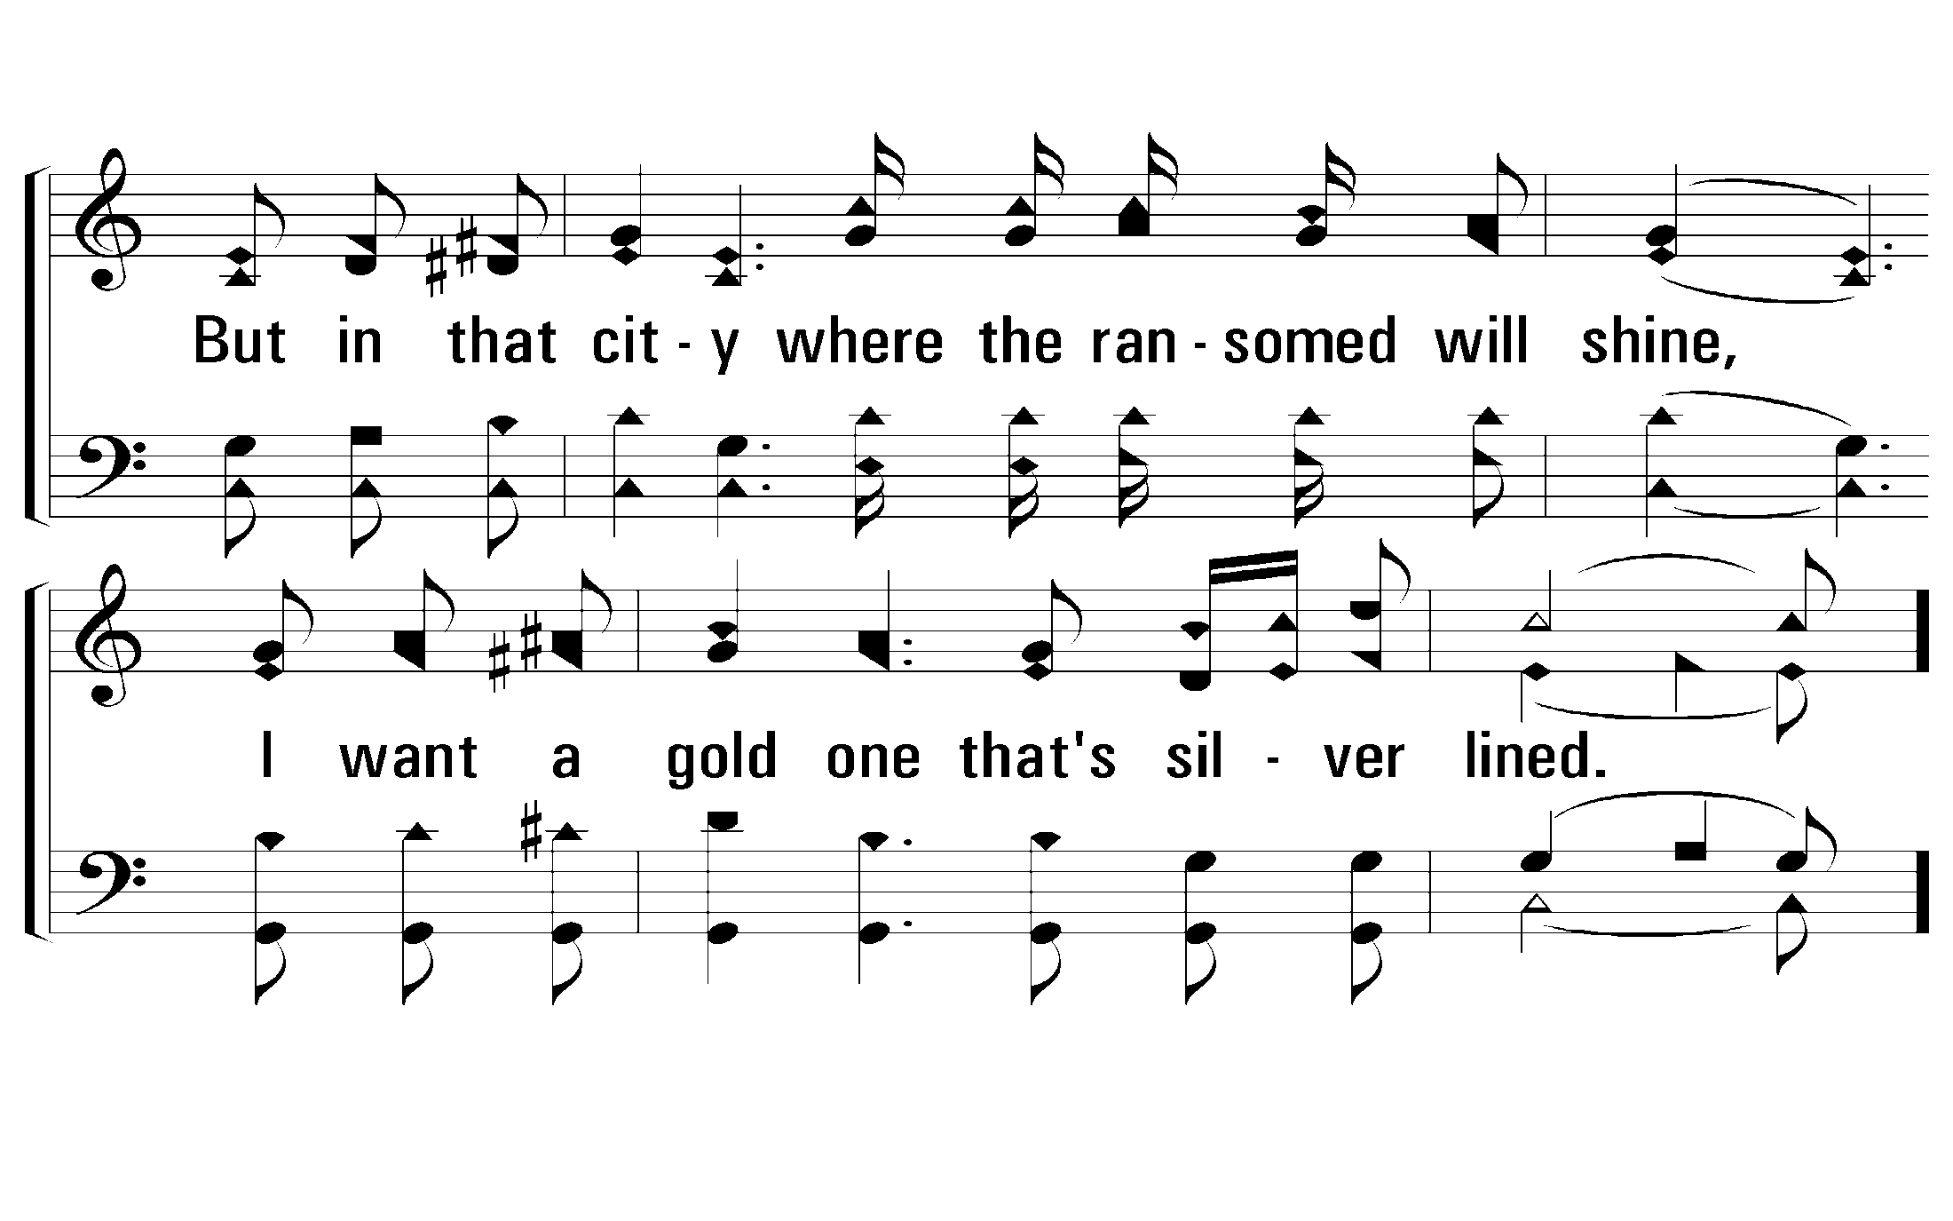
1 – Mansion Over the Hilltop
© 2001 The Paperless Hymnal™
Notes:
5 Enter - Verse 2
9 Enter - Verse 3

Slide 15
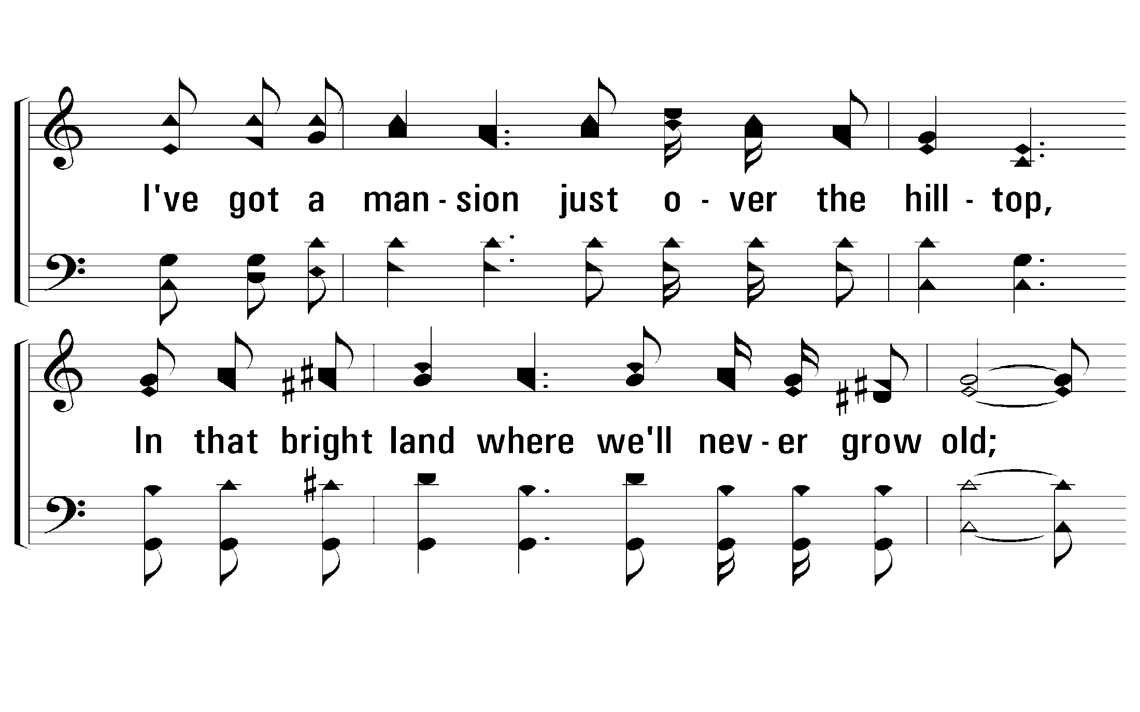
c – Mansion Over the Hilltop
I've got a mansion just over the hilltop,
In that bright land where we'll never grow old;
And some day yonder we will never more wander
But walk the streets that are purest gold.
© 2001 The Paperless Hymnal™
Notes:
5 Enter - Verse 2
9 Enter - Verse 3

Slide 16
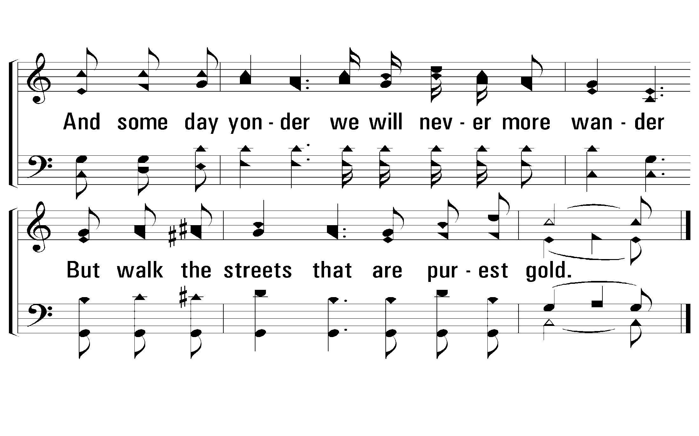
c – Mansion Over the Hilltop
© 2001 The Paperless Hymnal™
Notes:
5 Enter - Verse 2
9 Enter - Verse 3

Slide 17
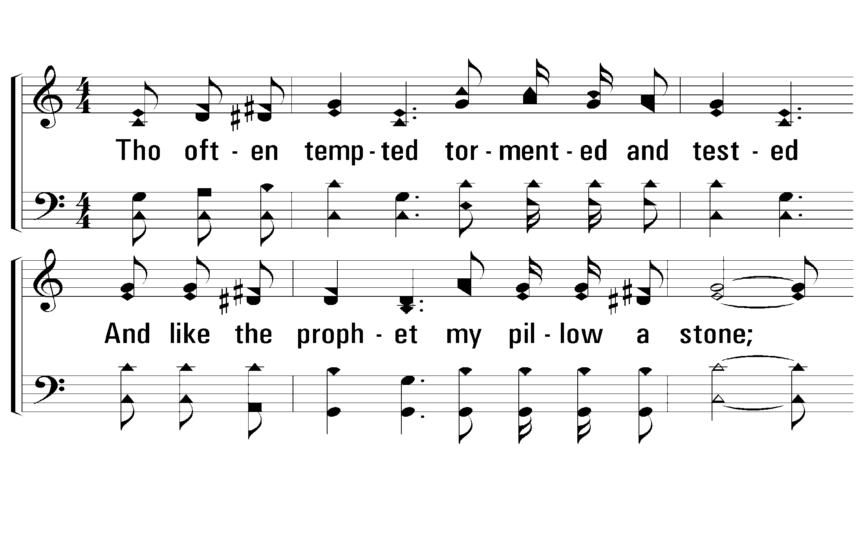
2 – Mansion Over the Hilltop
2.
Though often tempted tormented and tested
And like the prophet my pillow a stone;
And though I find here no permanent dwelling,
I know He'll give me a mansion my own.
Words and Music by: Ira Stanphill
Copyright © 1949 by Singspiration Music(ASCAP)(admin. By Brentwood-Benson Music Publishing, Inc.)
All Rights reserved. Used by permission.
© 2001 The Paperless Hymnal™
Notes:
5 Enter - Verse 2
9 Enter - Verse 3

Slide 18
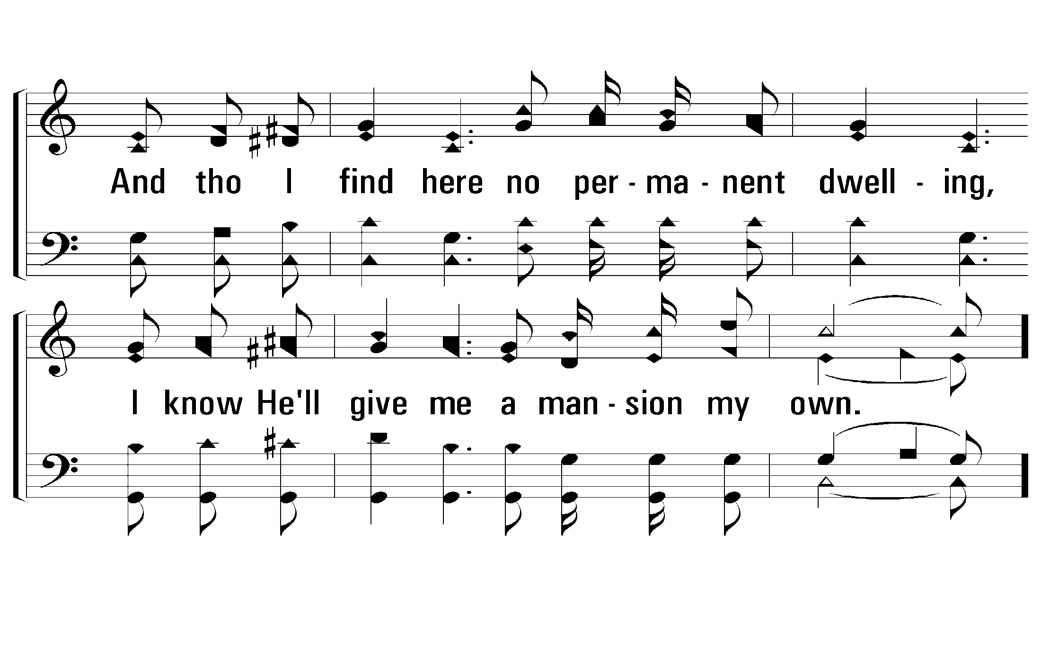
2 – Mansion Over the Hilltop
© 2001 The Paperless Hymnal™
Notes:
5 Enter - Verse 2
9 Enter - Verse 3

Slide 19
c – Mansion Over the Hilltop
I've got a mansion just over the hilltop,
In that bright land where we'll never grow old;
And some day yonder we will never more wander
But walk the streets that are purest gold.
© 2001 The Paperless Hymnal™
Notes:
5 Enter - Verse 2
9 Enter - Verse 3

Slide 20
c – Mansion Over the Hilltop
© 2001 The Paperless Hymnal™
Notes:
5 Enter - Verse 2
9 Enter - Verse 3

Slide 21
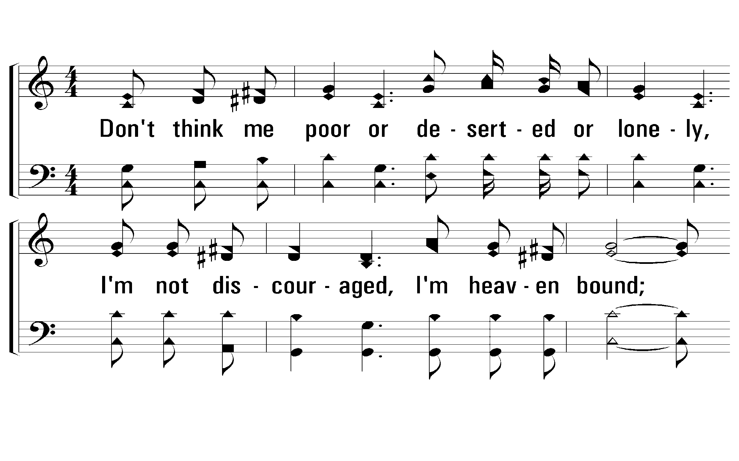
3 – Mansion Over the Hilltop
3.
Don't think me poor or deserted or lonely,
I'm not discouraged, I'm heaven bound;
I'm just a pilgrim in search of a city,
I want a mansion, a robe and a crown.
Words and Music by: Ira Stanphill
Copyright © 1949 by Singspiration Music(ASCAP)(admin. By Brentwood-Benson Music Publishing, Inc.)
All Rights reserved. Used by permission.
© 2001 The Paperless Hymnal™
Notes:
5 Enter - Verse 2
9 Enter - Verse 3

Slide 22
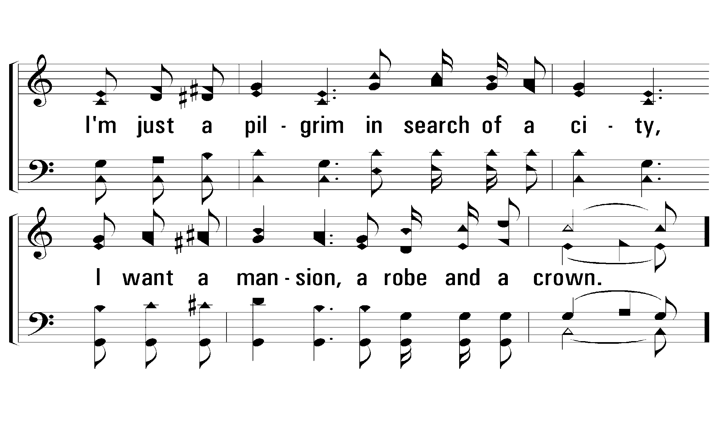
3 – Mansion Over the Hilltop
© 2001 The Paperless Hymnal™
Notes:
5 Enter - Verse 2
9 Enter - Verse 3

Slide 23
c – Mansion Over the Hilltop
I've got a mansion just over the hilltop,
In that bright land where we'll never grow old;
And some day yonder we will never more wander
But walk the streets that are purest gold.
© 2001 The Paperless Hymnal™
Notes:
5 Enter - Verse 2
9 Enter - Verse 3

Slide 24
c – Mansion Over the Hilltop
© 2001 The Paperless Hymnal™
Notes:
5 Enter - Verse 2
9 Enter - Verse 3

Slide 25
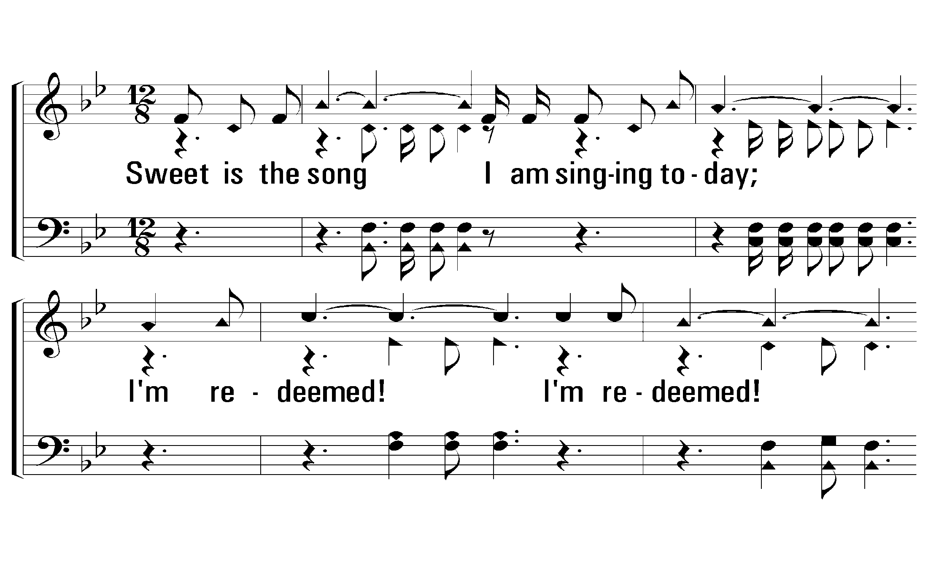
1 - Redeemed
1.
Sweet is the song I am singing today;
I'm redeemed! I'm redeemed!
Trouble and sorrow have vanished away;
I have been redeemed!
Words: James Rowe
Music: Stancel A. Ganus
© 2008 The Paperless Hymnal®
Notes:
5 Enter - Verse 2
9 Enter - Verse 3

Slide 26
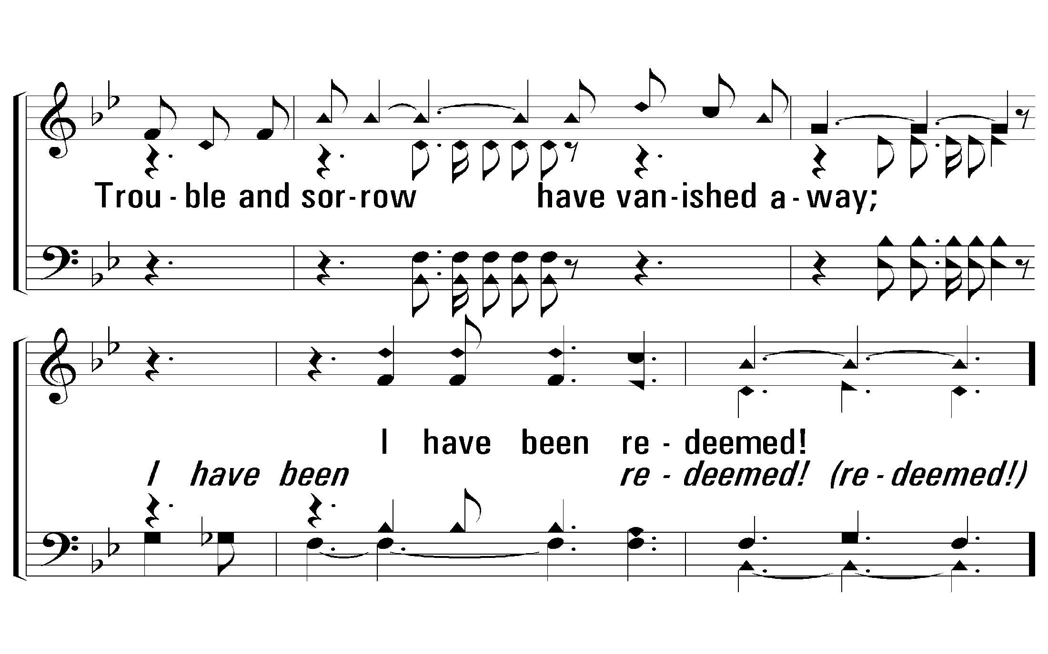
1 - Redeemed
© 2008 The Paperless Hymnal®
Notes:
5 Enter - Verse 2
9 Enter - Verse 3

Slide 27
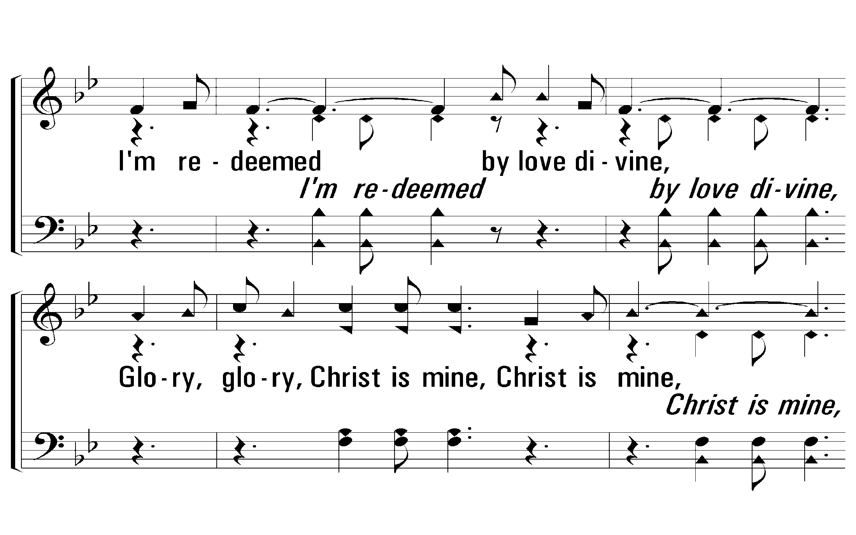
c - Redeemed
I'm redeemed by love divine,
Glory, glory, Christ is mine, Christ is mine,
All to Him I now resign,
I have been redeemed!
© 2008 The Paperless Hymnal®
Notes:
5 Enter - Verse 2
9 Enter - Verse 3

Slide 28
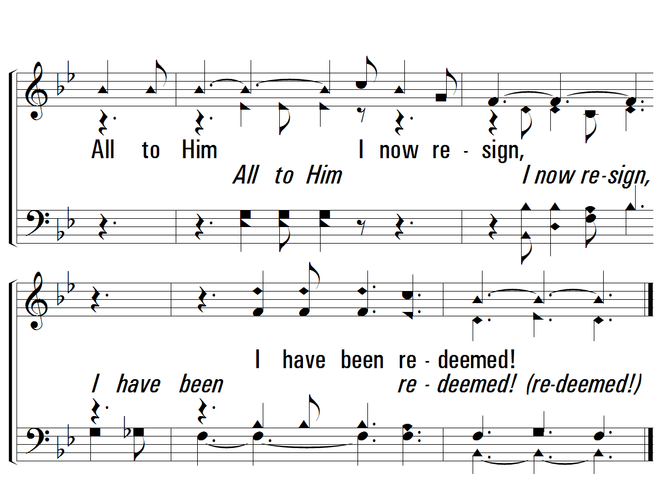
c - Redeemed
© 2008 The Paperless Hymnal®
Notes:
5 Enter - Verse 2
9 Enter - Verse 3

Slide 29
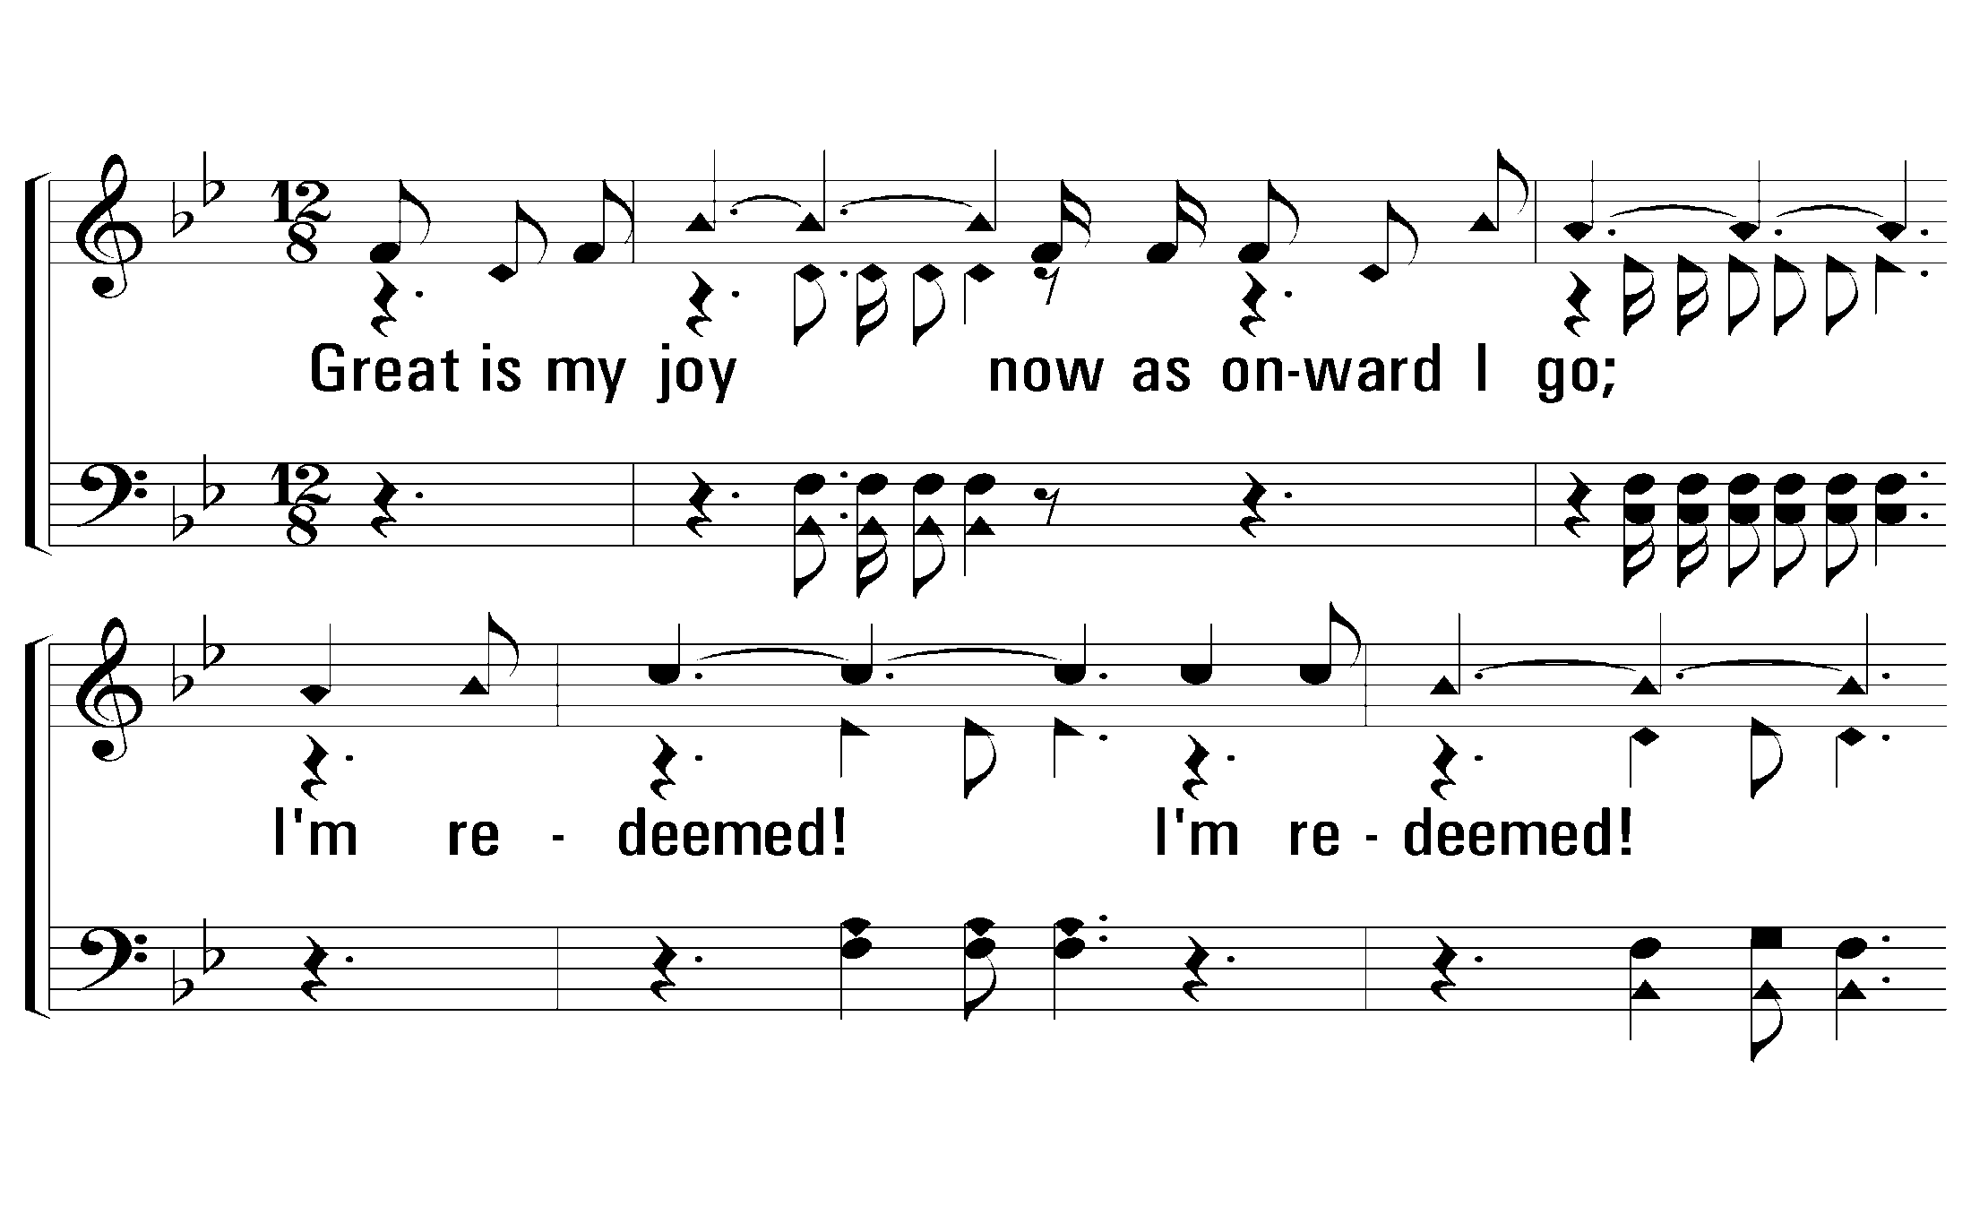
2 - Redeemed
2.
Great is my joy now as onward I go;
I'm redeemed! I'm redeemed!
All the way homeward my praises shall flow;
I have been redeemed!
Words: James Rowe
Music: Stancel A. Ganus
© 2008 The Paperless Hymnal®
Notes:
5 Enter - Verse 2
9 Enter - Verse 3

Slide 30
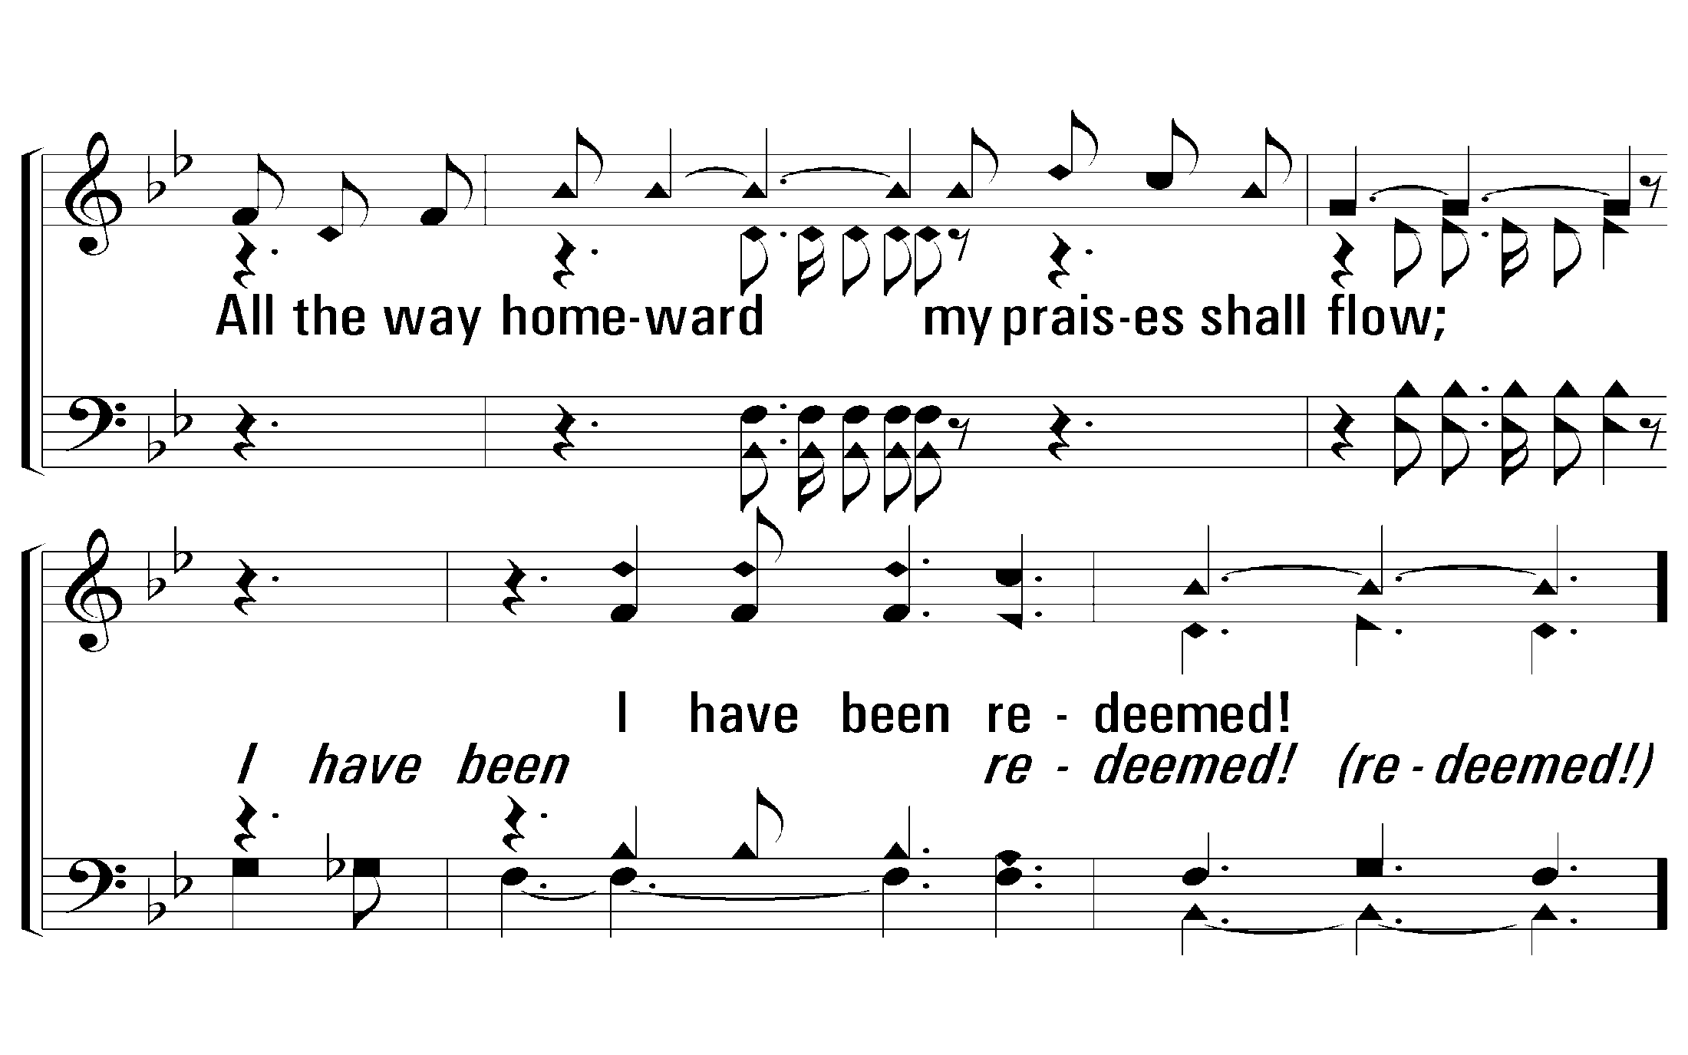
2 - Redeemed
© 2008 The Paperless Hymnal®
Notes:
5 Enter - Verse 2
9 Enter - Verse 3

Slide 31
c - Redeemed
I'm redeemed by love divine,
Glory, glory, Christ is mine, Christ is mine,
All to Him I now resign,
I have been redeemed!
© 2008 The Paperless Hymnal®
Notes:
5 Enter - Verse 2
9 Enter - Verse 3

Slide 32
c - Redeemed
© 2008 The Paperless Hymnal®
Notes:
5 Enter - Verse 2
9 Enter - Verse 3

Slide 33
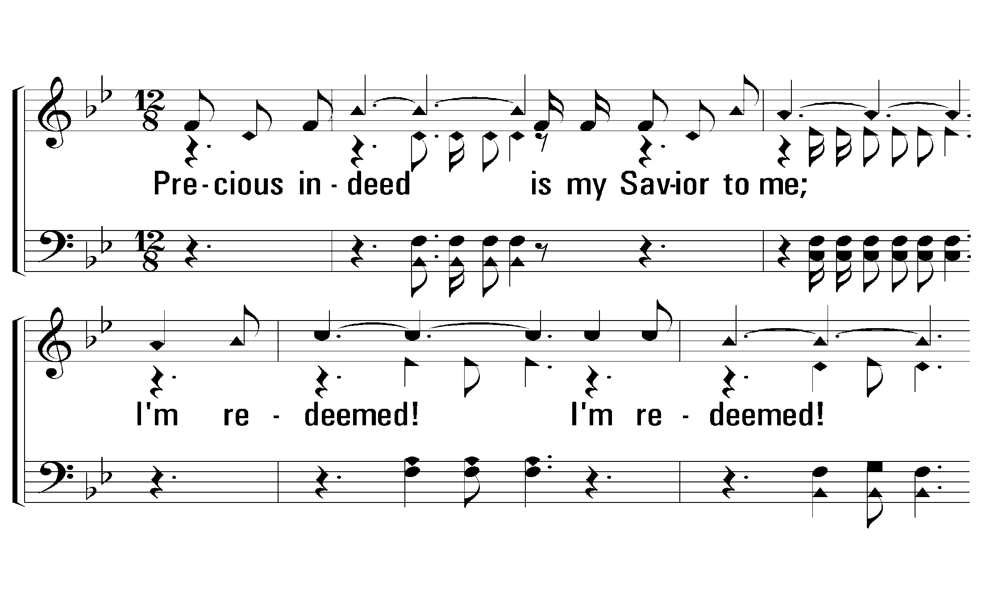
3 - Redeemed
3.
Precious indeed is my Savior to me;
I'm redeemed! I'm redeemed!
Happy in glory someday I shall be;
I have been redeemed!
Words: James Rowe
Music: Stancel A. Ganus
© 2008 The Paperless Hymnal®
Notes:
5 Enter - Verse 2
9 Enter - Verse 3

Slide 34
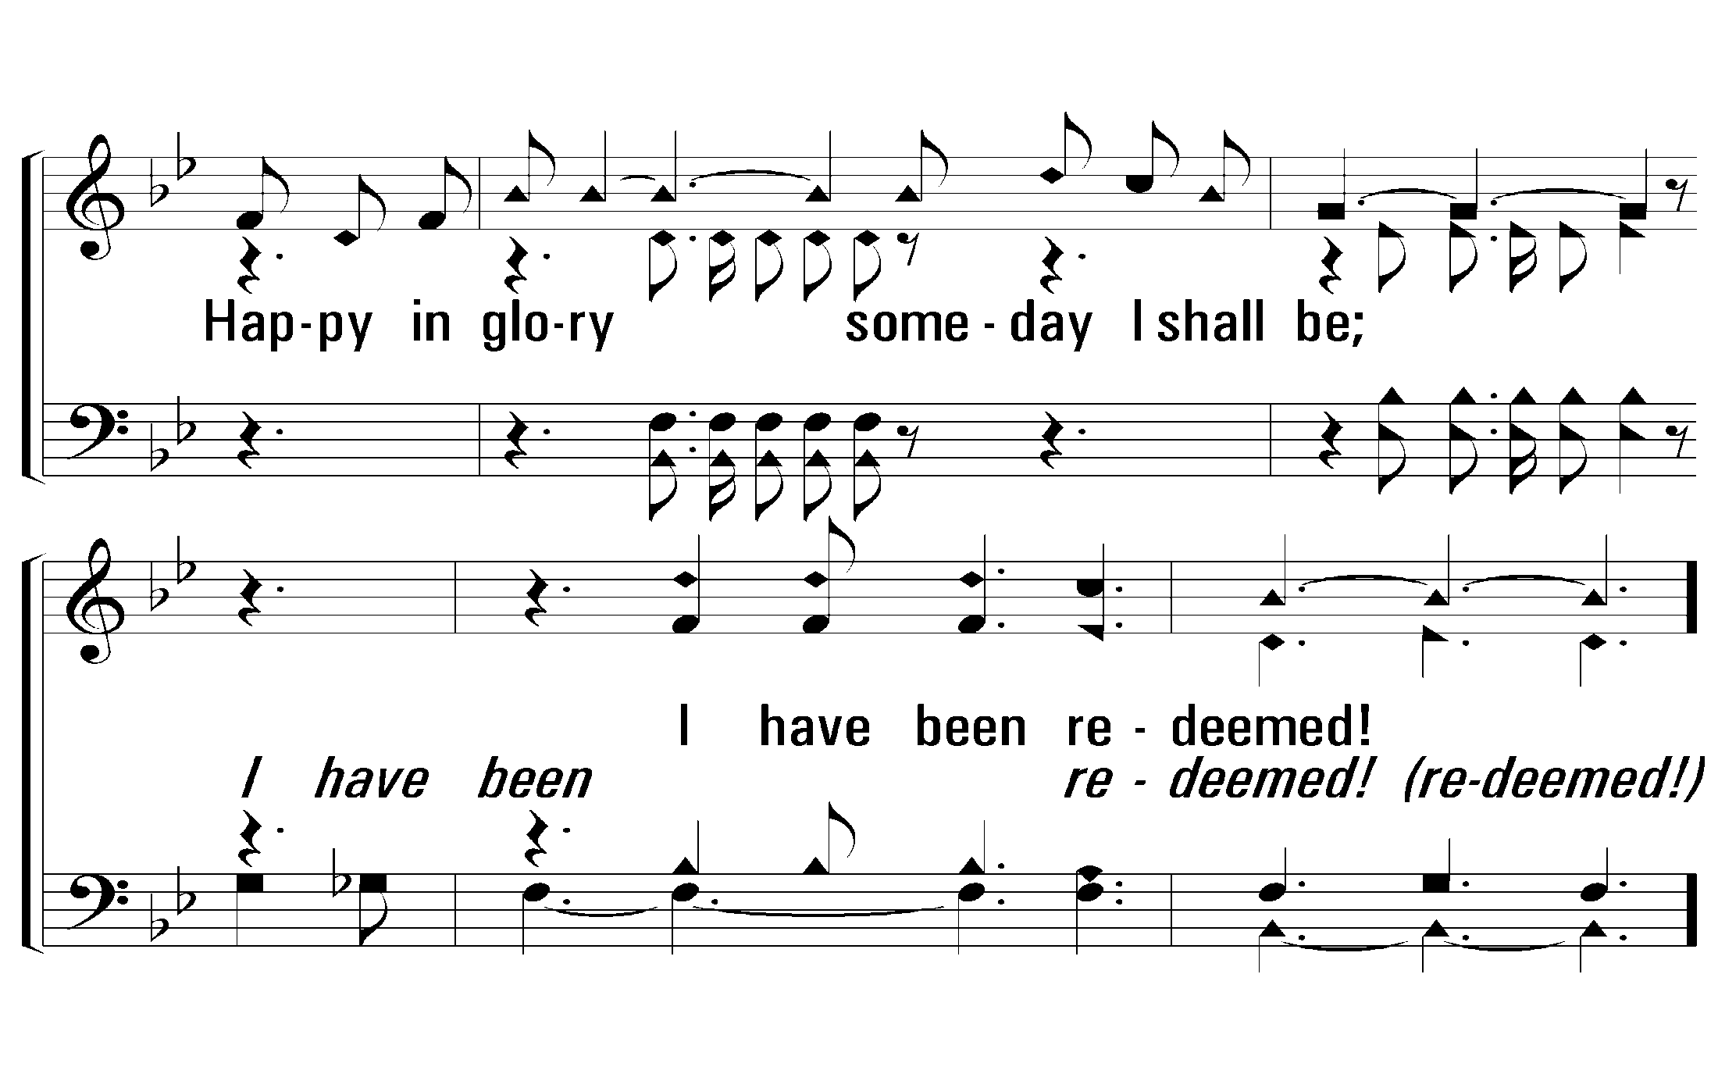
3 - Redeemed
© 2008 The Paperless Hymnal®
Notes:
5 Enter - Verse 2
9 Enter - Verse 3

Slide 35
c - Redeemed
I'm redeemed by love divine,
Glory, glory, Christ is mine, Christ is mine,
All to Him I now resign,
I have been redeemed!
© 2008 The Paperless Hymnal®
Notes:
5 Enter - Verse 2
9 Enter - Verse 3

Slide 36
c - Redeemed
© 2008 The Paperless Hymnal®
Notes:
5 Enter - Verse 2
9 Enter - Verse 3

Slide 37
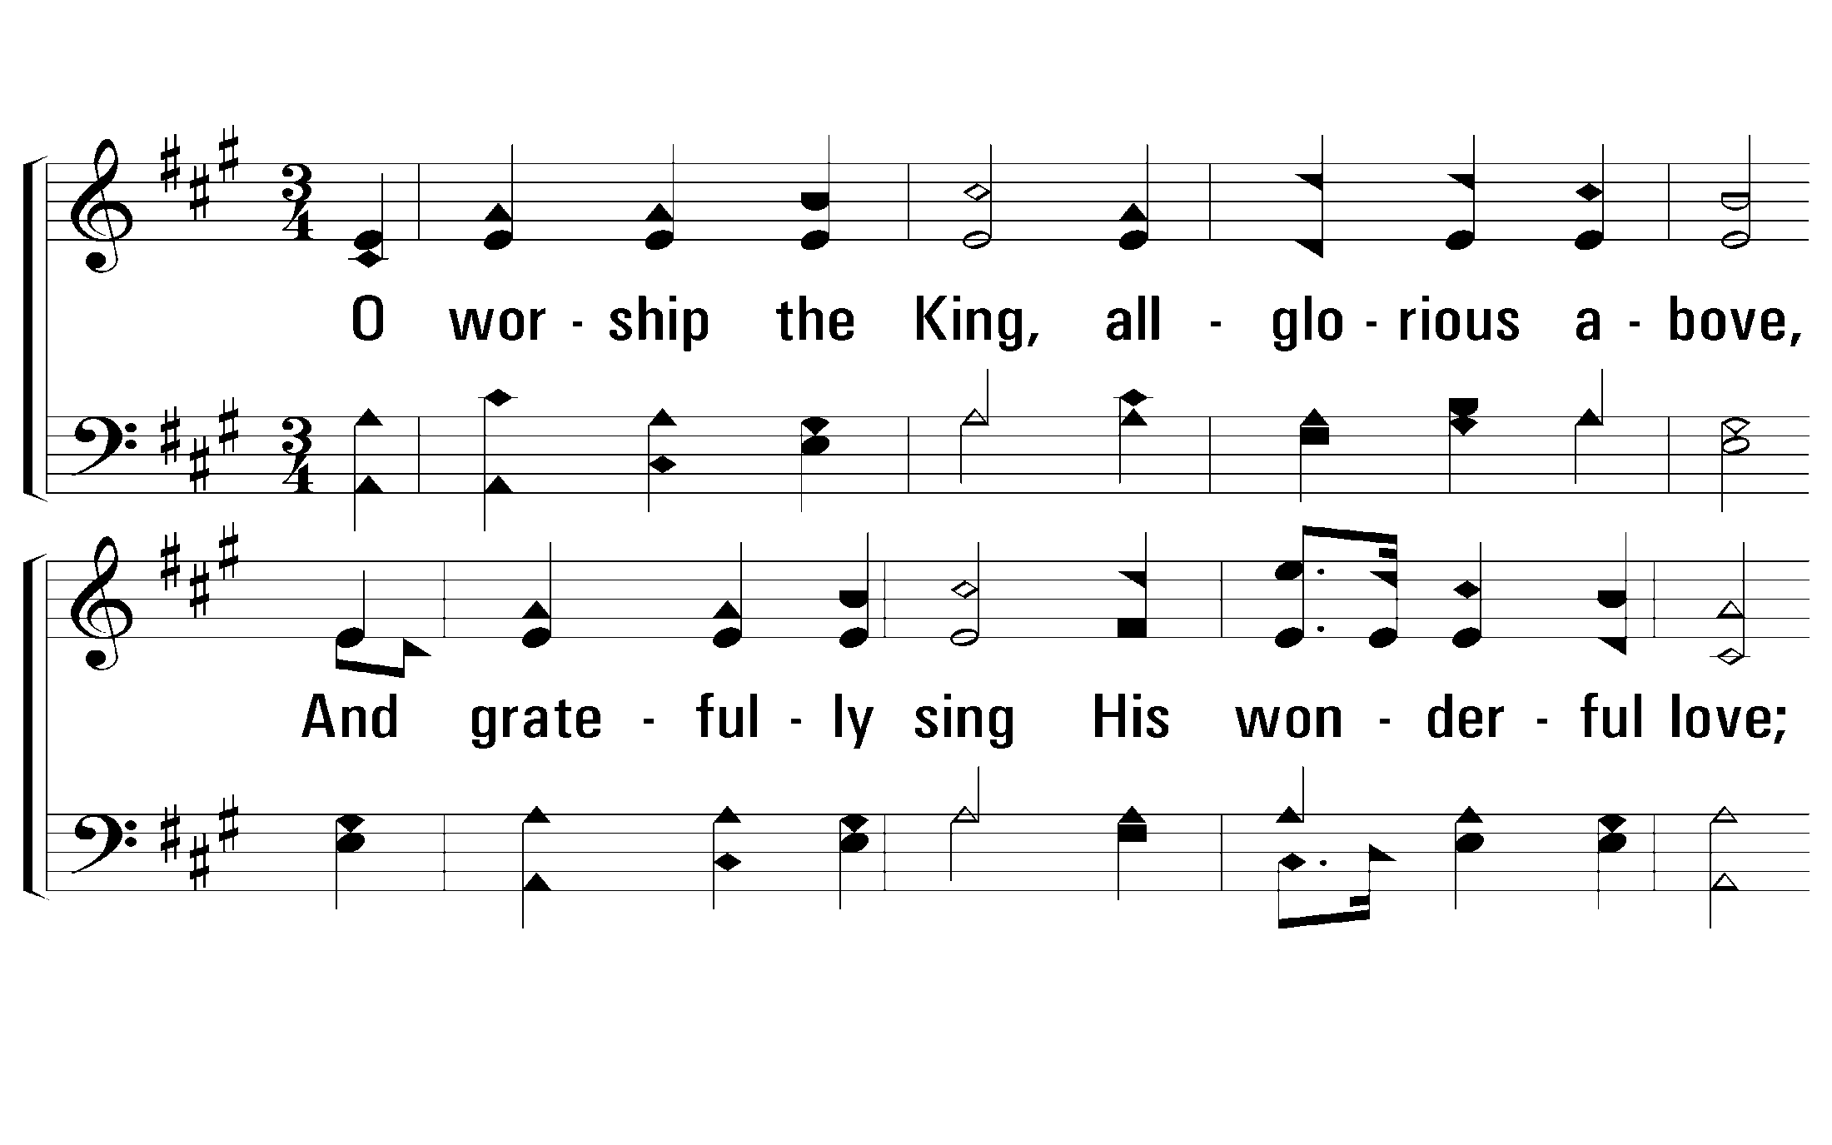
1 - O Worship the King
1.
O worship the King, allglorious above,
And gratefully sing His wonderful love;
Our Shield and Defender, the Ancient of Days,
Pavilioned in splendor and girded with praise.
Words by: Robert Grant
Music by: J. Michael Haydn
© 2001 The Paperless Hymnal™
Notes:
3 Enter - Verse 2
5 Enter - Verse 3

Slide 38
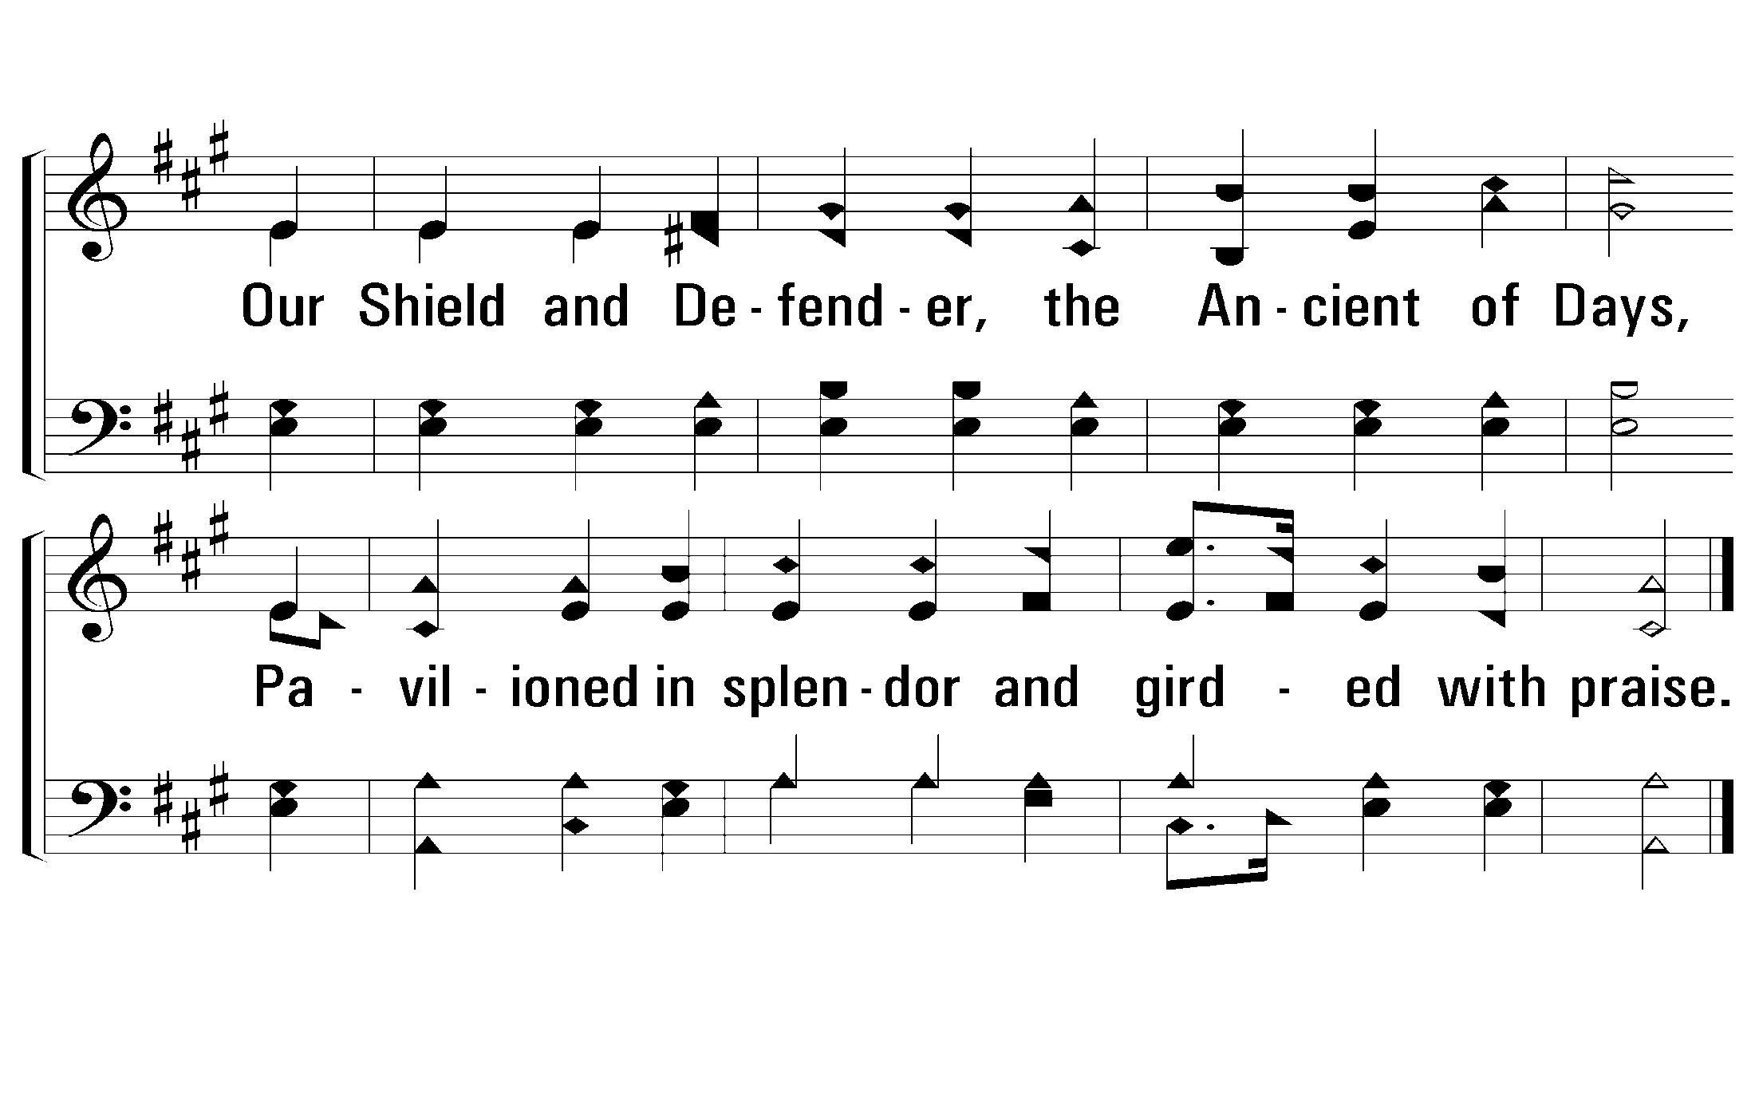
1 - O Worship the King
© 2001 The Paperless Hymnal™
Notes:
3 Enter - Verse 2
5 Enter - Verse 3

Slide 39
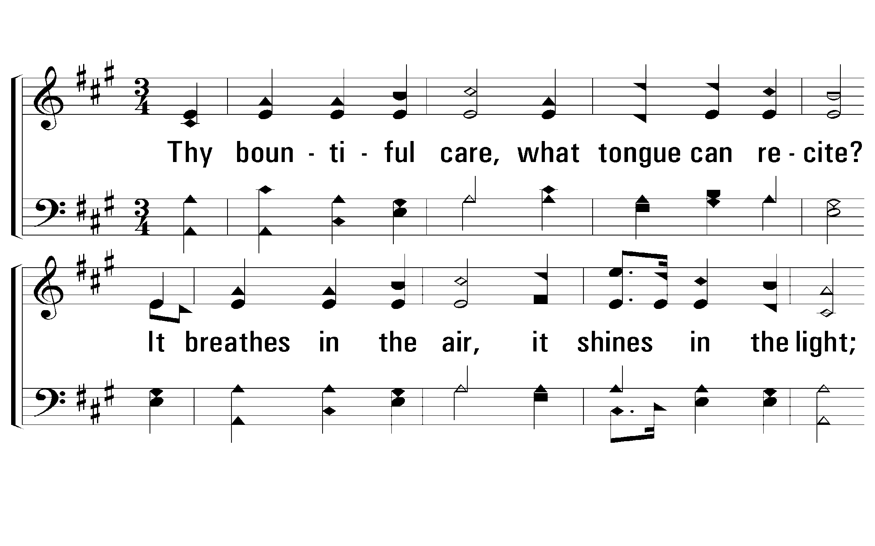
2 - O Worship the King
2.
Thy bountiful care, what tongue can recite?
It breathes in the air, it shines in the light;
It streams from the hills, it descends to the plain,
And sweetly distills in the dew and the rain.
Words by: Robert Grant
Music by: J. Michael Haydn
© 2001 The Paperless Hymnal™
Notes:
3 Enter - Verse 2
5 Enter - Verse 3

Slide 40
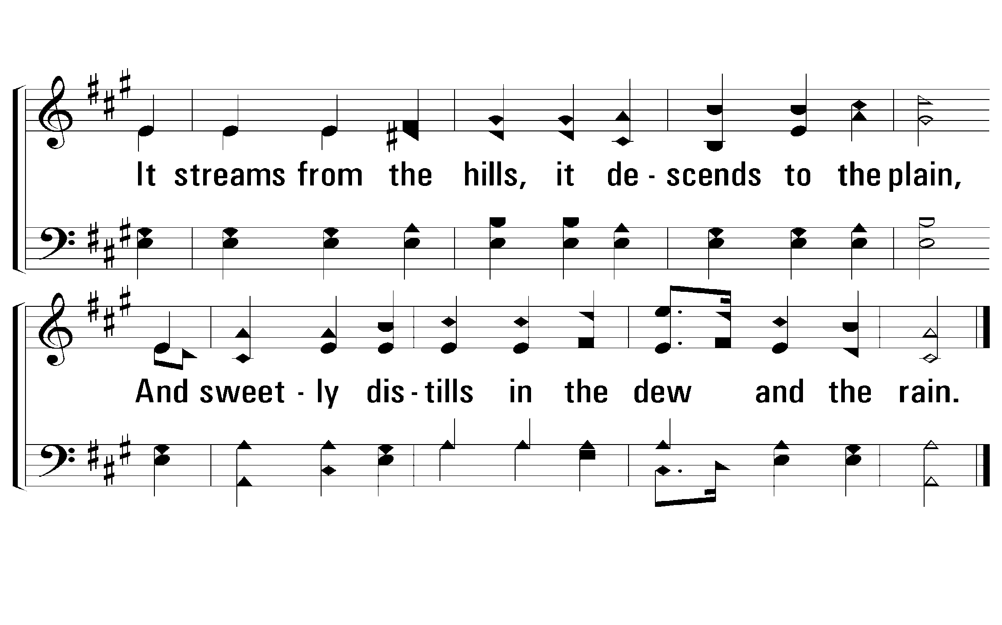
2 - O Worship the King
© 2001 The Paperless Hymnal™
Notes:
3 Enter - Verse 2
5 Enter - Verse 3

Slide 41
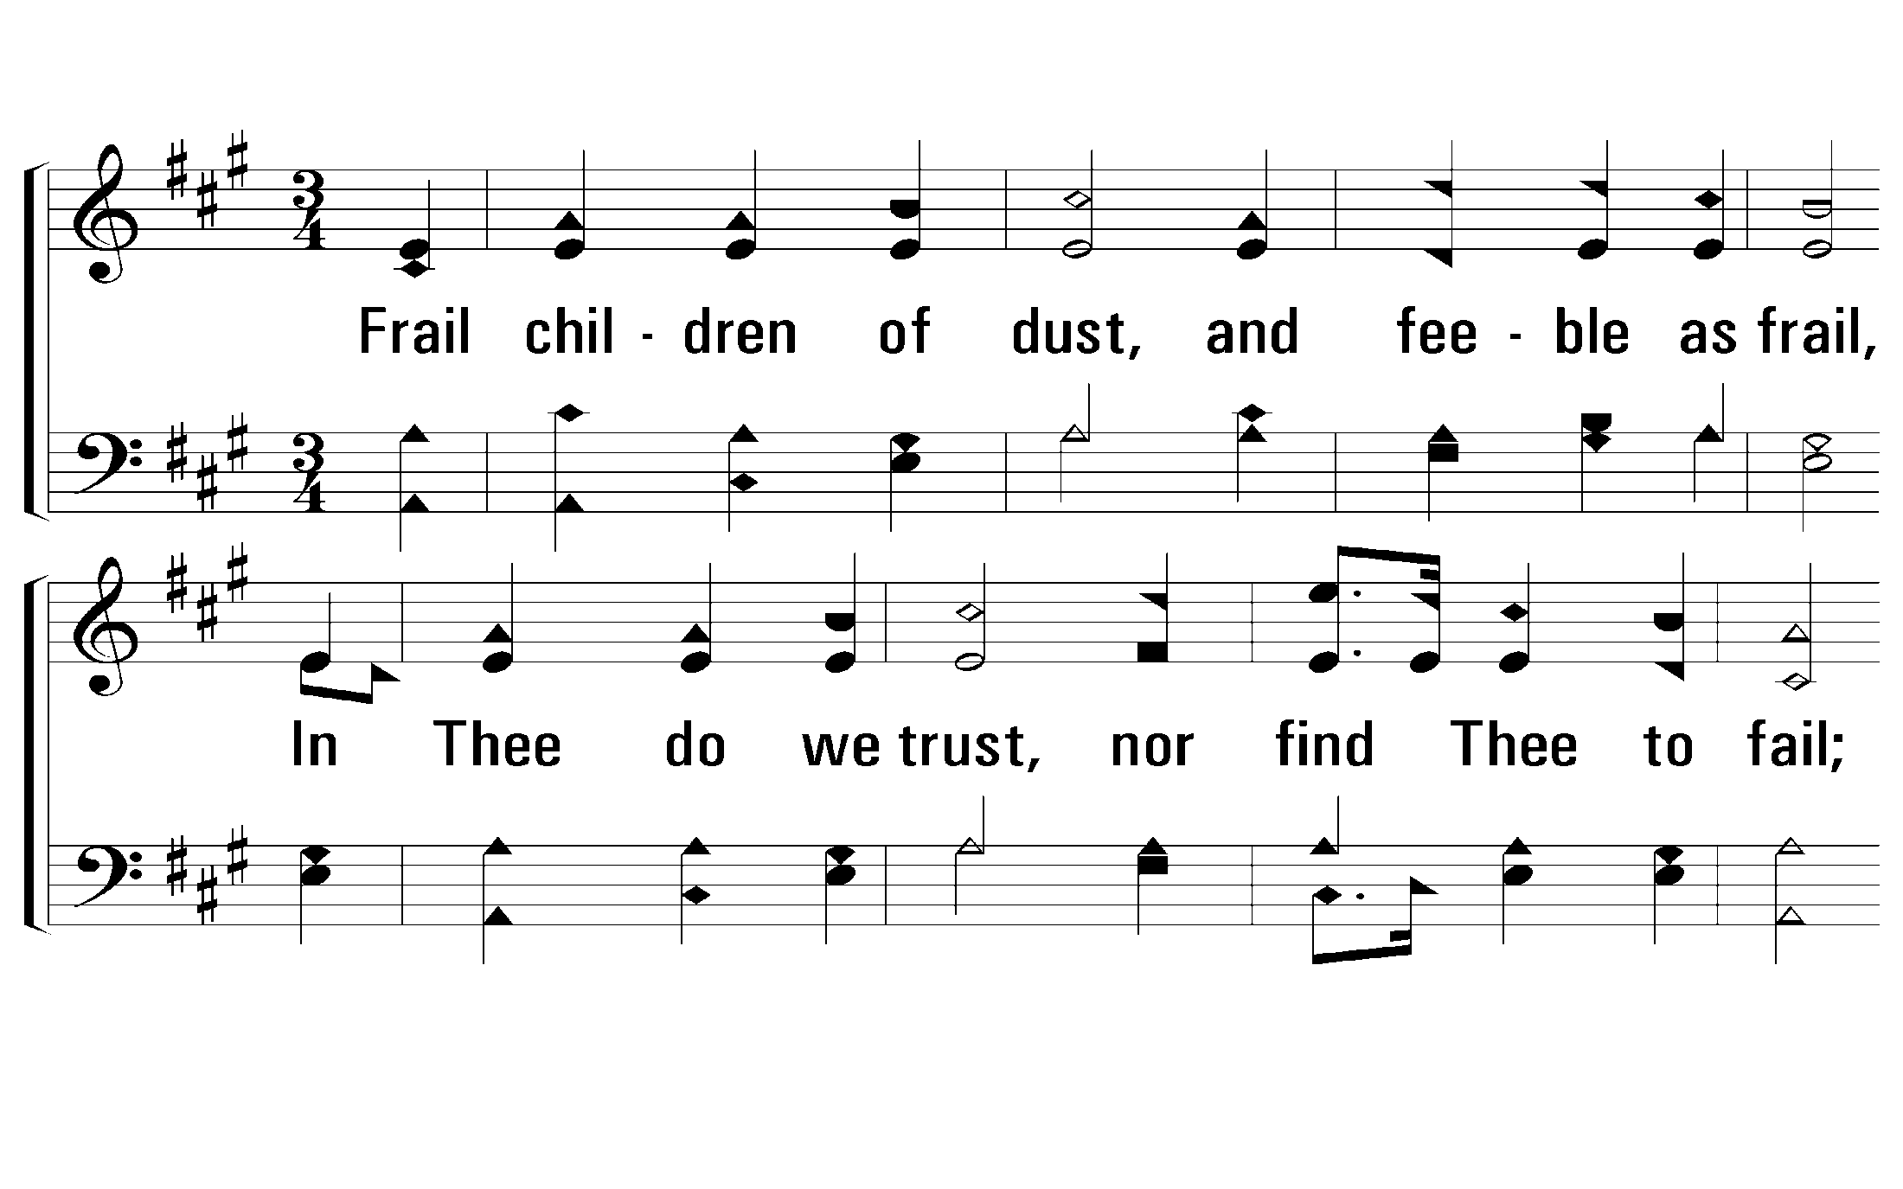
3 - O Worship the King
3.
Frail children of dust, and feeble as frail,
In Thee do we trust, nor find Thee to fail;
Thy mercies, how tender! how firm to the end!
Our Maker, Defender, Redeemer, and Friend!
Words by: Robert Grant
Music by: J. Michael Haydn
© 2001 The Paperless Hymnal™
Notes:
3 Enter - Verse 2
5 Enter - Verse 3

Slide 42
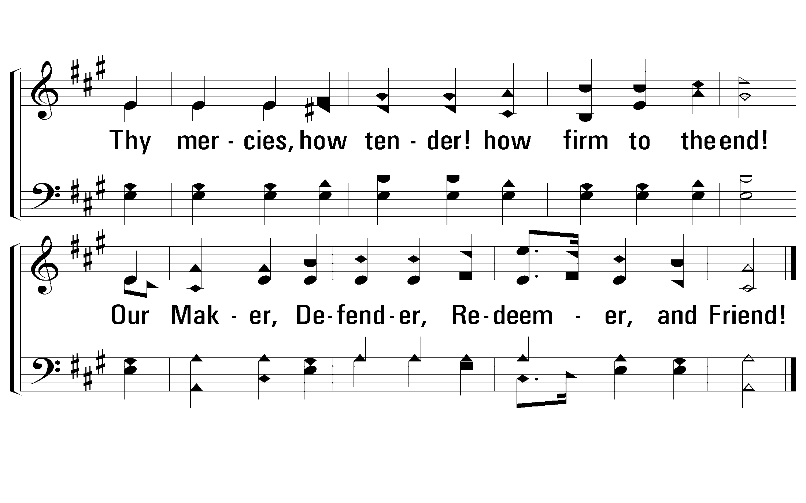
3 - O Worship the King
© 2001 The Paperless Hymnal™
Notes:
3 Enter - Verse 2
5 Enter - Verse 3

Slide 43
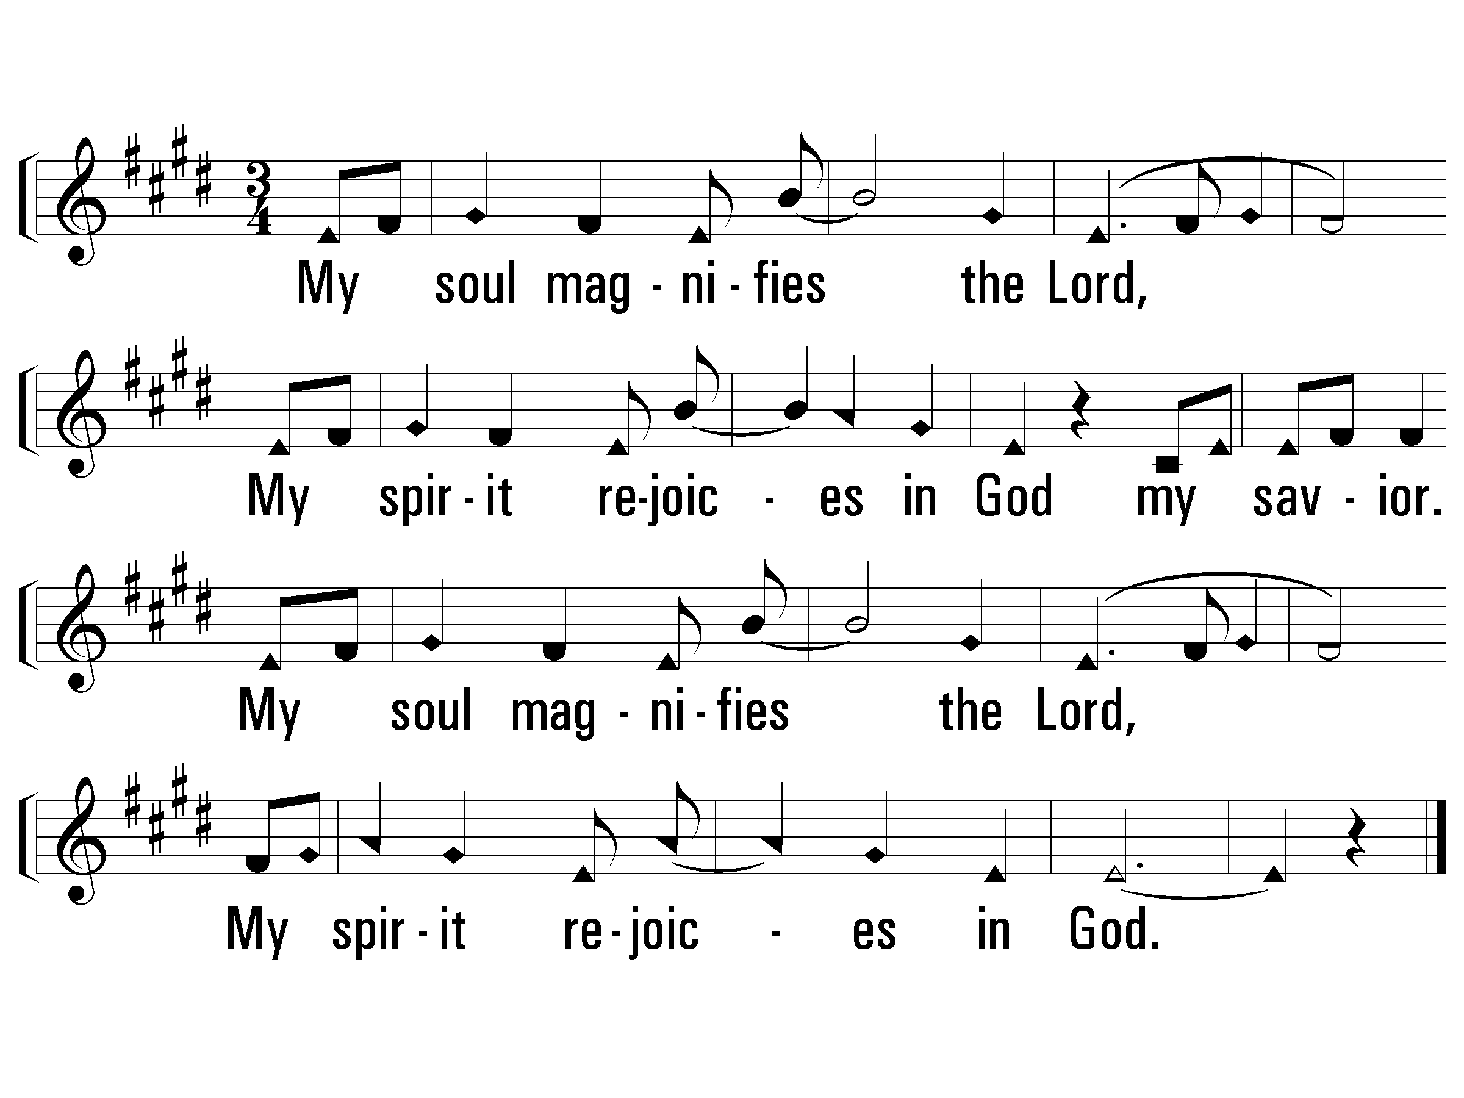
1 - Magnificat
Sopranos only
(Sop)
My soul magnifies the Lord,
My spirit rejoices in God my savior.
My soul magnifies the Lord,
My spirit rejoices in God.
Words & Music: Randy Gill
Copyright © 2003 by Randy Gill
PaperlessHymnal.com

Slide 44
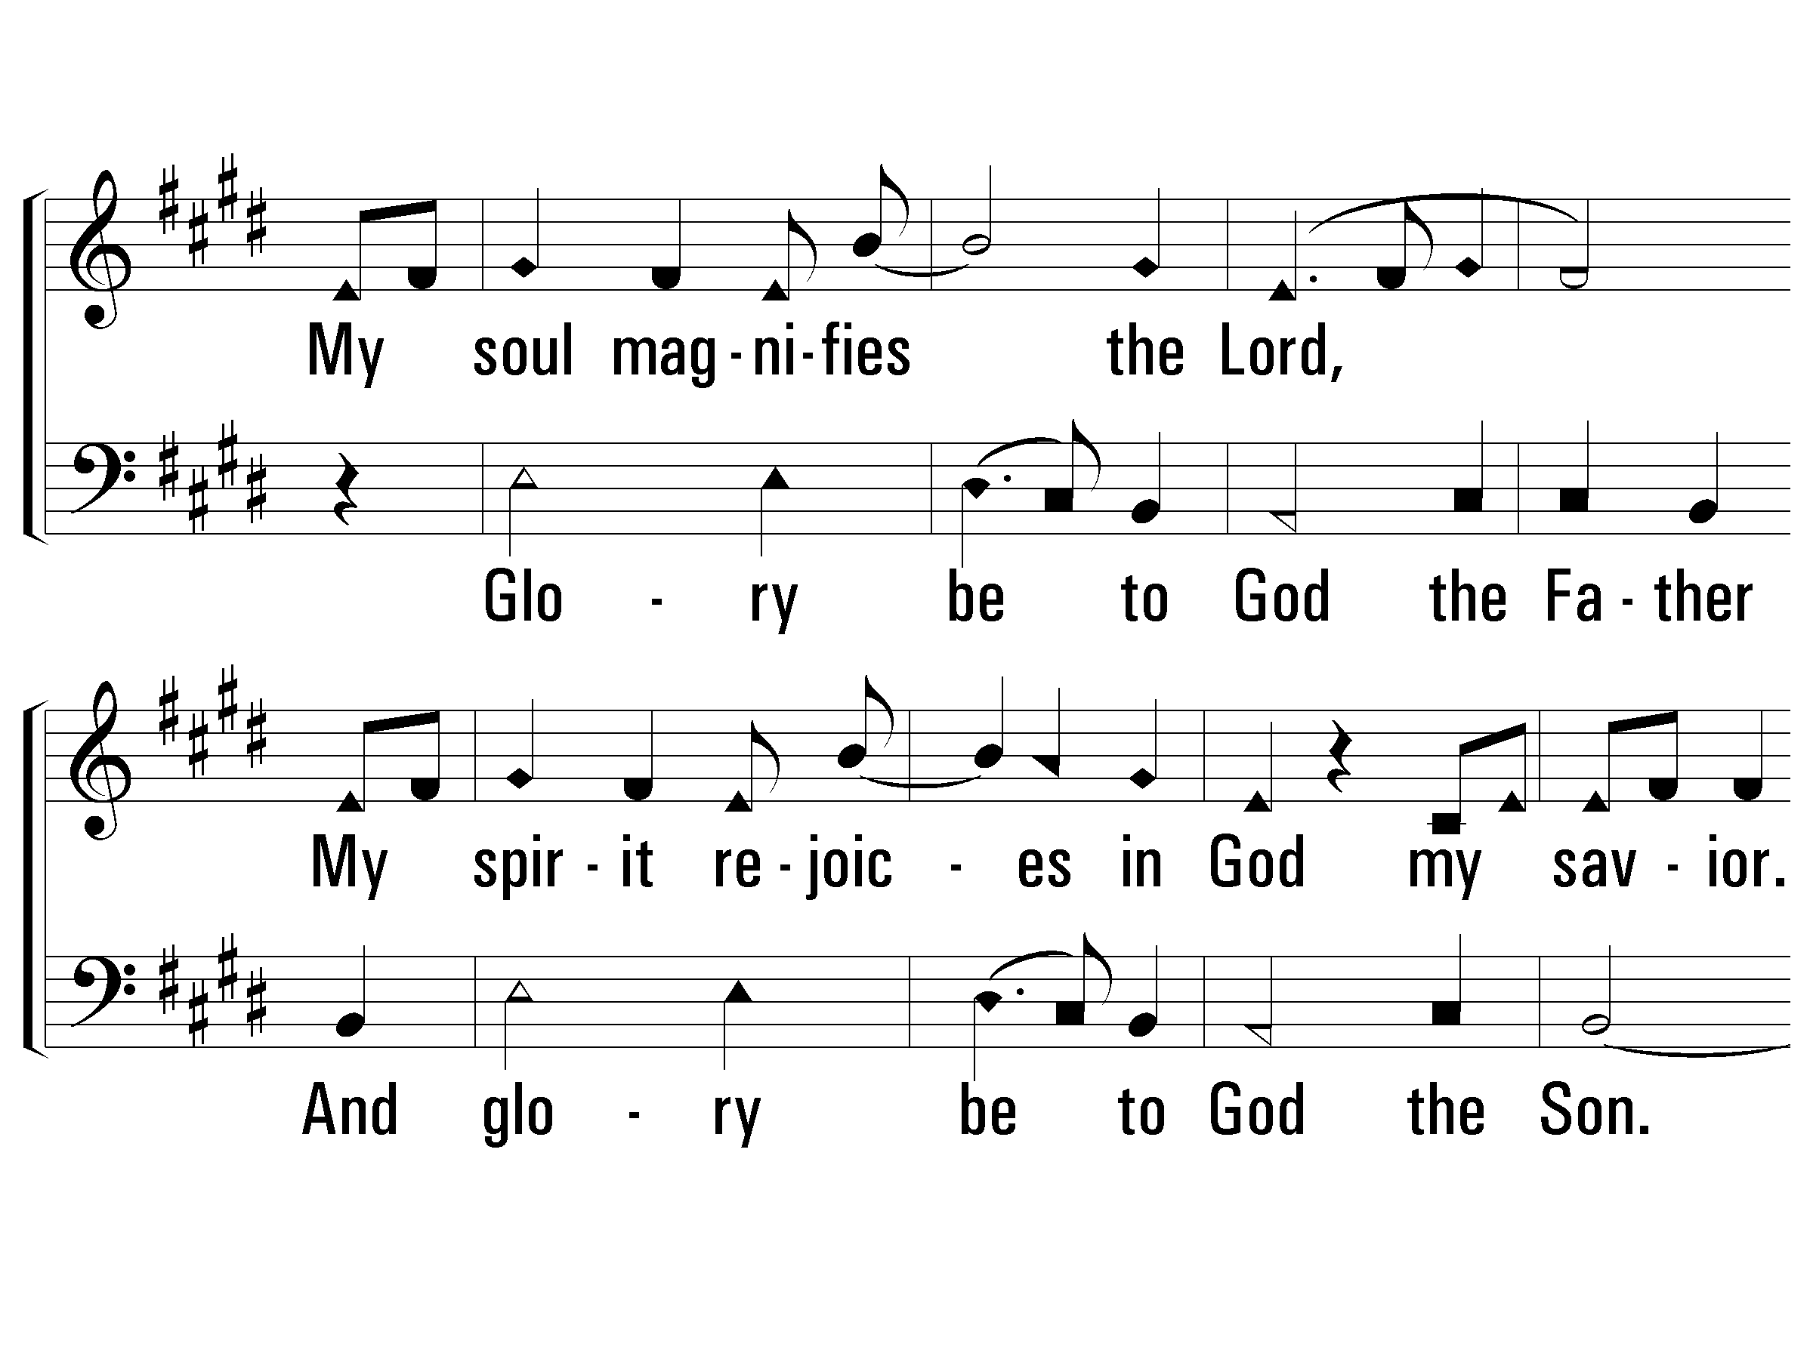
2 - Magnificat
Add Bass
Sop
(Alto)
He has been mindful of His servant,
He has been mindful of me.
I will be blessed forever, forever,
I will be blessed by the Lord.
Bass
S
B
Words & Music: Randy Gill
Copyright © 2003 by Randy Gill
PaperlessHymnal.com

Slide 45
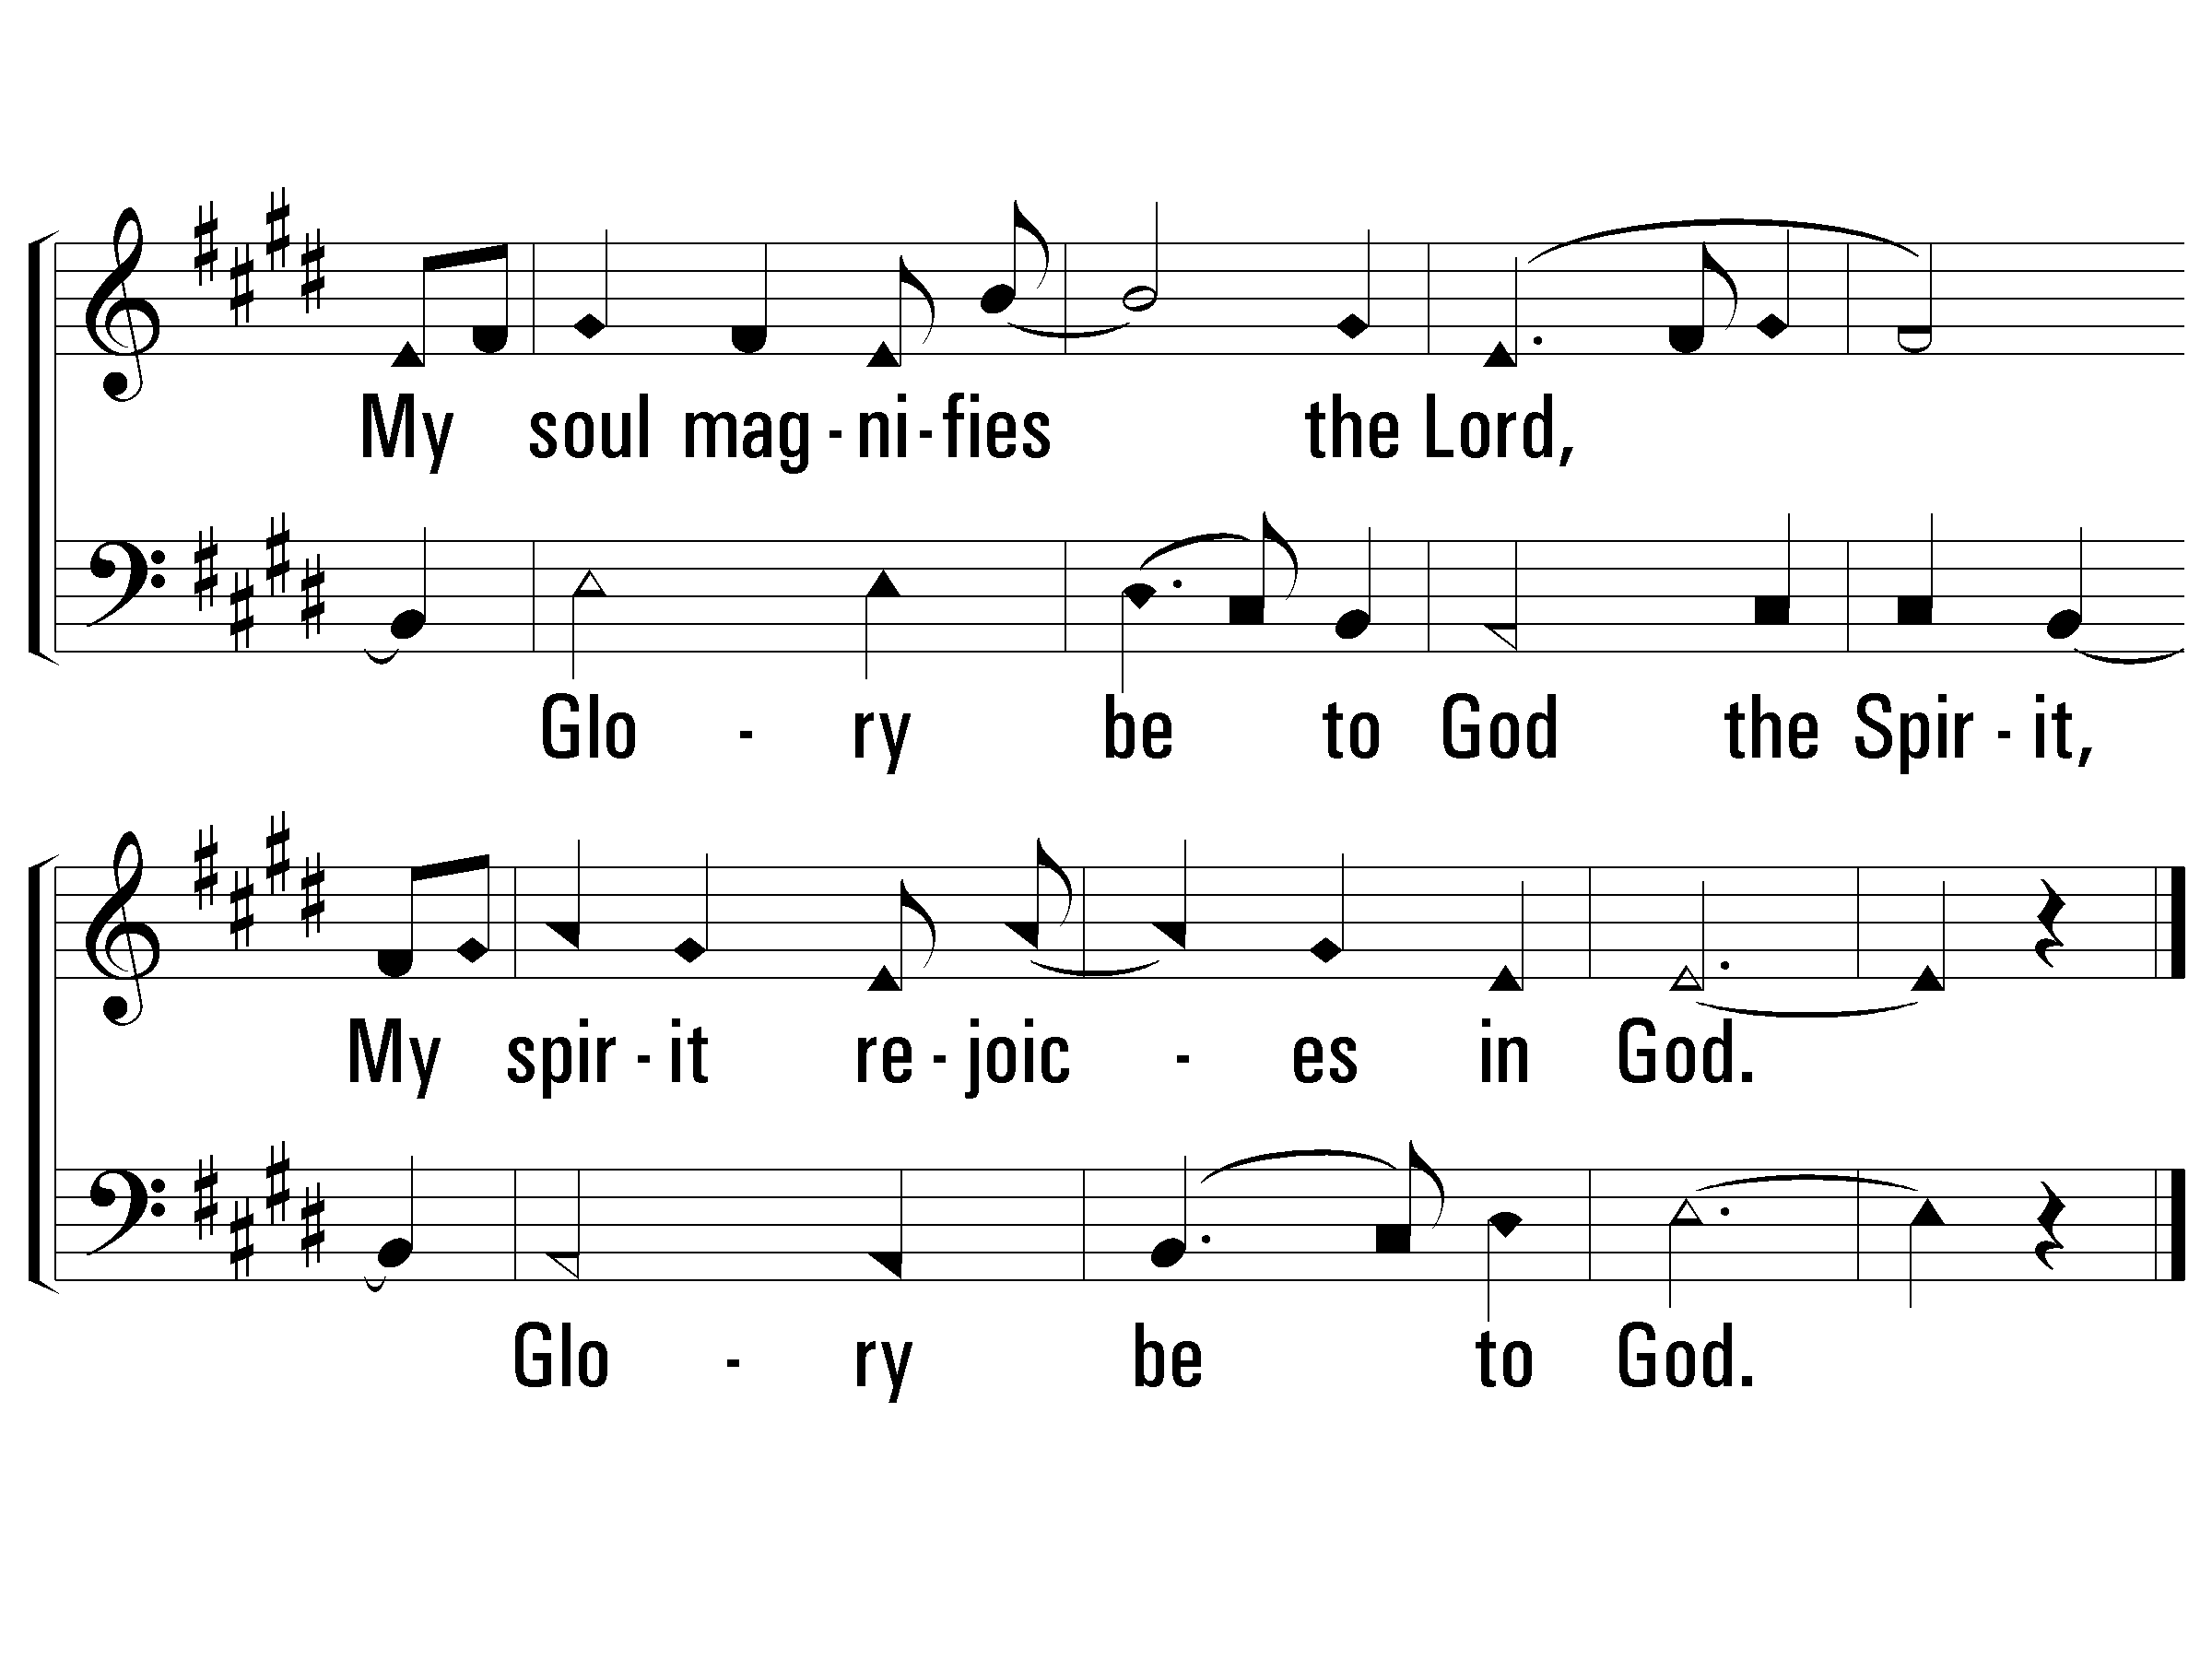
2 - Magnificat
S
B
S
B
PaperlessHymnal.com

Slide 46
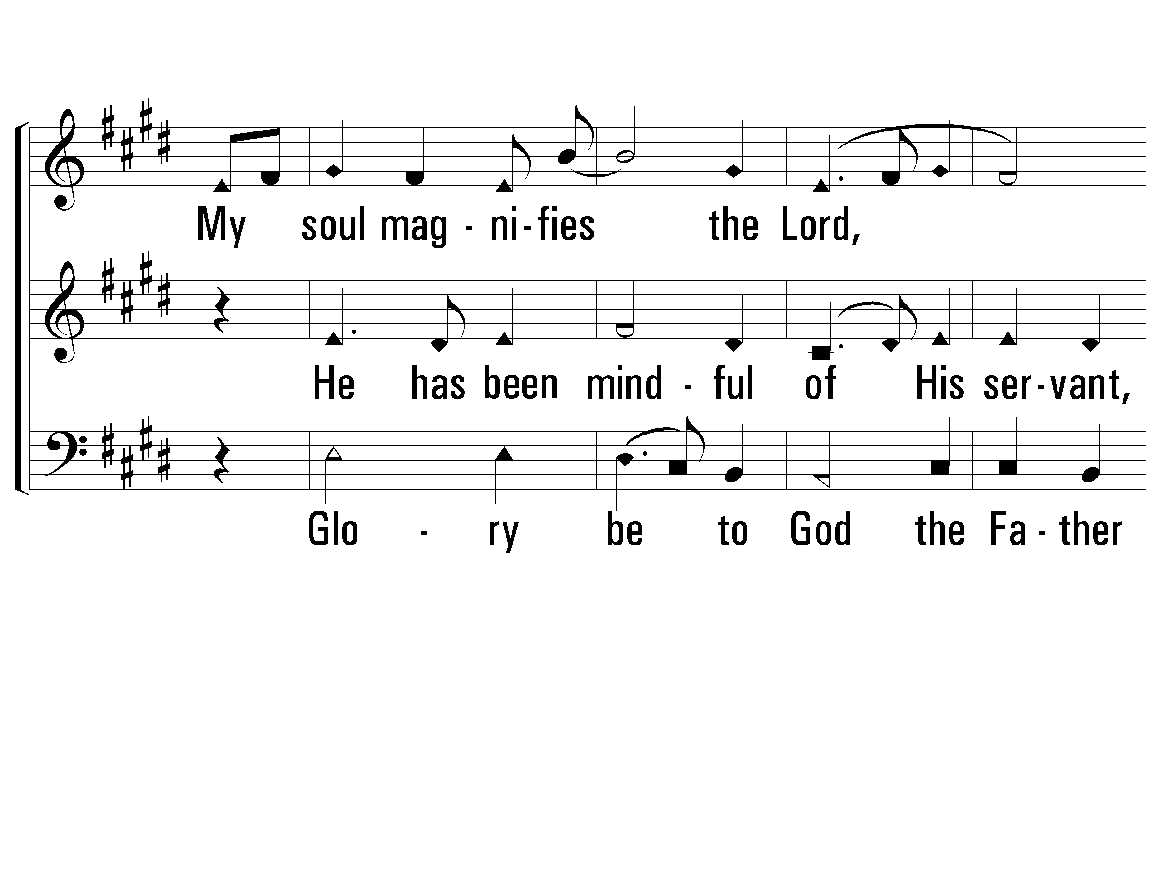
3 - Magnificat
Add Alto
Sop
(Tenor)
God alone is mighty, mighty;
Our God alone has done great things.
God alone is worthy, worthy;
Holy is His name.
Alto
Bass
Words & Music: Randy Gill
Copyright © 2003 by Randy Gill
PaperlessHymnal.com

Slide 47
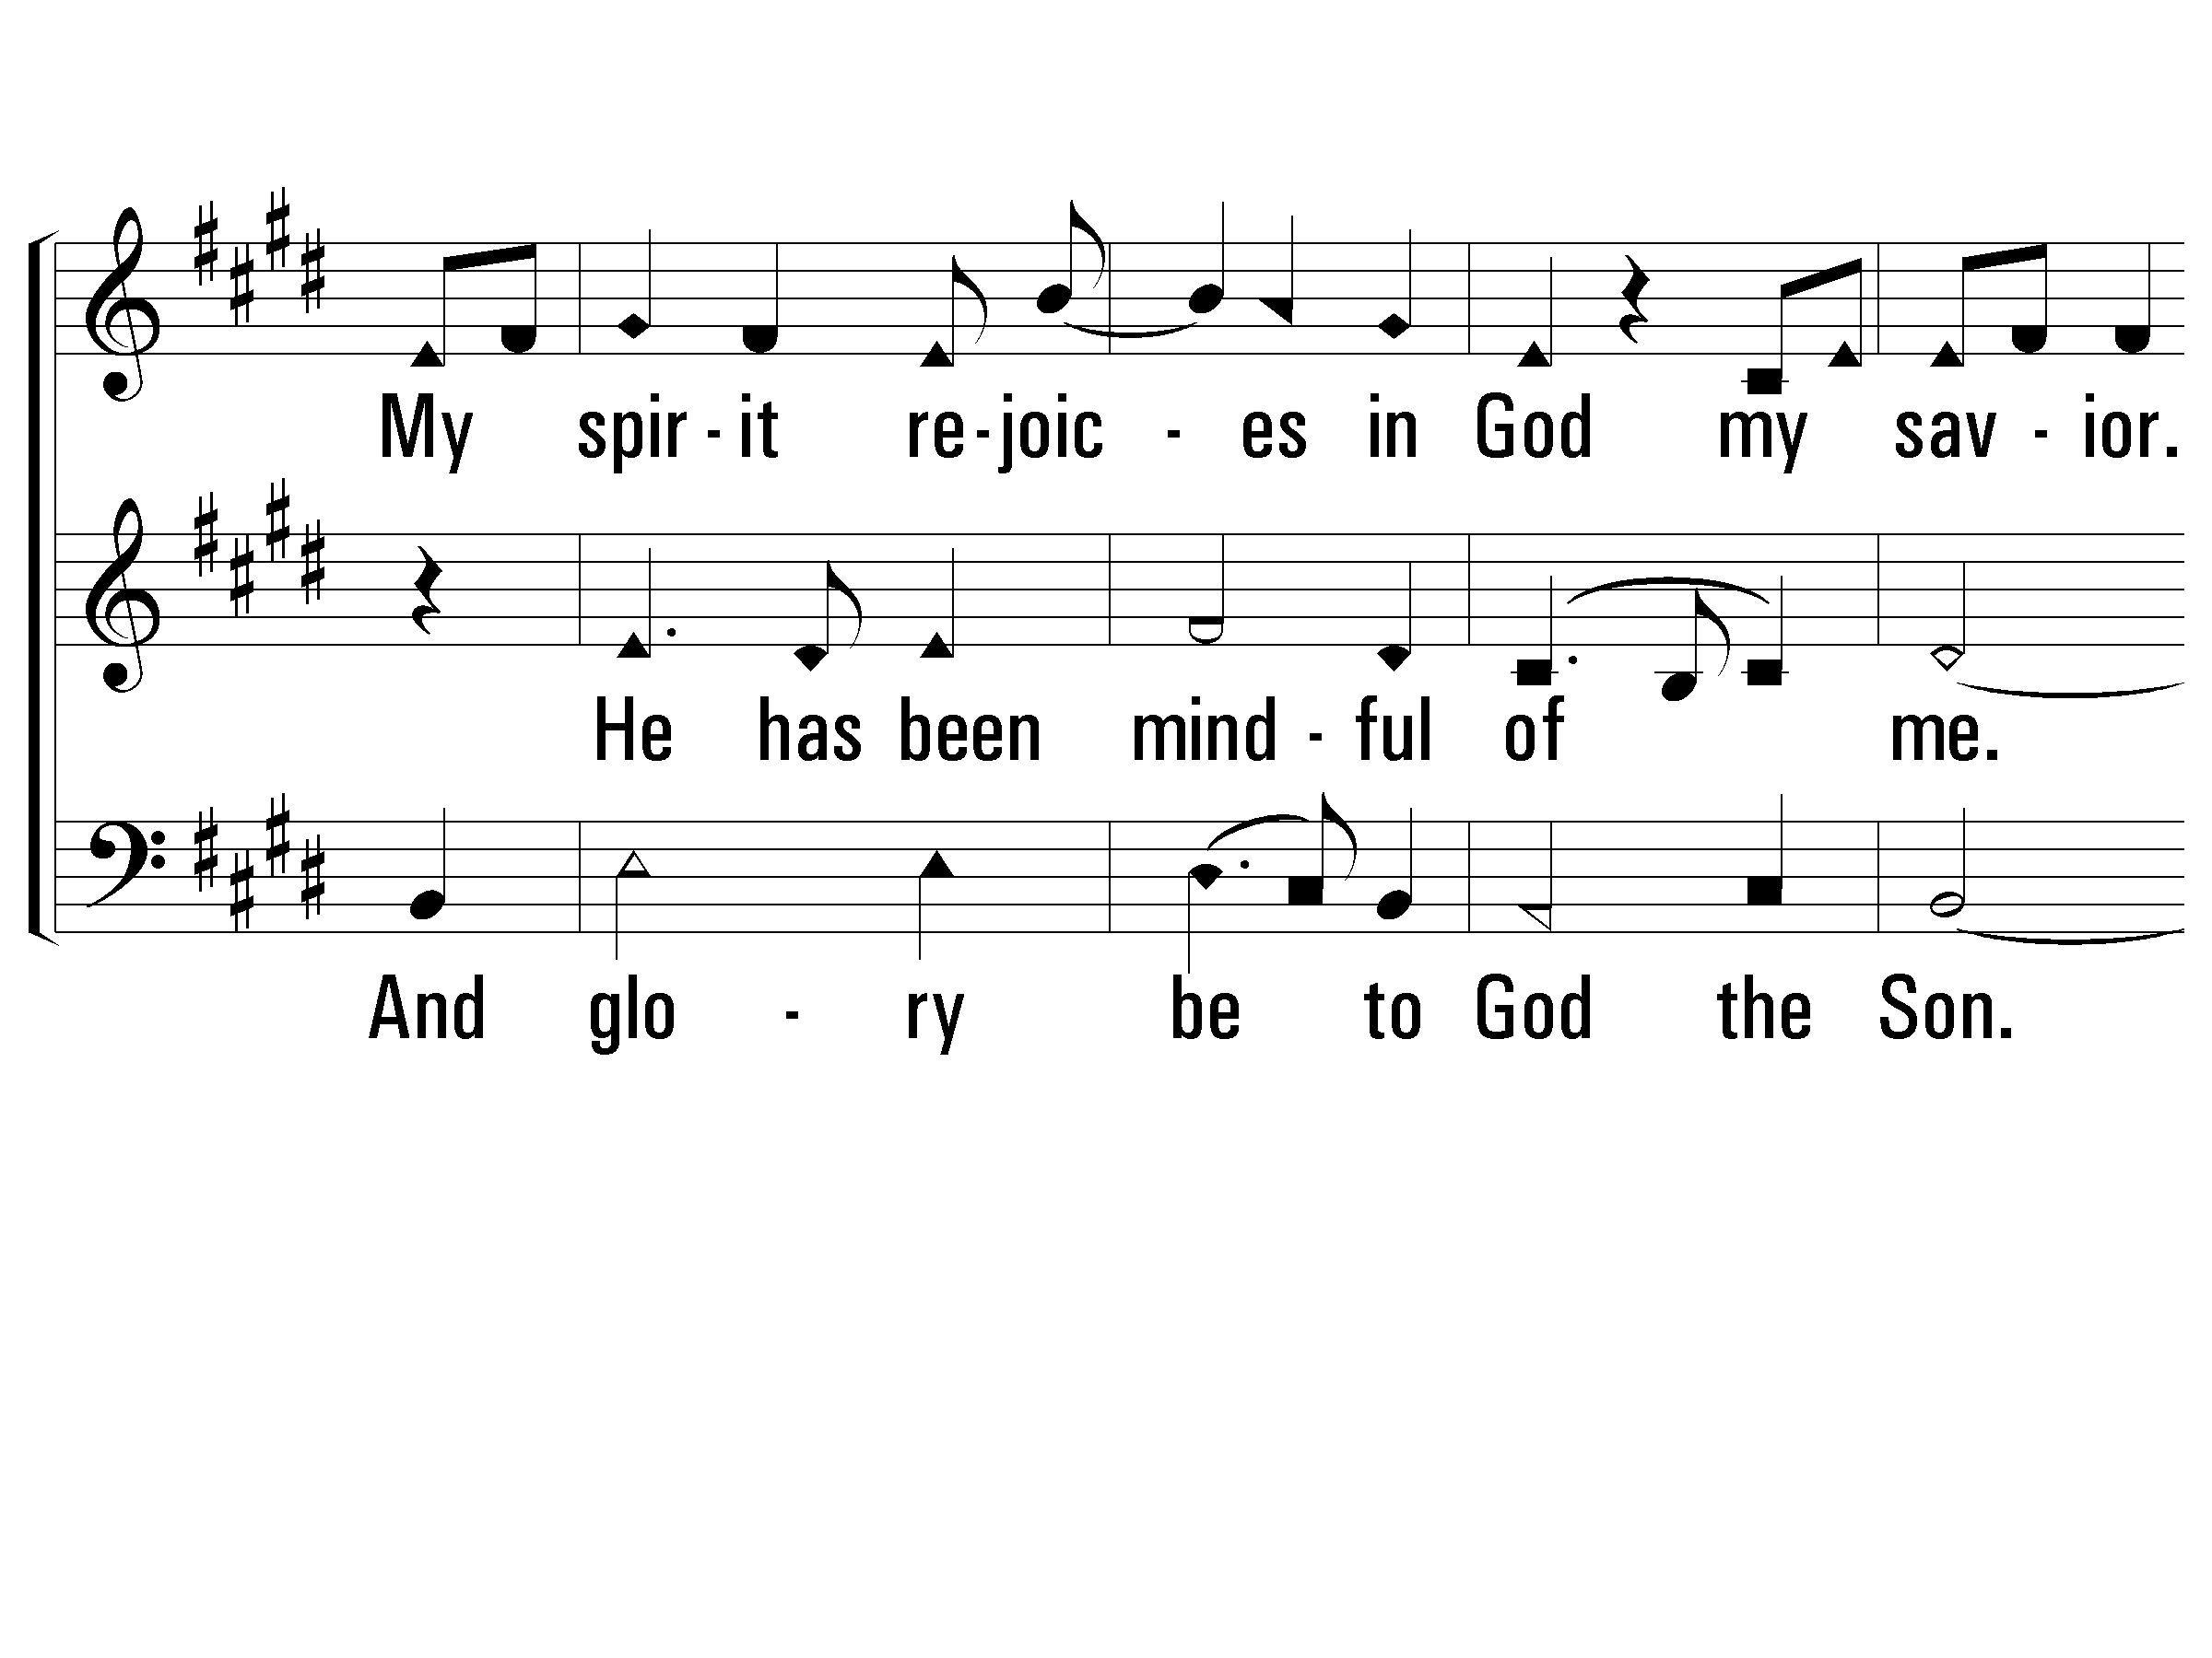
3 - Magnificat
S
A
B
PaperlessHymnal.com

Slide 48
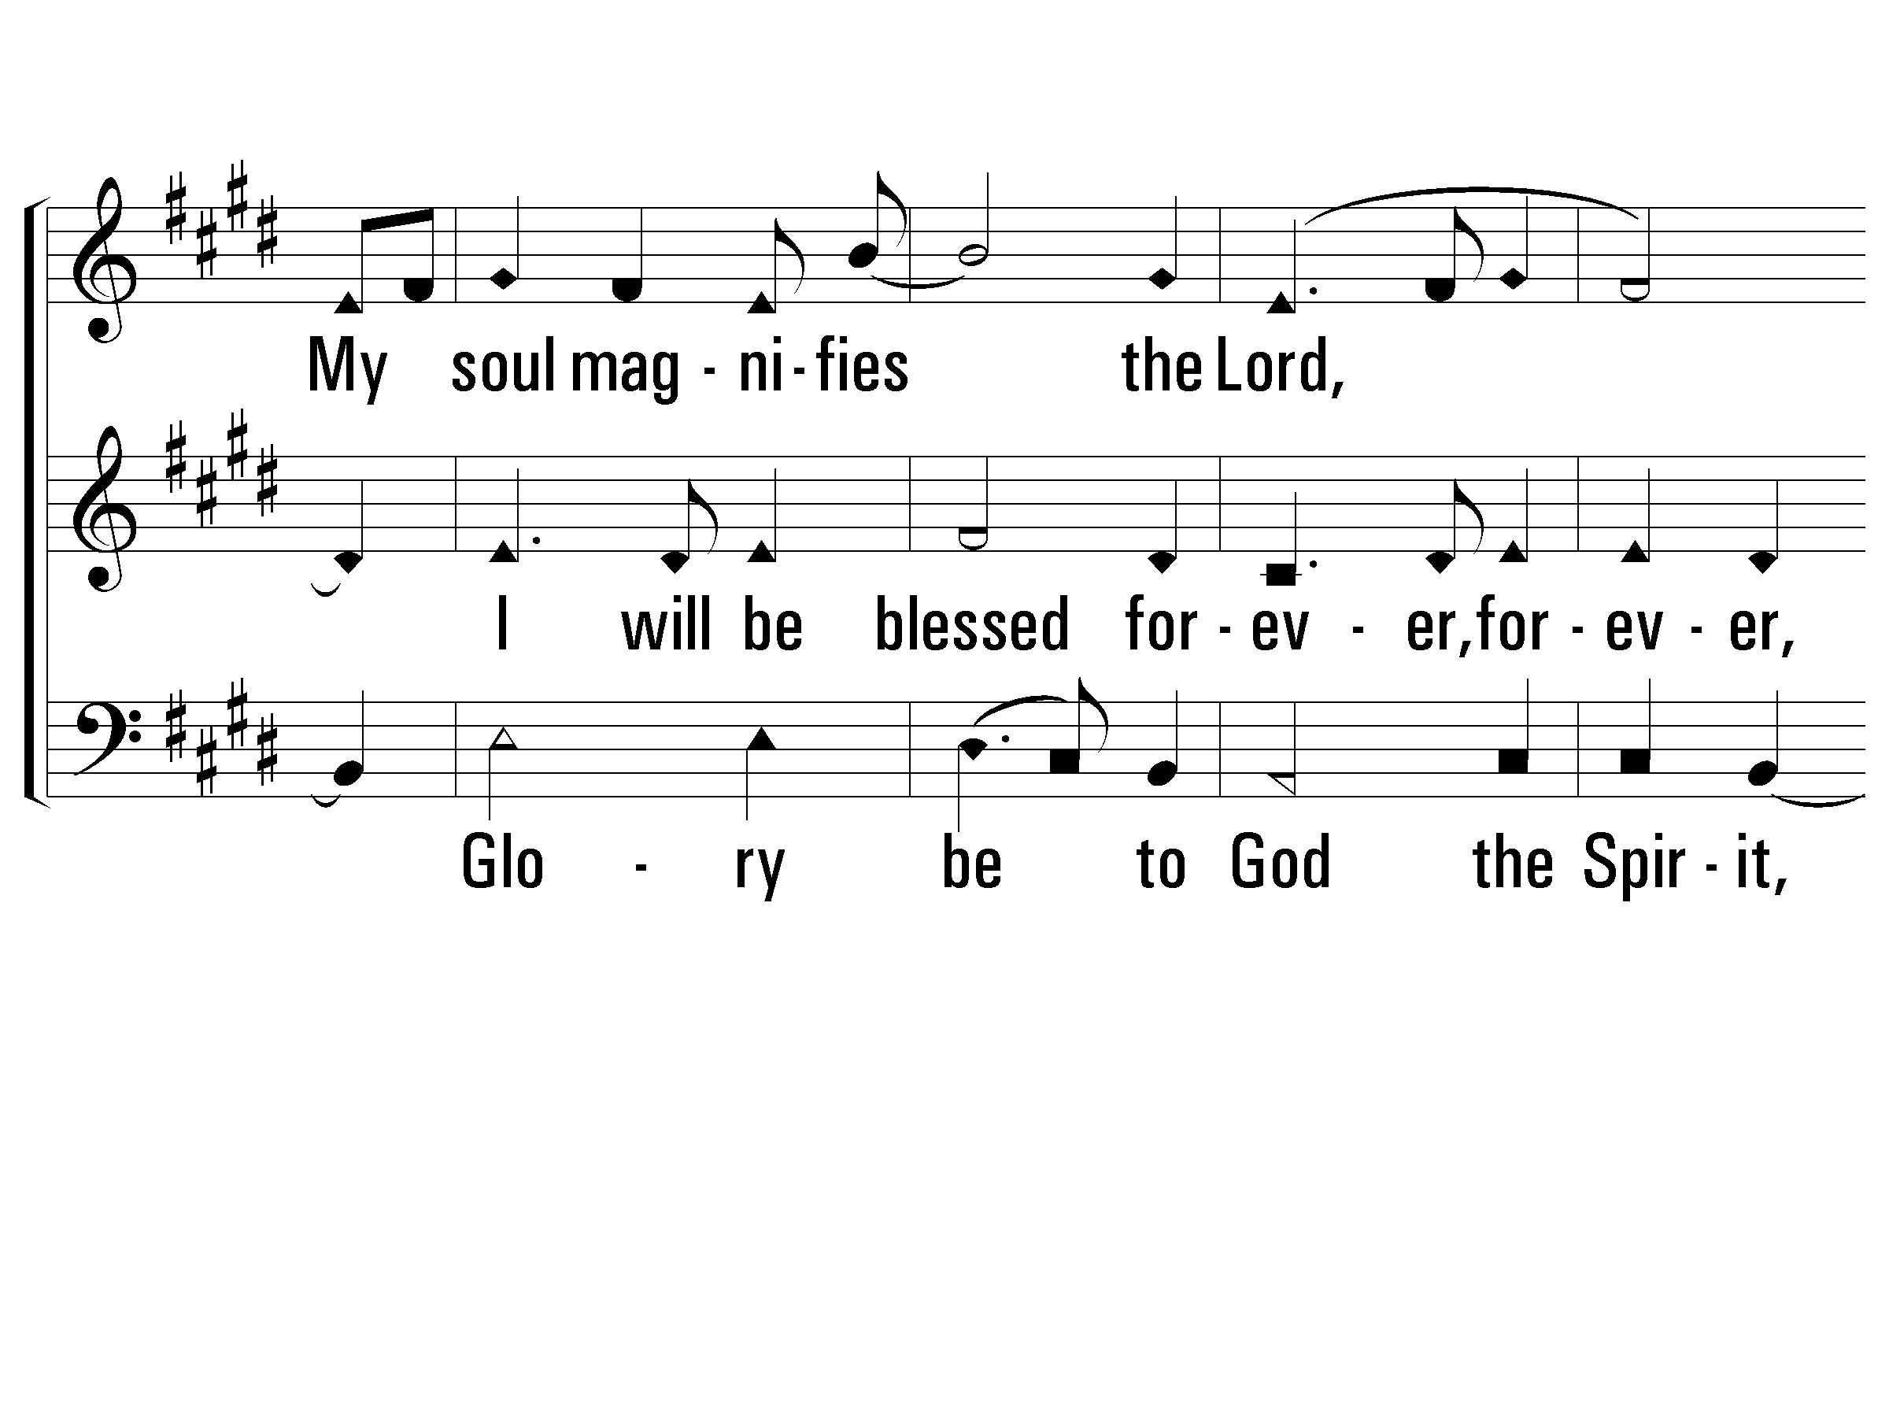
3 - Magnificat
S
A
B
PaperlessHymnal.com

Slide 49
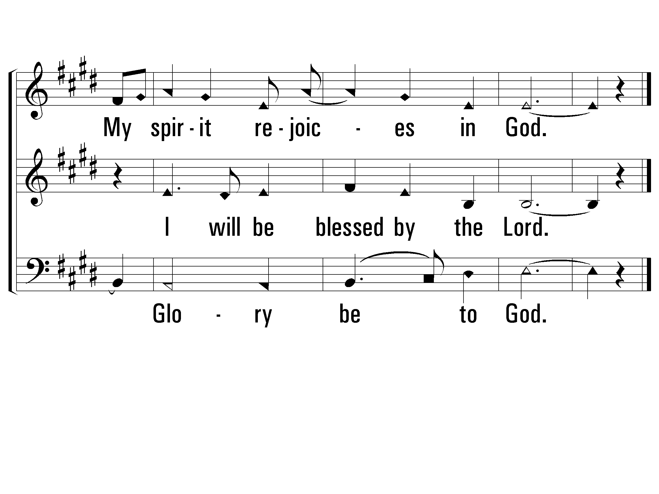
3 - Magnificat
S
A
B
PaperlessHymnal.com

Slide 50
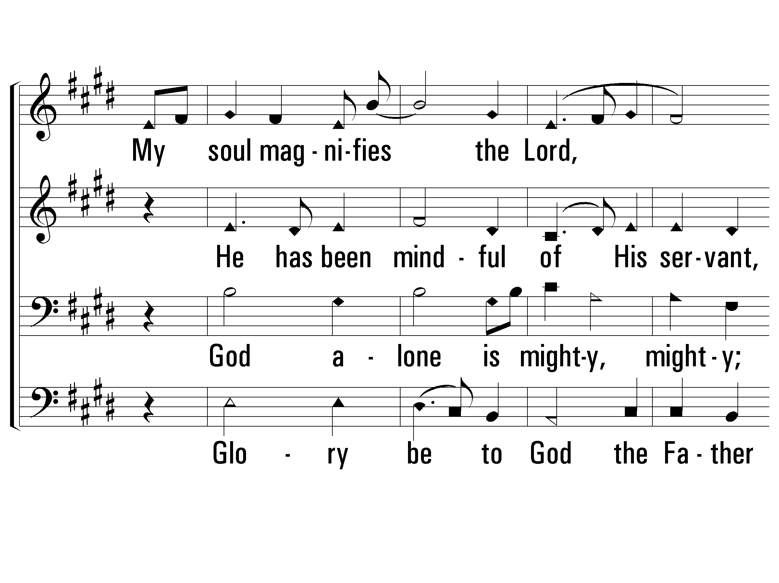
4 - Magnificat
Add Tenor
Sop
(Bass)
Glory be to God the Father
And glory be to God the Son.
Glory be to God the Spirit,
Glory be to God.
Alto
Tenor
Bass
Words & Music: Randy Gill
Copyright © 2003 by Randy Gill
PaperlessHymnal.com

Slide 51
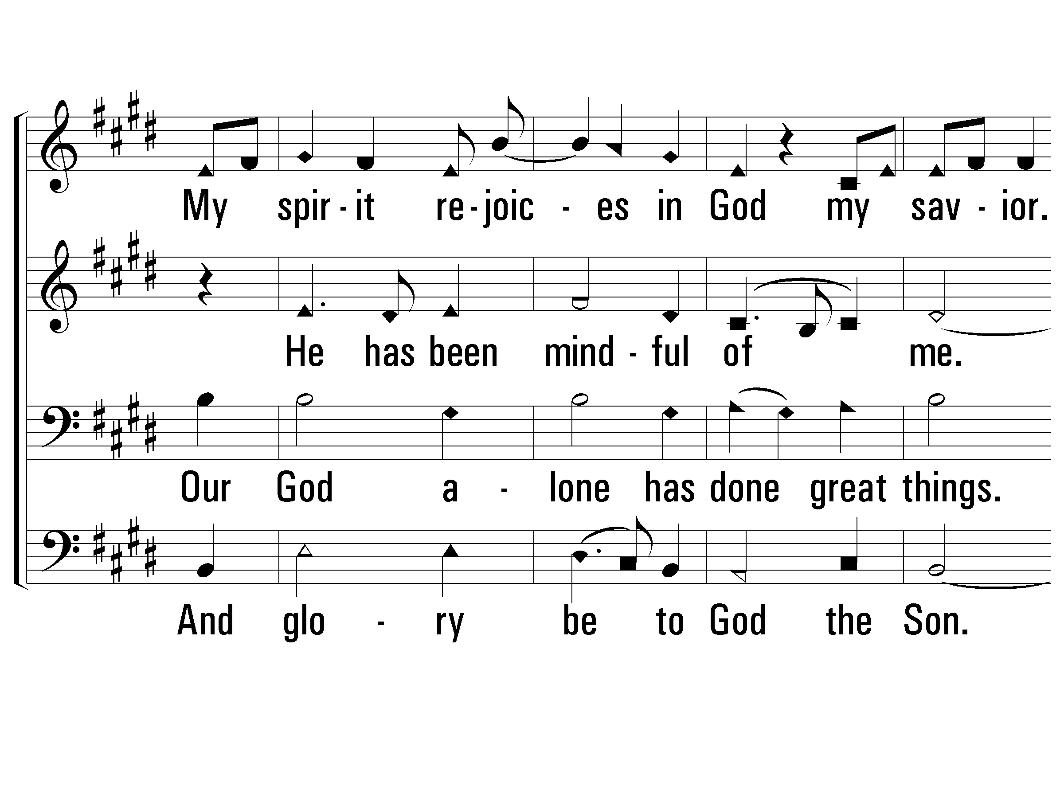
4 - Magnificat
S
A
T
B
PaperlessHymnal.com

Slide 52
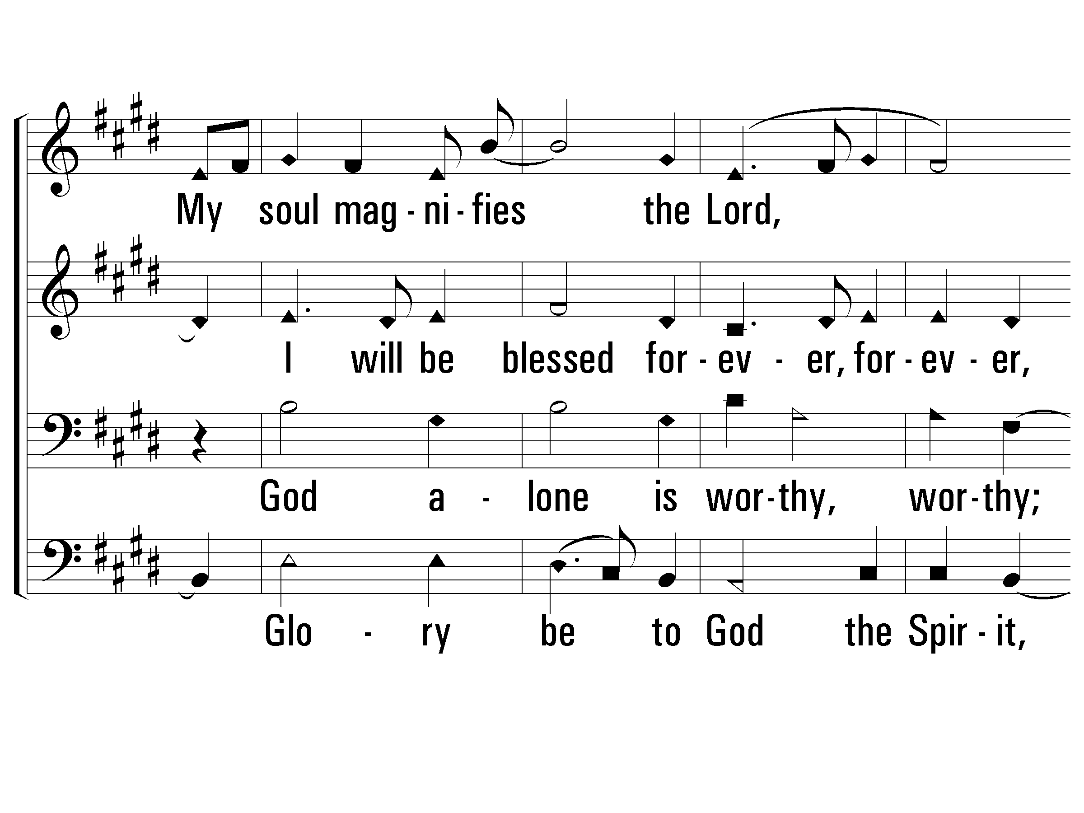
4 - Magnificat
S
A
T
B
PaperlessHymnal.com

Slide 53
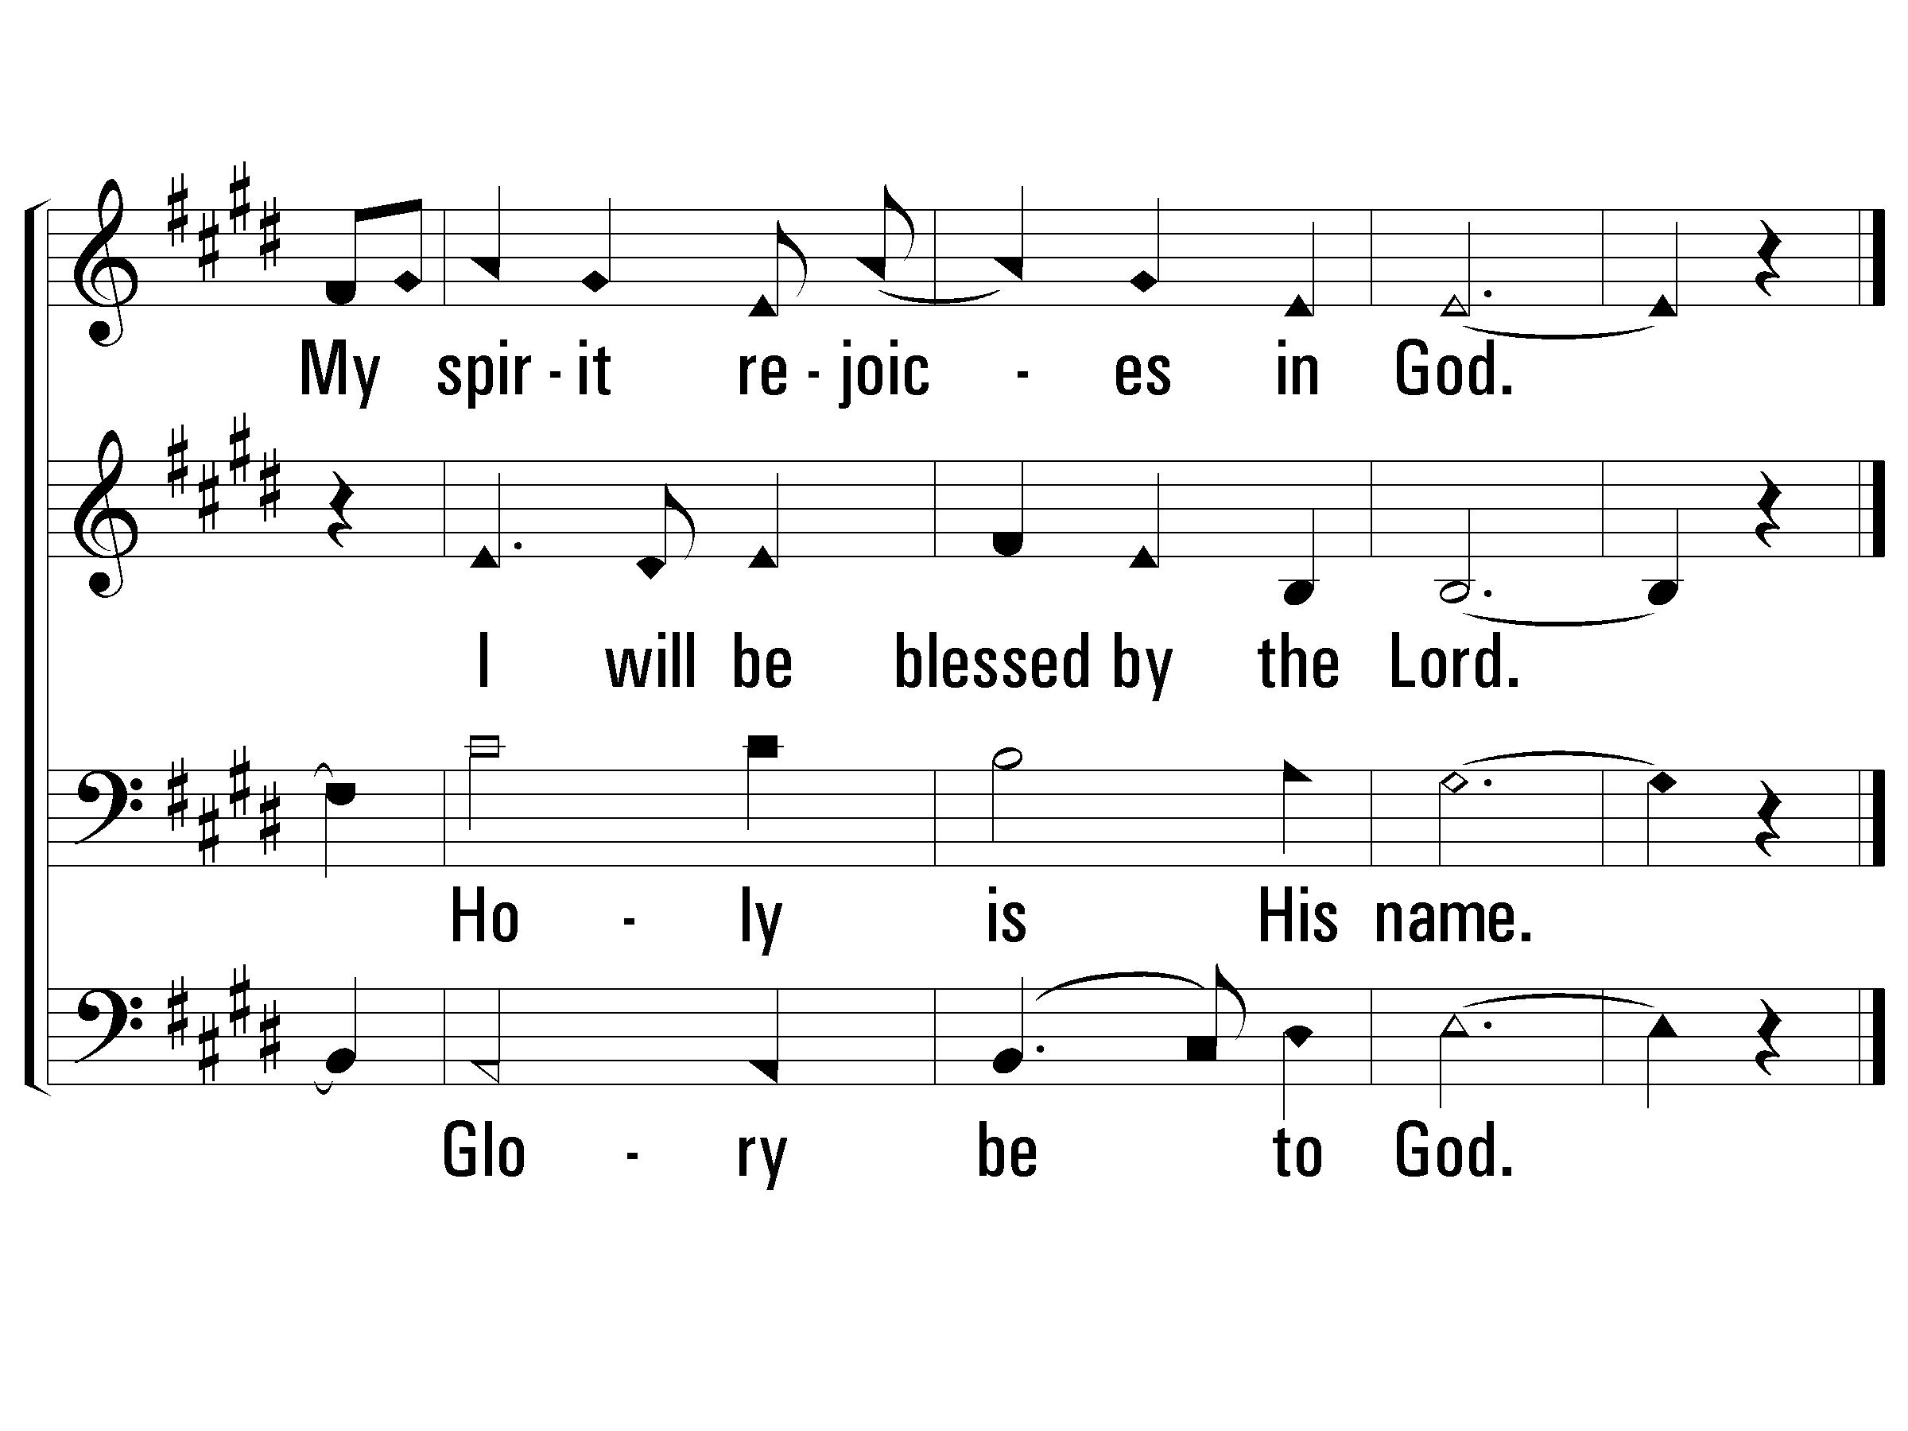
4 - Magnificat
S
A
T
B
PaperlessHymnal.com

Slide 54
5 - Magnificat
Words & Music: Randy Gill
Copyright © 2003 by Randy Gill
PaperlessHymnal.com

Slide 55
5 - Magnificat
PaperlessHymnal.com

Slide 56
5 - Magnificat
PaperlessHymnal.com

Slide 57
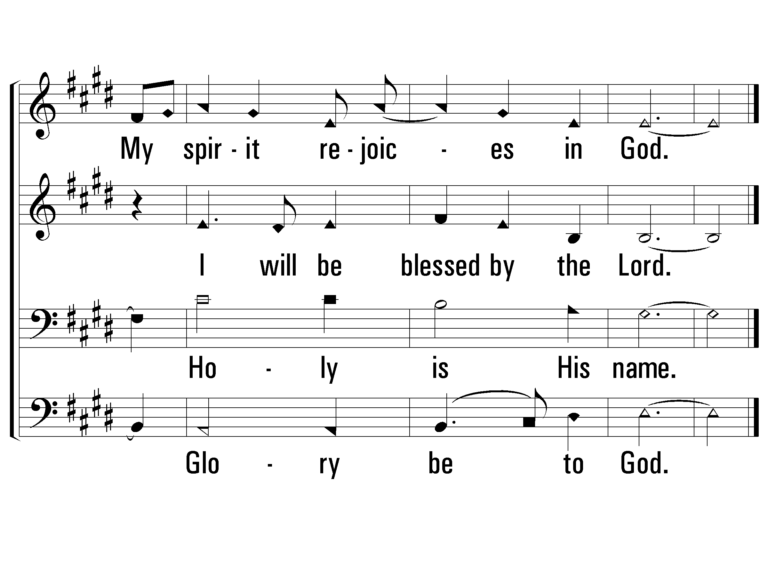
5 - Magnificat
PaperlessHymnal.com

Slide 58
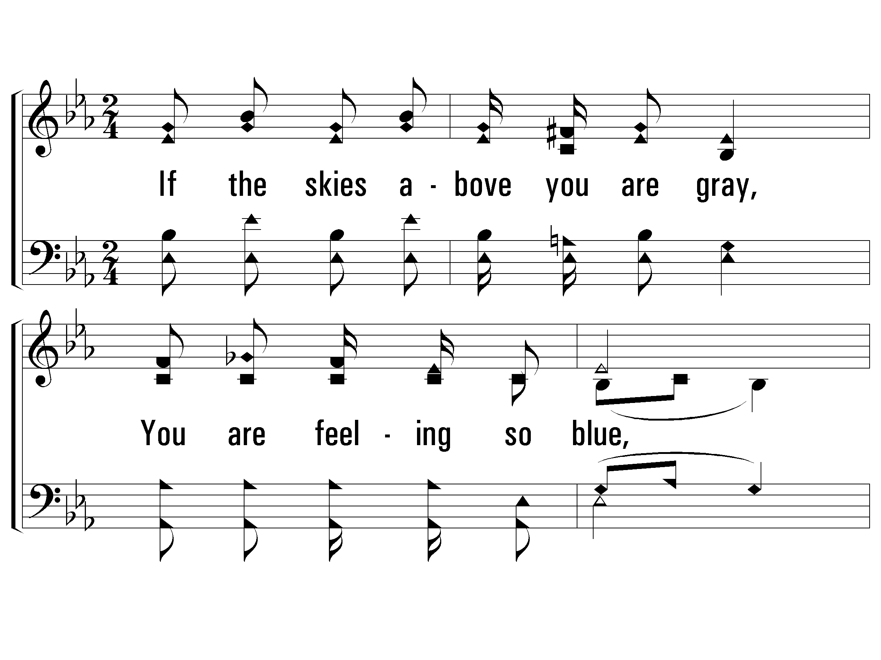
1 - Sing and be Happy
1.
If the skies above you are gray,
You are feeling so blue,
If your cares and burdens seem great
All the whole day through,
There's a silver lining that shines
In the heavenly land,
Look by faith and see it my friend,
Trust in His promises grand
Words and Music by: Emory S. Peck
Copyright © 1940 by Stamps-Baxter Music(BMI)(admin. by Brentwood-Benson Music Publishing, Inc.)
All Rights reserved. Used by permission.
PaperlessHymnal.com

Slide 59
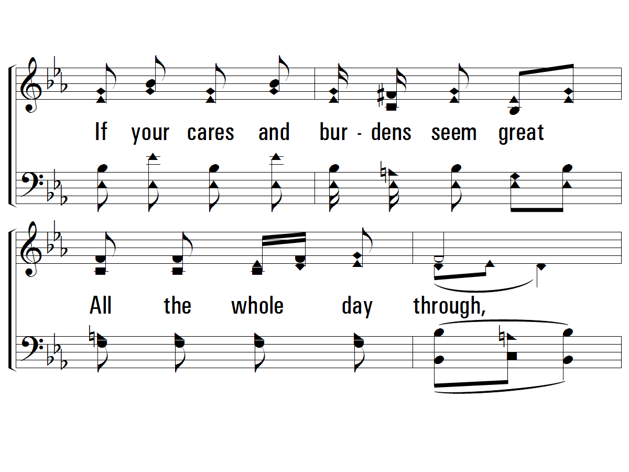
1 - Sing and be Happy
PaperlessHymnal.com

Slide 60
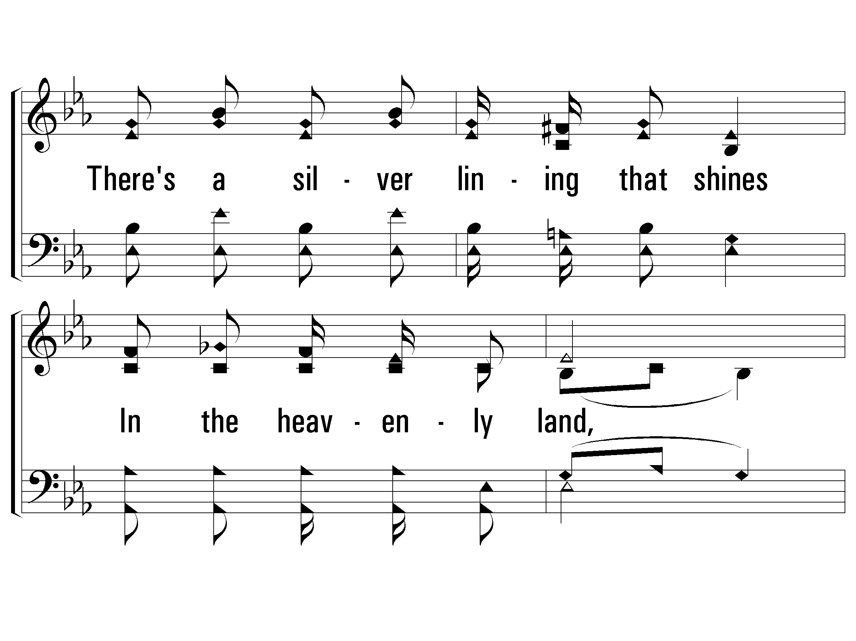
1 - Sing and be Happy
PaperlessHymnal.com

Slide 61
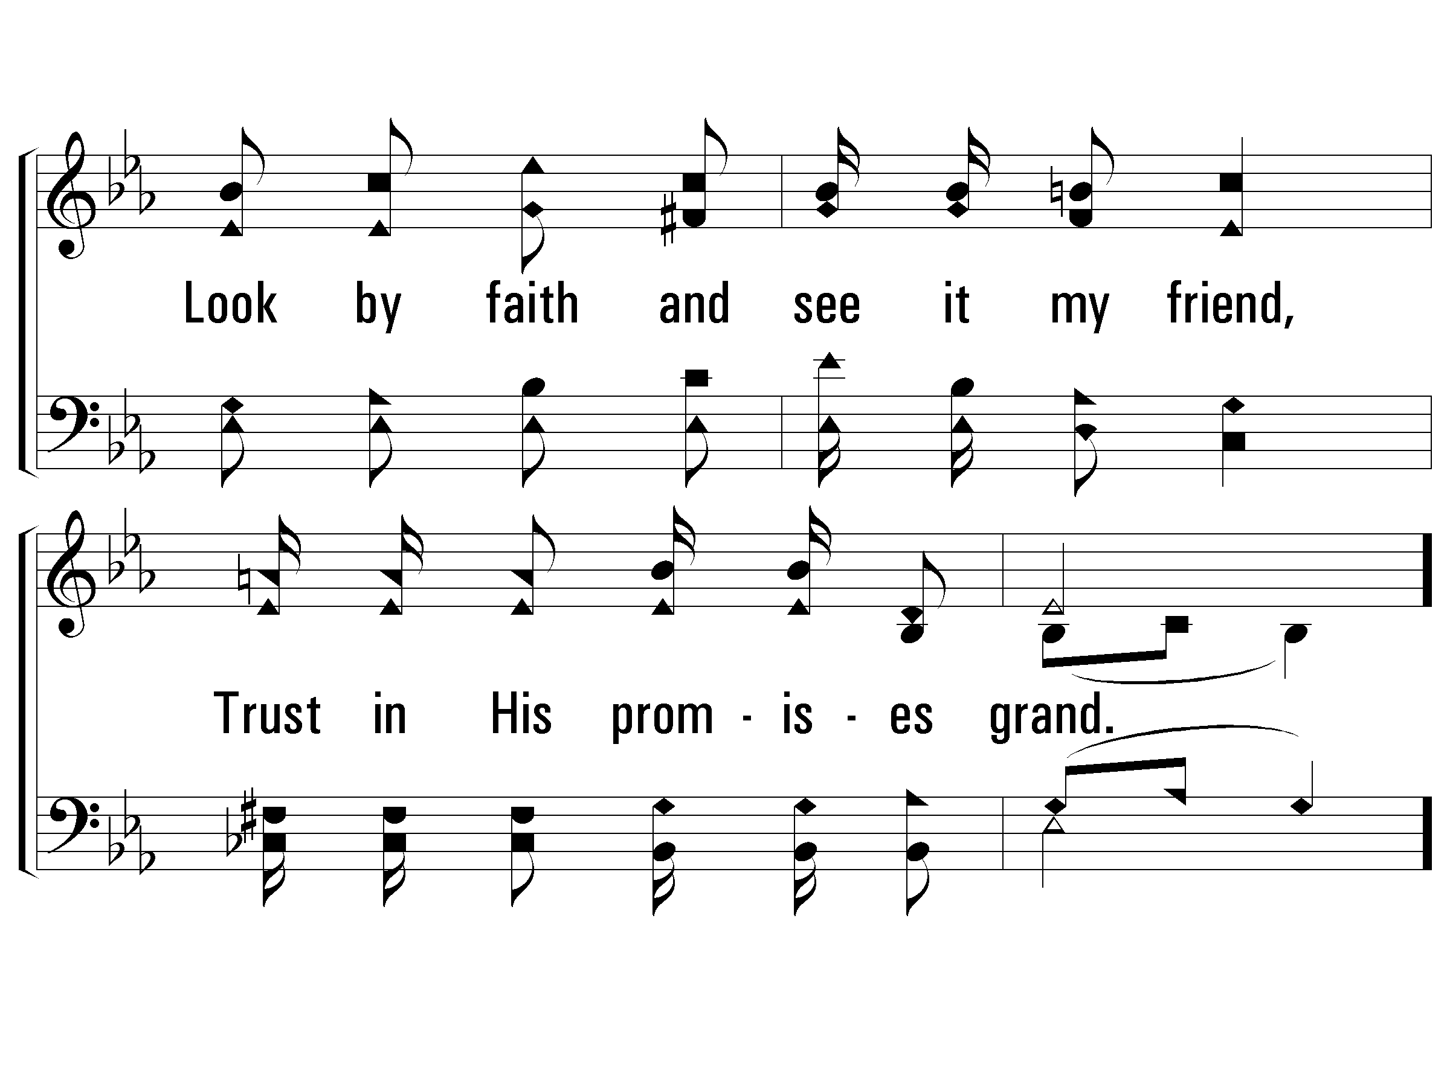
1 - Sing and be Happy
PaperlessHymnal.com

Slide 62
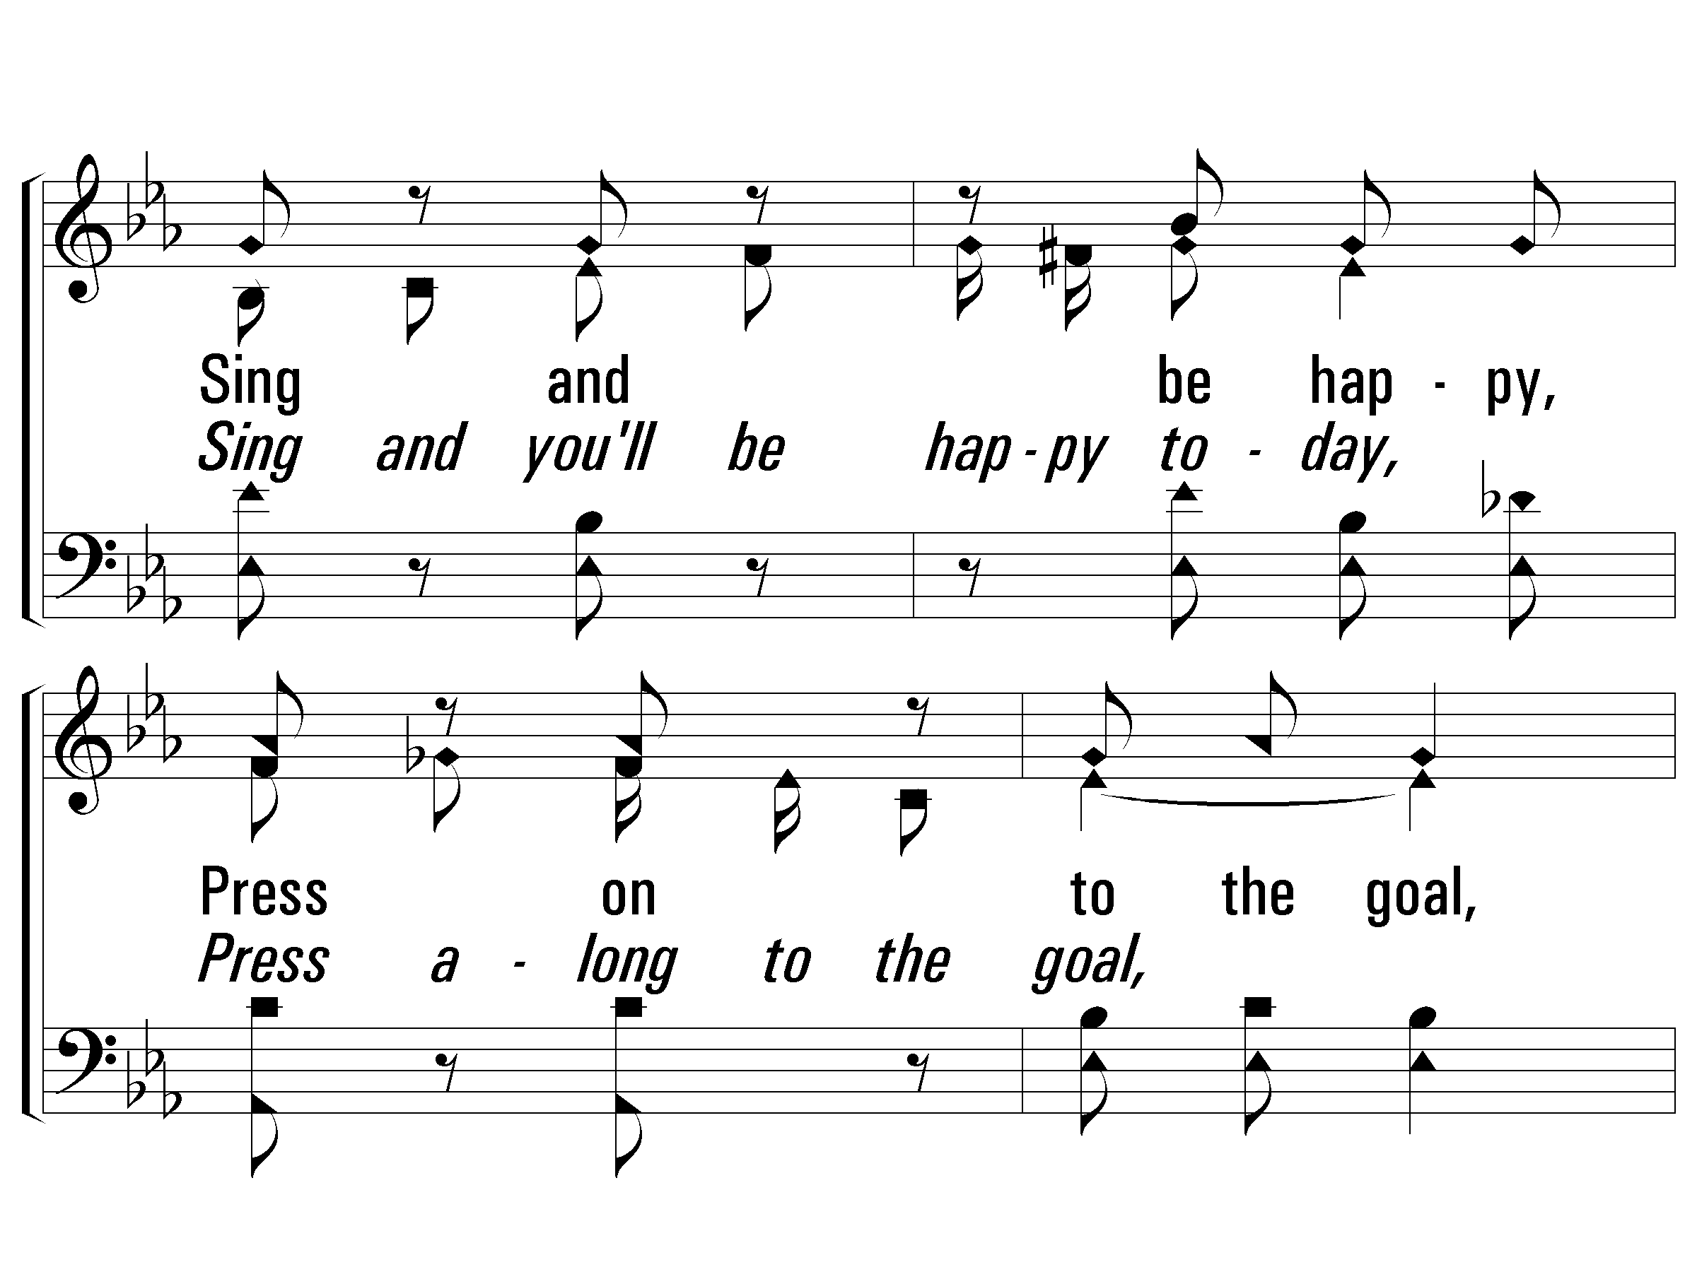
c - Sing and be Happy
Sing and be happy,
Press on to the goal,
Trust Him who leads you,
He will keep your soul;
Let all be faithful,
Look to Him and pray,
Lift your voice and praise Him in song,
Sing and be happy today.
PaperlessHymnal.com

Slide 63
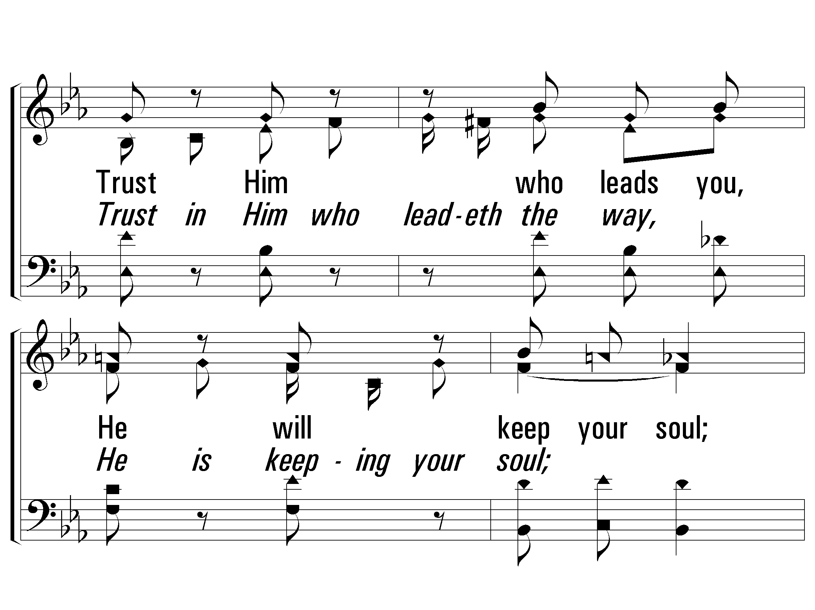
c - Sing and be Happy
Sing and you'll be happy today,
Press along to the goal,
Trust in Him who leadeth the way,
He is keeping your soul;
Let the world know where you belong,
Look to Jesus and pray,
PaperlessHymnal.com

Slide 64
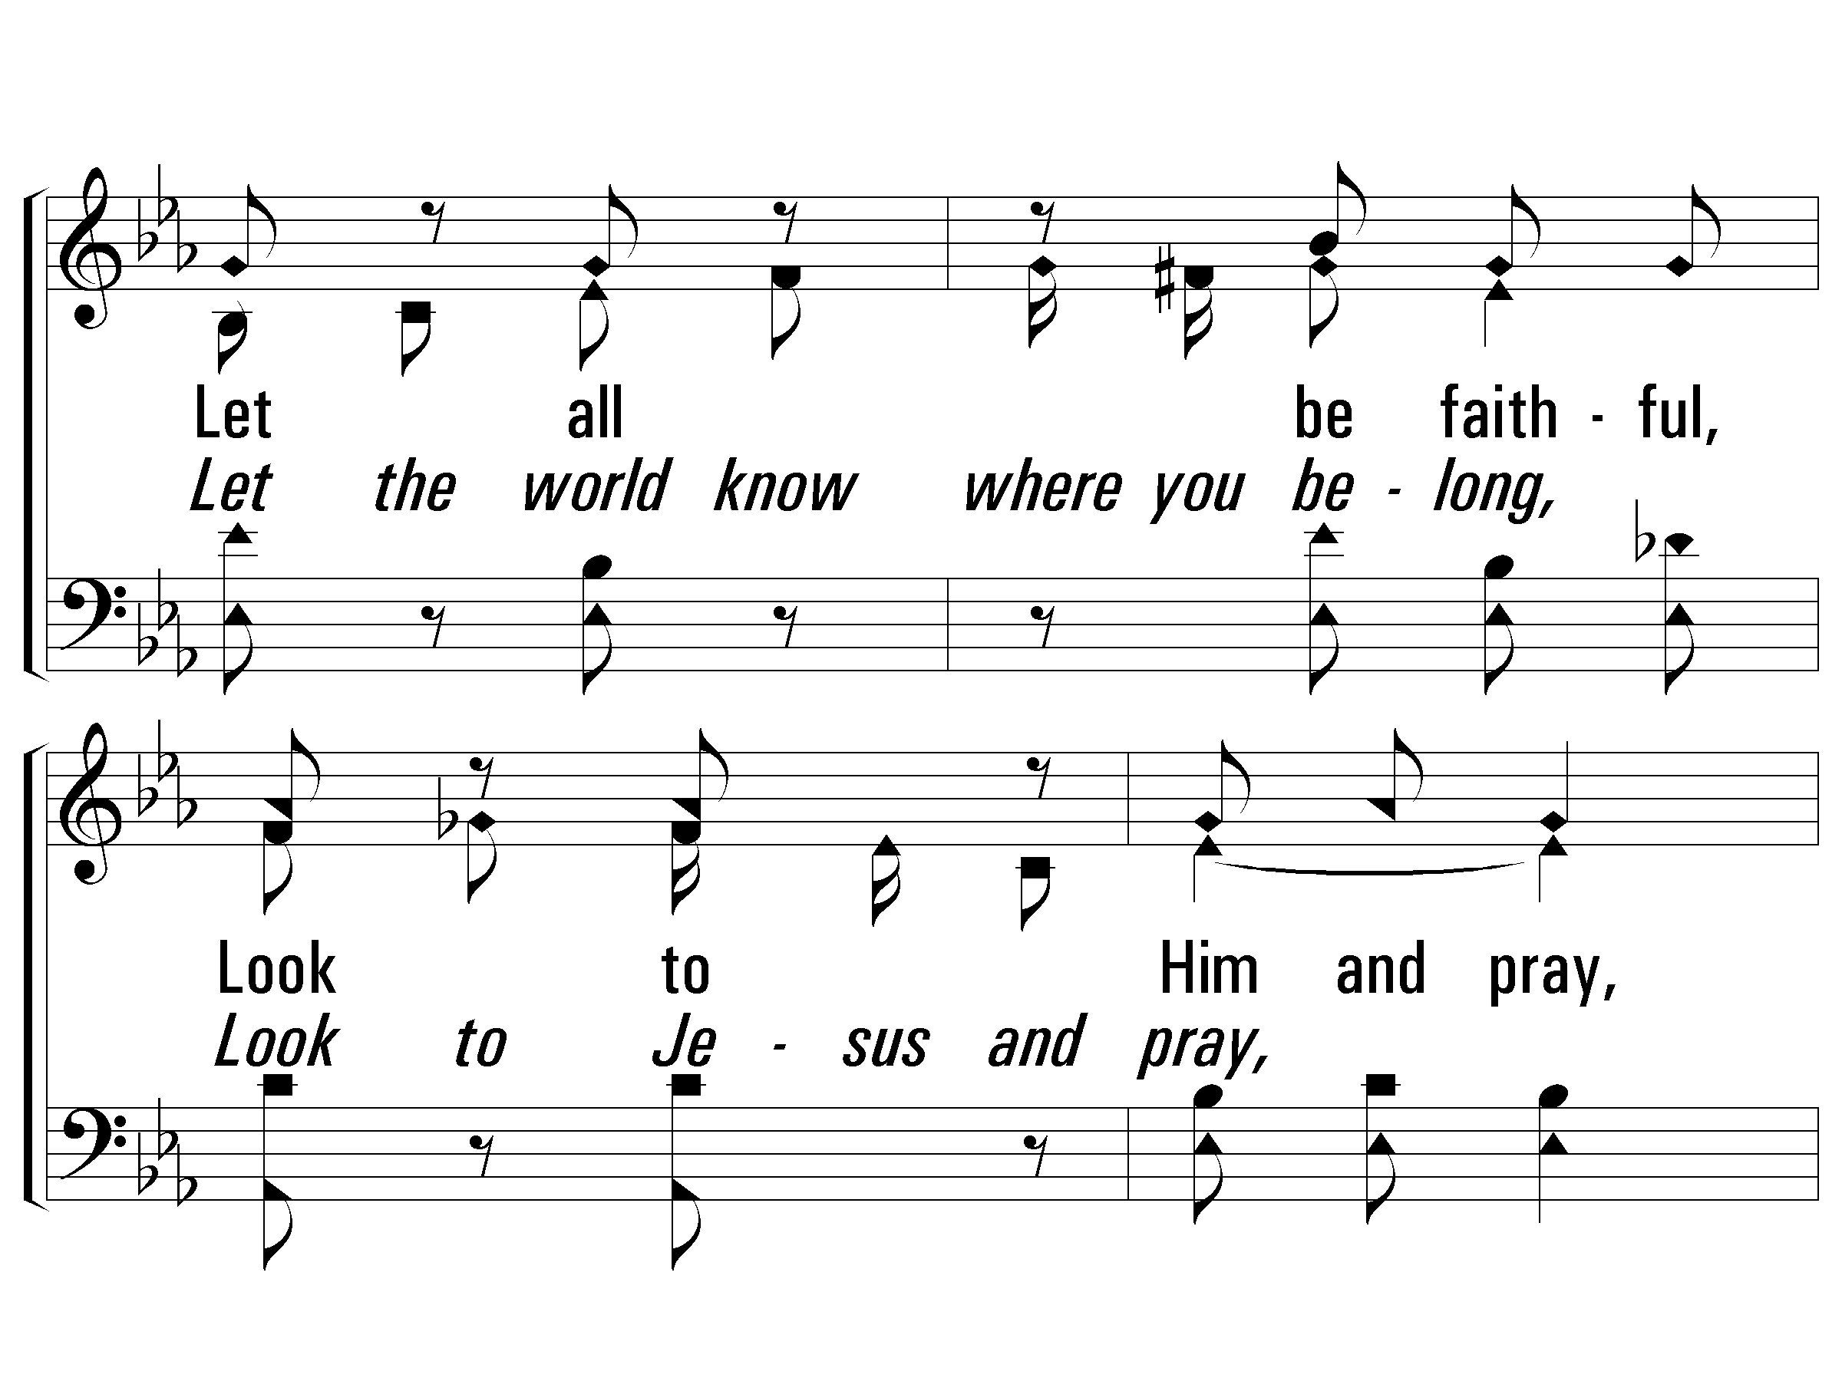
c - Sing and be Happy
PaperlessHymnal.com

Slide 65

c - Sing and be Happy
PaperlessHymnal.com

Slide 66

3 - Sing and be Happy
3.
Oft we fail to see the rainbow
Up in heaven's fair sky,
When it seems the fortunes of earth
Frown and pass us by,
There are things we know that are worth
More than silver and gold,
If we hope and trust Him each day,
We shall have pleasure untold.
Words and Music by: Emory S. Peck
Copyright © 1940 by Stamps-Baxter Music(BMI)(admin. by Brentwood-Benson Music Publishing, Inc.)
All Rights reserved. Used by permission.
PaperlessHymnal.com

Slide 67

3 - Sing and be Happy
PaperlessHymnal.com

Slide 68

3 - Sing and be Happy
PaperlessHymnal.com

Slide 69

3 - Sing and be Happy
PaperlessHymnal.com

Slide 70
c - Sing and be Happy
Sing and be happy,
Press on to the goal,
Trust Him who leads you,
He will keep your soul;
Let all be faithful,
Look to Him and pray,
Lift your voice and praise Him in song,
Sing and be happy today.
PaperlessHymnal.com

Slide 71
c - Sing and be Happy
Sing and you'll be happy today,
Press along to the goal,
Trust in Him who leadeth the way,
He is keeping your soul;
Let the world know where you belong,
Look to Jesus and pray,
PaperlessHymnal.com

Slide 72
c - Sing and be Happy
PaperlessHymnal.com

Slide 73
c - Sing and be Happy
PaperlessHymnal.com

Slide 74

1 - Come, We That Love the Lord
1.
Come, we that love the Lord,
And let our joys be known;
Join in a song with sweet accord,
Join in a song with sweet accord,
And thus surround the throne,
And thus surround the throne.
Words by: Isaac Watts / Ref.: Robert Lowry
Music by: Robert Lowry
PaperlessHymnal.com

Slide 75

1 - Come, We That Love the Lord
PaperlessHymnal.com

Slide 76

c - Come, We That Love the Lord
We're marching to Zion,
Beautiful, beautiful Zion;
We're marching upward to Zion,
The beautiful city of God.
PaperlessHymnal.com

Slide 77

2 - Come, We That Love the Lord
2.
Let those refuse to sing
Who never knew our God;
But children of the heavenly King,
But children of the heavenly King,
May speak their joys abroad,
May speak their joys abroad.
Words by: Isaac Watts / Ref.: Robert Lowry
Music by: Robert Lowry
PaperlessHymnal.com

Slide 78

2 - Come, We That Love the Lord
PaperlessHymnal.com

Slide 79
c - Come, We That Love the Lord
We're marching to Zion,
Beautiful, beautiful Zion;
We're marching upward to Zion,
The beautiful city of God.
PaperlessHymnal.com

Slide 80

4 - Come, We That Love the Lord
4.
Then let our songs abound,
And every tear be dry;
We're marching through Immanuel's ground,
We're marching through Immanuel's ground,
To fairer worlds on high,
To fairer worlds on high.
Words by: Isaac Watts / Ref.: Robert Lowry
Music by: Robert Lowry
PaperlessHymnal.com

Slide 81

4 - Come, We That Love the Lord
PaperlessHymnal.com

Slide 82
c - Come, We That Love the Lord
We're marching to Zion,
Beautiful, beautiful Zion;
We're marching upward to Zion,
The beautiful city of God.
PaperlessHymnal.com

Slide 83

1 - Our God, He Is Alive
1.
There is, beyond the azure blue,
a God, concealed from human sight.
He tinted skies with heavenly hue
and framed the worlds with His great might.
Words and Music by: Aaron W. Dicus
Copyright © 1966 by A. W. Dicus, Renewed 1994, Assigned to Ellis J. Crum 1973
PaperlessHymnal.com

Slide 84

1 - Our God, He Is Alive
PaperlessHymnal.com

Slide 85

c - Our God, He Is Alive
There is a God, He is alive,
in Him we live, and we survive;
From dust our God created man,
He is our God, the great I AM.
PaperlessHymnal.com

Slide 86

c - Our God, He Is Alive
PaperlessHymnal.com

Slide 87

2 - Our God, He Is Alive
2.
There was, a long, long time ago.
a God whose voice the prophets heard.
He is the God that we should know,
who speaks from His inspired Word.
Words and Music by: Aaron W. Dicus
Copyright © 1966 by A. W. Dicus, Renewed 1994, Assigned to Ellis J. Crum 1973
PaperlessHymnal.com

Slide 88

2 - Our God, He Is Alive
PaperlessHymnal.com

Slide 89
c - Our God, He Is Alive
There is a God, He is alive,
in Him we live, and we survive;
From dust our God created man,
He is our God, the great I AM.
PaperlessHymnal.com

Slide 90
c - Our God, He Is Alive
PaperlessHymnal.com

Slide 91

4 - Our God, He Is Alive
4.
Our God, whose Son upon a tree,
a life was willing there to give,
That He from sin might set man free,
and evermore with Him could live.
Words and Music by: Aaron W. Dicus
Copyright © 1966 by A. W. Dicus, Renewed 1994, Assigned to Ellis J. Crum 1973
PaperlessHymnal.com

Slide 92

4 - Our God, He Is Alive
PaperlessHymnal.com

Slide 93
c - Our God, He Is Alive
There is a God, He is alive,
in Him we live, and we survive;
From dust our God created man,
He is our God, the great I AM.
PaperlessHymnal.com

Slide 94
c - Our God, He Is Alive
PaperlessHymnal.com

Slide 95
c - Our God, He Is Alive
There is a God, He is alive,
in Him we live, and we survive;
From dust our God created man,
He is our God, the great I AM.
PaperlessHymnal.com

Slide 96
c - Our God, He Is Alive
PaperlessHymnal.com

