Slide 1




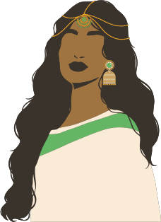

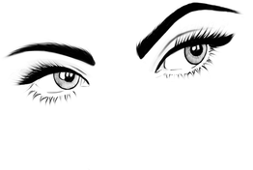
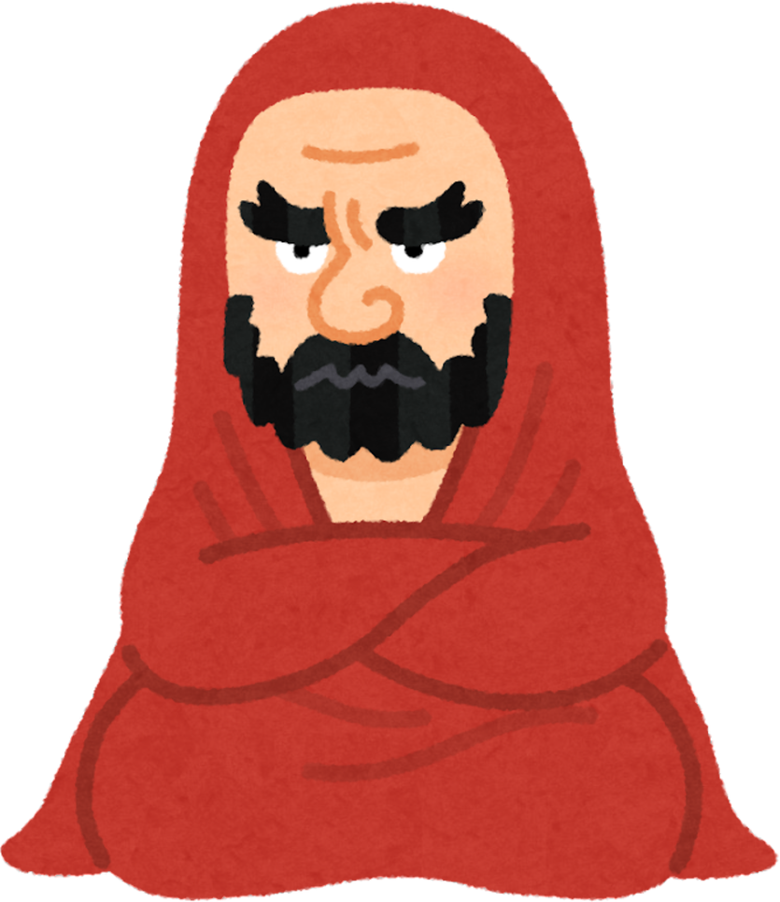


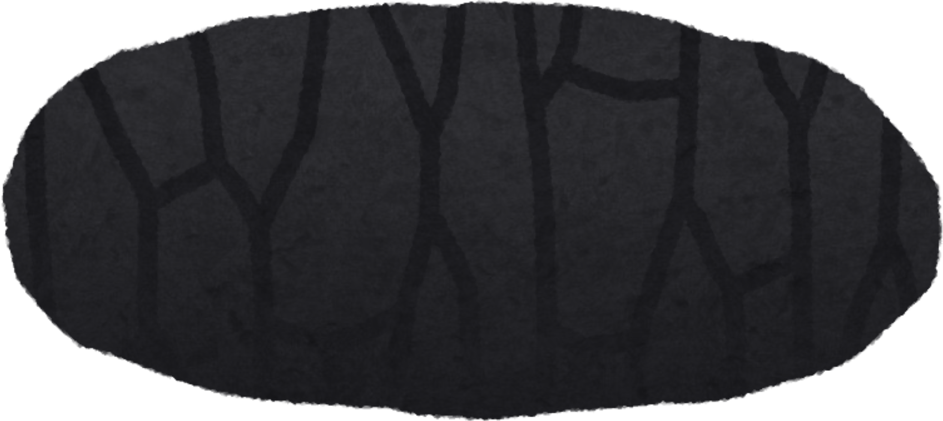

THE LIGHTER SIDE OF THE APOCRYPHA
(STORIES THAT MIGHT MAKE YOU SMILE)

Slide 2
WHY THE APOCRYPHA DOES NOT BELONG IN THE CANON
It postdates the age of inspiration
It was never included in the Hebrew canon
Its secondary status is recognized by those who accept it
It often contradicts Scripture
It often exalts Scripture as an authority

Slide 3
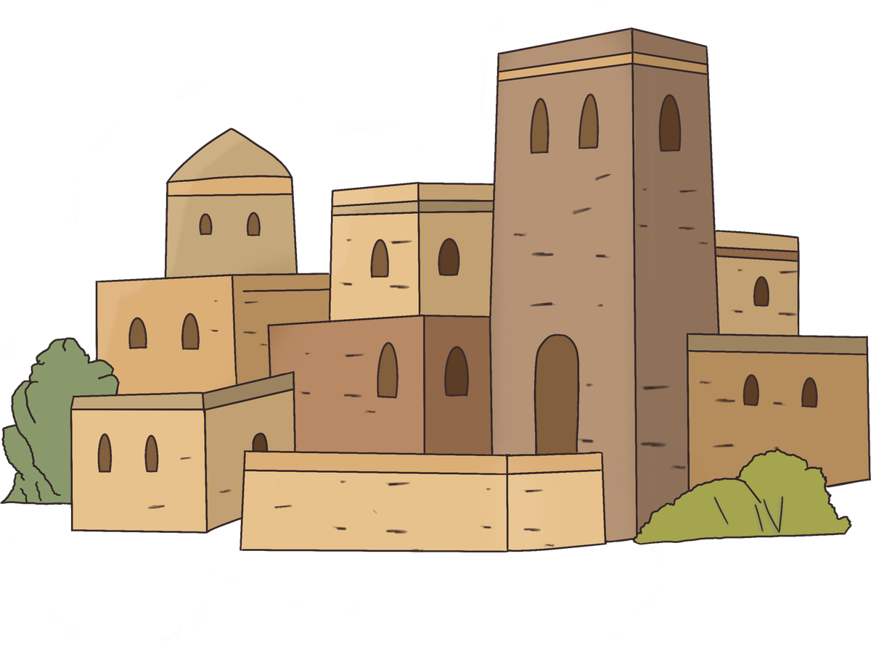

BEN SIRAH
Wealthy scribe and teacher
You might smile to hear what he says about the family
25:16 “I would rather live with a lion and a dragon than live with an evil woman.”
25:20 “A sandy ascent for the feet of the aged—such is a garrulous wife to a quiet husband.”

Slide 4

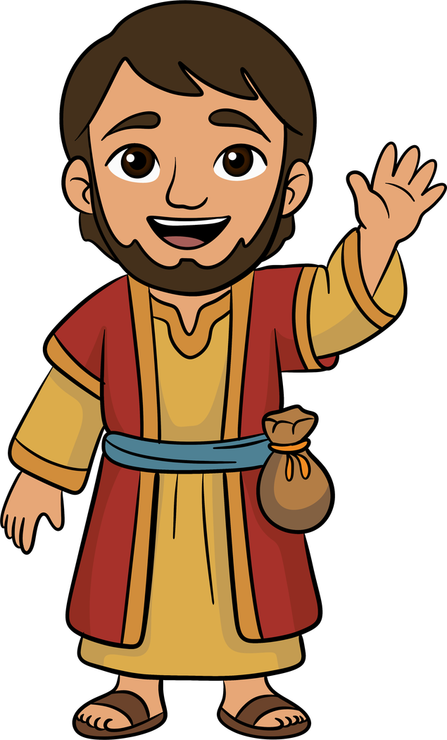
BEL AND THE DRAGON
Part of the Greek additions to Daniel
You might smile to hear how Daniel kills the dragon
Babylonians worshiped a snake
Daniel bet the king he could kill the snake
He makes cakes of pitch, fat, and hair
The snake eats the cakes and chokes to death

Slide 5

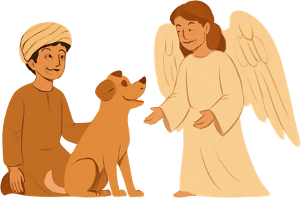
TOBIT
One of the earliest Apocrypha
You might smile to hear its story
Tobit is righteous but suffers blindness when a bird drops droppings in his eyes
Sarah is beautiful and righteous, but her husbands keep getting killed by a demon named Asmodeus
Tobias obtains a cure for his father and drives the demon away so he can marry Sarah

Slide 6

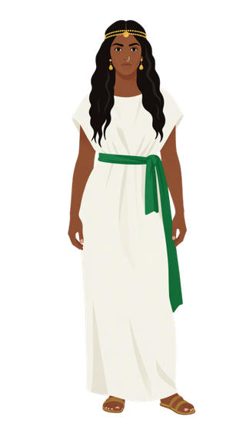

JUDITH
Probably late 2nd century BC
You might smile to hear:
Judith decks herself out to fool the Assyrians
She lies about her mission, pretending to defect
She sets up the Assyrian general Holofernes, and cuts off his head with his own sword
She sneaks back to Jerusalem undetected

Slide 7

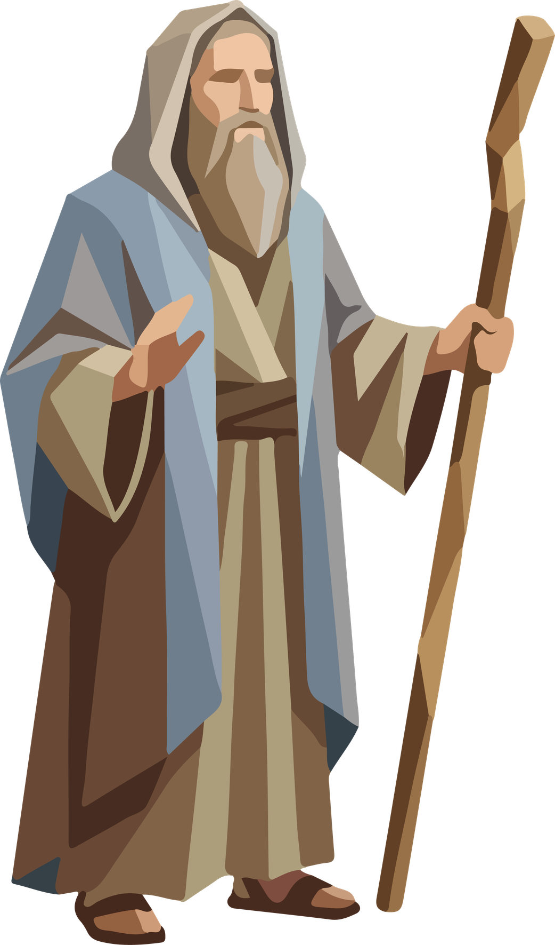

2 MACCABEES
Late 2nd century BC abridgement
You might smile to hear:
Jeremiah hides the tent of meeting, ark of the covenant, and the altar of incense in a cave on Mount Nebo
When people try to follow him, they are somehow prevented from remembering where the cave is
Jeremiah declares that the location will only be revealed in a future era when God’s glory is revealed again

Slide 8

“IF YOU THINK THE APOCRYPHA BELONGS IN THE CANON, THEN READ IT”

