Slide 2
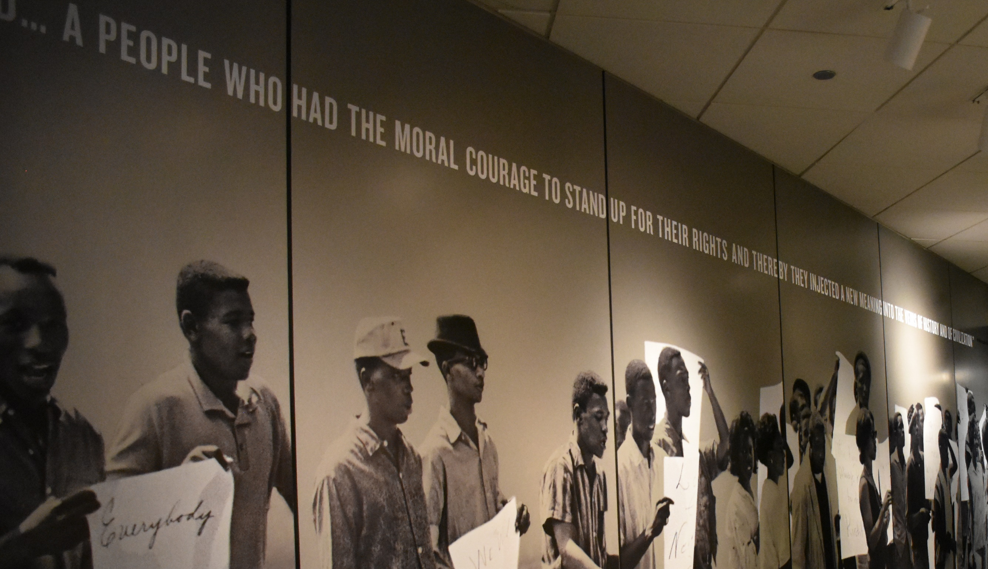
Unrealized Battlegrounds
2 Corinthians 10:3-5

Slide 3
Reality of the War 2 Corinthians 10:3
1. We are at war SPIRITUALLY 1 Cor 9:7;
1 Tim 1:18; 2 Tim 2:4; Jas 4:1; 1 Pet 2:11
2. This is the greatest war ever!
▪ longer ▪ more at stake ▪ most powerful opponents ▪ most critical outcome (eternity)

Slide 4
Rudiments of the War 2 Corinthians 10:4-5
1. Not carnal / fleshly Eph 6:12
2. Enemy’s goal – destroy knowledge of
God’s word Luke 8:12
▪ Each stronghold “Exalts itself against
the knowledge of God” 1 Cor 1:17–2:5

Slide 5
Rudiments of the War 2 Corinthians 10:4-5
3. Enemy’s Strongholds
▪ “Arguments [imaginations, KJV;
speculations, NAS]” Rom 2:15 - thoughts
▪ “High things [lofty opinion, ESV]”
Rom 8:39

Slide 6
Rudiments of the War 2 Corinthians 10:4-5
3. Enemy’s Strongholds (continued)
▪ “Thought” = method, design, plot 2 Cor
2:11; 3:14; 4:4; 11:3; Phil 4:7

Slide 7
Rudiments of the War 2 Corinthians 10:4-5
4. DEMISE of Enemy’s Strongholds
▪ Weapons “mighty in God [divinely
powerful, NAS]” Eph 6:10-18
▪ “Pulling down [the destruction of, NAS]”
2 Cor 13:10; Jer 1:10

Slide 8
Rudiments of the War 2 Corinthians 10:4-5
4. DEMISE of Enemy’s Strongholds (cont’)
▪ “Casting down” (lift up + down)
Rom 1:16; Heb 4:12

Slide 9
Results of the War 2 Corinthians 10:4-5
1. Victory is OBEDIENCE to Christ!
▪ “Bringing … into captivity”
Luke 21:24; Rom 7:23
▪ “Obedience to Christ” Gal 2:20;
Rom 1:5; 16:26
2. Obedience must be fulfilled v. 6

Slide 10
Takeaways (2 Cor. 10:3-5)
1. The devil is constantly on the prowl
1 Pet. 5:8; Rev. 12:9
2. God has given us victorious spiritual
equipment Eph. 6:10-18
3. Through Christ, we can resist and
defeat the devil James 4:7; 1 Pet. 5:9

Slide 11
Are We Winning
The Battles?

