Slide 1
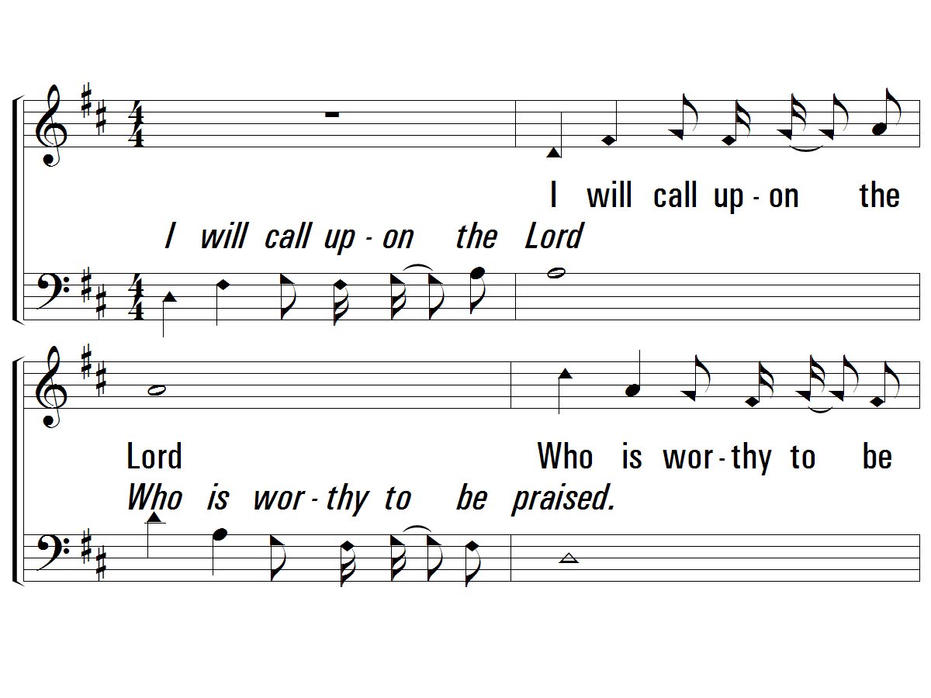
1 - I Will Call Upon The Lord
I will call upon the Lord
Who is worthy to be praised.
So shall I be saved from my enemies.
The Lord liveth, and blessed be the Rock,
and let the God of my salvation be exalted.
The Lord liveth, and blessed be the Rock,
and let the God of my salvation be exalted.
Words and Music by: Michael O’Shields
Copyright © 1981 by Sound III, Inc.
PaperlessHymnal.com

Slide 2
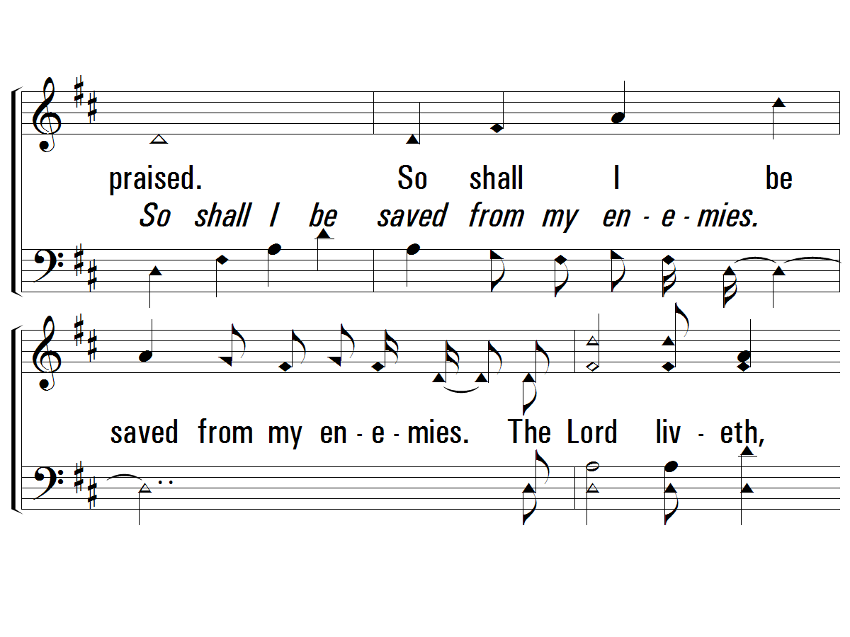
1 - I Will Call Upon The Lord
PaperlessHymnal.com

Slide 3
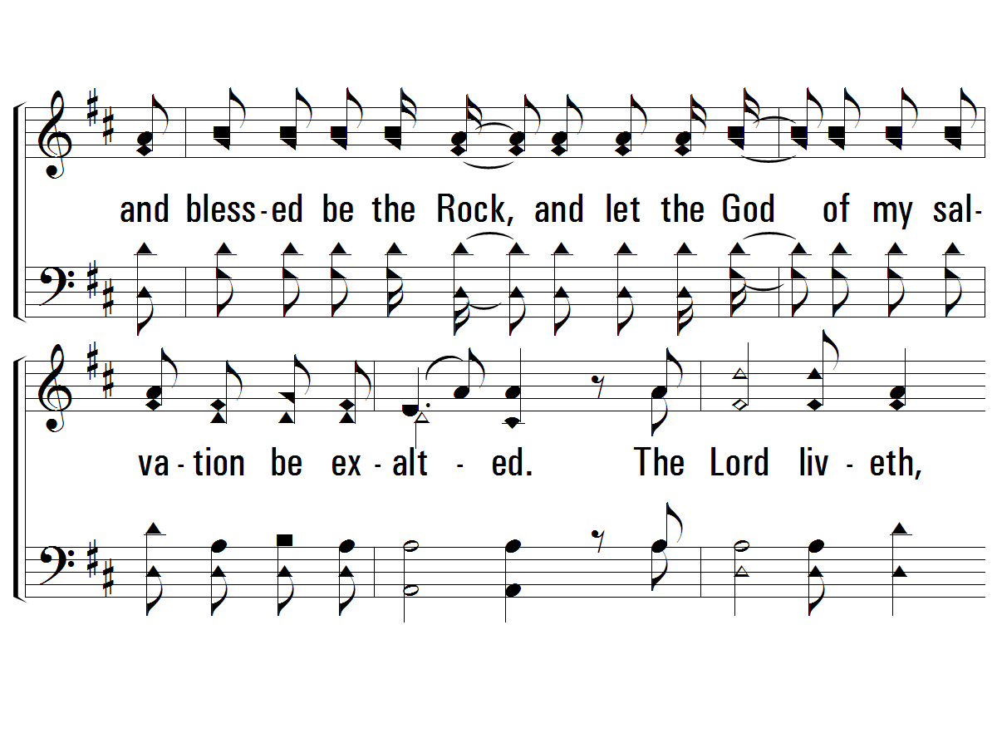
1 - I Will Call Upon The Lord
PaperlessHymnal.com

Slide 4
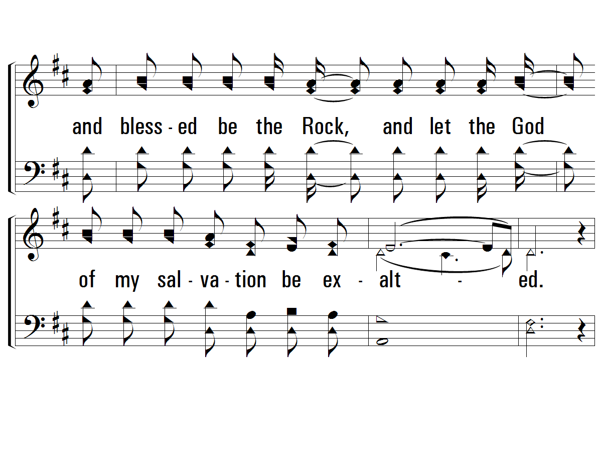
1 - I Will Call Upon The Lord
PaperlessHymnal.com

Slide 5
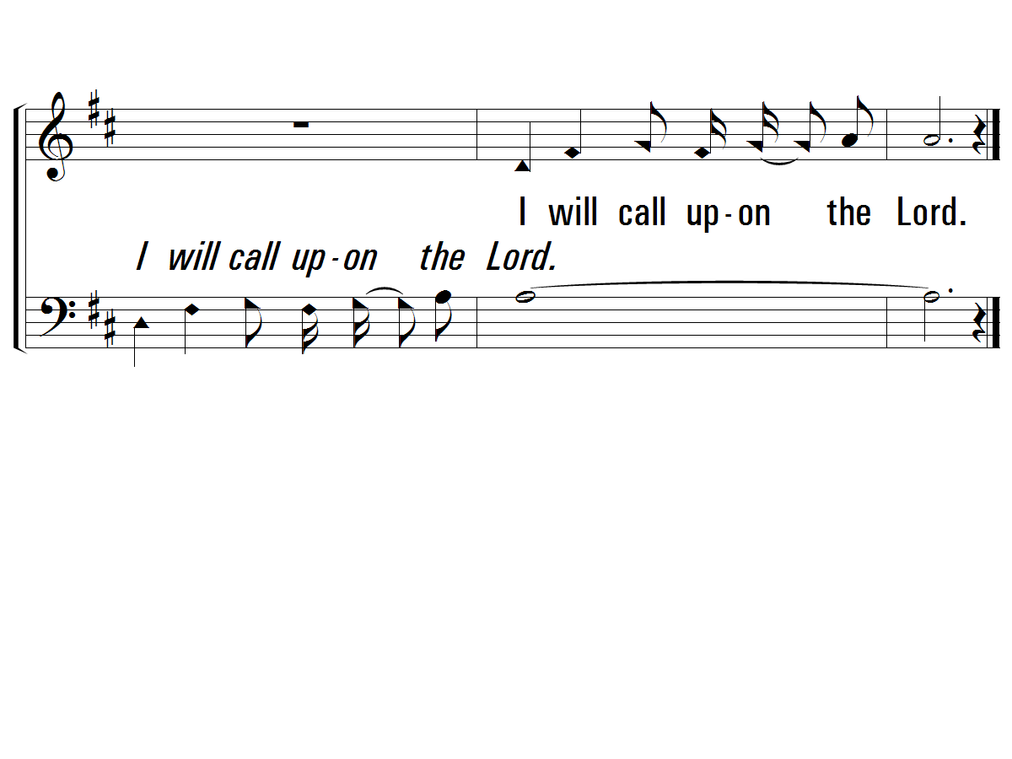
1 - I Will Call Upon The Lord
PaperlessHymnal.com

Slide 6
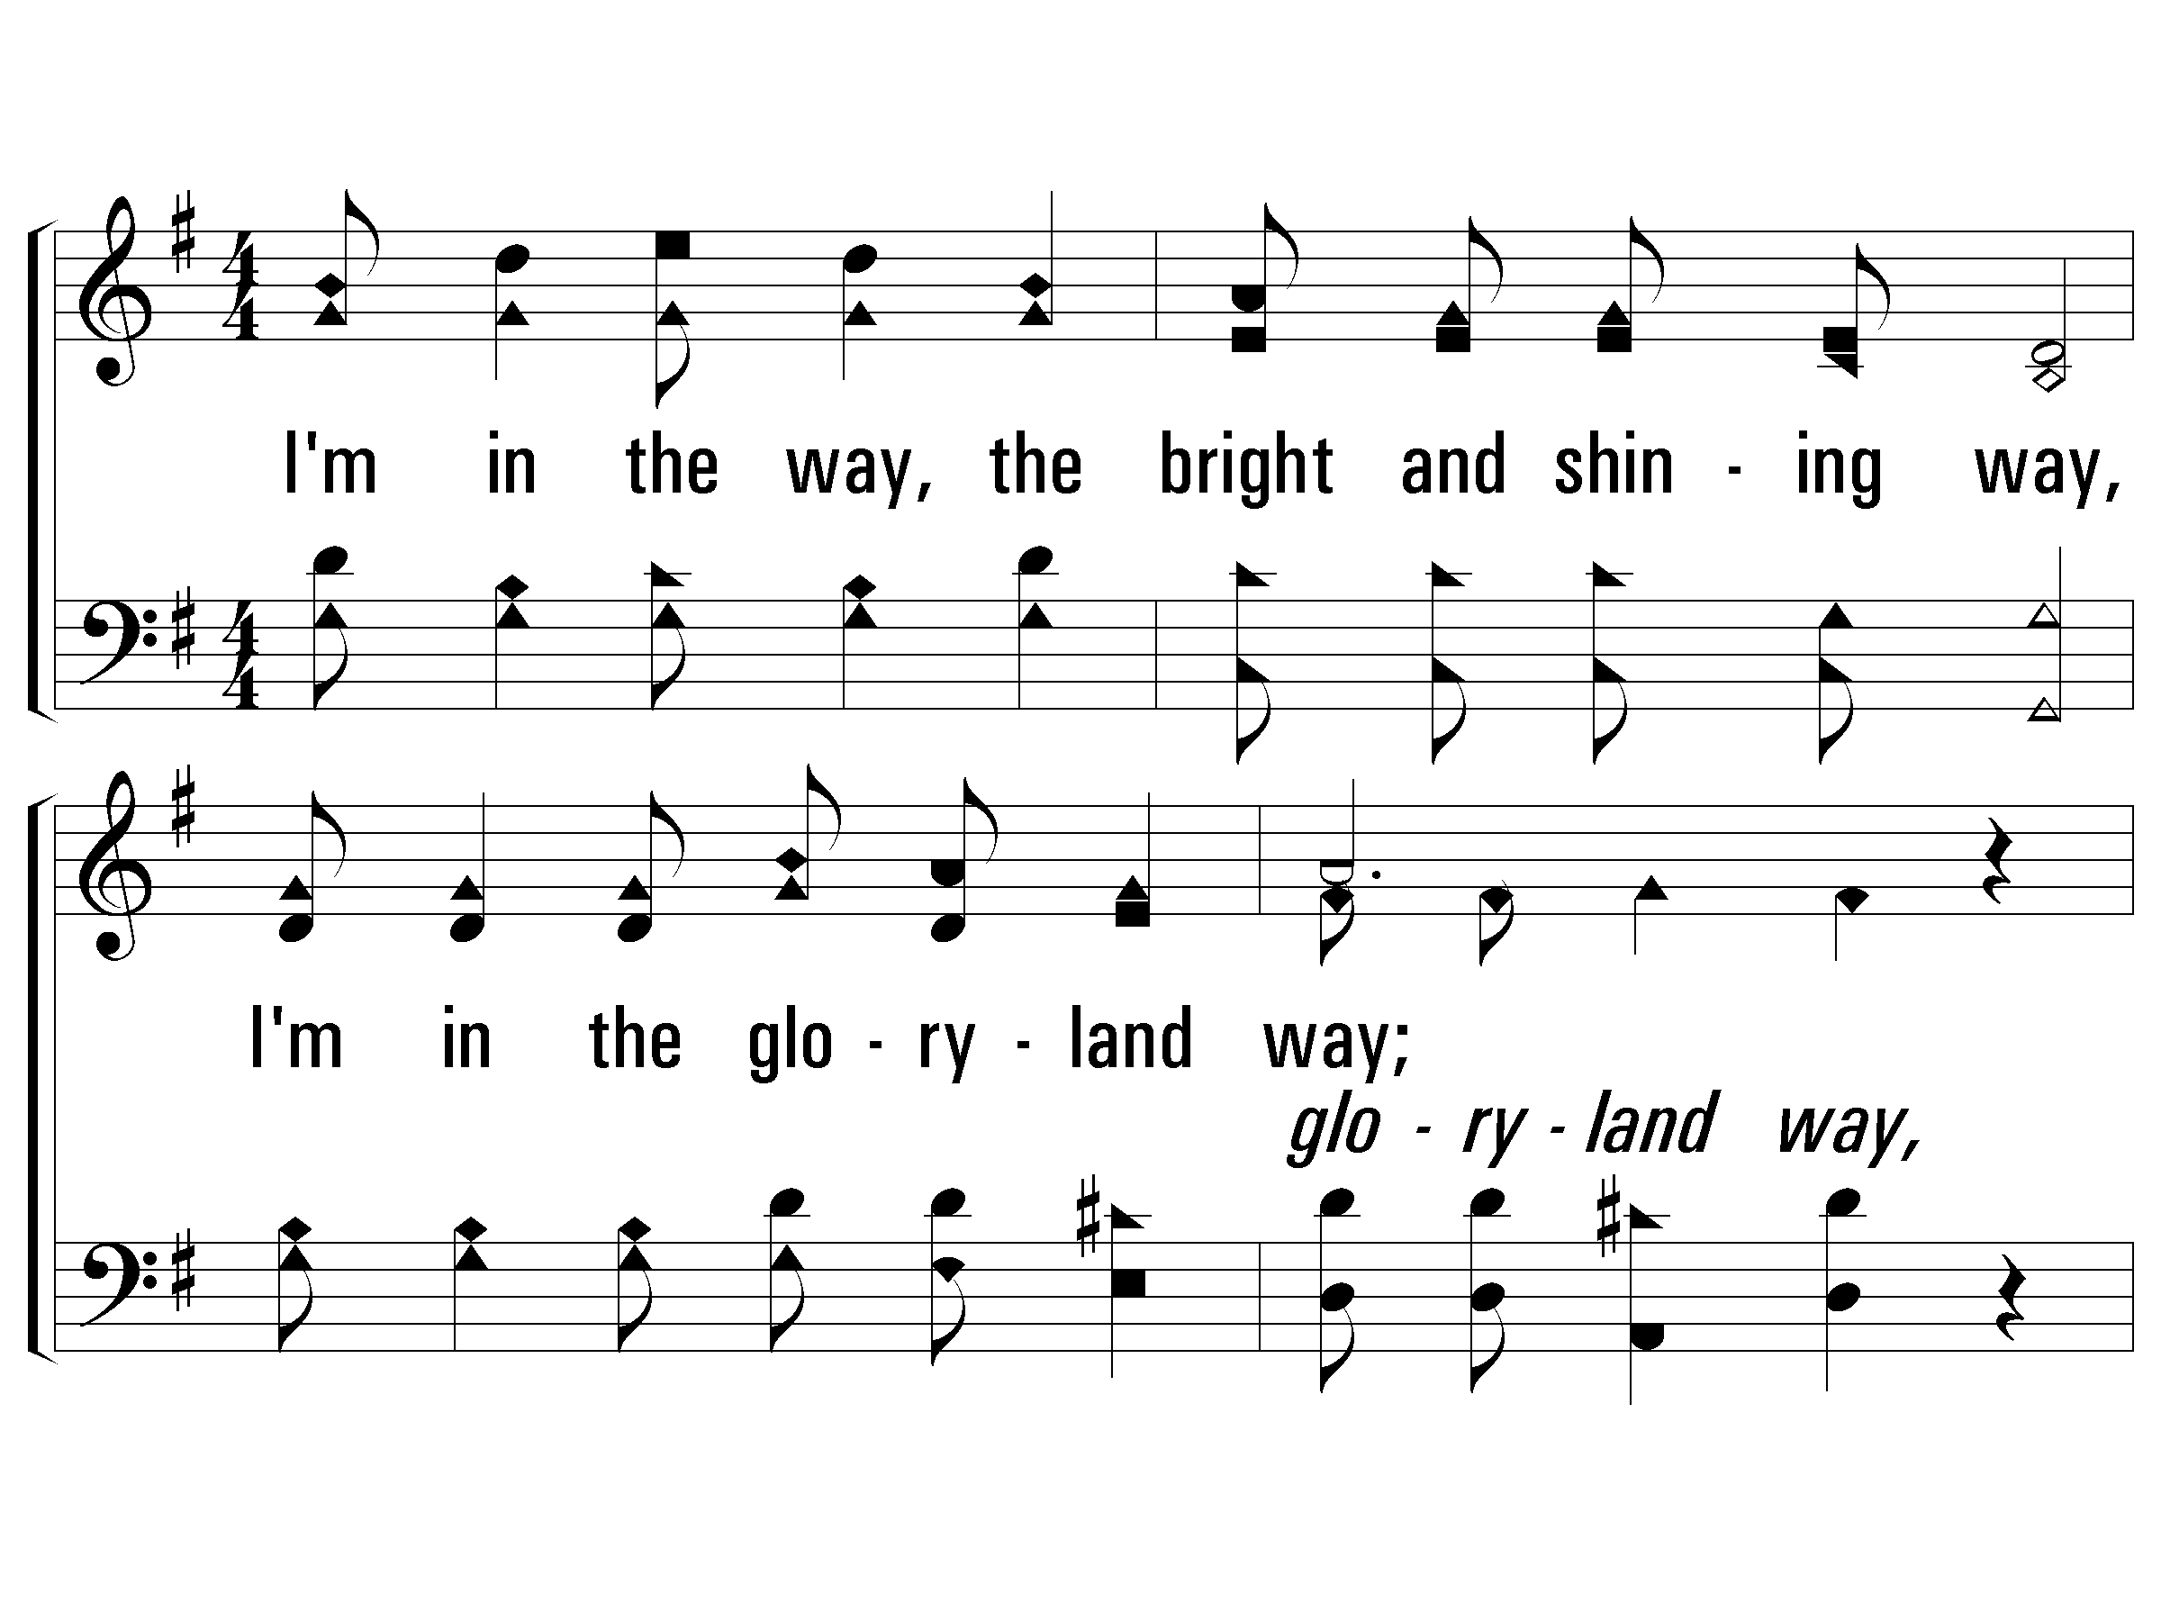
1 – The Glory-Land Way
1.
I'm in the way, the bright and shining way,
I'm in the gloryland way;
Telling the world that Jesus saves today,
Yes, I'm in the gloryland way.
Words and Music by: J. S. Torbett
PaperlessHymnal.com

Slide 7
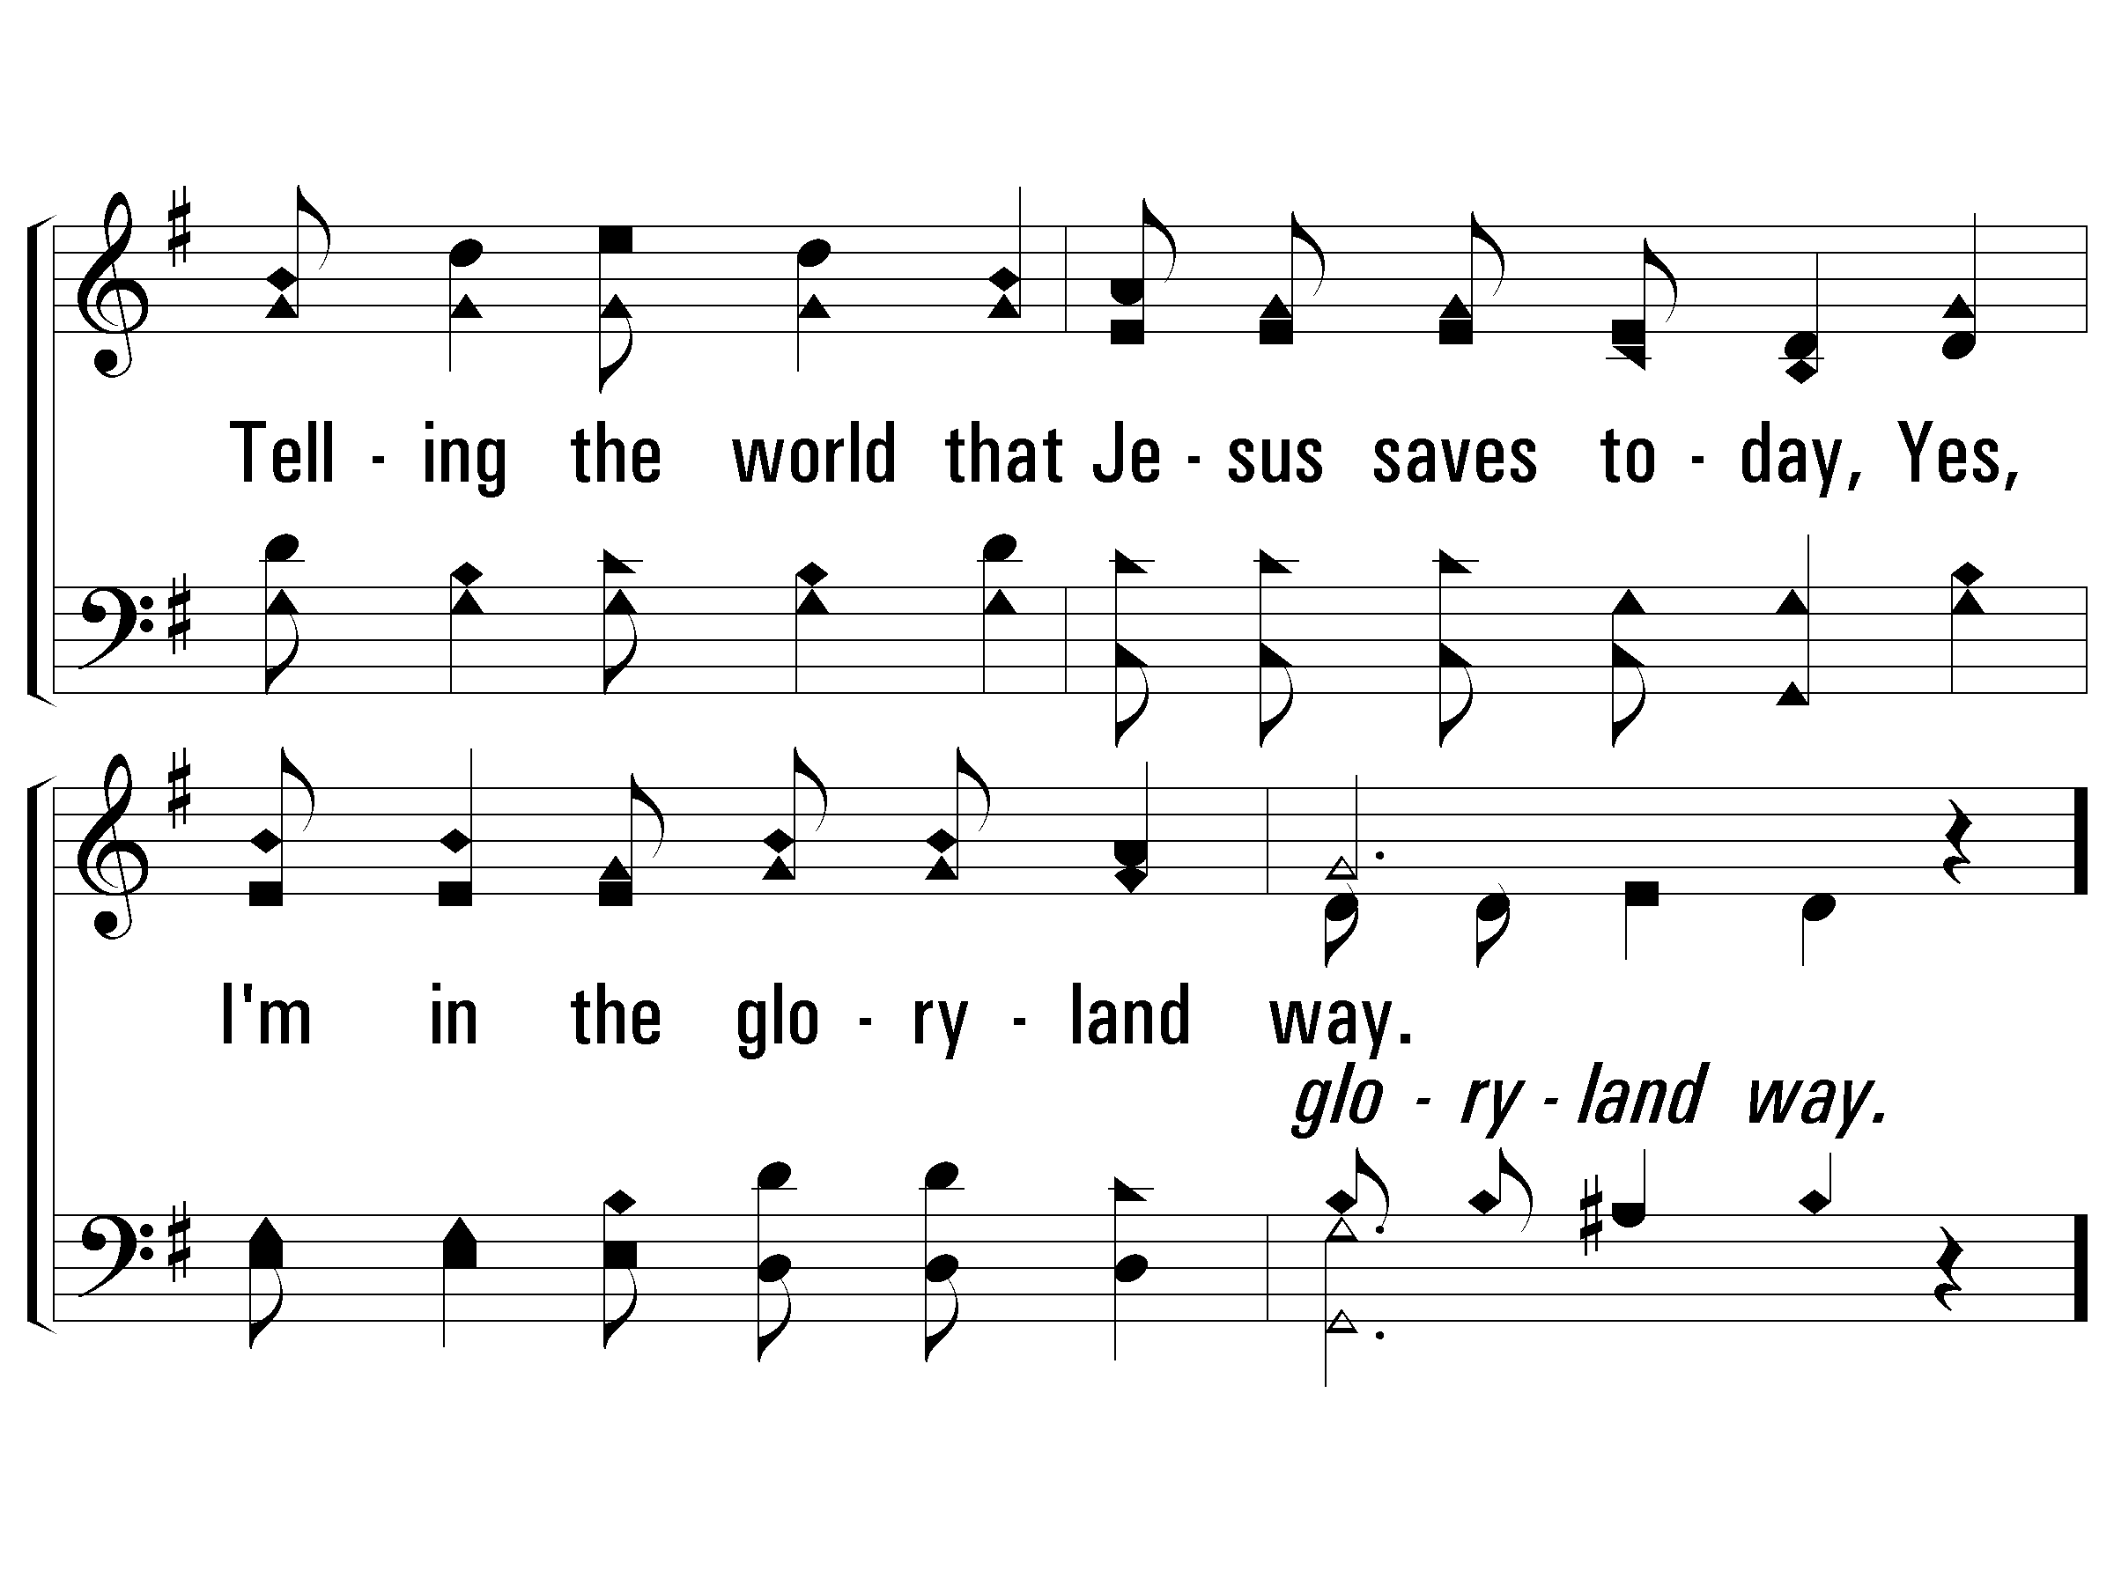
1 – The Glory-Land Way
PaperlessHymnal.com

Slide 8
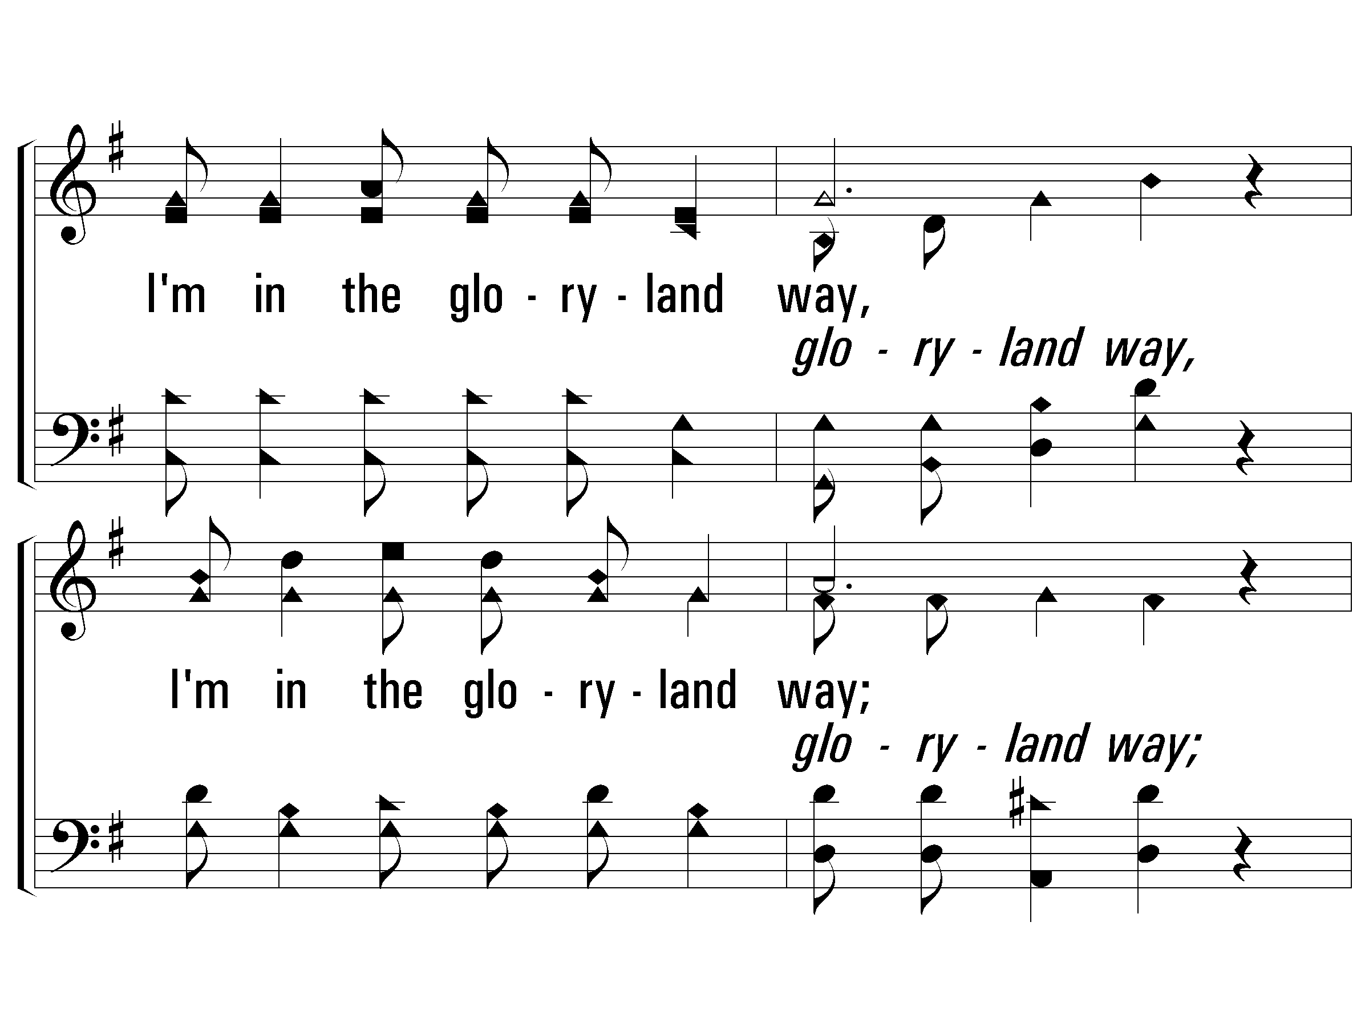
c – The Glory-Land Way
I'm in the gloryland way,
I'm in the gloryland way;
Heaven is nearer and the way groweth clearer,
For I'm in the gloryland way.
PaperlessHymnal.com

Slide 9
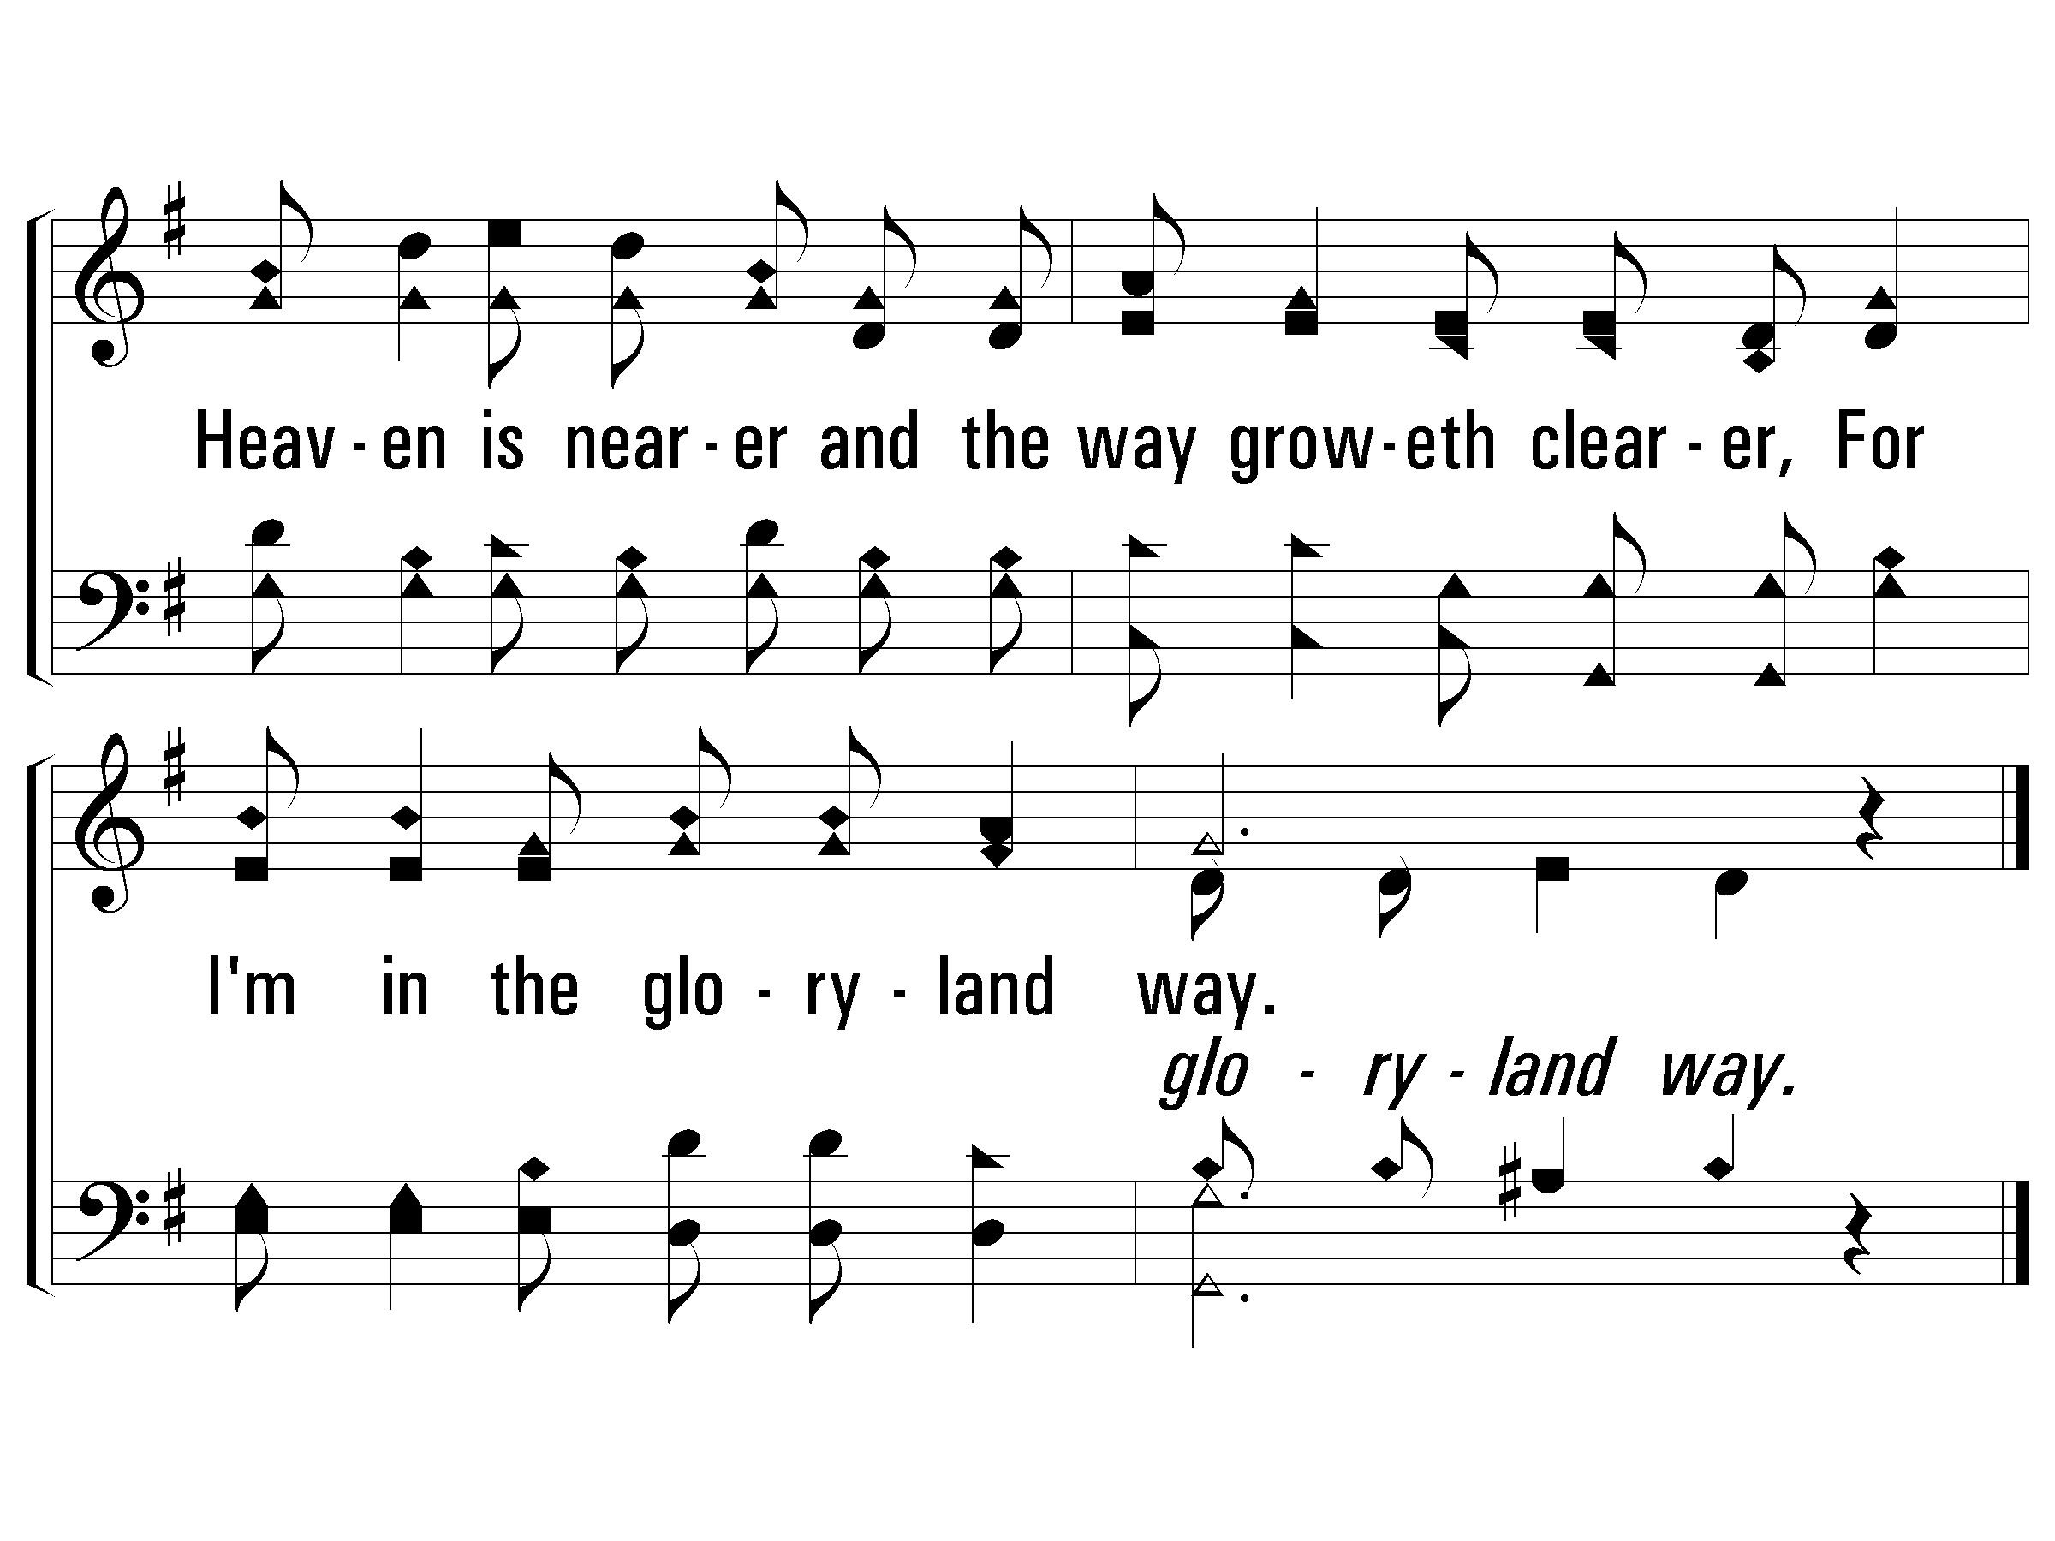
c – The Glory-Land Way
PaperlessHymnal.com

Slide 10
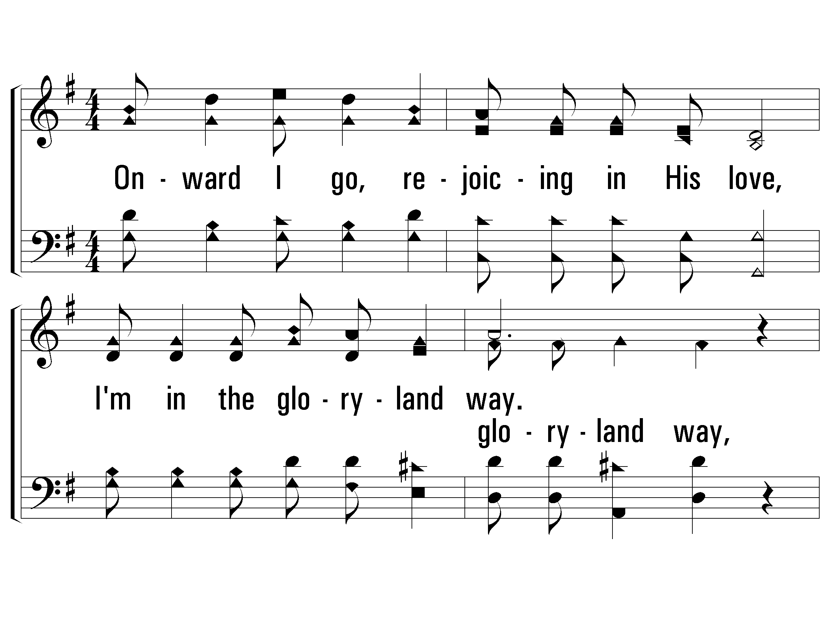
3 – The Glory-Land Way
3.
Onward I go, rejoicing in His love,
I'm in the gloryland way;
Soon I shall see Him in that home above,
O I'm in the gloryland way.
Words and Music by: J. S. Torbett
PaperlessHymnal.com

Slide 11
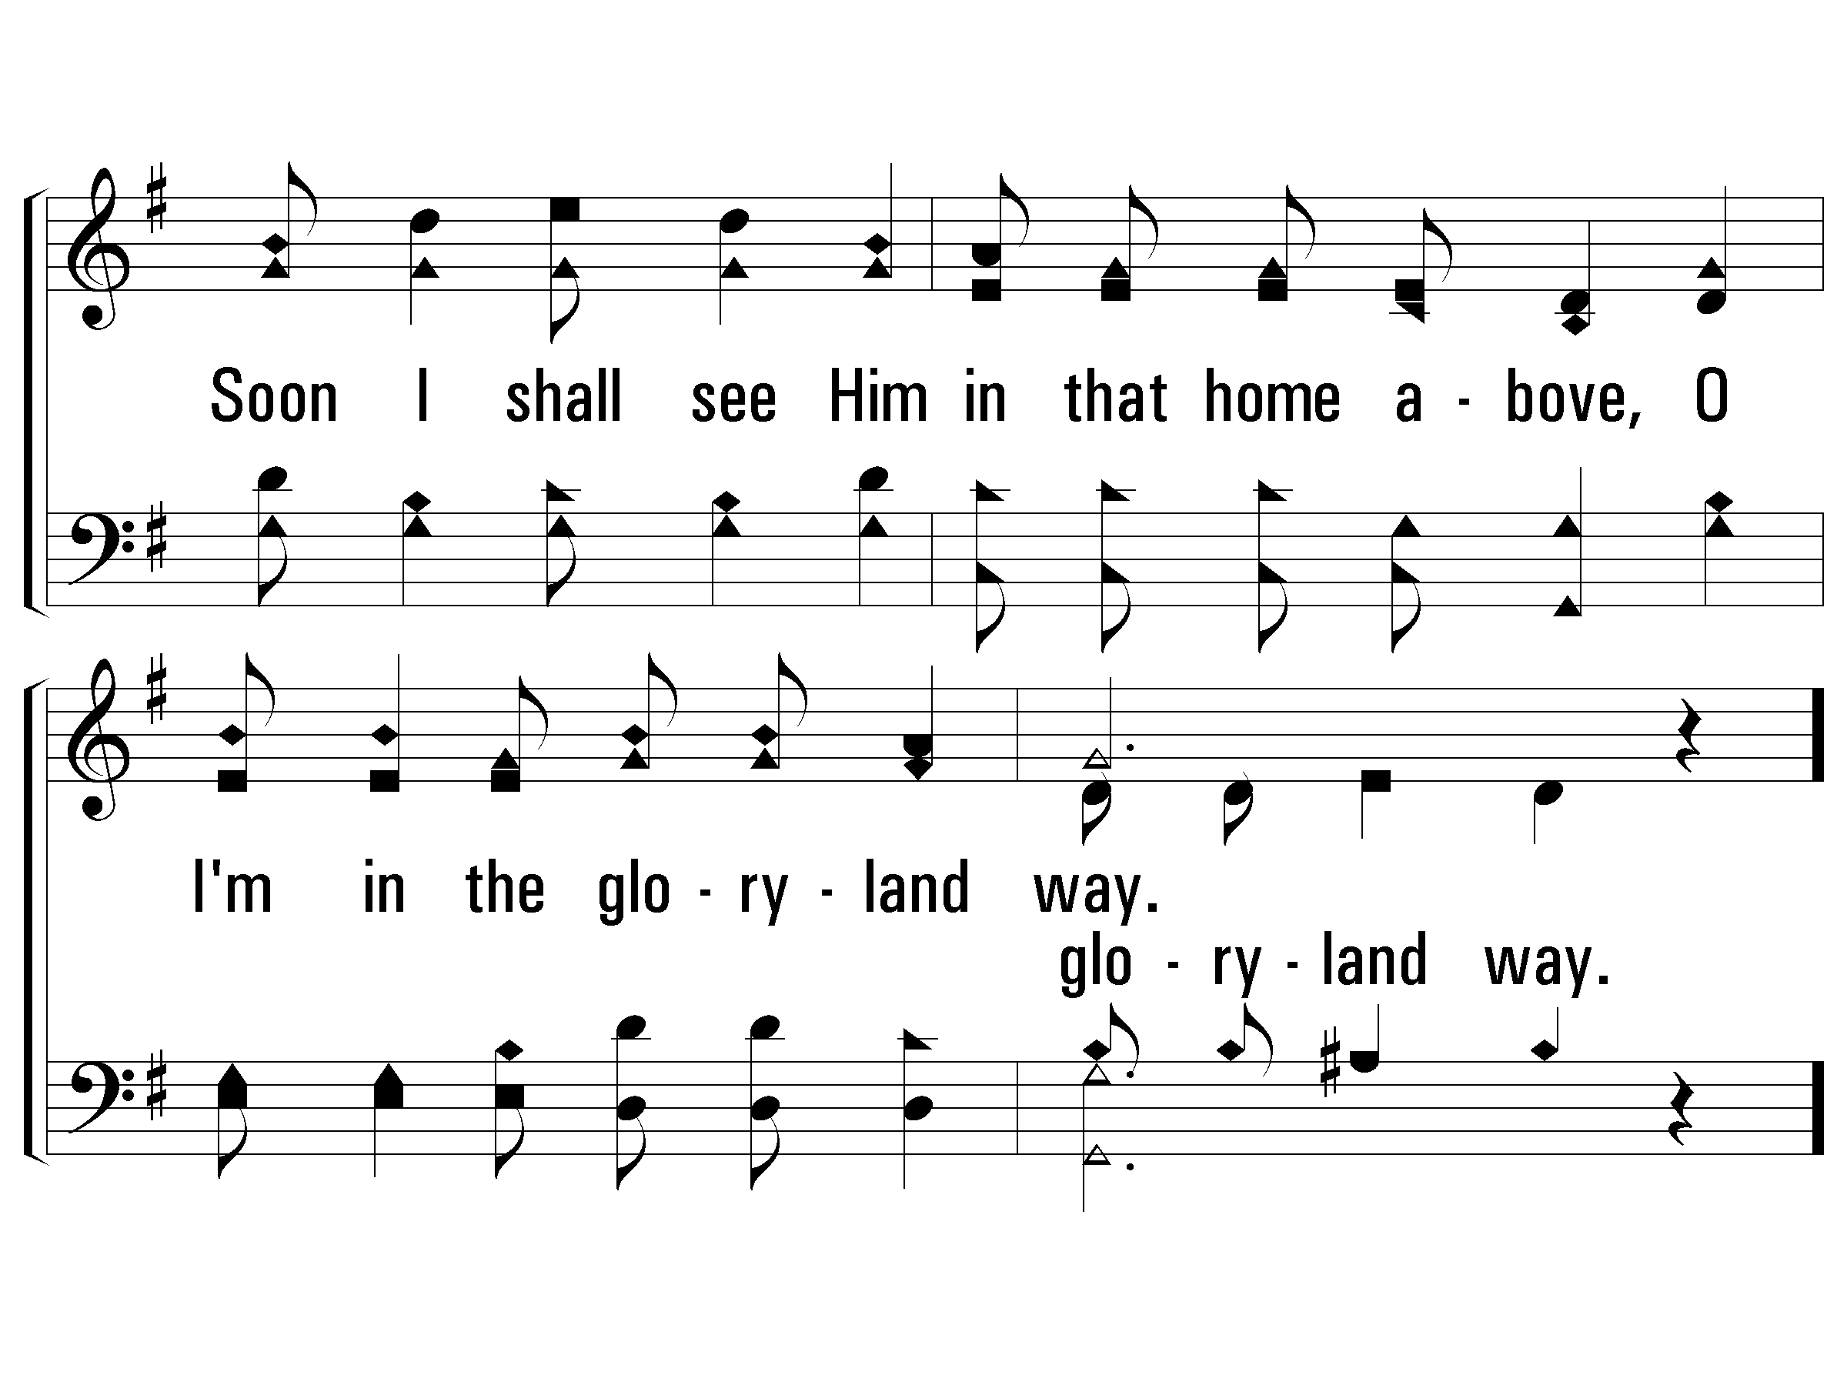
3 – The Glory-Land Way
PaperlessHymnal.com

Slide 12
c – The Glory-Land Way
I'm in the gloryland way,
I'm in the gloryland way;
Heaven is nearer and the way groweth clearer,
For I'm in the gloryland way.
PaperlessHymnal.com

Slide 13
c – The Glory-Land Way
PaperlessHymnal.com

Slide 14
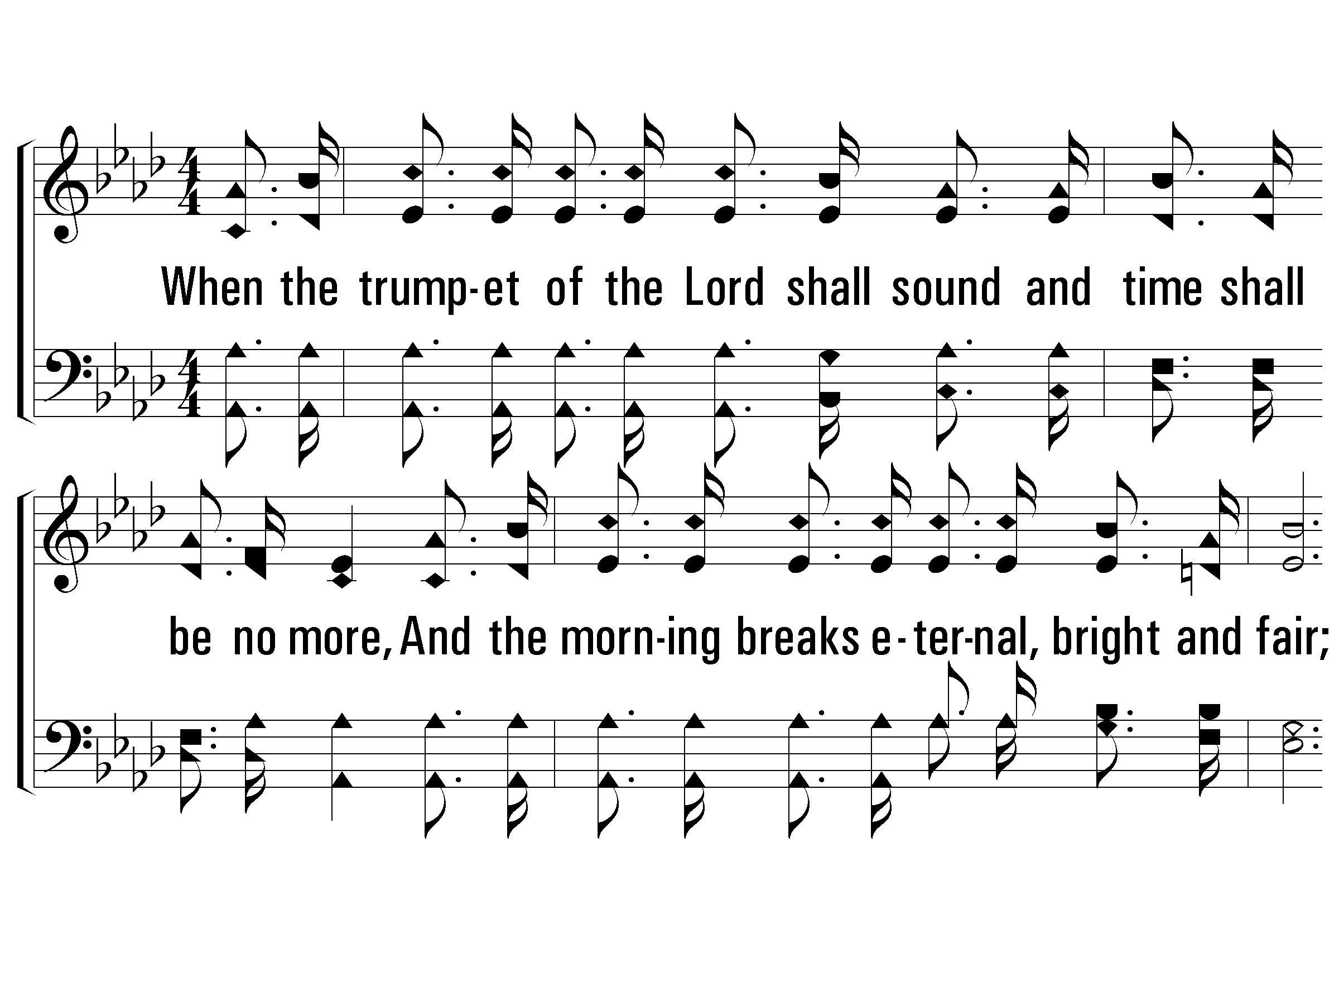
1 – When the Roll Is Called Up Yonder
1.
When the trumpet of the Lord shall sound
and time shall be no more,
And the morning breaks eternal, bright and fair;
When the saved of earth shall gather over on the other shore,
And the roll is called up yonder, I'll be there.
Words & Music: James M. Black
PaperlessHymnal.com

Slide 15
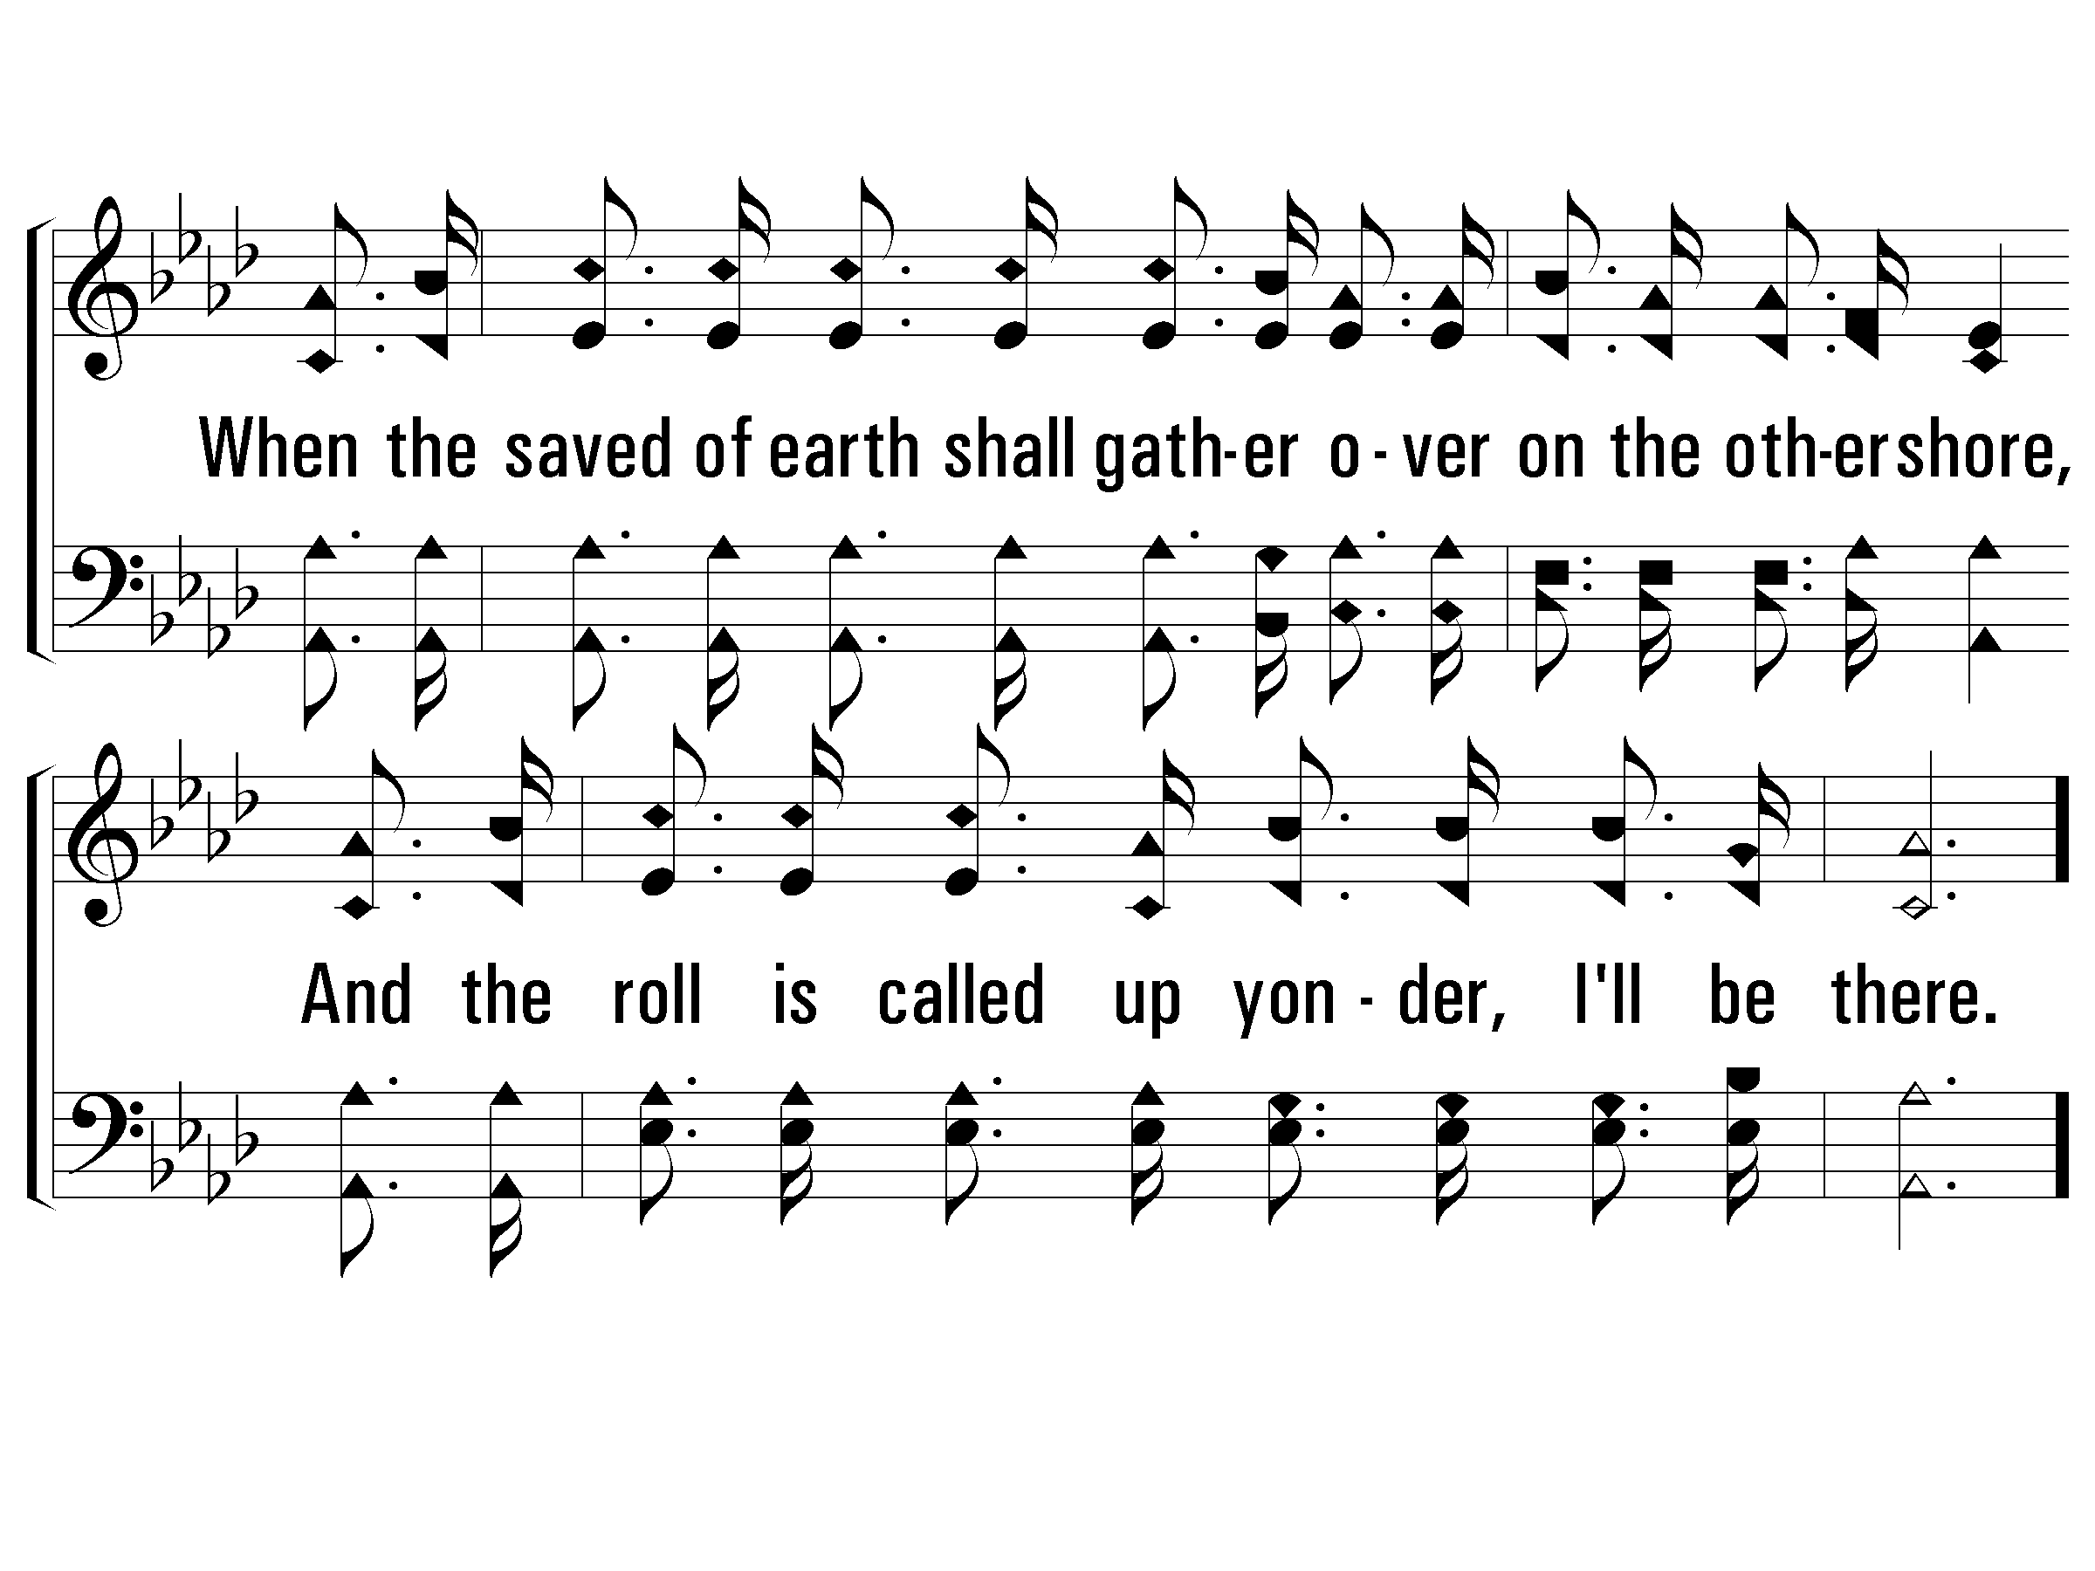
1 – When the Roll Is Called Up Yonder
PaperlessHymnal.com

Slide 16
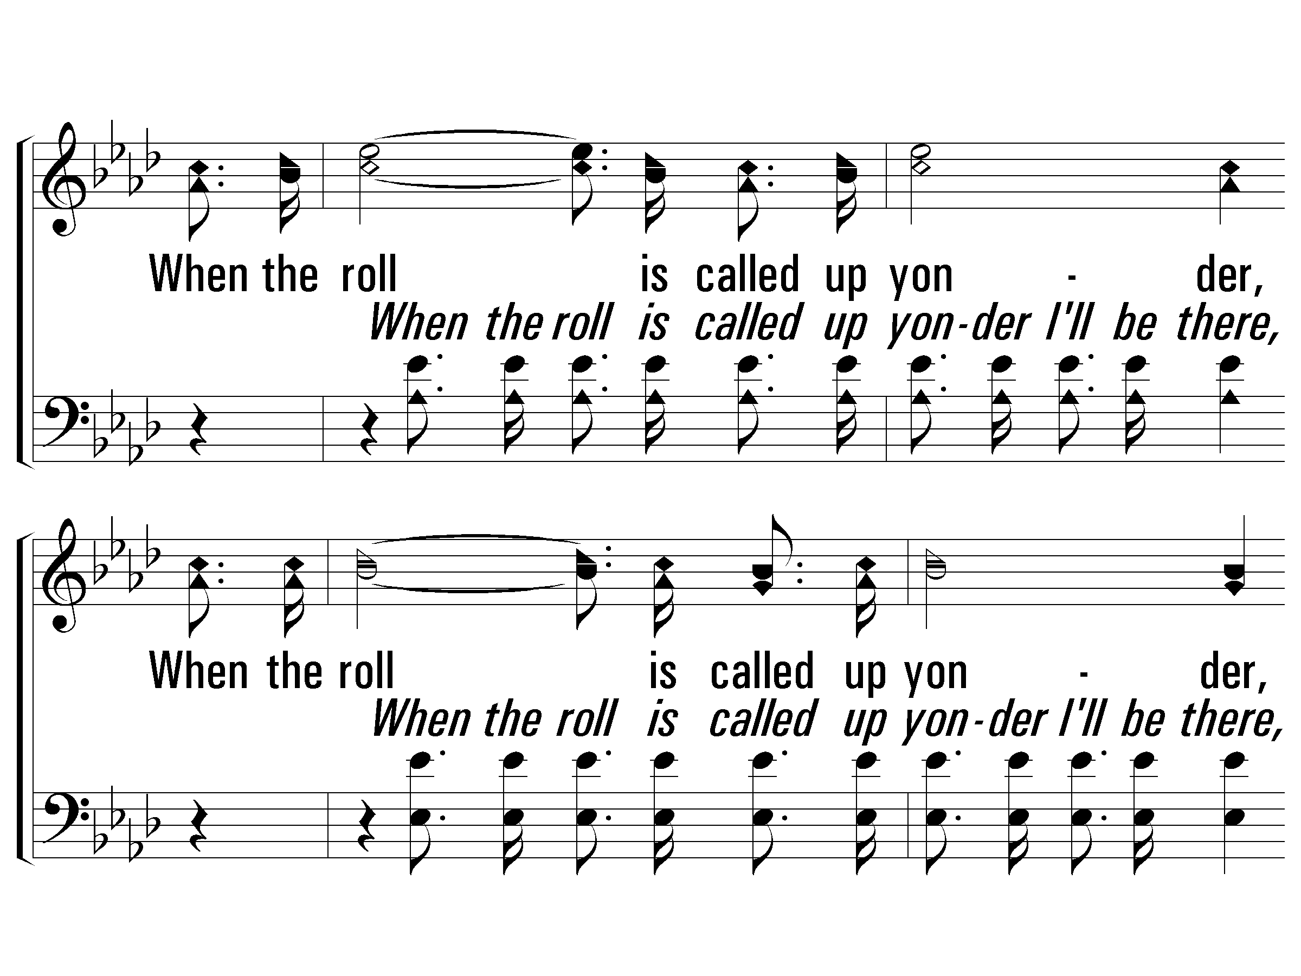
c – When the Roll Is Called Up Yonder
When the roll is called up yonder,
When the roll is called up yonder,
When the roll is called up yonder,
When the roll is called up yonder, I'll be there.
PaperlessHymnal.com

Slide 17
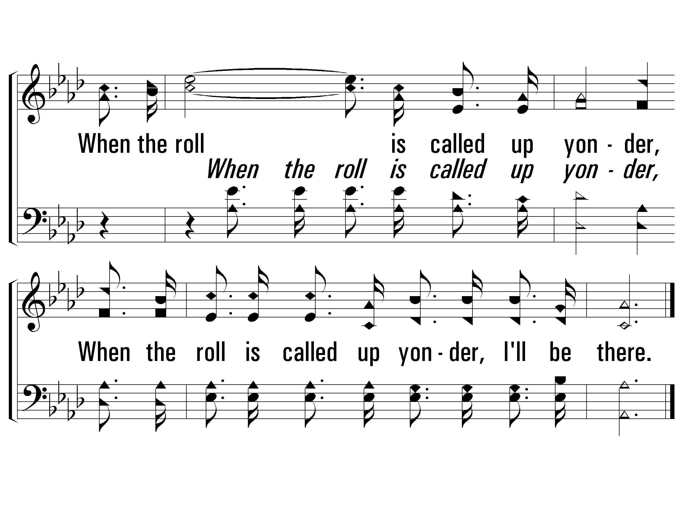
c – When the Roll Is Called Up Yonder
PaperlessHymnal.com

Slide 18
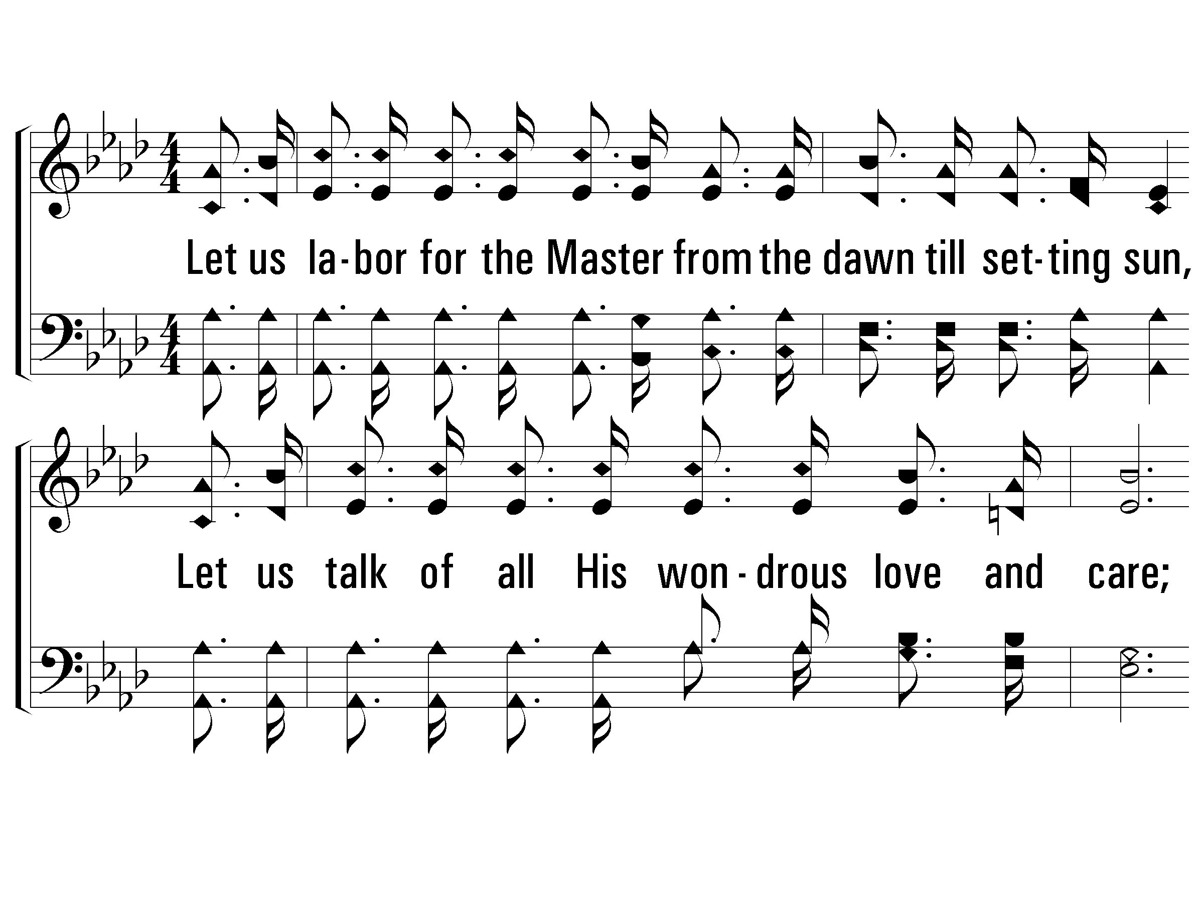
3 – When the Roll Is Called Up Yonder
3.
Let us labor for the Master from the dawn till setting sun,
Let us talk of all His wondrous love and care;
Then when all of life is over and our work on earth is done,
And the roll is called up yonder, I'll be there.
Words & Music: James M. Black
PaperlessHymnal.com

Slide 19
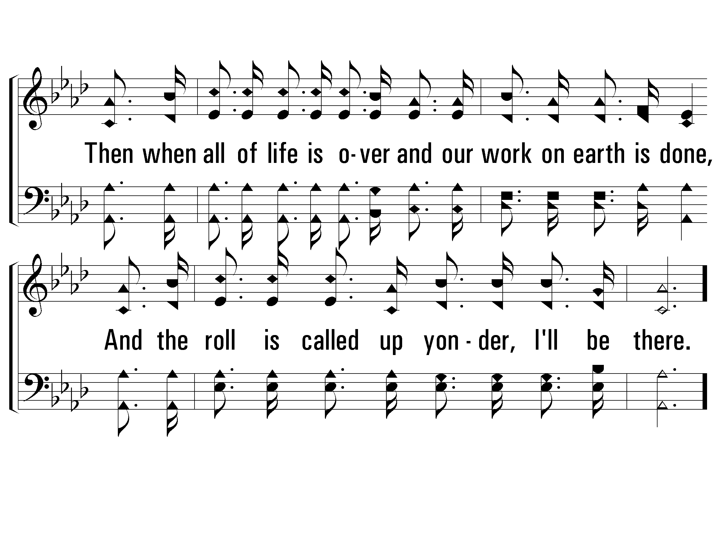
3 – When the Roll Is Called Up Yonder
PaperlessHymnal.com

Slide 20
c – When the Roll Is Called Up Yonder
When the roll is called up yonder,
When the roll is called up yonder,
When the roll is called up yonder,
When the roll is called up yonder, I'll be there.
PaperlessHymnal.com

Slide 21
c – When the Roll Is Called Up Yonder
PaperlessHymnal.com

Slide 22
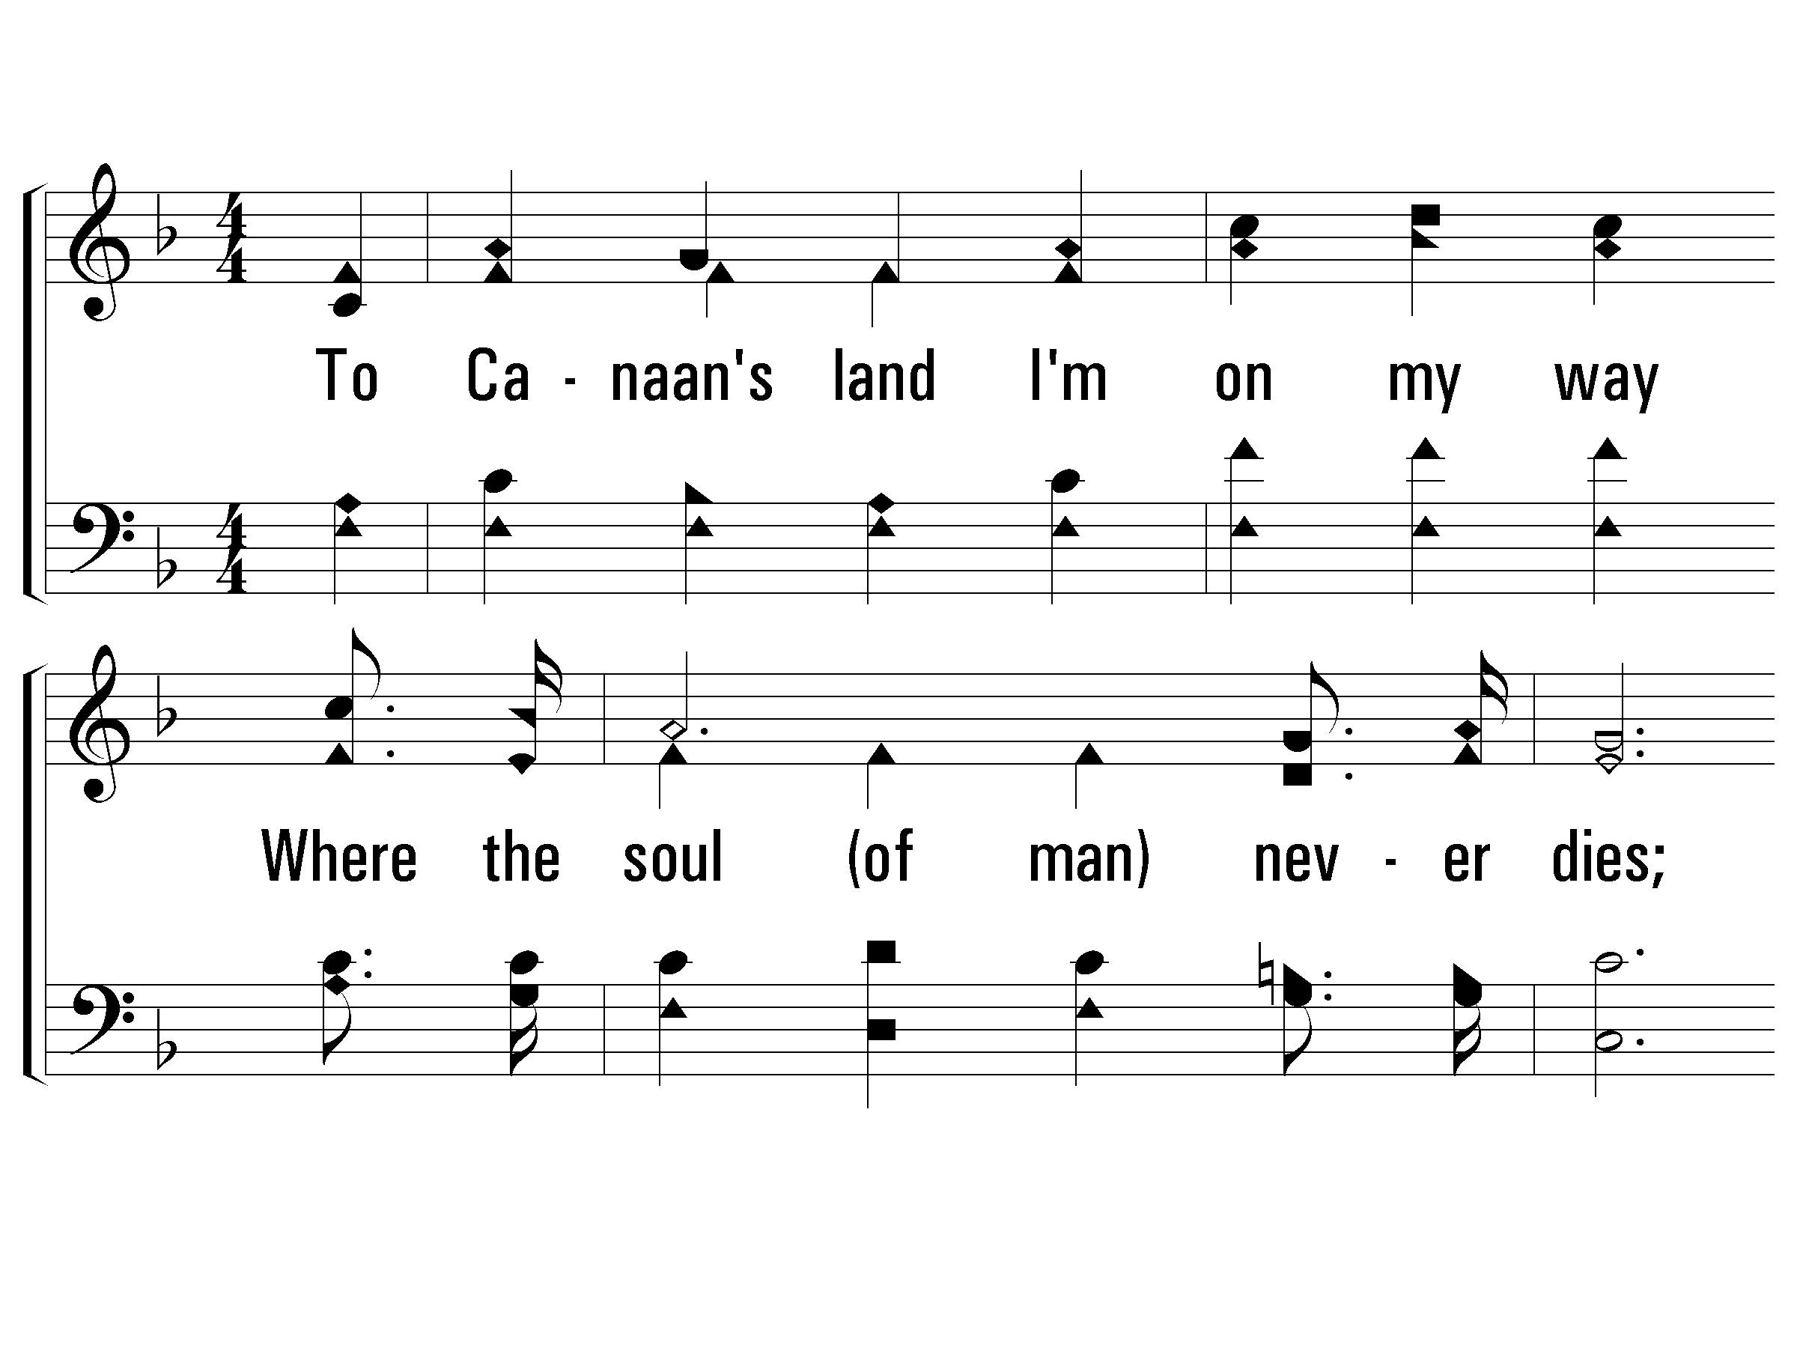
1 - To Canaan’s Land I’m on My Way
1.
To Canaan's land I'm on my way
Where the soul (of man) never dies;
My darkest night will turn to day,
Where the soul (of man) never dies.
Words and Music by: William M. Golden
PaperlessHymnal.com

Slide 23
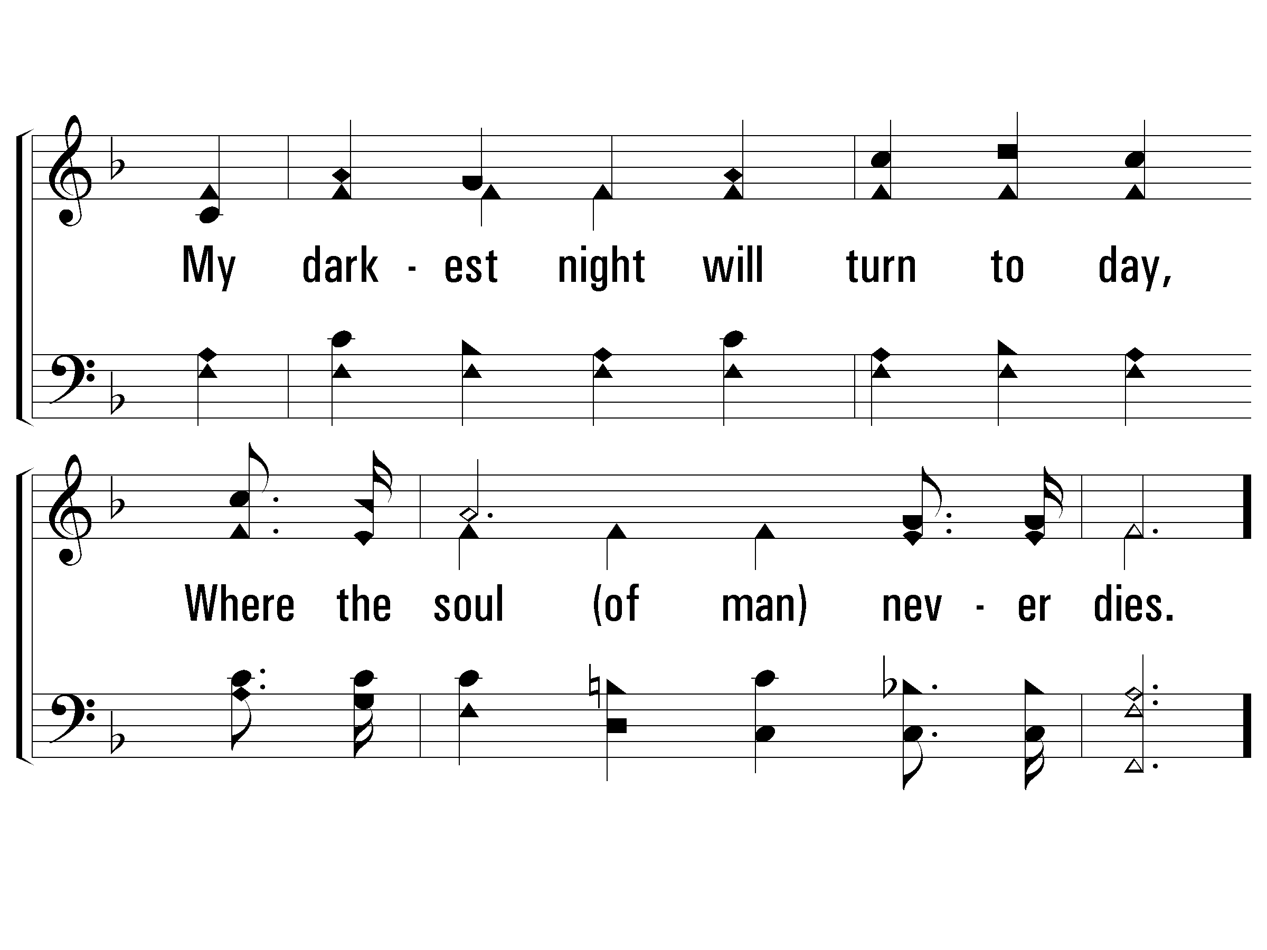
1 - To Canaan’s Land I’m on My Way
PaperlessHymnal.com

Slide 24
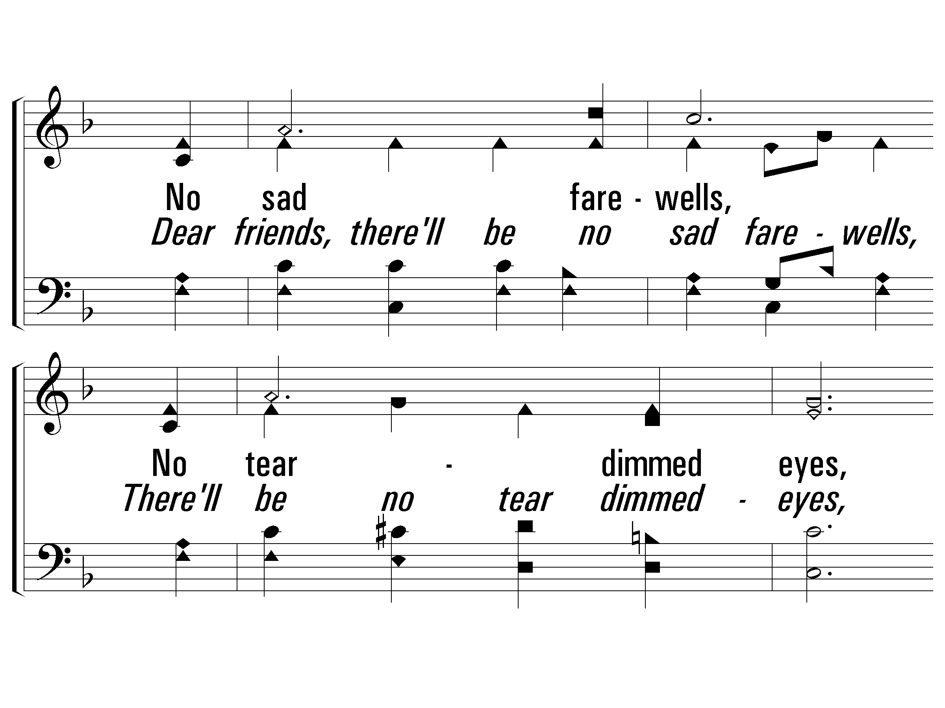
c - To Canaan’s Land I’m on My Way
Dear friends, there'll be no sad fair-wells,
There'll be no tear-dimmed eyes,
Where all is peace and joy and love,
And the soul of man never dies.
PaperlessHymnal.com

Slide 25
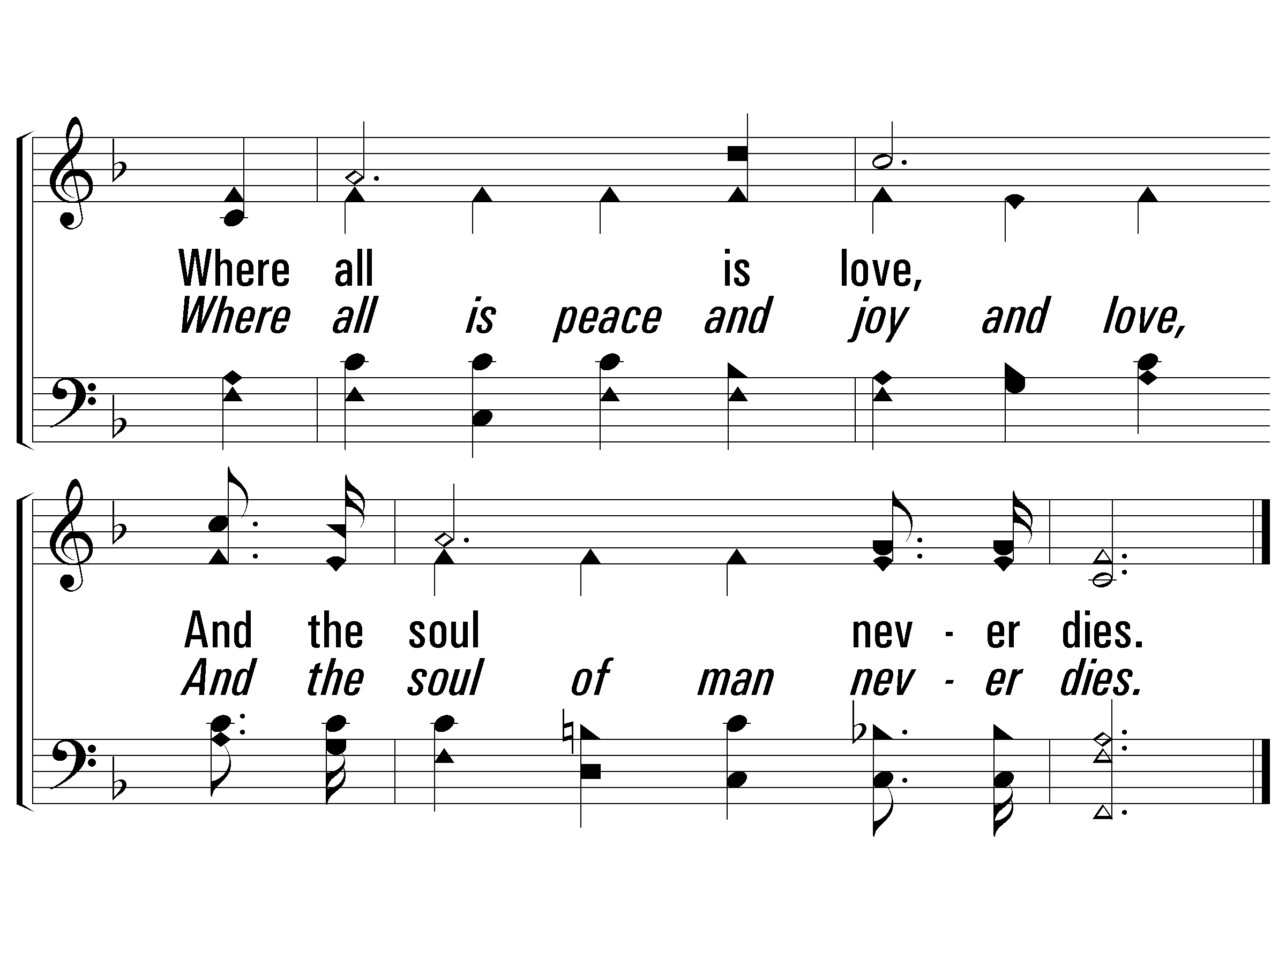
c - To Canaan’s Land I’m on My Way
PaperlessHymnal.com

Slide 26
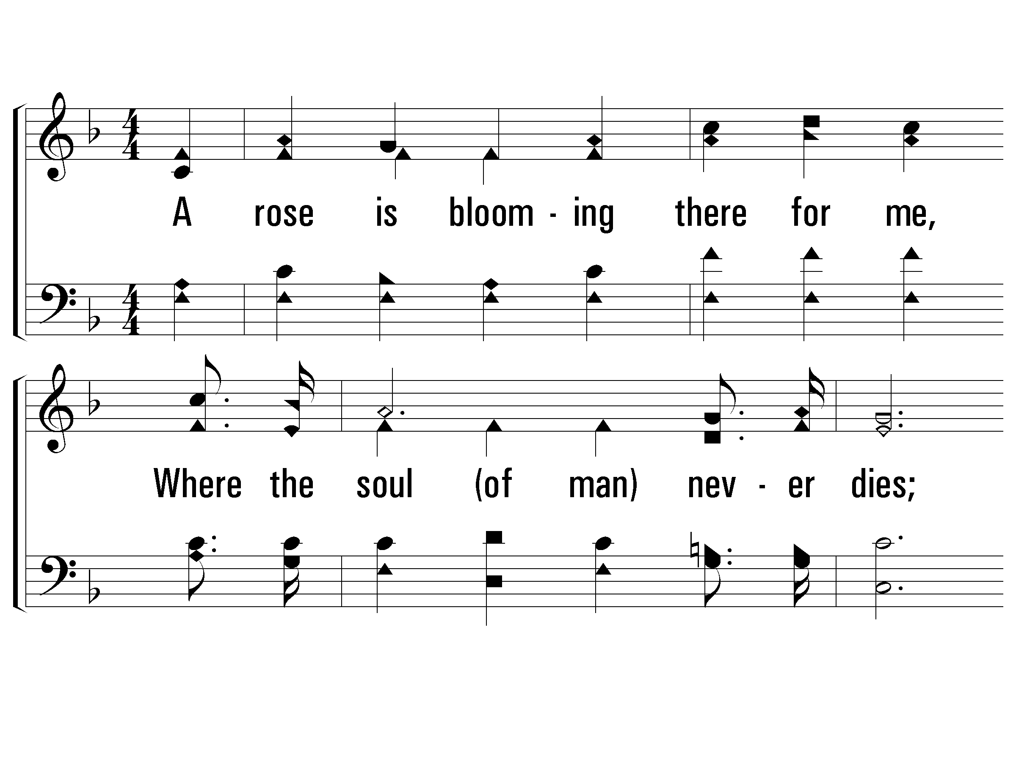
2 - To Canaan’s Land I’m on My Way
2.
A rose is blooming there for me,
Where the soul (of man) never dies;
And I will spend eternity,
Where the soul (of man) never dies.
Words and Music by: William M. Golden
PaperlessHymnal.com

Slide 27
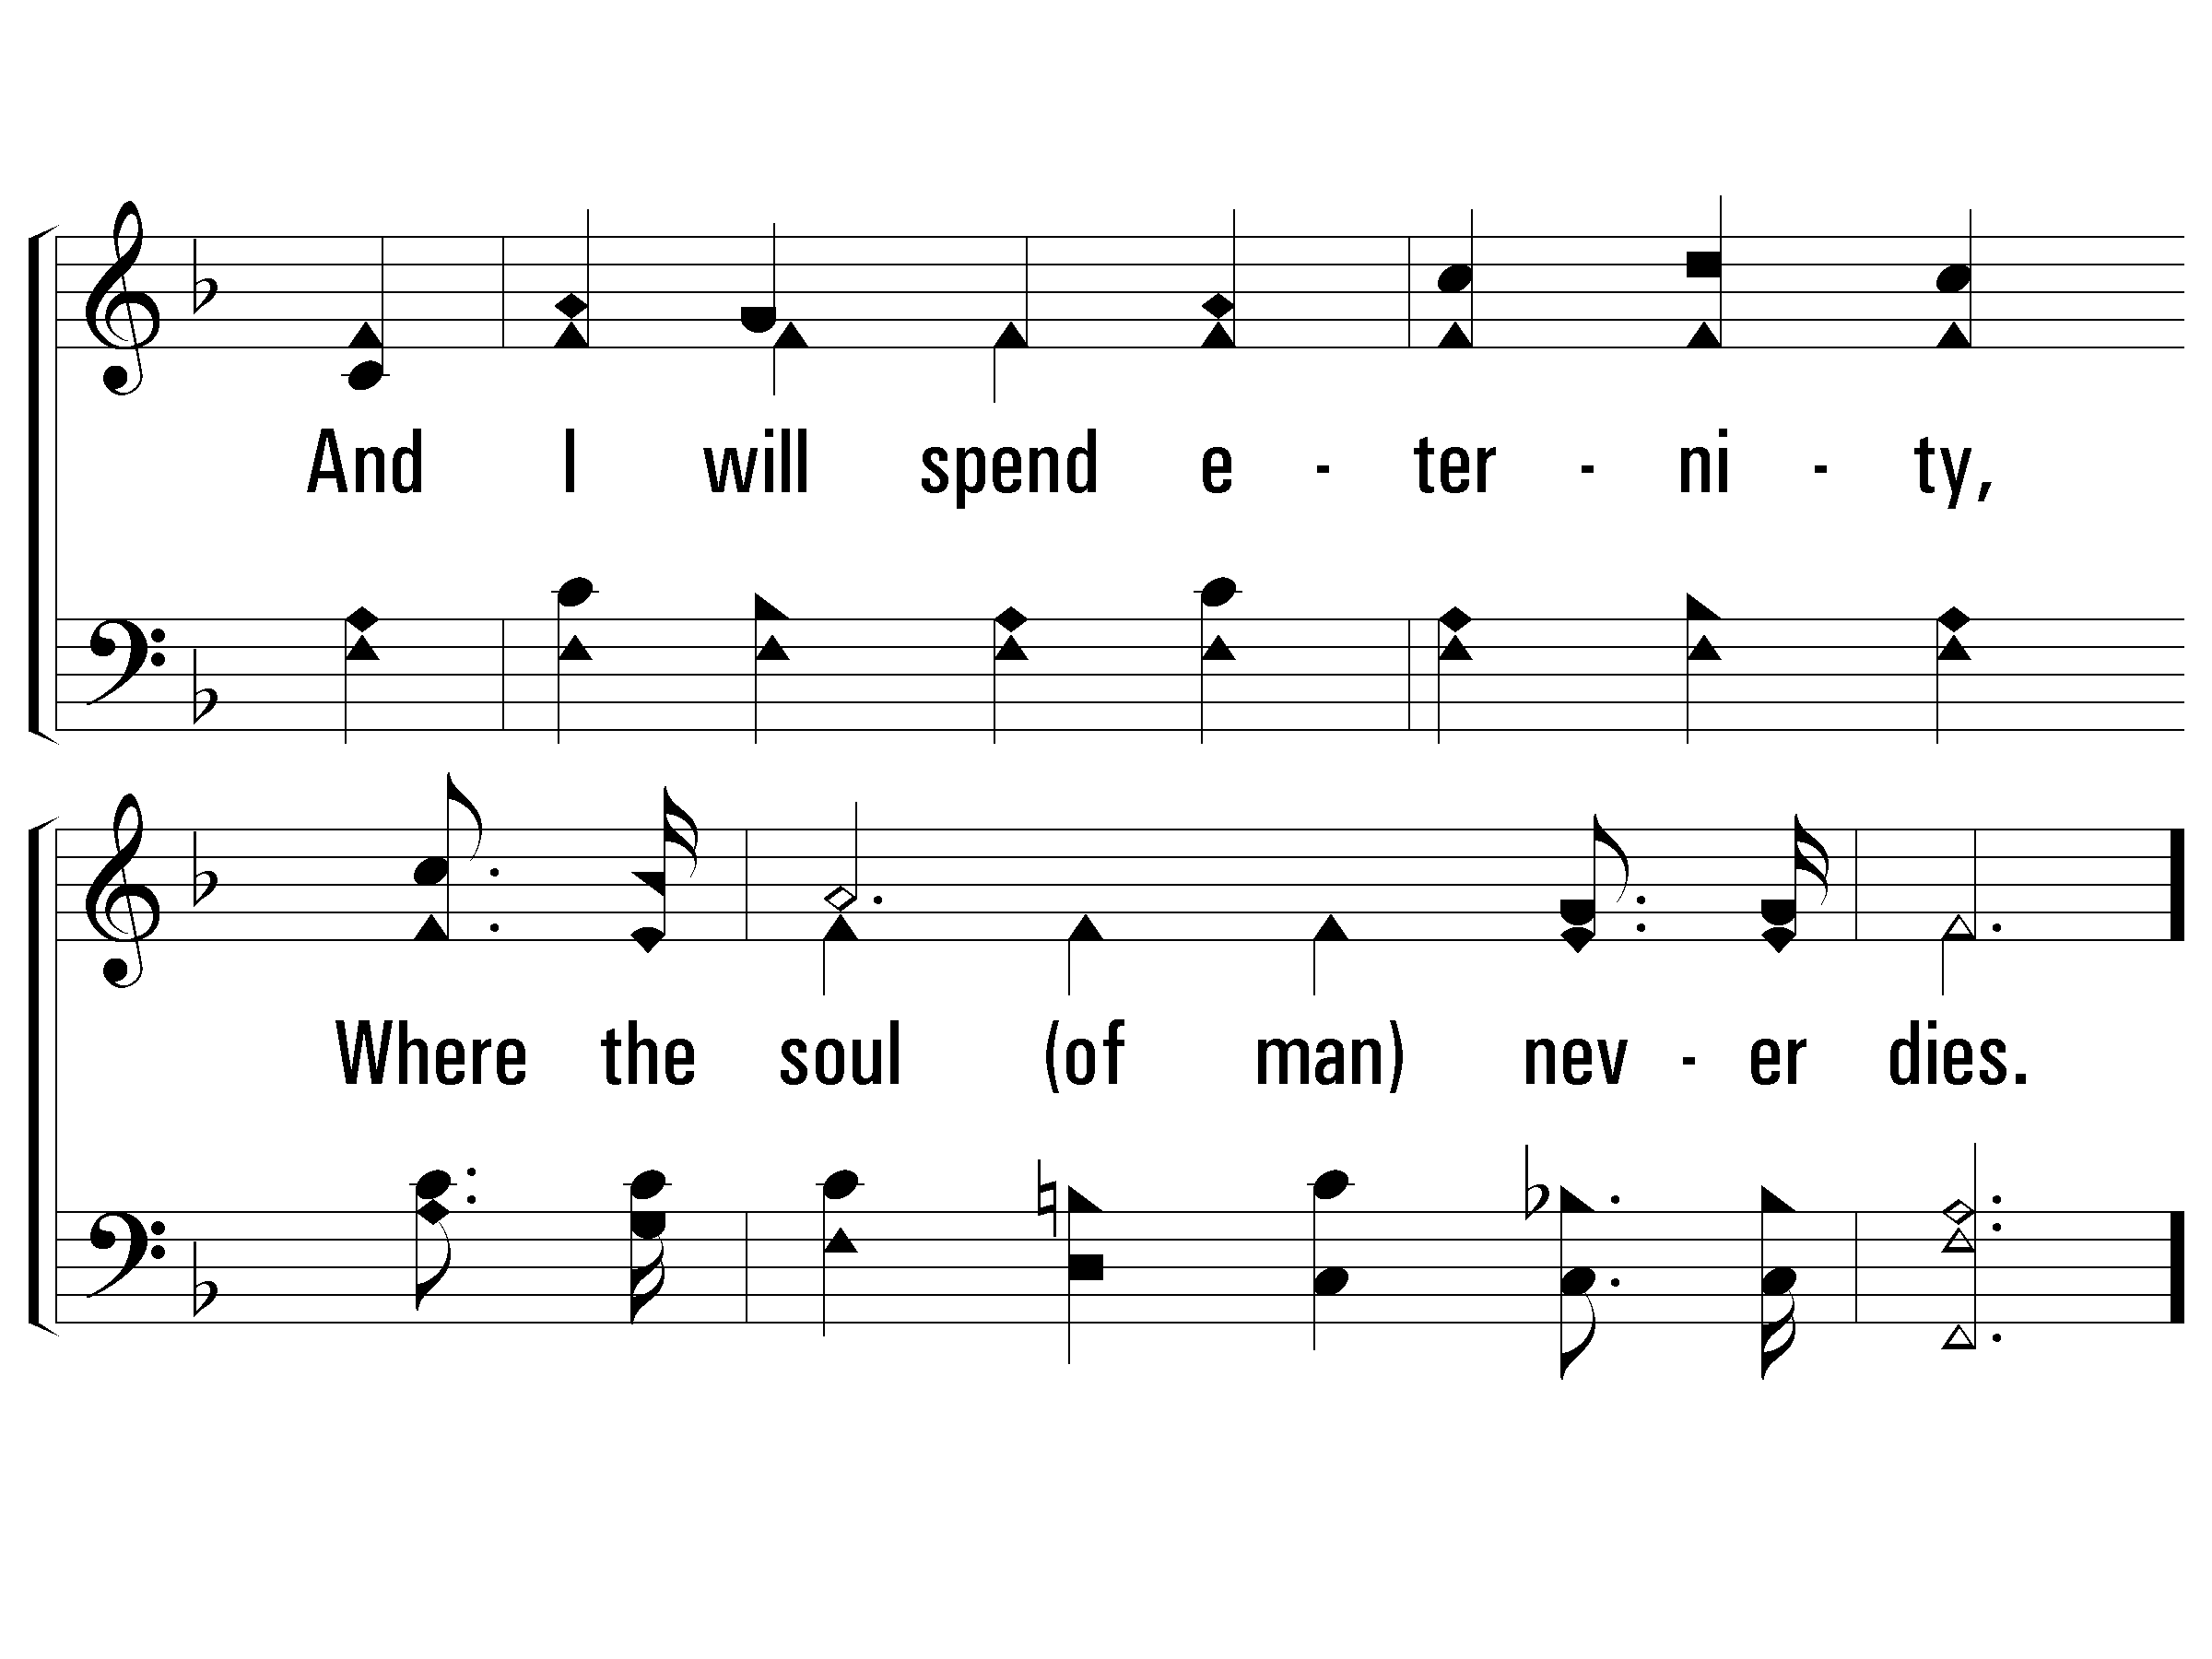
2 - To Canaan’s Land I’m on My Way
PaperlessHymnal.com

Slide 28
c - To Canaan’s Land I’m on My Way
Dear friends, there'll be no sad fair-wells,
There'll be no tear-dimmed eyes,
Where all is peace and joy and love,
And the soul of man never dies.
PaperlessHymnal.com

Slide 29
c - To Canaan’s Land I’m on My Way
PaperlessHymnal.com

Slide 30
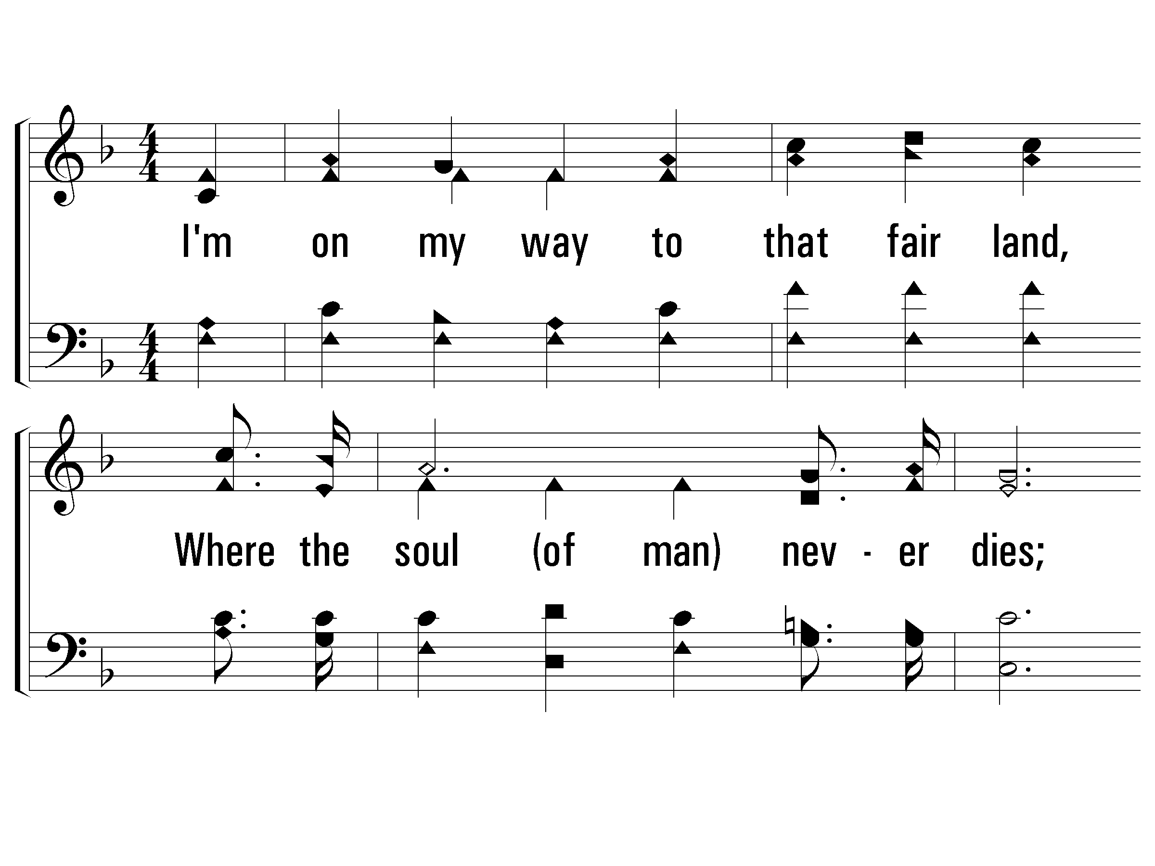
5 - To Canaan’s Land I’m on My Way
5.
I'm on my way to that fair land,
Where the soul (of man) never dies;
Where there will be no parting hand,
And the soul (of man) never dies.
Words and Music by: William M. Golden
PaperlessHymnal.com

Slide 31
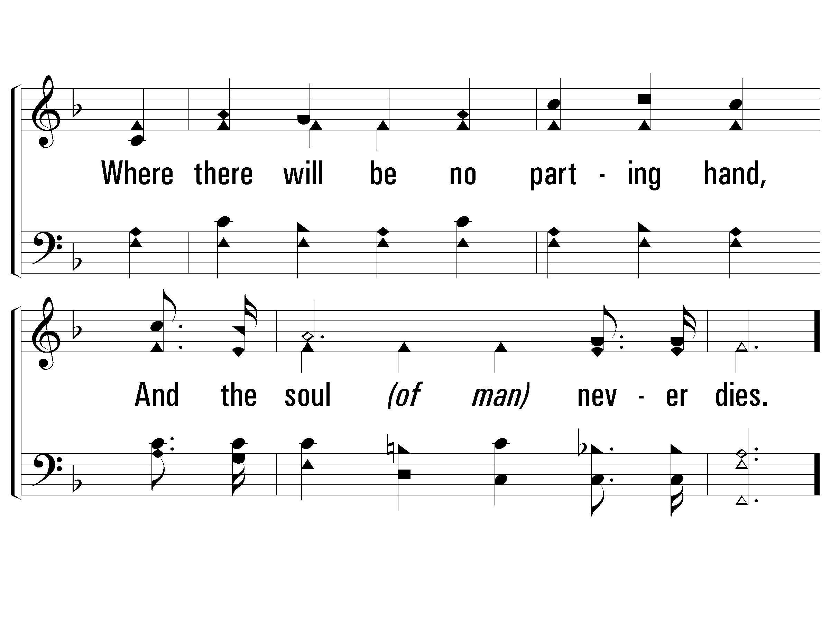
5 - To Canaan’s Land I’m on My Way
PaperlessHymnal.com

Slide 32
c - To Canaan’s Land I’m on My Way
Dear friends, there'll be no sad fair-wells,
There'll be no tear-dimmed eyes,
Where all is peace and joy and love,
And the soul of man never dies.
PaperlessHymnal.com

Slide 33
c - To Canaan’s Land I’m on My Way
PaperlessHymnal.com

Slide 34
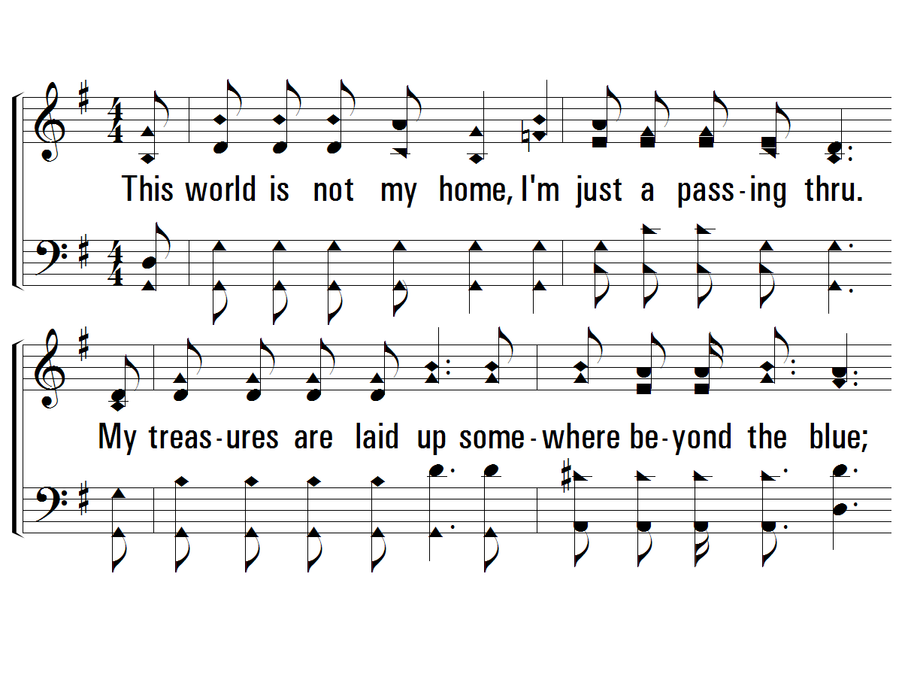
1 - This World is Not My Home
1.
This world is not my home, I'm just a passing thru.
My treasures are laid up somewhere beyond the blue;
The angels beckon me from heaven's open door,
And I can't feel at home in this world anymore.
Words and Music by: Traditional, Arr. by Albert E. Brumley
Arr. Copyright © 1936. Renewed 1964 by Albert E. Brumley & Sons/SESAC (admin. By ICG).
All rights reserved. Used by permission.
PaperlessHymnal.com

Slide 35
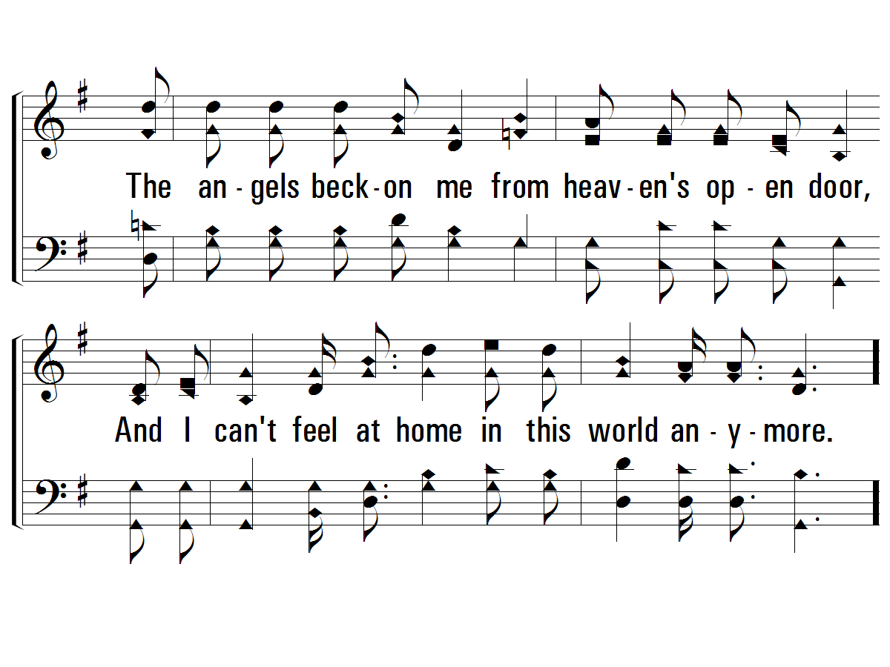
1 - This World is Not My Home
PaperlessHymnal.com

Slide 36
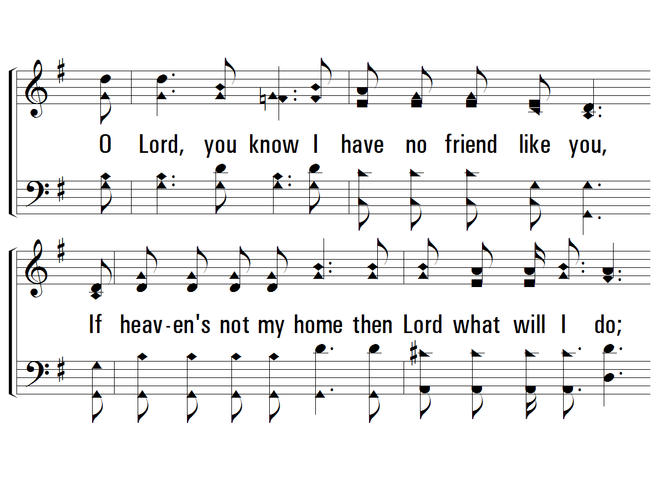
c - This World is Not My Home
O Lord, you know I have no friend like you,
If heaven's not my home then Lord what will I do;
The angels beck-on me from heaven's open door,
And I can't feel at home in this world anymore.
PaperlessHymnal.com

Slide 37
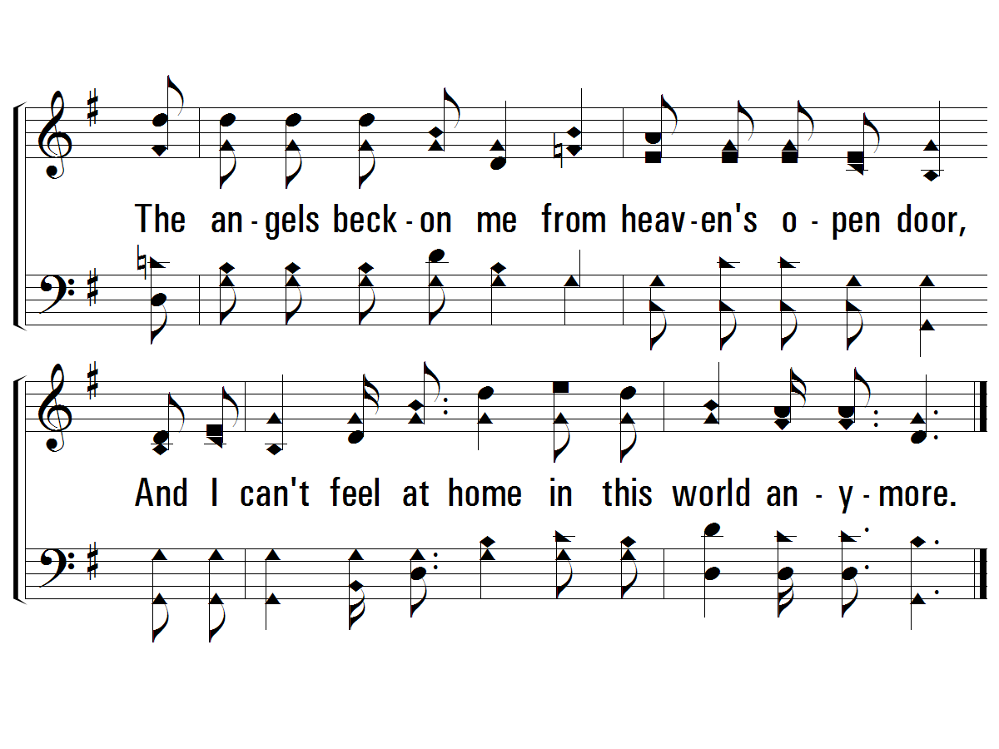
c - This World is Not My Home
PaperlessHymnal.com

Slide 38
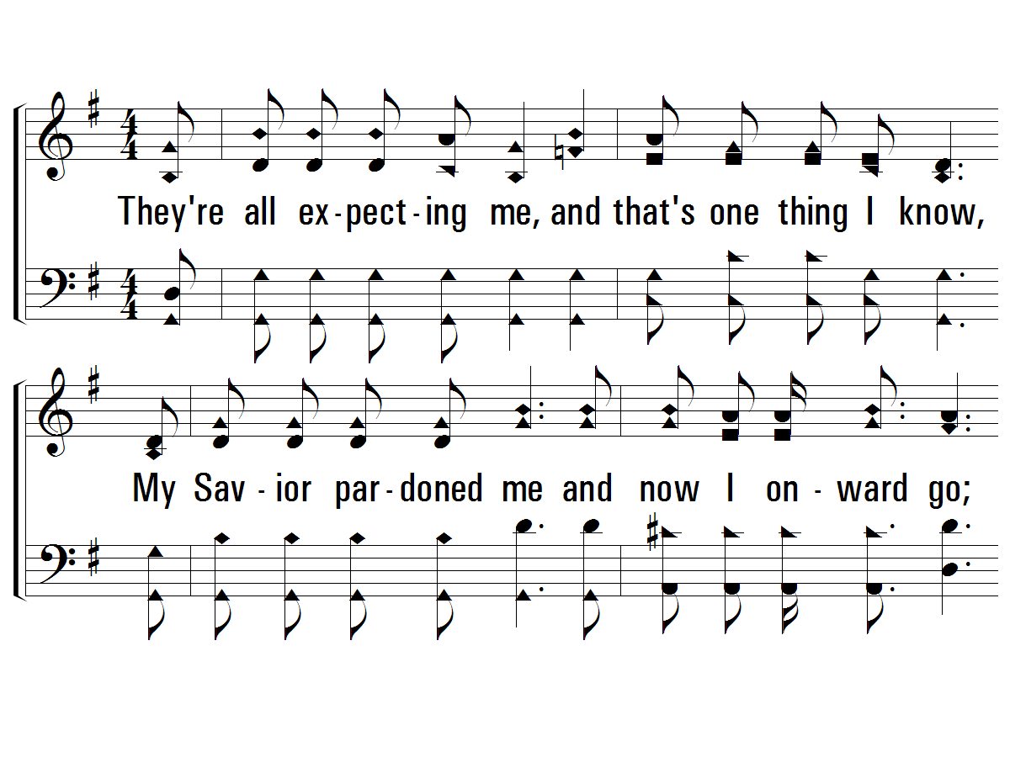
2 - This World is Not My Home
2.
They're all expecting me, and that's one thing I know,
My Savior pardoned me and now I onward go;
I know He'll take me thru though I am weak and poor
Words and Music by: Traditional, Arr. by Albert E. Brumley
Arr. Copyright © 1936. Renewed 1964 by Albert E. Brumley & Sons/SESAC (admin. By ICG).
All rights reserved. Used by permission.
PaperlessHymnal.com

Slide 39
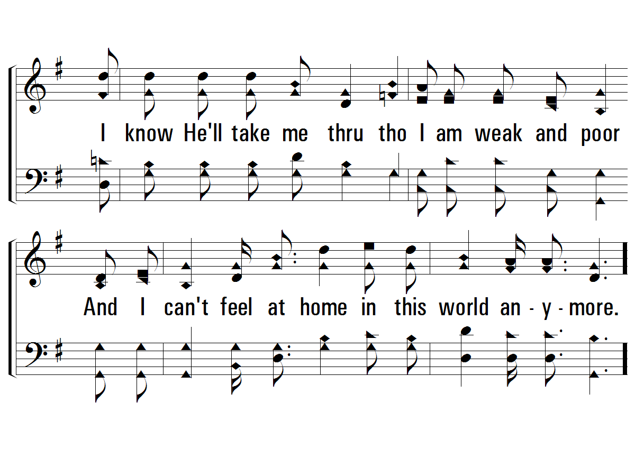
2 - This World is Not My Home
PaperlessHymnal.com

Slide 40
c - This World is Not My Home
O Lord, you know I have no friend like you,
If heaven's not my home then Lord what will I do;
The angels beck-on me from heaven's open door,
And I can't feel at home in this world anymore.
PaperlessHymnal.com

Slide 41
c - This World is Not My Home
PaperlessHymnal.com

Slide 42
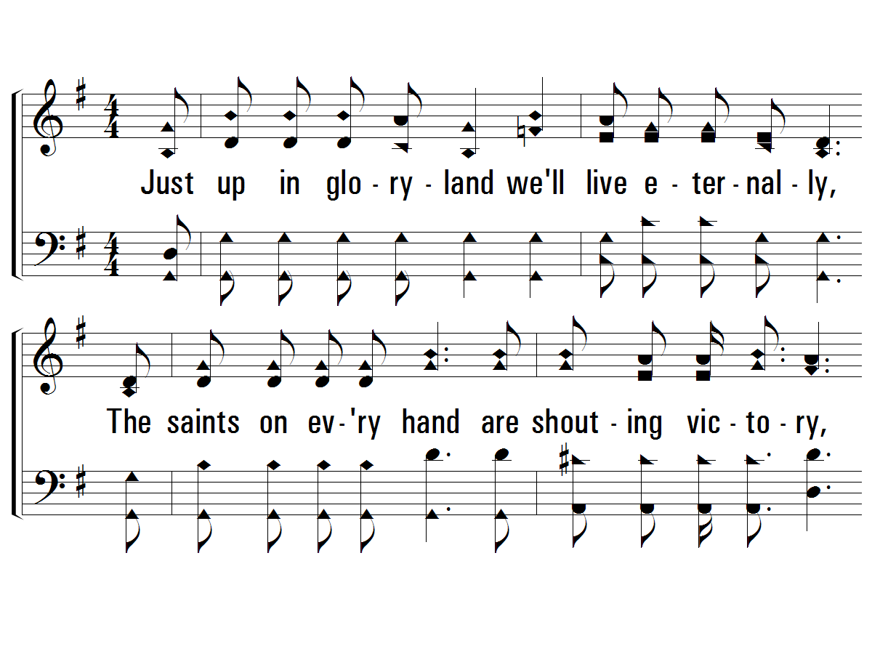
4 - This World is Not My Home
4.
Just up in glory-land we'll live eternally,
The saints on every hand are shouting victory,
Their song of sweetest praise drifts back from heaven's shore
Words and Music by: Traditional, Arr. by Albert E. Brumley
Arr. Copyright © 1936. Renewed 1964 by Albert E. Brumley & Sons/SESAC (admin. By ICG).
All rights reserved. Used by permission.
PaperlessHymnal.com

Slide 43
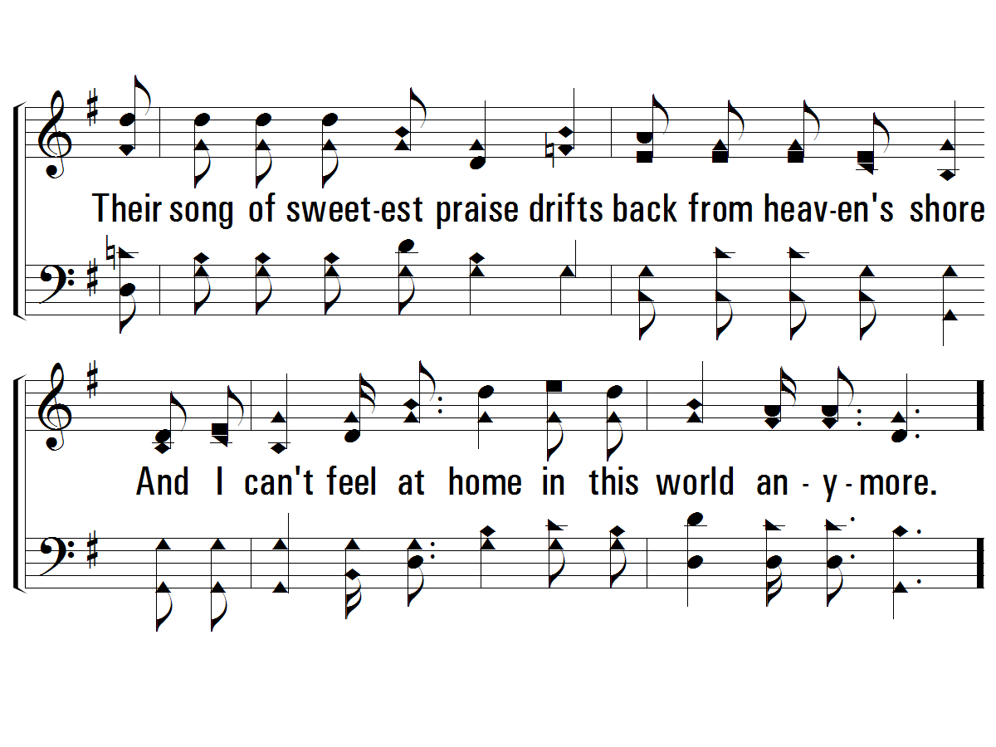
4 - This World is Not My Home
PaperlessHymnal.com

Slide 44
c - This World is Not My Home
O Lord, you know I have no friend like you,
If heaven's not my home then Lord what will I do;
The angels beck-on me from heaven's open door,
And I can't feel at home in this world anymore.
PaperlessHymnal.com

Slide 45
c - This World is Not My Home
PaperlessHymnal.com

Slide 46
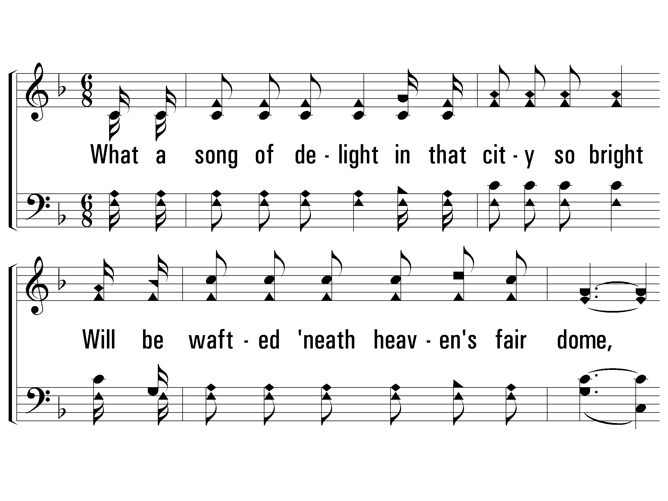
1 - When All of God’s Singers Get Home
1.
What a song of delight
in that city so bright
Will be wafted beneath heaven's fair dome,
How the ransomed will raise
happy songs in His praise,
When all of God's singers get home.
Words: Luther G. Presley / Cho.: Virgil O. Stamps / Music: Virgil O. Stamps
Copyright © 1937 by Stamps-Baxter Music (BMI) (adm. by Brentwood-Benson Music Publishing, Inc.)
All rights reserved. Used by permission.
PaperlessHymnal.com

Slide 47
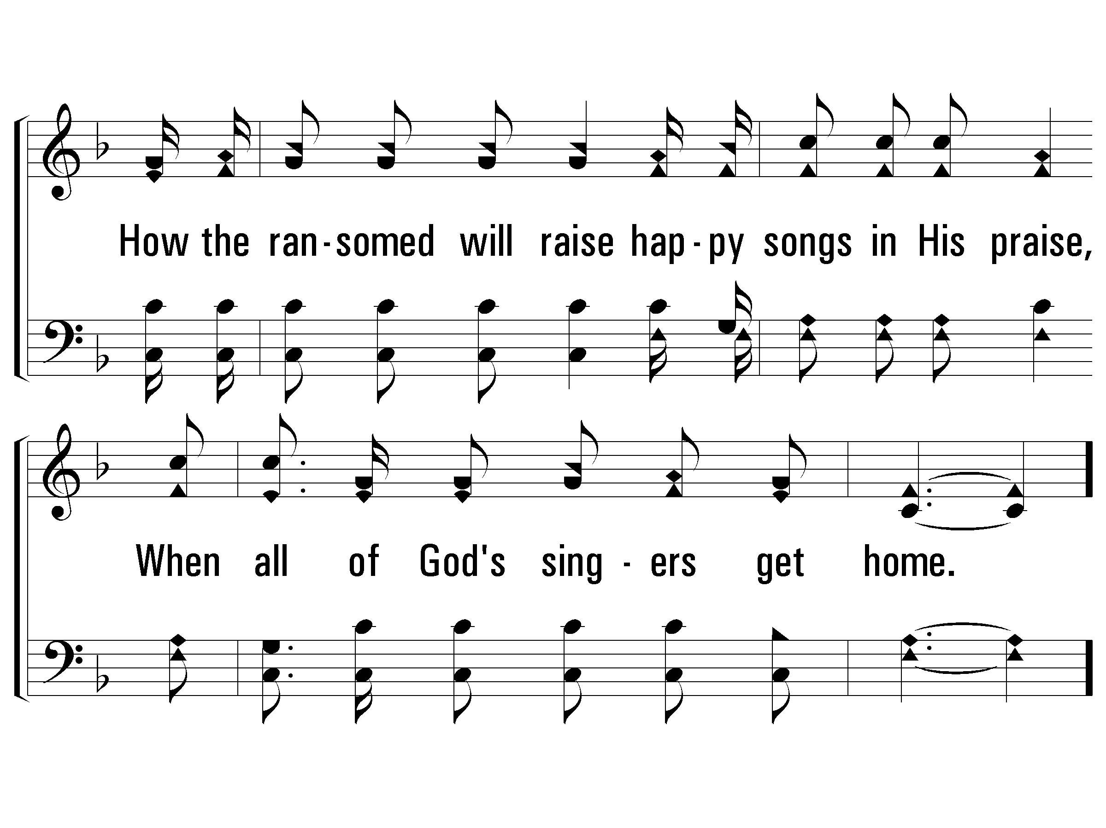
1 - When All of God’s Singers Get Home
PaperlessHymnal.com

Slide 48
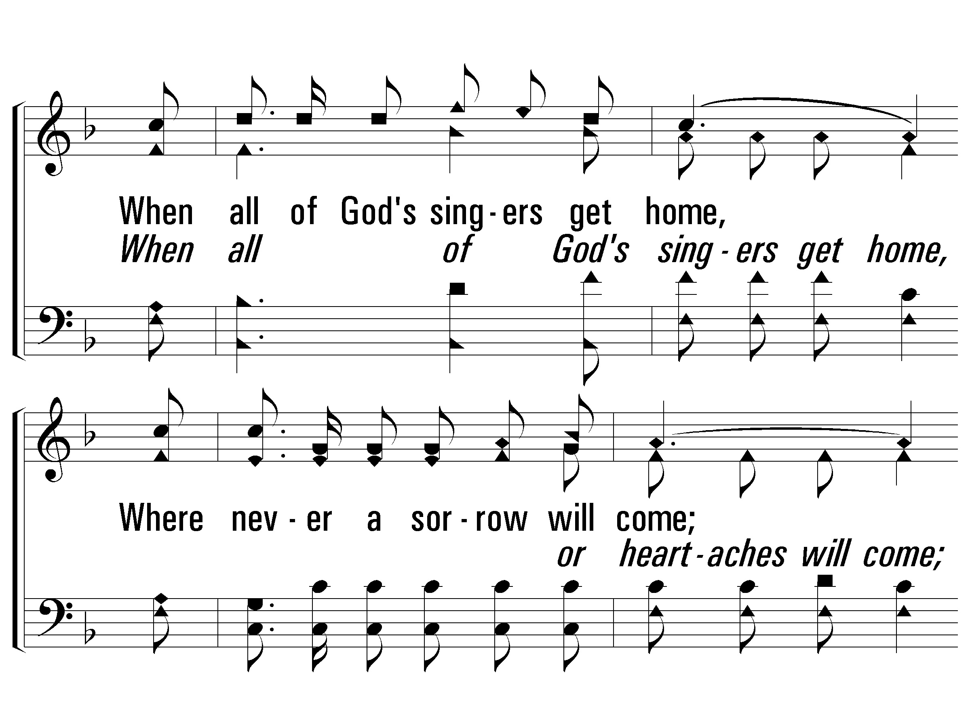
c - When All of God’s Singers Get Home
When all of God's singers get home,
Where never a sorrow will come;
There'll be "no place like home,"
When all of God's singers get home.
PaperlessHymnal.com

Slide 49
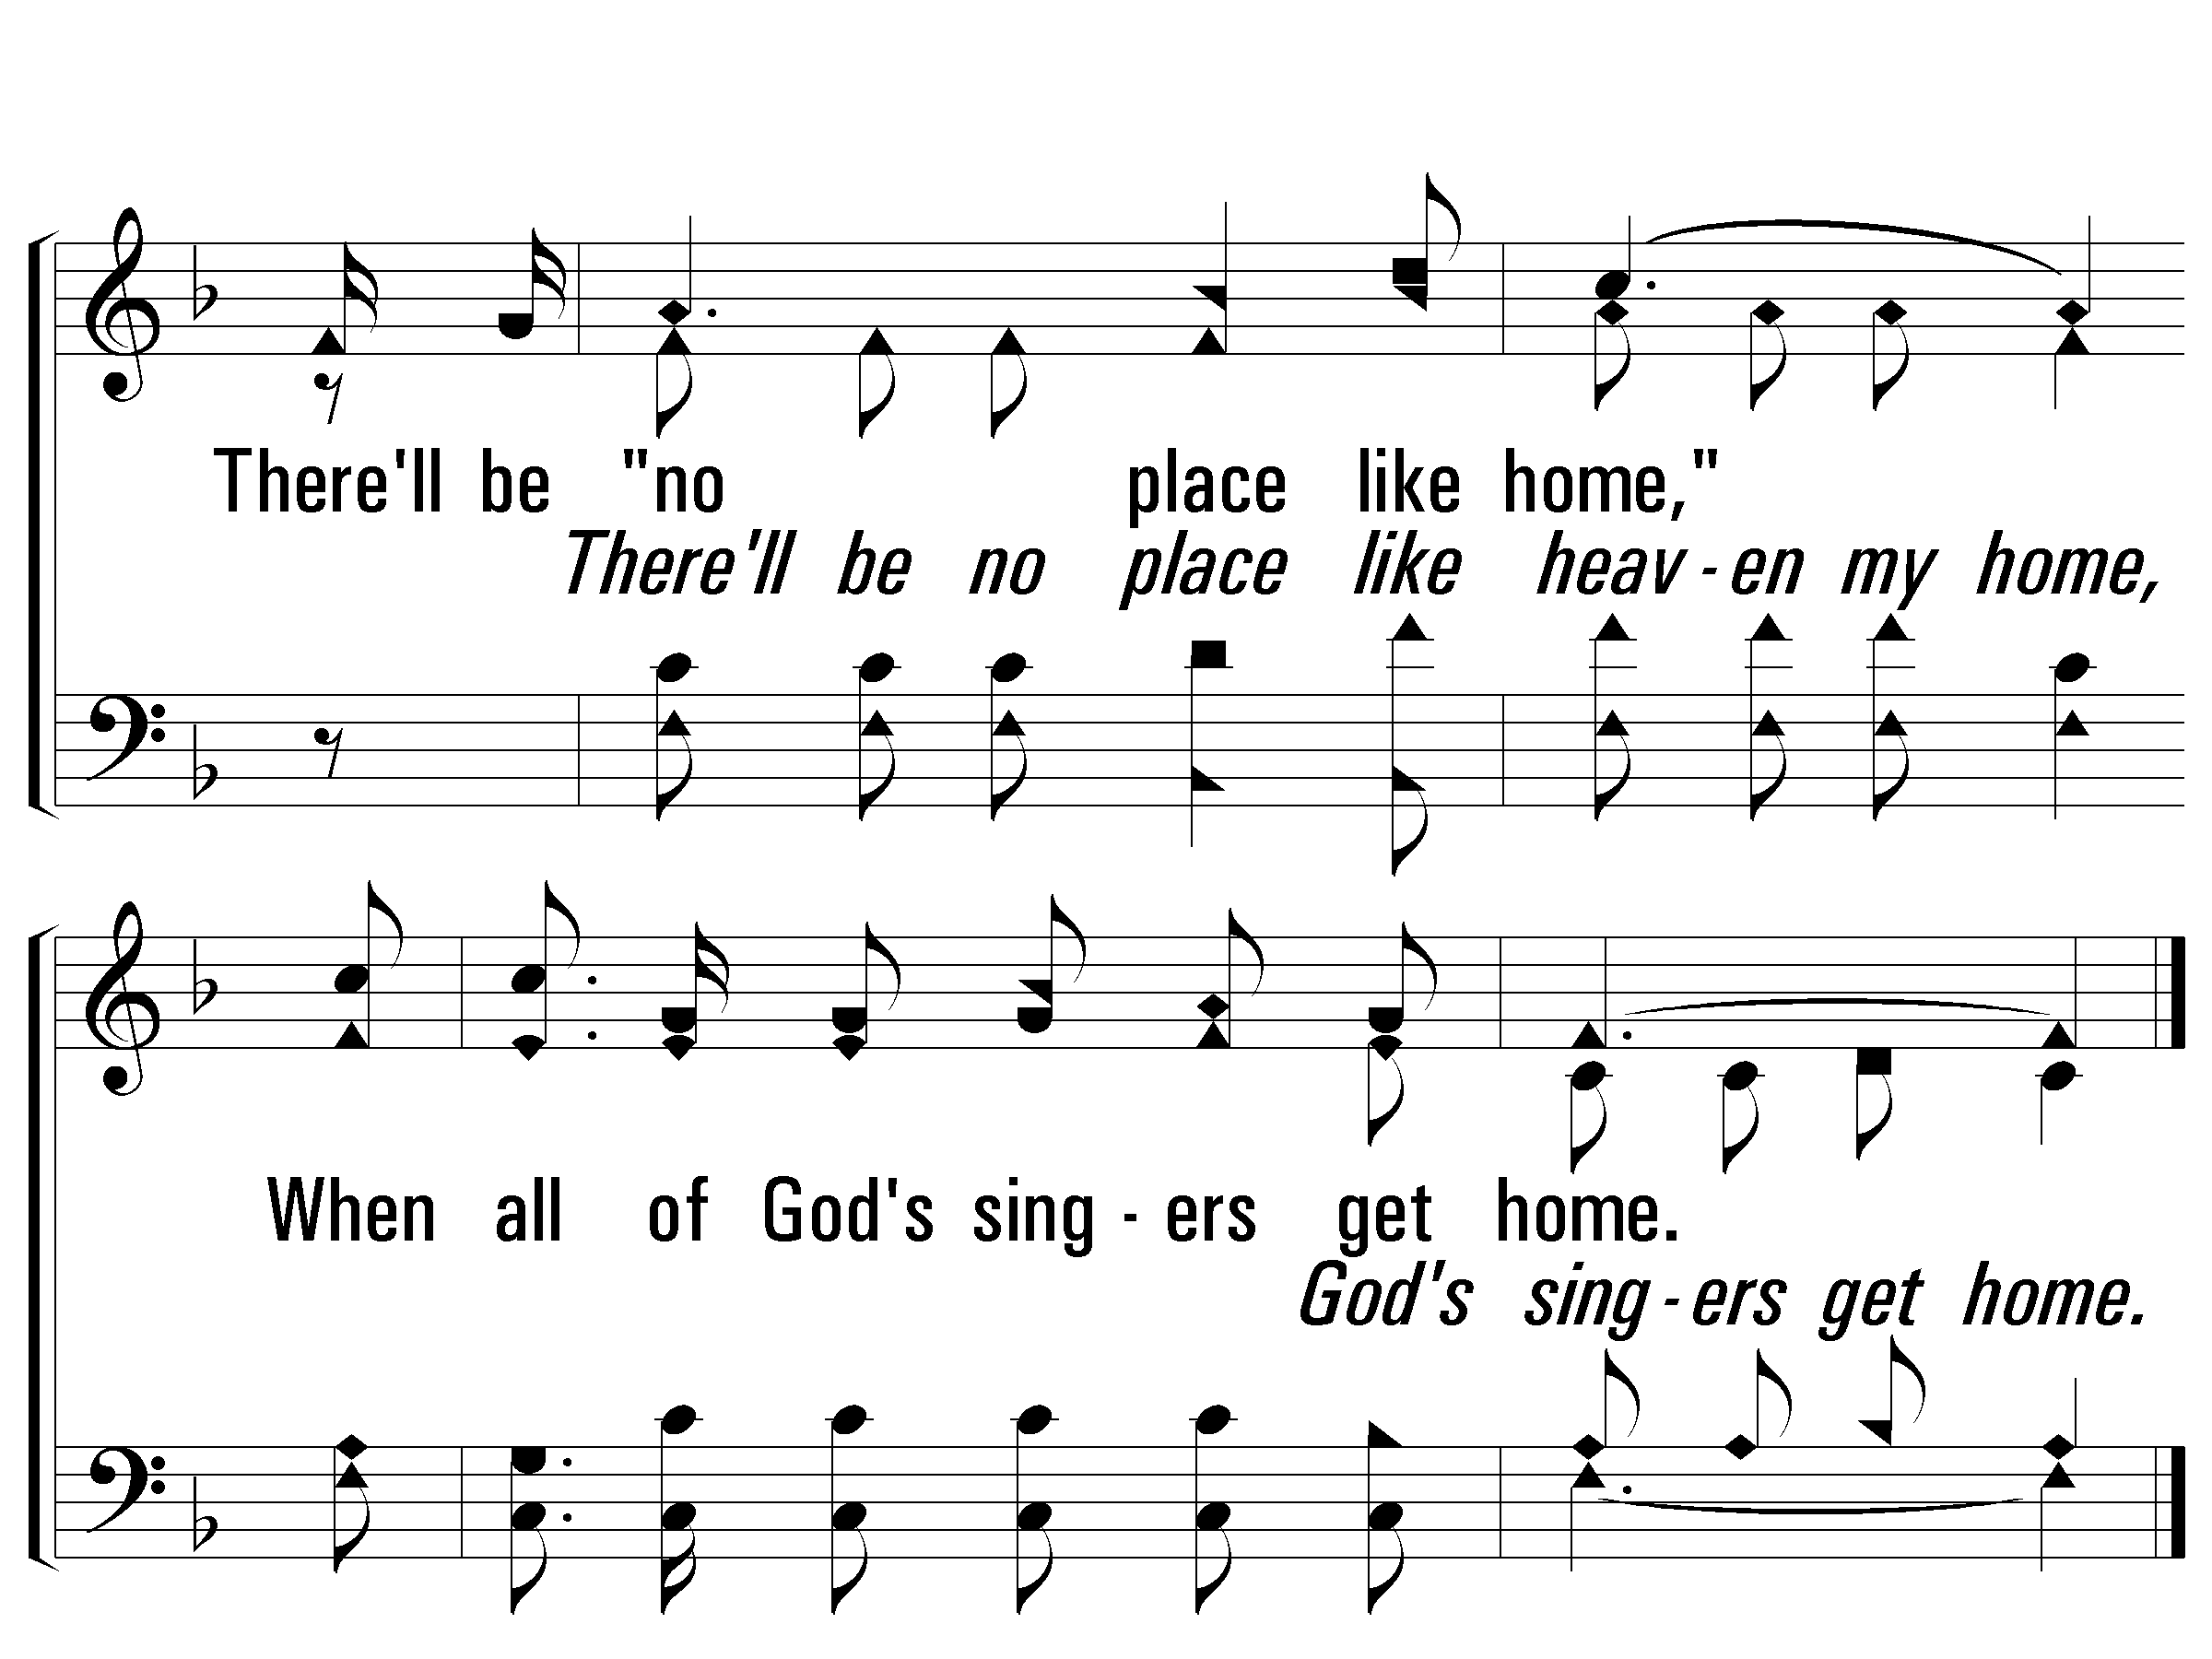
c - When All of God’s Singers Get Home
PaperlessHymnal.com

Slide 50
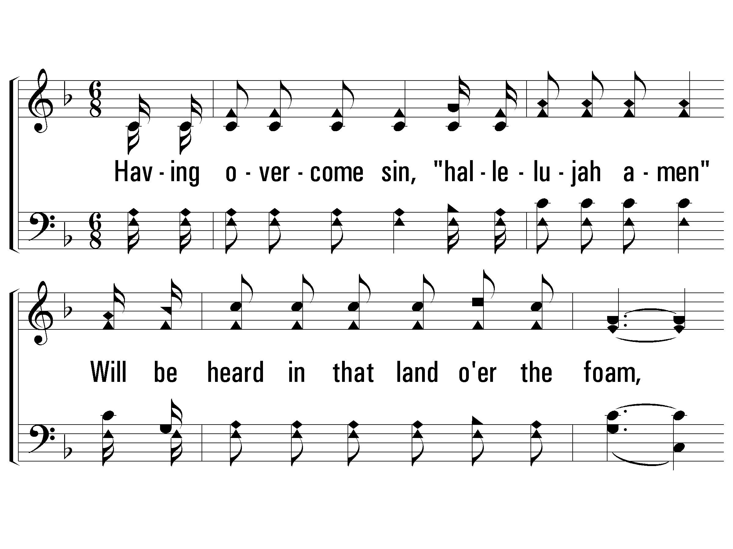
3 - When All of God’s Singers Get Home
3.
Having overcome sin,
"hallelujah amen"
Will be heard in that land over the foam,
Every heart will be light
and each face will be bright,
When all of God's singers get home.
Words: Luther G. Presley / Cho.: Virgil O. Stamps / Music: Virgil O. Stamps
Copyright © 1937 by Stamps-Baxter Music (BMI) (adm. by Brentwood-Benson Music Publishing, Inc.)
All rights reserved. Used by permission.
PaperlessHymnal.com

Slide 51
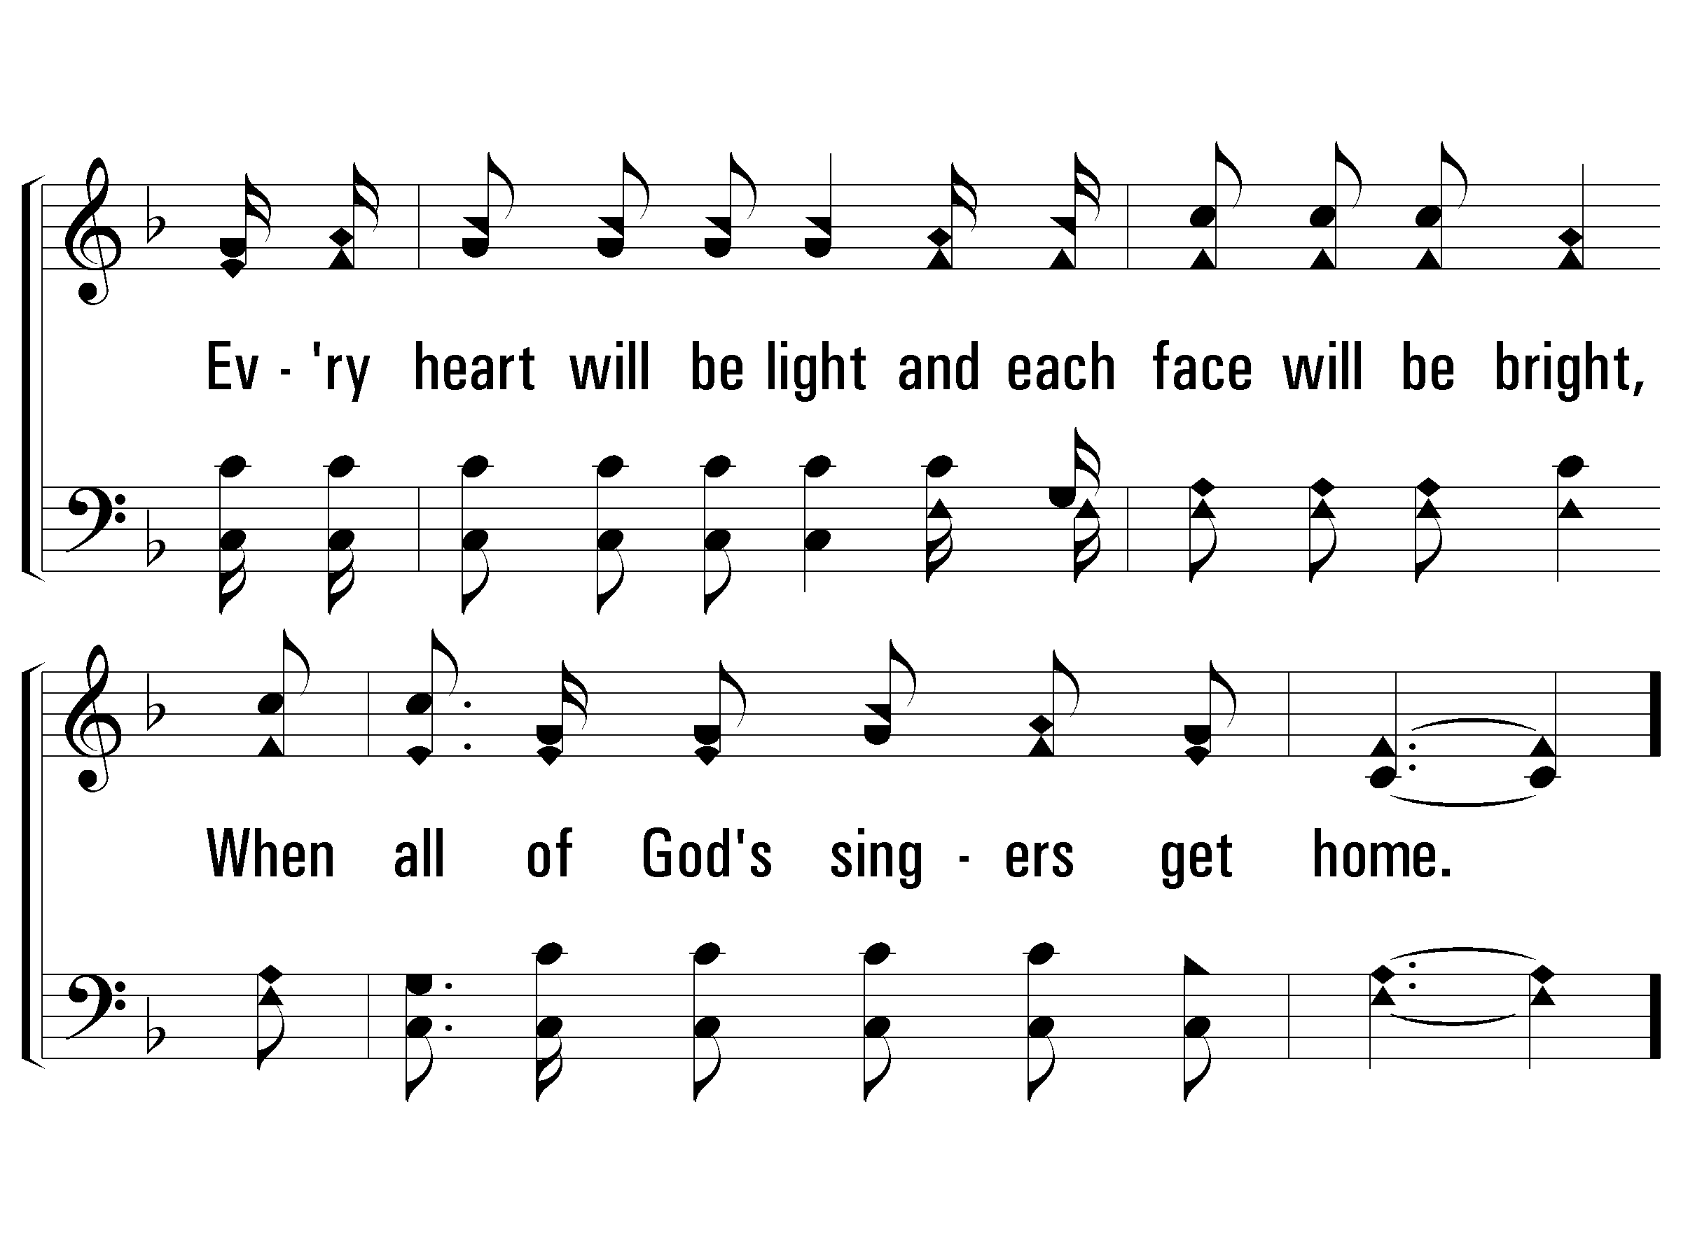
3 - When All of God’s Singers Get Home
PaperlessHymnal.com

Slide 52
c - When All of God’s Singers Get Home
When all of God's singers get home,
Where never a sorrow will come;
There'll be "no place like home,"
When all of God's singers get home.
PaperlessHymnal.com

Slide 53
c - When All of God’s Singers Get Home
PaperlessHymnal.com

Slide 54
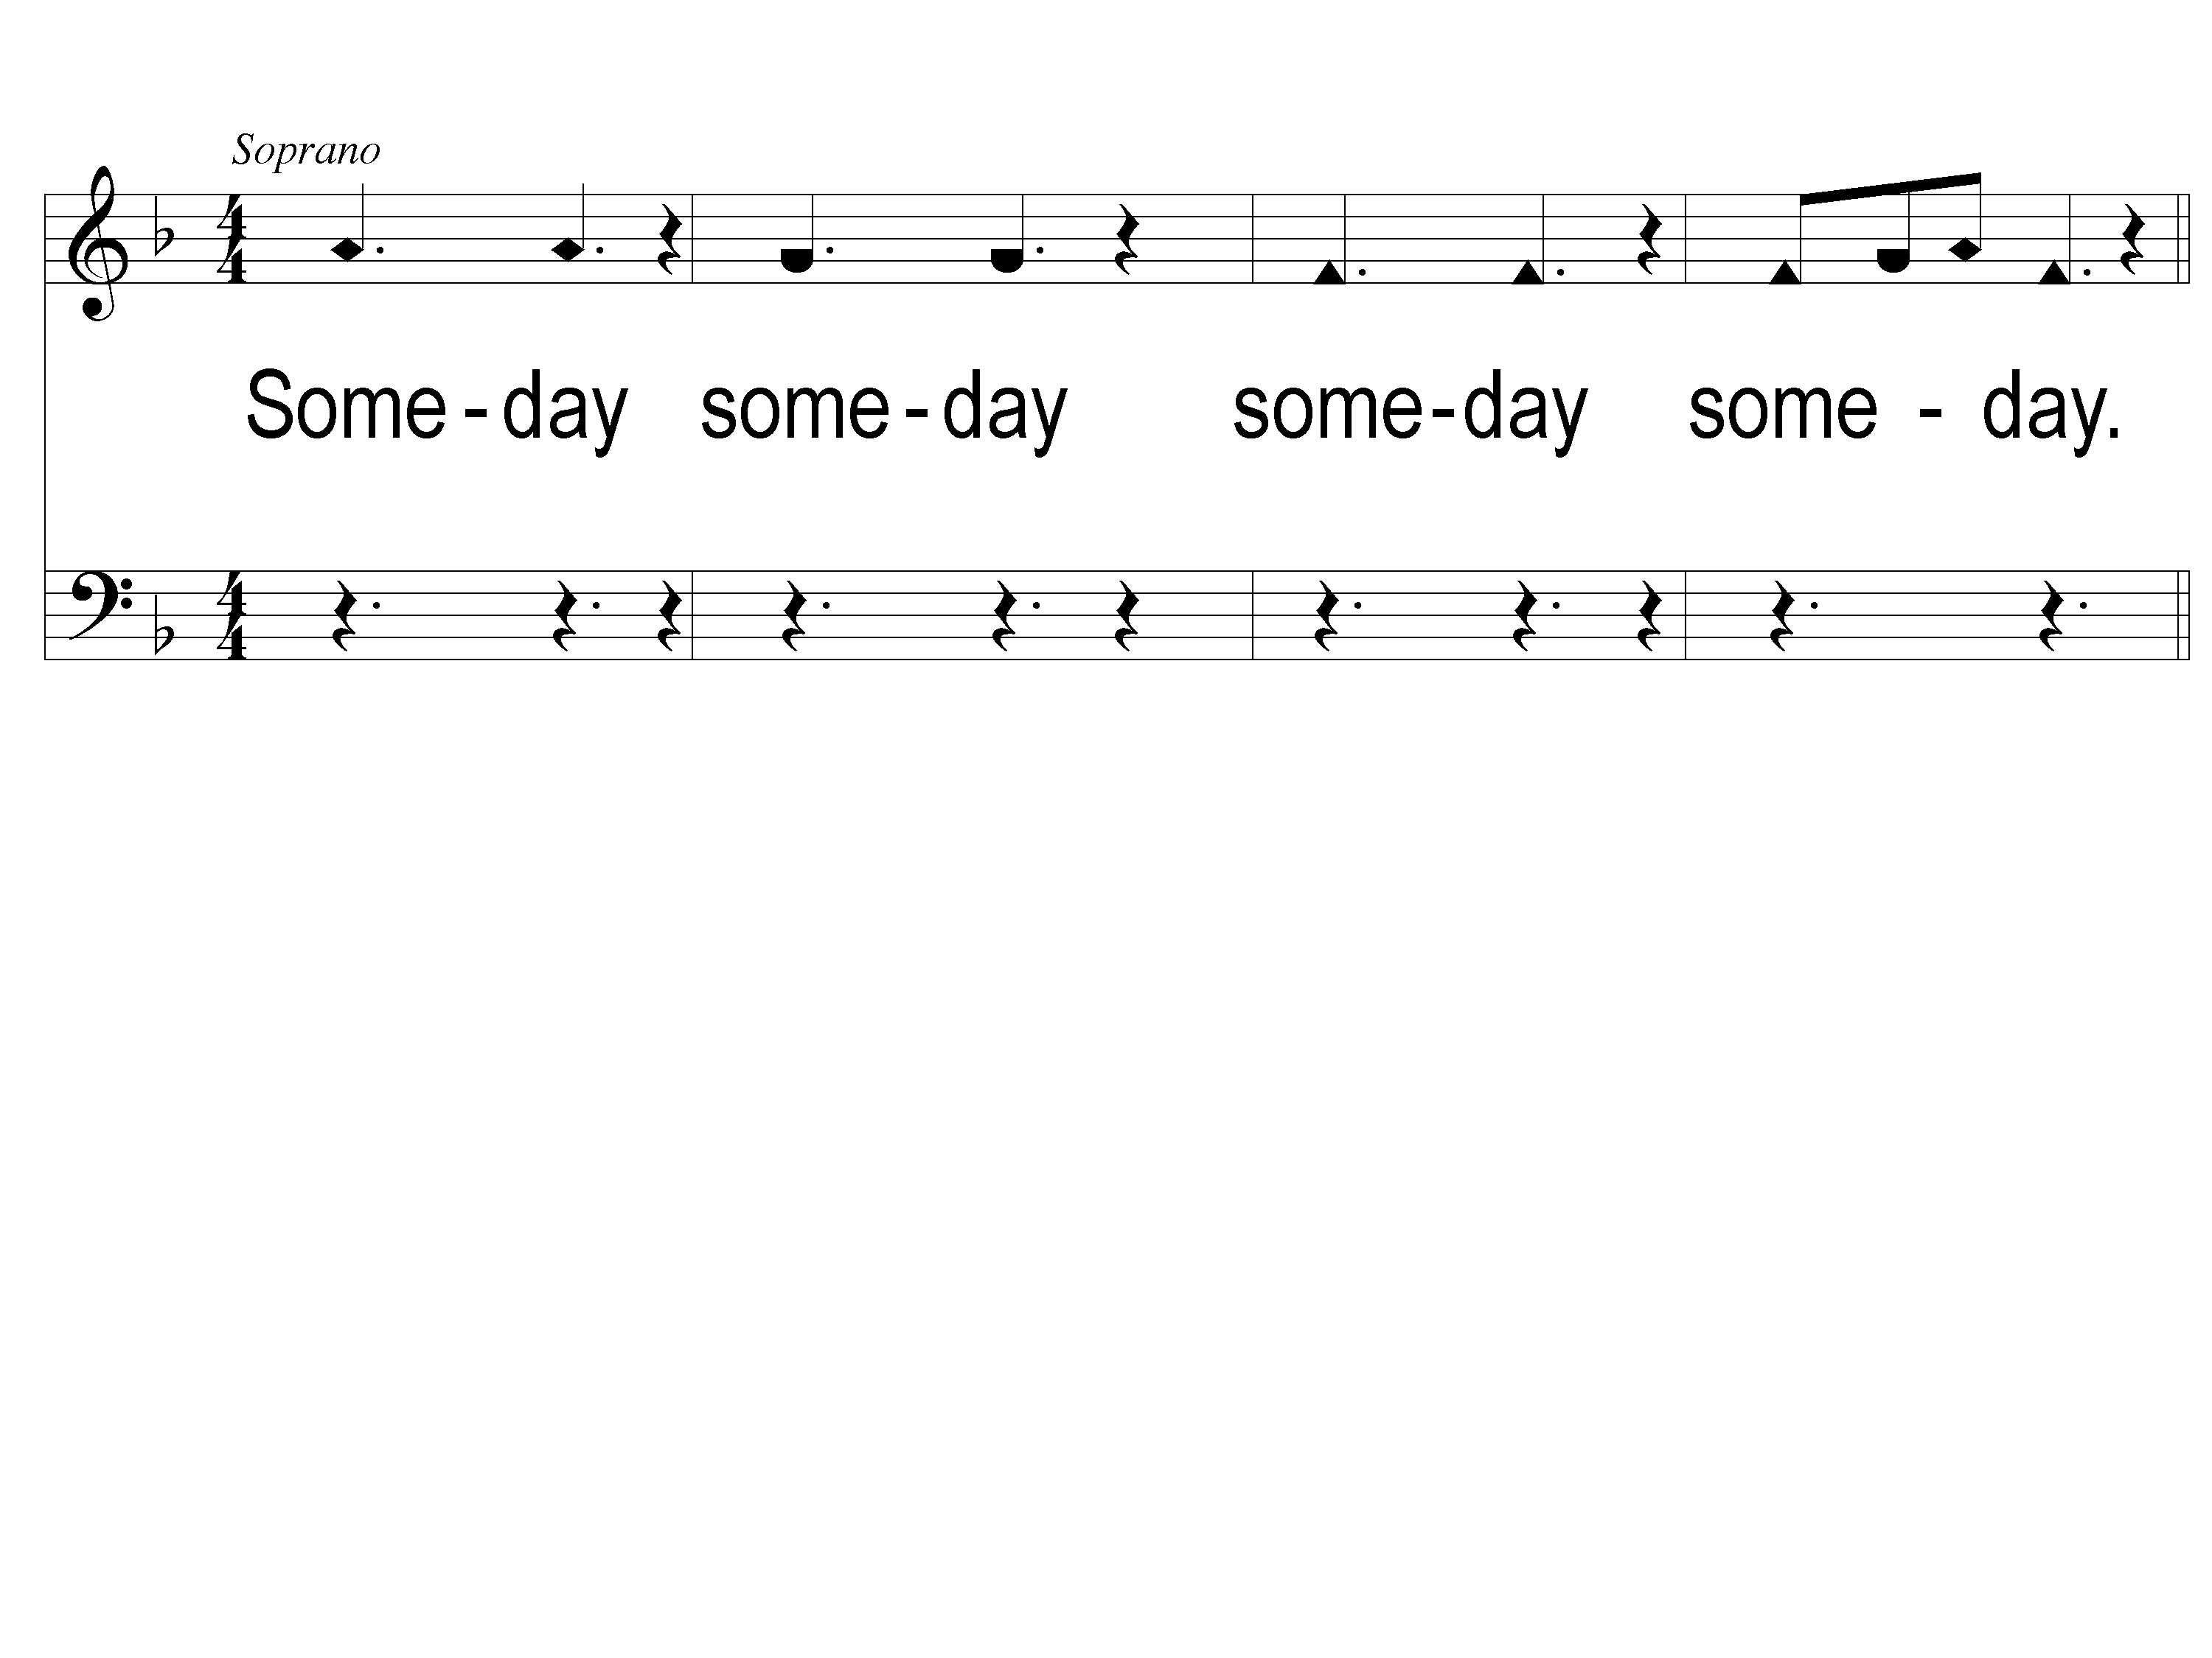
1 Someday
Someday
Arr. © Copyright 2005 by Taylor Publications
ePraise Hymn Presentation © Taylor Publications

Slide 55
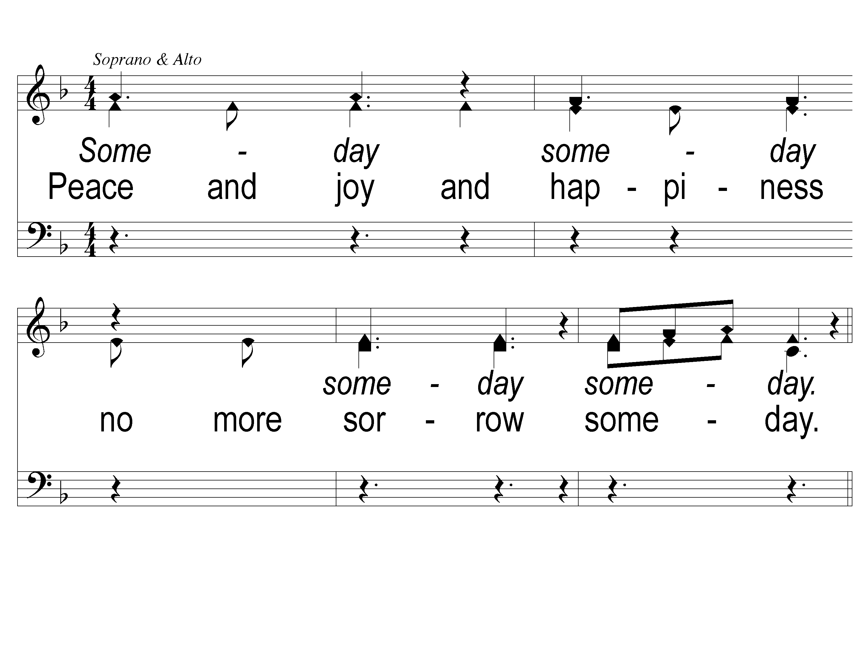
2 Someday
Someday
ePraise Hymn Presentation © Taylor Publications

Slide 56
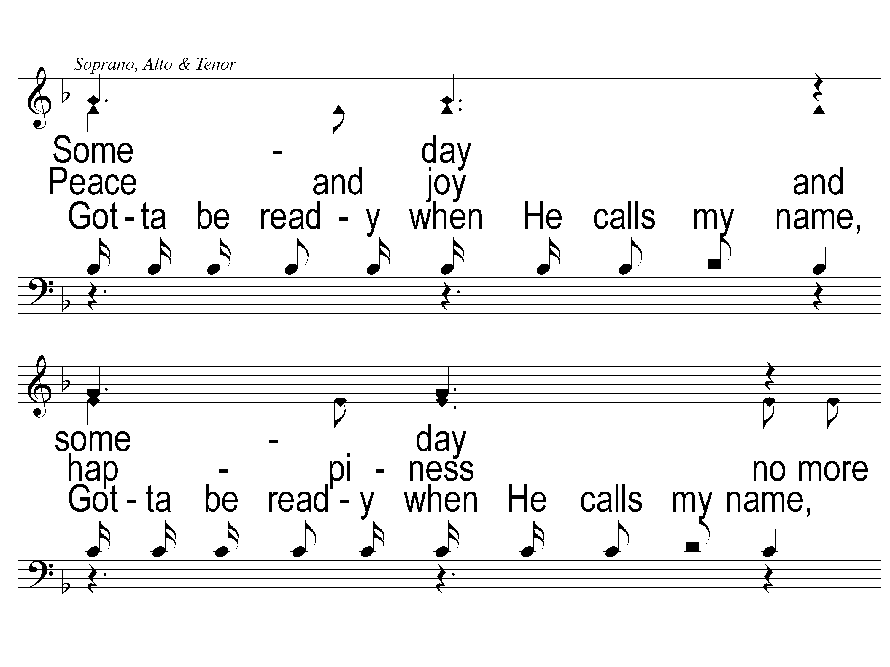
3-1 Someday
Someday
ePraise Hymn Presentation © Taylor Publications

Slide 57
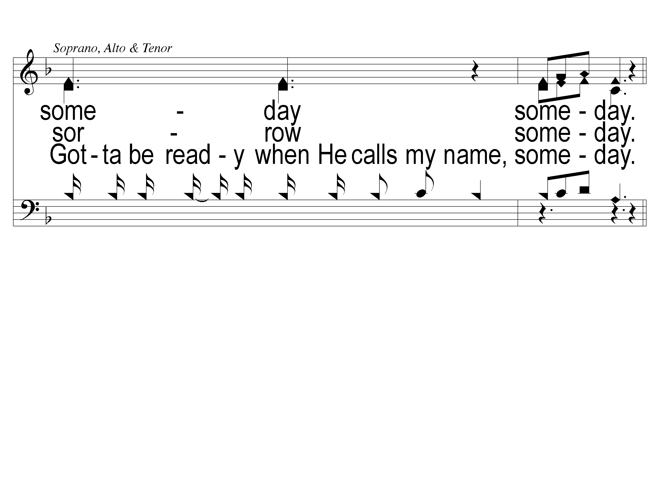
3-2 Someday
Someday
ePraise Hymn Presentation © Taylor Publications

Slide 58
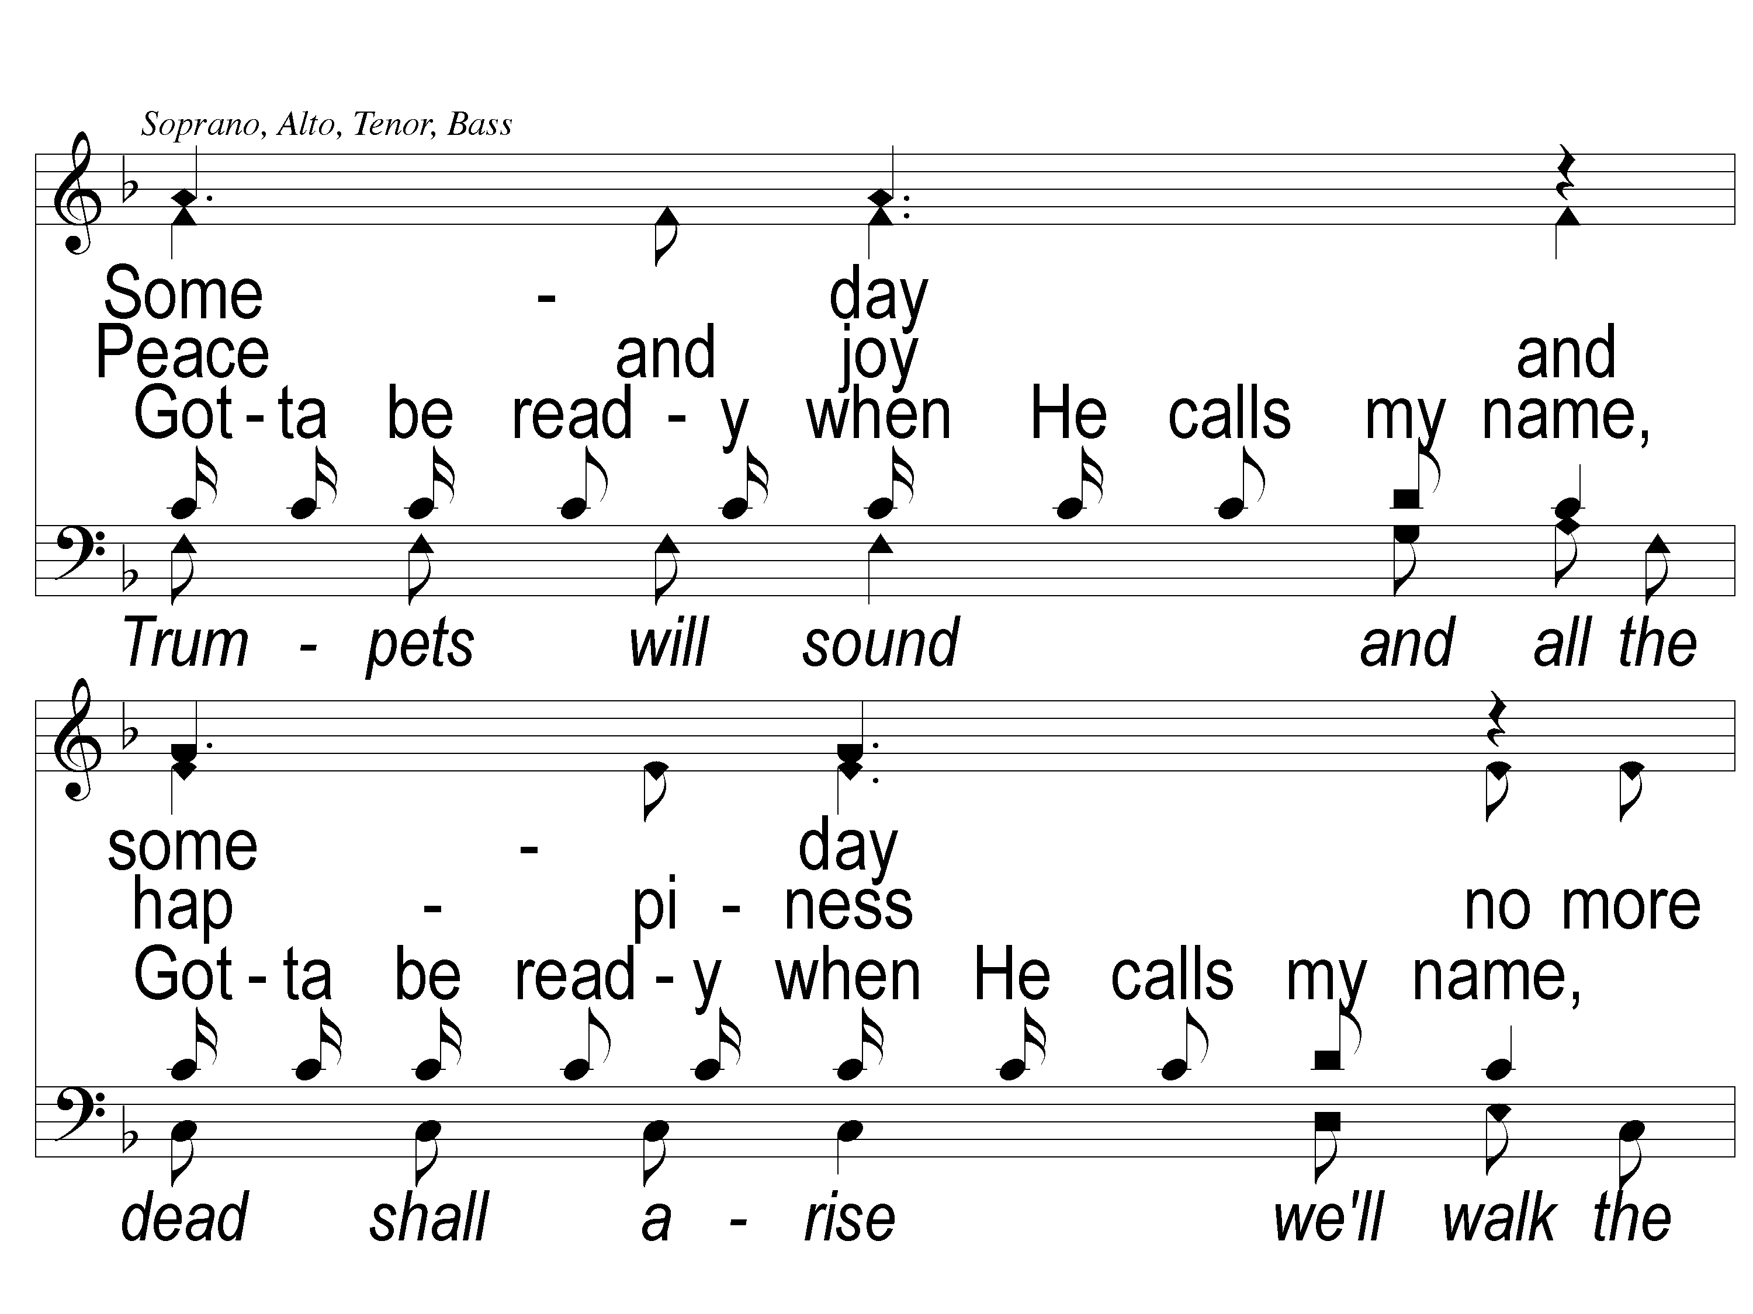
4-1 Someday
Someday
ePraise Hymn Presentation © Taylor Publications

Slide 59
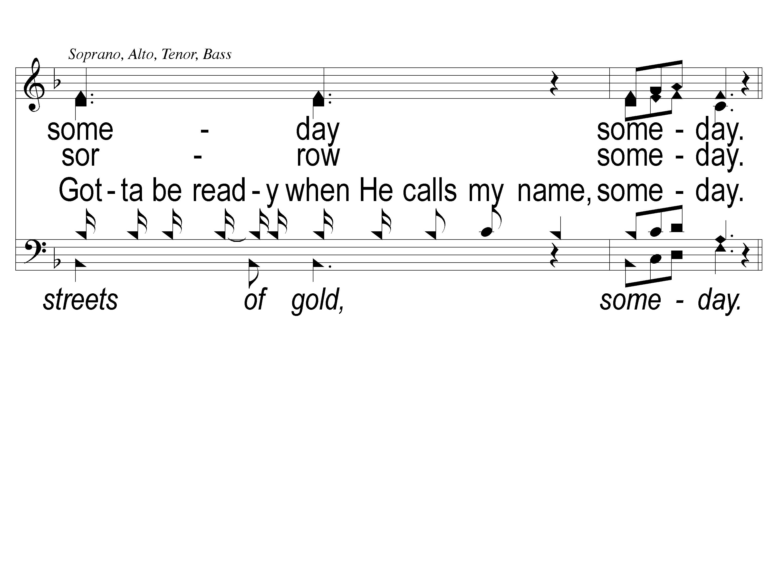
4-2 Someday
Someday
ePraise Hymn Presentation © Taylor Publications

Slide 60
4-1 Someday
Someday
ePraise Hymn Presentation © Taylor Publications

Slide 61
4-2 Someday
Someday
ePraise Hymn Presentation © Taylor Publications

Slide 62
3-1 Someday
Someday
ePraise Hymn Presentation © Taylor Publications

Slide 63
3-2 Someday
Someday
ePraise Hymn Presentation © Taylor Publications

Slide 64
2 Someday
Someday
ePraise Hymn Presentation © Taylor Publications

Slide 65
1 Someday
Someday
Arr. © Copyright 2005 by Taylor Publications
ePraise Hymn Presentation © Taylor Publications

Slide 66
4-1 Someday
Someday
ePraise Hymn Presentation © Taylor Publications

Slide 67
4-2 Someday
Someday
ePraise Hymn Presentation © Taylor Publications

Slide 68
4-1 Someday
Someday
ePraise Hymn Presentation © Taylor Publications

Slide 69
4-2 Someday
Someday
ePraise Hymn Presentation © Taylor Publications

Slide 70
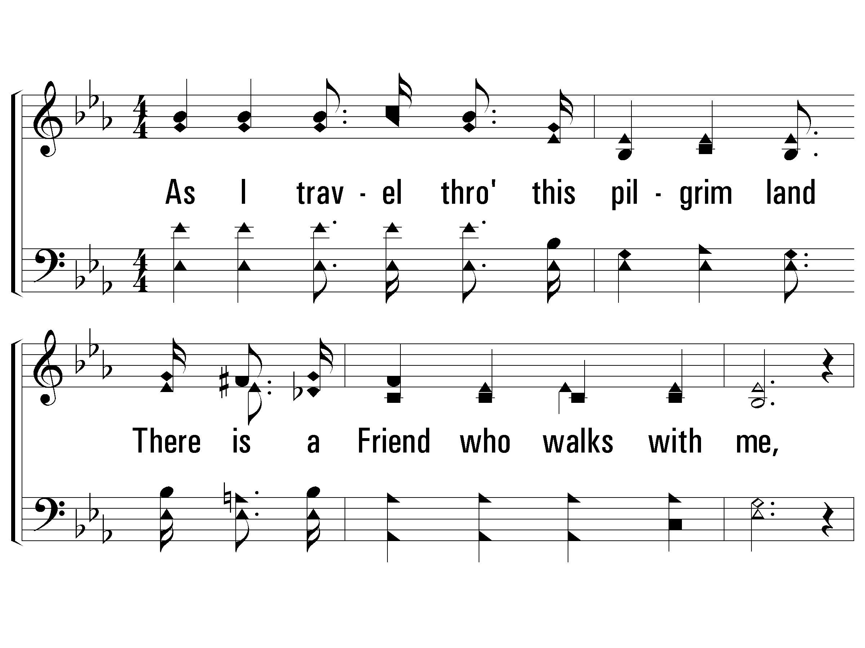
1 - Jesus, Hold My Hand
1.
As I travel through this pilgrim land
There is a Friend who walks with me,
Leads me safely through the sinking sand,
It is the Christ of Calvary;
This would be my prayer, dear Lord, each day
To help me do the best I can,
For I need Thy light to guide me day and night,
Blessed Jesus, hold my hand.
Words & Music: Albert E. Brumley
Copyright © 1933 in Gems of Gladness by Hartford Music Co, Renewal 1961 by Albert E. Brumley & Sons/SESAC (admin. y ICG).
All rights reserved. Used by permission.
PaperlessHymnal.com

Slide 71
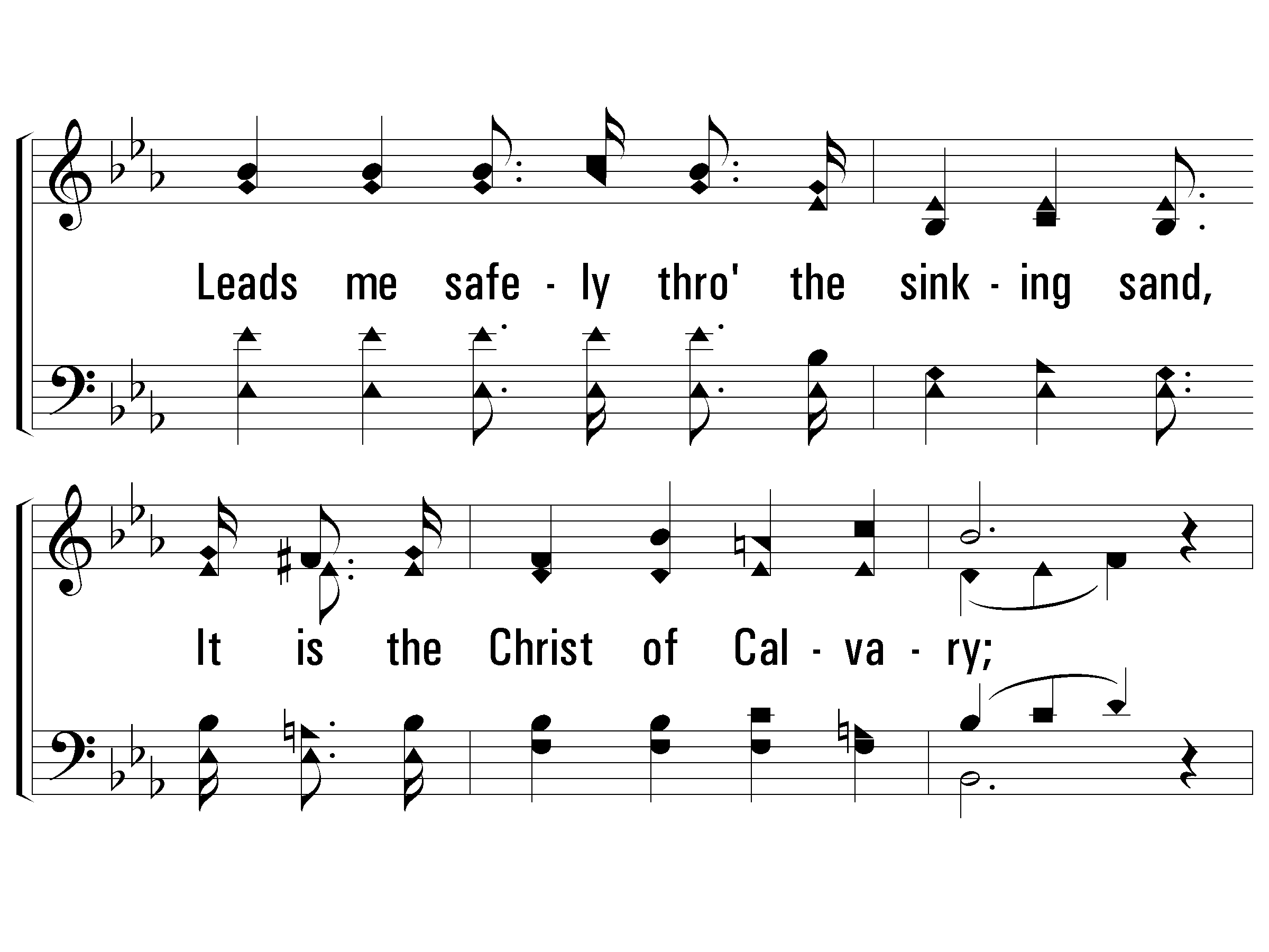
1 - Jesus, Hold My Hand
PaperlessHymnal.com

Slide 72
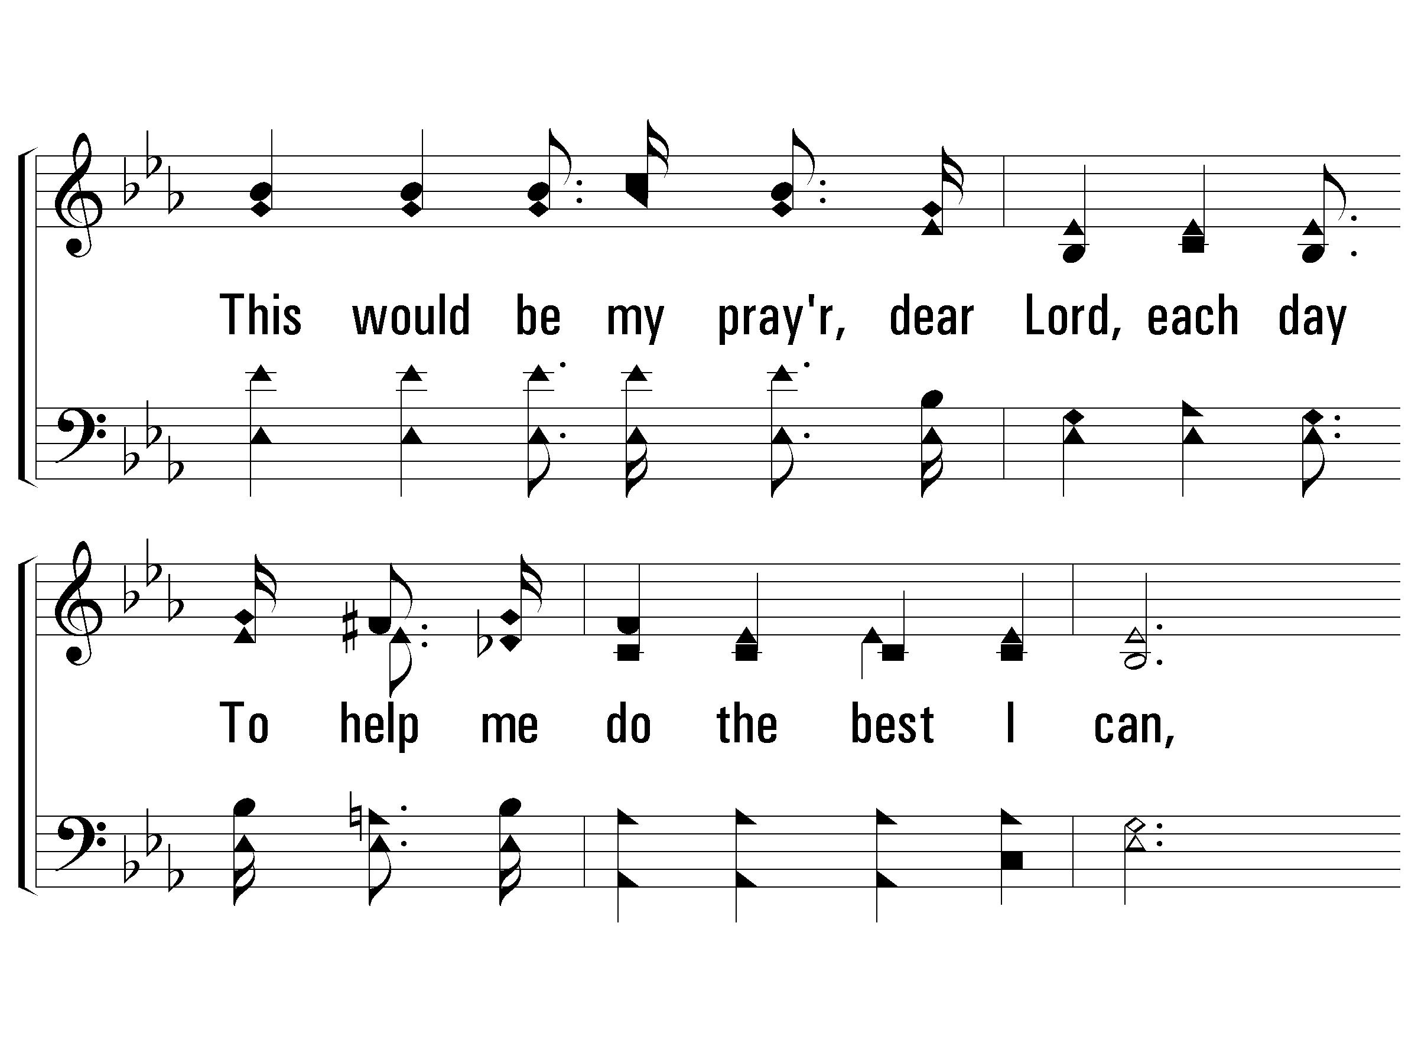
1 - Jesus, Hold My Hand
PaperlessHymnal.com

Slide 73
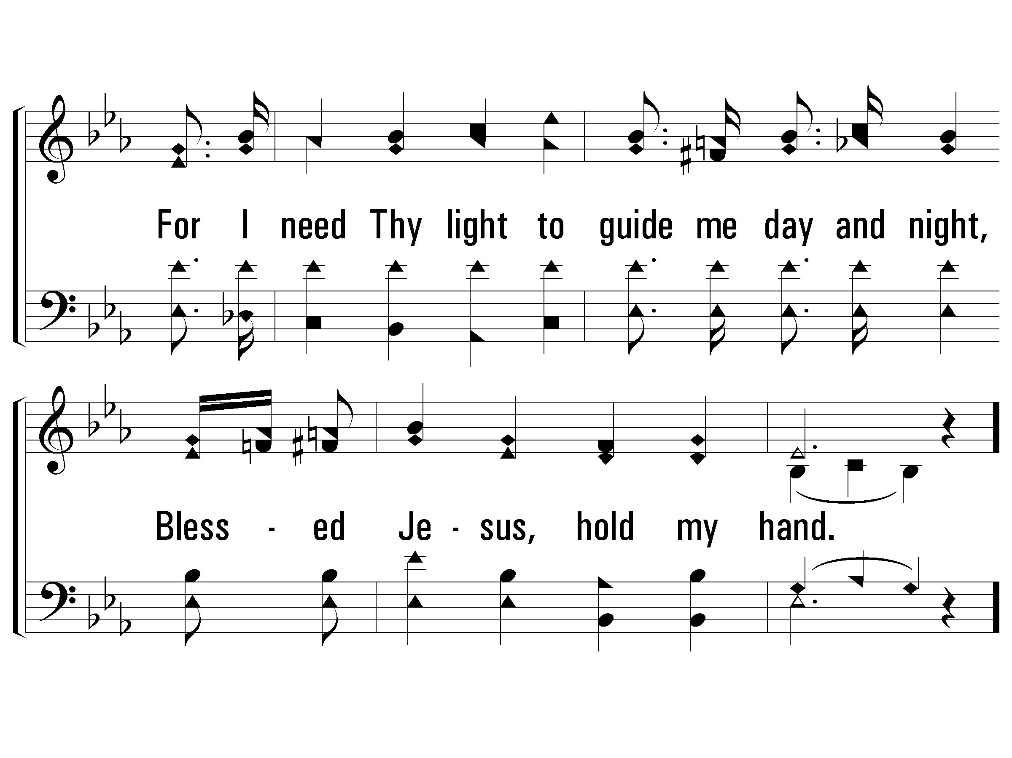
1 - Jesus, Hold My Hand
PaperlessHymnal.com

Slide 74
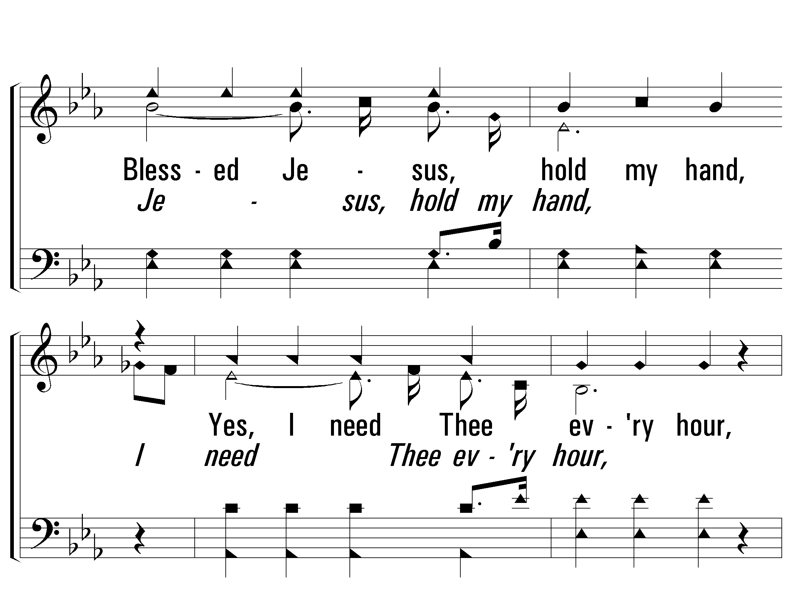
c - Jesus, Hold My Hand
Blessed Jesus, hold my hand,
Yes, I need Thee every hour,
Through this land, this pilgrim land,
By Thy saving power;
Hear my plea, my feeble plea,
Lord, dear Lord, look down on me,
When I kneel in prayer,
Blessed Jesus, hold my hand.
PaperlessHymnal.com

Slide 75

c - Jesus, Hold My Hand
PaperlessHymnal.com

Slide 76

c - Jesus, Hold My Hand
PaperlessHymnal.com

Slide 77

c - Jesus, Hold My Hand
PaperlessHymnal.com

Slide 78

3 - Jesus, Hold My Hand
3.
When I wander through the valley dim
Toward the setting of the sun,
Lead me safely to a land of rest
If I a crown of life have won;
I have put my faith in Thee, dear Lord,
That I may reach the golden strand,
There's no other friend on whom I can depend,
Blessed Jesus, hold my hand.
Words & Music: Albert E. Brumley
Copyright © 1933 in Gems of Gladness by Hartford Music Co, Renewal 1961 by Albert E. Brumley & Sons/SESAC (admin. y ICG).
All rights reserved. Used by permission.
PaperlessHymnal.com

Slide 79

3 - Jesus, Hold My Hand
PaperlessHymnal.com

Slide 80

3 - Jesus, Hold My Hand
PaperlessHymnal.com

Slide 81

3 - Jesus, Hold My Hand
PaperlessHymnal.com

Slide 82
c - Jesus, Hold My Hand
Blessed Jesus, hold my hand,
Yes, I need Thee every hour,
Through this land, this pilgrim land,
By Thy saving power;
Hear my plea, my feeble plea,
Lord, dear Lord, look down on me,
When I kneel in prayer,
Blessed Jesus, hold my hand.
PaperlessHymnal.com

Slide 83
c - Jesus, Hold My Hand
PaperlessHymnal.com

Slide 84
c - Jesus, Hold My Hand
PaperlessHymnal.com

Slide 85
c - Jesus, Hold My Hand
PaperlessHymnal.com

Slide 86

1 - Seek Ye First
1.
Seek ye first the kingdom of God
And His righteousness,
And all these things shall be added unto you.
Allelu, alleluia!
Words and Music by: Karen Lafferty / Arr.: John P. Wiegand
Copyright © 1976 Maranatha Praise, Inc. (Administered by The Copyright Company Nashville, TN)
All Rights Reserved. International Copyright Secured. Used By Permission.
PaperlessHymnal.com

Slide 87

1 - Seek Ye First
PaperlessHymnal.com

Slide 88

1 - Seek Ye First
PaperlessHymnal.com

Slide 89

1 - Seek Ye First
PaperlessHymnal.com

Slide 90

2 - Seek Ye First
2.
Ask and it shall be given unto you,
Seek and ye shall find.
Knock and the door shall be opened unto you.
Allelu, alleluia!
Words and Music by: Karen Lafferty / Arr.: John P. Wiegand
Copyright © 1976 Maranatha Praise, Inc. (Administered by The Copyright Company Nashville, TN)
All Rights Reserved. International Copyright Secured. Used By Permission.
PaperlessHymnal.com

Slide 91

2 - Seek Ye First
PaperlessHymnal.com

Slide 92

2 - Seek Ye First
PaperlessHymnal.com

Slide 93

2 - Seek Ye First
PaperlessHymnal.com

Slide 94

3 - Seek Ye First
3.
Man shall not live by bread a-lone,
But by every word
That proceeds from the mouth of God.
Allelu, alleluia!
Words and Music by: Karen Lafferty / Arr.: John P. Wiegand
Copyright © 1976 Maranatha Praise, Inc. (Administered by The Copyright Company Nashville, TN)
All Rights Reserved. International Copyright Secured. Used By Permission.
PaperlessHymnal.com

Slide 95

3 - Seek Ye First
© 2001 The Paperless Hymnal™
PaperlessHymnal.com

Slide 96

3 - Seek Ye First
© 2001 The Paperless Hymnal™
PaperlessHymnal.com

Slide 97

3 - Seek Ye First
© 2001 The Paperless Hymnal™
PaperlessHymnal.com

Slide 98

1 - Our God, He Is Alive
1.
There is, beyond the azure blue,
a God, concealed from human sight.
He tinted skies with heavenly hue
and framed the worlds with His great might.
Words and Music by: Aaron W. Dicus
Copyright © 1966 by A. W. Dicus, Renewed 1994, Assigned to Ellis J. Crum 1973
PaperlessHymnal.com

Slide 99

1 - Our God, He Is Alive
PaperlessHymnal.com

Slide 100

c - Our God, He Is Alive
There is a God, He is alive,
in Him we live, and we survive;
From dust our God created man,
He is our God, the great I AM.
PaperlessHymnal.com

Slide 101

c - Our God, He Is Alive
PaperlessHymnal.com

Slide 102

4 - Our God, He Is Alive
4.
Our God, whose Son upon a tree,
a life was willing there to give,
That He from sin might set man free,
and evermore with Him could live.
Words and Music by: Aaron W. Dicus
Copyright © 1966 by A. W. Dicus, Renewed 1994, Assigned to Ellis J. Crum 1973
PaperlessHymnal.com

Slide 103

4 - Our God, He Is Alive
PaperlessHymnal.com

Slide 104
c - Our God, He Is Alive
There is a God, He is alive,
in Him we live, and we survive;
From dust our God created man,
He is our God, the great I AM.
PaperlessHymnal.com

Slide 105
c - Our God, He Is Alive
PaperlessHymnal.com

Slide 106
c - Our God, He Is Alive
There is a God, He is alive,
in Him we live, and we survive;
From dust our God created man,
He is our God, the great I AM.
PaperlessHymnal.com

Slide 107
c - Our God, He Is Alive
PaperlessHymnal.com

