Slide 1

Should You Put Any Pressure
On Your Children To Be Baptized?

Slide 2
QUESTION: How Do YOU
Respond To Pressure?
Notes:
Vicky and I, just married; I am in my last year of college; barely getting by.
Compton’s Encyclopedia salesman comes to our little apartment; drives up in a Cadillac; I thought “We are in trouble!”
Tried to pressure us to buy Compton’s when we could barely buy food.
I resented that immensely!

Slide 3

Notes:
You find out you are pregnant -- you are SO excited because you longed for a child.
After 9 months of anticipation, discomfort and the AGONY of labor, you experience the THRILL of a precious, healthy child AND THE OVERWHELMING RESPONSIBILITY-- a child made in the image of God to love but also to guide to Heaven to dwell with his God forever!

Slide 4

Areas Of Life Where You Must At Least NUDGE,
Or Event “Put Your Foot Down!”
Notes:
Sometimes children do things because:
1. That is just what we do! (It’s not questioned, they just cooperate)
2. It’s fun -- We creatively do things to make it fun!
3. We talk about why it is important
3. Positive & Negative consequences -- Great Smile; Rotten Teeth; “Gum It!” (How are you going to eat a Hamburger or steak?
4. Parents realize the importance when often the child doesn’t!
Brushing Your Teeth!

Slide 5


Areas Of Life Where You Must At Least NUDGE,
Or Event “Put Your Foot Down!”
Notes:
School:
Not just 1st day separation anxiety
Emotionally distraught!
Teen adamantly refuses!
Church -- struggles about wanting to go to every service.
What do you do?
Try to help them see blessings, make learning fun
Try to understand
Encourage
Try to address or alleviate underlying causes
Consequences -- you can be disciplined; I as a parent can be in trouble with the authorities

Slide 6
QUESTION: How Do Your Children
Respond To Pressure?
Notes:
Eph. 6:4 “And you, fathers, do not provoke your children to wrath, but bring them up in the training and admonition of the Lord.”

Slide 7
Areas Of Life Where You Must At Least NUDGE,
Or Event “Put Your Foot Down!”
Notes:
Sometimes children do things because:
1. That is just what we do! (It’s not questioned, they just cooperate)
2. We talk about why it is important
3. Positive & Negative consequences -- Great Smile; Rotten Teeth; “Gum It!” (How are you going to eat a Hamburger or steak?
4. Parents realize the importance when often the child doesn’t!
Brushing Your Teeth!

Slide 8
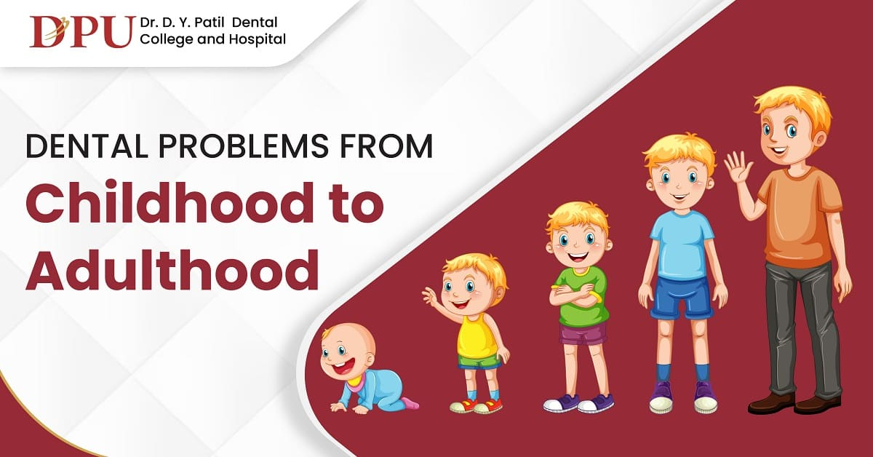
What About Concern For Them Spiritually?
Notes:
Will you pressure your baby to be baptized?
What if they are in elementary school?

Slide 9
Questions:
Do We Have The Authority To Baptize People Who Are NOT Believers?
Do We Have The Authority To Baptize Those Who Will Not Repent?
Do We Have The Authority To Baptize Those Who Will Not Confess Jesus?
Notes:
What IS Faith?
It begins with the realization that I am a sinner.
It involves the realization of the horribleness of sin.
Ie is the realization that I MUST find an answer for my sin!
It involves a LONGING for a Savior!
It is acknowledging that God has promised me that Jesus is the Savior I need and the ONLY ANSWER for my sins!
It includes OBEDIENCE to Christ!

Slide 10
Sadly, We Baptize Unbelievers And Then Wonder:
WHY Aren’t They Staying Faithful?
Why Aren’t They Committed?
WhyDo They Want To Be Rebaptized Later?

Slide 11
One Last Question: What Do Parents Do When
Your Children Are Pressuring You To Be Baptized
But You Have Grave Concerns If They Are Old
Enough Or You KNOW They Are Not Ready?
Notes:
Approaches:
My child can quote the steps of salvation as well as any adult I have ever baptized!
I knew of a Christian Church preacher who baptized his 4-year-old because “she can say the steps of salvation better than any adult I ever taught!”
That’ s just a knowledge of facts; NOT a person ready for conversion and commitment.
Well, if we don’t go ahead and do it, they may never do it!
So if my 2-year-old, 6-year-old, or 12-year old want to drive, must I give in because “if I don’t let them, they may NEVER ask to drive again?????????????????????
My approach to children:
I have parents and the child to sit down and talk with me.
I commend the child for their love for Jesus.
I ask them what they want to do.
They tell me they want to be baptized; it’s wonderful that you have a heart for Jesus. [WHY are they eager to be baptized? Bible Class teachers; sermons; parental concerns and questions; see friends doing it]
It’s great you have a heart for Jesus.
Questions:
If we invited your parents and you to come over to our house tonight, do you think they would come?
If I asked, “Would you like to ride with me?” how do you think they would respond?
What if I am driving and pull out on the road and a car comes flying down the road and I don’t see it and it hits me in the side and I am instantly killed. Where would I go?
Their response: “You would go to Heaven.”
“Well, that’s what I have lived my whole life for!”
“What if you died in that wreck? Where would you go? HEAVEN! “I THINK YOU ARE RIGHT!” [I have NEVER had an 8,9,10 year old child say, “Hell!”
My response: “I think you are right!”
Baptism is NOT for boys and girls who would go to Heaven.
It is for sinners who would go to Hell if they died!!!
You see, there are some things that we are simply not mature enough to do! Example, what if you went to your dad and said, “Give me the keys; I’m going to drive home today!”?
What would he answer? ‘NO!” You are not old enough!”
Is that a put down of you? NO [You are not old enough; you don’t understand liability” it would not be legal!!!!!
You see, baptism is for sinners, people who will go to Hell when t hey die.
Now, the time will come when you understand sin and its consequences and realize that when you die, you will not go to Heaven. When you realize that, have your parents call me and we will talk immediately!!!!!
Also, you need to understand commitment!

