Slide 1
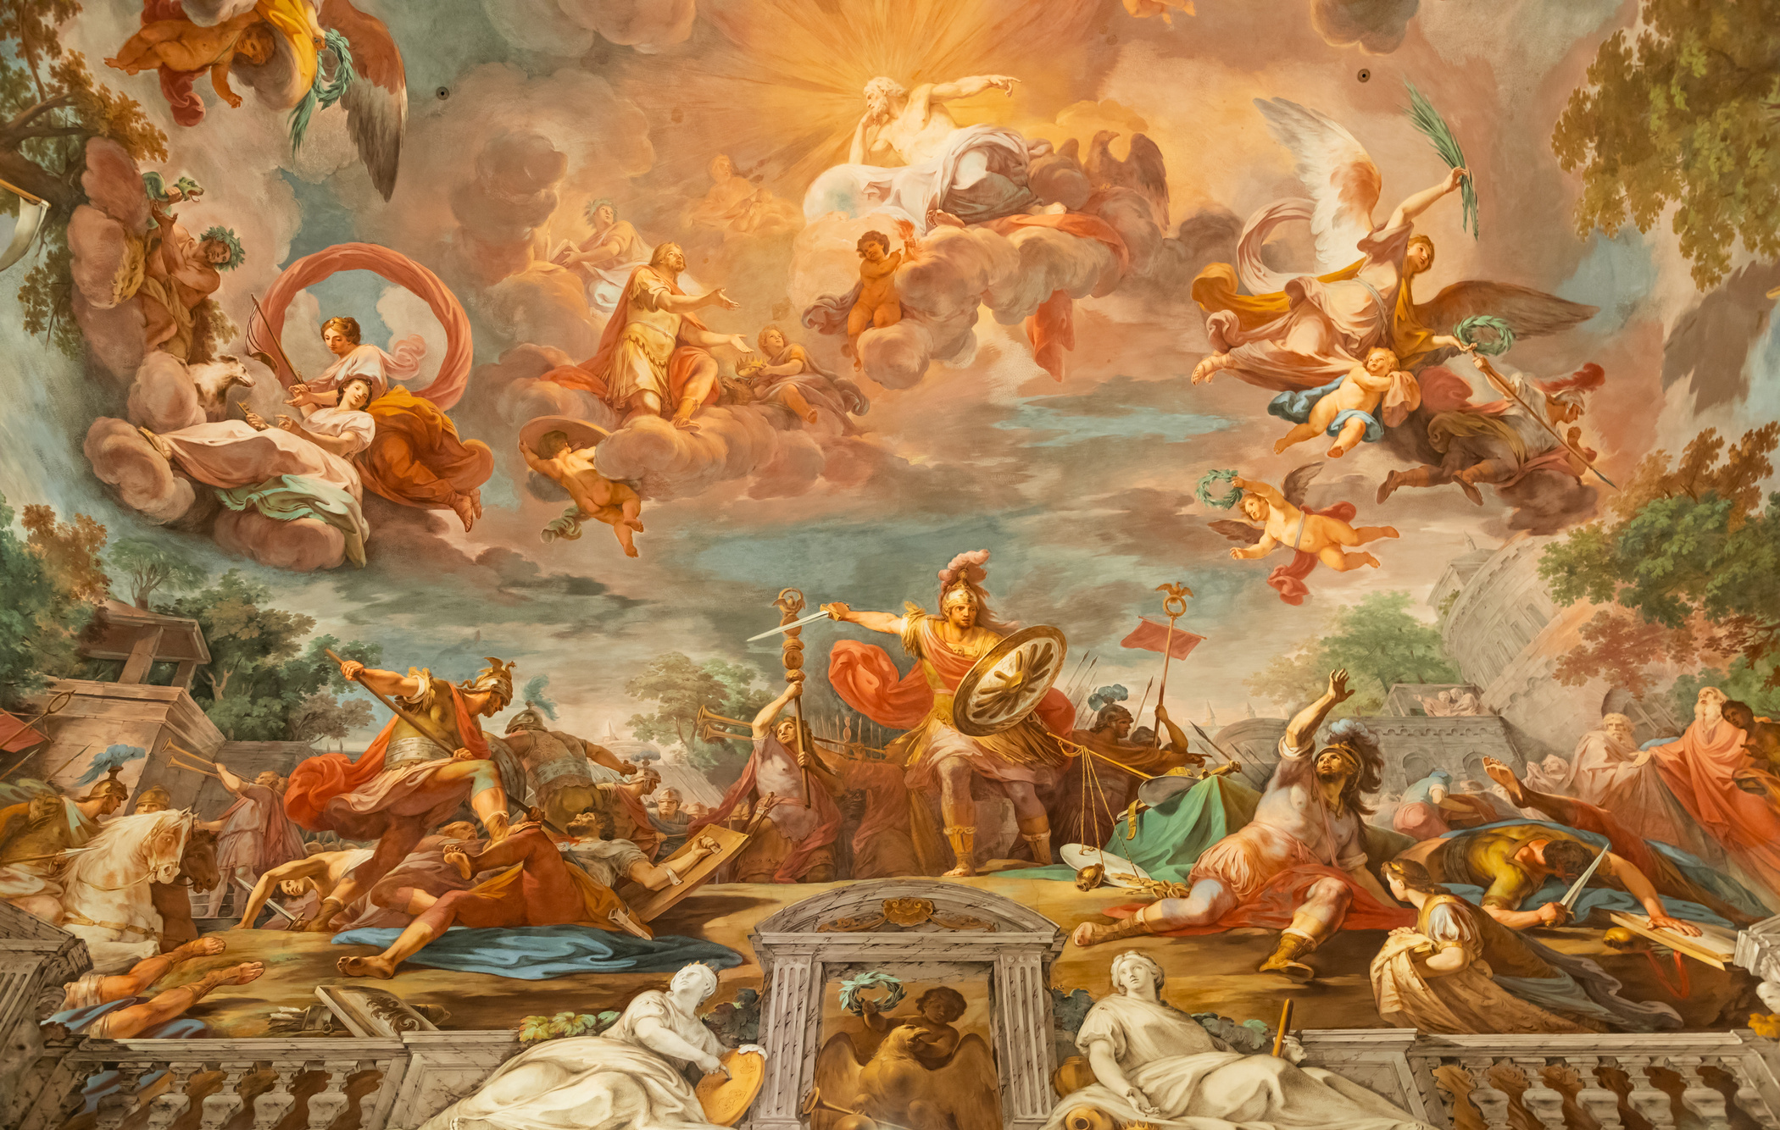
GO DEEP!
Go Deep! How Original Languages Help to Clarify Our Understanding of Spiritual Concepts
The Trinity

Slide 2
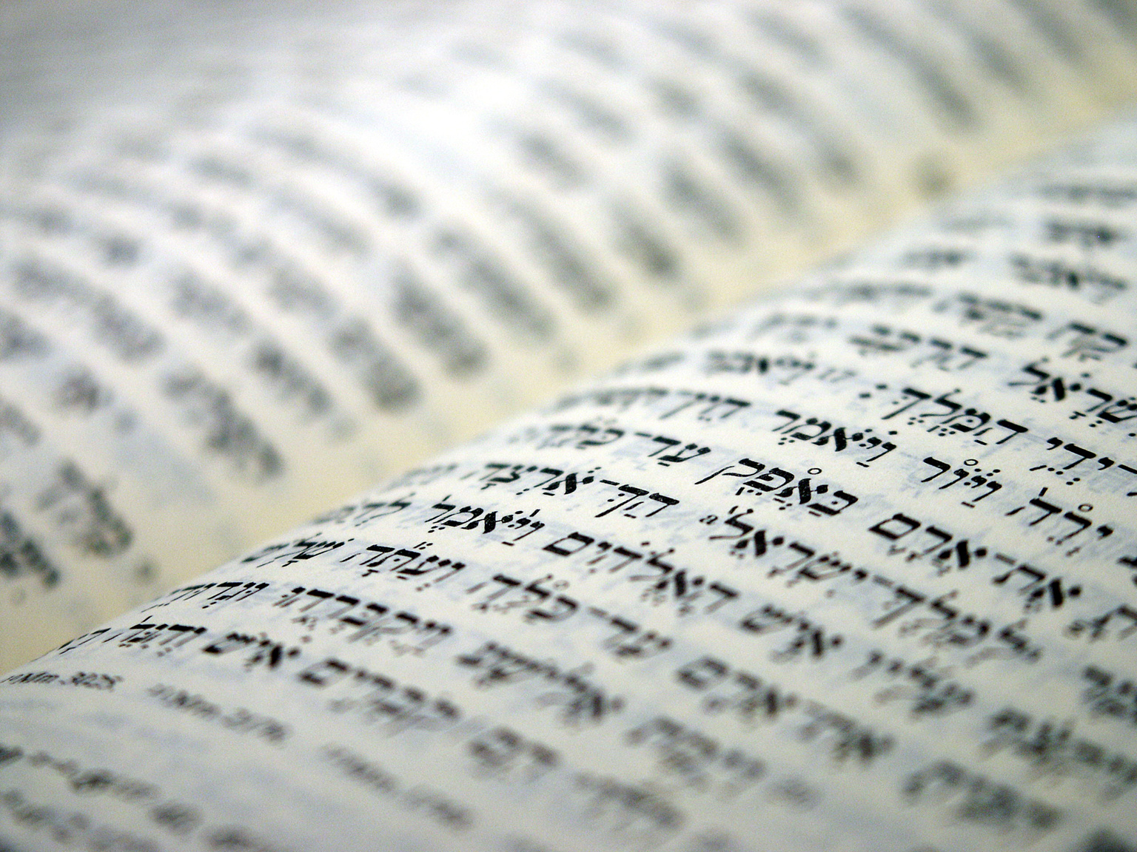
Arguments from Hebrew
’elohim
“let us”
“one” (’eḥad)

Slide 3
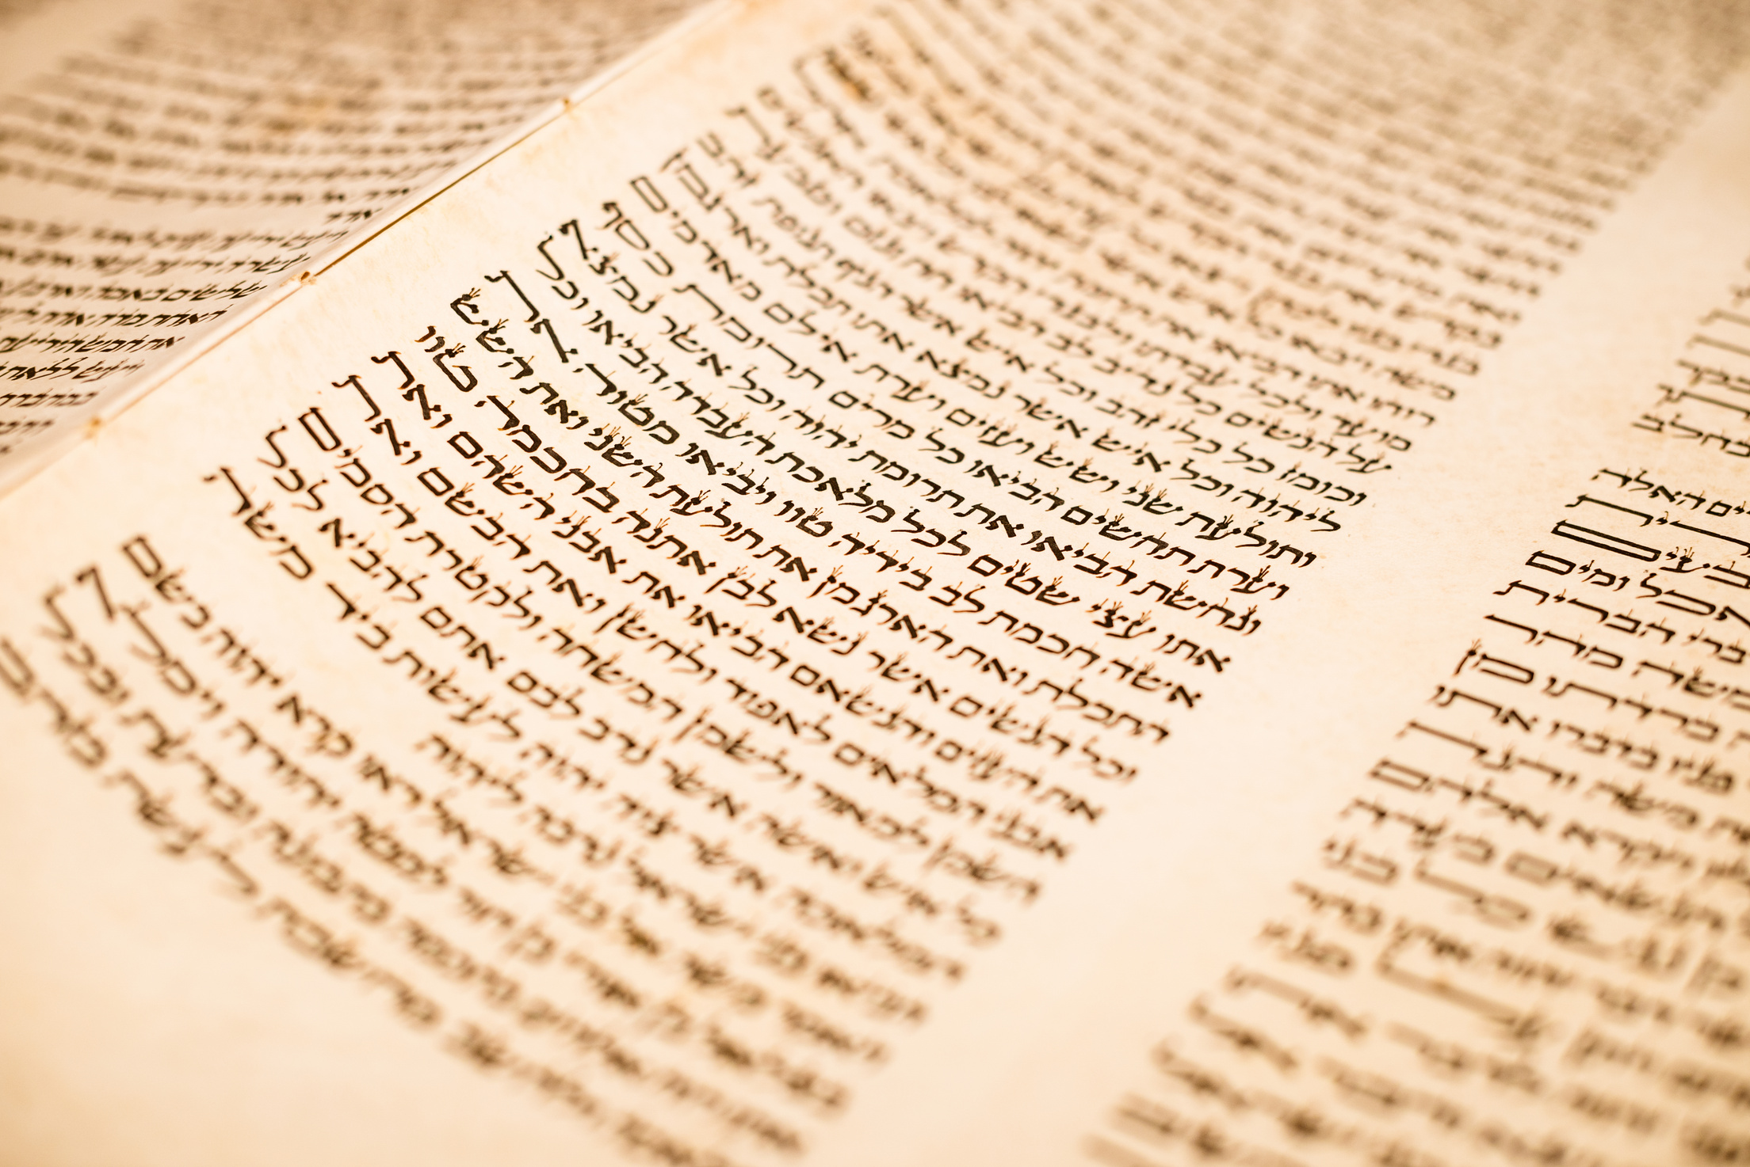
’elohim
NOT a secret reference to the Trinity
A plural is more than one
’elohim does not ALWAYS refer to the Godhead, but to a singular member (Ps 45:6–7)
No one in ancient times uses this argument

Slide 4
The “let us” passages
Grammatical explanations
A “plural of deliberation with oneself”
A cohortative to set up the jussive
Personal explanations
Angels
Jesus (John 1:3; Col 1:16–17)
What about the Spirit?

Slide 5
“One” God
’eḥad can sometimes refer to a compound unity
Gen 2:24; the “one man” verses
But not so fast...
An option is not an obligation
No Hebrew interpreters so interpret
This meaning is rare (970x!)

Slide 6
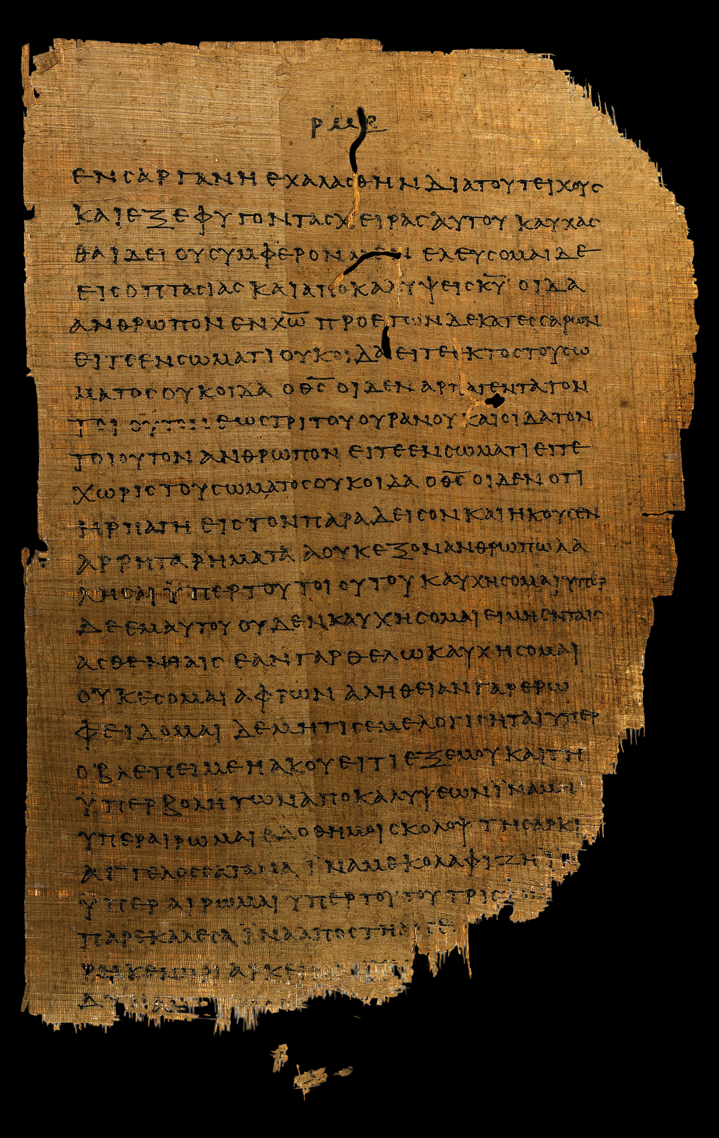
Trinitarian Clues
The word of the Lord
The angel of the Lord
Jesus as God
The Holy Spirit as a Person

Slide 7
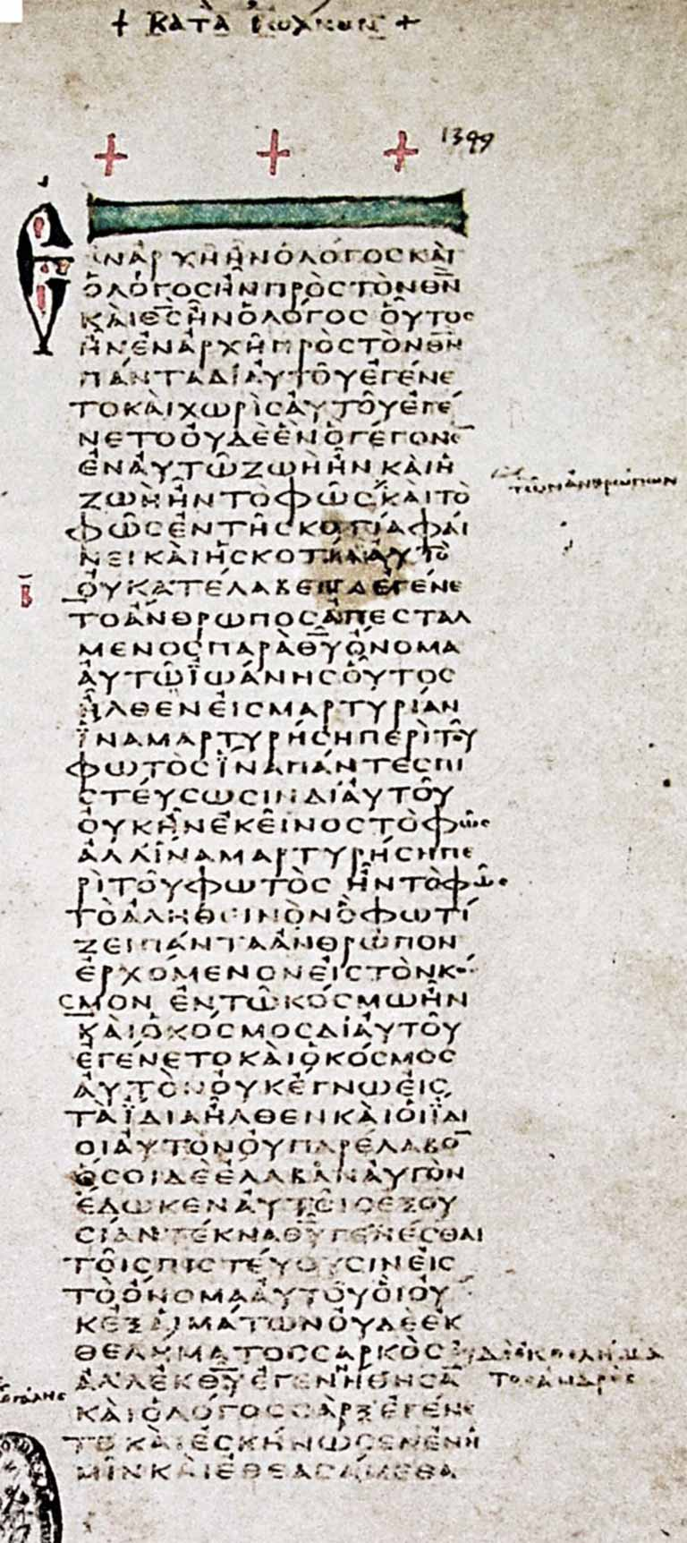
The Word of the Lord
Appears independently
100+x in the Hebrew Bible
Ascribed creative activity
Ps 33:6

Slide 8
The Angel of the Lord
Speaks for God
Genesis 22:1, 11–12
God speaks for him
Exodus 3:2, 6–7

Slide 9
Jesus as God
Called the Logos and God
John 1:1–2
Called the Lord
Hebrews 1:8

Slide 10
The Holy Spirit as a Person
The term “spirit” is neuter, but can take masculine modifiers when referring to the Holy Spirit
John 16:13–14

Slide 11

Conclusion
The doctrine of the Trinity is taught in Scripture
BUT...
No additional light is supplied from the original languages
To treach the truth of Scripture, we must teach the truth from Scripture

