Slide 1
Supporting Diverse Learners
Secondary Teachers

Slide 2
Learning Intentions
We are learning to…
Differentiate between an IEP and a 504 plan
Understand the special education models in FSUSD
Understand the role of the General Education teacher in supporting students with IEPs
Learn how to prepare for an IEP meeting
*Veteran teachers- review IEP/504 basics and learn the FSUSD models.
Notes:
Kristin

Slide 3


“Equity is hearing somebody’s voice about what they need and providing them with that.”
-Dr. Christopher Emdin, HipHopEd
Notes:
Kristin

Slide 4
What is an IEP?
IEP stands for Individualized Education Plan
Supports students with documented disabilities (learning, speech, autism)
Law abiding document
Confidential
Notes:
Hailey

Slide 5
Who is part of the
IEP team?
Parents/Guardians
General Education Teacher
Special Education Teacher
Related Service Providers
Administrator or Admin. Designee
*School Psychologist
*Student
Notes:
Hailey

Slide 6
Who are the other service providers?
Speech and Language Pathologist (SLP)
Occupational Therapist (OT)
Mental Health Clinician
Behaviorist (BCBA)
School Nurse
Adaptive PE Teacher (APE)
Notes:
Hailey

Slide 7
Who are the Case Managers?
If a student has a Speech only IEP, then the case manager is the Speech and Language Pathologist.
A case manager is usually the Special Education teacher.
Notes:
Hailey

Slide 8
IEP vs. 504
Let’s discuss the major differences
Notes:
How does a student get an IEP or 504? Briefly discuss testing and SST.

Slide 9
Who’s Eligible for an IEP?
To get an IEP, there are two requirements:
A child has one or more of the 13 disabilities listed in IDEA. The law lists specific challenges, like learning disabilities, ADHD, autism, and others.
The disability must affect the child’s educational performance and/or ability to learn and benefit from the general education curriculum. The child must need specialized instruction to make progress in school.
Notes:
Gary
https://www.understood.org/articles/the-difference-between-ieps-and-504-plans
Gary– discuss the overlap and the differences and what is LRE

Slide 10
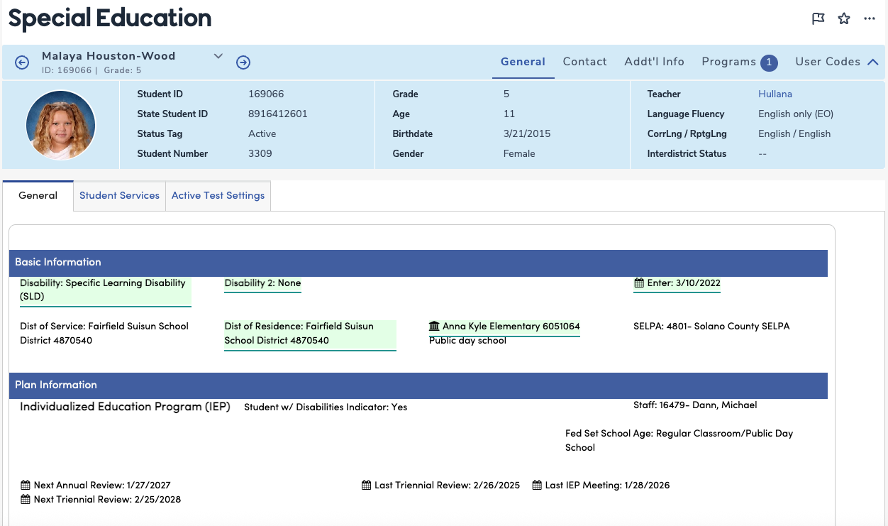

Slide 11
Who’s Eligible for a 504 Plan?
To get a 504 plan, there are two requirements:
A child has any disability. Section 504 covers a wide range of different struggles in school.
The disability must interfere with the child’s ability to learn in a general education classroom.
Section 504 has a broader definition of a disability than IDEA. (It says a disability must substantially limit one or more basic life activities. This can include learning, reading, communicating, and thinking.)
*Check with your site administrator to identify students with a 504 plan.
Notes:
https://www.understood.org/articles/the-difference-between-ieps-and-504-plans
Gary– discuss the overlap and the differences and what is LRE

Slide 12
Examples
Student with an IEP
Example #1: Child has been diagnosed with autism. The child has difficulty with visual processing. For example, it is difficult for them to copy notes from the screen or whiteboard to their own paper.
Example #2: Child has been diagnosed with Oppositional Defiant Disorder. This child exhibits explosive behaviors toward staff when being redirected. This child qualifies for an IEP as well as a Behavior Intervention Plan (BIP).
Student with a 504 Plan
Example #1: Child has been diagnosed with ADHD. The child has minor difficulties with executive functioning skills, such as completing and turning in assignments.
Example #2: Child was recently involved in a car accident and suffered a concussion. The child could qualify for a 504 plan because he temporarily has light sensitivity issues as well as short term memory issues.
Notes:
https://www.understood.org/articles/the-difference-between-ieps-and-504-plans

Slide 13
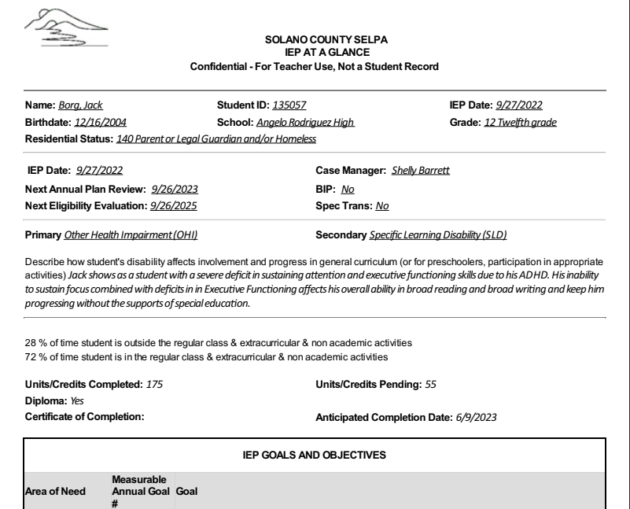
Understanding the IEP
Parts of the IEP at a Glance
  Accommodations or Modifications
  IEP Goals
  BIP (Behavior Intervention Plan)
Student Info
IEP Info
Disability Info
IEP Goals
Notes:
https://www.nwea.org/blog/2021/3-ways-gen-ed-teachers-can-support-students-with-disabilities/

Slide 14

Common Accommodations
Which of these common accommodations would be useful to you or has been useful to you as a learner?
Audiobooks or text-to-speech software
Large print or Braille materials
Visual aids and graphic organizers
Repeated directions or clarification
Highlighted key information
Captions or transcripts for videos
Verbal instead of written responses
Typing instead of handwriting
Extended time on tests and assignments
Breaks during work or testing
Preferential seating
Use of checklists, calendars, and visual schedules

Slide 15
The best way to support students with IEPs is to focus on support for ALL students.

Slide 16


An accommodation changes how a student learns the material.
A modification changes what a student is taught or expected to learn.
Most students who are part of the General Education program will not have modifications listed on their IEPs. This means that teachers must provide supports and scaffolds for those students to reach the same CA State Standards as all other grade-level students.
It is a legal requirement that teachers provide students with their accommodations.
An example of an accommodation may be extra time to complete assignments.
An example of a modification is providing a text at a lower reading level.
Notes:
https://www.understood.org/en/articles/the-difference-between-accommodations-and-modifications
Kristin– changes to the Standards/ access to grade level. Make sure teachers are not altering or modifying the Standards being taught. Importance of Terminology. Diploma vs. Non-Diploma.

Slide 17
Questions?

Slide 18

Special Education Service Models in FSUSD (Secondary)
Co-Teach (Middle/High School)
  A collaboration between General Education & Special Education teacher in one classroom.
Directed Studies (Middle/High School)
  Students with IEPs have a class in their schedule to help support their academic work and executive functioning skills. This is taught by a Special Education teacher.

Slide 19
Special Education Programs in FSUSD
FA- Functional Academics
Vocational Ed- Students earn a certificate of completion
Non-College Prep (NCP)- Students earn a High School Diploma
PERL- Program for Effective Relationships and Learning

Slide 20
The Role of the General Education Teacher in the IEP Process
Sees the student the most often and builds relationships
Conducts daily informal and formal assessments
Understands the grade level standards and content
Observes the student and their interactions with others (behavior, academic, social-emotional)
Can speak to additional supports that would benefit the student

Slide 21
The Role of the Case Manager in the IEP Process
Connects parents and the school team in IEP related communication
Collects and monitors data/progress from all parties
Coordinates IEP meetings and check ins
Drafts and completes all necessary IEP paperwork; communicates updates to team
Ensures supports and accommodations are available and implemented

Slide 22

Prepare for an Upcoming IEP Meeting
Focus on the positives; write these down and share with the IEP Team
Bring work samples/ examples of progress toward IEP goals
  Class work
  MAP Scores
  Informal assessments
  Observations (behaviors, executive functioning skills, time on task, etc.)
Approach the meeting with an assets-based mindset
Follow all accommodations and provide feedback on how well they are working

Slide 23
Questions?

Slide 24

Optimistic Closure
What is the first step you will take to support your students with IEPs and 504s this school year?

Slide 25
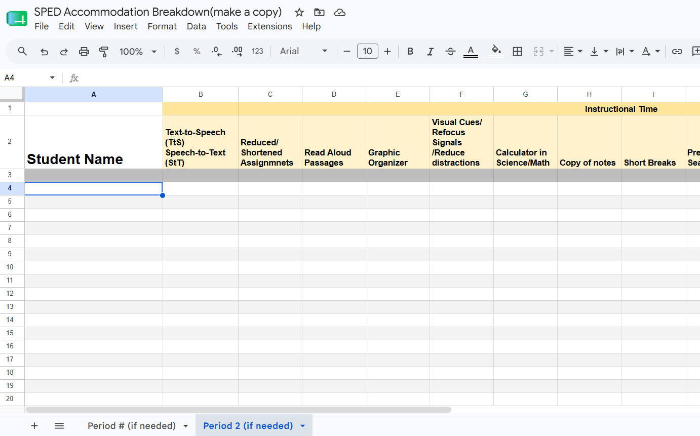
Next Steps
Gather your IEPs at a Glance
Analyze the accommodations by student
Plug into this Accommodations Breakdown sheet
Click on picture to make yourself a copy.
Notes:
Jess

