Slide 1

Not All Tokens are Equal Semantic KV-Cache for Agentic LLM Serving
Maroon Ayoub, IBM Research, llm-d core maintainer
Hyunkyun Moon, Moreh.io, llm-d/vLLM contributor

Slide 2
About “Moreh”
Distributed inference platform for heterogeneous GPU data centers
Cross-vendor PD disaggregation (e.g., NVIDIA-AMD)
SLO-driven automatic chip selection and deployment
Vertical optimization for AMD GPU clusters
Notes:
Hi, I'm HyunKyun Moon, an ML platform engineer at Moreh. Before we dive in — a quick word about our company.
Moreh builds a distributed inference platform for heterogeneous GPU data centers.
Our core focus is cross-vendor prefill-decode disaggregation, for example running prefill on NVIDIA and decode on AMD.
On top of that, we work on SLO-driven automatic chip selection, and vertical optimization for AMD GPU clusters.

Slide 3
“Well-lit” Paths
llm-d provides “well-lit” paths for running LLM inference workloads
Intelligent Inference Scheduling
P/D Disaggregation
Wide Expert Parallelism
KV Cache Management
Notes:
The goal is showing KV-cache orchestration as key optimization across each

Slide 4
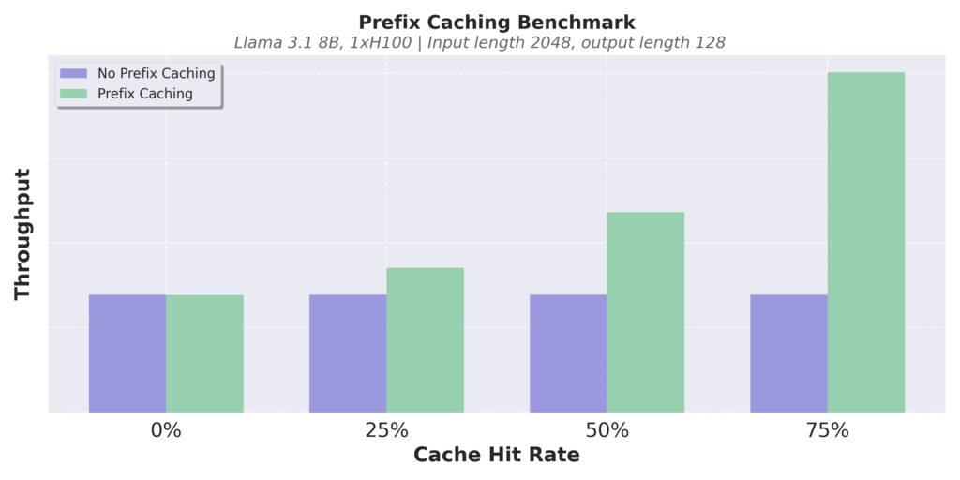
Automatic Prefix Caching
vLLM skips prompt processing by automatically reusing KV cache blocks across requests
Example: Multi-turn conversation
Prompt (round 1)
Human: What's AI?
LLM Result (round 1)
LLM: AI is technology that simulates human intelligence, like Siri or Google Maps.
Cached
Prompt (round 2)
Human: What's AI?
LLM: AI is technology that simulates human intelligence, like Siri or Google Maps.
Human: Cool, thanks!
LLM Result (round 2)
LLM: No problem!
Notes:
Maximize reuse of computed context

Slide 5
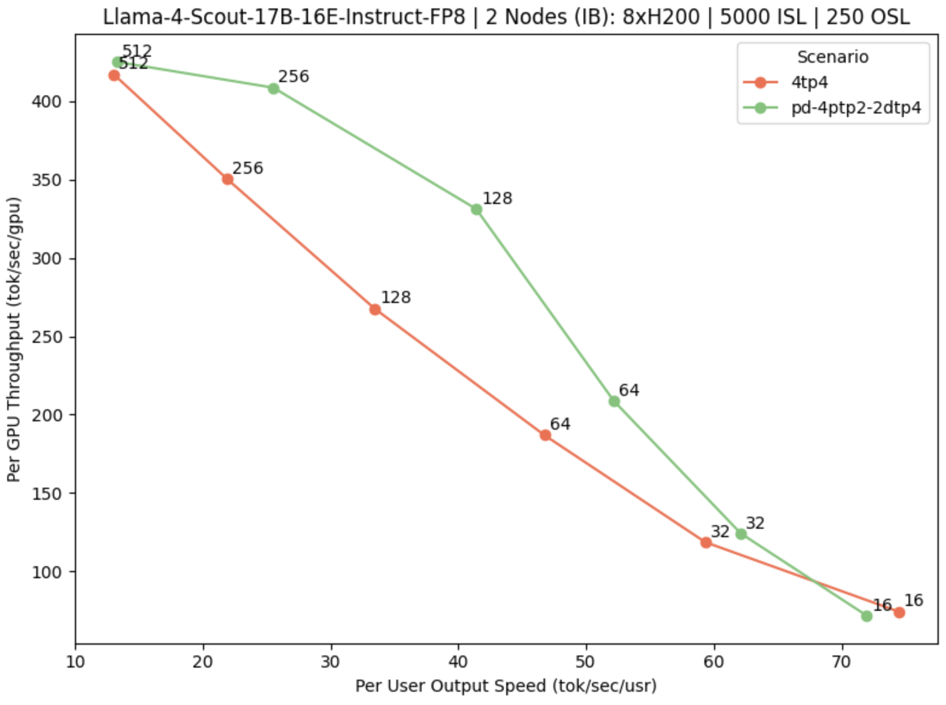
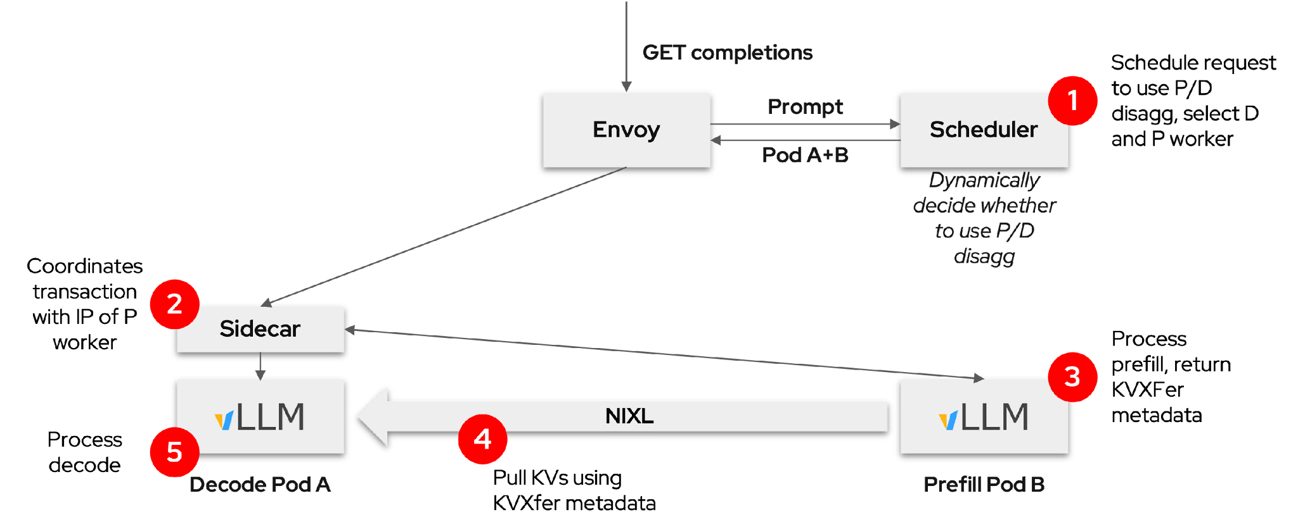
“Well-lit” Path: Prefill/Decode Disaggregation
llm-d composes vLLM and Gateway to enable P/D disaggregation
Separate prefill and decode
Allows specialization
Dynamically decided
Easier to meet TTFT and ITL SLO requirements
Best for “medium” server load
Typical: small prefillers, large decoders
P/D benefits are most clear when jointly optimizing efficiency and interactivity
Separate KV-cache production from consumption - let each scale and specialize independently
Notes:
Separate prefill and decode so that you have specialized deployments (hardware+scale wise)

Slide 6


“Well-lit” Path: Wide Expert Parallelism
llm-d’s K8s-native design integrates EP implementation directly with the broader system, including DP-aware load balancing
GET completions
Prompt
EPP
*Composes with other scorers*
Pod D
LeaderWorkerSet
Expert-Parallel MLP
Pod A
(DP-0)
Pod B
(DP-1)
Pod C
(DP-2)
Pod D
(DP-3)
Pod E
(DP-4)
Pod F
(DP-5)
Pod G
(DP-6)
Pod H
(DP-7)
Reduce per-node model weight footprint and attention duplication for increased KV-cache capacity
Notes:
DP - minimize KV-cache duplication across worker ranks

Slide 7
“Well-lit” Path: Intelligent Inference Scheduling
vLLM-aware load-balancing enables smarter request routing that improve SLOs
Prefix-Aware Routing
Load-Aware Routing
GET completions
GET completions
Prompt
EPP
Prompt
EPP
Pod A
Pod A
Prefix-tree.
“Pod A has hit”
Scrape metrics. “A has low load”
KV Events
/metrics
Pod A
Pod B
Pod C
Pod A
Pod B
Pod C
Dramatically increase prefix-cache hit rate
Load-balancing based on actual replica state
Unify the disaggregated KV-cache pool for optimized orchestration and maximal reuse
Notes:
Your load balancer knows where state is, and routes to maximize prefix-cache hits

Slide 8
“Well-lit” Path: KV Cache Management
Leverage all system resources to maximize prefix cache hit rate within the cluster
North/South KV Management
East/West KV Management
GET completions
GET completions
Gateway
Prompt
EPP
Gateway
Prompt
EPP
Pod A
Pod A
KV Index
KV Index
CPU RAM
CPU RAM
CPU RAM
CPU RAM
Remote
Storage
CPU RAM
KVEvents
KVEvents
Pod A
Pod B
Pod C
Pod A
Pod B
Offload KV caches to local memory with global index
Offload KV caches to global shared remote storage
Extend the pool beyond GPU, computed once and reused anywhere in the cluster
Notes:
We discussed efficient orchestration - but it is gapped by the scarce GPU memory
North-south: expand the KV-cache of a single instance to available memory tiers
East-west: compute once, reuse anywhere through an extended tier of shared storage

Slide 9
The Problem: Blind State Management
Leverage all system resources to maximize prefix cache hit rate within the cluster
System Prompt (4K)
Tool Definitions (8K)
Conversation History (12K)
A single ReAct turn. LRU treats all 26K tokens identically.
Eviction is blind
A 4K system prompt reused every turn has the same eviction priority as a 2K single-use scratchpad
No semantic tiering
Blocks can't be offloaded to CPU/storage based on what they represent
No cross-node state orchestration
Shared prefixes across 50 child agents are recomputed per node instead of replicated

Slide 10
Cache Orchestration Policies
Treat KV-Cache as a programmable, orchestrated resource
Semantic context types
system-prompt, tool-definitions, reasoning-branch, checkpoint, ...
Retention policies
Priority + TTL per context type. Which blocks survive memory pressure, for how long, where they land when offloaded
Movement policies
When and where to distribute blocks across tiers or nodes — replication for fan-out, proactive prefetch, tier offloading
Specific policies are consumers of the surface, not the surface itself

Slide 11
Policy: ReAct-Loop Retention
Continuum: Efficient and Robust Multi-Turn LLM Agent Scheduling with KV Cache TTL
arXiv 2511.02230 · arxiv.org/abs/2511.02230
Core idea: TTL-based KV cache retention to bridge tool-call pauses in multi-turn agent loops
Insight: tool definitions and system prompts are reused every turn but evicted during tool-call pauses (2–30s). TTL bridges the gap.
Evidence: 1.12–3.66× delay reduction on SWE-Bench and BFCL
policy: react-loop-retention
system-prompt → pri: 95
tool-definitions → pri: 90
conversation-history → pri: 60, ttl: 30s
reasoning-scratchpad → pri: 30, ttl: 10s
Notes:
The policy example.
There's a paper called Continuum. focuses on is the agent's behavioral pattern.
An agent reasons, calls a tool, waits 2~30s for the result, then reasons again.
The problem is that during this wait, blocks look old to LRU, so it evicts them.
Even though system prompts and tool definitions are guaranteed to be needed on the very next turn.
So the core idea is differential retention.
Context that's guaranteed to be reused every turn gets high priority like this. Transient context gets low priority, but with TTL to survive the expected tool-call pause like this.
This showed 1.12~3.66x delay reduction on SWE-Bench (real agentic coding) and BFCL (function calling), with the largest improvement when memory is tight.
—
Continuum (OSDI '25 / arXiv 2025) observed that agentic tool-use loops have a specific pattern: the agent reasons, calls a tool, waits 2-30 seconds for the result, then reasons again. During that wait, LRU evicts the agent's KV blocks because they look "old." But the system prompt and tool definitions are guaranteed to be needed on the very next turn. Their solution: differential retention. High-value durable context (system prompt, tools) gets high priority. Transient context (reasoning scratchpad) gets low priority. TTL bridges the expected tool-call pause so blocks aren't evicted prematurely. Results: 1.12-3.66× delay reduction on SWE-Bench (real agentic coding) and BFCL (function calling). The improvement is largest when memory is tight and multiple agents share the cluster. As an llm-d policy: this maps directly to the Retain primitive. The router tags token ranges with context types from request structure, the indexer records priorities, and under memory pressure blocks evict in priority order. No changes to the engine.

Slide 12
Policy: Workflow-Aware Scoring
KVFlow: Efficient Prefix Caching for Accelerating LLM-Based Multi-Agent Workflows
NeurIPS 2025 · arxiv.org/abs/2507.07400
Core idea: eviction priority from workflow DAG — agents close to execution keep their cache
Insight: in a multi-agent pipeline (Researcher → Analyst → Recommender), agents far from execution don't need GPU-resident cache. Priorities update as the workflow progresses.
Evidence: Up to 2.19× speedup over LRU under concurrent multi-agent workloads
policy: workflow-aware-scoring
imminent-agent → pri: 90
next-in-pipeline → pri: 70, ttl: 60s
distant-agent → pri: 30, ttl: 120s
completed-agent → pri: 10, move → cpu
Notes:
second policy
There's a paper called KVFlow, addresses is multi-agent workflows where agents are connected in sequence. For example, in an investment analysis pipeline, a Researcher agent investigates, a Financial Analyst agent analyzes, and an Investment Recommendation agent produces the final output.
The problem is that all three agents' KV blocks compete for the same cache. Under LRU, the Researcher's blocks were generated first, so they get evicted first, even though the Analyst needs the Researcher's output as input context.
The core idea is computing priority from the workflow DAG. The imminent agent gets the highest priority, and priorities update dynamically as the workflow progresses. When the Researcher finishes, the Analyst becomes the imminent agent.
You could set it up like this.
Imminent agent at priority 90, next in pipeline at 70 with TTL 60s, distant agent at 30 with TTL one hundred 120s, completed agent at 10 and moved to CPU.
By preventing cross-workflow cache thrashing when multiple workflows share the cluster, this showed up to 2.19x speedup over LRU.
–
KVFlow addresses multi-agent workflows where agents are connected in sequence or parallel. Example: Investment analysis — Researcher agent → Financial Analyst agent → Investment Recommendation agent. The problem: all three agents' KV blocks compete for the same cache. Under LRU, the Researcher's blocks (generated first) get evicted before the Analyst even starts, even though the Analyst needs the Researcher's output as input context. KVFlow's insight: compute priority from the workflow DAG. The imminent agent (about to execute) gets highest priority. Agents further away in the pipeline get lower priority with TTL. Completed agents can be offloaded to CPU. Priorities update dynamically as the workflow progresses — when the Researcher finishes, the Analyst becomes imminent. Results: up to 2.19× speedup over LRU under concurrent multi-agent workloads. The key is that multiple workflows share the cluster, and workflow-aware scoring prevents cross-workflow cache thrashing. As an llm-d policy: the program-aware scheduler (PE-I) maintains the workflow DAG. The indexer tracks which blocks belong to which agent in which program. Priority updates flow through the Retain primitive as agents complete.

Slide 13
Policy: Branching Exploration
Tree-of-Thought · N parallel branches from shared prefix
Insight: shared prefix is high-value (reused by all branches). Completed branches can offload to CPU. Discarded branches move to storage or evict.
Exercises both dimensions: retention (priority + TTL) and movement (tier offloading)
policy: branching-exploration
shared-prefix → pri: 95
active-branch → pri: 70
completed-branch → pri: 40, ttl: 30s
move → cpu
discarded-branch → move → storage
Notes:
and, Branching Exploration.
This pattern has three key characteristics.
First, the shared prefix is very large, 30K~100K tokens. It's extremely valuable because all branches share it.
Second, branch-specific context is transient. It has value while active but drops off once evaluated.
Third, branches run in parallel but results need to be gathered before moving to the next step.
You could set it up like this.
Shared prefix at 95 so it's never evicted. Active branches at 70. Completed branches waiting for aggregation at 40 with TTL 30s, offloaded to CPU to free GPU for active branches. Discarded branches after evaluation move to storage.
What makes this policy special is that it exercises both dimensions, retention and movement. Priority and TTL control retention, tier offloading controls movement. The previous two policies were about retention. This one demonstrates the full surface our framework provides.
This pattern is also valuable for RL (like Monte Carlo Tree Search or self-play) where the branching structure is the same.
—
This policy exercises both orchestration dimensions — retention AND movement — making it a good example of the full surface. Tree-of-Thought pattern: generate N parallel reasoning paths from a shared context (e.g., 8 code implementation approaches from the same problem description). Evaluate each, expand the top candidates. Key characteristics: - Large shared prefix (30-100K tokens) across all branches — very high value - Branch-specific context is transient — moderate value while active, low value once evaluated - Parallel execution but results needed together before the next step The policy: - Shared prefix: highest priority, never evicted - Active branches: moderate priority (all running in parallel) - Completed branches (evaluated, waiting for aggregation): lower priority, TTL, offload to CPU to free GPU for active branches - Discarded branches (evaluated and rejected): move to storage with TTL, eventually evict This pattern is also valuable for RL (MCTS, self-play) where the branching structure is the same. Evidence is TBD — this is a contribution target for the benchmarking workstream (PE-V). The OTel trace replay infrastructure will enable validating this policy against real Tree-of-Thought traces.

Slide 14
Where is Lives in llm-d
Declarative rules over semantic types
Router / EPP — workload understanding + policy evaluation
Extracts agentic structure from request traffic. Issues Retain and Move directives.
Semantic Indexer — the global view
Extends kvblock tracking with context_type, program_id, priority, TTL.
Primitives
Retain(blocks, priority, ttl) — engine-local Move(blocks, src_tier, dst_tier, dst_node) — cross-node via NIXL KVEvents — engine reports, indexer tags semantics
The model server does not evaluate policies. All intelligence in the control plane.

Slide 15
Status
Progress across the stack
Pillar | Name | What | Status
PE-III | Semantic Indexer | Context types + program IDs on kvblocks | Design
PE-IV-a | Context-Aware Eviction | Retain(blocks, priority, ttl) primitive | In Progress
PE-IV-b | Context-Aware Offloading | Move directives driven by retention policies | Scoped
PE-I | Program-Aware Scheduler | Workload-aware routing via semantic view | Design
PE-V | Workload Benchmarking | OTel trace replay for agentic simulation | In Progress
llm-d as an Agentic Runtime Northstar

Slide 16
Where is Lives in llm-d
Declarative rules over semantic types
Router / EPP — workload understanding + policy evaluation
Extracts agentic structure from request traffic. Issues Retain and Move directives.
Semantic Indexer — the global view
Extends kvblock tracking with context_type, program_id, priority, TTL.
Primitives
Retain(blocks, priority, ttl) — engine-local Move(blocks, src_tier, dst_tier, dst_node) — cross-node via NIXL KVEvents — engine reports, indexer tags semantics
The model server does not evaluate policies. All intelligence in the control plane.

Slide 17
What’s Next
Declarative rules over semantic types
Retention API in vLLM
The Retain primitive — validating context-aware eviction (in progress)
Semantic fields in the indexer
Context types and program IDs on kvblocks — the semantic memory map
Policy-driven benchmarks
OTel trace replay validating each tested policy against LRU baseline
Workload structure extraction
Meeting frameworks where they are — recognizing patterns from request traffic

Slide 18



Join us!
Your Contributions Matter!
GitHub: https://github.com/llm-d/llm-d-kv-cache https://github.com/llm-d/llm-d-inference-scheduler
Slack: #sig-kv-disaggregation
#sig-inference-scheduler
#agentic-inference
linkedin.com/in/v-maroon
linkedin.com/in/hyunkyun

