Slide 1
KV-Cache Centric Inference
Building a State-Aware Serving Platform with llm-d and vLLM
Maroon Ayoub, IBM Research
Martin Hickey, IBM Research
Notes:
What are the 3 core Service Level Objectives (SLOs) for using AI:
Latency: Fast response
Cost: As low as possible
Error rate: No hallucinations
Lot of work has been done in the space of Floating‑Point Operations Per Second (FLOPS): how fast a system can perform calculations.
Its now in the area of caching and separating prefill and decode stages of inference where the wins for latency and cost are proving to be most fruitful, especially with the growth of more and more agantic workloads.

Slide 2
Cost & Latency Problems
“The KV-cache hit rate is the single most important metric for a production-stage AI agent. It directly affects both latency and cost.”
- Manus, Context Engineering for AI Agents
Mainstream AI API Pricing:
OpenAI GPT-5: $1.25 per 1M input tokens vs $0.125 per 1M cached input tokens
Anthropic Claude Sonnet: $3 per 1M input tokens vs $0.3 per 1M cached input tokens
“A single monolithic serving process starts to hit its limits.”
- Nvidia, Deploying Disaggregated LLM Inference Workloads on Kubernetes
“A long 32K‑token prompt arriving mid‑generation stalls every other user in the queue. This head‑of‑line blocking is the core problem disaggregation solves.”
- Spheron
Notes:
What we’re going to talks about really affects your bottom-line!
Without key optimizations:
you pay 10x AND
Under-use your resources

Slide 3
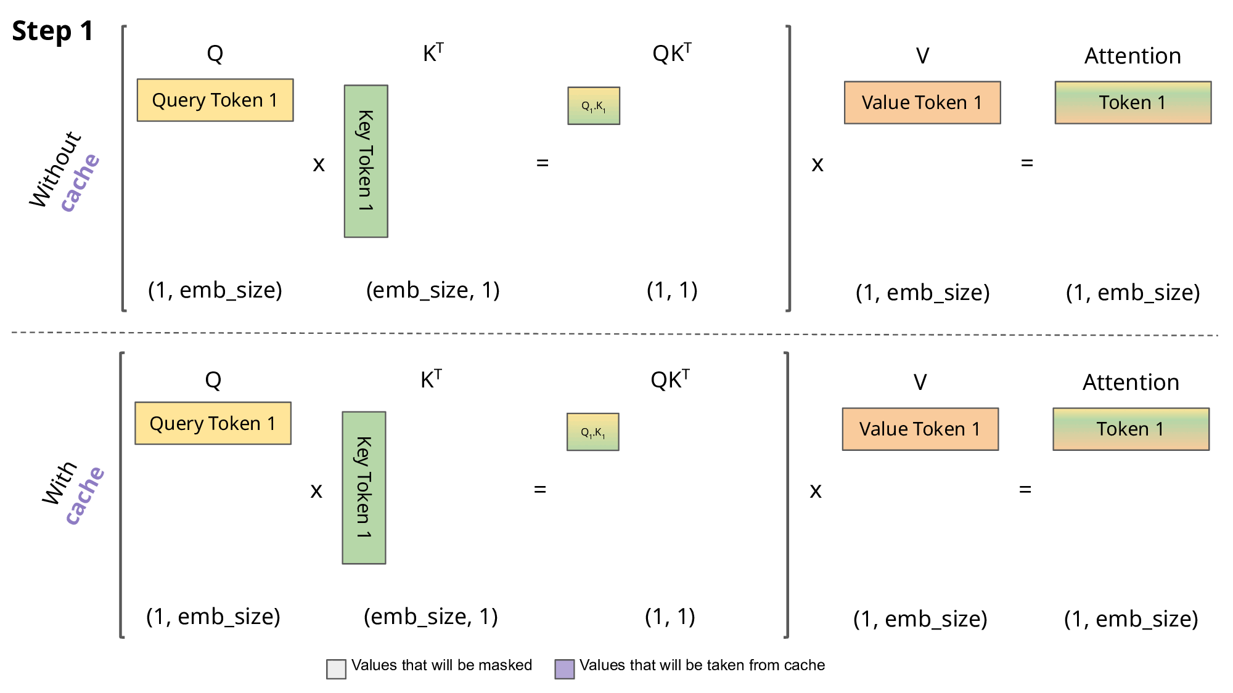
Attention
KV cache stores the attention state for all previous token
Notes:
Attention is a mechanism used be a lot of modes tol decide which parts of the input matter most when producing an output. Helps generate output.
At inference time, most transformer models operate in two distinct phases:
Prefill (a.k.a. prompt processing, context building)
Process the entire input prompt in parallel
Decode (a.k.a. autoregressive generation)
Generate one token at a time
Prefill KV‑cache is caching the Key (K) and Value (V) tensors from the model’s attention mechanism during prefill phase of nference and it is the single biggest speedup for inference.

Slide 4
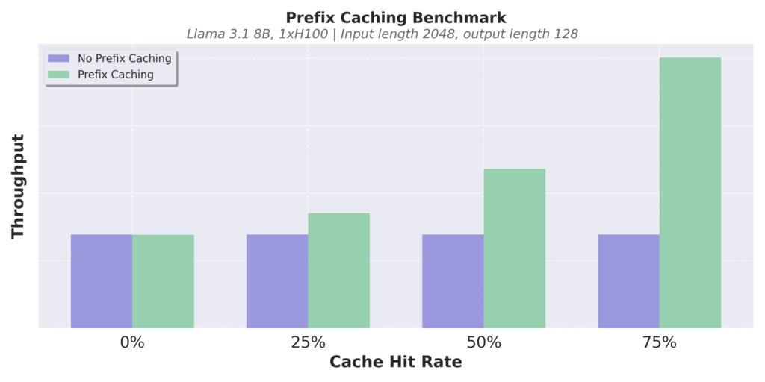
Automatic Prefix Caching
vLLM skips prompt processing by automatically reusing KV cache blocks across requests
Example: Multi-turn conversation
Prompt (round 1)
Human: What's AI?
LLM Result (round 1)
LLM: AI is technology that simulates human intelligence, like Siri or Google Maps.
Cached
Prompt (round 2)
Human: What's AI?
LLM: AI is technology that simulates human intelligence, like Siri or Google Maps.
Human: Cool, thanks!
LLM Result (round 2)
LLM: No problem!

Slide 5
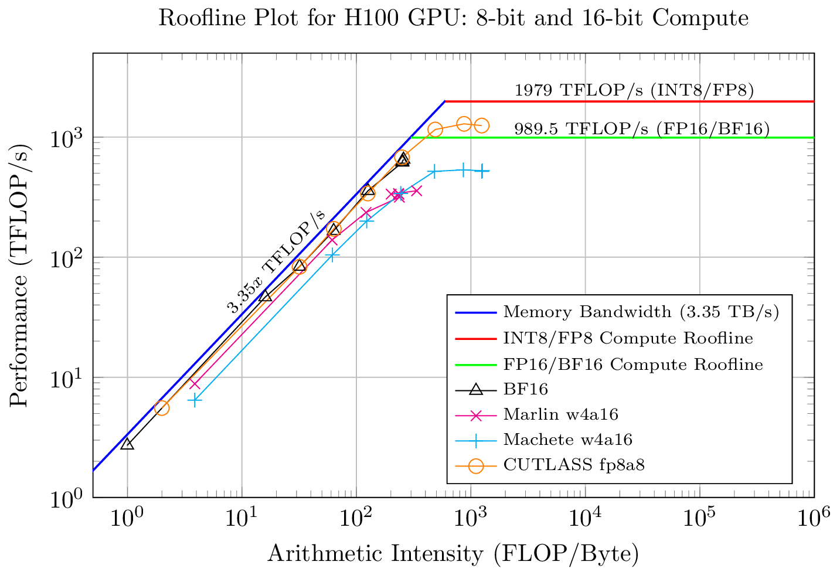
Prefill and Decode
Two Phases of LLM Inference - different computational regimes
Decodes are limited by VRAM Bandwidth!
Prefills are compute-bound!
Prefill - Prompt Processing
All tokens processed in one pass
Reads the KV Cache once
Compute-intensive
Attention: Matrix-matrix multiplication
Decode - Token Generation
Each token processed sequentially
KV cache is loaded each forward pass
Bandwidth-limited
Attention: Matrix-vector multiplication
Notes:
Decode workloads dominate GPU walt‑time and prefill efficiency is lost as a consequence and under-use your resources
Prefill is compute intensive and decode is memory intensive

Slide 6



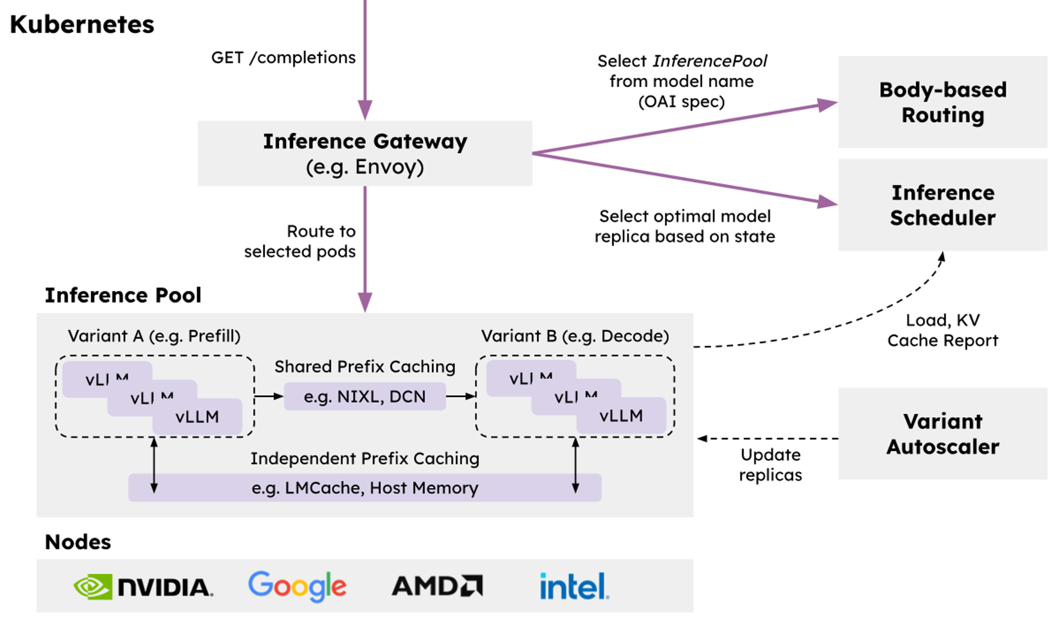

🤝
🤝
Operationalizability
Modular and resilient architecture with native integration into Kubernetes via Inference Gateway API
Flexibility
Cross-platform with extensible implementations of key composable layers of the stack
Performance
Leverage distributed optimizations like prefix-aware routing and disaggregation to achieve the highest throughput while meeting SLOs
Notes:
llm-d is an open source distributed scaling inference platform. It was announced as a CNCF sanbox project at KubeCon 2 weeks ago.
Its built using Open Source projects like vLLM, Istio, Envoy, LMcache and deploys on Kubernetes.
llm-d’s optimizations in prefix-aware routing and disaggregation has achieved great performance in throughput, latency and resource utilization, hence hitting SLOs. Going to hand over to my co-speaker Maroon now who will walk you through some of these optimizations.

Slide 7
llm-d “Well-Lit” Paths
KV-Cache Centric Orchestration
P/D Disaggregation
Wide Expert Parallelism
Intelligent Inference Scheduling
KV Cache Management

Slide 8
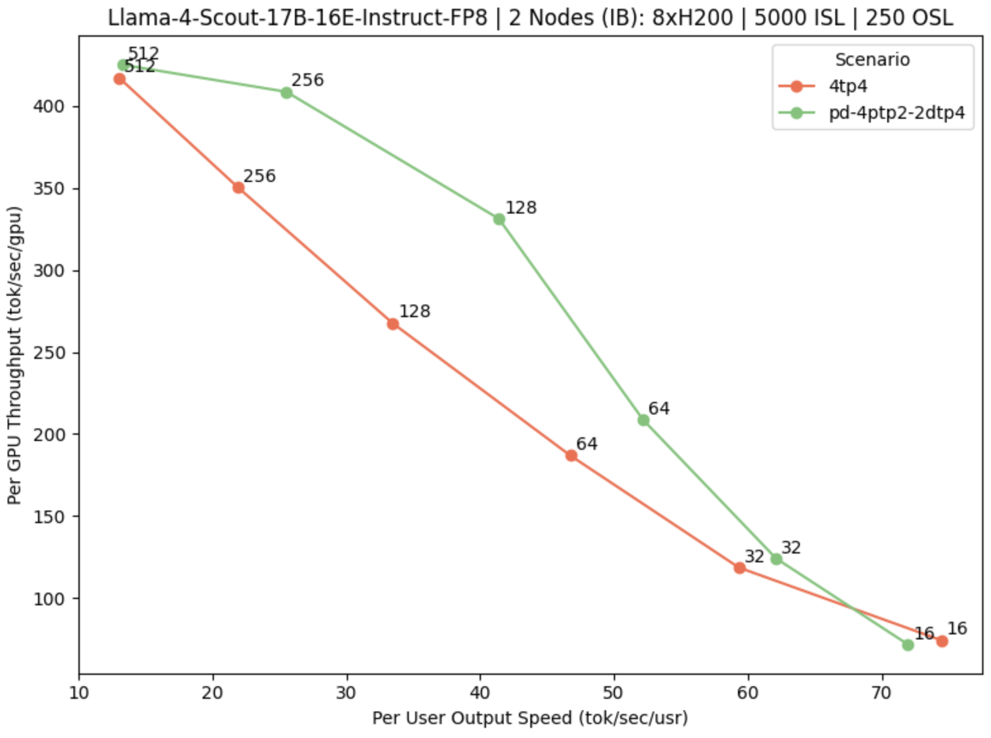
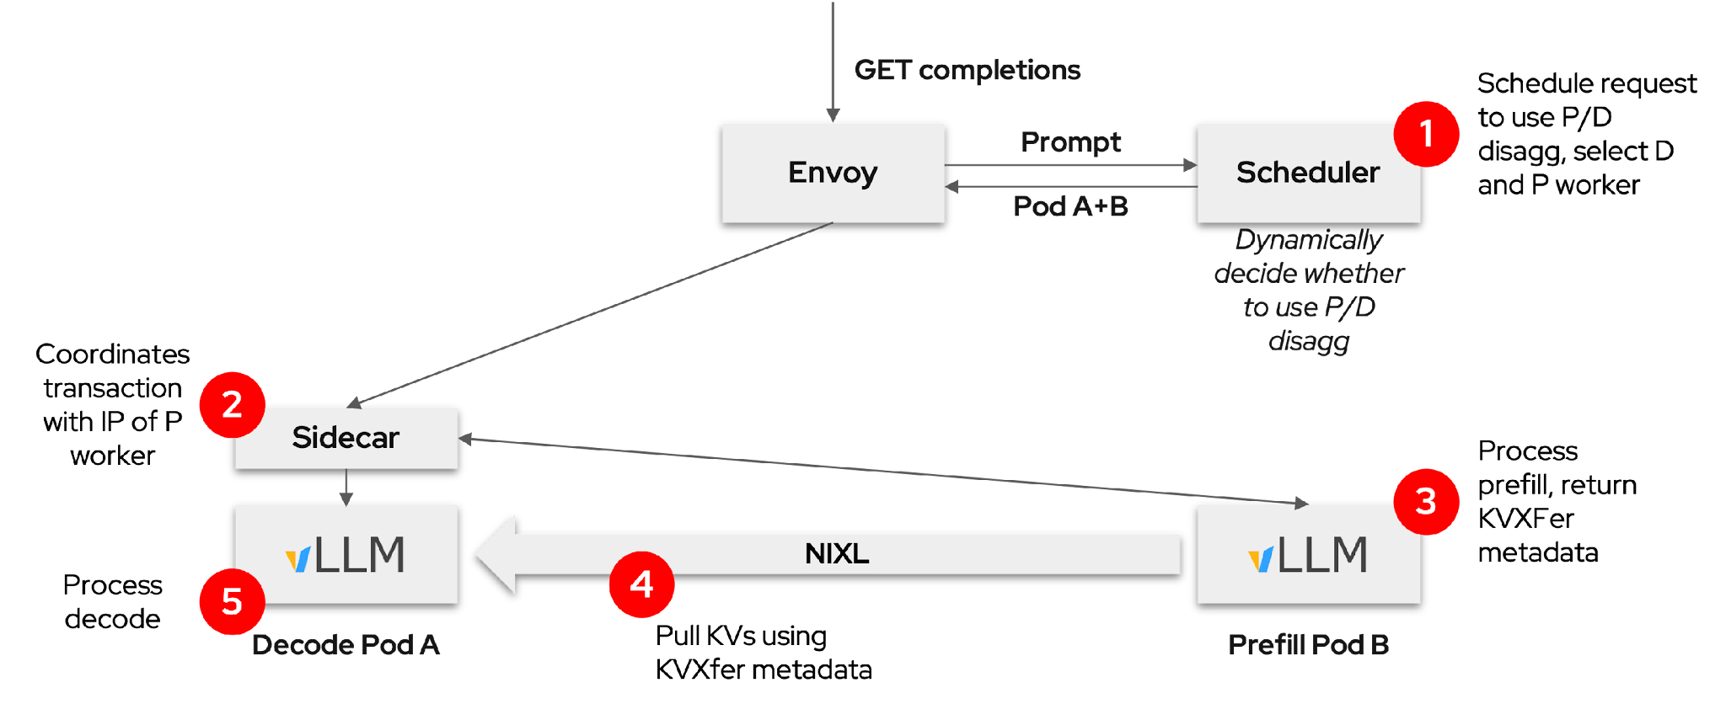
Prefill/Decode Disaggregation
llm-d composes vLLM and Gateway to enable P/D disaggregation
Separate prefill and decode
Allows specialization
Dynamically decided
Easier to meet TTFT and ITL SLO requirements
Best for “medium” server load
Typical: small prefillers, large decoders
P/D benefits are most clear when jointly optimizing efficiency and interactivity
https://llm-d.ai/blog/llm-d-v0.2-our-first-well-lit-paths

Slide 9


Wide Expert Parallelism
llm-d’s K8s-native design integrates EP implementation directly with the broader system, including DP-aware load balancing
GET completions
Prompt
EPP
*Composes with other scorers*
Pod D
LeaderWorkerSet
Expert-Parallel MLP
Pod A
(DP-0)
Pod B
(DP-1)
Pod C
(DP-2)
Pod D
(DP-3)
Pod E
(DP-4)
Pod F
(DP-5)
Pod G
(DP-6)
Pod H
(DP-7)

Slide 10
Intelligent Inference Scheduling
vLLM-aware load-balancing enables smarter request routing that improve SLOs
Prefix-Aware Routing
Load-Aware Routing
GET completions
GET completions
Prompt
EPP
Prompt
EPP
Pod A
Pod A
Prefix-tree.
“Pod A has hit”
Scrape metrics. “A has low load”
KV Events
/metrics
Pod A
Pod B
Pod C
Pod A
Pod B
Pod C
Dramatically increase prefix-cache hit rate
Load-balancing based on actual replica state

Slide 11
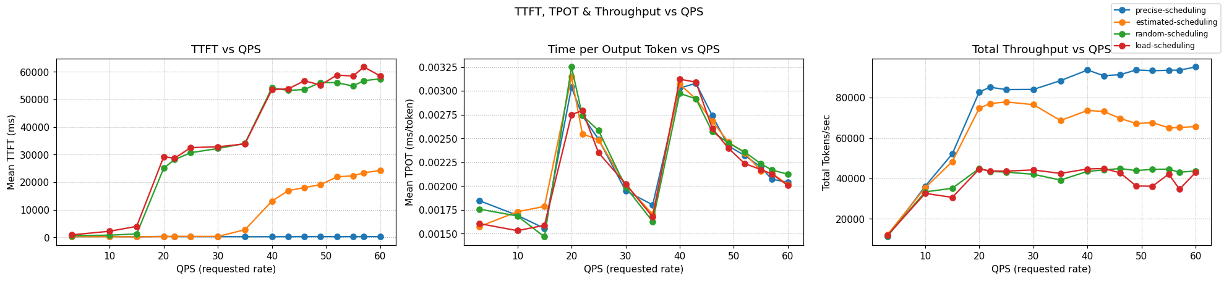
Intelligent Inference Scheduling
Inference scheduling is a no-brainer optimization which can have huge impacts on repeated prompts
    llm-d provides different levels of prefix-cache aware scheduling capabilities in our guides
    In a workload that demands only 73% of a 16 H100 GPUs KV-cache capacity, optimal performance is achieved:
  x57 faster response time than naive scheduling
  x2 throughput than load-aware scheduling
Notes:
Emphasize squeezing performance on identical hardware

Slide 12
KV Cache Management
Leverage all system resources to maximize prefix cache hit rate within the cluster
North/South KV Management
East/West KV Management
GET completions
GET completions
Gateway
Prompt
EPP
Gateway
Prompt
EPP
Pod A
Pod A
KV Index
KV Index
CPU RAM
CPU RAM
CPU RAM
CPU RAM
Remote
Storage
CPU RAM
KVEvents
KVEvents
Pod A
Pod B
Pod C
Pod A
Pod B
Offload KV caches to local memory with global index
Offload KV caches to global shared remote storage
‹#›
Notes:
We discussed efficient orchestration - but it is gapped by the scarce GPU memory
North-south: expand the KV-cache of a single instance to available memory tiers
East-west: compute once, reuse anywhere through an extended tier of shared storage

Slide 13
3 Takeaways
Cost and latency are key SLOs for AI inference
Efficient KV-Cache orchestration is essential for performant inference
llm-d provides out-of-the-box optimizations in KV-cache-aware routing and disaggregation
https://llm-d.ai/

