Slide 1
Bringing Monarch to AMD GPUs:
Single-Controller Distributed Training on ROCm
AMD: Liz Li, Zach Streeter, Xinyu Kang, Chaojun Hou, Lei Zhang, Yuankai Chen, Yao Fu, Wen Chen, Zhenyu Gu, Andy Luo
Meta: Matthias Reso, Hamid Shojanazeri, Davide Italiano
Thanks to: Niles Burbank, Jithun Nair, Guru MP, Peng Sun, Ramine Roane, Emad Barsoum

Slide 2
Content
PTC 2025 Recap
  Scaling TorchTitan to 1K+ GPUs on AMD
Monarch Overview
Monarch on AMD
  Hipification / RDMA path
Case Study: Fault-Tolerant Training
  Stack: Monarch + Torchtitan + TorchFT
Next steps
Notes:
a distributed programming framework for PyTorch that makes the cluster programmable through a single-program Python API. handling fault tolerance, orchestration, tooling integration

Slide 3
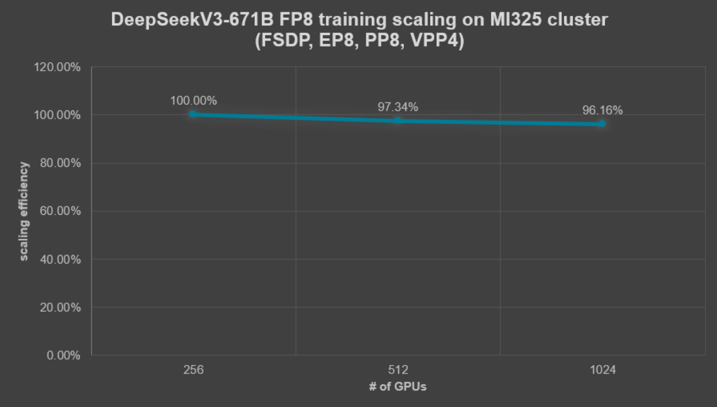
Recap from PTC 2025 –Scaling TorchTitan to 1K+ GPUs on AMD
Achieved Linear Scaling of FP8 Training at Scale
Upstream Contributions
  Key Optimizations upstreamed to OSS (TorchTitan, TorchAO)
Key Challenge: Reliability at Scale
Exploring Monarch for resilience
  Supervision tree, fault isolation, etc.
Reference: Efficient MoE Pre-training at Scale on 1K AMD GPUs with TorchTitan – PyTorch
Notes:
In last year ptc,
We demonstrated FP8 training at scale on AMD GPUs,
and achieved near-linear scaling up to over 1,000 GPUs.
Afterwards, we have been contributing key optimizations back to open source, including both torchtitan and torchao.
However, training failures at scale becomes a very challenging problem. This led us to explore
how can we make distributed training more resilient by design?
And this is where Monarch comes in.
With concepts like a supervision tree and fault isolation,
it provides a fundamentally different way to manage failures.

Slide 4
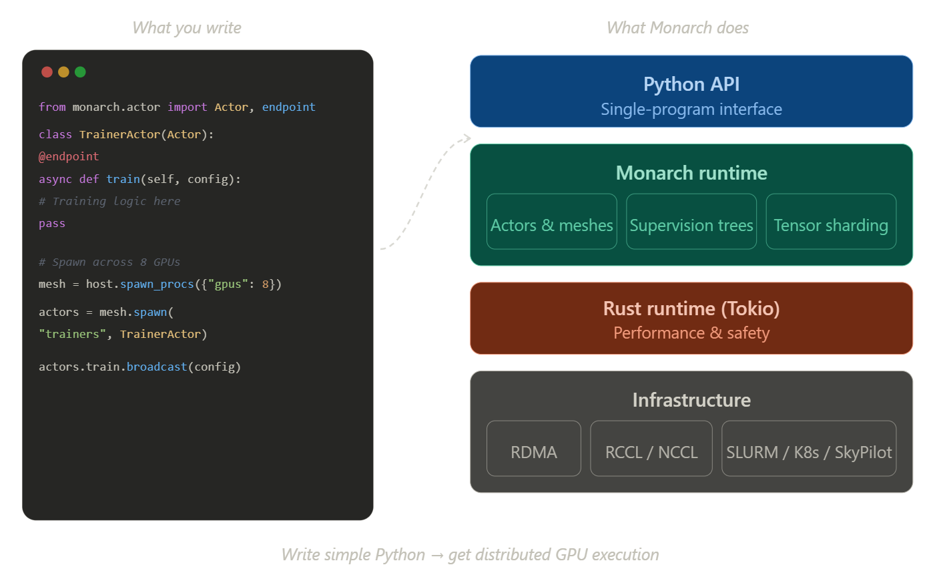
What is Monarch?
Notes:
You've just heard about Monarch, so let me briefly set the stage for how we're using it before we dive into our fault tolerance work.
On the left is the programming model—simple Python. You define an actor class with endpoints, spawn it across a mesh of GPUs, and call those endpoints. The code looks local, but it's running distributed.
On the right is what Monarch provides under the hood. The Python API gives you a single-program interface. The runtime handles actors and meshes, supervision trees—which we'll focus on next—and tensor sharding.
Underneath, it's Rust for performance, and at the infrastructure layer you have RDMA for direct GPU memory transfer, collective communication through RCCL on AMD, and scheduler integration for SLURM, Kubernetes, or SkyPilot.
For our work, the key pieces are the actor model and supervision trees—that's what enables the fault tolerance we're about to show you. Let's look at how that works.

Slide 5
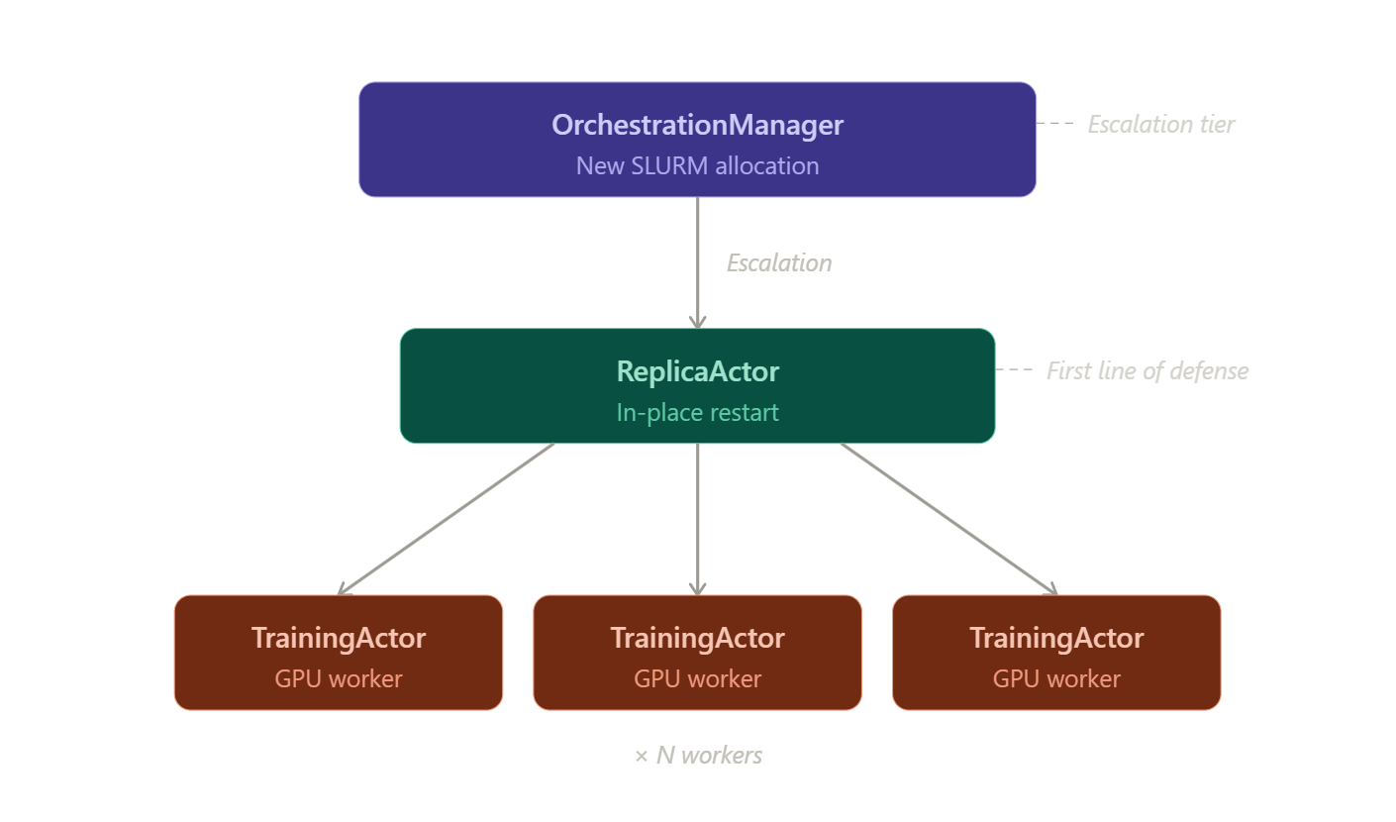
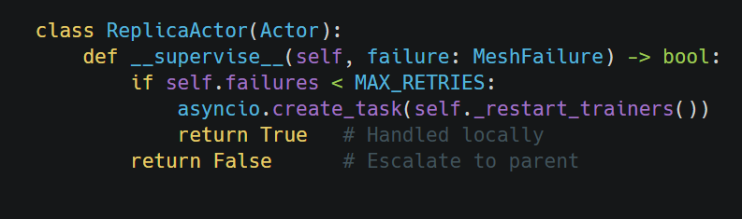
How Monarch Handles Failures
Failures are isolated — actors have private state, crashes don't propagate
Failures are hierarchical — handled at the lowest possible level
Recovery is fast — seconds for local restart, minutes only if escalated
Notes:
So how does Monarch actually handle failures? There are three key properties.
First, failures are isolated. Actors have private state—no shared memory. When one actor crashes, it doesn't corrupt the state of other actors. This is fundamental. In traditional distributed training, a crash in one process can leave shared state in an inconsistent state, forcing a full restart. With actors, that doesn't happen.
Second, failures are hierarchical. Look at the diagram on the right. When a TrainingActor fails, the failure doesn't propagate sideways to other trainers. It propagates up to its supervisor—the ReplicaActor. The ReplicaActor then decides: can I handle this locally, or do I need to escalate?
That's what the code snippet shows. When a child fails, Monarch calls the parent's __supervise__ method. If the failure count is under the limit, the ReplicaActor restarts trainers in-place and returns True—handled. If failures keep happening, it returns False, escalating to the OrchestrationManager for a new SLURM allocation.
Third, recovery is fast. The ReplicaActor handles most failures with an in-place restart—that's seconds, not minutes. Only when you've exhausted local recovery do you escalate to the OrchestrationManager, which takes longer because it's allocating new resources. But that's rare.
The result: most failures recover quickly at the lowest level, training continues on healthy replicas, and only catastrophic failures require heavier intervention.

Slide 6
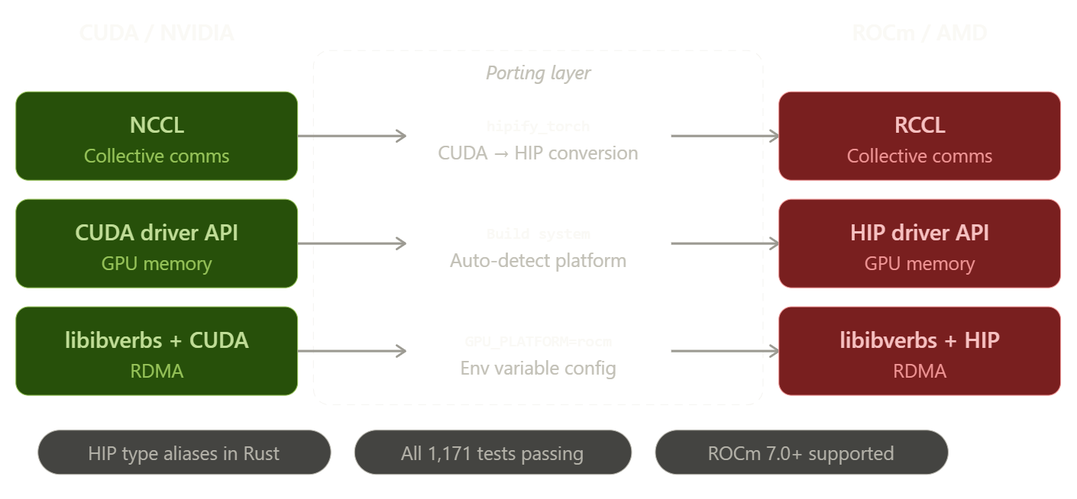
Porting Monarch to ROCm
References: https://github.com/meta-pytorch/monarch/pull/2393 | https://github.com/meta-pytorch/monarch/pull/2891
Notes:
So how did we bring Monarch to AMD GPUs? This diagram shows our porting strategy.
On the left is the NVIDIA/CUDA stack that Monarch was originally built on. On the right is where we needed to get to: ROCm and AMD.
In the middle, you see the porting layer—the translation mechanisms we used.
For collective communications, Monarch uses NCCL on NVIDIA. The equivalent on AMD is RCCL. We integrated hipify_torch to handle the CUDA-to-HIP source conversion automatically. hipify_torch is an AMD tool, originally integrated into PyTorch to enable seamless AMD hardware adoption. It converts CUDA API calls to HIP at build time-no code change required. We applied same approach to Monarch: automatic conversion, same user code.
For GPU memory operations, we needed to translate the CUDA driver API to HIP. The build system now auto-detects which platform you're on and configures accordingly.
For RDMA—the direct GPU-to-GPU memory path—we updated the libibverbs integration to work with HIP instead of CUDA. This is configured via the GPU_PLATFORM=rocm environment variable.
At the bottom, you see three key results: we added HIP type aliases in the Rust layer so the same Rust code compiles for both platforms; all 1,171 tests pass on ROCm; and we support ROCm 7.0 and above.
This work is upstream—you can see the PRs linked at the bottom. PRs 2393 and 2891 contain the core enablement. This isn't a fork; it's merged into the main Monarch repository.

Slide 7
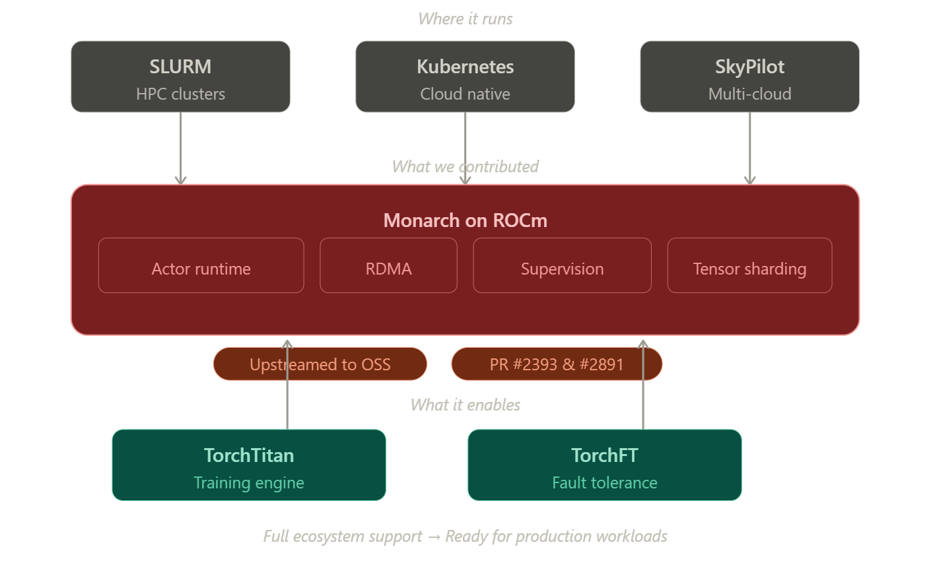
Monarch on AMD: Ecosystem Integration
Notes:
Now let's zoom out and see where Monarch fits in the broader ecosystem.
At the top, you see where Monarch runs: SLURM for traditional HPC clusters, Kubernetes for cloud-native deployments, and SkyPilot for multi-cloud scenarios. Monarch abstracts away the scheduler—you write your training code once, and it runs on whatever infrastructure you have.
In the middle is what we contributed: Monarch on ROCm. This includes the actor runtime, RDMA support, supervision trees, and tensor sharding—all working on AMD GPUs. The two PRs listed there are the main upstream contributions.
At the bottom, you see what this enables: TorchTitan as your training engine, and TorchFT for fault tolerance. These are the tools the PyTorch community is already using, and now they work with Monarch on AMD.
The tagline at the bottom captures it: full ecosystem support means this is ready for production workloads. You're not adopting experimental software—you're using the same stack that Meta runs internally, now available on AMD hardware.
And that brings us to our case study, where we'll show this whole stack working together for fault-tolerant training.

Slide 8
Real World Case Study: Fault-Tolerant Training at scale
Challenges of Training at Scale
  Frequent failures across the stack: GPU memory errors, network timeouts, hardware faults, and software crashes
Solution: Monarch + TorchTitan + TorchFT
  Monarch - Leverages a supervision tree for fine-grained fault detection and isolation
  TorchFT - Enables replicas to continue training independently despite peer failures
Before (traditional training) | After (with monarch + TorchFT)
1 failure -> restart entire job | Failure isolation
dependency on checkpointing | Local recovery
High compute waste | Minimal disruption
Hard debugging | Faster iteration
Notes:
Now let’s look at a real-world case study: fault-tolerant training at scale.
At large scale, we frequently see failures, caused by issues across the entire stack:GPU memory errors, network timeouts, hardware faults ,even software crashes
👉a single failure can force a restart of the entire job in traditional distributed training
So we built a solution to solve this problem, combining:
👉 Monarch + TorchTitan + TorchFT
Leveraging Monarch's supervision tree, to enable fine-grained fault detection and isolation.
And TorchFT's capability to allow continuous training independently, even when peers fail.
Comparing with traditional training's nature:
one failure we need restart entire job
heavy reliance on checkpointing
high compute waste
difficult debugging
with this stack:
failures are isolated
recovery is local, not global
disruption is minimal
and iteration becomes much faster

Slide 9
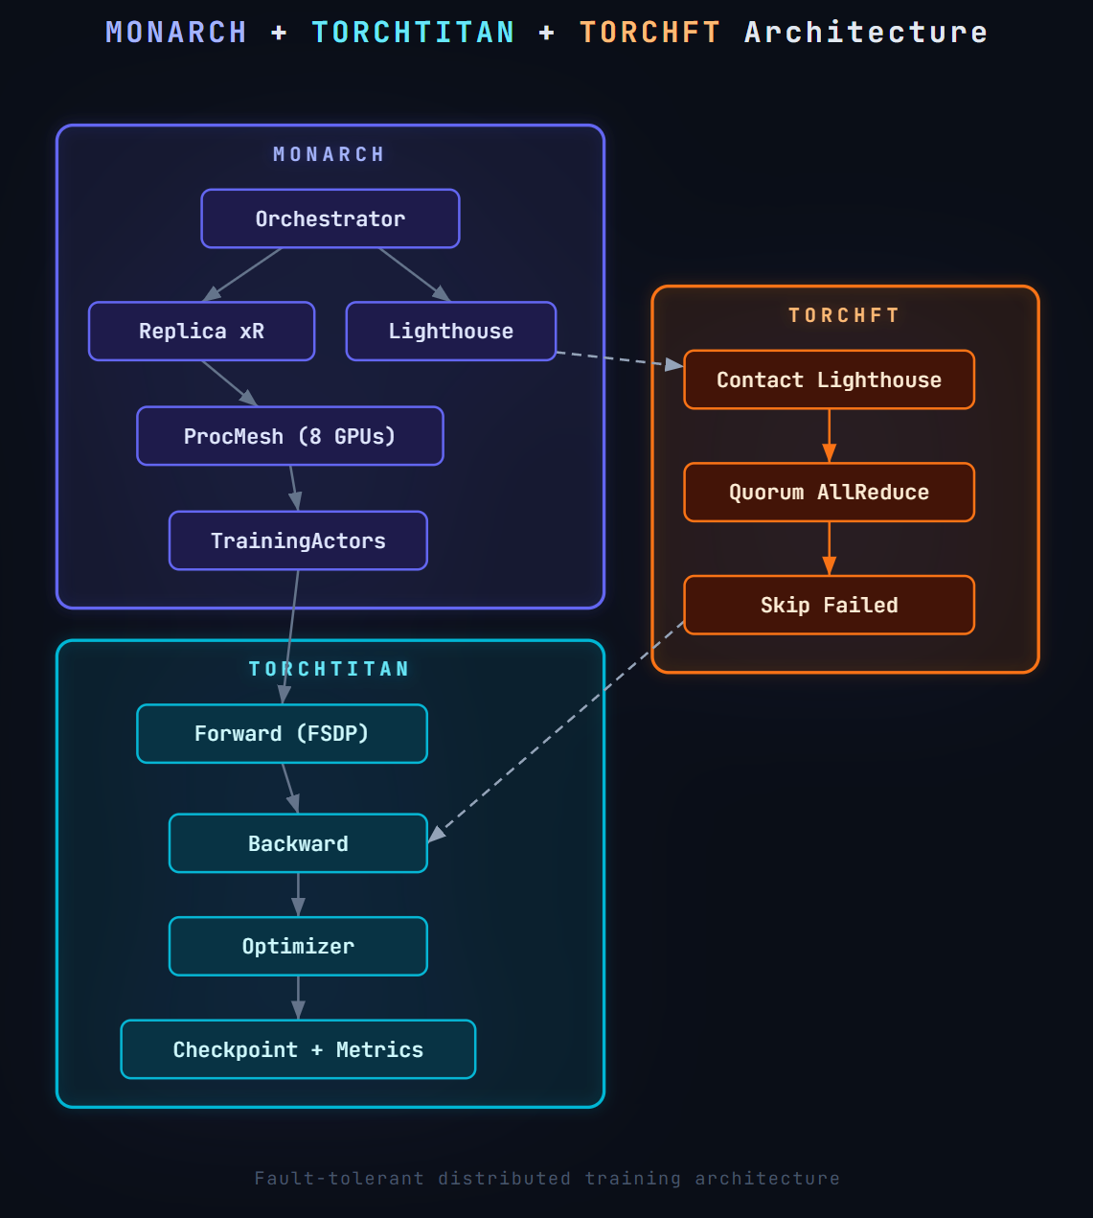
Fault Tolerance Training Architecture
Three-layer architecture
Monarch – process & cluster orchestration
TorchFT – fault tolerance at step level
Torchtitan – training engine
How they work together?
MONARCH → TORCHFT : Lighthouse provides membership info for fault-tolerant coordination
TORCHFT → TORCHTITAN: Failure is injected into training actors, and detected by torchft
Failures are
Detected by lighthouse
Handled by TorchFT
Training continues without global interruption
Notes:
Now let’s look at the architecture in detail.
At a high level, this is a three-layer architecture:
At the top, we have Monarch, which handles cluster orchestration
In the middle, TorchFT, which provides fault tolerance at the step level
And at the bottom, TorchTitan, which is the training engine itself
First, Monarch communicates with TorchFT through Lighthouse, which .provides
membership information like which replicas are alive and participating, for fault-tolerant coordination.
Then, TorchFT integrates directly into the training loop.
After a failure is injected in training,
TorchFT can detect failures and adapt dynamically —
From the training loop’s perspective:
failures are detected by Lighthouse
handled by TorchFT
and the training continues without global interruption

Slide 10
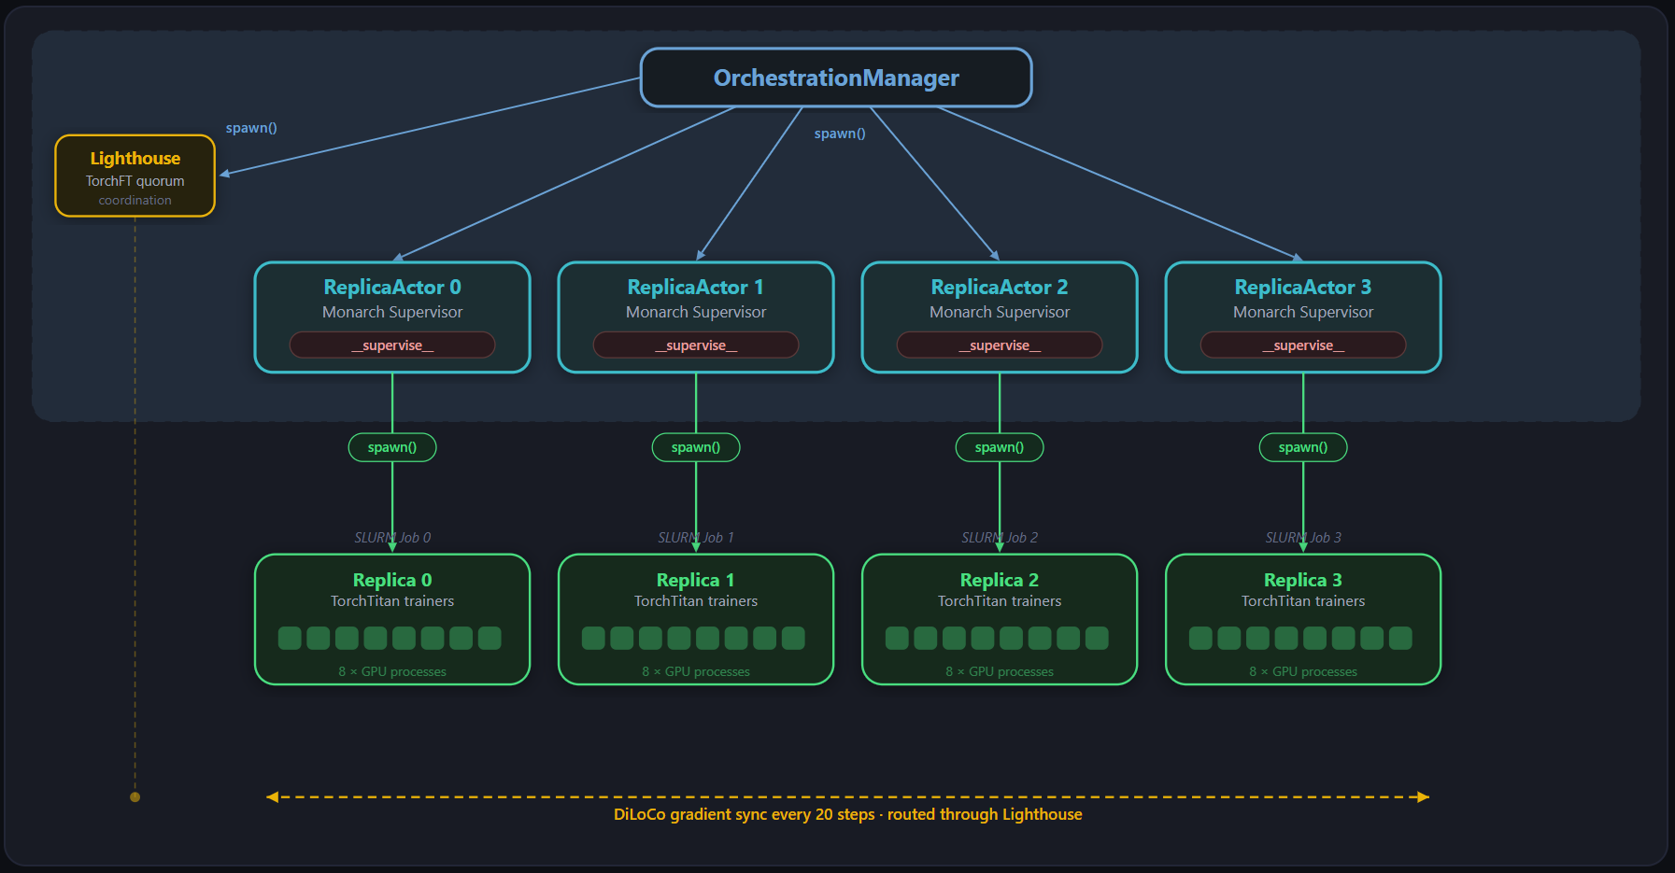
Demo Workflow
Notes:
We built a demo o show how Monarch and TorchFT turn a replica failure from a global restart into a local recovery and rejoin workflow.”
At the top, we have the OrchestrationManager, which launches and coordinates the job.
On the left, Lighthouse handles TorchFT quorum coordination.
In the middle, each ReplicaActor is a Monarch supervisor.
And at the bottom, each replica runs a TorchTitan training job with 8 GPU processes.
In this setup, DiLoCo gradient sync happens every 20 steps, and that sync is coordinated through Lighthouse.”

Slide 11
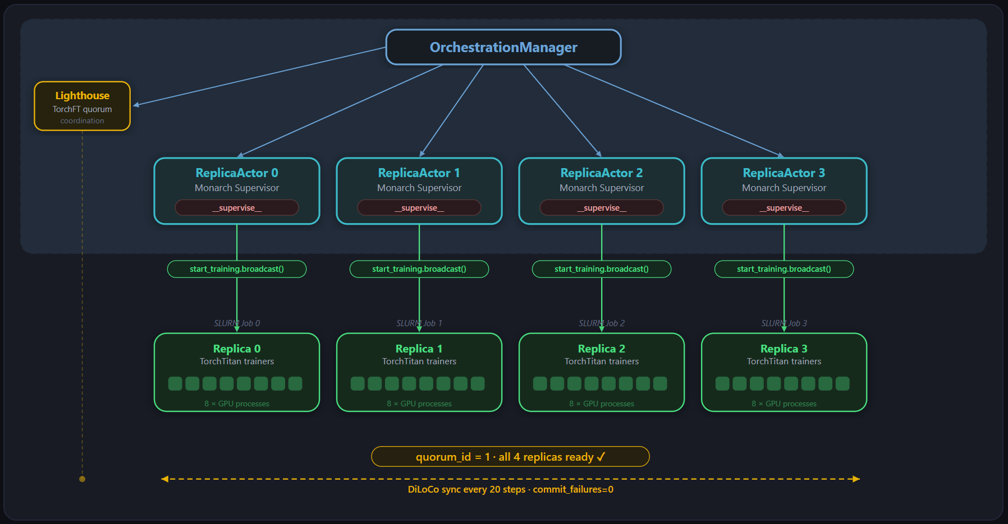
Demo Workflow
Notes:
“In the next step, training begins normally.
The OrchestrationManager starts all four ReplicaActors, and each ReplicaActor starts its local TorchTitan training job.
At this point, all four replicas are healthy and ready.
So Lighthouse forms quorum 1, meaning all four replicas are participating, and DiLoCo synchronization proceeds normally with no failures.”

Slide 12
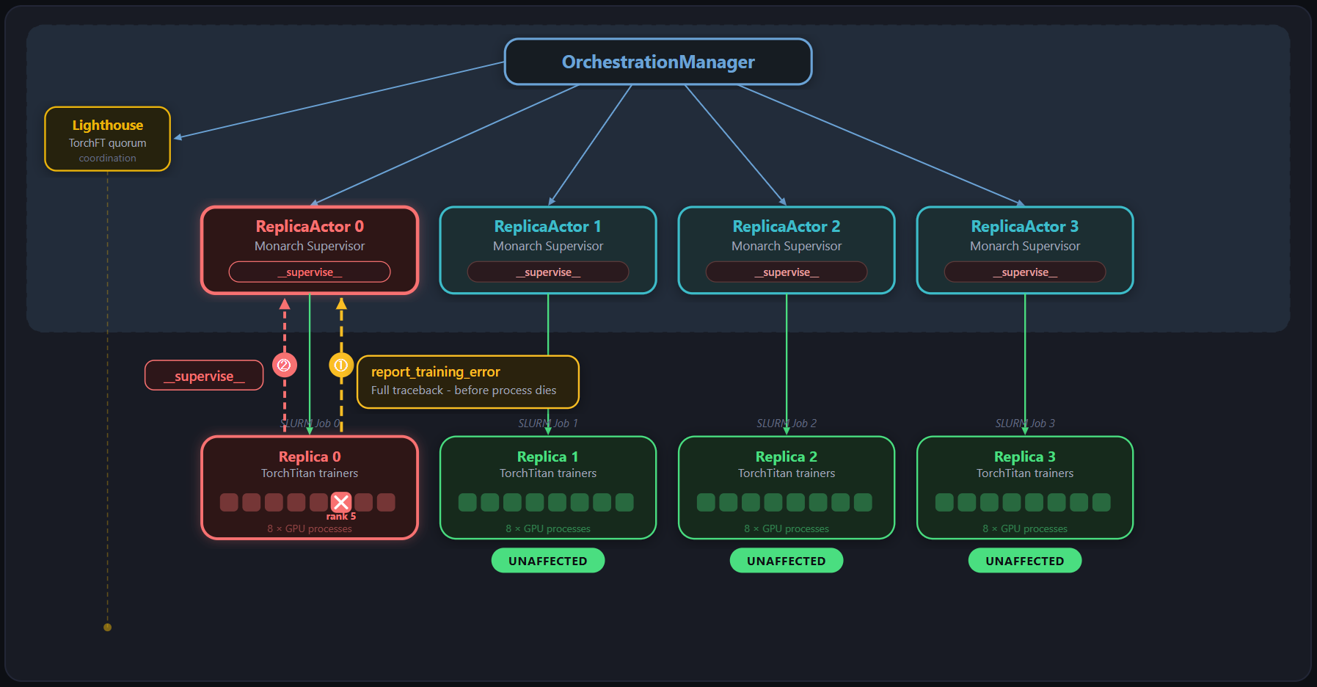
Demo Workflow
Notes:
“Now we inject a failure into Replica 0.
That error is reported upward to the local ReplicaActor through Monarch supervision.
the failure is isolated locally.
The other replicas — Replica 1, 2, and 3 — are still healthy and remain unaffected.”

Slide 13
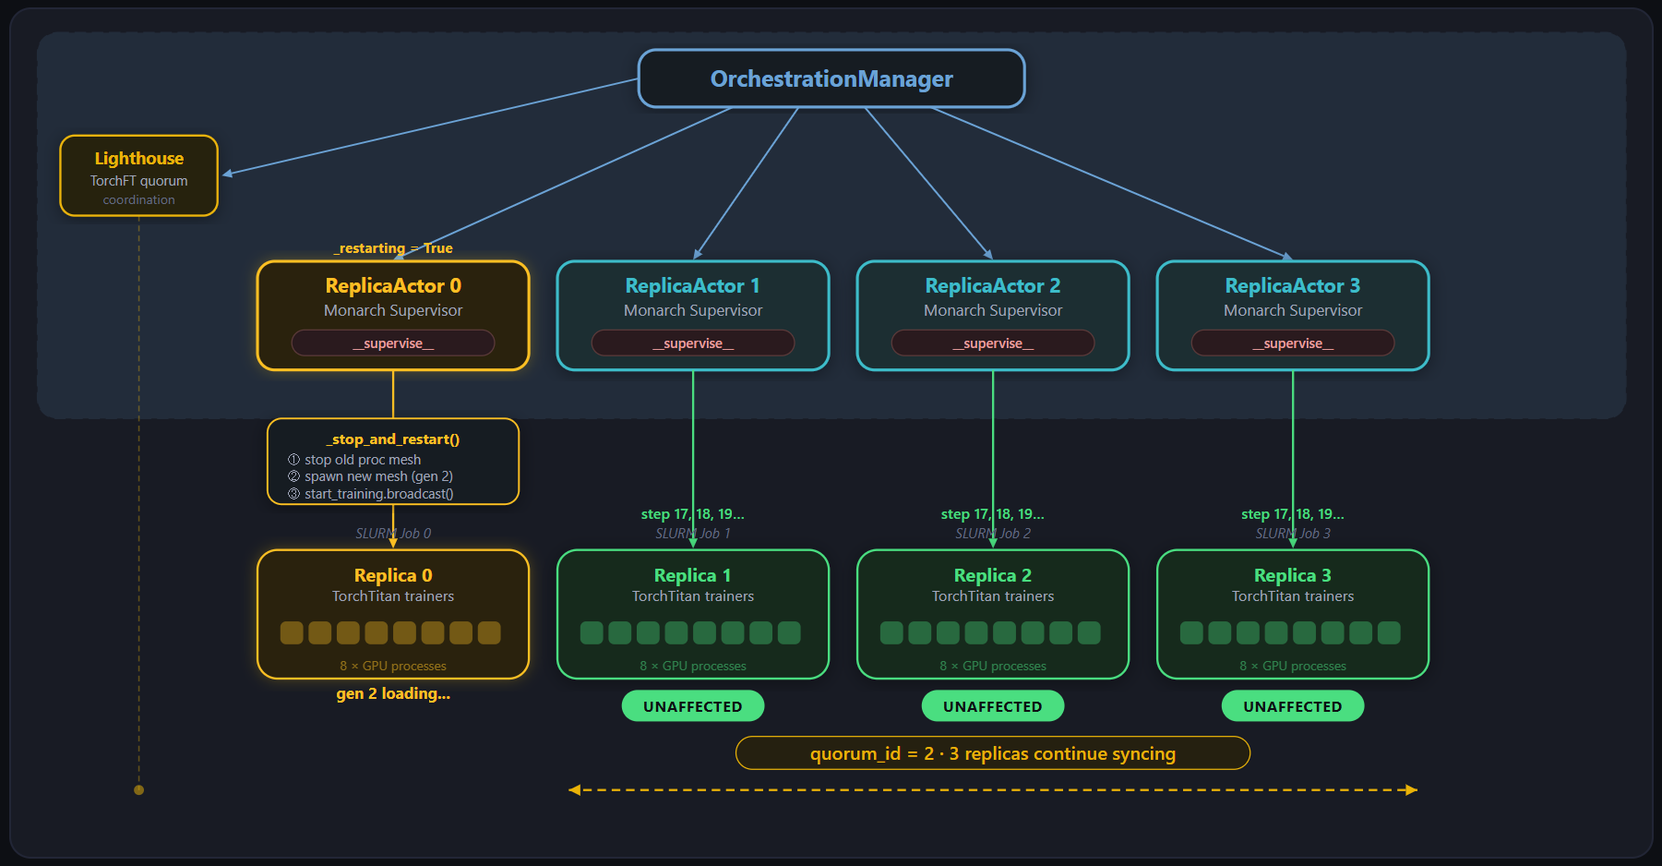
Demo Workflow
Notes:
“In this step, Replica 0 begins recovery.
Its ReplicaActor marks the replica as restarting, stops the old process mesh, spawns a new one, and start loading a new generation of the training job.
Meanwhile, the other three replicas keep making forward progress and continue syncing with each other.
So Lighthouse creates a new quorum with the remaining healthy replicas.
This shows the key benefit: one replica can recover locally without forcing the whole job to restart.”

Slide 14
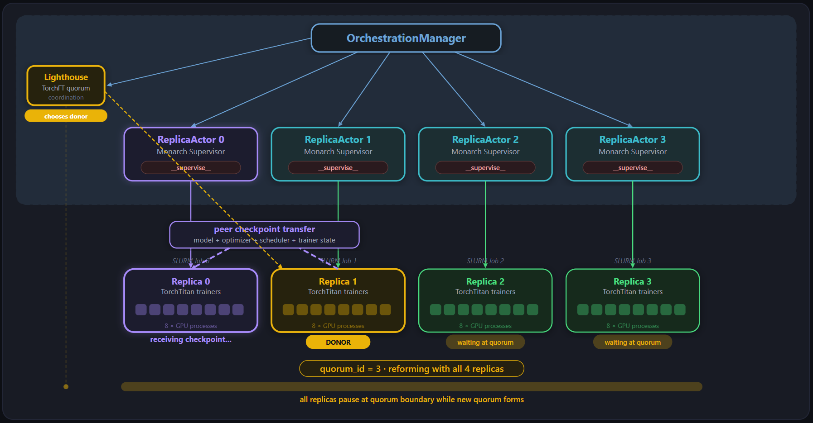
Demo Workflow
Notes:
“Once Replica 0 is back up, it needs to catch up before rejoining the group.
Lighthouse selects a healthy replica as the donor — here it is Replica 1.
Then a peer checkpoint transfer happens, including model state, optimizer state, scheduler state, and trainer state.

Slide 15
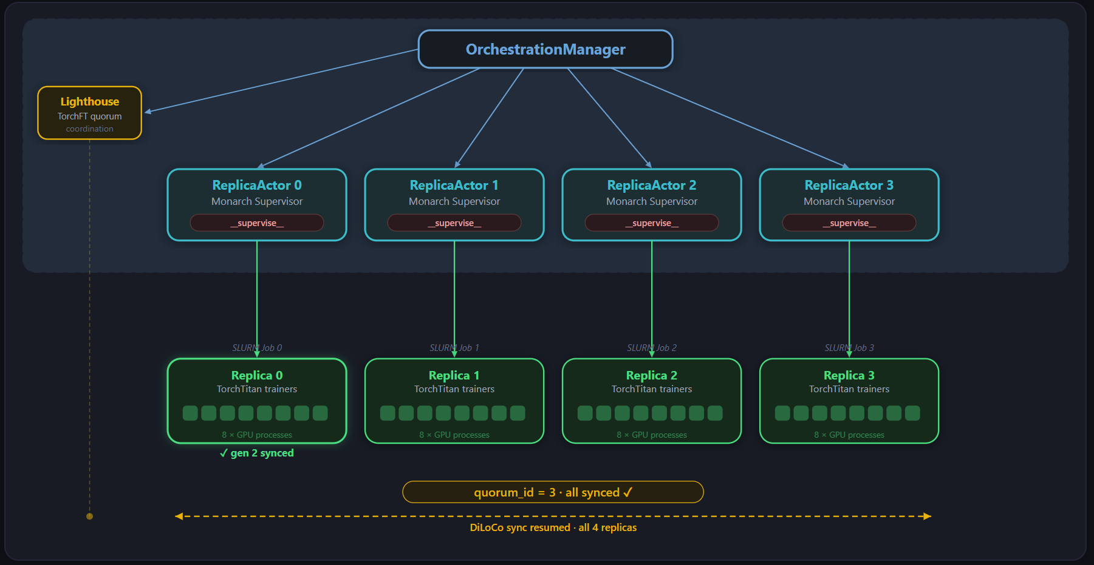
Demo Workflow
Notes:
“Finally, recovery completes.
Replica 0 has received the checkpoint and is synchronized again.
Lighthouse forms the new quorum with all four replicas, and DiLoCo synchronization resumes across the full group.
So the system returns to normal operation —
but without a global restart, without rolling the whole job back, and with only minimal disruption.”

Slide 16
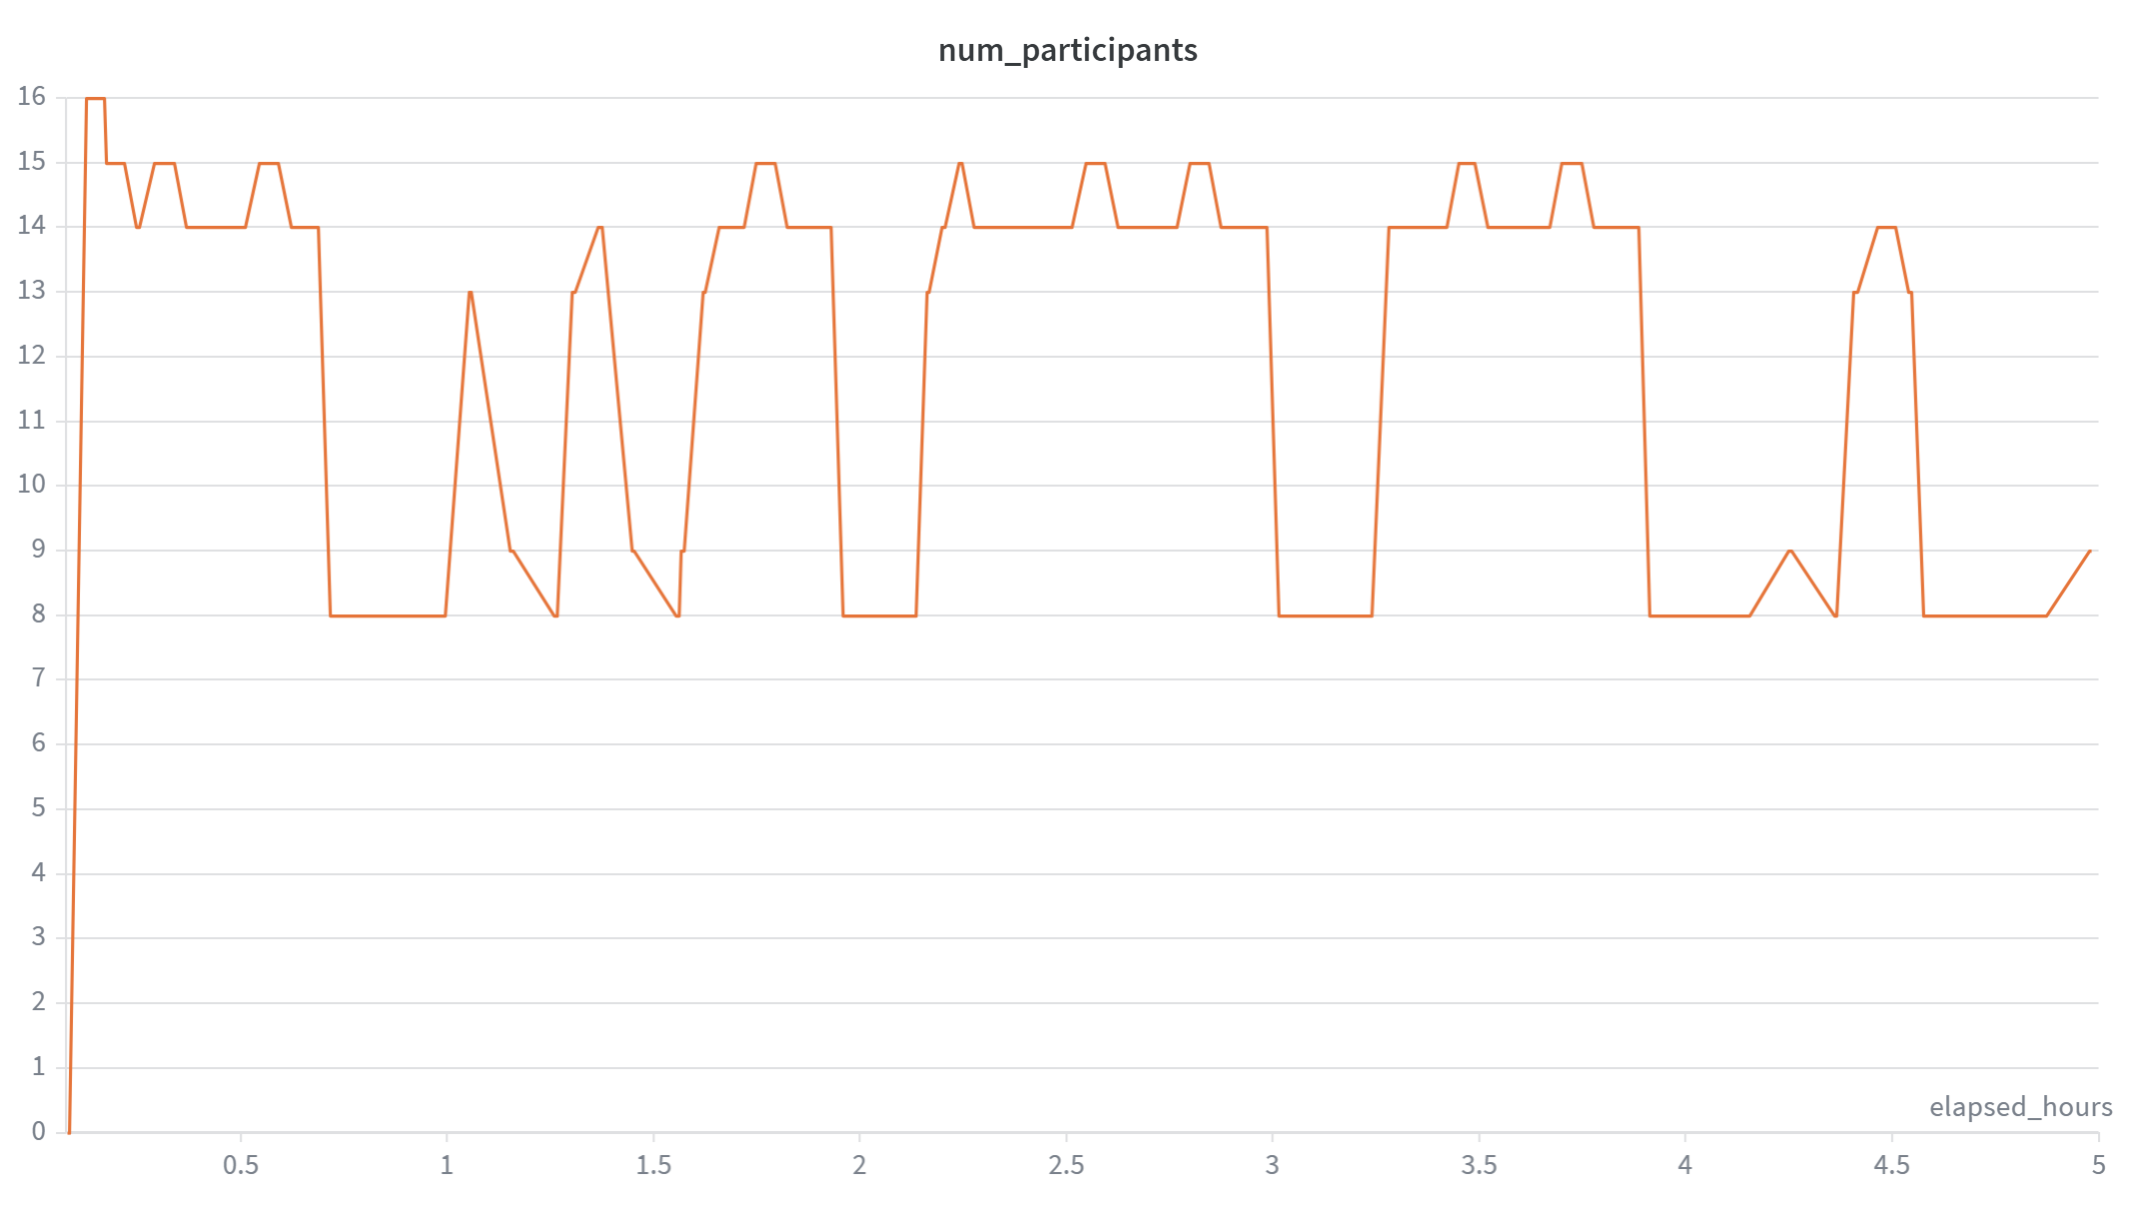
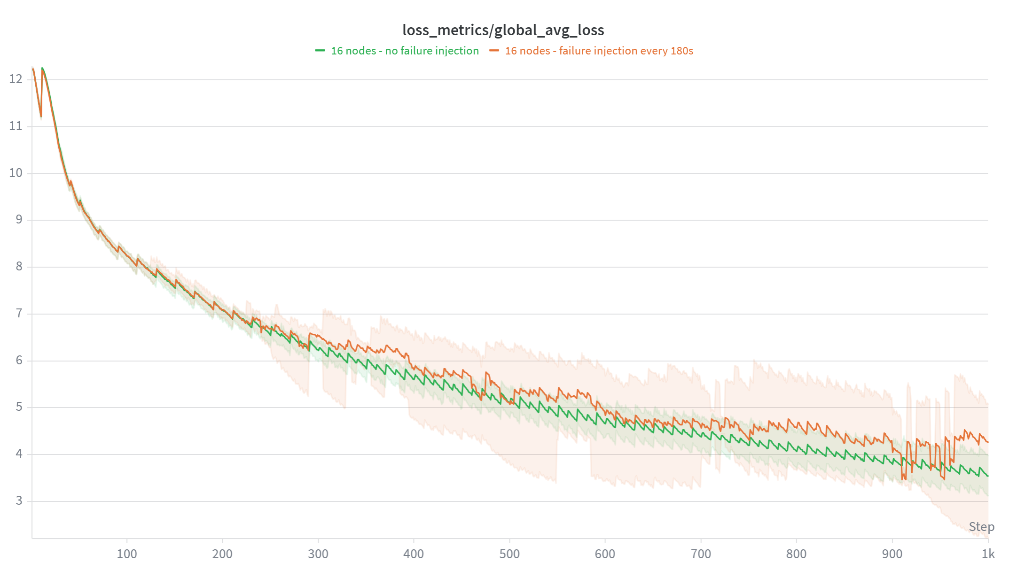
Results – Slurm 16 Nodes MI300 Cluster
16node, Llama3-8b, failure (rccl) injection: 180s. Quorum sync: 20 steps
The number of active workers fluctuates due to injected failures
Training continues despite frequent failures — no full restart
Loss curve shows steady convergence
Notes:
let's see some results. we ran llama3 training on 128 mi300 GPUs, intentionally inject RCCL failures every 180 seconds, and quorum synchronization every 20 steps
Now, looking at the left chart:
You can see the number of active workers fluctuating over time.
This is expected — every time we inject a failure,
some replicas temporarily drop out and then rejoin.
on the right chart:
This shows the training loss curve.
The green line is the baseline with no failures,
and the orange line is with continuous failure injection.
👉 The key observation is:
Even with frequent failures,
the loss curve still shows steady convergence,
and closely tracks the no-failure baseline.
this validates our approach:
We can maintain both reliability and convergence,
even under persistent failure conditions.

Slide 17
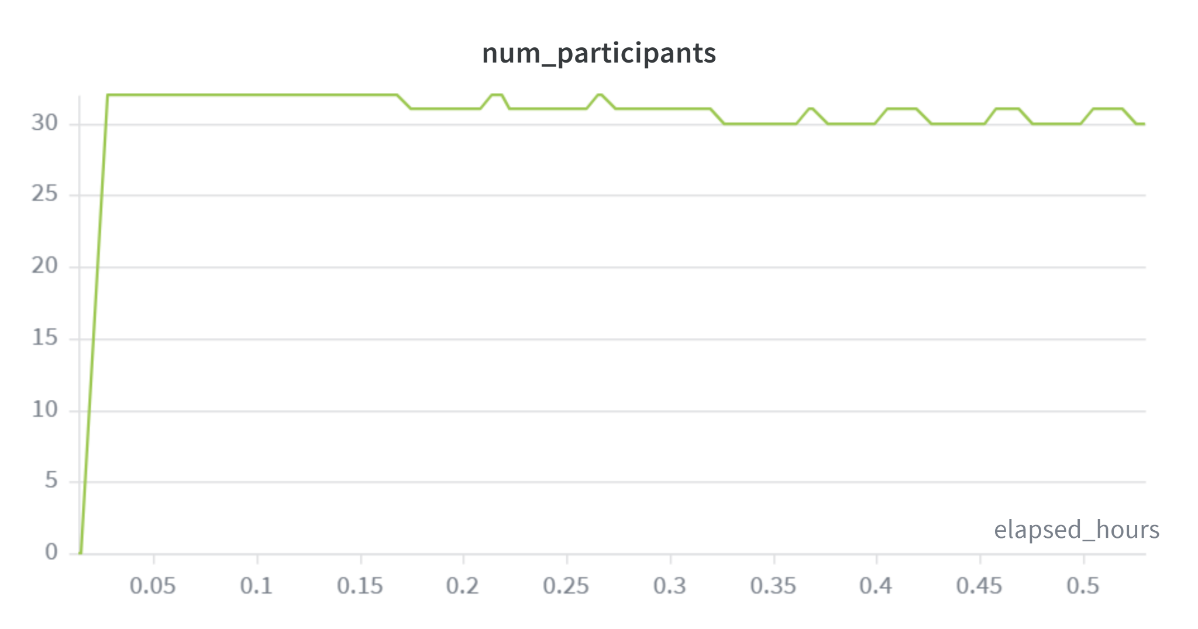
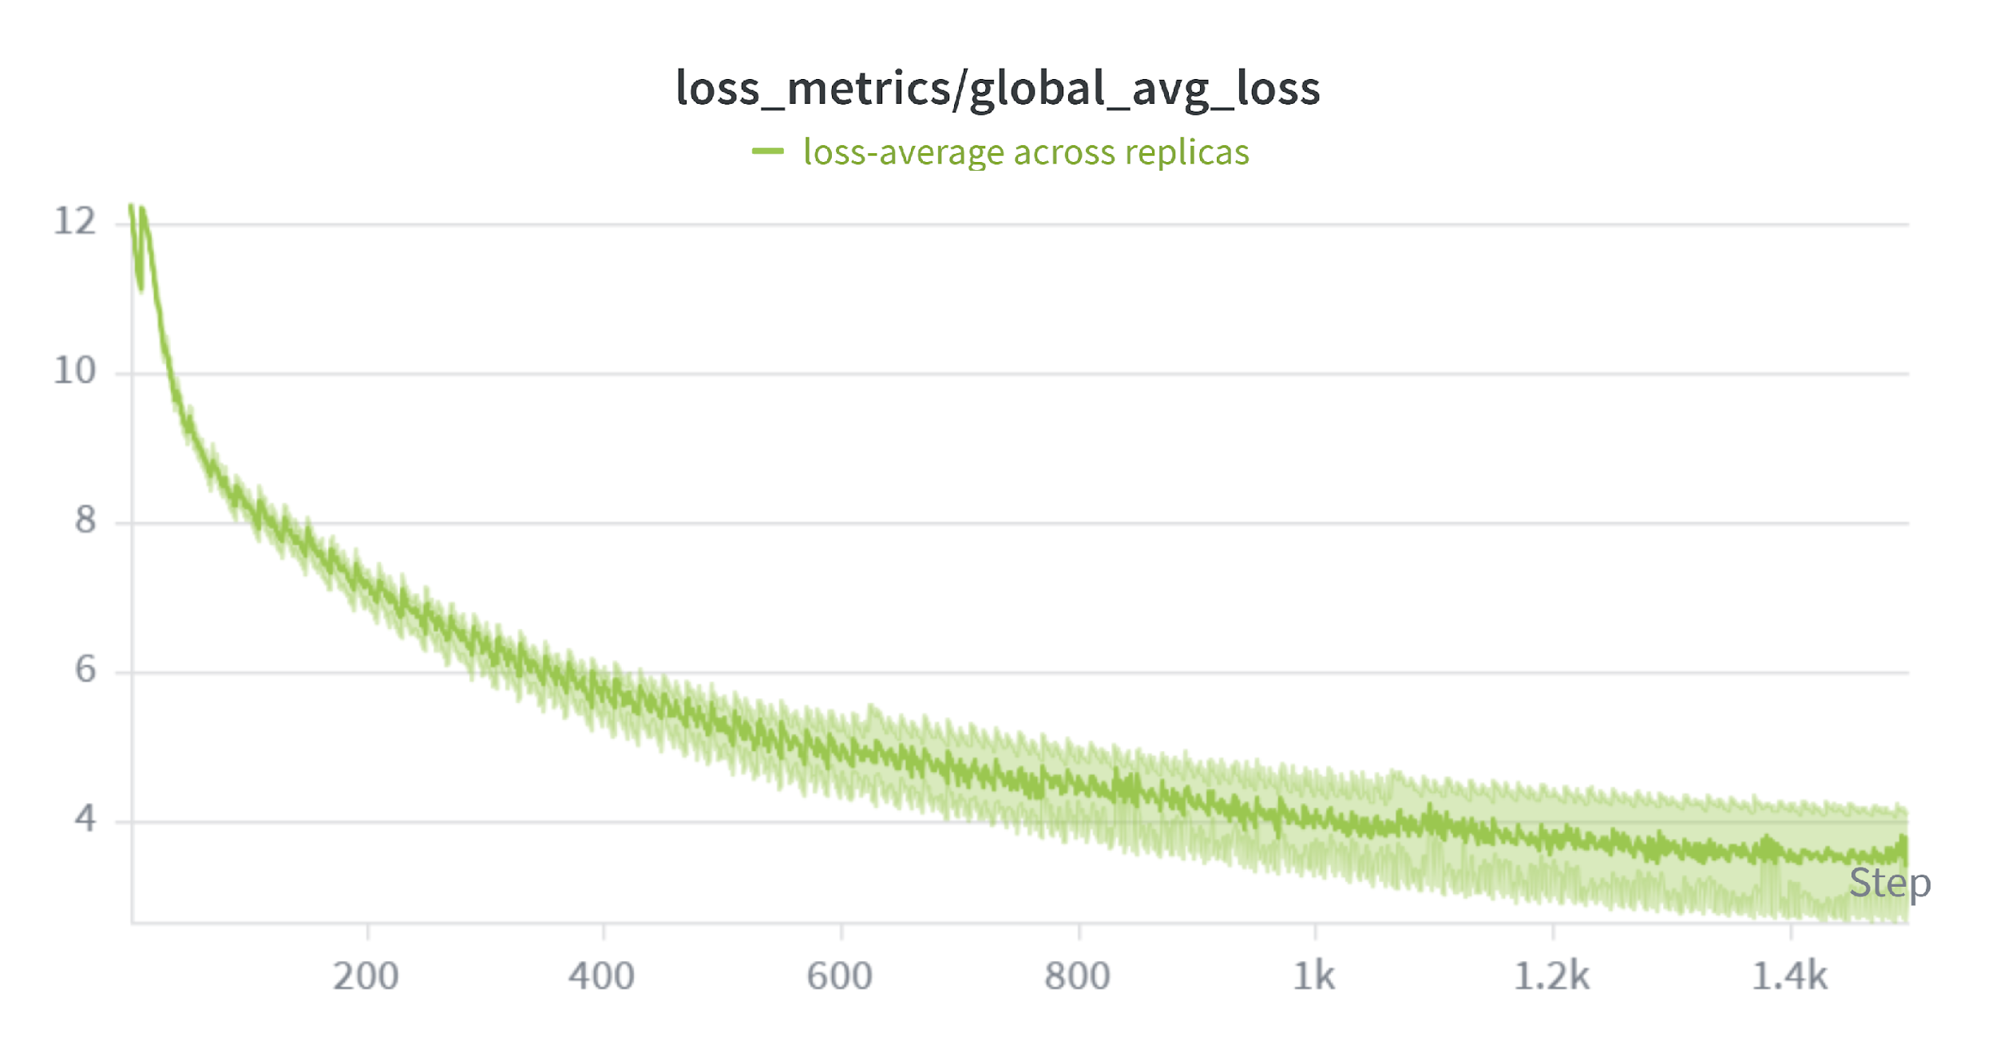
Results – k8s 32 Nodes MI355 Cluster
Key takeaways:
Scaling is not enough — training must also recover from failures
Monarch gives us a cleaner fault-tolerance model
The approach works on both SLURM and Kubernetes
Notes:
we also ran same experiment on 256 Mi355 GPUs k8s cluster. On the left, the GPUs recovers faster than previous mi300, because we enabled RDMA, we see smooth and steady convergence
To summarize:
First:
👉 Scaling alone is not enough —
at this scale, training must also be able to recover from failures.
Second:
👉 Monarch provides a cleaner fault-tolerance model,
with structured supervision and isolation built into the system.
And finally:
👉 This approach is portable across different environments —
we’ve shown it working on both SLURM and Kubernetes clusters.

Slide 18
Next Steps
Extend NIC support and improve runtime performance
Expand Monarch in more Pre-training and RL frameworks on ROCm
Further optimize fault tolerance performance
  Rejoin reload latency / overlap recovery & compute
Continuous open-source collaboration
Notes:
As next steps,
First, we are continuing to extend NIC support and improve runtime performance for monarch
Second, we’re expanding Monarch into more pre-training and RL frameworks on ROCm,
so this model can be broadly adopted across different workloads.
Third, we’re focusing on improving fault-tolerance performance itself —
especially reducing rejoin latency,
and exploring ways to overlap recovery with ongoing computation.
And finally, we’ll continue to work closely with the community through
👉 open-source collaboration,
to upstream improvements and make this capability widely available.

Slide 19
Show Details

Slide 20
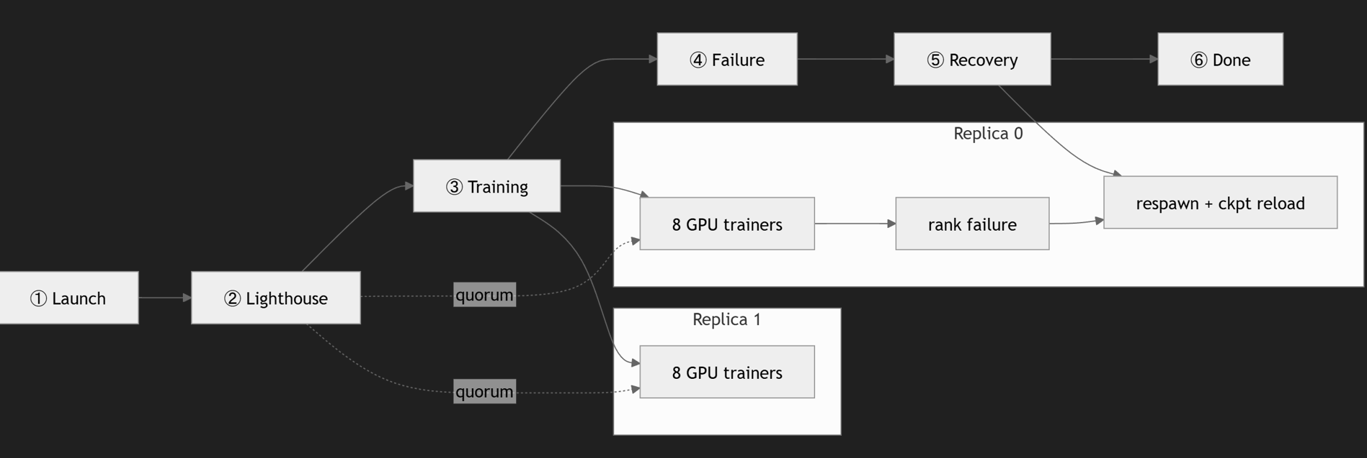
Demo workflow
Notes:
a distributed programming framework for PyTorch that makes the cluster programmable through a single-program Python API. handling fault tolerance, orchestration, tooling integration

