Slide 1
The Token Slice
Implementing Preemptive Scheduling via Chunked Decoding

Slide 2



Kellen Swain
Sr SWE
Google
Maroon Ayoub
Staff Research Scientist
IBM

Slide 3

Agenda
Problem statement
What is llm-d?
Token Slice design
Related/Future work

Slide 4
What problem does token slice solve?

Slide 5
Decode length blues
Unknown decode length is challenging when scheduling a request
Once a request is committed, our options are limited
Wait: unpredictable latency
Set priority to preempt: unless running batch is already prioritized
Evict: Wasted resources as need to restart from beginning
Operational pain: in a multi-tenant environment, multiple long-running requests can overconsume their fair share of decode capacity, leaving other tenant workloads stranded
This sound like an inference orchestration problem! Sounds like a job for…
Notes:
Accurate scheduling requires accurate cost estimation
Accurate cost estimation is difficult with unknown decode duration/length
Can lead to long running requests taking more than their fair share

Slide 6

(llm-d)ude!

Slide 7
What is llm-d?

Slide 8
What is llm-d?
A composable OSS ecosystem for SotA inference serving
Indepentent components to be used in solving problems for inference such as
Scheduling
Autoscaling
Sophisticated orchestration (Wide EP)
Built via ‘well-lit paths’ to act as a blueprint for deploying specific solutions, such as P/D disagg

Slide 9



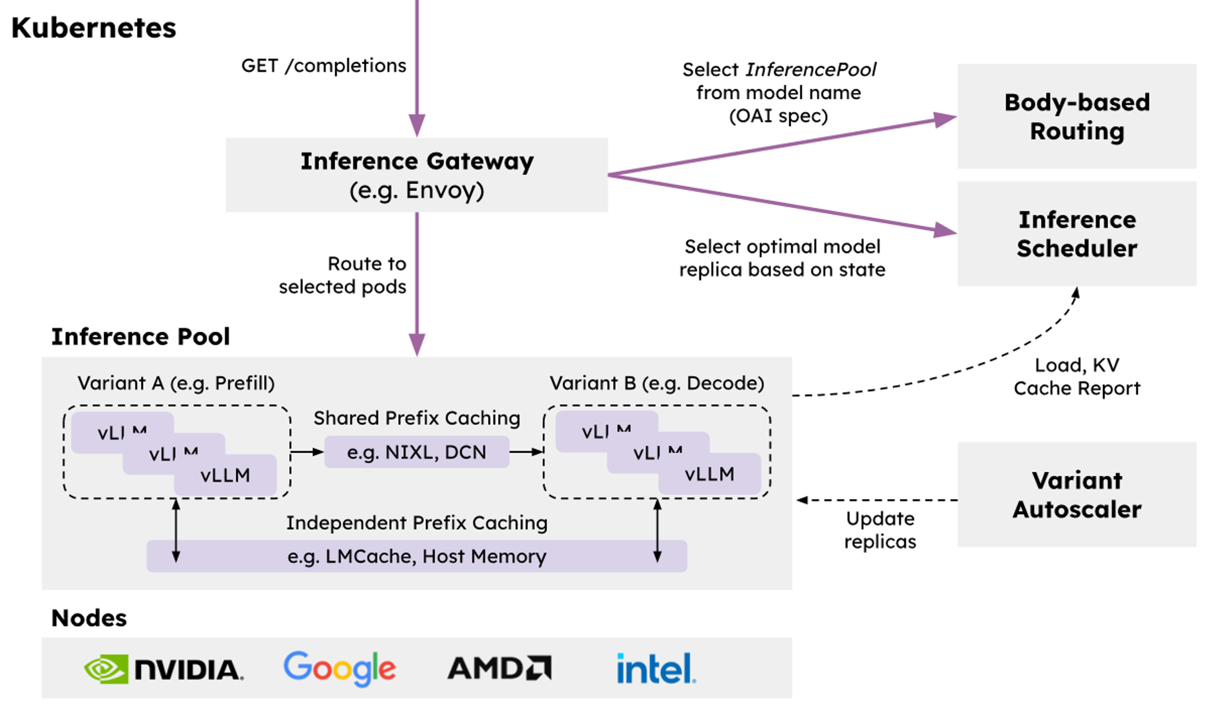

🤝
🤝
Operationalizability
Modular and resilient architecture with native integration into Kubernetes via Inference Gateway API
Flexibility
Cross-platform with extensible implementations of key composable layers of the stack
Performance
Leverage distributed optimizations like prefix-aware routing and disaggregation to achieve the highest throughput while meeting SLOs
Notes:
A composable OSS ecosystem for SotA inference serving
Indepentent components to be used in solving problems for inference such as
Scheduling
Autoscaling
Sophisticated orchestration (Wide EP)
Built via well lit paths

Slide 10
“Well-lit” Paths
llm-d provides “well-lit” paths for running LLM inference workloads
P/D Disaggregation
Wide Expert Parallelism
Intelligent Inference Scheduling
KV Cache Management
‹#›

Slide 11
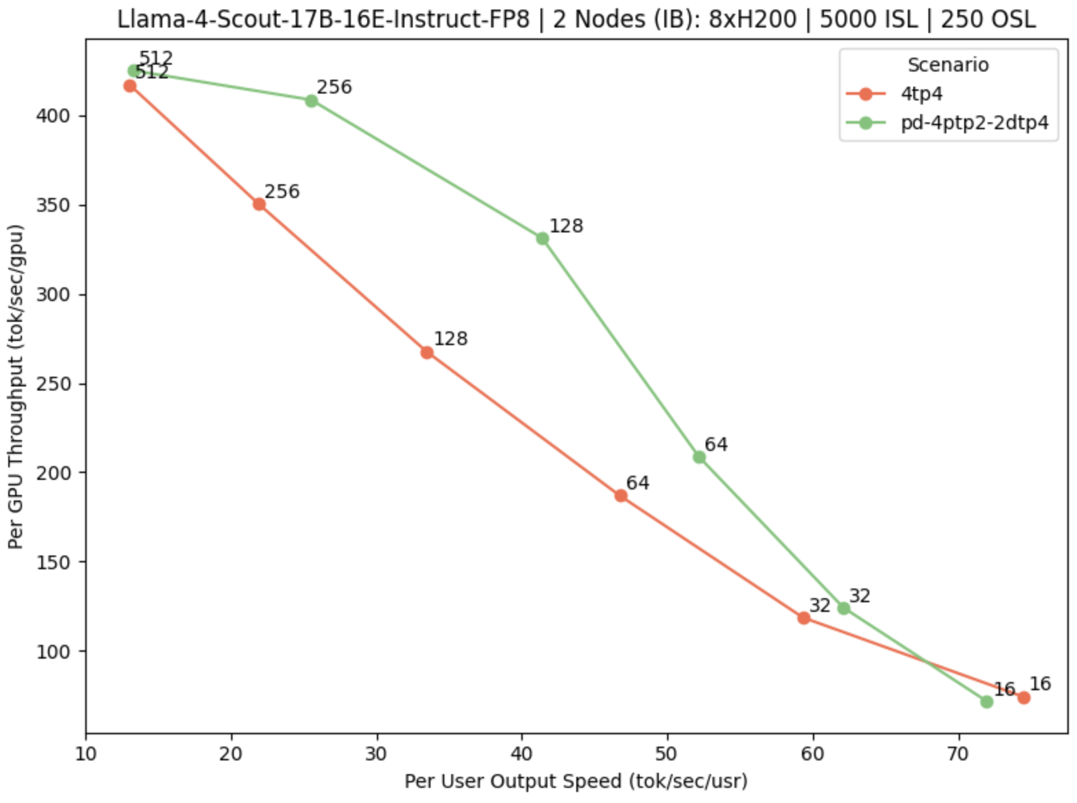
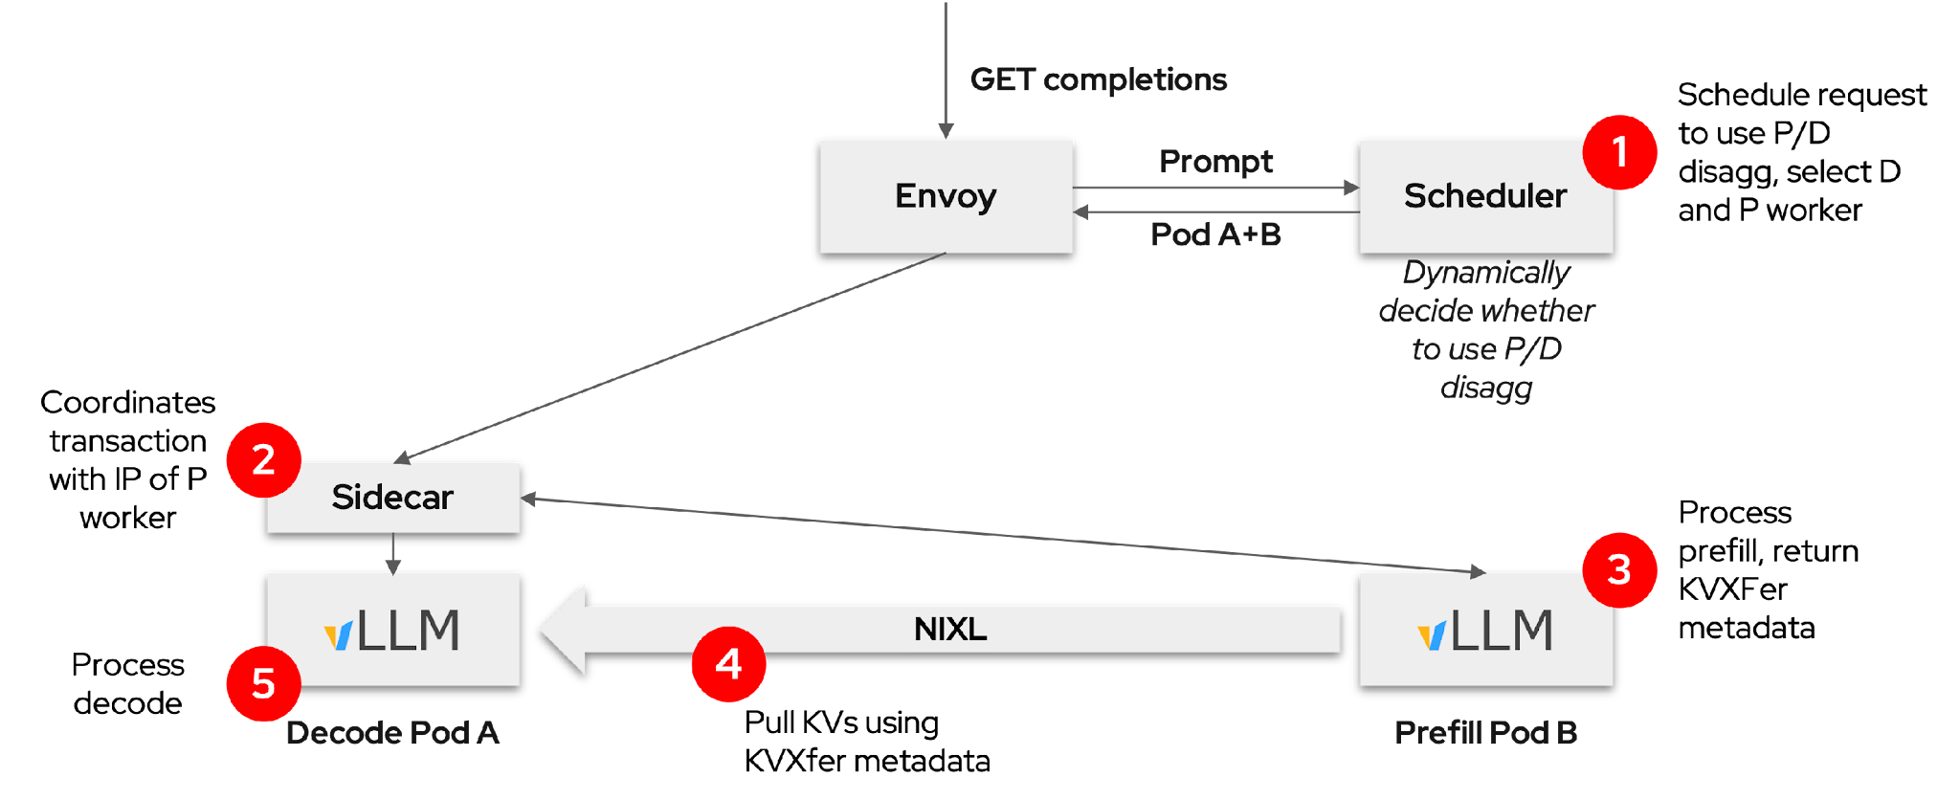
“Well-lit” Path: Prefill/Decode Disaggregation
llm-d composes vLLM and Gateway to enable P/D disaggregation
Separate prefill and decode
Allows specialization
Dynamically decided
Easier to meet TTFT and ITL SLO requirements
Best for “medium” server load
Typical: small prefillers, large decoders
P/D benefits are most clear when jointly optimizing efficiency and interactivity
https://llm-d.ai/blog/llm-d-v0.2-our-first-well-lit-paths

Slide 12


“Well-lit” Path: Intelligent Inference Scheduling
vLLM-aware load-balancing enables smarter request routing that improve SLOs
Prefix-Aware Routing
Load-Aware Routing
GET completions
GET completions
Prompt
EPP
Prompt
EPP
Pod A
Pod A
Prefix-tree.
“Pod A has hit”
Scrape metrics. “A has low load”
KV Events
/metrics
Pod A
Pod B
Pod C
Pod A
Pod B
Pod C
Dramatically increase prefix-cache hit rate
Load-balancing based on actual replica state

Slide 13
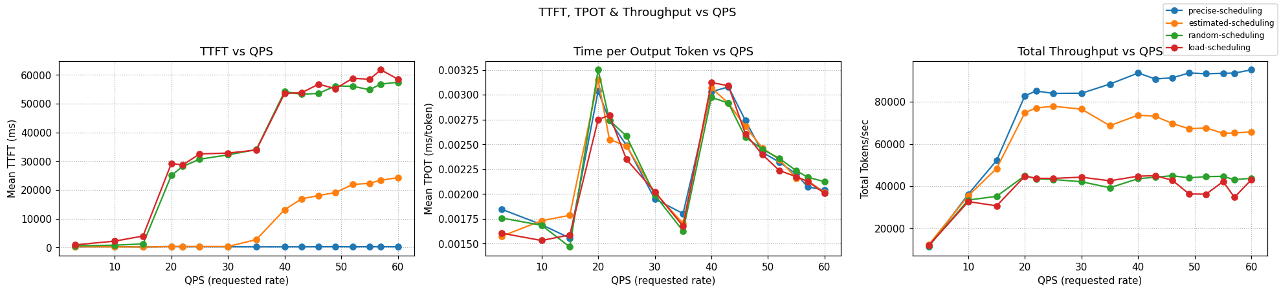
Intelligent Inference Scheduling
Inference scheduling is a no-brainer optimization which can have huge impacts on repeated prompts
llm-d provides different levels of prefix-cache aware scheduling capabilities in our guides
In a workload that demands only 73% of a 16 H100 GPUs KV-cache capacity, optimal performance is achieved:
x57 faster response time than naive scheduling
x2 throughput than load-aware scheduling
Notes:
Emphasize squeezing performance on identical hardware

Slide 14
“Well-lit” Path: KV Cache Management
Leverage all system resources to maximize prefix cache hit rate within the cluster
North/South KV Management
East/West KV Management
GET completions
GET completions
Gateway
Prompt
EPP
Gateway
Prompt
EPP
Pod A
Pod A
KV Index
KV Index
CPU RAM
CPU RAM
CPU RAM
CPU RAM
Remote
Storage
CPU RAM
KVEvents
KVEvents
Pod A
Pod B
Pod C
Pod A
Pod B
Offload KV caches to local memory with global index
Offload KV caches to global shared remote storage
‹#›

Slide 15
The Token Slice

Slide 16
From Cooperative to Token Slice Inference
Cooperative (now); the request runs until EOS or maximum output
Preemptive (proposed): check-in/return to sender every N tokens
Break generation into discreetly schedulable segments
The Token Slice becomes the atomic unit of work - a fixed size of token generations
The scheduler can re-evaluate the waiting queue mid-stream
Interleaved execution of different requests in batches
Fixed size slice => ~fixed execution time
Moving from Request Level to Step-Level scheduling
Bringing CPU scheduling functionality to AI infrastructure
And similarly will need to address the cost of “context switching” to minimize overheads
Notes:
The core concept is bringing well established ideas from the CPU scheduling world into AI
Instead of letting requests run till EOS/max_tokens, we slice them into fixed-size token slices, defining a new predictable atomic unit of work
That lets the scheduler re-evaluate placement mid-stream, interleave execution of different requests, and make the scheduling of the near future more predictable

Slide 17
Experimental design: The llm-d Sidecar
Prototype and experiment by using a Sidecar pattern over modifying the core
Model server stays lean, focusing on raw tensor operations
Sidecar handles the priority logic, queue management and preemption triggers
PR 603 on the llm-d inference scheduler repo
Once validated, portions can move into the core
Anecdote: Linux now allows user level scheduling policies
Notes:
An experimental design was done with the llm-d sidecar pattern
Sidecar handles prioritization, queue mgmt and preemption

Slide 18
Minimizing the Overheads of Context Switching
Challenge: what happens to the “in-progress” data?
Sidecar accumulates tokens generated by each slice iteration
KV cache retains in progress computation (offloaded to CPU RAM)
On resumption of request for next token slice - reload KV cache
For reasonable size token slice (e.g., 256 tokens or more), the reloading stage is much smaller than slice processing time
This is still small enough to allow improved queue management for tail latency and fairness management
Note: disaggregated P/D continues to work as-is, chunked decode is decode node only
Notes:
This does come at a price:
Queueing requests and managing their internals
KV-cache management becomes more critical, as you don’t want to overpay for prefills in between request cycles

Slide 19
Future Work & Alternative Options

Slide 20
Integration with llm-d scheduler’s Flow Control
Token Slice needs to manage multiple priorities and tenants when handling dispatch
Flow Control is a system built to manage the InferencePool resources to be fairly allocated across tenants and priorities
It’s a natural fit to include this logic here
Notes:
As we learned the token slice is concerned with concepts like fairness between tenants, managing multiple priorities, and dispatch, all concepts thatt flow control is concerned with
FC manag

Slide 21
Llm-d inference scheduler’s flow control
Flow Control
Flows/Priority-associated queues
Saturation Detection
p=4
‘Throttle control’
p=0
p=-2
Dispatch ‘valve’
Flow of Requests
Request shed

Slide 22
Open Questions/ Future Work
Is Flow Control’s eviction sufficient?
Dynamically adjust token slice sizes based on priority?
Is the KV-offload overhead minimal enough to justify enabling Token Slice on all workloads?

Slide 23
Would you use this? Let us know!
Have an improvement to offer? Join us!

Slide 24


Join us in llm-d!
llm-d inference scheduler
Py-inf scheduler

Slide 25
Q&A

Slide 28
Summary
Head of Line blocking - the silent killer of production LLM SLAs
Token Slices provide granular control needed for preemptive scheduling
Sidecar architecture ensures logic portability and keeps the core engine clean
Preemption enables fairness with near-zero performance impact
Contribute: try it out, engage with the community!

