Slide 1

Governance, Community Engagement, and Power: Threats and Opportunities from Data Centers
Charles R. Miller, J.D. Policy Director, Alabama Rivers Alliance
Notes:
So this is kind of a continuation of our themes from our presentation from yesterday. We discussed the technical aspects of data centers, how they use water, how they use power, all that good stuff. Now we’re going to talk about the stuff I really like, which the social, political, and a little bit of the financial landscape.
And then hopefully, we’re going to give you some tools that you can use to navigate the impact that these enormous, national and even international trends are having in your state or your community. Then, we’re going to let y’all do a little exercise that should hopefully help you operationalize some of the frameworks we’re talking about in the context of some real-world campaigns you might want to run.

Slide 2
Why We Care about Data Centers
Power use
Water use
Tendency to locate in communities of color, rural communities, and the south
Tendency to use fossil fuel for electric generation instead of renewables
Transparency
Outsized power and influence on local and state governments
Social, economic, and political impacts
Notes:
So first just a real quick rundown of some of the environmental and community issues with data centers

Slide 3
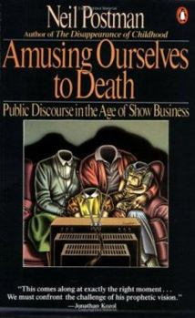
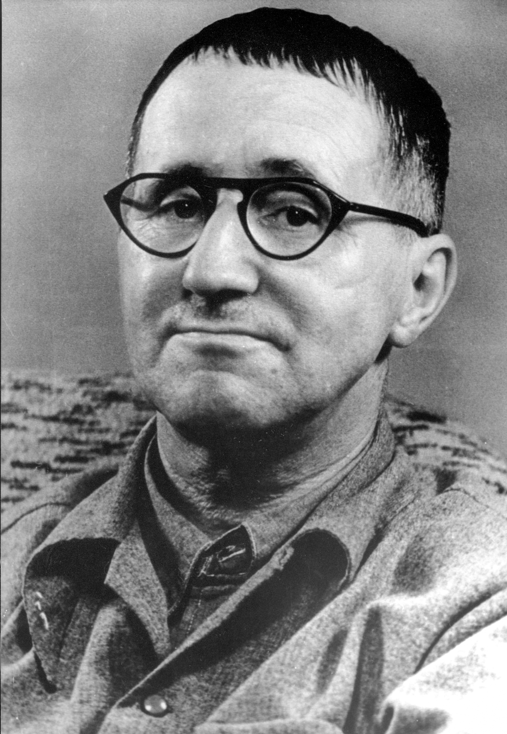

Slide 4
“What [George] Orwell feared were those who would ban books. What [Aldous] Huxley feared was that there would be no reason to ban a book, for there would be no one who wanted to read one. Orwell feared those who would deprive us of information. Huxley feared those who would give us so much that we would be reduced to passivity and egoism. Orwell feared that the truth would be concealed from us. Huxley feared the truth would be drowned in a sea of irrelevance.”
Neil Postman, Amusing Ourselves to Death

Slide 5
“Would it not in that case
Be simpler for the government
To dissolve the people
And elect another?”
- Bertold Brecht, Die Loesung (“The Solution”)

Slide 6
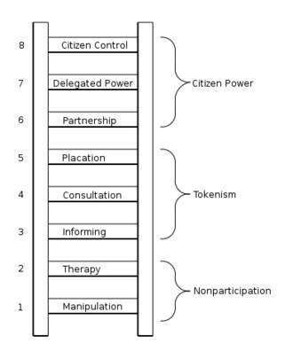
Adapted from “A Ladder of Citizen Participation,” Sherry Arnstein, (1969)

Slide 7
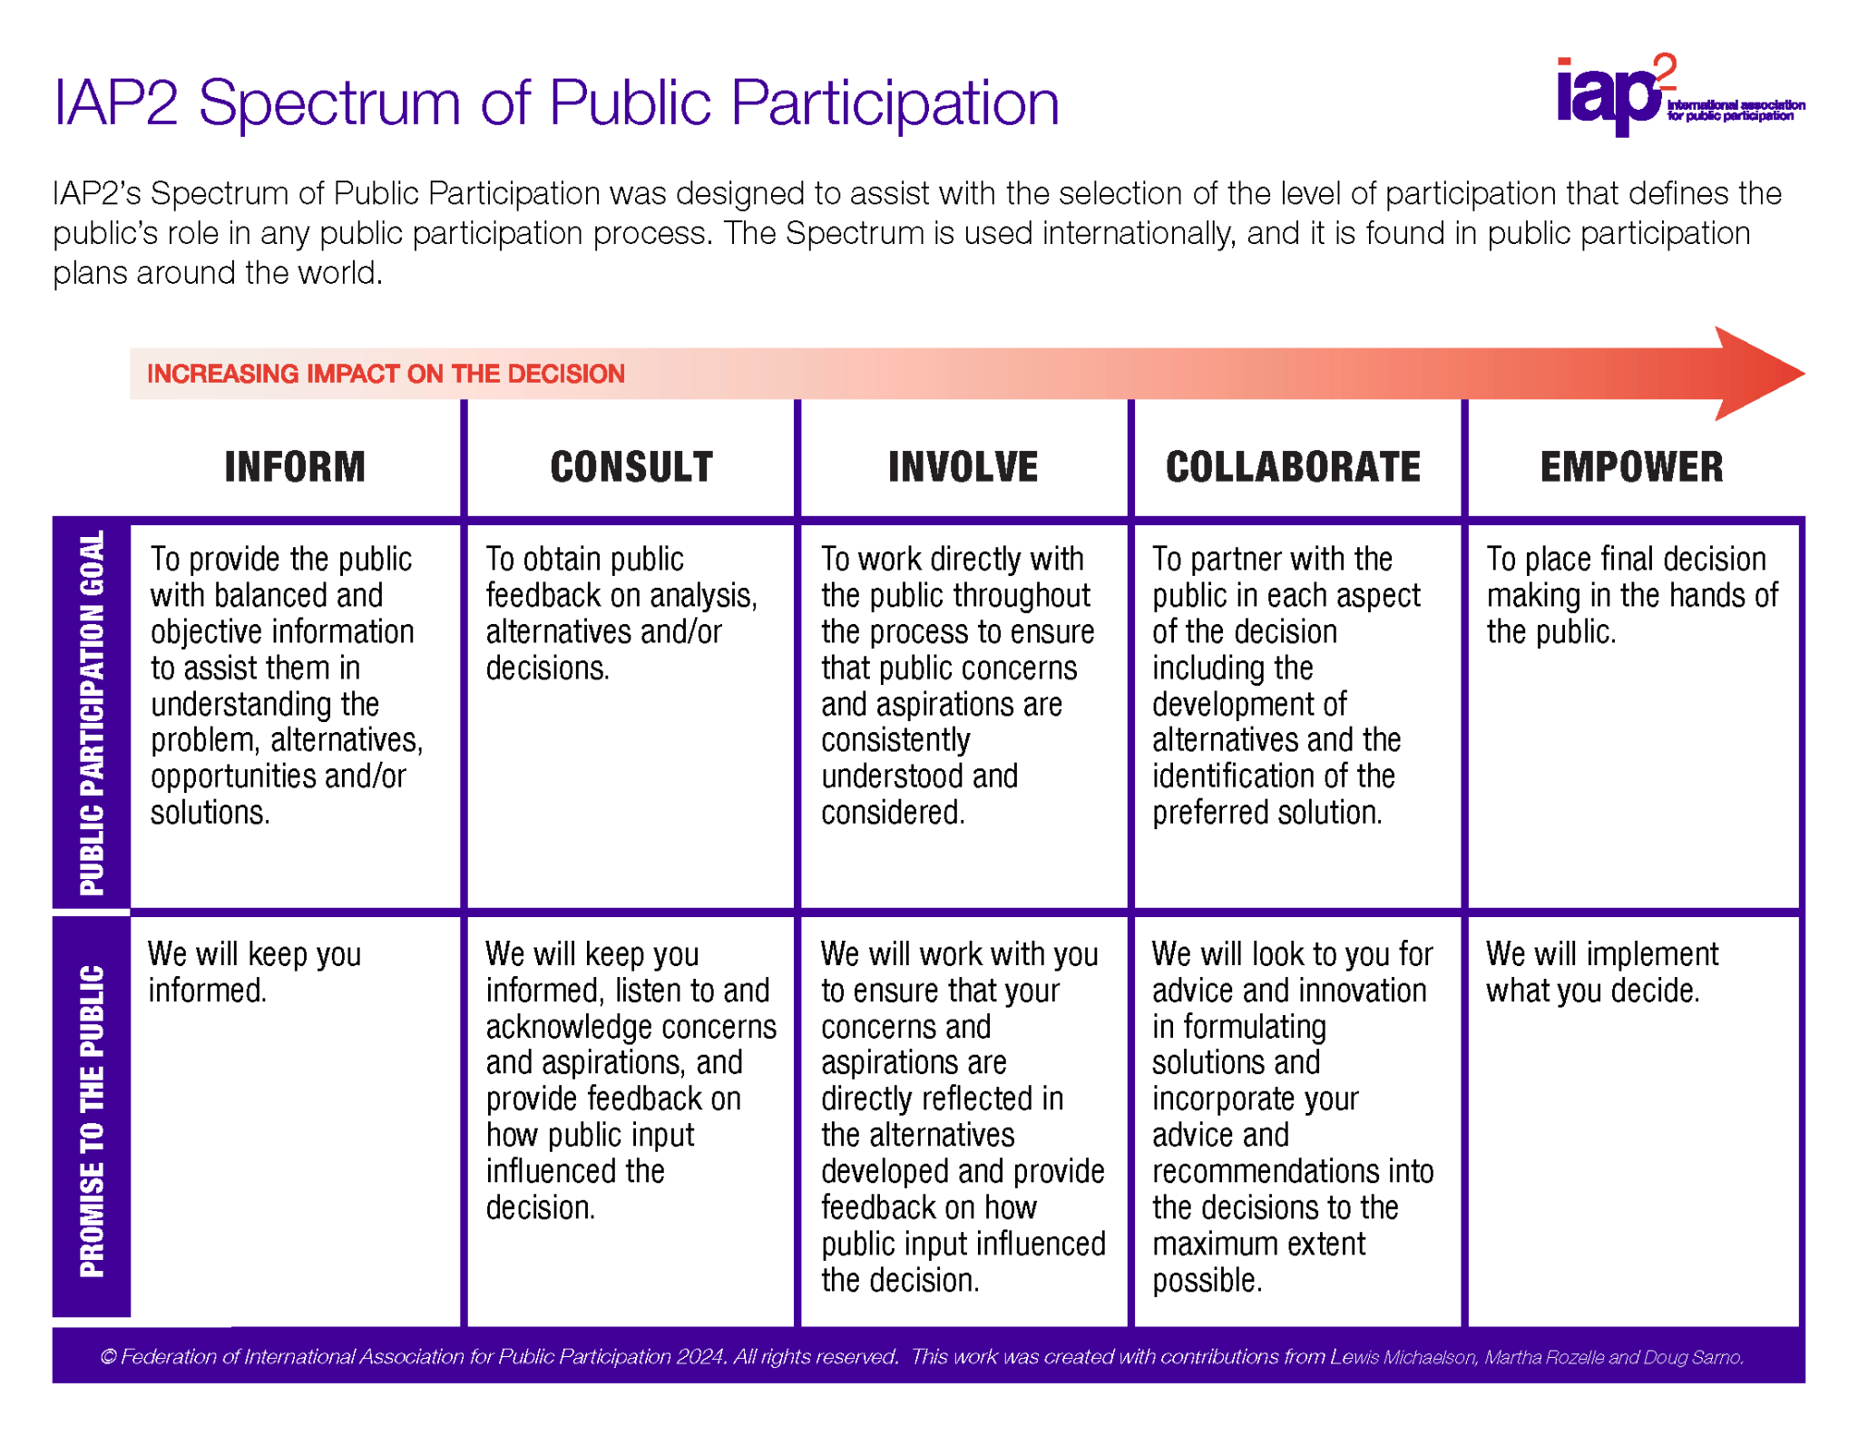
The International Association for Public Participation (2021)

Slide 8
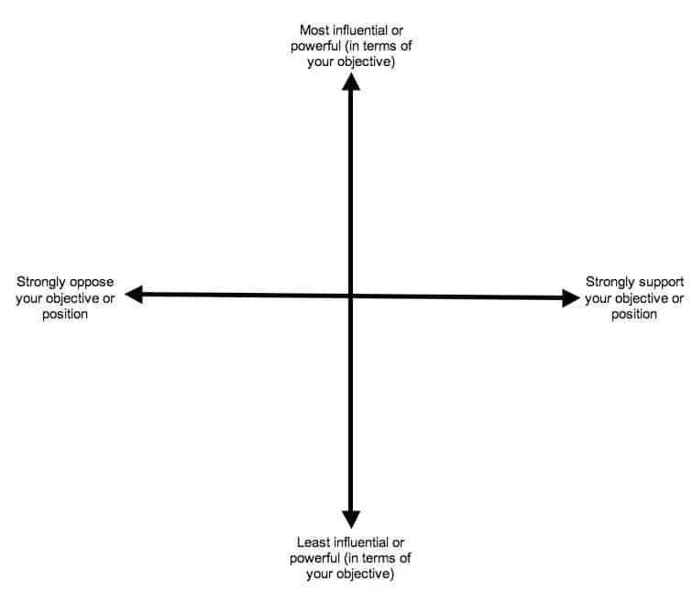
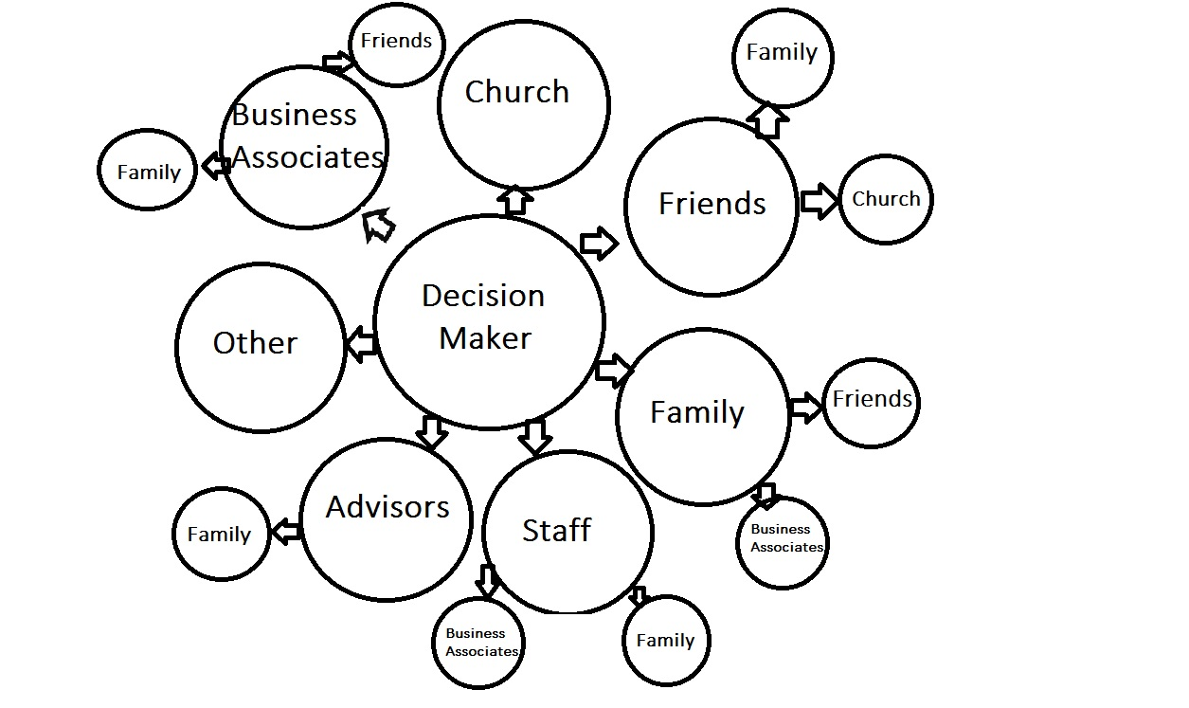
Power Mapping Examples
The Change Agency via commonslibrary.org
Notes:
Dive deep on this

Slide 9
Major Tech Companies Investing in AI Data Centers
Hyperscalers
  Microsoft (Azure)
  Meta (Facebook, Instagram)
  Amazon Web Services
  Oracle
  Google
Hardware companies
  NVIDIA
  AMD
  Intel
  Samsung
Software companies
  Open AI (ChatGPT)
  Anthropic (Claude)
  Google (Gemini)
  Microsoft (Copilot)
  Palantir
Notes:
But to me, what’s the most interesting about all of this is the last thing I mentioned – the social and political aspects of it.

Slide 10
Other Potential Stakeholders
State Level:
  Legislature
  State Agencies: DEQ/DEP, Dep’t of Commerce, Public Service Commission
  Utility Companies
  University Systems
  Large-scale landowners
Regional and Local Level:
  City or County Government
  Local economic development boards
  Local Utilities (Water, Power, Sewer)
  Unions

Slide 11
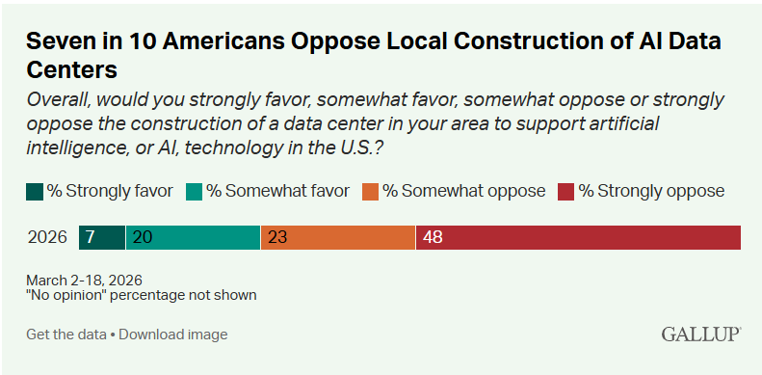
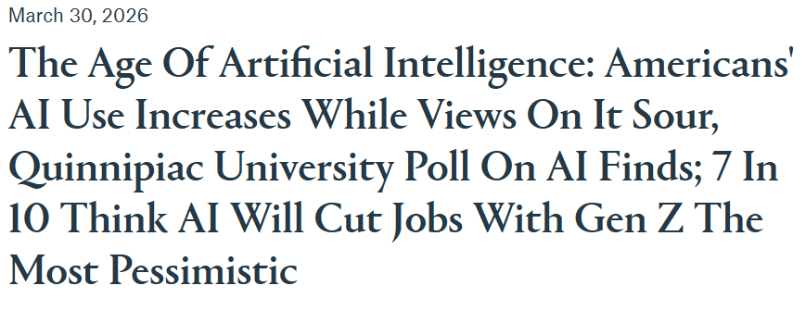
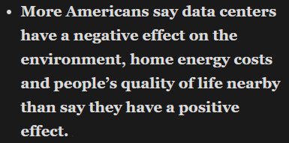
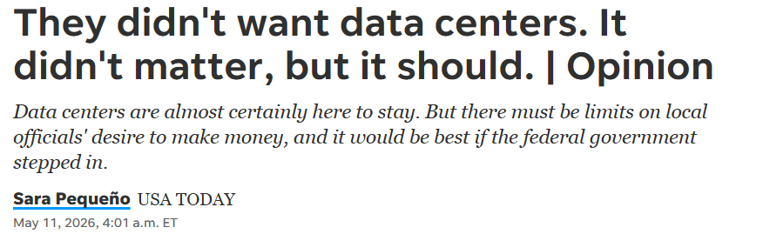
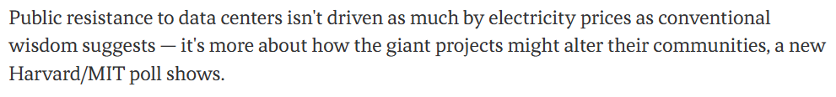
Public Opinion
Notes:
76 percent think they can trust AI either hardly ever (27 percent) or only some of the time (49 percent), while 21 percent think they can trust AI either most of the time (18 percent) or almost all of the time (3 percent).
Just over one-third of Americans (35 percent) are either very excited (6 percent) or somewhat excited (29 percent) about AI, while 62 percent are either not so excited (29 percent) or not excited at all (33 percent).
Fifty-five percent of Americans think AI will do more harm than good in their day-to-day lives, while 34 percent think AI will do more good than harm, with 11 percent not offering an opinion.
– Quinnipiac

