Slide 1




OUR PARTNERS

Slide 2
Alexis and Dean Indot’s Videos
Debit Card Autopay
Individual Stocks vs. Index Funds
People Search Sites

Slide 3
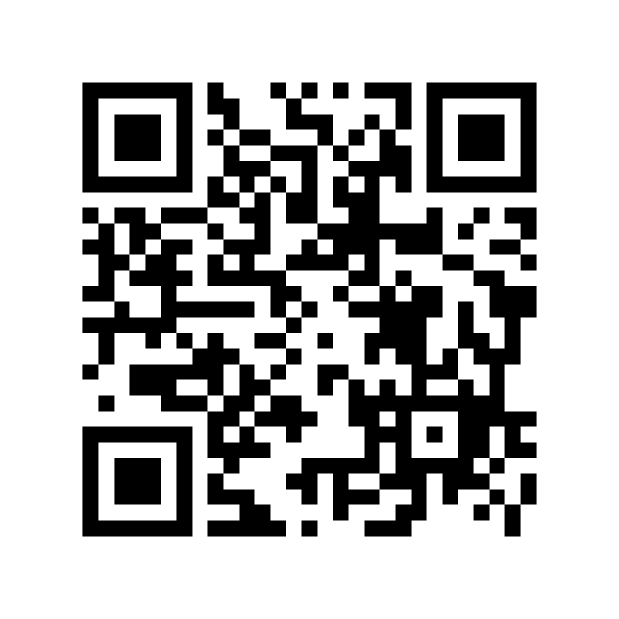
Connect with RTDNA!
Scan this to join our mailing list and give us feedback on this session

