Slide 1





OUR PARTNERS

Slide 2
Community Reporting Examples
Papi Stores
Economic Impact
Food Deserts

Slide 3
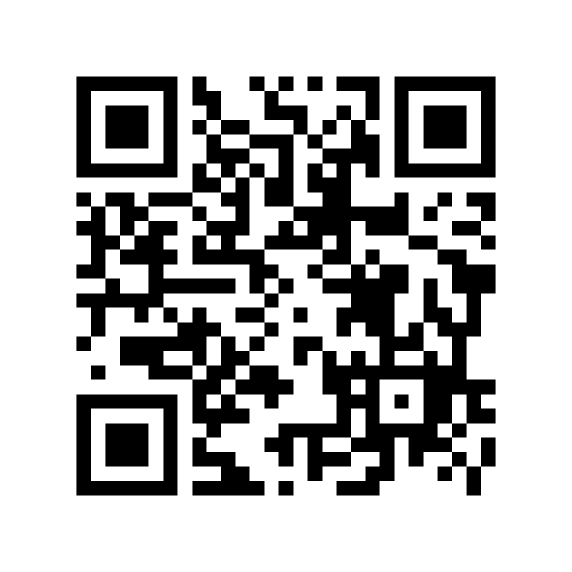
Connect with RTDNA!
Scan this to join our mailing list and give us feedback on this session

