Slide 1
Open-Source Tidy Education Finance Data
A Hands-On Workshop with edfinr

Slide 2




About Bellwether
Bellwether envisions a future where all young people have access to an excellent education, and live lives filled with opportunity.
Bellwether is a national nonprofit that works hand in hand with education leaders and organizations to accelerate their impact, inform and influence policy and program design, and share what we learn along the way.
Bonnie O’Keefe
Partner
Alex Spurrier
Associate Partner
Krista Kaput
Associate Partner
Biko McMillian
Senior Analyst

Slide 3
About Our State School Finance Initiative
Education finance sets the foundation for what is possible in every school in the country. Education finance equity is essential to leveling the playing field for marginalized students in under-resourced schools and communities.
Bellwether’s work in state education finance equity aims to improve funding systems, state by state, through:
Analyses that shape the public conversation on education finance and help advocates and policymakers understand and improve finance policies in their states.
Trainings that equip state advocates with policy knowledge and data modeling skills to unlock the potential for policy reforms.
Capacity-building support, policy advising, and technical modeling assistance for state advocacy groups or public agencies in states on the precipice of enacting change.

Slide 4
Key Objectives
Understand the basics of LEA school finance data collected by the federal government through the F-33 survey.
Learn how edfinr provides easy access to an opinionated and tidy version of F-33 data
Use edfinr to create exploratory analyses of school finance data

Slide 5
Today’s Agenda
1:15–1:25 Welcome + Setup
1:25–1:35 Overview of federal finance data
1:35–1:50 Introducing edfinr
1:50–2:20 Hands-On Coding
2:20–2:30 Share-Out + Wrap

Slide 6
Here’s what you’ll need on your computer to follow along in this workshop
Before the session, you should:
Download and install R and RStudio
Install required packages by running this code in RStudio:
install.packages(c("tidyverse", "scales", "viridis", "edfinr"))
Clone (or download) the workshop GitHub repo: https://github.com/bwedfinance/2026-sdp-edfinr-workshop
If you’re not a GitHub user, you can download the files
Or copy/paste/save the code as we go

Slide 7
Let’s make sure everyone is ready to go with their tech setup
Run 00_setup_check.R from the workshop GitHub repo: https://github.com/bwedfinance/2026-sdp-edfinr-workshop
If you’re all set, you should see this output in your R console:
edfinr loaded 16,651 rows of SY22 data.
You're ready for the workshop!
If you need help:
👥 Ask a neighbor first
✋ Raise your hand for Bellwether troubleshooting support

Slide 8
What is the F-33 survey?
The F-33 survey collects detailed information on revenues and expenditures at the local education agency (LEA) level
The survey form and items are pretty consistent from year to year
Changes tend to be additions, like new subset categories to track COVID-19 relief funding revenues and expenditures
Since every LEA fills out the F-33 survey each year, it is the only source of comparable, highly-detailed information on LEA finances.

Slide 9
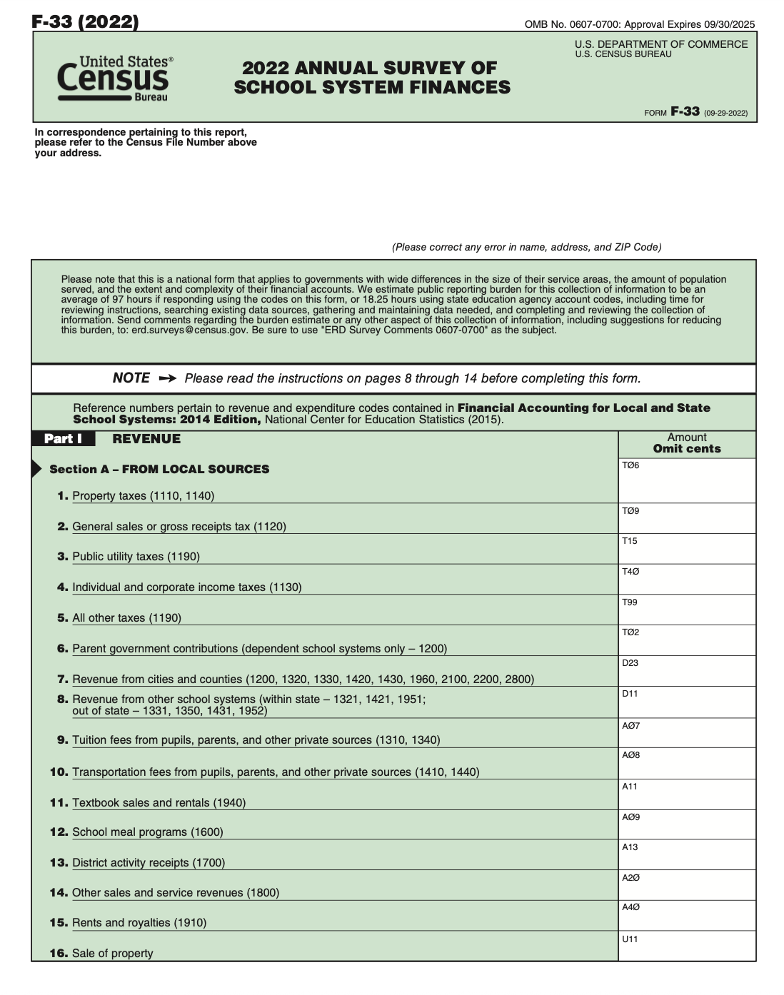
What is the F-33 survey?
Sounds like F-33 data would be a great asset to study school finance policy!
So…what's the catch? 🤔

Slide 10
There are some quirks in F-33 data…
Do you know….
How many school districts are in the United States? | More than 13,000! Also, the number of CA LEAs jumped by ~1k in 2019 after a change in how charter schools were classified…
How state/local/federal dollars flow to LEAs that don’t serve the full K-12 grade span? | Some middle/high school LEAs receive direct funding; sometimes funding passes through elementary/middle school-only LEAs
How much per-pupil revenue Kelleys Island (OH) receives? | $153,800 per-pupil (They had 5 enrolled students in SY12)
How much per-pupil revenue Norwich Free Academy (CT) receives? | $26 per-pupil (They serve > 2k students as a quasi-private school)
How F-33 data is published? | The Census Bureau and NCES release their own versions that differ in significant ways!

Slide 11

F-33 data has limitations and requires some data adjustments for useful analysis
If you use the Census Bureau version:
Revenues/expenditures need to be multiplied by 1,000
For some states, line C24 needs to be subtracted from state revenue and added to local revenue
Charter LEAs are not included
If you want to use the NCES version, you need to be patient.
In either case, you’ll need to decide how you want to handle:
Special purpose/outlier LEAs
Pass-through payments
Tuition payments to other school systems
One-time property sales

Slide 12
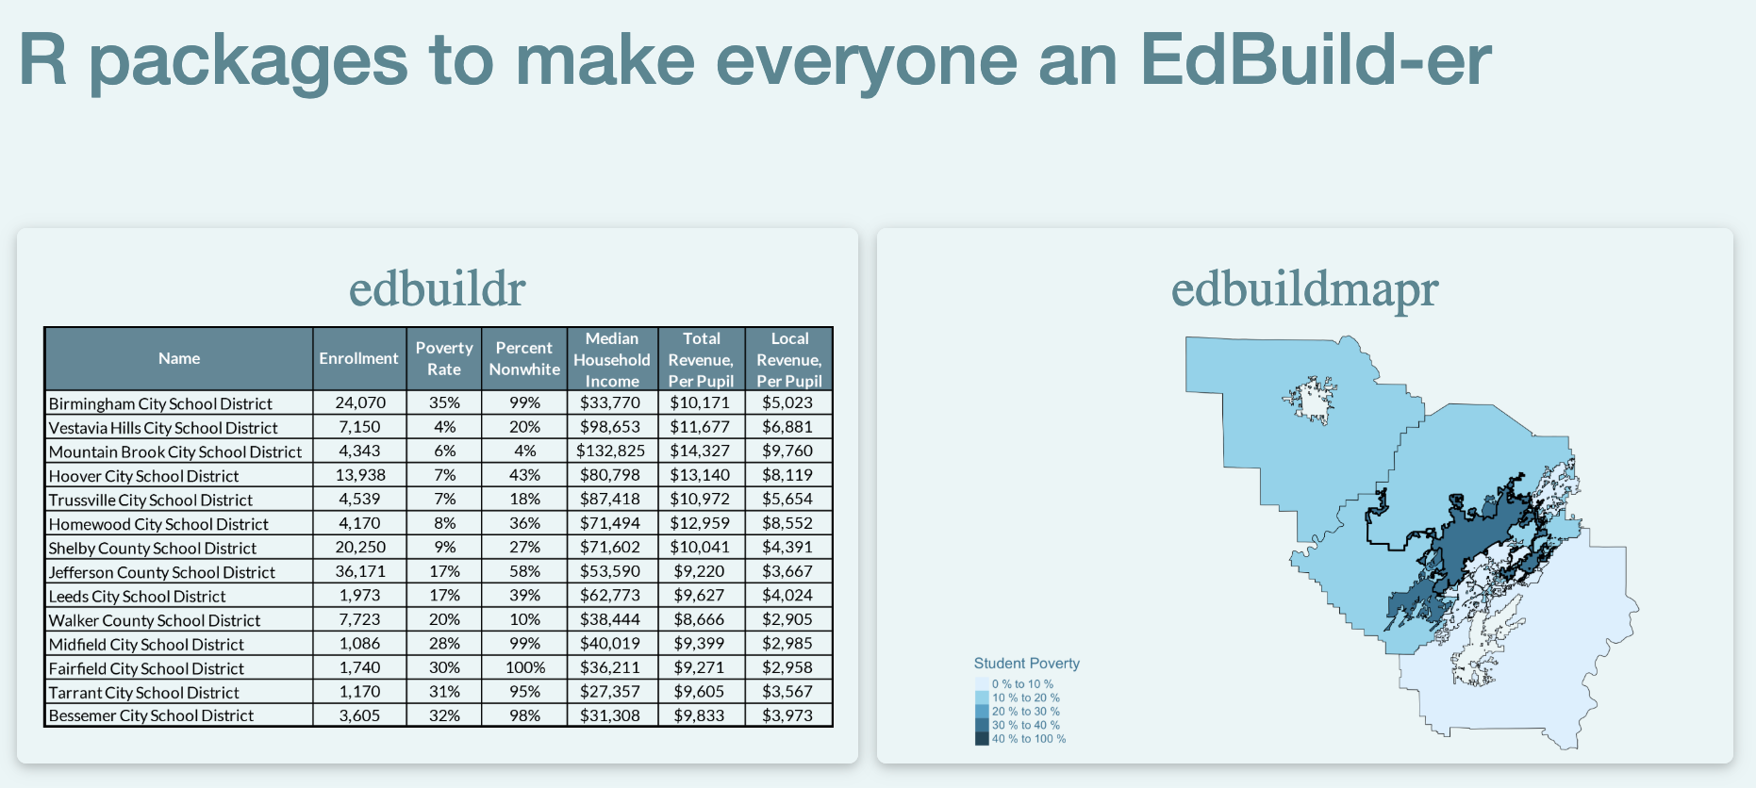
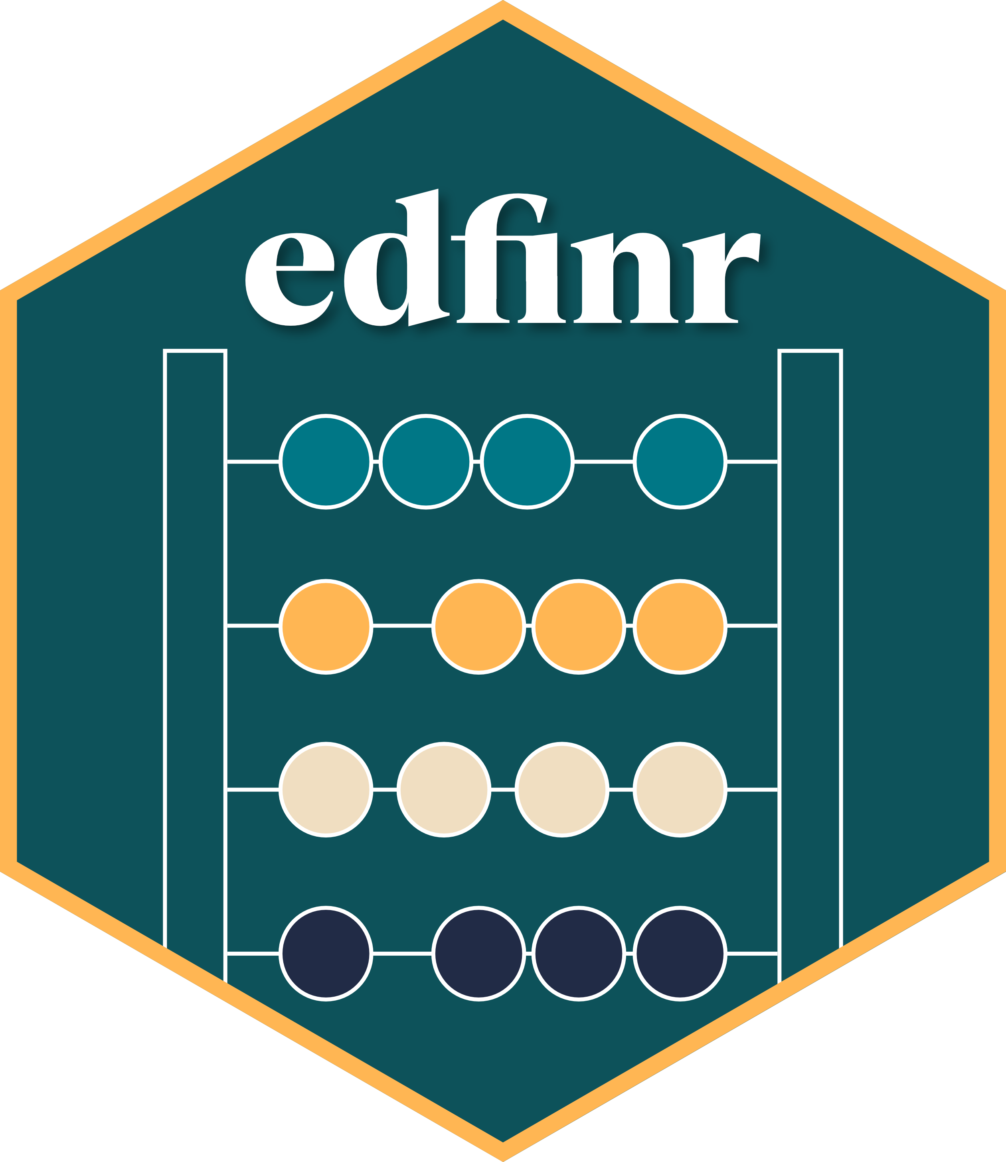
edfinr carries on the torch lit by EdBuild to enable responsible use of F-33 data
EdBuild created a pair of R packages, edbuildr and edbuildmapr, to make school finance data analysis a little easier.
R packages are collections of functions and data that attempt to make your life easier in a very specific way.
After EdBuild’s sunset as an organization, so did updates to edbuildr: its F-33 data only goes through SY18.
edfinr is Bellwether’s effort to carry on the spirit of edbuildr by providing an opinionated approach to tidying and adjusting F-33 data for policy analysis.
edfinr includes NCES F-33 data from SY12 through SY22.
SY23 data will be coming to edfinr later this year!

Slide 13
edfinr is an easy-to-use tool for fast, consistent school finance data analysis
edfinr is hosted on CRAN, so it can be installed using a single line of code:
install.packages(“edfinr”)
The edfinr package is simple to use – there are only two functions:
get_finance_data(): A function that pulls school finance data for specified years and/or states. Data comes in “skinny” and “full” versions (more detailed expenditure info in the latter).
list_variables(): A data dictionary for edfinr

Slide 14
edfinr also bundles richer context data alongside F-33 finance data
Because you’re probably interested in more data than is in the F-33, edfinr also provides:
NCES Common Core of Data – Directory via the Urban Institute’s educationdata R package adds contextual school district information, such as urbanicity, CSBA codes, and congressional districts.
Small Area Income and Poverty Estimates
5-year ACS community survey data via tidycensus, including median household income, median property value, and percent of adults with a BA+.
Check out the edfinr package website for documentation, vignettes, and more!

Slide 15
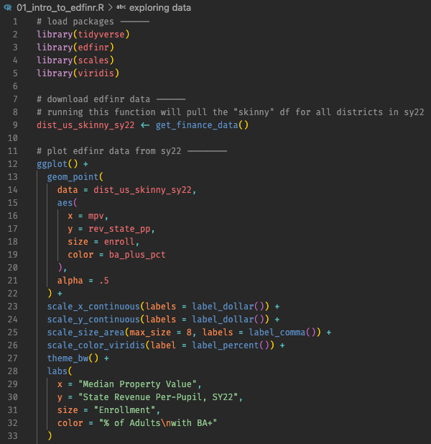
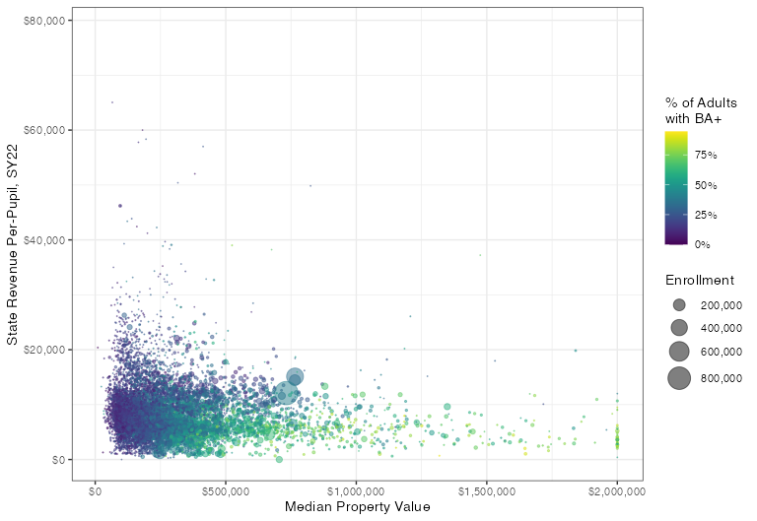
Live demo: How edfinr can help you build a chart in 2 lines of code*
* 2 lines after excluding loading packages

Slide 16
Your Turn: Build Your Own Analysis
Open the GitHub repo for this session:
https://github.com/bwedfinance/2026-sdp-edfinr-workshop
Work through these scripts in order, adjusting the state parameters to focus on state(s) that interest you the most:
02a_state_basic.R
02b_state_polished.R
03_state_urbanicity.R
04_state_comp.R
We’ll work through 02a_state_basic.R together, but feel free to work ahead if you’re comfortable working with R independently!

Slide 17
Report Out
What insight(s) did this exercise spark?
What question(s) do you want to explore next?

Slide 18


Ways to stay involved
Subscribe to Bellwether’s State Education Finance Newsletter!
Help us make edfinr better!
Methodology updates: All of our data cleaning code is availble on GitHub. If you have suggestions for improving how we’re using F-33 and/or other data sources, send us an email and/or open an issue on GitHub!
Feature requests: We’d like to keep edfinr lean, but if there are functionality updates you’d like to see, please send us an email and/or open an issue on GitHub!

Slide 19
Thank You
Alex.Spurrier@bellwether.org
Bonnie.Okeefe@bellwether.org
Krista.Kaput@bellwether.org
Biko.Mcmillian@bellwether.org

