Slide 1
Positive Program Review Through Shared Goals and Accessible Data
Wyl McCully, PhD
Lansing Community College, Lansing MI

Slide 2
Speaker Checklist
!! When finished with your slide deck, remember to delete this slide !!
As you plan your session, some reminders:
What are your key takeaways? What is your key activity? How much time do you need minimum?
If running short on time, what could be shortened/omitted earlier in your session to ensure you have ample time for your key activity?
What strategies or tools will you use to ensure this session is interactive for attendees?
How will you balance presentation time with discussion and Q&A time?
At what point(s) will you pause for questions? What questions do you anticipate from our data-savvy and diverse audience?
SDP Fellows care deeply about the success of those historically underserved and marginalized by the education system. In preparation, please also reflect:
Does your session speak to the experiences of folks working in districts/LEAs, state ed agencies, and education-focused nonprofits?
Are you ready to address questions about how folks of different socioeconomic, racial, and/or ethnic backgrounds are supported or positively/negatively impacted by your work?
How does your session help advance work towards equity in education?
!! When finished with your slide deck, remember to delete this slide !!

Slide 3
Session Structure
Information Dump (25 Minutes)
Break (5 Minutes)
Practice Time (15 Minutes)
Discussion and Questions (15 Minutes)
Wrap-up (5 Minutes)

Slide 5
Our Process
Credential Assessment Algorithm
Faculty Response
Final Decision
Program Response
Dean Conversation

Slide 6
Key Objectives
Develop intentional strategies for linking project goals to assessment methods, and assessment methods to healthy conversations.
Identify strategies for developing a shared sense of ownership and responsibility when making difficult decisions.
Define appropriate methods of interaction to create environments in which consensus becomes commonplace.

Slide 7
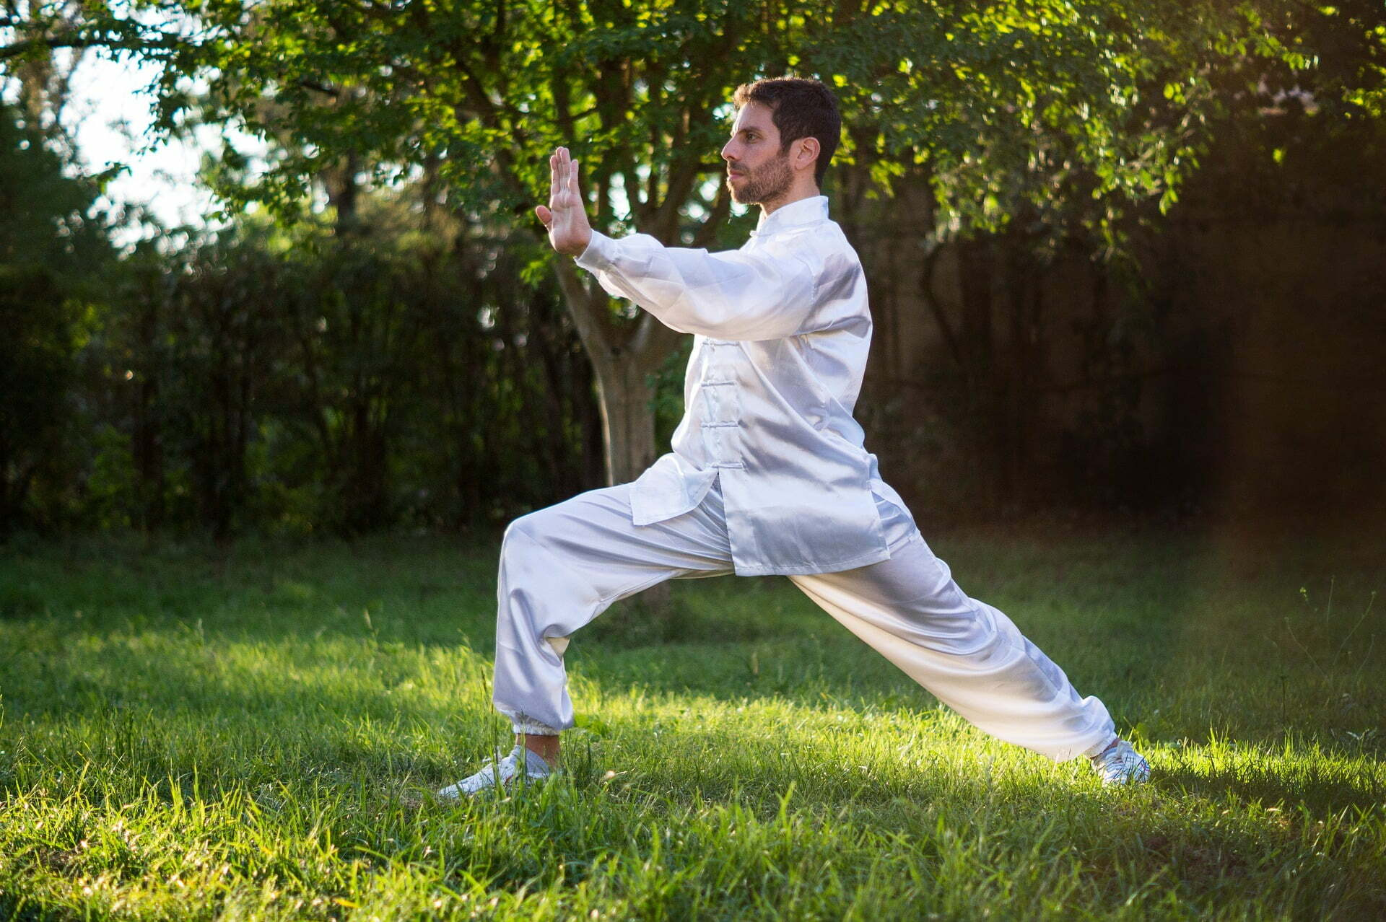
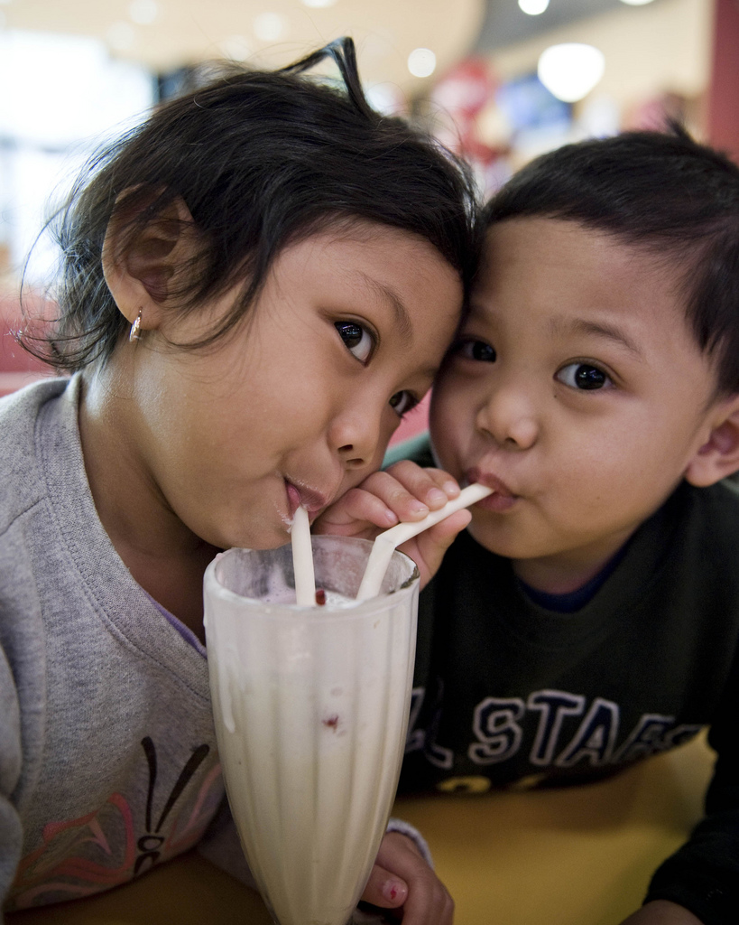

Be Intentional
Build Consensus
Share Power

Slide 8
Be Intentional

Words matter
Translation is challenging
Intentional actions lead to shared understanding.

Slide 9
Be Intentional
Build Consensus
Share Power

Slide 10
Share Power

Resources are shared
Concerns need to be addressed
Power given up is power shared.

Slide 11
Be Intentional
Build Consensus
Share Power

Slide 12
Build Consensus

Conversation is vital
Time is required
Aim for support, not agreement.

Slide 13
Be Intentional
Build Consensus
Share Power

Slide 14
5 Minute Stretch Break
Feel free to turn off your video

Slide 15
Roleplaying Instructions
For Actors
  Agree on the situation and take on the roles.
  Don’t spend too much time on details; rely on “yes, and”
For Talkers
  Discuss your situation(s).
  How might these techniques work?
  What issues might these techniques cause?
For Others
  Find a willing group and observe.
  Feel free to chime in with your own take on the situation

Slide 16
  Suggested Scenarios
Be you
  Identify an issue at your institution where difficult decisions will lead to difficult conversations.
Be Me
  You are an administrator charged with objectively assessing the quality and efficacy of degree pathways.
Be A Teacher
  Your school has created a program for problem students; how would you identify the best candidates and inform parents?
Be An Administrator
  You have created a program to improve teaching quality. How do you identify and invite faculty?

Slide 17
Report Out
Takeaways and/or Questions

Slide 18
Thank You
Wyl McCully
mcculw@star.lcc.edu

Slide 19

Thank You

