Slide 1
Generative AI in Education Data:
Peer-to-Peer and Cross-Role Networking and Collaboration

Slide 2
Help us create your discussion groups!
As you come in…
Text (765) 737-2668 < (765) SDP-CONV > with 1 – 3 sentences describing the areas of AI use you are most interested in discussing.
Take a sticker!

Slide 3
Facilitator Introductions
If you’ve just come in…
Text (765) 737-2668 with 1 – 3 sentences describing the areas of AI use you are most interested in discussing.
Take a sticker!
Erin Dillon
- Project Lead The Way·SDP Cohort 3
Stephen Fedore (Hoch)
- K12 Data Partners·SDP Cohort 5
Holly Karakos
- Project Lead The Way
Carlos Romero
- Apex Evaluation
Elena Schmidt
- Apex Evaluation·SDP Cohort 10

Slide 4
Key Objectives
If you’ve just come in…
Text (765) 737-2668 with 1 – 3 sentences describing the areas of AI use you are most interested in discussing.
Take a sticker!
Build meaningful connections with peers who share similar roles, challenges, or responsibilities
Surface common needs around training, governance, evaluation, and tool development
Gain insight into how other sectors and roles are approaching generative AI
Identify opportunities for future collaboration and learning

Slide 5
Session Plan
1. Birds of a Feather Discussion – 30 minutes
2. Transition – 5 minutes
3. Idea Exchange – 20 minutes
4. Reflection & Next Steps – 10 minutes

Slide 6
Discussion norms
Come as you are – curious, cautious, or experienced. There’s no expectation to be an “AI expert”.
Be open about benefits and risks.
Listen to learn – different roles and contexts bring different perspectives
Connect to follow-up – use the discussion to find people, ideas, or questions to follow-up on after today.

Slide 7
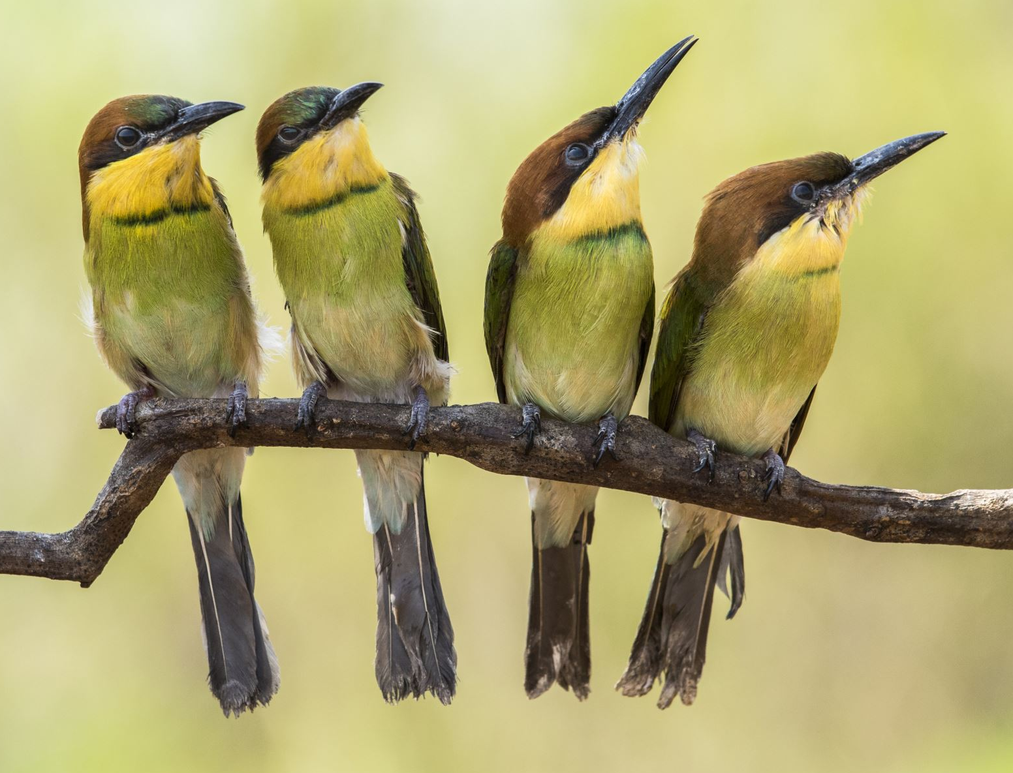
Birds of a Feather Discussion Prompts
Where have AI tools changed how you approach your work related to education data?
How is your organization using – or not using – AI for tasks related to education data?
What are your hopes and fears related to AI?
What are the risks and benefits of using AI in your work?


Slide 8
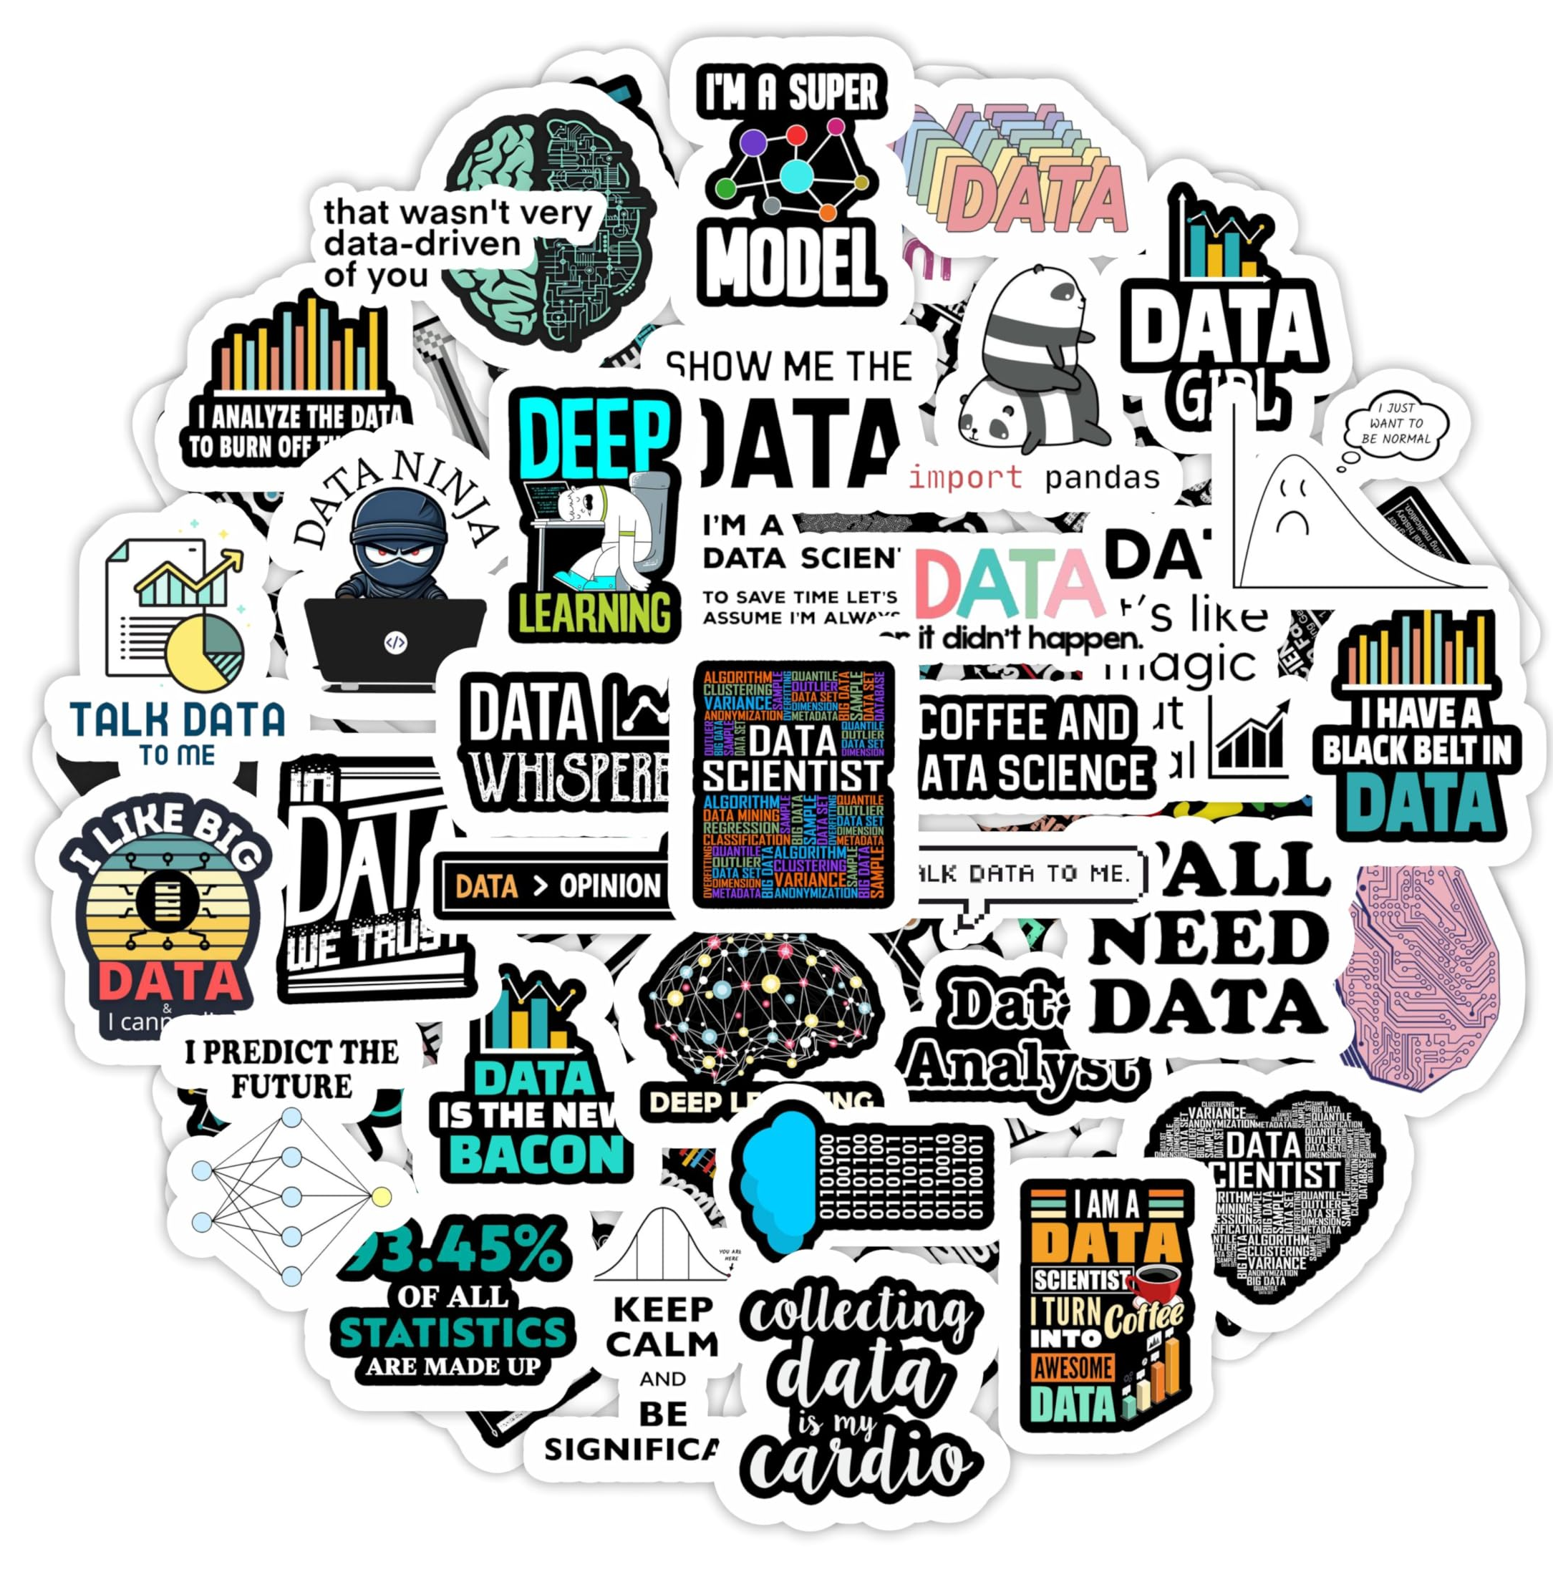
5 Minute Transition
Find 2 – 3 people who:
Were in a different group
Has a sticker from the same state as you.
Sit down at a table together

Slide 9
Idea Exchange
What is one takeaway from your conversation that you are still thinking about?
What is one point you disagreed with or were concerned about from your table discussion?
Did anything you heard today shift how you think about AI—or how others are experiencing it?
What is one small step you’re interested in taking next related to AI in your work?


Slide 10
What’s next?
What kind of ongoing conversation or community around AI would feel useful to you?

Slide 11
Thank You!
Erin Dillon·edillon@pltw.org
Stephen Fedore (Hoch)·stephen@k12datapartners.com
Holly Karakos·hkarakos@pltw.org
Carlos Romero· c.romero@apexeval.org
Elena Schmidt· e.schmidt@apexeval.org

Slide 12

Thank You

