Slide 1
Proof in the Periphery
Illuminating Impact from Outside the Research Office

Slide 2
Networking Session Objectives
Problem-Solve Together
Build a Network
Commit to Action
Notes:
Problem-solve Together
Work through specific problems of practice with similarly-positioned peers who “get it.”
Build a Network
Gain a persistent network of people to call when the going gets tough.
Commit to Action
Leave with a personal commitment to try 1 new strategy in your work starting next week.

Slide 3
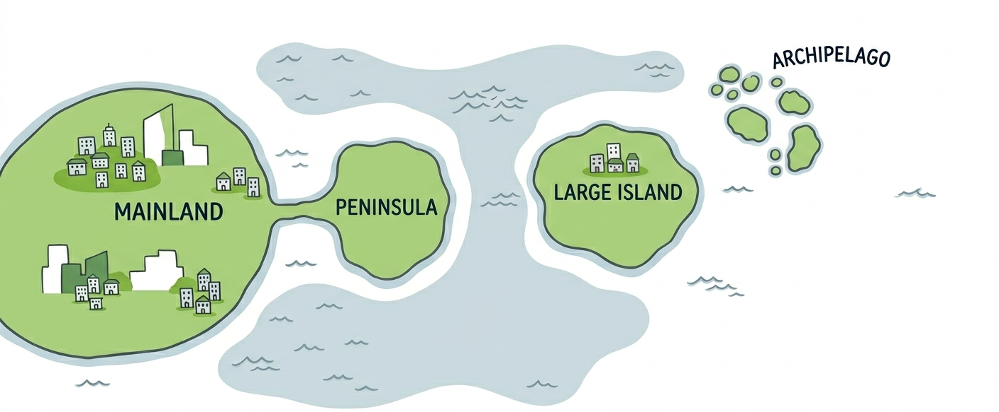
Icebreaker: Find Your Place on the Map

Slide 4
Table Talks
Role/
Value Setting
Communication
Collaboration and Politics
Longevity

Slide 5
Report Out
Takeaways and/or Questions

Slide 6
Commit to Action
Which strategy from today’s conversation will you use to illuminate your work starting Monday morning?

Slide 7

Thank You

