Slide 1
From Proof to Practice: Using District Data Partnerships to Improve Summer Learning in Boston Public Schools

Slide 2

Key Objective
insights
Explore the evolving relationship between data and practice through the lens of summer learning in Boston Public Schools.

Slide 3
Agenda / Outline
Introduction of the key players and context setting
  How do you see your context reflected here?
Generating proof - overview of key findings
  How would you have used these findings?
Sharing impact and supporting practice
  Navigating tensions between rigor and actionability

Slide 4
Presenters
Magaly Sanchez
Chief Family Advancement Officer
Office of Family and Community Advancement
Meg Caven
Director of Organizational Insight
Nicole Reddig
Research and Partnerships Analyst
Chris Zieminski
Internal Evaluation Manager
Office of Data and Accountability

Slide 5
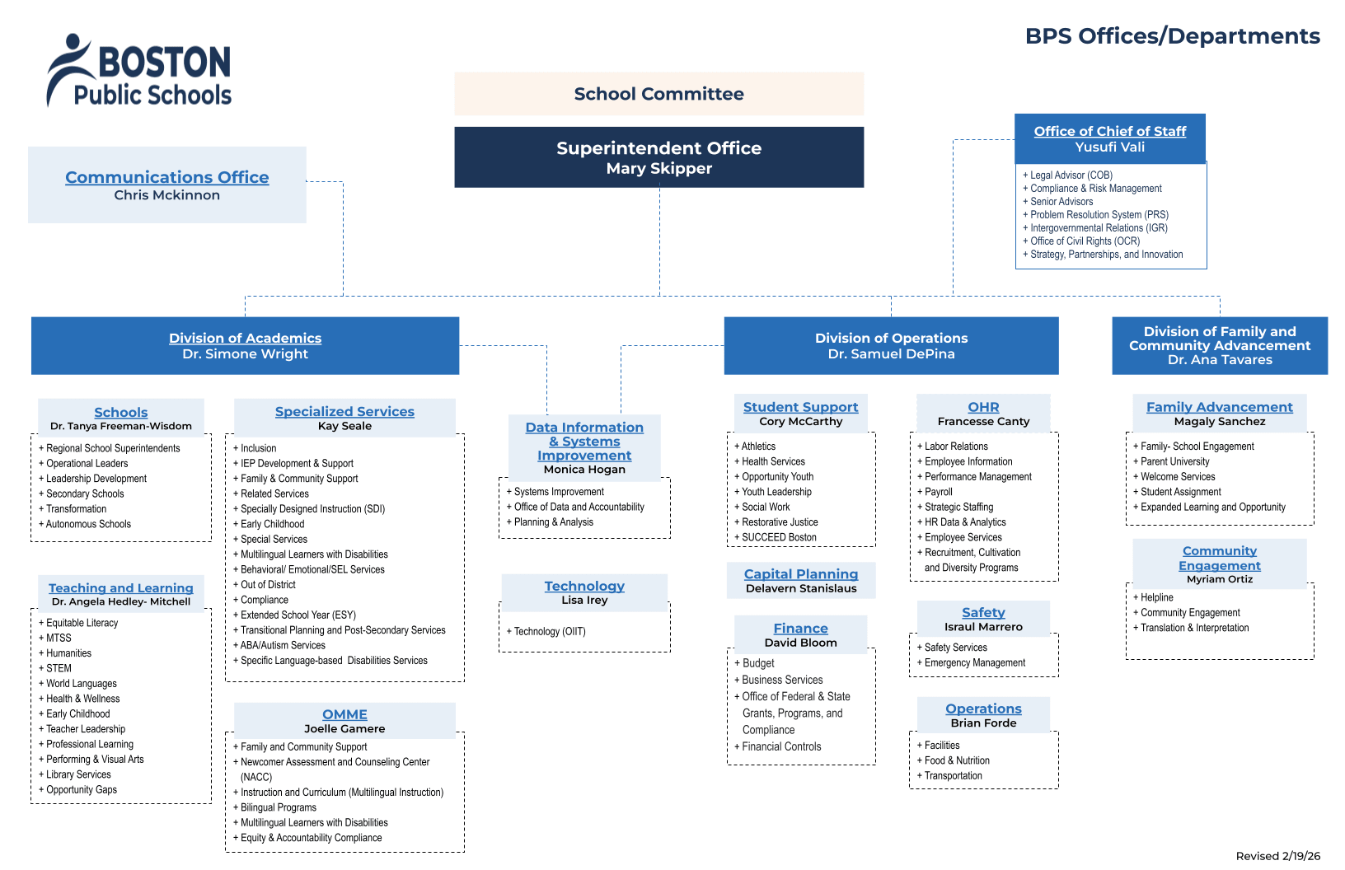
ODA - spans verticals, supporting multiple departments

Slide 6
Introducing the players
Office of Data and Accountability
5 priority teams:
Data Warehousing
Assessment
Analytics
Inquiry
Organizational Insight - supporting BPS as a learning organization through research, evaluation, and data access.

Slide 7
ODA - spans verticals, supporting multiple departments
OFCA - Supporting family school engagement and out of school time.

Slide 8

Introducing the players
Office of Family and Community Advancement (OFCA) strengthens partnerships among families, students, schools, staff, and community organizations to support authentic engagement, improve access to services, and advance student success.
Expanded Learning Opportunities (ELO) is responsible for student learning beyond the traditional school day through before- and after-school programs, Acceleration Academies, Summer/5th Quarter programming, 21st Century Community Learning Centers, High School Credit Recovery, and other enrichment opportunities aligned to district priorities.

Slide 9
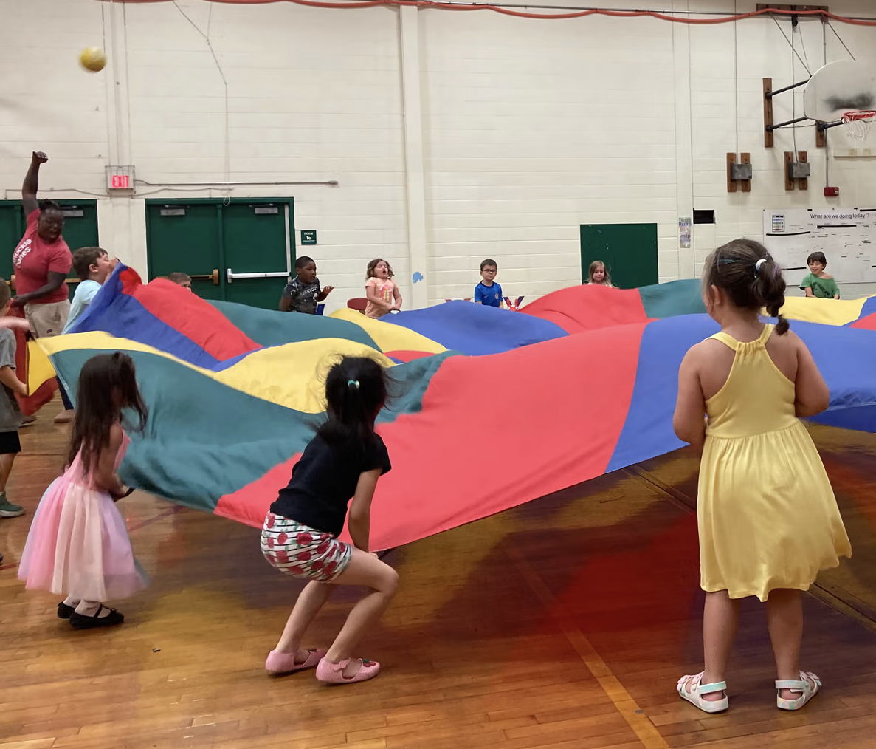

Office of Family and Community Advancement (OFCA)
Expanded Learning Opportunities (ELO)
Creating access to high-quality learning, enrichment, wellness, and opportunity outside traditional school hours.
Core Work and Responsibilities
1
Before & after school
2
5th Quarter Summer & Beyond
Coordinate programs that extend learning time and provide safe, engaging academic and enrichment supports.
Lead citywide summer opportunities combining academics, enrichment, career exposure, and joyful learning.
3
Acceleration Academies
4
Homeschooling & 21st Century
Support February and April break programming that keeps students connected, active, and learning.
Manage portfolios by aligning program models, strengthening implementation, and expanding equitable access for students and families
5
Family access & operations
6
Quality, data & improvement
Promote programs, support registration, coordinate communications, and connect families to help resources.
Use standards, curriculum resources, evaluation tools, and professional development to improve outcomes.
Source basis: BPS Expanded Learning Opportunities, 5th Quarter Summer & Beyond, BPS Summer Programming 2026, and 5th Quarter Portfolio pages.

Slide 10
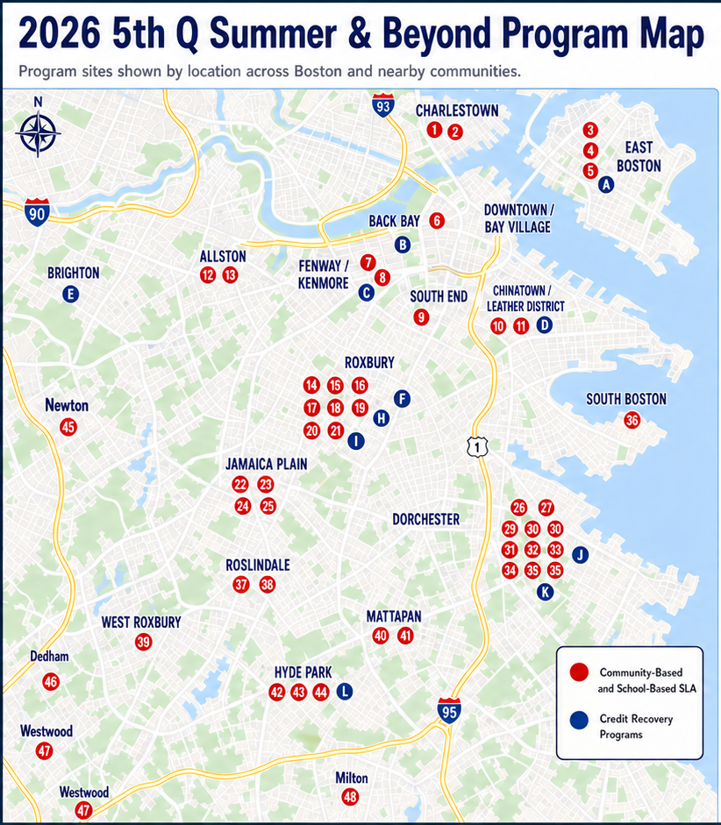
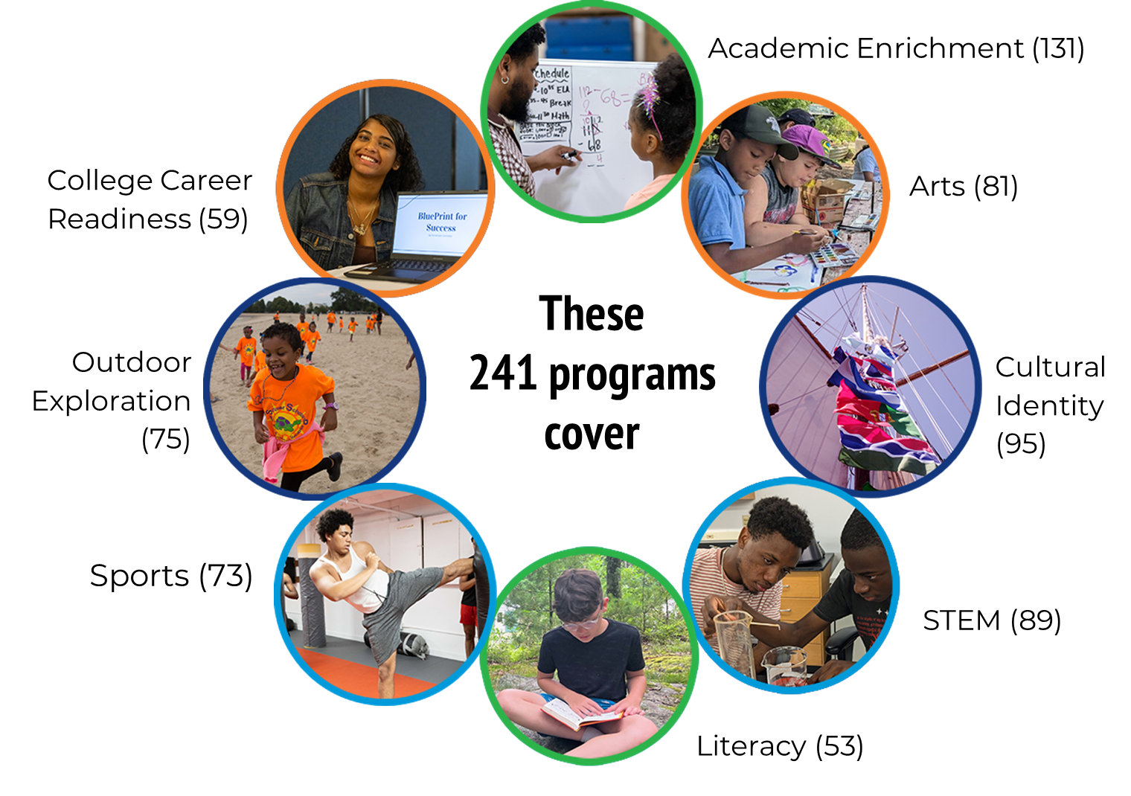
5th Quarter Programming

Slide 11

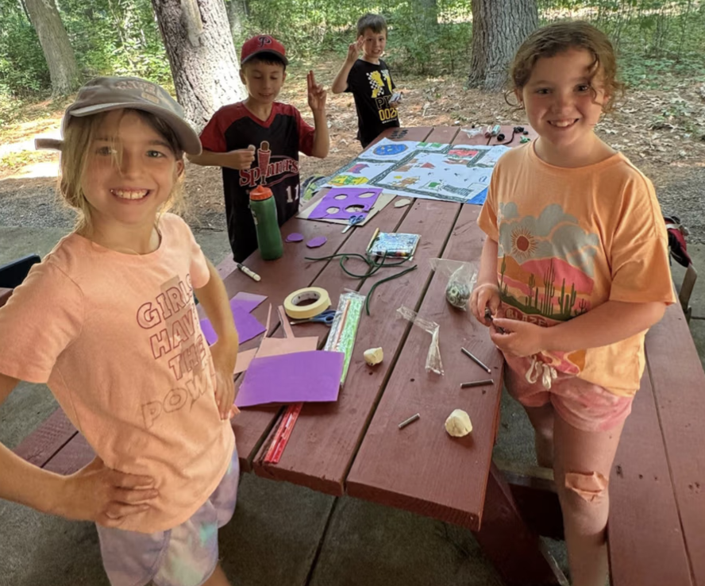
What the model delivers
Turning summer into an additional learning “quarter” for academic support, enrichment, and student engagement.
1
Extended learning time
Programs extend academic support, enrichment, and engagement beyond the traditional school year.
2
School/Community-based Partnerships
Schools, community-based organizations, and city partners deliver no-cost programming across Boston neighborhoods.
6,000+
SEATS
K–11 Summer Learning Academies
Literacy, STEM, school readiness, social-emotional development, and hands-on enrichment help students stay engaged, build skills, and reduce learning loss.
2,500+
SEATS
Credit Recovery | 47+ courses
Targeted pathways help students recover credits, stay on track for graduation, and attain MassCore completion.

Slide 12
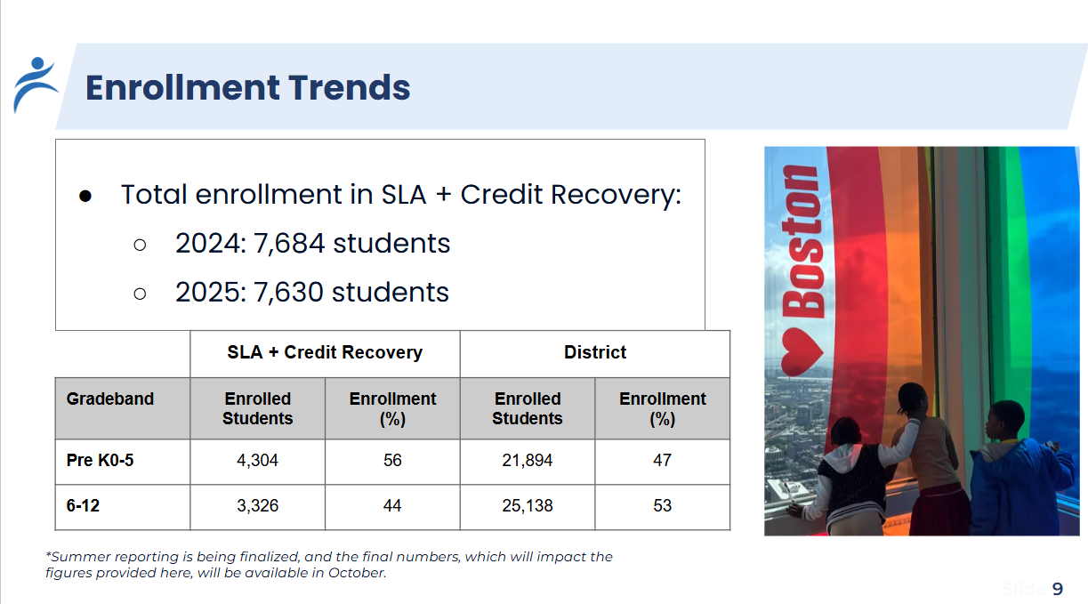
Setting the context
ODA has historically supported ELO with managing and reporting enrollment and attendance for 5th quarter and HSCR programs.

Slide 13
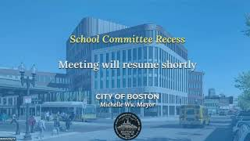
Setting the context
In the Fall 2025 School Committee meeting, we heard asks for better measurement of impacts.

Slide 14

Responding to the call: enabling factors
Districtwide use of NWEA MAP assessment across grades
Established data warehouse that stores diverse metrics
Team dedicated to organizational learning

Slide 15
How do you see your context reflected here?

Describe a time that a program or initiative in your district was called to provide stronger evidence of effectiveness?
To what extent were you able to respond?
What barriers did you have?

Slide 16
Report Out

Slide 17


Generating proof, supporting practice
lightbulb
insights
share
Commitment to quality evidence
How we approached the initial problem and defined our research methodology.
Key Learnings
What we learned through data analysis and our key takeaways.
Sharing Impact
Engagement and dissemination that ensures validity and promotes data literacy.
@HarvardSDP | #SDPconvening

Slide 18
Two studies with common throughlines
Summer Learning Academies
High School Credit Recovery
What is the academic impact of participation in Summer Learning Academy (SLA)?
How does this impact vary by grade, economic disadvantage (ED), or multilingual learner (ML) status?
Who are HSCR attendees and do their experiences vary by group?
How does attending HSCR impact subsequent year engagement?

Slide 19
Commitment to quality evidence
Both studies leveraged comparison groups to better understand program impacts
Summer Learning Academies
High School Credit Recovery
Value added model controlling for prior test scores and demographics
Comparing HSCR participants to eligible non-participants.

Slide 20
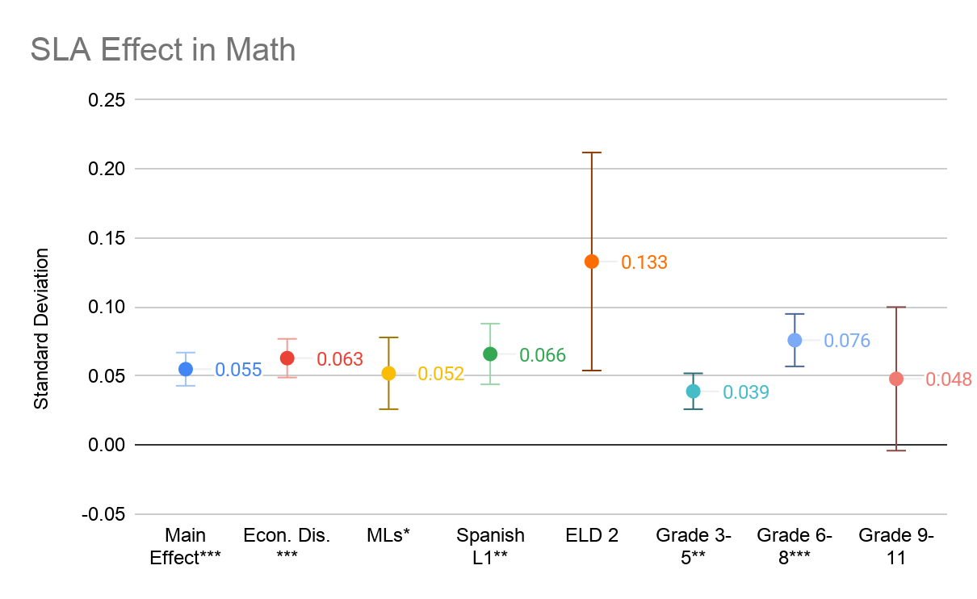
Key Learnings: SLA findings overview
Participation in SLA is associated with a significant, positive impact in math; this effect has little variation by student group.
Equivalent of 0.91 RIT points for a 4th grader
* = p< 0.05; ** = p < 0.01; *** = p < 0.001
Bars represent standard error

Slide 21
Key Learnings: SLA findings overview
functions
Mathematics Impact
Participating in SLA is associated with a positive, significant impact on student math scores across student groups.
menu_book
Reading Impact
Participating in SLA is associated with a positive, significant impact on reading scores for students who are multilingual learners.

Slide 22
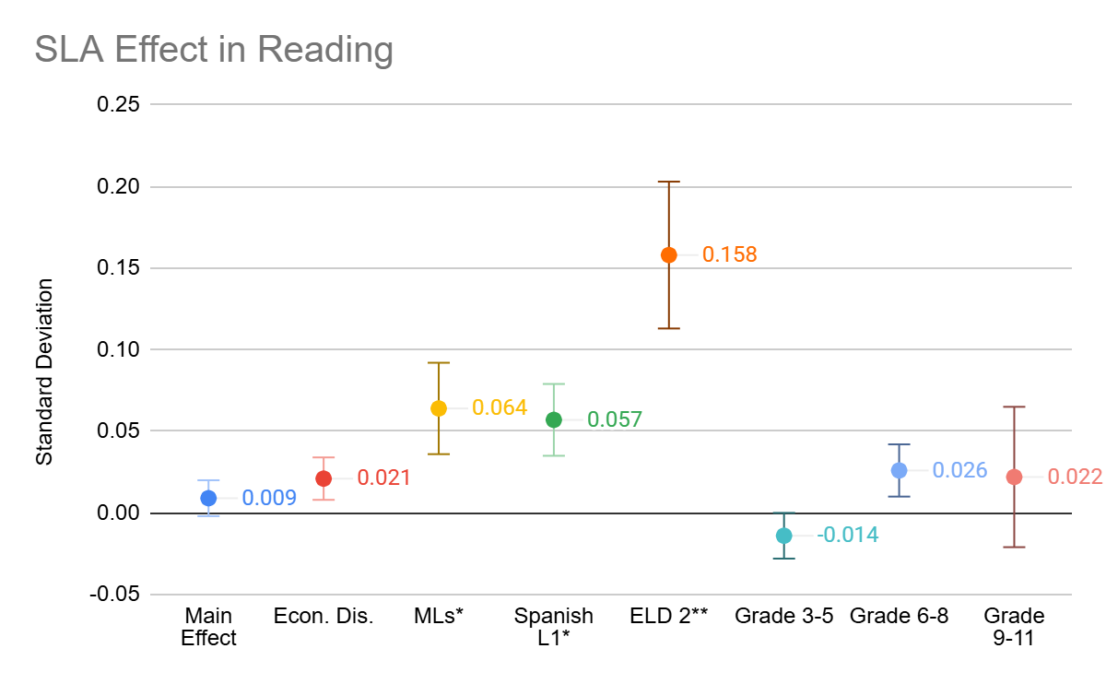
Key Learnings: SLA findings overview
No significant differences in reading scores attributed to SLA participation; however, this varies by student group.
Participation in SLA is associated with a large positive impact on reading scores for Multilingual Learners.
* = p< 0.05; ** = p < 0.01; *** = p < 0.001
Bars represent standard error

Slide 23
Key Learnings: HSCR findings overview
Participation in HSCR matters
Compounding equity gap
Program implementation
Students who attended HSCR showed much stronger fall engagement than eligible non-participants
Current EL students face challenges in both:
Access to programs
Success within programs
Credit attainment rates vary by program, even after accounting for student characteristics.

Slide 24
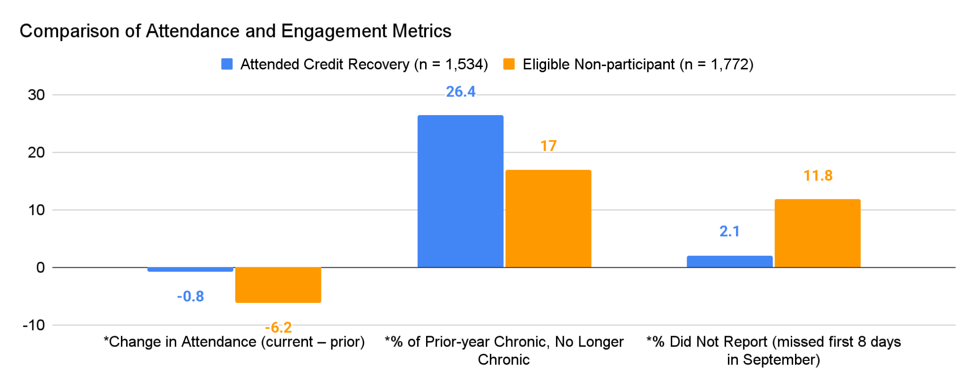
Compared to eligible non-participants, HSCR attendees showed:
A smaller attendance decline (SY2425–SY2526)
Improvement in chronic absence (among prior-year chronically absent)
Lower chance for DNR (Did-Not-Report)
Students who attend HSCR are more likely to stay engaged with school the subsequent year
*results significant at p<0.05

Slide 25
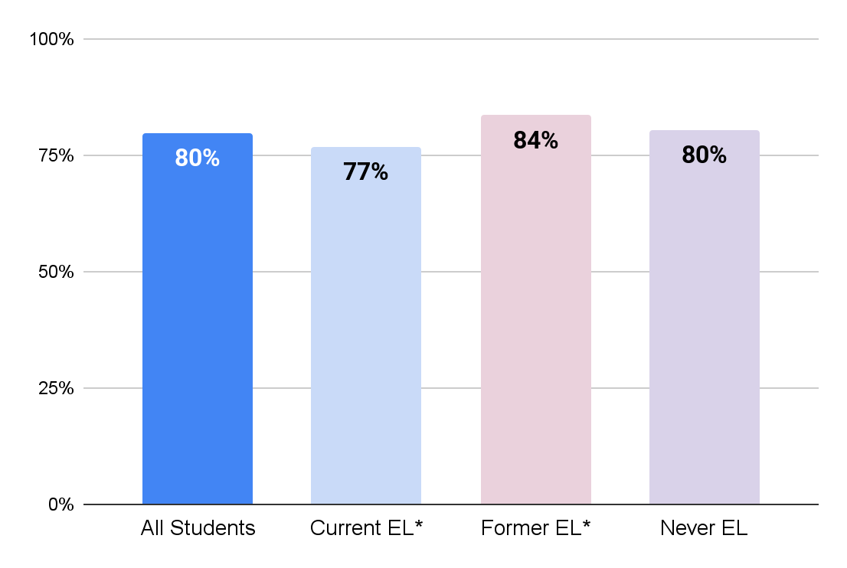
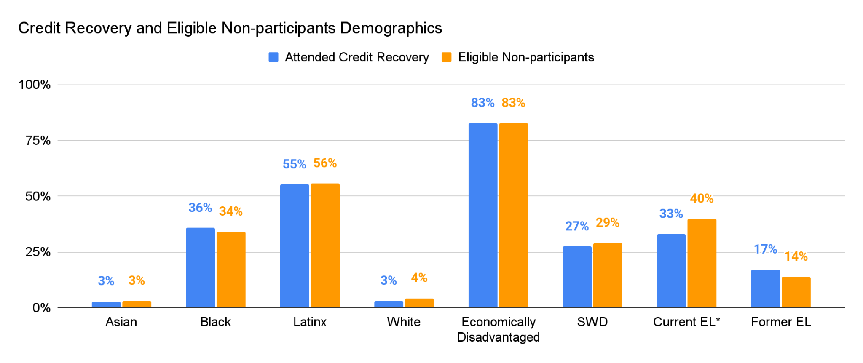
Eligible ELs are less likely to attend HSCR, suggesting barriers to participation
Current ELs are attaining credits at a lower rate, suggesting barriers to success.

Slide 26
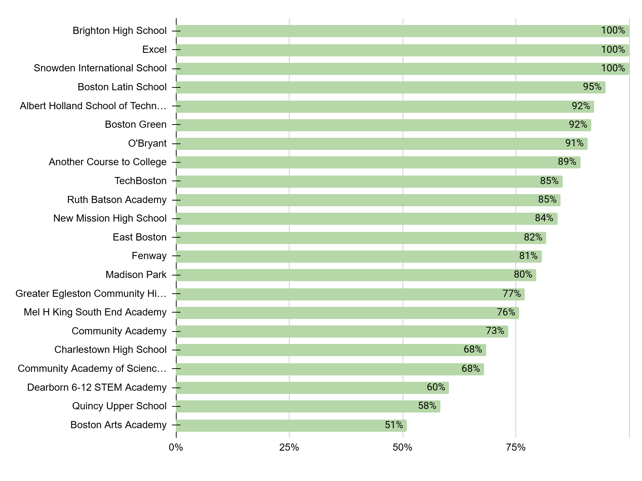
Passing Rates Vary Widely by Program
Variation in course pass rates by program raises questions about scalable best practices and areas in need of targeted support

Slide 27
In 8 programs, students had significantly higher or lower odds of passing their courses, independent of their own characteristics.
HSCR students at BLS were more than 4 times more likely to pass their course, and students at BAA were 80% less likely to pass than students at Madison Park (the average program)
Students had different likelihoods of achieving a successful outcome (passing a course) based on which program they attended.
Programs where students have higher odds of passing |  |  | Programs where students have lower odds of passing
Program | Odds Ratio |  | Program | Odds Ratio
Boston Latin School* | 4.14 |  | Community Academy of Science and Health* | 0.56
Albert Holland School of Technology* | 2.97 |  | Charlestown High School* | 0.53
Boston Green | 2.49 |  | Dearborn 6-12 STEM Academy* | 0.37
O'Bryant* | 2.29 |  | Quincy Upper School* | 0.28
TechBoston | 1.49 |  | Boston Arts Academy* | 0.20
*results significant at p<0.05

Slide 28
From evidence to practice: what would you have done with these findings?


Slide 29
Sharing impact
Focus on building data literacy
Peer review of results
Centering programmatic recommendations

Slide 30



Sharing impact: Building data literacy
Comparing of averages
Just analyzing averages compares two distinctly different groups (like apples and oranges).
To identify the impact of SLA participation, we need to use other methods to create two groups that are as similar as possible (apples and apples) except for participation in SLA.
SLA participants
All non-participants
Identifying impact of SLA treatment
SLA participants
Matched non-participants
SLA

Slide 31
Sharing impact: Building data literacy
Why compare HSCR attendees to eligible non-participants?
HSCR attendees are different from the average BPS student. To test whether HSCR is associated with next-year engagement and to explore patterns in participation, we need to compare them to a group of like-students.
Both groups needed credit recovery. Comparing them shows who accesses HSCR and how outcomes differ for students who did vs did not participate.

Slide 32
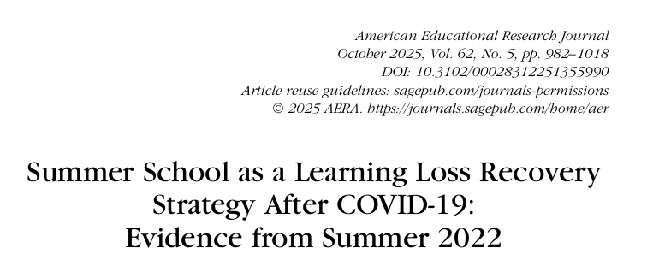
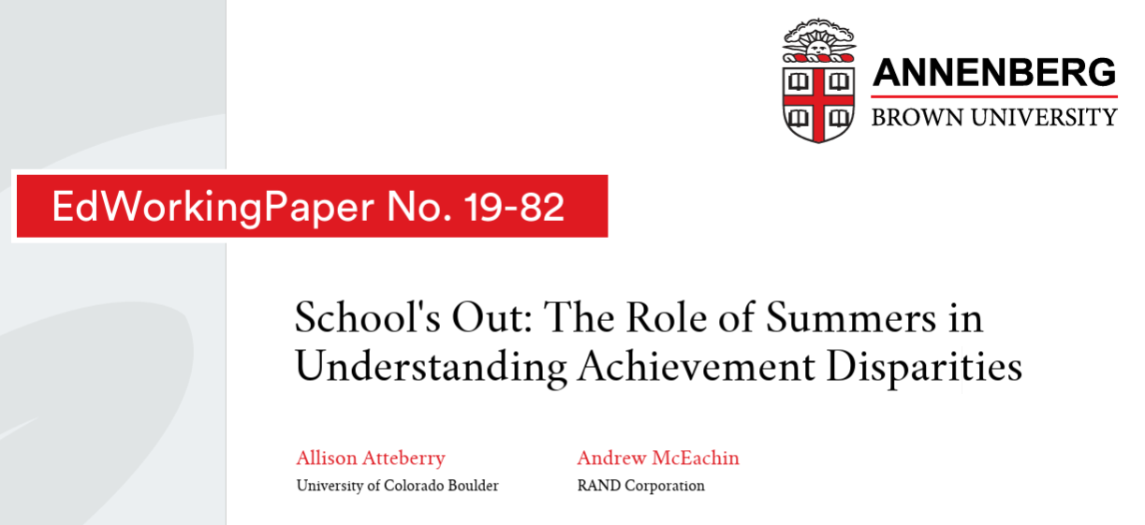
Sharing impact: Peer review of results
Consulted with the research team at NWEA to check results.
Revised model to align with their published approach.
Slowed down timeline for public sharing - may have come at a cost for programmatic decision-making.

Slide 33
Sharing impact: Centering recommendations
BPS should continue to provide SLA (BPS and non-BPS programming), particularly for multilingual learners and economically disadvantaged students
Multilingual learners and economically disadvantaged students should be specifically targeted in recruitment for SLA
BPS and BASB should share findings with SLA teachers and families to show gains from their Summer 2025 efforts
ELO should investigate the mechanisms that produce outsized impacts for MLs, such that best practices can be scaled.

Slide 34
Sharing impact: Centering recommendations
HSCR should prioritize closing the access and success gap for Current EL students - from enrollment to classroom supports.
BPS should work to understand variation in program-level course pass rates with the goal of scaling promising practices/programs, providing targeted supports, and informing resource allocation.
BPS should treat HSCR as an engagement strategy and work towards understanding the relationship between HSCR and next-year engagement.

Slide 35
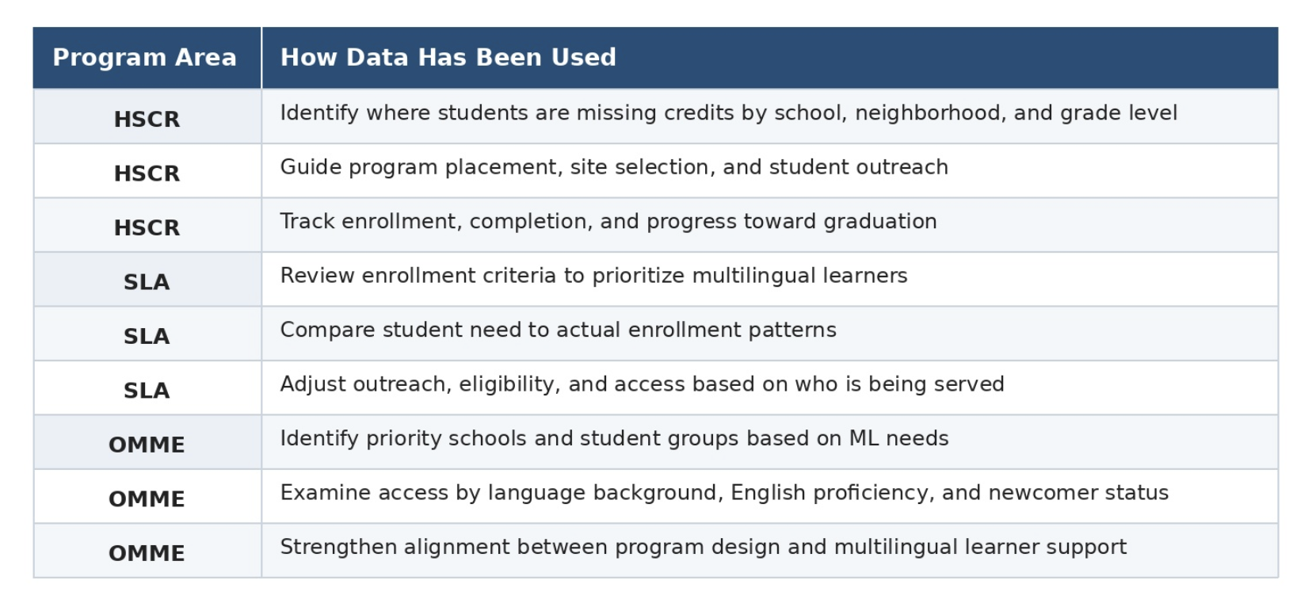
How were data used?

Slide 36
How we could have done it differently
Vetting was critical - but slowed down reporting and maybe compromised timeline for decision-making.
Stopped short of the full picture - eg: what explains the variation in credit attainment rate
Didn’t collect the kinds of data that ELO really need for decision-making (program-level)

Slide 37
Exploring Tensions
Most robust analysis we could do - and yet maybe this is not exactly most actionable data.
Could empower advocacy for the program broadly, but not motivate program-by-program funding choices
  SLA - not responsible (n sizes)
  HSCR - not clear what they desired

Slide 38
How are you balancing rigor and actionability?


Slide 39
Report Out

Slide 40
Where are we going next - research-wise?
Making this kind of impact reporting routine.
Deeper exploration of effects for ELs, though particular methods are
Novel questions: longitudinal impacts.
Implementation

Slide 41
Looking ahead, what new opportunities does this research partnership open up for ELO?
Confirm summer program impact on student achievement and social-emotional outcomes;
Identify which models drive the strongest results;
Understand which students benefit most and where gaps remain;
Examine equity of access across schools, neighborhoods, and student groups;
Use data to improve program design, quality, and resource decisions;
Strengthen evidence base for district leaders, families and students.

Slide 42

Thank You

