Slide 1
Monkey SEA, Monkey Do: Identifying Challenges and Practices for Accountability, Assessment, and Reporting in SEAs
Sadeq Sohrabie & Jeremy Simon, MA Department of Elementary and Secondary Education

Slide 2
Introductions
Name
Organization
Role
What have you heard at Convening that you’ll be thinking about/bringing back to your department?


Slide 3
Identifying Challenges (10 min)
Please write any challenges you’re facing on the easel pads around the room
Pads are organized by functional area

Slide 4
Identifying Challenges…and Solutions (10 min)
Please write any challenges you’re facing on the easel pads around the room
Pads are organized by functional area
Please use Post-it notes to add “solutions” to others’ challenges

Slide 5
Small Group Conversation (25 min)
Which processes in your department work well? Which don't?
If you had the time, what would your department be doing?
Why don't you have the time? (What are you doing instead?)
What's a workaround or "hack" you rely on that you think others might benefit from?
Where would you benefit from working with other states?


Slide 6
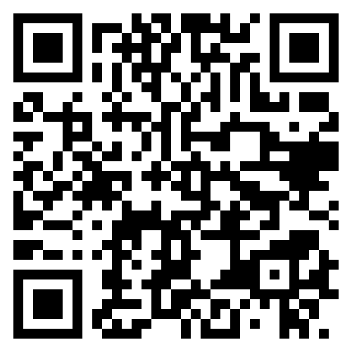
Thank You
↑ Use this exit ticket to share your contact info!
Sadeq.Sohrabie@mass.gov
Jeremy.Simon@mass.gov

Slide 7

Thank You

