Slide 1
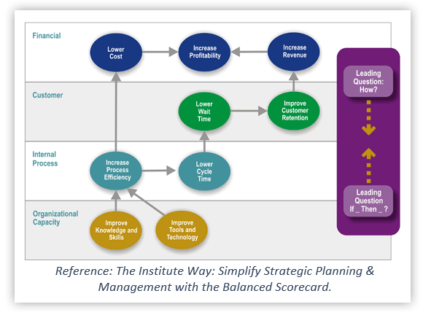
For-Profit Strategy Map Example:
Technology Service Company
Source: Balanced Scorecard Institute

Slide 2
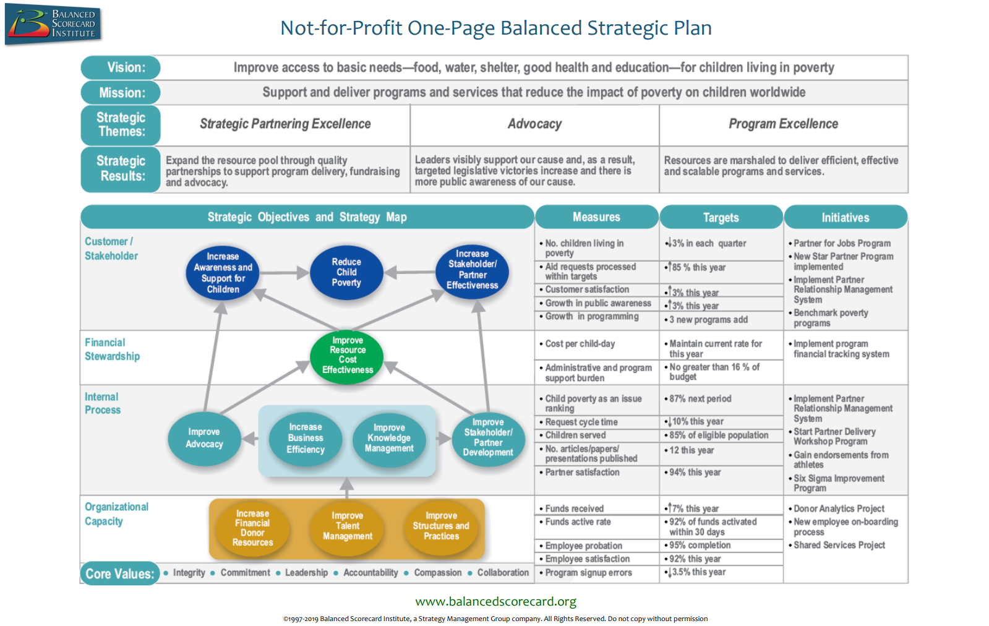
Notes:
https://balancedscorecard.org/wp-content/uploads/2022/02/11x17-Not-for-Profit-One-Page-Scorecard-Graphic-2.pdf

Slide 3
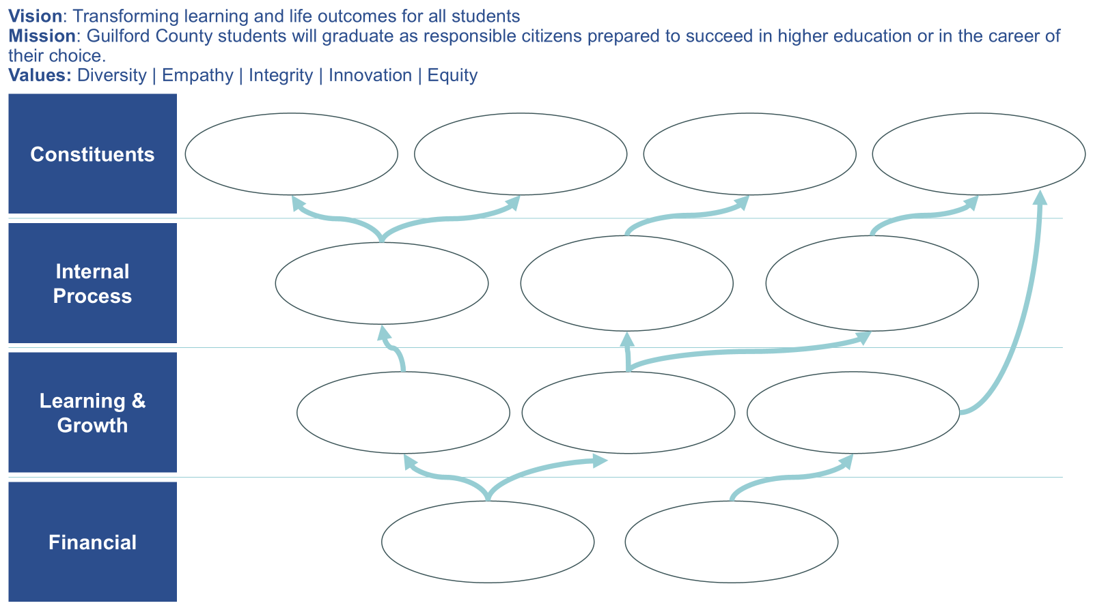
Draft a Strategy Map
Use the template to reflect your organization’s strategy
Capture the most important (~12 – 18) objectives across perspectives
Consider how elements of your organization’s strategic direction show up
Draw arrows to illustrate cause and effect
Example of a draft GCS Strategy Map (excluding text)

Slide 4
Vision: Transforming learning and life outcomes for all students Mission: Guilford County students will graduate as responsible citizens prepared to succeed in higher education or in the career of their choice. Values: Diversity | Empathy | Integrity | Innovation | Equity
Constituents
How do we get our constituents to perceive our product, services, and brand in the desired way?
How do we deliver what is important to our constituents?
Internal Process
What do we need to do well internally to meet constituents’ needs?
Learning & Growth
What skills, culture, and capabilities do we need to have in order to execute our internal processes?
Financial
How do we provide resources that fuel our learning and growth? How do we support and utilize human capital and infrastructure resources to meet goals?
Notes:
GCS example and guiding questions

Slide 5
Vision: Mission: Values:
Constituents
Internal Process
Learning & Growth
Financial
Notes:
Use shapes and arrows to connect key objectives across the strategy map perspectives. Plug in your organization’s vision, mission, and values at the top.

