Slide 1
New tools for working across education datasets for interoperability at scale
Part 2: Generative AI data mapping experiments for the Learner Information Framework
CONFIDENTIAL

Slide 2

Who We Are
DataKind® is tackling the world's toughest challenges with data science and AI.
CONFIDENTIAL

Slide 3
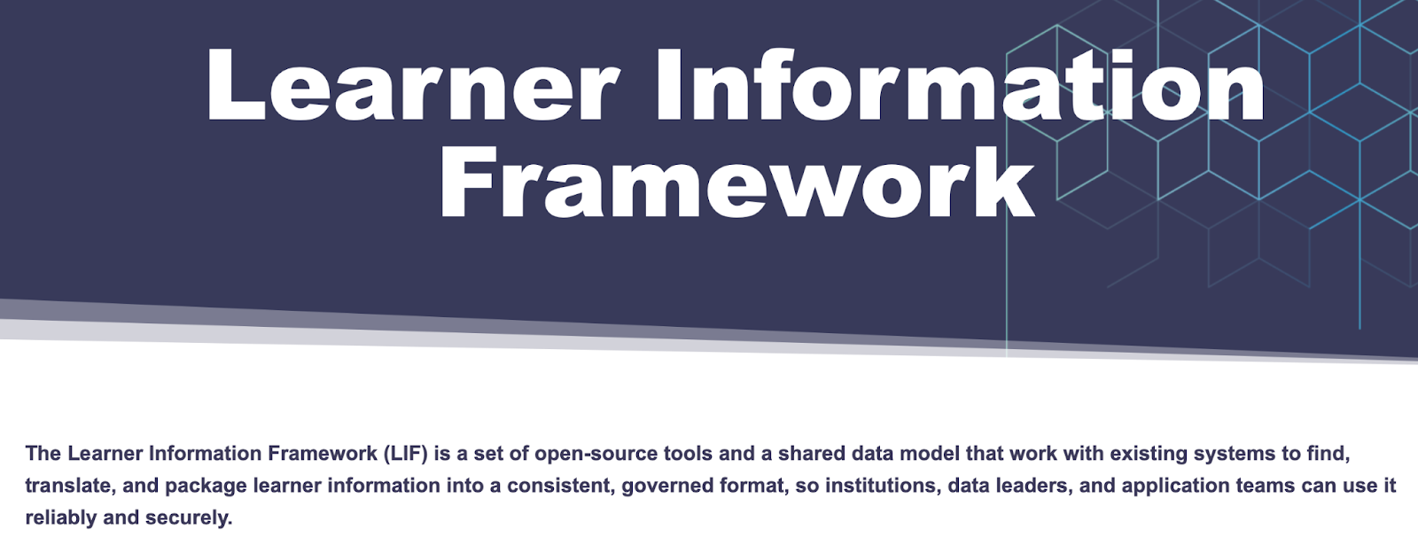
CONFIDENTIAL

Slide 4

Why Data Mapping Matters
Find, translate, and package learner information
A consistent, governed format
CONFIDENTIAL

Slide 5

What We Asked
How accurate is data mapping performed via natural language processing compared to generative AI?
Do larger, more expensive generative AI models meaningfully outperform smaller, cheaper ones?
How do accuracy and cost compare between batch mode and a field-by-field approach?
CONFIDENTIAL

Slide 6
What We Did: Model Tiers
We tested 12 methods across three tiers of sophistication to find the best approach for mapping institutional data to the LIF standard.
Tier 1 — Traditional natural language processing (4 methods): Text-matching tools that compare field names and descriptions without understanding meaning
Tier 2 — Small AI (5 methods): Compact language models that reason about semantics and follow instructions
Tier 3 — Large AI (3 methods): Frontier language models with the strongest reasoning capabilities
CONFIDENTIAL

Slide 7
What We Did: Data Schemas Used
Two source schemas with 140 fields:
The Postsecondary Data Partnership (PDP) schema by the National Student Clearinghouse
The Credential Transparency Description Language (CTDL) by Credential Engine
One target schema with 521 fields: the Learner Information Framework (LIF)
Human-validated mappings created for experimentation for acceptable matches between source and target
Solving the needle-in-haystack challenge for each source field
Either correctly determine that no valid target field exists
Or select the correct target field from 521 options (0.2% correct by chance)
CONFIDENTIAL

Slide 8
Schema Examples
PDP
number_of_credits_earned_year_1: Total number of academic credits a student earned during their first year of enrollment
certificate_endorsing_industry: Industry associated with the certificate or endorsed curriculum program
21% with valid mappings vs. 79% with no match
CTDL
AssessmentProfile.industryType: Type of industry; select from an existing enumeration of such types such as the SIC, NAICS, and ISIC classifications
Course.offerFrequencyType: Type of frequency at which a resource is offered; select from an existing enumeration of such types
51% with valid mappings vs. 49% with no match
CONFIDENTIAL

Slide 9
What We Did: Experimental Approach
When people say they “experimented with AI”, they generally mean they tried out many different prompts, models, and inputs and cannot determine which combination led to the desired result.
This experiment enforced strict variable isolation:
When comparing models, prompts remained identical
When comparing prompting strategies, models remained fixed
All parameters (temperature, token limits, prompt versions) were frozen before execution
Every run was logged with complete inputs and outputs
CONFIDENTIAL

Slide 10
What We Did: Metrics
Precision: When the AI proposes a mapping, how often is it correct?
Precision=Correct proposals /Total proposals
Why precision matters: Wrong mappings that look plausible can slip through human review and cause data errors downstream. We want to minimize these false positives.
Recall: Of all the real mappings that exist, how many did the AI find?
Recall = Correct mappings found/Total real mappings
Why recall matters: Missed mappings mean data doesn’t transfer correctly between systems. However, missed mappings are usually obvious (a field with no mapping gets flagged for human review), so they’re less dangerous than wrong mappings.
F0.5: A combined score that weights precision more heavily than recall.
The harmonic mean of precision and recall that gives 2x the weight to precision.
Why F0.5: Since we believe wrong mappings (precision failures) are more costly than missed mappings (recall failures), we use F0.5 which weights precision twice as heavily.
CONFIDENTIAL
Notes:
Precision: A precision of 70% means: of every 10 mappings the AI proposes, 7 are correct and 3 are wrong.
Recall: A recall of 80% means: if there are 30 real mappings, the AI found 24 and missed 6.
F0.5: F0.5=1.25* (Precision * Recall) / (0.25*Precision+Recall)

Slide 11
Pair Share: Your Guesses
How accurate is data mapping performed via natural language processing compared to generative AI?
Do larger, more expensive generative AI models meaningfully outperform smaller, cheaper ones?
How do accuracy and cost compare between batch mode and a field-by-field approach?
CONFIDENTIAL

Slide 12
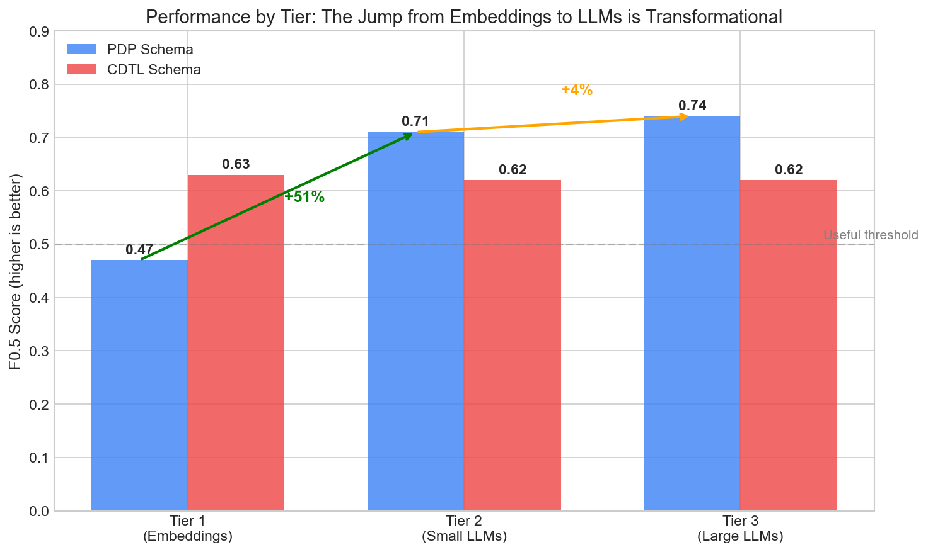
Results
CONFIDENTIAL

Slide 13
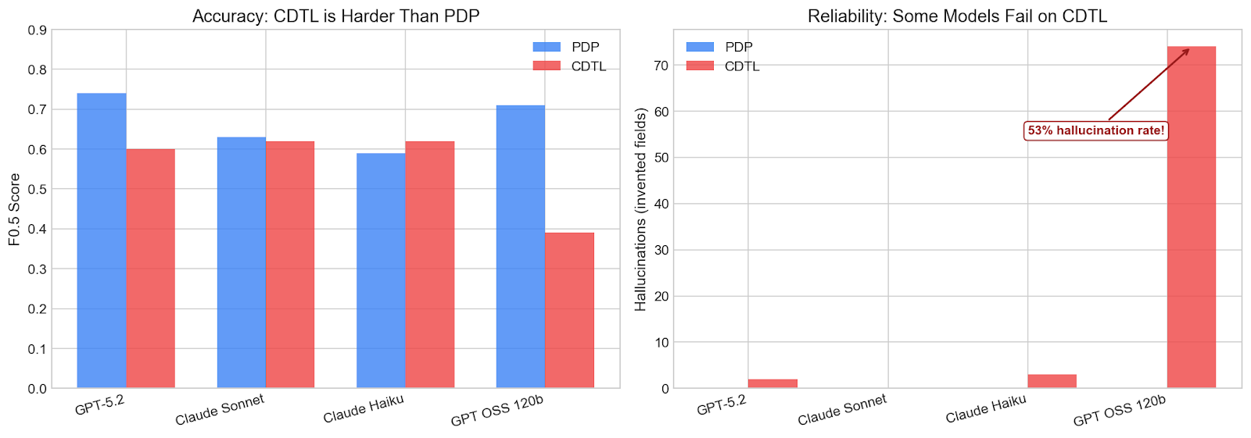
Results
Schema-Specific Findings
CTDL proved notably harder than PDP.
Higher stakes: There are more mappings to find but also more opportunities for false positives.
Vocabulary overlap: CTDL uses terms like “Competency,” “Credential,” “Assessment,” and “Course” extensively. These same terms appear throughout the LIF target schema. The AI finds many “close matches” that aren’t quite right.
Accuracy: PDP vs. CTDL (Batch Mode)
Hallucinations: PDP vs. CTDL (Batch Mode)
Characteristic | PDP | CDTL
Best F0.5 | 0.74 | 0.62
Best Precision | 71% | 60%
Average Hallucinations | 1.5 per run | 24 per run
CTDL Field | AI Proposed | Why It’s Wrong
Credential.audienceLevelType | Credential.level | “type of level” ≠ “level”
Course.audienceLevelType | Course.courseLevelType | Same semantic confusion
IdentifierValue.identifier | Person.Identifier.identifier | Nothing indicates “person”
CONFIDENTIAL

Slide 14
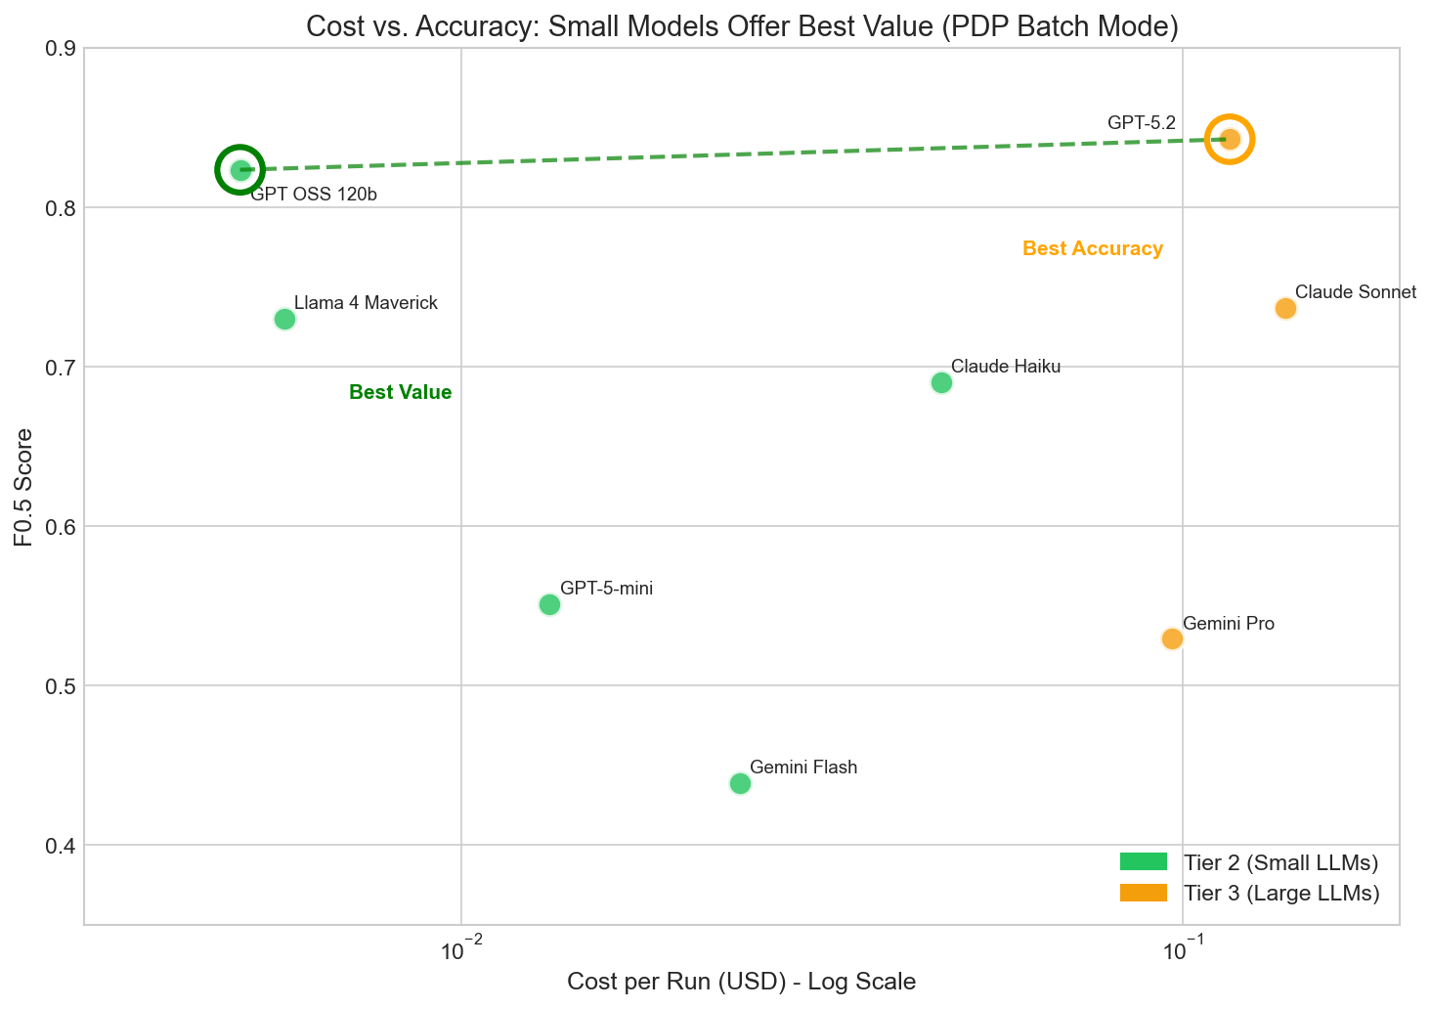
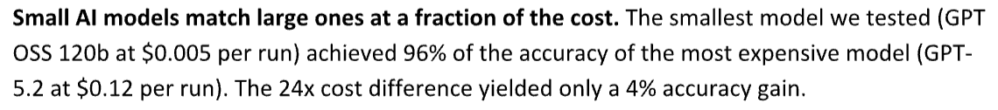
Results
CONFIDENTIAL

Slide 15
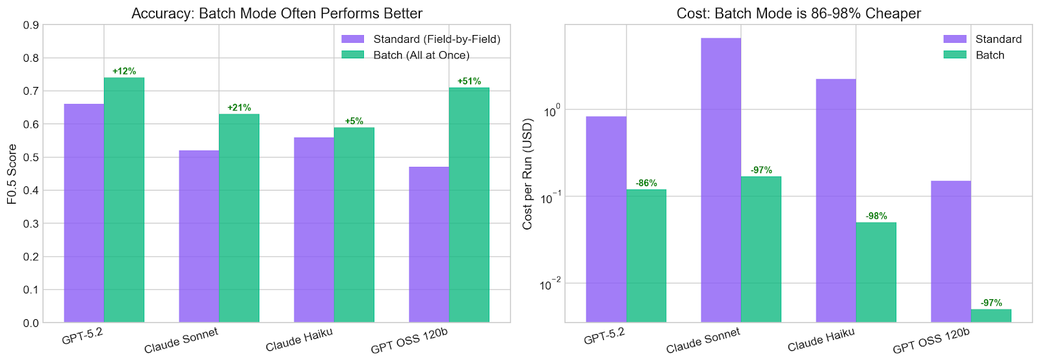
Results: Batch vs. Field-by-field
Theory for Why Batch Mode Works Better
Context awareness: When the AI encounters all fields together, it can maintain consistency. If it maps first_name to Person.Name.firstName, it’s more likely to correctly map last_name to Person.Name.lastName rather than proposing an inconsistent target.
Global reasoning: The AI can recognize patterns across fields, such as address components that should all map to the same parent entity.
Reduced prompt overhead: In field-by-field mode, the full LIF schema (521 fields) is sent with every request. In batch mode, it’s sent once.
Note: Visualization is for PDP → LIF.
All shown models demonstrated higher accuracy in batch mode for CTDL → LIF except GPT OSS 120b.
CONFIDENTIAL

Slide 16
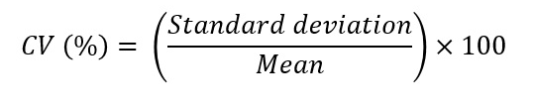
Bonus Research Question
Q: Are the results presented representative of the large language models used?
A: Yes. We reran the same task on the models six additional times and found little variability, as measured by the coefficient of variation (CV):
CVs ranged from 0 to <5% across the precision and recall.
The model was uncertain about the same borderline "no match" cases across runs, suggesting that the uncertainty exists for fields near the decision boundary.

Slide 17
Findings to Action
If using a source schema with more expected matches and a similar vocabulary as the target schema, expect to spend more time reviewing the mapping.
For cost efficiency without sacrificing (much) accuracy, use smaller generative AI models.
For cost efficiency and accuracy, run calls to AI in batch mode (not field-by-field processing).

Slide 18
Why I Love This Study
The cost-efficient models and batch mode mean:
Saving money so that non-profits like DataKind can offer more services.
Being kinder to the planet.
Having concrete recommendations from evidence means:
Using generative AI when it is most likely to help.
Avoiding AI use when it is likely to really mess things up.
I can do less of this:

Slide 19

Questions

Slide 20
5 Minute Stretch Break
Feel free to turn off your video

Slide 21

Thank You

Slide 22
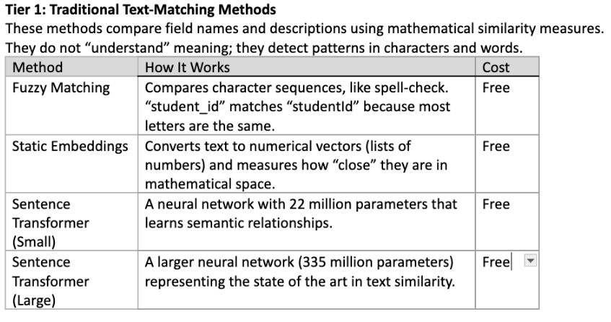
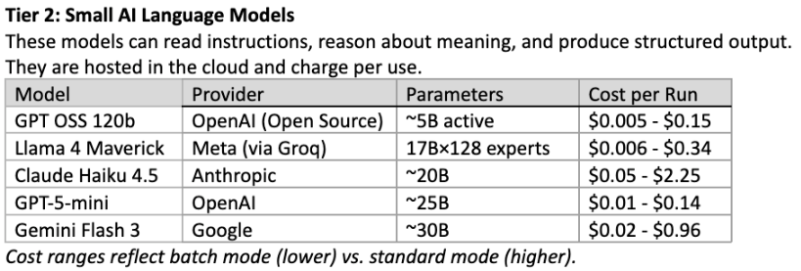
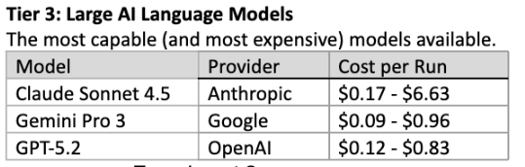
Appendix: Models Used

Slide 23
Appendix: Prompt Used (programmatic call)
# =============================================================================
# Batch Mapping Prompts (all fields in one call)
# =============================================================================
BATCH_PROMPT_VERSION = "v1.0-batch”
BATCH_MAX_TOKENS = 16000 # ~113 tokens per field for 141 fields BATCH_SYSTEM_PROMPT = """You are a data schema mapping expert. Map source fields to target schema fields with precision."""
BATCH_USER_PROMPT_TEMPLATE = """Map ALL source fields to the target schema in a single response. SOURCE SCHEMA: {source_schema_name}
TARGET SCHEMA: Learner Information Framework (LIF)
TARGET SCHEMA FIELDS: {target_field_list}
SOURCE FIELDS TO MAP ({field_count} fields): {all_source_fields}
For EACH source field, identify the best matching target field(s).
Respond with JSON containing all {field_count} mappings:
{{
"mappings": [
{{"source": "<field_name>", "target": "<LIF.Path.field>", "type": "<CLEAN_MATCH|SPLIT|NO_MATCH>", "transform": <true|false>}},
...
]
}}
Rules:
- target: Use exact field name from TARGET SCHEMA FIELDS, or "NO_MATCH"
- For SPLIT mappings (one source to multiple targets): target should be an array ["field1", "field2"]
- type: CLEAN_MATCH (1:1 mapping), SPLIT (1:many), NO_MATCH (no valid target)
- transform: true if data transformation needed (format conversion, enum mapping, etc.)
- Include ALL {field_count} source fields in output - do not skip any
- Output ONLY valid JSON, no additional text

