Slide 1
From Roadmap to Reality
Refreshing Strategy through Data and Dialogue
Notes:
Session Total: 75 minutes
Section Total: 8 min
Tiffany
<1 min
Welcome! Thank you all for joining us today. My name is Tiffany Perkins and I am the Executive Director of Strategic Planning at Guilford County Schools. I am co-presenting with my colleague Erin Philip who is our Director of Strategic Planning and Special Projects. We’re excited to share with you about our processes and learnings about using data and dialogue to support our strategic direction.

Slide 2
Key Objectives
Share ideas for monitoring strategic direction progress
Explore how structured feedback loops can foster trust
Learn about tools to support alignment, focus, and a holistic view of organizational health
Notes:
Tiffany
<1 min
Our objectives for today’s session are to (read slide).

Slide 3
Coherence and Strategy
To what extent does/is….
the organization clearly articulate its strategy?
the strategy understood by most people?
the strategy guiding day-to-day decisions?
the organization monitor progress in a meaningful way?
Notes:
Tiffany
3 min
We’d like you to take a moment and ask you to think about your current district or organization’s reality with coherence and strategy.
On a scale of 1-5, with 5 being to the fullest extent possible, raise your hand with the number that best describes current reality for each of the following:
Click
The strategy is clearly articulated.
Click
Now, what number best describes the extent to which you believe
Most people understand it.
Click
To what extent does it
Consistently guides day‑to‑day decisions.
Click
And, finally, to what extent can you
Monitor progress in a meaningful way.
Comment on drop off of hands and/or those we need to learn from if they kept their hands raised
The gap between having a strategic plan and having coherence – where everyone across the organization knows what we’re doing, and why, AND buys in to it – is what today’s session is about.

Slide 4
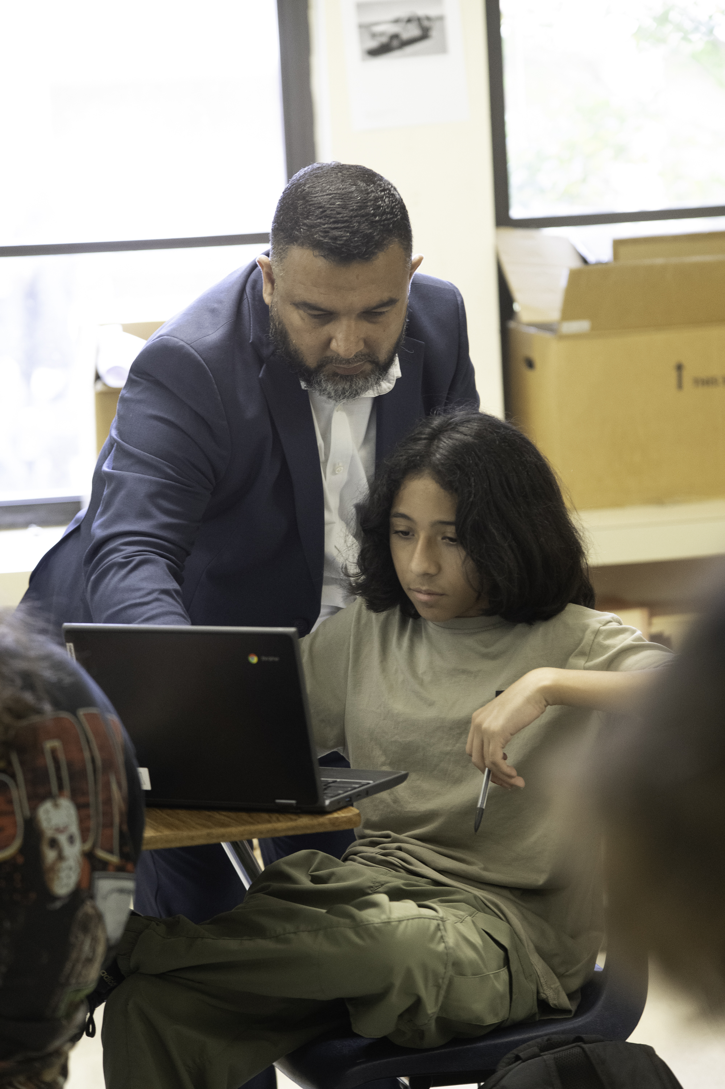




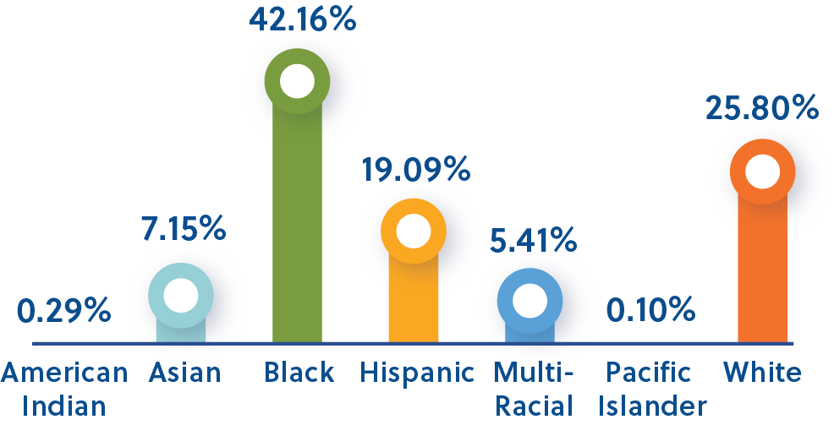

GCS by the Numbers
Students
92.1%
Nearly
43.7%
121
67K
Pre-K-12 Students
Graduation
Rate
Student Poverty Rate
Languages/Dialects Spoken
12K
10K+
Advanced Learners
Special Education Learners
2
Notes:
Tiffany
<1 min
Before we dive in, we want to share a bit of background about our district. GCS is the 3rd largest school district in North Carolina. We have nearly 67,000 students and 121 schools. Being a large district, you can imagine that setting a strategic direction that steers such a large ship and is understood by everyone is complex work.

Slide 5
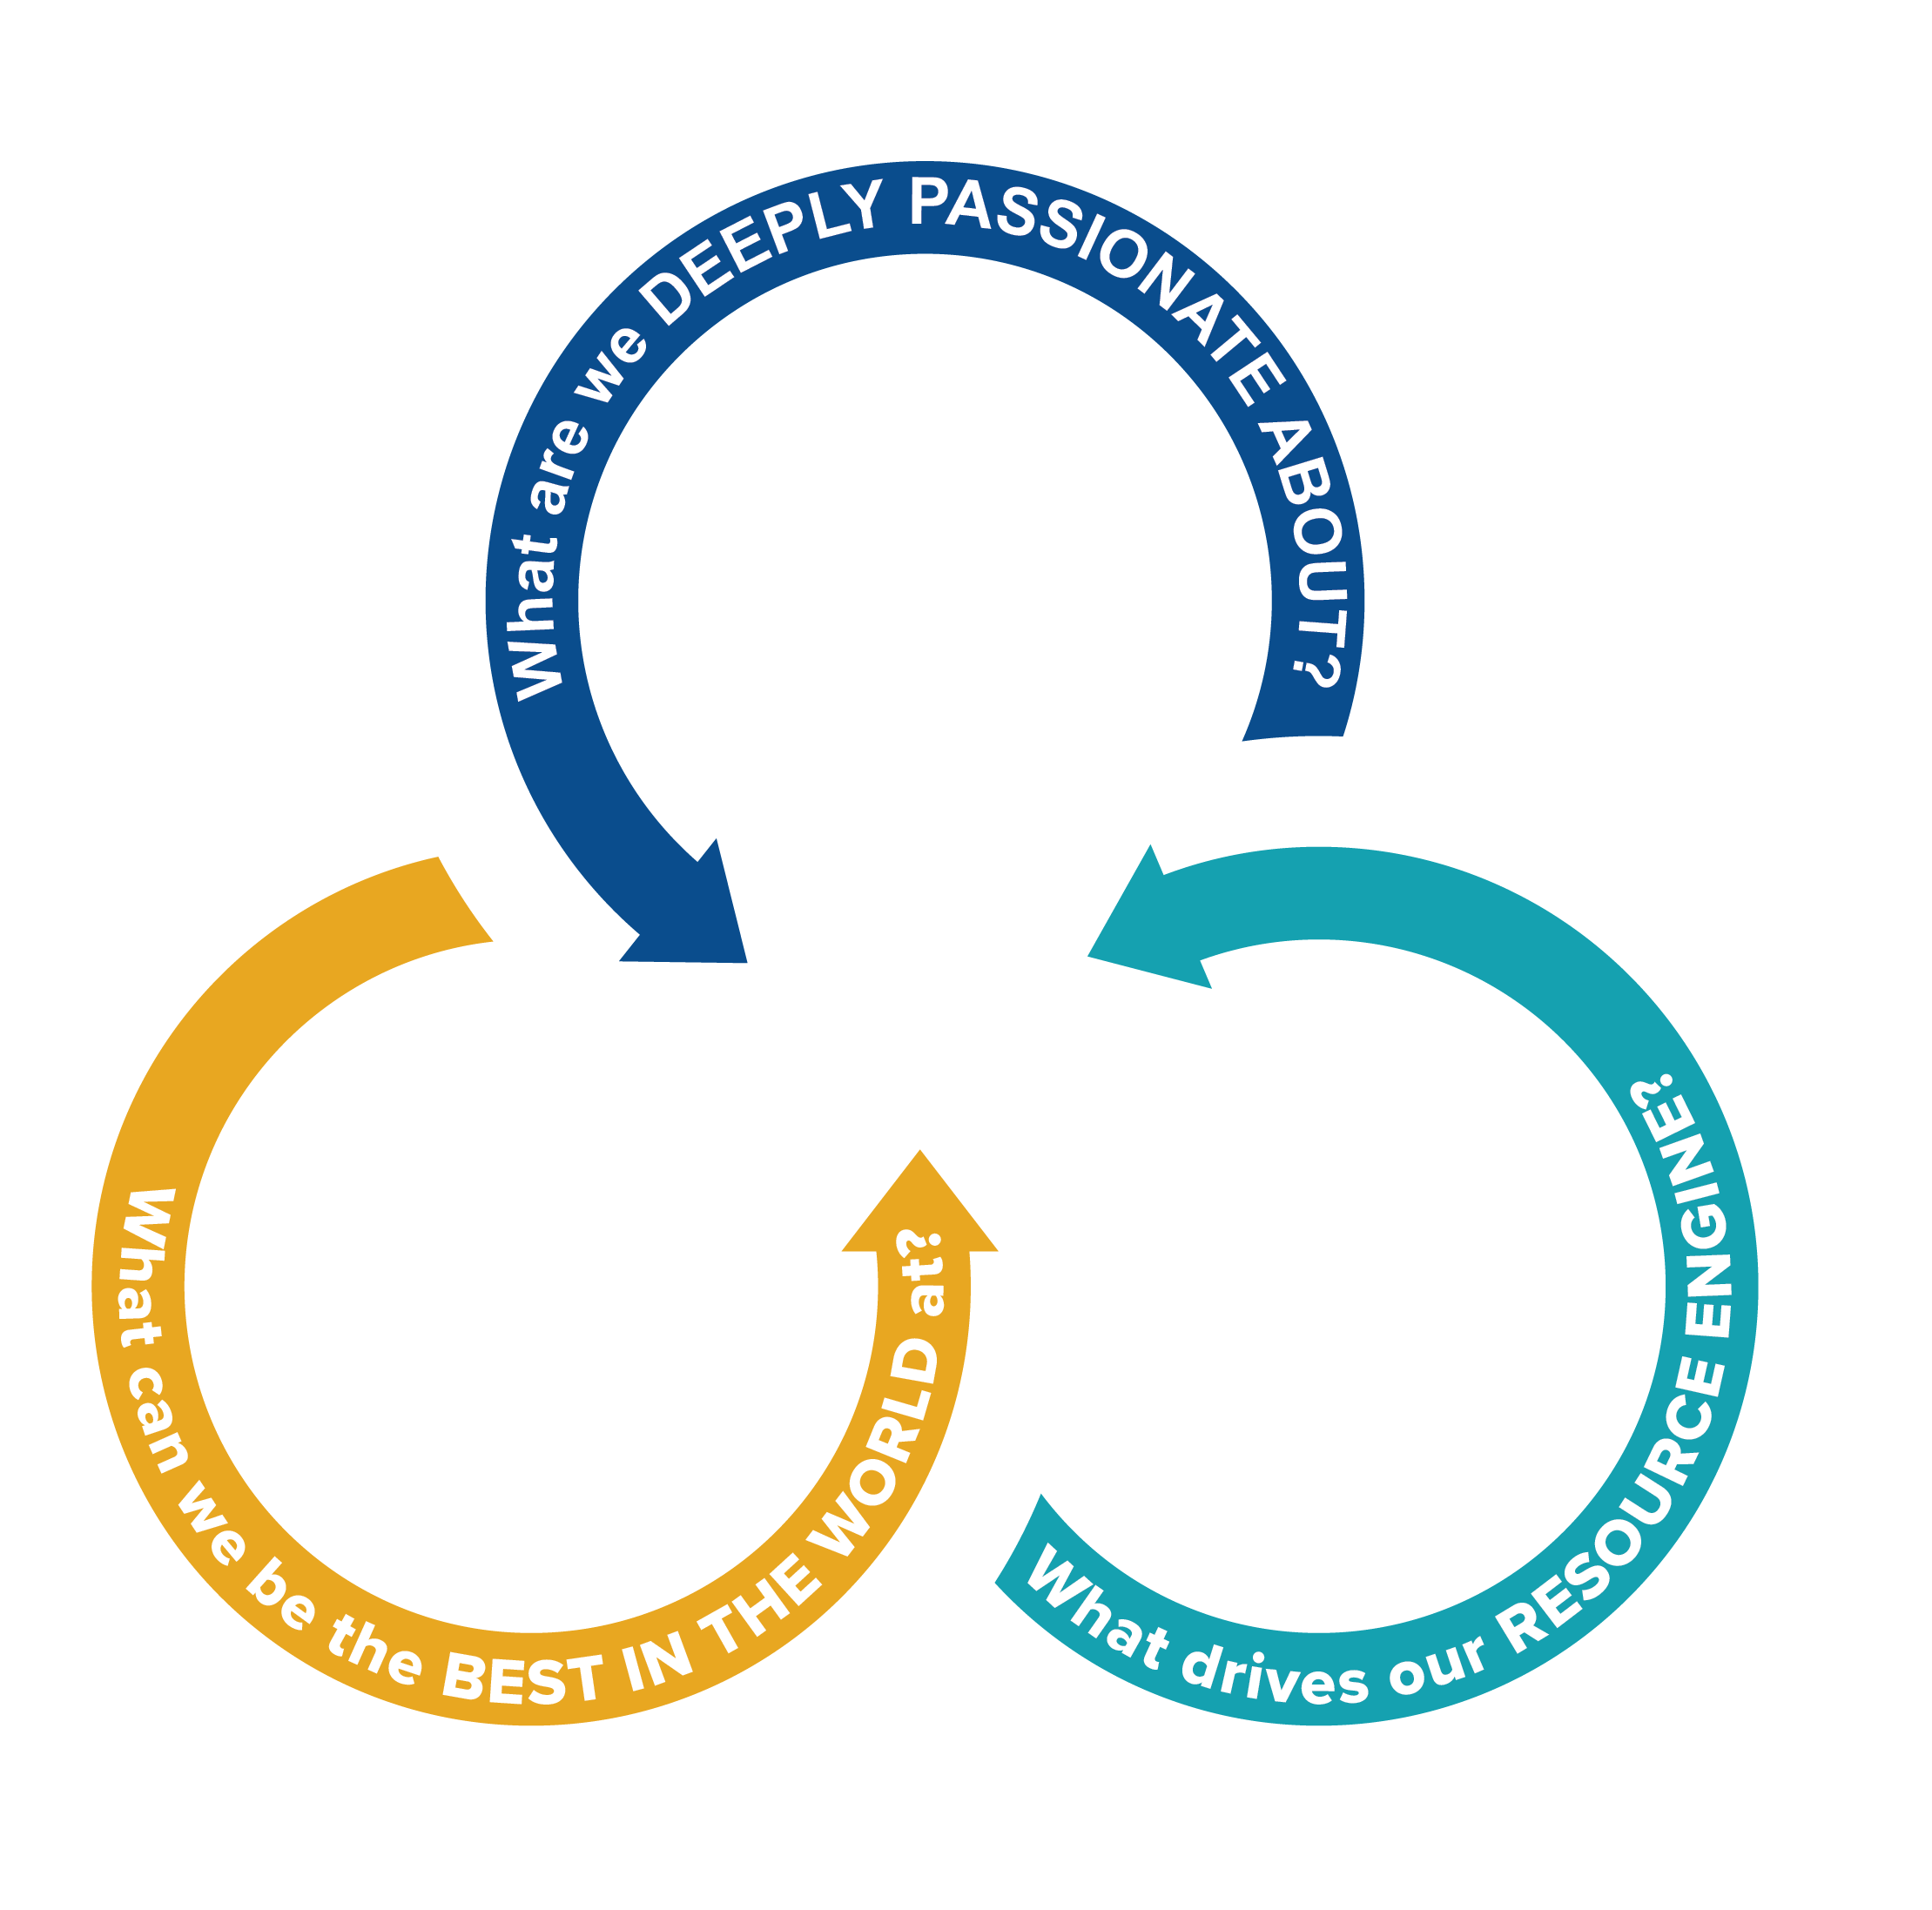


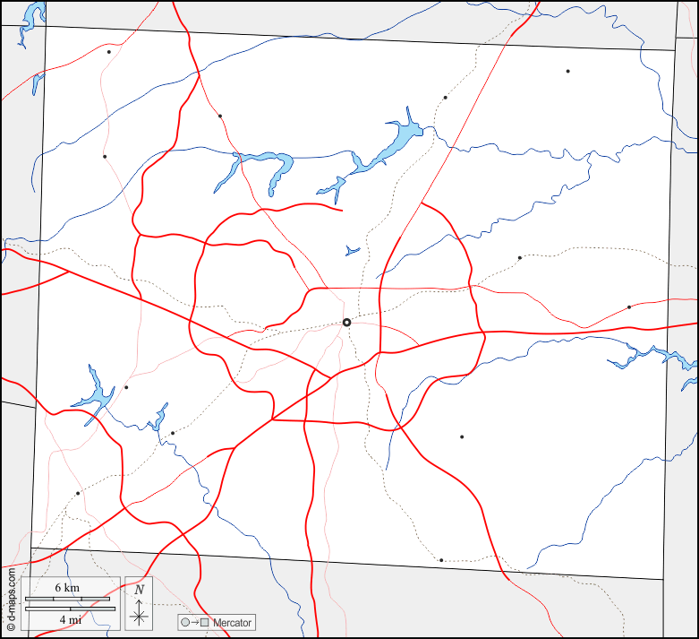
Evolution of GCS Strategic Direction
Fall 2022-Spring 2023
Constituent engagement – hopes & dreams
Fall 2023
Initiative inventory, Focus Area working groups
July 2024
Cabinet Leadership Retreat – Good to Great
October 2025 Cabinet Leadership Retreat – planning for strategic direction refresh
May 2023
GCS Better Together Strategic Direction 2023-2026 launch
Spring 2024
Roadmap to Success Framework
Fall 2024 – Summer 2025
Cabinet Leadership Retreats and building shared understanding of The Guilford Guarantee
Notes:
Tiffany
3 mins
As a district, we have come a long way since the early stages of the current strategic direction that’s guided the district since 2023. We want to share a timeline of our evolution for your context and to highlight what we’ve learned about strategy, data, and implementation.
Click
Our initial focus when Dr. Oakley began as Superintendent was on listening to our constituents. We asked about their hopes and dreams for our students, and those conversations laid the foundation for everything that followed.
Click
The strategy was intentionally aspirational, with four focus areas and a strong equity lens. But like many districts, we learned quickly that launching a plan is the easy part—implementing it in a way that’s coherent and measurable is much harder.
Click
In the fall of 2023, we rolled up our sleeves with internal and external constituents by focus area working groups, and began the hard work, especially in light of sunsetting ESSER funding, of making decisions about what initiatives would get us further, faster. One of the most poignant outcomes was that we lacked reliable, or in some cases any, data to speak to the impact of most of the initiatives we were currently investing in.
Click
That realization forced a shift in our strategy work. Instead of adding more initiatives or metrics, we focused on building organizational capacity—common ways of planning, monitoring, and reflecting on implementation. In the spring of 2024 we launched the Roadmap to Success framework to improve consistency of implementation and progress monitoring. This gave us the structure to move from ideas to impact.
Click
In July 2024, we engaged Cabinet leadership in a retreat anchored in Jim Collins’ Good to Great. One important concept was challenging ourselves to identify what we could be best in the world at - what were we uniquely situated to provide that others could not. This was a launching off point that ultimately led us to what we now call The Guilford Guarantee - our commitment that every student graduates with college credit, an industry credential, or workplace experience.
Click
Over the 2024-2025 school year and into the summer, we did a lot of work to build shared understanding of the Guilford Guarantee – what it is and why we are prioritizing it as a district. We held three more Cabinet Leadership Retreats, each focused on building coherent systems and structures for making the vision come to life.
Click
The original Better Together strategic direction was set to last from 2023-2026. In October 2025, we looked ahead with the Cabinet Leadership team to plan for the strategic direction refresh.
We’ll be sharing lessons learned throughout the evolution of the strategic direction, and this timeline helps ground us in where we’ve been.

Slide 6




Focus Areas & Priorities
Recruit, Retain, and Reward Top Talent
Strengthen Health, Wellness & Safety
Prepare Students for the World
Accelerate Learning
Strengthen core curriculum and increase access to high-quality instruction across the district​
Grow instructional leaders with a strong equity lens committed to increasing student
achievement across racial groups​
Expand learning recovery efforts (high-dosage tutoring and
learning hubs)​
Improve support at key academic transition points, including kindergarten, sixth, and ninth grade
Advocate for competitive living wages for all staff​
Foster working environments where all staff feel respected, seen and appreciated​
Provide all staff with meaningful professional opportunities to learn and grow
Grow mental health supports for students and staff​
Expand school safety strategies, including deploying school bond dollars​
Support student wellbeing and physical health
Build 21st-century schools that prepare students to compete in a global economy​
Invest in programs that provide students with the tools to perform 21st-century jobs​
Strengthen alignment between GCS programs, college readiness, and workforce development needs​
Expose students early to a broad range of post-secondary opportunities and prepare our graduates to seek various
pathways, including employment, enrollment, entrepreneurship, enlistments
Notes:
Tiffany
<1 min
Here are the 2023-2026 focus areas and priorities, for your reference. Our major focus areas are accelerate learning, recruit retain and reward top talent, strengthen health, wellness & safety in schools, and prepare students for the world. There are specific priorities that fall underneath each of those focus areas.

Slide 7
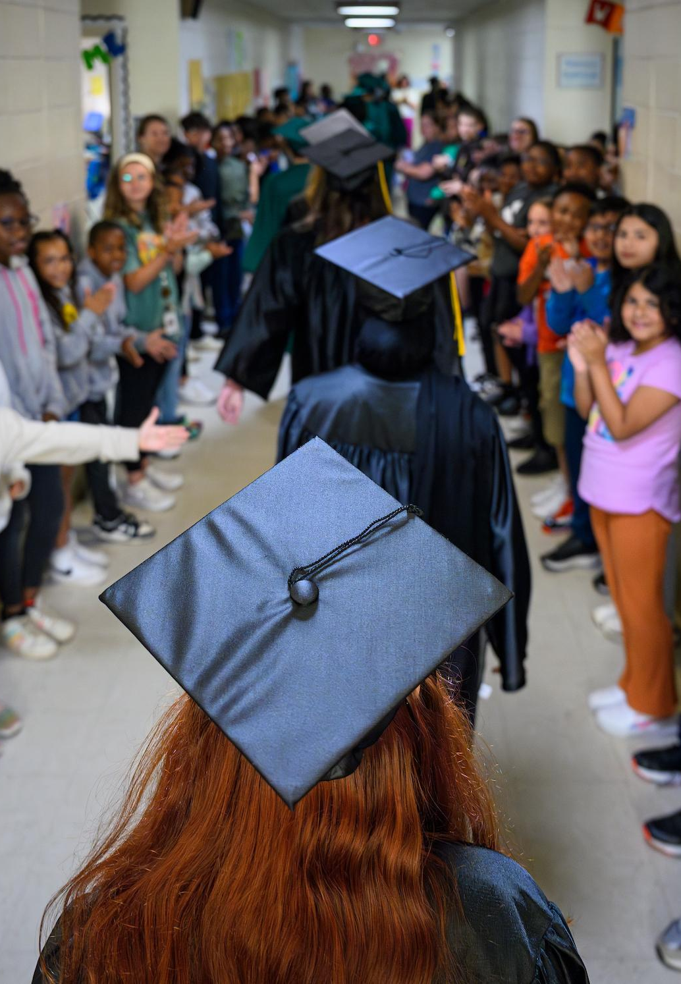

Every Student Graduates
At least a semester’s worth of college credits up to an associate’s degree OR
An industry-recognized credential OR
Workplace experience (internship, apprenticeship, job shadowing, etc.)
Notes:
Tiffany
<1 min
Through the evolution of our strategic direction, we worked with the Superintendent’s Cabinet leadership to reflect on what is at the intersection of what we are passionate about, what drives our resource engine, and what we could be best in the world at – known as the Hedgehog Concept in Jim Collins’ Good to Great.
Through that process, we landed on what we refer to as the Guilford Guarantee – our promise that all students can graduate with up to a semester’s worth of college credit, an industry-recognized credential, or workplace experience. The Guilford Guarantee is also about giving students agency to explore their options and build confidence about their future pathways. This has been our charge for about the past two years and continues to inform the refresh process.

Slide 8
Building Implementation & Monitoring Capacity
Notes:
Section Total: 12 min
Erin
<1 min
In the early phases of the strategic direction, we recognized that for several of our key initiatives, we didn’t have a consistent way to track implementation and outcomes data. We knew this had to change if we wanted a return on investment for the time and resources spent on implementation of initiatives.
To address this, we introduced what we call the Roadmap to Success framework – an approach that has helped us build capacity for initiative teams to monitor their own progress. Some of you may be familiar with this if you’ve been following along with our work at GCS or attended our previous sessions at SDP.

Slide 9
Roadmap to Success Framework
Components
Utilize cross-departmental implementation team and regular cadence of meetings
Develop Theory of Change, Logic Model, and Progress Monitoring Plan
Continuously improve implementation
Attend capacity-building sessions designed for team leads
Notes:
Erin
<1 min
What do we mean by the Roadmap to Success Framework?
Click for each bullet
That means that each strategic initiative has a cross-departmental implementation team that meets regularly, the team has collaborated to develop a ToC, LM, and PMP, they focus on continuous improvement, and the team leads attend capacity-building sessions where they have the opportunity to engage in peer learning around improvement science frameworks.

Slide 10
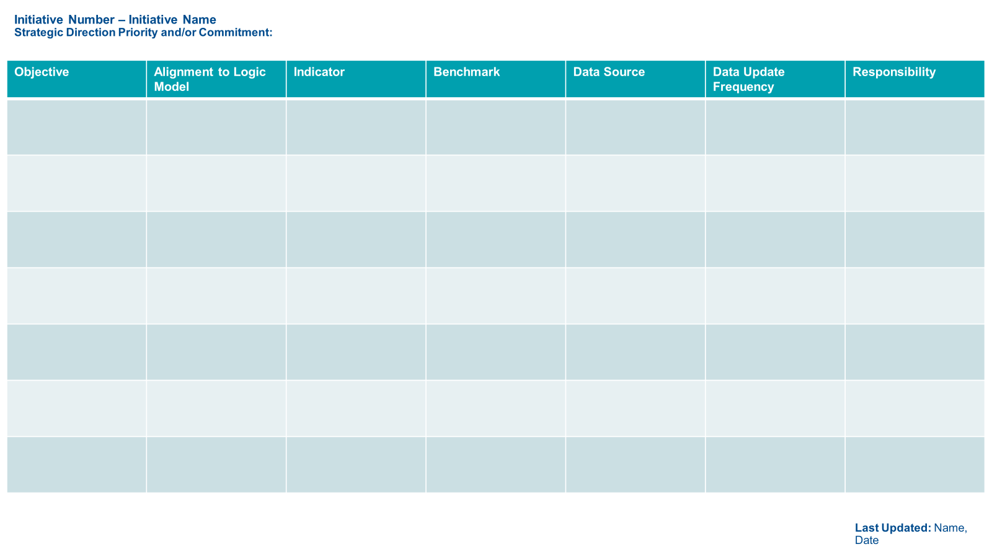
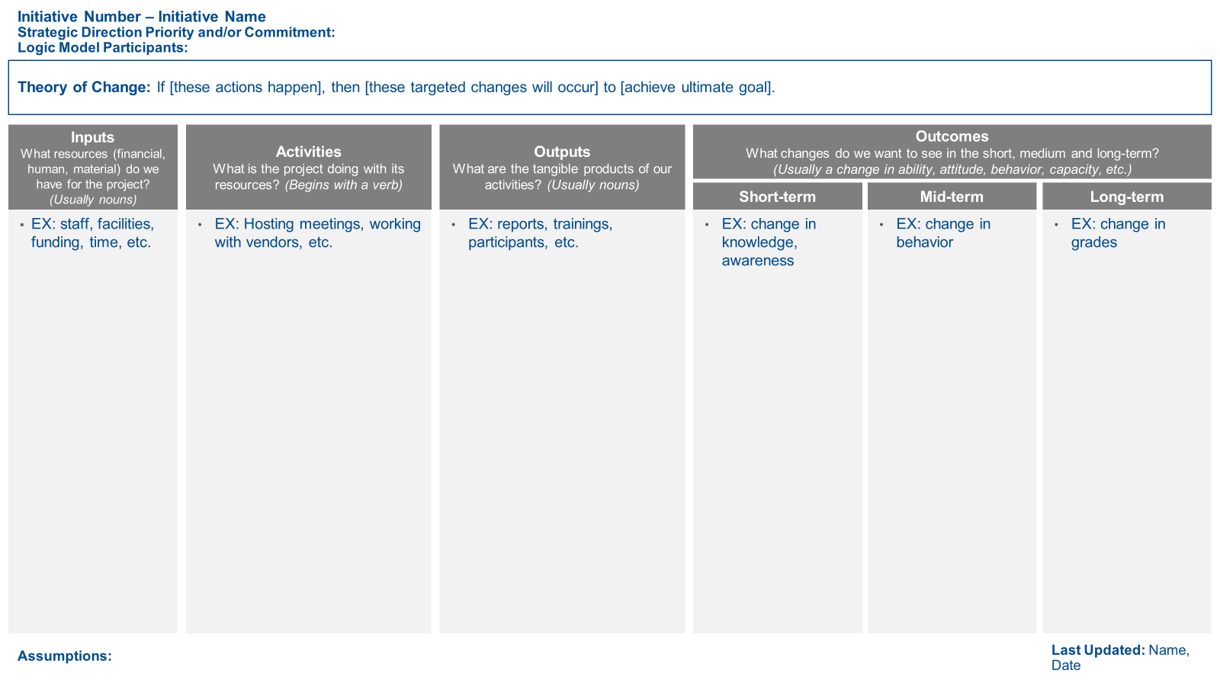
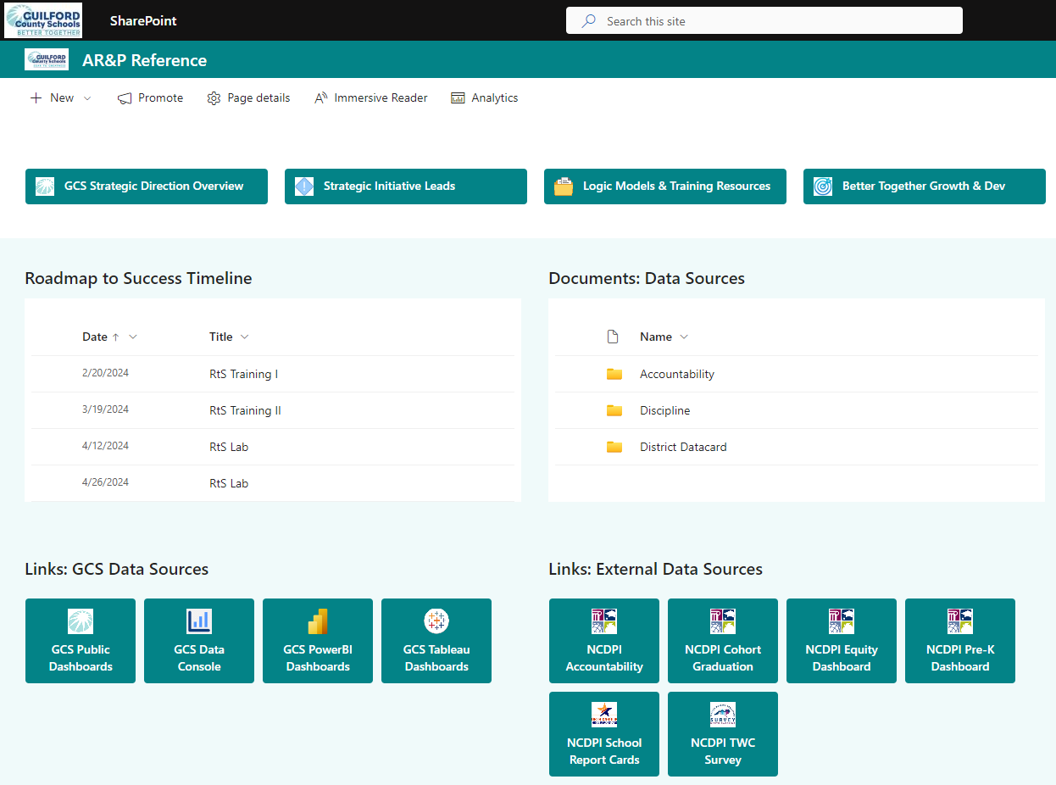

After Action Review (AAR)
1
2
3
4
What was supposed to happen?
What actually happened?
What went well and why?
What can be improved and how?
Progress Monitoring Plan
+
Data Sources & Report(s)
Theory of Change & Logic Model
Implementation Team
Data Review & Discussion
Notes:
Erin
1 min
A major emphasis of the Roadmap to Success framework is continuous improvement. We have worked with initiative leads to build their capacity for a process known as After Action Reviews. The after action review (AAR) is a simple method for facilitating an assessment of performance by bringing together a team to reflect on implementation in an open and honest fashion. There are four simple questions: What was supposed to happen? What actually happened? What went well and why? And what can be improved and how?
The AAR uses tools from the Roadmap to Success so they all tie together as part of a unified process. The theory of change & logic model are the vision of what is supposed to happen. The progress monitoring plan and data sources/reports tell us what actually happened. With this information the implementation team can have data-based discussions about what went well and why and what can be improved and how.
What we like about using AARs is that they are flexible and simple to use. Most importantly, AARs connect past experience with future action – it’s not just about dissecting things that have gone well or not; it’s about informing what will be done differently next time.

Slide 11
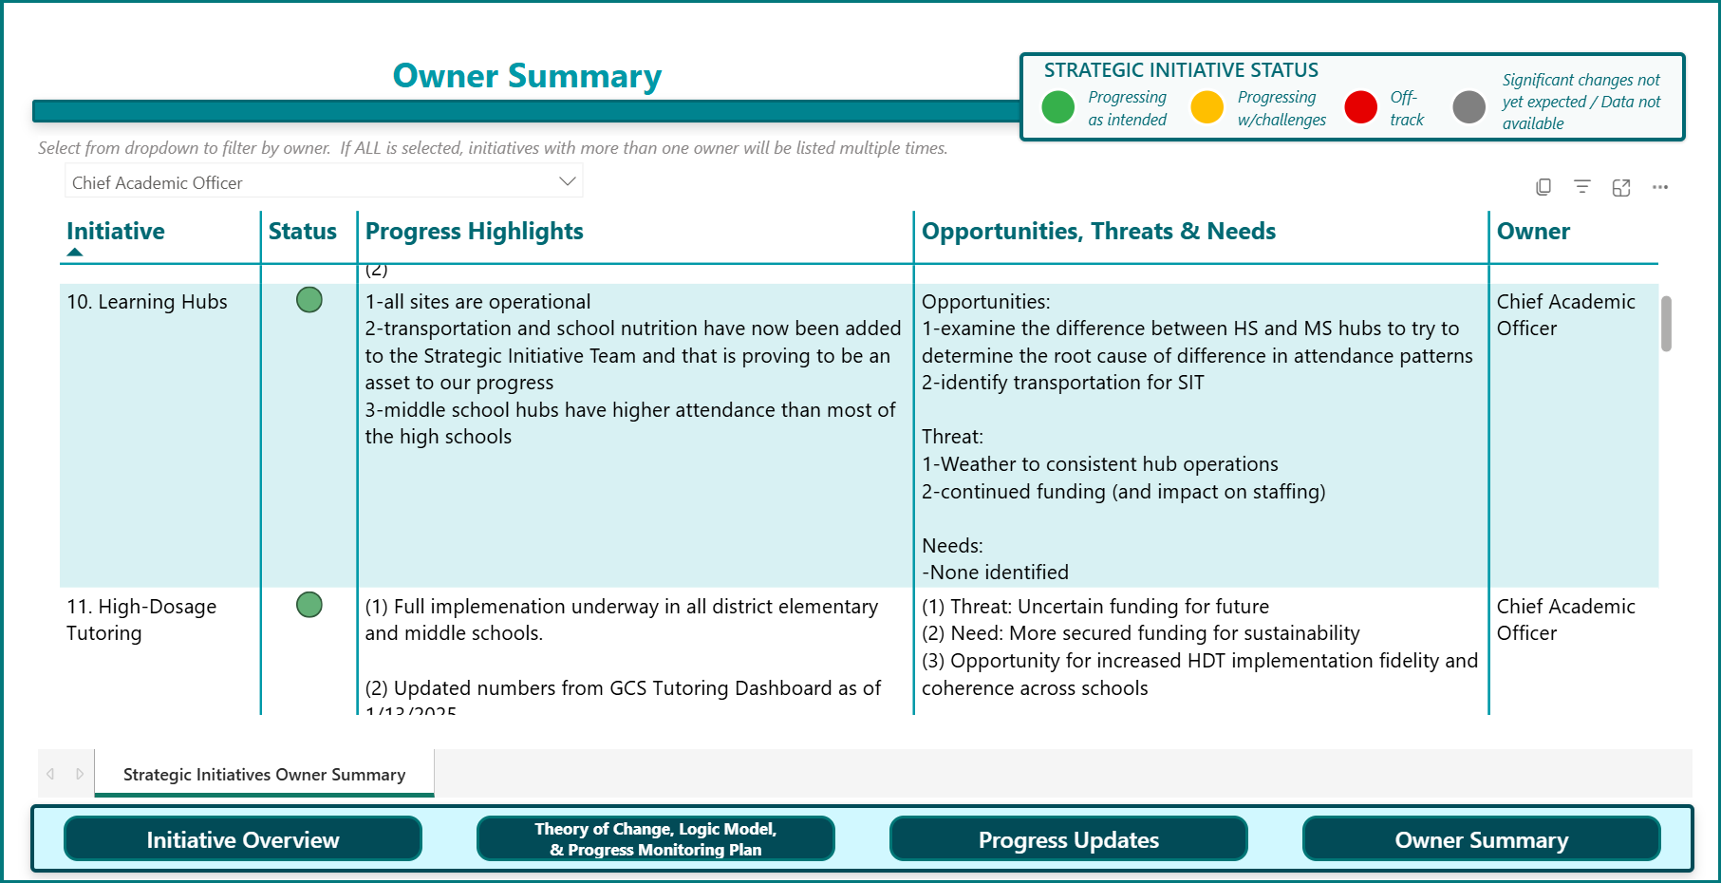
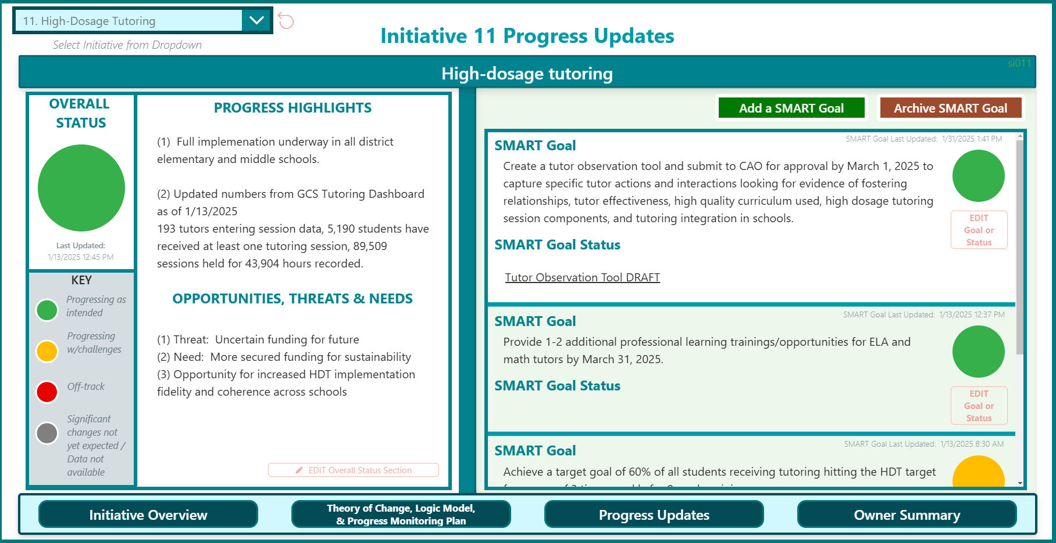
Progress Monitoring Infrastructure
Select initiative from dropdown
Categories align with what is discussed with implementation team and supervisors
Use edit buttons to update information
Notes:
Erin
1 min
As part of our progress monitoring infrastructure, we introduced a Power App that has been published on an internal Strategic Initiative site where information that goes into after action reviews can be documented. The site is meant to help get stakeholders on the same page about understanding progress.
On the slide there is a screenshot of the third tab called “Progress Updates”.
This page has been designed in alignment with the sample agenda protocols for implementation team meetings and is meant to inform check-ins with leads and their supervisors to improve implementation and address barriers as needed.
However, as many of you have probably experienced, just because you build a dashboard, doesn’t mean people will use it. As of April of this year, we only had 62% of initiatives with a progress update (that didn’t include the boilerplate language).

Slide 12
Guiding Questions for Owners
What data is/will be available that will help the audience understand implementation progress?
What evidence is/will be available that will help the audience understand the initiative’s impact on outcomes?
How does the data tell a collective story of impact across multiple initiatives?
Notes:
Erin
2 min
We recognized that we needed to foster more dialogue about the progress updates data. We knew that there were upcoming Board of Education meetings where an update would need to be provided for each focus area of the strategic direction. To support preparation for the Board of Education meetings, we provided initiative Owners these guiding questions.
(Read questions)
We strongly recommended reviewing these questions with respective leads because they are closest to the work and can support Owners’ thinking on how best to update Cabinet and the Board of Education.

Slide 13
Backwards Planning for Board of Education Updates
December |  |  | January |  |  |  | February |  |  |  | March |  |  |  |  | April |  |  |  | May |  |  |  | June
16 | 23 | 30 | 6 | 13 | 20 | 27 | 3 | 10 | 17 | 24 | 3 | 10 | 17 | 24 | 31 | 7 | 14 | 21 | 28 | 5 | 12 | 19 | 26 | 2 | 9 | 16 | 23
AL
SHWS
PSW
TGE
(Comms & Enrollment,
Program Alignment)
TGE
(Customer Service)
RRR Top Talent
Guilford Guarantee
EL Program
Notes:
Erin
1 min
We also knew that Cabinet would need to hear updates on each focus area before the Board of Education update. Using the planned Board of Education meeting timeline, we backwards mapped when each focus area would need to share initiative-specific updates with Cabinet.
The dark colored squares represent BoE update dates for each update area. We have grayed out columns where there is not a Cabinet meeting that week. Based on the BoE topics meeting schedule, we suggested bringing updates on the related initiatives up to 4 Cabinet Meetings in advance. These windows of time are represented by the lighter colored squares. For example, for the Accelerate Learning Update on February 10, we recommended Cabinet receive updates on initiatives that will be included in the Accelerate Learning BoE update (at a minimum) December 16 and January 6.

Slide 14
Protect Time for Data Review
Lesson Learned
Myth: If you build it, they will come
Data doesn’t review itself
Structured questions provide a starting point
The process is as important as the tool
How does your organization protect time (or not) for data review? How might you improve how data review gets prioritized?
Notes:
Erin
6 min
1 min explain
3 min shoulder partner
2 min share out
One of our biggest lessons learned from our efforts to build capacity for progress monitoring is that if data review isn’t built into the schedule, then it won’t get done. You have to protect time for data review.
With our PowerApp dashboard we learned that the idea “If you build it, they will come” is a myth. Data doesn’t review itself, and although we have a repository for progress monitoring information to be collected, we needed to also think about the structures and processes in which that data is used.
The guiding questions we provided for owners was a starting point to encourage dialogue about progress monitoring data. The process is just as important as the tool, and having Owners equipped with these questions helped make it easier for intentional data-based check-ins to occur. The Board of Education meeting schedule helped add another layer of accountability.
Now, we’d like to ask you to talk with a shoulder partner about these questions: How does your organization protect time (or not) for data review? How might you improve how data review gets prioritized?
Would anyone like to share some examples that stood out?

Slide 15
Fostering Trust
Notes:
Section Total: 32 min
Erin
<1 min
If you recall from the evolution of the GCS Better Together Strategic Direction, it extended from 2023 through 2026. This year, we began the process of refreshing our strategic direction as we respond to shifting context. This was a great opportunity to engage many constituents, foster trust, and reflect diverse perspectives in the future direction of GCS.

Slide 16
Purpose of Strategic Direction Refresh
Reflect on what we’ve learned from 2023-2026
Make improvements based on our current context
Strengthen connections between strategy and daily work
Notes:
Erin
1 min
Our main goals for the strategic direction refresh process have been to:
Reflect on what we’ve learned from 2023-2026. We have introduced initiatives, systems and structures that are new compared to when we began the Better Together strategic direction in 2023. We want to be sure we are taking the time to reflect on what’s worked and what could be improved.
Make improvements based on our current context. When we first started the Better Together strategic direction, we were coming out of the pandemic. Now, we are in a different environment and want to be sure our priorities reflect our current context.
And strengthen connections between strategy and daily work. We want the strategy and vision for the district to be tangible and clear so that staff make regular connections between their day-to-day work and the priorities of the district. It’s important to us that this work does not seem like a foreign language to our families and community. Instead, we want to bring you to be a part of our journey.

Slide 17


Feedback Collection
Surveys
Focus Groups
2200+
115+
Responses Online
Focus Group Participants
Family Members
District and School Staff
Community Members
Families of Exceptional Children
Families of English Learners
Native Families
Students
Notes:
Erin
1 min
The first phase of the strategic direction refresh process involved collecting constituent input through the month of February.
We conducted three surveys, including one for GCS families, district and school staff, and community members. We also collaborated with internal departments to conduct 4 focus groups, including families of exceptional children, families of English learners, Native families, and student advisory council members.
In total, we heard from over 2300 people through surveys and focus groups. While the number of respondents represents only a portion of our full community, the feedback provides valuable insight into themes that emerged consistently across groups.
As part of the strategic direction refresh, we established a strategic direction working group which consists of key representatives across the superintendent’s advisory councils (e.g. teacher, family, student, principals, classified staff, external community members).
We’re going to simulate a modified version of what we shared with the strategic direction working group to make sense of the data. As we go into the data review, we want to be transparent that this data is directional rather than comprehensive. We treat this as one important source of information among many. It helps us understand people’s experiences and identify areas for improvement, especially when we see feedback overlapping across groups.
Additional info:
EC Family focus group = 13
Students = >70 (multiple students in one room, + includes 2 students at Native Family focus group)
Native family = 6 (excludes 2 students)
EL family = ~30
Family survey = 1301 + 10 Swahili = 1311
Staff = 805
Community = 94
TOTAL = 2329

Slide 18
Data Review
Students
Families
District & School Staff
Community
What priorities come through strongly from the feedback?
Where do you hear overlap across groups?
Notes:
Erin
19 min
2 min to set up activity
8 min data review and discussion
6 min hear from each group (1-2 min each)
3 min whole group
Person not presenting can help divide the room into quadrants
We collected feedback from students, families, district & school staff, and community members. Each quadrant of the room will focus on a different set of feedback.
Point out where each quadrant begins and ends and corresponding chart papers
You will have 8 minutes to review the slides with your group. Put yourself in the shoes of your assigned constituent group. Think about what priorities came through strongly from the feedback. Pick a spokesperson to share your top takeaways at the end of the ten minutes.
What were the top takeaways from each group?
Click
What do we hear in common across groups?
Data to Print:
https://gcsnccom-my.sharepoint.com/:p:/g/personal/philipe_gcsnc_com/IQCTzc-ngzAKSJZed23aaJFBASs91hGOfagaHXnwCaye9Hk?e=bEUIgw

Slide 19
Sensemaking with Signals
Personalized Guidance
Experiential Learning
Strategic Communication
Strong Academics, Staff, & SEL
Access & Opportunity
Early
Student-specific
Inclusive
Proactive
Build awareness
Strengthen partnerships
Increase depth and variety
Simple
Clear
Timely
Strong academic foundation
Effective and supported staff
Student support and safety
Awareness
Navigation
Participation
Outcomes
Notes:
Erin
2 min
After our working group reviewed the feedback in role-alike groups similar to what you just experienced, we shared back what we called “signals” with the group and across constituents that we collected feedback from. Signals tell us the things we should pay attention to because they are coming up again and again across groups, whether we are talking to students, families, staff, or community members.
We won’t go through these themes in depth, but the top things that came up were (Click for each theme).
In addition to gathering feedback from the strategic direction working group to inform the development of these signals, we also shared these back with the advisory councils and representatives who participated in focus groups as a way to loop back around with them and give them an update on the refresh process.

Slide 20

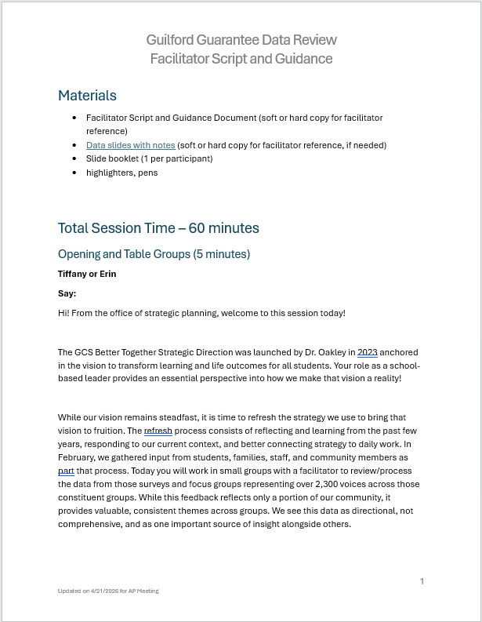
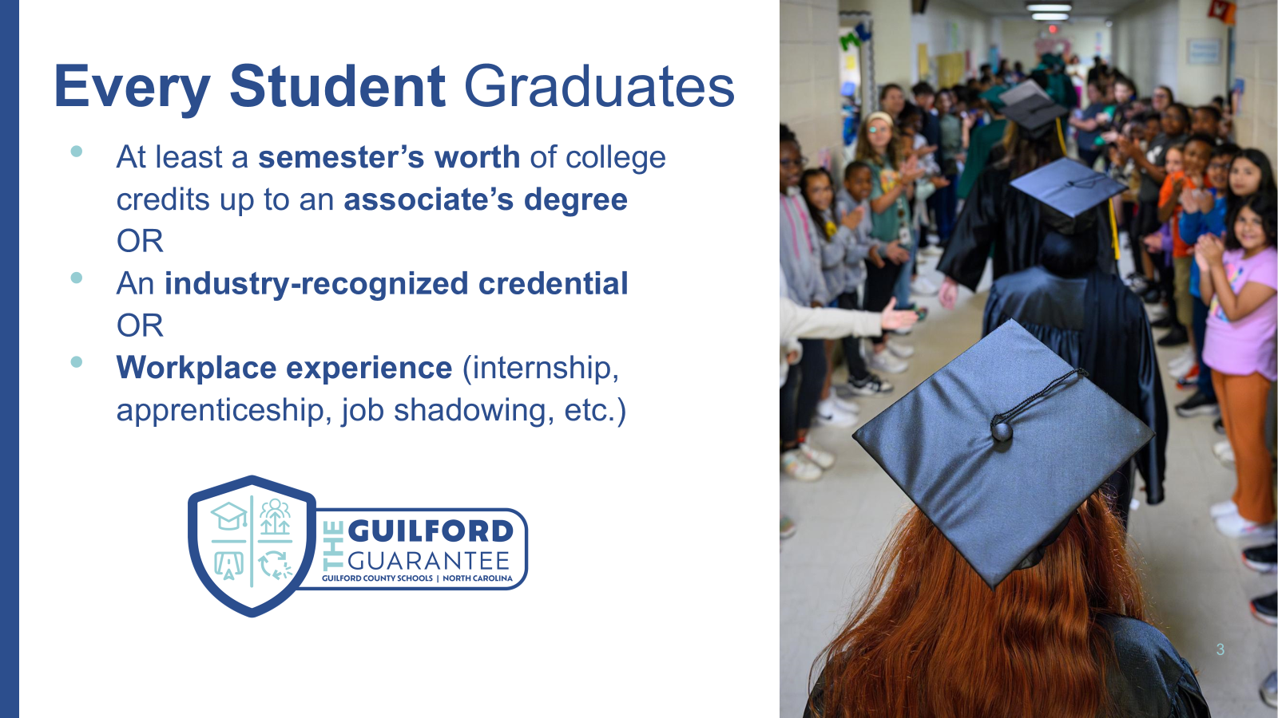
Many Voices, One Shared Goal
35
Trained data discussion facilitators
Differentiated Data Packets & Facilitation Scripts
120+
140+
130+
230
Principals & Principal Interns
Assistant Principals
Instructional & Classroom Leaders
School Counselors
Notes:
Erin
3 min
The process you just participated in is just one example of how we engaged the strategic direction working group in making sense of the feedback, but it did not end there. It was important for us to share this feedback widely and bring people along to shape the strategic direction. In total, we ended up engaging over 680 additional staff members, and the slide shows a breakdown of who those voices included.
After the data review with the strategic direction working group, there was a lot of excitement among the team about sharing the data far and wide. However, we were intentional not to make it the same exercise that the strategic direction working group participated in. Instead, we wanted to be sure additional reflection opportunities helped us shape our strategy for the Guilford Guarantee. As mentioned before, we have started to build momentum around what we call the Guilford Guarantee, which focuses on giving students postsecondary experiences while they are in school with us. We had asked specifically about the Guilford Guarantee in the surveys and focus groups, so we were able to pull out the Guilford Guarantee-specific data analysis to build understanding and create space for dialogue around this shared goal.
We trained 35 district leaders to lead a data review protocol based on the Guilford Guarantee feedback by first engaging them in that same process. After being a participant, they transitioned to the role of facilitator in subsequent sessions. We provided them with differentiated data packets and facilitation scripts to guide a variety of people, including principals, assistant principals, curriculum facilitators, multi-classroom leaders, special populations coordinators, and college and career managers. The protocol included individual data review, time to share quotes and ideas that resonated with them, and at the end, participants submitted ideas for improvement for internal processes and adult capacity needed to deliver the Guilford Guarantee. We’ll share more about how we plan to use that feedback in the next section.
It was both surprising (to me) and gratifying to hear that this process has been one of the first times many of our district and school staff have been more directly involved in shaping the strategic direction, which can also support shared ownership of the refreshed strategic direction. Feedback indicated that participants found this process very meaningful and appreciated the chance to explore feedback and think strategically about the Guilford Guarantee from their roles, especially when we were able to mix up elementary, middle, and high school participants to help draw out connections across levels.
2329 from surveys and focus groups
30 SDWG (not including Tiffany and Erin)
35 trained facilitators
31 facilitators * 6 avg per facilitator = 186 principals (est)
136 CF, MCL, SCP, CCMs
140 APs
90 HS counselors
90 Elementary counselors
50 MS counselors
SUBTOTAL: 757 beyond surveys and focus groups (est) / 685 conservative estimate
GRAND TOTAL: 3014 (conservative estimate)

Slide 21
Create feedback loops
Lesson Learned
Myth: Collecting input is enough
Ensuring diversity of voices is the first step
“Play back” what we’re hearing
Encourage active contribution to the district’s future
How does your organization prioritize equity of voice in shaping strategy?
In what areas might you improve trust through feedback loops?
Notes:
Erin
6 min
1 min explain
3 min shoulder partner
2 min share out
Bringing people along in the strategic direction refresh has been a big success of the process so far. Often, strategic plans are revealed only once when they are being launched, rather than being shared and shaped formatively by those they most impact. The idea that collecting input from constituents once is enough is a myth. Having diversity in the voices represented for feedback is a critical first step. Our English Learner, Exceptional Children (special education), and Native family representatives were especially grateful their voices were elevated through this process, and it was really powerful to see similar quotes and patterns resonating as we shared the data with over 600 district and school staff. People also appreciated that the data showed a balance of perspectives, including negative ones or gaps that the district can address. This built trust in the process.
Another strategy for building trust was for us to “play back” what we’re hearing. We made clear as we facilitated focus groups that their feedback will not go into a black box, and we came back to the groups we collected data from in April to share what we’re learning.
By training facilitators to guide small groups in reflecting on the data, we were able to transform staff’s engagement from passive recipient to active contributor to shaping the district’s future.
Now, talk with a shoulder partner about these questions: How does your organization prioritize equity of voice in shaping strategy? In what areas might you improve trust through feedback loops?
Would anyone like to share some examples that stood out?

Slide 22
Measuring What Matters
Notes:
Section Total: 18 min
Tiffany
<1 min
In total, we’ve collected input from over 3000 people through this process of refreshing the strategic direction. In this section, we’ll share more about what we plan to do with all the input so that we can measure what matters.

Slide 23
How does your organization create and measure impact?
Notes:
Tiffany
2 min
First, let me pose a question: How does your organization and measure impact? Just call out your answers.
Anticipated responses:
Delivering quality education for students
Supporting families to support their children
Recruiting and retaining effective staff
How we know:
Academic accountability metrics
Operational metrics (e.g. budget surplus or deficit)
First you have to know what you’re aiming to impact. As we shared at the beginning of this presentation, we have four focus areas with specific priorities that have guided us from 2023-2026. While the focus areas will remain the same, the priority statements will be refined based on our current context. These will serve as our guide for what we hope to impact and how we will measure it.

Slide 24
Strategy Maps
Visual representation of how an organization creates value
Shows cause-and-effect relationships between goals across four general perspectives*
  Constituent
  Internal Processes
  Learning & Growth
  Financial
*Exact names and order of perspectives can vary with the organization context
Source: Kaplan and Norton (2000). Having Trouble with your Strategy? Then Map It.
Notes:
Tiffany
2 min
The process we used and the questions we used in the facilitated data discussions were intentionally designed to inform the next phase of strategic planning. You may be familiar with strategy mapping and we will provide a quick overview.
Click
A strategy map is a visual representation of how an organization creates value.
Click
It shows cause-and-effect relationships between goals across four perspectives:
Click for each
Customer/Constituent, Internal Processes, Learning & Growth (foundation), Financial/Stewardship
When I asked how we have created value, we heard some examples across these categories
Name examples
The exact names and order of the perspectives can vary with the organization. This is going to feel abstract right now, but you’ll see what each of these mean as we explore some examples.
Strategy maps help teams understand how their work contributes to broader outcomes. It’s a tool that in one page can explain what are the most critical objectives for an organization to deliver value across these perspectives.

Slide 25
Vision: Transforming learning and life outcomes for all students
Mission: Guilford County students will graduate as responsible citizens prepared to succeed in higher education or in the career of their choice.
Values: Diversity | Empathy | Integrity | Innovation | Equity
Constituents
How do we get our constituents to perceive our product, services, and brand in the desired way?
How do we deliver what is important to our constituents?
Internal Process
What do we need to do well internally to meet constituents’ needs?
Learning & Growth
What skills, culture, and capabilities do we need to have in order to execute our internal processes?
Financial
How do we provide resources that fuel our learning and growth? How do we support and utilize human capital and infrastructure resources to meet goals?
Notes:
Tiffany
2 min
These are some guiding questions to consider across each perspective. We have included a strategy map template on the Sched page if this is a tool that you believe could be valuable for your organization. There are also examples from the Balanced Scorecard Institute for you to review if you are interested.
Read questions.
We have ordered the perspectives in this template in a way that is common for public sector organizations. You’ll notice the financial perspective is on the bottom, and constituents are at the top of the perspectives. The vision, mission, and values are also across the top.
Adapted from: https://www.clearpointstrategy.com/blog/what-is-a-balanced-scorecard-a-definition and https://online.hbs.edu/blog/post/balanced-scorecard

Slide 26
Strategy Requires a Map Before Metrics
 | Strategy Map | Balanced Scorecard
 | Objectives | Measures | Targets
Constituent
Internal Process
Learning & Growth
Financial
Source: Cote, C. (2023). What is a balanced scorecard?
Notes:
Tiffany
3 min
As we refresh the strategic direction, we want to be intentional about naming where we are going without jumping straight to metrics and measurement. Many organizations fail to implement strategy because they skip the step of mapping how their goals connect to actions. This is the approach we embrace with our Roadmap to Success.
A balanced scorecard is a tool directly linked to the strategy map that helps measure progress for each objective.
For each objective in the strategy map, a balanced scorecard outlines measures and targets.
This ensures measurement doesn’t happen in absence of what the most important strategies actually are. The strategy map and balanced scorecard are tools that go hand in hand, just like a logic model and progress monitoring plan.
Anticipated responses:
Incorporates strategy map side by side with measurement
Aligns specific initiatives to strategic objectives
Includes vision, mission, and core values
The balanced scorecard is something that can be cascaded through departments as well, which helps connect big picture strategy to individual department work.

Slide 27
From Data to Decisions
Raw Data
Focus Groups and Surveys
Environmental Scan
Signals
Differentiated Data
Data Collection
Sensemaking & Input Gathering
Signals
Differentiated Data
Facilitator Training
Cross-role & Role-alike Meetings
Internal Process & Adult Capacity Input
Strategy Formation
Internal Process & Adult Capacity Input
Leadership Input
Revised Priorities
Strategy Map
Widespread Communication & Reinforcement
Strategy Map
Revised Priorities
Strategic Initiative Review
Balanced Scorecard
Cascading Scorecard
Strategy-aligned Decisions
Notes:
Tiffany
3 min
While we are still in the refresh process, this slide boils it down into tangible steps of how to go from raw data to strategy-aligned decisions.
Click
We started with data collection – collecting input from focus groups and surveys, alongside an environmental scan including things such as reviewing other district’s strategic plans and considering opportunities and threats.
Click
From these we got our signals (common themes across constituents) and the differentiated data we used in the next step.
Click
We needed to do sensemaking and input gathering with the data. We trained facilitators and used the data in cross-role and role-alike meetings to collect
Click
input on internal processes and adult capacity building.
Click
From there, we had the ingredients to start forming the refreshed strategy. Along with input from leadership, we are now in the process of
Click
revising priorities and thinking about how to create a strategy map.
Click
Then, over the next few months, we’re going to take that strategy map, revised priorities, and a comprehensive review of our strategic initiatives to ultimately
Click
create a balanced scorecard which can then cascade into departments.

Slide 28
Build shared understanding of priorities
Lesson Learned
Myth: People “get” the strategy when it’s launched
When everything is a priority, nothing is a priority
Strategy map can clarify what truly matters, while balanced scorecard can direct meaningful measurement
Cascading scorecards support connection to strategy
How does your organization make priorities understood?
In what areas might you improve connecting daily work and strategy?
Notes:
Tiffany
6 min
1 min explain
3 min shoulder partner
2 min share out
As you can tell from the previous slide, there is a lot that goes into taking raw input and transforming it into something meaningful that informs strategy. It is a myth that people will “get” or understand the strategy when it’s launched. In fact, much of our staff feedback indicated that there were gaps in people feeling connected to the overarching strategy, and confusion about what is truly the priority. As the saying goes, when everything is a priority, nothing is a priority.
As we move into the strategy formation and communication phase of the strategic direction refresh, we are hopeful that the strategy map can help us narrow in on what truly matters to achieve the Guilford Guarantee, and the balanced scorecard ensures that measurement is both holistic and meaningfully tied to key objectives.
People also need to see how organizational goals tie to their own work, and cascading scorecards are a way to support individual and department connections to strategy.
Click
With a shoulder partner, discuss: How does your organization make priorities understood? In what areas might you improve connecting daily work and strategy?
Would anyone like to share out?

Slide 29

Thank You
Notes:
5 min
Questions & discussion

