Slide 1
When Data Systems Are Asked to Do More Than They Were Built For:
Lessons from an Emergency Response
May 13, 2026
SDP Convening 2026
Cambridge, MA
Christopher Salem Ozuna, PhD
Research, Analytics & Data
California Community Colleges Chancellor’s Office

Slide 2
What happens when this new purpose is urgent and in the public eye?
What happens when a data system built for one purpose gets asked to do something else?

Slide 3

Chapter 1
Compliance vs. Action
I’m gonna throw a box of books and my beloved guitar into the back of my truck, and try my luck in California.

Slide 4
Data Systems: Compliance vs. Action
Compliance
Action
Built for: Did we meet the requirements?
Often lagging indicators
Highly standardized & auditable
Designed for consistent reporting
Built for: What do we do next?
Leading indicators
Flexible, contextual
Designed for decision-making

Slide 5
The purpose of a system is what it does.
Compliance
Action
Many large, public data systems in the US live on the left.
This is the result of intentional design choices (and compromises).
This is not necessarily a failure: we want people to trust the data we put forward.
What happens if you usually live on the left, and then you suddenly need to move to the right?

Slide 6
Data Systems: Compliance vs. Action
Compliance
Action
Built for: Did we meet the requirements?
Often lagging indicators
Highly standardized & auditable
Designed for consistent reporting
Checkpoint 1
With your partner discuss:
Where do your organization’s data systems sit on this spectrum?
Where does your day-to-day work live?
Built for: What do we do next?
Leading indicators
Flexible, contextual
Designed for decision-making

Slide 7
Chapter 2
Case Study: LA Wildfires
It never rains in California, but girl, don’t they warn ya, it pours, man, it pours.

Slide 8
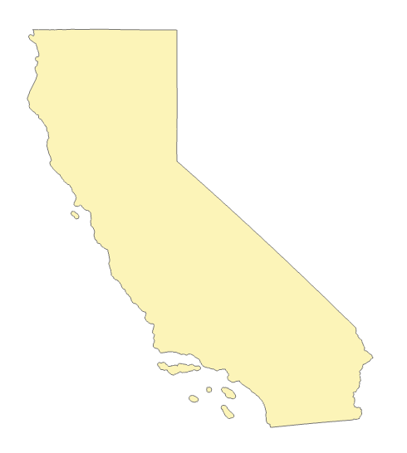
We are one system.
The CA Community Colleges is the largest higher education system in the United States.
116 colleges
72 districts
2.2+ million students
One unified data warehouse for reporting
One set of reporting standards
One Chancellor’s Office that oversees the system

Slide 9
Sources of Chancellor’s Office Data
3rd Party Partners
(NSC, UCOP, CSU, EDD)
COMIS
Transformation to MIS Standard for Upload on Term or Annual Basis
Enrollment & demographic data
Coursetaking information
Awards
“Live” data
Limited to college or district-level
Local Data – SIS/Local Warehouses
Single College District
Multi-College District

Slide 10

Our data belong to California.
We are the stewards of the data.
It is our responsibility to care for and protect it.
It is our responsibility to use the data in the interest of California & Californians.

Slide 11
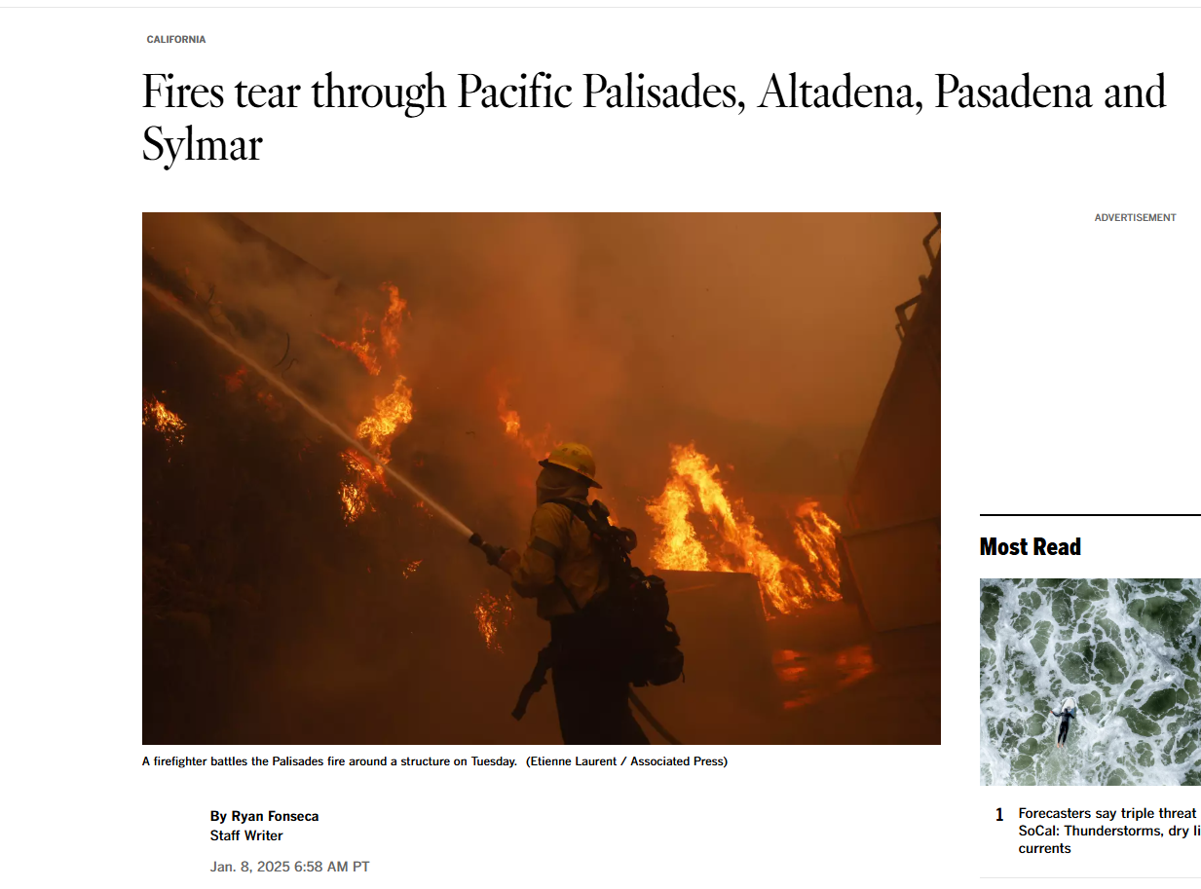
Who are the CCC students affected by the Eaton & Palisades fires?
What can the Chancellor’s Office do provide support to affected colleges & students?

Slide 12
What do we know, and how soon can we know it?
What I could see | Limitations (that I knew about)
Full enrollment (courses, grades, services) data up through Fall 2024. | Colleges have 30 days after term end to submit data. The fires started January 7th, right when many colleges are starting new terms.
The last ZIP code a college submitted for a student. | Local districts have different policies about when they update this: generally seems to come from CCCApply.
Fire perimeter data & structure analysis from CalFire and OES. | Updated daily (or more), but no direct sharing between state agencies.
Compliance
Action

Slide 13
Checkpoint 2
With your partner, imagine:
An emergency event is impacting your organization’s community. Your leadership is asking for data on 1) what’s going on, and 2) where do you need to direct short-term resources?
How would you & your team approach this? What strengths does your current setup provide? What challenges do you need to be aware of?

Slide 14



Data Sources
Formal request to CalFire: never answered.
Ended up finding:
  Historical Fire Perimeters
  Eaton & Palisades Structure Analysis
ZCTAs shapes from Census
COMIS
COMIS

Slide 15
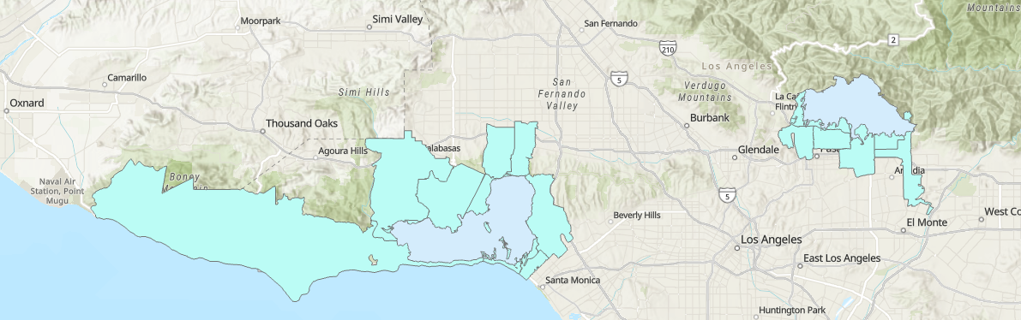
Method & Analysis 1:
Geographic Overlap
ZCTA
Fire Perimeter
Used fire perimeter file to identify overlapping ZCTAs for each fire.
From this, 14 ZCTAs were identified as overlapping with the fire perimeters.
Doesn’t include evacuation zones and is not CalFire’s “final” perimeter.
Eaton
Palisades

Slide 16

Identified ZCTAs
Reminder: ZCTAs are not the same as ZIP codes, but they are related.
Eaton | Palisades
91001 | 91302
91006 | 90049
91024 | 90290
91103 | 90272
91104 | 91316
91107 | 90265
 | 90402
 | 91356
Note: Colleges report a ZIP code for each student in each term, which may or may not be their most recent ZIP.

Slide 17
Method Analysis 2: Student Match
For the Fall 2024 term, I flagged students who had a ZIP code that matched the previous list.
Unique Affected Students Across System | 7,200
Colleges with At Least 1 Affected Student | 114*
Share of Affected Students, Eaton | 75.54%
Share of Affected Students, Palisades | 24.46%
Important Note: After rerunning this in Summer 2025, the total number of unique students in affected ZIP codes in the 2024/25 academic year jumped to 18,200. Pasadena City College was directly impacted and their Spring term started Jan 6, 2025. Santa Monica College has a long Winter Intersession that started Jan 6, 2025.

Slide 18
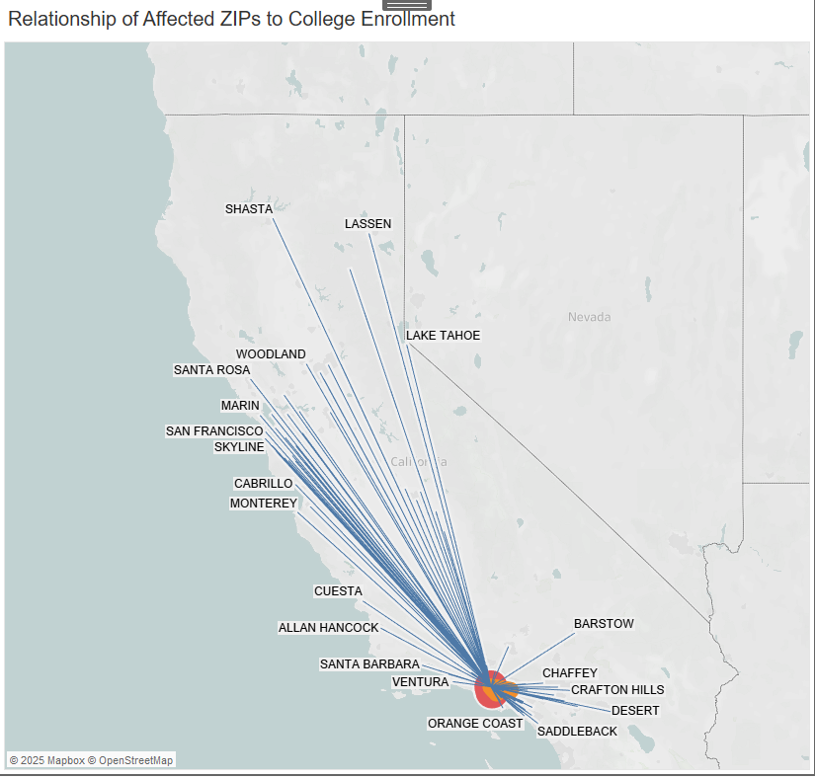
Product 1: Tableau Tool
View by college to see some demographic factors of affected students.
View by ZIP to see extent of impact across the system.

Slide 19
Chapter 3
Historical Analysis
Destruction leads to a very rough road, but it also breeds creation.

Slide 20
In a statewide system, local emergencies become statewide emergencies.

Slide 21
Historical Analysis of Impact of Emergencies on CCC Students
How can looking at past emergencies and the subsequent impacts on students help us plan for the future?
Investigate 4 past emergencies:
  1994 Northridge Earthquake (LA County)
  2017 Thomas Fire (Ventura & Santa Barbara Counties)
  2018 Camp Fire (Butte County)
  2023 Pineapple Express Flooding (Santa Cruz County)

Slide 22
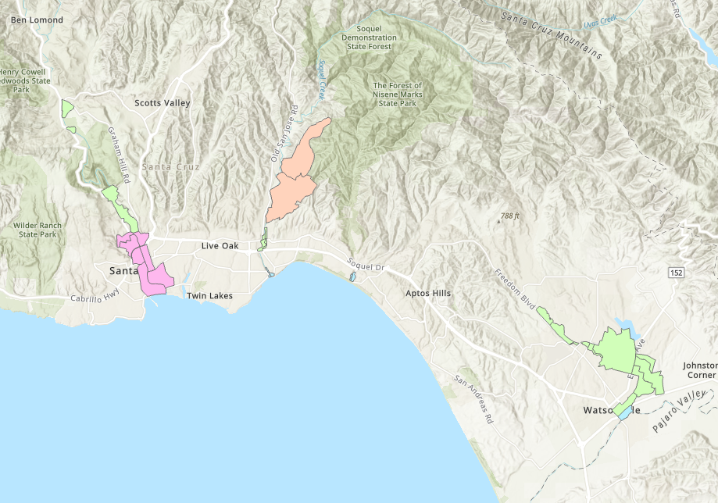
Pineapple Express Floods, 2023
A powerful series of atmospheric rivers brought intense rainfall and flooding in Santa Cruz County.
County evacuation zones that received an evacuation advisory, warning, order or shelter-in-place order are included as affected area.

Slide 23
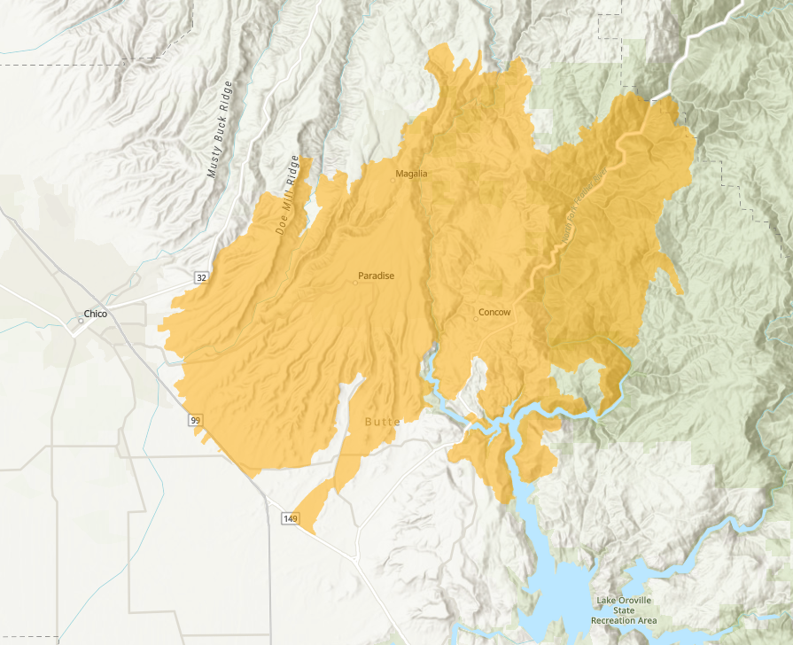
Camp Fire, 2018
The Camp Fire started on November 8, 2018 in Butte County.
The fire destroyed 19,000 structures and burned 150,000 acres.
85 people died: 50,000 people were displaced. Most of the town of Paradise was destroyed.

Slide 24
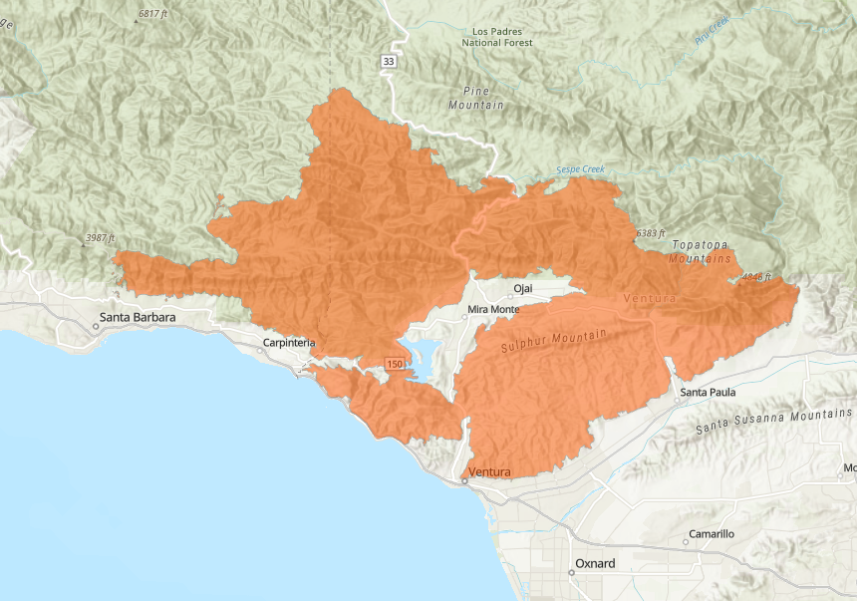
Thomas Fire, 2017
Started on December 4, 2017 in Ventura County.
Burned over 280,000 acres in Ventura and SB counties.
Not fully contained until January 2018, and the burn area became the site of the Montecito floods.

Slide 25
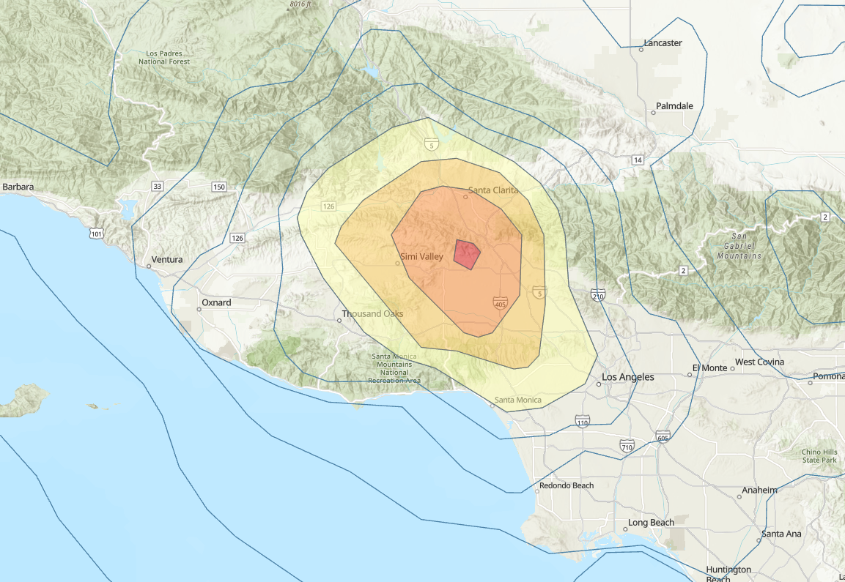
Northridge Earthquake, 1994
A 6.7 magnitude quake on January 17, 1994 caused widespread damage in the SF Valley and parts of LA.
57 people died, thousands more were injured.
25,000+ structures were damaged or destroyed, along with critical infrastructure such as the 10 and the 14 freeways.

Slide 26
Four past events give us a way to understand the present.
Northridge Earthquake
Thomas Fire
Camp Fire
Pineapple Express Floods

Slide 27
Method for Finding Affected ZCTAs
Used “perimeter” to identify overlapping ZCTAs for each emergency.
Matched each emergency to the relevant Census ZCTA (2000, 2010, 2020).
From this, 224 total ZCTAs were identified (some overlap between Northridge & Thomas Fire).
Introduced idea of Primary and Secondary Affected Areas.

Slide 28
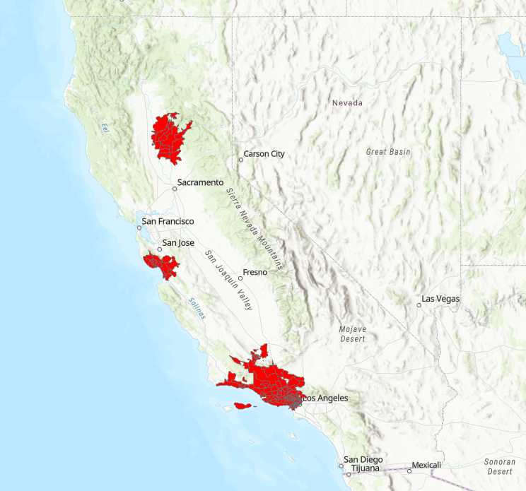
Affected ZIPs for 4 Emergencies
Emergency | Potentially Affected Students
Northridge Quake, 1994 | 184,072
Thomas Fire, 2017 | 37,470
Camp Fire, 2018 | 6,642
Pineapple Express Floods, 2023 | 18,503

Slide 29
Example Descriptive: Regional Headcounts
Emergency | Bay Area | Central Valley | Inland Empire | Los Angeles | North/Far North | Orange County | San Diego | South Central Coast | Systemwide
2025 LA Wildfires | 266 | 50 | 153 | 16,184 | 79 | 390 | 149 | 896 | 18,209
2023 Pineapple Express Flooding | 17,339 | 109 | 66 | 194 | 339 | 144 | 90 | 184 | 18,645
2018 Camp Fire | 134 | 26 | 15 | 19 | 6,277 | 111 | 25 | 33 | 6,640
2017 Thomas Fire | 337 | 4,137 | 52 | 658 | 134 | 479 | 121 | 31,547 | 37,465
1994 Northridge Earthquake | 466 | 242 | 338 | 142,709 | 244 | 1,633 | 530 | 36,594 | 182,756
Takeaway: Local emergencies affect students statewide. Do “faraway” colleges know to consider this?

Slide 30
Example Descriptive: Race/Ethnicity Breakdown
Takeaway: In the emergencies we examined, immediate impacts are spread throughout the community. How does this look as time passes?

Slide 31
Example Descriptive: Dual Enrollment Students
Takeaway: For the CCCs specifically, we have many types of students. How do we know that they are not falling through the cracks if they’re not our idea of a “typical” postsecondary student?

Slide 32
Example Outcome: 1-Year Persistence
1 Year Still in Progress
Affected by Emergency
Not Affected by Emergency
Takeaway: Broadly, there is a slight advantage for emergency-affected students in terms of same-college persistence. How true is this for other metrics?

Slide 33
Where we’re going next:
Building profiles of students who experience emergencies, are there common outcomes/dispositions?
Access
Immediate Persistence
Long-Term Persistence
Progress
Units Progression
Course Success
Success
Awards
Transfer
By:
Demographic characteristics
Service participation (DSPS, EOPS, Rising Scholars, etc)
Point in education journey
Using:
Descriptive techniques
Correlational methods
Causal methods
Reproduced at the local level
Unexpected Challenges:
Different data elements come online at different points of time.
Measure of the emergency varies by emergency type.
Controlling for changes in unrelated systemwide legislation (AB705/AB1705)

Slide 34
Checkpoint 3
With your partner, discuss:
At your organization, what data would you use to help plan for the use of medium- and long-term resources after an emergency?
Do the processes already exist for this to happen?

Slide 35
Chapter 4
Strategy Implications aka How Can We Help?
California, here we come, right back where we started from.

Slide 36
We are one system.
The CA Community Colleges is the largest higher education system in the United States.
116 colleges*
72 districts*
2.2+ million students*
One unified data warehouse for reporting*
One set of reporting standards*
One Chancellor’s Office that oversees* the system
*ish

Slide 37
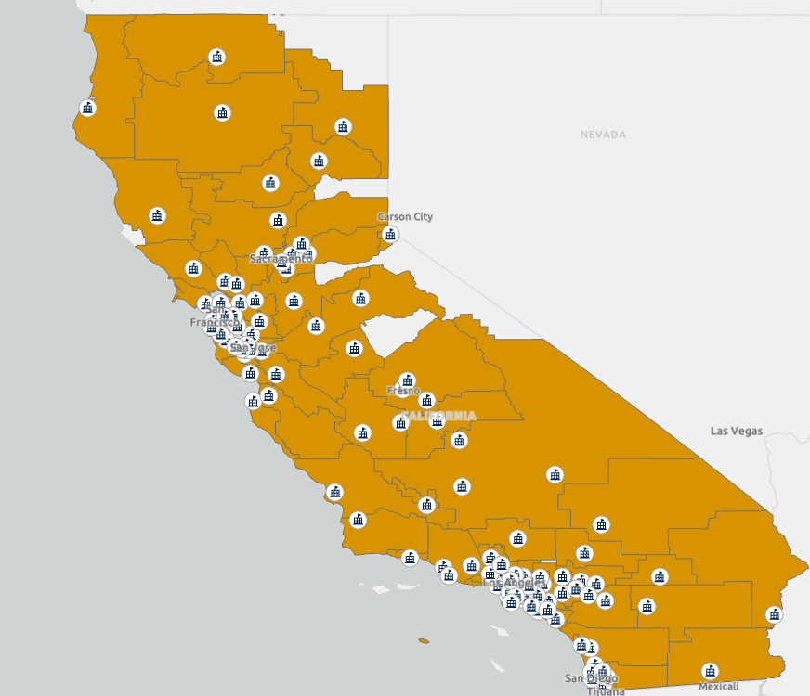
We are 116 different colleges.
The CA Community Colleges started as extensions of K-12 district, only formally separating from CDE in 1970.
2.2+ million students are spread across 72 districts in 116 colleges, many “swirling” over the course of their community college career.
Local districts have authority over nearly all data collection procedures.
Locally elected boards determine priorities for their district.
College presidents oversee the day-to-day operations of their institutions.

Slide 38
Why was our data system built this way?
Compliance
Action
Built for: Did we meet the requirements?
Often lagging indicators
Highly standardized & auditable
Designed for consistent reporting
Our data system struggles to act fast since it was designed for a completely different purpose.
Built for: What do we do next?
Leading indicators
Flexible, contextual
Designed for decision-making
Or, how can we promote compliance with emergency protocols?

Slide 39
Two Strategy Strands
Better Understand the Way Students Experience Emergencies
Continue analyses to understand the short- & long-term impacts of being affected by an emergency.
Identify the factors that are linked to the greatest impacts: who do we need to wrap our arms around?
Utilize findings for system-level advocacy.
Utilize findings for individual-level proactive reach out.
All of this is done by repurposing our existing data system in service of students.
Put in Place Logistics for the Next Emergency
Build a repo of emergency-relevant data: County-level evacuation zones, pre-matched ZCTA shapes, scripts for identifying potentially impacted students.
Contact points at college/district IR offices to receive information as an emergency unfolds.
Co-create these protocols/best practices with colleges to share resources.
Practice scenarios at regular intervals in pre-existing structures (RP, CAIR segment, etc).

Slide 40
Questions? Reactions?
Ideas?

Slide 41
Thank you and stay safe out there.
Questions?
Chris Ozuna
cozuna@cccco.edu

