Slide 1
Creating a Data Warehouse that Inspires Educators to Act
Dr. Robert Balfanz, Johns Hopkins University, Everyone Graduates Center
Dr. JT Stark, SDP Fellow, Washoe County School District
Dr. Laura Davidson, SDP Supervisor, Washoe County School District

Slide 2

What We'll Cover Today
· The Journey | (10 minutes)
13 years of building BIG, our data warehouse. How we got here, what drove adoption, the wins that mattered, and usage metrics.
· Reports That Transform Practice | (20 minutes)
The high-impact reports educators rely on daily. From our catch-all to the Absenteeism Dashboard to Insight. Data that inform in the moment.
· Scope & Sequence | (20 minutes)
Not all data need to be addressed each month, but certain data analysis tasks are critical in certain months. Quality analytics professional learning is critical.
· The Bigger Picture | (20 minutes)
Where student success systems are heading. What the field should focus on. And why connection still matters most. Followed by Q&A.

Slide 3
The Journey
Operationalizing and mobilizing educators around a data warehouse

Slide 4
Continuous Improvement of WCSD's Automated Data Reporting
Pilot
BIG
BIG 2.0
BIG 3.0
Build Automated Data Reporting
User Focus
Dashboard Focus
Transformation
Streamline
2013
2014
2015
2016
2017
2018
2019
2020
2021
2022
2023
2024
2025
2026
HUGE
BIGGER
BIG

Slide 5


Things We Wish We Knew From the Beginning
Get the Data In
Data are messy and confusing. Just getting data into your warehouse is a massive win. Don't wait for perfection; you need to know what you have to work with.
Design and Utility
Educators in schools should be informing how data are received: Standalone report (specialized), dashboard (holistic), or addition to existing reporting (upgrades)?
Adoption
Educator focus drives adoption. Accuracy and Ease of use is everything. Count clicks… Our edict: 2 clicks to students
Bonus – Save SIS Data
Taking snapshots allows for point-in-time comparisons later
Also: New layout, limit redundancy, add search, more charts everywhere, auto-default-filters, and dashboards.

Slide 6
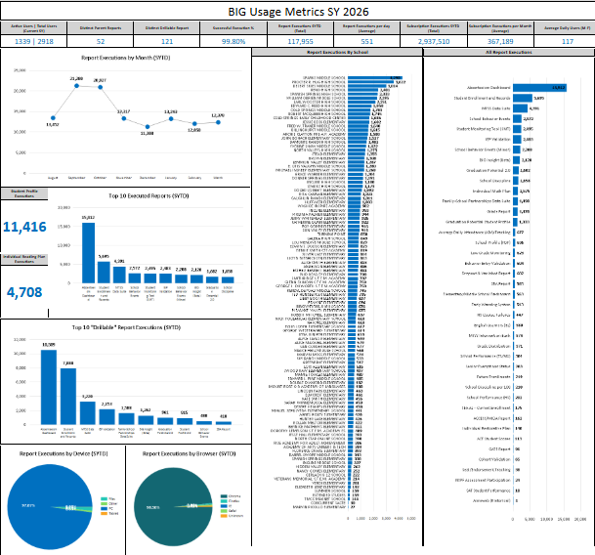
Usage Metrics Highlight Reporting & Adoption Gaps
We track who is accessing specific reports and how often. These metrics drive our planning and decision-making.
BIG Usage Metric | Used for
Total Users, Reports, Subscriptions, and Report Generations | Justify budget, monitor general adoption, use, and growth.
Reports generated month over month and YOY | Subject need temperature, use patterns
Top 10 Reports Generated | Monitor what educators are drawn to. Focus maintenance and upgrades.
Top 10 Reports user Drill through | Monitor reporting needed at the student-level. Ensure end-user experience is efficient
Reports generated by School | Feedback from high usage schools. Targeted training for low usage schools
Reports generated by Report | Examine low-use reports to determine need to keep, delete, or upgrade.

Slide 7
High Usage Reports that Transform Practice
The reporting educators in schools rely on daily

Slide 8

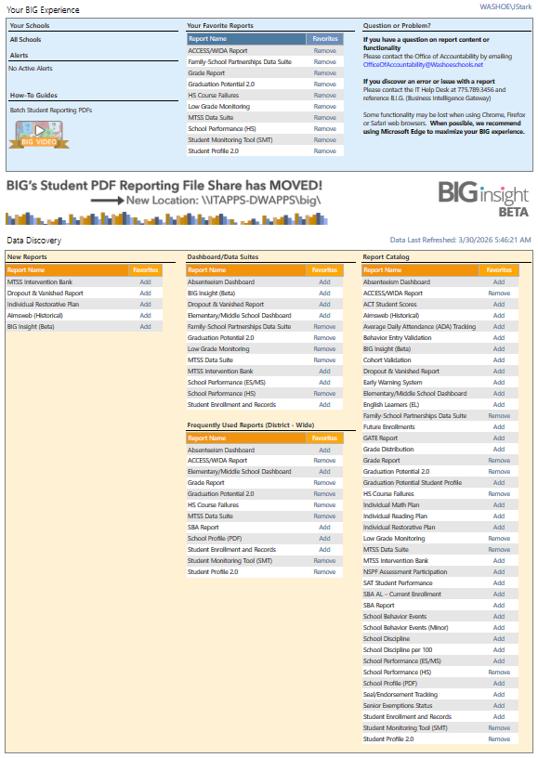
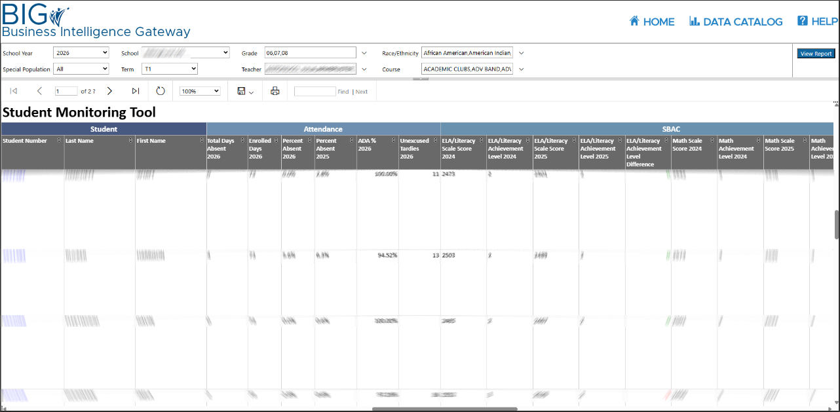
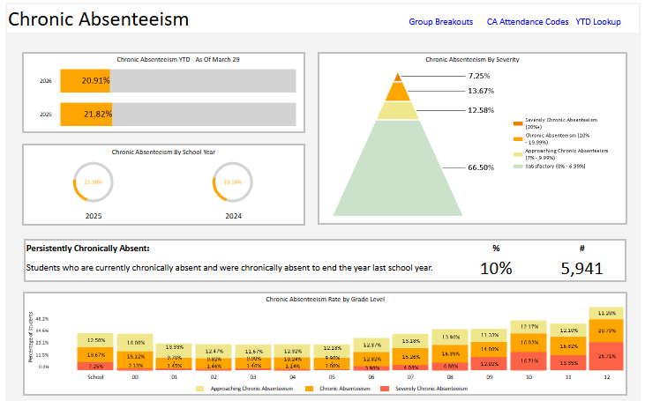
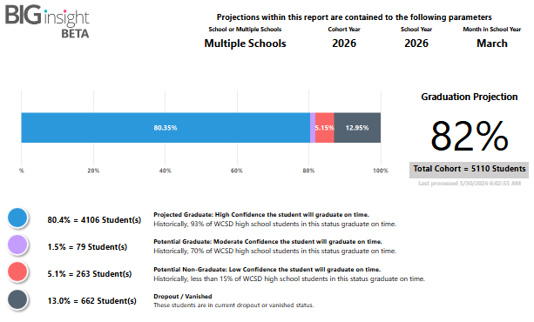
Which data are schools drawn to naturally?
Student Monitoring Tool
Absenteeism Dashboard
Insight
Schools need data at a
moments notice?
Go to the SMT.
Is my attendance
intervention working?
Go to the Dashboard.
Does my student need more supports or intervention?
Go to Insight.
Our Three Most Used Reports Serve Different Purposes

Slide 9
Student Monitoring Tool (The Catch-All)
The first stop for schools needing quick, student-level information.
Nearly 100 individual variables
covering these topics:
Student Details | Demographics | Special Pop Detail
Enrollment Details | Assessment | Family Engagement
HS Athletics | Grades/GPA | iReady
Early Warning | MTSS | Graduation
The SMT allows us to adopt data faster by getting needed information out quickly.

Slide 10
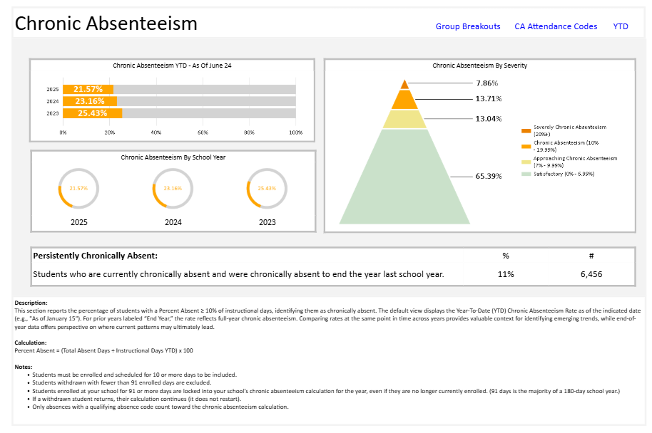
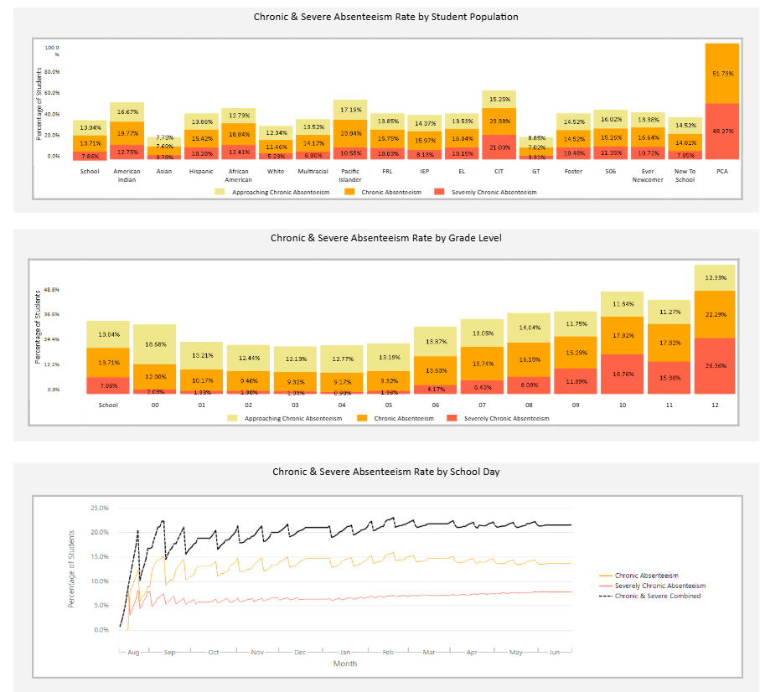
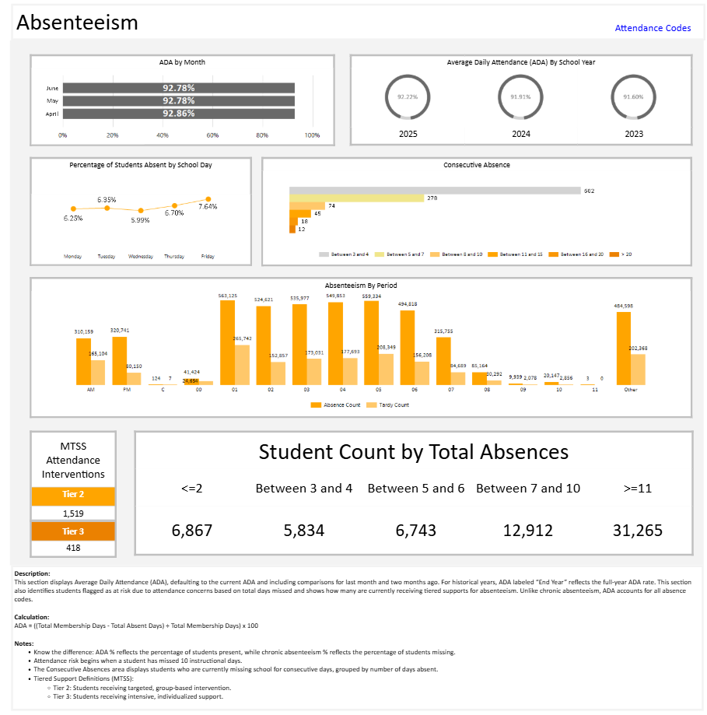
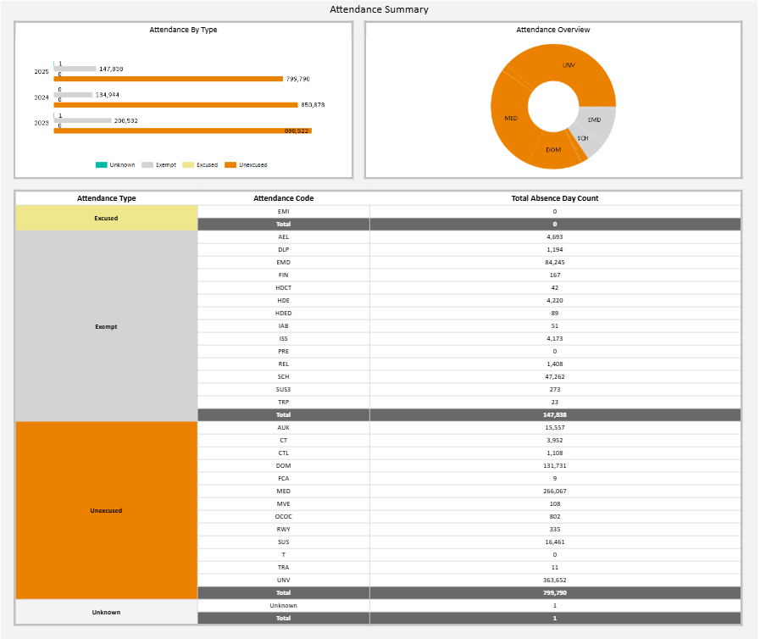
The Absenteeism Dashboard
Getting the most out of our absenteeism data
Chronic Absenteeism
Chronic Absenteeism | Average Daily Attendance (ADA) | Other Attendance
Chronic Year-to-Date (YTD) Chronic YTD vs. Prior Year on the same date Chronic YTD vs. Prior End Year(s) Chronic Severity Breakout Persistently Chronically Absent Current Chronic vs. Prior Date in Current Year | Current ADA Current ADA vs. Prior End Year(s) Consecutive Absences Period Absences Tardies | Current Enrollment Count Day Enrollment MTSS Transiency
Grade Level &
Student Populations
ALL Absenteeism
Reasons for Absences

Slide 11
The Absenteeism Dashboard
Game Changer: Student-Level Year-to-Date Lookup
Chronic as of 9/1/2025
Chronic as of 9/16/2025
DIFFERENCE
Intervention
Days Absent | % Absent | Days Absent | % Absent | Days | % | Current Intervention Start Date | Current Attendance Intervention
4 | 26.7% | 4 | 15.38% | 0 | -11.32% | 9/1/2025 | Check-in and Connect
3 | 20.0% | 3 | 11.54% | 0 | -8.46%
6 | 40.0% | 8 | 30.77% | 2 | -9.23% | 8/20/2025 | Attendance Plan
2 | 13.33% | 3 | 11.54% | 1 | -1.79% | 9/10/2025 | Attendance Monitor
2 | 13.33% | 2 | 7.69% | 0 | -5.64%
5 | 33.33% | 5 | 19.23% | 0 | -14.1%
4 | 26.7% | 8 | 30.77% | 4 | +4.07%
3 | 20.0% | 3 | 11.54% | 0 | -8.46% | 9/1/2025 | Check-in and Connect

Slide 12
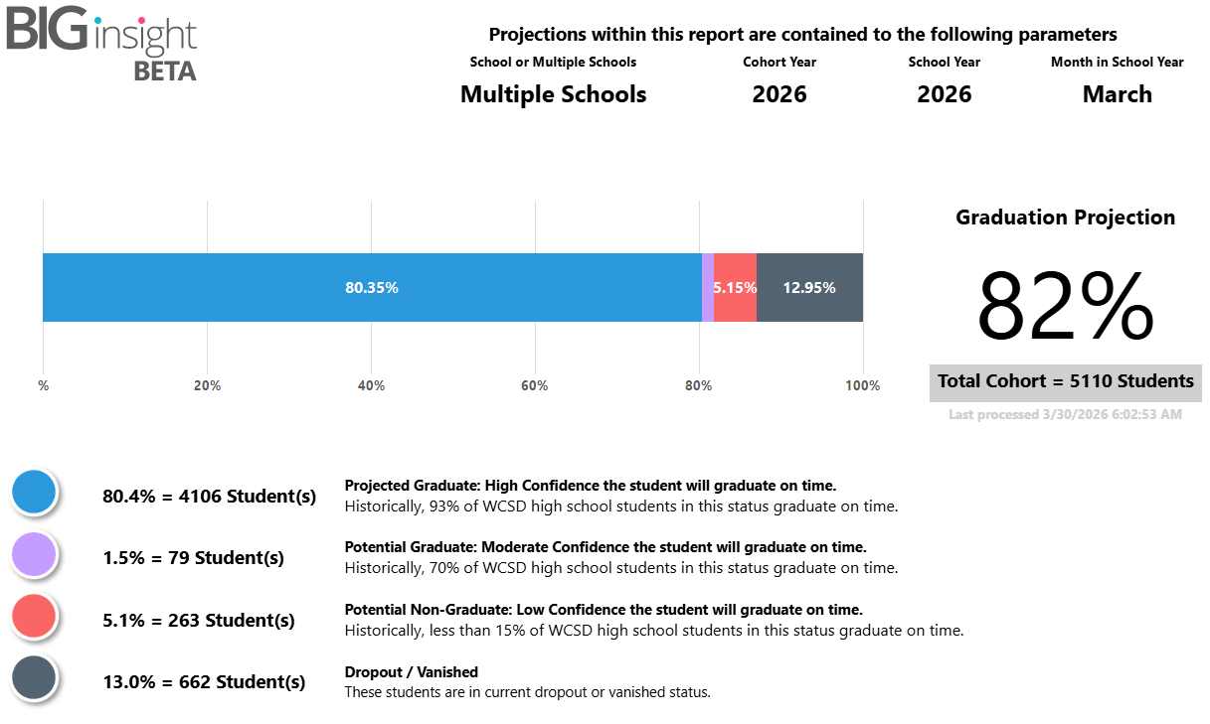
Insight: Our Algorithmic Early Warning System
100% homegrown. Not a vendor product
43 variables; 8 years of data
Dozens of variables that are student-centric, special population based, or related to graduation requirements
Released to all HS in 2024-2025
Operationalizing in 2025-2026 around school admins and counselors. Full release for grades 4-8 coming in 2026-2027.
Accuracy
Historical testing suggests we are 96.5% accurate in predicting graduation on a freshman’s first day of school.

Slide 13
How Accurate was Insight in 2024-2025?
96.5% sound great in research, but how did Insight perform month-over-month with active students?
School Name | 24-25 ACGR | Aug | Sep | Oct | Nov | Dec | Jan | Feb | Mar | Apr | May | Jun
School 01 | 100% | 100% | 100% | 100% | 100% | 100% | 100% | 100% | 100% | 100% | 100% | 100%
School 02 | 83.8% | 88% | 87% | 88% | 87% | 86% | 87% | 85% | 84% | 84% | 82% | 83%
School 03 | 93.5% | 92% | 93% | 93% | 93% | 93% | 93% | 94% | 93% | 92% | 93% | 93%
School 04 | 77.6% | 78% | 78% | 77% | 76% | 75% | 76% | 75% | 74% | 74% | 75% | 76%
School 05 | 97.6% | 97% | 96% | 98% | 98% | 98% | 98% | 98% | 98% | 98% | 96% | 96%
School 06 | 45.1% | 54% | 48% | 53% | 47% | 46% | 50% | 51% | 47% | 48% | 43% | 49%
School 07 | 87.1% | 89% | 89% | 90% | 90% | 89% | 89% | 88% | 88% | 86% | 87% | 86%
School 08 | 80.0% | 82% | 79% | 83% | 82% | 80% | 81% | 84% | 80% | 79% | 78% | 80%
School 09 | 83.4% | 84% | 83% | 83% | 83% | 82% | 84% | 82% | 82% | 82% | 82% | 83%
School 10 | 85.5% | 86% | 87% | 87% | 86% | 85% | 85% | 86% | 85% | 85% | 84% | 85%
School 11 | 85.3% | 87% | 87% | 87% | 87% | 86% | 87% | 87% | 85% | 85% | 85% | 85%
School 12 | 89.0% | 92% | 91% | 91% | 91% | 90% | 91% | 90% | 89% | 90% | 89% | 89%
School 13 | 100% | 100% | 100% | 100% | 100% | 100% | 100% | 100% | 100% | 100% | 100% | 100%
School 14 | 80.9% | 79% | 79% | 80% | 79% | 78% | 78% | 80% | 78% | 79% | 78% | 80%
District | 82.95% | 85% | 85% | 85% | 84.5% | 83.6% | 84% | 84% | 83.0% | 82.9% | 82.8% | 83.3%
Within
2%
Within
3%

Slide 14
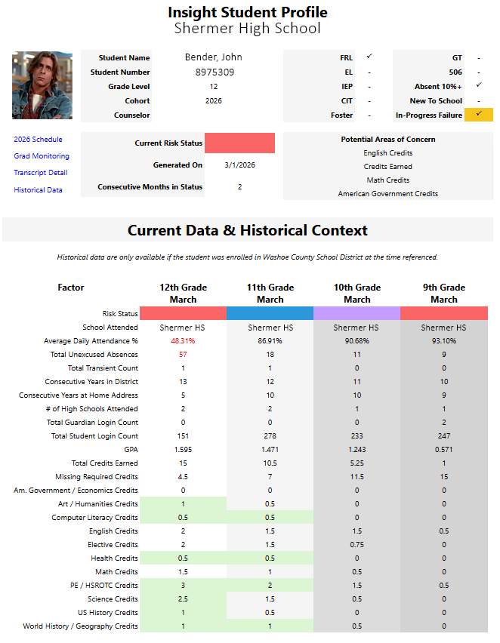
Insight Goes Above and Beyond
Predictions are just an entry point; schools treat it like a one-stop-shop
Consecutive Month Prediction Tracking
Four Years of Context
Universal Caseloads
Variable Ranking Driving Failure
In-Progress Failure Flagging
Companion Pop-ups
Transcripts
Graduation requirement tracking
Full-year schedule view
Current schedule & grades

Slide 15
Data Alone Is Not Enough
Simplifying principal data tasks into relevant monthly and manageable actions.

Slide 16
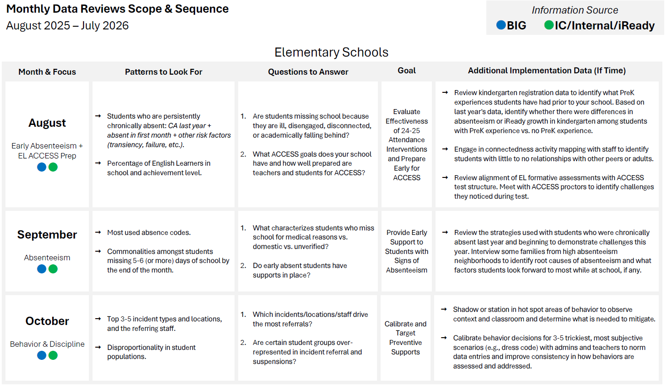
Monthly Data Scope & Sequence
Aligning principals to address data analysis strategically and efficiently each month.
What is our Data Scope and Sequence?
Our data scope and sequence provides school leaders with a structured, month-by-month focus in an environment where priorities constantly shift.
It ensures that quantitative and qualitative data drive initial analysis, helping teams ask the right questions and identify gaps.
By aligning everyone around a shared focus, it promotes collaboration and surfaces immediate, actionable insights.
Ultimately, it gives administrators clarity and consistency while preserving their authority to make final decisions based on context.

Slide 17
Actual Data
Scope & Sequence Guidance
Five Areas
Monthly Focus
Goal
Patterns to Look For
Questions To Answer
Additional Implementation Data Worth Collecting

Slide 18
Steps to Create a Data Scope & Sequence
The hardest part is creating one that matches the needs of the moment.
Know your school calendar. What is most relevant to decisions month-to-month in school (by level)?
Which data are available? When are they available? Are they easy to compile?
Map the natural rhythms of the school year to determine when specific data conversations should occur. Anchor your scope and sequence to key moments like the start of school and assessment windows.
Identify what data sources exist and when they become reliable or actionable throughout the year. This ensures teams are analyzing the right data at the right time, not forcing conversations before data are meaningful.
What analysis or patterns should they be looking for?
Provide professional learning on how to use the data scope and sequence.
Define the specific trends, comparisons, and risk indicators teams should examine each month. This creates consistency in how schools interpret data. Encourage deeper reflection on data through local quantitative and qualitative data collection including via student and teacher voices.
Do not assume that because guidance exists, it will be used or relevant. Schools are busy places and comfort with collecting, using, and interpreting data vary sizably across districts. Teach the skills and let staff practice in real-time with their own data.

Slide 19
The Bigger Picture
Leveraging systems to ensure school teams have what they need

Slide 20
The Evolution of Early Warning Systems
From traditional models to machine learning to artificial intelligence
2007
2012
2020
Now
Scorecard EWS
Data Warehouse
Algorithmic
Artificial Intelligence
The ABCs: Attendance, Behavior, Course performance. Risk points assigned manually.
A breakthrough.
Districts build centralized data systems. Automated reporting replaces manual pulls.
Access expands.
Machine learning and neural network models start using more variables and scaling across grade-levels
Advance and scale.
AI supports human decision-making. Making information and resources clearer. Prescriptive.
New frontier.

Slide 21
Important Work Happening Right Now
More districts than ever are moving from early warning to student success systems
Across the Country
What’s Ahead?
Moving from reporting risk factors to proactive systems that identify which students need which supports and when
Moving from mainly identifying individual students who need support to using data systems to help schools identify groups of students who can be helped together, via analysis of patterns, trends, and co-occurrences
Adding well-being indicators (the second abc’s agency, belonging, connectedness) which often drive/influence attendance, behavior and course performance
Putting more emphasis on prevention and including student, family, and community voice in identifying effective solutions
With a data warehouse and agentic AI districts will have more ability than ever to create more powerful, user-friendly and affordable data systems in-house, tailored to their size and needs
More schools creating student success teams, which bring together siloed student supports (MTSS, PBIS, EWS, CCR, Attendance team) into a holistic, unified approach
More precision in interventions, better alignment of evidence-based strategies to the students and circumstances where impact will be greatest
AI is creating new possibilities and risks-can accelerate and impede student success

Slide 22
What Becomes Possible at the Next Level
When systems reach the maturity level of WCSD’s Insight system
Predict Earlier, Act Sooner
Move from Early Warning to Prescription
Algorithmic models can flag risk that isn’t always apparent to us, sometimes years before traditional indicators appear. Intervention windows widen dramatically.
Knowing a student is at risk is step one. The next frontier is matching students to the interventions most likely to work for them based on students who had similar experiences.
Measure What Matters is Real Time
What questions should every school be able to answer that month?
Intervention tracking becomes continuous. Schools see within weeks whether a strategy is working, not at the end of a semester.
Technology handles the identification. People handle the relationships. The system frees up counselors and teachers to do what they do best: connect and support.

Slide 23
Where Should the Field Focus Next?
1
Equity at the Center
Ensure algorithmic systems don't encode existing biases. Every EWS/Student Success System must be audited for disparate impact across student populations.
2
Implementation Over Innovation
Most districts don't need fancier tech tools. They need better human systems to create and expand access to action-improving data at the school level. Execution is the bottleneck, not technology.
3
Whole-Child Data Integration
Academic, behavioral, social-emotional, and community data need to converge. Siloed systems produce siloed interventions.
4
Building District/School Capacity
Hire data people. Train existing staff. Create sustainable infrastructure that doesn't depend on one champion or one vendor.
5
Connection is Everything
Even the best data is only as good as the adults who act on it. Teams at schools, working with kids, families, and teachers. That's the work. Use AI to enhance it, not undermine it.

Slide 24
Let's Talk
Q&A with Dr. Balfanz and team.

Slide 25



Thank You
Robert Balfanz, PhD
rbalfanz@jhu.edu
410.516.4272
JT Stark, PhD
jstark@washoeschools.net
775.225.6779
Laura Davidson, PhD
ldavidson@waschoeschools.net
775.348.3850

