Slide 1
GAme to think differently about Content
[Myriad of games to consider for your classroom]

Slide 2

Jason Dreier
John Dewey Academy of Learning
Hello, meet your host!
A project based learning charter school in Green Bay Area Public Schools

Slide 3
Attendance link
Evaluation Link
https://bit.ly/sita26attend
https://bit.ly/sita26evaluation

Slide 4
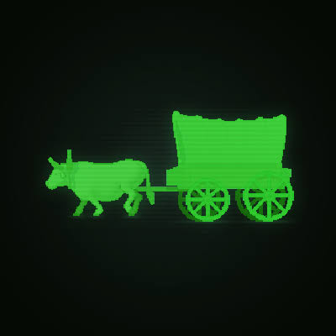

IntroDuctions
01.
Name and School
02.
Grade Level
03.
Favorite Game

Slide 5
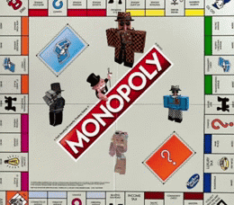
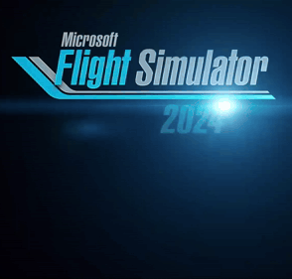
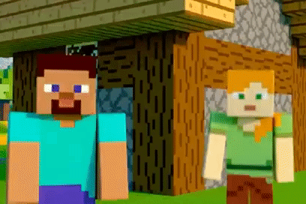
Board Games
Simulations
Video Games
This isn’t New
Some teach concepts outright, others can be modified to go deeper into content. Monopoly, Chess, Cribbage, Scatergories…
Teaching from a standpoint of practice before doing
Using video games like Minecraft EDU and other online games to teach/demonstrate/simulate a host of concepts

Slide 6
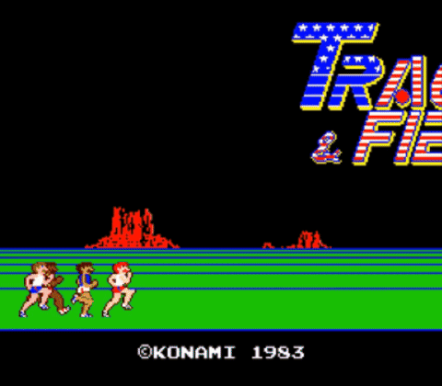
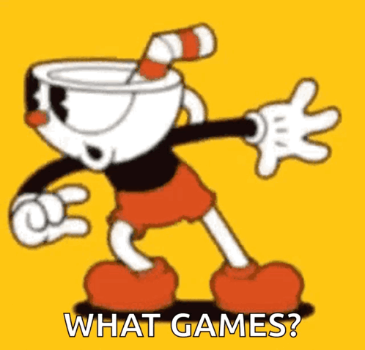
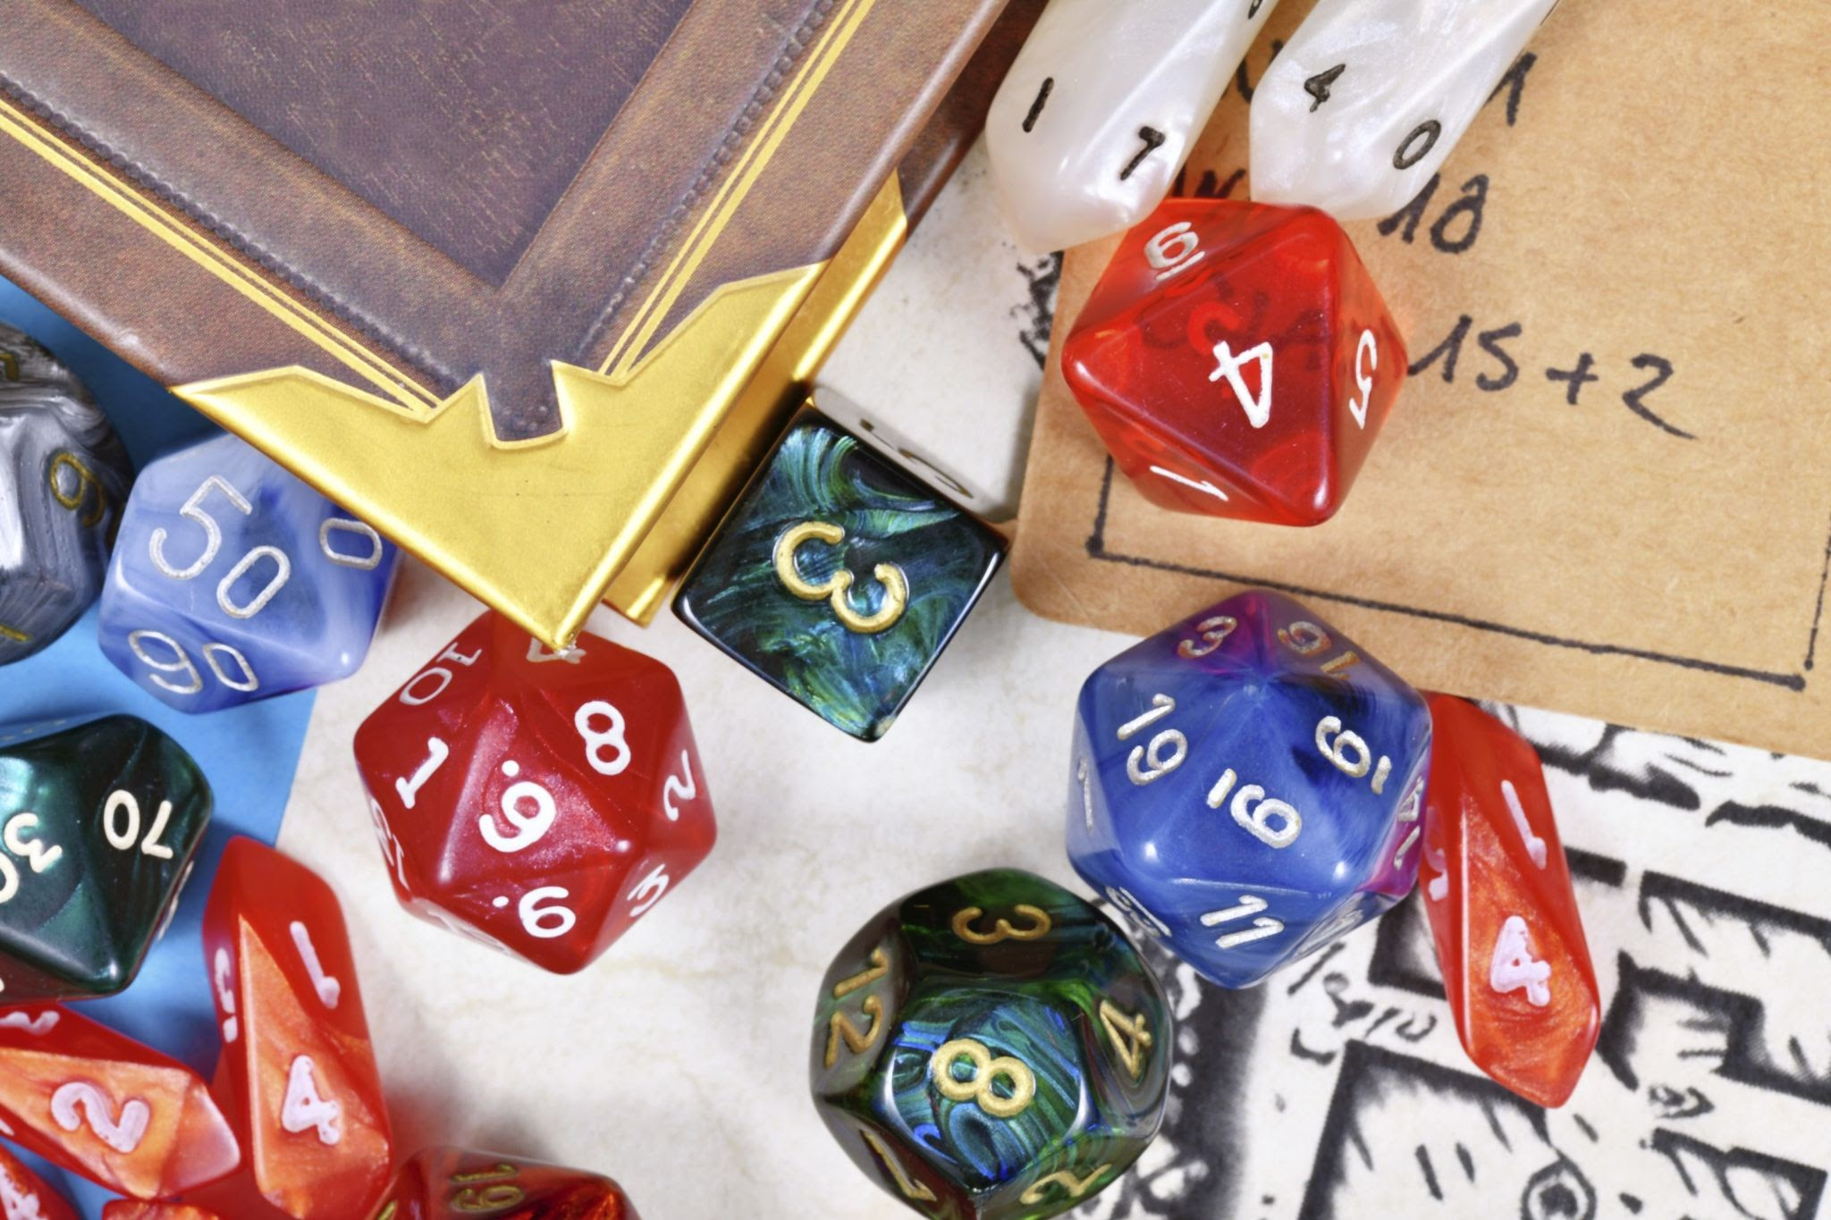
Engaging
Exciting
Entry Point to Learning
Why Games?
Games pull attention to a topic - to play well, you must know a particular concept
Games can reframe an approach to traditional routine or topic
Games can be used to introduce new topics or units and can be “developed” along with the complexity of the topic at hand

Slide 7








Select cATEGORY

Slide 8
ELA
Linxicon - A Word Connection/Vocabulary Game
Pimantle - Guess the Word/Vocabulary Builder
Fictogram - Guess the fictional character
Quordle - Like Wordle on steroids
Back

Slide 9
Math
Guess What- A number estimation/prediction game
Nerdle - Wordle but with Math and maybe some algebra?
Make 10 - Just what the title suggests, but in puzzle format
Cribbage
Back

Slide 10
Science
Elemingle- A Periodic Table Game
Metazooa - Guess the Animal with (some) proper classification names
Wingspan - A board game which teaches about birds, habitat, and the food chain
Back

Slide 11
Social Studies
Chronogram - Guess the historical Figure
Globle - Guess the Mystery Country
Diplomacy - WWI Era Game With secret alliances and global takeover
Minecraft.edu - With some effort on your part, you can use creative mode to set up a kinds of economic, sociological, historical scenarios
Back

Slide 12
Music
Chrome Music Labs - So many “games, so much need for headphones
Spotle - Guess song in second increments
Classics for Kids - A more “classical Music” Approach to Chrome Music Labs
Back

Slide 13
ART
Forgeous - Timed “mimic the classic art” game
Pictionary Word Generator
Google Arts and Culture - A host of “games” related to classic and modern artworks - Beware the AI…
Back

Slide 14
STEM
Engineering Games - An entire catalog of games with varying degrees of usefullness
ThinkyGames - Another catalog of games, a much different vibe
Quoridor - A two player strategy game which requires executive function, math, and logic to be victorious
Back

Slide 15
The Kitchen Sink
Games for Change - A catalog of games, some of which are educational/social issue heavy, others not so much.
Map Generator - It’s just that. Set your parameters and create your own fictional world.
Incompetech - Green Bay based kevin MacLeod has graph paper, royalty free music*, and all kids of other resources.
The White Box - The Anti Board game Board game - A series of design essays to get started on building your own game
Finish

Slide 16
Attendance link
Evaluation Link
https://bit.ly/sita26attend
https://bit.ly/sita26evaluation

